Slide 1
Beam Loss Monitors
Randy Thurman-Keup – AD/Instrumentation Physicist
John Seraphin – AD/Instrumentation Technician
Andrea Saewert – AD/Instrumentation Technician
External Beamline & Instrumentation Independent Design Review
6 October 2015

Slide 2
Outline
M4 Line Beam Loss Monitors (BLM)
M4 Line BLM Readout Electronics
M4 Line BLM Installation Efforts
Delivery Ring BLMs

Slide 3
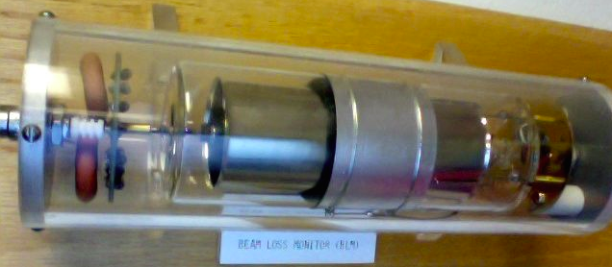
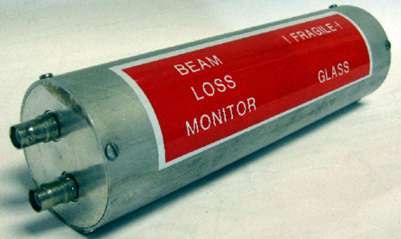
M4 Line BLMs – Physical Detectors
Physical detectors will be ionization chambers
Sealed, Ar filled, concentric cylindrical electrodes
Sensitivity of 70 nC per Rad
Require 30 loss monitors
Will be reused from the Tevatron
Electrodes ~100 mm length
Inner Anode
~6 mm DIA
Outer Cathode ~40 mm DIA

Slide 4
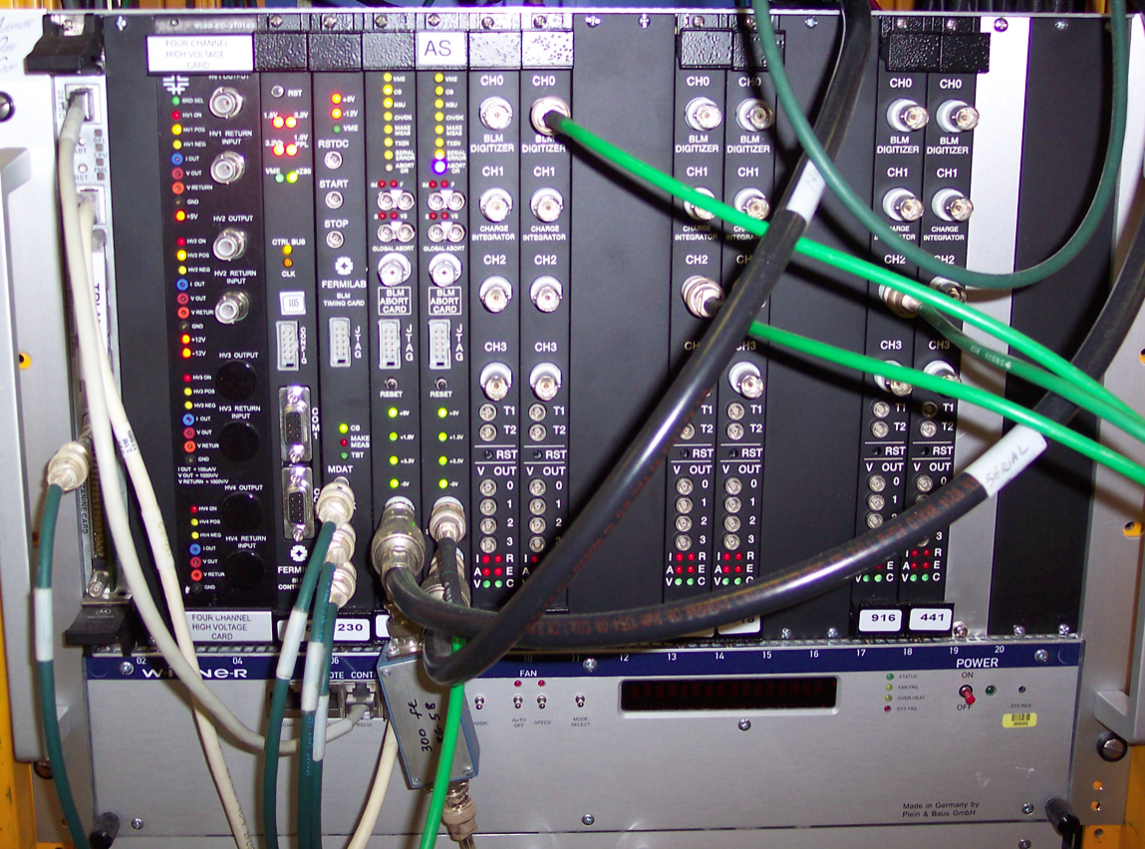
M4 Line BLMs – Readout Electronics
VME based
8 Digitizer Cards (4 ch / card)
Timing Card
Abort Card
Control Card
High Voltage Card
Crate Controller
Filter Box
Ferrite core for common mode noise rejection
Additional capacitance to equalize time constants for all cables
Electronics will be reused from the Tevatron
One crate located in MC-1 will readout all 30 loss monitors

Slide 5
M4 Line BLMs – Readout Electronics
Digitizer Card
Operates with a pair of alternating integrators
No deadtime
Single integration period is ~20 μs
Circular buffer contains 64k integration samples
Three additional variable length sums of the single integration samples
The sum lengths are specified by the user
The maximum integration rate is 720 Rad/s with a single ADC count corresponding to 11 mRad/s or 0.22 μRad in ~20 μs
Performs abort threshold comparison on single integration samples and all three sum length values

Slide 6
M4 Line BLMs – Readout Electronics
Abort Card
Gets over-threshold information from Digitizer
Can mask off channels
Can require multiplicity
Can generate a digital abort signal for each summing length
Timing Card
Takes TCLK, MDAT, BSCLK
TCLK and MDAT sent to Control Card
BSCLK used for AA marker to generate integration clock
Also has internal timing generator for transfer lines

Slide 7
M4 Line BLMs – Readout Electronics
Control Card
Initializes other cards in crate based on information obtained from the VME crate processor
Reads loss data from Digitizer and stores in circular buffers for access by crate processor
Starts and stops integration based on TCLK events
Changes abort settings based on MDAT machine state

Slide 8
M4 Line BLMs - Effort
Crate must be moved from Tevatron location and installed at MC-1
Loss monitors must be installed in tunnel
Cables must be terminated
Filter box must be modified to reflect cable lengths
ACNet devices must be created
Possible minor modifications to readout software
Application software must be adapted

Slide 9
Delivery Ring BLMs
The delivery ring BLMs will be the exact same system as the M4 line
60 loss monitors are required
3 readout electronics crates are required
These will be reused from the Tevatron
Effort is similar to M4 line, but 2-3 times as much due to more systems

Slide 10
Summary
System design is finished
Low risk due to reuse of existing Tevatron loss monitor systems
Needed modifications are minor

