Slide 1
MICE Spectrometer Solenoid Update
Mark Palmer
FNAL
September 4, 2015

Slide 2
Current Status: SSU
SSU
A center coil problem was discovered during initial checkout in July
Isolated
Magnet warm-up was initiated
As of July 28th, the issue had been identified as a cross-wiring of the Center Coil leads
NOTE: 1st SS delivered to RAL and further feed-through and lead issues identified with second magnet
Cross-wire occurred during retrofit of feed-throughs, HTS leads, and thermal connections on this magnet, which were carried out at RAL
Magnet warm checks carried out successfully
Magnet pumpout and cool-down initiated
Magnet was cold on Sunday, August 23rd
Magnet cold checks carried out successfully
Training resumed on Wednesday, August 26th
6 training quenches completed
Maximum current attained: 235 Amps

Slide 4
Current Status: SSD
SSD
Magnet training carried out in July
5 training quenches + 1 ramp-down quench completed
Maximum current attained: 212 Amps
Current issues:
Missing voltage tap
Need dI/dt signal to properly protect SC leads
Ground fault circuit has a fault
Need to diagnose

Slide 5
SSD Training Quench

Slide 6
Quench History
Currents shown are
for the Center Coil
of each magnet

Slide 7
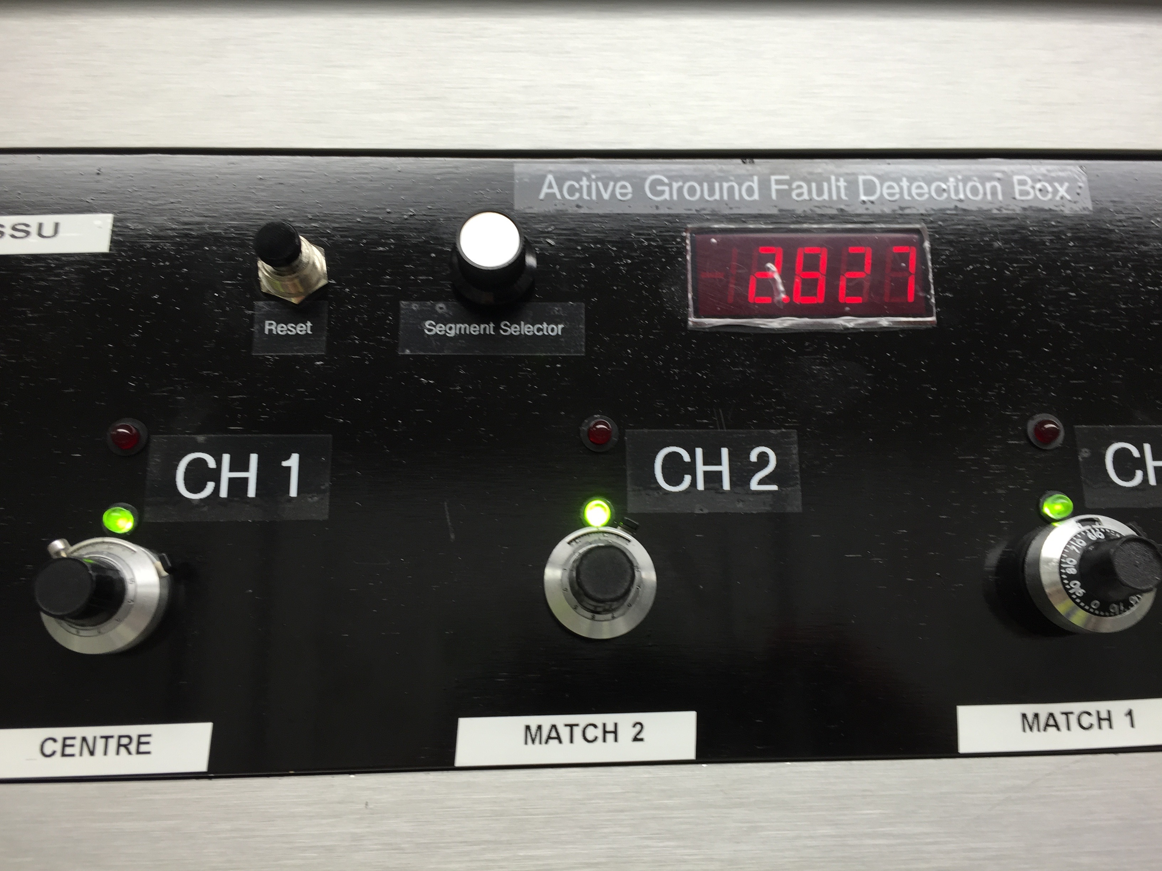
SSD Training Quench

Slide 8
Power Supply System
Both SS magnets currently have training challenges due to the power supply system
Cable resistance significantly increased when decision made to move power supplies to Rack Room 2
Need larger cross-section cable to maintain PSU design specifications
Remedies now being evaluated
Making every effort to get the cooling channel operational before the end of the present ISIS run

