Slide 1
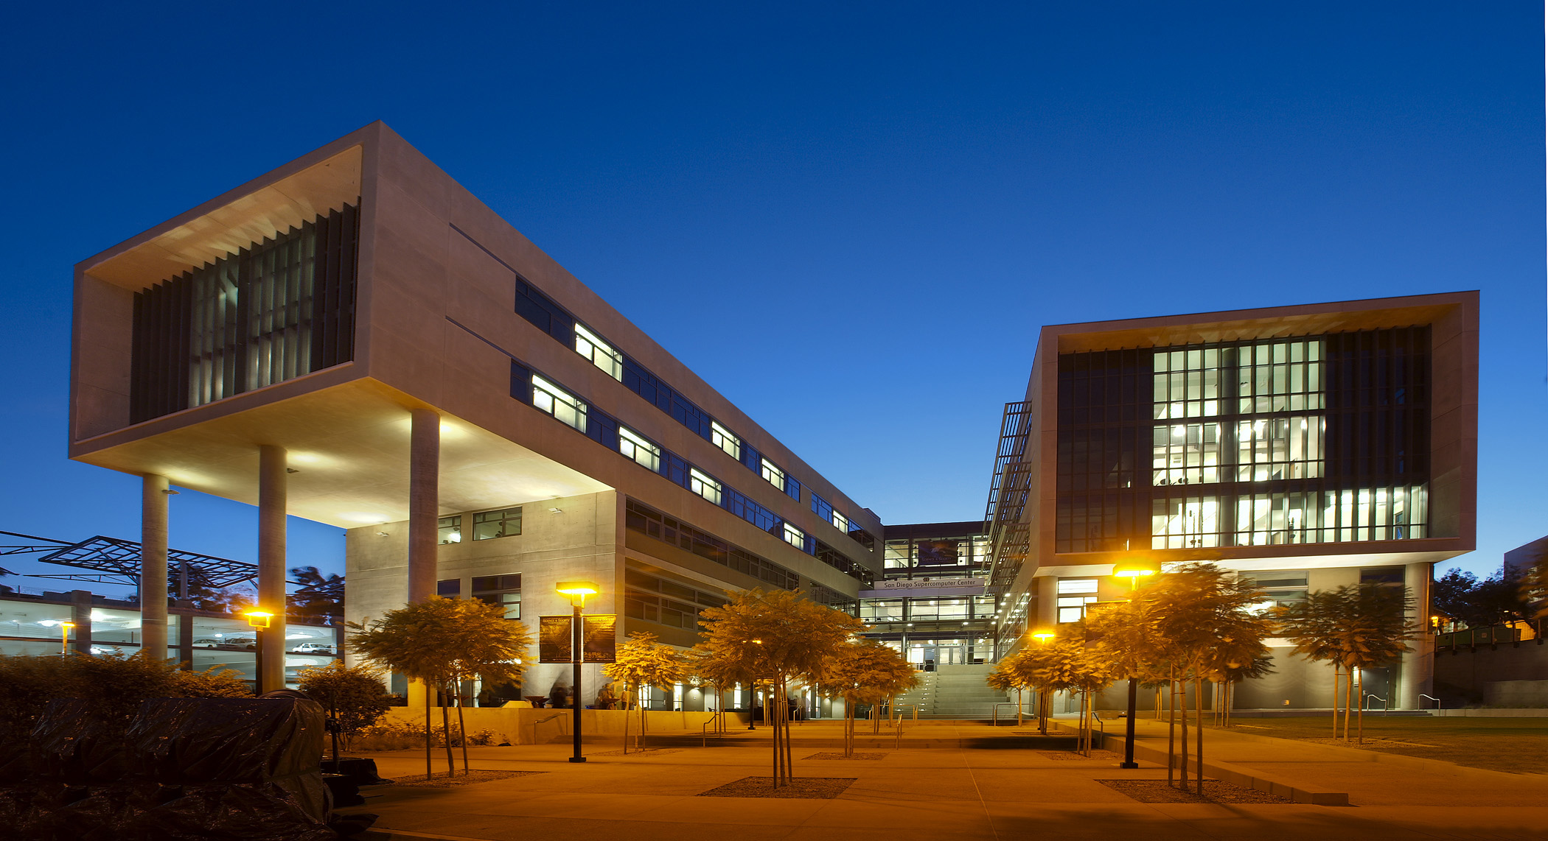
The Next 5 Years
SDSC & UCSD
Mike Norman
SDSC

Slide 2
OSG @ SDSC
SDSC created a “Distributed High Throughput Computing Group” under the leadership of Würthwein.
Würthwein joined the management team of SDSC in order to increase visibility and concerns for OSG and DHTC at SDSC.
In the following, we will mention some of the impact this is having as we move forward.

Slide 3
Resources @ SDSC
Comet is presently being integrated into OSG via its virtual cluster interface.
Allocations on Comet will be serviceable via OSG because of a Comet entrypoint in glideinWMS.
Spare capacity of Comet will be available to anybody in OSG via T2_US_UCSD, independent of the allocations-only entrypoint above.
Spare capacity of SDSC Cloud resources will be made available in the same way as spare Comet resources.

Slide 4
Science on the La Jolla Mesa
UCSD Integrated Digital Infrastructure grant awarded to SDSC
bring workflows from across campus into SDSC using OSG tools plus campus wide Lustre filesystem.
Step towards the larger OSG vision of “submit locally – run globally”.
Science use cases span multiple departments, divisions, and even institutions:
Integrative Omics
Cryo-EM
Quantitative Biology
Astronomy

Slide 5
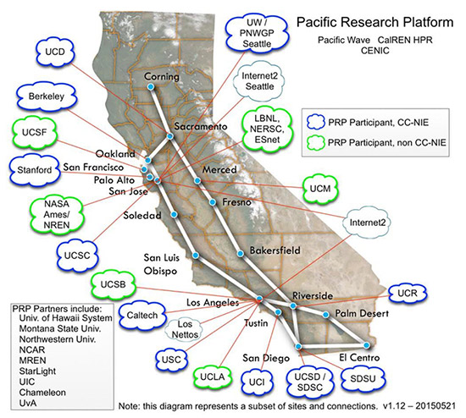
Collaborating with regional Science DMZ
Adding
+
Pacific Research Platform
as a regional science DMZ
OSG Software & Services
on top of a regional science DMZ
Science includes:
ATLAS & CMS, Telescopes, Galaxy Evolution, LIGO, Cancer Genomics, Integrative Omics, Structural Biology, Earth Sciences, Visualization CS R&D
Collaboration of SDSC with OSG, Calit2, and CITRIS

Slide 6
Partnership with AWS for next 5 years
Goal: Offer transparent operations across Cloud & Grid for all of Science
OSG offers allocations on AWS as part of the XRAC process
NSF-ACI funds an AWS service provider operated by OSG as part of the next 5 year OSG grant
OSG offers to provision AWS resources for individual PIs, campuses, and other communities, independent of XRAC.
This is an NSF activity synergistic with DOE-HEP goals and experience gained by ATLAS & CMS in working with AWS.

Slide 7
Initial Technical Targets with AWS
Focus on adding capabilities to OSG
full node scheduling
large memory applications
small scale multicore
full node with GPU scheduling
Focus on Science other than LHC
LHC is doing this already via both BNL & FNAL.

Slide 8
Timeline
Exploratory phase during Fall 2015 – Spring 2016
complete technical integration into OSG-XD offerings
Prototype production phase starting with XRAC in Spring 2016
learn how to write & review AWS specific XRAC allocation proposals
pick up one existing XRAC proposal for OSG-XD that is then serviced transparently across OSG and AWS
Socialize Pitch to NSF throughout 2016
Write into next 5 year proposal to NSF in Fall 2016
Target a “hardware” budget of $1M/year for the full 5 years of the next OSG grant.
OSG-XD would thus have guaranteed resources for 5 years.
OSG-XD is no different than Comet, Stampede, …
… except that it scales out elastically and hardware is determined by needs rather than fixed by initial purchase.

Slide 9
Expect more in the next 5 years
SDSC has been steadily expanding its intersection points with OSG since we joined the Council.
We expect to continue with this expansion in the future, especially in the context of increasing regional involvement across the entire West Coast.
BDHub: SDSC leads NSF Big Data Hub West Coast region, together with Berkeley & UW Seattle
UC System: SDSC is heavily engaged in discussions about a coherent UC-wide Cyberinfrastructure.

