Slide 1
OSG Council Meeting
Oct 2015

Slide 2
Request you endorse Paul Avery to lead the committee to search for a new Council Chair to transition at the AHM 2016
(he will report later today on initial committee and plans)

Slide 3
Reminder that the AHM 2016 is March 14-18th at Clemson
Program Committee will start at Thanksgiving.
Anticipate some co-scheduled/synergistic ACI-REF meeting

Slide 4
Todays focus is on the future of OSG after this project period (2012-2017)

Slide 5
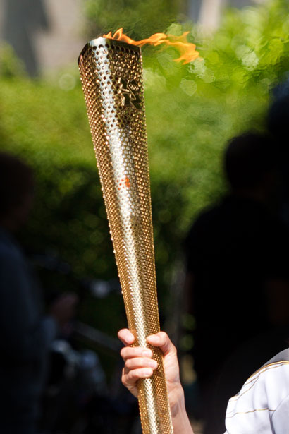
Carry the Flame and reach the Vision

