Slide 1
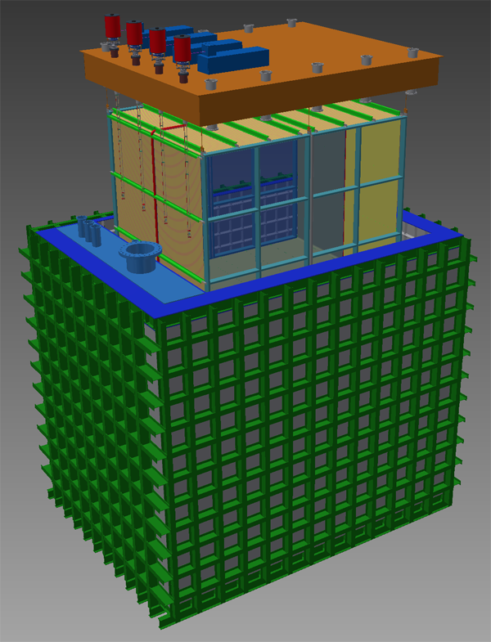
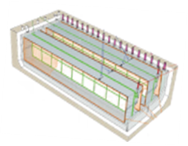
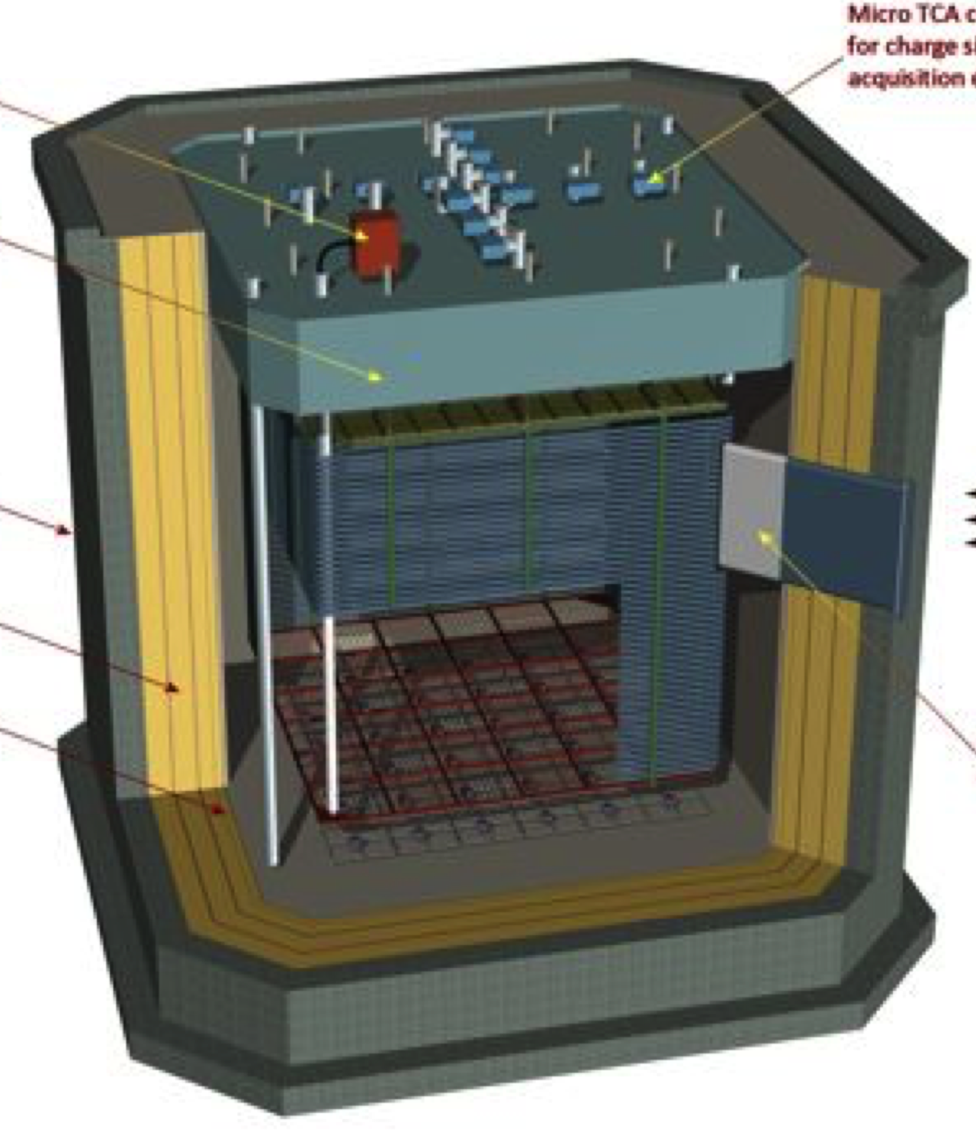
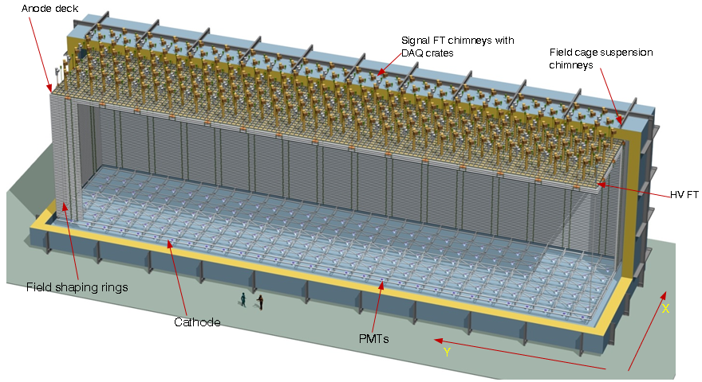
Introduction and context for the workshops
David MacFarlane,
LBNC Chair
Reconstruction Assessment & Requirements Workshops

Slide 2
Origins of the two contiguous workshops
Reconstruction assessment workshop:
Requested through the Fermilab PAC by the Long-Baseline Neutrino Committee (LBNC) as a first step along a path of focusing community attention on automated reconstruction in LAr TPCs
Requirements workshop:
Community-led effort to collectively put together a shared goal of setting overall requirements for a LAr eco-system of software, hardware, and computing to guide work over the next few years
While strongly encouraged by the LBNC, bottoms up is a much better approach!
Two goals are tightly connected and the LBNC would like to see ownership of the outcomes by the community

Slide 3
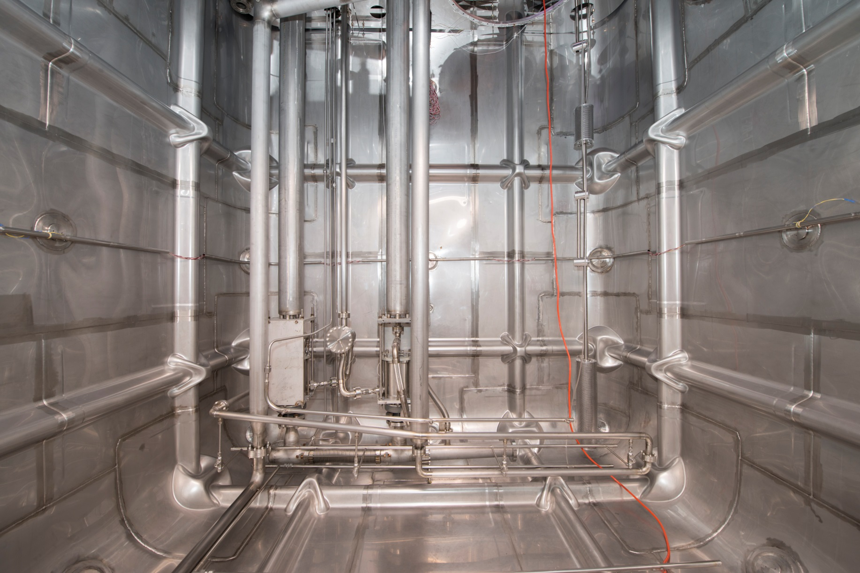
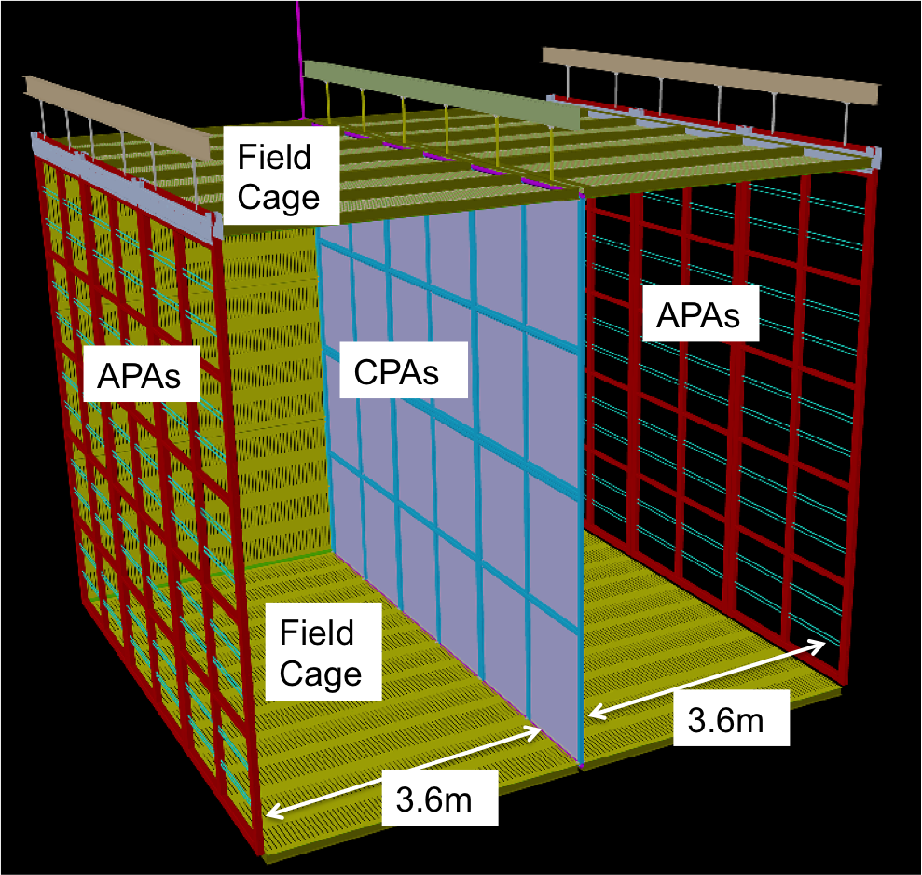
LArTPC Development Path
Fermilab SBN and CERN neutrino platform provide a strong LArTPC hardware, electronics and software development and prototyping program
Single-Phase
35-t prototype
ProtoDUNE @ CERN
DUNE Reference Design
ICARUS
LBL
2015
2018
SBL
MicroBooNE
SBND
Dual-Phase
2016
2018
DUNE Alternative Design
WA105: 1x1x3 m³
WA105

Slide 4
PAC feedback on the SBN program from June 2015
Reaffirmed that the SBN program:
Is a critical part of the development of the LArTPC program leading up to DUNE
Is capable of definitely addressing the unresolved anomalous results seen by LSND and MiniBooNE
Is very well aligned with the program outlined by P5.
Pleased by:
Completion of CD4 by MicroBooNE and start of commissioning
Significant progress on the SBND and ICARUS buildings.
Impressive technical progress, from the preparations for the arrival of ICARUS to the design work on the SBND TPC, photon, and counter systems.
Critical support from DOE, NSF, CERN, INFN, STFC, & SNSF.

Slide 5
PAC feedback on the SBN program from June 2015
Concerned about:
Pace at which automated LAr reconstruction is developing, despite being absolutely crucial to the SBN and LBN programs
Slow progress in coordinating the analysis across the three experiments, which is critical to the success of the SBN program and required for Stage 2 approval
Very aggressive SBN schedule with little flexibility
Recommended that Fermilab continues:
Monitoring progress on achieving automated event reconstruction
Providing relevant resources and expertise towards catalyzing this effort, since it is critical to quickly demonstrate the capabilities of the LArTPC technology.

Slide 6
PAC feedback on the SBN program from June 2015
Recommended that Fermilab extend the LBNC mandate to include elements of SBN oversight:
Oversee and advise on coordination among the MicroBooNE, SBND and ICARUS collaborations & other LAr detectors at FNAL and at CERN both from the technical and physics points of view
Monitor the knowledge exchange and coordination of efforts between the SBN and LBN programs

Slide 7
LBNC: Genesis, scope and membership
Recommended by Fermilab PAC in January as a new advisory committee focused specifically on LBNF/DUNE
Modeled after the LHCC at CERN
Scope includes scientific, technical and managerial decisions/preparations of the experiment & facility
Provides continuous oversight, reports to Fermilab Director
Membership:
Chair, David MacFarlane (SLAC)
Ursula Bassler (IN2P3)
Francesca Di Lodovico (Queen Mary)
Patrick Huber (Virginia Tech)
Mike Lindgren (FNAL)
Naba Mondal (TIFR)
Tsuyoshi Nakaya (Kyoto)
David Nygren (UT Arlington)
Stephen Pordes (FNAL)
Kem Robinson (LBNL)
Nigel Smith (SNOLAB)
David Wark (Oxford)

Slide 8
Charge from Fermilab Director on SBN oversight: Initial steps taken on SBN program coordination
LBNC met with SBN, DUNE, & LAriat spokespersons in early Sept
Discussed steps to achieve greater coordination on automated LAr reconstruction, starting with an assessment workshop in October leading to development of a longer-term strategy
Contiguous to a LArSoft framework requirements workshop jointly sponsored by the SBN/DUNE collaborations
SBN Executive Board will revive a Steering Committee to develop a concrete plan for a joint analysis strategy
LBNC will monitor discussions between SBND and DUNE on coordination of TPC hardware, electronics, and photon detection systems to the degree possible
LBNC will move to continuous oversight model, with some additional LBNC members to take on this scope

Slide 9
LBNC comments on DUNE Far Detector (FD) Task Force
Comments from Sept review
The LBNC notes that the 80% efficiency for automated reconstruction for quasi-elastic, resonant elastic scattering and deep-inelastic scattering events is a key assumption in the projected physics reach of DUNE. Much progress in demonstrating this capability should be accomplished by the TF within the next 18 months.
An important part of the FDTF planning would be to lay out a common understanding of the level of reconstruction sophistication needed at various stages during the 18 months and then beyond through the DUNE design phase leading up to CD-2

Slide 10
LBNC request post the reconstruction workshop
Ambitious: will take time and effort beyond these two days!
A comprehensive summary of the current status of and future plans for further development of automated reconstruction efforts:
Basic physics information, such as event classes and topologies, backgrounds for each experiment, performance requirements, etc.;
Current state-of-the-art, including quantified performance of the reconstruction;
Leadership for the current effort and the level of effort across the collaboration;
Degree to which the effort relies on common software tools, such as analysis framework development, etc. and their further development;

Slide 11
LBNC request post the reconstruction workshop
Timeline, milestones, deliverables and level of effort required for further development;
Linkages to hardware system development and experience with neutrino and test beam data
Assessment of areas of commonality with other SBN or LBN experiments; and
Assessment of resource limitations and impact of bringing additional targeted help, either from Fermilab or in cooperation with other science collaborations.
Workshop should consider mechanisms for sharing the results of development progress on a more continuous basis
e.g., though an ongoing joint steering committee, a regular forum for exchange on development progress, and/or future more extensive workshop devoted to LAr reconstruction

Slide 12
LBNC encouragement for collaborative approaches
LBNC welcomes the Requirements Workshop as a first important step in a common community approach
Will be very interested to see the outcome/success – or not – of the approach
Understand that, if successful, requirements may then evolve towards putting in place resources and a development plan
As part of the workshop planning, a LArSoft steering group has been established between the participating collaborations
Could be a model and/or extended/renamed/reformed to meet the needs of the joint steering committee suggested as part of the reconstruction workshop follow-up

Slide 13
Summary
Within the US HEP program, there is a very high degree of scrutiny & expectation focused on the SBN & LBN programs
Two workshops should be viewed as the first step in developing a comprehensive & focused program for understanding LAr TPC performance & demonstrating LAr reconstruction
LBNC will actively follow reconstruction & common analysis preparations by the SBN & LBN communities
LAr TPC technology is the foundation both these programs
Automated reconstruction is a key part of this strategy and an as yet unproven assumption in physics capability
A common software framework approach across these programs will greatly enhance their effectiveness & efficiency
Bottoms up is always better: very pleased to see community ownership in addressing these questions

