Slide 1

DUNE Project Status
Eric James
DUNE PMG Meeting
September 15, 2015

Slide 2
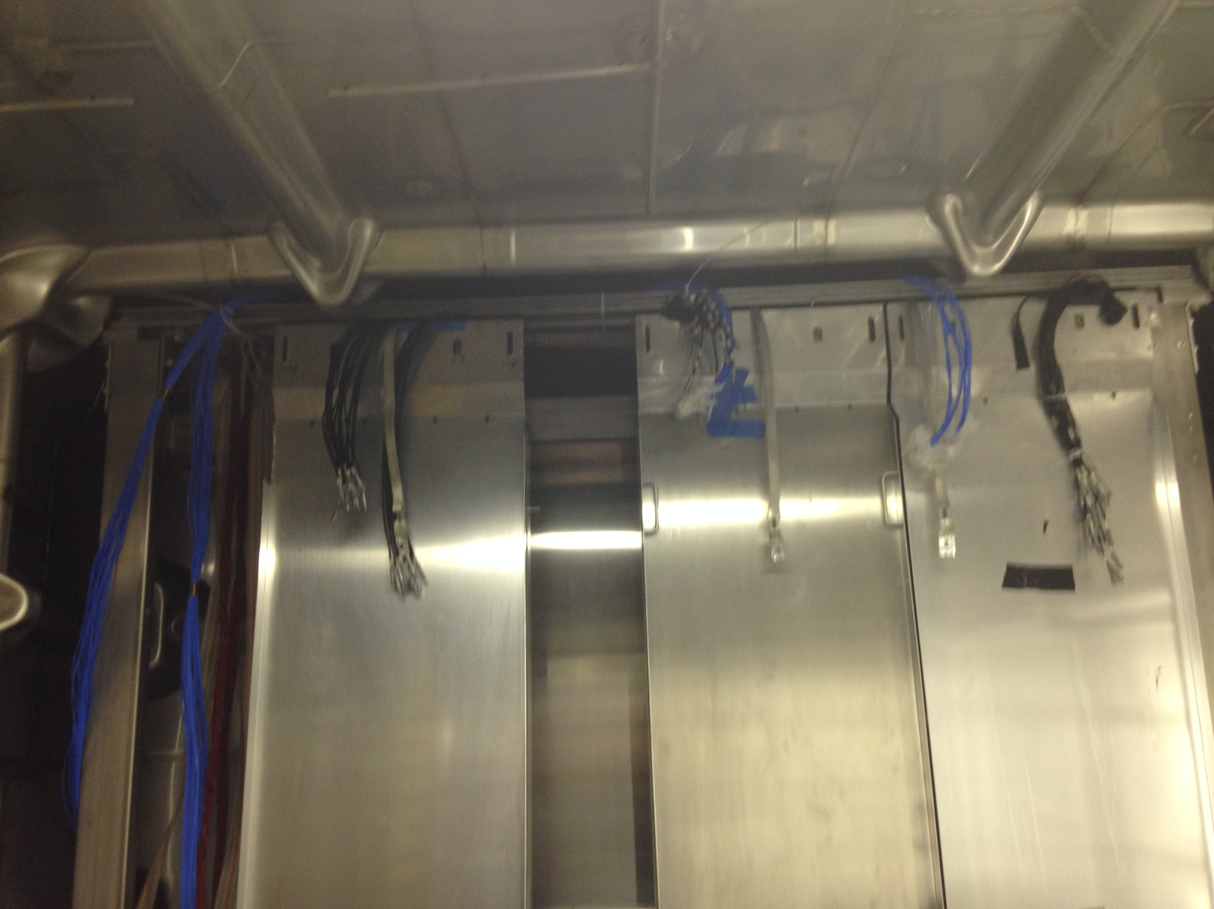
Big Picture
35-ton
  APAs installed in cryostat
  Final check-out in progress
  Goal is button up the cryostat and begin cryogenic operations by the end of the month
  More details in Alan Hahn presentation

Slide 3
Big Picture
CD-3A Review
  Main focus for DUNE is ensuring that all interfaces to the far site conventional facilities are well understood and documented
  A list of 17 potentially open interface issues has been generated (see next slide)
  DUNE will provide feedback on each of these issues and initiate change requests as necessary
  Input required on the time scale of early to mid-October

Slide 4
Big Picture
Interface issues list
  Ground and shielding requirements throughout campus
  Power and cooling requirements for electronic racks
  Underground control room requirements
  Liquid Argon temperature stability requirements
  Liquid Argon flow requirements (Need for bi-directional pumping)
  Cavern space for detector installation and cryostat pumps
  Detector/cryostat/cavern alignment tolerances
  Detector/cryostat/cavern level tolerances
  Requirements for cryostat bridges

Slide 5
Big Picture
Interface issues list (cont.)
  Clean room interferences
  Utilities and cryostat piping ground isolation (closed)
  Cavern mezzanine requirements
  Detector requirements on potential shaft modifications
  Detector requirements on drift cross-sections
  Detector requirements on monorail locations and functionality
  Ventilation requirements around cryostat annulus and base
  Need for ventilation barrier wall between adjacent caverns

Slide 6
Cavern Grounding and Shielding
DUNE grounding and shielding committee has developed a revised plan, which was presented to the DUNE Technical Board at its first meeting on September 3rd
Consensus is forming on the elements of the plan that involve the conventional facilities (proposed changes are expected to be cost-neutral)
Sign-off on these elements expected at the next DUNE Technical Board Meeting (last week of September)

Slide 7
Cavern Grounding and Shielding

Slide 8
DAQ Infrastructure Requirements
DAQ working group charged with exploring needs for two potential fabrication options
  Custom front-end hardware (reference design)
  Off-the-shelf components (FELIX)
For both options need to estimate rack-space, power, and cooling requirements for detector caverns, central utility cavern, and surface
Also, need to estimate bandwidth requirements from detector caverns to central utility cavern and from central utility cavern to surface

Slide 9
DAQ Infrastructure Requirements
DAQ working group will also discuss potential needs for back-end processing and data storage capabilities in the surface and underground areas
Additionally, need for surface and/or underground control room areas will be reviewed
Summary of potential DAQ infrastructure requirements will be prepared internally and discussed at the first working group meeting on Monday, September 21st
This information will then be presented and discussed at the next DUNE Technical Board Meeting (last week of September)

Slide 10
Preliminary Designs for Conventional Facilities
ARUP 100% preliminary design reports are available for review
  Buildings and Site Infrastructure (DUNE docdb #136)
  Excavation (LBNE docdb #11392)
Meeting tomorrow Wednesday, September 16th from 12:30pm to 1:30pm CST where an overview of the reports will be given (ReadyTalk 1-866-740-1260, 6437868)
Comments are due on October 9th
Russ Rucinski (Project Mechanical Engineer) has submitted some initial comments on behalf of DUNE, but additional feedback from the collaboration/project is needed

Slide 11
Draft Logistics Report
ARUP has released their draft logistics report (located in DUNE docdb #423)
Meeting tomorrow Wednesday, September 16th from 2pm to 4pm CST at which ARUP will present an overview of the plan (ReadyTalk 1-866-740-1260, 6742551)
Comments are due to Mike Headley by Monday, September 21st for incorporation into the final report, which will be made available to the CD-3A reviewers

Slide 12
Synergies between DUNE/SBND
DUNE and SBND have agreed to jointly pursue the development of front-end cold electronics chips at BNL
Joint DUNE/SBND workshop was held during the DUNE collaboration week (September 2nd ) to discuss additional potential synergies
Photon detection, field cage design, and APA design were identified as potential areas for further cooperative efforts
Meeting today (September 15th) from 12pm to 2pm CST to discuss potential joint development of photon detector readout electronics (ReadyTalk 1-866-740-1260, 5945709)

Slide 13
BNL Engineering Meetings
Engineers from BNL, PSL, Princeton, Duke, and CERN met at BNL last week to further develop the interfaces between the detector and cryostat
Progress was made in a number of important areas
  Design and placement of the required cryostat penetrations
  Design of cryostat support structure for the detector
  Design of mechanisms for supporting field cages and ground planes from the anode and cathode plane assemblies
Formed an interface engineering team whose primary task will be to create a combined 3-D engineering model of the detector inside the cryostat (Jack Fowler will lead this effort)

Slide 14
Upcoming reviews
A number of important technical reviews will need to take place this fall (dates still to be determined)
  Evaluation of alternative photon detection technologies under consideration for protoDUNE
  Pre-submission design review for front-end and ADC ASIC chips (anticipated January submission)
  Joint DUNE/LBNF pre-submission design review for protoDUNE cryostat (anticipated January submission)

Slide 15
Collaboration News
A highly successful collaboration meeting was held during the first week of September (~250 people attended in person)
The conveners and deputy conveners for the majority of the proposed collaboration working groups have been identified
A proposed schedule for DUNE collaboration meetings has been developed and working group meetings are expected to get underway next week
A LBNC review of DUNE was also held during the week of the collaboration meeting, which provided useful feedback and some homework for the collaboration to complete prior to the upcoming Director’s CD-3A review in October

Slide 16
Far Detector Working Groups
E. Blucher
E. Pantic

Slide 17
DUNE Collaboration Meeting Schedule

Slide 18
DUNE-US Project Issues
Jolie Macier (Fermilab) has agreed to take on the position of DUNE-US Project Manager and will be transitioning into this new role through the week of October 12th
COLDATA ASIC development at Fermilab is still on critical path for detectors (PPD has posted opening for new ASIC engineer and we need to get this person in place as soon as possible)
DUNE WBS structure has been modified to fit within the new joint DUNE/LBNF framework
Managers in consultation with the collaboration working group conveners will be tasked with updating the project schedule to reflect the rapid evolution of the project over the past year

