Slide 1
Comments on Target Length
Bob Zwaska
24 September 2015
Beam Optimization / Interface / Simulation / etc. Meeting

Slide 2


Slide 3
Some Fairly Obvious Concerns
Sag (deflection) of a cantilevered target
  Grows roughly as L⁴
  What is allowable?
  Compensate with additional material / size?
  Compensate with larger horn inner conductor?
Cooling
  Longer target will absorb appreciably more energy
  Must be removed by coolant volume
  Nearby horns reflects energy back into target
  Possibly puts water cooling lines in jeopardy
Systematics…

Slide 4
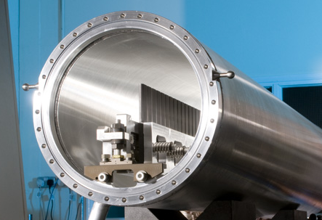
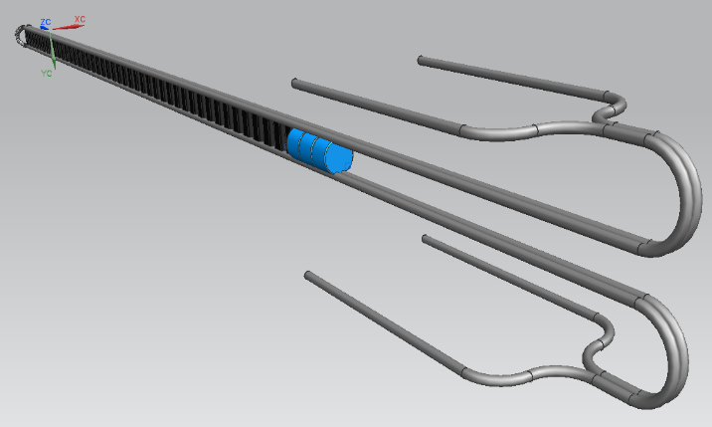
A Longer Target is No Surprise
NOvA Target is 1.2 m of graphite intended for higher-energy mesons
LBNF reasonably will desire lower-energy mesons which could result from supplemental interactions
“Default LBNF Target is 0.94m – inherited from NuMI

Slide 5
How well is the optimal length number known?
Why is 5 interaction lengths advantageous?
What is the range of near-identical values?
  Re-optimize at smaller values?
What if we had to compensate with more material?
(Also, curious that target width seems so insensitive)

Slide 6
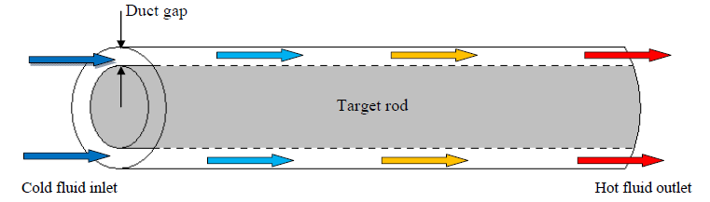
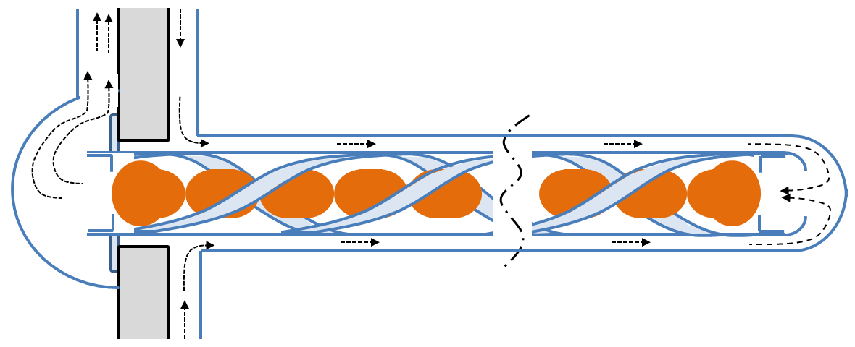
Alternative approaches
Multiply support target
  “catcher” mounted to front of horn
  Contact inside horn
    Single or multiple points
Integrate / Embed to horn inner conductor
Issues:
  Coolant flow (single pass?)
  Vibration / stresses
  Current flow
  Damage multiple components
Some of these issues have been investigated over the years (much by RAL) for LBNx and other purposes.

Slide 7
Systematic Issues
5 interaction lengths implies that a large fraction of the resultant mesons will be from re-interactions, including reactions like n-p, π-p, π-n, K-p, K-n, etc.
  These interactions are even less well known
  Need to get a feeling for impact
Alignment of target? Is sag an effect.
Current flow on internally supported targets
  Magnetic field less-well defined

Slide 8
Questions / Actions Needed (Summary)
What is bound on optimized target length?
  Have some information, but down to 1.7 m? 0.7 m?
What are the bounds on horn inner conductor size?
What are the bounds on target width/height? (as a proxy for cooling and support system)
How much energy is deposited in the target?
  Scaling with length and material?
  Including horn energy reflection
What is the allowable sag of the target from a systematics point of view?
What would be the systematic effect of poorly-controlled current short-circuits into target material?
How does the uncertainty on the flux change with greater re-interactions? (e.g. less well known π-p cross-sections)

Slide 9
Supplemental Material

Slide 10
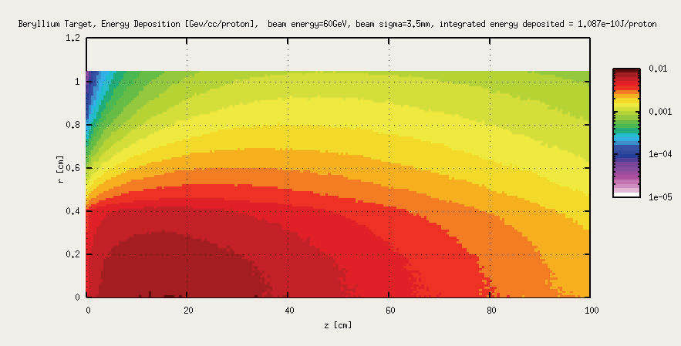
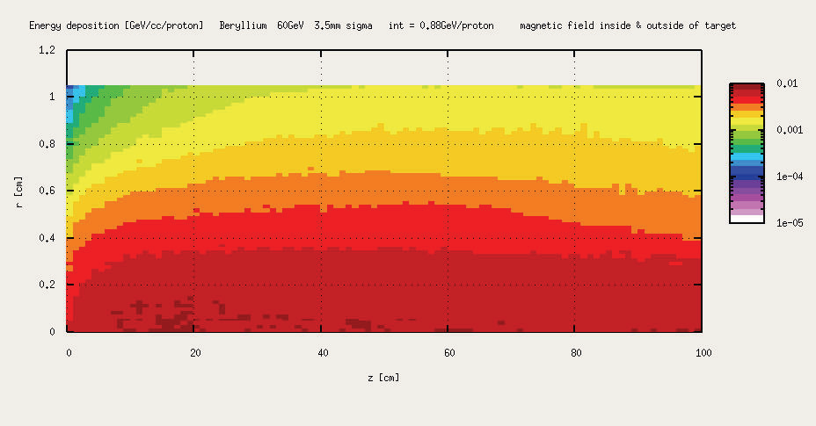
Reentrant Heating (RAL)
Magnetic field bends secondaries back into target
  Proportionally larger effect in target exterior
Not a limiting effect, but something that needs to be considered for target and inner conductor cooling

Slide 11
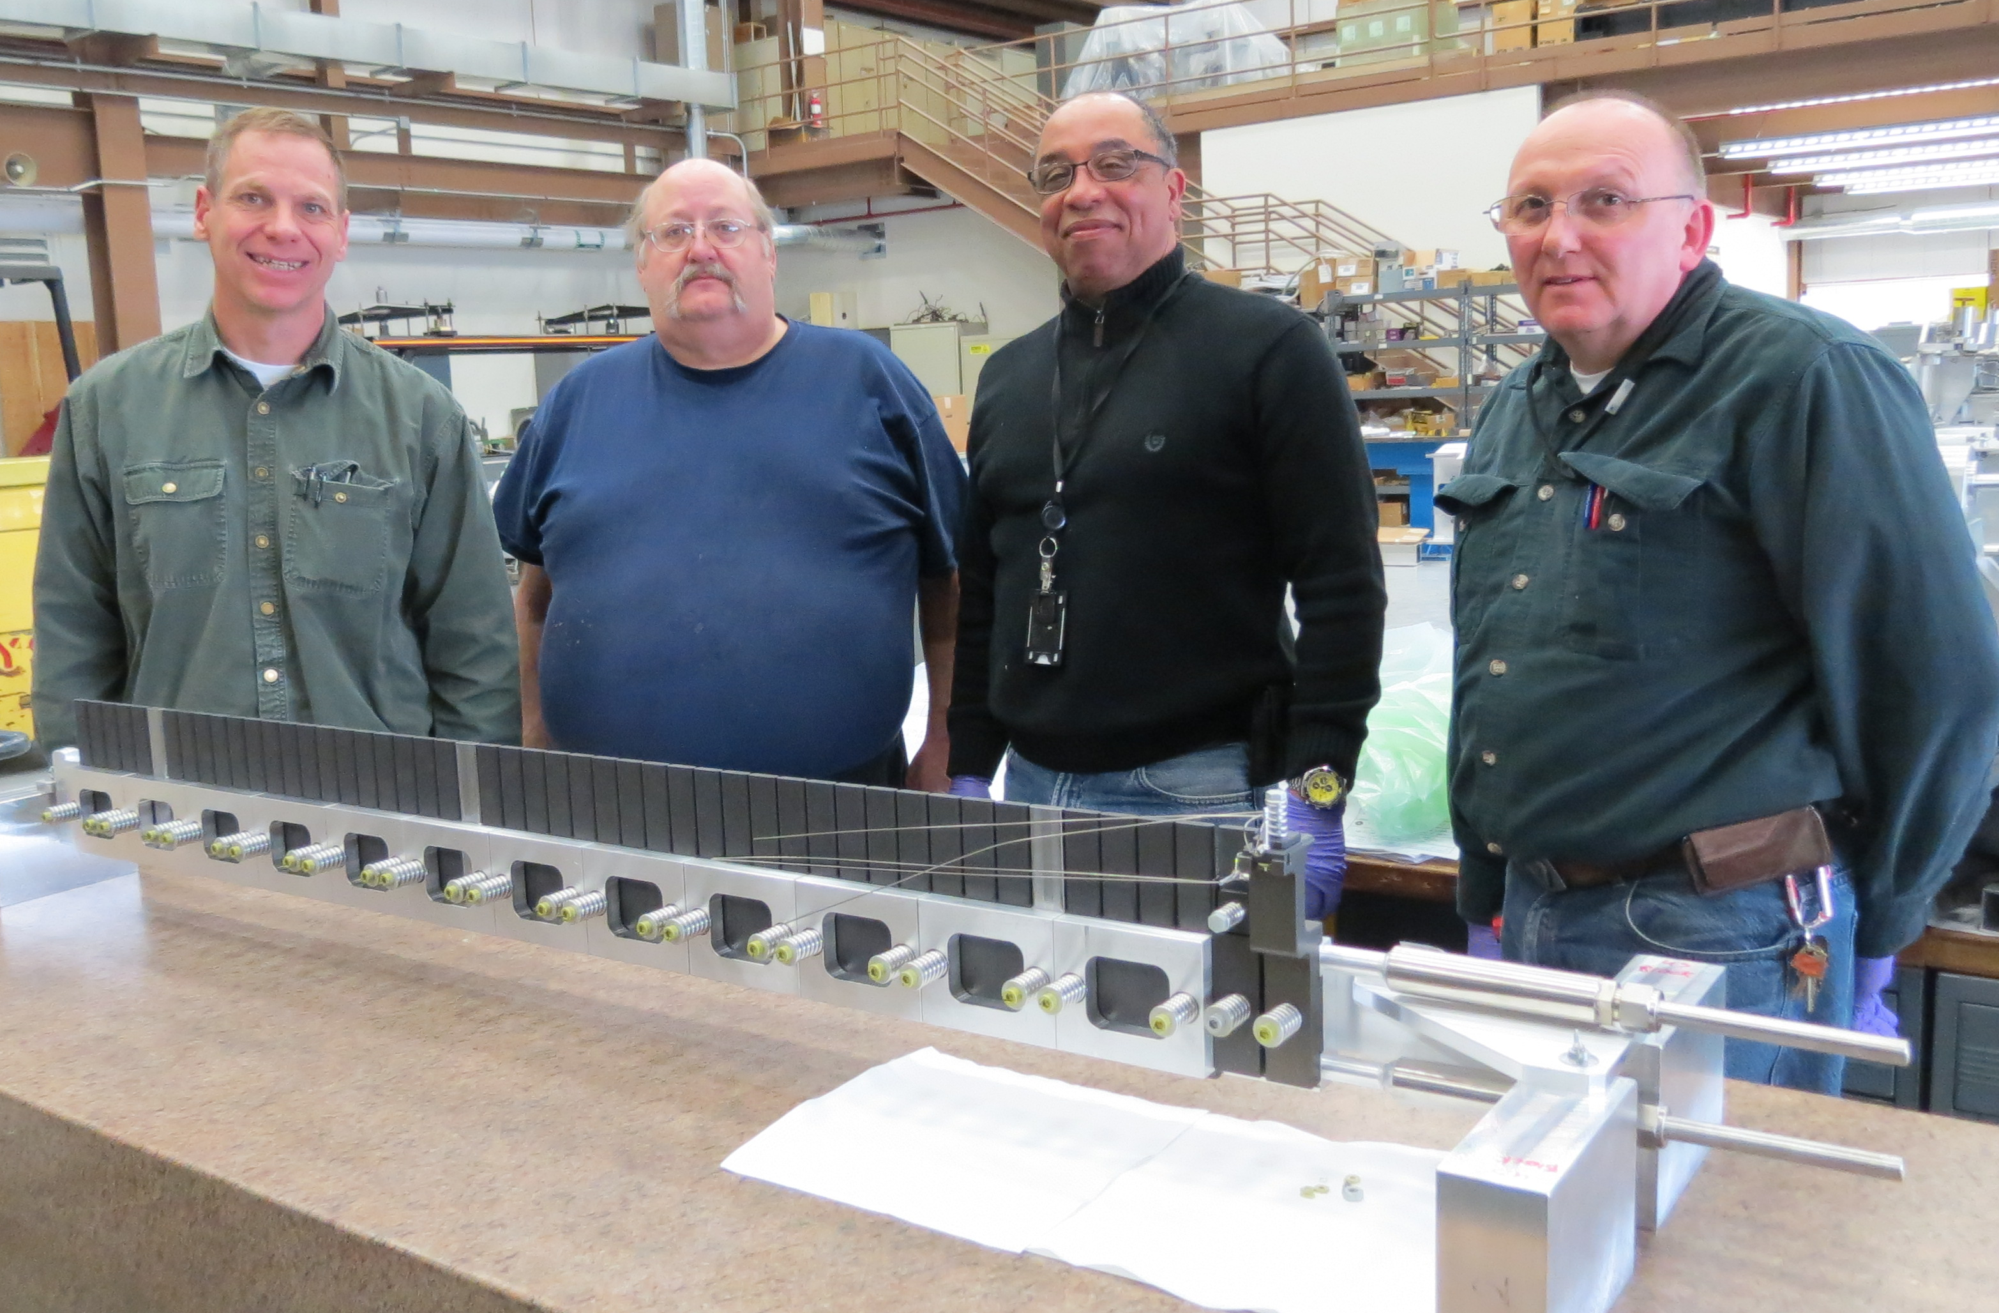
NOvA Fin Test
Beryllium Fins

Slide 12
NuMI versus NOvA
NuMI- Low Energy Configuration
Target inserted into Horn 1 Inner Conductor
NOvA- Medium Energy Configuration
Target well US of Horn 1

