Slide 1
Initial thoughts on Long Targets for LBNF
Chris Densham

Slide 2
1. Divide Horn 1 into Collector (Horn 1a) and Horn 1b
Horn 1a
Horn 1b

Slide 3
2. Target installed in Horn 1a
c.2000 mm
Target position fixed in Z- inside cylindrical collector (Horn 1a)
  No need for separate target carrier (a la NuMI)
  Target can be supported directly within horn bore (a la T2K)
Optimum target length 1.7 m– 2.4 m
  Fairly flat optimum
    Select what fits best
  But 1.7 m = 2x longer than NuMI, T2K
    Difficult to cantilever within horn
    Extra heat load
Horn 1a

Slide 4
3. Proposal: split target into two lengths
c.2000 mm
Upstream & downstream targets installed in Horn 1a
Each target similar length to existing targets
Heat load divided in 2 (solutions proposed)
Can be cantilevered inside horn
Targets supported from horn support structure (like T2K)
Horn 1a

Slide 5
4. Think about installation into target chase
c.1000 mm
c.2000 mm
Horn 1a
Horn 1b

Slide 6
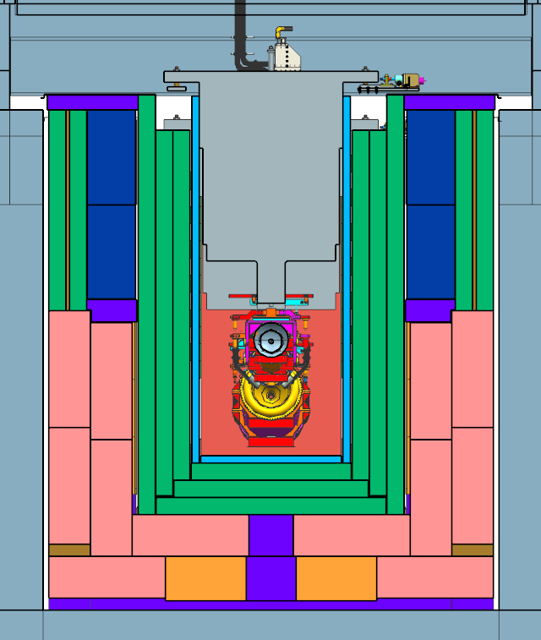
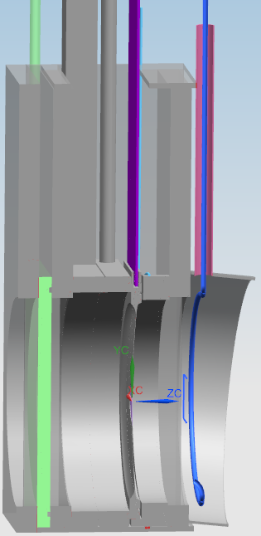
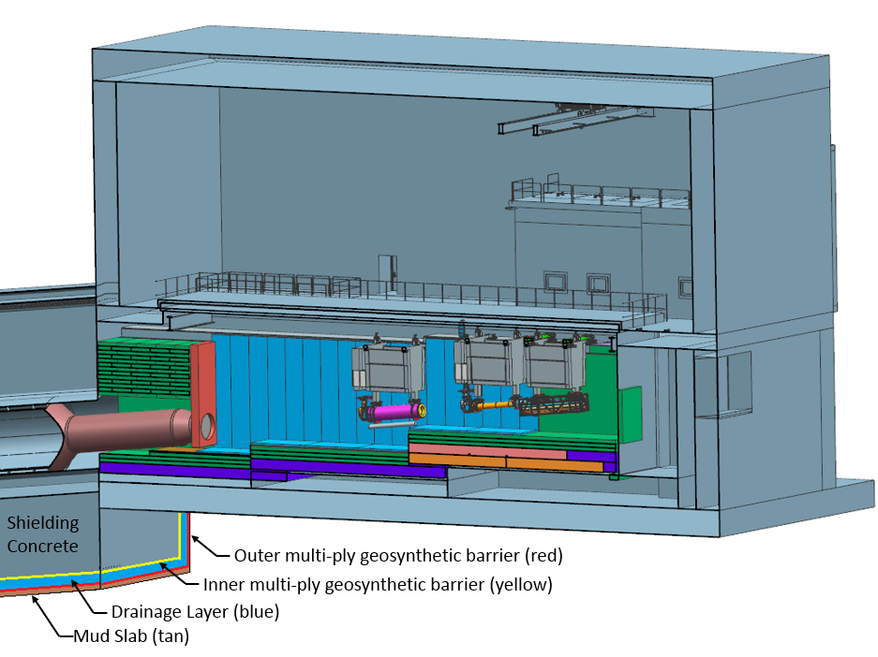
Reminder: Baseline Target Hall/Decay Pipe Layout
~ 40% of beam power in target chase
~ 30% of beam power in decay pipe
50 TON CRANE
DECAY PIPE
UPSTREAM
WINDOW
WORK CELL
Cooling panels
DECAY
PIPE
SNOUT
Beam
Decay Pipe: 194 m long, 4 m in diameter, double – wall carbon steel, helium filled, air-cooled.
Target carrier
Installs target in horn, Z-pos variable
5.6 m
Target Chase: 2.2 m/2.0 m wide, 34.3 m long air-filled and air & water-cooled (cooling panels)

Slide 7
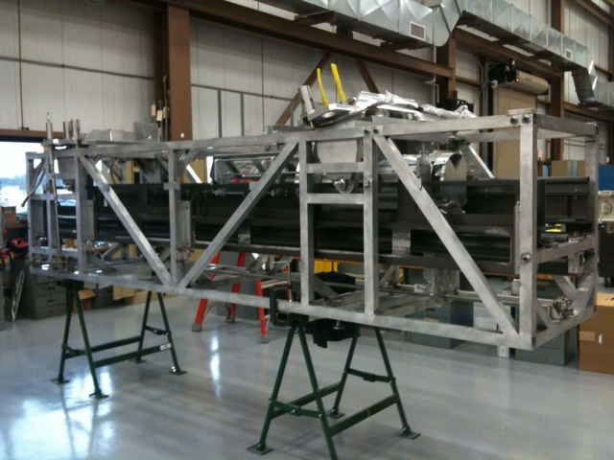
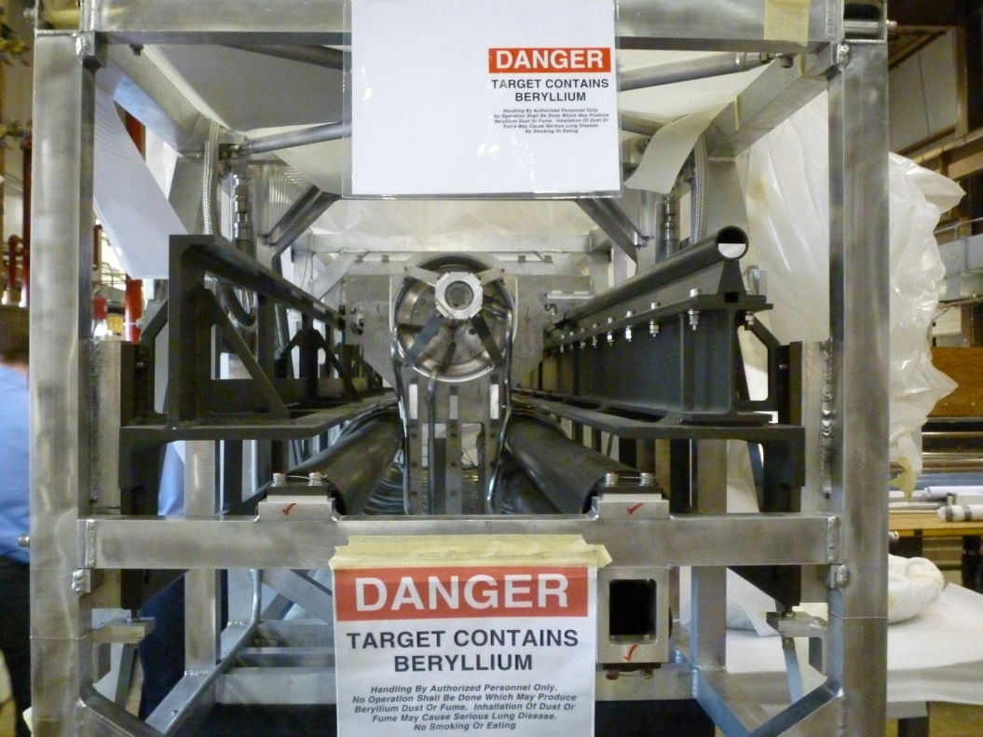
NuMI target carrier – 1 per target

Slide 8
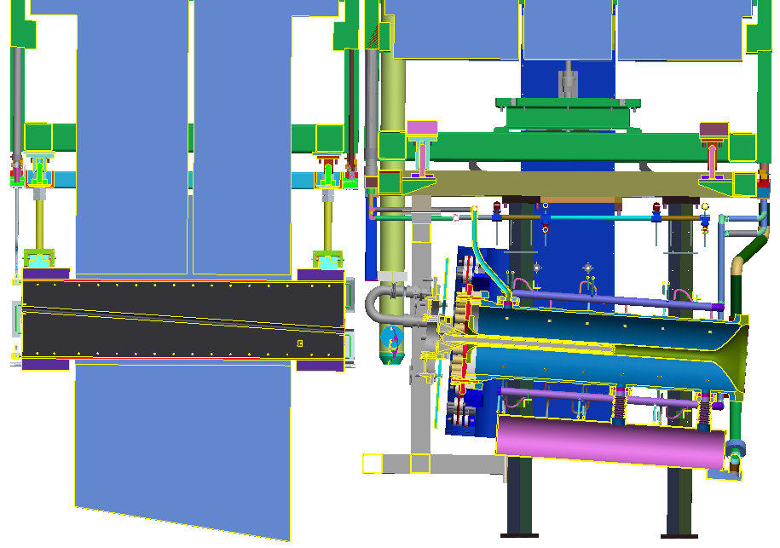
Alternative concept layout (look familiar to anyone?)
Separate baffle
Target 2 goes here
Target 1

Slide 9
Implications for target station design
No separate target carrier
  Reduces cost?
  Can make target chase shorter?
Targets need to be installed and replaced in Horn 1a in separate hot cell

Slide 10
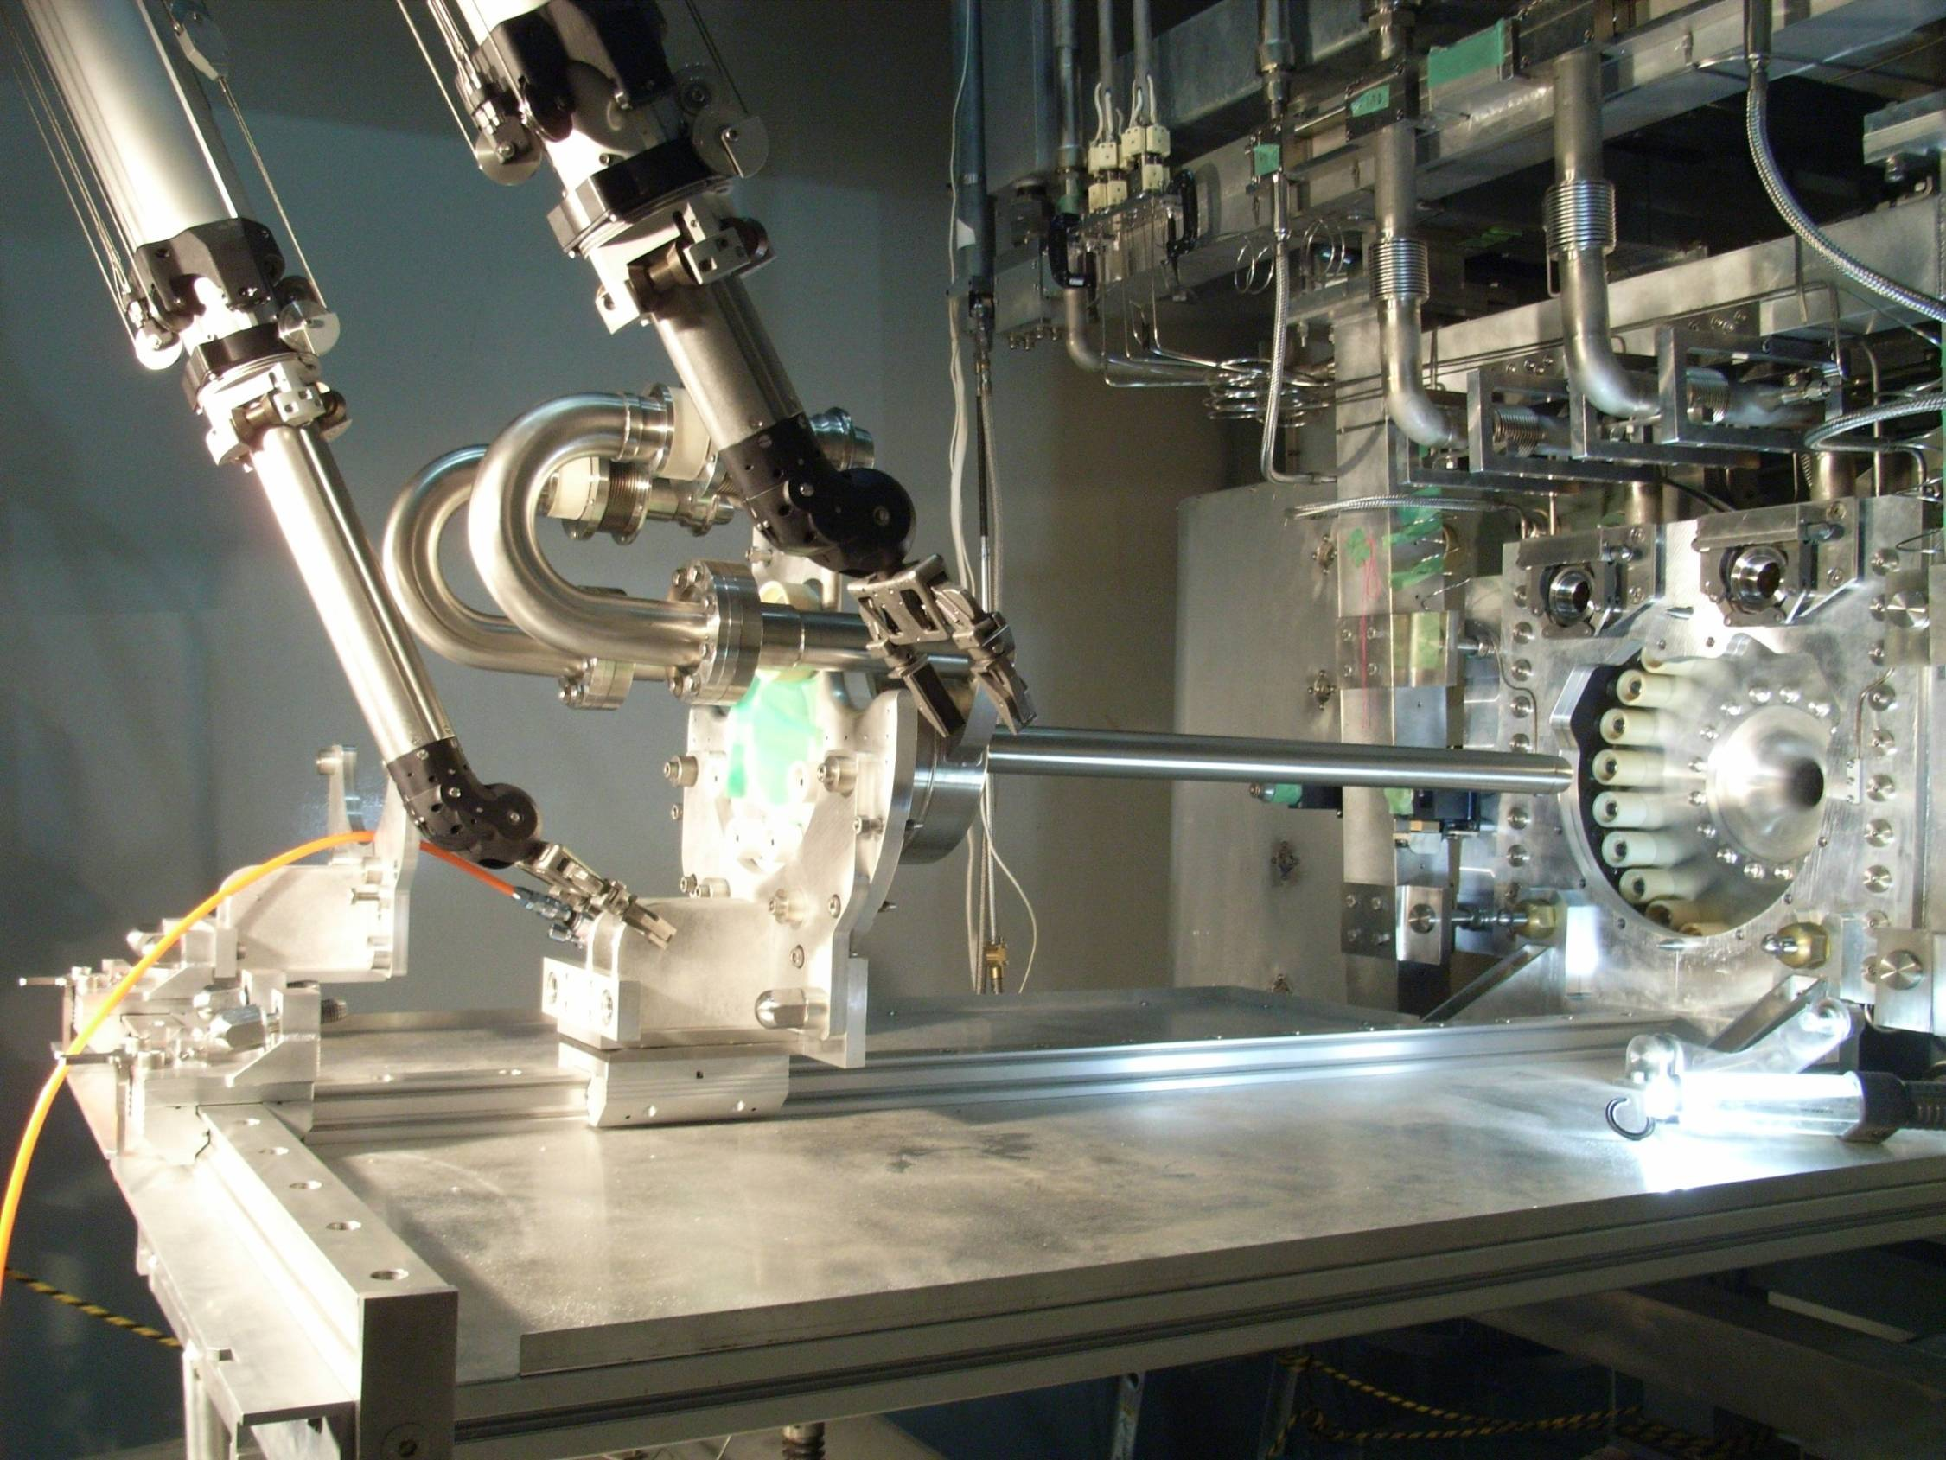
Prototype target exchange system?

Slide 11
Target technology for 2.4 MW?
Material and cooling medium choice
  Graphite
    Excellent track record, obvious candidate
    Best tolerance to radiation damage when operated at c.500 - 1000 C
    Helium cooling favored
  Beryllium
    May be more tolerant to radiation damage – jury still out (ref. RaDIATE program)
    As for all metals, best properties at low temperatures
    Water cooling most effective, but difficult to implement reliably
    Helium cooled Spherical Array Target looks promising

Slide 12
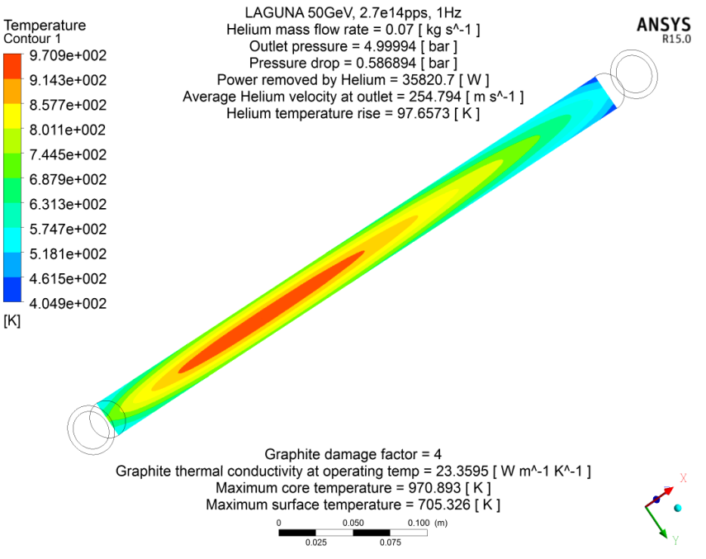
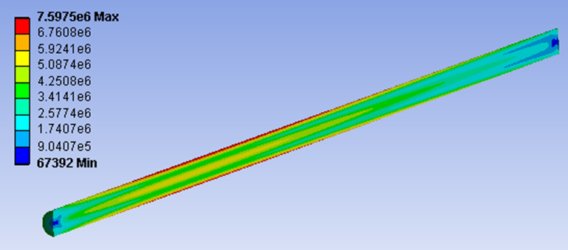
Helium cooled graphite rod (Mike Fitton)
Simple study of rod for 50 GeV beam
36 kW in target at 2 MW
Lower heat load for 120 GeV beam
70 g/s helium
5 bar outlet pressure
0.6 bar pressure drop
Single pass only – needs more work to include full geometry – higher pressure drop
Appears feasible – but what is expected lifetime?
Mean temperature
c. 700°C
Thermal conductivity degraded x4
Max. stress = 7.6 MPa
Safety Factor = 4.9

Slide 13
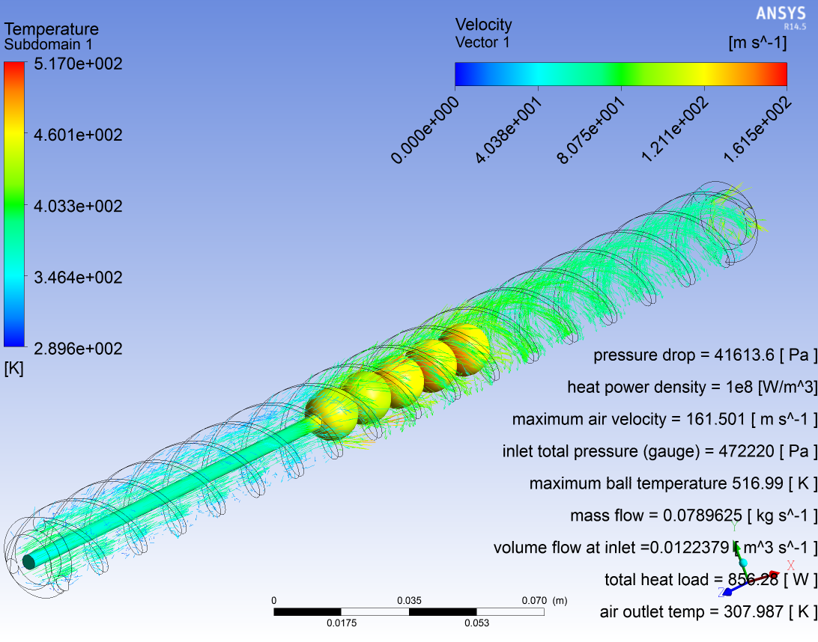
Spherical Array Target concept (Tristan Davenne)
Helical helium flow around spherical target material

Slide 14
Questions/issues
Performance of finned (NuMI style) target vs cylindrical?
Performance of graphite vs beryllium?
Beam RMS radius
  Target radiation damage rate inversely proportional to maximum power density
  Bigger beam = longer target lifetime
  Need to compromise for optimum overall performance
    E.g. 4 mm RMS please

