Slide 1

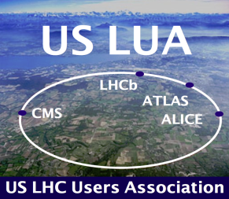
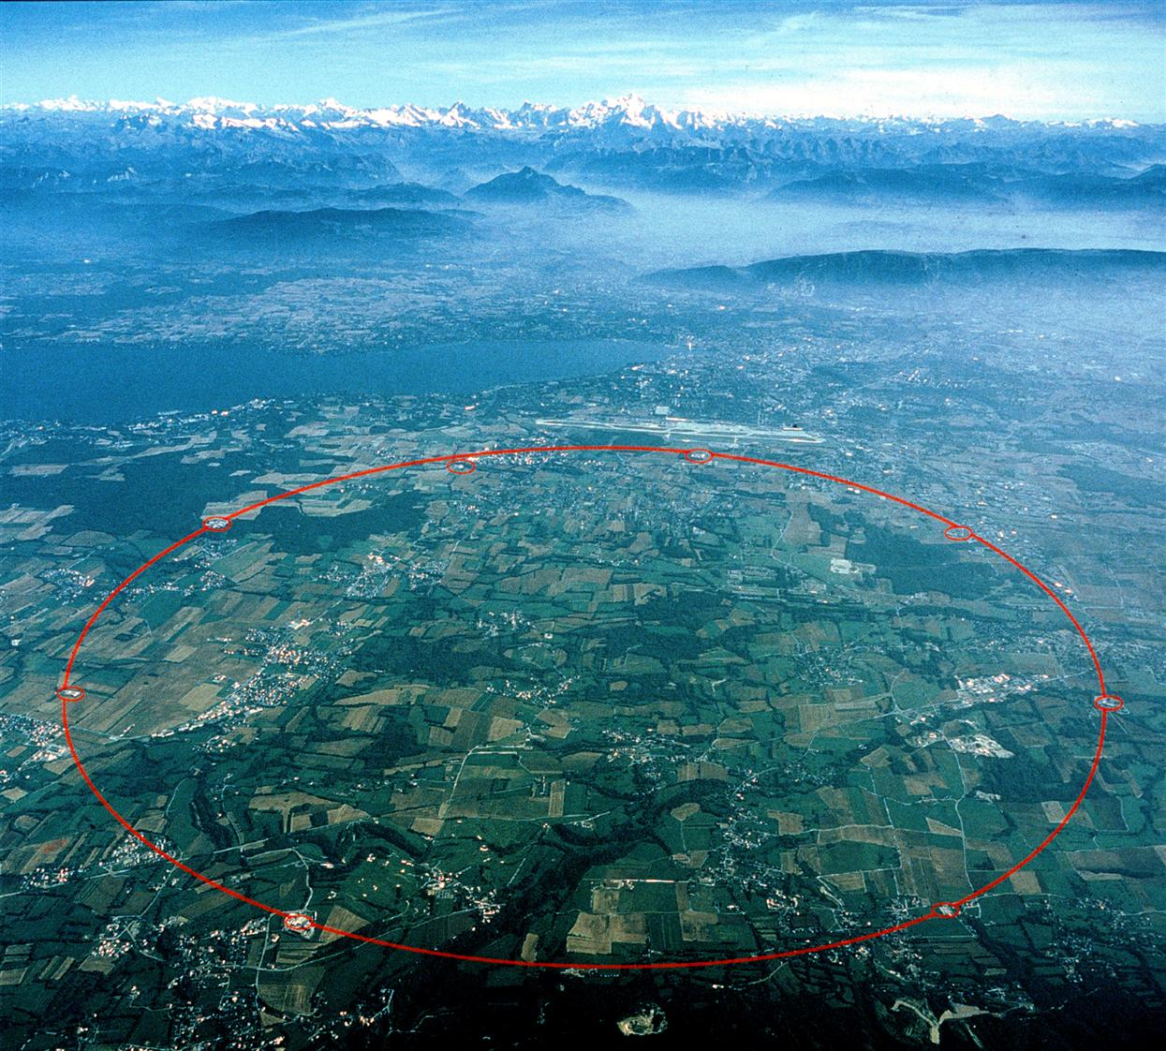
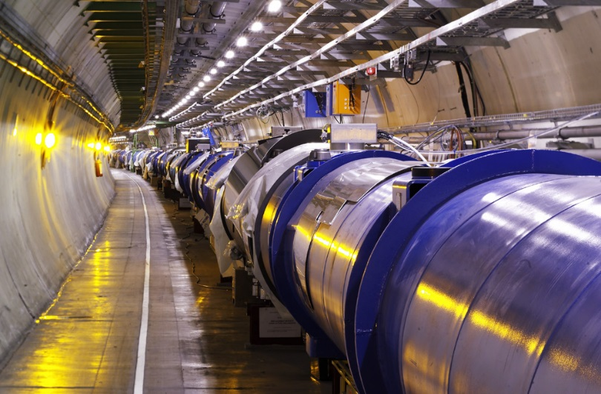

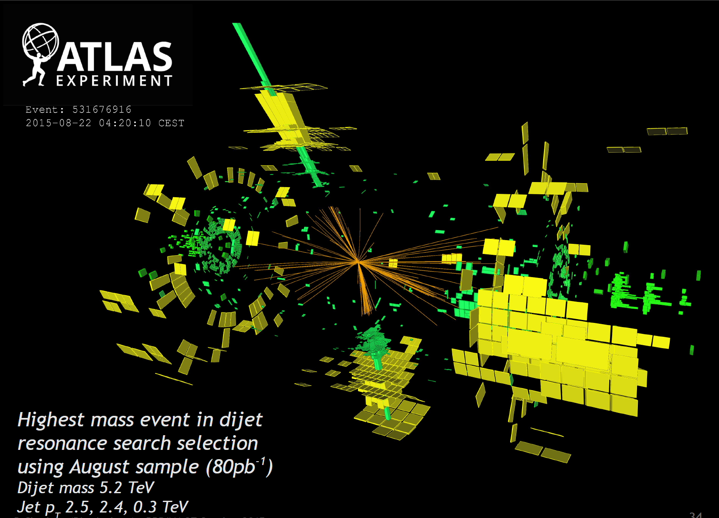
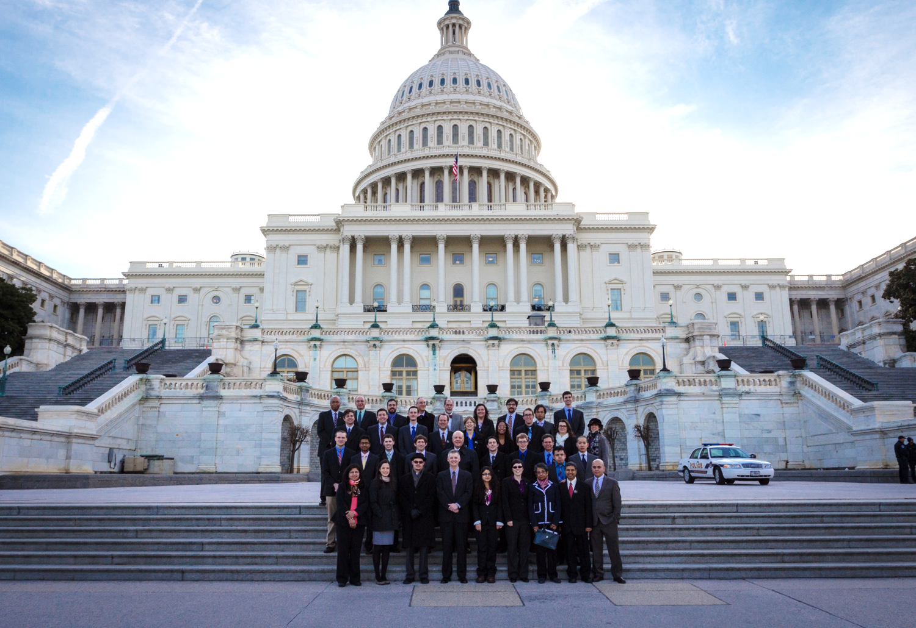
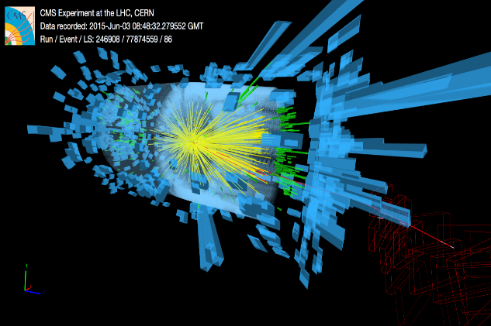

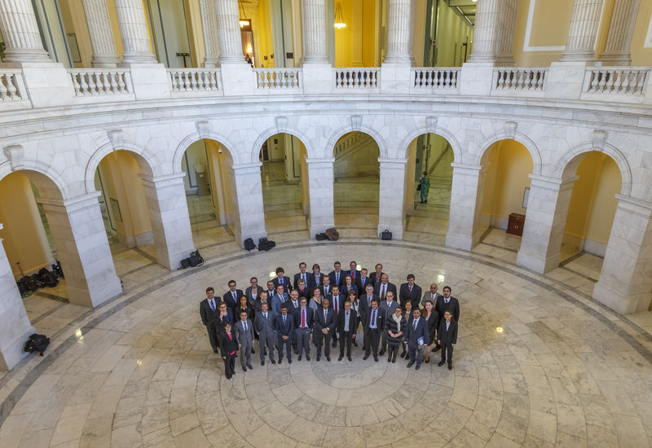
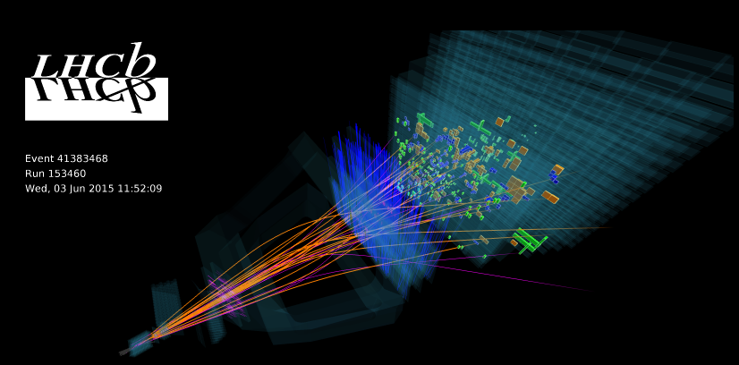
13 TeV
US LUEC Chair Report
Harvey Newman
Fermilab
November 12 2015
Notes:
1

Slide 2
Annual US LUA Meeting 2015 Thursday
November 12 Agenda: Building 327
9:00 – 9:10 Welcome to Fermilab Nigel Lockyer
9:10 – 9:40 US LUEC Chair’s Report Harvey Newman (Caltech)
9:40 – 10:10 Status and Outlook of the LHC Mike Lamont (CERN)
10:10 – 10:30 LARP Giorgio Apollinari (Fermilab)
10:30 – 10:50 COFFEE BREAK
10:50 – 11:20 ATLAS Status and Outlook Beate Heinemann (UCB, LBNL)
11:20 – 11:50 CMS Status and Outlook Jorgen d’Hondt (VU Brussel)
11:50 – 12:20 US HEP Program Status and Outlook Nigel Lockyer (Fermilab)
12:20 – 1:20 LUNCH
1:20 – 1:30 GROUP PHOTO
1:30 – 2:00 LHCb Status and Run2 Results Mike Williams (MIT)
2:00 – 2:30 ALICE Status and Run2 Results Rene Bellwied (Houston)
2:30 – 3:30
3:30 – 3:50 AFTERNOON BREAK
3:50 – 4:15 CMS Run2 Results Guenther Dissertori (ETH Zurich)
4:15 – 4:40 ATLAS Run2 Results Jessica Metcalfe (Argonne)
4:40 – 5:05 DOE Office of HEP Report Simona Rolli (DOE/HEP)
5:05 – 5:30 DOE Office of NP Report Tim Hallman (DOE/NP)
5:30 – 5:45 P5 Plan: Progress and Visibility Steve Ritz (UCSC)
5:45 – 7:15 Careers Session (Panel, Q&A) Toyoko Orimoto (Northeastern)
7:20 – 9:20 Conference Dinner; Cocktail at 7:20
Young Physicists’ Lightning Round Session 1 [5]
Notes:
2
2
2

Slide 3
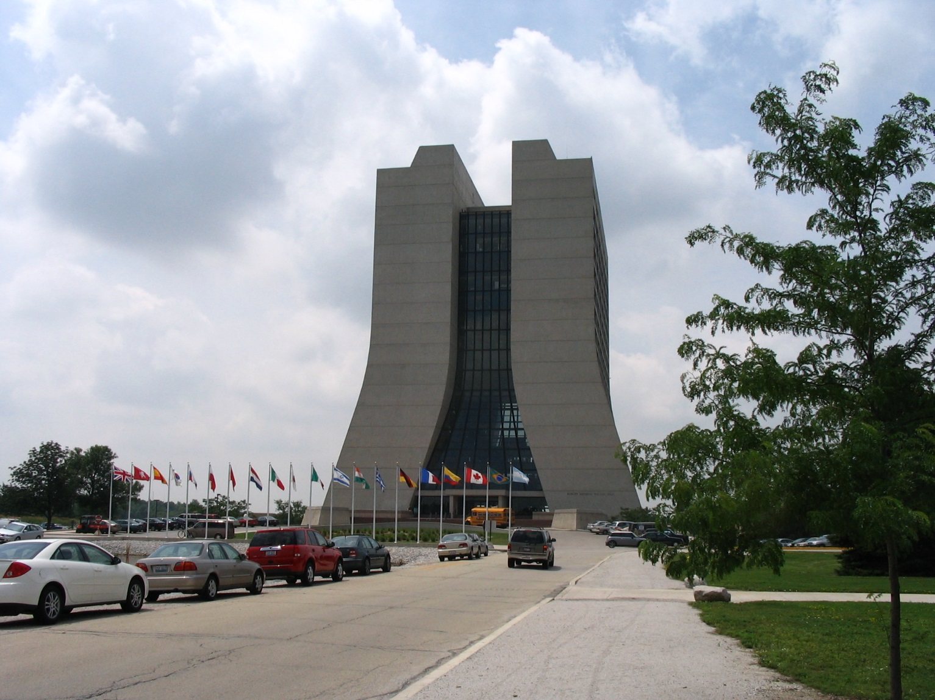
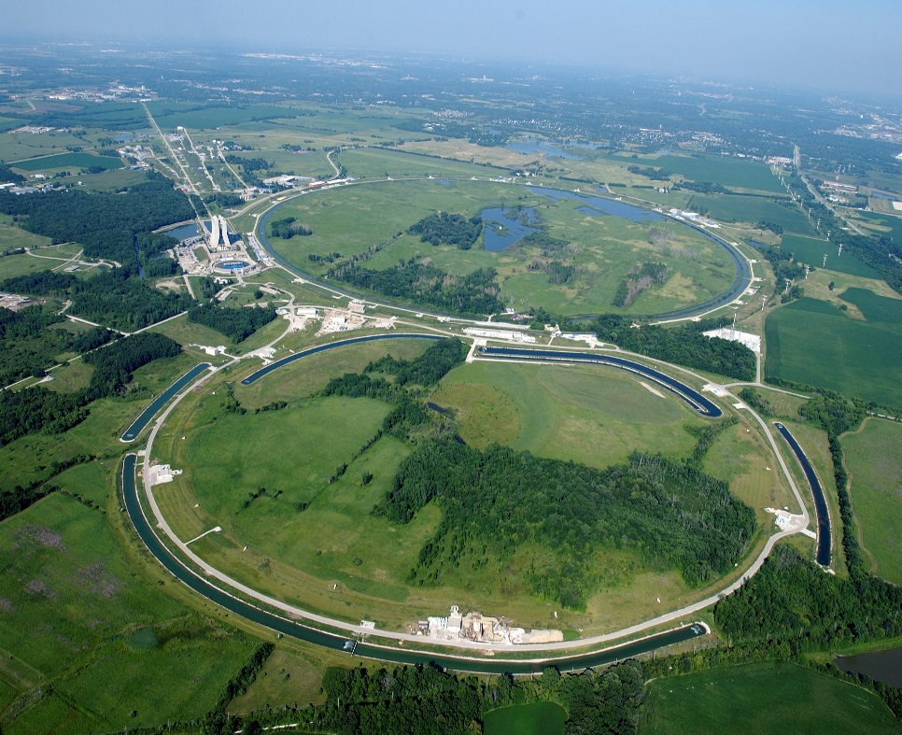
Thank You Fermilab, FRA and
the LPC For Hosting Our 2015 Meeting
Our Hosts also in 2008, 2010, 2012
Greatly appreciated strong support: for US LUA
(and US LUO before it) from the Start
3
Notes:
3

Slide 4
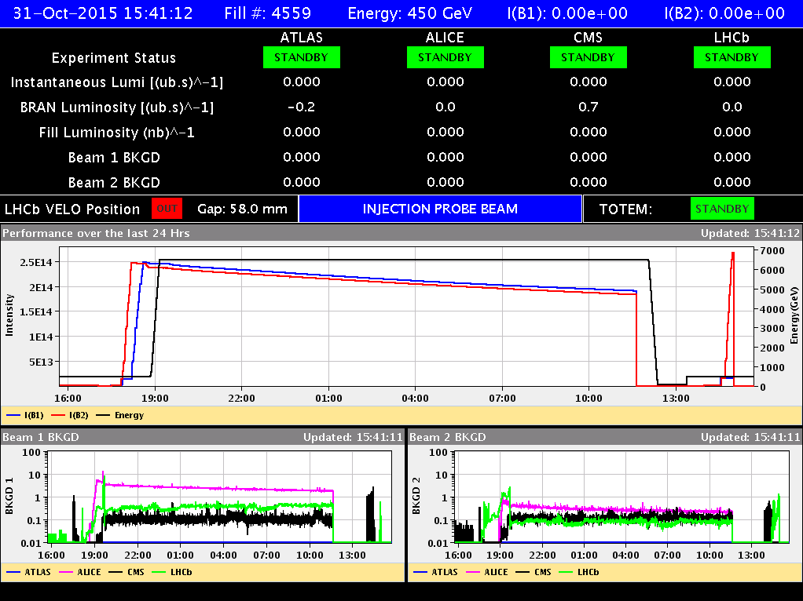
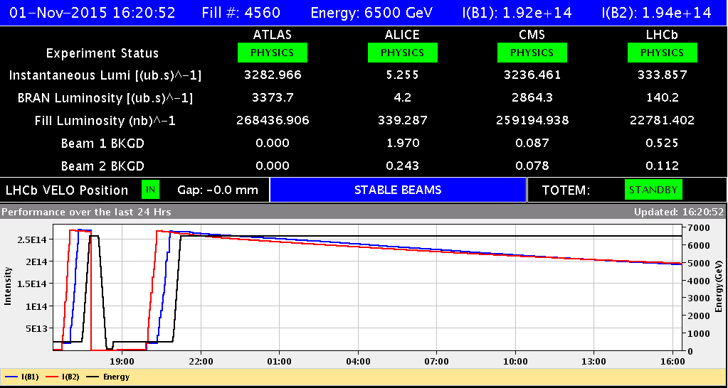
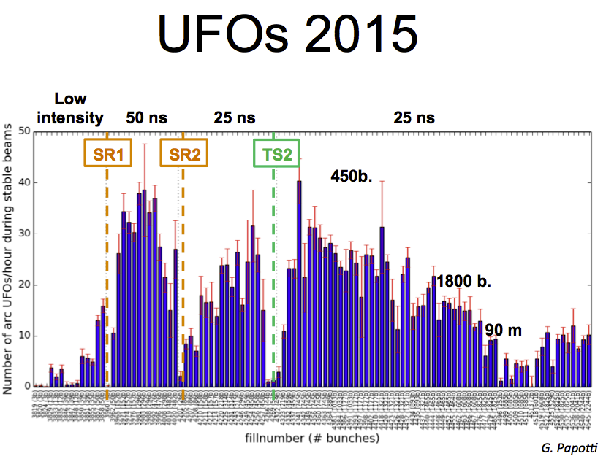
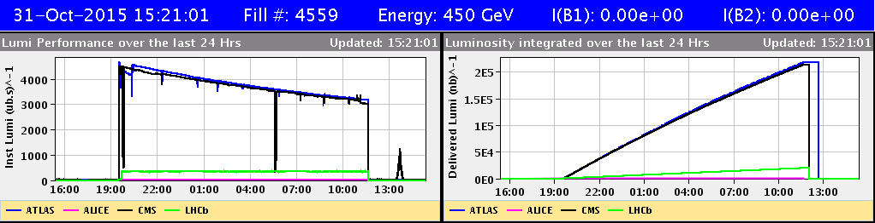
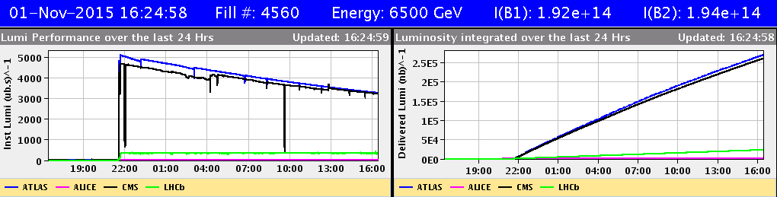
US LUO Activities (1)
LHC At 13 TeV: Impressive Progress
Climbing a Steep Learning Curve
  Dealing with
  25 ns Electron Cloud
  new filling schemes
  Heating at Injection
  UFOs: Declining with
  Sustained Running
  ULO: Steering
  Very Effectively
  270/pb Run with 2244 Bunches
Luminosity Lifetime 48 Hours
Notes:
4

Slide 5
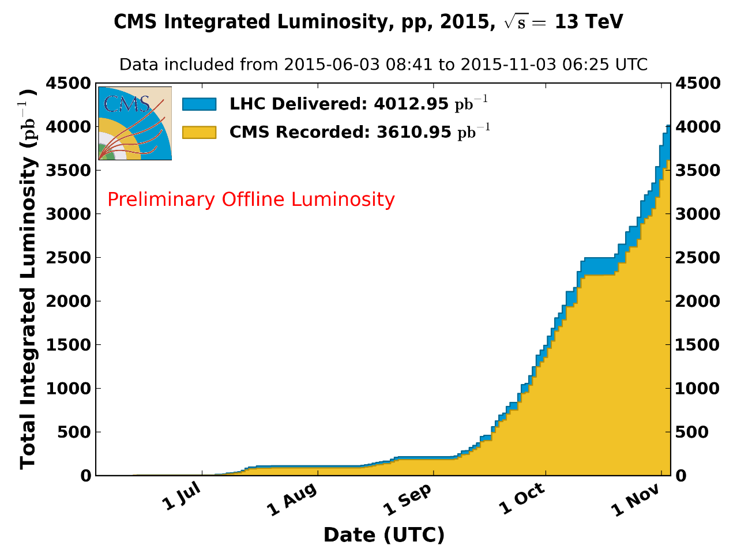
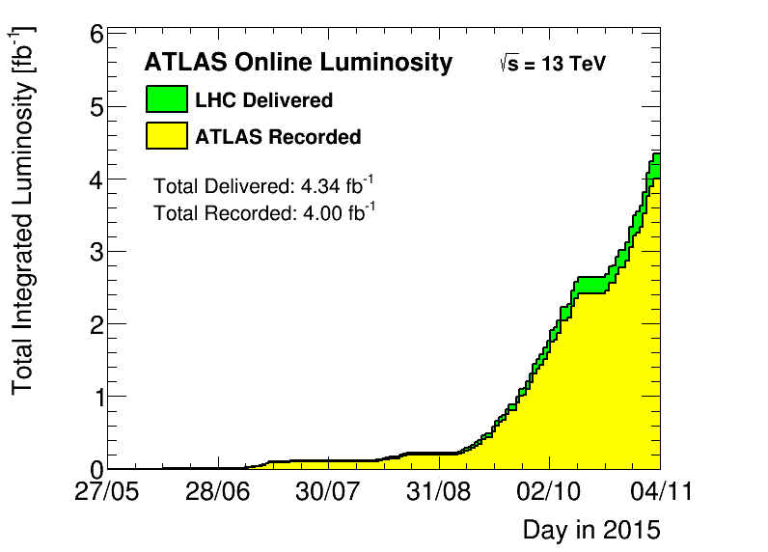
2015 LHC Integrated pp Luminosity
Adapting to the 25 nsec 13 TeV Environment
CMS Preliminary Offline Luminosity
4+ Inverse Femtobarns Delivered; 90 – 93% Recorded
5 X 10³³/cm²/sec Peak; <μ> ~18
https://twiki.cern.ch/twiki/bin/view/CMSPublic/LumiPublicResults
https://twiki.cern.ch/twiki/bin/view/AtlasPublic/LuminosityPublicResultsRun2
B=3.8T: 3.0 fb^{–1} delivered, 2.8 fb^{–1} recorded (93%)
B≠3.8T: 1.0 fb^{–1} delivered, 0.8 fb^{–1} recorded (80%)

Slide 6
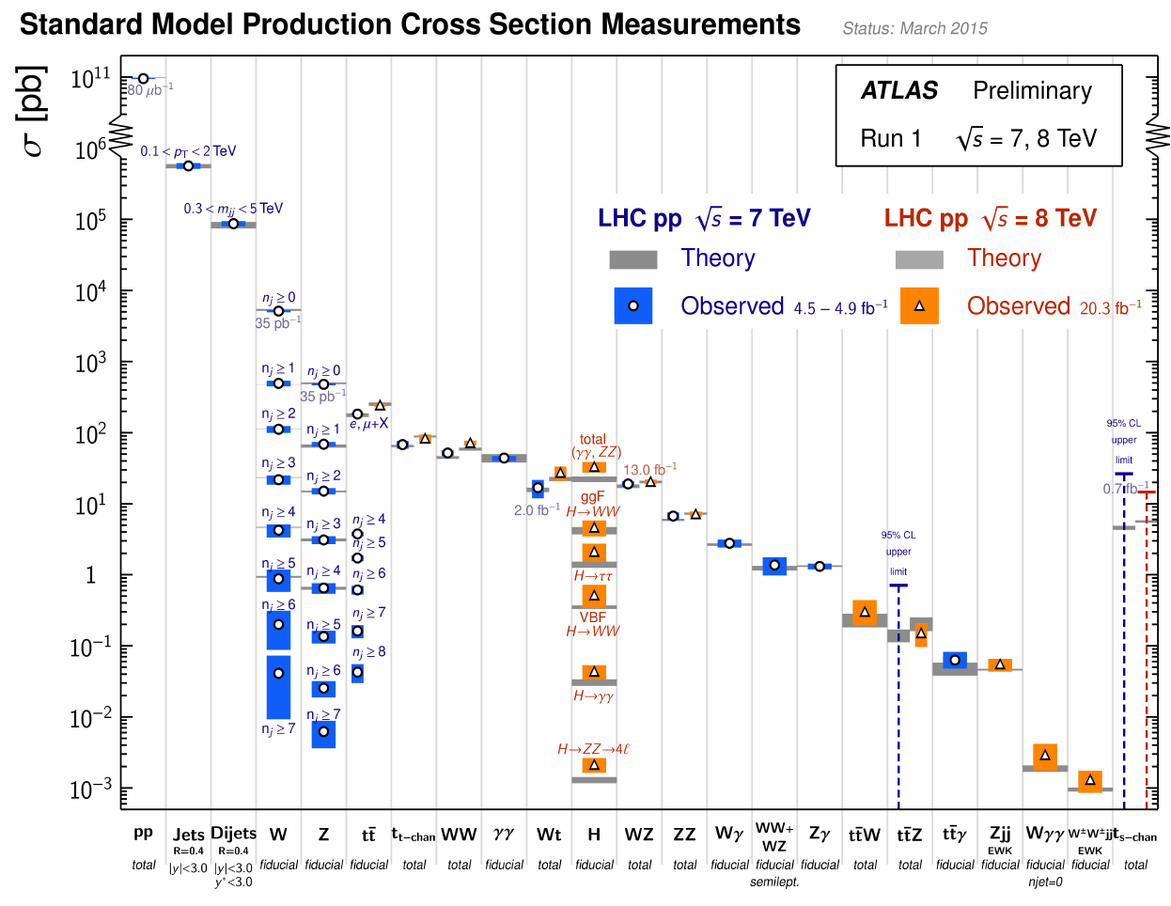
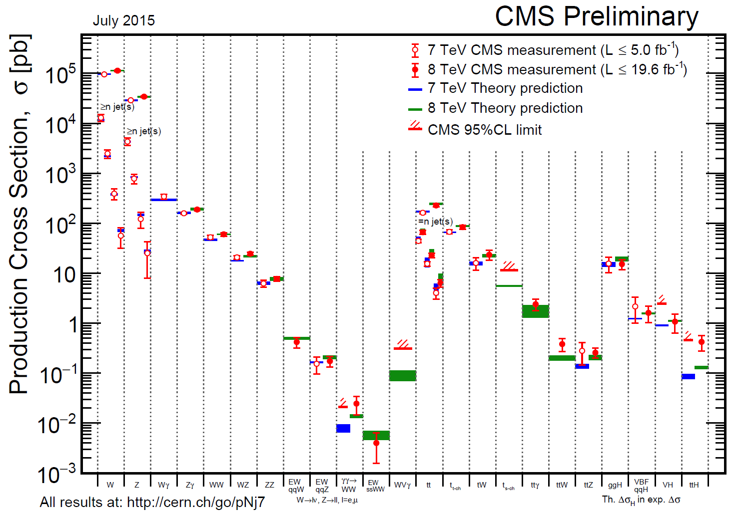


LHC: SM Cross Sections
Testing the SM Over 14 Orders of Magnitude
A tribute to experimentalists and theorists
A rich legacy that is still being written

Slide 7
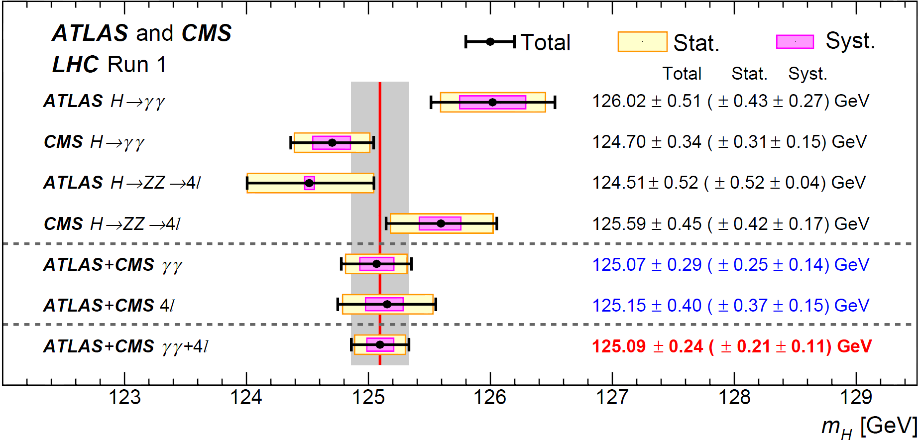
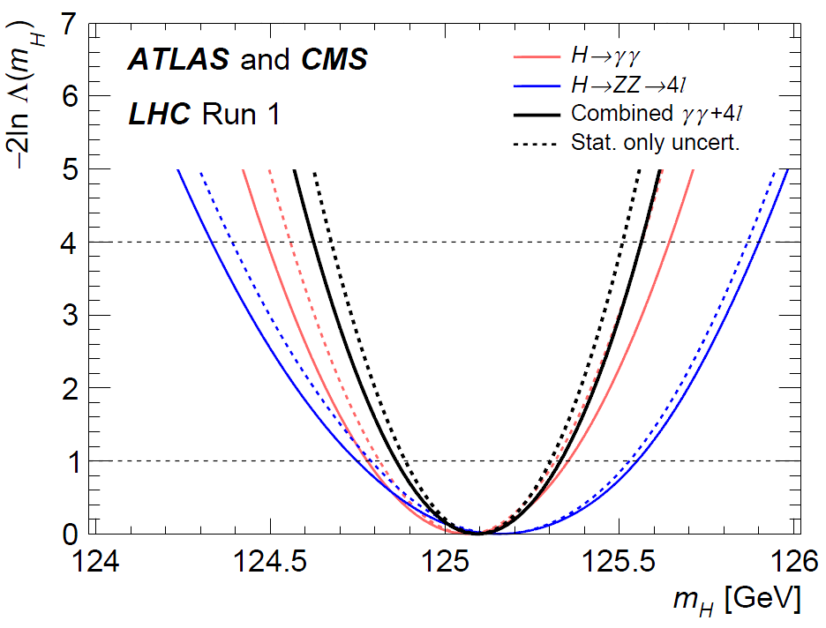
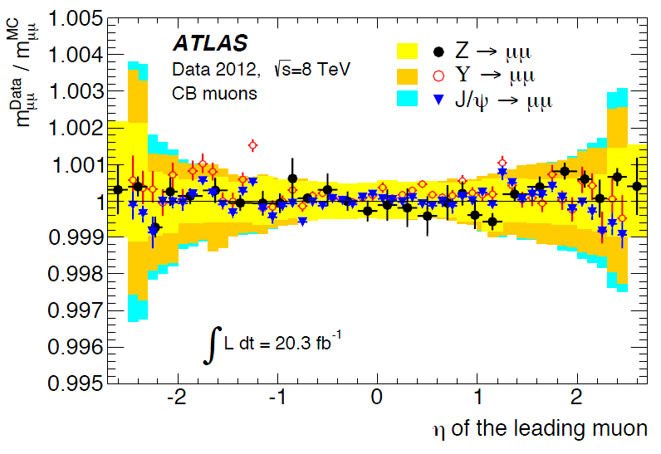
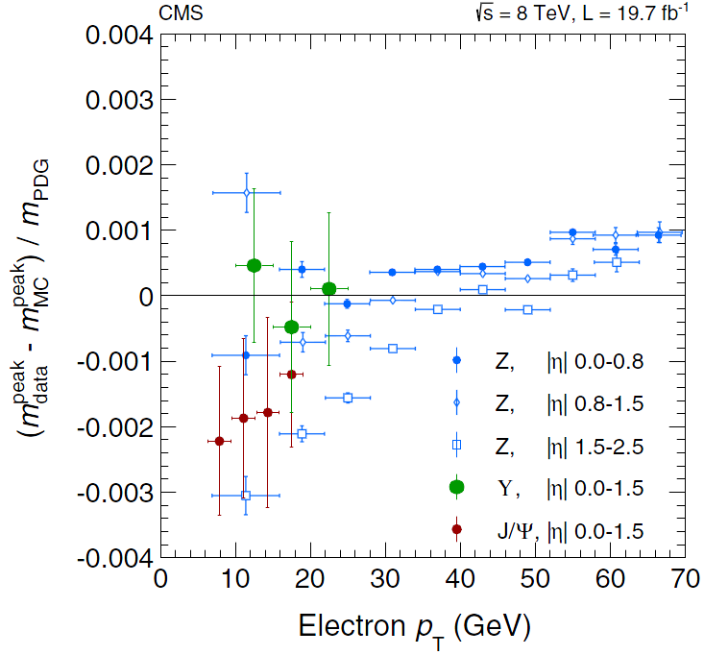
Combined Mass Measurement from H  ZZ  4l, H  γγ
arXiv:1503.7589
Profiling M_{H}; μ(ggH,ttH) and μ(VBF, VH) for γγ; μ(4l) for ZZ
Good Agreement
Calibration with
Z, Υ, J/ψ  ee, μμ
Improvement on syst. uncertainties
• final e, γ, μ calibrations
• final detector simulation
Impressive ±0.2% accuracy: Statistical uncertainty dominates
M_{H} Values (ATLAS+CMS)
H  γγ: 125.07 ± 0.25 ± 0.14
H  4l: 125.15 ± 0.37 ± 0.15
Combined Channels:
M_{H} = 125.09 ± 0.21 ± 0.11
Impressive
0.1 – 0.3% Mass
Scale Accuracy

Slide 8
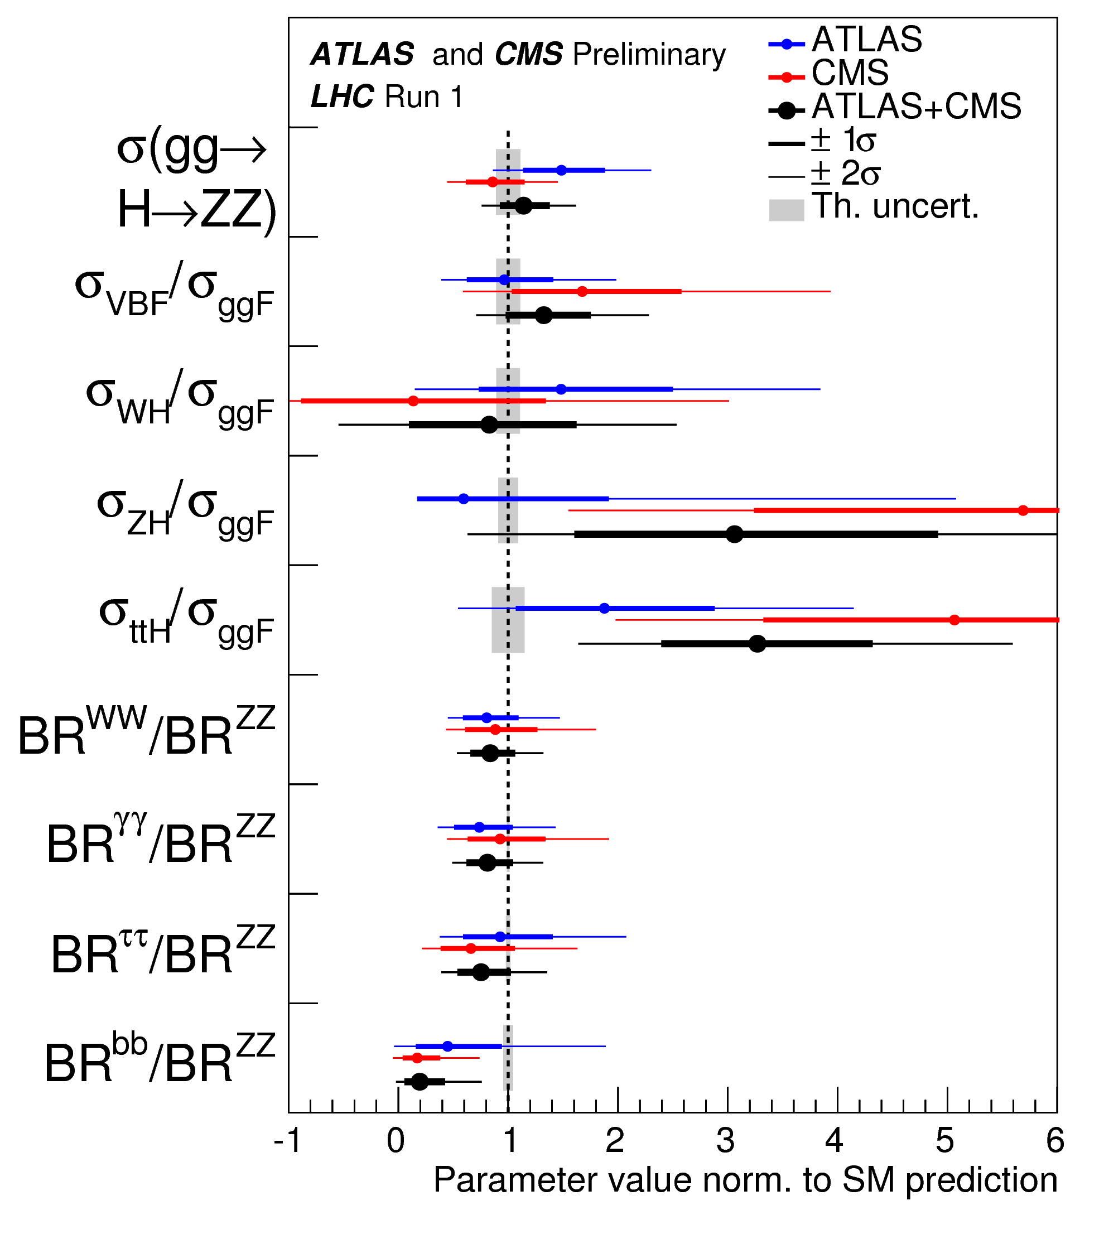
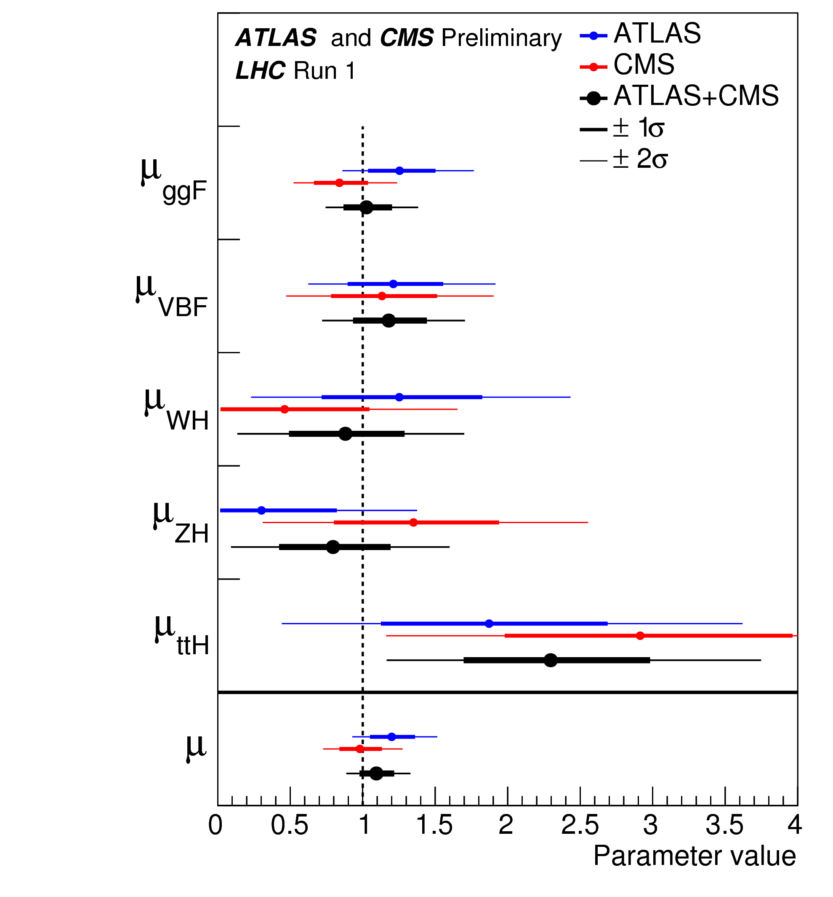
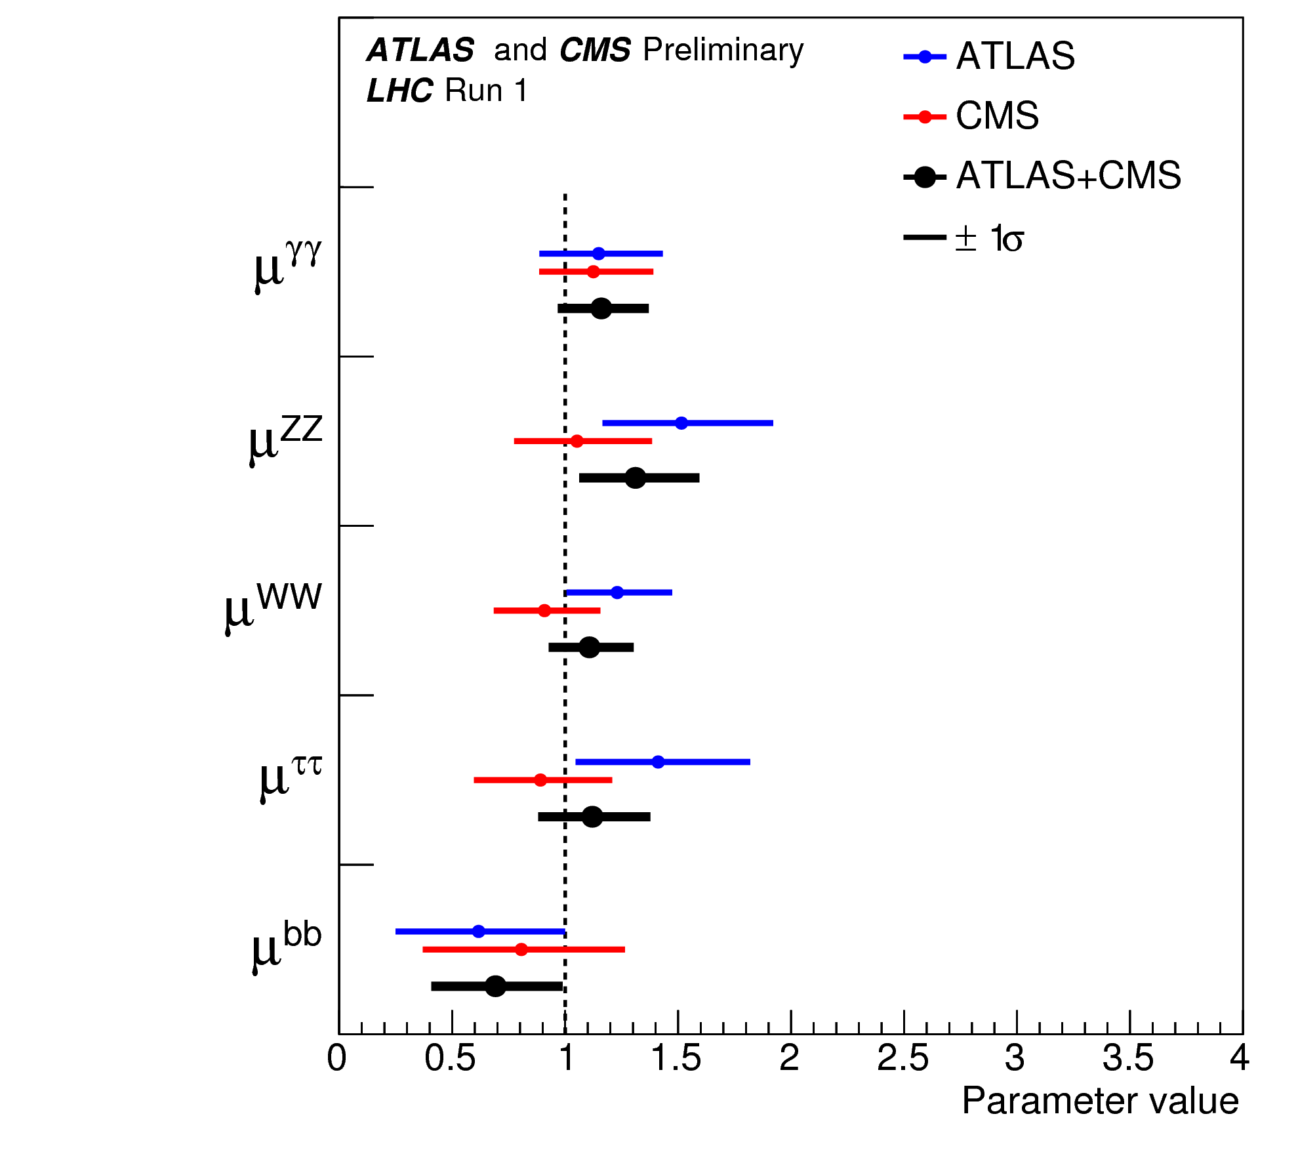
ATLAS and CMS Combined Higgs Properties and Couplings Analysis Relative to the SM
σ(ggHZZ), Prod.
σ, decay BR ratios
Production Strengths
Decay Strengths
Compatible with SM
κ_{f} vs κ_{v}
_{CLOSE to SM}
μ = 1.09
+0.11
- 0.10
SM-Like. Run2 will go a long way to clarify any hints of deviations

Slide 9

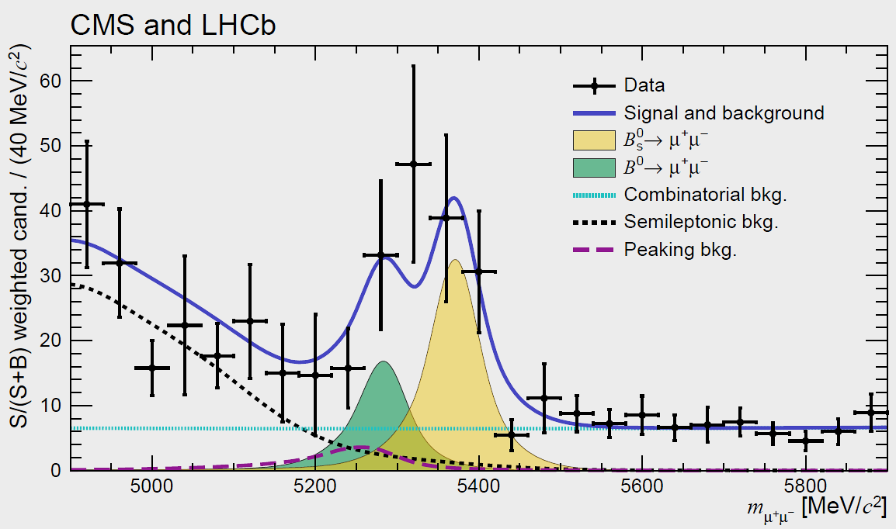
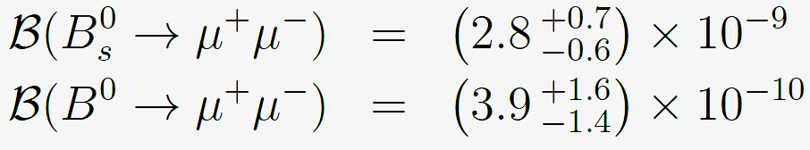


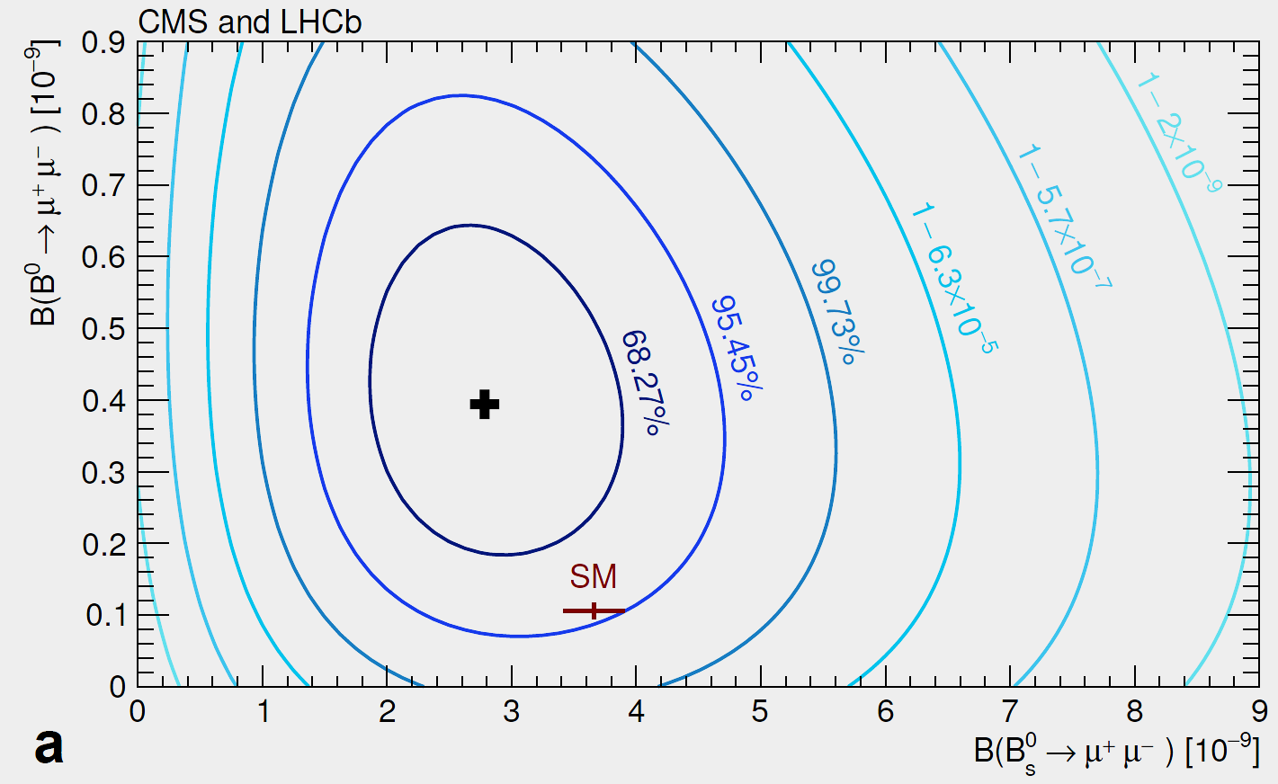
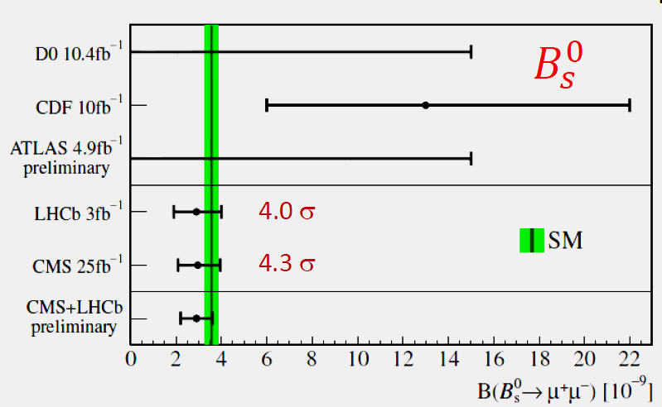
LHCb + CMS Combined B⁰_{s} and B⁰  μμ
An Observation of B⁰_{s} Compatible with the SM
B_{s}⁰ > 0 at > 5σ
B⁰ Compatible with SM ?: at the 2.3σ level
CMS-BPH-13-007 LHCb-PAPER-2014-049 CERN-PH-EP-2014-220 Oct. 14, 2014

Slide 10

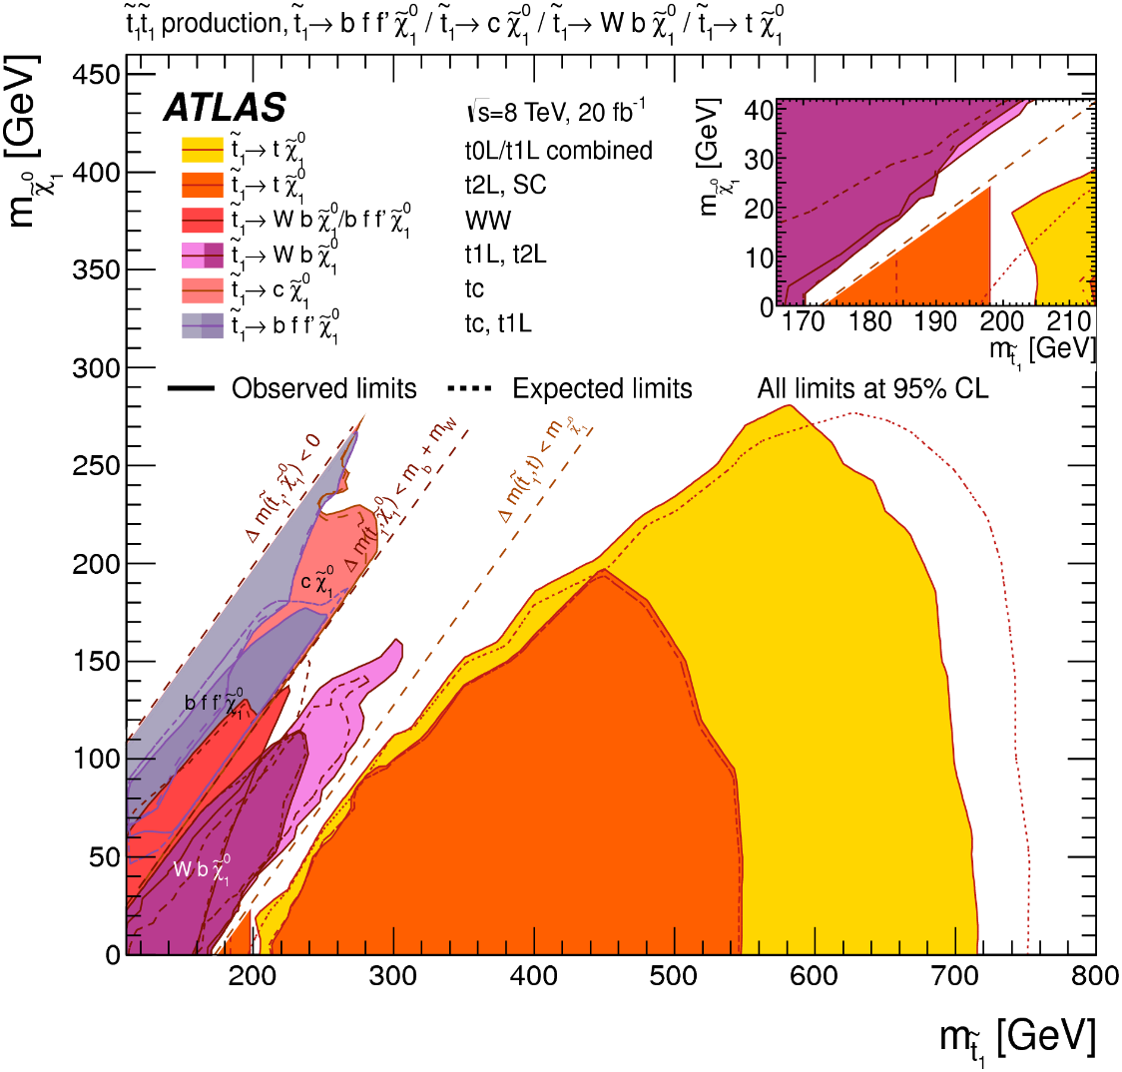
ATLAS and CMS Stop Searches: Wide range of signatures probed: “natural” SUSY under stress
Charm Tag
+ Monojet
Probing Difficult Regions; a vast (pMSSM and Beyond) SUSY Space Remains

Slide 11
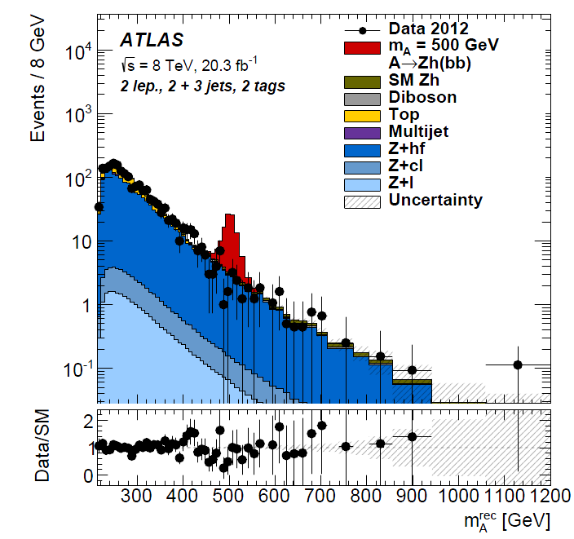
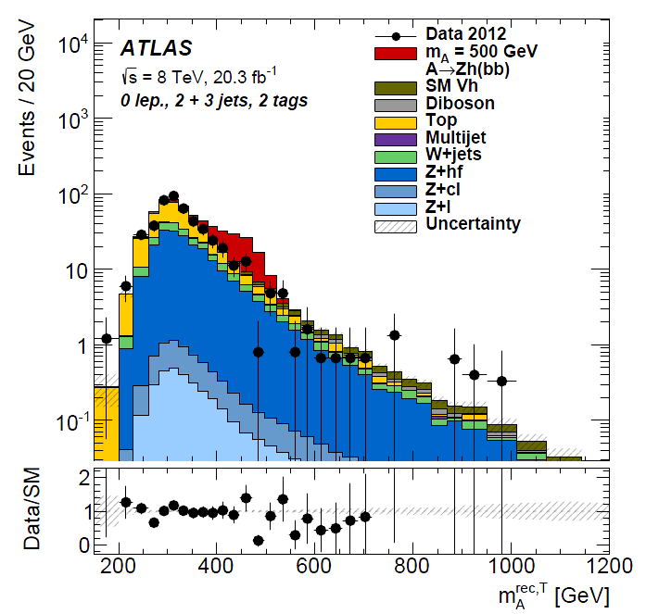
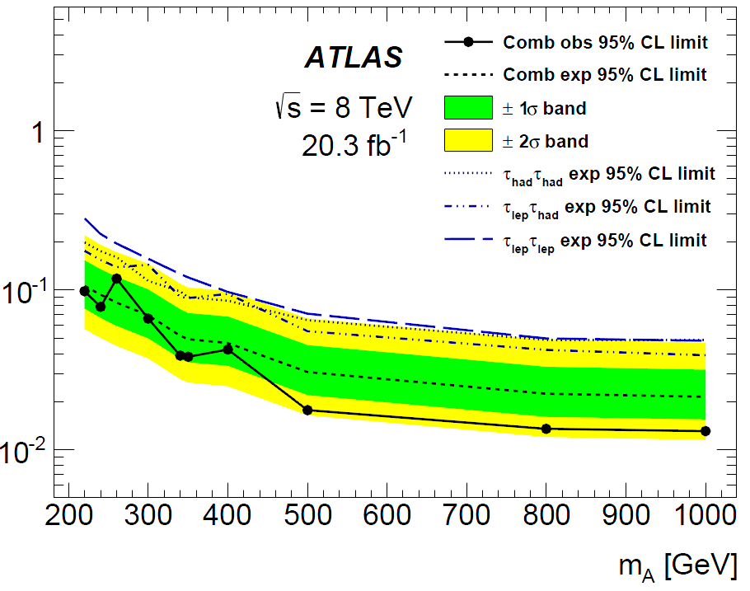
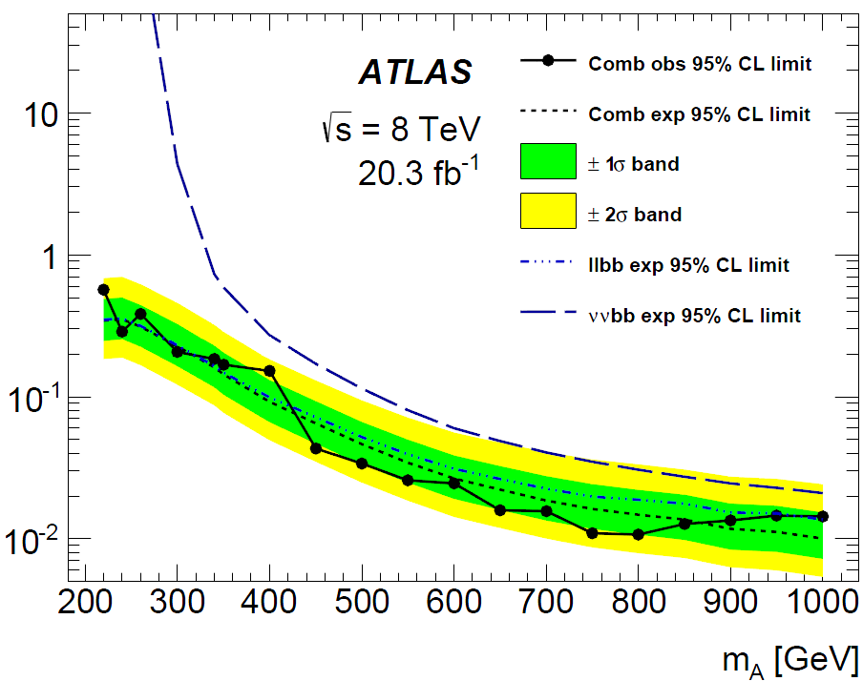
Search for Another Higgs in 2HDMs
CP Odd A  ZH  llbb, llττ, ννbb
Arxiv 1502.04478
M_{A} in the
llbb channel
M_{A} in the
ννbb channel
95% CL UL on
95% CL UL on
2 leptons,
3 jets and
2 tags
0 leptons,
2 or 3 jets,
2 tags
M_{A} in
h  ττ Channel
M_{A} in
h  bb Channel
500 fb signal example
Most significant excess is in the combined ll bb and ll ττ channels
in the region centered at: M_{A} ~ 220 GeV
Local p value = 0.014 corresponding to ~2.5 σ
We will see what ATLAS-CMS Combination and Run 2 bring

Slide 12
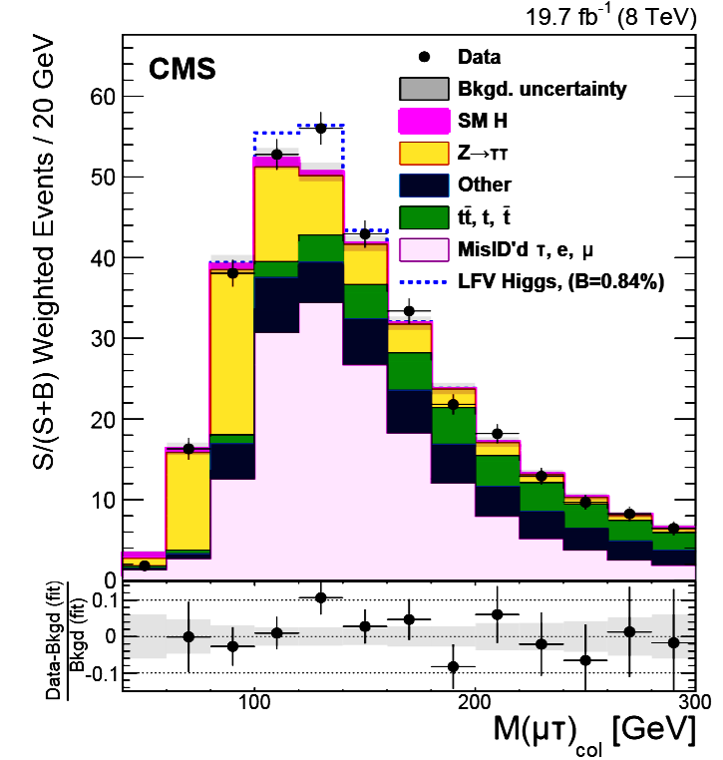
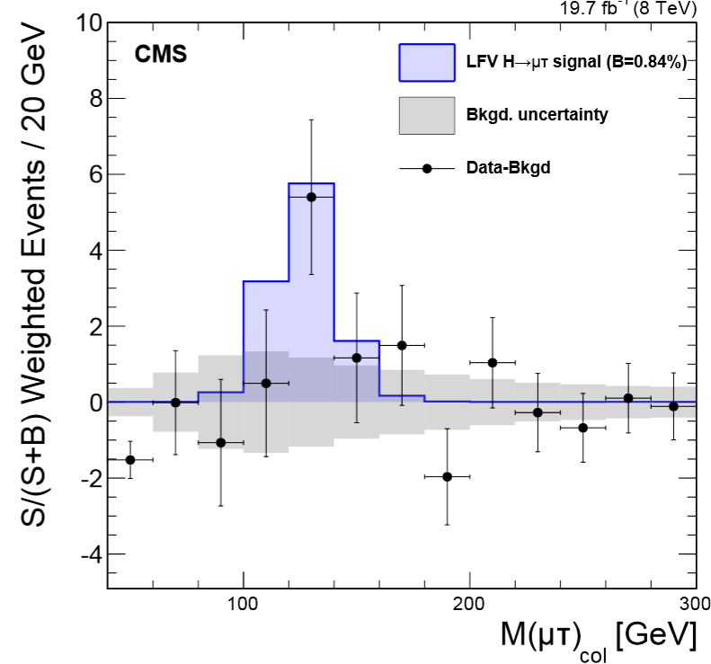
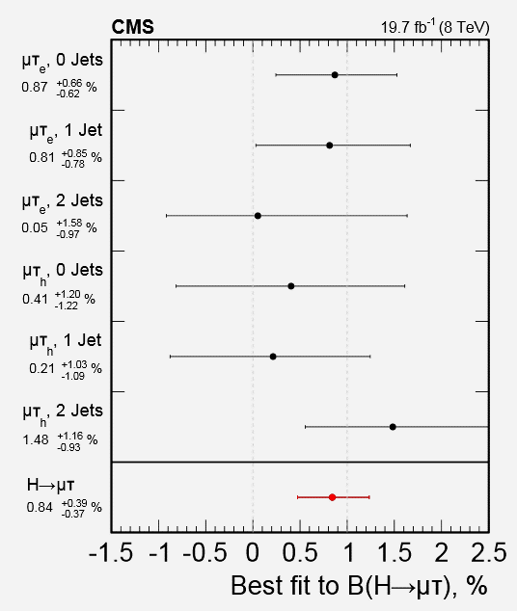
LFV H μτ Results
M_{col} (μτ) S/(S+B) Weighted.
Best Fit BR(μτ) = 0.84 ± 0.4%
M_{col} (μτ) with
BR(μτ) = 0.84%,
background subtracted
Best Fit μ= σ/σ_{SM}
by mode, combined
ATLAS-CONF-2015-006
BR > 0 ? Significance ~2.4σ (p value 0.007)
Arxiv 1502.07400

Slide 13
Run 2 performance goals 2016-18
Aim to start 2016 in production mode
  6.5 TeV, machine scrubbed for 25 ns operation
  Beta* = 40 cm in ATLAS and CMS [vs 80 cm in 2015]
  New injection protection absorbers – full injection
  Peak lumi limited to 1.7e34 by inner triplets
 | Peak lumi E34 cm⁻²s⁻¹ | Days proton physics | Approx. int lumi [fb⁻¹]
2016 | 1.5 | 160 | 35
2017 | 1.7 | 160 | 45
2018 | 1.7 | 160 | 45
  [~10X 2015]
Mike Lamont Talk

Slide 14
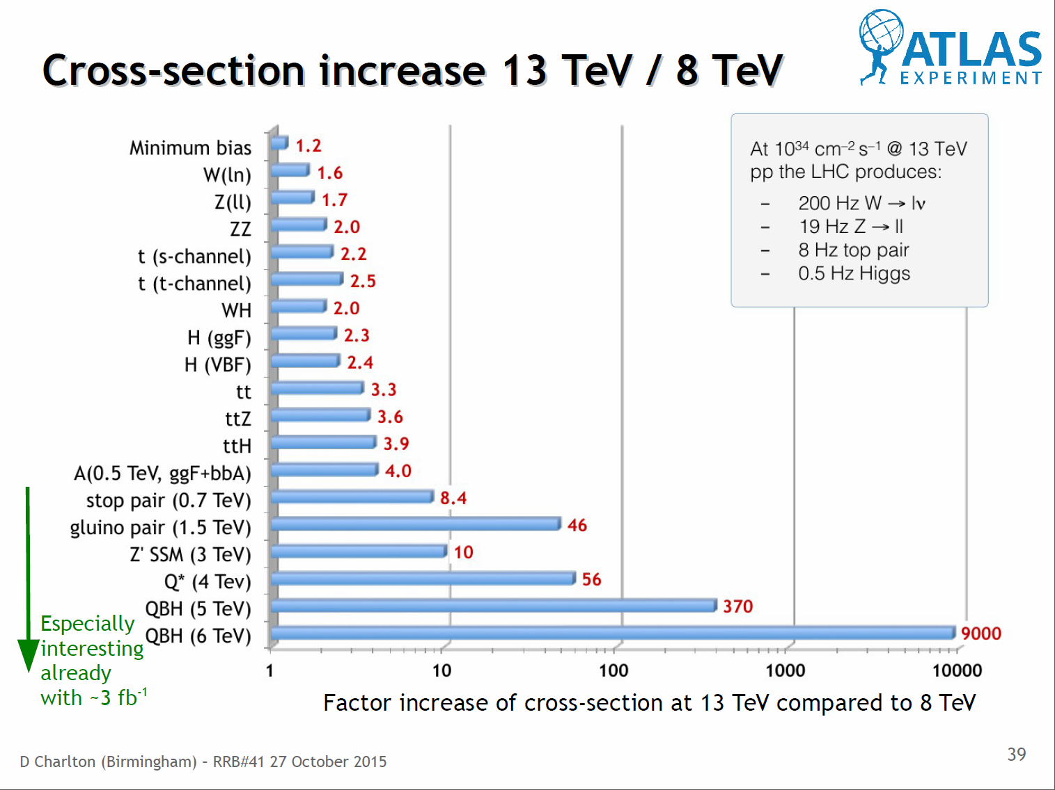
LHC Run2 Cross Section Ratios: 13 Vs 8 TeV
Entering a New Era of Discovery
Dave Charlton at October RRB

Slide 15
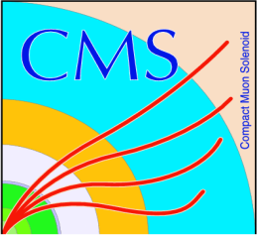
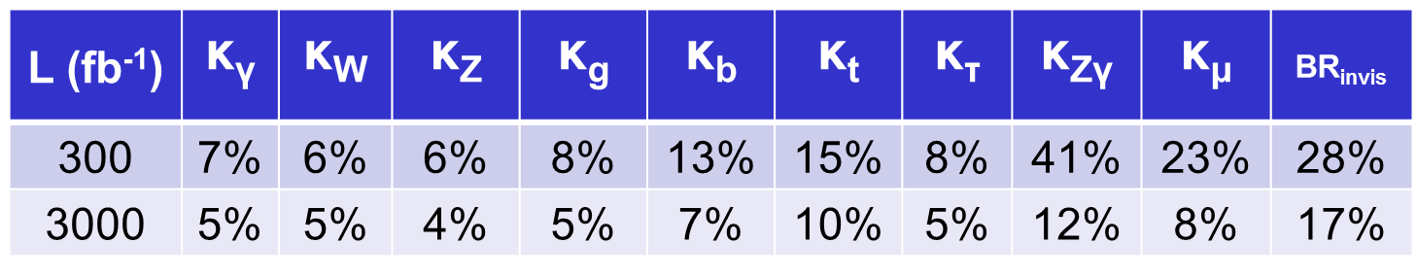
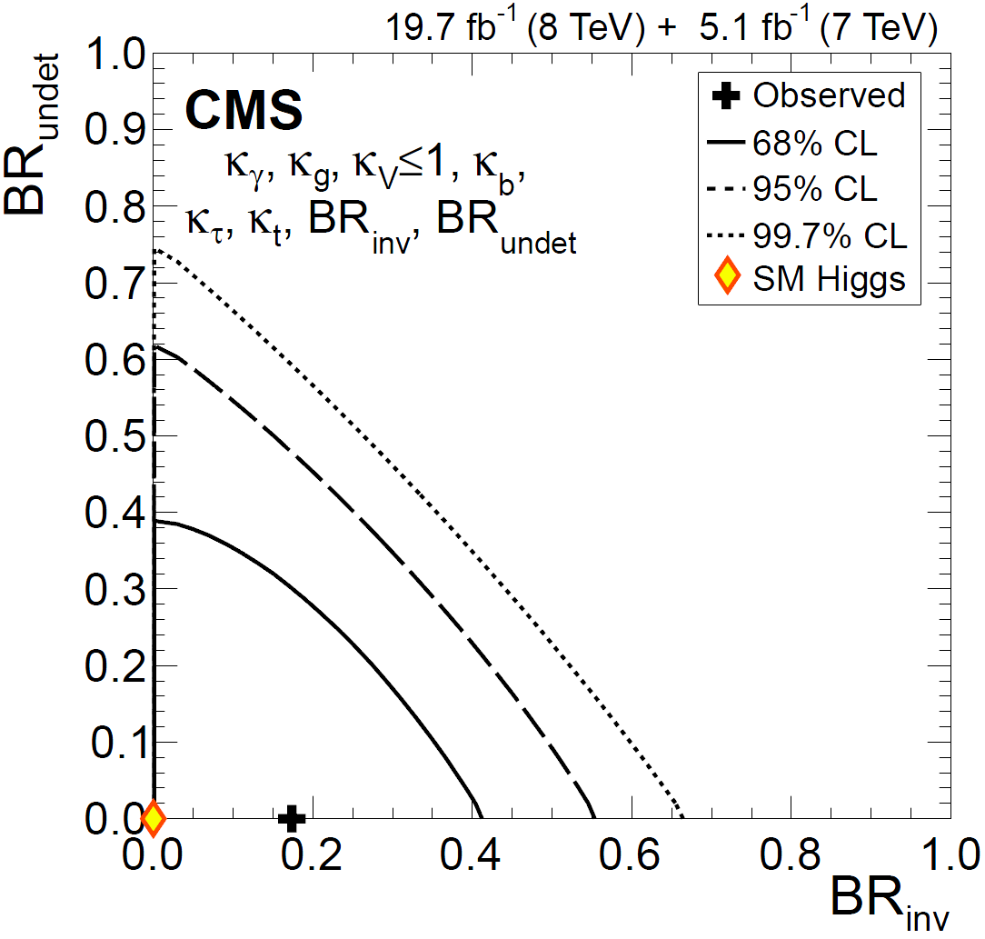
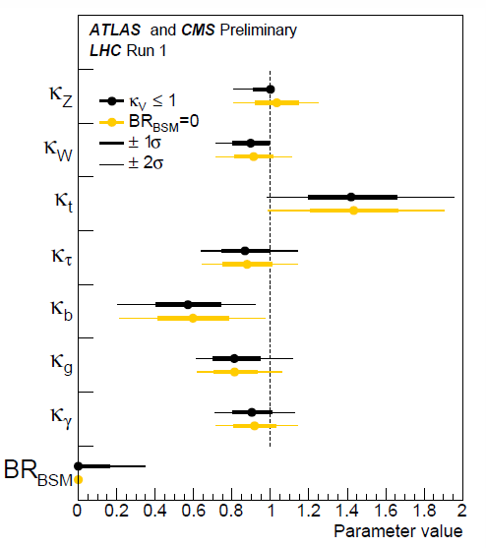
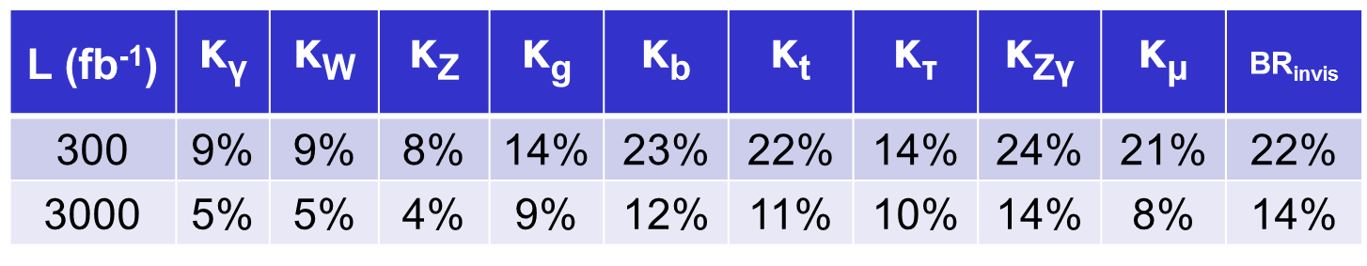

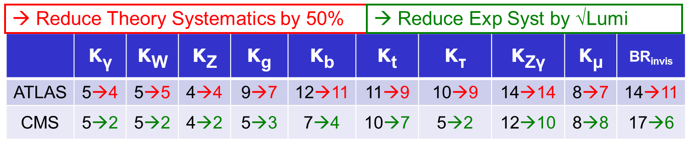
  Prospects for Run2 and Beyond
  “There’s Plenty of Room at the Bottom”
  An Invitation to Enter a New Field of Physics
  (Feynman Lecture at Caltech, December 29, 1959)
  There is So Much Room
CMS
ATLAS
And if We Improve
  We have only just begun

Slide 16

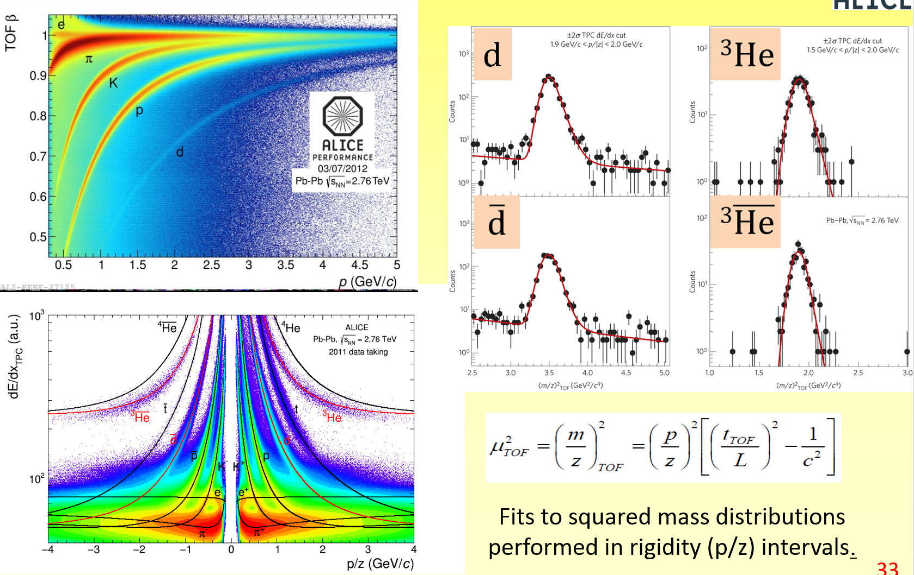
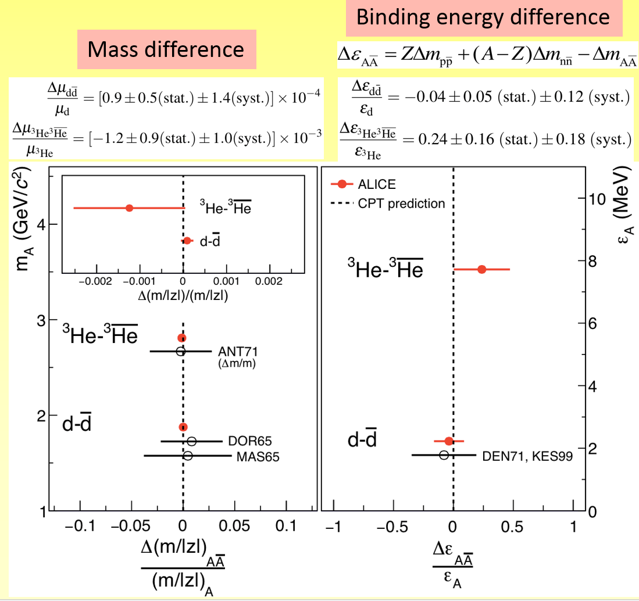
ALICE: Measuring Nuclei Versus Antinuclei
Small Mass Differences
One to two orders of magnitude
more precise than previous measurements
Outstanding dE/dx and TOF performance

Slide 17
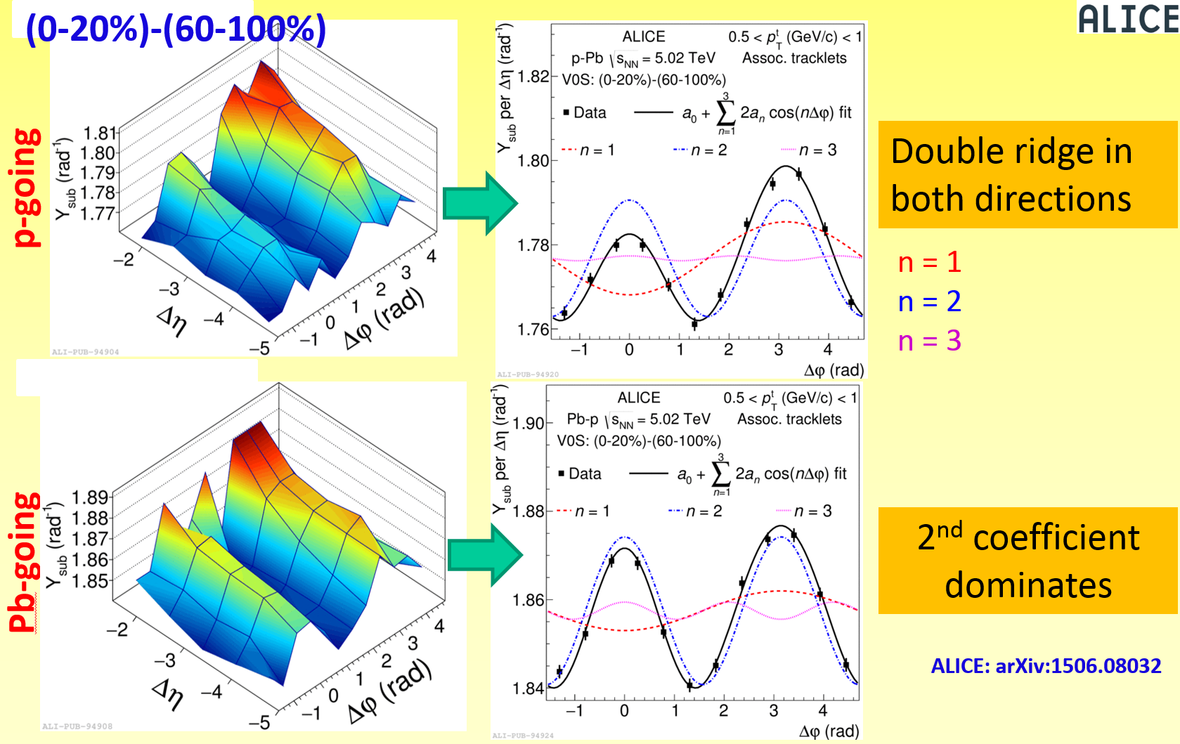
ALICE: The Double Ridge
Forward-Central Correlations in Both Directions

Slide 18
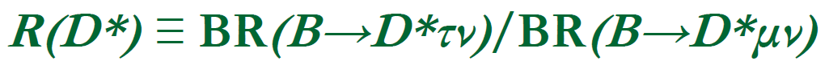
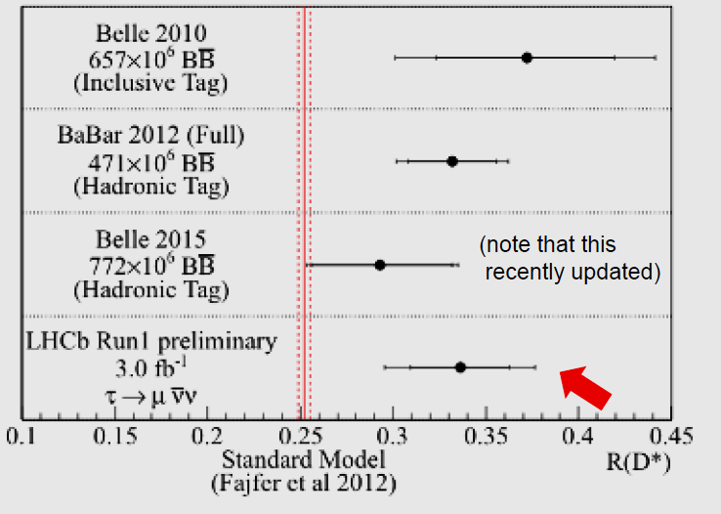

LHCb:Testing Lepton Universality in
Sensitive to Charged H Effects
Suggestive Babar/Belle Legacy
PRL 115 (2015) 112001
Was thought to be the Province
of e+e- B Factories,
But: It can be done
LHCb Confirms the B Factory Measurements;
R(D*) and R(D) Combined: 3.9σ tension with the SM
Expect more from: Run2 data; more decay modes at Run1

Slide 19




LHCb J/Ψ p Resonances: Consistent
With Pentaquark States PRL 115 (2015) 072001
Need to add two states with content uudccbar.
Best fit has J = 3/2 and J=5/2 with opposite parities
“Clear resonant behavior for the narrower
(4450) state. Need more statistics
to clarify the broader (4380) state”
G. Wilkinson 10/15 RRB

Slide 20

Many More
Public Physics Results
https://twiki.cern.ch/twiki/bin/view/AtlasPublic/HiggsPublicResult
http://cms.web.cern.ch/org/cms-higgs-results
The View Before LHC Run1

Slide 21

Many More
Public Physics Results
https://twiki.cern.ch/twiki/bin/view/AtlasPublic/HiggsPublicResult
http://cms.web.cern.ch/org/cms-higgs-results
LHC Run2
Launched on a River of Discovery
  Amazon Sunrise

Slide 22
US LHC Users Association (US LUA) http://www.uslua.org
Represents the entire community: Universities and Labs
  Covers the LHC experiments and LARP (Accelerator R&D)
  Forum for information and concerns; special “international” needs
Established as a non-profit tax exempt association, headquartered
in DC, collocated & hosted by URA since May 2013
In our eighth year: Successor to the US LHC Users Organization,
that was approved by the LHC experiments and LARP in April 2007
Mission Statement:
“The purpose of USLUA is to provide a forum for discussions of the US
participation in the LHC research program, with a focus on how best to enhance scientific participation in the discoveries expected from this research. In particular, USLUA aims to help the US LHC community work effectively with their colleagues at CERN while in the US, and to adapt to work at CERN and to living in the environs of the CERN laboratory. USLUA also provides communication channels between scientists working on the LHC experiments, the US agencies supporting this research and the US Congress.”
Working in close cooperation: UEC, SLUO, US LHC Ops Program, ACCU
Notes:
22

Slide 23
US LUA Executive Committee
2015 Membership (2 Year Terms)
Nominations for 2016-17 Term on Now: Until Nov. 21
Name Institution Collaboration Term Expires
Darin Acosta Florida CMS 2016
Jahred Adelman (Elections) NIU ATLAS 2016
Usha Mallik (Elections) Iowa ATLAS 2016
Toyoko Orimoto Northeastern CMS 2016
Sheldon Stone (Treasurer) Syracuse LHCb 2016
Julia Thom Cornell CMS 2016
Kevin Black (Secretary) Boston ATLAS 2015
Sridhara Dasu Wisconsin CMS 2015
John Harris Yale ALICE 2015
Harvey Newman (Chair) Caltech CMS 2015
Michael Tuts (Vice Chair) Columbia ATLAS 2015
Gordon Watts Washington ATLAS 2015
Observer: Tulika Bose (Boston); ACCU Representative: Usha Mallik
Totals: CMS 5+1, ATLAS 5, LHCb 1, ALICE 1; LARP +1
Ex-Officio: US ATLAS and CMS PMs, Deputies, CB Chairs, IB Chairs
With Thanks to: Eric Torrence, our ACCU Representative in 2014-15.
23
Notes:
23

Slide 24
US LUEC Sub-Committees: Geared
to Better Serve Our Community
Quality of Life: Usha Mallik (Chair and ACCU Representative);
Darin Acosta, Sridhara Dasu, Harvey Newman, Toyoko Orimoto,
Julia Thom, Sarah Demers
Gov’t Relations: Mike Tuts (Chair); Kevin Black, Sridhara Dasu,
Usha Mallik, Harvey Newman
Outreach: Julia Thom (Chair); John Harris, Harvey Newman,
Toyoko Orimoto
Web Presence: Gordon Watts, Tulika Bose (Co-Chairs);
Darin Acosta, Sarah Demers, Toyoko Orimoto; D. Kcira
Annual Meeting TF: H. Newman (Chair); Sridhara Dasu, Tulika Bose
Finance, Fund Raising: Sheldon Stone (Chair); Mike Tuts,
Harvey Newman, Kevin Black
Communications: Kevin Black (Chair); Gordon Watts, Darin Acosta,
Toyoko Orimoto
Rules Taskforce: Jahred Adelman (Chair); Usha Mallik,
Harvey Newman, Sheldon Stone, Mike Tuts
24
Notes:
24

Slide 25
US LUO Activities (1)
US LHC Users Association (US LUA)
Activities (1)
  Formed 8 Sub-Committees in 2014:
  Quality of Life, Gov’t Relations, Outreach, Communications, Finance
  +Fund Raising, Web Presence; Rules and Annual Meeting Task Forces
  Annual Fall Meetings
    Thanks to Fermilab, FRA and the LPC for Hosting our Meeting in 2015,
    as well as: 2012, 2010, and 2008.
    Also Argonne HEP (2014, 2011), Wisconsin HEP (2013), LBNL (2009)
    Our Focus: Young Physicists’ Work ! Lightning Round
    A tradition thanks to Sridhara Dasu; Julia Thom, Darin Acosta, Ken Bloom
    Review the LHC experimental & accelerator program, the view from
    Washington, US-CERN Relations
    Discussion of issues that affect US LHC users at home & abroad
  Annual HEP Visits to Washington DC:
  3/2008, 4/2009, 2/2010, 4/2011, 3/2012, 3/2013, 3/2014, 3/2015
    Coordinated with FNAL UEC, SLUO, DPF, DPB
    Great occasions to highlight our science, the impact and need
    2015 LR Winners+ Joined Us; Some of our best spokespeople !
    A talk reviewing the 2015 Trip: Tomorrow
Notes:
25

Slide 26



HEP DC Trip 2016: 46 People, 13 from USLUA
Visited 360 Offices in Congress + Executive Branch
Including Senate, House, NSF, DOE HQ, DOE Germantown, White House OSTP & OMB Committees: Senate CJS Appropriations, Senate E&W Appropriations, House E&W, House SST, Energy & R&T Subcommittees, House E&W Ranking Member
USLUA
Andrew Hard
Barak R. Gruberg Cazon
Dominick Olivito
Giordon Stark
Harvey Newman
Ho Ling Li
Jahred Adelman
Jessica Metcalfe
Kevin Black
Michael Tuts
Sarah Demers
Souvik Das
Sridhara Dasu
Special thanks to UEC: Sandra Biedron, Jesus Orduna, Breese Quinn and SLUO: Andrea Albert
[*]A record; we ran out of folders for Congress
http://www.fermilab-uec.org/mediaWiki/index.php?title=DC2015 [login]
Notes:
26

Slide 27

The P5 Report: 5 Intertwined
Science Drivers. 29 Recommendations
One Major Milestone for HEP
  Use the Higgs boson as
  a new tool for discovery
  Pursue the physics associated with neutrino mass
  Identify the new physics
  of Dark Matter
  Understand cosmic acceleration: dark energy
  and inflation
  Explore the unknown:
  new particles, interactions
  and physical principles
Recommendation 10: Complete the LHC phase-1 upgrades and continue the strong collaboration in the LHC with the phase-2 (HL-LHC) upgrades of the accelerator and both general-purpose experiments (ATLAS and CMS). The LHC upgrades constitute
our highest-priority near-term large project.
“The enormous physics potential of the LHC, which will be entering a new era with its planned high-luminosity upgrades, will be fully exploited.”

Slide 28
Community Letter
In Support of the P5 Report
  Drafted and assembled by the “HEP Community Rollout Committee” [*], a joint committee of:
    The APS DPF, and the Users Organizations: US LUA, UEC, SLUO
  Sent to DOE Energy Secy Moniz and NSF Director Cordova 6/23/14
    2095 signatures gathered in first week were sent with the letter
    2331 signatures collected in total
  The letter was effective in communicating the broad support in the
  particle physics community for the P5 Plan
    Important message in light of our reputation as a “fractious” community
  Received strong positive feedback from the agencies
  The report combined with the message of community support
  resonated in Congress, and at OSTP and OMB
* The HEP Community P5 Rollout Organizing Committee consisted of: Daniel Akerib, Robert Bernstein, Pushpa Bhat (Co-Chair), Edward Blucher, James Brau, Raymond Brock, Sally Dawson, Robin Erbacher, Yuri Gershtein, Howard Haber, Nick Hadley, JoAnne Hewett, Harvey Newman, Nicola Omodei, Laura Reina, B. Lee Roberts, Jonathan Rosner, Sally Seidel, Ian Shipsey (Co-Chair), Michael Tuts, Breese Quinn, Michael Sokoloff, Nikos Varelas, Hendrik Weerts

Slide 29

“P5 Report has Legs”
J. Siegrist, HEPAP Meeting April 6 2015
The P5 Report was warmly received by DOE Office of Science,
and resonated in the halls of Congress, OSTP and OMB:
A compelling, balanced program, with a feasible budget profile.
It makes the hard choices, with strong HEP community support

Slide 30
FY2016 HEP Budget Update at UEC Meeting October 2015
Report from Washington by Leland Cogliani of Lewis-Burke Associates:
The Senate request [$ 788 M] for HEP is $ 22M higher than the previous budget.
It matches the President’s request, with more money going to projects
and less to basic research.
Request on the House side is less, a $ 10M increase over the previous budget.
A budget deal would mean we would try to increase basic research and money
for R&D, then later we could advocate for more money to HEP funding.
HEP does have supporters in Congress. Senators Durbin and Kirk are on the Senate Appropriations Committee. Senator Rounds from South Dakota is a strong supporter
of the neutrino program. Representative Bill Foster is always supportive of Fermilab.
Work could be done to try and get support from the Minnesota delegation, since their constituency is involved with NOvA.
The President’s 2016 request for LBNE was $ 20M, and he encouraged the House and Senate to increase their appropriations. The House went up to $ 22M, and the Senate
to $ 30M including $ 10M for the expansion of the caverns in South Dakota.
The Senate level is needed to keep construction on schedule.

Slide 31
US LUA Activities (2)
  Quality of Life Committee (Usha Mallik, Chair)
        Get-togethers of students and young postdocs
        at CERN: a success: 230 at the July party;
        DG, Spokespeople, key staff as speakers
        we plan more – Volunteer to help !
    Provide Information on everyday + important issues,
    such as health insurance, visas, tax laws, work at
    the lab, hostels, time management, careers, etc.
    Resources to help with problem cases; worked with
    ACCU to improve handling of such cases at CERN
    New “Young LHC” group started (thanks to Usha)
  Outreach about the LHC Program
    National Events [more later]; VIP Visits to CERN
    Work actively with the US LHC Ops Program,
    US LHC Communications
    Considering: Partial support for young people going
    to conferences, when funds are available
  Media Training: how to talk to Congress, the public, media
  Thanks to Katie Yurkewicz [Another before the 2016 DC Trip]
Notes:
31

Slide 32
US LUO Activities (1)
US LUA Activities(3): Helping the US Community Adapt to Work at CERN and Life in the Region
  In 2015 we Launched Our New Website www.uslua.org:
    Thanks to Tulika Bose and Gordon Watts
  Useful Information Linked to It:
    New Student Orientation Guide (Darren Acosta): www.dropbox.com/s/ckrjbj4ax2g9gph/NewStudentOrientationAtCERN.pdf
    required documents, registering, getting a computer account,
    getting around the sites, local transportation, etc.
    Welcome Center website for CERN newcomers supported by Volunteers: visas, housing, schools, taxes, childcare, emergency contacts, etc.
    Information on daily life issues: credit cards fees, taxes, health insurance, etc.
    US LUA QoL Committee will soon post information on help for students with personal problems; advice and resources on careers, time management, work/life balance, job pointers, get-togethers
  We are On Facebook and Twitter: Thanks to Toyoko and Tulika
Notes:
32

Slide 33


Thanks to
Tulika Bose
and Gordon Watts
Darin Acosta
Notes:
33

Slide 34

Newcomers Guides www.uslua.org
Newcomers Guide
How to Survive
and Thrive
At CERN
In Switzerland
In France
Visas, permits
Getting a Bank Acct.
Exchange Rates
Paying Bills
Taxes
Childcare
Health (Insurance,
Emergency Contacts)
Finding Housing
Schools
Shopping
Transport, Mobility
Buying a Car
Learning French
Culture, Dining
Whole Experience
http://newcomerwelcomecenter.weebly.com/
Other valuable resources: US CMS & US ATLAS Program Offices
    Darin Acosta’s Newcomer’s Guide: www.dropbox.com/s/ckrjbj4ax2g9gph/NewStudentOrientationAtCERN.pdf
https://twiki.cern.ch/twiki/bin/view/Main/USCMSProjectOfficeCERN
http://www.usatlas.bnl.gov/twiki/bin/view/Support/CERNVisitorInfo
Notes:
34
34

Slide 35



Follow USLUA on Facebook (USLUA)
and Twitter (@us_lhc)
Thanks to Toyoko Orimoto and Tulika Bose
Notes:
35

Slide 36
US LUO Activities (4):
National and International Events
  USA Science & Engineering Festival in DC: April 16-17 2016
  Julia Thom and Students: We will have a US LUA Exhibit
  “linked” to the Fermilab and JHU booths
  User Science Exhibitions on the Hill: Organized by NUFO;
  June 2014: Randy Ruchti and Mike Tuts
  Special Events. Excellent examples:
    November 20, 2013 Community Visit to the House
    celebrating the Higgs discovery and recent advances
    in particle physics
    The October 20, 2014 CERN Event at UN HQ: Celebrating
    60 Years of Science for Peace and Development
    August 31 – September 1 VIP Visit by 3 US Congresspersons
    (SST and Ways and Means) to the LHC, ATLAS and CMS
Notes:
36

Slide 37

CERN UN Event: 60 Years of Science for Peace and Development
  At the UN Economic and Social Council
  Keynotes: Rolf Heuer, Ban Ki-Moon, Kofi Annan,
  Hitoshi Murayama, Carlo Rubbia
  Remarks by Fabiola Gianotti (UN Scientific Advisory Committee);
  Ambassadors of France, Switzerland and the US
  “Featuring contributions from eminent politicians and scientists, the event will:
Celebrate the values promoted by science - neutrality, inclusion, and co-operation;
Highlight the role of science and scientific education in sustainable development;
Promote, through an open discussion between the fields of science and politics, the idea of better integrating science into global decision-making processes.
Issue Raised: Integrating science, including fundamental science,
in the decision making process is necessary for sustainable development
Notes:
37

Slide 38
USA Science & Engineering Festival in DC: the largest
STEM education event
http://usasciencefestival.org
An ideal forum to educate the public, and show our science!
Over 300 Schools, 750 STEM organizations
More than 350,000 visitors over 4 days
Dozens of Congressmen, dignitaries; heads of state
USLUA in 2014 joined the existing Fermilab exhibit:
Higgs event display, games, CR detectors;
staffed booth with young LHC scientists.
Plan for 2016: US LUA Booth: Separate but “linked” to the JHU and Fermilab booths; thanks to Andrei, Randy for help and advice
We are looking forward to the involvement of (more) US LHC scientists (including ~6 students) to join, help and represent us!
With thanks to Julia Thom (Cornell); Evan Wolfe (UVa) and Rafael de Lima (NEU)

Slide 39
Visit to CERN by US Congressional Leaders
August 31 – September 1 2015
Frank Lucas (R-OK): House Science, Space and Technology Committee, leading the delegation
Eddie Bernice Johnson (D-TX): Ranking Member of the SST Committee
Kenny Marchant (R-TX): House Ways and Means Committee
Their staff included Adam Rosenberg, former DOE Fusion Energy Sciences Program Manager and staff member on Energy & Environment Subcommittee responsible for oversight of the Office of Science
Met with CERN DG, many US students and postdocs and young faculty, and present & former members of the LHC and US LHC leadership,
DOE representative Abid Patwa and NSF representative Fleming Crim
DG Rolf Heuer’s introduction covered all the main points: the value of our field to science and society, education, our field's impact more broadly on the workforce and everyday progress. He highlighted the new mutually supportive framework of US-CERN cooperation with the dual focus on the HL LHC and Neutrinos. He said that CMS and ATLAS could not have been built or operated without the US.

Slide 40
Visit to CERN by US Congressional Leaders
August 31 – September 1 2015
The meeting was relaxed and cordial. The visitors were evidently impressed by the LHC accelerator and CMS and ATLAS, as well as the new bilateral partnership expressed in the new US-CERN Agreement.
Fleming Crim was openly very supportive of what was going at CERN. He mentioned some of the other experiments at CERN such as the antiproton deceleration experiment that forms antihydrogen. He said that the synergy between particle and atomic physics was remarkable.
Congresswoman Johnson said she was impressed by the level of inclusiveness she observed at the laboratory.
Johnson asked if some of the SSC equipment was used in the LHC program. The answer was no but some of the ideas and technologies first developed there were adopted.
There were several examples given of members of the HEP community who went on to work in industry, especially in computing, finance,
and other diverse areas where they are applying their problem
solving skills.

Slide 41
US LUA Updated Budget Outline
Expenses
Annual Trip to Washington (12 young members) $ 12k
Get-togethers for young physicists at CERN $ 12k
Trips to participate in other events in Washington [e.g. APS, NUFO]: $ 6k
Funds to encourage participation by young members in the Annual US
LUA meeting, or other science society meetings: $ 10k
Funds to allow US LUA to participate in national events, such as $ 8k
the USA Annual Science and Engineering festival
Part time URA staff person $ 32k
Webmaster part time $ 6k
Total Annual Expenses (Estimated): $ 85k
Funding
HEP Lab directors’ discretionary funds $ 25k
Return from fees at Annual Meeting returned to US LUA $ 5k
Requested as donations from US LUA Universities $ 55k
Total Annual Funds (Estimated): $ 85k
+ Targeted NSF travel grants will be proposed, to support more young physicists

Slide 42
US LUA Budgets and Fund Raising
Transitioned to URA HQ when the tax exemption last May
application was submitted to the IRS
Staff support, financial and legal advice: URA CFO J. Shapiro
URA has been very accommodating:
the clock on staff time charges has not started.
  But it will soon; We will need your support
Fund Raising: Annual funding from the lab directors
($ 25k) forms the core, but the rest will need to come from
Institutional Donations
  Targeting $ 55k or more, per year.
  Requested donations: $ 1k/year ($ 500/year for small groups)
  per university (or your department or faculty discretionary fund)
    More if your group can manage
  Individual contributions also are welcome,
  at http://www.uslua.org/outreach/donate
Notes:
42

Slide 43

US LUA Budgets and Fund Raising
With thanks to our first responders
We will be contacting
each US LHC Group PI
Notes:
43

Slide 44


We have come a long way;
we have a long way to go.
We will need your support.
If your group members or colleagues involved in the LHC Program are not already US LUA Members, ask them to please sign up at
www.uslua.org
Notes:
44

Slide 45
Backup Slides Follow
Notes:
45

Slide 46







Discovery of a Higgs “Like” Boson
July 4, 2012. Confirmation by March 2013
A billion people watched
Theory : 1964
LHC + Experiments Concept: 1984
Construction: 2001
Operation + Discovery: 2009-12
Nobel Prize to Englert, Higgs: 2013
Run2: The Next Round with greater reach.
Adrift on a sea of discovery
2013 Prize

Slide 47


The LHC: Spectacular Performance
A new era of opportunity; a new era of challenges
Data Complexity: The Challenge of Pileup
  ~3.5 X 10¹⁵ pp Collisions
  1M Higgs Bosons created in Run 1
2010, <μ> = 2
2011, <μ> = 7
Run2 and Beyond:
Higher energy and intensity
Greater science opportunity
Greater data volume &
complexity
A new Realm of Challenges
~50 Vertices, 14 Jets, 2 TeV
2012, <μ> = 21
Average Pileup
Run 1 21
Run 2 42
Run 3 53
HL LHC 140-200
1.1x10¹¹ → 1.5x10¹¹ ppb L X 2
Emittance: ε 3.5→ 2.3 → 2 micron L X 1.8
2012: 8 TeV X 50 nsec β* → 0.6m

Slide 48



  Higgs Boson Couplings
  Expressed in Terms of the Particle Mass
  Yukawa coupling for fermions = m_{f}/v * κ_{f}
  (g_{v}/2v)^{1/2} = coupling for bosons = m_{V}/v * κ_{V}^{1/2}
  Quite Compatible with SM
  Non-universal, mass dependent couplings observed for the first time

Slide 49


Anomalous CP Couplings of a Spin 1 or 2 Higgs Using H  V⁽*⁾V⁽*⁾ (V= Z, W, γ) Decays
Effective Amplitude Parametrization
SPIN 1
ArXiv:1411.3441
SPIN 2
CMS: J^{P} Values: many models Other
than 0+ Ruled out with ≥ 4σ significance
ATLAS : results on spin/parity (using H→γγ, ZZ and WW) Also favor 0+

Slide 50


BSM Hunt: Hints Here and There
A  ZH  llbb, llττ Results
M_{H} versus M_{A}
95% CL UL on μ = σ/σ_{Theory}
HIG-15-001
Two most significant excesses are in
ll bb channel in regions centered at:
(1) M_{bb} ~93 GeV, m_{llbb} ~ 286 GeV:
Local significance: 2.6 σ
Global Significance
(with LEE): 1.6 σ
This is in a region where
one might expect sensitivity
to a signal, e.g. SUSY
(2) M_{bb} ~575 GeV, m_{llbb} ~ 662 GeV
Local significance: 2.85 σ
with LEE: 1.9 σ
Expected
Excess (1) is here
Atlas A  ZH Analysis:
Hints as well ? 
Observed

Slide 51



Higgs as a Tool for Discovery
H  Dark Matter Portal
Translate H  Invisible BR Limit
to Coupling of H to Wimp and
σ for wimp-nucleon scattering
HL LHC Projected
Run 1 Result
Sensitive to low mass dark matter: Complementary to direct searches

Slide 52

To 2035: and beyond
★
Mike Lamont

Slide 53









ALICE: Excellent Performance at 13 TeV
No degradation in dE/dx, dp/p, TOF: PID in great shape
dE/dx vs. p
TOF vs p
PID: π, K, p, d, t…
The Particle Zoo at 13 TeV

Slide 54

ALICE An Antimatter Factory
Separation up to ⁴He:
Heaviest Antinucleus known
Antinuclei/nuclei Abundance
Ratios Compatible with 1
Independent of PT

Slide 55



ALICE: Blast Wave Spectral Function for Pb-Pb

Slide 56

LHCb: Delivering in Its Core Areas
Matching or Exceeding Expectations
Unitary Triangle Angle γ
New Physics Search in EW Penguins
Measuring CPV in B_{s} Sector
Ultra-Rare Decays: B_{s}  μμ
LHCb and CMS
And Beyond: Unexpected Areas, Hints of New Physics 

Slide 57


LHCb Results: Electroweak Penguins
Transitions in b sμμ arXiv 1308.1707
Penguin-dominated B⁰  K*μμ
decays. Angular Variables
Sensitive to New Physics
One of these (P₅’) shows
a local 3.7σ deviation from SM predictions
More data available still to be analyzed
NP ?: great deal of theoretical interest deeper understanding needed

Slide 58

LHCb: R(D*) Analysis

Slide 59



LHCb: Test of Lepton Universality
in
Non Standard ?

Slide 60



eff
LHCb: Measurement of sin²θ_{W}:
A Major Result in Electroweak Physics
Arxiv 1509.07645
From AFB vs M_{μμ} in
In the LHC Upgrade Era,
might shed light on the
LEP-SLD Difference
Precise sin²θ_{W} Values
from hadron colliders
D0, CDF, LHCb, ATLAS, CMS

Slide 61

LHCb J/Ψ p Resonances in Λ_{b} Decays:
Consistent with Pentaquark States PRL 115 (2015) 072001

Slide 62



ACCU News
The US LHC Community: a Central, Essential Part of the Higgs Discovery
http://uslhc.us/The_US_and_the_LHC
US LHC
2000 Scientists, engineers, students and technicians
from 96 US institutions in
33 US States and Puerto Rico
http://uslhc.us/files/FINAL_USLHC_Higgs_Poster.pdf

Slide 63
US LHC Users Association
A Brief History: Legal Status
US LUA is an independent Unincorporated Nonprofit Association
  Based in Washington DC, collocated with URA HQ
  Follow-on to the US LHC Users Organization formed in 2007
Legal framework
  Under the “Uniform Nonprofit Association Act”
  Clear and precise Articles & Bylaws written with the help of URA General Counsel, and CFO Jeff Shapiro in 2013; updated in 2015
  Simple to form, but must be operated and managed with due care
Agreement for Services approved, signed by URA & USLUO 5/17/13
Applied to DC.gov to Form US LUA 6/6/13; Approved 9/17/13
Officers: Vice Chair (Tuts), Treasurer (Stone),
Election Committee (Adelman, with Mallik)
Applied to IRS for 501(c)(3) tax-exempt status April 7 2014; approved
Sept 8 [Quick: after 4 months; 18 months was predicted]
Notes:
63

Slide 64

ACCU News
US LUA: Includes 70 of the
83 US Universities in URA
Alabama
Arizona
Brown
Boston Univ.
Caltech
UC Berkeley
UC Davis
UC Irvine
UCLA
UC Riverside
UCSD
UCSB
Carnegie Mellon
Case Western
Chicago
Colorado
Columbia
Cornell
Duke
Florida
Florida State
Harvard
UIC
UIUC
IIT
Indiana
Iowa
Iowa State
Johns Hopkins
Maryland
MIT
Michigan
MSU
Minnesota
Nebraska-Lincoln
New Mexico
Northeastern
NIU
Northwestern
Notre Dame
Ohio State
Oklahoma
Oregon
Pennsylvania
Pittsburgh
Princeton
Purdue (+Calumet)
Rice
Rochester
Rockefeller
Rutgers
South Carolina
Southern Methodist
Stanford
SUNY Buffalo
SUNY Stony Brook
Syracuse
Tennessee Knoxville
Texas A&M
UT Arlington
UT Austin
UT Dallas
Texas Tech
Tufts
Vanderbilt
Virginia
Washington
Wayne State
Wisconsin
Yale
US LHC
2000 Scientists, engineers, students and technicians from 96 US institutions in
33 US States and Puerto Rico

Slide 65


2013-15: Embarking on the Road to Our Future: Multi-Step Process
Snowmass: Oct. 2012
to August 2013
P5 Panel and Report:
Oct. 2013 – June 2014
http://science.energy.gov/hep/hepap/reports/

Slide 66
Notes on the Community Letter
A.Lankford: HEPAP Meeting Sept. 29-30 2014
Community Letter sent to the Secretary of Energy
on June 23, 2014
http://dpfnewsletter.org/wp- content/uploads/2014/09/P5_CommunityLetter_DOE.pdf
Community Letter sent to the NSF Director on June 23, 2014 http://dpfnewsletter.org/wp- content/uploads/2014/09/P5_CommunityLetter_NSF.pdf
Final Signatories List
http://dpfnewsletter.org/wp-content/uploads/2014/09/signatories_list-final.pdf

Slide 67

P5 Guidance on Energy Frontier Machine

Slide 68



Higgs Discovery Celebration
Nov. 20: Rayburn HOB
Sponsored by DPF & URA, Hosted by House
Science & National Lab Caucus
Dozens of Congressional visits
Reception with remarks by Reps. Hultgren, Nunnelee, Fattah, Foster, and Holt;
Speeches by Incandela, Shipsey, Bhat
– A Packed Room !
About a dozen other Congressional offices
were represented at the reception
http://physics.uoregon.edu/~jimbrau/dpf/dcevent/

Slide 69


Marge Bardeen (FNAL) organized the effort- young LHC scientists from NEU and UVa came to participate: Thank you!
The Higgs Postcard handed out to visitors
Rutherford Scattering Activity
Next year: Come join and help !
Excited young visitors
doing hands-on activities

Slide 70
Visit to CERN by US Congressional Leaders
August 31 – September 1 2015
Frank Lucas and Adam Rosenberg praised the P5 report. Rosenberg said he had heard nothing negative at all about the P5 report in Congress, which he found notable.
Congressman Marchant who describes himself and a staunch fiscal conservative, when asked privately at the dinner last evening what he hoped to learn on the visit, said he hoped to learn if the money spent here was being well spent or being wasted
  He then quickly added that he felt that this sort of basic science is something the federal government should support.
  He advised the CERN DG to also invite other key Congressmen including Culberson (Chair of the Appropriations Subcommittee of CJS) to CERN in the near future.
Congressman Lucas said to Rolf: if the LHC does bring the world to an end, as some of his constituents keep wondering, then please
do it before he has to go through another round of appropriations.
The meeting will help us reach their offices, and continue the conversation when we visit the Congress next Spring.

