Slide 1


CERN-US Relations
and the LHC Program
Rüdiger Voss
Head of International Relations, CERN
USLUA Annual Meeting | Fermilab, November 11-13, 2015

Slide 2
Outline
The strategy/policy framework
HL-LHC upgrade and US contributions
The formal framework: past, present, future
LBNP and CERN contributions
Some news from CERN…

Slide 3
European Strategy Update
After careful analysis of many possible large-scale scientific activities requiring significant resources, sizeable collaborations and sustained commitment, the following four activities have been identified as carrying the highest priority.
c) The discovery of the Higgs boson is the start of a major programme of work to measure this particle’s properties with the highest possible precision for testing the validity of the Standard Model and to search for further new physics at the energy frontier. The LHC is in a unique position to pursue this programme.
Europe’s top priority should be the exploitation of the full potential of the LHC, including the high-luminosity upgrade of the machine and detectors with a view to collecting ten times more data than in the initial design, by around 2030. This upgrade programme will also provide further exciting opportunities for the study of flavour physics and the quark-gluon plasma.

Slide 4
P5 report:
Recommendation 10: Complete the LHC phase-1 upgrades and
continue the strong collaboration in the LHC with the phase-2
(HL-LHC) upgrades of the accelerator and both general-purpose
experiments (ATLAS and CMS). The LHC upgrades constitute
our highest-priority near-term large project.

Slide 5
A roadmap of roadmaps
With
  the European Strategy Update, approved by the CERN Council May in 2013,
  the P5 recommendations, approved by HEPAP in the US,
  the Japanese roadmap
we have developed for the first time a cross-region vision for our field
CERN and US will play a major role in this global endeavour

Slide 6
HL-LHC upgrades
HL-LHC is formal part of European Strategy and approved CERN Medium-Term Plan (MTP) 2016-2020
Significant US contributions to accelerator upgrade
  Deliverables largely based on LARP work (BNL, Fermilab, LBNL, SLAC) (cf. talks by G. Apollinari and S. Rolli)
  Participation in FP7 EuCARD high luminosity project
Significant US participation in detector and Grid computing upgrades (cf. talk by S. Rolli & experiments)

Slide 7
The formal framework
US have Observer status at CERN
  Granted in recognition of significant in-kind contributions to LHC
CERN-DOE-NSF Co-operation agreement on LHC activities (ICA-US-0058)
  Signed December 8, 1997 for 20 years duration
  Protocol on accelerator co-operation (expired) and on co-operation on ATLAS and CMS detectors (P026/LHC, concluded December 19, 1997 for 20 y)
  Accelerator Protocol II (2014) provides framework for CERN-USLARP collaboration

Slide 8
New CERN-US Co-operation Agreement
CERN, DOE and NSF signed new International Co-operation Agreement (ICA) on 7 May 2015, to replace present ICA expiring in 2017
Open-ended “umbrella” agreement
Collaborative projects to be implemented through Protocols, Addenda etc.:
  Enhanced flexibility
  Focus on scientific and technical aspects
Old ICA (1997) will remain in force until end-2017
  Required to maintain 1997 Experiment Protocol
  Maintains Observer status in force

Slide 9
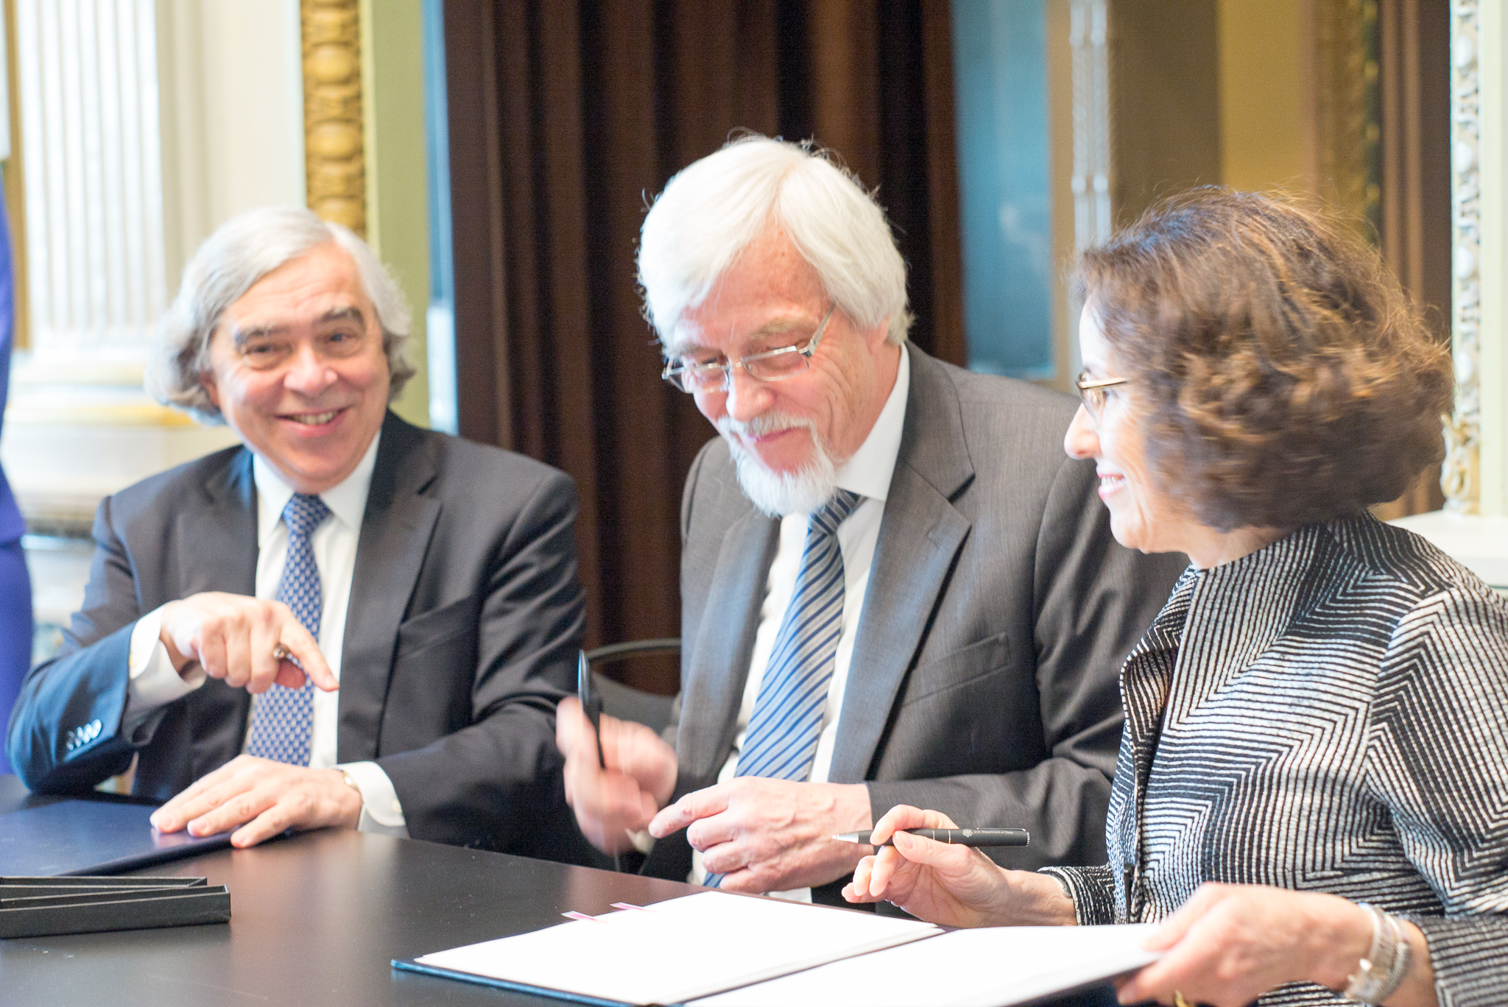
New CERN-US Co-operation Agreement
Signature ceremony: White House Indian Treaty Room, May 7, 2015

Slide 10
First-generation Protocols
Intense work underway on:
Accelerator Protocol III: framework for US contributions to HL-LHC
  Implementation through (bilateral) addenda etc.
  Deliverables will build on LARP R&D
  Also framework for collaboration on future collider studies, Addendum on FCC drafted
Experiments Protocol II: framework for US participation in ATLAS and CMS HL upgrades
  Implementation through (multilateral) MoU
  Technical content: cf. talks by experiments
Neutrino Protocol: European gateway into LBNF
Hope to sign these documents at CERN on December 18, 2015!

Slide 11
CERN-DOE Neutrino Protocol
Strategy framework:
CERN Council decision (2010) allowing for participation in international accelerator projects.
European Strategy Update (2013): CERN should develop a neutrino programme to pave the way for a substantial European role in future long-baseline experiments. Europe should explore the possibility of major participation in leading long-baseline neutrino projects in the US and Japan.
P5 Recommendation 13 (2014): Form a new international collaboration to design and execute a highly capable Long-Baseline Neutrino Facility (LBNF) hosted by the U.S. To proceed, a project plan and identified resources must exist to meet the minimum requirements in the text. LBNF is the highest-priority large project in its timeframe.

Slide 12
CERN participation in LBNF & DUNE
CERN Neutrino Platform:
  Test beam facility in SPS North Area
  General logistics support (detector assembly, integration, shipping…) for interested European partners
In-kind contributions to cryogenics infrastructure, detector infrastructure and components (both SBN and SURF)
Governance & management largely modeled on LHC collaborations

Slide 13
The wider (political) context
CERN continues to grow:
  12’500 Users, almost 40% from non-Member States, ~15% from US
  Turkey and Pakistan joined as first Associate Member States in 2015
  Romania & Serbia expected to become full Member States in 2016/2017
  Pending applications (MS or AMS) from Azerbaijan, Brazil, Croatia, Cyprus, India, Russia, Slovenia, Ukraine
Beyond new ICA, Associate Membership remains an opportunity for the US

Slide 14
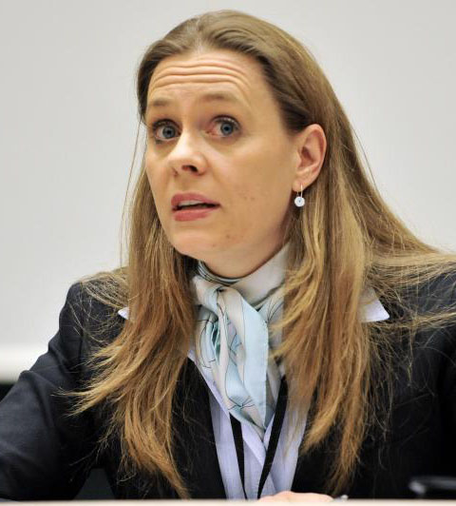
Some news on CERN organisation
Director of International Relations
Charlotte Warakaulle
…..
…..
ECO
NN
Non-Member State Relations
NN
Starting
January 1, 2016

Slide 15
Conclusions
The US-CERN partnership in building and operating the LHC has become a paradigm of a successful scientific and technological collaboration of unprecedented, global dimensions
  Now underpinned by coherent cross-continent roadmaps
  Soon to be expanded by the first-ever participation in an accelerator project outside Europe
CERN wants this partnership to continue, to expand, and to flourish!

