Slide 1
PXIE Overview
Lionel Prost
Proton Accelerators for Science and Innovation Workshop
11-13 November 2015

Slide 2
Outline
Context
Requirements and goals
PXIE concepts/status
  Ion source/LEBT
  RFQ
  MEBT
  HWR
  SSR1
Some results

Slide 3
Proton Improvement Plan II (PIP-II)
The goal of PIP-II is to support long-term physics research goals outlined in the P5 plan, by delivering increased beam power to the U.S. neutrino program and providing a platform for the future
Design criteria
  Deliver >1 MW of proton beam power from the Main Injector over the energy range 60 – 120 GeV, at the start of LBNF operations
  Support the current 8 GeV program including Mu2e, g-2, and short-baseline neutrinos
  Provide an upgrade path for Mu2e
  Provide a platform for extension of beam power to LBNF to >2 MW
  Provide a platform for extension of capability to high duty factor/higher beam power operations

Slide 4
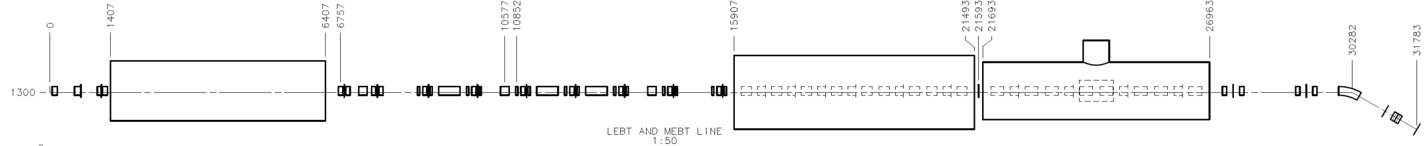
Proton Improvement Plan II Injector Experiment (PXIE)
PIP-II: A 800-MeV superconducting linac, constructed of CW-capable accelerating structures and cryomodules, operating with a peak current of 2 mA and a beam duty factor of 1%
PXIE is part of the R&D program, which addresses the risks associated with the front-end
  Nominal regime is CW
    Needs to work in pulsed mode (e.g.: for commissioning)
  While not specific to PXIE superconducting structures, solutions to SRF challenges such as Lorentz Force Detuning (pulsed) and microphonics (CW) will be tested
30 keV
2.1 MeV
10 MeV
25 MeV
LEBT
RFQ
MEBT
HWR
SSR1
HEBT
40 m, ~25 MeV

Slide 5
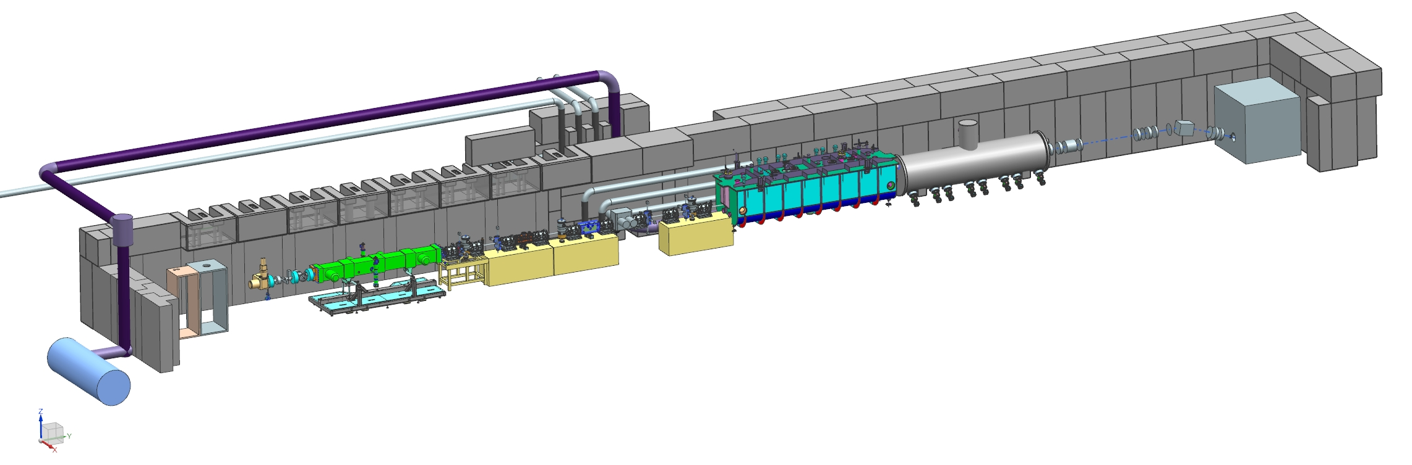
PXIE scope
Development and integrated systems testing of a high power Linac front-end components
  Deliver up to 2 mA average current with 80% bunch-by-bunch chopping of beam delivered from the RFQ
  Demonstrate efficient acceleration with minimal emittance dilution through at least 15 MeV

Slide 6
Nominal beam requirements at the end of PXIE
* RMS, normalized
Capability of an arbitrary micro-bunch structure

Slide 7
PXIE Goals
PXIE will address/measure the following:
  LEBT pre-chopping
  Vacuum management in the LEBT/RFQ region
  Validation of MEBT chopper performance
  Bunch extinction
  MEBT beam absorber
  MEBT vacuum management
  Operation of HWR in close proximity to 20 kW absorber
  Operation of SSR with beam, including resonance control and LFD compensation in pulsed operation
  Emittance preservation and beam halo formation through the front end

Slide 8
Major PXIE features
  Operation to up to 2 mA average beam current
LEBT with non-neutralized transport section
  LEBT chopper
    Supports machine tuning in pulsed mode: Δt ~ 1-20 μs, 60 Hz
RFQ
  162.5 MHz RFQ
    CW operation
    Frequency low enough for bunch-by-bunch chopping (T ≈ 6.2 ns)
MEBT
  “Two-kickers chopping” makes chopping possible with present technology
  21 kW beam dump for chopped-out beam
  Differential pumping to minimize H₂ leakage to the SC cryomodules and RFQ

Slide 9
Major PXIE features (cont’)
SC cryomodules operating at 2 K
  Solenoidal focusing
  Warm gap between cryomodules
  Fast vacuum valves at both sides of the cryomodules
Resonance Control to mitigate both microphonics (CW) and LFD (pulsed)
  Low beam current ⇨ High loaded Q ⇨High sensitivity to vibrations
RF separation at the top energy for beam extinction studies
Instrumentation (not a complete list)
  Allison scanners, toroids, BPMs, wire scanners, laser wires, scrapers

Slide 10
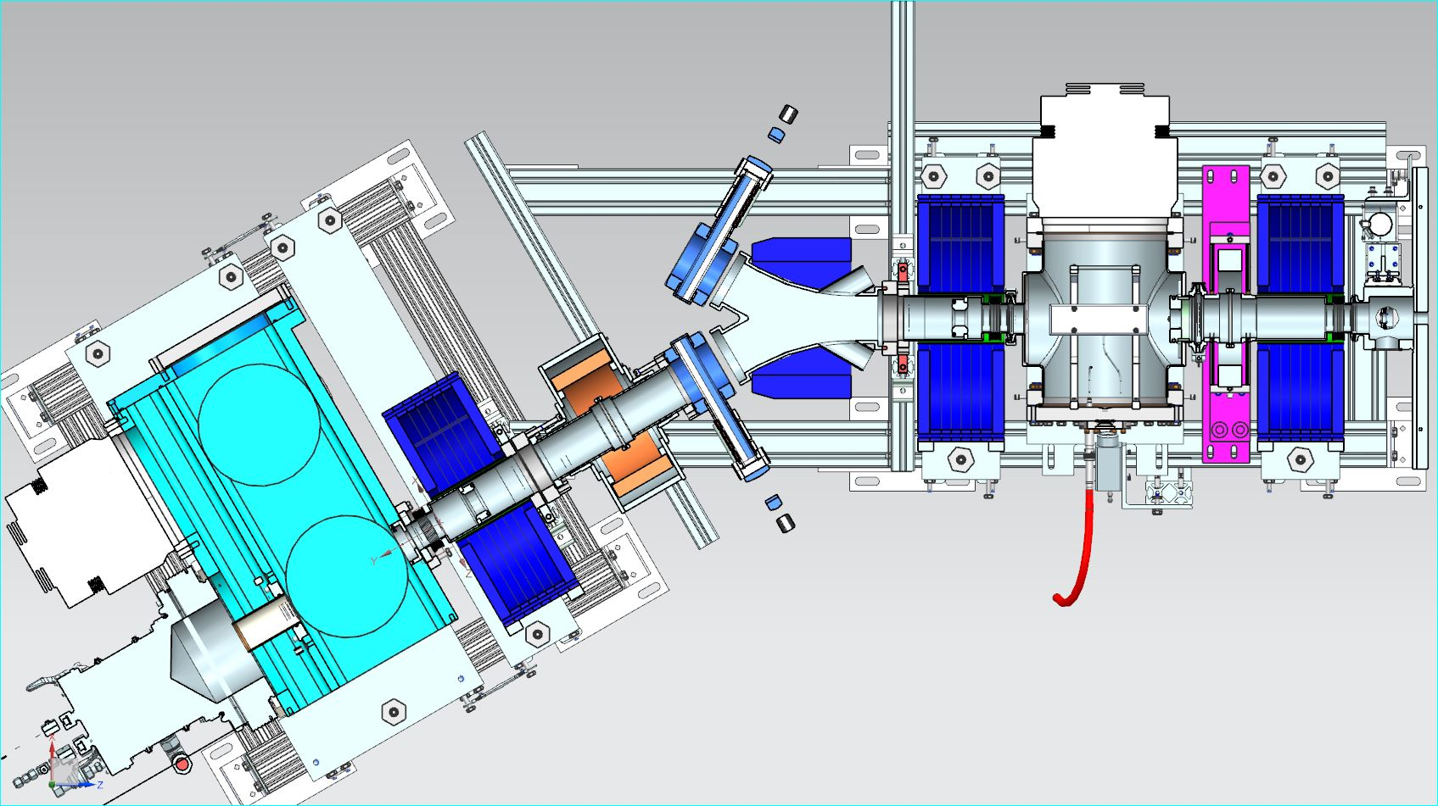
PXIE Ion source and LEBT
Commercial ion source
  D-Pace, Inc.
  30 kV, 10 mA DC
3 Solenoids
Bending dipole
  Accommodate 2 IS
  Part of Personnel Protection System
  No direct line of
  sight between
  IS and SRF
Chopper
  Pre-chopping, MPS, pulse mode
Possibility of partially un-neutralized transport
Possibility of scraping the beam at various locations
  Tail particles management
T. Hamerla
R. Andrews
D. Snee
Ion Source
Chopper
Scheme of
PXIE IS and LEBT
in final configuration
Solenoids

Slide 11
LEBT Design Concept – The problem
Beam that exits the source is almost entirely neutralized but the chopper removes neutralization before the RFQ
  Commissioning (pulsed/chopped beam) and normal operation (DC beam) have different beam parameters at the entrance of the RFQ
    May result into large envelope mismatches during normal operation after the beam has been tuned with a pulsed beam ⇒ emittance dilution in the RFQ
Space charge for red envelope only
No space charge (both envelopes)
RFQ entrance
‘PIC-like’ simulations for a 5 mA beam with Gaussian initial distribution
V. Lebedev MathCAD code

Slide 12
LEBT Design Concept – The solution
Dynamics of the beam with initial constant current density (and Gaussian velocities distribution) was simulated with V. Lebedev’s MathCAD code (PIC-like)
  Beam profile measurements just downstream of the first solenoid indicate that the constant current density model is realistic
  Emittance growth is significantly lower than in a case of a double-Gaussian distribution: ~20% vs. ~75% (for similar envelope profiles)
    Measurements of low emittance beam downstream support the behavior modeled in these simulations (next slides)
Completely neutralized
Completely un-neutralized (10 mA)
‘PIC-like’ simulations for a 10 mA beam

Slide 13
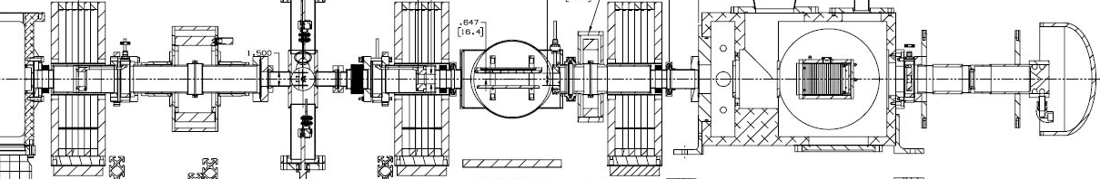
Transport optimization
Beam line has been designed such that the neutralization pattern could be changed
  Biasing apertures
  DC voltage offset on the chopper kicking plate
+40 V
+40 V
Approximate location of RFQ 1st vane
Ions trap
Configuration without ion clearing
Grounded
Ion clearing
Approximate location of RFQ 1st vane
+40 V
Ions trap
+40 V
Space charge ‘enhanced’ configuration
-300 V

Slide 14
Phase space portraits with and without ion clearing
Chopped beam, 5 mA
In both cases, w/ or w/o ion clearing, achieved low emittance with small beam size at the location of the RFQ 1st vanes
  Same focusing and IS settings
No ion clearing
Space charge ‘enhanced’
X’, mrad
X’, mrad
ε_{n, rms} = 0.11 mm mrad
(1% cut)
ε_{n, rms} = 0.13 mm mrad
(1% cut)
03/19/15 data
End of pulse
03/19/15 data
End of pulse
X, mm
X, mm

Slide 15
Ion source and LEBT status
IS and LEBT are assembled, fully commissioned
  Straight configuration; dipole will be installed in FY16
  Beam current up to 10 mA in pulse and DC modes
    24 and 72 hrs runs at 5 mA; current stabilization loops
  At 5 mA, Twiss parameters for the RFQ are on target
    With low emittance
Phase space measurements at the end of the beam line for different IS and beam line tunes but appropriate Twiss parameters at the RFQ entrance
ε_{n, rms} = 0.22 mm mrad
(1% cut)
ε_{n, rms} = 0.11 mm mrad
(1% cut)
X’, mrad
X’, mrad
α = -8.06
β = 1.37 m
α = -8.35
β = 1.38 m
03/16/15 data (12:34)
End of pulse
03/16/15 data (18:04)
End of pulse
X, mm
X, mm

Slide 16
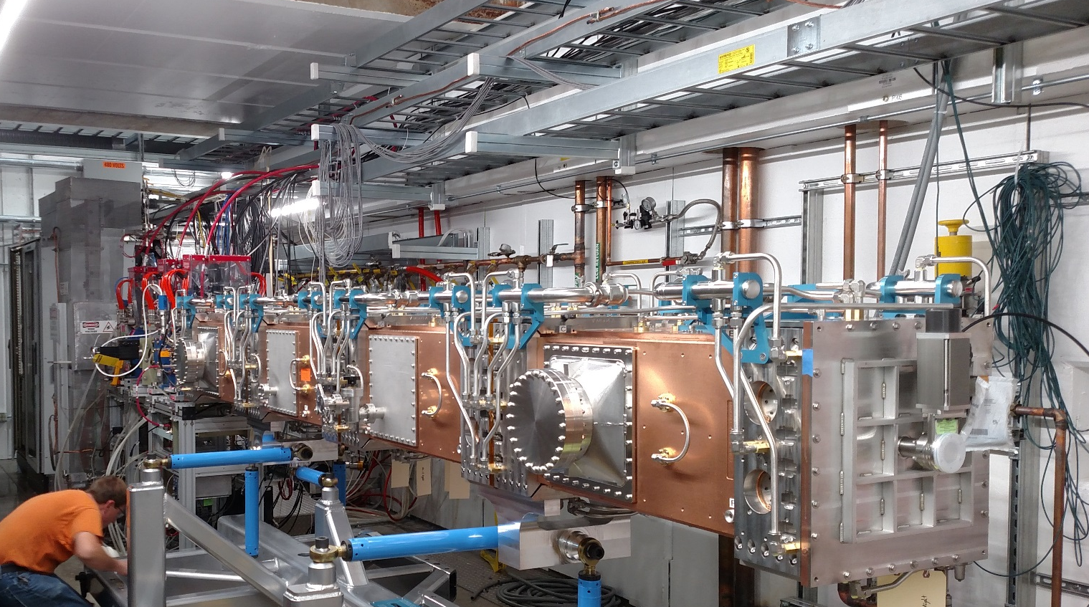
RFQ
Designed and fabricated by LBNL
  4 vane, 4 module brazed copper body
  Fixed tuners
  Output energy: 2.1 MeV
    Below neutron production level
  Similar RFQ has been commissioned at IMP (Lanzhou, China) with 10 mA CW
  Delivered beginning
  of September
Two 75 kW 162.5 MHz
solid-state amplifiers
are installed and
partially commissioned
Matt Hoff
Notes:
Amplifiers good enough to commission in pulsed mode (not CW at the moment)

Slide 17
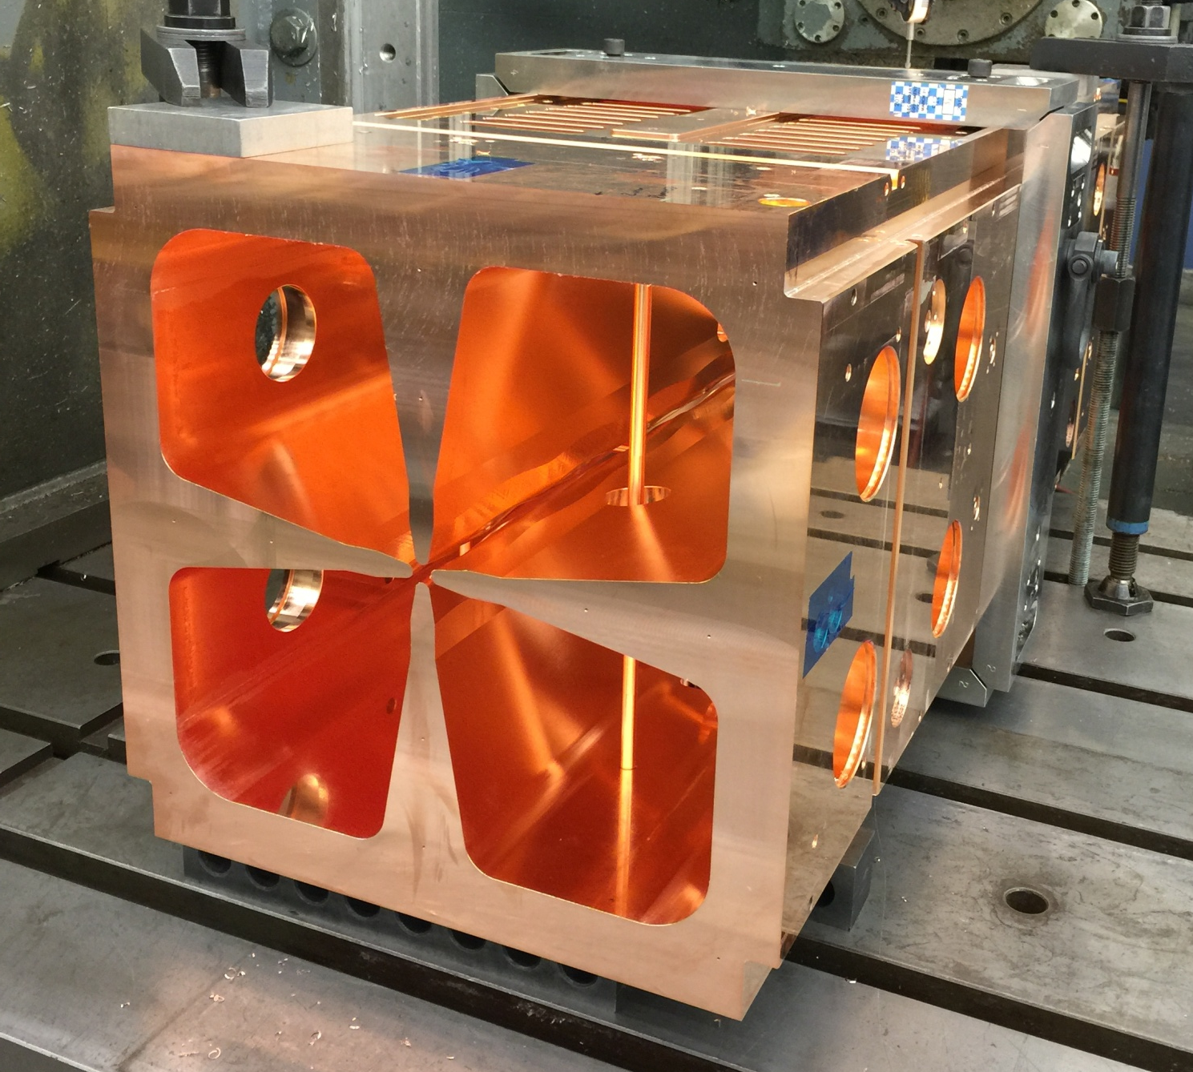
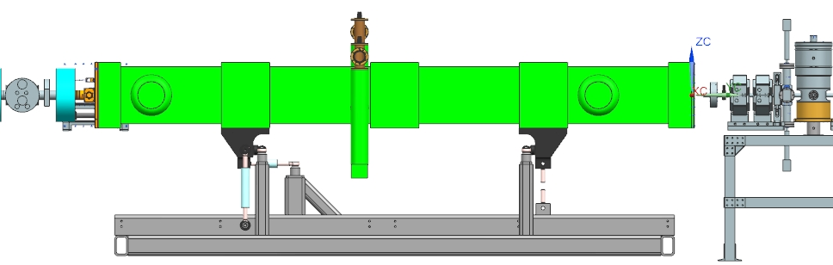
RFQ setup
Installation in progress
Resonance control via cooling water circuit
Identical and cross-calibrated current
transformers before and after RFQ to
directly measure transmission
Current transformer
Current transformer
Matt Hoff
Last LEBT solenoid
Bunching cavity

Slide 18
MEBT concept
Transverse focusing with 2 doublets and 7 triplets
  First short section for beam matching; 1.14 m period after
Longitudinal focusing with 3 bunching cavities
Chopping system: Two TW kickers in sync + absorber
Last ~2 m are particle-free, UHV
Scrapers: 4 sets by 4 jaws in each
  Independently moving, electrically isolated, radiation- cooled plates
Differential pumping
HWR
Bunching cavity
Absorber
Space for diagnostics
Scrapers
RFQ
Quadrupoles
Kickers
Space for diagnostics

Slide 19
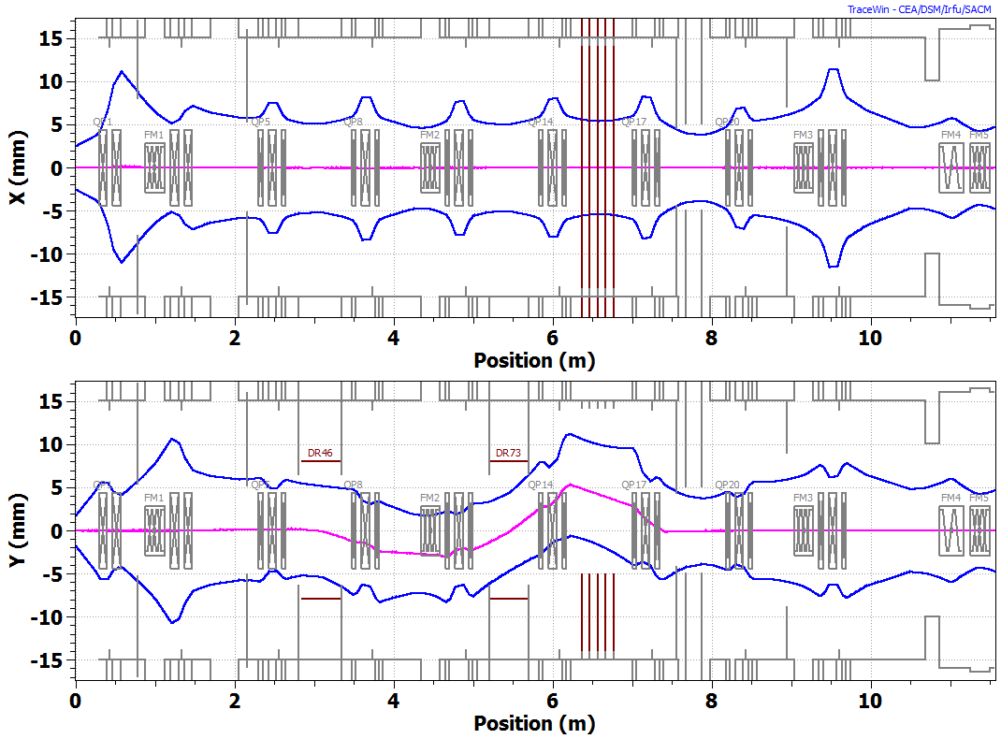
MEBT goals
Demonstrate creation of an arbitrary bunch pattern from initially CW 5-10 mA, 2.1 MeV H⁻ beam
Compatible with SRF downstream
3σ envelopes of passing bunches. 2.1 MeV, 5 mA. TraceWin.
A. Saini.

Slide 20
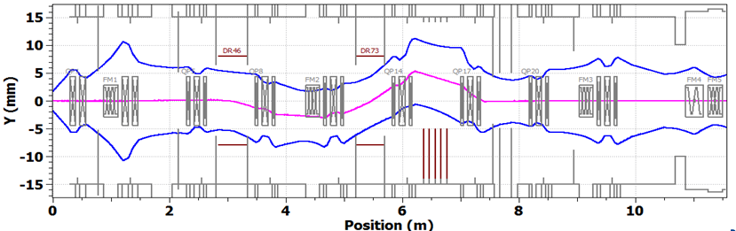
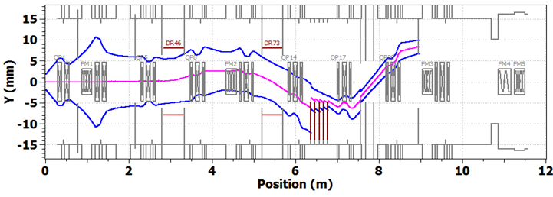
Chopping system
Two travelling-wave kickers working in synch and absorber
  Two kicker versions, 50 Ohm and 200 Ohm
Passing bunch.
-250V, +250V on upper plates.
Removed bunch. +250V, -250V on upper plates. Case with 0.05% of beam leaking to scrapers is shown.
3σ envelopes. 2.1 MeV, 5 mA. A. Saini.

Slide 21
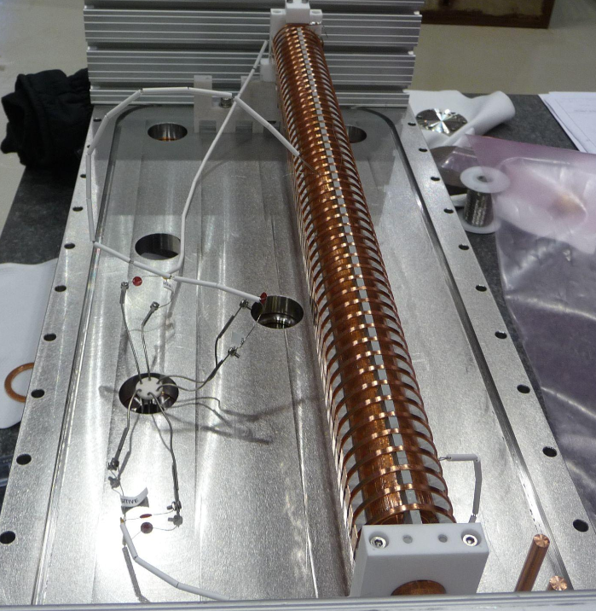
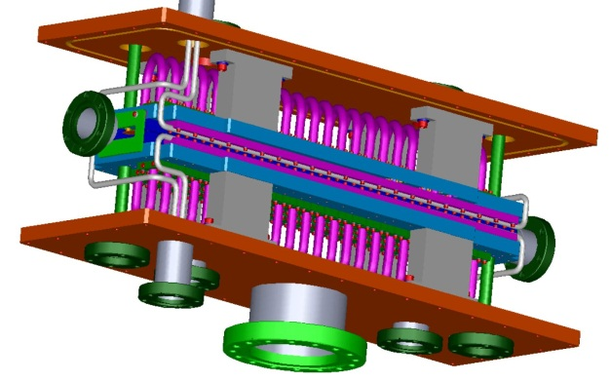
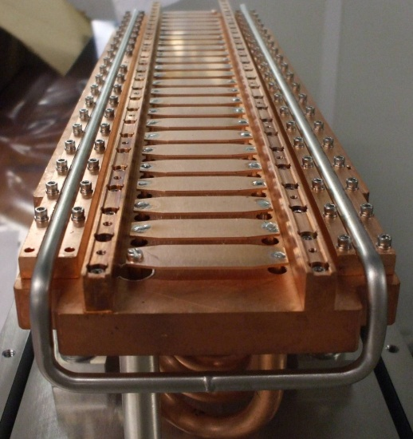
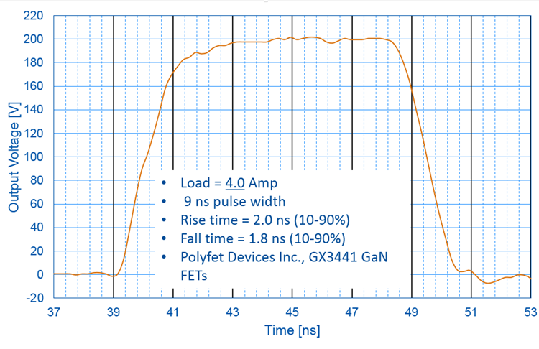
Kickers
Development in parallel of two versions
  Choice of technology to be made after tests with beam
“50 Ohm”
“200 Ohm”
24 electrodes per plate connected in vacuum by 50 Ohm cables
Driver: commercially available bipolar linear amplifier
  Bunches to be removed or passed are kicked in opposite directions
Helix as a travelling-wave structure
Driver is being developed at Fermilab (G. Saewert)
  Unipolar switch
    3 FETs driven individually
D. Sun, A. Chen
Kicker prepared for power testing in vacuum.
A.Chen, G.Saewert

Slide 22
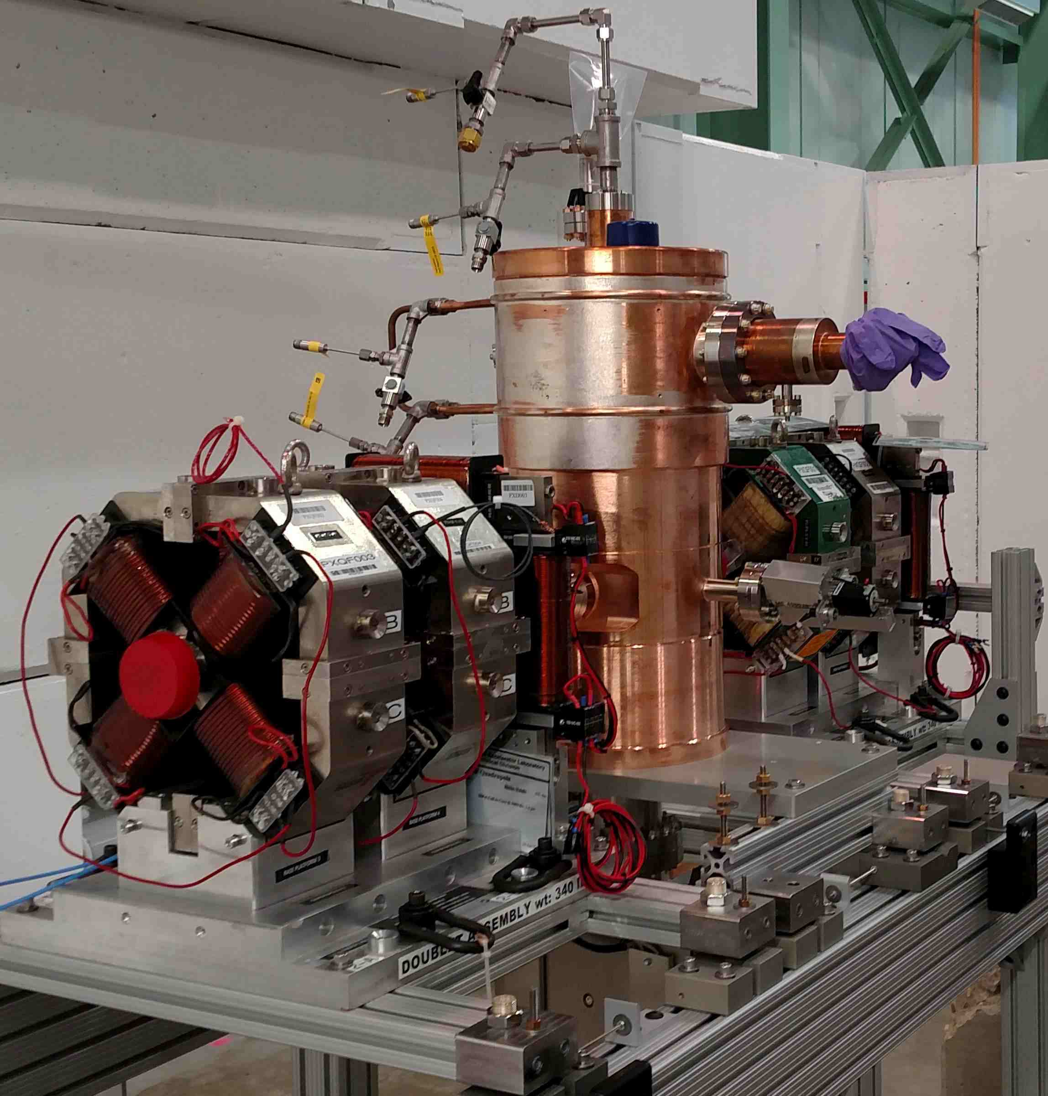
MEBT components status
All major components have been prototyped and
most have been ordered or in fabrication
  Magnets
    Quadrupoles and dipole correctors have
    been developed and will be built at BARC,
    India
      Design incorporates a BPM inside triplets/doublets
      Prototypes will be used for RFQ beam
      commissioning
    All power supplies are on hand
  Prototype bunching cavity has been tested and 3 “production” cavities have been ordered
    3 kW 162.5 MHz PA prototype has been used for testing
    the prototype bunching cavity
  A 4-jaws scraper set was tested with LEBT beam
    Two more sets are in production
  Prototype absorber tested with an e-beam at power
  density well above the one expected at PXIE
    ~30 W/mm² with surface temperature up to ~1600K
    Survived >10⁴ thermocycles in 8 days

Slide 23
Beyond the warm front end
Cryomodules: Half-Wave Resonator (HWR) and Single-Spoke Resonator (SSR1) cryomodules
  HWR:
    8 162.5 MHz, β = 0.11 half-wave cavities
    8 SC focusing solenoids (& BPM)
    2.1 → 11 MeV
  SSR1:
    8 325 MHz, β = 0.22 single-spoke cavities
    4 SC focusing solenoids (& BPM)
    11 → 25 MeV
  Indian contribution:
    Some of SSR1cavities; 10 kW 325 MHz amplifiers;
    Participation in LLRF and RF protection systems
High Energy Beam Transport (HEBT) and beam dump
  To analyze properties of the beam coming out of SRF
    Emittance, halo, stability, bunch extinction
  To safely accept 50 kW beam
  At the stage of conceptual design

Slide 24
PXIE commissioning plan
FY16
  Commission RFQ (RF and beam)
  Install most of the MEBT magnets
FY17
  Install and test kicker prototypes
  Finalize design of all MEBT components
  Receive both cryomodules
FY18
  Install final MEBT; demonstrate bunch-by-bunch selection
  RF commissioning of both cryomodules
FY19
  Final beam parameters
Notes:
Likely a couple of years running in the final configuration ⇨ could entertain proposal for beam physics experiments

Slide 25
Additional slides

Slide 26
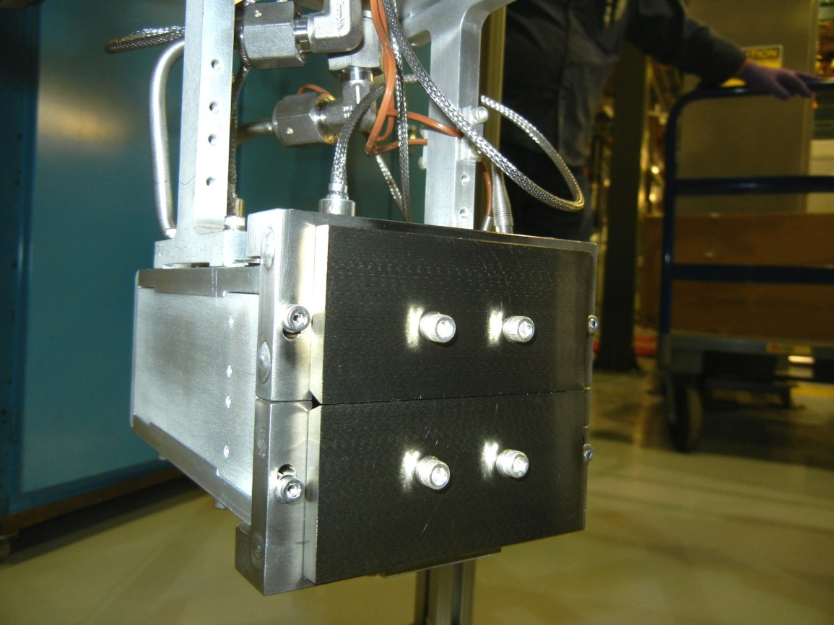
LEBT diagnostics
DCCT, toroid, electrically isolated electrodes, Faraday cup (not permanent)
  Beam current, controlled beam loss
Allison-type emittance scanner
  Designed and built in collaboration
  with SNS
    Front-slit made of TZM pressed
    against water-cooled aluminum blocks
  Workhorse for beam measurements
    Located at the end of the beam
    line
      Moves as more elements are
      added
      Final permanent location is
      in the IS vacuum chamber
  Baseline for MEBT Allison
  scanner design

Slide 27
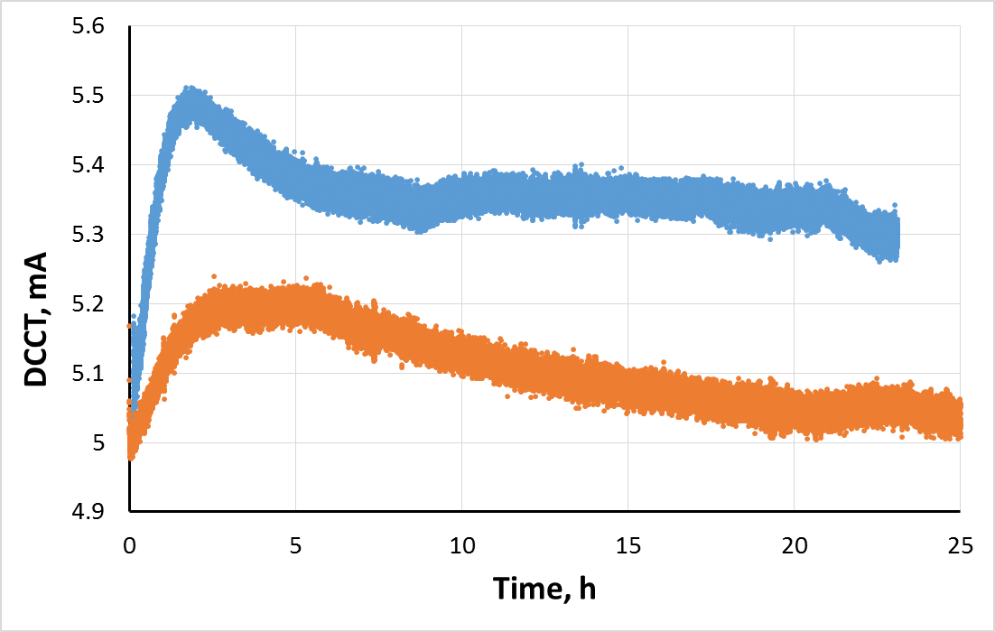
LEBT performance
Demonstrated up to 10 mA, DC and pulse
  Low uncontrolled beam loss (<2%)
  1-60 Hz pulses
  ~24 hours without beam interruption
Simultaneous use of the “modulator”
and chopper to produce clean
pulses
  “Modulator” ⇨ Ion source pulses
  Chopper ⇨ 1μs to 16.6 ms pulses
    Sharper rise and fall times than ion
    source pulse
December run
January run
10 ms
Ion source extractor voltage
0 kV
5 ms
-300 V
Chopper voltage
-5 kV
0.5 ms

Slide 28
LEBT performance (cont’)
ε_{n, rms} = 0.13 mm mrad
Twiss parameters nearly matched
to RFQ’s with low emittance
  Caveat: emittance scanner
  located ~20 cm downstream
  of where the RFQ first vane
  tip would be ⇨ Measuring
  large diverging beam while it
  is a small converging beam
  at the RFQ ‘entrance’
Twiss parameters do not
vary widely within the pulse
  Partially un-neutralized
  scheme
X’, mrad
X, mm

Slide 29
LEBT reproducibility/stability
The beam Twiss parameters vary day-to-day for seemingly identical settings
  Origin is not understood yet
  Linear relationship between α and β
    Similar slope while changing the beam current may point to fluctuations in neutralization factor as a culprit
  Likely, can be mostly corrected by adjusting Solenoid #3 focusing
Twiss parameters compiled over several weeks for identical IS and focusing settings (blue circles) (“File #1553”) and during a study where only the beam current was varied (black squares).

Slide 30
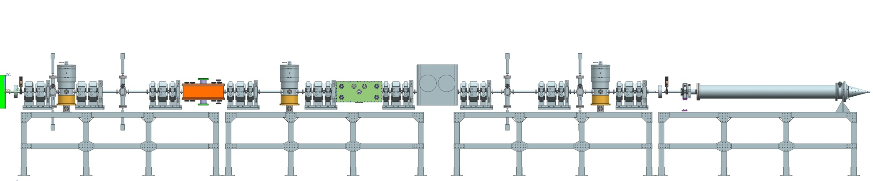
MEBT elements
Magnets
  Quadrupoles and dipole correctors
Kickers
  ΔU = 500 V on each plate
  Two 50 cm-long kickers
  6.15 ns bunch separation
  1.3 ns 6σ bunch length
Absorber
  21 kW CW (17 kW/cm² max)
  2 mm 1σ beam
  50 cm-long
Bunching cavities
Scrapers
  4 assemblies
  4 jaws for each
Diagnostics
  BPMs, DCCT, toroids
  Emittance scanner
  Wire/laser wire scanners
  Fast Faraday cup
  Extinction monitor

Slide 31
Absorber
Two ¼-length prototypes have been built
  Molybdenum alloy TZM, transverse slits to alleviate stress, shadowing steps to protect the slits
    29 mrad grazing angle of incidence
  Second prototype tested successfully with an e-beam (28 keV, 0.19 A) at comparable power density
    Separate TZM plates pressed against a water-cooled aluminum plate ⇨ Remove chances to develop a crack to water channels
    Tested at a power density well above the one expected at PXIE, to ~30 W/mm² with surface temperature up to ~1600K
    Survived >10⁴ thermocycles
    in 8 days
Plan to test Prototype-II in full
length MEBT before
proceeding to final absorber
C. Baffes

Slide 32
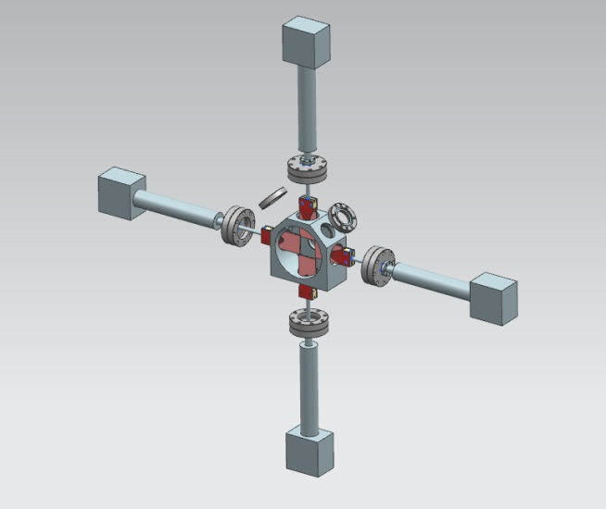
Scrapers
To be used for beam scraping, machine protection and beam size estimations
Prototype tested with an electron beam
to up to 150 W
  Radiation-cooled, electrically isolated,
  independently movable TZM plates
  Max. expected in MEBT: 50 W (per jaw)
First set of 4 has been assembled and
installed in the LEBT for testing
with beam
  Two more sets will be fabricated in FY15
Model of the scraper set. C. Baffes

Slide 33
Diagnostics
HWR
Bunching cavity
Absorber
Scrapers
RFQ
Quadrupoles
Kickers
Diagnostics sections
Mainly 2 ‘diagnostics’ sections in the final MEBT configuration for large devices (e.g.: emittance scanner, laser wire)
It might include: 9 BPMs, 2 toroids, a DCCT, 4 scraper assemblies, an emittance scanner, 2 wire scanners, a Fast Faraday cup, 2 laser wires, an extinction monitor
  In FY15, 2 toroids, 2 BPMs, 1 scraper assembly and a Fast Faraday cup should be enough for initial RFQ characterization

Slide 34
Diagnostics status
Toroids – 2 on hands
BPMs
  One BPM is complete and measured
  One more BPM is in production; have buttons for
  2 more
  Electronics for 2 BPMs should be ready by this
  summer
  Buttons for all MEBT BPMs have been ordered
Time-of-Flight monitor (“movable BPM”) – being designed
  To measure the beam energy by recording the phase as a function of the longitudinal BPM position, following an idea from SNS
Fast Faraday Cup – Tested with LEBT
  Small portion of the beam is cut by a pinhole and
  collected to a strip line
  Modifications to SNS design to improve robustness
Ring pickup – being procured
  To estimate average beam current from RFQ for MPS
  purpose

Slide 35
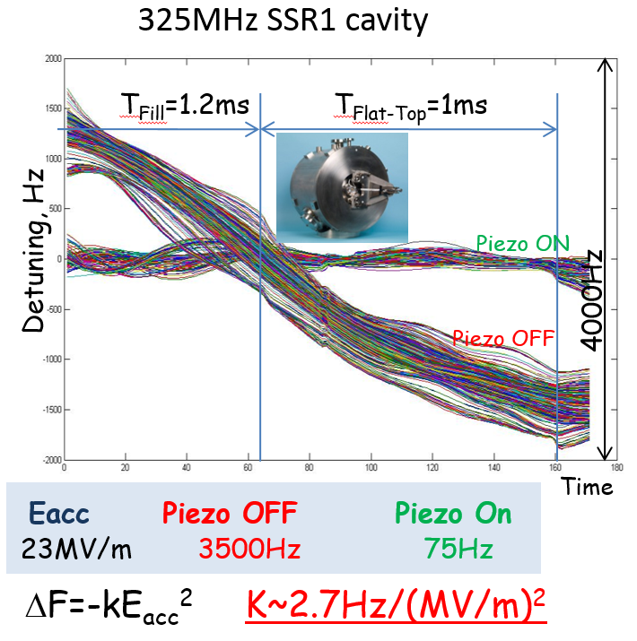
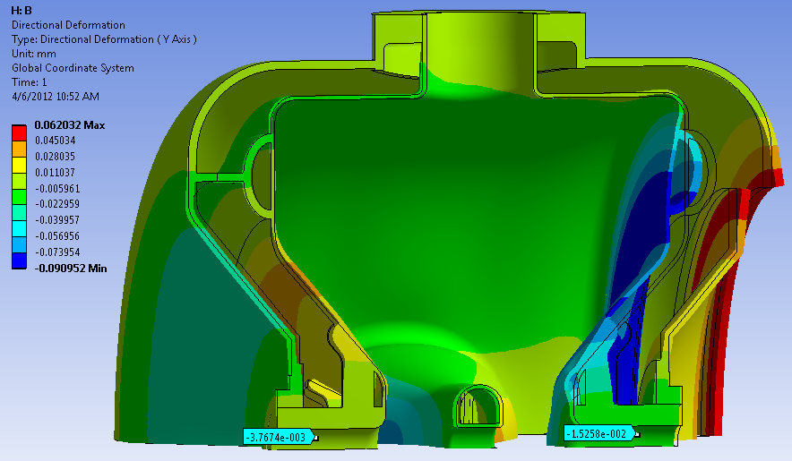
Resonance control
Reduction of df/dp through mechanical design improvements
  A self-compensating design was developed allowing low sensitivity to Helium pressure fluctuations, without increasing the stiffness to frequency-tuning.
  Prototype cavity ~ 150 Hz/torr -> New design
  ~4 Hz/torr ( ~40 times less)
  Ease of tuning virtually unchanged:
  39 N/kHz (bare), 40 N/kHz (with He vessel)
Adaptive Lorentz Force Detuning compensation
  Successfully applied to different cavities/tuner configurations

Slide 36
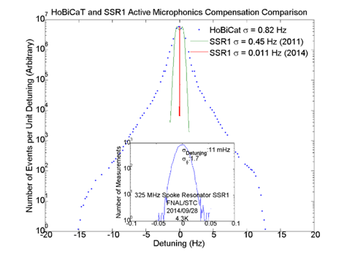
Resonance control (cont’)
SSR1 Active microphonics control
  Feedforward compensation of the ponderomotive effects and active resonance stabilization using feedback

Slide 37
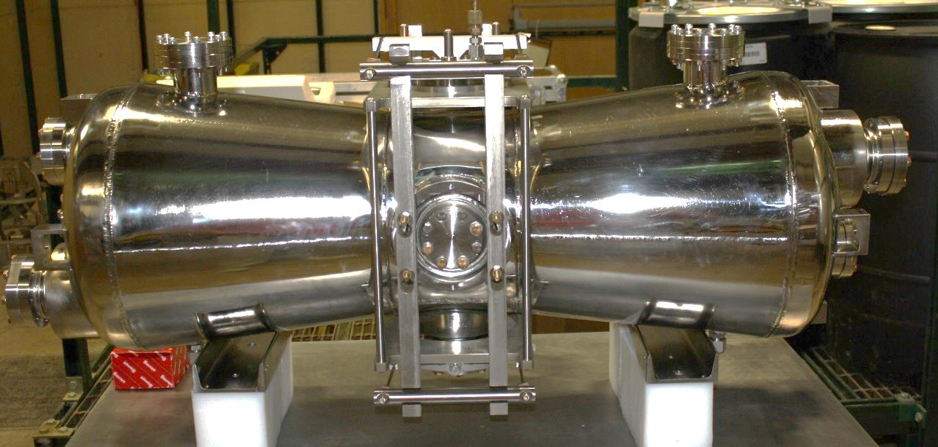
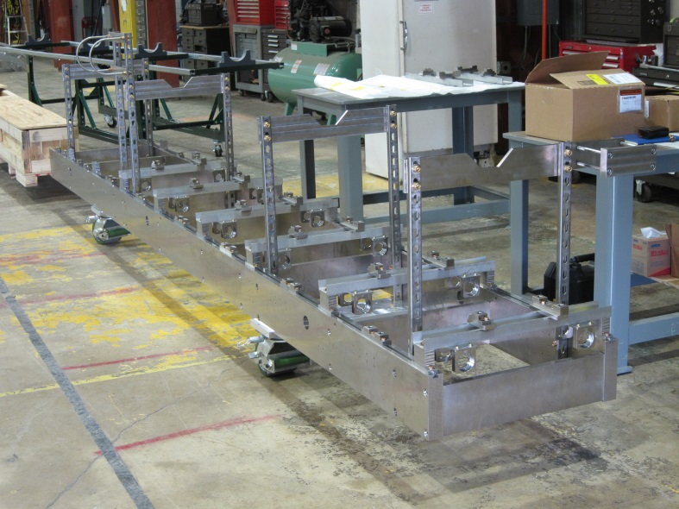
HWR components status
Cavities
  Design complete
  First 2 HWR cavities were tested at 2K
  Cavities were electro-polished after fabrication was complete
  Niobium work in all remaining 7 cavities is nearly complete
Cryomodule
  Design complete and under
  fabrication
HWR electropolish is low-β EP tool
Titanium strongback

Slide 38
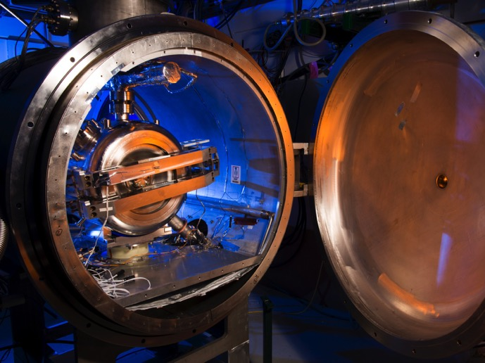
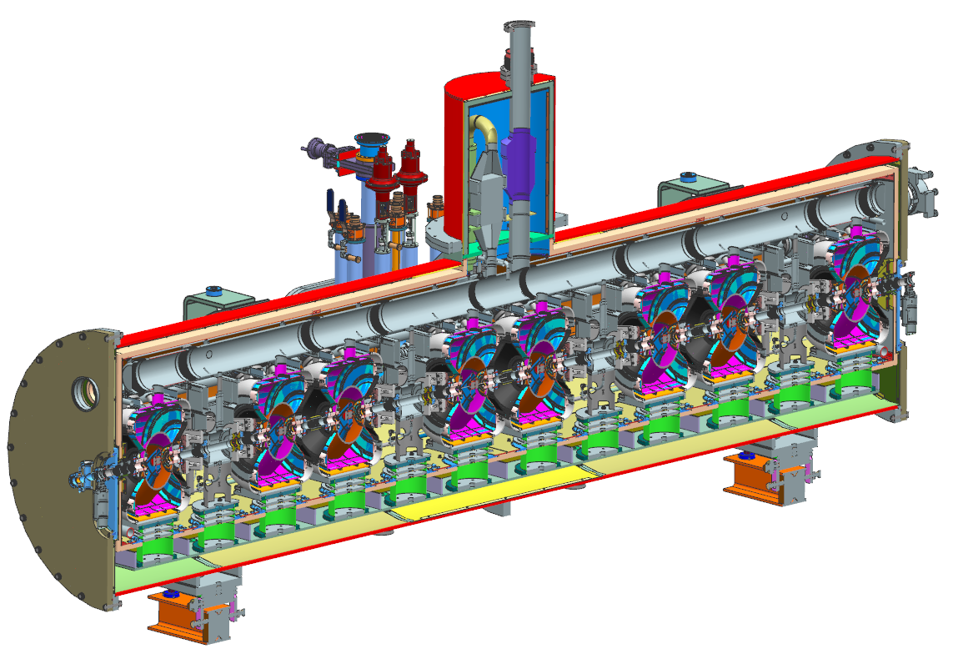
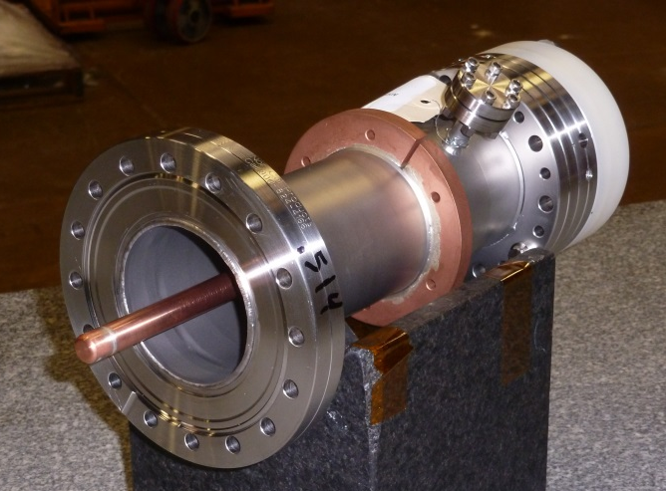
SSR1 components status
Cavities & Solenoids
  Design complete
  12 cavities fabricated
    10 FNAL, 2 IUAC New Dehli
325 MHz couplers
  Prototyped, tested & ordered
Cryomodule
  Design underway
Dressed SSR1 cavity in test cryostat
Coupler prototype

Slide 39
PXIE infrastructure
CMTF building, housing PXIE, has all required capacity
  Cryo, power, water
  Distribution systems are being designed and implemented
All components for the PXIE cave are on hand
Cryoplant

