Slide 1
Overview of FAST
Alexander Valishev
PASI-2015, Fermilab
12 November 2015

Slide 2
Acknowledgments
D.Broemmelsiek, A.Burov, K.Carlson, A.Didenko, N.Eddy, V.Kashikhin, V.Lebedev, J.Leibfritz, M.McGee, S.Nagaitsev, L.Nobrega, H.Piekarz, E.Prebys, A.Romanov, G.Romanov, V.Shiltsev, G.Stancari, J.Thangaraj, R.Thurman-Keup, A.Valishev, S.Wesseln, D.Wolff (FNAL)
S.Chattopadhyay, P.Piot, Y.M.Shin (NIU)
D.Shatilov (BINP)
G.Kafka (IIT)
S.Danilov (ORNL),
S.Antipov (U of Chicago)
J.Cary (Tech-X)
D.Bruhwiler, N.Cook, S.Webb (RadiaSoft)
F.O’Shea, A.Murokh (RadiaBeam)
R.Kishek, K.Ruisard (UMD)

Slide 3

Strategic Plan for Accelerator R&D in the U.S.
April 2015 report of the High Energy Physics Advisory Panel (HEPAP) subpanel on Accelerator R&D
Short-term (PIP-II, LARP)
Emphasis on Medium-term (Next Step)
accelerator R&D
  Multi-MW proton accelerator
  Very high-energy proton-proton collider
    Superconducting magnet development
  TeV-scale ILC upgrade
    SRF technology at lower cost
Long-term (Further Future)
AND
  Accelerator workforce development and Training
  Core capabilities
  April 6, 2015

Slide 4
Fermilab Accelerator Program: P5-Aligned
Advanced Accelerator R&D Towards Next Generation Machines
Exploratory Long-term R&D
Operational Support and Complex Upgrade (PIP-II)
Accelerators Training and Education
Accelerator and Beam Physics
Develop and explore transformative concepts and technologies for beyond next-generation multi-MW accelerators at FAST/IOTA and in the area of SRF
e.g. assess feasibility and demonstrate technologies for future 100 TeV pp collider and conclude ionization cooling demo for possible future muon facility
Provide accelerator physics and technology support for operation and upgrades of the Fermilab’s accelerator complex, ν and µ experiments
Train the next generation of accelerator designers and builders through the USPAS and Fermilab programs
Contribute to the fundamental understanding of beam dynamics through experiment , simulation and theory
FAST
Fermilab Accelerator
Science and Technology facility

Slide 5
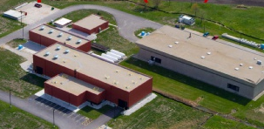
NML – FAST
IOTA
FAST/IOTA
PXIE

Slide 6
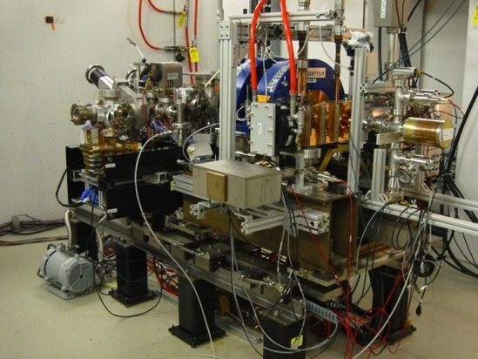
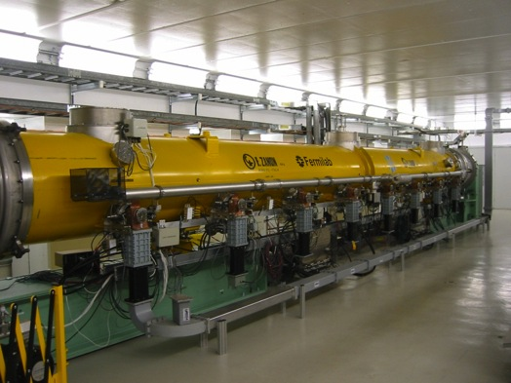
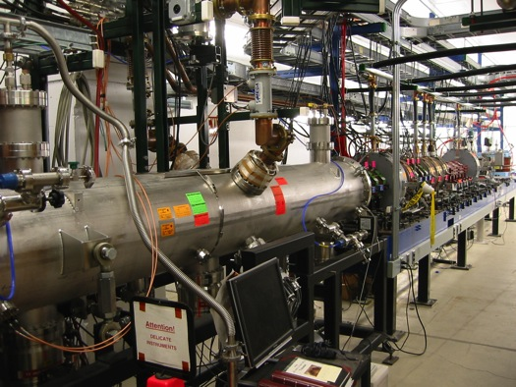
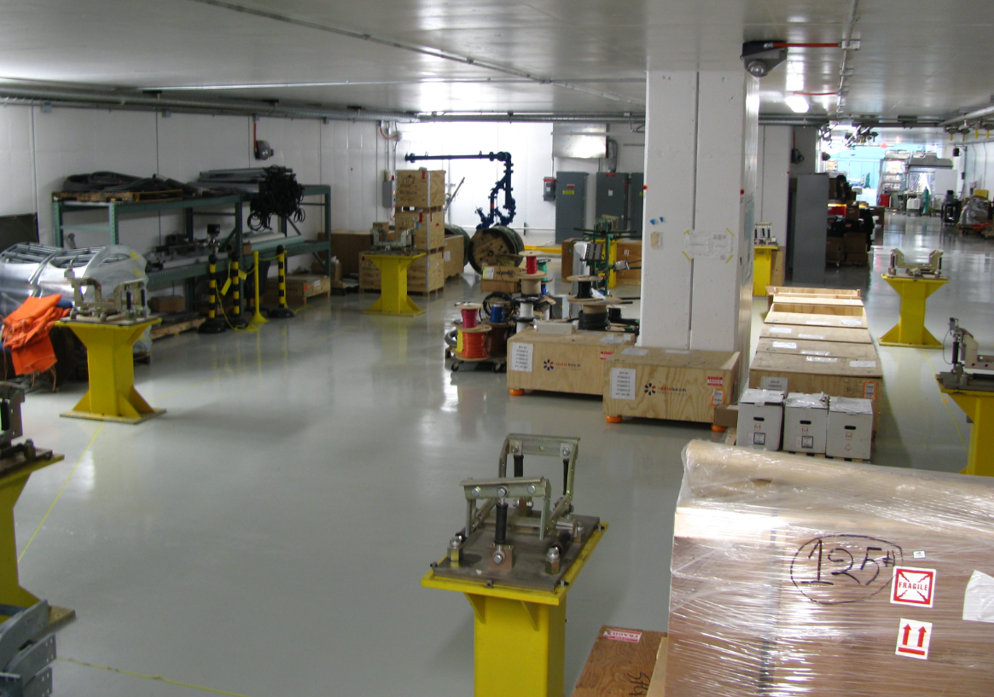
FAST
Need accelerator R&D beam facilities !

Slide 7
Existing Infrastructure - Injectors
FAST/IOTA capitalizes on the investments made by OHEP for highly successful ILC/SRF R&D Program and HINS research.
Electron Injector:
  Construction of NML (aka ASTA) began in 2006 as part of the ILC/SRF R&D Program and later American Recovery and Reinvestment Act (ARRA). The facility was motivated by the goal of building, testing and operating a complete ILC RF unit.
  Multi-million (>$90M) investment resulted in the successful commissioning of 1.3 GHz SRF cryomodule (CM2).
    Beam through low-energy photo injector (20MeV achieved)
    Facility nears completion (will provide 300MeV e-)
Proton injector: H- source for High Intensity Neutrino Source (HINS).
  Ion source and RFQ. (50keV ion source, 2.5MeV p+)

Slide 8
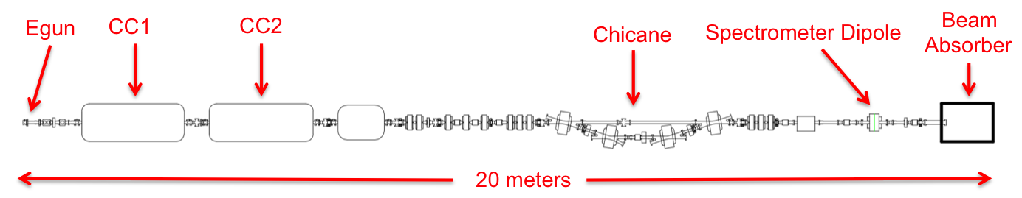
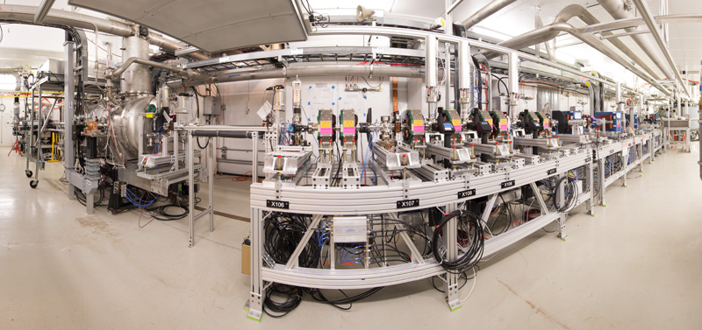
Electron Injector

Slide 9
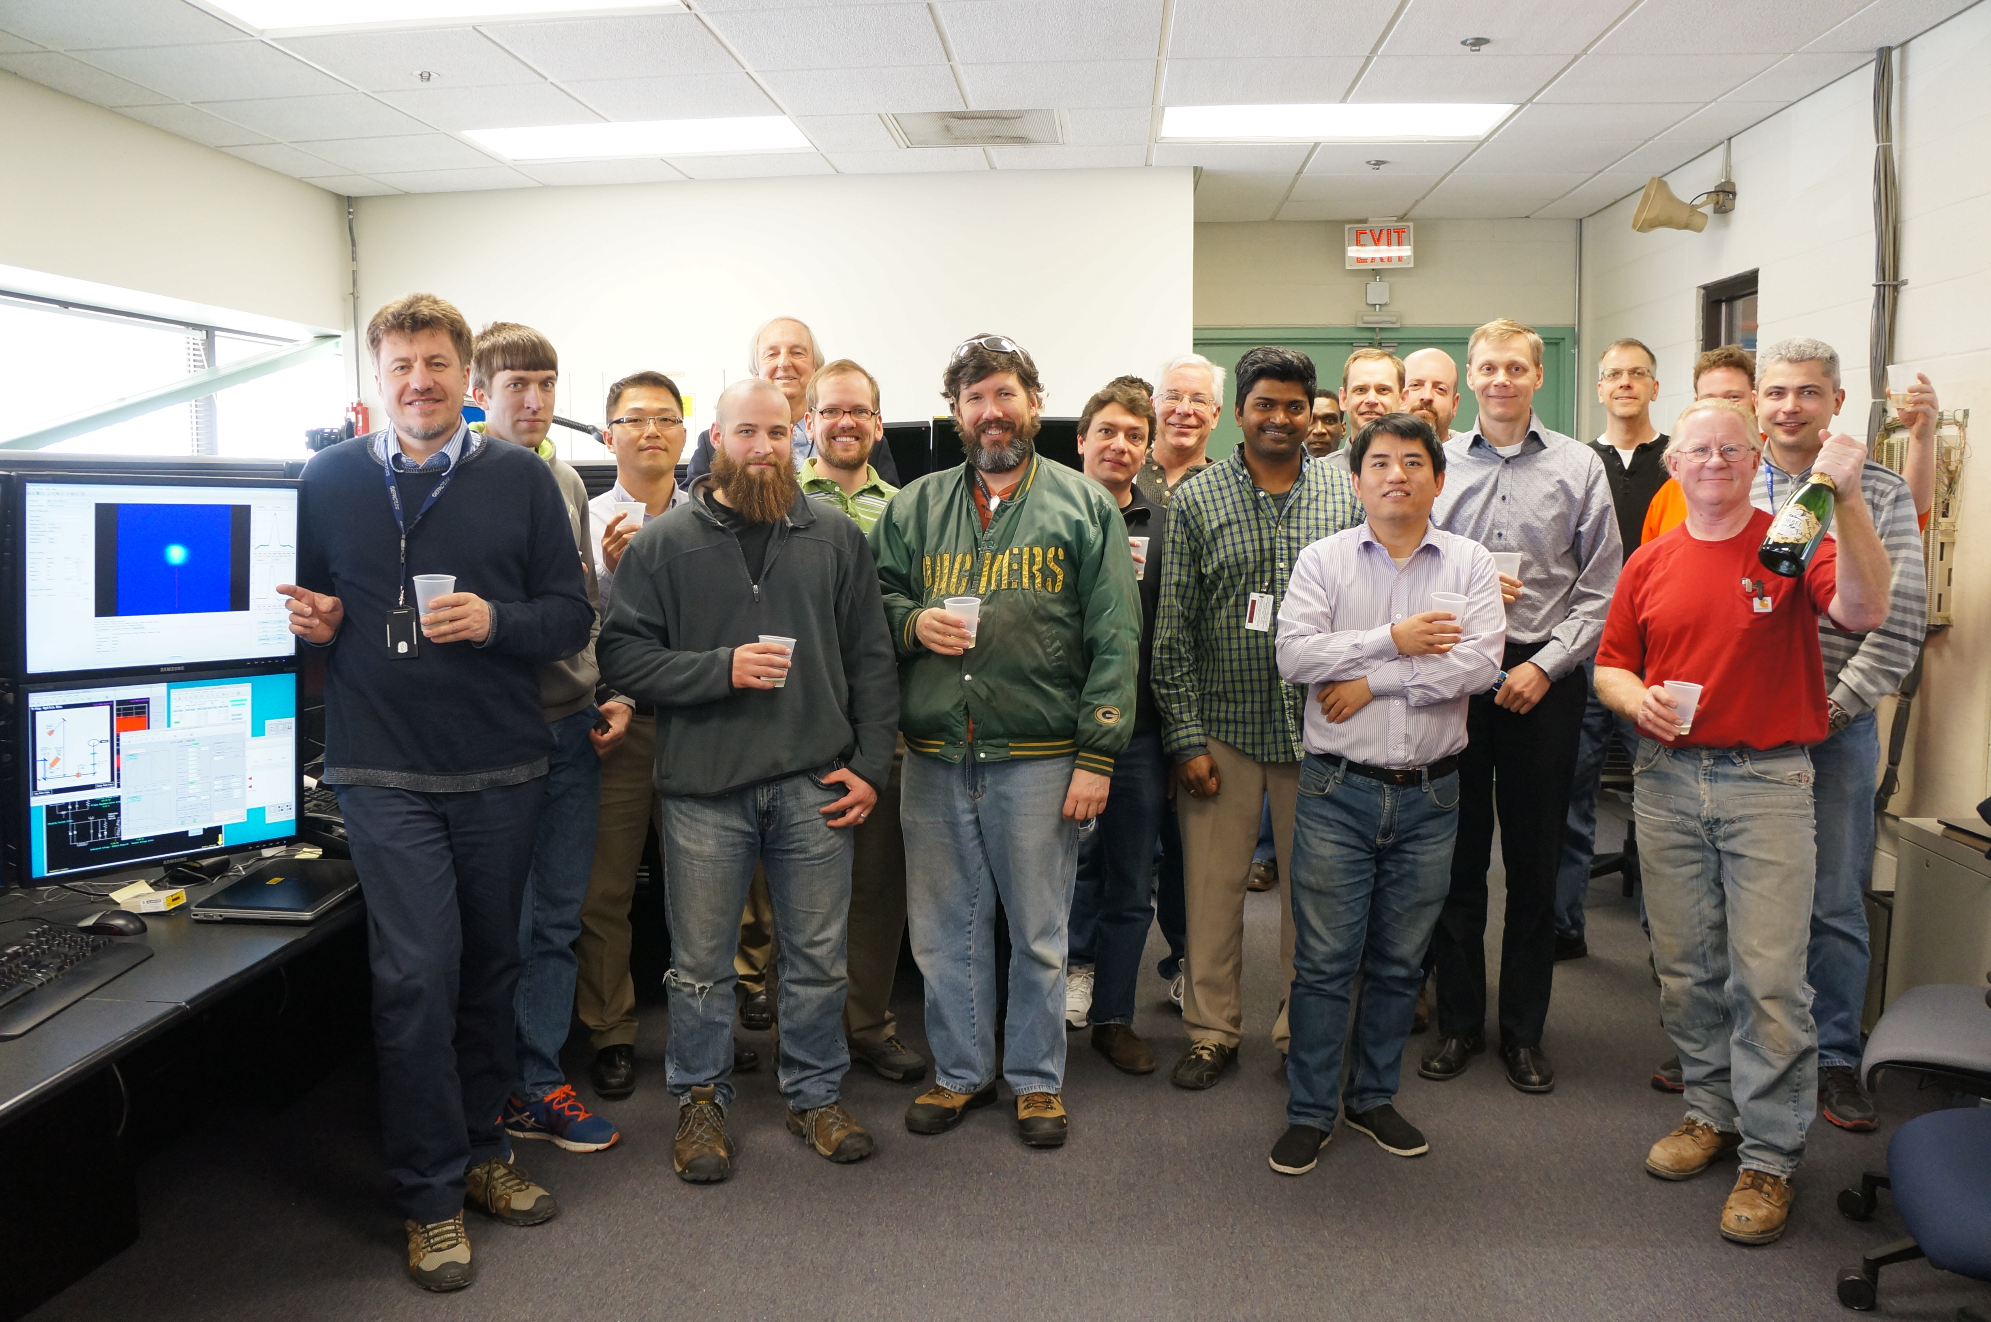
20 MeV e⁻ beam through injector

Slide 10
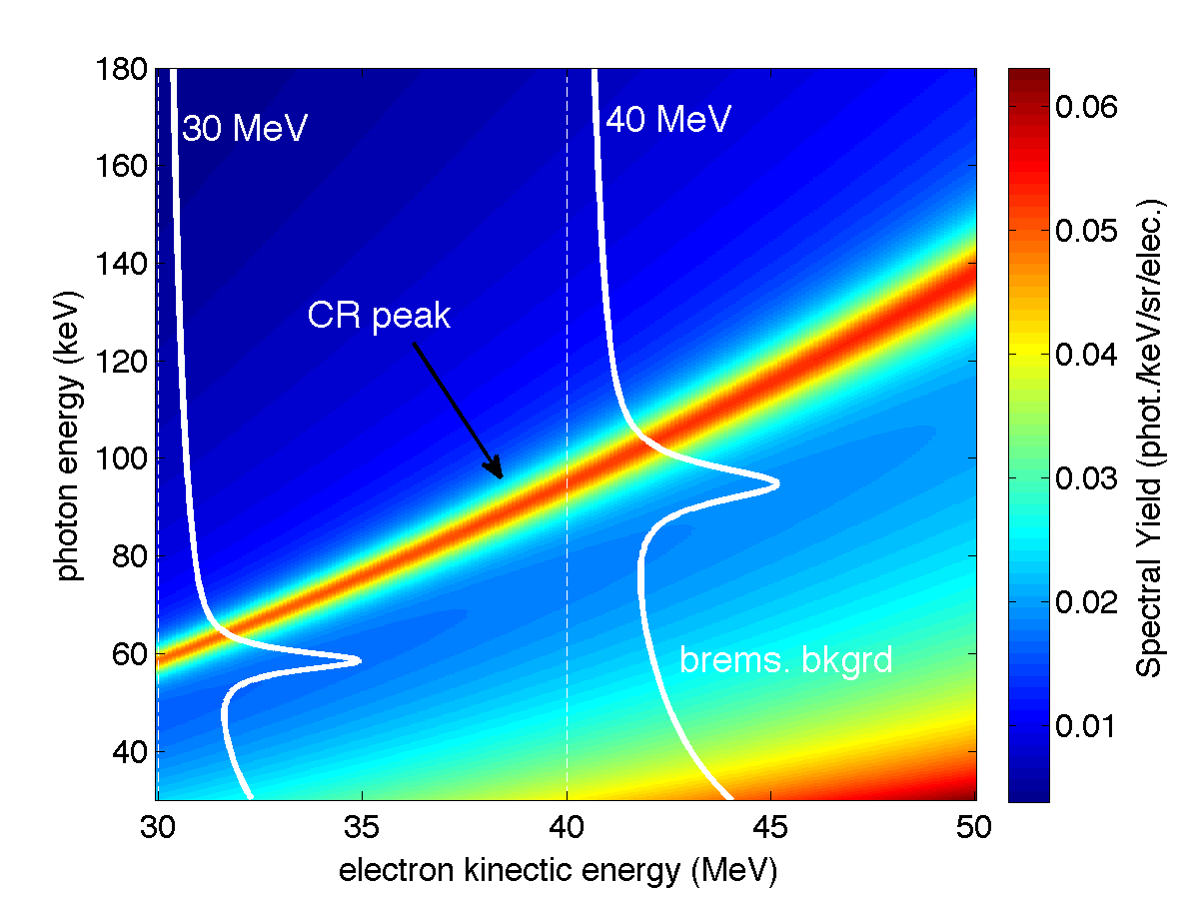
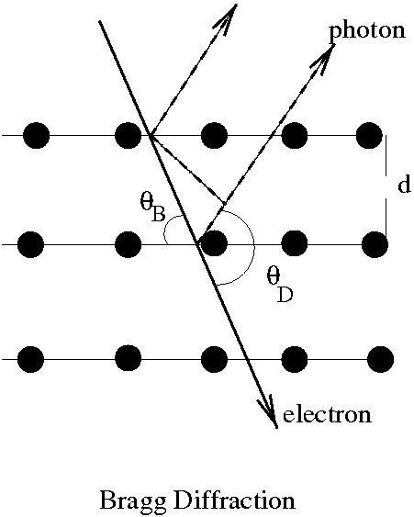
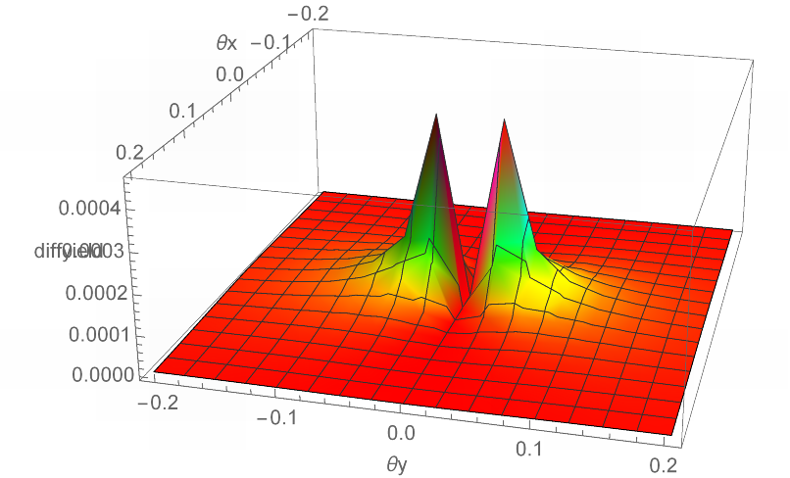
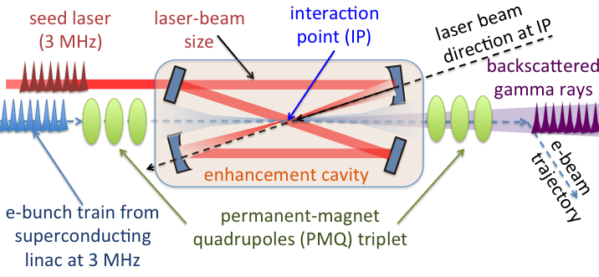
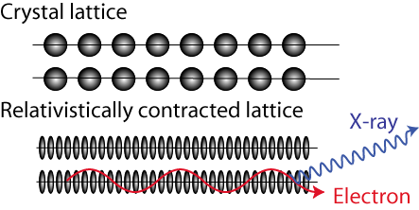
FAST Electron Linac
Injector for IOTA ring
AND a research tool in its own right
  X-ray sources in the FAST 50-MeV injector
  High-rep-rate tunable γ-ray source with FAST 300 MeV beam
NIU/FNAL
Collaboration
Channeling radiation
Parametric x-rays
Applications: Phase contrast imaging, medical diagnostics, material science
Applications: Nuclear Astrophysics, Nuclear Medicine, Oncology, and Security
Science now
while the rest of facility
is under construction

Slide 11
FAST Proton Injector
To study high-intensity proton beam physics we need proton beam. Luckily, we have an extra RFQ just lying around…
The HINS (“High Intensity Neutrino Source”) was developed as the front end of a pulsed “Project X” 8 GeV proton linac
Because of cooling problems, it never reached its design pulse rate
ProjectX (now PIP-II) specification was changed to a CW front end
  HINS->PXIE
HINS RFQ available for our use

Slide 12
HINS Program: Original Goals
Built as prototype front-end for Project-X
Stated Mission - To address accelerator physics and technology questions for a new concept, low-energy, high intensity, long-pulse H⁻ superconducting Linac; in particular, to demonstrate:
  beam acceleration using superconducting spoke-type cavity structures starting at a beam energy of 10 MeV
  multiple high power RF vector modulators controlling RF cavities driven by a single high power klystron for acceleration of a non-relativistic beam
  beam halo and emittance growth control by the use of solenoid focusing optics
  a fast, 325 MHz bunch-by-bunch, beam chopper

Slide 13
HINS Layout, as Built
50 keV
2.5 MeV
3.0 MeV
Vector modulators distribute the power from a single kylstron

Slide 14
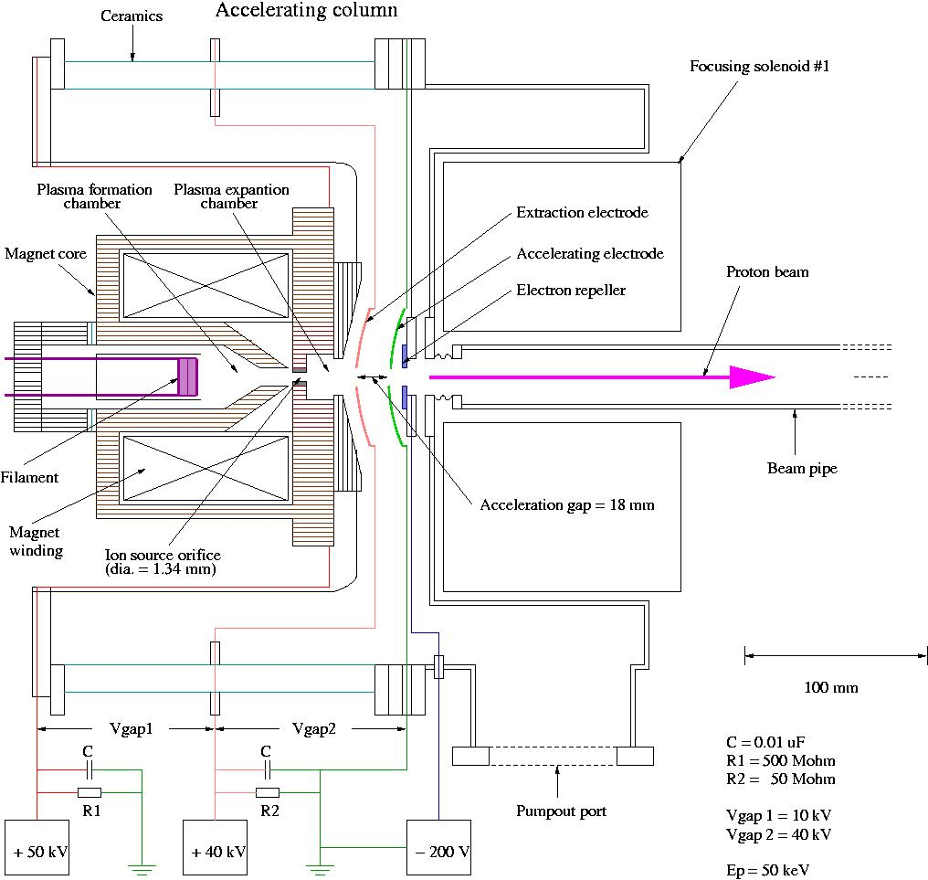
HINS Proton Source Arrangement
HINS proton source is a re-configured,
and much improved Loma Linda Ion
Source (1989).
Major changes include:
Increased operational HV from 30 kV to 50 kV
Increased beam pulse duration from 65 μs @ 15 Hz to 3 ms @ 2.5 Hz (8 times higher beam power)
Installed new, 7 times stronger vacuum system
Installed digitally controlled supporting electronics for all ion source subsystems (HV, LV, H2 flow, vacuum, magnets, etc.)
Ion source operations are fully directed from HINS Main Console

Slide 15
RFQ Design and Specifications
Pulsed 4-vane RFQ (specs):

Slide 16
HINS Parameters for IOTA
matched to IOTA momentum, but β=.073!
Demonstrated for 1 ms pulses. Should go to >40 mA for short pulses. I recommend we assume that.
Is this big enough?
Why no one will steal this RFQ from us

Slide 17
MDB ➔ FAST
Plan: resurrect HINS in situ at MDB
Completely character its performance
Once it works, move everything to FAST
  Put all high power RF hardware in the upstream gallery and run coax to the RFQ itself
source, RFQ and injection girder
Charging supply,modulator, pulse transformer, and klystron

Slide 18
R&D Towards Multi-MW Beams at Fermilab
Innovative design approaches will allow multi-MW beam power at lower cost
Push performance of synchrotrons by a factor 3-4
Reduce cost of the SRF / GeV by a factor of 3-4
Develop multi-MW targets
Train next generation of accelerator scientists and engineers
Advance general accelerator knowledge and explore exciting science

Slide 19
PIP-III “multi-MW”- Option A: 8+ GeV smart RCS
(Rapid Cycling Synchrotron – ring)
120 GeV RCS
Main Injector
8 GeV
Recycler ?
≥ 2.5 MW
target
new 8-12 GeV “smart” RCS
800 MeV
SC Linac PIP-II

Slide 20
R&D on High Current Synchrotrons
The future is in beam control and mitigation of beam losses!
  High energy machines – beam can damage components
  High current machines – component activation
To enable multi-MW beam power, losses must be kept well <1% at high intensity:
  Very challenging after 50 years of development
Need to develop technology for
  Beam halo control
  Single-particle and coherent beam stability

Slide 21
Enter IOTA
We have two innovative ideas:
  Integrable Optics
  Space Charge Compensation
To test them, we are building the Integrable Optics Test Accelerator
  To become a machine for proof-of-principle R&D
There is are no dedicated ring-based accelerator test facilities in the US for high intensity research
  UMER at UMD is operating with 10keV electrons, only few turns

Slide 22
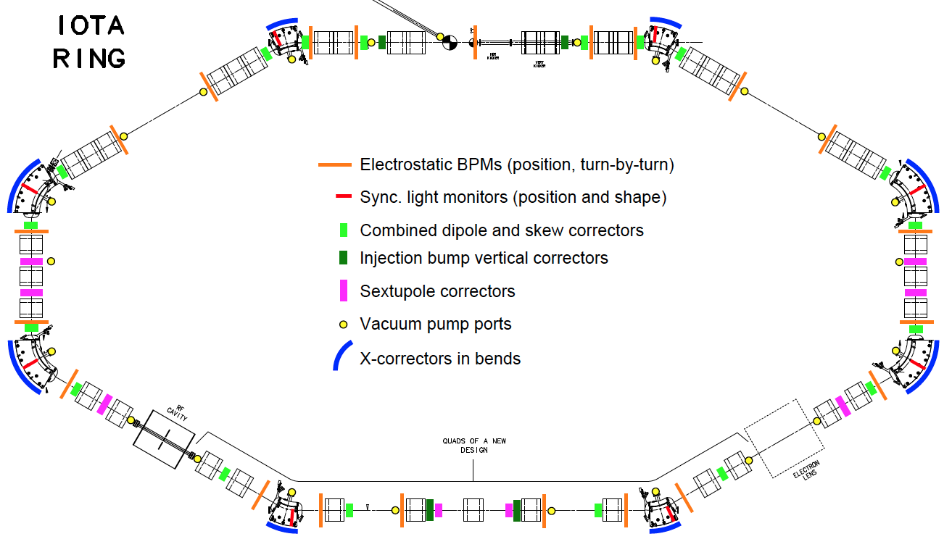
IOTA Layout
16m

Slide 23
IOTA Physics Drivers
Nonlinear Integrable Optics – Experimental demonstration of NIO lattice in a practical accelerator
Space Charge Compensation – Suppression of SC-related effects in high intensity circular accelerators
  Nonlinear Integrable Optics
  Electron lenses
  Electron columns
  Circular betatron modes
Optical Stochastic Cooling – Proof-of-principle demonstration
Beam collimation – Technology development for hollow electron beam collimation
Electron Cooling – Advanced techniques
Laser-Plasma Accelerator – Demonstration of injection into synchrotron
Quantum Physics – Localization of single electron wave function

Slide 24
Plan of Activities and Status
Phase 1: FY15-17
Construction of main elements of the FAST/IOTA facility:
  electron injector based on existing FAST electron linac
    Low energy injector operational. Connect CM2 and send beam down HE beamline in FY16
  IOTA ring
    Most components procured. Begin assembly in FY16
  proton injector based on existing HINS proton source
    Resurrecting the ion source in FY15, RFQ in FY16
  special equipment for AARD experiments.
Commissioning of the IOTA ring with electron beam – FY17
Study of single-particle dynamics in integrable optics with electron beams.

Slide 25
Plan of Activities – Outlook
Phase 2: FY18-20
Commission IOTA operation with proton beams.
Carry out space-charge compensation experiments with nonlinear optics and electron lenses.
Phase 3: FY21 and beyond
Study the application of space-charge compensation techiques to next generation high intensity machines.
Expand the program beyond these high priority goals to allow Fermilab scientists and a broader accelerator HEP community to utilize unique proton and electron beam capabilities of the FAST/IOTA facility

Slide 26
Collaboration
A lot of interest to participate in IOTA from the accelerator community
  2013 and 2014 Collaboration Meetings, ~60-80 participants
  ‘IOTA Focused Workshop’, April 2015
Significant intellectual and in-kind contributions, expressions of interest
  NIU, Univ. Chicago, UMD, RadiaSoft, CERN, ORNL, BINP, Colorado State, Univ. Mexico, PPPL – integrable optics, space charge effects, phase space manipulation
  LBNL, ANL – optical stochastic cooling demonstration
  UMD – multi-pickup beam profile monitor for IOTA
  JINR – integrable optics and space charge, contributed quadrupole magnets for IOTA
  Univ. Frankfurt – electron lens

Slide 27
Training and University Collaboration
Excellent connection to the university community through the Joint Fermilab/University PhD program
  Already 9 graduate students doing thesis research at FAST/IOTA
Partnership with university groups
  NIU – DOE GARD, DHS and NSF grants on FAST
  Univ. Chicago – NSF grant for IOTA-related work
  Univ. Maryland – NSF grant for IOTA-related work
  Univ. Frankfurt – IOTA electron lens
  Univ. Mexico – ASTA linac commissioning
  Colorado State – ASTA gun stability
  Princeton Plasma Physics Lab – ion traps
  Interest from: UC Berkeley, MIT, Oxford

Slide 28
Summary
Experimental accelerator R&D at FAST/IOTA is one of the cornerstones of the proposed national R&D thrust “Multi-MW Beams and Targets”, and is well aligned with P5 priorities
FAST/IOTA offers a unique scientific program aiming at breakthrough research to allow for x3-5 increase of beam intensity in future proton rings
  IOTA augments the US program lacking ring facilities for accelerator research and training
FAST/IOTA experiments are a great opportunity to explore something truly novel with circular accelerators
FAST/IOTA will be a strong driver of national and international collaboration and training

Slide 29
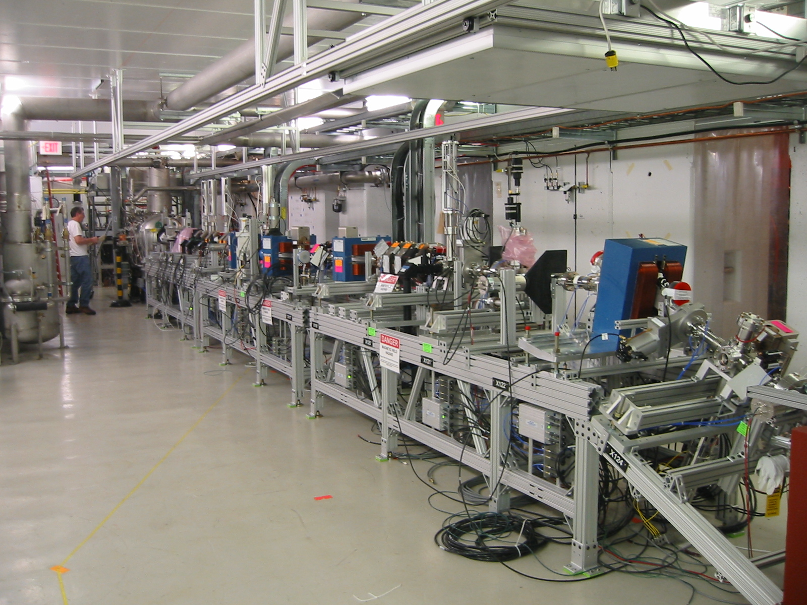

Slide 30
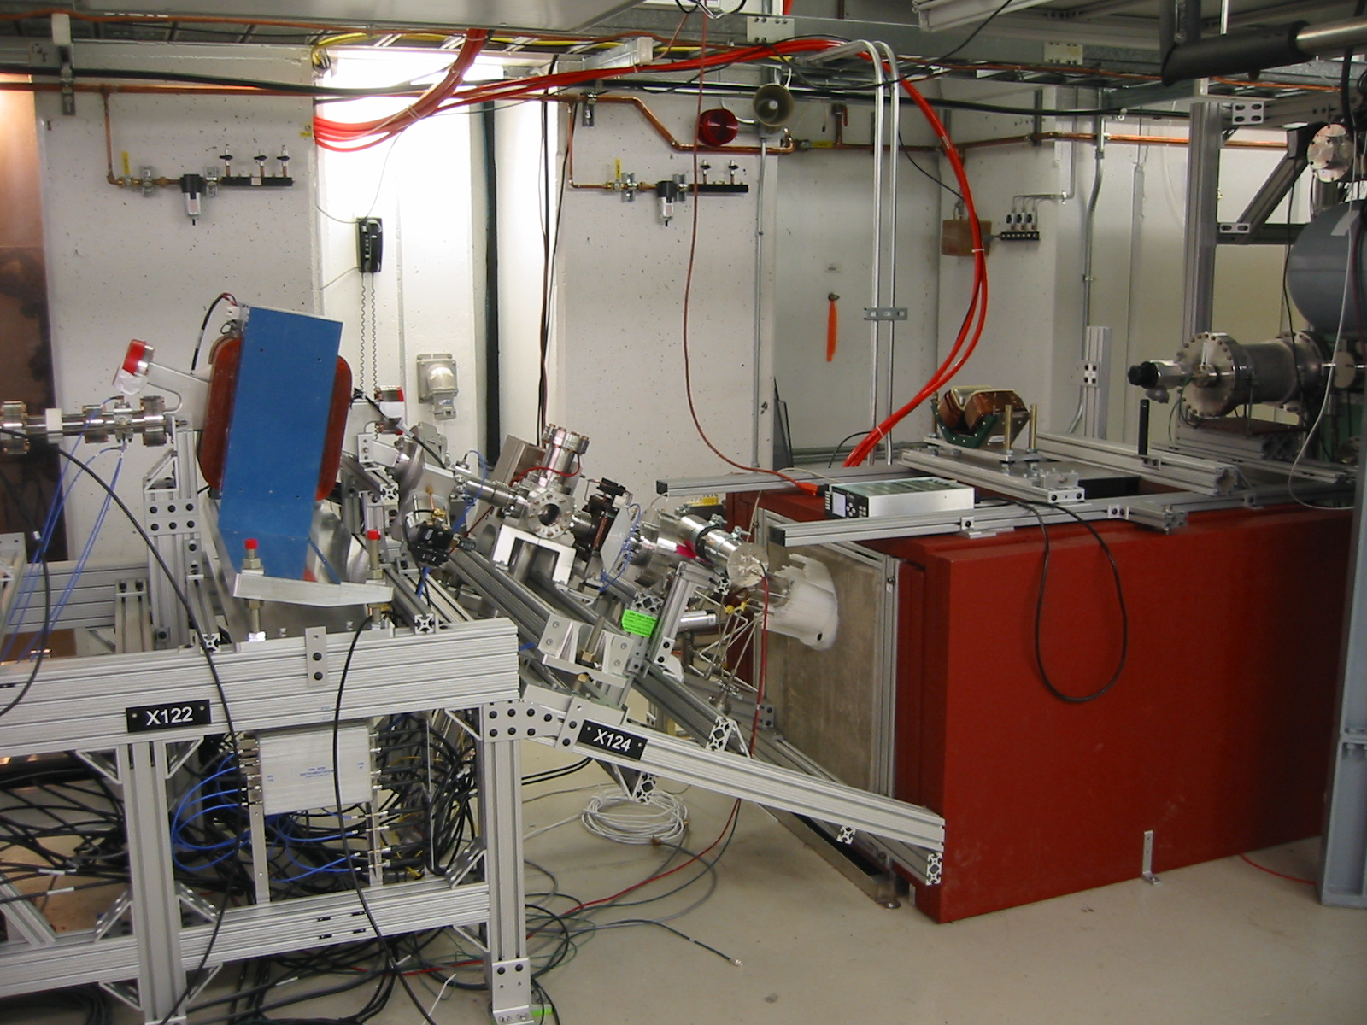

Slide 31
