Slide 1
Beam Diagnostics at PXIE
Vic Scarpine
Nov 12, 2015
2015 PASI Workshop, Fermilab

Slide 2
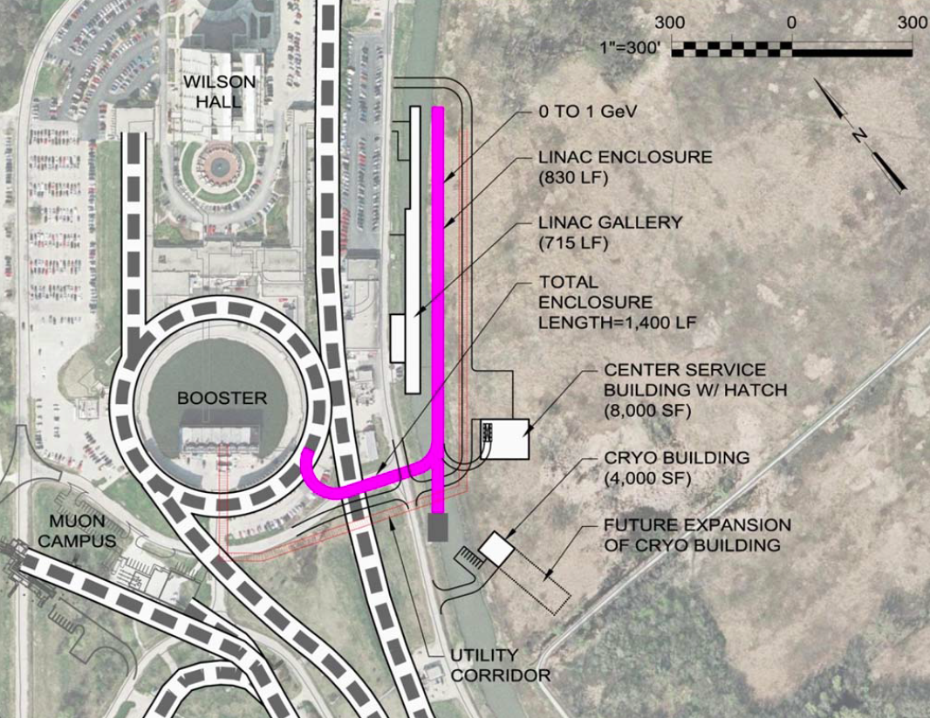
Scope – PXIE and PIP-II
See talks:
“High Power Proton Accelerators: PIP II & III” – E. Prebys
“Overview of PXIE” – L. Prost
The scope of beam diagnostics are to identify and provide the instrumentation systems necessary to successful commission, characterize and operate PIP-II. PXIE is the prototype front-end of PIP-II.
  Present focus is development of instrumentation for PXIE
  PIP-II focus on pulsed operation with an eye toward CW
    Impact on instrumentation choices
PXIE Accelerator instrumentation
sections:
  Ion source & LEBT
  MEBT
  Superconducting linac – HWR, SSR1

Slide 3
PIP-II/PXIE Beam Diagnostic Measurements and Proposed Instruments
Beam current
  DCCTs, Toroids, High-Bandwidth Resistive Wall Current Monitors (RWCM), BPMs
Beam transverse position
  Warm and cold BPMs
Beam energy
  BPM phase, movable BPM (energy)
Beam transverse profiles
  Wire scanners, laser wires, IPM, electron beam profiler, isolated beam scrapers
Beam transverse emittance
  Allison scanner, slit-slit or slit-wire scanners, quadrupole scans
Beam longitudinal profiles
  Fast Faraday Cup, picosecond laser wires
Beam halo
  Vibrating wire, high-gain wires, laser wire, isolated apertures, diamond detectors
Beam loss monitoring
  Ion chambers, neutron detectors, diamond detector
Chopped beam extinction efficiency
  High-Bandwidth RWCM, single (few) particle detection
Large variety of instruments needed for PIP-II
Develop many at PXIE
Green = developed or under development at PXIE
Orange = developed or tested at other Fermilab accelerators

Slide 4
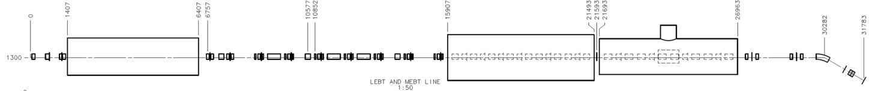
PXIE (PIP-II Injector Experiment)
Now
2016
2017
2018
2018
30 keV
2.1 MeV
10 MeV
25 MeV
RFQ
MEBT
HWR
SSR1
HEBT
LEBT
40 m, ~25 MeV
PXIE will address the address/measure the following:
  LEBT pre-chopping
  Validation of chopper performance
    Bunch extinction, effective emittance growth
  MEBT beam absorber
    Reliability and lifetime
  CW Operation of HWR
  Operation of SSR1 with beam
    CW and pulsed operation
  Emittance preservation and beam halo formation through the front end

Slide 5
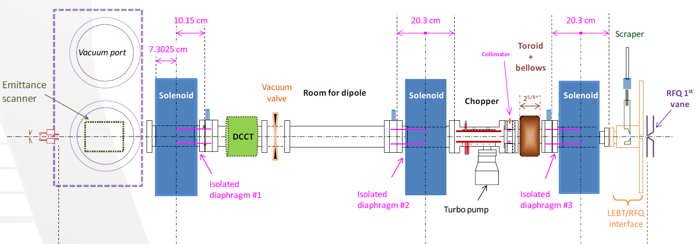
PXIE Source-LEBT Instrumentation
Beam Current
  DCCT
    Unchopped Beam Current
  Toroid
    Chopped Beam Current
  Isolated diaphragms
    Beam tails
    Beam steering
Beam Emittance
Water-cooled Allison Scanner
  Measurements at ion source
  Measurements in LEBT during commissioning

Slide 6
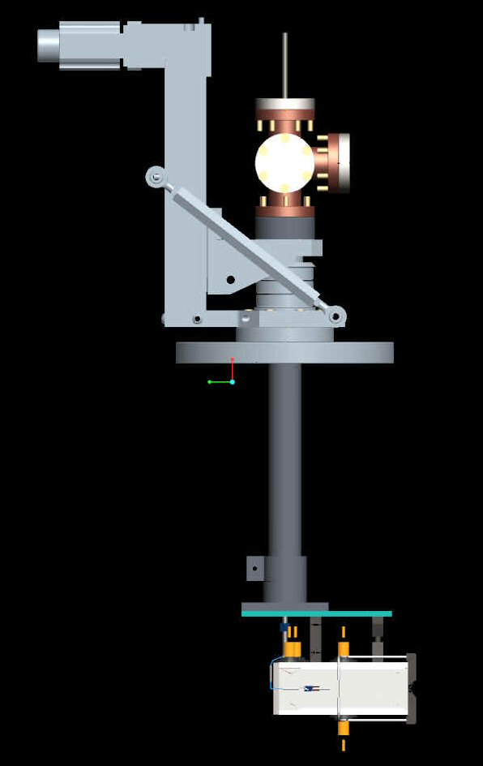
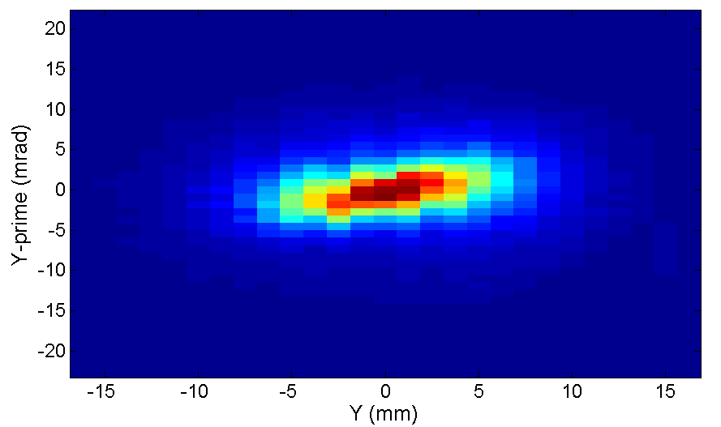
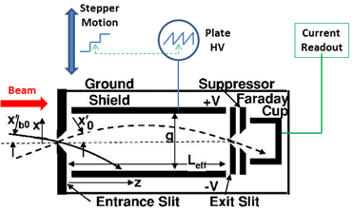
Allison Scanner for Source/LEBT Emittance Measurements
Water cooled Allison scanner – CW operation
Developed in collaboration with SNS
Adjustable entrance slits
Status:
  Installed in multiple locations in LEBT
  Over 1000 phase-space measurements

Slide 7
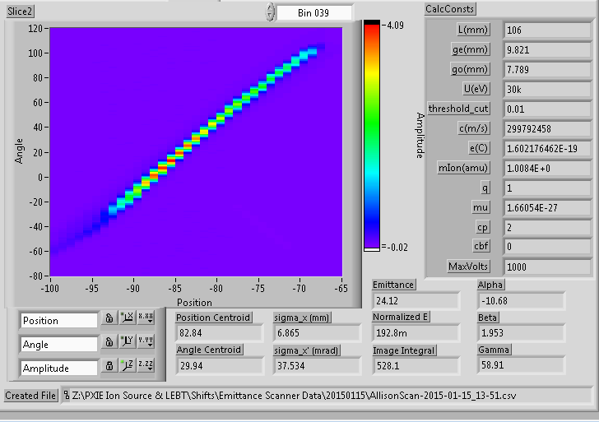
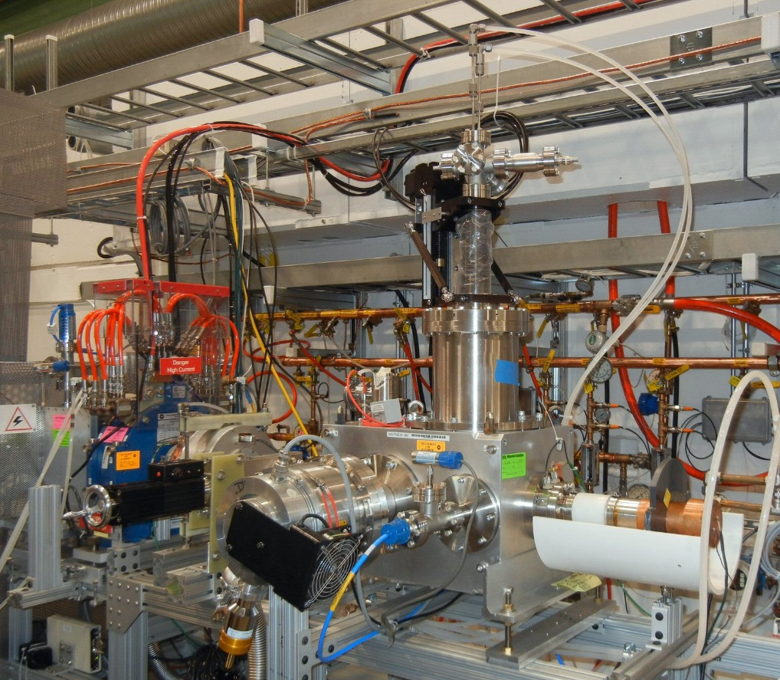
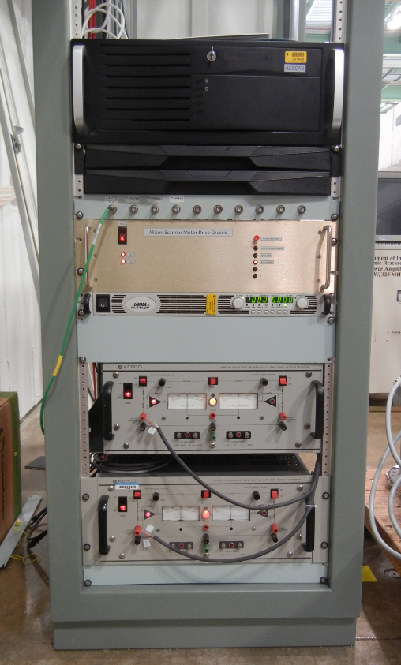
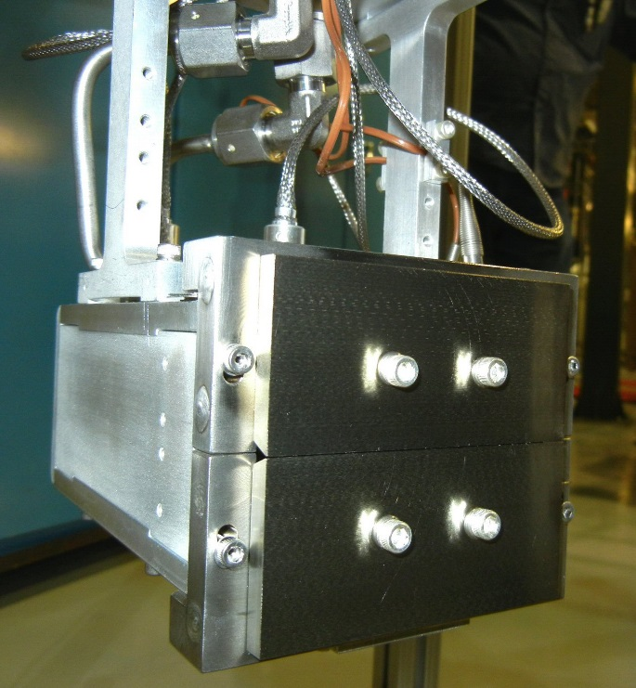
Allison Scanner Installation
Labview-based DAQ and analysis
software
Installation after 1st Solenoid – May 2014
Operated in both vertical and horizontal orientations
    Front-slit made of TZM pressed
    against water-cooled blocks
Electronics rack

Slide 8
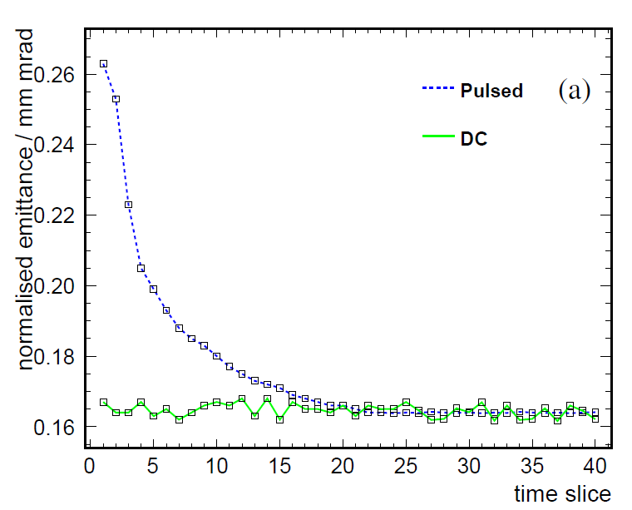
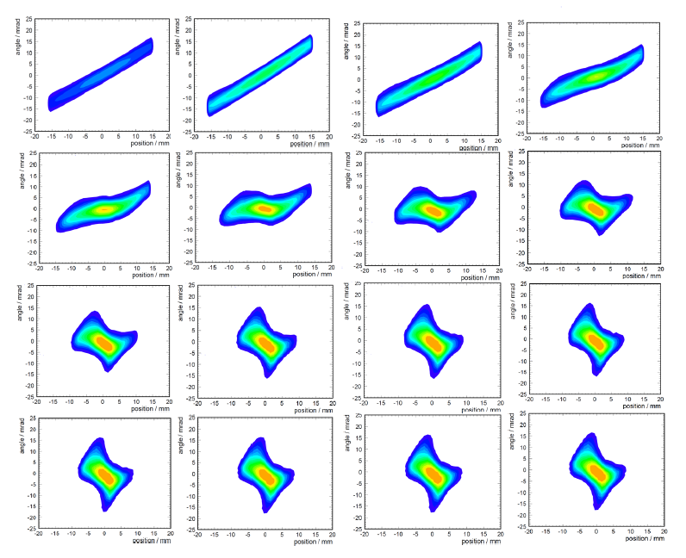
Allison Scanner Measurements
Evolution of phase space in 2 ms, 5 mA beam pulse
Emittance evolution for pulsed versus DC beam. Pulsed beam shows neutralization of H- beam.

Slide 9
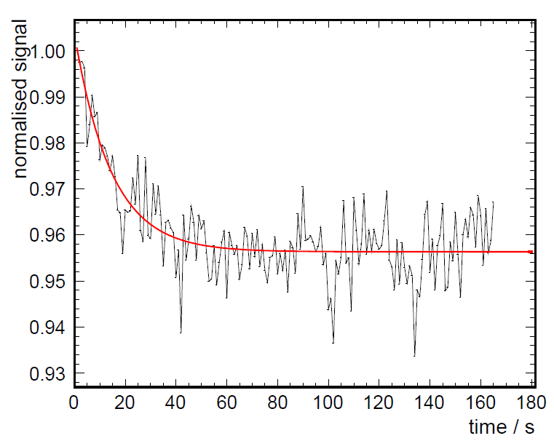
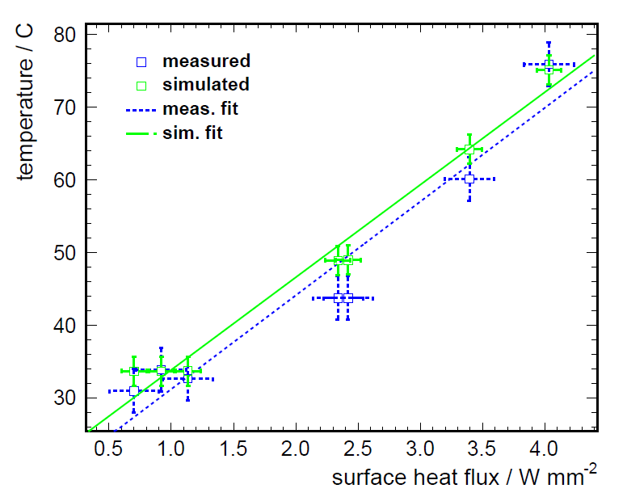
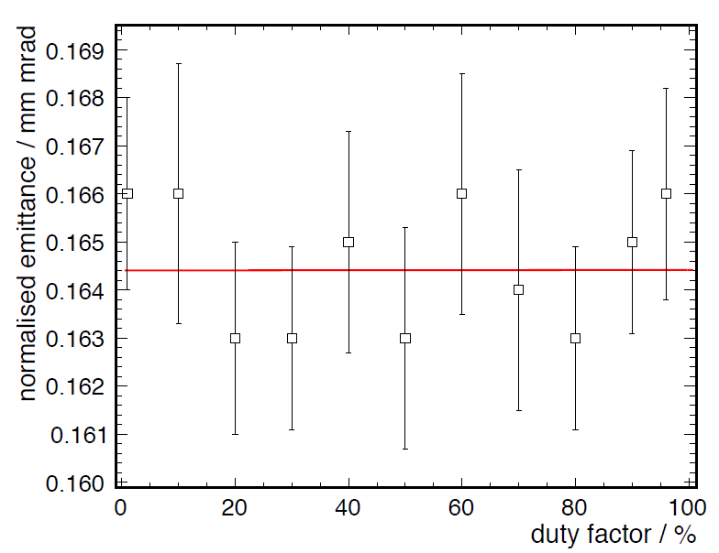
Allison Scanner Thermal Studies
H- signal drop in emittance scanner due to thermal expansion of front slits for DC beam.
Normalized emittance versus beam duty factor
Measured and simulated front slit temperature versus surface heat flux

Slide 10
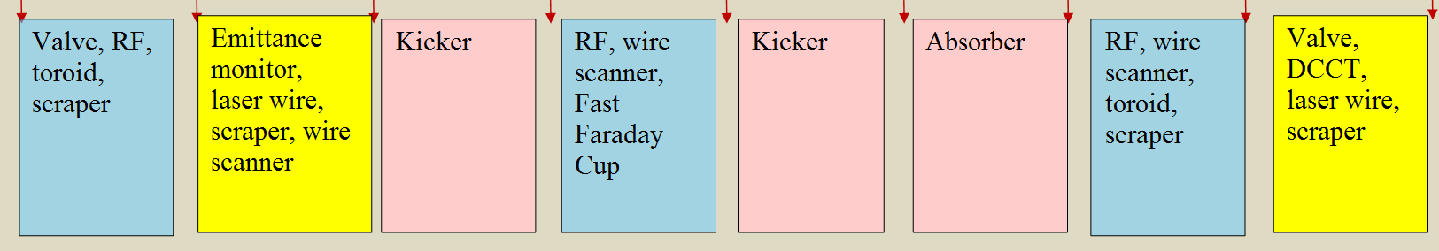
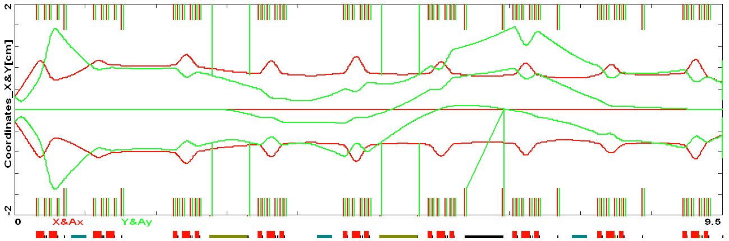
PXIE MEBT Block Diagram
RFQ
HWR
Ion type: H-
Output energy: 2.1 MeV, same as input
Max bunch freq: 162.5 MHz
Operational beam current: 1 – 10 mA
Nominal input beam current: 5 mA
Particles per bunch: 1.8e8 nominal
Bunch extinction: < 1e-4

Slide 11
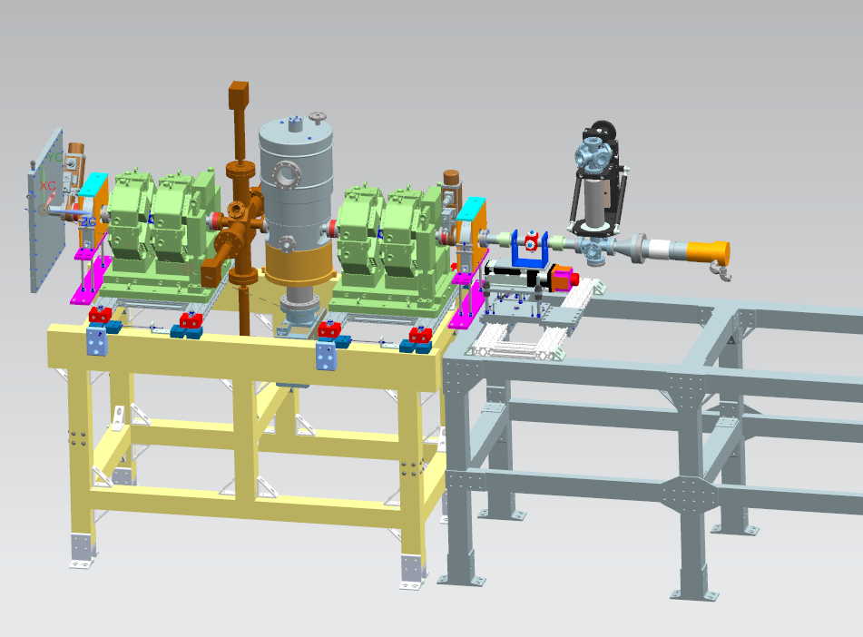
Initial MEBT configuration showing beam diagnostics
Toroid
Scraper/
Profiler
Time
of
Flight
BPM
Fast
Faraday
Cup
BPM
Toroid
RFQ
Faraday Cup
Dump
Ring Pickup –
machine protection

Slide 12
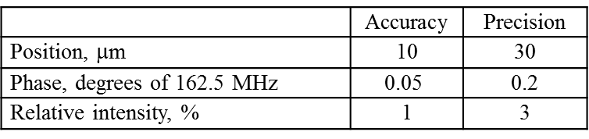
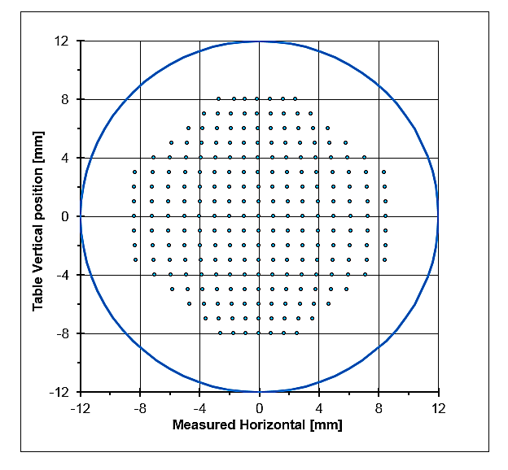
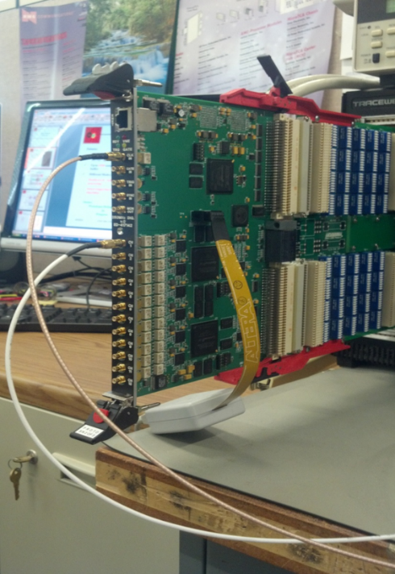
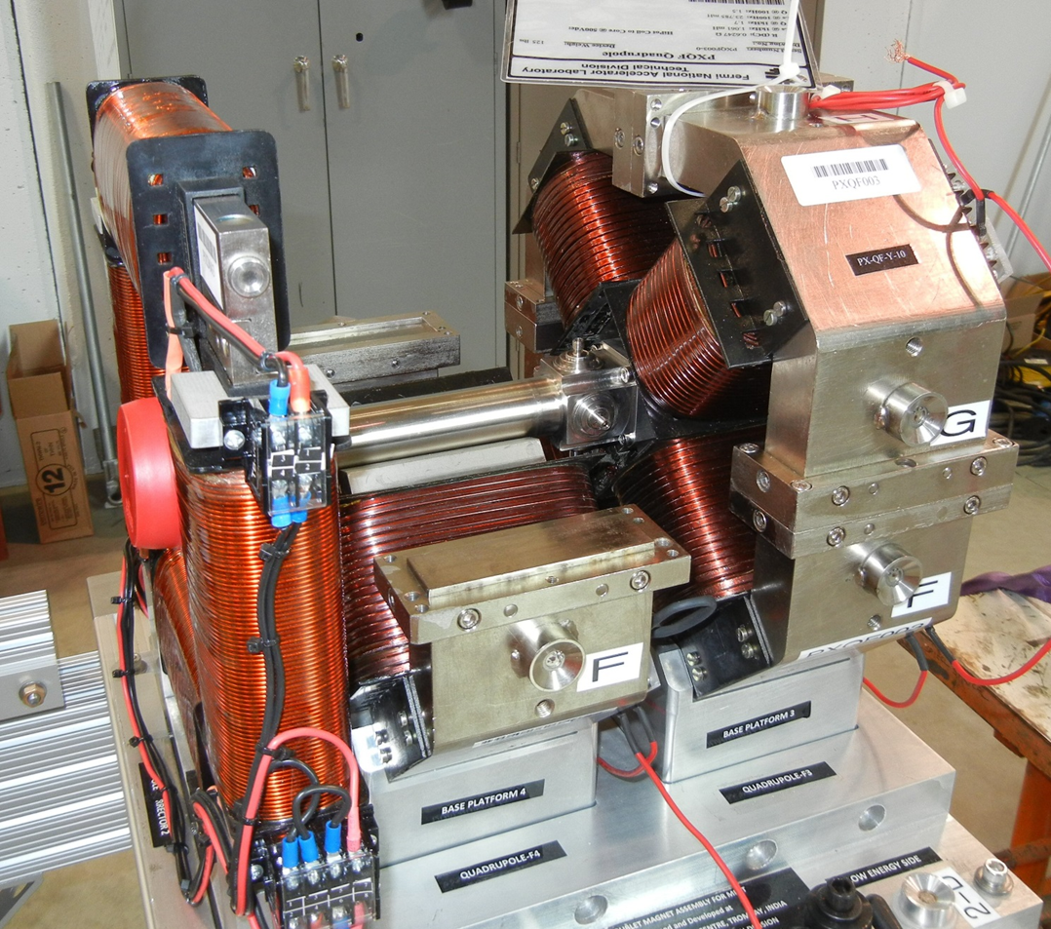
MEBT BPMs
Requirements:
DAQ with FPGA-based electronics for CW and pulsed beam
12 channel boards
14 bits, 250 MSPS
Different operational modes
Adding lock-in synchronous signal detection capability
  For laser wire development
Four button Warm BPM in Quad Doublet
Stretched wire mapping
Simulating low-β corrections

Slide 13
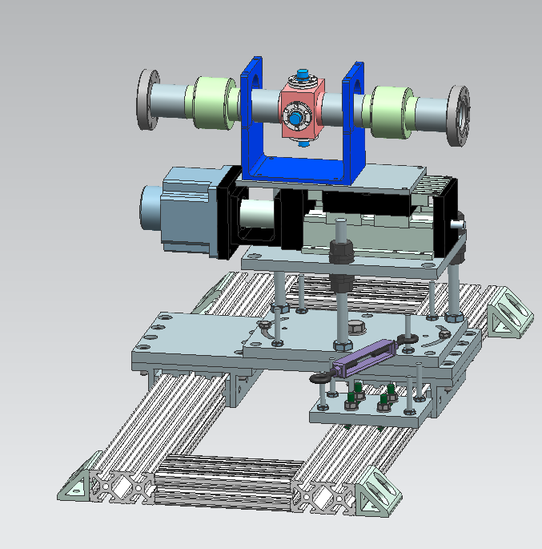
Time of Flight (ToF) Movable BPM
Measure beam velocity via ToF
Utilize movable BPM to minimize systematics
  e.g. BPM response, bunch shape effects
Use BPM on linear stage
  ~ 1” of travel; ~10 μm resolution
  Allows for “continuous” phase measurements
  MEBT energy resolution: 0.1%
Utilize ToF BPM to commission PXIE MEBT

Slide 14
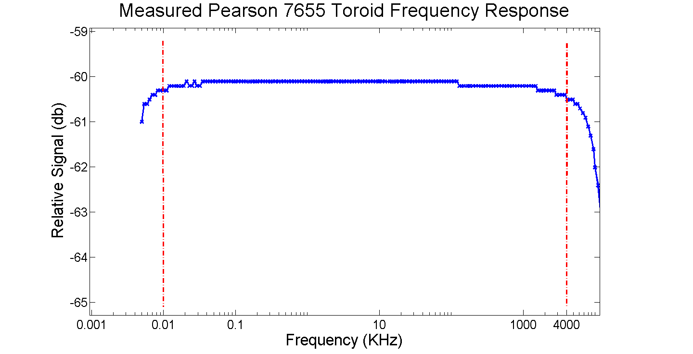
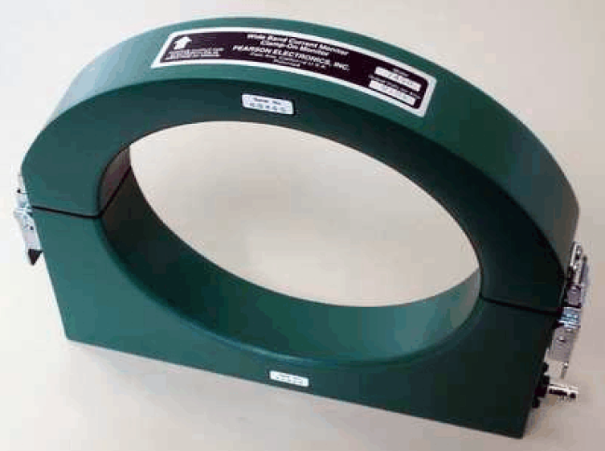
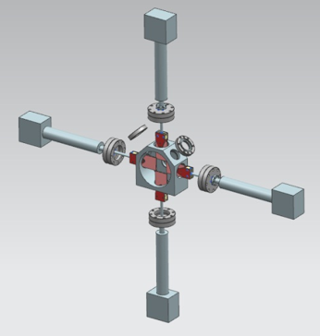
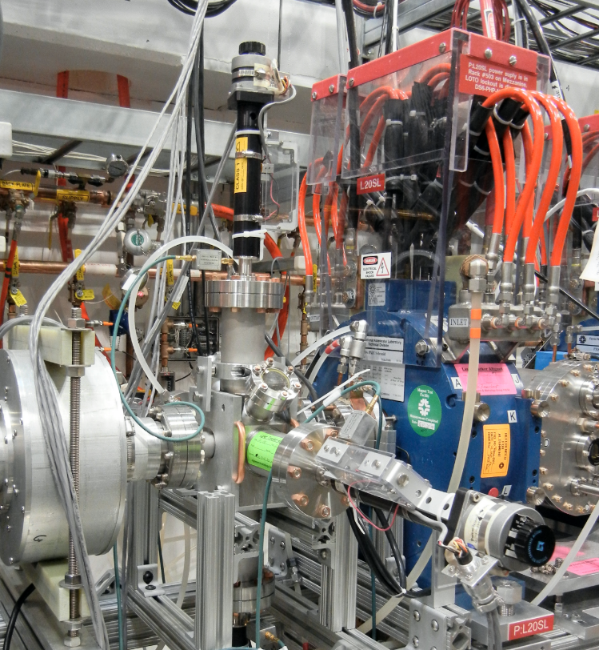
MEBT Beam Current and Profiles
Faraday cup and two toroids
  Pearson 7655 split toroids
    Identical to LEBT toroid
  Signal DAQ thru VME FPGA-based digitizers
Beam profiles via scraper scans
  Scrapers isolated and biased
  Prototype scraper installed in LEBT
  Signal DAQ thru VME FPGA-based digitizers
  Profile reconstruction via Controls application

Slide 15
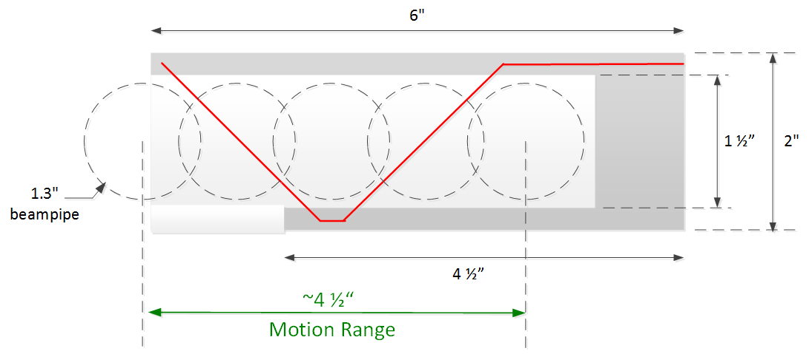
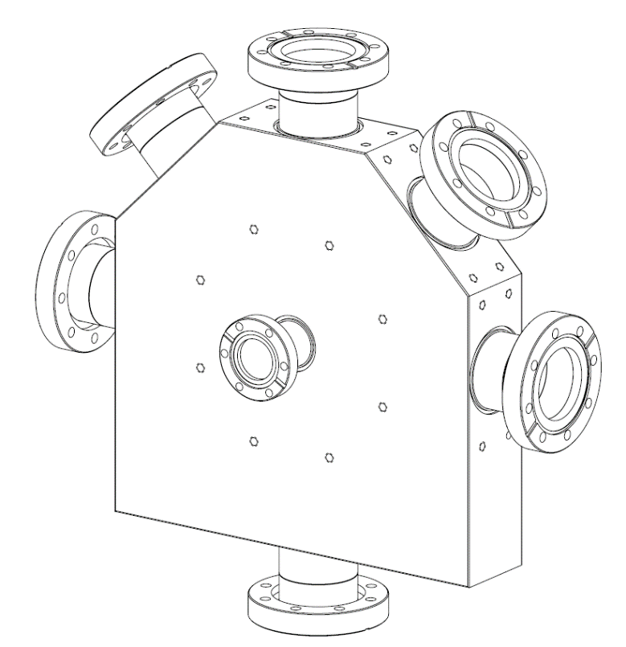
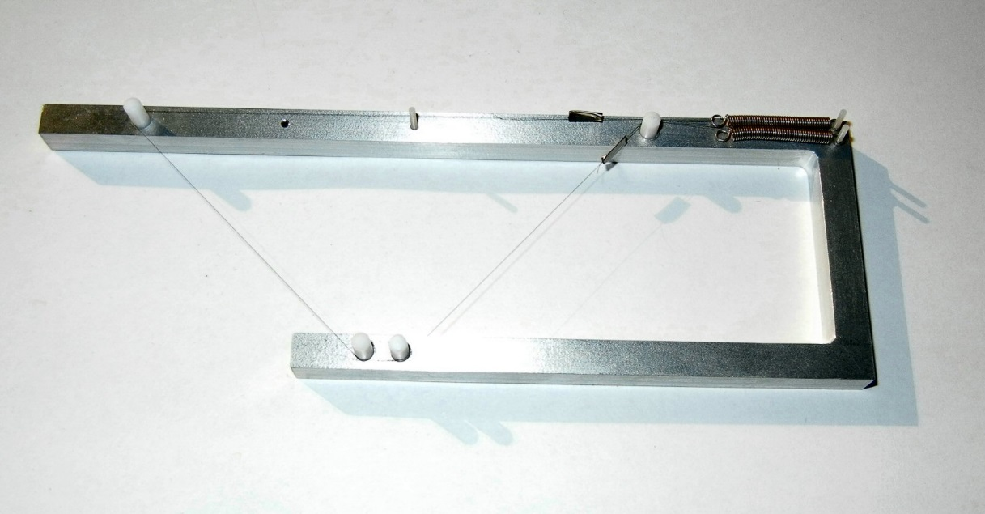
Prototyping Wire Scanner
Developing prototype wire scanner for profile measurements
Test in diagonal port of MEBT scraper
Constructed mock-up to test wire stretching and mounting issues

Slide 16
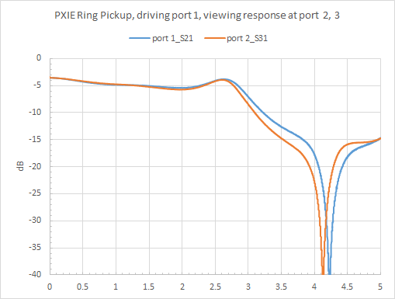
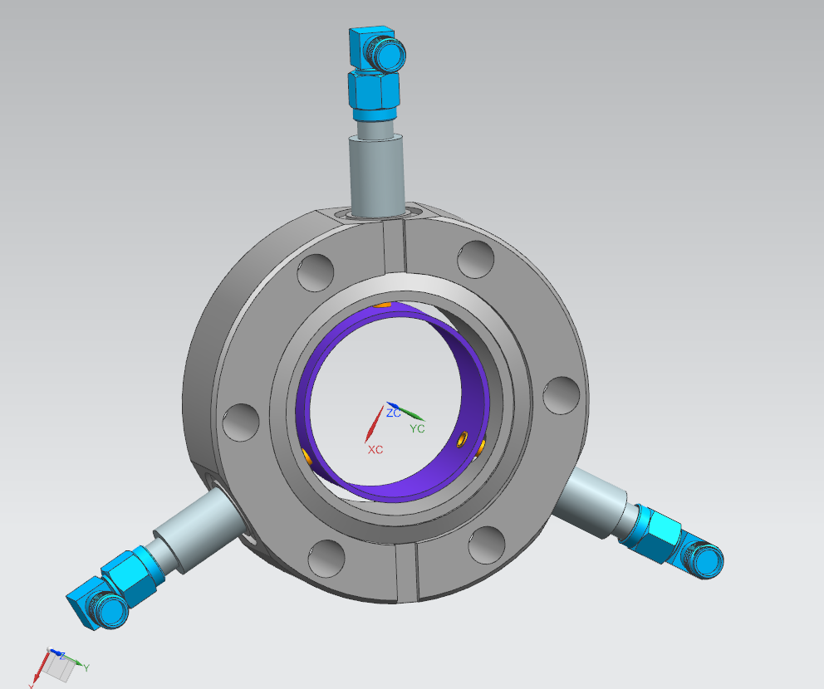
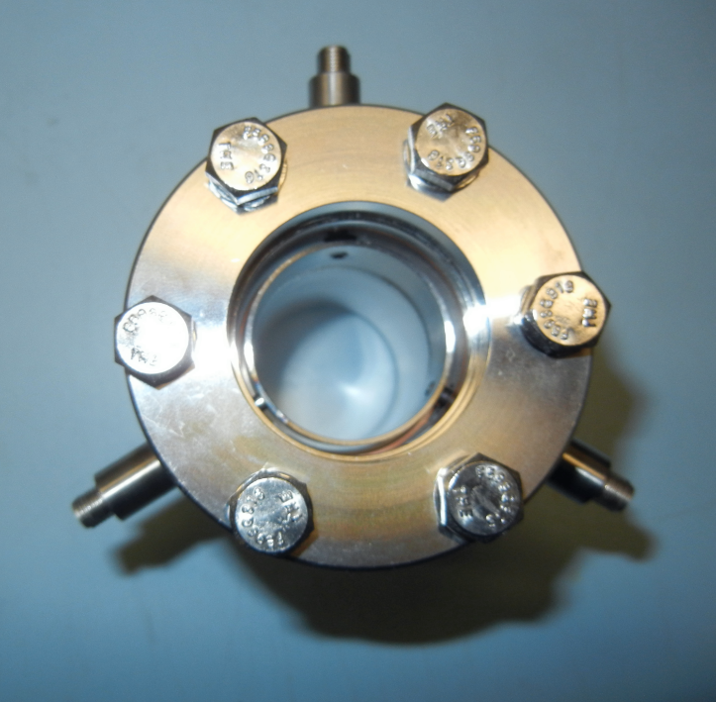
Ring Pickup - Machine Protection
Dedicated ring pickup to measure bunched-beam current
  Wide bandwidth pickup
  Independent of “standard” beam diagnostics
Simple analog circuit to generate beam intensity

Slide 17
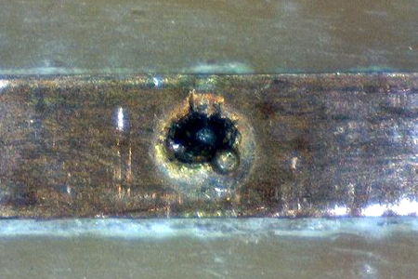
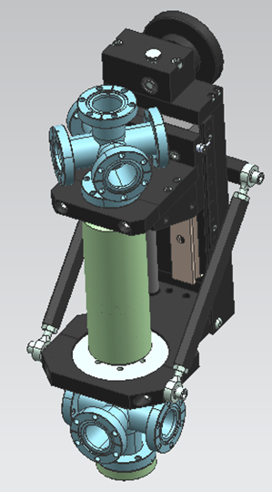
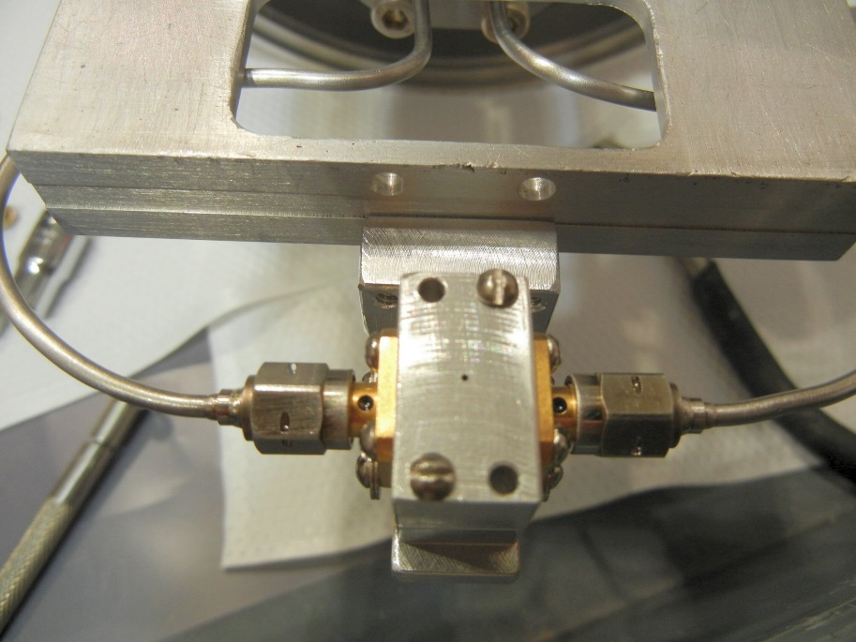
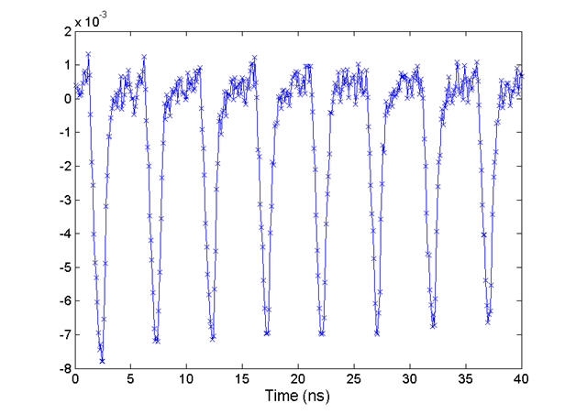
Bunch Length - New Fast Faraday Cup
Embedded 50 Ω stripline – initially designed by SNS
High Bandwidth ( > 6 GHz) – need scope DAQ
  Beam damage at HINS (2.5 MeV protons)
  We are redesigning with better thermal properties
Old model tested at HINS and Linac
Prototype new design tested in PXIE LEBT
Old design - Damage with HINS beam
2.5 MeV protons
5 mA, 200 μs, 1 Hz
Linac MEBT Measurements
New design

Slide 18
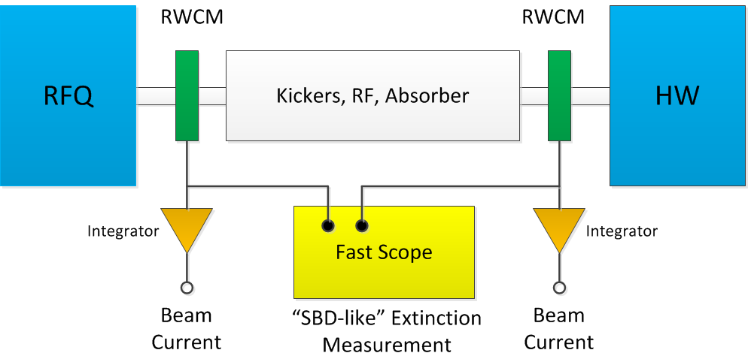
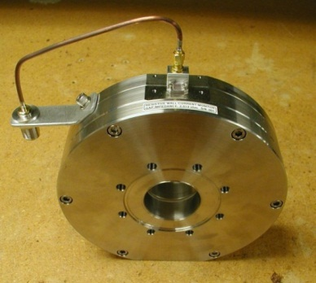
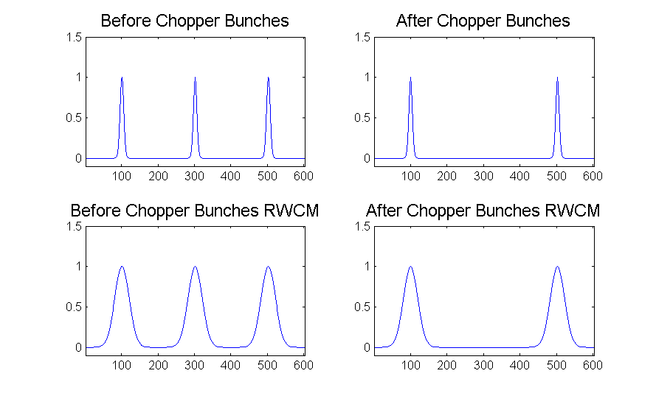
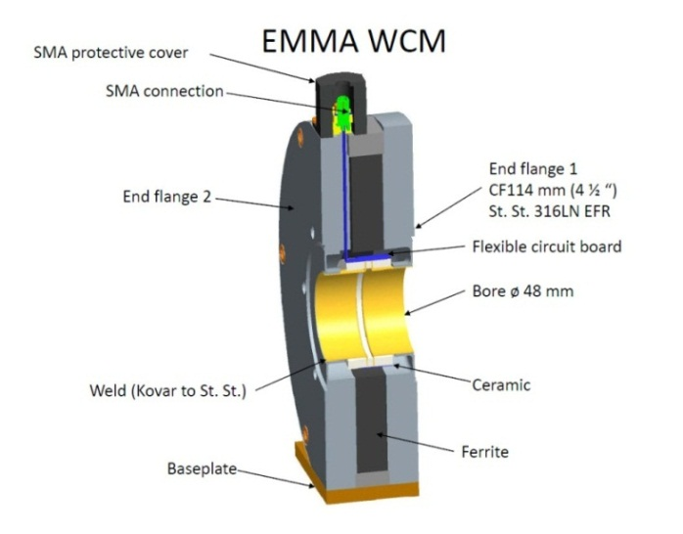
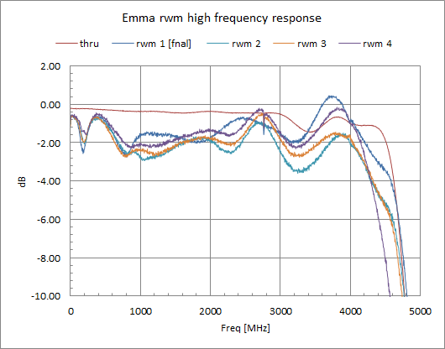
MEBT Chopper Extinction Measurement
Use upstream and downstream Resistive Wall Current Monitors (RWCM)
Extinction -> ‘SBD-like’ monitor
  Average over many bunches
  < 1 Hz BW
  Fits to bunch shape
  Measure impact on adjacent bunches

Slide 19
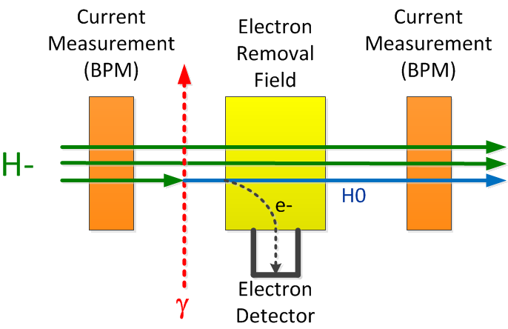
Laser diagnostics R&D
  History of laser diagnostics:
  Transverse profiling with high-power free-space laser and electron collection operational at SNS
  Longitudinal profiling using lower-power fiber delivery system and electron collection demonstrated at SNS
  Transverse profiling using high-power free-space laser and measurement of reduced beam current demonstrated at BNL
  Research goal to demonstrate transverse and longitudinal profiling using lower-power fiber lasers and reduced beam current technique
H⁻ + γ → Hº + e-
Primary Goal: Demonstrate both transverse and longitudinal profile measurements to a sensitivity of 1e-6 using low-power laser through fiber distribution and synchronized detection
Secondary Goal: To understand any technology and systematic effects that would limit achieving primary goal

Slide 20
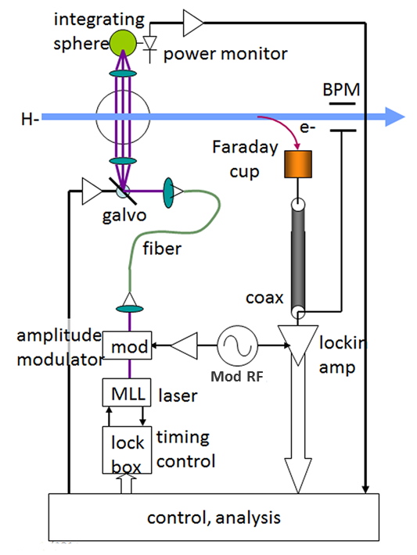
Laser Diagnostics R&D
162.5 MHz, psec mode-locked laser (MML) used to measure both transverse and longitudinal profiles
Laser rep-rate is locked to accelerator RF
Amplitude modulate laser pulses
Distribute modulated laser pulses via fibers
Measure profiles by either:
  Collection of electrons
  Use BPM as reduced-beam intensity pickup
Narrow-band lock-in amp detects modulated signal
H⁻ + γ → Hº + e-
Questions:
What are the noise issues?
What are the power limits in the fiber?
What signal-to-noise ratios and averaging times are practical?
What are the accelerator systematics?
Status
Test system at PXIE - infrastructure development underway
Laser design/development underway
System commissioning end of 2016
R. Wilcox, LBNL

Slide 21
Summary
PXIE LEBT beam instrumentation has been tested during initial source/LEBT beam commissioning
Water-cooled LEBT Allison scanner has proved to be a key instrument
PXIE MEBT instrumentation under various stages of development
  Initial MEBT configuration focusing on commissioning of RFQ
Operation with CW beam proving to be challenging
PXIE provides an exceptional opportunity to develop beam diagnostic instrumentation for high-power H- beams

