Slide 1
Nonlinear proton dynamics in the IOTA ring
Nathan Cook
RadiaSoft, LLC., Boulder, CO
ncook@radiasoft.net
November 12, 2015
Proton Accelerators for Science and Innovation
Fermi National Accelerator Laboratory
This work is supported the US DOE Office of Science, Office of High Energy Physics: DE-SC0011340.
Boulder, Colorado USA – www.radiasoft.net

Slide 2
Collaboration
DOE HEP Phase II SBIR project
Ongoing collaboration between RadiaSoft and Fermilab
This work is supported the US DOE Office of Science, Office of High Energy Physics: DE-SC0011340.
D.L. Bruhwiler& N. Cook& S. Webb& A. Valishev#
R. Nagler& R. Kishek^{&,ψ} E. Prebys# S. Nagaitsev#
&
#
^{ψ}

Slide 3
Outline
Integrable optics at IOTA
Synergia 2.1 for beam dynamics simulations
Nonlinear dynamics in the zero current limit
Higher order terms in the nonlinear Hamiltonian
Variation with H0 and emittance
Correlations between 1st and 2nd invariant
Chromaticity correction schemes
Initial studies of nonlinear dynamics with space charge
Tune depression
Diffusive dynamics and phase space mixing

Slide 4
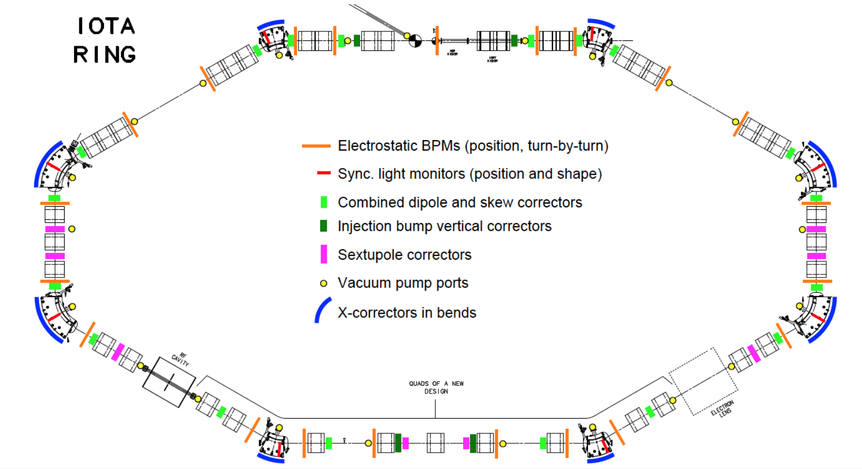
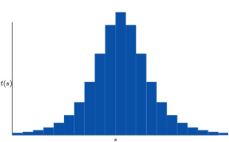
Integrable Optics and the IOTA lattice
Experimental initiative to test nonlinear integrable optics
Danilov & Nagaitsev “Nonlinear accelerator lattices with one and two analytic invariants,” PRSTAB 13, 084002 (2010)
Use of special nonlinear magnet can result in a 2nd invariant of motion, completely integrable dynamics
Single particle trajectories are regular and bounded
Mitigate parametric resonances via nonlinear decoherence
A. Valishev, “IOTA - A Brief Parametric Profile,” presented at Focused Workshop on Scientific Opportunities in IOTA (Batavia, April, 2015); http://asta.fnal.gov/IOTA/IOTAmeeting/IOTA_Short.pdf

Slide 5
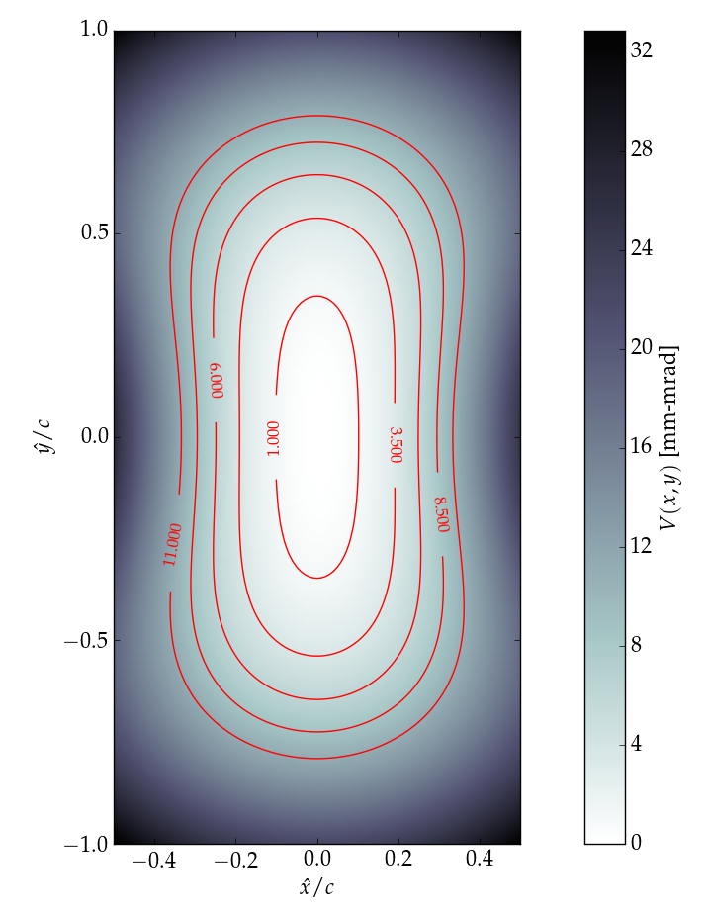
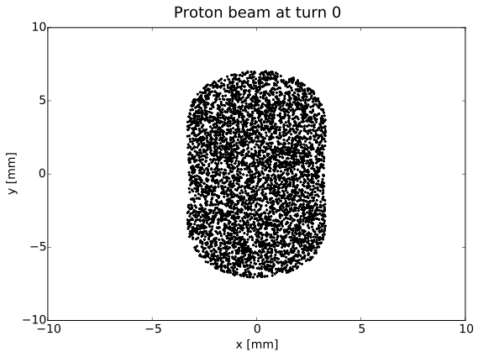
Bunch matching with the nonlinear lattice
Danilov & Nagaitsev derived potential which produces Hamiltonian with two analytic invariants
Vary magnetic field strengths to obtain order unity tune spread
Symmetric motion through NL section preserves integrability
A generalized K-V distribution with fixed H demonstrates shape

Slide 6
Beam dynamics with space charge via Synergia 2.1
James Amundson, Qiming Lu, Alexandru Macridin, Leo Michelotti, Chong Shik Park, (Panagiotis Spentzouris), Eric Stern and Timofey Zolkin
Accelerator Simulation Group
Computer time from INCITE
Funded by DOE
Slide courtesy of James Amundson | Advancing Particle Accelerator Science with High Performance Computing
11/12/15

Slide 7
Synergia 2.1 Overview
Capabilities include:
symplectic tracking for single particle dynamics
PIC (validated with GSI space charge benchmark)
dynamic lattice element adjustments
Fit tunes or chromaticities to desired values
Construct arbitrary 6x6 matrix elements
New capabilities added by RadiaSoft:
bunch matching with arbitrary distributions
interactive simulations with an IPython notebook
Thanks very much to the Synergia development team, from the Accelerator Simulation group within Fermilab’s Scientific Computing Division!
Especially: J. Admundson, E. Stern, C.S. Park, L. Michellotti, and P. Spentzouris

Slide 8
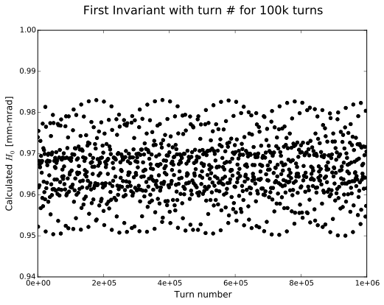
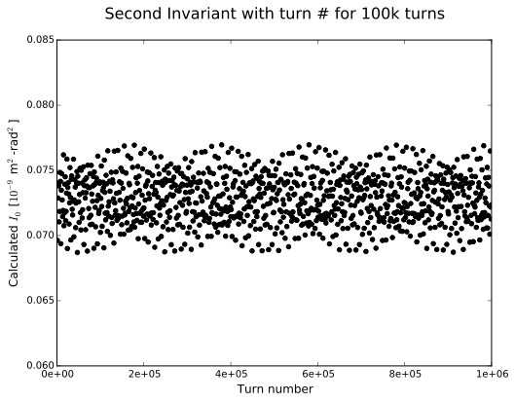
Initial simulations - 100k turns with NL element
Tracking matched proton bunch in lattice
Generalized KV distribution with fixed H0
𝜀x = 0.03 mm-mrad normalized emittance
𝛿 = 0% — no variation in particle energy
Resulting variation is consistent over 100k turns
𝜎H = 1.07%, 𝜎I = 2.56% for the particle shown below
Periodic variation which appears bounded

Slide 9
Higher order terms in the Nonlinear Hamiltonian
Original analysis computed the single turn map for the ideal integrable optics lattice
Expansion of the Hamiltonian lowest order correction to H in 𝜈0, the “tune-advance” through the nonlinear drift
The leading order correction to the ideal Hamiltonian H0 scales with 𝜈0³, thus implying a variation in H from the first order estimate H0

Slide 10
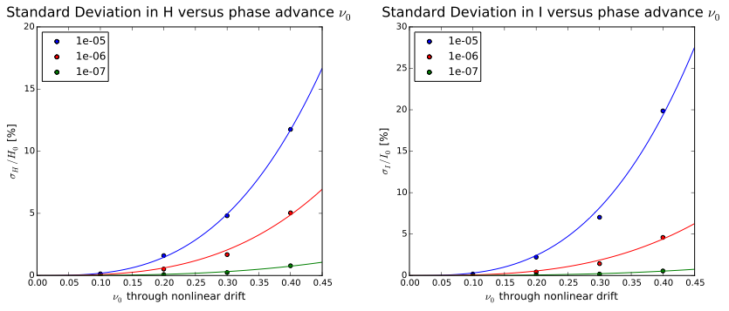
Variation in the first invariant - H0
Simulated a toy-model IOTA lattice, comprised of a nonlinear element followed by a corresponding 6x6 matrix representing a thin double-focusing lens.
Variations of the nonlinear element with different 𝜈0 are calculated using a MADX script

Slide 11
Variation in H0 with increasing emittance
Greater variation in H0 with increasing emittance — coefficients in the expansion of the Hamiltonian vary with 𝜀³.
Ex. For a NL segment with 𝜈0 =0.3, a KV distribution with H0 = 10 mm-mrad demonstrates an average r.m.s. variation of 5% in calculated value of of H0.

Slide 12
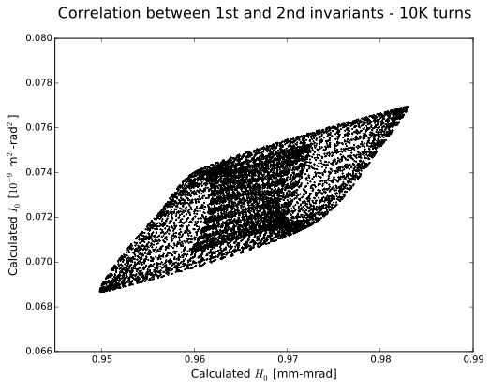
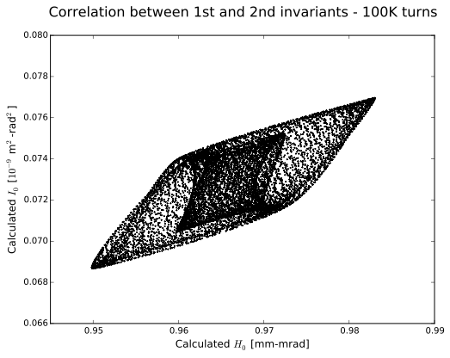
Higher order correlations between H and I
Turn by turn variation observed over many turns
Variations appear bounded and well behaved
Suggestive of some surface relating to a new invariant
Can we calculate this hyper-surface?

Slide 13
Chromatic Considerations in IOTA
Tests performed for matched bunches with energy deviations 𝛿 ≤ 0.5%, with and without chromaticity correction
Simulations of chromaticity corrected lattice
Beam loss observed (4%) even for a bunch with 𝛿 = 0.1% and a normalized emittance of 𝜀x = 0.03 mm-mrad
Invariant clearly not preserved - 𝜎H > 15%
As 𝛿 approaches 0.4%, the majority of the beam is lost
Uncorrected lattice retains better single particle dynamics
For 𝛿 = 0.1%, no particle loss and 𝜎H ≈ 10%
Conclusion: Off-energy particles in IOTA are more sensitive to sextupole fields than to natural chromaticity of the lattice.

Slide 14
Chromaticity Correction Schemes
For realistic energy spreads, chromaticity significantly perturbs integrable motion
Recent work by Webb et al. presents a chromaticity correction scheme which preserves integrability
Require equal horizontal and vertical chromaticities Cx = Cy
Sextupoles must be optically transparent (𝛿φ = (2n +1)𝜋 )
Recover normalized Hamiltonian with adjustment to nonlinear strength parameter, t
Complete correction may not be needed!
Carefully placed sextuples at low strength may correct for energy spread
Current work aimed at adjusting IOTA-1IO design to meet these requirements for basic testing

Slide 15
Initial simulations with space charge
Lattice Parameters:
Iota v6.6 lattice with a single NL magnet
zero sextupole strength, zero RF
CHEF propagation of all lattice elements, 4 slices per element
Nonlinear strength parameter t = 0.4
Nonlinear aperture parameter c = 0.01 m^{1/2}
diagnostics at center of NL magnet
Space Charge parameters:
2D open solver with 64x64 mesh, periodic in z
100 particles per cell
Proton beam parameters:
2.5 MeV protons, matched at center of NL element
dp/p = 0, to minimize chromatic effects
generalized KV distribution with first invariant H₀ = 9.74 mm-mrad
corresponds to 𝜀x,n = 0.3 mm-mrad, and 𝜀y,n = 0.6 mm-mrad

Slide 16
Space charge tune shift in IOTA
Linear lattice with zero current
tunes are equal and vary weakly with amplitude
Qx = Qy = 0.3
Nonlinear lattice with zero current
tunes are asymmetric and vary strongly with amplitude
Qx = 0.403 Qy = 0.232 (very near the axis)
With space charge, tune varies orbit to orbit
Compute incoherent tune shift
Compare against single particle orbits
Observe dQx ~ dQy (near axis)
evidence of strong coupling in x and y

Slide 17
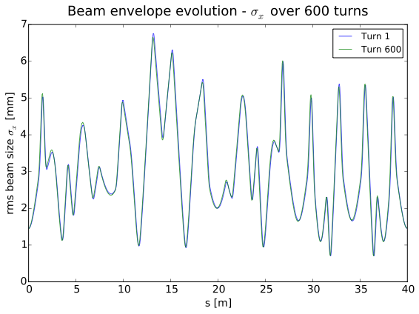
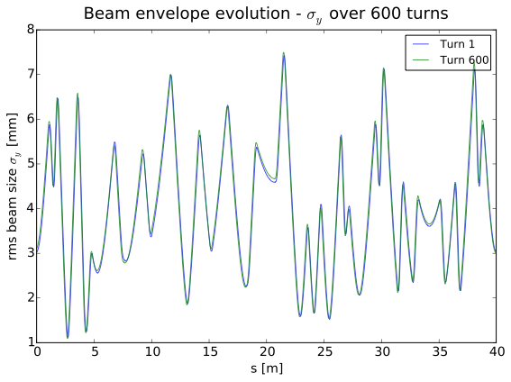
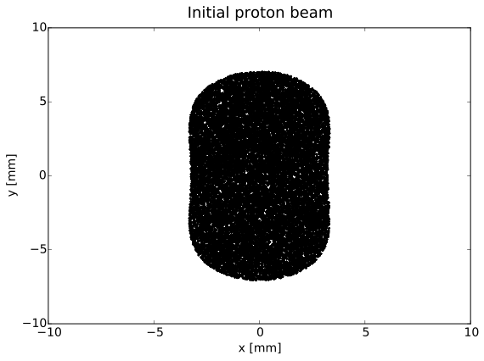
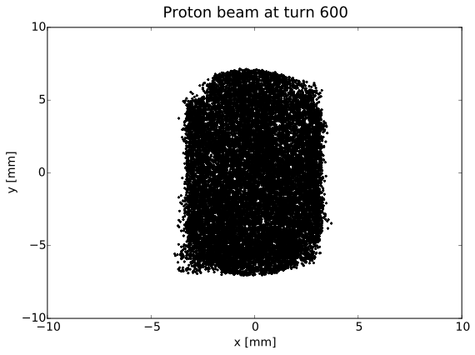
Beam evolution at dQ = -0.01 IOTA lattice

Slide 18
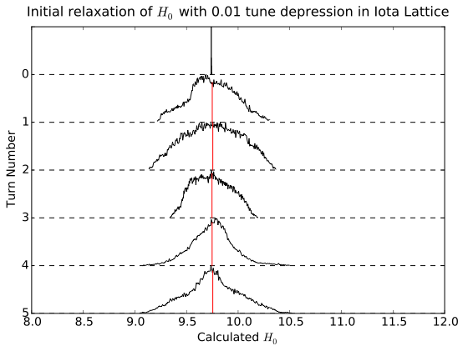
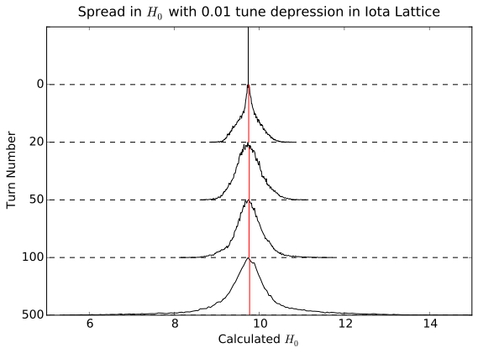
Particle dynamics - Equilibration and diffusion
Mixing on the scale of 1 turn
t = 0.4 is rather large, so tune spread leads to fast mixing
Diffusion varies with H0
consistent at median values
strong tails at large H0

Slide 19
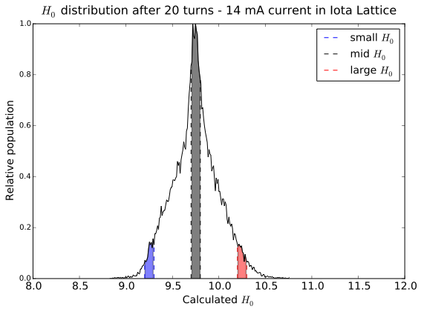
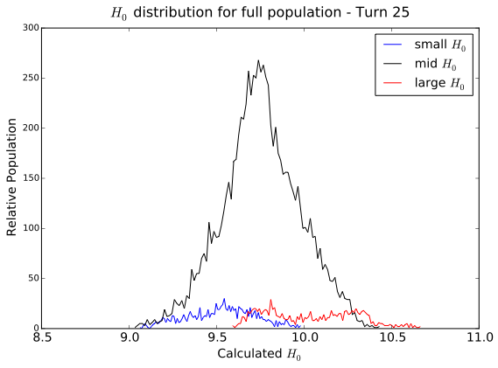
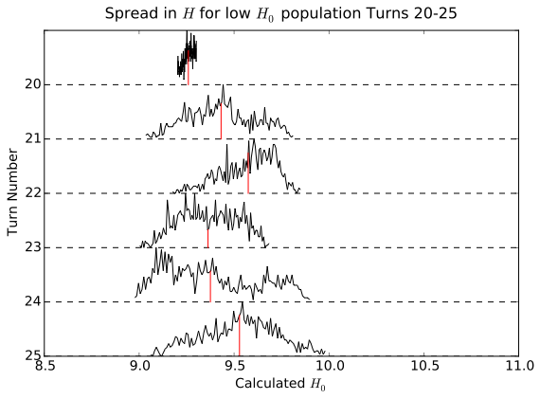
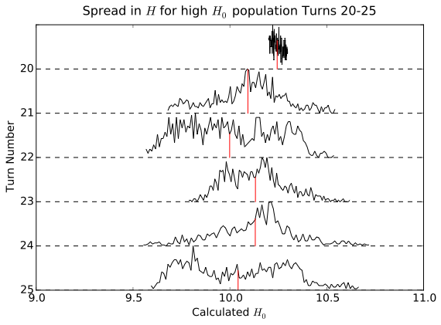
Dependence of diffusion on H0

Slide 20
Conclusions
Simulated IOTA lattice with segmented NL element
Invariants appear well behaved over 1 million turns
Higher order contributions of NL magnet at zero current
Variation in the invariants scales with 𝜈0³ and 𝜀³
Large energy spread breaks integrability
Dynamics are especially sensitive to sextupole fields
Initial simulations with space charge
Tune depression appears to break integrability
But there may be other nearby invariants
Look for bounded behavior to retain nonlinear decoherence
Operation at modest currents will likely require adjustments to the magnets surrounding the integrable optics insert

Slide 21
Future Work
Understand dynamics with space charge
Investigate single particle dynamics with low nonlinearity
Adjust lattice incrementally to recover integrability
Calculate diffusion coefficient in perturbative regime
Implement chromaticity correction scheme
Optically transparent sextuples to equate chromaticities
Optimize dynamic aperture
Simulate wakefields in IOTA
Quadrupolar term along vertical axis may limit peak current
Simulate injection of matched beam
Consider machine perturbations
misalignments and mismatches

