Slide 1
Proton Therapy in the UK
Karen Kirkby
University of Manchester
Christie NHS Trust

Slide 2
Clatterbridge
The UK has the world’s first hospital based proton centre at Clatterbridge
20 years of experience
Low energy, treats predominantly eye tumours
Very sucessful

Slide 3
UK proton therapy
2 NHS Centres
London (UCLH) and Manchester (Christie)
Indications list
£250m
Varian – 3 360 Gantries
1500 patients per annum (1%)
Oxford £110m HEFCE + private investment
Pro Nova
Research, trials; 750 patients per annum?
Private providers YAPC
Proton Partners – IBA single room
700 patients per annum?
AVO……..

Slide 4
Benefits of protons
  Superior dose distribution
Notes:
Ed

Slide 5
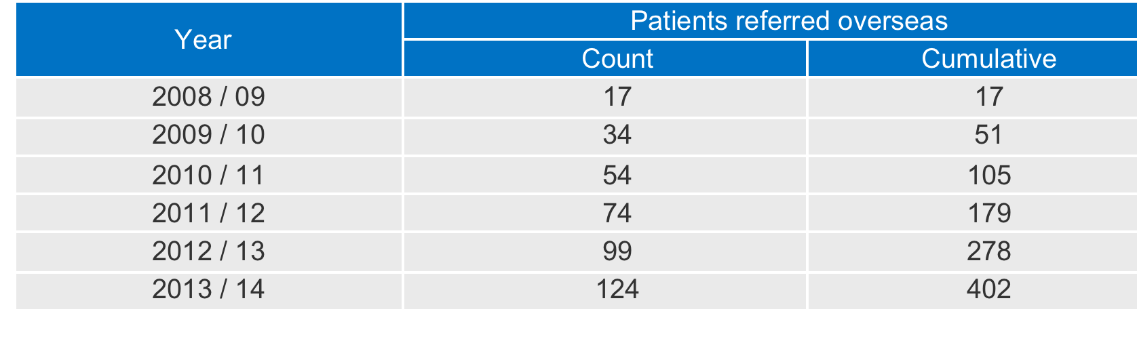
Overseas Programme Activity

Slide 6
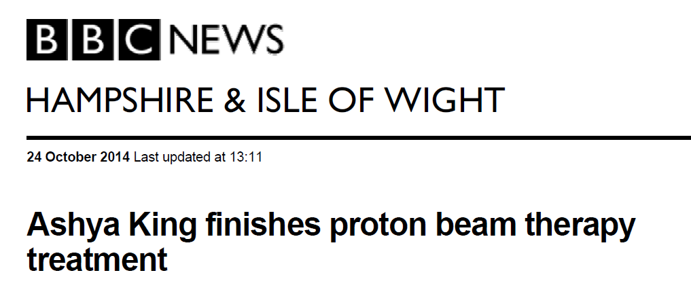
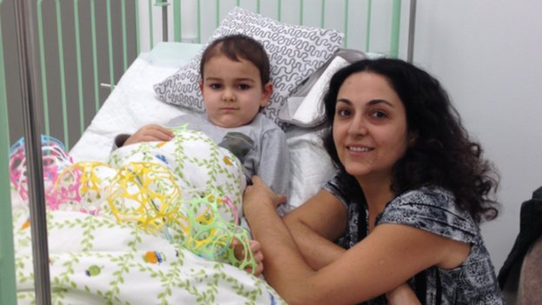
Notes:
Ed

Slide 7







Slide 8
PBT Activity per UK centre
(Anticipate changes)
Disease Group | Diagnosis
Paediatric | Paediatric
 | True paediatric type cancers not serviced by adult site specialists (TYA)*
H&N | Advanced H&N (TYA)*
 | Advanced H&N
 | Oropharyngeal Ca (CtE)***
 | Nasopharyngeal Ca (CtE)***
 | Re-Treat rT1/2 N0 (CtE)***
Base Of Skull CNS | Chondrosarcoma (TYA)*
 | Chordoma
 | Chondrosarcoma**
 | Chordoma (TYA)*
 | Meningioma (TYA)*
 | Adult Craniospinal (TYA)*
 | Meningioma
 | Adult Craniospinal
Sarcoma | Spinal/Paraspinal Sarcoma (TYA)
 | Orbital/Skull Base Sarcoma NOS (TYA)
 | Spinal/Paraspinal Sarcoma
 | Orbital/Skull Base Sarcoma NOS**
Breast | Breast Cancer (TYA)*
 | Breast Ca Lt/inner quadrant (CtE)***
 | Int mammary node N3 (CtE)***
Gynaecology | Selected Gynae Cancers) (TYA)*
 | Ca Cx nodal disease (CtE)**
 | Advanced Vaginal Ca (CtE)***
GI | Ano-Rectal cancer (TYA)*
 | Recurrent Ano-Rectal Ca (CtE)***
 | Oesophageal Ca (CtE)***
Lung | Lung Ca St3 (CtE)***
 | Mediastinal rare e.g. Thymoma (CtE)***
Lymphoma | Lymphoma (TYA)*
 | Hodgkins/Non-Hodgkin mediastinal <50yo (CtE)***
Urology | Seminoma (TYA)*
Core Indications
Evaluative (CtE)

Slide 9
          Progress to date
Competitive process launched to identify Trusts
DH’s Strategic Business Case approved
Draft Appointment Business Case - approved
Final Business Case - approved
Christie & UCLH selected as two preferred sites
Outline Business Case approved
Varian -preferred supplier
2009 | 2010 | 2011 | 2012 | 2013 | 2014 | 2015

Slide 10
Indicative timeline
Notes:
Ran

Slide 11
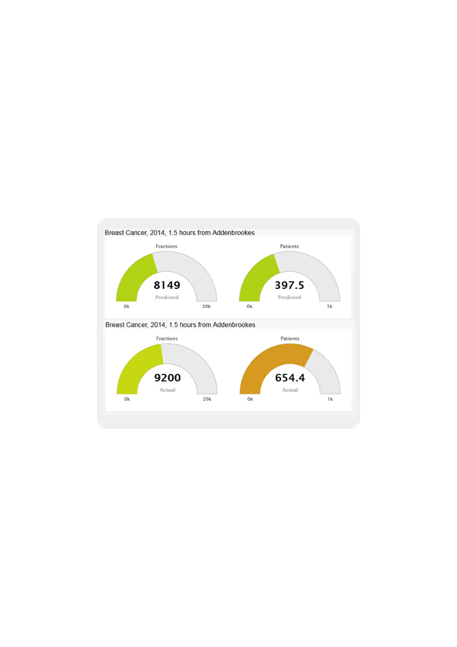

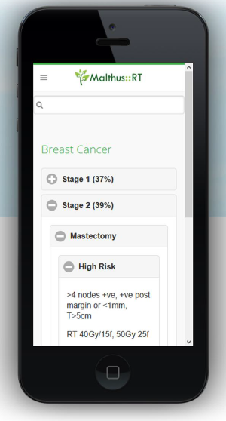
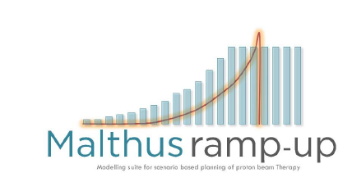
Decision tree model commissioned by NCAT and developed by Raj Jena (Cambridge) and Norman Kirkby and Tom Mee (Manchester) to predict demand for photon radiotherapy
Being developed for proton ramp-up
and proton therapy

Slide 12
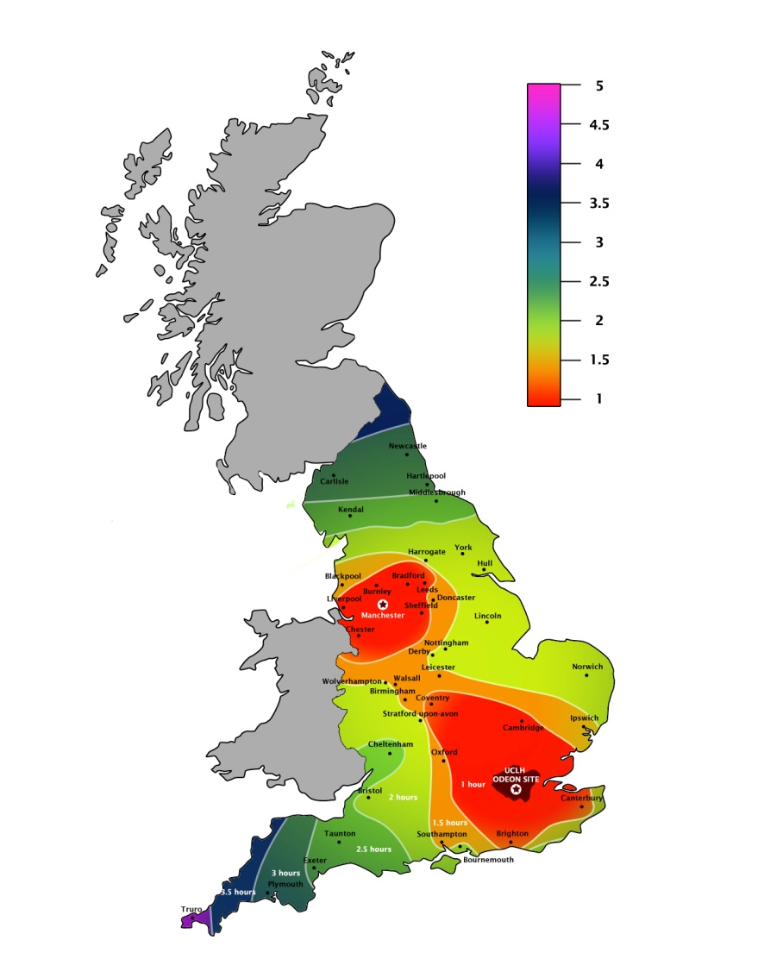
NHSe commissioned provision
  Care within a wider NHS setting
    Mostly rare tumours/inidications
    Complex pathway management
    Comprehensive outcomes analysis
      Core and evaluative indications
    Established research environment
  Care within established Cancer Centres
    Protons - 3 Gantries, 360º
    Advanced photon capacity
    Comprehensive support services
      Paediatric/TYA/Adult
      Acute care
      Diagnostics
      Chemotherapy
      Patient Support
      Academic/Research environment
      Accommodation

Slide 13
Christie NHS Foundation Trust

Slide 14
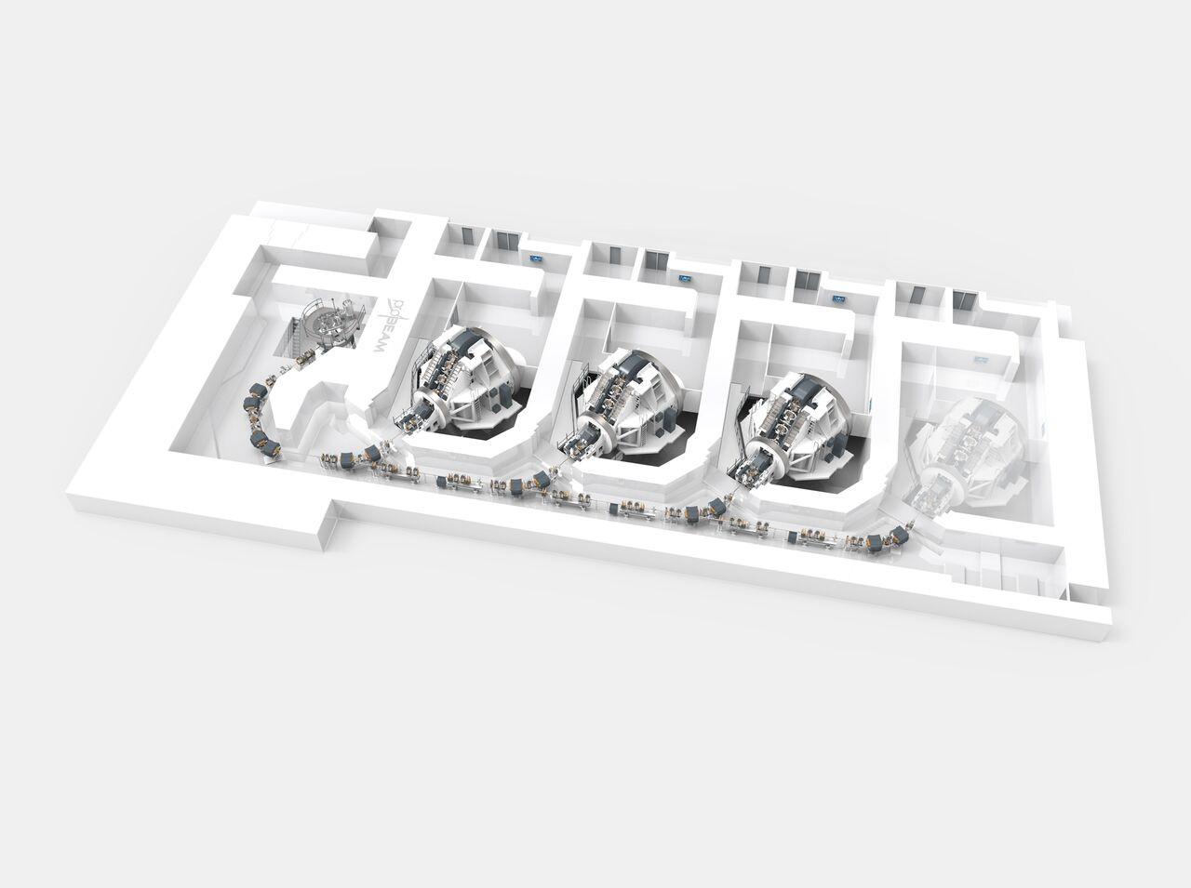

Slide 15
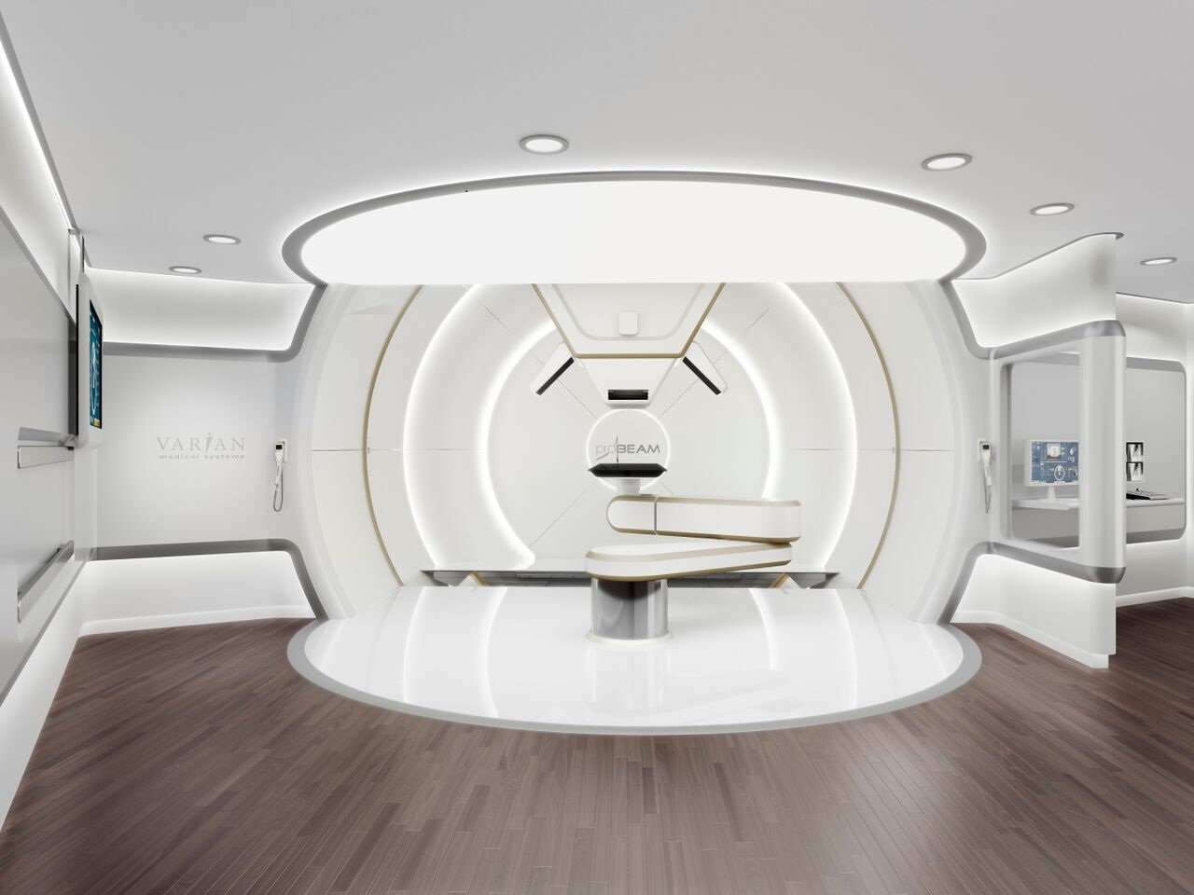

Slide 16
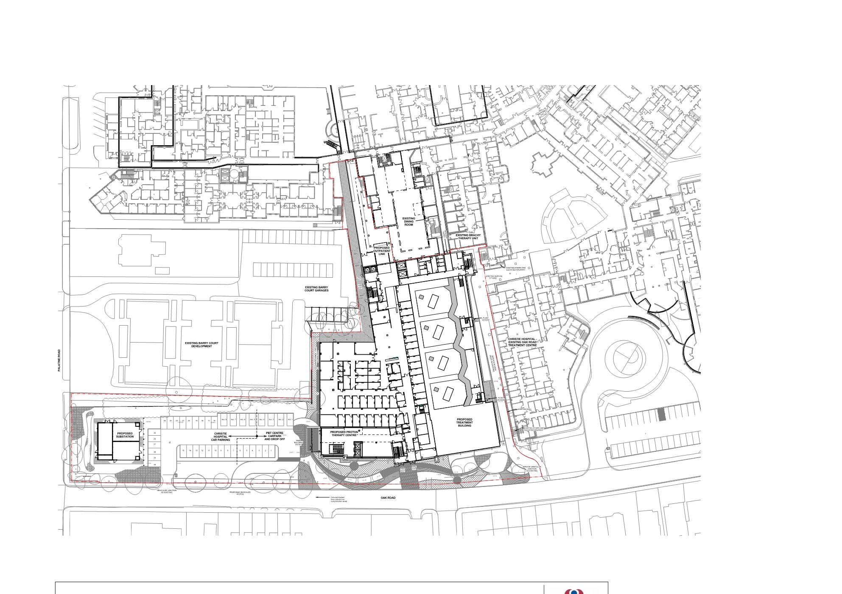
Overall
Site Plan
Substation
PBT Building

Slide 17
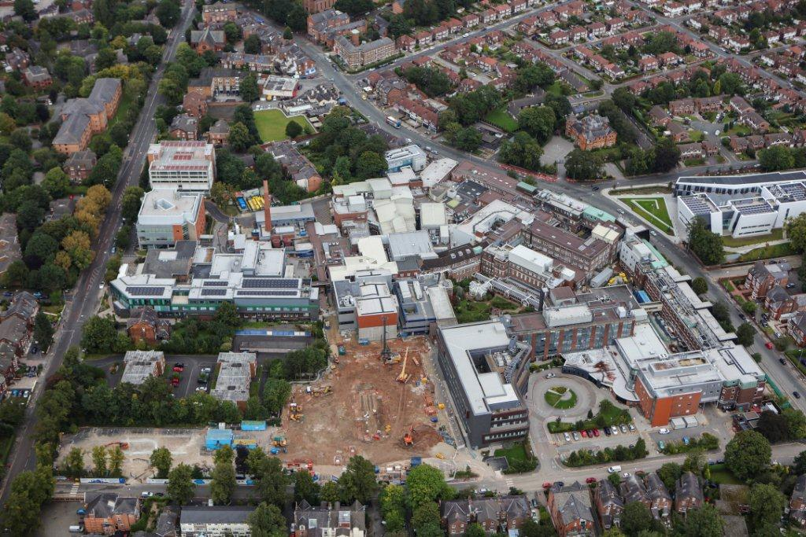

Slide 18
http://remotealert.camvista.co.uk

Slide 19
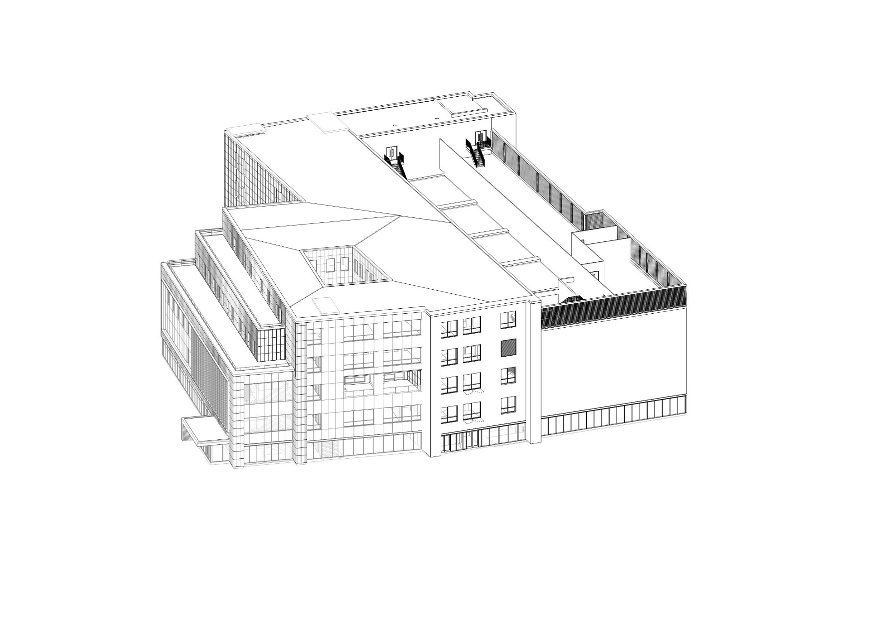
Building Massing
Clinical
Building
Treatment Building

Slide 20
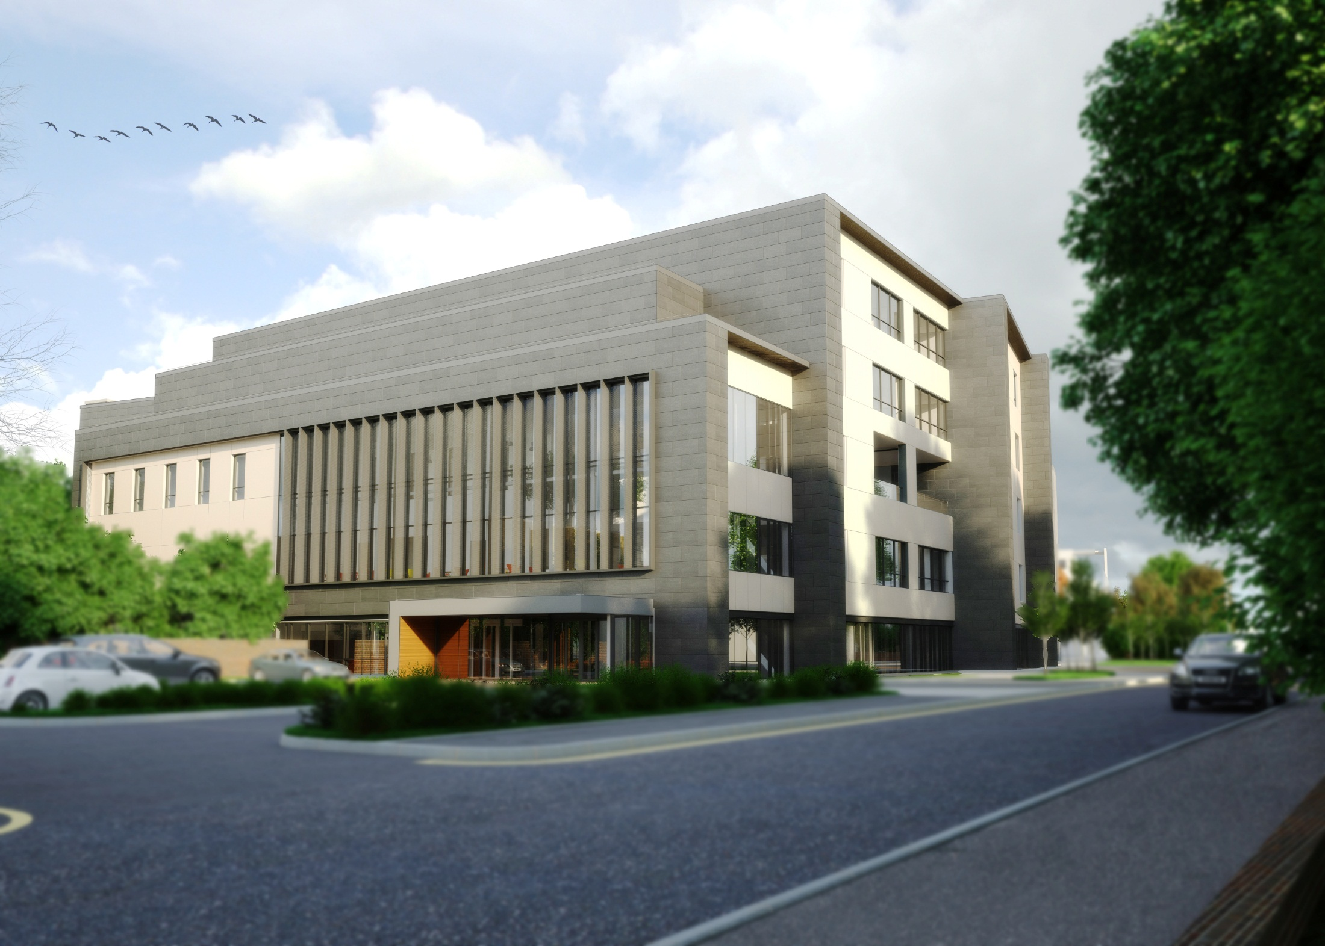
View of Entrance

Slide 21
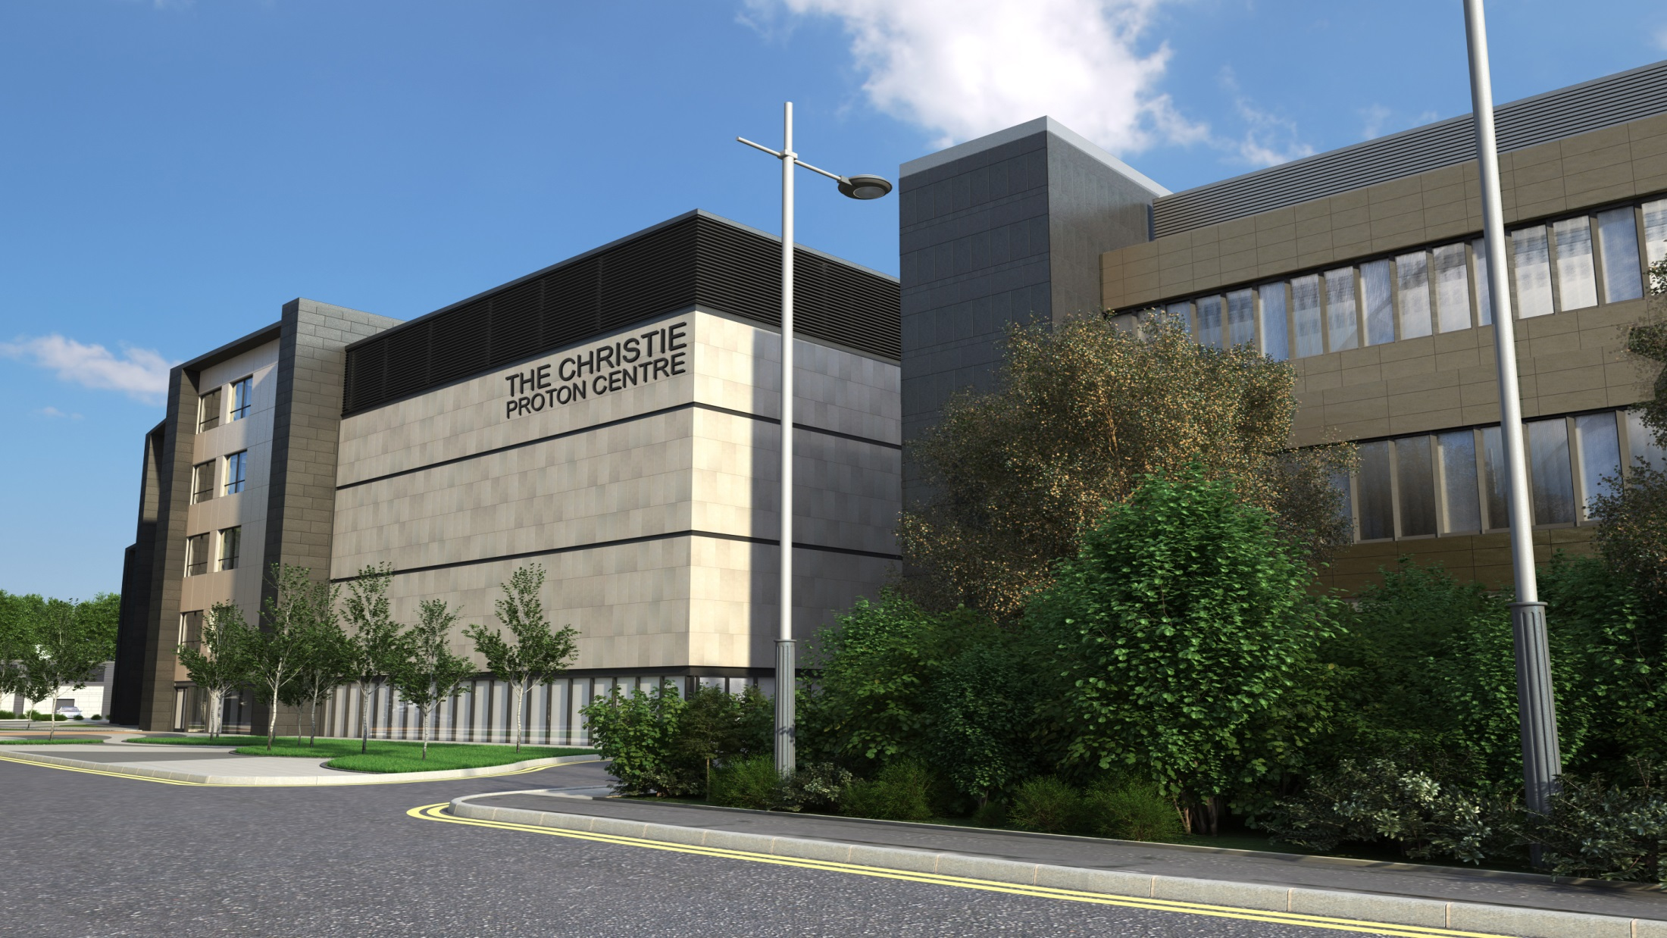
Bunker View
View of Treatment Building

Slide 22
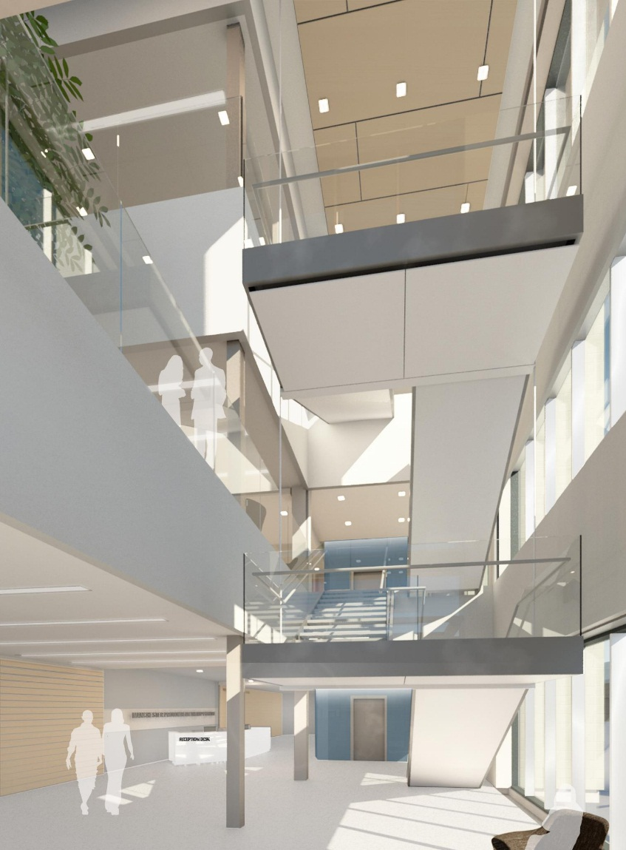
Main Entrance

Slide 23
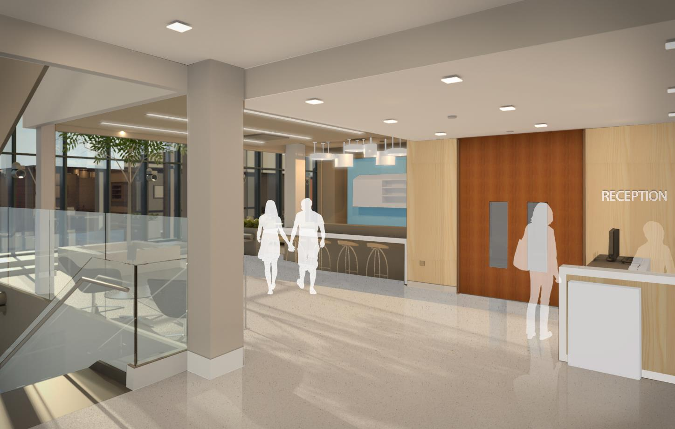
Treatment Reception

Slide 24
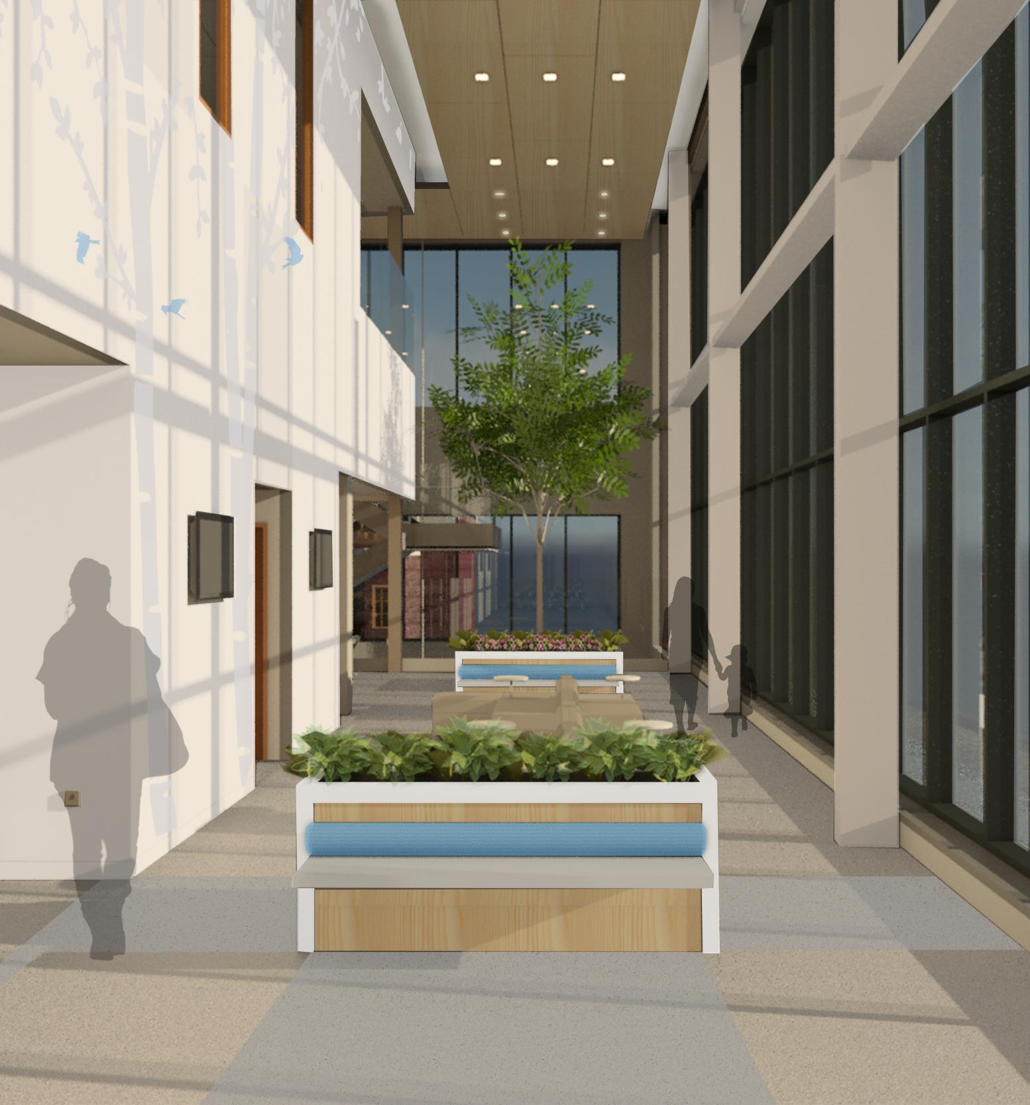
Winter Garden

Slide 25
Where are we now?
August 2015
January 2017
April 2018
Start Construction
Ready for Equipment (RFE)
1st Patient

Slide 26
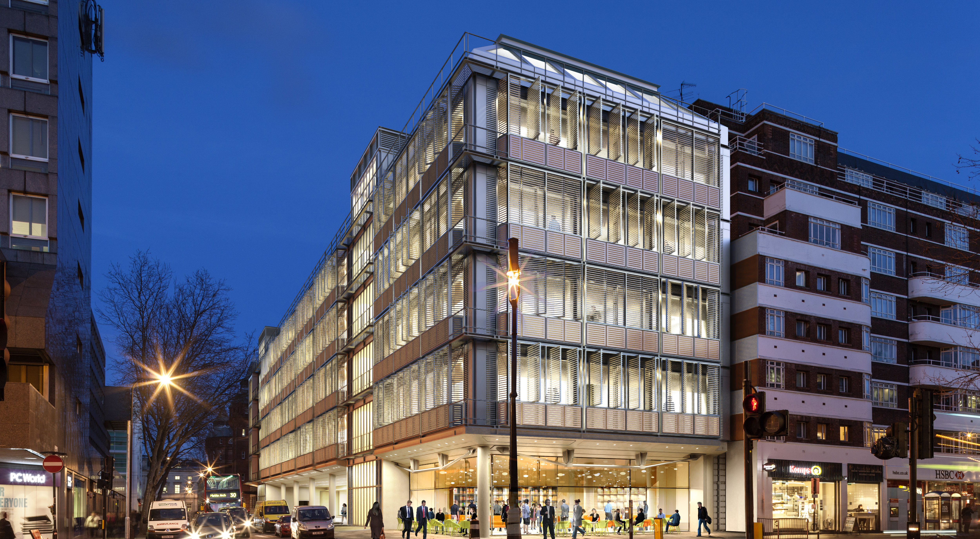
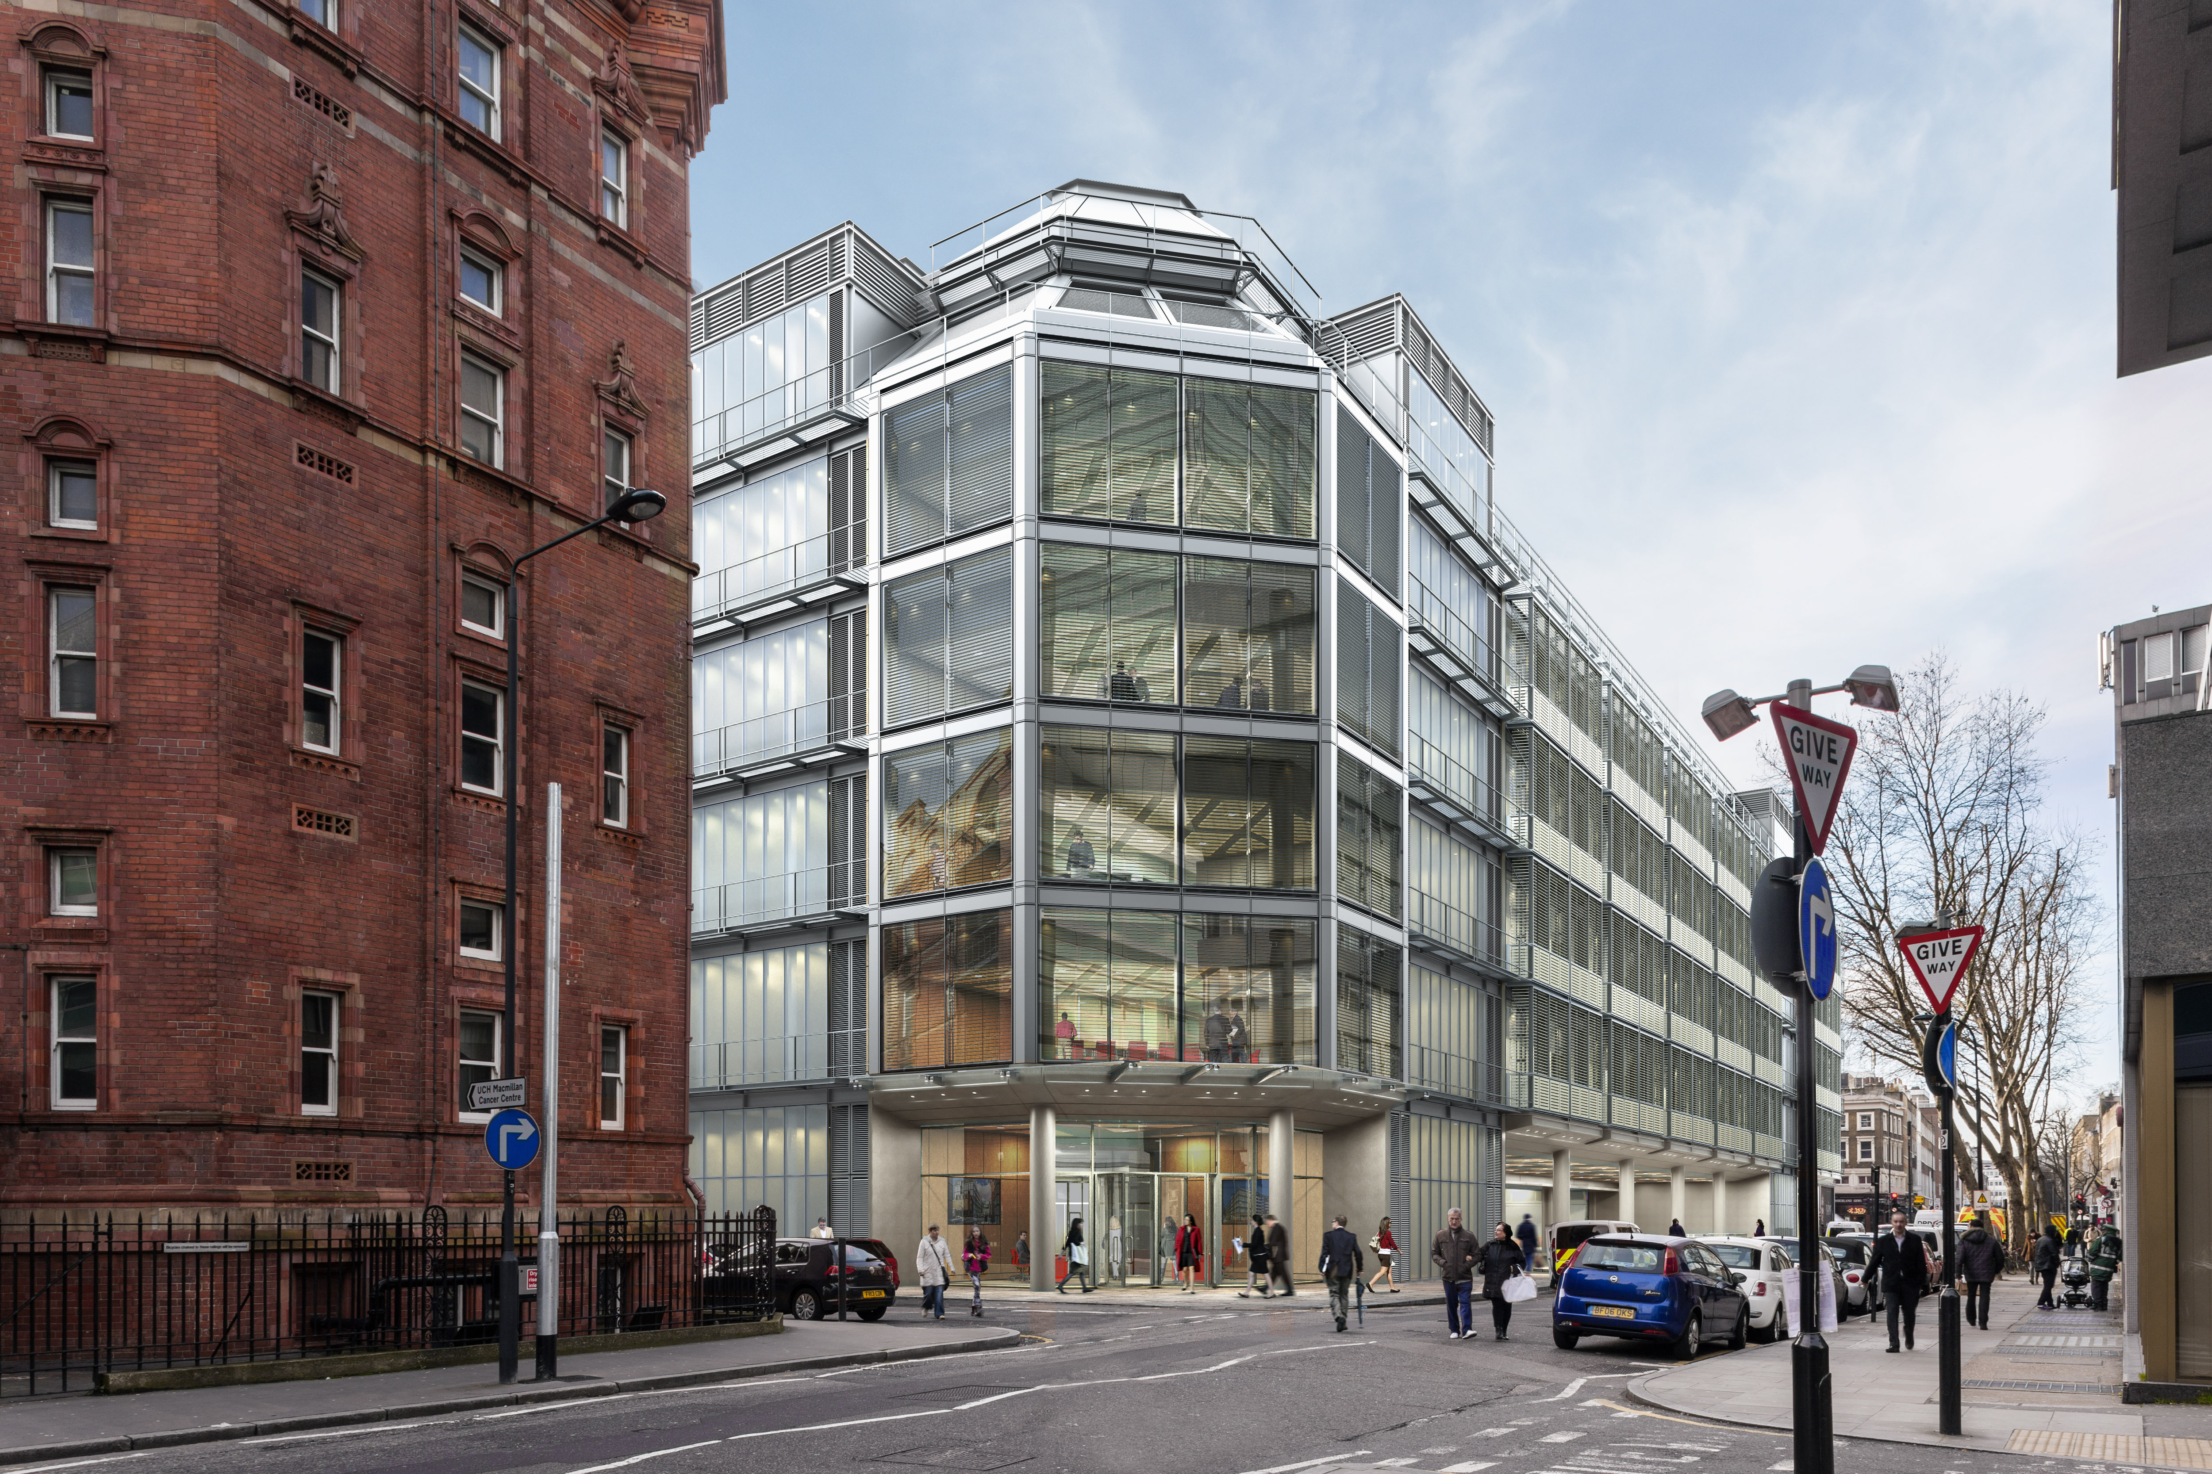
UCLH

Slide 27
Key issues
Complexity
  It shall deliver proton radiotherapy for the prescribed Indication List
  Complex indication list with high proportion of paediatrics
Dose
  Improved dose distributions compared to photon radiotherapy
Throughput
  It shall deliver the improved dose distribution to as many patients as possible
Value for money

Slide 28
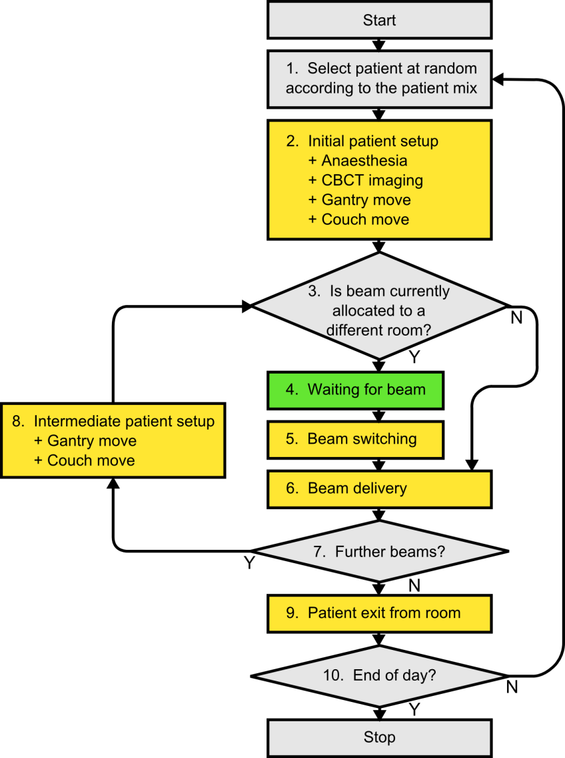
Workflow and Throughput
 | US caseload |  |  | UK caseload
Number of rooms | t_{fraction} | t_{waiting} | P_{annual} | t_{fraction} | t_{waiting} | P_{annual}
 | (minutes) | (minutes) | (patients) | (minutes) | (minutes) | (patients)
2 | 26.6 | 0.1 | 546 | 32.8 | 0.1 | 443
3 | 26.9 | 0.4 | 811 | 33.2 | 0.4 | 657
4 | 27.8 | 0.7 | 1046 | 34.2 | 0.7 | 850
5 | 28.8 | 1.1 | 1262 | 35.5 | 1.1 | 1024
Modelling the throughput capacity of a single-accelerator multi-treatment room proton therapy centre
Aitkenhead et al. BJR

Slide 29
Staffing
Medical Staffing | 60 PA’s across a number of clinicians
Physics | 20
Therapeutic Radiotherapy | 44
AHP and Nurse support | 14
Service Management, Reception, Clerical Support | 13
Information Technology | 3

Slide 30
Training
Vendor training: Vendors routinely train radiography staff on new equipment.
Visits to foreign PBT centres: These will be short placements (between one and four weeks), based at centres which use the same vendor we are intending to. A core group of radiographers (around five) alongside lead clinicians will then return and deliver continual training to the rest of the staff
Early access: All radiographers will be given the opportunity to visit the Department prior to opening and familiarise themselves with the environment, treatment equipment, rooms, software and hardware
External support after opening: For a period of 3-6 months after opening, we plan to have a radiographer experienced in PBT stationed in the Department, to assist with the continuous on-going development of all staff. We anticipate it being much easier to hire such an expert radiographer than similarly qualified clinicians and physicist

Slide 31
What is the proton therapy development?
It is the development of a complex radiotherapy service using a new radiation modality
Three room facility where you can only have beam in one treatment room
More complex service in terms of:-
  Pre- treatment
  Treatment planning
  Treatment
Service with a complex set of specialist indications

Slide 32
Key points
Image Guidance
  In room in the treatment position
  Cone beam on the 360 degree gantry
Scanning
  Increased throughput
  IMPT
In room set up
Anaesthetic induced outside the room

Slide 33
Wider Context
Proton therapy evidence base
  The indication list chosen by NHS has been targeted at cases where protons should show an advantage. We have the opportunity to collect the data and extend the evidence base.
Research
  We have several groups in the UK leading in related research fields such as accelerator development and radiobiology. The UK should be conducting research and development in proton therapy.

Slide 34

The Case for a research room
Technical developments of Proton Therapy
Radiobiology research
Complement clinical research
Train the next generations
National Service – one of two centres in the UK

Slide 35
Research
Themes
Clearly defined research themes which link to existing radiotherapy research
radiobiology
Multi-scale Mathematical modelling
ltechnical radiotherapy
Proton therapy
In Manchester
Data analysis, big data, data theragnostics
Clinical trials
Translational
radiobiology
Translational technical radiotherapy
(Wade)
Clinical Oncology and translational research

Slide 36
Proton Therapy Research Pipeline
Basic Research
Pre-clinical Research
Translational Research
Clinical trials
Patient Benefit
Underlying basic research; physics, biology, chemistry
(TRL 1-2)

Slide 37
Proton Therapy Research Pipeline
Basic research
Pre-clinical research
Translational research
Clinical Trials
Patient benefit
Application of basic research to address PBT research questions (TRL 2-4)

Slide 38
Proton Therapy Research Pipeline
Basic Research
Pre-clinical Research
Translational Research
Clinical Trials
Patient benefit
Application of basic and preclinical research to address real clinical issues (TRL 4-6)

Slide 39
Proton Therapy Research Pipeline
Basic Research
Pre-clinical research
Translational research
Clinical trials
Patient benefit
Clinical trials
(TRL 5-9)

Slide 40
Proton Therapy Research Pipeline
Basic Research
Pre-clinical Research
Translational Research
Clinical Trials
Patient benefit
Patient benefit

Slide 41
Proton Therapy Research Pipeline
Basic research
Pre-clinical research
Translational research
Clinical trials
Patient benefit
Application of basic and preclinical research to address real clinical issues (TRL 4-6)
Clinical trials (TRl 5-9).
Patient benefit
Application of basic research to address PBT research questions (TRL 2-4)
Underlying basic research; physics, biology, chemistry
(TRL 1-2)

Slide 42
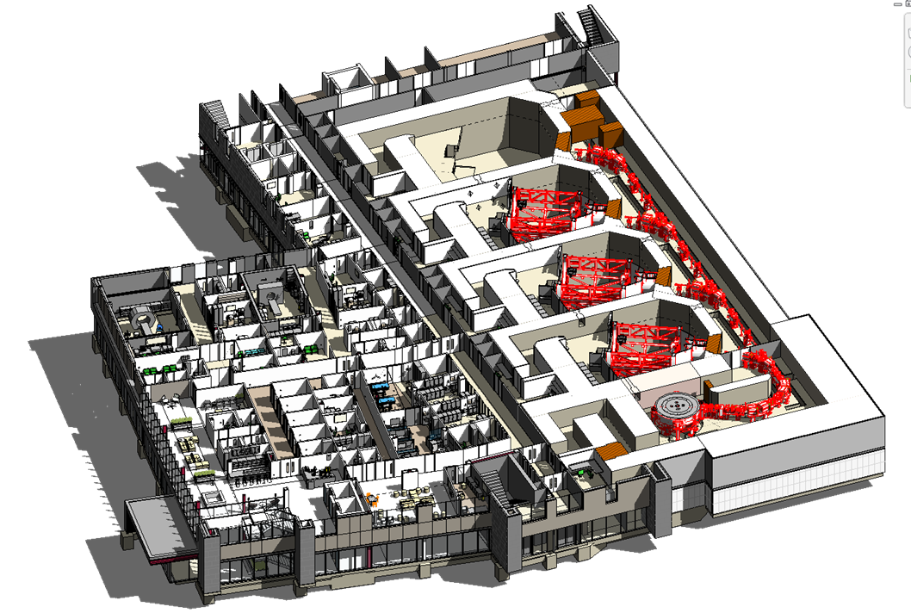
The Research Room
4th Gantry room research space
Two beamlines.
Modular experimental end-stations.
Design in progress

Slide 43
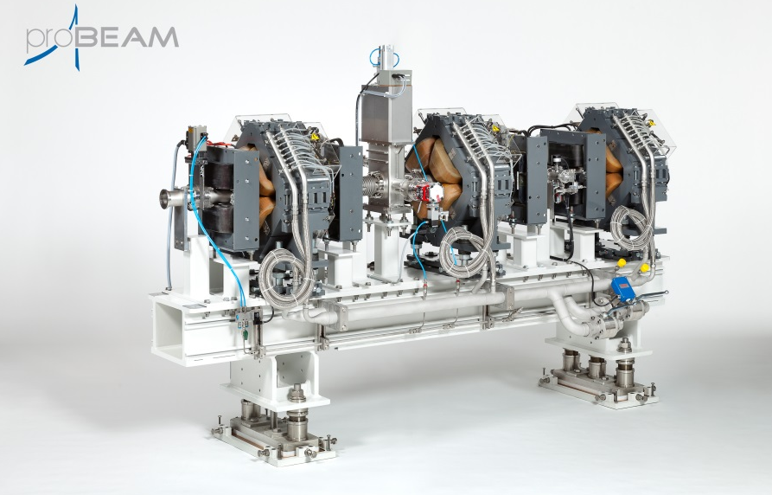
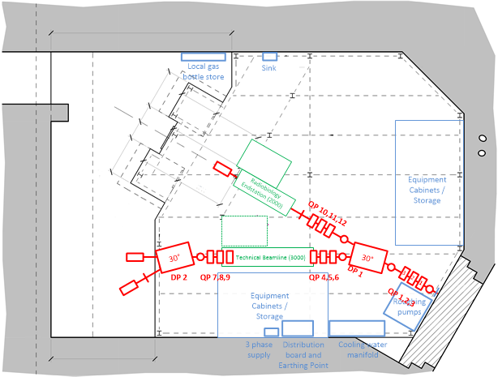
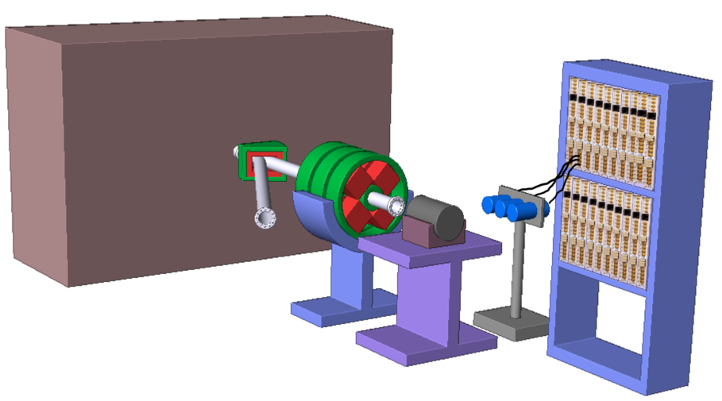
Research Room Overview
Artist’s impression of technical beamline endstation
Courtesy of Mike Taylor

Slide 44
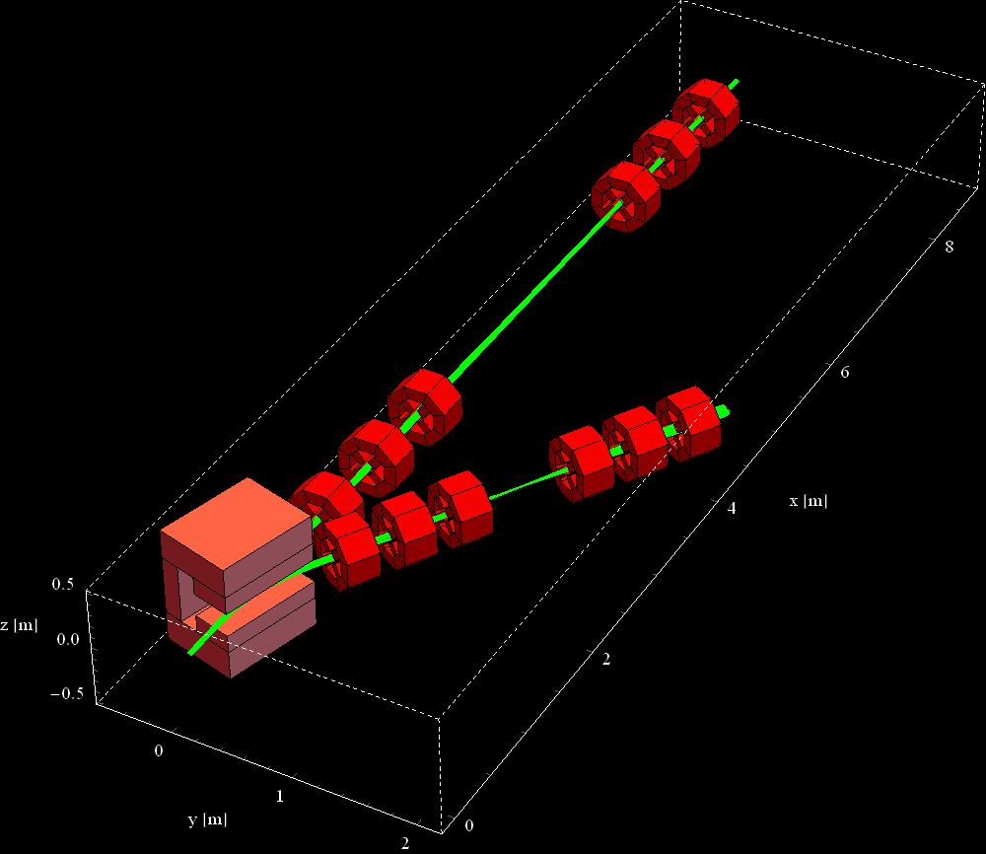
Beam Optics Calculations

Slide 45
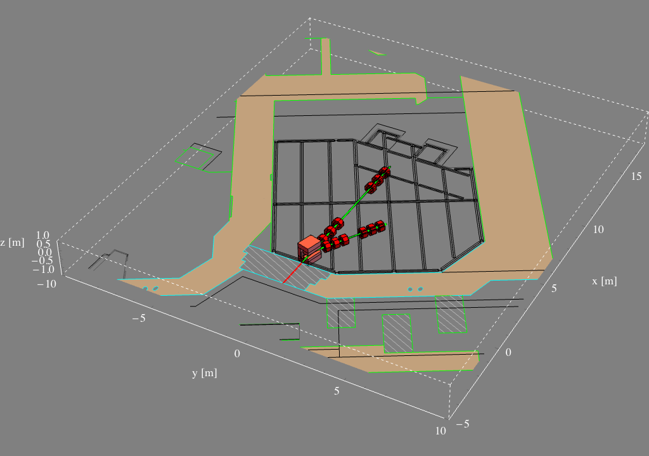
Beam Optics Simulation
Rigidity 1.23 to 2.44 Tm
Spot size 6.5 to 3.2 mm
245 to 70 MeV
Courtesy of Hywel Owen
Notes:
Parameters of the beam…
On-going design….

Slide 46
+ Research room
  In space of 4th Gantry
  Funding from christie Trust to build
  Flexible, modular experiments
  National facility

Slide 47
Research room
Engineering nozzle for PBS
Detachable modules for different experiments
  Dosimetry
  Detectors – range uncertainties
  Imaging
  Radiobiology
  Adaptive radiotherapy
  Ion tracks - nanodosimetry

Slide 48
Why track single hits?
Sort-of a microbeam…
Give exact low-doses of particles
‘broad-field’ of particles
microbeam
Non-microbeam: average of one particle per cell and a Poisson distribution of particles to individual cells
Microbeam: exactly one particle per cell

Slide 49
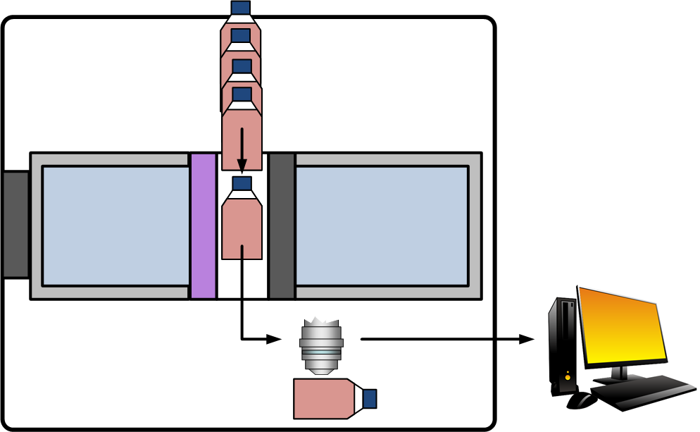
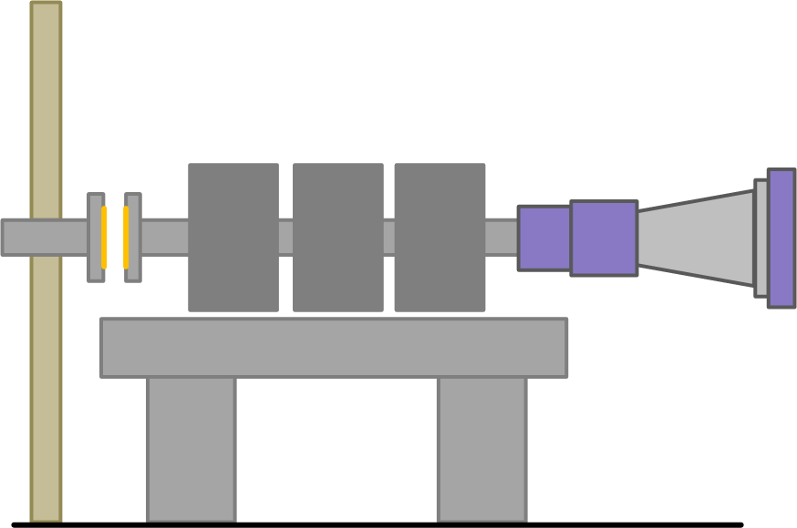
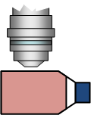

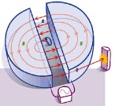

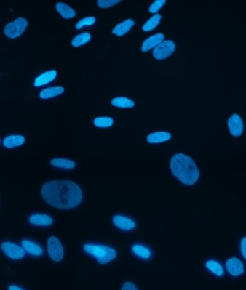
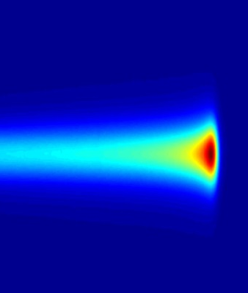
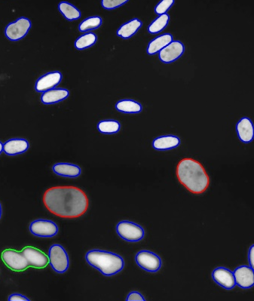
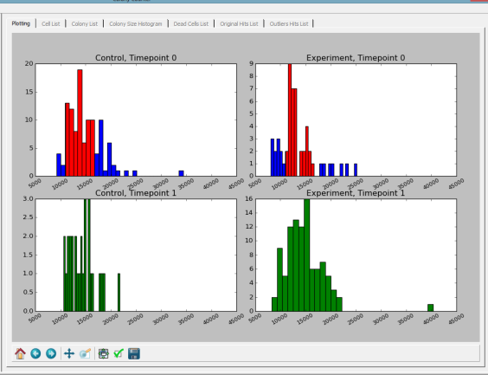
Radiobiology Beamline
Radiobiology Endstation: Environmental Enclosure
Robotic cell loader
70 – 240 MeV
Vacuum gap
Engineering Scanning Nozzle
Beam Optics
Water Phantom
Analysis
Single particle track detector
Microscopy
(timelapse)
Image
Irradiate
Identify particle tracks
Cell recognition
Analyse

Slide 50
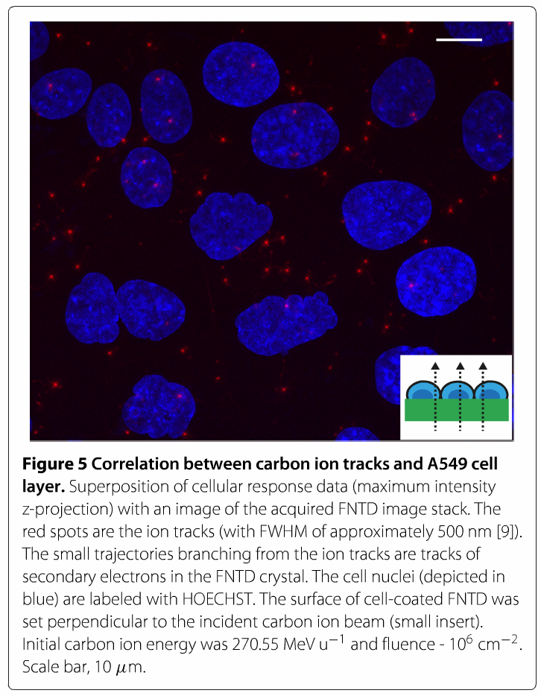
Single Hit Detection:
Fluorescent Nuclear Track Detectors
(FNTDs)
Sub-micron resolution
  Better resolution than most microbeams.
Heidelberg Ion Therapy Centre example (Carbon)
Cell nuclei – Hoescht - Blue
Carbon ion hits – red dots
Al₂O₃: C,Mg
Landauer Europe
M. Niklas, S. Greilich, C. Melzig, M. S. Akselrod, J. Debus, O. Jäkel, and A. Abdollahi, Radiat Oncol 8, 141 (2013)

Slide 51
THANK YOU

