Slide 1
Increasing Beam Power to High Energy Neutrino Program: PIP-(I,II,III)
Eric Prebys
AD/APC
PIP-III Task Force
(former Proton Source Head and “Proton Plan” Project Manager)

Slide 2
Context: P5 Report
The Particle Physics Project Prioritization Panel (P5) advises the DOE Office of High Energy Physics on research funding priorities in high energy physics
After a lengthy process, the panel released a report in May, 2014. Top priorities for Fermilab:
  Support the LHC and its planned luminosity upgrades
  Pursue the g-2 and Mu2e muon programs*
  Focus on a high energy neutrino program to determine the mass hierarchy and measure CP violation.
    “Flagship” activity
    Will ultimately require a “multi-megawatt” beam at 60-120 GeV
  Continue at least R&D toward a future linear e⁺e⁻ collider (ILC)

Slide 3
Caveats
LBNF/DUNE is a long program, which is forced to make choices now based on an incomplete knowledge of the future.
  PIP-II (1.2 MW) does not yet have CD-0
  Increasing power beyond that has both “known unknowns” and “unknown unknowns”.
While we want to remain optimistic about what we might achieve in the future, it’s also important to manage expectations!
I will present what we believe at this time to be reasonable – but by no means guaranteed – “reference values” to serve as a basis for planning, understanding that these may be refined up or down in the future.
Everything I’m saying has been seen and (mostly) approved by knowledgeable people, but it hasn’t been vetted or reviewed in any meaningful way.

Slide 4
PIP-II + 1 = PIP-III
Recognizing the need to increase beam power beyond 1.2 MW, the Director has commissioned the formation of task force to coordinate the necessary R&D to produce a plan to move forward, generically called “PIP-III”
  A lot of thought has already gone into this under PIP-II, and its predecessors
  In many cases, it will simply involve liaising to ongoing activities.
Current (ad-hoc) task force composition: Eric Prebys (chair), Phil Adamson, Sam Childress, Paul Derwent, Ioanis Kourbanis, Valeri Lebedev, Alexander Romanov, Vladimir Shiltsev, Eric Stern, Alexander Valishev, Bob Zwaska
  These people have contributed much of the material in this talk, and are all willing to have their names associated with it.
The exact charge is still under construction, however
  The emphasis will be on identifying the most cost effective way to deliver high power to LBNF/DUNE, with no specific mandate for a low energy program.
  The final recommendation “may include alternatives”, at which point the low energy program might come into consideration (more about this later).
  Time scale will be a few years (exact schedule with milestones TBD)
  This task force will focus strictly on accelerator issues.
    Concurrent R&D, such as targetry, will proceed separately, although there will certainly be communication and coordination

Slide 5
PIP-III Power Goal
P5 Recommendation:
    “[…] , we set as the goal a mean sensitivity to CP violation of better than 3σ (corresponding to 99.8% confidence level for a detected signal) over more than 75% of the range of possible values of the unknown CP-violating phase δCP”
Assuming a LAr detector and an optimized beam line, this corresponds to ~900 kt•MW•y*
  P5 report says 600, but a more carful study recommends more.
~20 years with 40 kt detector and 1.2 MW (PIP-II) beam
LBNF plan**:
  ~10 years to build
  5 years at 1.2 MW (PIP-II)
  Many years at “higher power”
*G. Rameika, PIP-II Project Review
**CD-1 re-Review

Slide 6
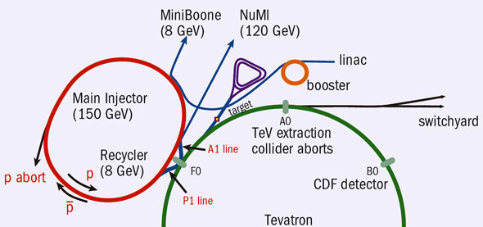
Orientation: Fermilab Accelerator Complex
Following the LHC turn-on, FNAL has transitioned to an intensity based program
The 8 GeV source is the chief limit to intensities
Accumulator/Debuncher: Formerly for pBar accumulation, soon muon and proton manipulation for g-2 and Mu2e
Neutrinos
Recycler: Formerly for pBar storage, now for proton pre-stacking for NOvA
LBNF
(120 GeV)
~45 years old!
/400 MeV
/8 GeV
120 GeV+secondaries

Slide 7
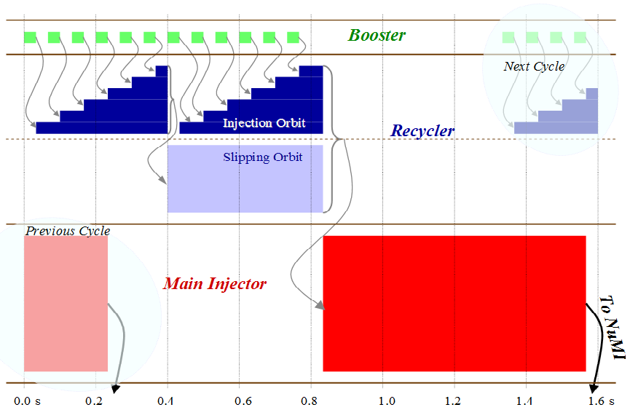
NuMI/NOνA Timeline
15 Hz Booster sets fundamental clock (“tick”)
“slip-stacking” cleverly gets around limits on Booster batch size
The installation of a direct injection line from the Booster to the Recycler to eliminate Main Injector loading time was the key component of the “ANU” improvement campaign for NOνA (400 kW->700 kW)

Slide 8
Staged Plan to Increase Intensity
PIP (ongoing)
  Achieve full 15 Hz Booster operation
  Provide 700 kW to NuMI + 30 kW to 8 GeV program
PIP-II (CD-0 ESSAB scheduled for 11/12!)
  Keep existing Booster, but increase cycle rate to 20 Hz
  Continue to slip-stack in Recycler
  Replace existing 400 MeV linac with 800 MeV superconducting linac that has CW capability
  Deliver 1.2 MW to NuMI or LBNF
  Support 8 GeV program and 800 MeV program
    (eg. 100kW 800 MeV beam to Mu2e-II)
PIP-III (conceptual)
  Keep PIP-II linac
  Replace Booster with “something”
  Deliver 2.5 MW to LBNF + ??
Rapid Cycling Synchrotron (RCS) or pulsed linac?

Slide 9
Proton Improvement Plan (PIP)
The goal of PIP is to allow continuous operation of the Fermilab Linac/Booster at 15 Hz, through
  The elimination of the physical limitations of the pulsed elements
    Injection and extraction hardware
    RF cooling
    Solid state RF amplifiers
    Bias supplies
    Anode supplies
  Reduction of beam loss, such that higher throughput is allowed
    New ion source
    Improved beam control and collimation
    Improved beam cogging
    New, larger aperture, RF cavities (designed for later use)
Complete!

Slide 10
Critical Issue: Space Charge Limit
Injected intensity is limited by the space charge tune-shift, which can drive harmonic instabilities.
So the maximum injected charge grows
rapidly with increasing energy
total protons
“Bunch factor” = I_{peak}/I_{ave}
(Reduce with higher RF harmonics)
= 3 for 95% Gaussian emittance
1 for 100% uniform (painted) emittance
normalized emittance
doesn’t include improvement of going to uniform distribution with painting

Slide 11
PIP-II
Key elements:
  Replace existing 400
  MeV linac with an 800
  MeV linac capable of
  CW operation.
    Higher energy + painting
    = more beam in Booster
  Increase Booster rate
  to 20 Hz
  “Modest” improvements to
  Recycler and MI
Goals:
  1.2 MW @ 120 GeV
  100+ kW @ 800 MeV
    Thanks to cryoplant from India

Slide 12
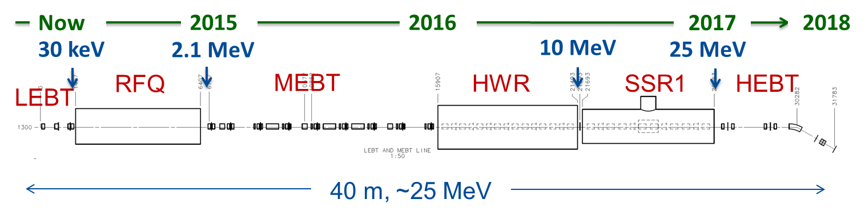
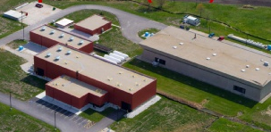
PIP-II R&D
The PIP-II Injector Experiment (PXIE)* is designed to test the technology needed for the PIP-II Linac
Among other things, PXIE will investigate
  Low Energy Beam Transport (LEBT)
  pre-chopping. Demonstrated.
  Validation of chopper performance
  Bunch extinction
  Operation of Half Wave Resonator (HWR)
  in close proximity to 10 kW absorber
  Emittance preservation
FAST/IOTA
PXIE
*Pay no attention to the X
Notes:
Eric, I replaced your picture with the one I have been using lately with the timeline superimposed. Also noted that the first goal has been demonstrated.

Slide 13
Beyond PIP-II
By the time PIP-II is realized, the Booster will be more than a half century old, and it’s unrealistic to believe that it can be pushed further, in terms of performance:
  No beam pipe in magnets! ➔ troublesome impedances from magnet laminations.
  Presently the decelerating voltage (from impedance) at transition is above 100 kV/turn
    Transition crossing with more than 50% intensity increase looks impossible without reducing impedance
    No realistic way to do this.
Further increases in power will require replacing the Booster. Options are:
  A pulsed linac to go from the PIP-II linac to 8 GeV
    Possibly increase the energy of the CW portion to 3 GeV?
  Some sort of Rapid Cycling Synchrotron (RCS)
Replacing the Booster is the core component of “PIP-III”

Slide 14
Cost of Linac vs. RCS
Most recent (of many) cost comparison was done for the 3➔8 GeV portion of Project X*
  pulsed Linac: $420M
  RCS: $302M
Have not yet done a direct comparison for our case, but
  Expect RCS ~the same (depends on peak energy)
  Expect Linac to go up by ~20% due to lower starting energy
Working to bring linac cost down
  Higher gradients and industrialization
  Don’t expect miracles
For the moment, we feel confident in saying a linac is the more expensive option, but cost is not the whole story…
*http://tinyurl.com/project-x-doe-briefing/, “Accelerator Overview”

Slide 15
PIP-III: Linac or RCS?
8 GeV pulsed linac:
  Pros:
    Everyone loves SRF (sexy, fun, test-bed for future facilities)
    Lots of power at 8 GeV and/or lower energies
      MI energies < 60 GeV
      Short baseline neutrinos
      Rare K decays
      That other program we don’t talk about anymore
  Cons:
    More expensive than RCS
    Potential 8 GeV users want short bunches, so
    must keep Recycler, which complicates things
    and has worries about long term viability.
    Charge stripping makes H⁻ injection at 8 GeV a big deal*:
      Weak magnets, extended optics in the beam transport
      Even black body radiation stripping a problem -> cooled beam pipe
*see D. Johnson, WG1+4, Sess. 4

Slide 16
Linac or RCS? (cont’d)
RCS
  Pros:
    Demonstrated performance (J-PARC)
    Less expensive than linac
    Can eliminate Recycler (and associated risks and inefficiencies)
    Option of increasing MI injection energy
  Cons:
    Less exciting technology
    Limited protons at 8 GeV.
      No extra protons at 60 GeV MI
      MI power falls off below that
Straw man approach
  Pursue RCS without Recycler as primary option.
  Pursue linac+Recycler as an alternate.
    Could consider injecting into MI, but using Recycler increases options for other 8 GeV program.

Slide 17
PIP-III Straw Man Parameters*
~6x record Booster ppp
~4x record Main Injector ppp
*P. Derwent

Slide 18
Mitigating Space Charge in the RCS
Recall:
Other ways?
  FAST/IOTA program (more about this in a moment)
Can paint beam to increase emittance, but limited by Main Injector aperture (~20-25 π-mm-mr)
Can increase injection energy (costly)

Slide 19
Demonstrated Performance: J-PARC RCS
Circumference: 343 m
Injection Energy: 400 MeV
Extraction Energy: 3 GeV
Frequency: 50 Hz
protons per pulse: 8.3x10¹³
  more than 2x PIP-III spec!
RF: h=2 (~2 MHz + harmonics)
Normalized admittance: 325 π-mm-mr
  >100 π-mm-mr painted
Power: 1 MW (max, demonstrated)
Key features
  ceramic beam pipes
  sophisticated transverse and longitudinal beam painting
  large aperture (we’ll be limited by MI).

Slide 20
RCS Comparisons
2.5 MW @ 60 GeV
Probably an overestimate. Beam is not Guassian. Plus, we lose a lot of beam.
Too big for “ordinary” synchrotron

Slide 21
Novel Ways to Mitigate Space Charge
Non-linear integrable optics
  All synchrotrons ever built are based on linear optics (magnetic quadrupoles). Non-linearities are handled perturbatively, and eventually lead to instabilities.
  Is has been shown* that non-linear magnetic fields that satisfy a very particular set of conditions can result in stable orbits, but without a unique tune
    Extremely insensitive to harmonic instabilities
    Stable up to space charge tune shifts of order unity!
Electron lens
  A beam of electrons can be used to cancel the space charge effects of the protons
  Demonstrated in the Tevatron
  Used operationally at RHIC
*Danilov, Nagaitsev, PRSTAB 2010

Slide 22
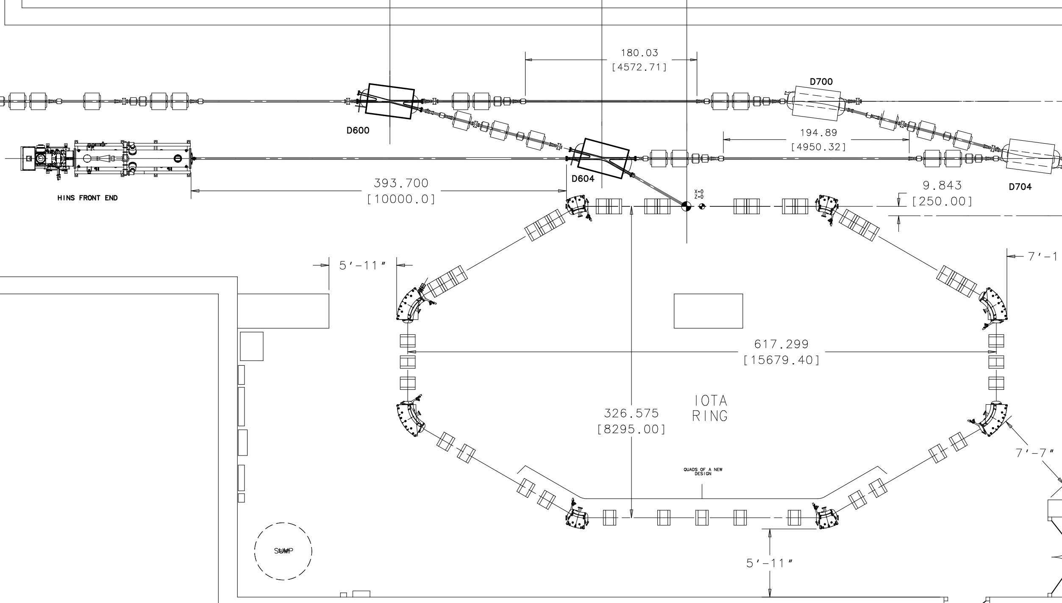
FAST/IOTA Program*
The Fermilab Accelerator Science Test (FAST) facility, including the Integrable Optics Test Accelerator (IOTA) is being built to test non-linear integrable optics, electron lenses, and other novel accelerator physics.
  Electrons in FY17 (formerly ASTA program)
  Protons a bit later (reuse old HINS source and RFQ)
*see A. Valishev and N. Cook, WG1+4, Sess. 4

Slide 23
Main Injector Issues for PIP-III
Not enough power to accelerate 2.0E14 ppp with the current RF system (44 years old). New RF system will be required.
  Cavity design exists.
  Plan to use prototype cavity in Recycler for PIP II.
Transition crossing will be an issue. A first order gamma-t jump system with ±1 units will be required.
  Design exists. Will be implemented for PIP II with ±1/2 units.
  There are space limitations for adding more gamma-t quads.
Electron cloud instabilities. Beam scrubbing might not enough to suppress the electron cloud and we will have to coat the MI beam pipe.
  Have an active program of Secondary Emission Yield (SEY) in situ measurements in MI for different coatings.

Slide 24
Key Questions for PIP-III task force
RCS injection energy?
  800 MeV (PIP-II linac)? Must ameliorate space charge effects through injection or more novel techniques (electron lens? non-linear optics?)
  >800 MeV? This would eliminate space charge effects at the cost of an expensive extension of the PIP-II Linac
    What should the higher energy be?
RCS circumference?
  Increasing circumference would reduce number of loading cycles to Main Injector
Main Injector injection energy?
  Increasing RCS energy could reduce Main Injector cycle time
Main Injector RF design
  Specifications?
  Harmonics?
  Filters and feedback?
  Damping?
Bring back the linac?

Slide 25
Linac R&D Topics
Getting from 800 MeV➔8 GeV is currently straightforward but costly
  Most the hard (and interesting) beam-physics stuff is
  < 800 MeV, however
  Lots of interesting SRF work going on to bring the cost down
    Higher gradients, industrialization, etc
H⁻ injection at 8 GeV is a very big deal
  Magnetic stripping grows as γ
    scale of optics grows like βγ² (24 times worse than SNS)
  Black body stripping ➔ cryogenic beam screen
  Foil and loss issues at injection, etc.
    Laser stripping, maybe?

Slide 26
Linac vs. RCS Revisited
Project X was a fairly mature, linac-based proposal that would produce high power at 60-120 GeV, while supporting a broad program at lower energies
  It was judged to be too expensive.
The current charge is to find the most cost effective way to achieve the physics goals of DUNE
  Currently no explicit mandate for a low energy program
Unless there’s a huge breakthrough in SRF technology, an RCS is the best way to do this, HOWEVER
The charge says the final recommendation “may include alternatives”
  The alternative will almost certainly be a linac-based option.
  Reduced costs and/or changing physics priorities may well make that the ultimate frontrunner.

Slide 27
Summary
Fermilab is committed to LBNF/DUNE as the flag ship of our long term experimental program.
The lab has a mature plan for reach the initial 1.2MW beam power required by the experiment.
  PIP-II should get CD-0 “soon”
  more details at http://pip2.fnal.gov/
We are forming a task force to determine the best path to increase the beam power to the “multi-Megawatt” level.
  Stay tuned at http://pip3.fnal.gov/

