Slide 1
Beam energy optimization for Mu2e @ PIP-II
Vitaly Pronskikh, Doug Glenzinski, Kyle Knopfel, Nikolai Mokhov, Robert Tschirhart
Fermi National Accelerator Laboratory
November 13, 2015
Particle Accelerator for Science and Innovation, Fermilab, Batavia

Slide 2
Introduction
An improved proton source will be required for a next generation Mu2e
Necessary to understand:
  Expected muon yield and muon stopping rates as a function of proton energy
  Potential performance constraints as a function of proton beam energy
MARS15 is used because the energy-deposition-related quantities are well modeled as well as DPA damage (displacement-per-atom)
PIP-II : Mu2e upgrade potential (@800 MeV) > 100 kW (linac), 120 kW (@8 GeV) (Booster), energies within the range were also considered
The energy range studied: 0.5 GeV – 8 GeV.

Slide 3
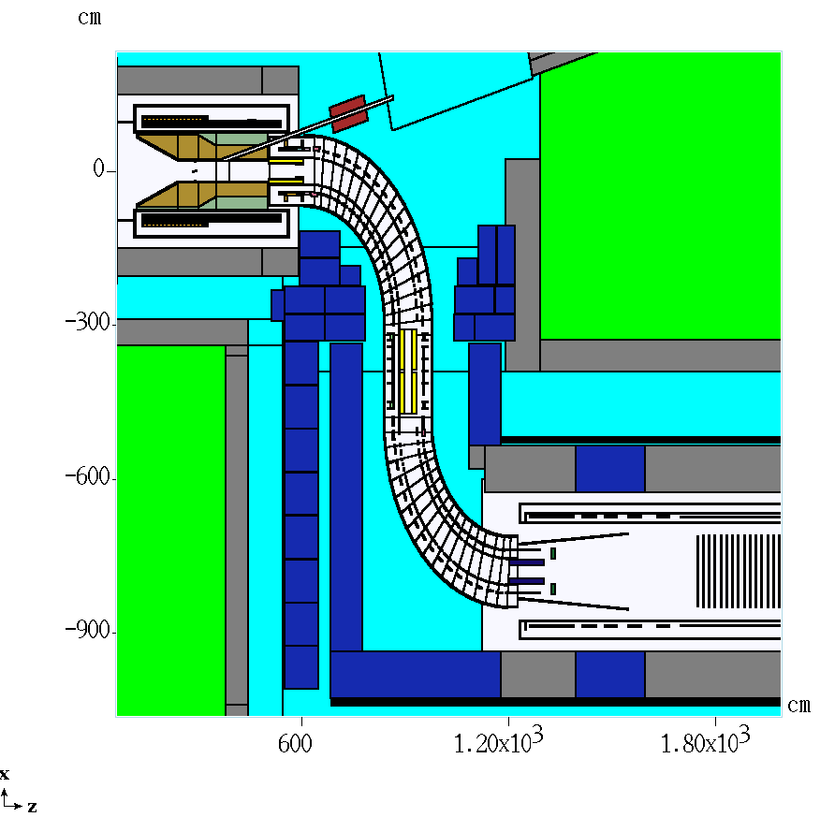
Baseline Mu2e and MARS15 simulations
8 GeV 8 kW proton beam
W target L=16 cm D=0.6 cm (beam σ=0.1 cm)
Bronze HRS (tungsten considered for upgrade), CDR design is used for the study
PS, TS, DS (17-foil Al stopping target (STT))
In MARS15 simulations: LAQGSM, thresholds: 1E-12 GeV for neutrons, 100 keV for charged h., muons, photons
PS
TS
STT
DS
DPA and power density vs beam energy
vs HRS material
Muon yield/stopping rate vs beam energy
Figure of merit (stopping rate per DPA)

Slide 4
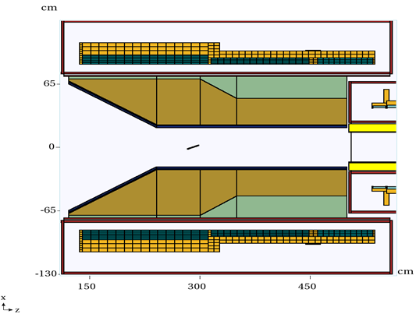
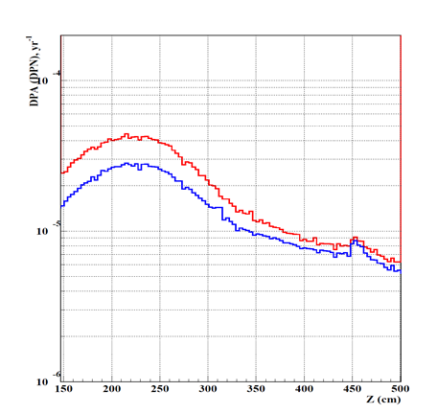
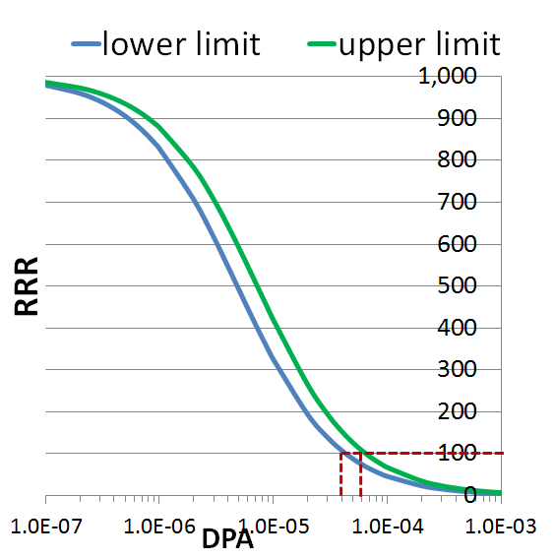
DPA limit and model
Total DPA
Neutron-induced DPA
HRS: Bronze, Tungsten
DPA model: NRT (below 20 (150) MeV
ENDFB-VII/NJOY based cross section
library FermiDPA 1.0) is used. NbTi coils
DPA limits incorporate KUR measured data
4-6E-5 DPA

Slide 5
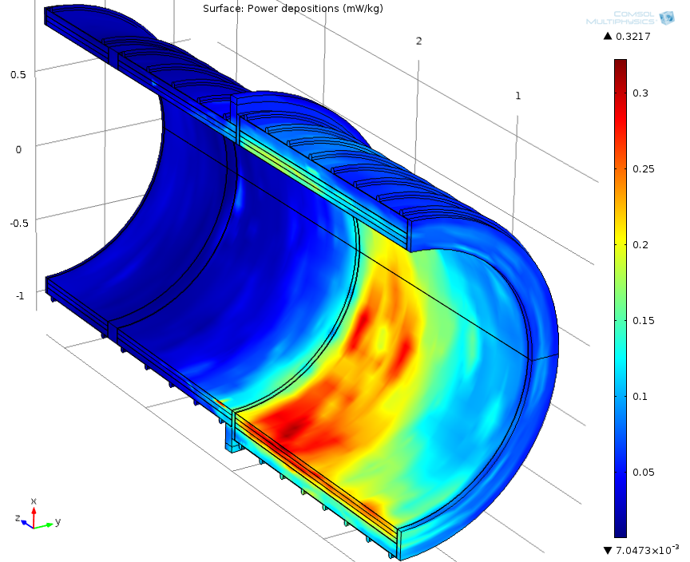
Power density (PD) and other limits
Power density limit:
-depends on the cooling scheme
-involves many other assumptions
Dynamic heat load limit:
-scales with the number of cooling
stations
Absorbed dose limit: usually high
Quantity | DPA, 10⁻⁵ | Power density, µW/g | Absorbed dose, MGy/yr | Dynamic heat load, W
Specs | 4-6 | 30 | 0.35 | 100

Slide 6
DPA as a function of beam energy
DPA damage and peak power density are:
Largest at ~3 GeV and drops with energy below that energy
Larger for bronze than for tungsten by a factor of ~3-4

Slide 7
DPA and power density @ 100 kW
DPA: Current coil design can likely tolerate 100 kW at proton energies < 1 GeV (if HRS thickness is increased).
Power density: current coil design/cooling scheme can tolerate 100 kW at Ep = 0.8 GeV and lower. For higher energies another cooling scheme may be required.
Above 1 GeV (DPA) or 2 GeV almost flat with energy.

Slide 8
Mu- spectra and yields at TS
Constant beam intensity (not power) = 6 · 10¹² p/s
Steepest rise in µ⁻ yields is between 0.5 and 2 GeV.
Effective flux-based approach was used for counting muons

Slide 9
Acceptance
Fraction that stops in the Al target
Fraction that stops in the Al target
Mu- momentum at entrance to TS (MeV/c)
Mu- momentum at entrance to TS (MeV/c)
At 0.8 GeV Average 1-8 GeV
Calculated using G4beamline, used with MARS15 calculated
muon spectra at TS

Slide 10
Mu- stopping rates and Figure of Merit
3 years = 4.7E21 protons on target @ 8 GeV (4.7E22 @ 0.8 GeV)
If only stopped muons are considered: 2-3 GeV
If DPA is also considered: 1-3 GeV
The FOM for 0.8 GeV is about the same as it is for 8 GeV

Slide 11
Single-event sensitivity and limiting beam power
The single-event-sensitivity (SES)
corresponds to the rate of μ-to-e
conversion at which the experiment would observe 1 event
Current Mu2e R_{ses}=3·10⁻¹⁷
Estimated SES as a function of proton beam energy
Estimate is made assuming
  3y run at 100 kW (same timing structure, but increased duty factor)
  Aluminum stopping target (ie. unchanged)
  Total number of stopped muons as on page 10
  Detectors can be made to handle increased rates so that acceptance and resolution comparable to current estimates
Could achieve >x10 improvement for Tp in 0.8 – 5 GeV range

Slide 12
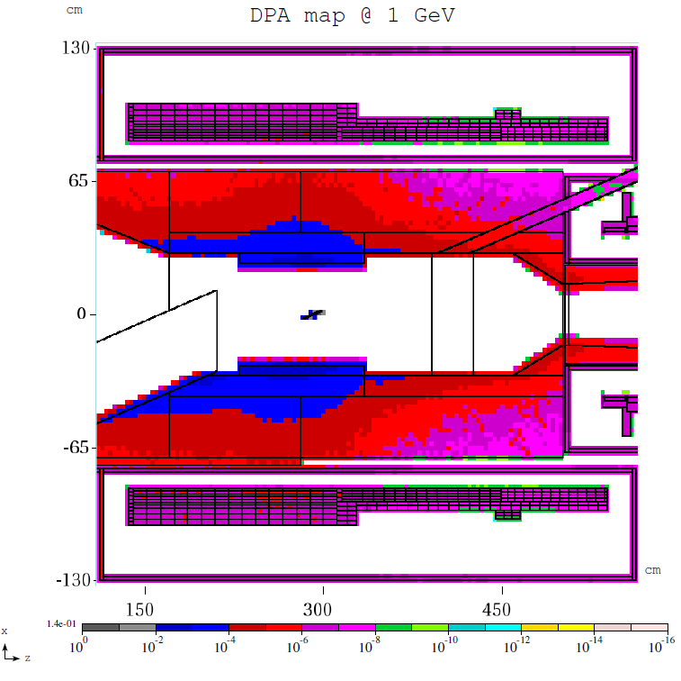
Future plans
Inner bore radius=20 cm
No yield drop for R>17 cm
Investigate the DPA and Power density deposition for a tungsten
HRS with a reduced inner bore

Slide 13
Conclusions
Energy dependence of DPA damage, power density, muon yield and muon stopping rate is studied.
A Figure of Merit is proposed: the ratio of stopped muon rate to DPA
  FOM is largest in the 1-3 GeV range
  FOM for 0.8 GeV is comparable to 8 GeV
Assuming detectors can be made to handle increased rates, can plausibly achieve x10 improvement in sensitivity for 100 kW at Tp = 0.8-5 GeV
Additional work required to understand whether current coil + tungsten HRS design can likely tolerate 100 kW

Slide 14
Spare slides

Slide 15
Mu- entering TS
Ep, GeV | Mu-/proton | Stat. uncertainty | Stat. uncertainty, %
0.5 | 4.45E-04 | 5.17E-06 | 1.2
0.6 | 9.26E-04 | 3.96E-05 | 4.3
0.7 | 1.51E-03 | 9.53E-06 | 0.6
0.8 | 2.20E-03 | 5.51E-05 | 2.5
0.9 | 2.83E-03 | 1.31E-05 | 0.5
1 | 3.55E-03 | 7.06E-05 | 2.0
2 | 9.57E-03 | 1.16E-04 | 1.2
3 | 1.47E-02 | 1.44E-04 | 1.0
4 | 1.34E-02 | 1.38E-04 | 1.0
5 | 1.58E-02 | 1.50E-04 | 0.9
6 | 1.85E-02 | 1.93E-04 | 1.0
7 | 2.06E-02 | 2.83E-04 | 1.4
8 | 2.25E-02 | 2.51E-04 | 1.1

Slide 16
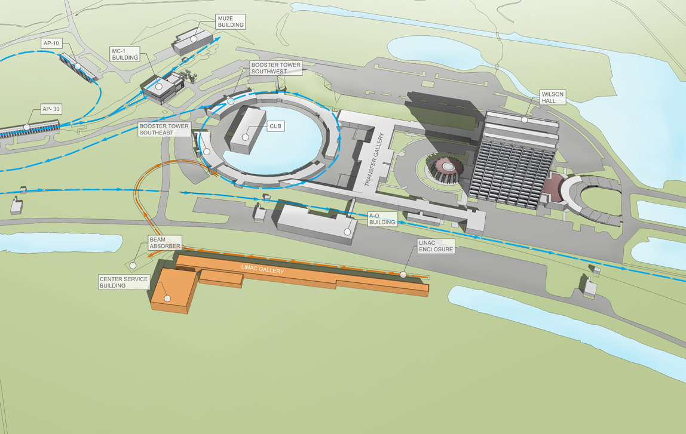
Mu2e@PIP-II upgrade plans
Performance Parameter | PIP | PIP-II
Linac Beam Energy | 400 | 800 | MeV
Linac Beam Current | 25 | 2 | mA
Linac Beam Pulse Length | 0.03 | 0.5 | msec
Linac Pulse Repetition Rate | 15 | 15 | Hz
Linac Beam Power to Booster | 4 | 13 | kW
Linac Beam Power Capability (@>10% Duty Factor) | 4 | ~200 | kW
Mu2e Upgrade Potential (800 MeV) | NA | >100 | kW
Booster Protons per Pulse | 4.2×10¹² | 6.4×10¹²
Booster Pulse Repetition Rate | 15 | 15 | Hz
Booster Beam Power @ 8 GeV | 80 | 120 | kW
Beam Power to 8 GeV Program (max) | 32 | 40 | kW
Main Injector Cycle Time @ 120 GeV | 1.33 | 1.2 | sec
LBNF Beam Power @ 120 GeV* | 0.7 | 1.2 | MW
LBNF Upgrade Potential @ 60-120 GeV | NA | >2 | MW
Early next decade
250 meter linac (20 Hz)?
800 MeV proton beam (2 mA)
-> Booster -> 8 GeV (120 kW)
-> Main Injector/Recycler
->120 GeV (1.2 MW)
Table from S.Holmes, Neutrino Summit, 2014

