Slide 1
Helium cooled target concept for a Next-Gen Mu2e Target
PASI Meeting
Fermilab
13th Nov 2015
Tristan Davenne
High Power Targets Group
Rutherford Appleton Laboratory

Slide 2
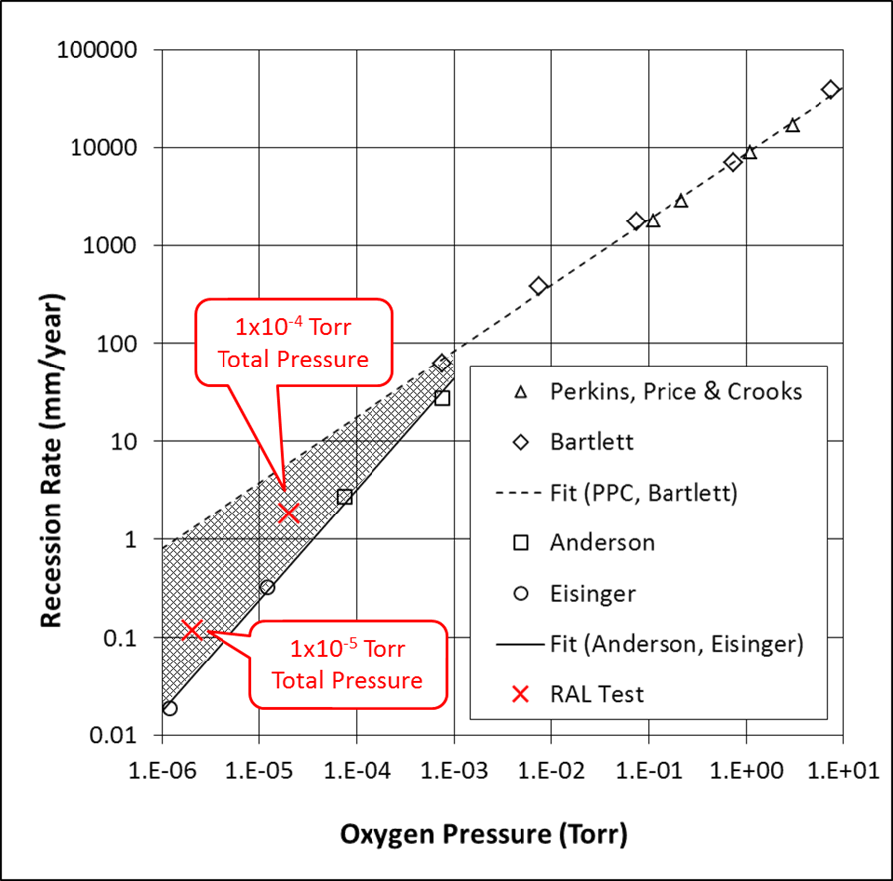
Main risk factors for the Mu2e baseline radiation cooled tungsten target
Oxidation of high temp tungsten in a poor vacuum
Thermal creep of the target (an issue with tungsten light bulb filaments)
Radiation damage of tungsten at very high temperature not well studied (NNL report)
Design already at limit with 8kW beam, no scope for power upgrade
P. Loveridge

Slide 3
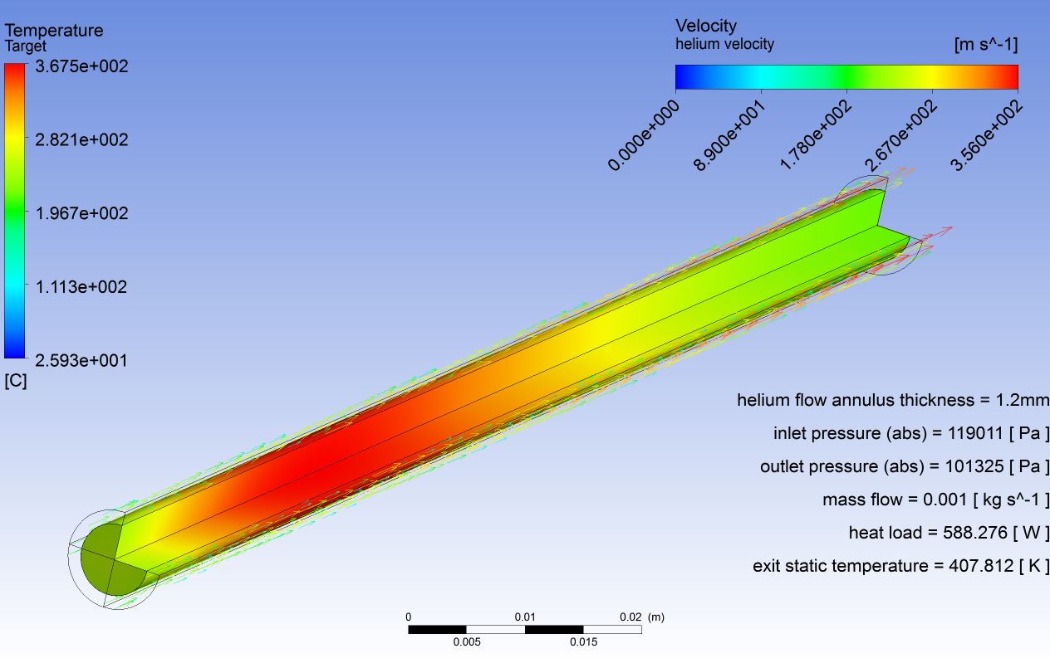
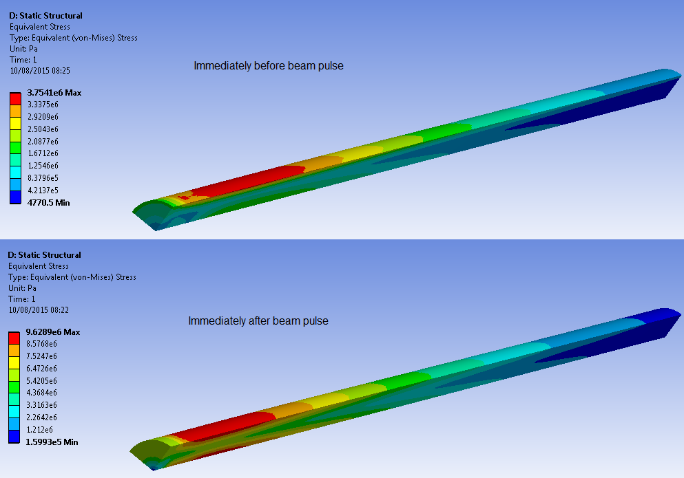
Helium cooled target
proton beam : 8GeV 8kW 1mm sigma
heat load = 588W
helium mass flow = 1g/s
max helium velocity = 356m/s
pressure drop = 0.2bar
max tungsten temperature = 368°C
temperature variation per pulse = 58°C
max von Mises stress = 10MPa
stress fluctuation = 6MPa

Slide 4
Residual Nuclei calculated with FLUKA
Predict 2e13 hydrogen nuclei/s
With 8kW beam power 1milligram of hydrogen per year
11cc of hydrogen gas at standard atmospheric conditions with calorific value of 140J
dealt with by occasional helium replacement during long service intervals?

Slide 5
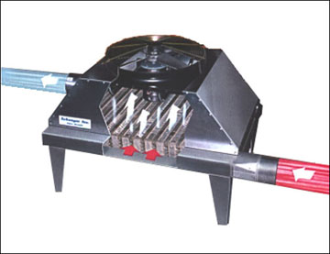
Helium Cooling Circuit
Heat exchangers:
Tube and fin helium to forced air convection units
Compressors:
Magnetic coupling driven, hermetically sealed aluminium scroll pump designed to compress helium
Approximate helium
operating conditions
1 – 40°C 1.25bar (abs)
2 – 40°C 1 bar (abs)
3 – 100°C 1.75bar (abs)
4 – 40°C 1.5 bar (abs)
5 – 40°C 1.5 bar (abs)
6 – 150°C 1.25 bar (abs)
Target:
Bicycle wheel design as per water cooled target design with helium delivered to target from an annular manifold system via thin supporting tubes

Slide 6
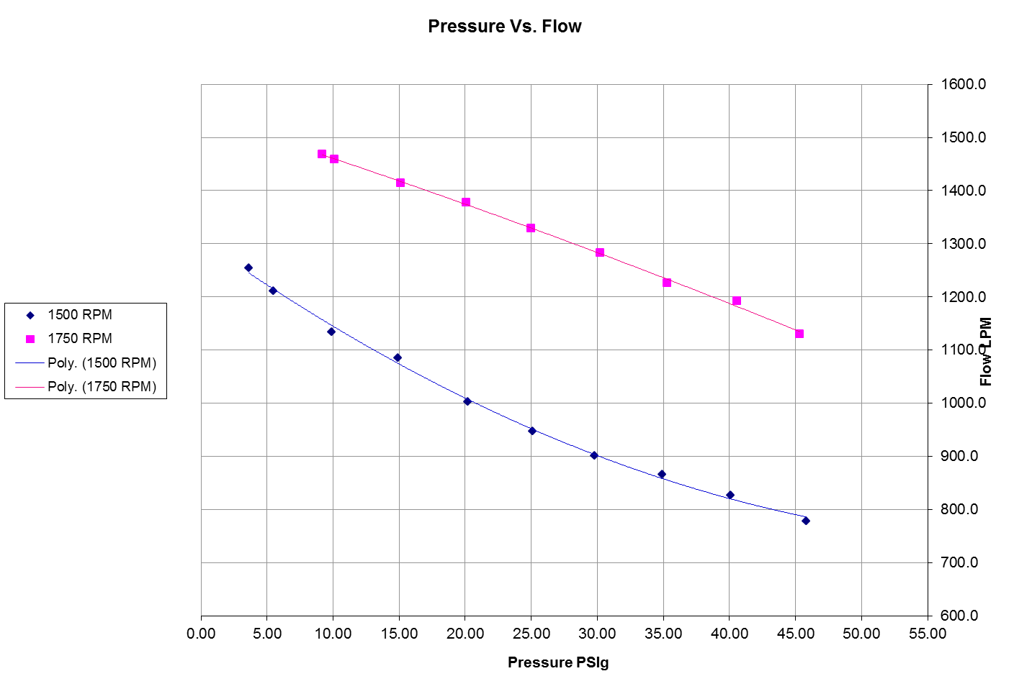
Scroll pump
Hermetically sealed mechanisms
Magnetic coupling drive systems
Patented bellows sealed scroll pump
Specifically designed to work on helium
Plot shows performance test of P25 scroll pump compressing helium
Performance in excess of Mu2e requirements with inlet temperature of 20°C
Air squared design be-spoke compressors for specific gases and temperature and pressure ratio requirements

Slide 7
Heat exchanger
Helium to Air heat exchanger
Large surface area (3m²) fin and tube structure
Forced air convection to chill helium back to target station air temperature
No additional water cooling circuit required

Slide 8
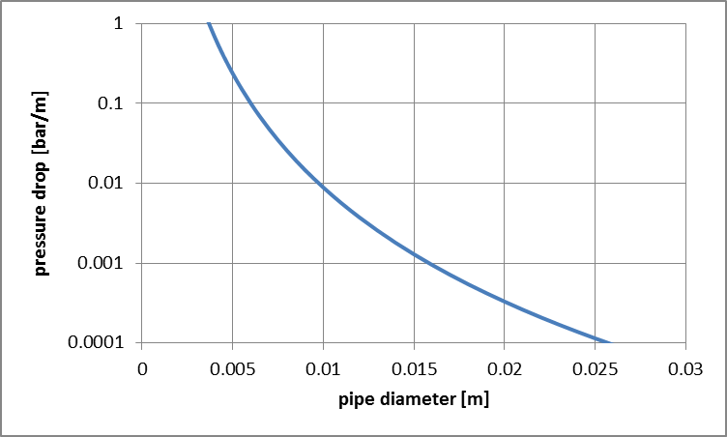
Connecting pipework
1gram/s of helium flowing down 25mm diameter pipe results in a pressure drop of 0.0001bar/m
0.01 bar for 100m of pipe
transport of helium between plant room and facility possible without requiring a significant pressure gradient.

Slide 9
Summary
Pros and Cons of a helium cooled target compared to a radiation cooled target
Pros | Cons
Lower temperature operation means -more favourable tungsten properties -lower stress magnitude -no risk of oxidation or chemical erosion / less contamination | Lower temp operation means tungsten may be brittle
A helium cooled target design could cope with beam power significantly higher than 8kW making a future upgrade possible without changing target technology | Requires additional plant including helium compressors and heat exchangers
Helium temperature measurements would act as a diagnostic for the health of the target | Residual nuclei such as hydrogen may build up in the closed helium circuit
Experience of operating tungsten targets at low temperature? | Requires a thin titanium can around tungsten target to form the helium cooling channel which may absorb some useful pions

Slide 10
Cost estimate of developing a helium cooled target
Description | Nominal Size | Estimated Cost in dollars
Helium cooled tungsten target with outer can to form helium cooling annular channel | 1cm diameter x 18cm long | 35k
Helium pipe work and valves | 1inch diameter pipe | 15k
Helium to Air heat exchanger, heat to be dissipated to hall air by convection from a finned radiator | 0.25m3 for each heat exchanger | 30k
Helium compressor and buffer tank if necessary | 1mx0.5mx0.5m for each compressor | 75k for two off the shelf machines modified for helium use 300k for two be-spoke machines
Vacuum pump and tank to provide helium circuit fill and emptying capability |  | 20k
Design and Development Effort |  | 2 man years 300k
Integration, manufacturing and installation effort |  | 2 man years 300k
 | TOTAL | 1000k$
Total similar to estimated budget for development of the radiation cooled target

