Slide 1
RaDIATE irradiation run at BNL’s BLIP facility
P. Hurh
2016 PASI Meeting
Fermilab
12 November 2016

Slide 2
Irradiation at BLIP
One of the only available facilities for high energy irradiation with high current and large beam spot size
Reasons for doing irradiations already presented in RaDIATE presentation
This presentation will give some of the details of what is planned thus far

Slide 3
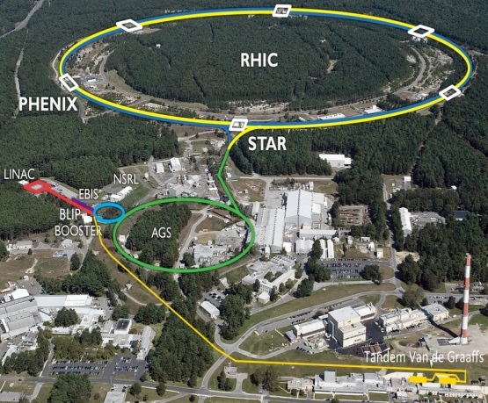
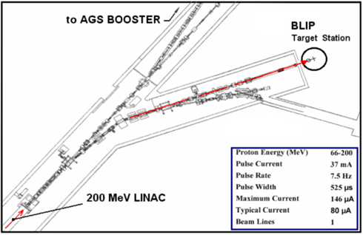
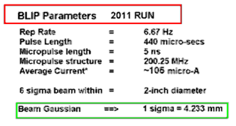
BLIP - Working Horse of Accelerator-based Irradiations
Slides from N. Simos (BNL)

Slide 4

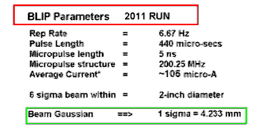
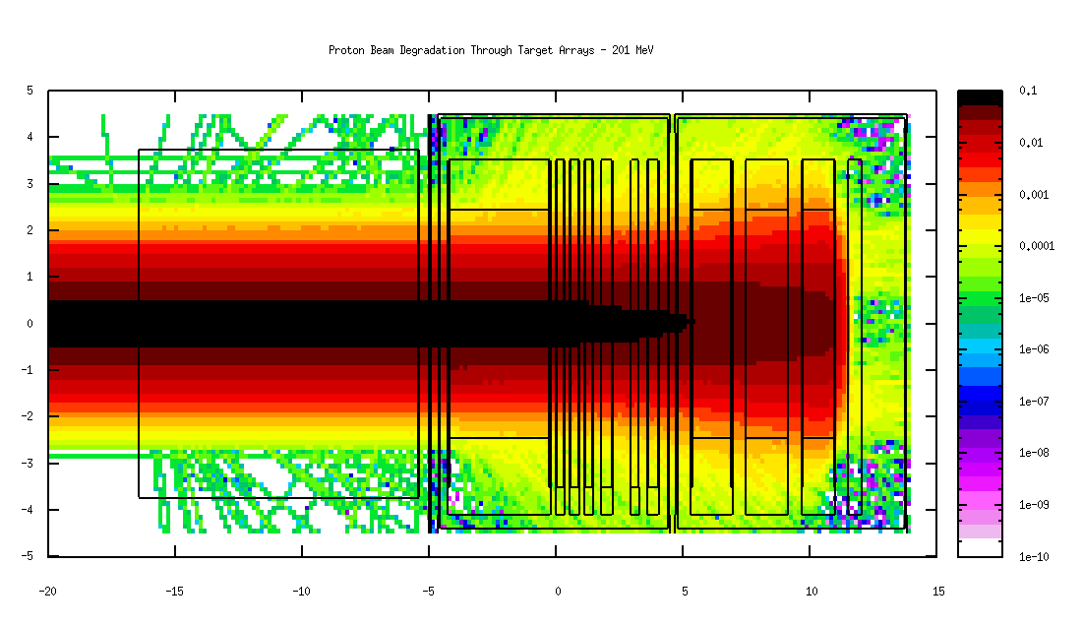
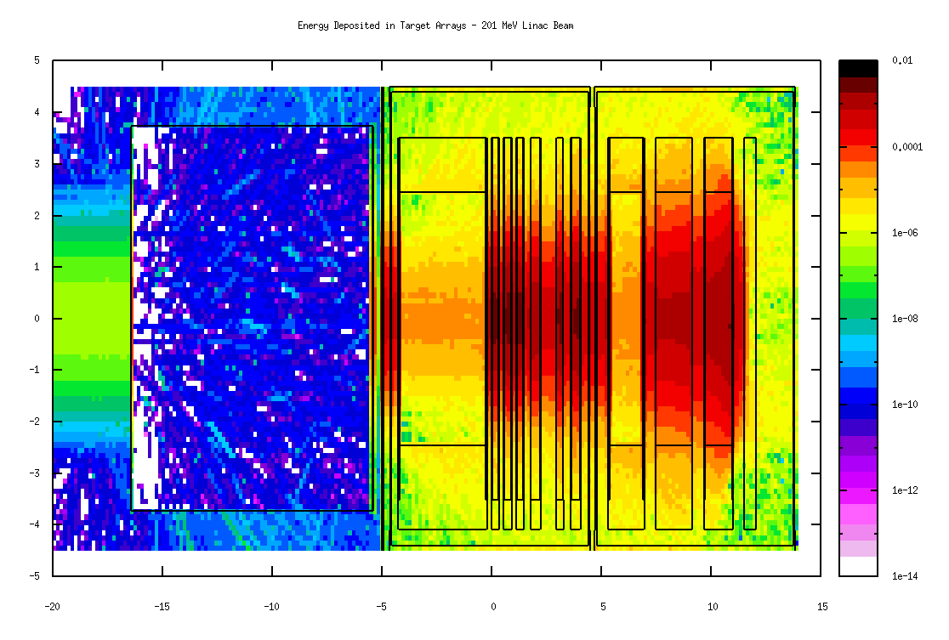
High Energy Proton Irradiation
(energies up to 200 MeV)
Material Irradiation Damage Studies for:
Large Hadron Collider (CERN)
Long Baseline Neutrino Experiment
Neutrino Factory
Challenging (and COSTLY) irradiation mode
due to simultaneous isotope production
Isotope array
Isotope array
Slides from N. Simos (BNL)

Slide 5
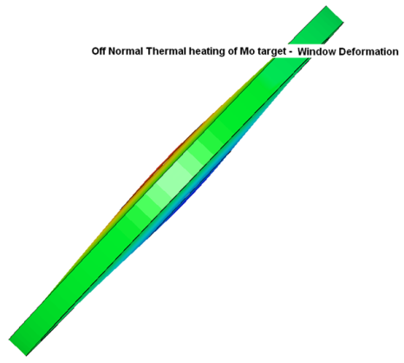
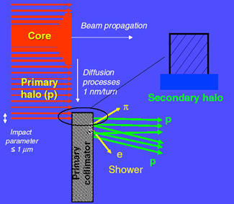
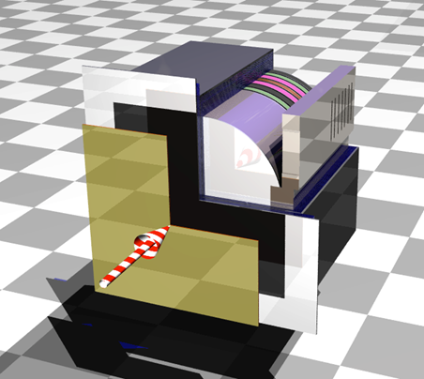
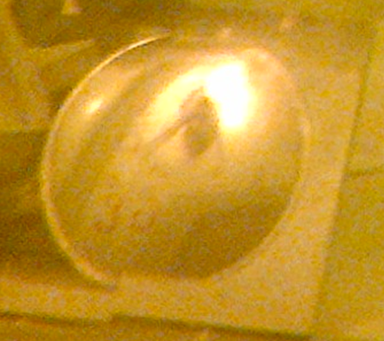
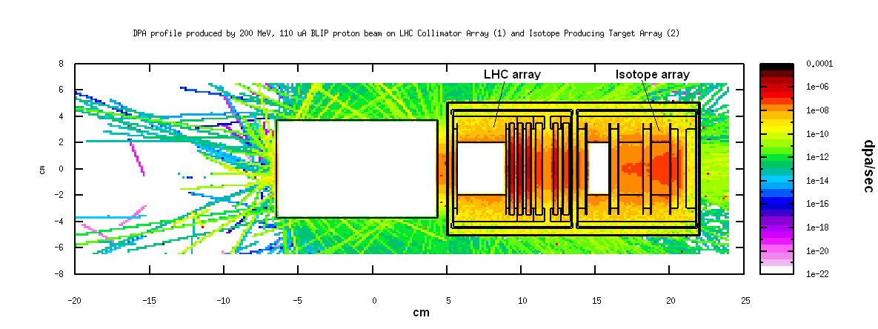
Slides from N. Simos (BNL)

Slide 6
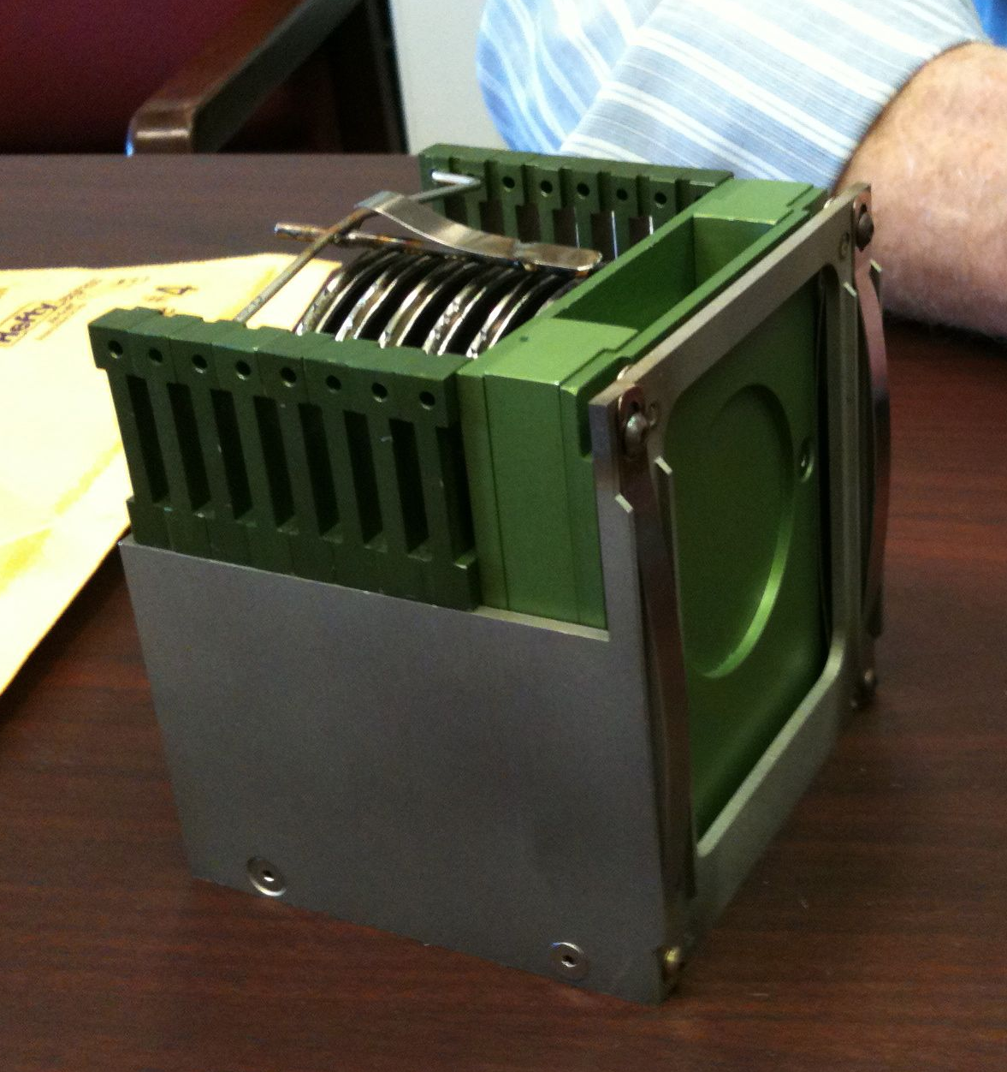
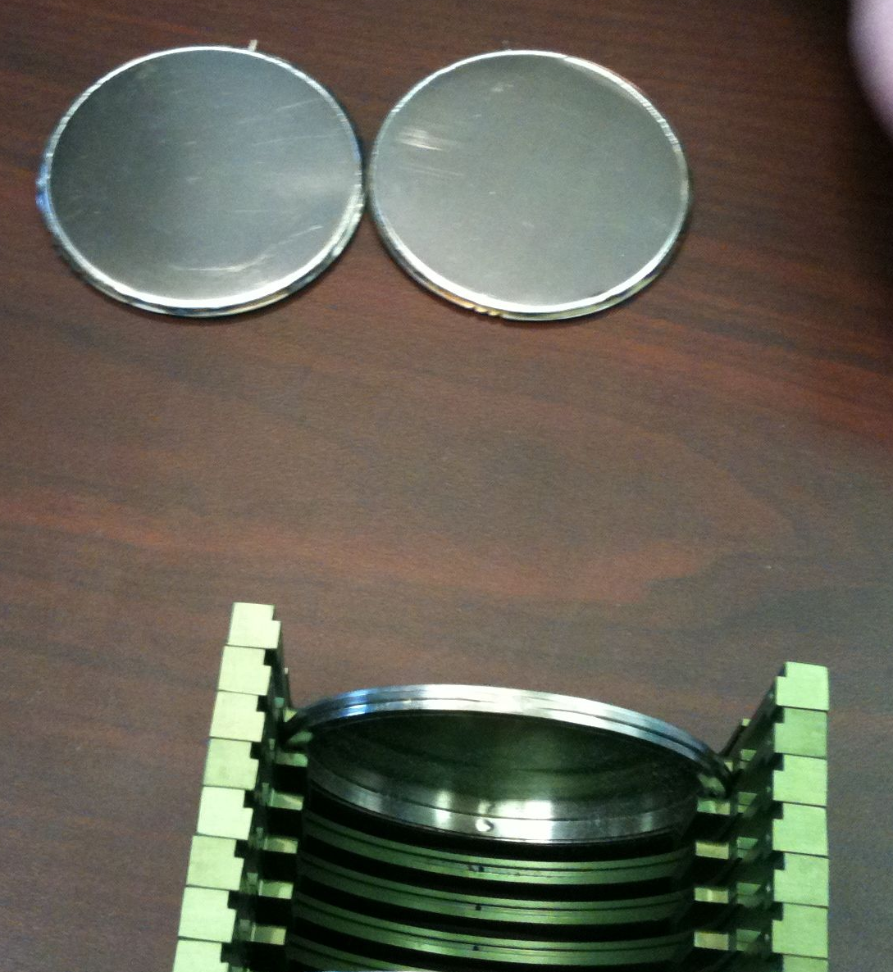
Capsule and Basket from 2010

Slide 7
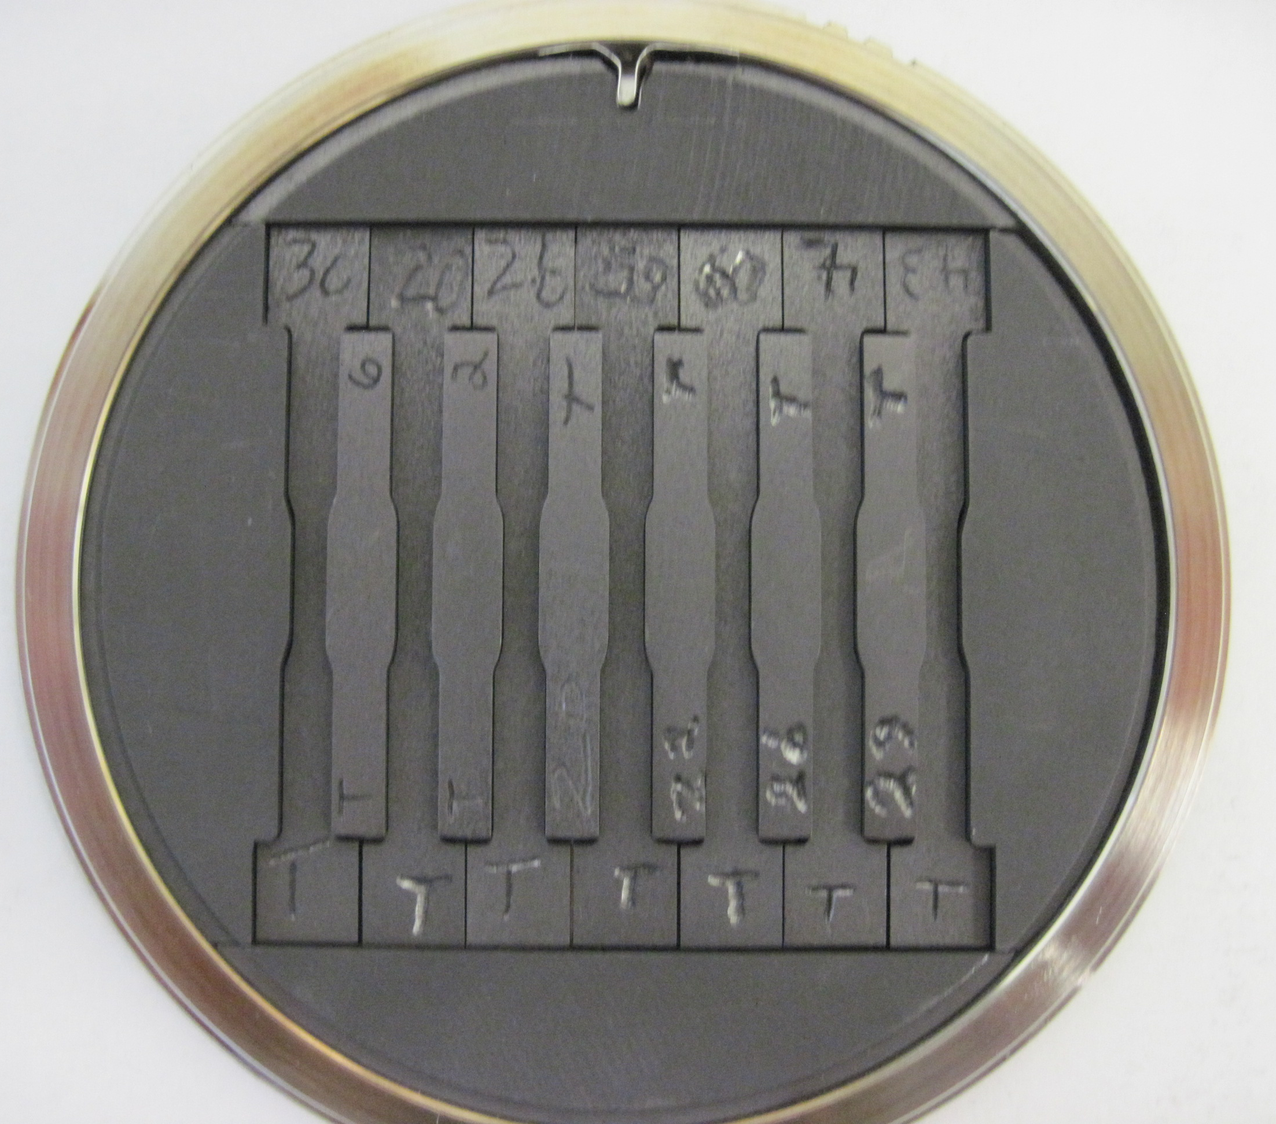
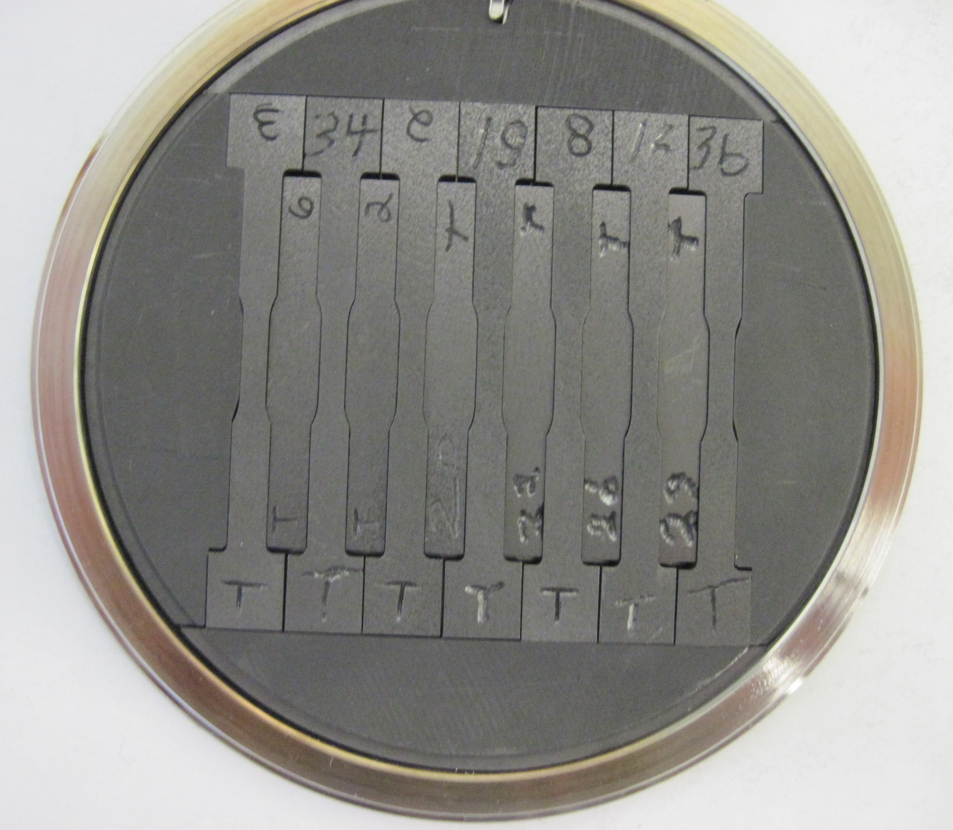
Capsule loaded with samples

Slide 8
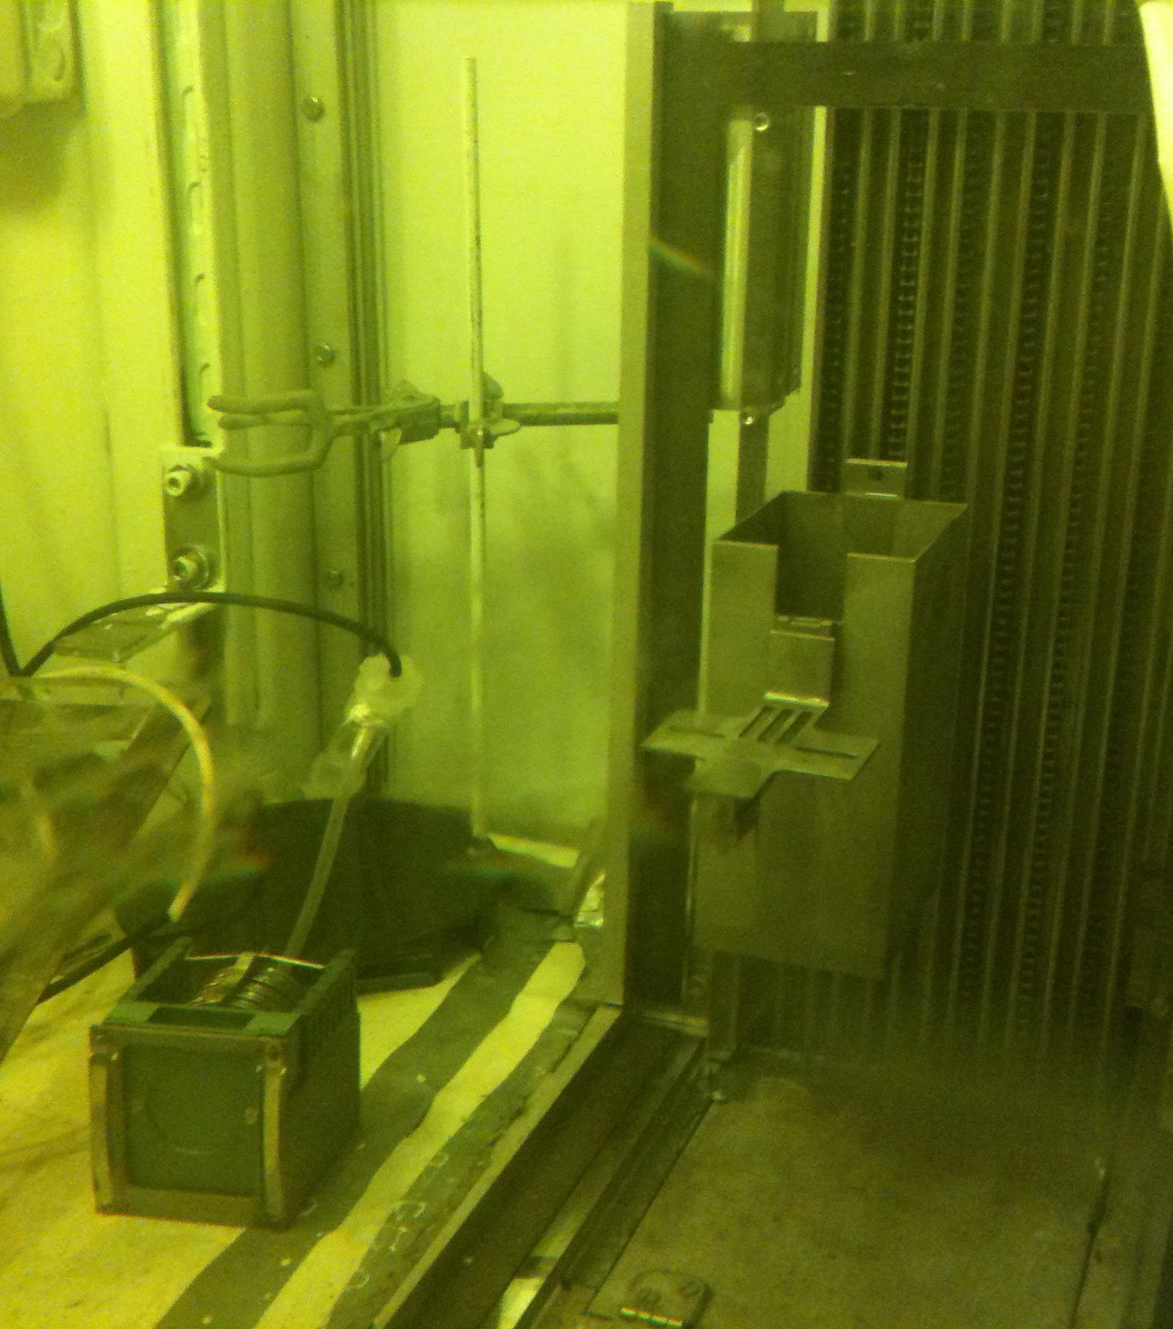
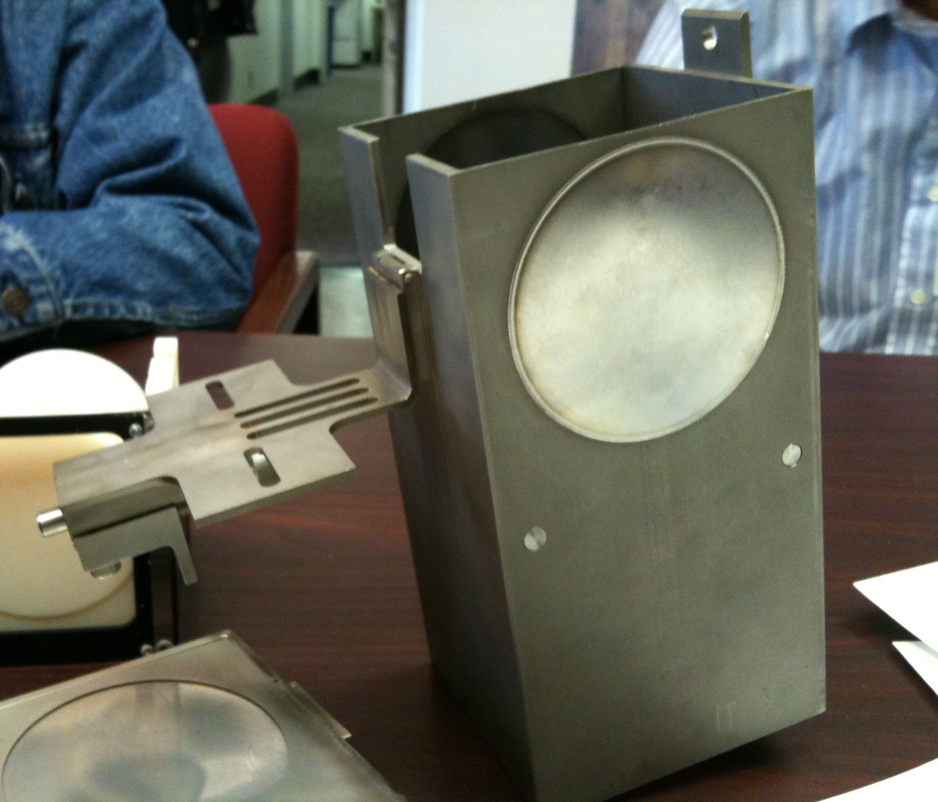
BLIP drive box and basket

Slide 9
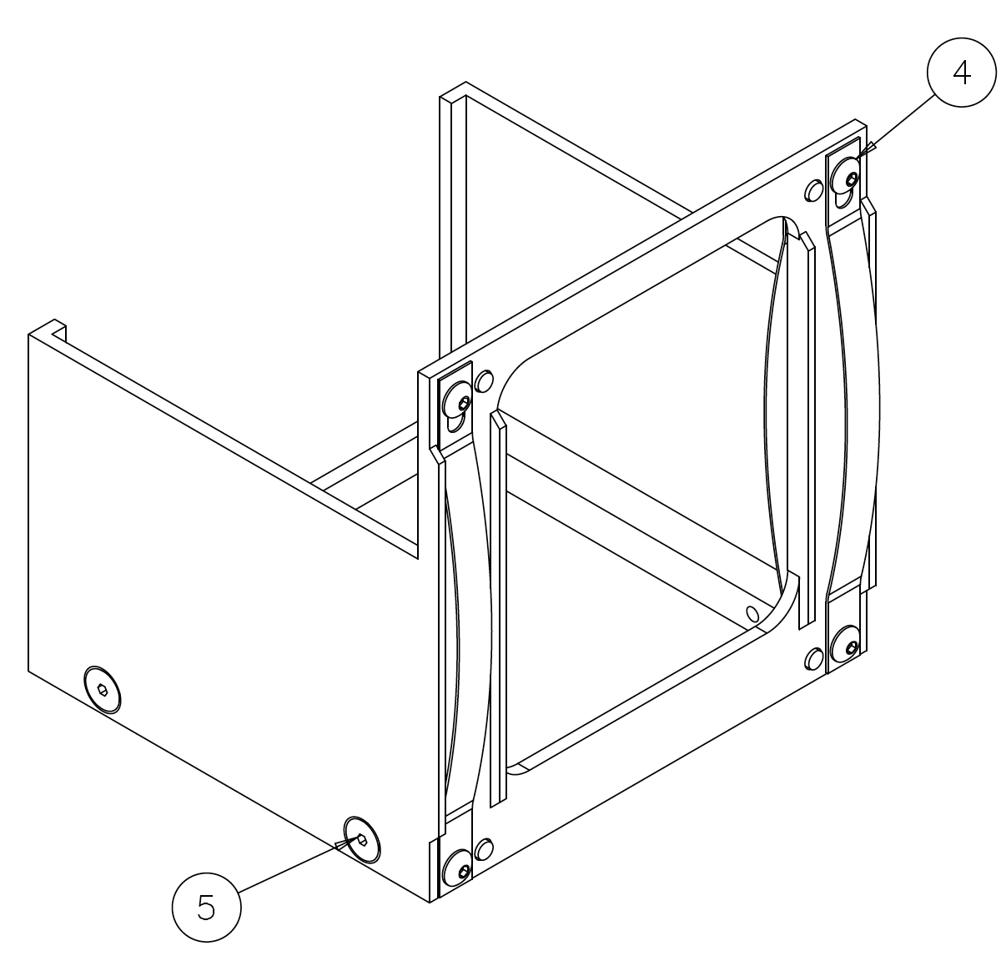
Drawings and Layouts

Slide 10
Experiment Matrix Spreadsheets
Input spreadsheet:
  BLIP Input Master Spreadsheet
  Ask for what participants are interested in irradiating
First pass proton energy budget spreadsheet:
  Proton Energy Budget Spreadsheet
  Our samples are upstream of the isotope production targets
  Our samples must degrade the beam to a pre-determined energy spectrum to ensure only a 20% loss in isotope production yield
Capsule & Sample spreadsheet:
  Capsule-Sample Spreadsheet
  Groups materials into capsules
MARS Analysis first pass results spreadsheet:
  MARS Results spreadsheet
  First pass at 200 MeV for Edep, DPA and gas production, residual dose needs additional post-processing

Slide 11
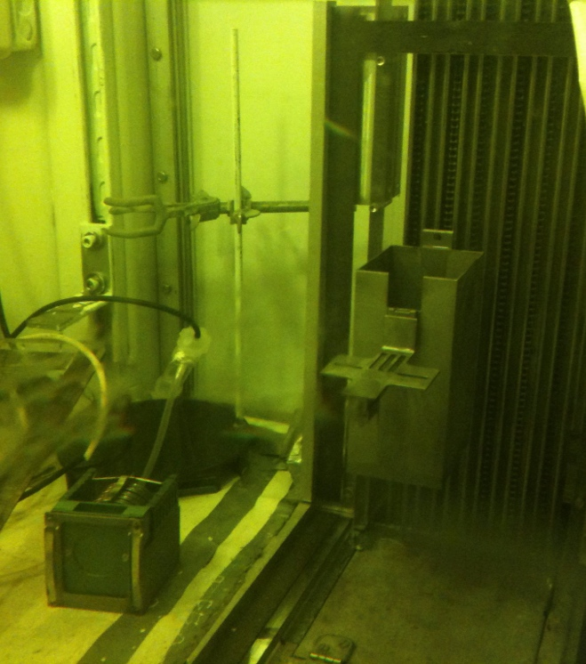
RaDIATE Upcoming Activities₍₁₎
RaDIATE Irradiation Run at BLIP-BNL
  In planning stage now
  Materials considered:
    Beryllium (4 grades)
    Glassy Carbon
    Si & SiC
    Titanium 6Al-4V (Grade 5 & 23)
    C-C Composite
    Graphite (IG-430 & POCO ZXF-5Q)
    Aluminum 6061-T6 & 5754-O
    TZM
    Molybdenum
    Tungsten
    Iridium
    MAX Phase Ti₃SiC₂
  8-12 week irradiation time
    0.06 DPA for Be; 1-3 DPA for Ti
  PIE funded and coordinated by each “User”
    PIE suppliers most likely PNNL, BNL, Oxford

Slide 12
Next Steps
Users: Review Test Matrix ASAP
  Confirm materials, number of layers, thicknesses, sample types
  Work with PIE suppliers to obtain acceptable sample geometries
  Review dose and temperature requirements
BNL: Identify nominal beam parameters
  Likely average beam current or flux
  Likely beam spot size
  Acceptable running periods (how long of a run is possible?)
Fermilab: Simple Calculations and Simulations
  Peak DPA per material
  Energy deposition
  First pass thermal calculation to identify capsules needing insulating layers
  First pass residual dose calculations
    High-Z materials may be too hot to handle!
    Possibility to exchange high-z sample capsules during run?

Slide 13
Goal of these next steps
Identify test matrix modifications to accommodate PIE requirements
Provide information for detailed sample and capsule design
Identify capsules/materials needing thermal insulation to reach acceptable irradiation temperatures
Assess expected total DPA and weigh against expectations
Get Users to start communicating with PIE suppliers to ensure sound experiment design
Allow scheduling of the run with the packed BLIP schedule

Slide 14
Meeting at BNL Nov 23 - 25
Meeting with majority of users planned for Nov 23 – 25 at BNL to:
  Tour facility
  Plan for sample and capsule geometry
  Set time-tables
  Discuss PIE capabilities
  Plan for PIE
Perhaps another meeting at BNL early in 2016

Slide 15
Other materials of interest?
If there are other materials of interest to include:
  Will “bump” other materials out of proton energy budget
  Almost too late to include
  Please let me know ASAP

Slide 16
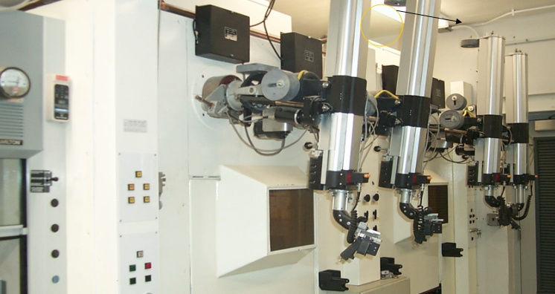
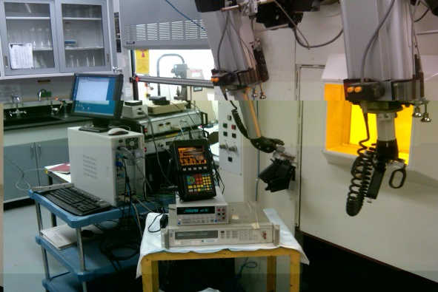
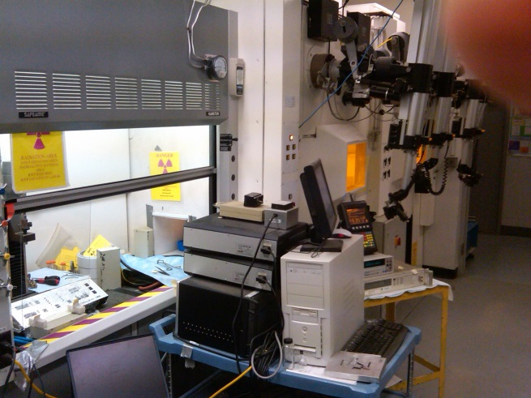
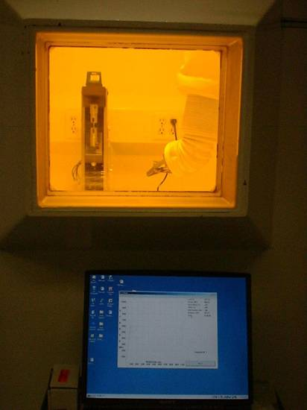
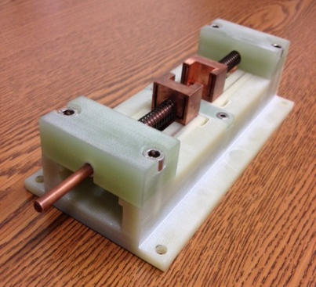
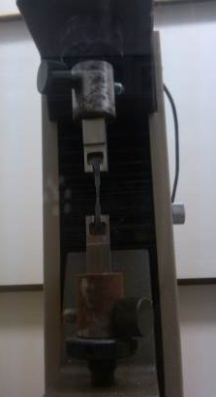
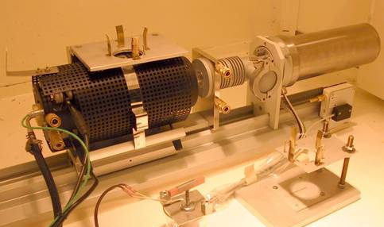
BNL Post-Irradiation Isotope Extraction/Processing Facility
Experimental Facility occupies 2 hot cells and a HEPA-filtered fume hood
PIE analyses performed are:
Stress-strain (tension, 3-point and 4-point bending)
Thermal Expansion and annealing (extremely sensitive dilatometer)
Thermal Conductivity (electrical resistivity)
Magnetic Whole probe
Ultrasonic measurements
PLUS
Photon spectra and isotopic analysis
Activity measurements
Weight loss or gain

Slide 17
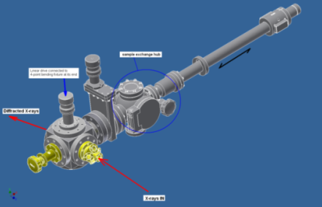
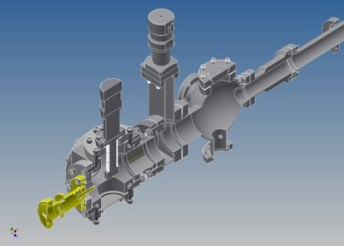
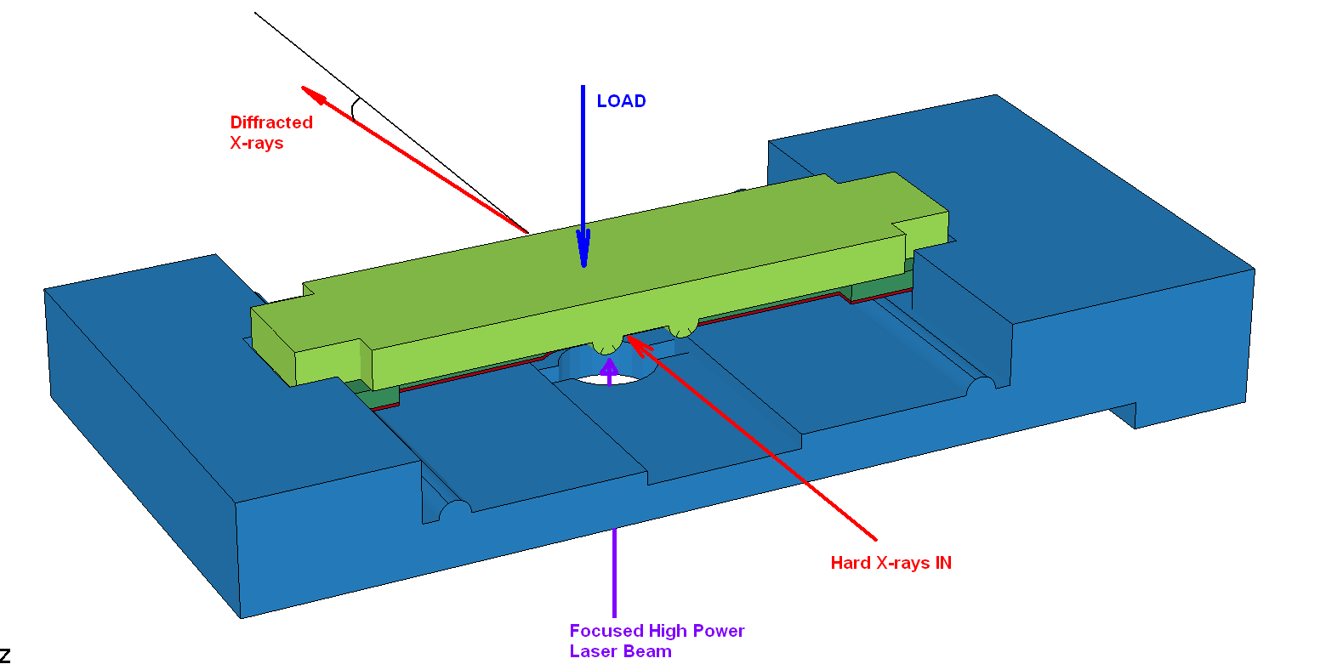
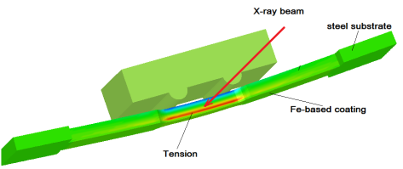
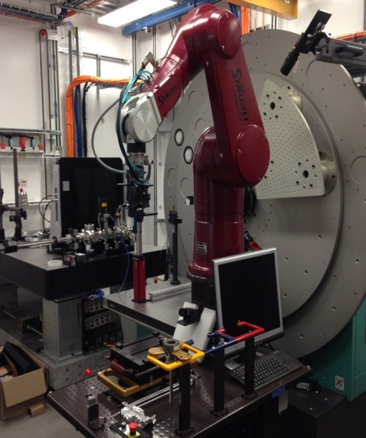
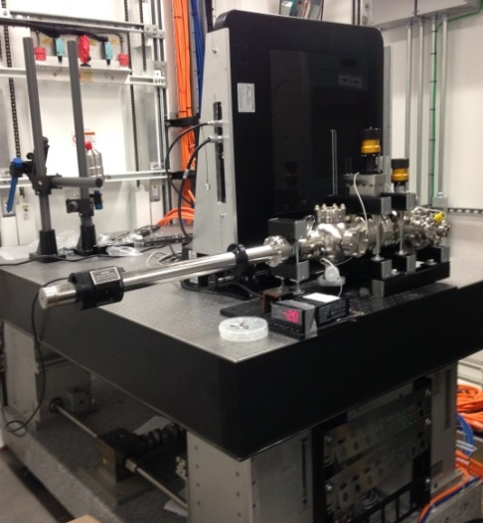
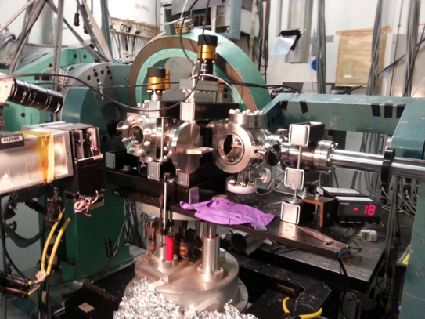
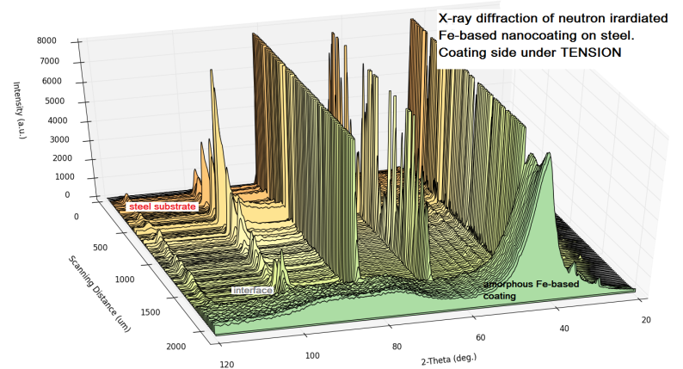
BNL Post-Irradiation Facilities X-ray Diffraction at NSLS II
X-ray diffraction studies of irradiated samples with the aid of a multi-functional experimental stage enabling:
Laser-induced annealing
Tension/twisting/4-point-bending
Exposure to different environments
Diamond anvil cell to be introduced in future update
Stage at NSLS II XPD Beamline

Slide 18
PNNL’s RPL
D. Asner PNNL
Notes:
Remove

Slide 19
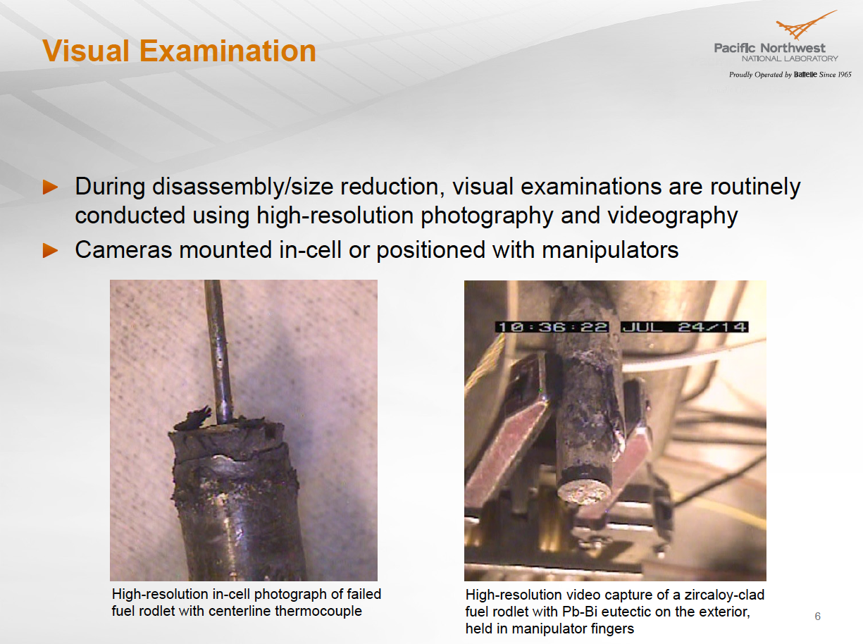

Slide 20
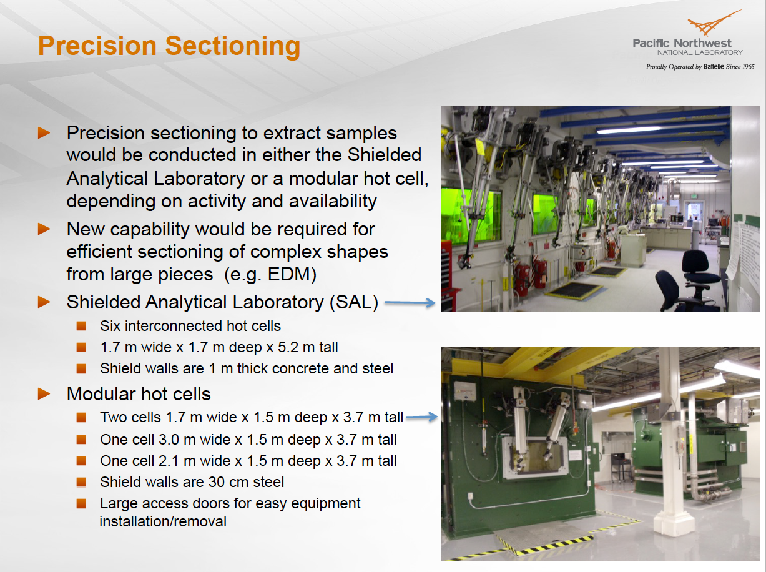

Slide 21
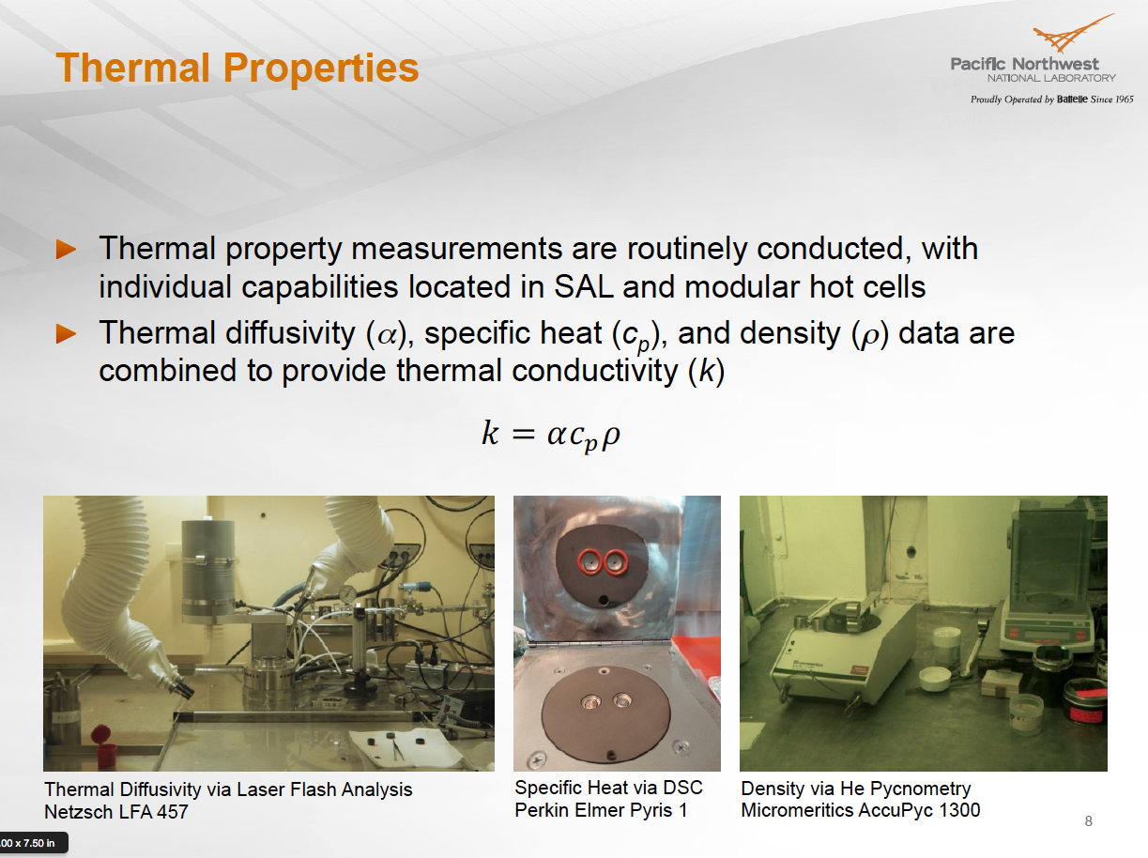

Slide 22
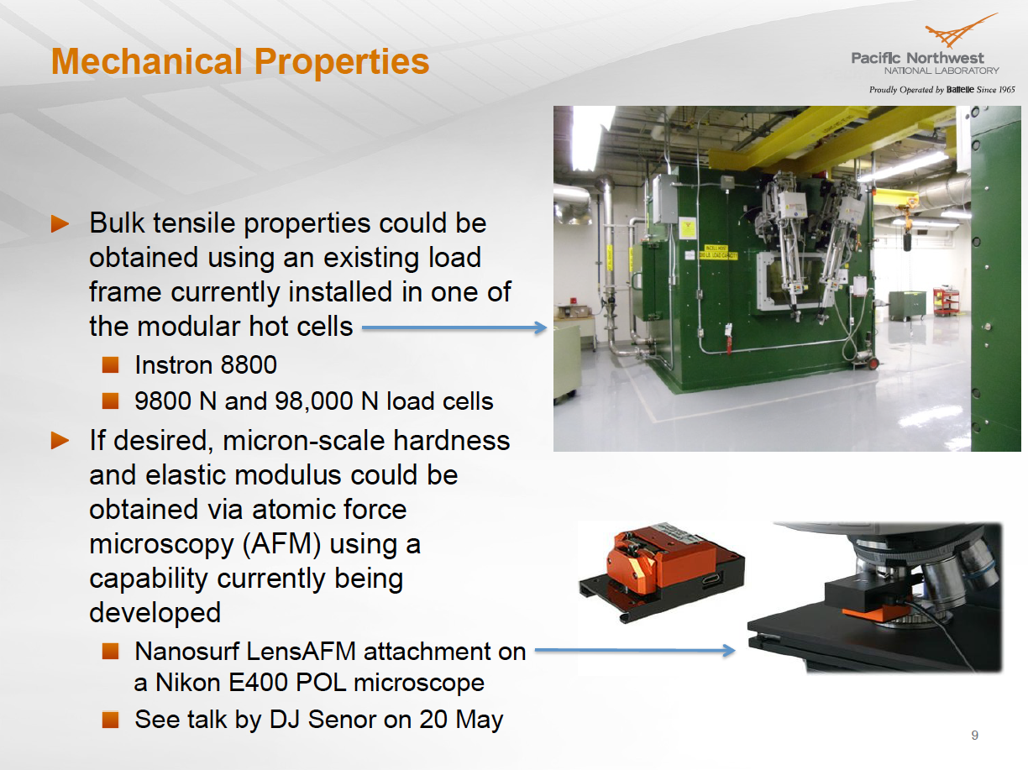

Slide 23
