Slide 1
HRMT24 BeGrid Experiment
Preliminary Results
Kavin Ammigan
Proton Accelerators for Science and Innovation Workshop
11-13 November, 2015

Slide 2




Collaborating Institutions
P. Hurh
R. Zwaska
B. Hartsell
K. Ammigan
R. Losito
M. Calviani
M. Butcher
M. Guinchard
S. Roberts
V. Kuksenko
C. Densham
A. Atherton
M. Fitton
J. O’Dell
T. Davenne
P. Loveridge
O. Caretta
G. Burton
CERN HiRadMat team and support groups:
A. Fabich, A. Bouvard, V. Clerc, L. Lacny, G. Vorraro, T. Lefevre, et al.

Slide 3
Motivation and Objectives
Investigate the use of beryllium as windows and targets for future high intensity particle accelerator facilities
Help successfully design and operate these components
Experiment objectives
Explore the onset of failure modes in beryllium under controlled conditions of highly localized strain rates and temperatures
Identify thermal shock limits of different beryllium grades
Validate highly non-linear numerical models with experimental measurements

Slide 4
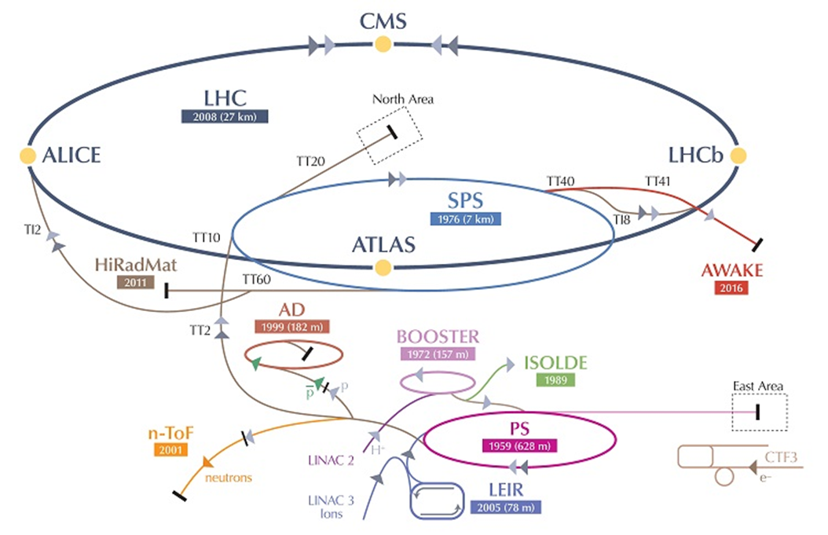
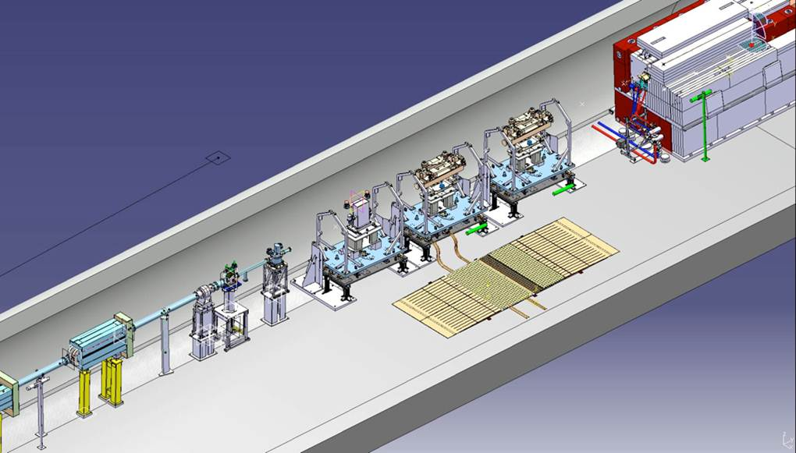
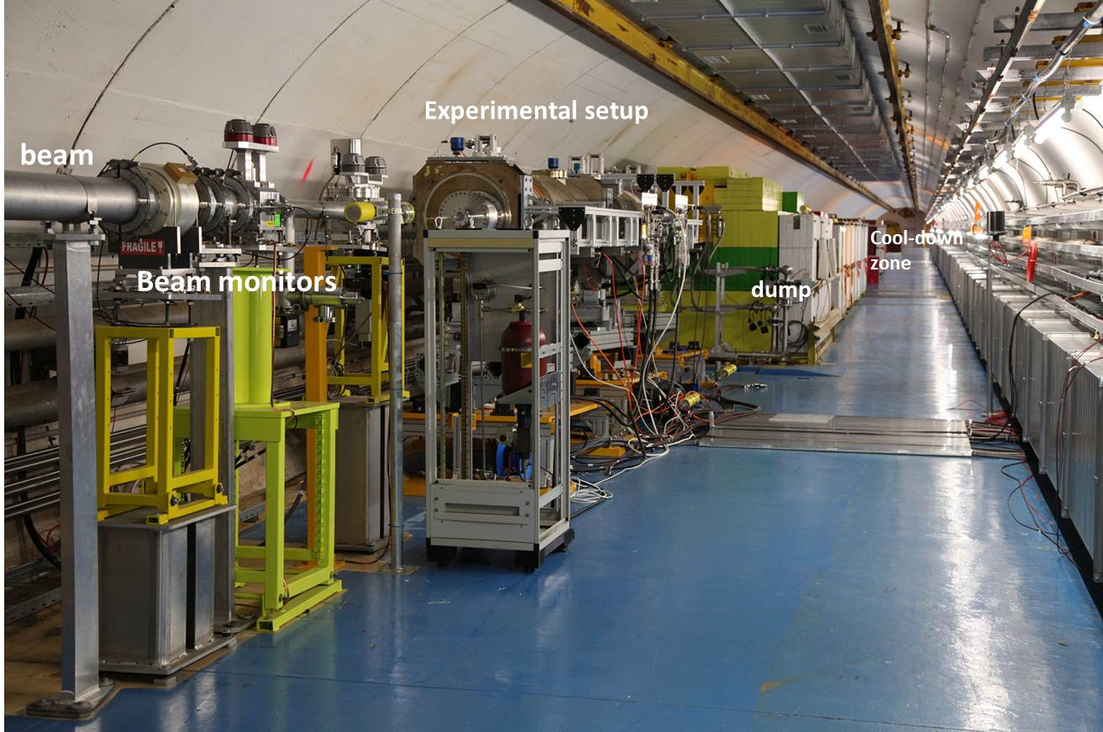
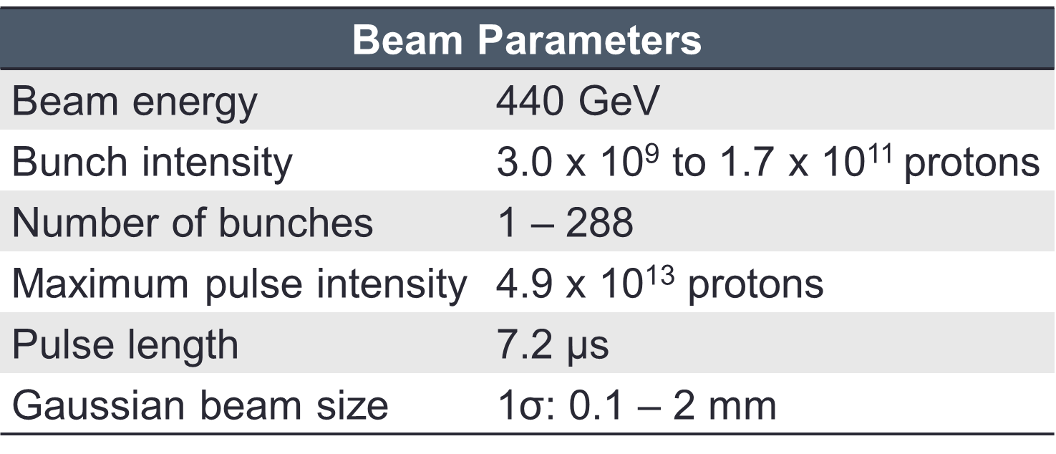
CERN’s HiRadMat Facility
‘single-shot’ experiments with 10¹⁶ POT/year limit

Slide 5
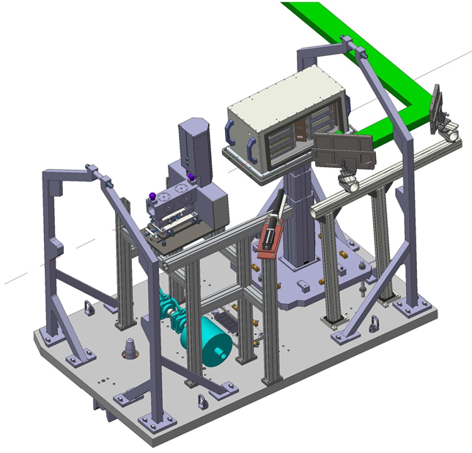
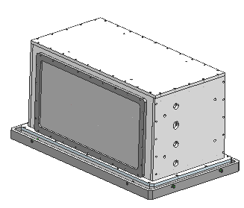
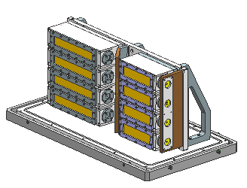
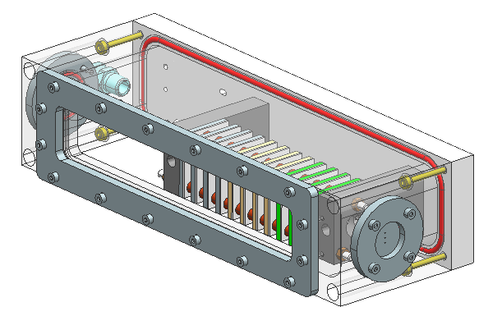
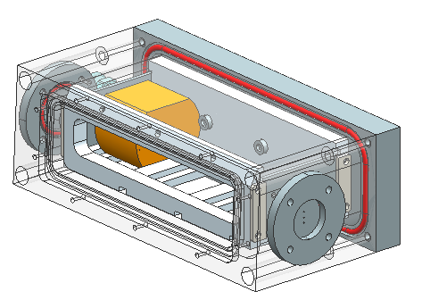
Experimental Set-up
Optical path
Experiment chamber
BPKG/BTV assembly
Mirrors
beam
Vertical lift tower
Rad-hard camera
HiRadMat mobile table
HEPA filter

Slide 6
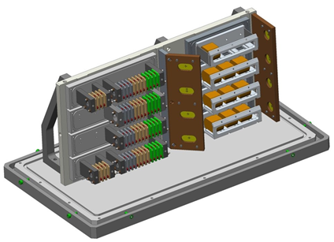
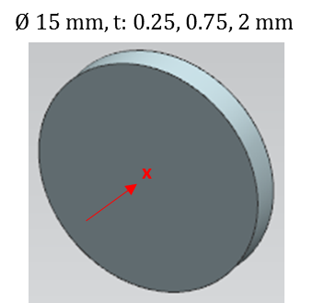
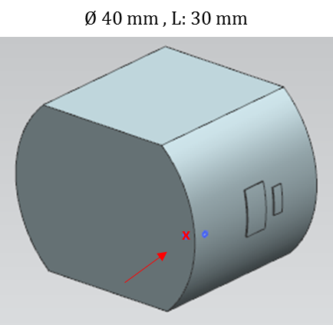
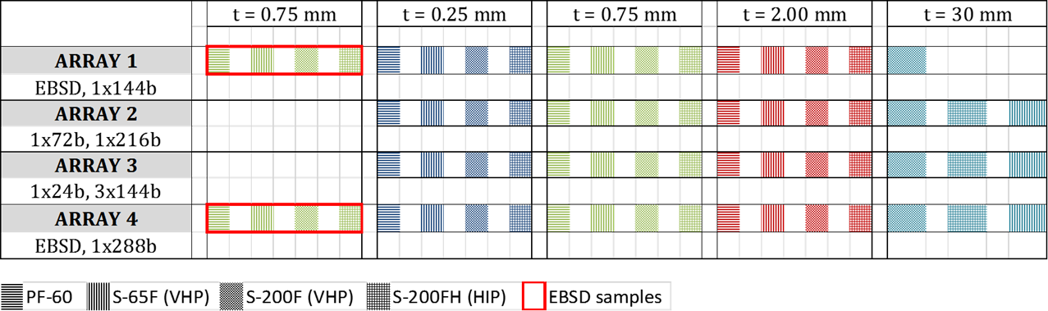
Test Matrix
Gafchromic foils
Specimen types
Cylindrical ‘slugs’ samples
Thin disc samples

Slide 7
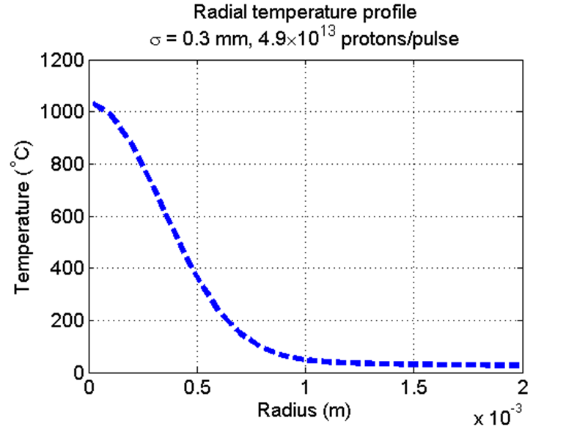
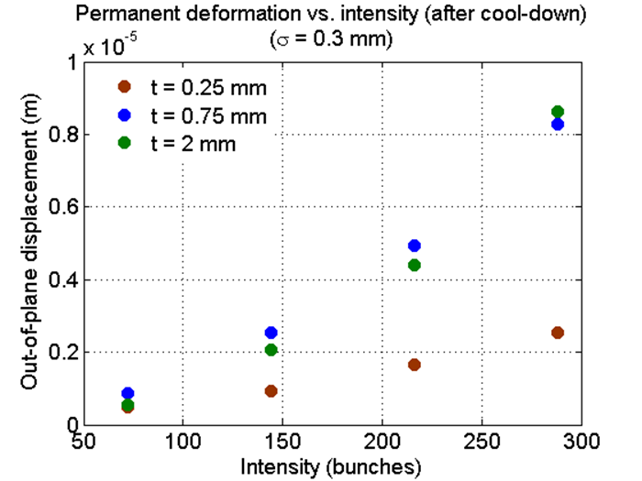
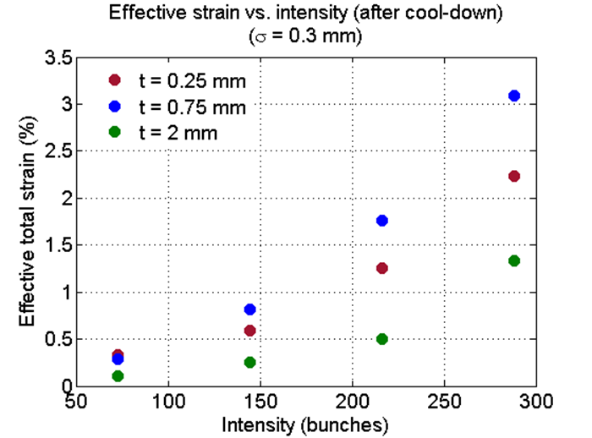
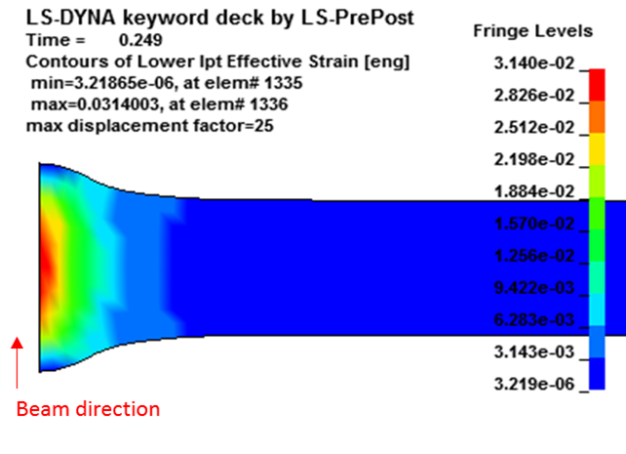
Numerical Simulations
Beam σ = 0.3 mm chosen to push beryllium to just below its melting point (1290 ◦C)
Peak ΔT for max. intensity pulse ~ 1050 ◦C
Thermal shock expected due to large temperature gradient in material

Slide 8
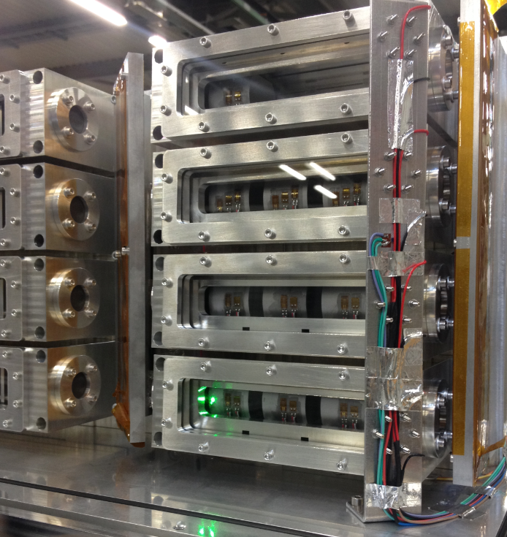
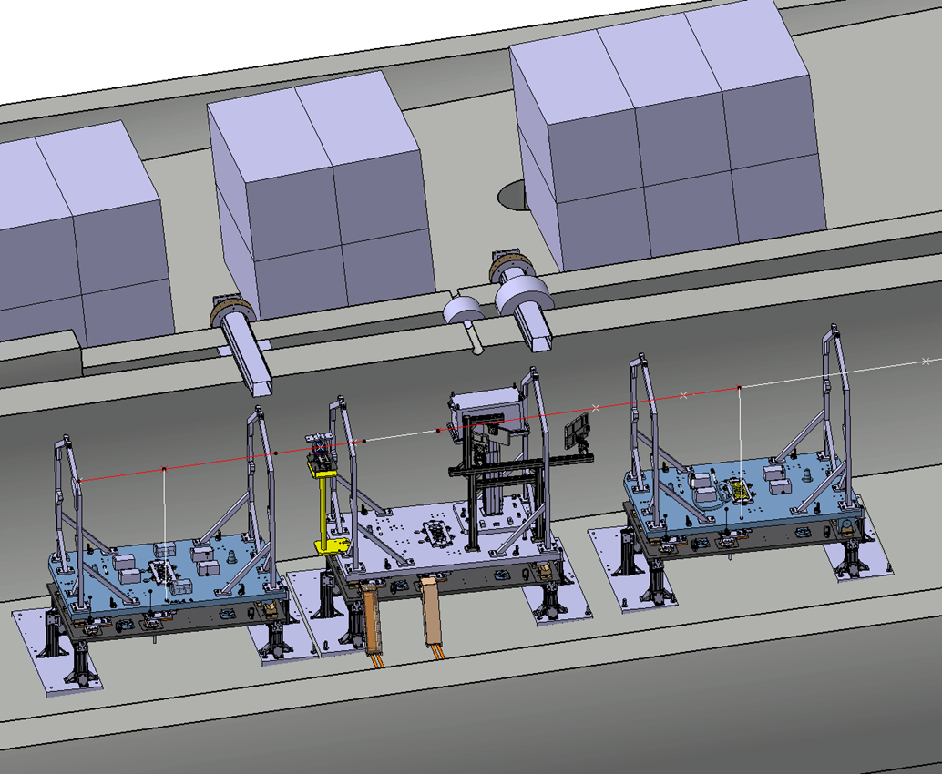
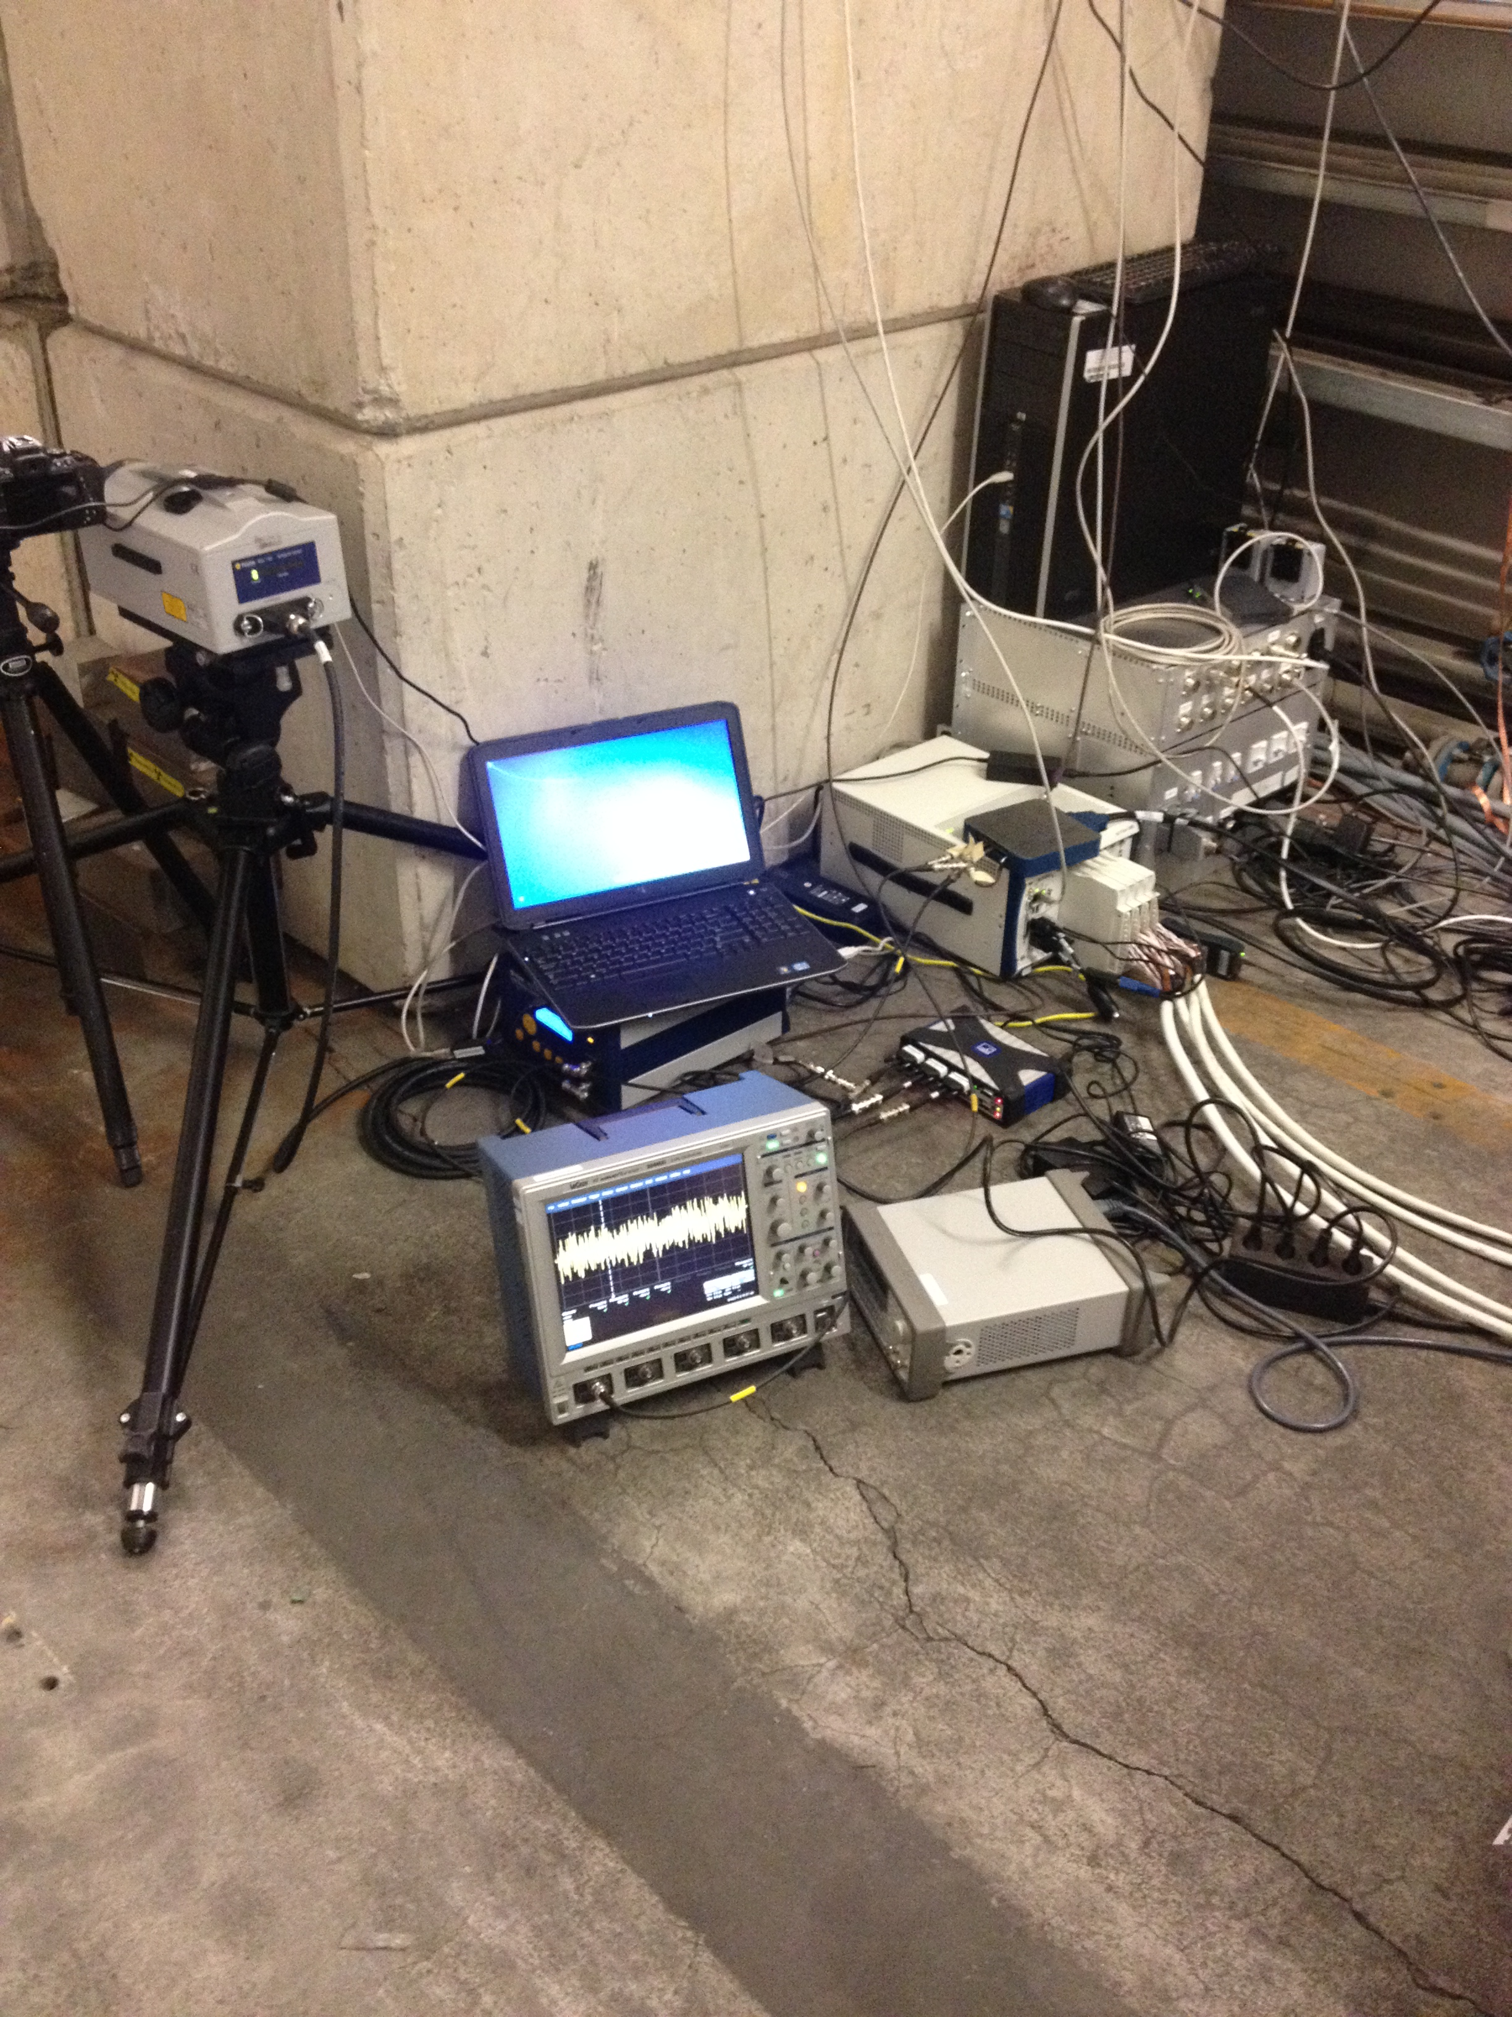
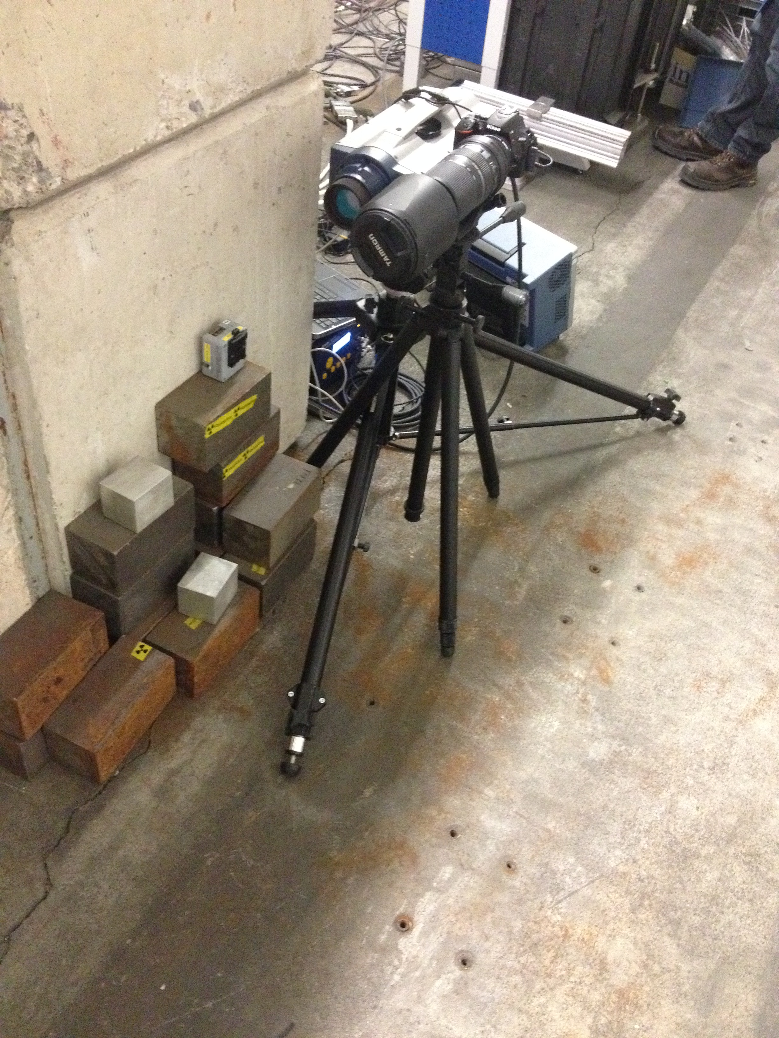
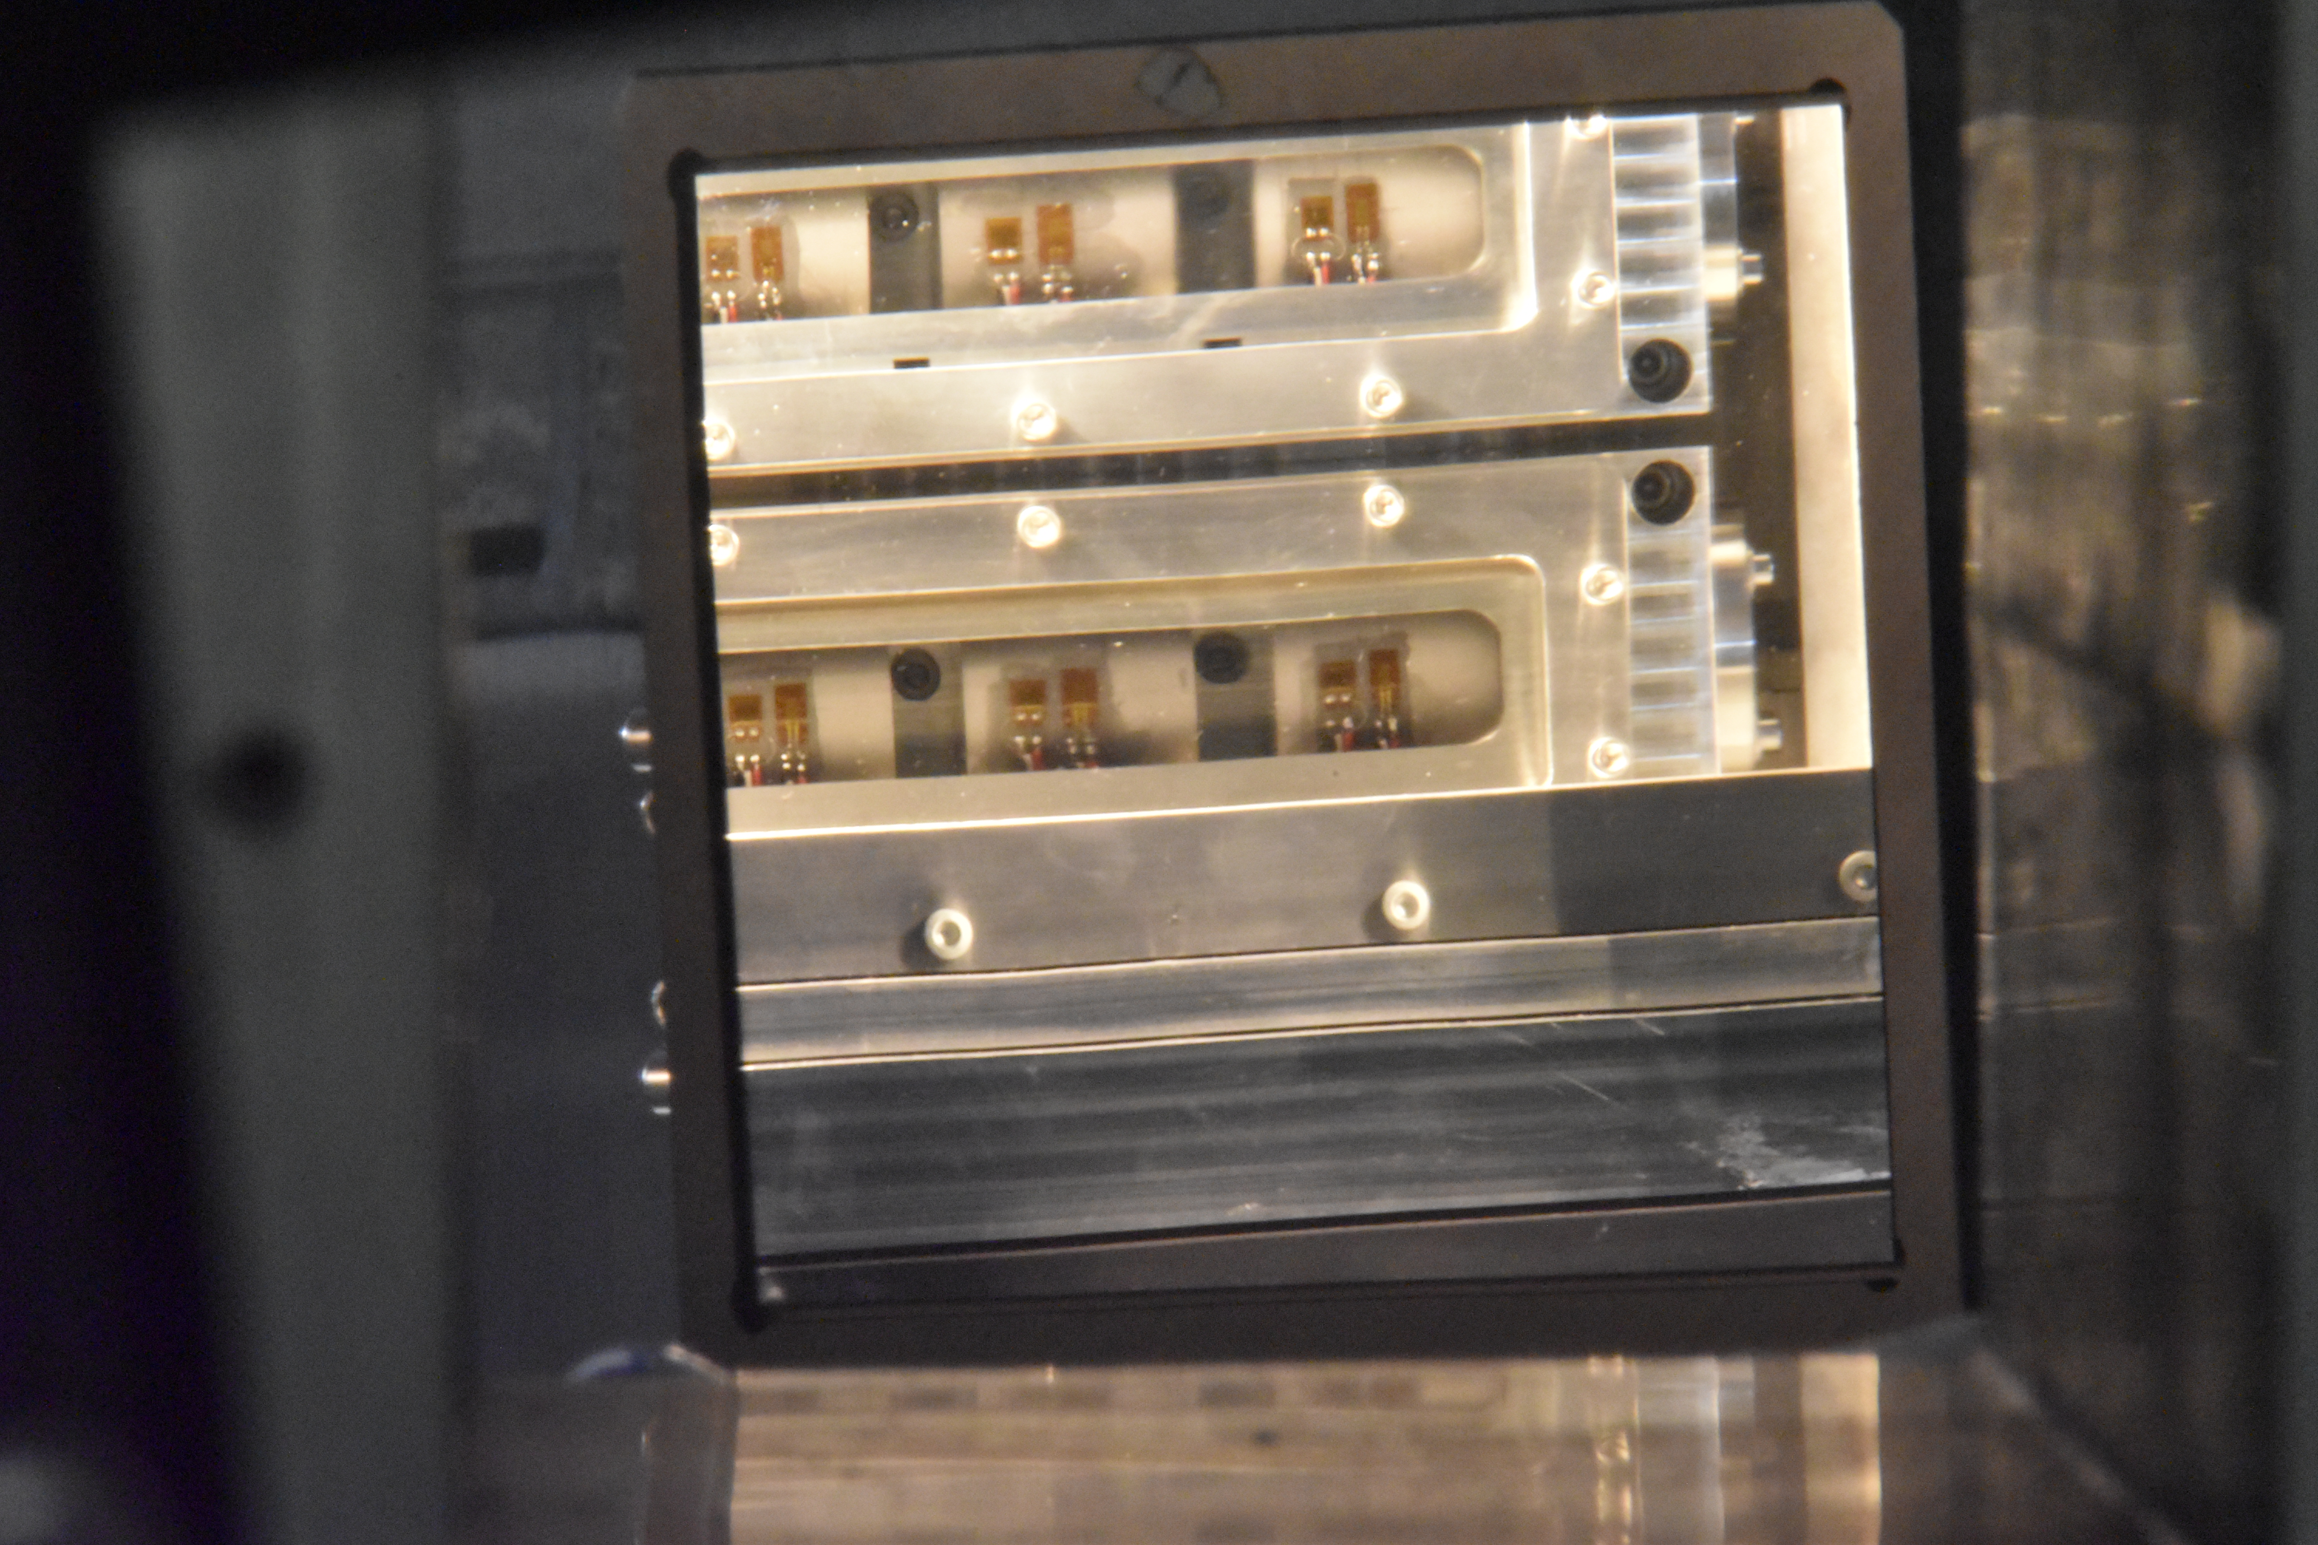
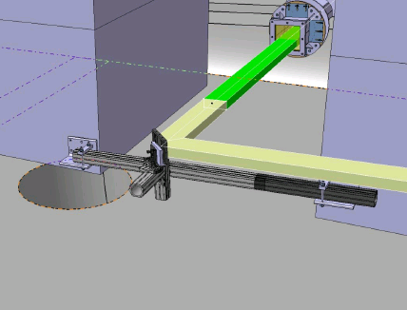
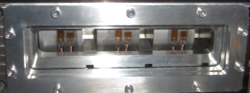
Instrumentation list
Physical measurements (slugs)
  Circumferential strain
  Temperature
  Radial displacement and velocity (LDV)
Camera for online visual monitoring
LDV spot
Beam alignment
  Rad-hard camera for foil imaging
  BPKG/BTV
Strain gauge
Temperature sensor

Slide 9
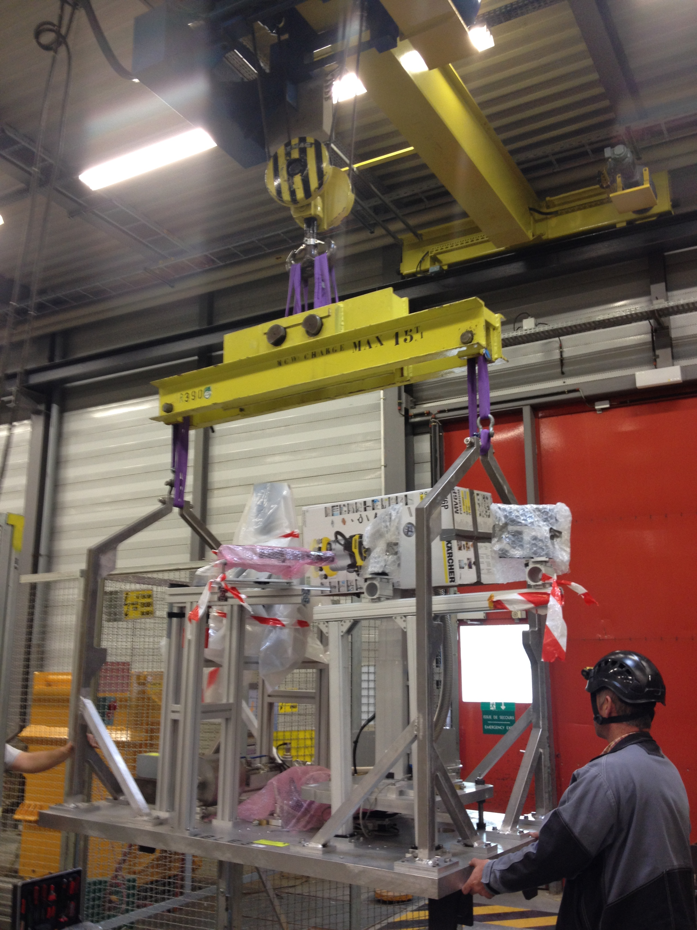
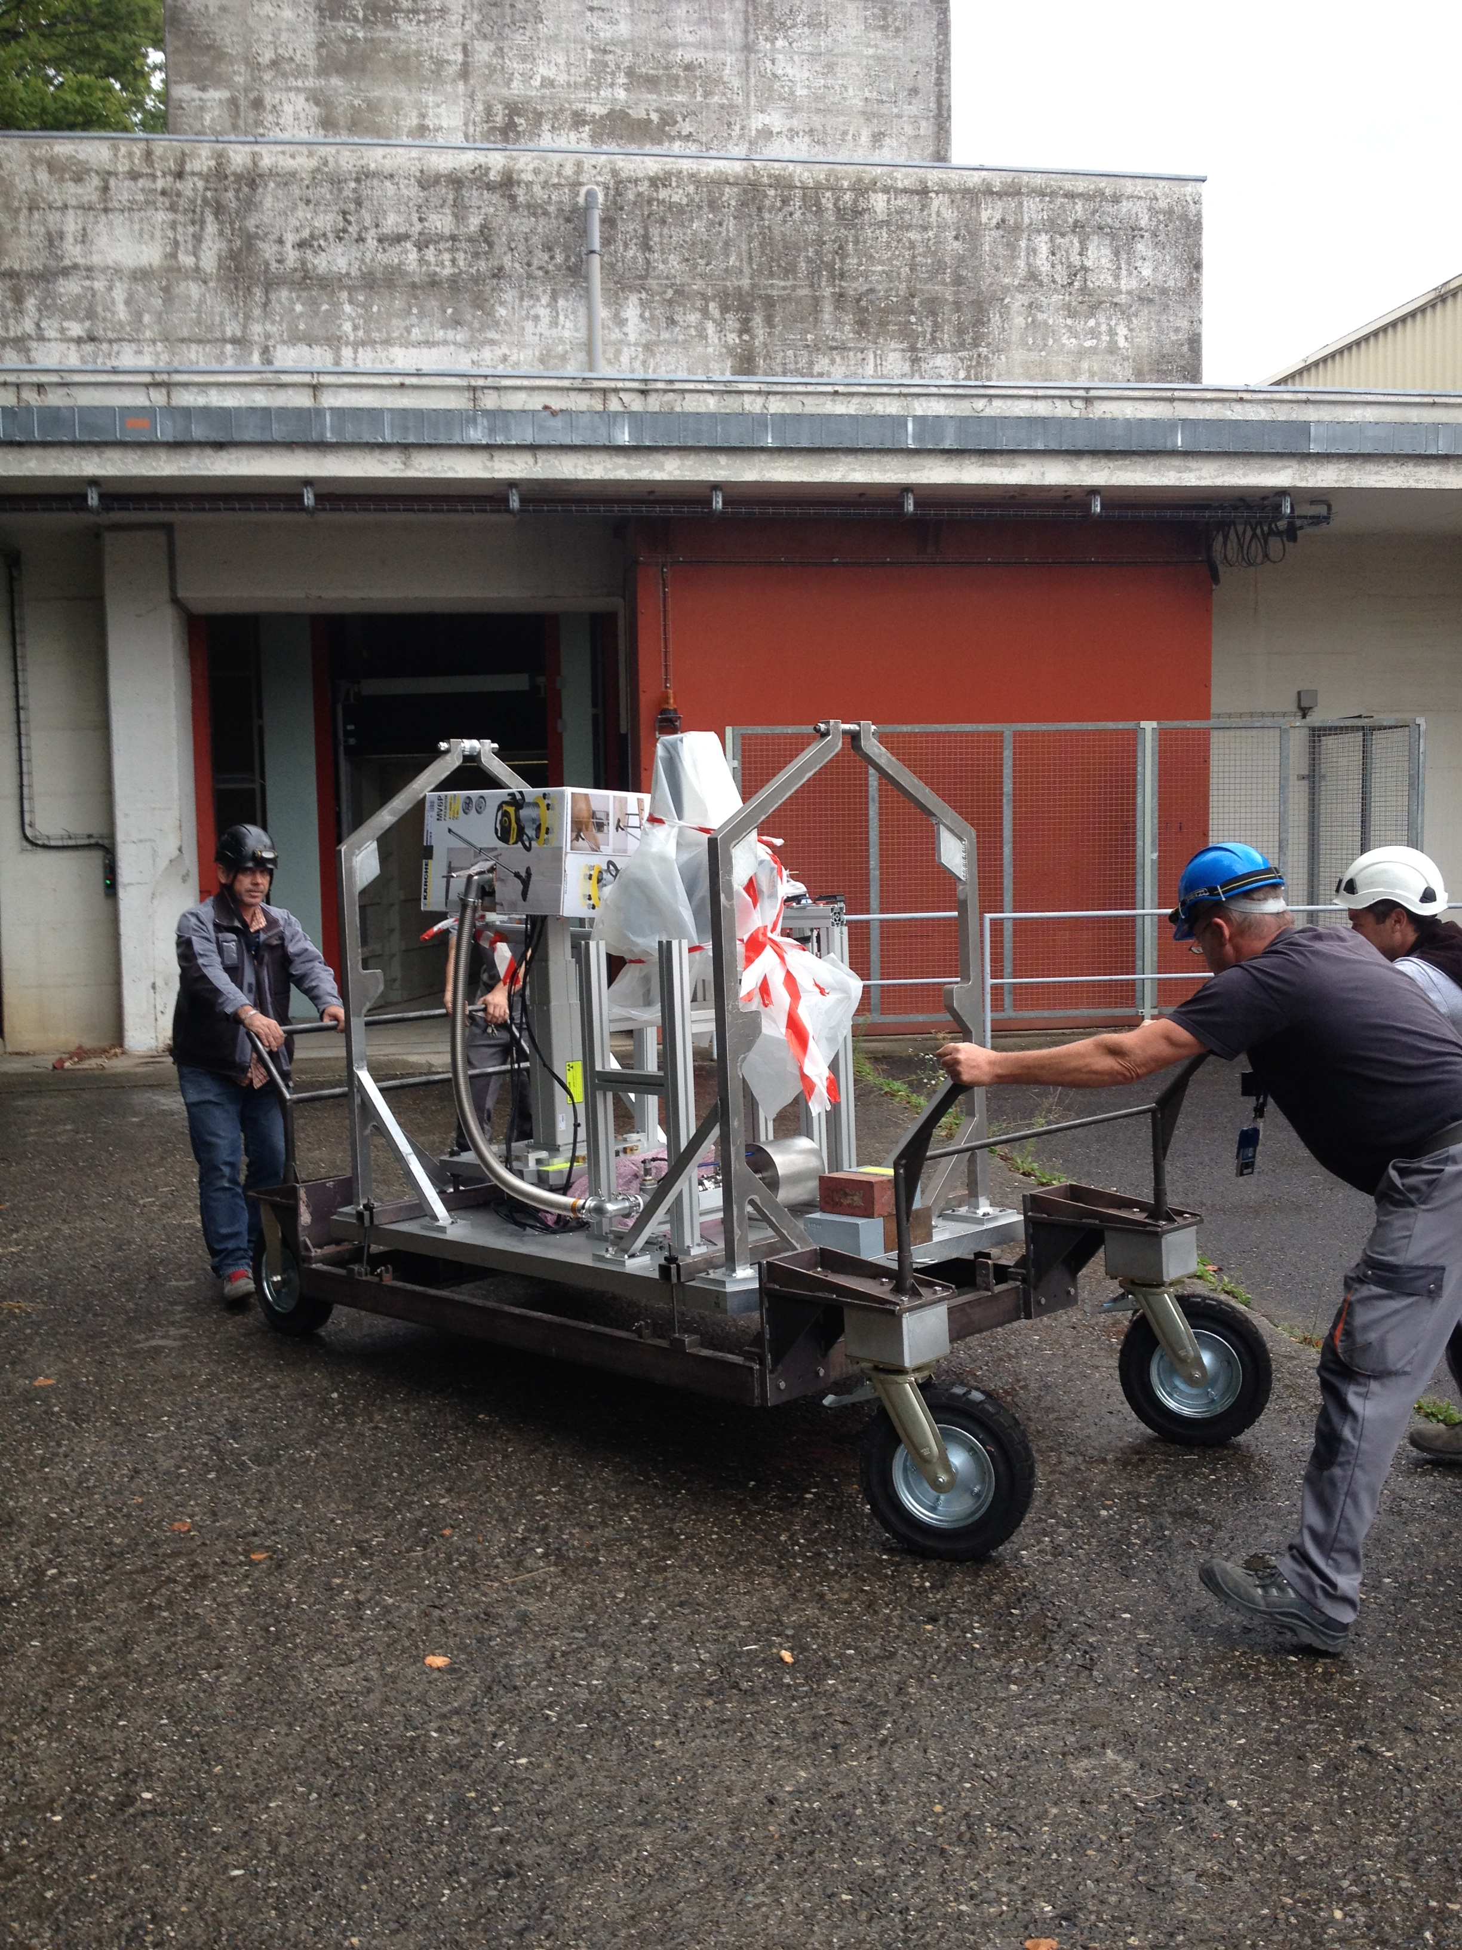
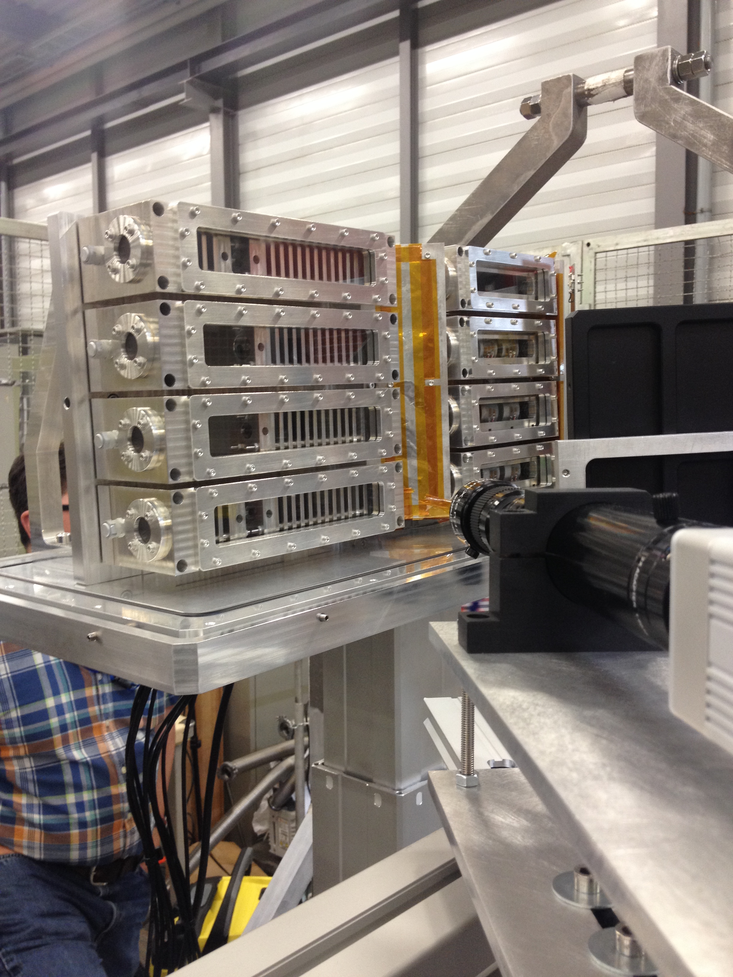
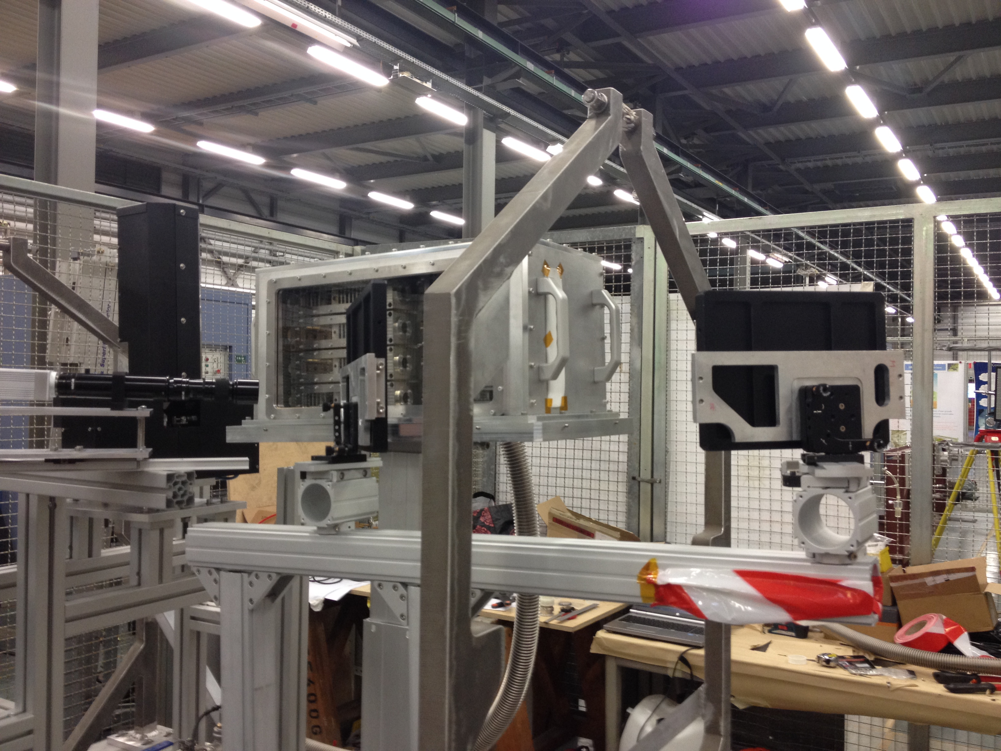
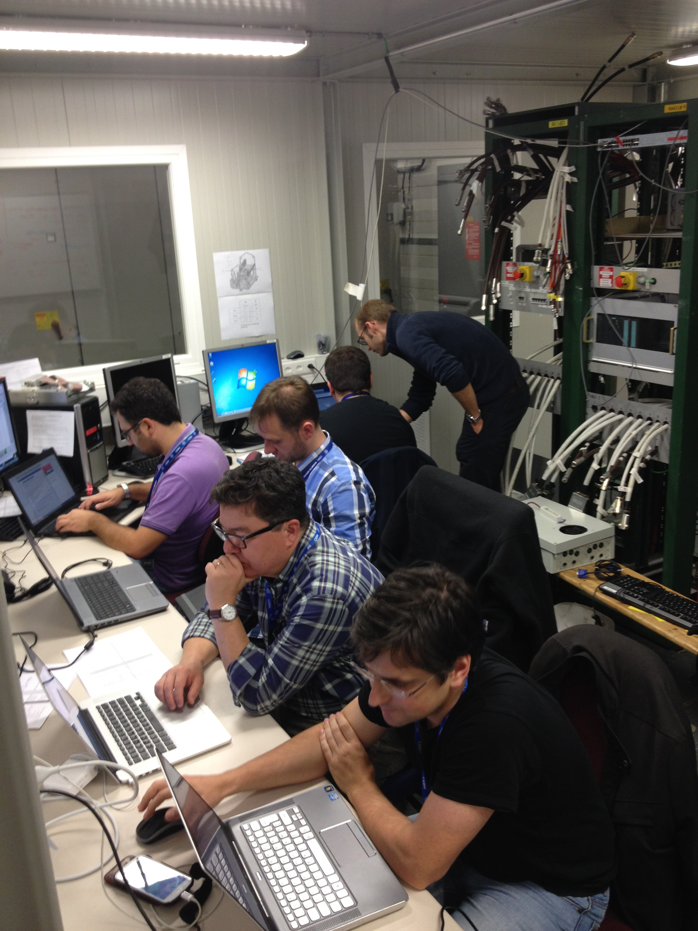
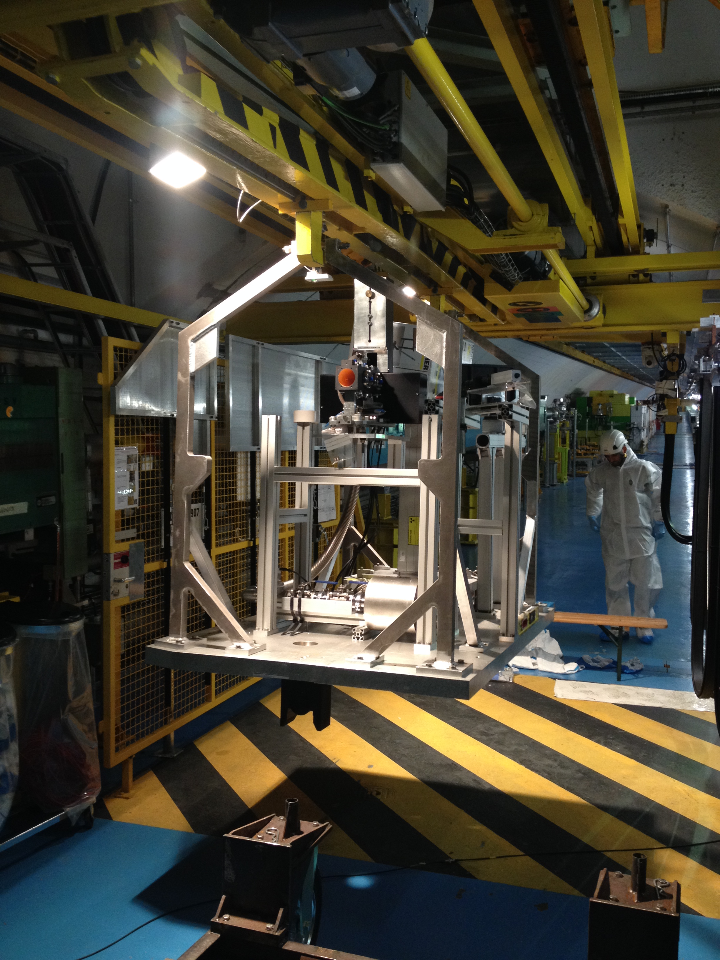
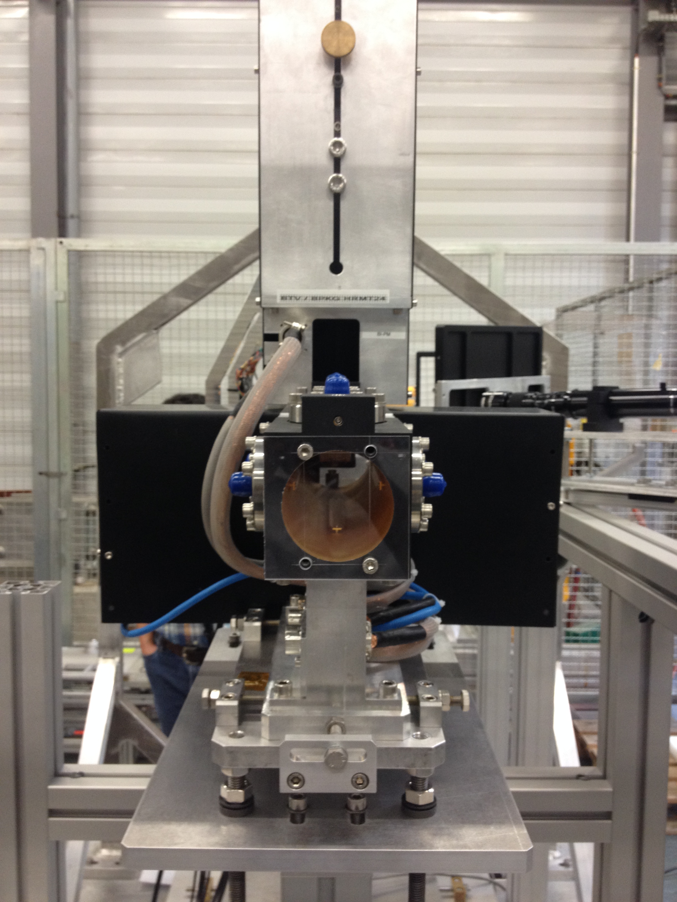
Experiment Installation
BA-7 installation (08/24 – 08/31)
Experiment box assembly
Array/beam position alignment
Optical path mock-up
  HD camera and LDV
DAQ system checks
TNC installation (09/01 – 09/04)
Transport table from BA-7 to TNC
Final connections
  BPKG/BTV calibration
  Vacuum pump connections
  Finalize optical path alignment
Beam time (09/17 – 09/18)

Slide 10
Experimental Beam Parameters
No wire scans on Pulses 8 – 11. Emittance estimated by averaging emittances of Pulses 4-7
Average bunch intensity: 1.3 x 10¹¹ ppb
σ_{x} : 0.268 – 0.306 mm
σ_{y} : 0.202 – 0.307 mm
Total protons on target: 1.8 x 10¹⁴

Slide 11
Beam Spot Position
Pulse 11: shift in BPKG baseline observed (need confirmation of data)
x-position: -0.47 to -0.07 mm
y-position: -0.02 to 0.12 mm

Slide 12
Preliminary Results
Array 3 slugs
24 bunches
3.196 x 10¹² POT
No residual plastic strain upon cool-down

Slide 13
Preliminary Results
Array 2.1 slugs
36 bunches
4.722 x 10¹² POT
Some residual plastic strain

Slide 14
Preliminary Results
Array 4 slugs
216 bunches
2.792 x 10¹³ POT
Significant residual plastic strain

Slide 15
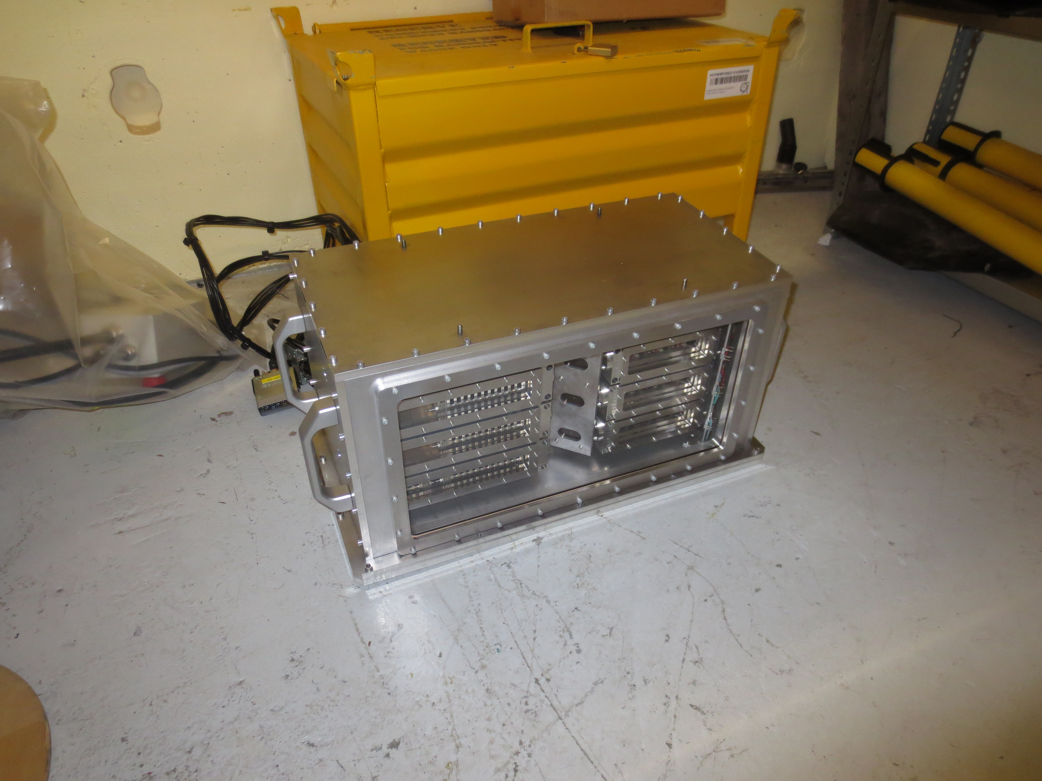
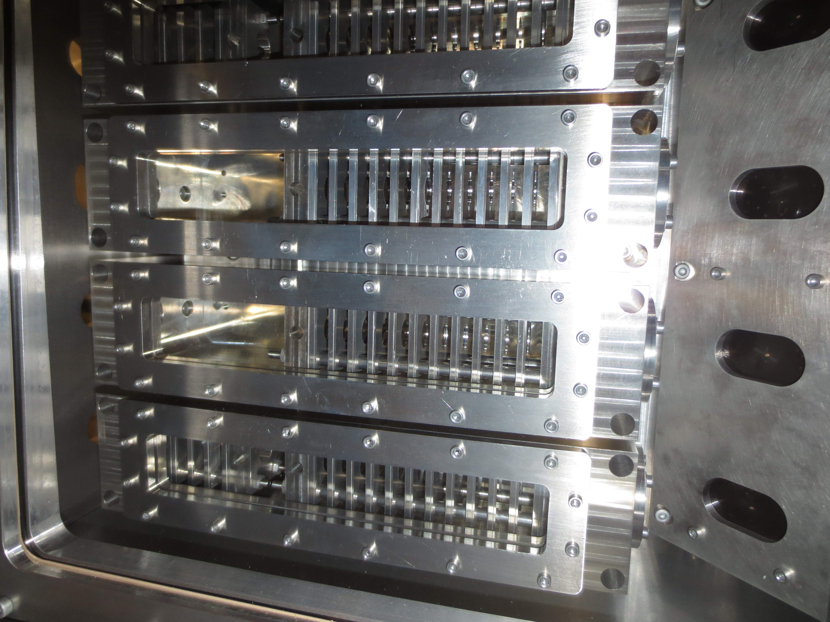
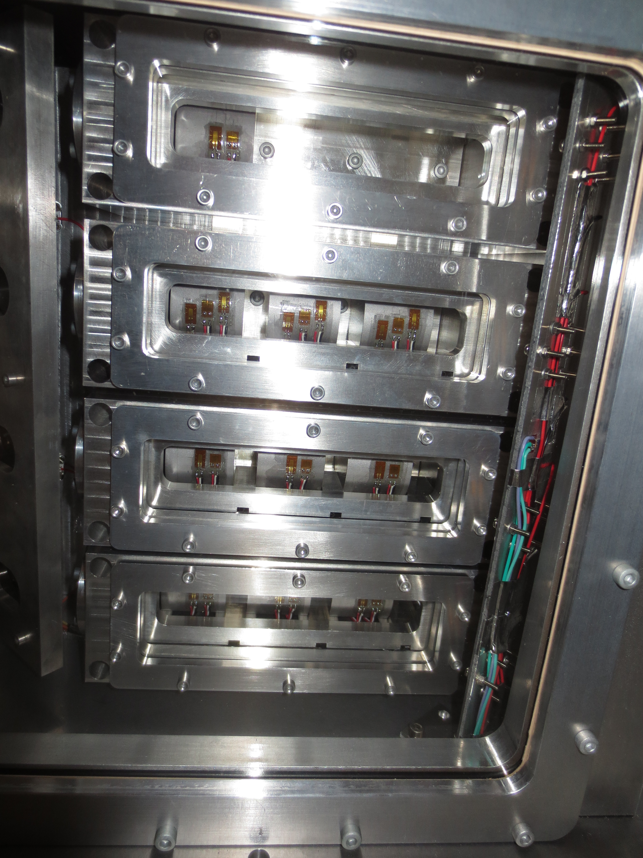
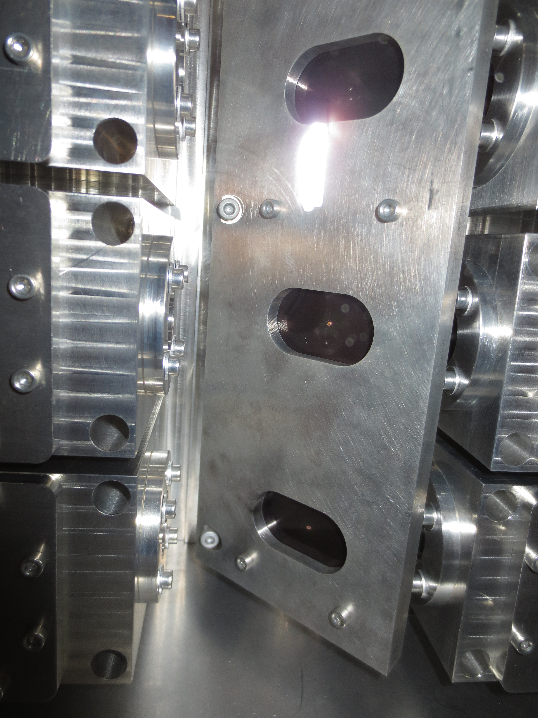
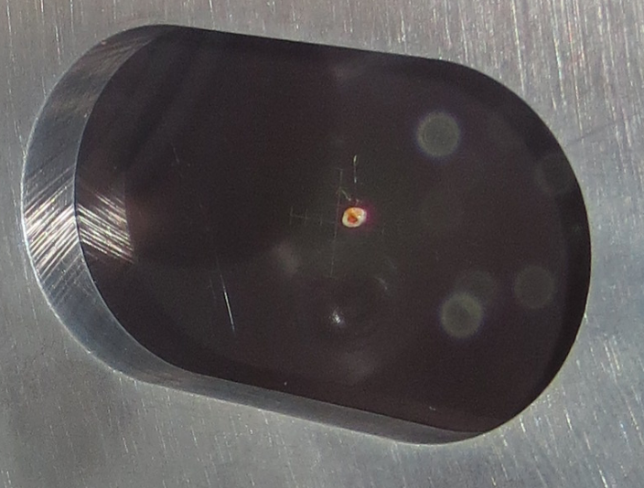
Next steps
Post-experiment pictures
Test rig disassembly
Be contamination check (filter inspection)
Disassemble experimental box
Pack individual array boxes accordingly based on gamma spectroscopy results
Ship to Oxford University for PIE
Post-irradiation activities
Thin disc specimen PIE
  Microstructural analyses
Benchmark numerical simulations and material strength models with experimental measurements

Slide 16
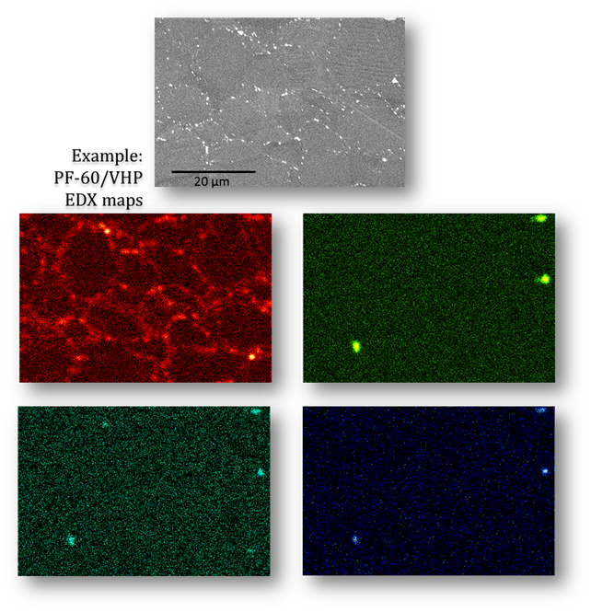
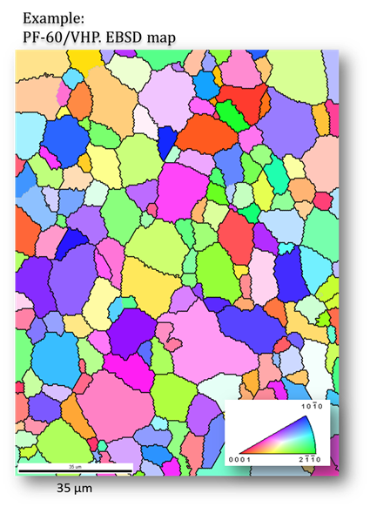
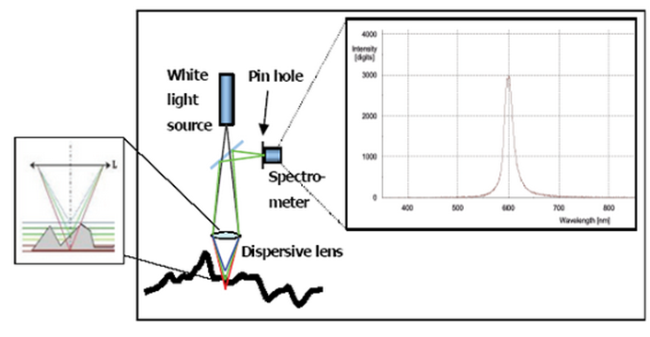
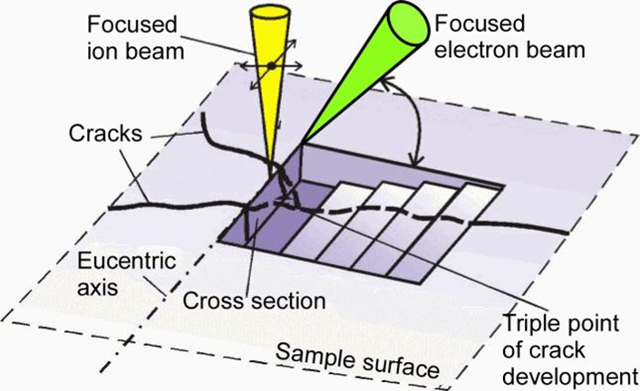
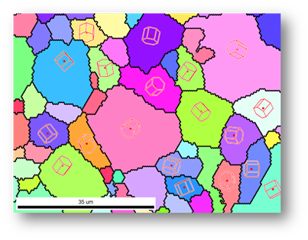
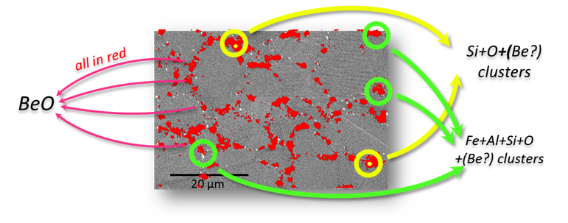
Post-Irradiation Examination
PIE of thin disc specimens at University of Oxford
Elemental analysis of the different Be grades
Measurement of out-of-plane deformation
Localized deformation and crack analysis
3D analysis of crack morphology
EDX spectroscopy
EBSD
Profilometry
FIB

Slide 17
Conclusions
Completed experiment successfully and safely
  No unforeseen or catastrophic events
  However…
    Large variations in beam sigma on target
    Array 4 did not receive the desired high intensity pulse
    Noisy LDV data due to faint signal from Be slug surface
    Gafchromic films exposed quicker than expected
      Offline analysis needed
Bulk of results will come from PIE work planned for next year
  Insight on thermal shock response of the different Be grades
  Findings will drive possible follow-up experiment (BeGrid2)

