Slide 1
Status of UK contribution to LBNF beam and target system
Chris Densham, Tristan Davenne, Otto Caretta, Mike Fitton, Peter Loveridge, Joe O’Dell, Andrew Atherton, Dan Wilcox (RAL)
Alfons Weber (RAL and Oxford)
John Back, Gary Barker (Warwick)

Slide 2
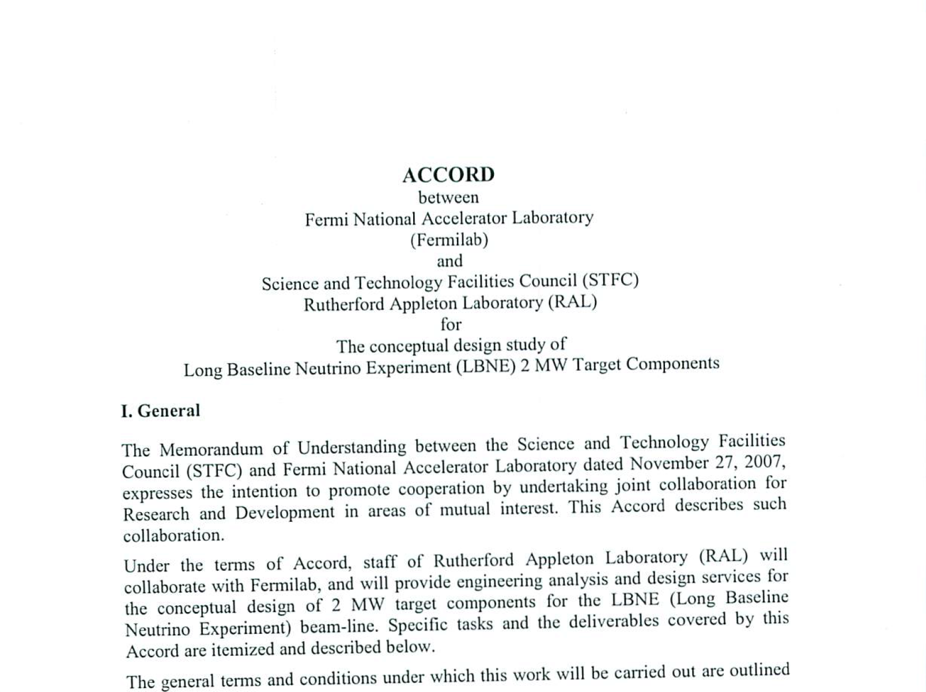
A quick look back to 2009 (c/o P.Hurh)

Slide 3
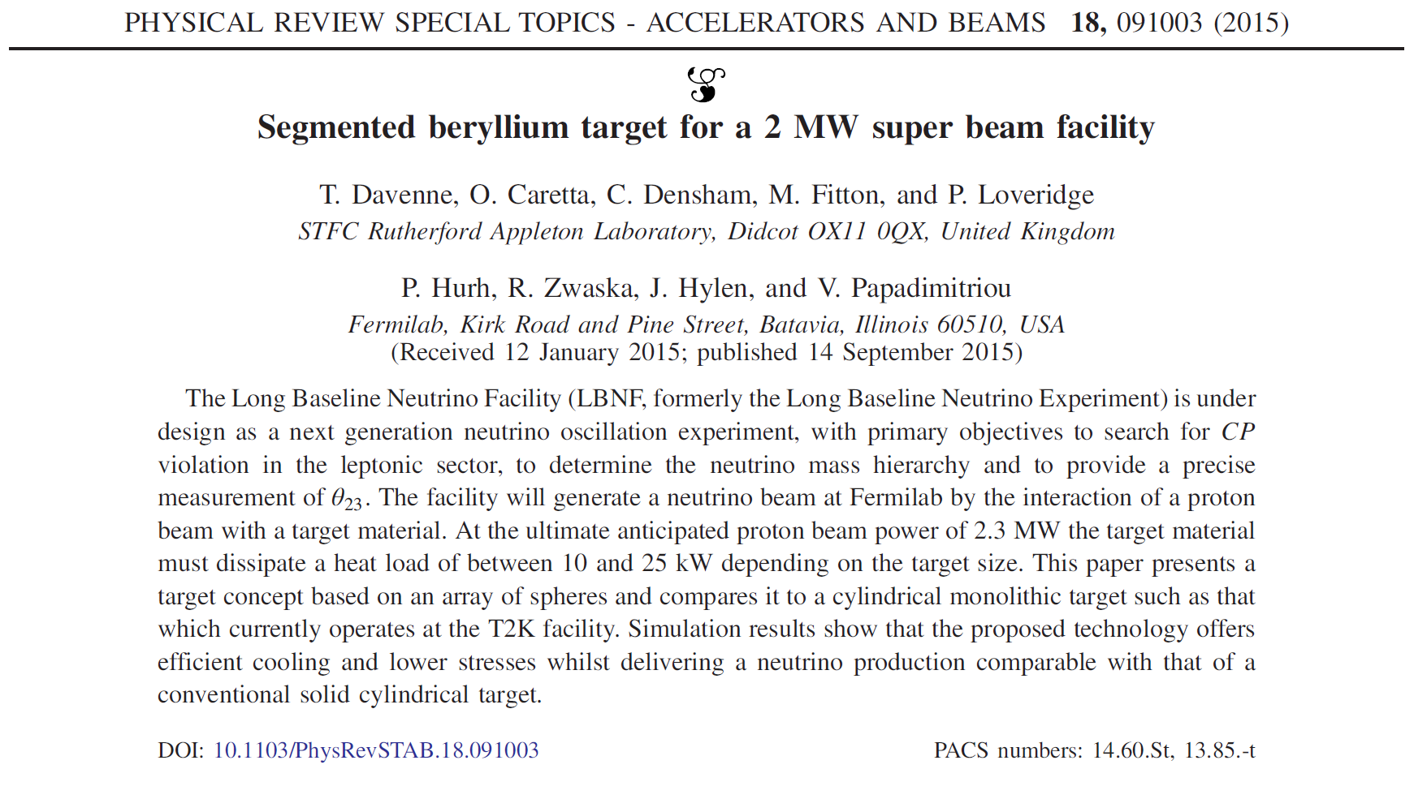

Slide 4
Statement of Interest submitted to STFC
Feedback received on 15th October 2015
Invited to submit a full proposal for LBNF/DUNE beam and target system for consideration by the STFC Project Peer Review Panel.
It was felt that this project can make a highly influential and substantial contribution to LBNF that will increase the impact and leverage of the UK neutrino community on the project. The fit of LBNF/DUNE with the STFC Science Strategy is described by the previously funded DUNE-UK and T2HK projects. It could potentially be a future in-kind contribution to the collaboration.
Outline proposal submission date tomorrow (done ☺)
Two week reprieve for full proposal – due 26th November

Slide 5
Conversation with STFC CEO on Monday
Expressed enthusiastic support for proposal and ‘positive intent’ to fund if at all possible – good strategic fit.
…but still has to get through Peer Review Process (of course)

Slide 6
Work Packages
WP0 Management
Chris Densham, Alfons Weber, Gary Barker
WP1 Physics & optimisation
John Back
WP2 Target & Cooling Plant
Tristan Davenne
WP3 Target & Horn Integration
Mike Fitton
WP4 Beam Windows, Shutters and Plant
Peter Loveridge
WP5 Target Station
Joe O’Dell
WP6 Materials
Otto Caretta

Slide 7
Submitted Objectives
In collaboration with Fermilab staff, the LBNF Beam Optimization Task Force and other international collaborators we propose to:
Study neutrino production, heat and thermal stress wave generation and fundamental engineering aspects for different target materials and geometry as input to the optimization of the target and electromagnetic horn system.
Develop, study and where possible test different target materials, designs and cooling concepts, leading to production of a prototype target.
Investigate how to integrate a long target with the magnetic horn system.
Investigate splitting target into upstream and downstream components.

Slide 8
Proposal: split target into two lengths
c.2000 mm
Upstream & downstream targets installed in Horn 1a
Each target similar length to existing targets
Heat load divided in 2 (solutions proposed)
Can be cantilevered inside horn
Targets supported from horn support structure (like T2K)
Horn 1a

Slide 9
Objectives continued
Outline design of target supports and cooling system
Investigate effect of the beam optimization work on the overall target station design and to what extent it is feasible to implement engineering designs
Outline Design of a Remote Handling System in the Target Hall Work Cell.
Provide input to target station conventional facilities specification and design.
Outline design and analysis of vacuum-to-air beam window.
Develop a concept for a helium-filled Target Station.

Slide 10
Objectives continued
Investigate cooling the Decay Pipe wall with helium rather than air.
Investigate replacing or augmenting the upstream Decay Pipe window with a large shutter or valve.

Slide 11
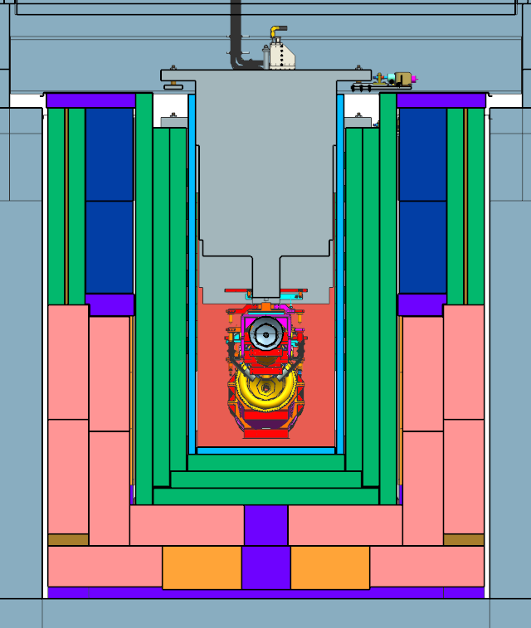
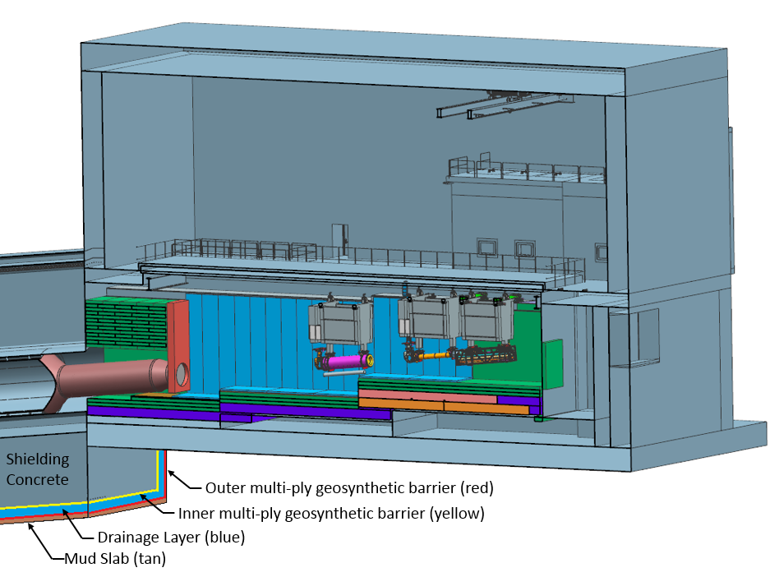
Thoughts on Target Hall/Decay Pipe Layout
~ 40% of beam power in target chase
~ 30% of beam power in decay pipe
Make helium vessel?
Replace window with shutter?
50 TON CRANE
WORK CELL
Cooling panels
DECAY
PIPE
SNOUT
Beam
Decay Pipe: 194 m long, 4 m in diameter, double – wall carbon steel, helium filled, air-cooled.
Helium cooled?
Target carrier
Installs target in horn, Z-pos variable .
Remove?
5.6 m
Target Chase: 2.2 m/2.0 m wide, 34.3 m long air-filled and air & water-cooled (cooling panels)

Slide 12
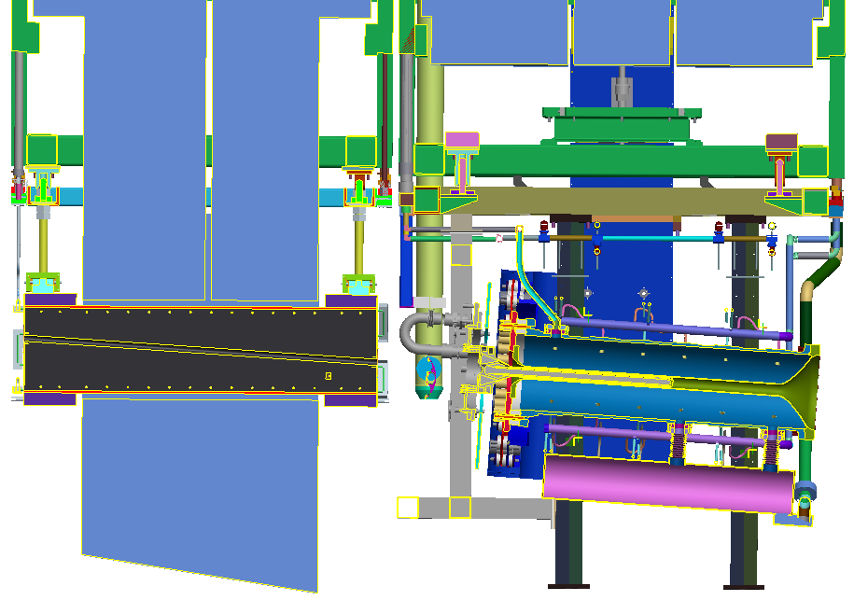
Alternative concept layout (looks familiar?)
Separate baffle
Target 2 goes here
Target 1

Slide 13
Implications for target station design
No separate target carrier
Reduces cost?
Can make target chase shorter?
Targets need to be installed and replaced in Horn 1a in separate hot cell
Want to be able to work in hot cell while beam is running

Slide 14
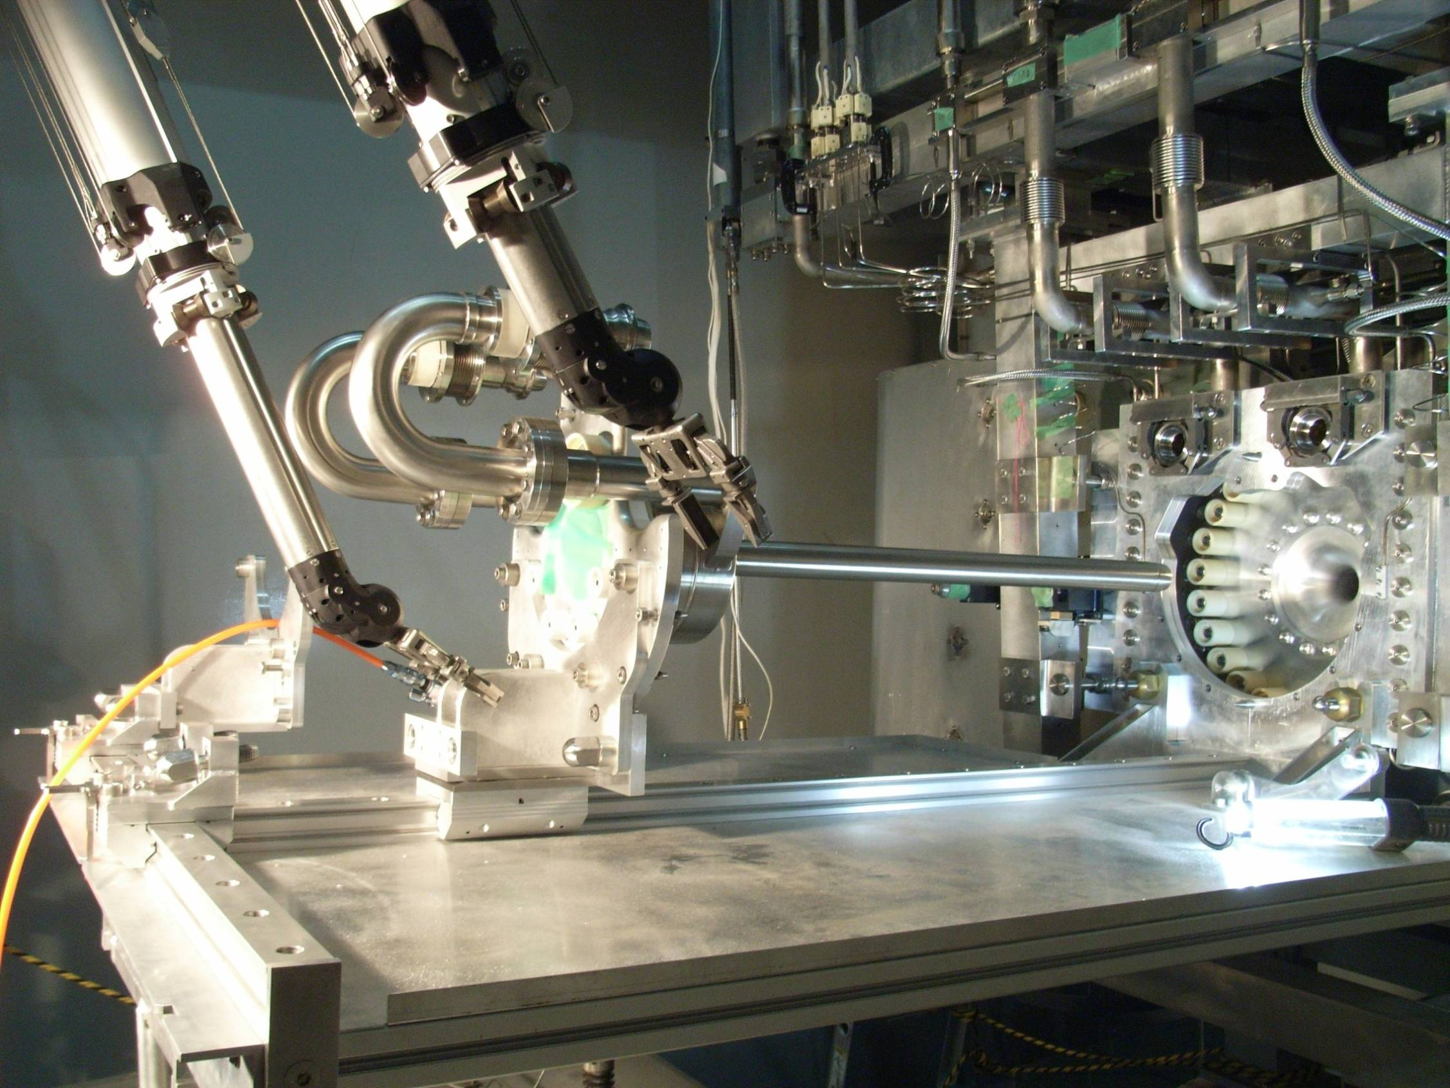
Prototype target exchange system?

Slide 15
Target technology for 2.4 MW?
Material and cooling medium choice
Graphite
Excellent track record, obvious candidate
Best tolerance to radiation damage when operated at c.500 - 1000 C
Helium cooling favored
Beryllium
May be more tolerant to radiation damage – jury still out (ref. RaDIATE program)
As for all metals, best properties at low temperatures
Water cooling most effective, but difficult to implement reliably
Helium cooled Spherical Array Target looks promising

Slide 16
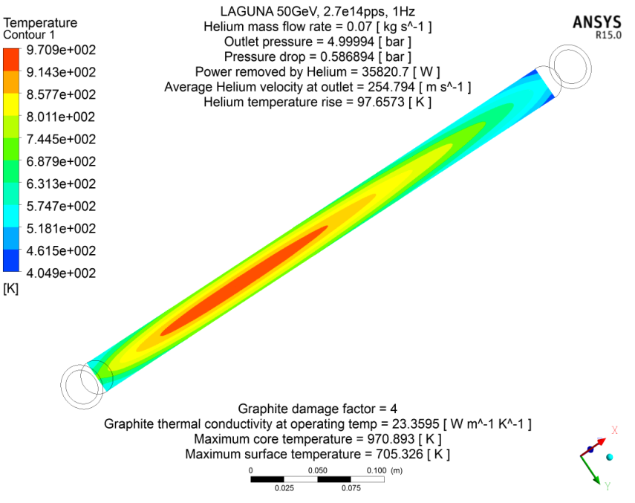
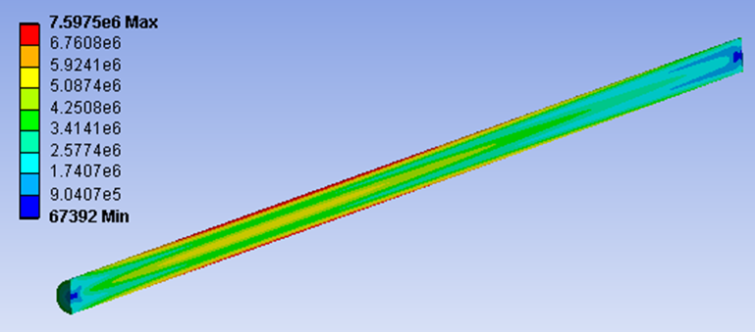
Helium cooled graphite rod (Mike Fitton)
Simple study of rod for 50 GeV beam
36 kW in target at 2 MW
Lower heat load for 120 GeV beam
70 g/s helium
5 bar outlet pressure
0.6 bar pressure drop
Single pass only – needs more work to include full geometry – higher pressure drop
Appears feasible – but what is expected lifetime?
Mean temperature
c. 700°C
Thermal conductivity degraded x4
Max. stress = 7.6 MPa
Safety Factor = 4.9

Slide 17
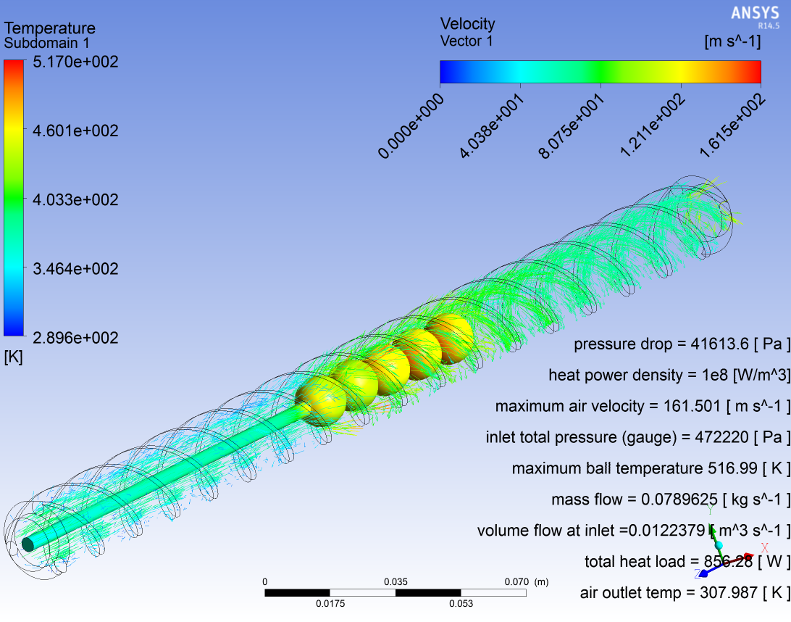
Spherical Array Target concept (Tristan Davenne)
Helical helium flow around spherical target material

Slide 18
Questions/issues
Performance of finned (NuMI style) target vs cylindrical?
Performance of graphite vs beryllium?
Beam RMS radius
Target radiation damage rate inversely proportional to maximum power density
Bigger beam = longer target lifetime
Need to compromise for optimum overall performance
E.g. 4 mm RMS please

