Slide 1
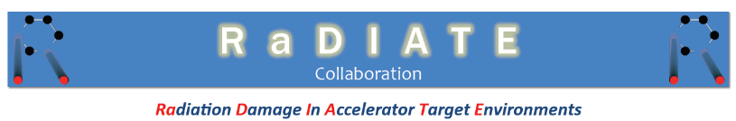

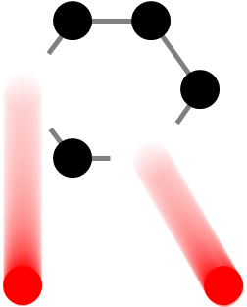


Radiation Effects in Beryllium: recent results from the NuMI beam window material
Slava Kuksenko¹ C. Densham², P. Hurh³, S. Roberts¹
¹ University of Oxford, UK
² Rutherford Appleton Laboratory, UK
³ Fermi National Accelerator Laboratory, USA
Many thanks to
Steven Van Boxel, Alex Cackett and Chris Hardie (CCFE)
K. Ammigan and B. Hartsell (FNAL)
PASI workshop. 12 November 2015, Fermi National Accelerator Laboratory

Slide 2
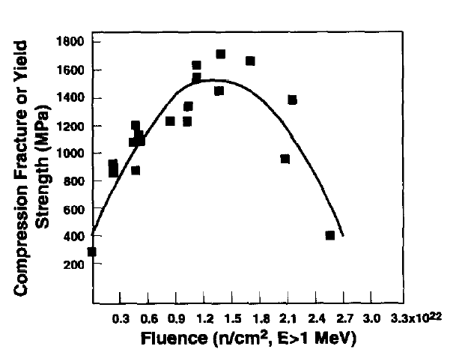
Beryllium
is extensively used as a material of neutrino targets parts, for example – beam window
is a promising candidate for future high-power neutrino sources
For example, the expected working conditions for some parts of the Long-Baseline Neutrino Facility (LBNF)
What can we expect?
Examples form n-irradiation
- reduction induced embrittlement
- irradiation induced hardening
Application | Operating conditions |  |  |  |  | Proton beam parameters
 | Avg. T (°C) | Peak T (°C) | Total DPA | Gas production (appm/DPA)
 |  |  |  | He | H
Beam window (vacuum to air) | 200 | 300 | ~ 0.23/yr | >2000 | >2000 | 700 kW; 120 GeV; ~1 Hz; σ_{rms} = 1.3 mm
Target | 375 | 450 | ~ 0.23/yr | >2000 | >2000 | 700 kW; 120 GeV; ~1 Hz; σ_{rms} = 1.3 mm
Environment: elevated temperature + radiation + pulsing loads
Compressive fracture or yield strength as a function of fluence (E > 1 MeV) for beryllium specimens irradiated at 75-125°C.
D.S. Gelles rt ul. /Journal of Nuclear Materials 212-2I5 (1994) 29-3X

Slide 3

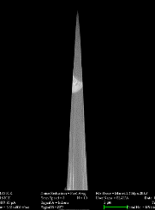
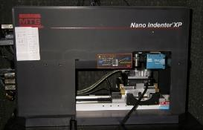
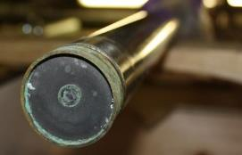
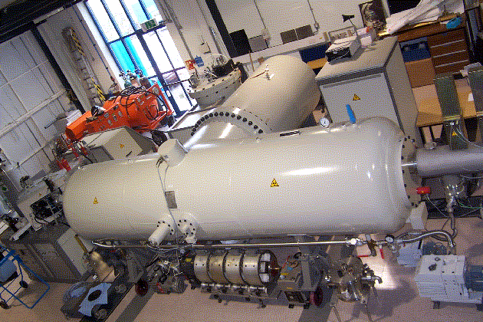
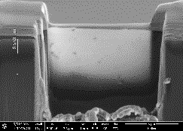
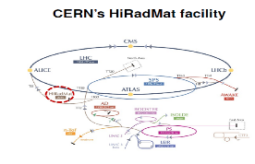
Experimental investigation
Investigation of the as-received Be
Investigation of the proton Be window (NuMI)
Ion irradiation experiments
Thermal shock experiments

Slide 4
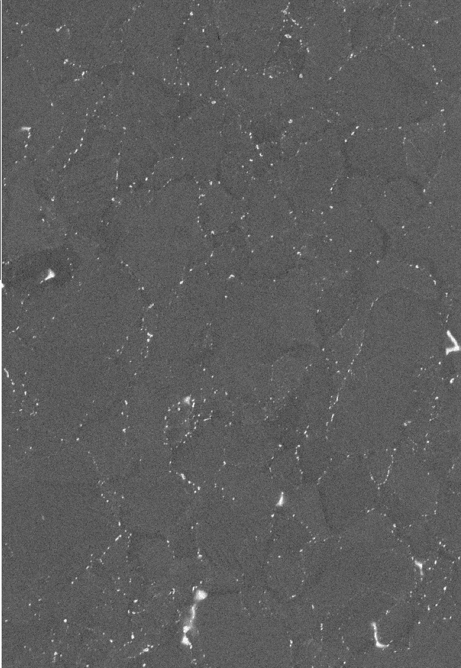
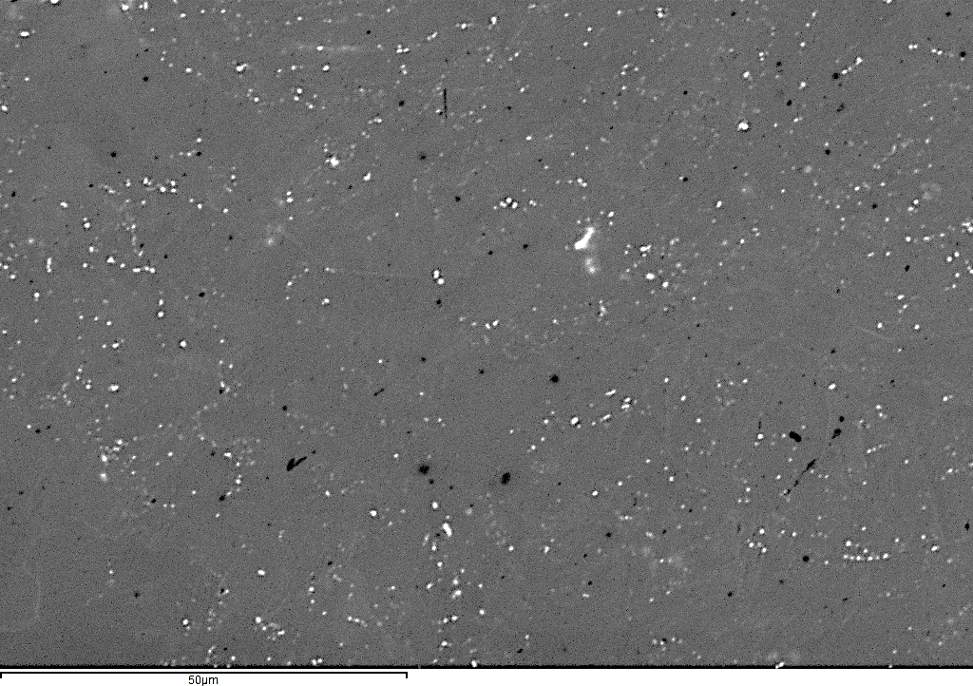

Materials
PF-60
PF-60 (VHP), rectangular sample. 5mm× 5mm 1mm
PF-60, cross-rolled disk sample
Ø15mm x 0.75mm
 | Max impurities, appm
Al | 170
C | 450
Fe | 130
Mg | 810
O | 2900
Si | 130
N | 195
Be | balance
Method of manufacture: vacuum hot pressing and cross-rolling
50 µm
50 µm
Industrial beryllium is a non-homogeneous material.
“White contrast particles” on SEM images (in the SE2 detector) decorate GB-s
Beryllium is of industrial purity

Slide 5




PF-60: Microstructure in the as-received state: VHP vs Cross-rolled
PF-60, VHP rectangular sample
5mm× 5mm 1mm
PF-60, cross-rolled disk sample
Ø15mm x 0.75mm
2 different states of the PF-60 are investigated: (a) VHP and (b) cross-rolled
2 grades are very different grain size
$$\left[0001\right]$$
$$\left[10\overline{1}0\right]$$
$$\left[2\overline{1}\overline{1}0\right]$$
60 µm
60 µm
60 µm
Average diameter – 9 ± 4 µm
Average diameter – 25 ± 14 µm

Slide 6
PF-60: Microstructure in the as-received state: VHP vs Cross-rolled
PF-60, rectangular sample
5mm× 5mm 1mm
No texture (macroscopically – isotropic)
60 µm
PF-60, disk sample
Ø15mm x 0.75mm
Strong (0001) texture
60 µm

Slide 7
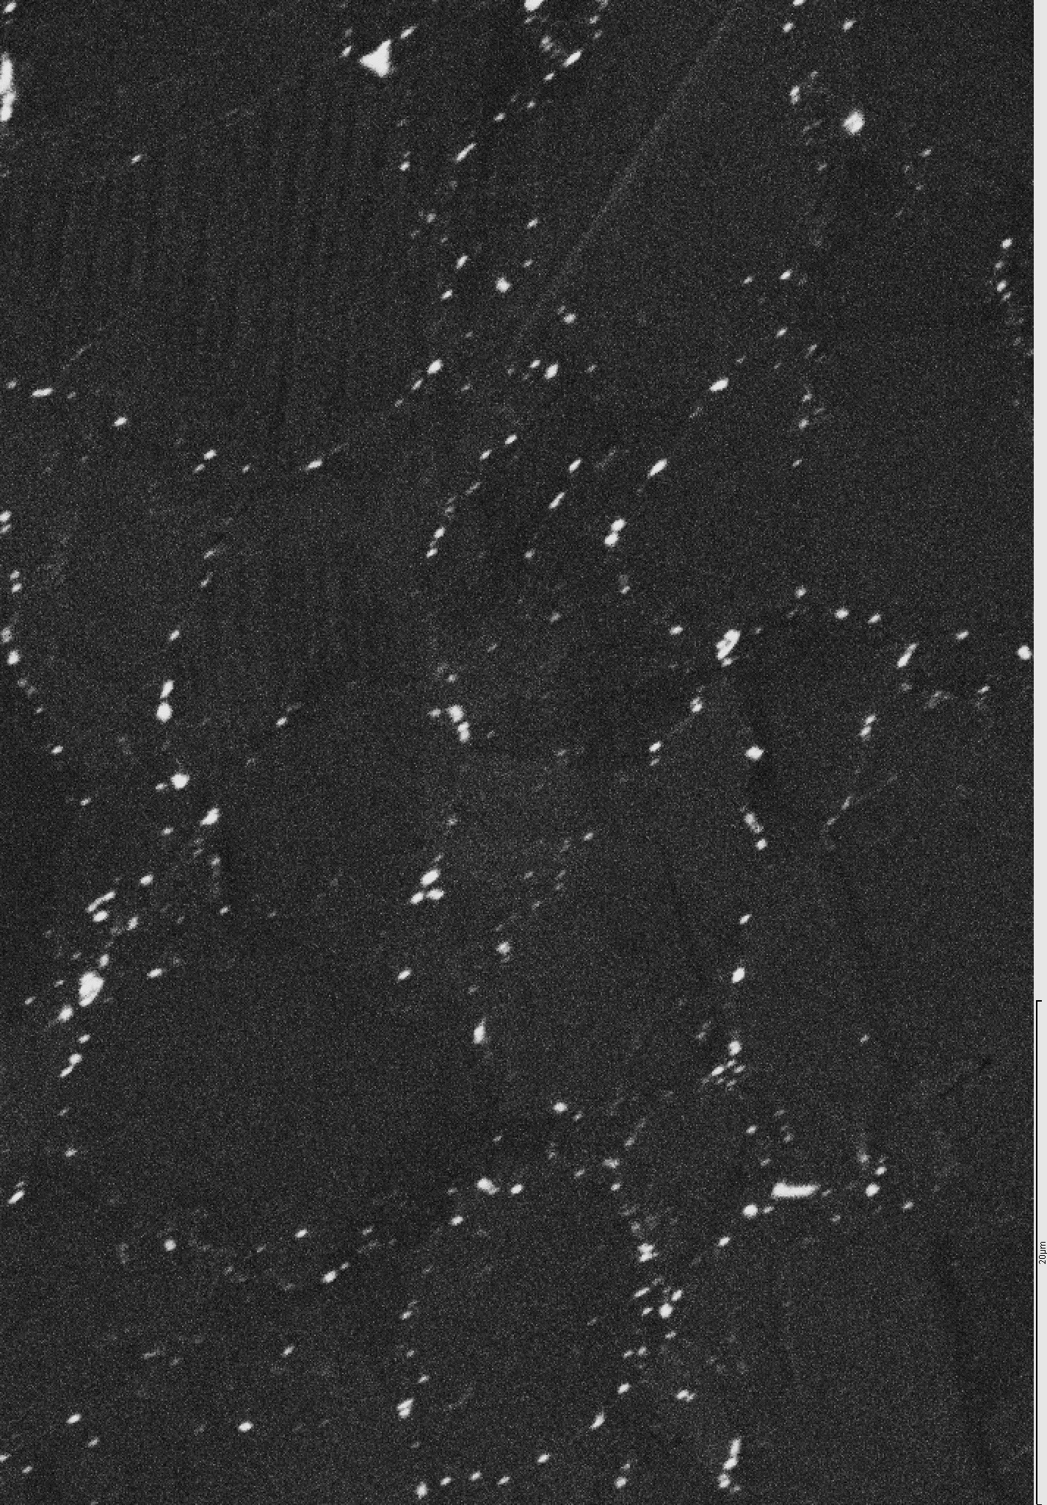
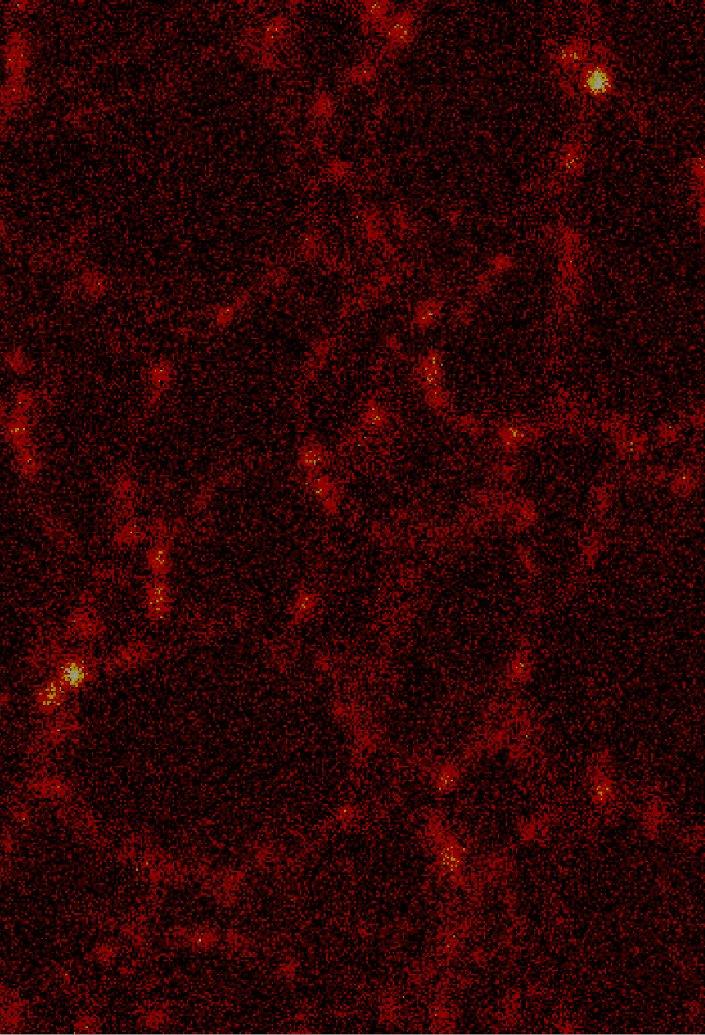
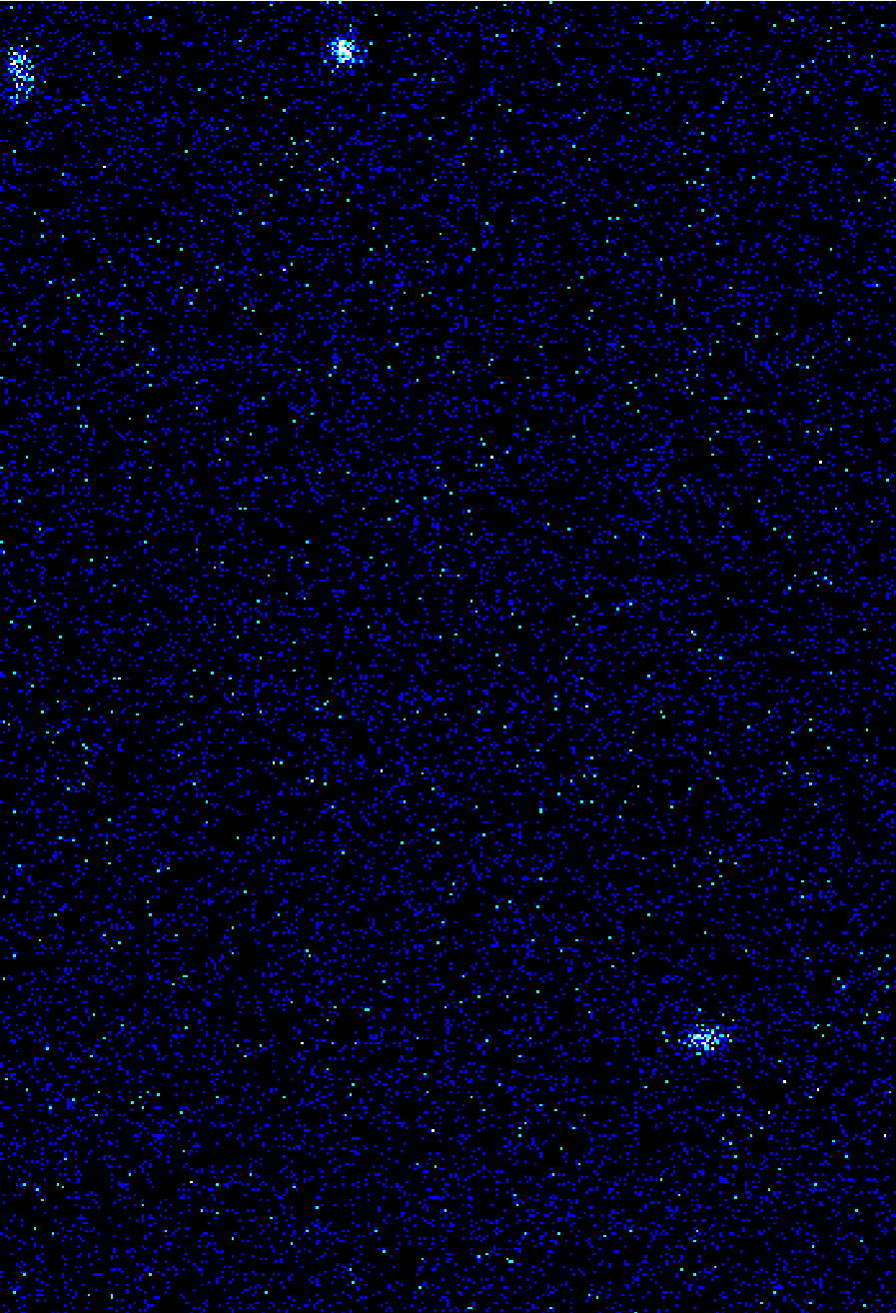
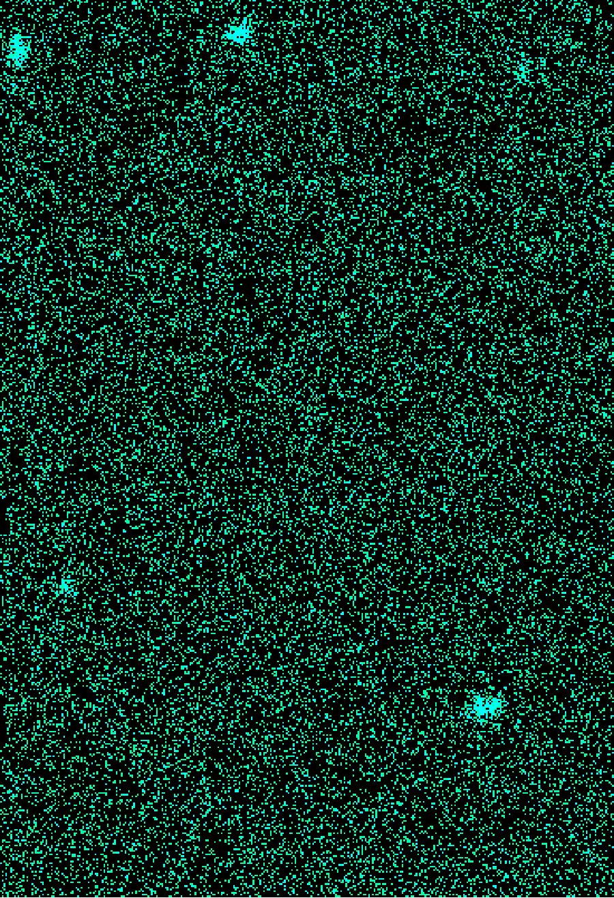
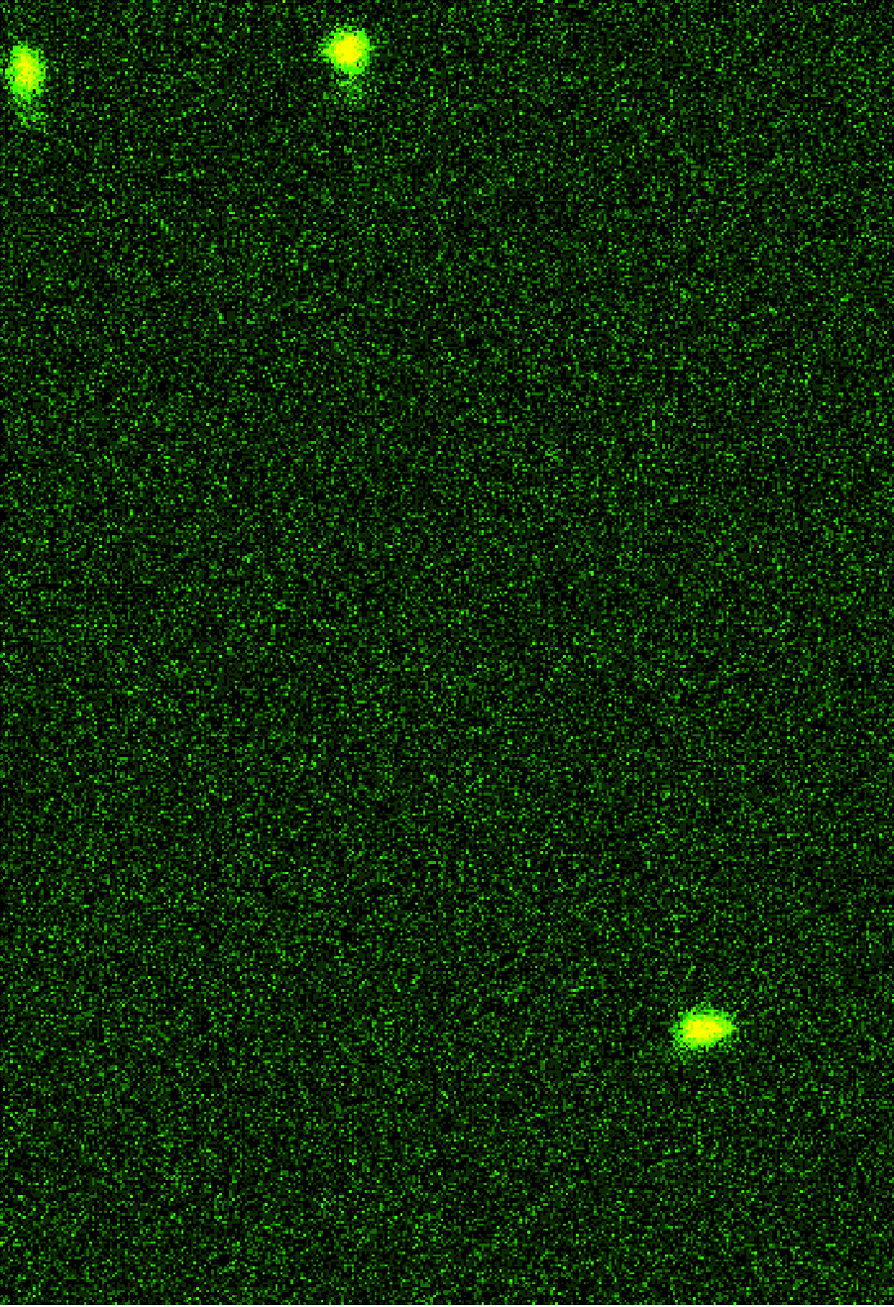
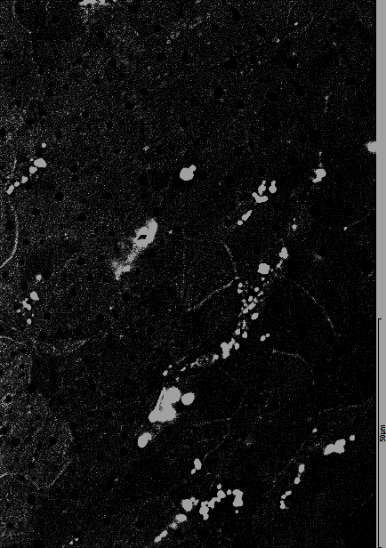
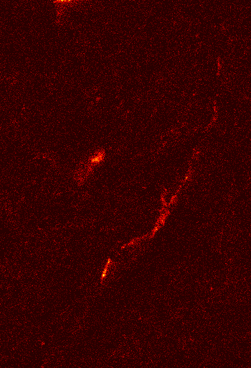
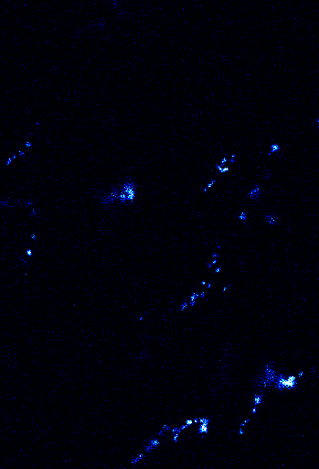
PF-60: Microstructure in the as-received state: impurities distribution
SEM
PF-60, rectangular sample
5mm× 5mm 1mm
20 µm
Oxygen
Iron
Silicon
Aluminium
SEM
PF-60, disk sample
Ø15mm x 0.75mm
50 µm
Oxygen
Iron
Silicon
Aluminium
Industrial beryllium is an impure alloy: relatively pure grains and strongly “alloyed” GB

Slide 8
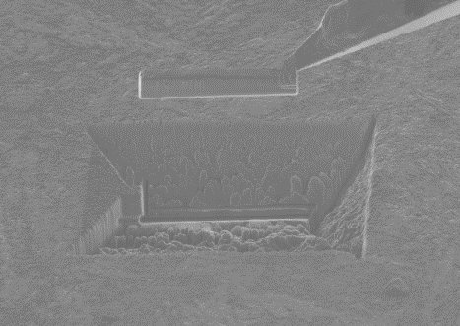

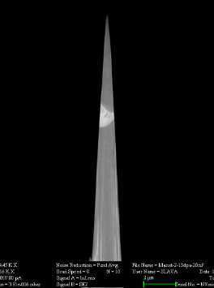

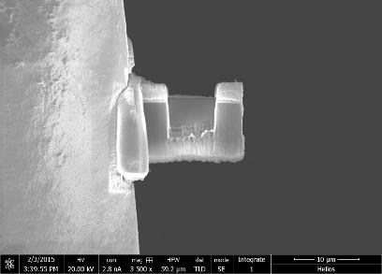
Preparation of samples for fine scale investigations
FIB lift out
Culham Materials
Research Facility
APT sample
FIB lift-out
investigation of localized microstructure and properties
minimize activity of samples
minimize toxicity of samples
TEM sample

Slide 9
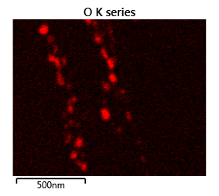
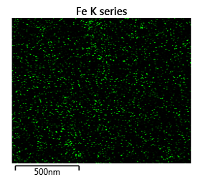
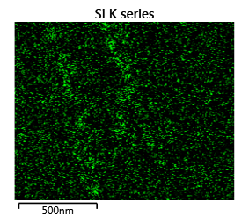
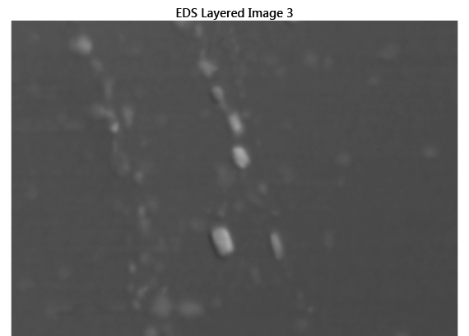
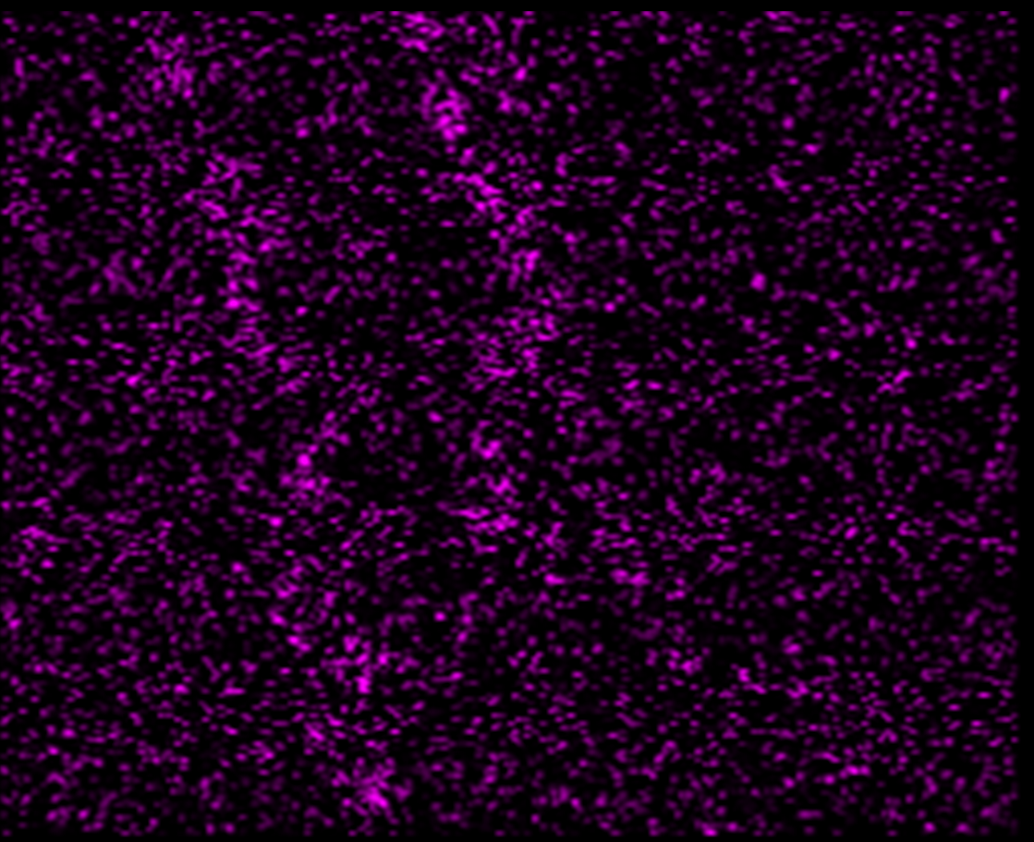
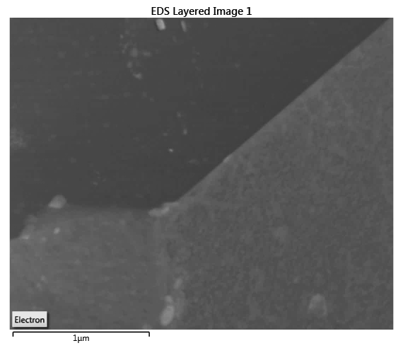
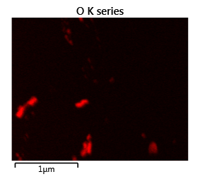
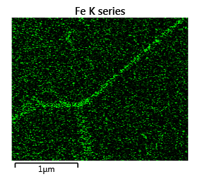
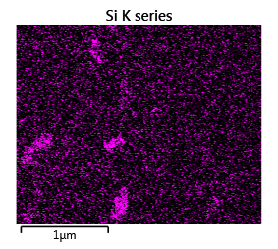
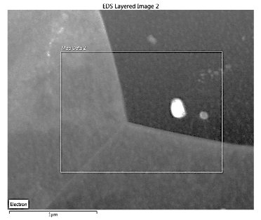
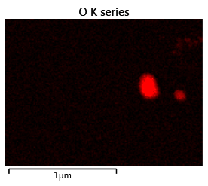
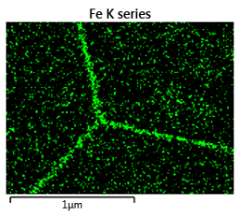
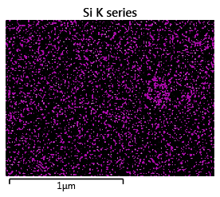
Industrial beryllium: GB – decorated by BeO(+Si) and Fe segregation

Slide 10

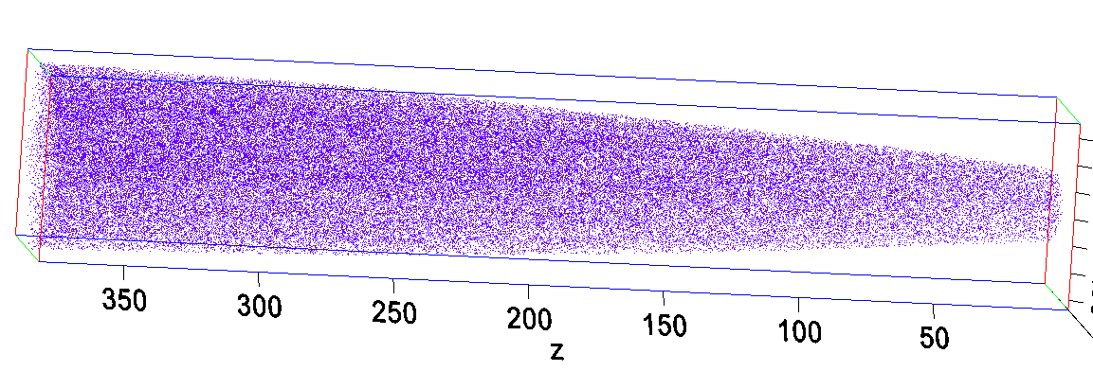
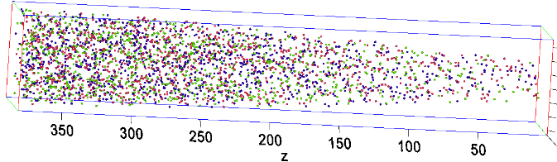
Preparation of samples for fine scale investigations
Be
, nm
PF-60 | Max impurities, appm | Impurities in Beryllium matrix (APT), appm
C | 450 | 15±10
Fe | 130 | 50±10
Ni | 31 | 25±10
Cu | 14 | 15±10
O | 2900 | ?
Al | 170 | Not detected (ND)
Mg | 810 | ND
Si | 130 | ND
N | 195 | ND
, nm
Fe
Ni
O
Small quantity of Fe, Cu, Ni and C are homogeneously distributed inside Be grains

Slide 11
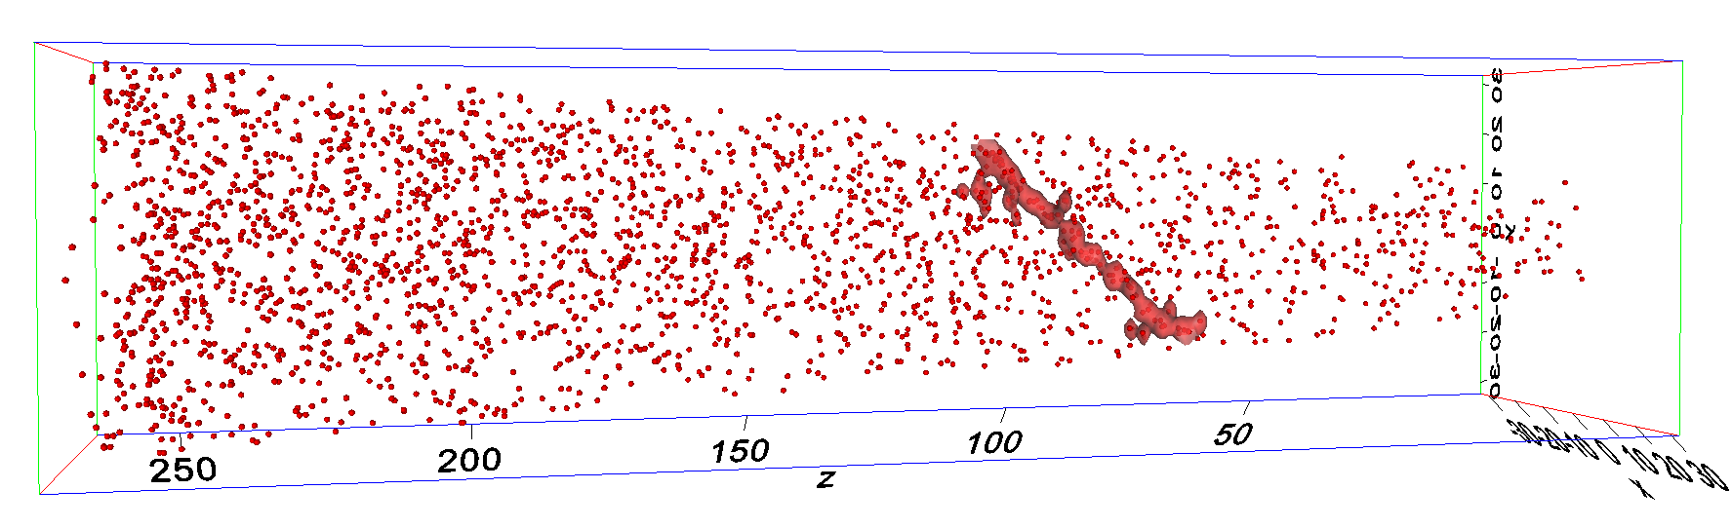
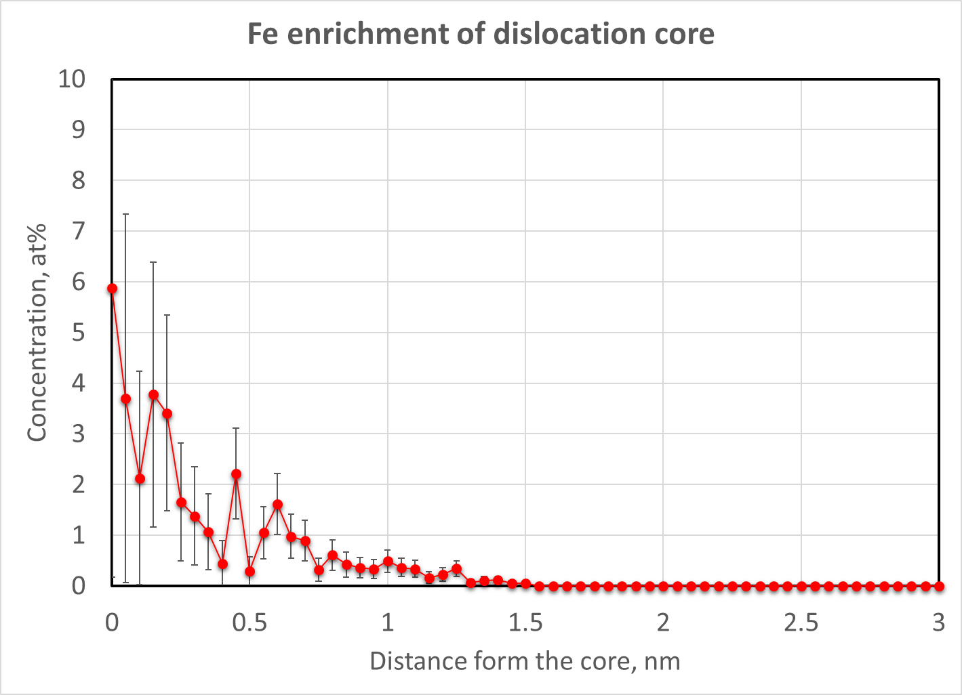
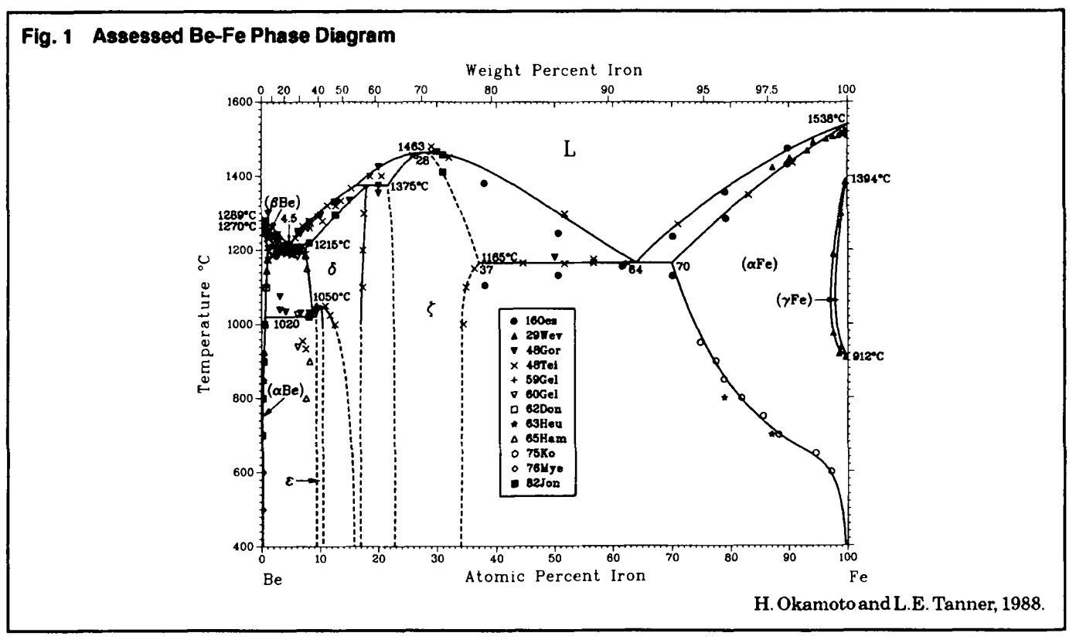
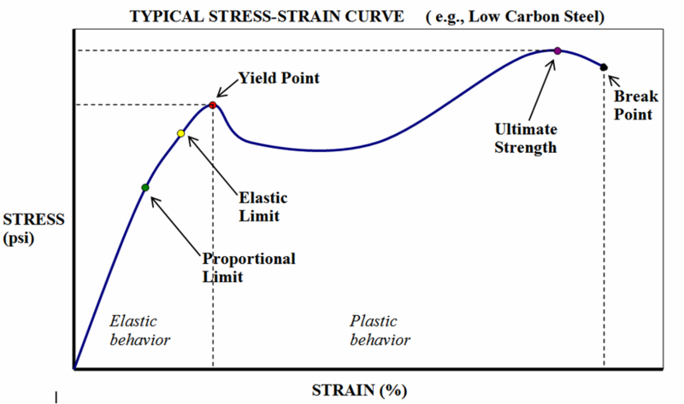
Isosurface C_{Fe}=500 appm
Fe
Fe segregates to dislocation lines
No evidence of other elements segregations
Possible consequences:
Cottrell-type solute pinning?
Yield Point ?

Slide 12
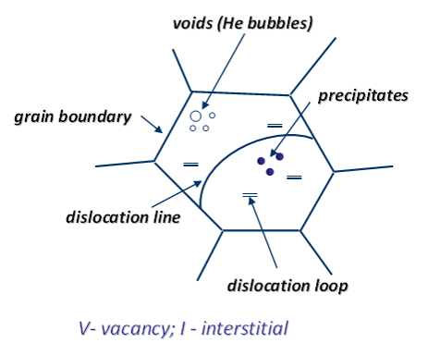
What can we expect during irradiation?
Microstructural response:
creation of transmutation products;
creation and agglomeration of point defects;
segregation (precipitation) or depletion on point defect sinks
Possible irradiation effects:
reduction induced embrittlement
irradiation induced hardening
swelling
reduction of thermal conductivity

Slide 13
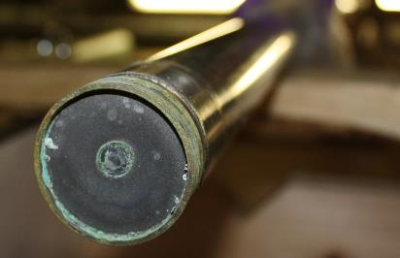
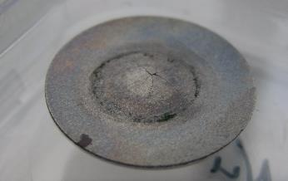
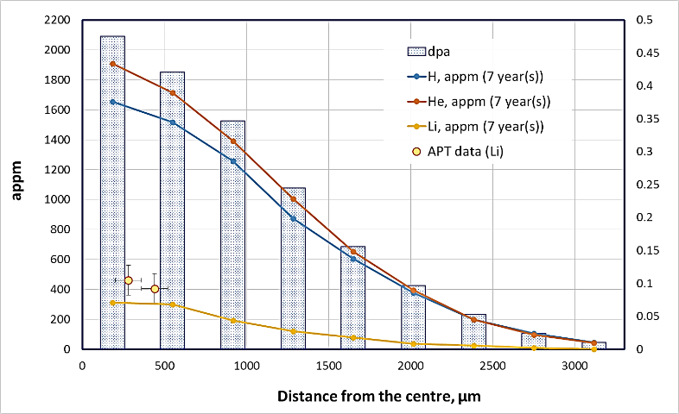
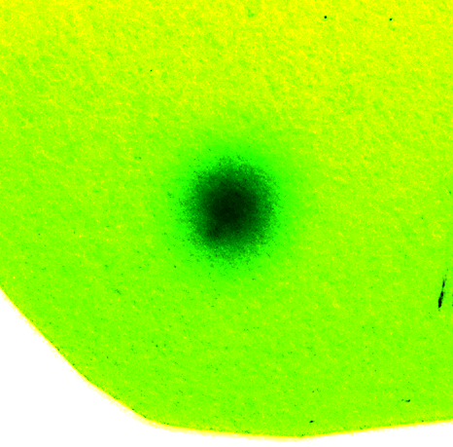
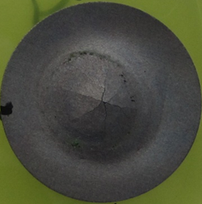
NuMI beam window experiments
300 kW NuMI beam window
(MARS calculations of Brian Hartsell, Fermilab)
120GeV proton beam
about 3×10¹³ protons per pulse, 0.5 Hz
1.57×10²¹ protons during its lifetime
1.1mm beam sigmas, X and Y
T ≈ 50ºC
dpa
Dosimetry film, 5 days of exposure
19 mm
Large difference of dpa and transmutants production is likely to produce non-homogeneous changes across the surface of Be window.

Slide 14
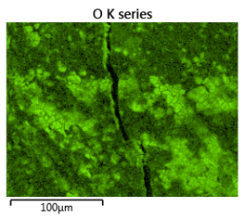
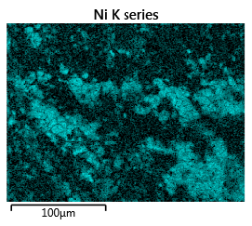
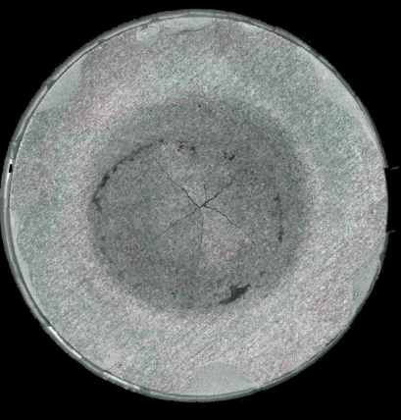






O
Surface contamination:
Ni - comes from plating?
Ca, S, Cl, C – drips of drainage water?
Oxide layer thickness is about 75 nm

Slide 15


9Be⁺⁺
9Be⁺
7Li⁺
0 dpa
0.3 dpa
6Li⁺
9Be⁺⁺
9Be⁺
(9Be+H) ⁺
(16O+H)⁺
New peaks on mass-spectrum – transmutation products
12C⁺
16O⁺

Slide 16
PF-60 | Max impurities, appm | Impurities in Beryllium matrix (APT), appm | Impurities in Beryllium matrix after p-irradiation 0.33 dpa (APT), appm
C | 450 | 15±10 | 245+50 (if we consider the natural abundance)
Fe | 130 | 50±10 | 50±10
Ni | 31 | 25±10 | 22±10
Cu | 14 | 15±10 | 15±10
O | 2900 | ? | ?
Al | 170 | ND* | Lithium: 420 appm
Mg | 810 | ND | Others: ~ 2400 appm
Si | 130 | ND
N | 195 | ND
Li is not soluble in Be. Will it segregate?

Slide 17





As-received
Be₉ ⁺⁺
Be₉ ⁺
Irradiated
Be₉ ⁺⁺
Be₉ ⁺
Li₆ ⁺
Li₇ ⁺
~ 460 appm of Li
~ 400 appm of Li
Good agreement between the MARS model and APT data on Lithium production

Slide 18


Be₉ ⁺⁺
Li
Be₉ ⁺
Li₆ ⁺
Li₇ ⁺
After irradiation inside grains:
Transmutant Li is homogeneously distributed
Impurities (Fe, Ni, Cu, C) are still homogeneously distributed
…but the temperature was low (50ºC), and the behaviour can be different under new working conditions (>200ºC). Ion implantation/annealing experiments are needed

Slide 19





NuMI beam window experiments
Irradiated
Irradiated
As-received
Radiation embrittlement?

Slide 20


FIB preparation for EBSD analysis

Slide 21



EBSD
~ 0.44dpa
~ 0.29dpa
~ 0.27dpa

Slide 22


~ 0.29dpa
~ 0.44dpa
Transition form transgranular fracture to grain boundary/mixed mode fracture
Non-irradiated beryllium – transgranular cleavage
Grain-boundary fracture is observed after high temperature irradiation (>500°C) due to GB decoration by He bubbles.
Grain-boundary fracture at low T the is dominated by strengthening of the matrix accompanied by losses in ductility

Slide 23


NuMI beam window experiments: TEM
~ 0.45dpa
1 µm

Slide 24

~ 0.45dpa
Some grains of beryllium are strongly deformed and full of dislocation and SGB:
cross-rolling?
Deformation during post-irradiation handling?

Slide 25



~ 0.45dpa
“black dots” are visible for certain “gb” contrast conditions;
they remind contrast from defect clusters after neutron irradiation, thus, they may be irradiation damage;
We didn’t find void/bubbles – where are He and H?

Slide 26




Irr. Be, TEM, BF, He bubbles, Tirr.=413 °С, F = 6.5×10²¹ сm⁻² (Е > 1 MeV) (Klimenkov et al. JNM 2013)
High swelling at low T?
But we have “only” about 2000 appm of He
We cannot confirm this now after our first TEM experiments.
… but we have investigated only few surface grains
Swelling?

Slide 27










~ 0.45dpa
Interesting behaviour of single located BeO – Al and Si shell. Al-Si eutectic is a low melting point phase
RIS is often observed, for example, in steels,
… but, we have no confirmation that this is radiation induced effect.

Slide 28
GB/mixed fracture?
Transgranular fracture
Transmutant Li can be one of the reasons of properties degradation under proton irradiation
But detailed TEM and He/H transmutants distribution analysis is needed
Micromechanical tests should be made

Slide 29


Conclusions
Beryllium is highly non-homogeneous at macroscale and highly anisotropic material.
Industrial beryllium is an impure alloy: relatively pure grains and strongly “alloyed” GB
Impurities strongly create GB precipitates and segregations, segregate to BeO and dislocations
Beryllium matrix has some quantity of homogeneously distributed carbon, iron, nickel and cupper
Proton irradiation cause Li production, which is homogeneously distributed (T=50°C)
Signs of irradiator induced embrittlement and change in fracture mode (from intra- to inter-granular) under high energy proton irradiation
20 µm

Slide 30




PLANS
Nanoindentation
EBSD map
Repeat at higher T up to 500˚C
Repeat after ion irradiation
Compare with the NuMI beam window
The scattering makes sense… but the anisotropy is impressive

Slide 31



Why use micro-cantilever testing?
PLANS
Chris Hardie
University of Oxford
D. Armstrong/ University of Oxford
Fe 6%Cr
0.3mm
Stress (Pa)
Beam Thickness 2um
Strain

Slide 32



PLANS
Focus: - 461 nm
1.5 dpa
Focus: +461 nm
Ions: He+
Beam energy: ~ 18keV
Mean He/dpa = 4000
Size: up to 1…2 nm
ND ~ 5·10²³…1·10²⁴ m⁻³
MIAMI irradiation – try to mimic the irradiation effects with ions

Slide 33





He implantation experiments
Surrey Ion Beam Centre, UK
(collaboration with Prof. R.Gwilliam)
Ions: He+
Maximum beam energy: 2 MeV => 7.5µm implantation depth (SRIM)
Dose: up to 1 dpa
Temperature: 50ºC and 200ºC
Micromechanical
tests
APT sample
TEM sample
Pt
Pre-tip
8 × 8 µm³
~ 300 appm(He)/dpa

Slide 34












0 dpa
He implantation, 1.5 dpa
0 dpa
He irradiation, 6000 appm of He, 1.5 dpa

Slide 35
Thank you for your attention!

