Slide 1
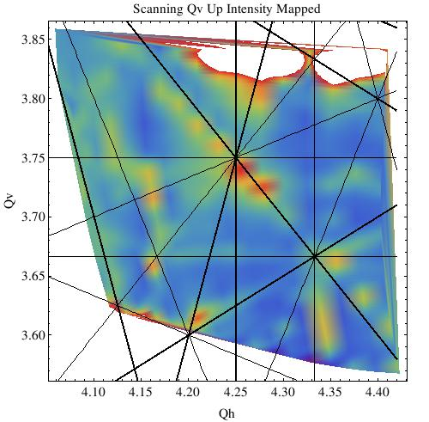
High Power Proton Accelerators:
UK Vision & Capabilities
John Thomason, STFC
PASI, 11 November 2015

Slide 2






UK Capabilities
Where?
Cockcroft Institute (CI – ASTeC, Lancaster, Liverpool, Manchester)
Huddersfield International Institute for Accelerator Applications
Imperial College London (ICL)
John Adams Institute (JAI – Oxford, Royal Holloway, Imperial)
STFC Accelerator Science and Technology Centre (ASTeC)
STFC ISIS Facility
University College London (UCL)
+ Laser Related Proton Acceleration at these and other institutes…

Slide 3
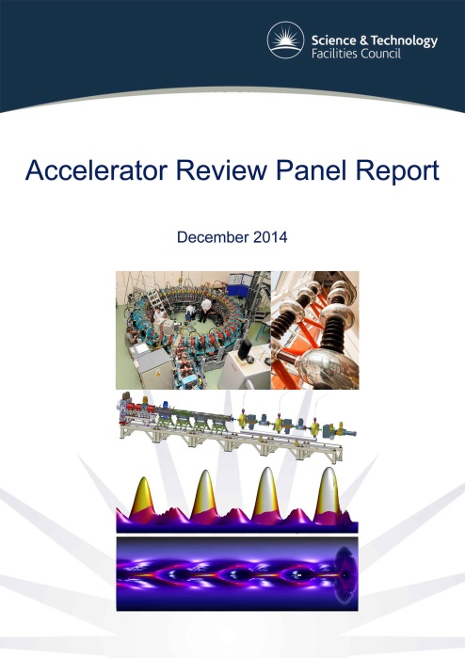
Laser Related Proton Acceleration
Plasma Wakefield (PW) projects are being carried out in the UK at JAI, ICL, University of Strathclyde and STFC Central Laser Facility
The UK plays a major role in the Proton Driven Plasma Wakefield Acceleration Experiment, AWAKE at CERN
Work is being undertaken on laser-driven ion acceleration with two national projects led by Queen’s University Belfast
“…laser related acceleration…a rapid advance in this technology would certainly be game-changing should it materialise in terms of current high power proton driver and neutron source thinking.”
Compact Proton Sources – Ceri Brenner
Working Group Session 3: WG3+WG4

Slide 4



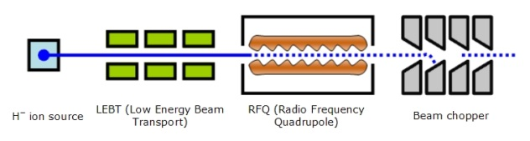


UK Capabilities
What?
UK Facilities
ESS
CERN
Proton Drivers for Particle Physics
ADS
Materials Irradiation
Front End Test Stand

Slide 5
UK Facilities

Slide 6
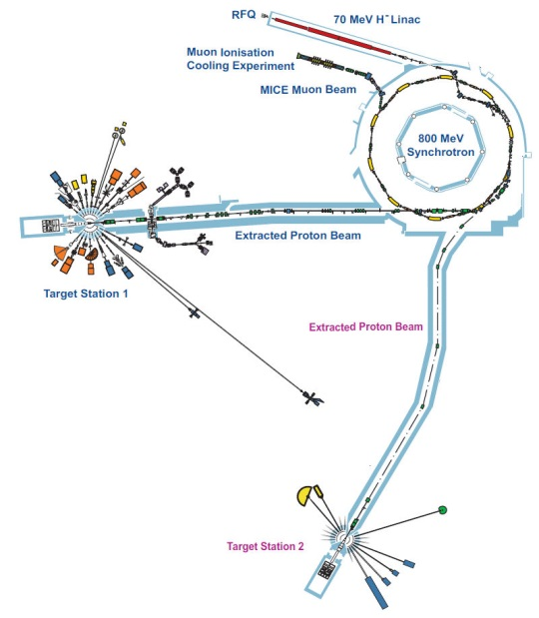
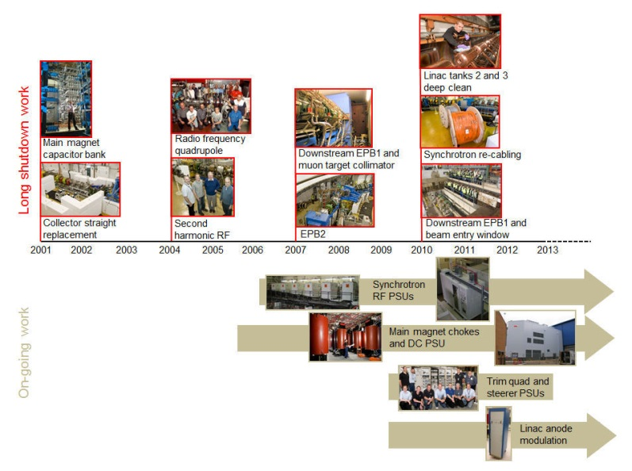
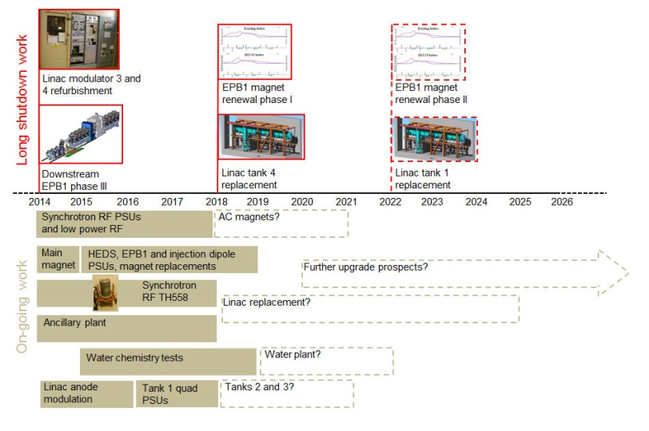
ISIS
ISIS supports a national and international community of more than 3000 scientists and gives unique insights into the properties of materials on the atomic scale, providing information which complements that provided by photon-based techniques. ISIS accelerator R&D activities are principally aimed at:
facilitating the programme of equipment renewal and upgrades required to keep the present ISIS accelerators running optimally and sustainably for the lifetime of the facility

Slide 7
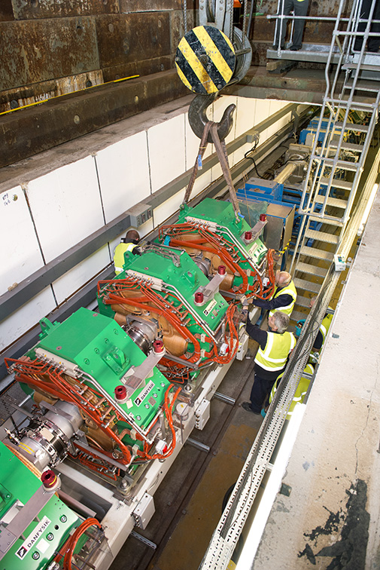
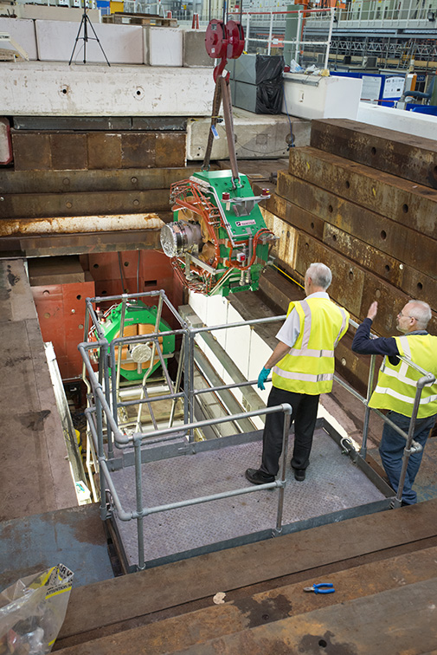
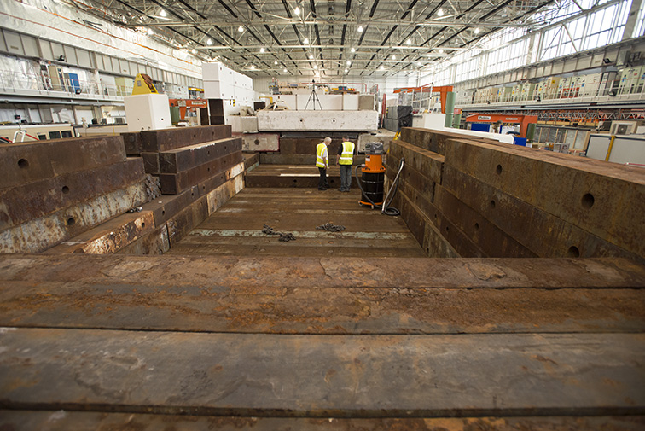

Slide 8
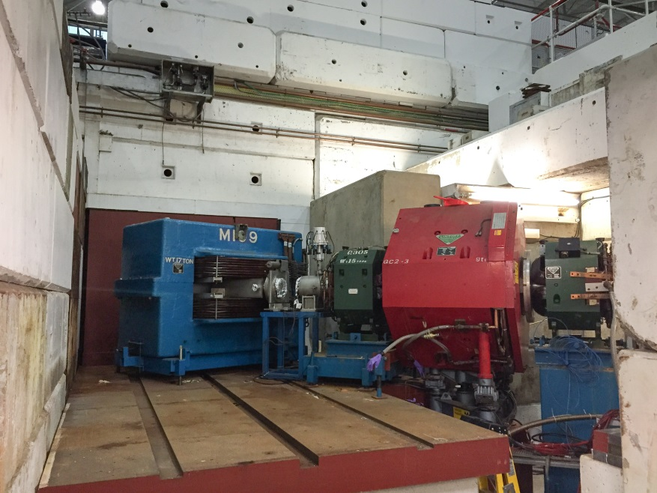
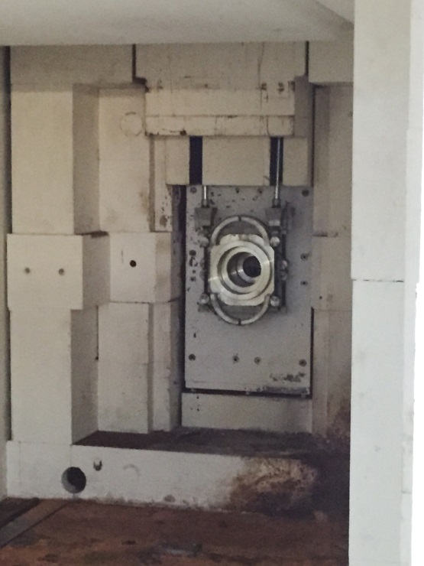
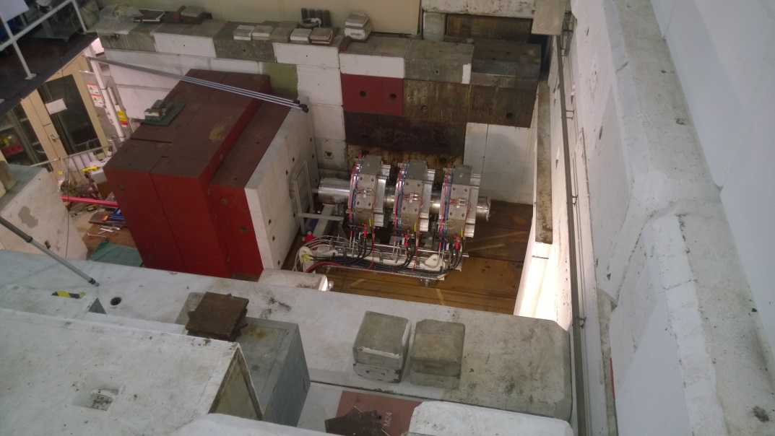

Slide 9
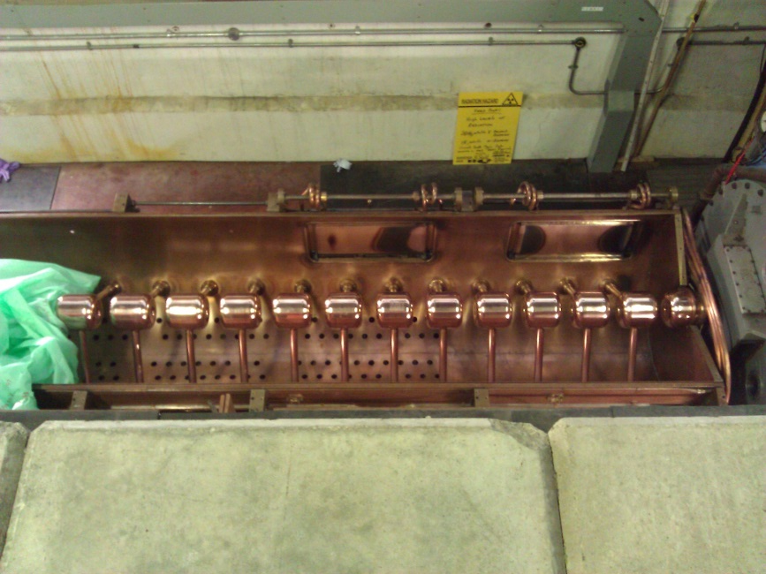
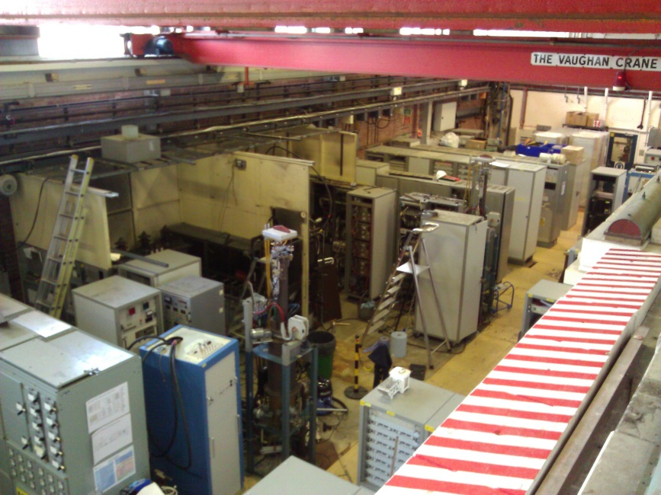
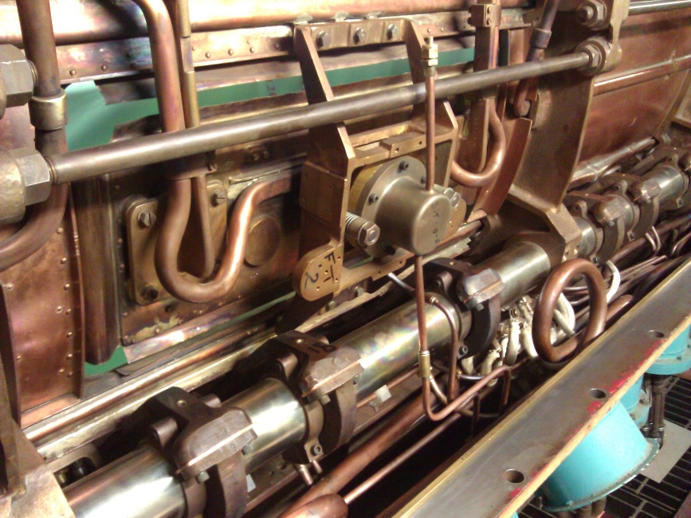
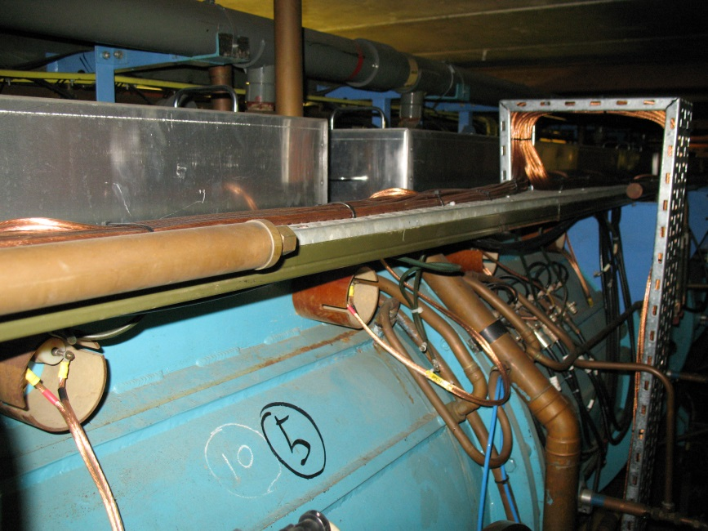

Slide 10
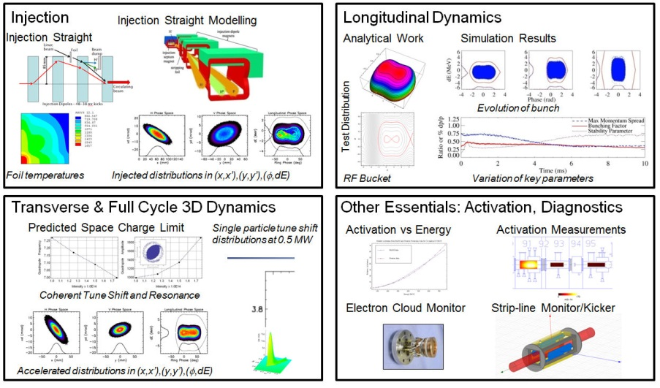
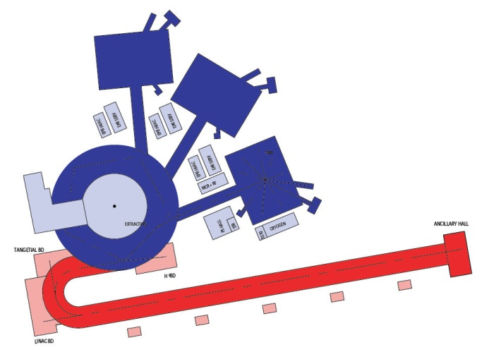
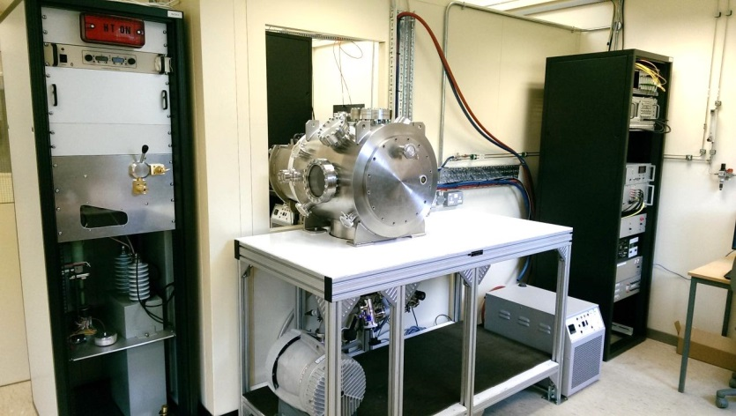
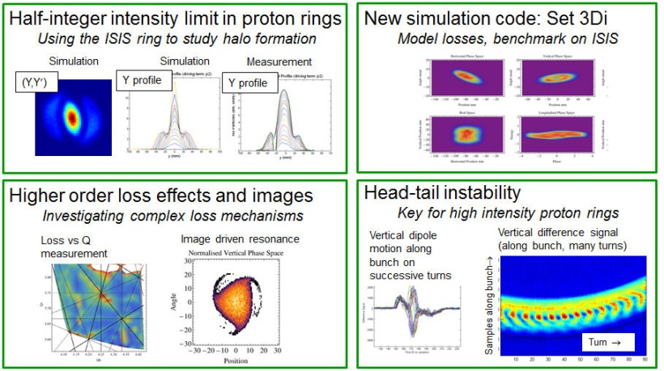
designing potential ISIS accelerator upgrades for increased capability
generic proton R&D
target upgrades
180 MeV injection
MW regime ‘ISIS-II’ scenarios
Including FFAG scenarios from ASTeC – more later…
e.g. ion source development
High intensity R&D studies

Slide 11
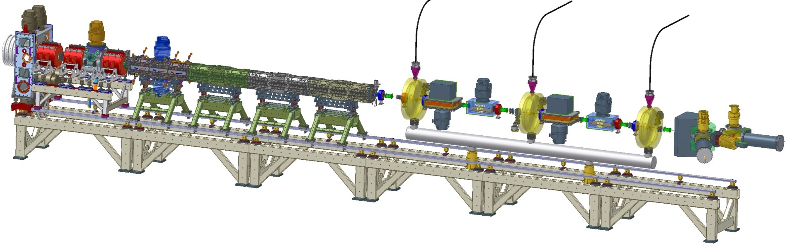
FETS
The Front End Test Stand (FETS) project is a generic proton accelerator R&D programme involving ISIS, ASTeC, JAI, Imperial College London, University College London, Huddersfield University, Warwick University and ESS Bilbao. The production of beams as envisaged with FETS will enable a significant increase in the flux of neutrons available for the neutron user community on ISIS and at similar facilities worldwide (SNS, ESS, JPARC, CSNS).
High brightness H– ion source
4 kW peak-power arc discharge
60 mA, 0.25 π mm mrad beam
2 ms, 50 Hz pulsed operation
Radio Frequency Quadrupole
Four-vane, 324 MHz, 3 MeV
4 metre bolted construction
High power efficiency
Diagnostics
Non-interceptive
Well distributed
Laser-based
Low Energy Beam Transport
Three-solenoid configuration
Space-charge neutralisation
5600 Ls⁻¹ total pumping speed
Medium Energy Beam Transport
Re-buncher cavities and EM quads
Novel ‘fast-slow’ perfect chopping
Low emittance growth

Slide 12
H– Ion Source Development at RAL – Dan Faircloth
Working Group Session 1: WG1
Overview of Diagnostics Work on the ISIS Accelerator – Alex Pertica
Working Group Session 3: WG1
High Power Proton Linac Development – Ciprian Plostinar
Working Group Session 4: WG1+WG4
Normal Conducting RF - An overview of the ISIS Accelerators – Mark Keelan
Working Group Session 5: WG1
Muon Science in the UK – Adrian Hillier
Working Group Session 1: WG4
Overview of FETS – Alan Letchford
Working Group Session 2: WG1
Diagnostics in FETS – Stephen Gibson
Working Group Session 3: WG1

Slide 13
ESS

Slide 14
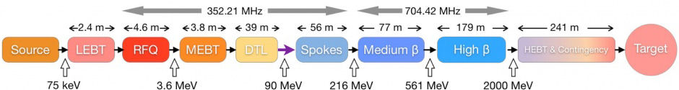

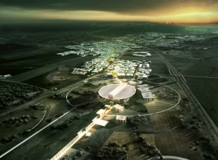
ESS
ASTeC at Daresbury Laboratory will lead the delivery of all qualified elliptical superconducting cavities for the high-beta section of the European Spallation Source (ESS) linac. This programme will form part of the UK contribution to the ESS.
ASTeC is already working with UK industry to develop the first superconducting cavity fabrication capability with the intention of opening up new market opportunities for UK plc.
SRF Development at Daresbury – Peter McIntosh
Working Group Session 5: WG1

Slide 15
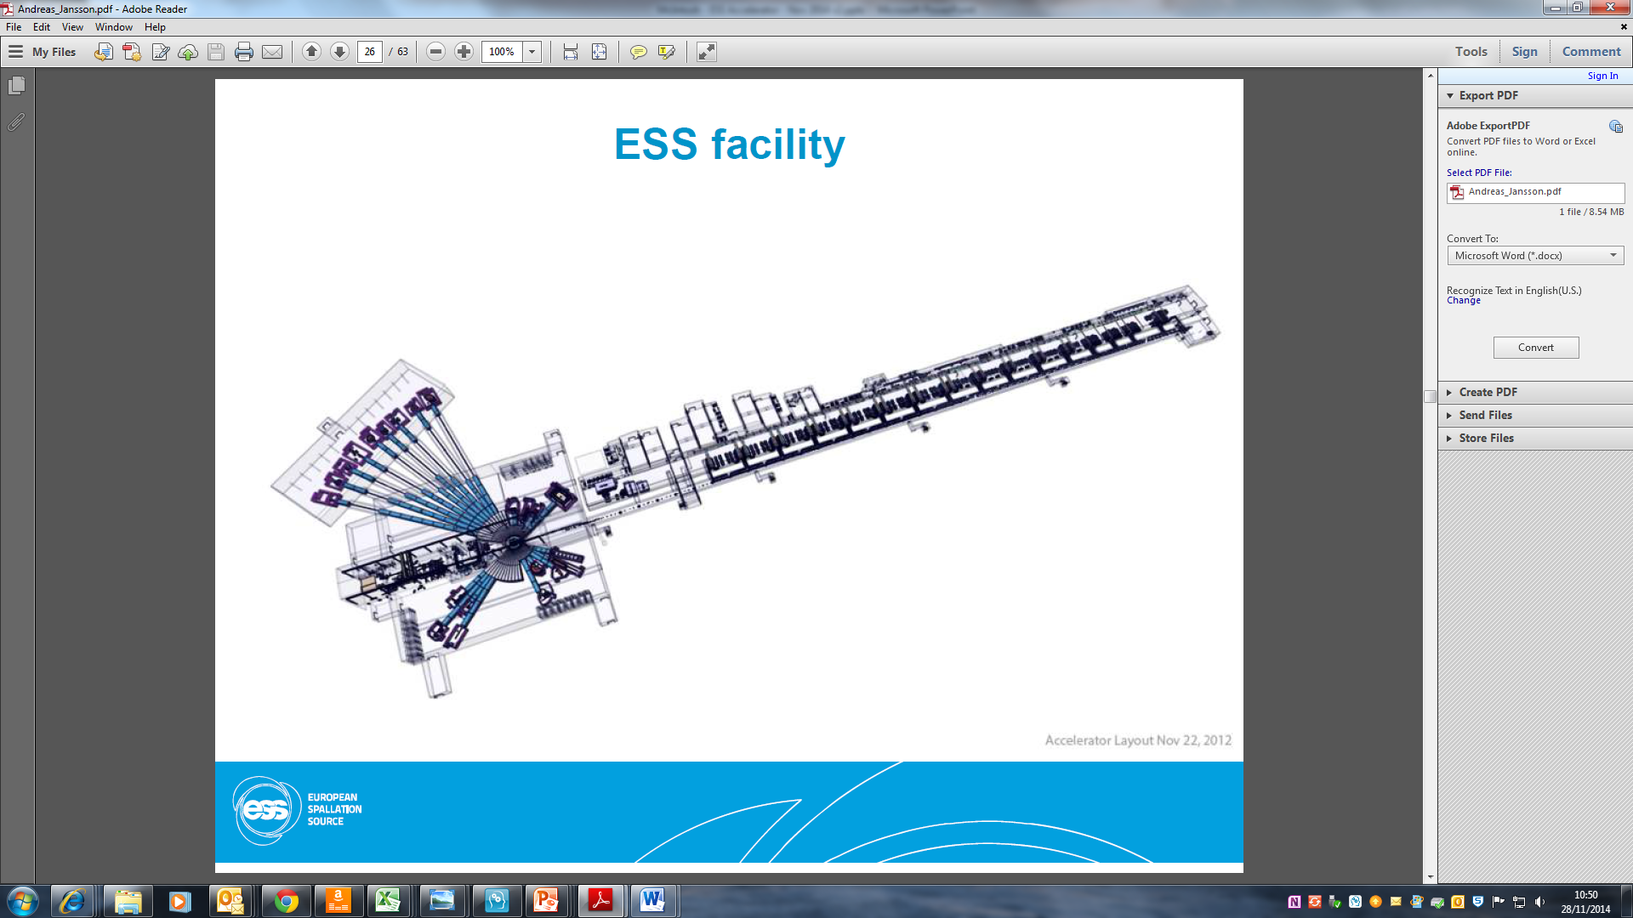
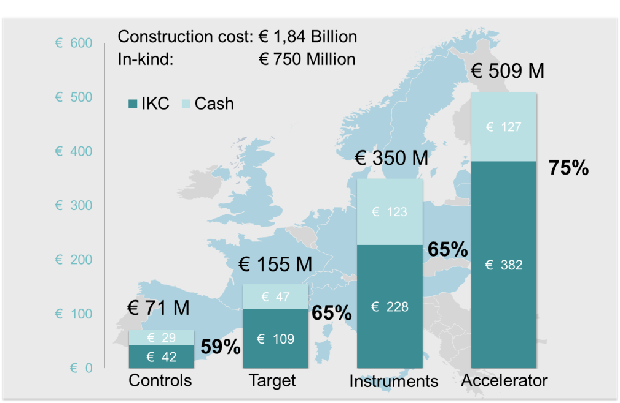
ESS Linac
The European Spallation Source (ESS) will house the most powerful proton linac ever built:
  Average beam power of 5 MW
  Peak beam power of 125 MW
  Acceleration to 2 GeV
  Peak proton beam current of 62.5 mA
  Pulse length of 2.86 ms at a rate of 14 Hz (4% duty factor)
97% of the acceleration is provided by superconducting cavities
The linac will require over 150 individual high power RF sources:
  With 80% of the RF power sources requiring over 1.1 MW of peak RF power
  RF system expected to cost over 200 M€ alone!

Slide 16
ESS Linac
Other UK Accelerator Contributions:
  Huddersfield providing procurement, test and delivery of high power RF distribution systems for both the spoke and elliptical cavities
  Liverpool University are developing Target Beam Imaging system
  ASTeC have provided dedicated vacuum testing equipment for ESS qualification purposes
  ASTeC/STFC Technology Department (TD) discussing possible contributions for the Linac Warm Unit sections
  CI/JAI/TD all discussing various aspects of diagnostics/instrumentation

Slide 17
CERN

Slide 18
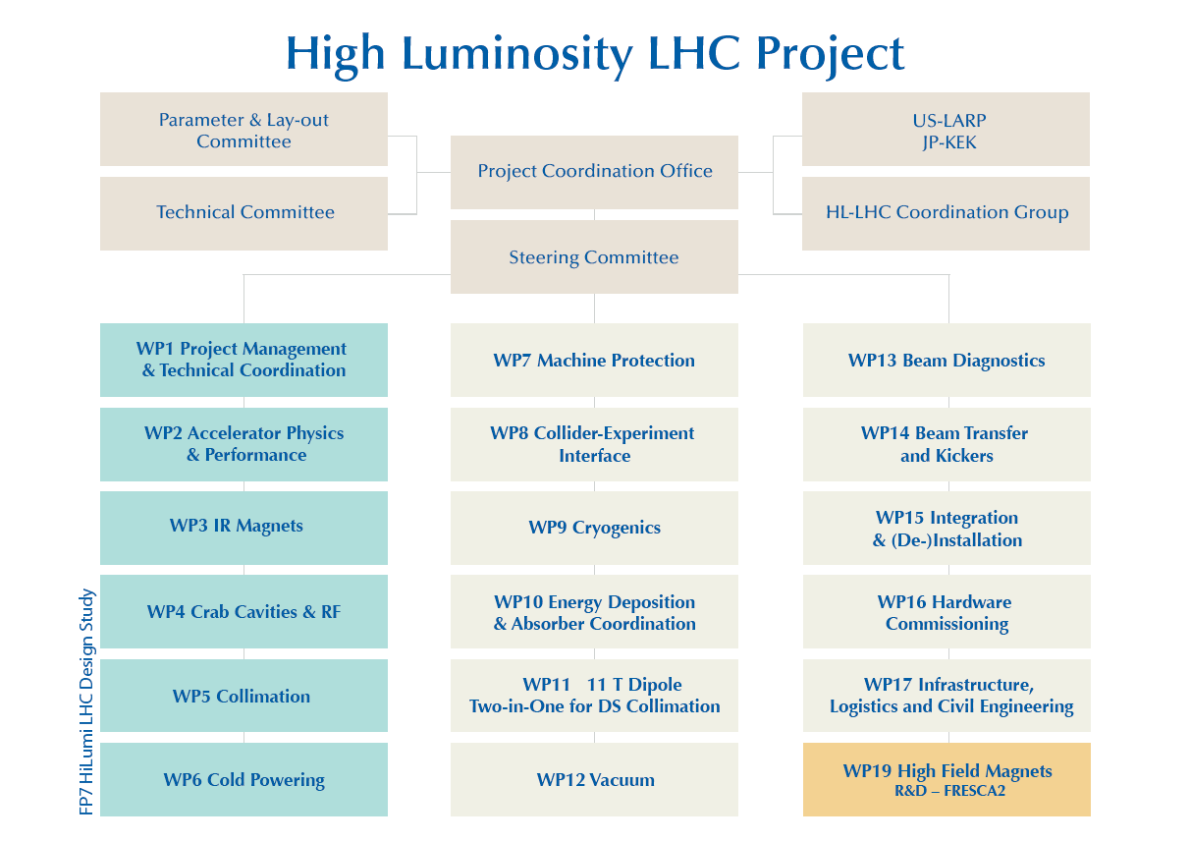
Where the UK Fits into HL-LHC
HiLumi-LHC
Leadership
HiLumi-LHC
involvement
HL-LHC-UK
Involvement

Slide 19
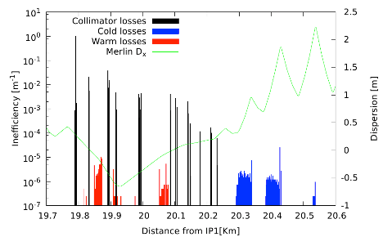
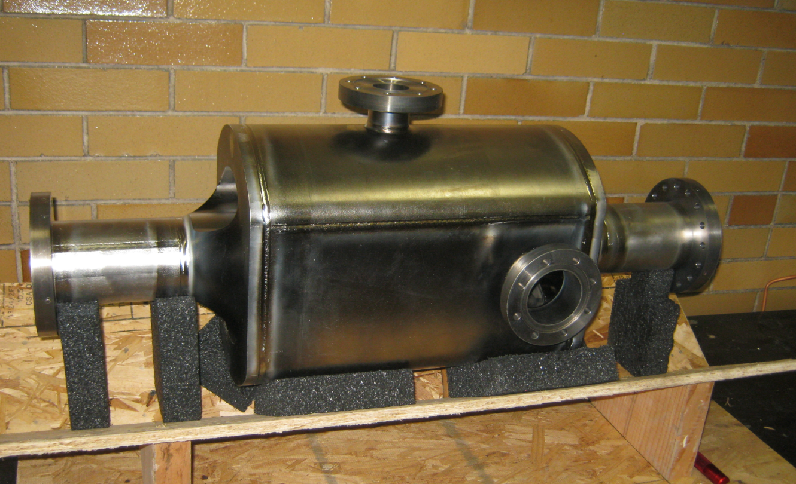
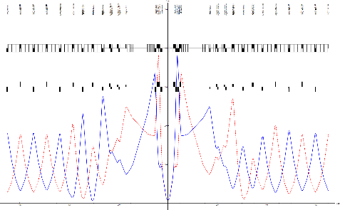
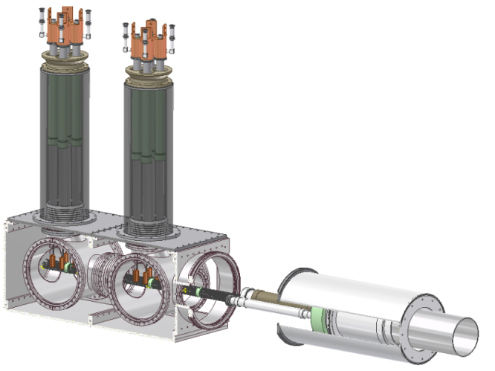
HiLumi-LHC: Science and Leadership
Manchester, Lancaster
ASTeC
Manchester, RHUL
Manchester, Liverpool
ASTeC
collimation
crab cavities
beam dynamics
HiLumi-LHC
UK
Manchester
Southampton
superconductivity and cryogenics
Liverpool, RHUL
diagnostics
machine-detector interface

Slide 20
HL-LHC-UK Overview
The HL-LHC-UK accelerator programme is focused, in order to create critical mass, on four key areas as part of the HL-LHC upgrade where the UK has existing expertise
  the development of the collimators
  the SCRF crab cavities
  novel diagnostics
  the superconducting links for remote powering
The UK spokesperson is Rob Appleby (CI/Manchester)
Each work package
  builds upon the design effort undertaken as part of the HiLumi project
  capitalises on UK strengths to develop the first prototypes for HL-LHC
So HL-LHC-UK delivers real hardware to the LHC upgrade, 2015-2019

Slide 21
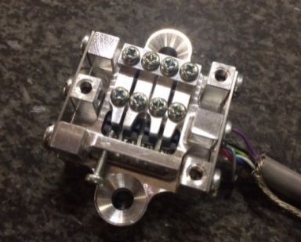
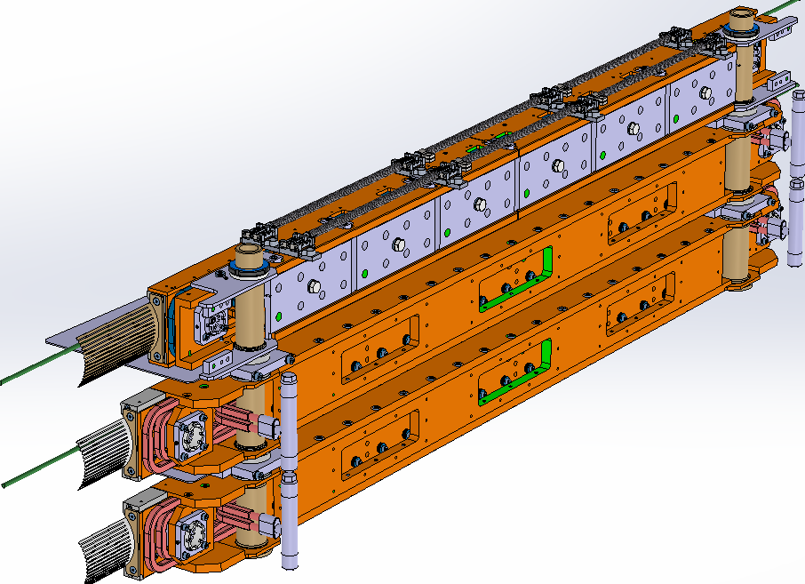
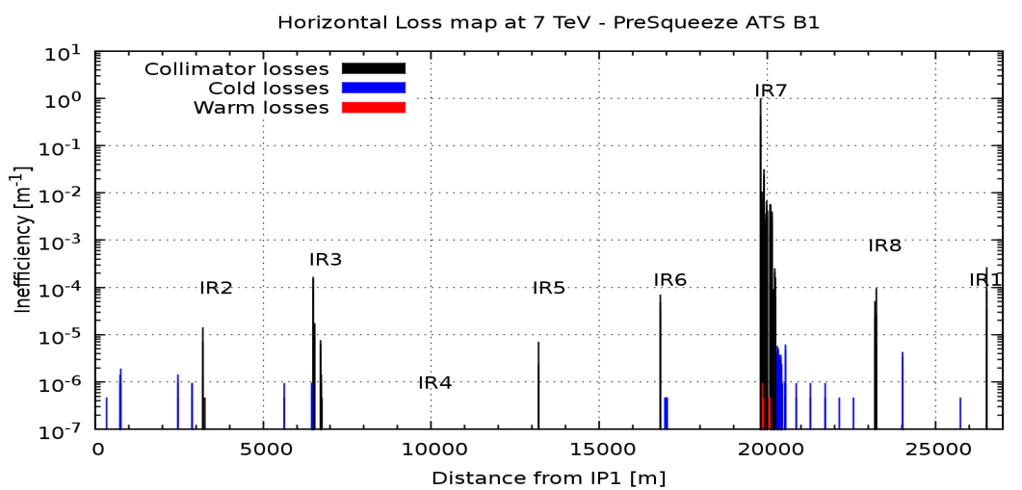
HL-LHC-UK Work Package 1
WP1 will focus on novel simulations and delivering two pieces of collimator prototype hardware. The leader is Rob Appleby (Manchester)
  Task 1 : Collimation dynamics and simulation (Appleby), Manchester, RHUL, Huddersfield
  Task 2 : Novel collimator
  prototyping (Fletcher),
  Manchester,
  Huddersfield
Sensor modules
HiRadMat
Beams

Slide 22
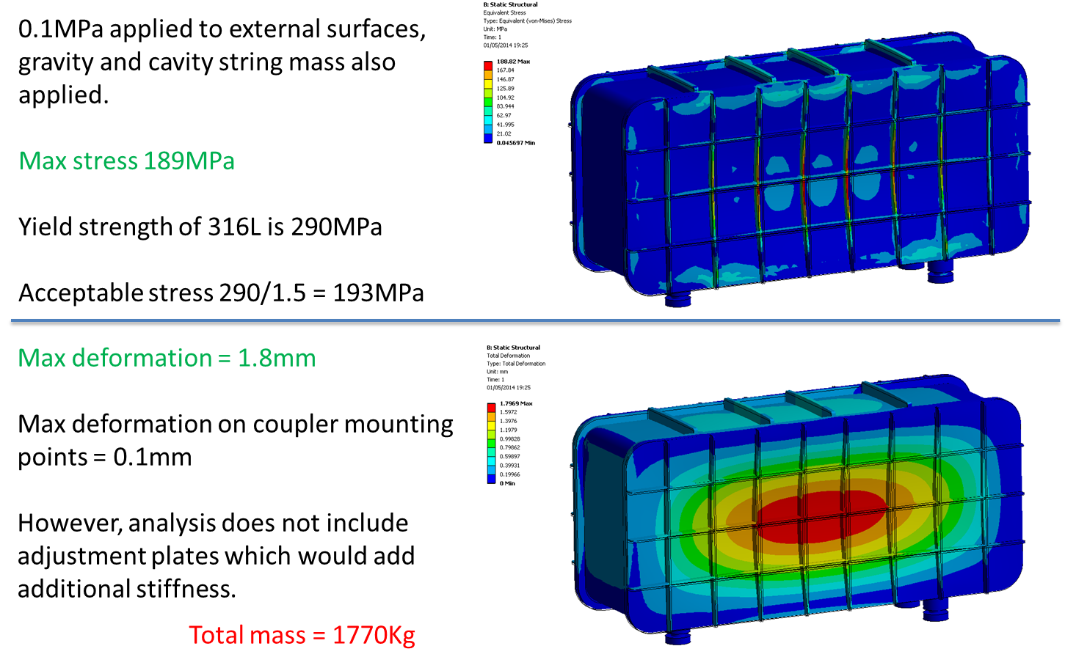
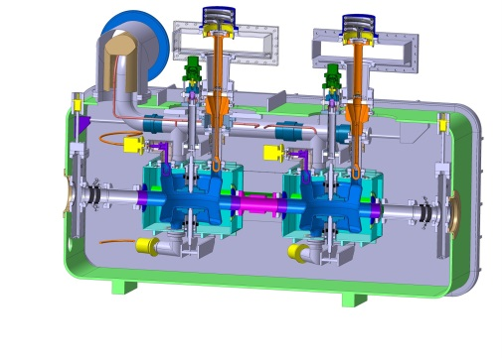
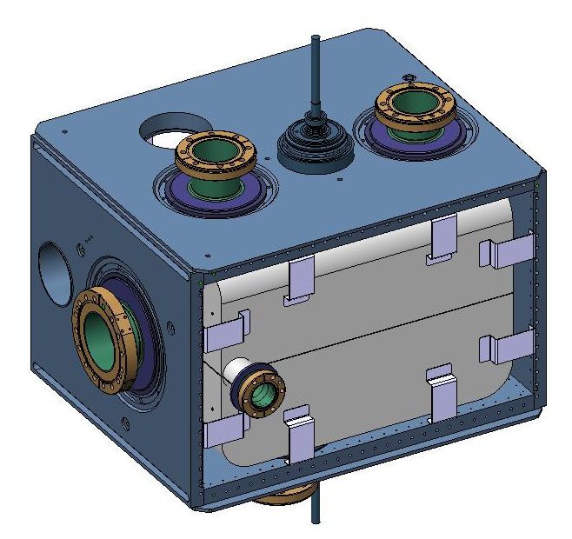
HL-LHC-UK Work Package 2
WP2 will focus on simulation, production and testing related to the crab cavities for HL-LHC. The leader is Graeme Burt (Lancaster)
  Task 1: Testing crab cavities in SPS (Burt), Lancaster
  Task 2: Pre-series cryomodule (Pattalwar), ASTeC, Lancaster
  Task 3: Beam dynamics and RF noise (Appleby), Liverpool, Manchester, Lancaster
The key goal of this WP is to deliver a UK-led pre-series cryomodule to CERN for testing, and to play a major role in tests on SPS

Slide 23
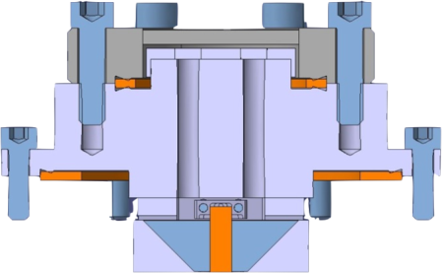
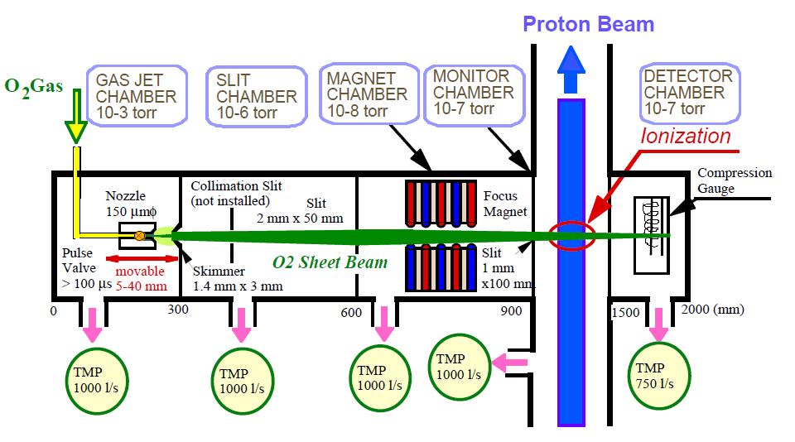
HL-LHC-UK Work Package 3
WP3 will focus on the development of novel beam diagnostics that have been identified as critical to the HL-LHC by the CERN Beam Instrumentation group. The work package leader is Stephen Gibson (RHUL)
  Task 1 : Electro-Optic Beam Position Monitor (Gibson), RHUL + CERN Beam Instrumentation
  Task 2 : Gas-jet based Beam Monitor (Welsch), Liverpool + CERN Beam Instrumentation
Proton bunch
eo-crystal

Slide 24

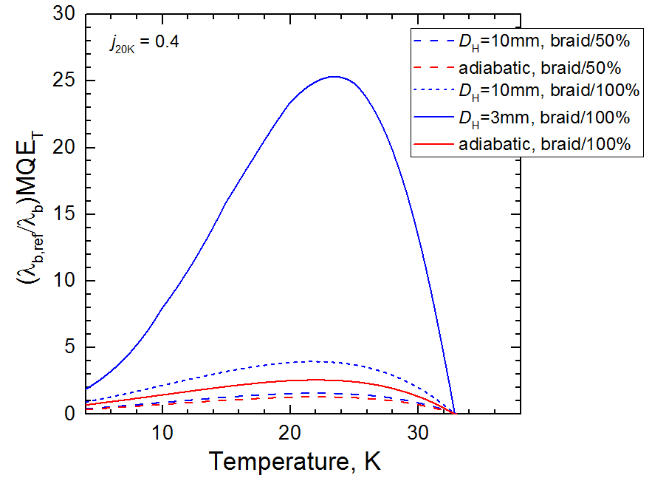

HL-LHC-UK Work Package 4
WP4 will focus on the cryogenic/electrical interfaces, quench protection, and the testing of the SC-Links. It will delivering the full mechanical design of distribution feedbox cryomodules and manufacture the pre-series prototype hardware . The leader is Yifeng Yang (Southampton)
  Task 1 : SC-Link interface to HTS current leads (Yang), Southampton
  Task 2 : SC-Link interface to Magnets (Yang), Southampton
Enhancing minimum quench energy by cooling optimisation
200kA HL-LHC SC-Link Layout
6x 20 kA cables
7x ±3kA cables
24x 600A cables
Extending optical thermal sensing to cryogenic temperatures for quench detection

Slide 25
Proton Drivers for Particle Physics

Slide 26
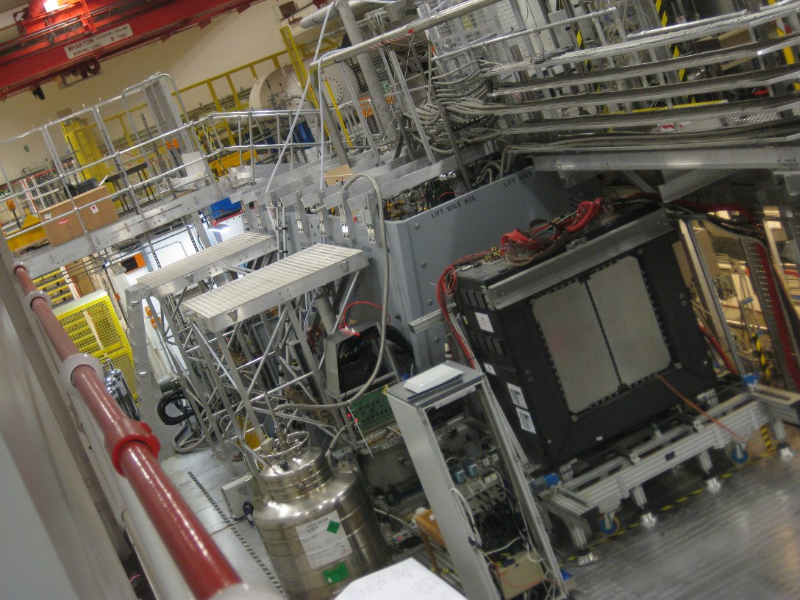
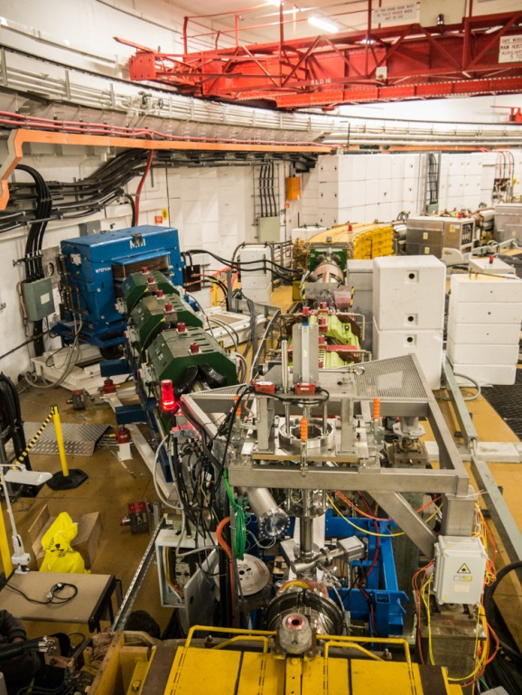
MICE and IDS-NF
ISIS is the proton driver for the Muon Ionization Cooling Experiment
MICE – Pavel Snopok
Working Group Session 1: WG4
Significant UK contributions towards proton drivers for neutrino factory as part of recent(ish) IDS-NF study – beam dynamics, conceptual layout, targetry, etc.

Slide 27
ADS

Slide 28
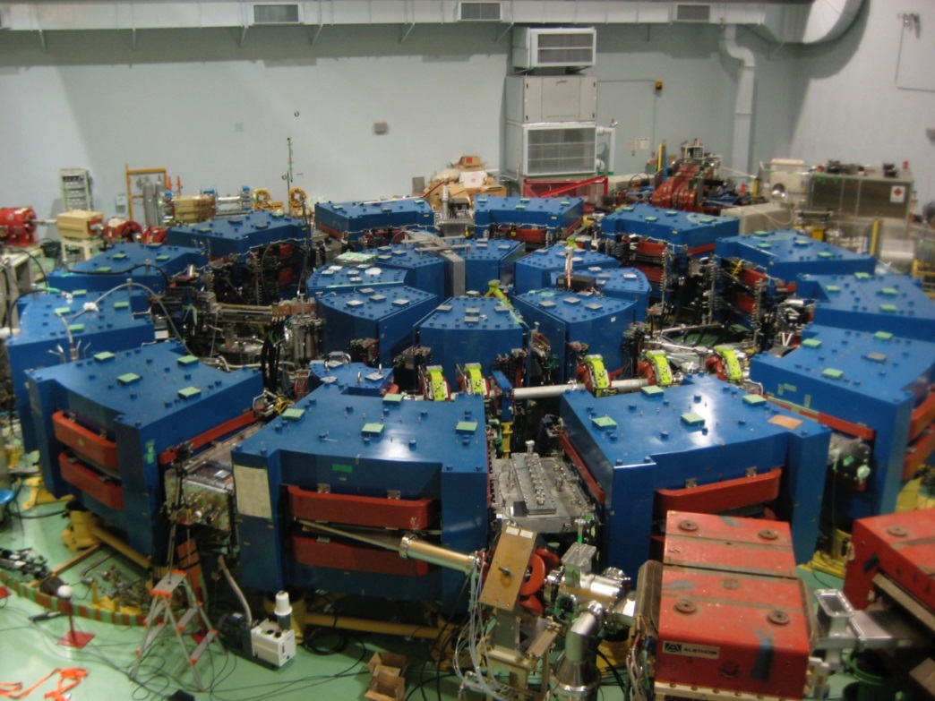
ADSR FFAGs
Potential for FFAGs for high power application requires simulation and experimental approach to show feasibility
Progress toward CW isochronous designs (FNAL), also Separated Orbit Cyclotron (ASTeC) in recent years
Simulation work ongoing using OPAL in ASTeC and Huddersfield in UK and BNL both toward ADS designs and high intensity isotope production machines, as well as general code development (ASTeC, PSI - OPAL code) to understand high intensity beam dynamics.
Collaboration (UK/JAPAN/US) experimental campaign using Kyoto University Research Reactor Institute (KURRI) 150 MeV proton FFAG to improve transmission and study high intensity operation.
FFAG Development in the UK – David Kelliher
Working Group Session 2: WG4

Slide 29
Materials Irradiation

Slide 30
FAFNIR (40 MeV, 3 - 30 mA, D⁺, CW)
FAcility for Fusion Neutron Irradiation Research
IFMIF accelerator and target both challenging → long time scales, politically difficult
Relaxed test requirements, improved interpretation of data → can relax machine requirements.
~ 100 kW – 1 MW
Rotating carbon target - C(d,n) reaction
14-MeV-like neutron spectrum
Can be built relatively easily
CCFE championing concept with fusion community, backed by technical accelerator advice from ISIS, ASTeC, JAI and others
HIPSTER/Dynamitron
High Intensity Proton Source for Testing Effects of Radiation
  Proposed extension of FETS to provide a unique high-intensity (3 MeV, 60 mA, H⁺, 10% duty cycle) materials irradiation facility
Upgrade to the University of Birmingham Dynamitron
  Increase beam current and lithium target capability to provide high intensity (3 MeV, 15 mA, D⁺, CW) UK based neutron irradiation facility

Slide 31

UK Vision
The development of existing and new high power proton accelerator based facilities in the UK, in Europe and across the world offers a diverse range of opportunities where the UK can contribute
But there are relatively few large-scale projects and the time required to execute each of the projects is long
These facts, combined with the wide range of expertise required to contribute across the life-cycle of a major project, make it difficult for any individual UK institute to exploit the opportunities as they arise, but together the UK proton accelerator community has the expertise, experience and capability to execute substantial, long-timescale projects
By establishing a coherent portfolio of projects at different stages in the accelerator life-cycle, the UK will be in a better position to contribute worldwide and increase the likelihood of there being a major new facility built in the UK

Slide 32
Example: ISIS Upgrade Paths

Slide 33
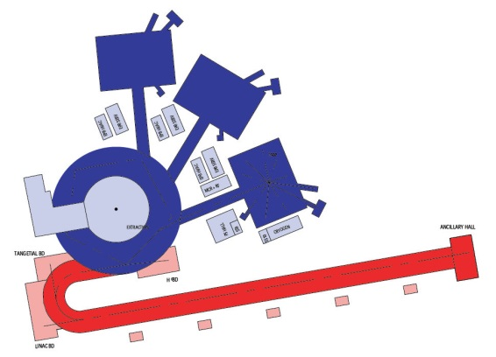
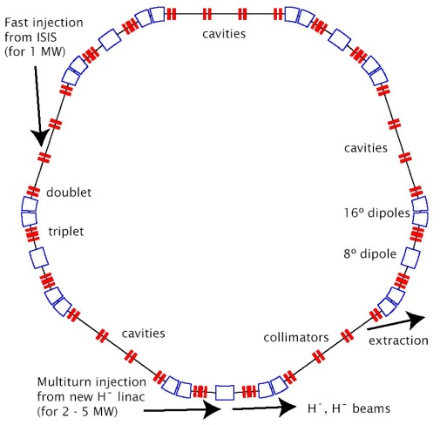

Important to stress that this must be envisaged as a facility upgrade, not simply an accelerator upgrade
Provision for multiple optimised targets (3+?) maximises capacity
Some options:
  0.8 GeV superconducting linac + 0.8 - 3.2 GeV RCS, baseline machine now under detailed study
  FFAG machine could be an important alternative (ASTeC Intense Beams Group), smaller, lower injection energy, higher efficiency and reliability, but will it work at high intensity?
  Higher energy linac + accumulator ring
ISIS-II scenario 1)
1 - 2 MW, upgradable, higher power option
0.8 – 3.2 GeV RCS
0.4 – 3.2 GeV FFAG
Ideas to study:
  can we design upgradeable facilities without making them much more expensive?
  can we save power, reduce costs?
  would smaller and cheaper with optimised targets be a better fit to the funding envelope and ultimately be better for the community…

Slide 34
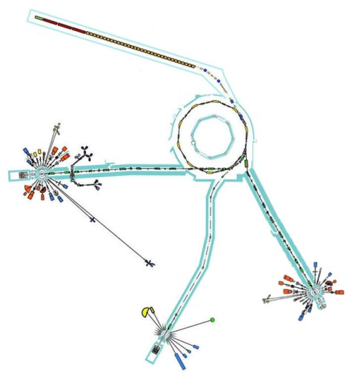
ISIS-II scenario 2)
0.5 - 1 MW medium power option
180 MeV linac replacement now a well studied, well understood option, but shouldn’t base a new facility on a 30+ year old RCS
Could be baseline for a new stand alone facility
Or could house completely new accelerator within existing ISIS infrastructure
  Probably cheapest possible option
  But can we can tolerate the consequent off-time?
Look at FFAG alternatives (ASTeC Intense Beams Group)
Know that there are effective target options available in this regime, but again need to optimise fully
May choose multiple optimised targets even in this power range (ISIS TS-2 has shown excellent science output at 40 kW)

Slide 35
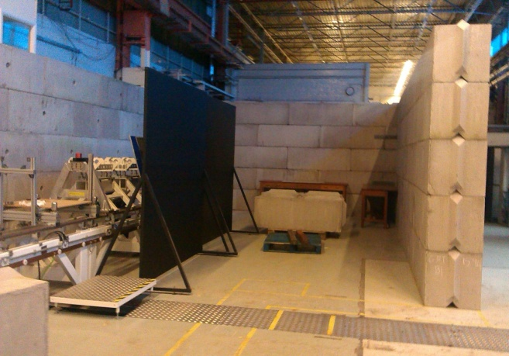
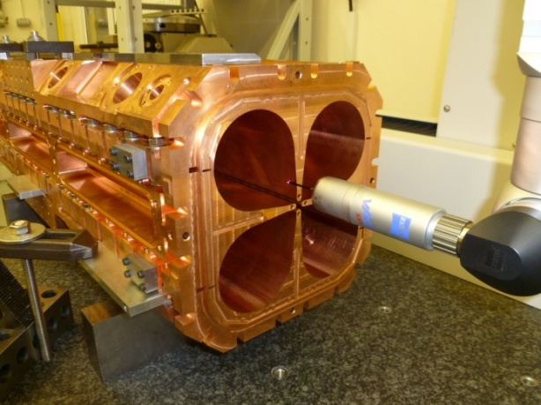
Compact neutron source (not ISIS-II)
Recent interest in a compact short pulse option with proton energy in the range 14 – 20 MeV
Could be an extension of the Front End Test Stand in R8 at RAL, which is likely to be handed over to ISIS at the end of Programmes Office funding in 2017
Other alternative uses (e.g. fusion materials irradiation, single event effect testing with protons) could be considered, but should not be allowed to detract from a unique opportunity to do accelerator development towards ISIS-II

Slide 36
Compact neutron source (not ISIS-II)
Look at FFAG alternatives (ASTeC Intense Beams Group) to take output from FETS (3 MeV) directly to required energy and pulse structure
  Study high intensity beam dynamics to establish whether FFAGs are really a possibility for ISIS-II
  Prototype relevant components
Lower risk (but less interesting) alternative is warm DTL to required energy, followed by an accumulator ring
Should be used to allow us to demonstrate technology readiness in areas we are not covering under another banner (ISIS sustainability, other UK proton R&D)
Engineering effort likely to be needed from Universities and Institutes

Slide 37
Technology Readiness
Staffing | Currently have strong leadership in most areas, but would need to retain this and hire lots of new engineers and draw on university resources.
Simulation codes | Lots of expertise and optimised codes within ISIS, ASTeC and universities.
Ion source, RFQ, MEBT, chopper | Covered by FETS programme.
Warm DTL | ISIS tank IV replacement, 4616 and TH116 replacements in hand.
SC Linac | ASTeC efforts towards ESS and engagement with PIP-II at Fermilab should put UK in a much stronger position.
Stripping foils | Recent investigations of carbon foils at ISIS are encouraging.
Vacuum | Nothing particularly new required, recent efforts to re-establish production of ceramic vacuum vessels, interest in new methods of RF screening at J-PARC and CSNS.
Large AC magnets | ISIS MMPS replacement, important to re-establish manufacture of large AC magnet yokes, but hope to cover under ISIS sustainability programme.
DC magnets | Lots of expertise built up within ISIS, also on PSUs.
Synch RF | Transition to TH558 tubes going well, watching brief on magnetic alloy cavities at J-PARC.
Pulsed magnets | Lots of expertise built up within ISIS, but retention of staff has become an issue.
Diagnostics | ISIS is world-leading in many areas.
Collimation | Recent HL-LHC work.
High power beam dumps, target windows, etc. | Probably OK.
Targets | Chris Densham’s group are world leaders
FFAG magnets, injection and extraction, RF systems | Need to design, prototype and build a real system to give sufficient credibility to pitch for this as a high-power solution.
In broad agreement with analysis of UK Underpinning Technologies presented to the STFC Accelerator Strategy Board in September 2015 by Peter McIntosh

Slide 38
Conclusions
In this specific example it would be expected that “ISIS should take the lead in specifying ISIS upgrades and then coordinating contributions from interested parties…”, but this would be equally true of whatever else the next major UK facility might be. The important factor is a coherent approach from the community
This coherent approach necessarily involves collaboration with strategic partners worldwide, such as Fermilab
Underpinning technology development programmes are fundamental in achieving next generation accelerator capabilities: without these activities, any existing and/or future large scale accelerator facility would not be feasible

