Slide 1
SRF Crab cavities and their ancillaries for HL-LHC
Peter Ratoff & Graeme Burt Lancaster University & The Cockcroft Institute

Slide 2
HL-LHC Upgrade IR problem
HL-LHC upgrade during LS3
Complete overhaul of the interaction regions of ATLAS and CMS
Aimed luminosity increase factor of 10, realistically ~4
The HL-LHC upgrade will have a smaller β*
This will increase the long range effect at the IR unless the crossing angle is increased

Slide 3
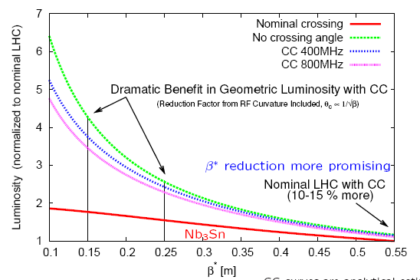
Crab cavities
Increasing the crossing angle decreases the long range effect but decreases geometric overlap
Rotating the bunches with crab cavities before and after collision can reduce this effect

Slide 4
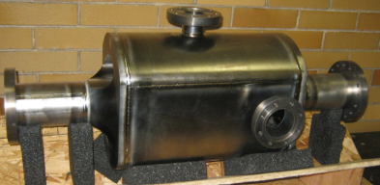
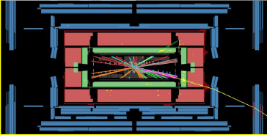
Crab crossing
4 Rod Crab cavities
IR

Slide 5
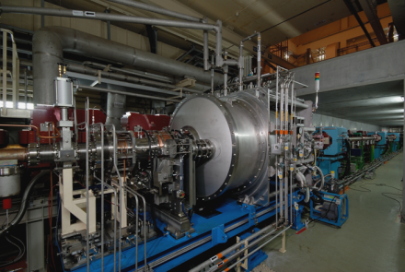
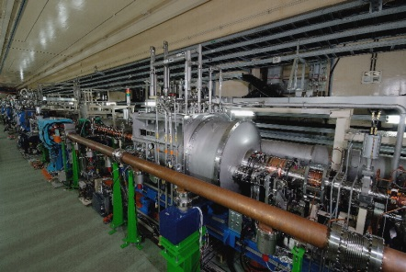
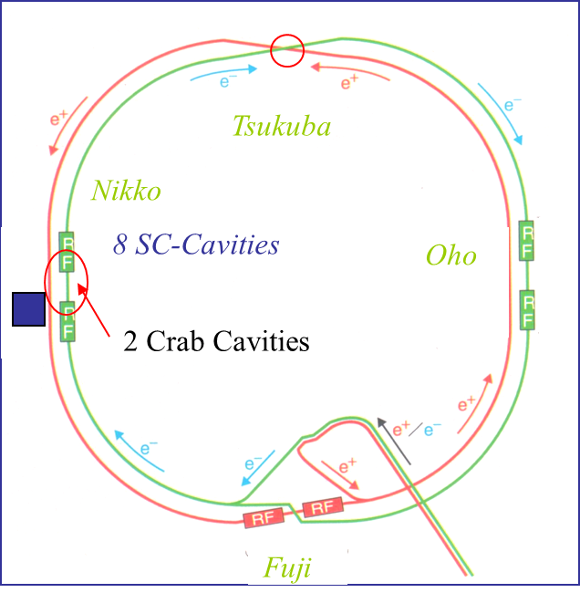
Crab Cavities at KEKB
Full crossing angle $θ_{C}$= 22 mrad
HER
LER
2 KEKB crab cavities were designed, constructed and installed in KEKB, and operated about 3 years under high current beam.
Peak luminosity L_{peak} =21.1 x 10³³ /cm²/s attained under crab on operation (peak luminosity world-record 2009).
KEKB operation terminated in June 2010 for the upgrade towards SuperKEKB.
K. Hosoyama @ CC10

Slide 6
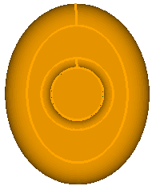
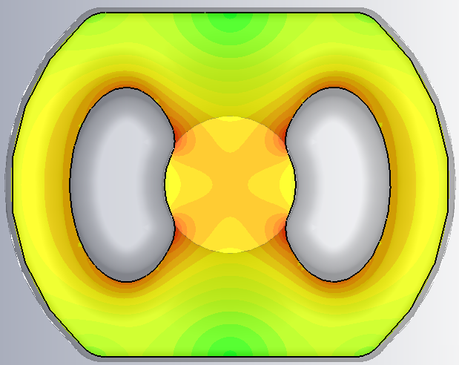
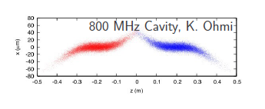
Why do we require compact cavities?
There is limited space for the crab cavities due to the opposing beamline
The cavity must be within a 143 mm radius
800 MHz elliptical
400 MHz elliptical
400 MHz compact
Using 800 MHz RF causes a S-shaped bunch which reduces luminosity hence a 400 MHz compact cavity is desired

Slide 7
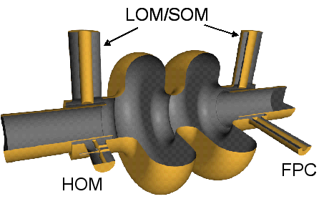
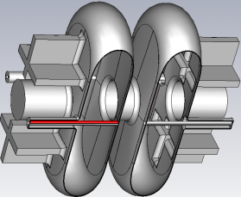
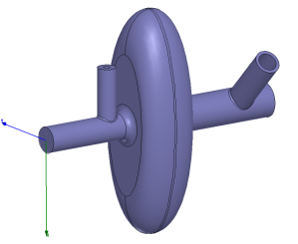
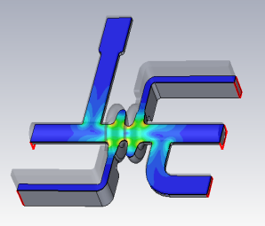
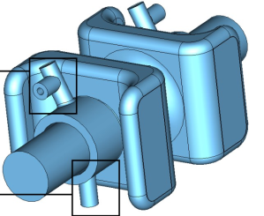
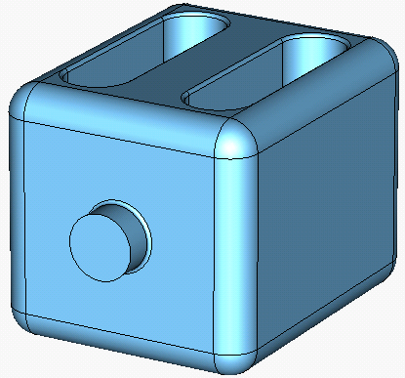
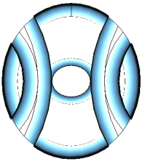
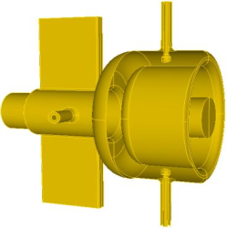
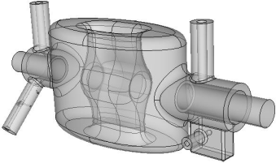
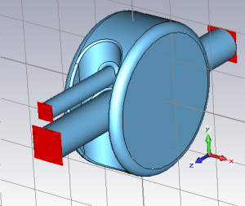
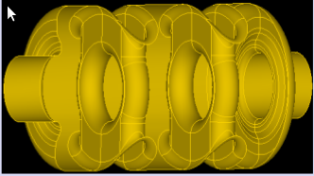
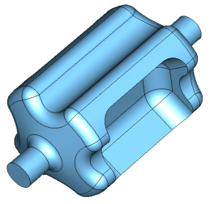
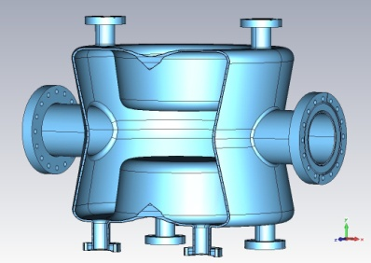
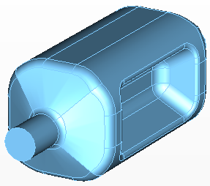
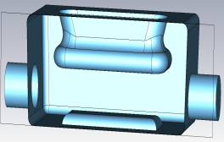
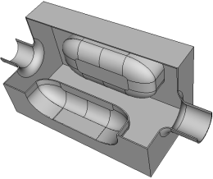
CC Down selection (CC’11)
R. Calaga, Chamonix ‘12
~4yr of design evolution
Exciting development of new concepts
(BNL, CERN, CI-JLAB, FNAL, KEK, ODU/JLAB, SLAC)

Slide 8
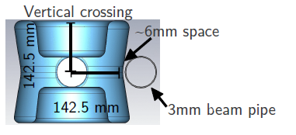
Double λ/4 TEM Cavity – BNL
Using two 1/4 wave cavities removes any monopole and quadrupole components from the dipole field.
However it then is only compact in one direction (LHC may need both planes).
Also has another monopole mode nearby.

Slide 9
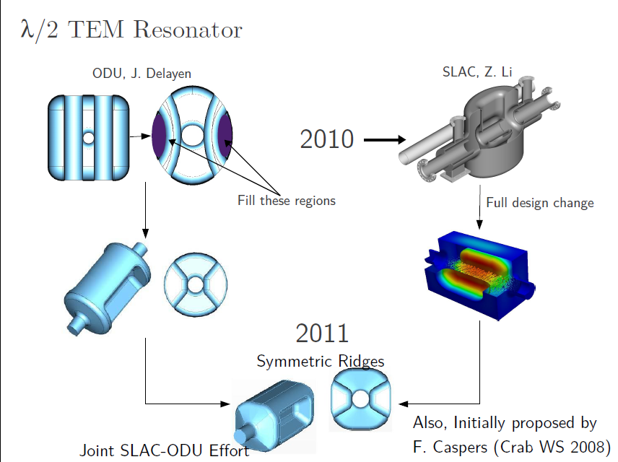
λ/2 RF Dipole Crab Cavity

Slide 10
Four rod crab cavity - Lancaster
499 MHz CEBAF Separator
CEBAF separator cavity is:
499 MHz,
2-cell, 8 rods
~λ long
∼0.3 m diameter,
can produce 600kV deflecting voltage (on crest) with 1.5kW input RF power.
To make suitable we increased the separation between the rods and made the rods wider.
Very compact in both planes and has a sparse HOM spectrum.

Slide 11
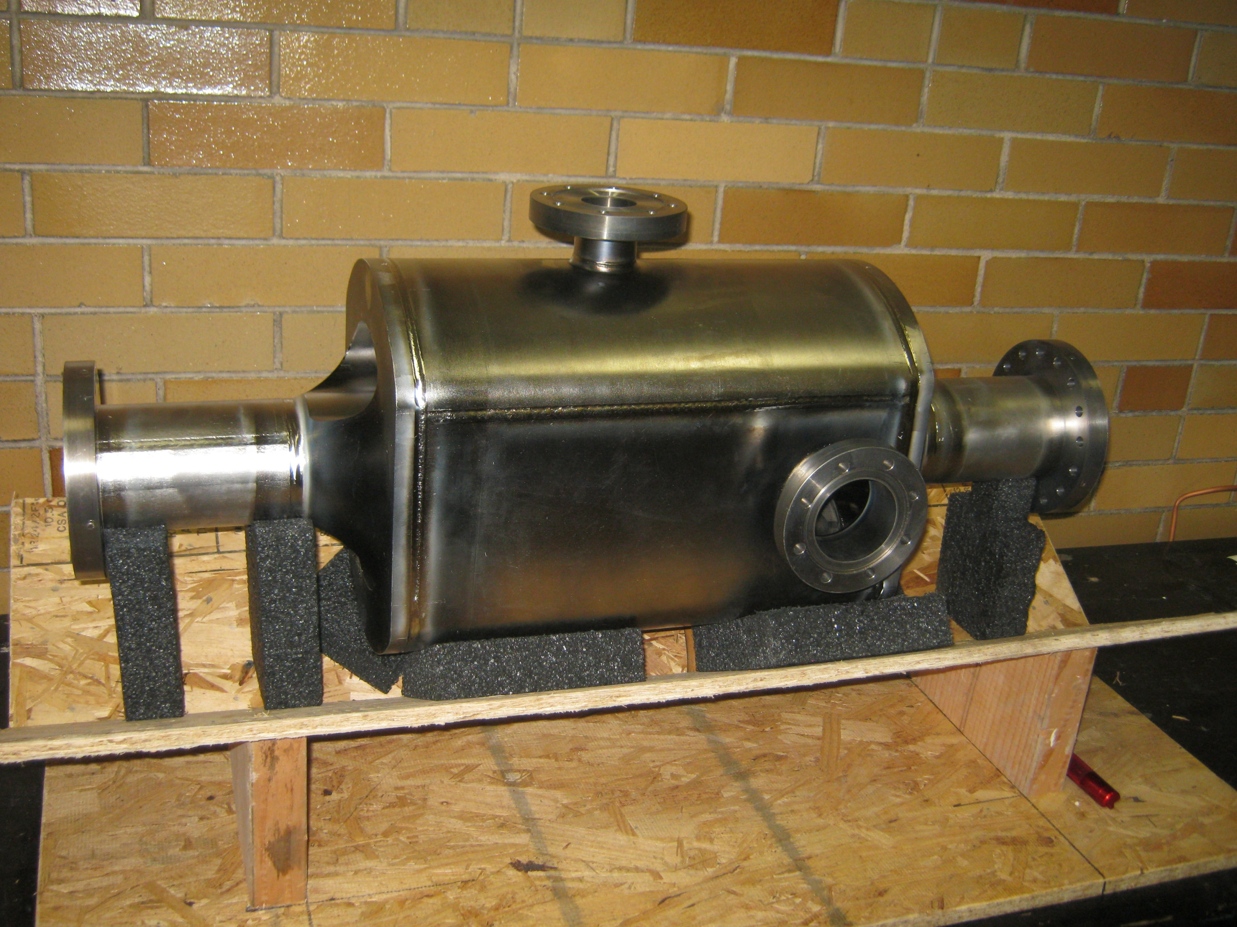
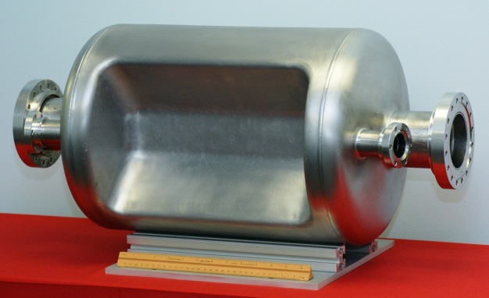
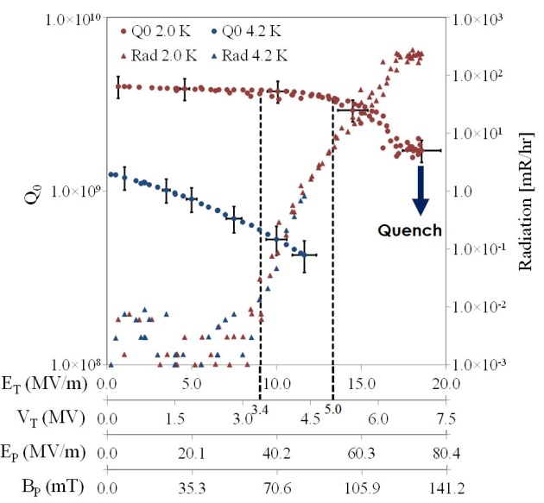
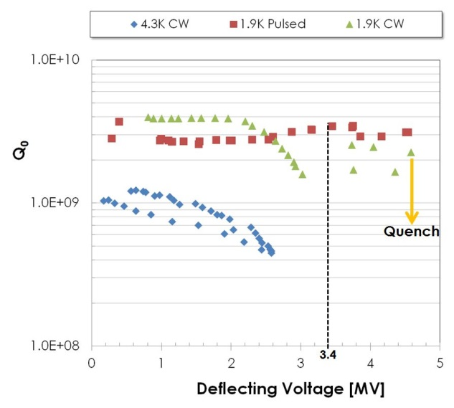
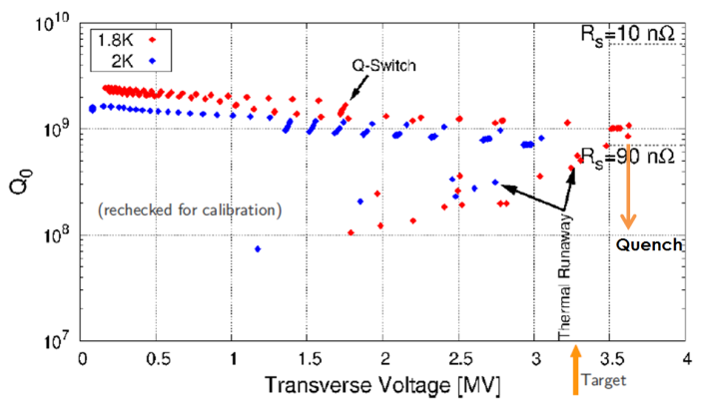
Successful Cold Testings
4 Rod
RF Dipole
Double Quarter Wave
HiLumi-LHC/LARP Crab Cavity System External Review, May 5-6 2014

Slide 12
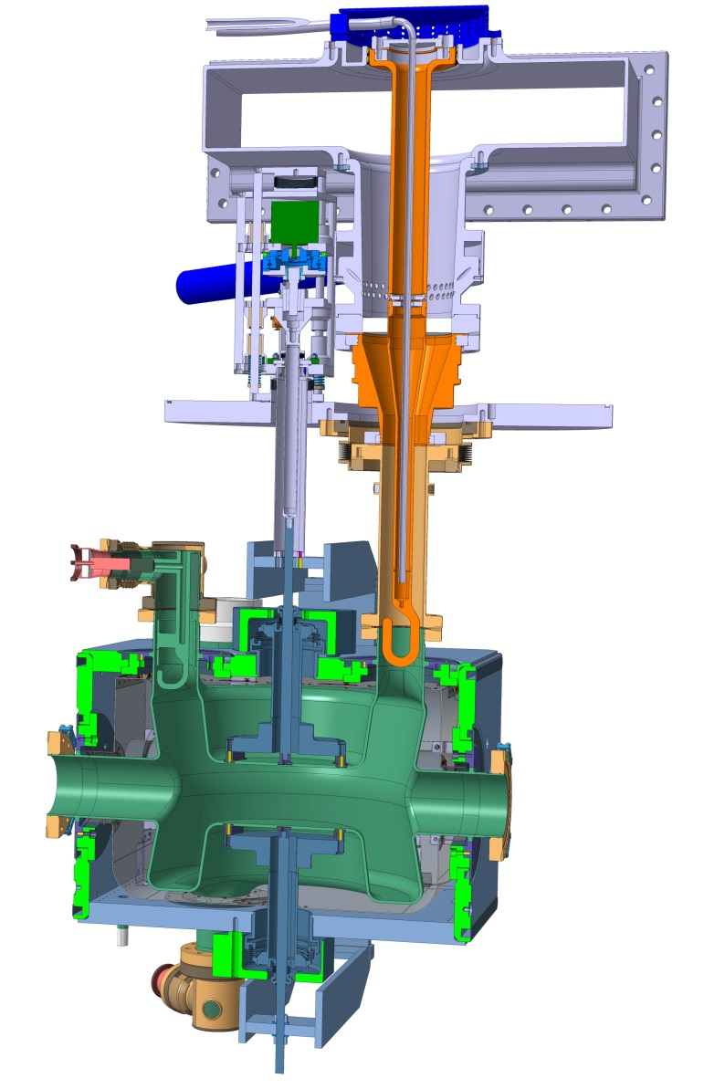
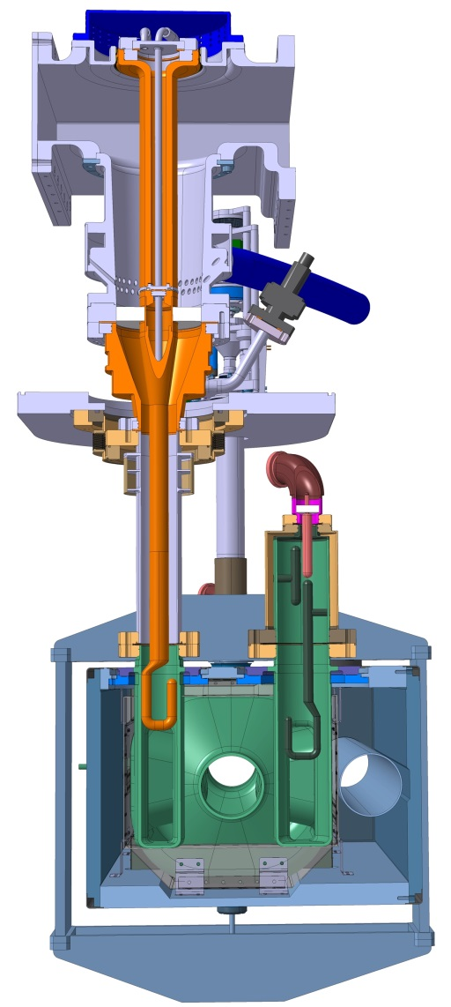
DQW
Dressed cavities
SPS cavities under production by US LARP; Parallel production line launched at CERN – expected 1st bare cavity in one year from now
FPC production ongoing at CERN
HOM production ongoing at CERN
Helium vessel prototype under tests at CERN
Tuning prototype under tests at CERN
Cold magnetic shields under manufacturing by UK
RFD

Slide 13
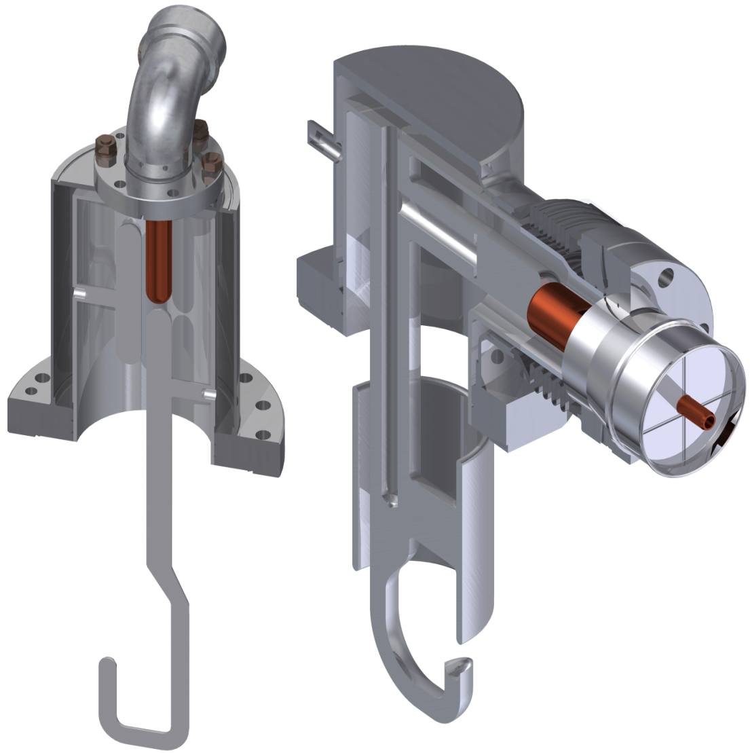
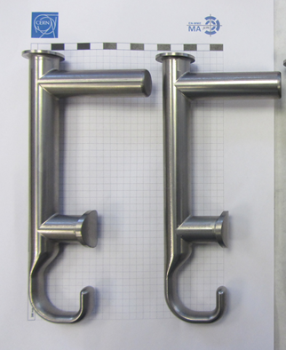
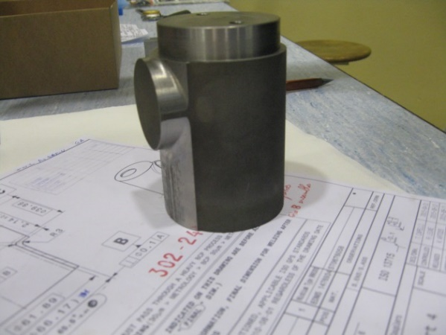
HOM Couplers
Three HOM in DQW, two for RFD
RF design done by USLARP & UK
Engineering common effort between UK, USLARP and CERN
Bulk Nb antenna, He-cooled
Coaxial lines evacuate 1 kW/HOM
RFD
DQW

Slide 14
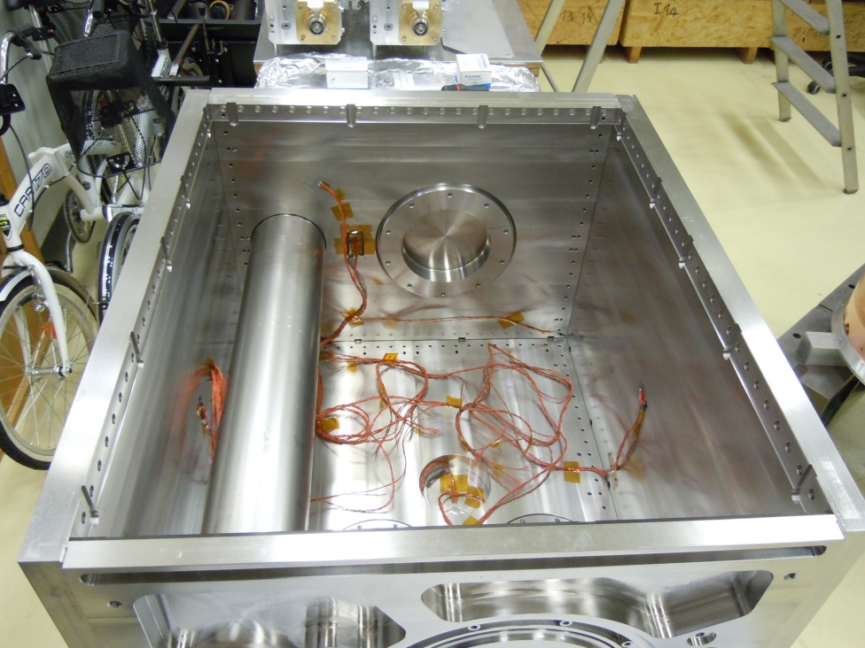
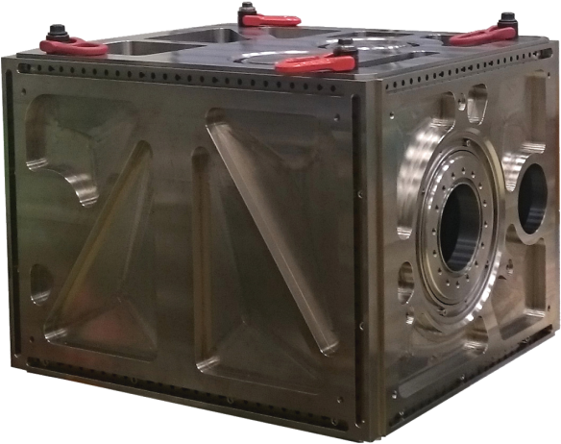
Helium tank prototype
Deformation of the tank is transferred to the cavity. Estimation (test) of ~1 mm deformation at interface if tank is fully welded.
Design approach: bolted tank with superficial welds for leak tightness
Assembly, welding procedure and main loads under test with a prototype
Notes:
Dividere la slide in 2

Slide 15
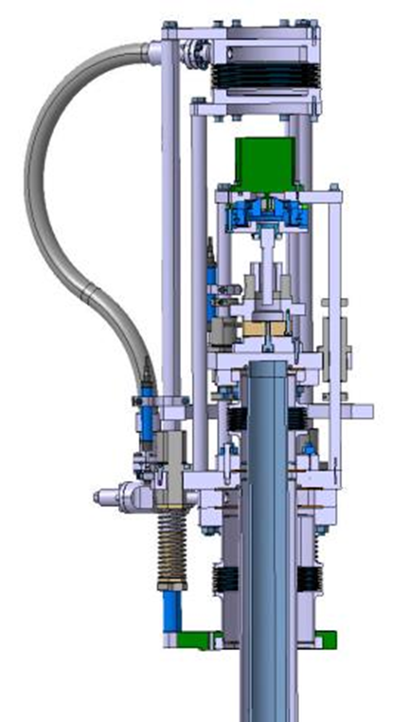
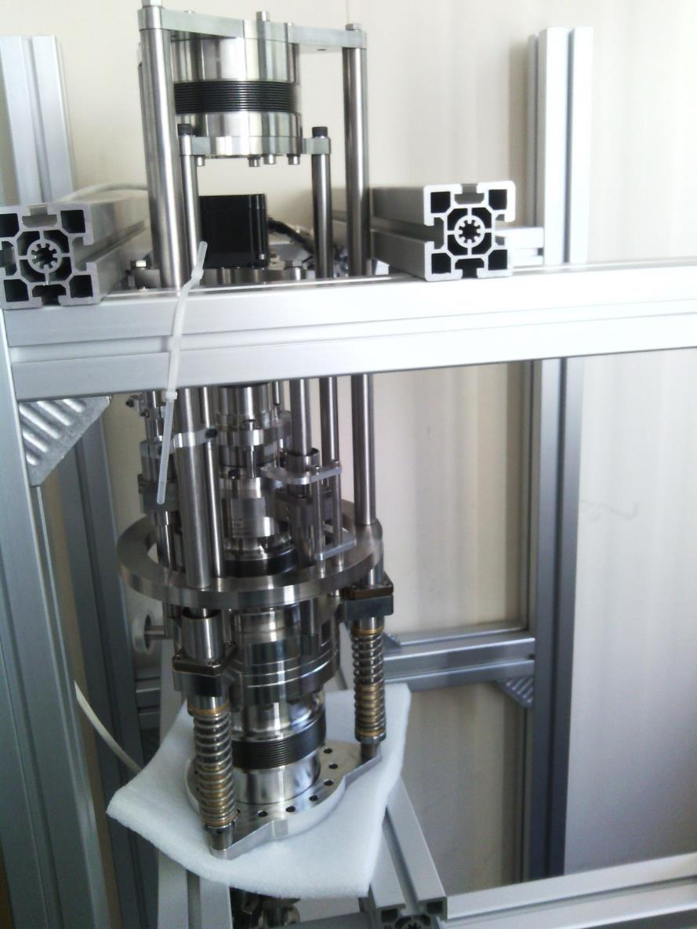
Tuning System
Crab prototype tuner actuator
First tests 0.5 µm precision

Slide 16
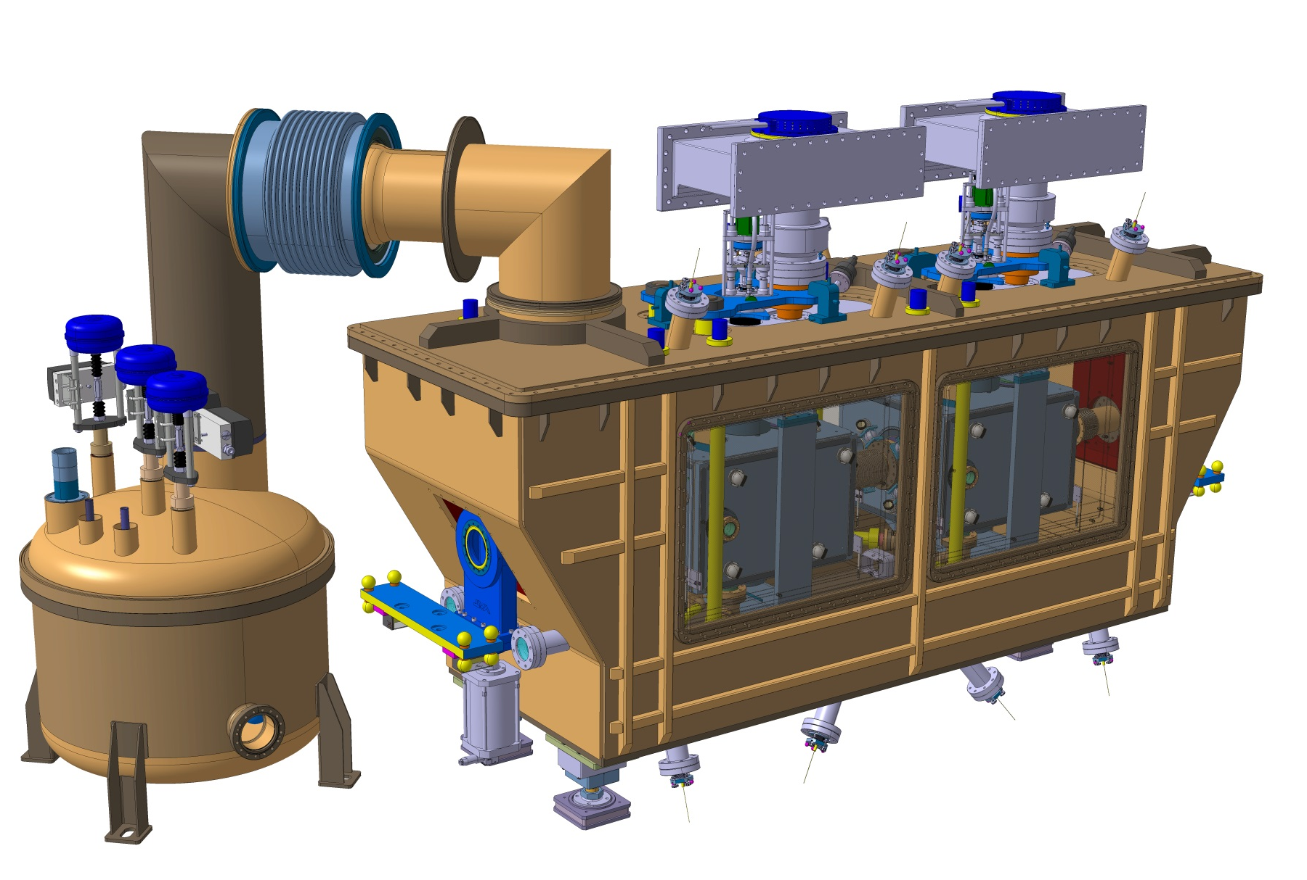
Cryomodule
Double Quarter Wave
Notes:
Design per SPS, lo stesso concetto da tenere per LHC. DQW: vertical kick

Slide 17
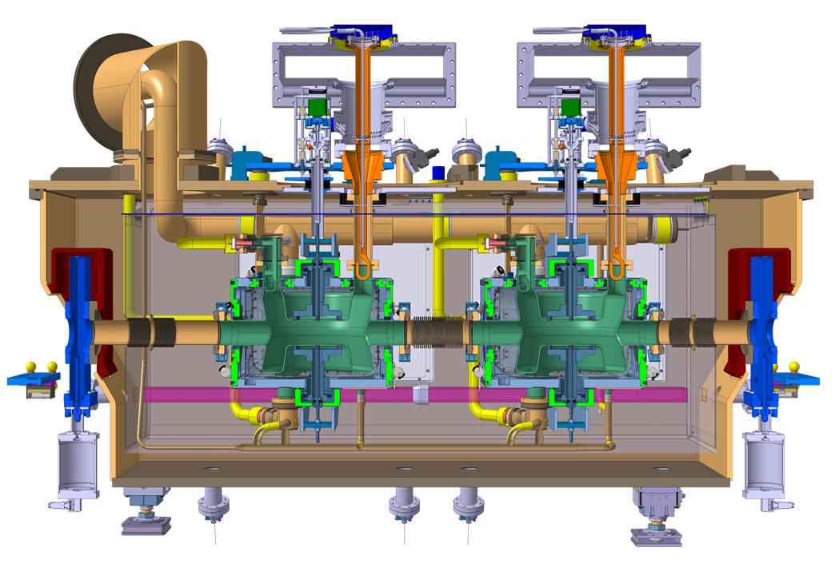
HL-LHC Crab Cryomodule
Design of both cryomodule types well advanced; Review at CERN on 10-11 Nov.
Common effort between CERN, UK and US-LARP
Double Quarter Wave
He supply
Vacuum tank
HOM
FPC
Thermal screen with MLI
Warm magnetic screen
Cold-warm transitions
Cold magnetic screen
Tuner
Bare cavity
He vessel
Notes:
Design per SPS, lo stesso concetto da tenere per LHC. DQW: vertical kick

Slide 18
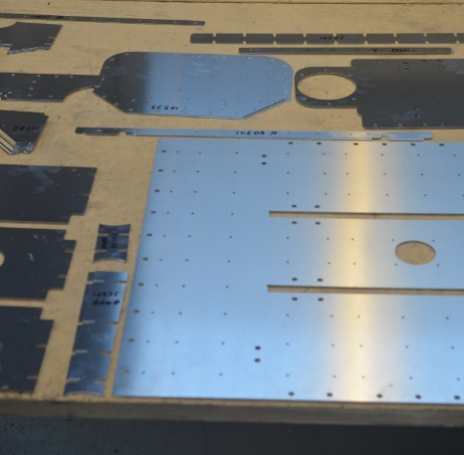
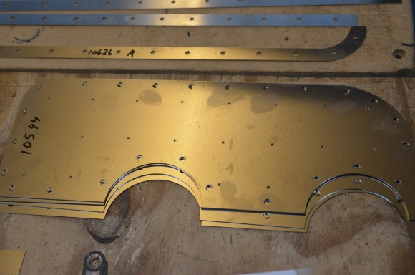
Magnetic Shielding
Cold magnetic shields design by UK
RFD
DQW
Magnetic field for external 200 μT
Maximum acceptable magnetic field on the cavity: 1 μT
The external screen, in mu-metal, is not enough to shield the cavities
One additional cold screen added per each cavity (Aperam Cryophy)

Slide 19
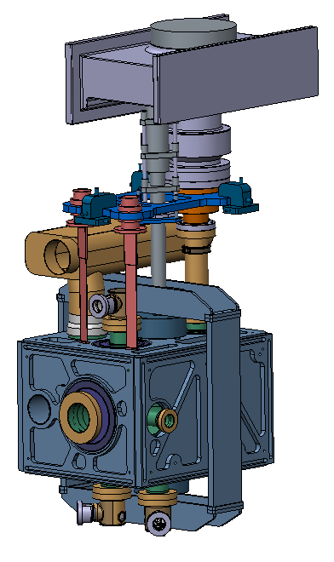
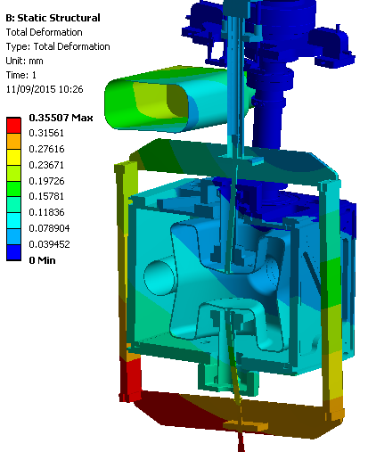
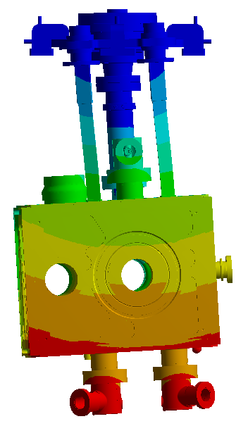
Blade stiffners
Blade stiffners were added to the cavity to provide additional structural support and push the lowest microphonic frequency above 20 Hz.

Slide 20
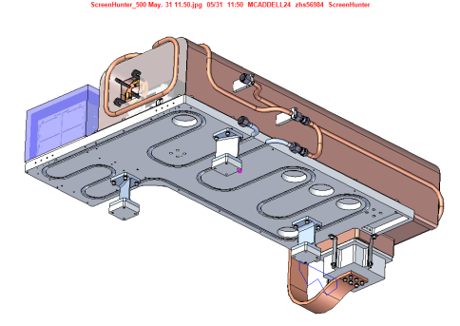
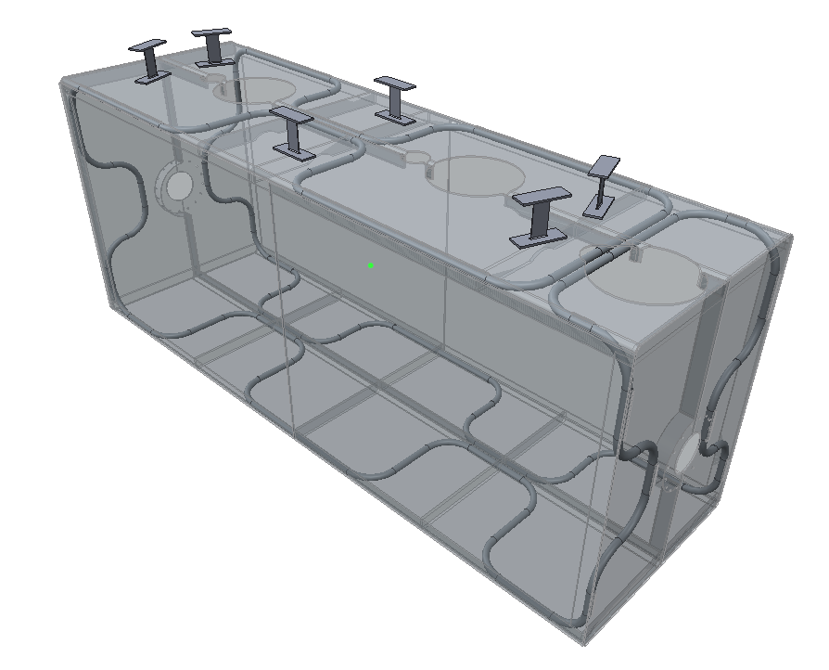
Thermal shield overview
Flexures optimised for maximum stiffness at 1W heat leak – 2mm thick x 40mm chosen
Flexure mounts arranged such that they create a fixed point at the centre of the shield.
Ref: Thomas Jones SPICE thermal test design
Aluminium alloy tubing
Thermal shield “Window frame”
1050 Aluminium shield
Removable side panels (fitted during initial assembly
Work performed by Manchester University undergraduate- Andy May

Slide 21
Cryomodules
Double Quarter Wave, Vertical Deflection (ATLAS)
RF Dipole,
Horizontal Deflection (CMS)

Slide 22
Hardware
Tuner
FPC
LHe vessel
RF Dipole
B shielding
DQW
HOM coupler

