Slide 1
INTRODUCTION PASI 2015
Swapan Chattopadhyay

Slide 2
ACKNOWLEDGMENT
Steve Geer
Steve Holmes
Ken Long
Peter McIntosh
Sergei Nagaitsev
Vladimir Shiltsev
Alexander Valishev
Eric Prebys
and
PASI Advisory/Organizing Committee

Slide 3
PASI 2015
WORKSHOP: the 3rd in a series. Forum to explore areas of UK-US collaboration on proton (ion) accelerator R&D
Focus: collaborative development :
→ Multi-MW sources for science (neutrinos and neutrons)
→ Novel concepts and techniques of nonlinear dynamics of
intense beams with self-fields
→ Innovations for translation to applications in health, energy,
environment and industry.
The U.S. program is centered on progressive development and implementation of high power proton accelerators (PIP → PIP II → PIP III), serving the future flagship international particle physics experiment (DUNE) involving multi-MW beams and viable targets, SCRF technology, novel accelerator test facilities (e.g. FAST/IOTA), industrial applications (IARC) and international collaborations (CERN-LHC, UK-MICE and India-PIP-II).

Slide 4
PASI 2015 (cont’d)
The UK proton (ion) accelerator program and skills base are anchored in the high intensity proton accelerator development connected with the ISIS facility at Rutherford Appleton Lab and SCRF technology program at Daresbury Lab, with major contributions on HL-LHC at CERN, ESS, international MICE collaboration and novel developments for medicine, energy, environment and industry
Within the context as above, there are accelerator challenges of mutual interest on both sides of the Atlantic. There is also room for new ideas that can lead to, or enable the exploitation of, even higher intensities, better control of beams, innovative concepts and compact cost-effective alternatives
This meeting offers the opportunity for discussing ongoing collaborative efforts and their next steps, including exploring new areas of collaboration.

Slide 5
US INSTITUTIONS
Fermilab
National Lab Partners: SLAC, Jefferson Lab, ANL, BNL
International Partners: CERN
STFC RAL, JAI and CI (UK)
BARC, RRCAT, VECC (India)
……….
University Collaborators:
Northern Illinois University, Univ. of Chicago, Illinois Institute of
Technology, Univ. of Maryland, Univ. of California at Berkeley,
University of Knoxville, MIT, Cornell University, Univ. of Oxford (UK),
Imperial College London (UK), Hiroshima University (Japan)
……
Industry:
Illinois Accelerator Research Center (IARC), Radia-Beam, RadiaSoft,
Tech-X, AEC, …

Slide 6
UK INSTITUTIONS
STFC: Rutherford Lab (ISIS) and Daresbury Lab (ASTeC)
National lab/Institute Partners:
Cockcroft Institute, John Adams Institute,
Huddersfield International Institute for Accelerator Applications
International Partners: CERN, ESS
University Collaborators:
Oxford, Imperial College London, Royal Holloway, University
College London, Liverpool, Lancaster, Manchester, Strathclyde,
Huddersfield,…..
Industry:
CERN BIC, DSIC, HSIC, Shakespeare Engineering, e2v, ….

Slide 7
Fermilab Today:
Fermilab operates the largest Particle Physics proton accelerator laboratory in the U.S. and collaborates with CERN housing the largest proton accelerator complex in the world.
Part of current operations/programs/projects:
Proton Improvement Plan (PIP), PIP-II and future PIP-III
Muons: Muon g-2, Mu2e, MAP (including MICE and Targets)
Neutrinos: LBNF, MicroBoone
LHC upgrades at CERN: HL-LHC (via LARP)
LCLS-II at SLAC (SCRF linac modules)
Novel Accelerator R&D and Test Facilities: FAST, IOTA, SRF Cavities, Magnets
Commercialization of our accelerator technologies (IARC)

Slide 8
Fermilab operates a total of 16 km of accelerators and beamlines:
A 400-MeV proton linear accelerator (0.15 km)
An 8-GeV Booster synchrotron (0.5 km)
An 8-GeV accumulator ring (3.3 km)
A 120-GeV synchrotron (3.3 km)
A Muon Campus Delivery ring (0.5 km) and soon Muon g-2 ring
Transfer lines and fixed target beam lines (8 km)
Two high power target stations, several low-power targets
People: 660 (Accelerator Science, Technology and Engineering) – operations, projects, programs, R&D, program support, Work For Others

Slide 9
Intensity Frontier Accelerators
Different merit matrix from colliders – instead of fb⁻¹ of ʃLdt :
600 MW*kTon*years for DUNE experiment
Thrust for Megawatts of beam power → challenges:
High intensity sources, Efficient acceleration without losses, Halo control and collimation, Advanced injection and extraction, Novel high-power beam targets and focusing systems
Cost efficient accelerator MW/$$ vs detector kTons/$$
PASI 2015 November 11

Slide 10
Accelerator Complex Now
120 GeV RCS
Main Injector
8 GeV
Recycler
0.5→0.7 MW
on ν target
400 MeV
NC Linac
8 GeV RCS
Booster

Slide 11
“Near future”, PIP-II , ca 2023-24
120 GeV RCS
Main Injector
8 GeV
Recycler
1.2 MW
on target
800 MeV
SC Linac
8 GeV RCS
Booster

Slide 12
PIP-III “multi-MW”- Option A: 8+ GeV smart RCS (Rapid Cycling Synchrotron – ring)
120 GeV RCS
Main Injector
8 GeV
Recycler ?
≥ 2.5 MW
target
new 8-12 GeV “smart” RCS
800 MeV
SC Linac PIP-II

Slide 13
PIP-III “multi-MW” - Option B: 8 GeV linac
120 GeV RCS
Main Injector
8 GeV
Recycler
≥2.5-MW
on target
8 GeV SC Linac
=0.8→3→8

Slide 14
Fermilab Accelerator Program: P5-Aligned
Advanced Accelerator R&D Towards Next Generation Machines
Exploratory Long-term R&D
Operational Support and Complex Upgrade (PIP-II)
Accelerators Training and Education
Accelerator and Beam Physics
Develop and explore transformative concepts and technologies for beyond next-generation multi-MW accelerators at FAST/IOTA and in the area of SRF
e.g. assess feasibility and demonstrate technologies for future 100 TeV pp collider and conclude ionization cooling demo for possible future muon facility
Provide accelerator physics and technology support for operation and upgrades of the Fermilab’s accelerator complex, ν and µ experiments
Train the next generation of accelerator designers and builders through the USPAS and Fermilab programs
Contribute to the fundamental understanding of beam dynamics through experiment , simulation and theory
FAST
Fermilab Accelerator
Science and Technology facility

Slide 15
UK Proton Program
ISIS Operations and Upgrade
Front-End Test Stand and MICE at RAL
HL-LHC at CERN and ESS at Lund builds on work of CI/JAI and others
Superconducting RF at Daresbury Lab
Novel R&D: Paul Traps, Laser-related proton acceleration, Compact Sources
ADS, ADSR/FFAGs, Material Irradiation and Medical Accelerators
Possible contributions to PIP-II, PIP-III and novel R&D on FAST/IOTA
Already a collaborator on LBNFand DUNE

Slide 16
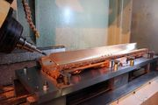
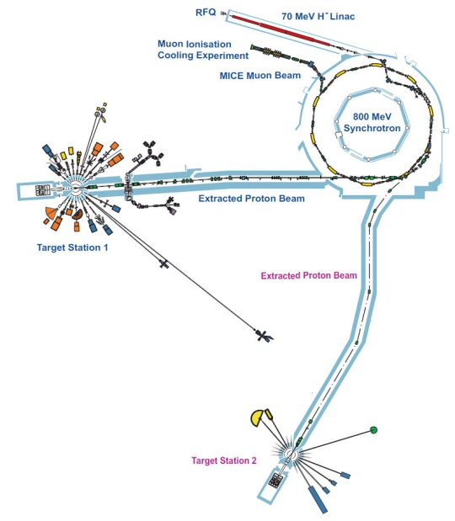
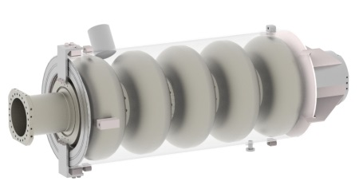
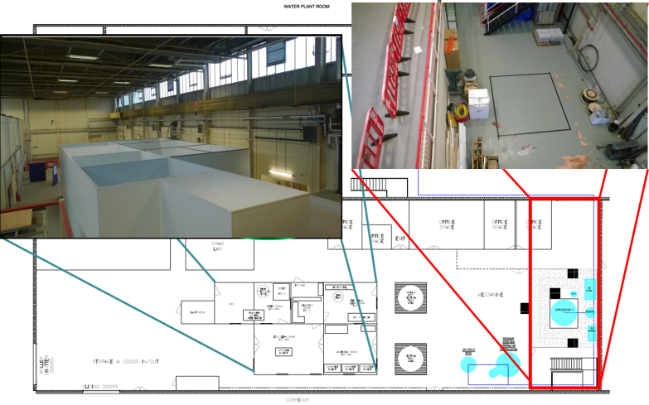
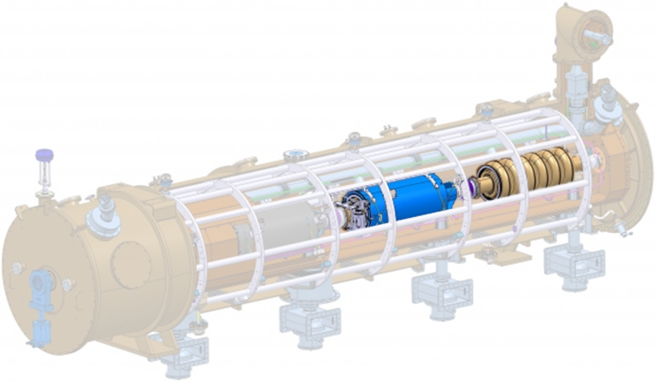
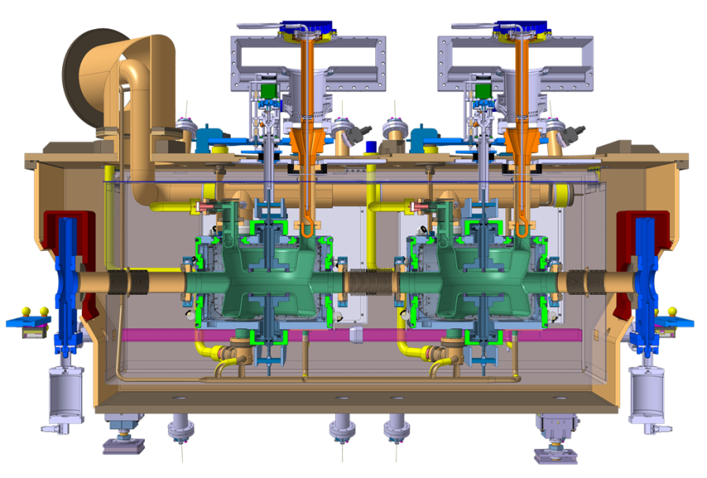
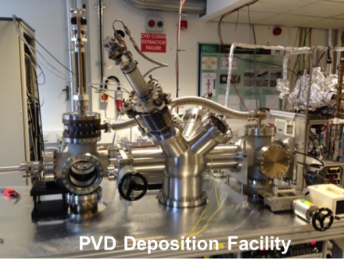
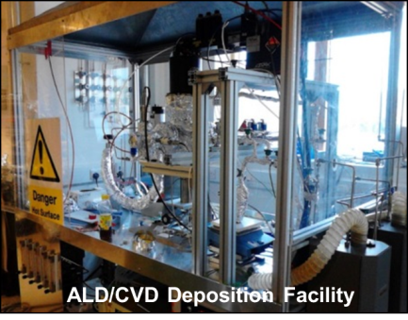
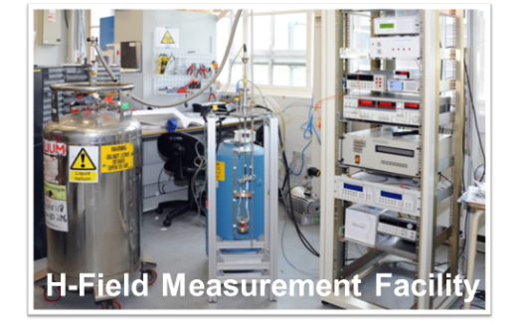
Front-end test stand
UK Accelerator and SCRF Facilities at RAL and DL
ISIS
MICE
HL-LHC Crab
Cryomodule
ESS High-β Cavities
SRF Thin Films
at CERN by 2020

Slide 17
PASI 2015: OUTLOOK
There are accelerator challenges of mutual interest on both sides of the Atlantic. There is also room for new ideas that can lead to, or enable the exploitation of, even higher intensities, better control of beams, innovative concepts and compact cost-effective alternatives for SCIENCE, HEALTH, ENERGY, ENVIRONMENT and INDUSTRY
The FOUR Working Groups in this workshop have been very carefully formulated by the organizers for us to focus on the specifics of these topical areas of relevance
This meeting offers the opportunity for discussing ongoing collaborative efforts and their next steps, including exploring new areas of collaboration
Wish you a SUCCESSFUL three days of workshop!!!!

