Slide 1
PASI15 WG3: Medical applications review from PASI13
Rob Apsimon
(Tom Kroc, George Coutrakon)

Slide 2
General comments
First PASI workshop with a dedicated medical applications working group
Emphasis from previous workshops to focus on medical applications
Apparent disparity between US and UK approaches to medical applications
Aim to focus on areas of common interest
Attempt to establish collaborative efforts in some areas
Discuss short-term and mid-term goals for collaboration on medical applications.

Slide 3
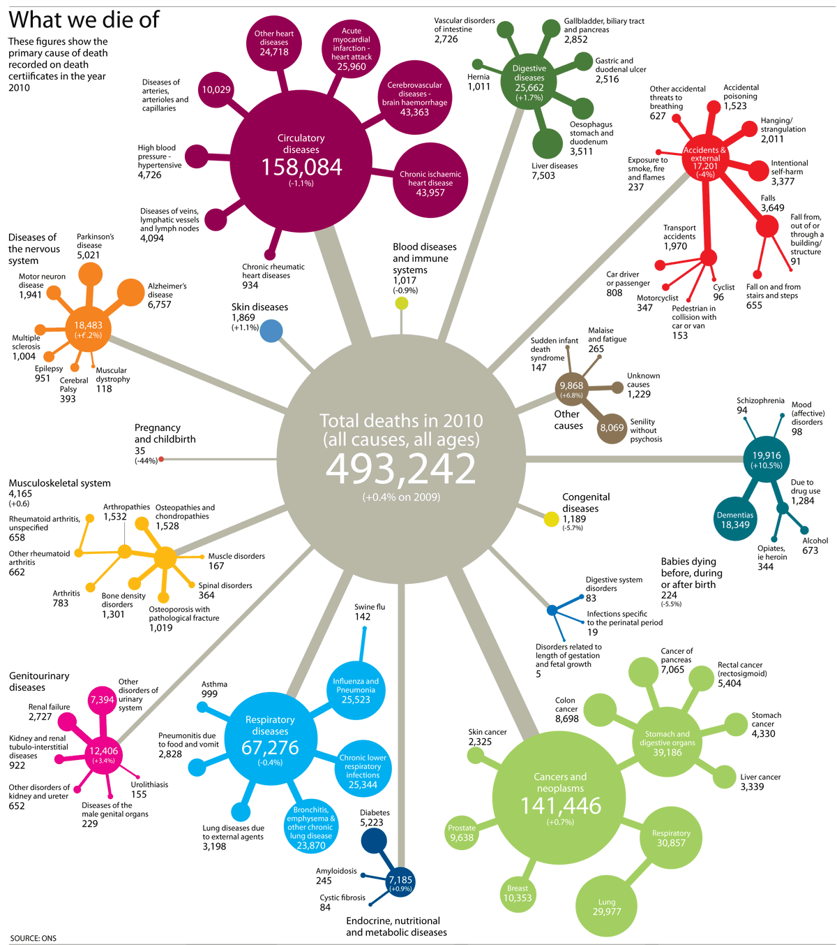
Cancer stats: UK
1 in 3 deaths caused by cancer
(in 2010)
40% of cancer cures from radiotherapy
~300 linacs for X-rays >130,000 treatments per year
1 60 MeV eye treatment with protons (Clatterbridge)
2 x 250 MeV Varian centres under construction
Other centres envisaged:
- IBA (Wales)
Proton therapy centres:
Christie, Manchester (in 2018)
UCLH, London (in 2019)

Slide 4
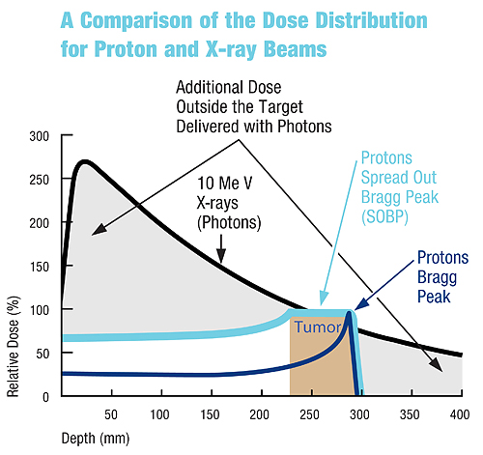
Why proton therapy?

Slide 5
Radiotherapy stats for the UK
‘Radiotherapy Services in England 2012’, DoH
130,000 treatments, most common age around 60 yrs
2.5 million attendances
More than half of attendances are breast/prostate
X-rays
265 linacs in clinical use
Almost all machines IMRT-enabled, 50% IGRT (Image-Guided)
Each machine does >7000 ‘attendances’
147 more linacs required due to increasing demand
Protons
1x Scanditronix 62 MeV, Clatterbridge, operating
2x Varian ProBeam (3 rooms each), NHS, Christie Hospital and UCLH, 2018
1x ProNova SC360 (2/3 rooms), University of Oxford, 2018
3x IBA ProteusONE, Newport (Wales), Newcastle + ?, 2017
1x AVO LIGHT, London Harley Street, 2017
Cancer care
40% curative treatments utilise radiotherapy
16% cured by radiotherapy alone

Slide 6
UK main proton therapy activities
EMMA, PAMELA (completed) – FFAG demo and study
NORMA (completed) – FFAG study for protons/pCT
OMA (funded) – EU training/research on medical accelerators (www.oma-project.eu)
UK: Halo monitors, radiobiology, high-gradient acceleration, imaging calorimeters, SC gantries
collaboration with PSI, CERN, TERA, GSI etc.
Christie Research Beamline (funded) – test facility for proton medical research
Radiobiology, high-gradient linacs, dosimetry, etc. (see Karen Kirkby’s talk)
PRAVDA (funded) – Si tracker detector for pCT, includes extensive simulation
PROBE – booster linac for imaging (see my talk)
Laser-driven proton acceleration – Gabor lenses, post-acceleration, radiobiology etc.
FETS proposal – 3-20 MeV for future FFAGs, gantries, isotopes etc.
BNCT – (p,Li) neutron production for therapy, facility being upgraded

Slide 7
US main medical accelerator activities
Clinical
Radioisotopes
Cyclotron based systems
Therapy
Proton – growing, but concern of cost/benefit on part of insurance co’s.
Ions – none
Neutrons – one remaining, but healthy
Industry
Radioisotopes
5 US groups working on Mo-99
Investigating new avenues, Ac/Bi
Proton Therapy
While Loma Linda was a success clinically, it failed to commercialize the accelerator system
16 proton therapy facilities operating in the US (one closure)
15 more planned to open in the next 2 years
Cyclotrons are winning
US hardware providers: have at least substantial interests in 4 out of 5 (Mevion, ProTom, Varian/Accel, ProCure/IBA)
National Labs
Ion Therapy – planning, component development

Slide 8
WG3 agenda
Session 1 (Wednesday 16:00 – 17:30):
ProBE: Proton Boosting Extension for Imaging and Therapy - Rob Apsimon
Proton CT in the US - George Coutrakon
Session 2 (Thursday 09:00 – 10:40):
UK overview of Proton Therapy - Karen Kirkby
US overview of Proton Therapy - Chris Beltran
Proton Therapy - Mark Pankuch
NorthStar Radioisotope Production - James Harvey
Session 3 (Thursday 11:00 – 12:30) – Joint session with WG4:
Laser-driven, high-brightness proton and neutron sources - Ceri Brunner
Solid State Proton Acceleration - Arun Persaud
NORMA FFAG - Sam Tygier
Session 4 (Thursday 13:30 – 15:30) – WG3 Roundtable discussion
Session 5 (Friday 09:00 – 10:40):
Ion Therapy - Tom Kroc
Applications of FETS - Stephen Gibson

