Slide 1
Overview of the LBNF Beamline baseline design and target R&D activities
Vaia Papadimitriou
LBNF Beamline Manager
3rd PASI Workshop, Fermilab
November 11-13, 2015

Slide 2
Outline
LBNF/DUNE Introduction
LBNF Beamline design status
Target R&D Activities
LBNF Beamline plans for the near future

Slide 3
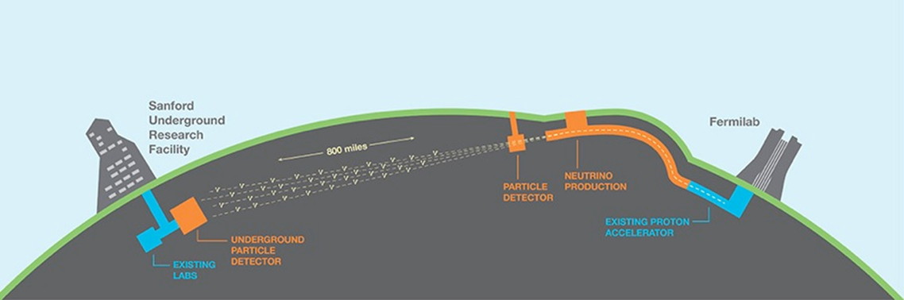
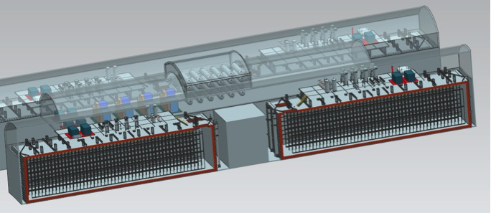
Facility and Experiment
  LBNF: provides facility infrastructure at two locations to support the experiment:
    Near site: Fermilab, Batavia, IL – facilities and infrastructure to create neutrino beam and host the near DUNE detector
    Far site: Sanford Underground Research Facility, Lead, SD – facilities to support the far DUNE detectors
  DUNE: Deep Underground Neutrino Experiment
    Near and far site detectors
ν_{μ}
ν_{μ} & ν_{e}
FD
ND

Slide 4
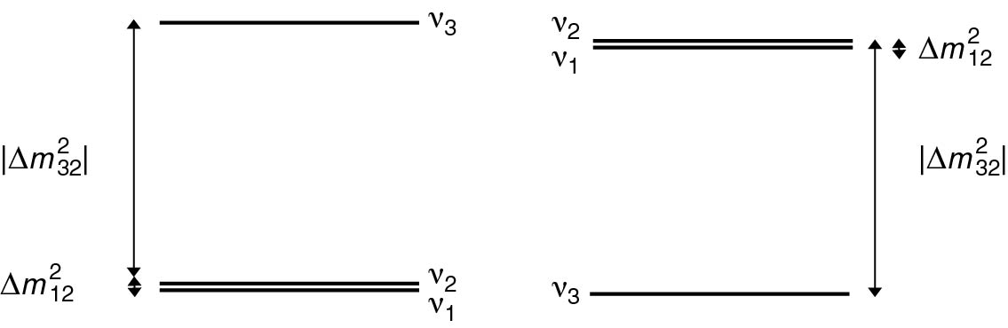
LBNF/DUNE Science Goals
LBNF/DUNE is a comprehensive program to:
Measure neutrino oscillations
  Direct determination of CP violation in the leptonic sector
  Measurement of the CP phase δ
  Determination of the neutrino mass hierarchy
  Determination of the θ₂₃ octant and other precision measurements
  Testing the 3-flavor mixing paradigm
  Precision measurements of neutrino interactions with matter
  Searching for new physics
Study other fundamental physics enabled by a massive, underground detector
  Search for nucleon decays (e.g. targeting SUSY-favored modes)
  Measurement of neutrinos from galactic core collapse supernovae
  Measurements with atmospheric neutrinos
In a single experiment

Slide 5
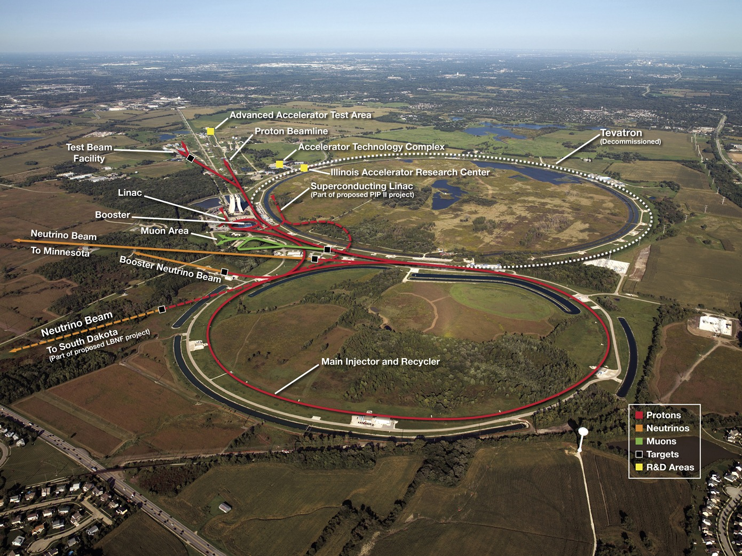
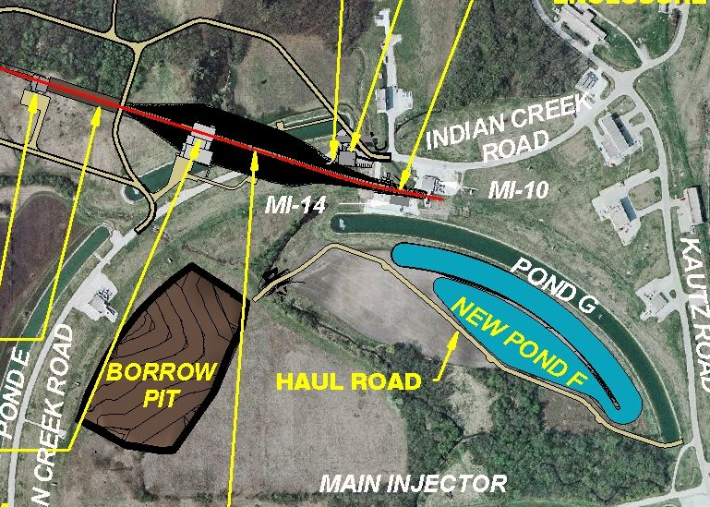
Fermilab Accelerator Complex
521.3 KW on 07/01/15.
~ 21,000 m²
12 Booster batches are to be injected and slip- stacked in Recycler while Main Injector is accelerating. 700 kW demonstration expected on the NuMI/NOvA target in March 2016 – Proton Improvement Plan.
Main Injector

Slide 6
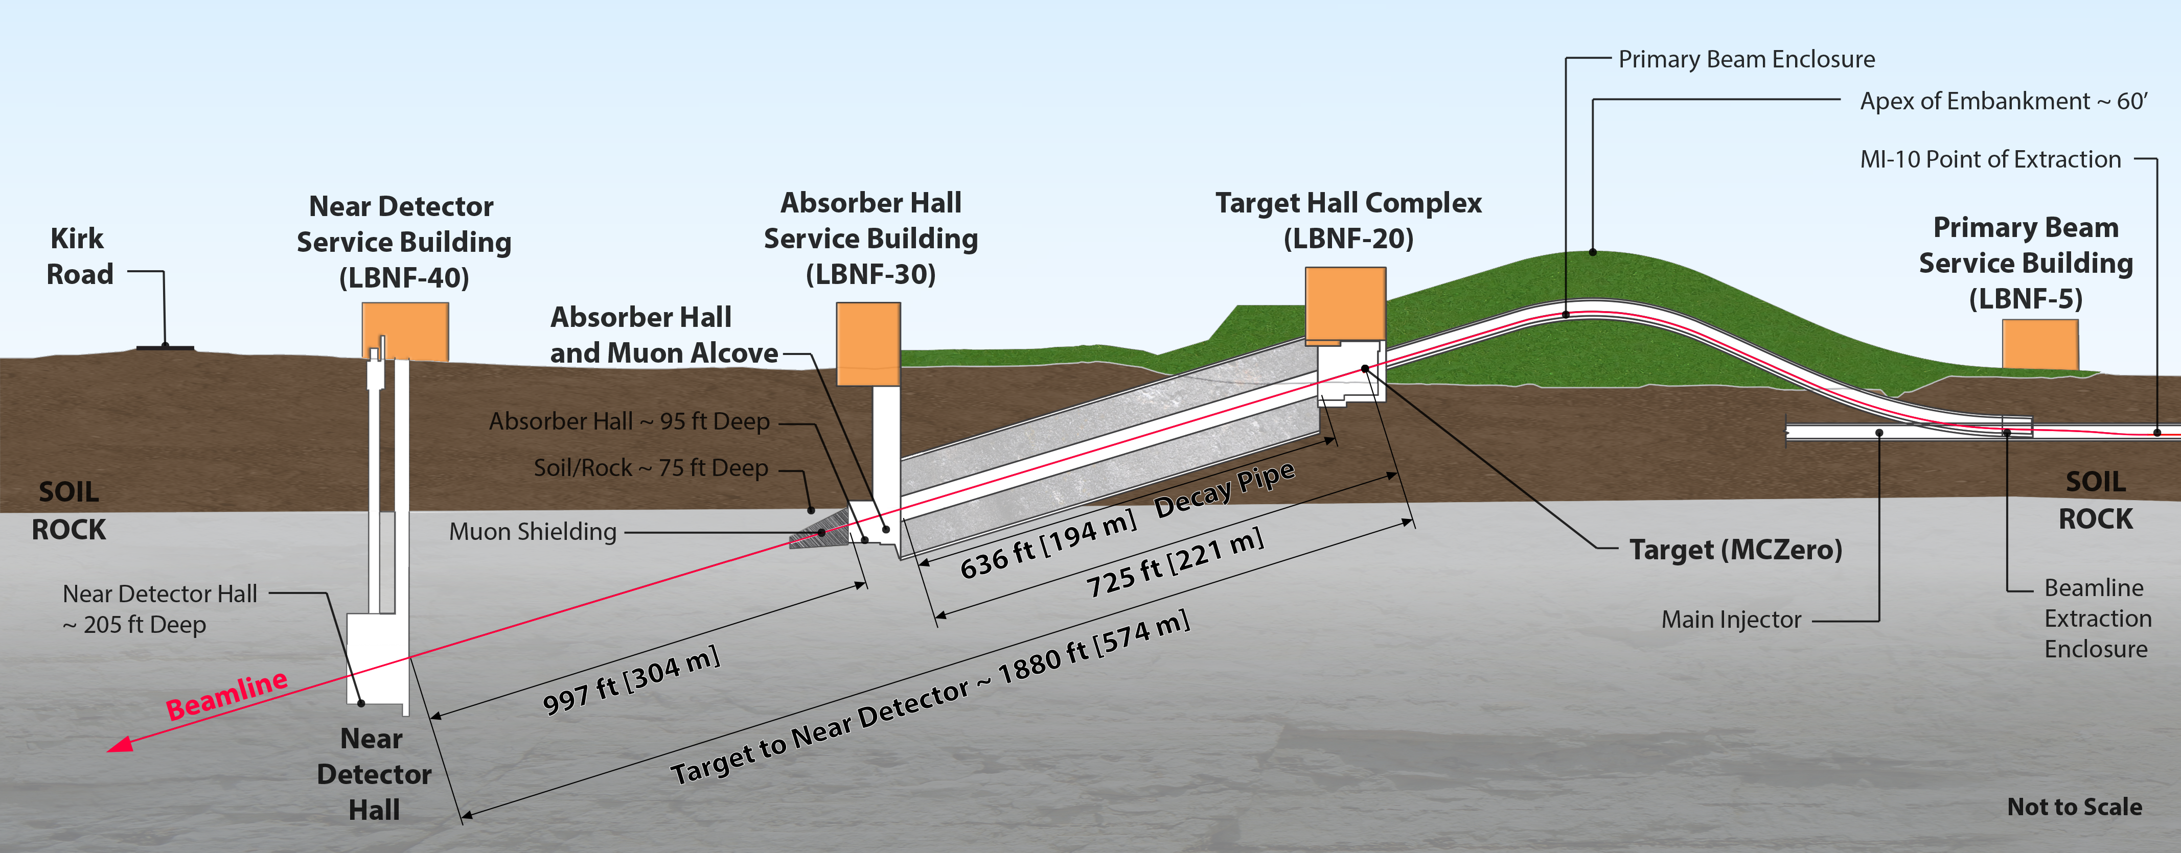
Beamline for a new Long-Baseline Neutrino Facility
MI-10 Extraction, Shallow Beam
Beamline Facility contained within Fermilab property
~ 21,000 m²
Constructed as Tunneled excavation
Constructed in Open Cut

Slide 7
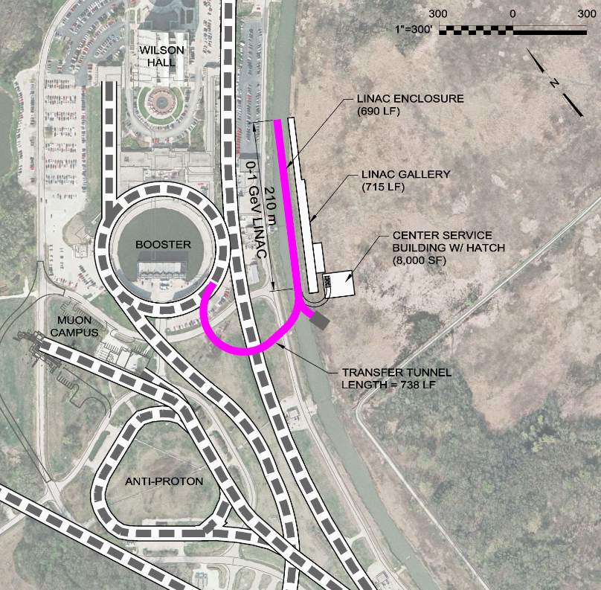
Proton Improvement Plan – II (PIP-II) provisional Site Layout
PIP-II
800 MeV SC Linac
(Replacing existing 400 MeV Linac)
Expected Beam Power: 1.2 MW for 120 GeV p
20 Hz
PIP-III
Keep PIP-II Linac and replace Booster with pulsed Linac (8 GeV) or RCS
Expected Beam Power: ~ 2.4 MW for 120 GeV p
http://projectx-docdb.fnal.gov/cgi-bin/RetrieveFile?docid=1295 , 2 June 2014,
P. Derwent, S. Holmes, I. Kourbanis, V. Lebedev
CD-0 review in June 2015. CD-0 approval expected very soon.
More from E. Prebys on Plenary Session 1

Slide 8
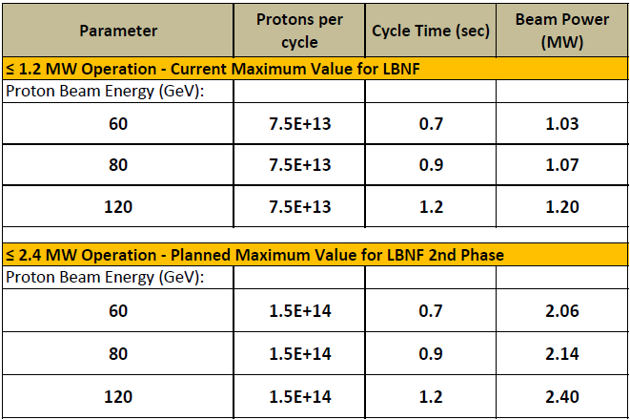
LBNF Beam Operating Parameters
Summary of key Beamline design parameters for ≤1.2 MW and ≤2.4 MW operation
(1.1 – 1.9)x10²¹ POT/yr
Pulse duration: 10 μs
Assuming a pulsed linac instead of the Booster

Slide 9
Beamline Design Requirements (relevant to the physics)
A design for a new Beamline at Fermilab is under development, which will support the new Long-Baseline Neutrino Facility.
The primary beam, single turn extracted from MI, is designed to transport high intensity protons in the energy range of 60-120 GeV to the LBNF target. (Current reference energy is 80 GeV).
A broad band, sign selected neutrino beam with its spectrum to cover the 1st (2.4 GeV) and 2nd (0.8 GeV) oscillation maxima => Covering 0.5 ~ 5.0 GeV
All systems designed for 1.2 MW initial proton beam power (PIP-II, ~2024).
Facility is upgradeable to 2.4 MW proton beam power (PIP-III).
  We are currently assuming 20 year operation of the Beamline, where for the first 5 years we operate at 1.2 MW and for another 15 years at 2.4 MW.
  Uptime (including the uptime of accelerator complex): aiming to at least 55%.

Slide 10
What is being designed for 2.4 MW
Designed for 2.4 MW, since upgrading later would be prohibitively expensive and inconsistent with ALARA:
  Size of enclosures (primary proton beamline, target chase, target hall, decay pipe, absorber hall)
  Radiological shielding of enclosures (except from the roof of the target hall, that can be easily upgraded for 2.4 MW when needed)
  Primary Beamline components
  The water cooled target chase cooling panels
  The decay pipe and its cooling and the decay pipe downstream window
  beam absorber
  remote handling equipment
  radioactive water system piping
  horn support structures are designed to last for the lifetime of the Facility

Slide 11
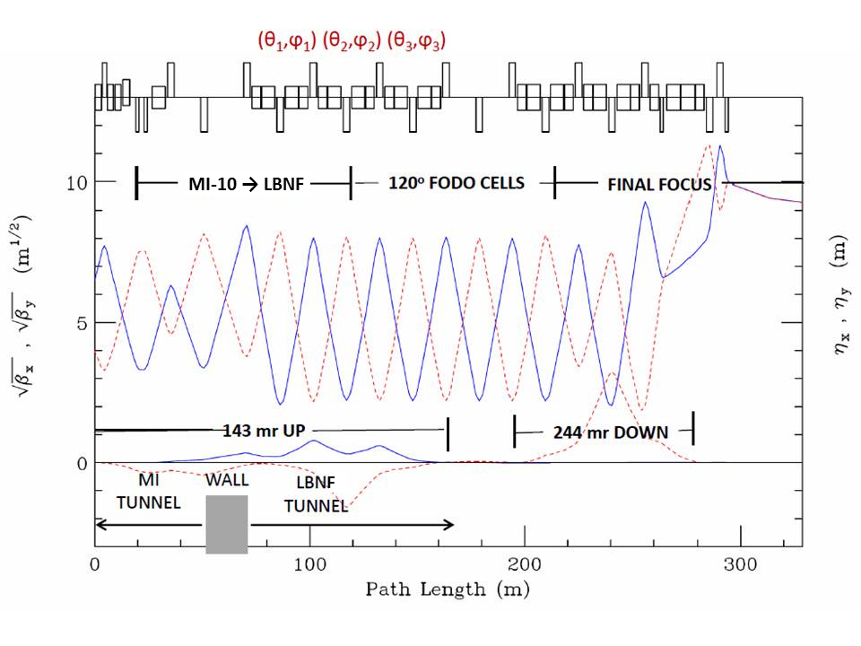
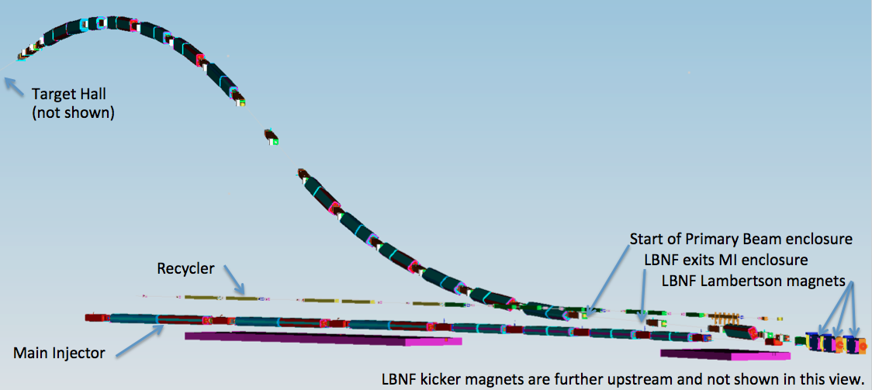
Primary Beam and Lattice Functions
The LBNF Primary Beam will transport 60 - 120 GeV protons from MI-10 to the LBNF target to create a neutrino beam. The beam lattice points to 79 conventional magnets (25 dipoles, 21 quadrupoles, 23 correctors, 6 kickers, 3 Lambertsons and 1 C magnet). (See CDR: Volume 3 and Annex 3A)
3D model of the Primary proton beamline
Embankment
MI-10
Beam size at target tunable between 1.0-4.0 mm
Horizontal (solid) and vertical (dashed) lattice functions of the LBNF transfer line

Slide 12
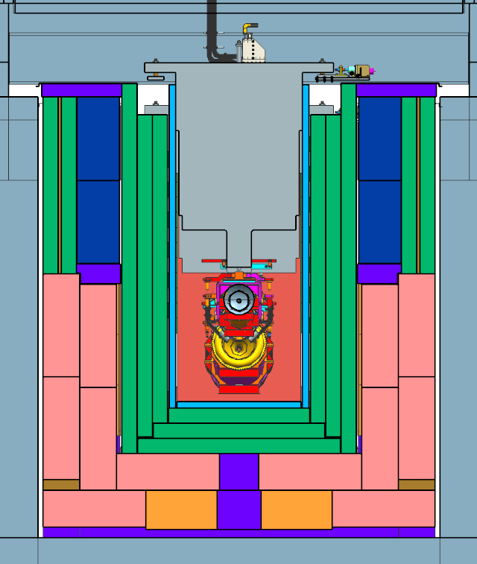
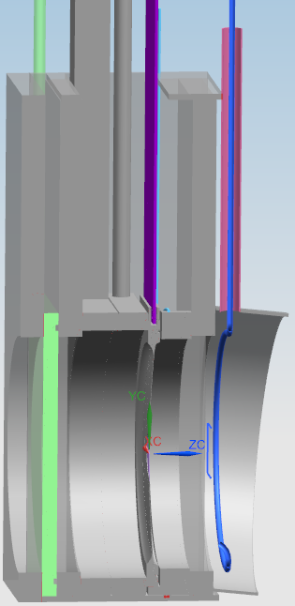
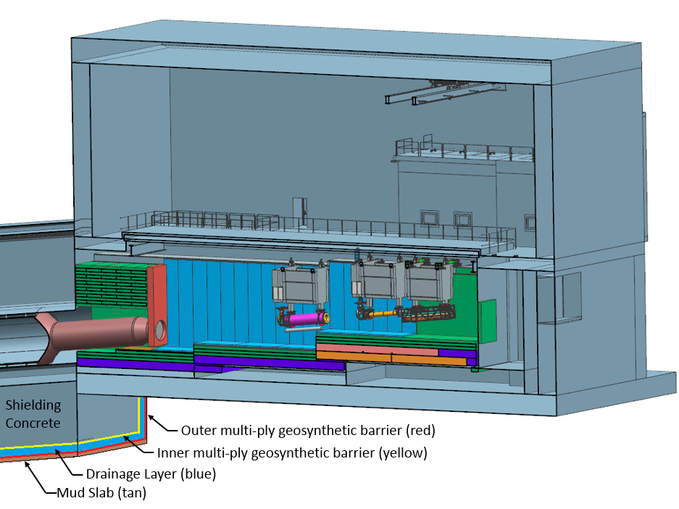
Target Hall/Decay Pipe Layout
~ 40% of beam power in target chase
~ 30% of beam power in decay pipe
50 TON CRANE
DECAY PIPE
UPSTREAM
WINDOW
WORK CELL
Cooling panels
DECAY
PIPE
SNOUT
Beam
Decay Pipe: 194 m long, 4 m in diameter, double – wall carbon steel, helium filled, air-cooled.
5.6 m
Target Chase: 2.2 m/2.0 m wide, 34.3 m long air-filled and air & water-cooled (cooling panels)

Slide 13
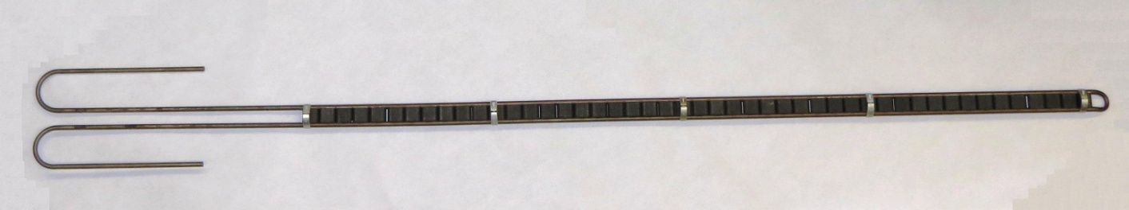
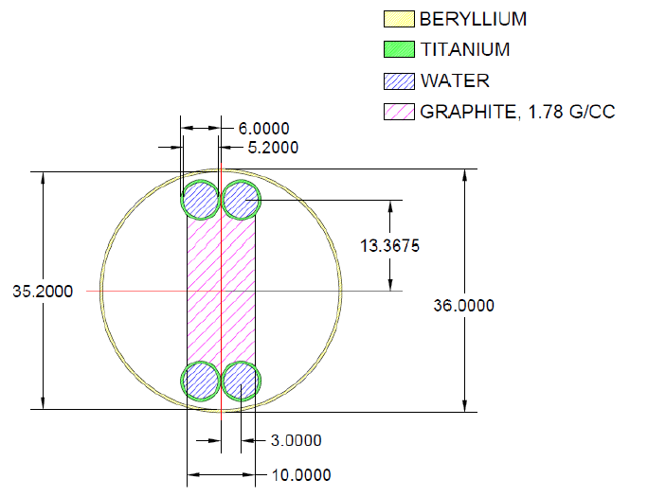
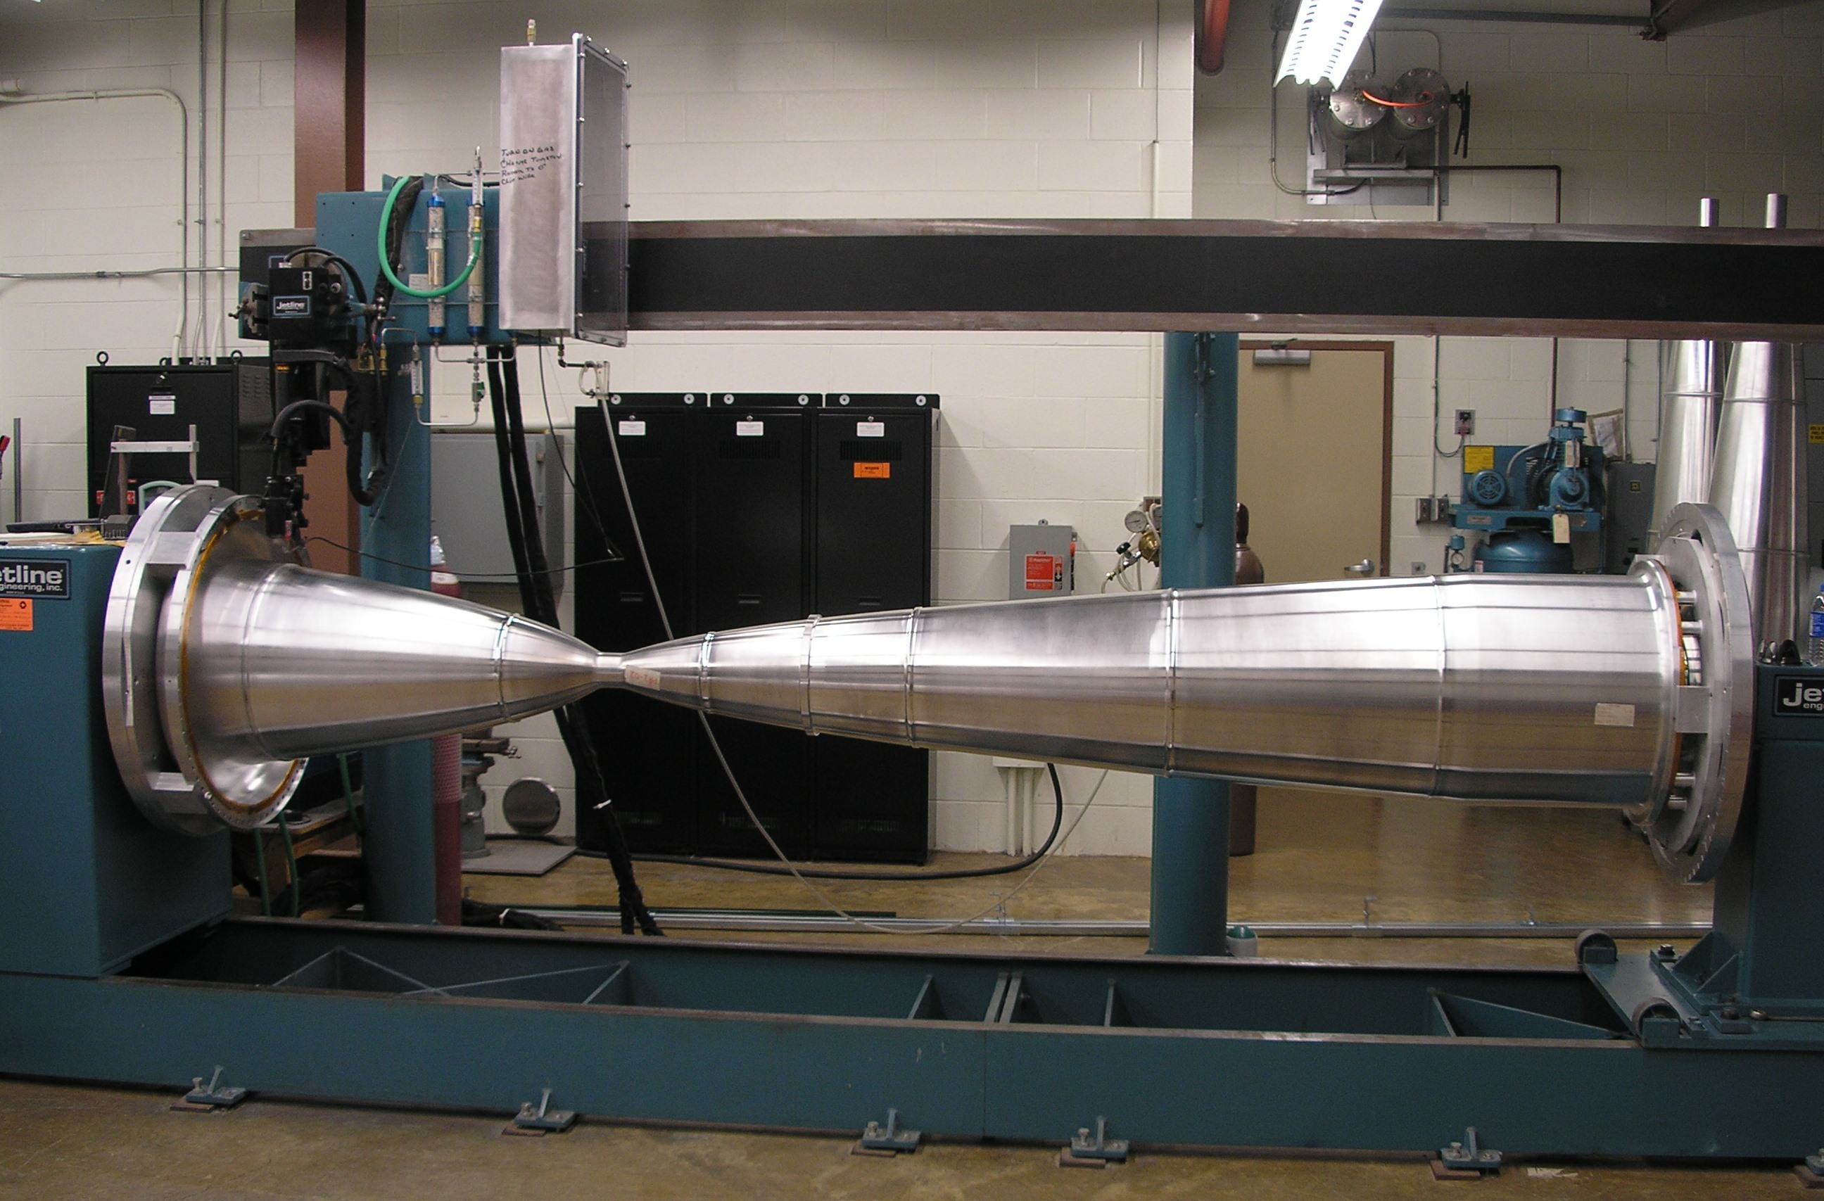
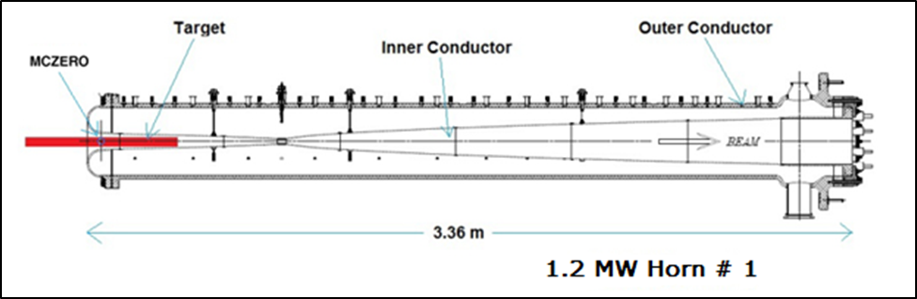
1.2 MW target and horns inside the target chase
47 graphite target segments, each 2 cm long
NuMI-like target and horns with modest modifications
0.2 mm spacing between segments
Two interaction lengths, 95 cm
Assuming 2.5 (target) and 0.67 (horn) replacements per year
Target cross section
Inner Conductor of NuMI Horn
More from C. Crowley
Target starts 45 cm upstream of MCZERO
mm
Operated at 230 kA for LBNF
New Horn power supply needed to reduce the pulse width to 0.8 ms.

Slide 14
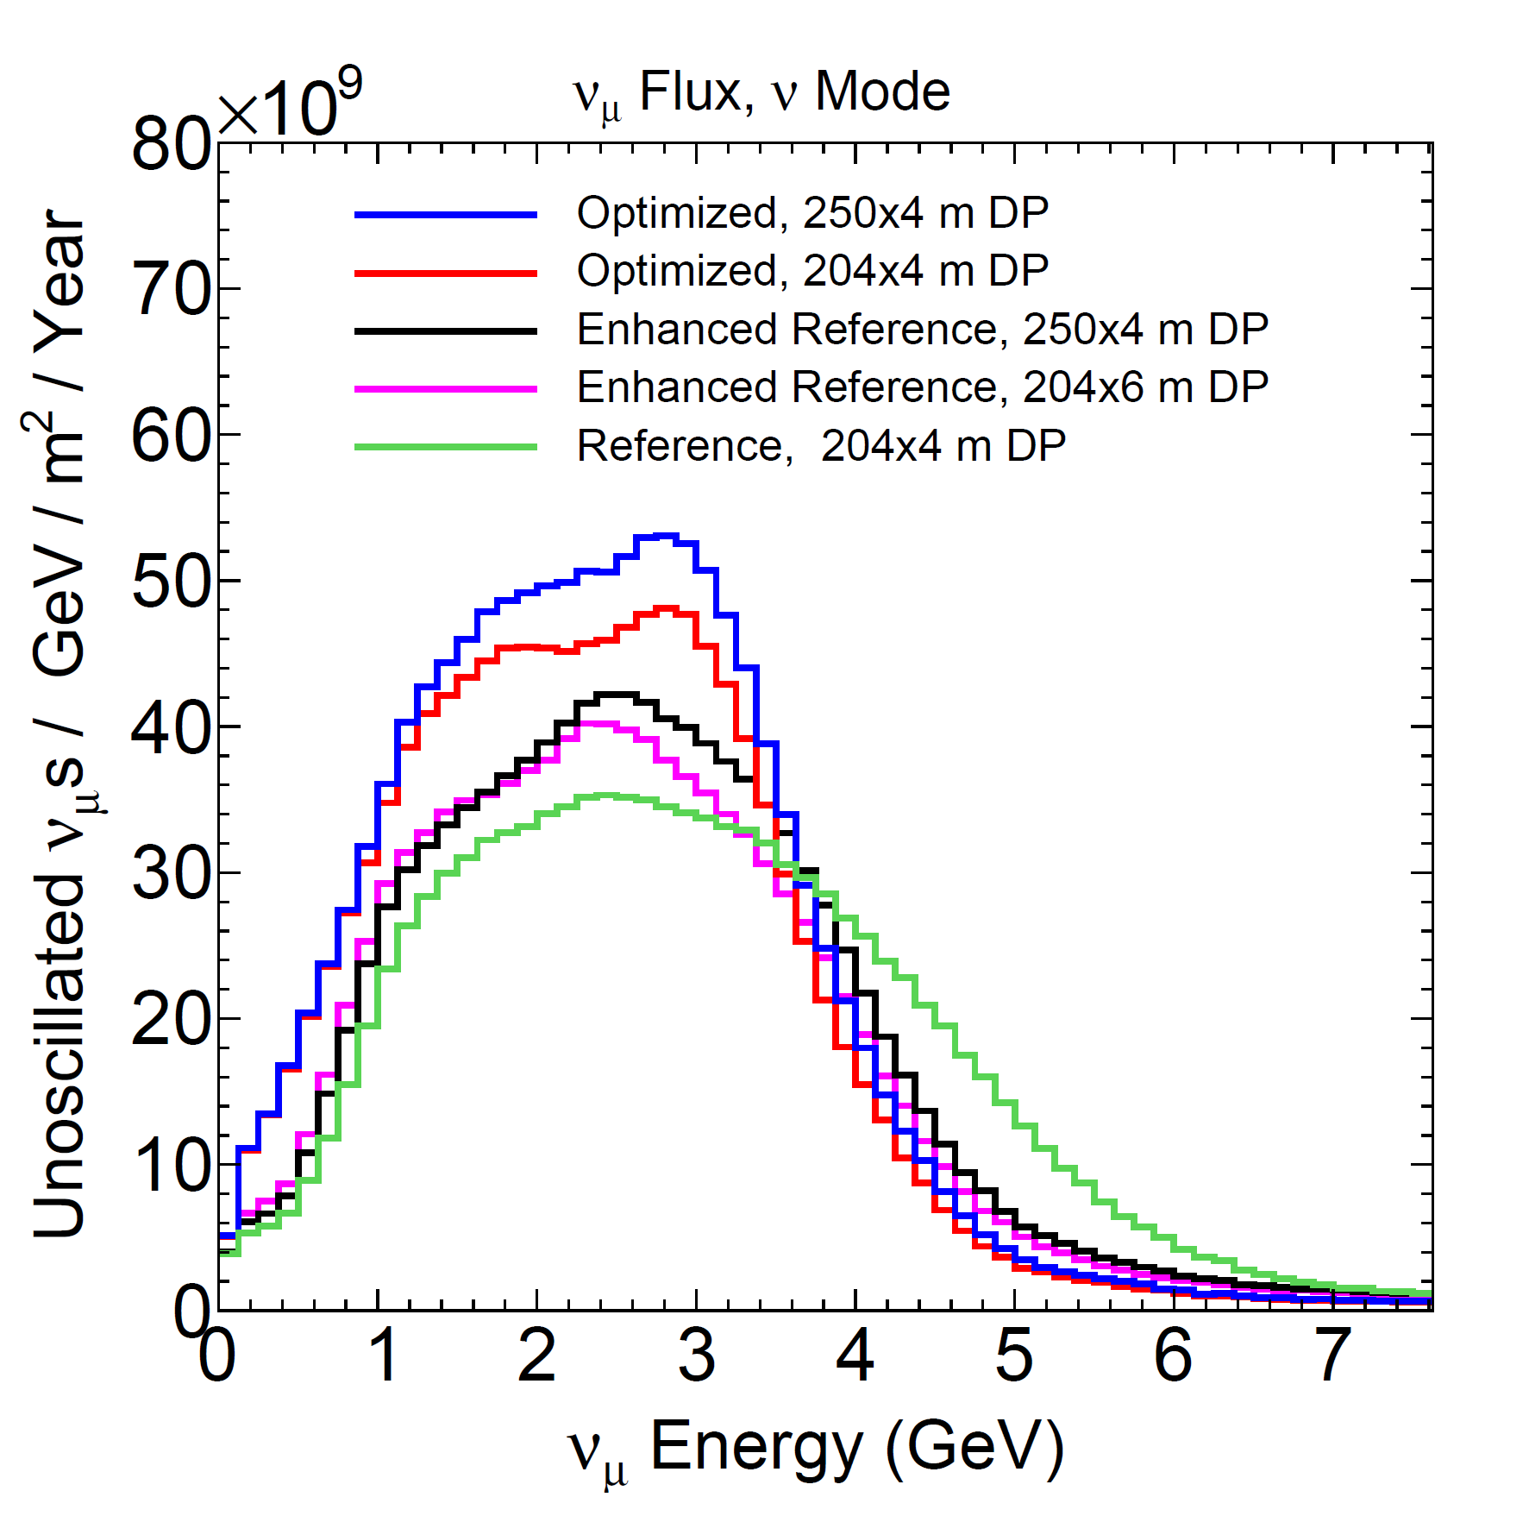

Target chase allows for optimized focusing systems
Reference Design Target Chase indicating the positions of the reference design horns (in red) and the optimized horns (in blue)
80 GeV protons
1.3 m
NuMI-like
5.5 m
More from L. Fields

Slide 15
Cooling gas selection for target chase - alternative
There are two studies in progress that could eventually affect which gas is selected for use in the target pile cooling system (the reference design assumes air):
(1) LBNF Corrosion Working Group studies
  Could motivate reduction/elimination of Oxygen
(2) LBNF Air Releases to the Atmosphere
  Could motivate reduction/elimination of Argon
Nitrogen or Helium are possible alternatives
Measurements are being made at NuMI and compared with simulations in support of making decisions on the above.
  Corrosive chemicals (ozone, nitric acid, NxOx)
  Air-born radioisotopes (Ar-41, C-11, /N-13, O15)
  Humidity

Slide 16
Target R&D activities – LBNE/LBNF
Motivation:
  Maximize up-time of the experiment
  Maximize neutrino flux (in conjunction with the horn)
Target parameters to optimize:
  Materials (graphite, Beryllium, etc.)
  Shape (fins, segmented cylindrical rod, spheres,…)
  Cooling (water, helium, water-spray,…)
  Size and position with respect to the horn
Strong R&D program in place during the past six years
  Graphite
    BNL/BLIP irradiation run in 2010 of seven different materials (graphites, C-C, HBN). Follow up studies confirmed POCO ZXF-5Q graphite is the best choice on the basis of strength and coefficient of expansion after irradiation.
    Cylindrical, segmented rod with double layer water cooling (IHEP/Protvino 2009).
    RADIATE (upcoming irradiation run at BNL; fatigue testing machine).
    NuMI target NT-02 fin studies (PNNL).

Slide 17
Target R&D activities – LBNE/LBNF
  Beryllium
    STFC/RAL, 2010
    RADIATE
    HiRadMat (CERN) thermal shock experiment (September 2015)
    Beryllium fin fatigue and radiation damage studies at NuMI/NovA

Slide 18
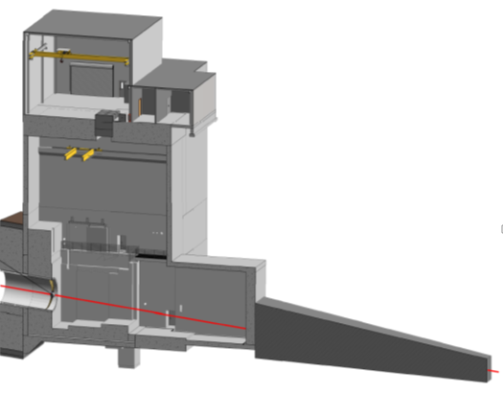
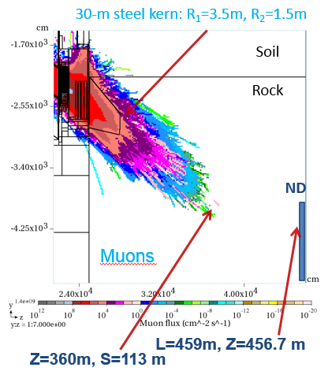
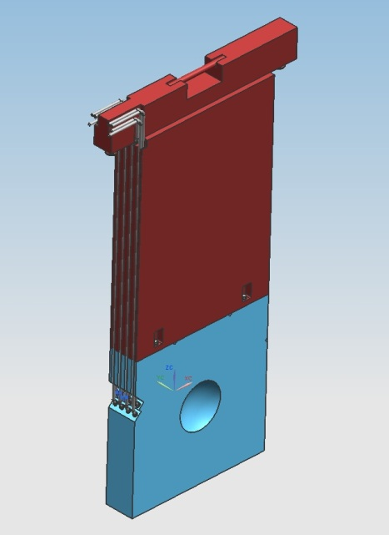
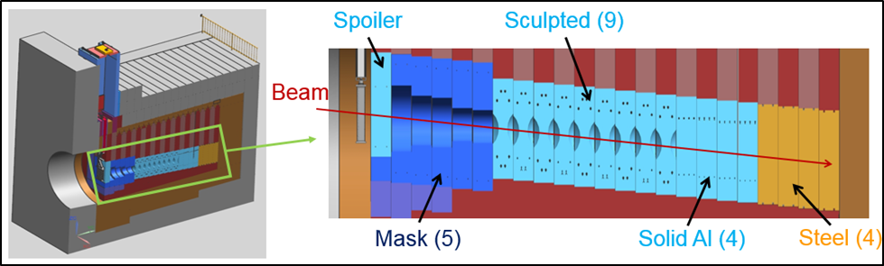
Hadron Absorber
The Absorber is designed for 2.4 MW
Absorber Hall and Service Building
Absorber Cooling
Core: water-cooled
Shielding: forced air-cooled
~ 30% of beam power in Absorber
Muon Alcove
Muon Shielding (steel)
Core blocks replaceable (each 1 ft thick)
Beam
Sculpted Al (9)
Beam
Hadron Monitor

Slide 19
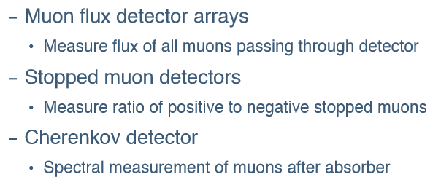
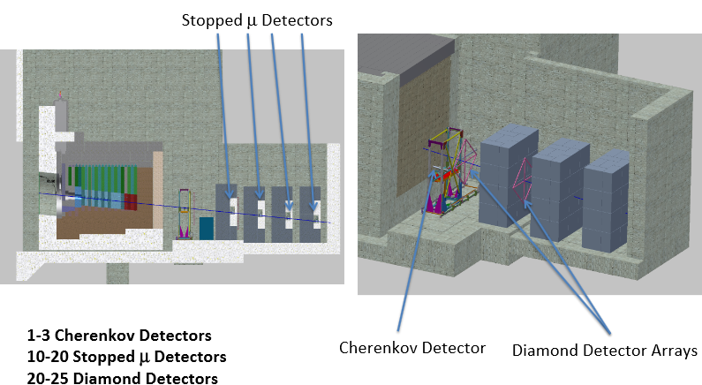
Beamline Muon Detectors in Muon Alcove
Scope just added to the LBNF Beamline

Slide 20


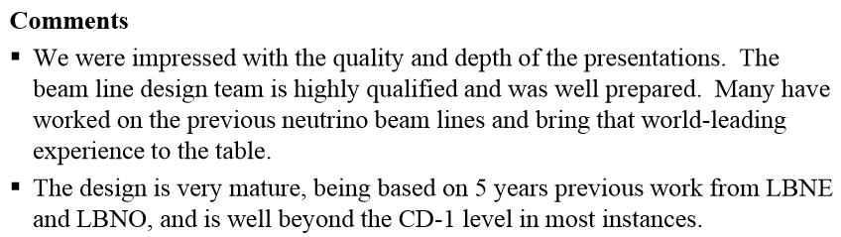
Conclusions of the CD-1 Refresh Review - Beamline

Slide 21

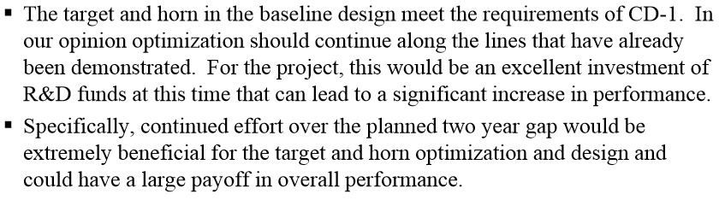
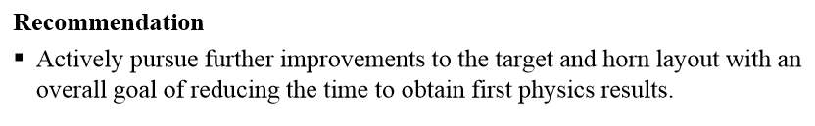
Conclusions of the CD-1 Refresh Review - Beamline

Slide 22
LBNF/DUNE - Schedule Summary Overview
Dec-19
CD-2/3c Project
Baseline/ Construction
Approval
Oct-15
CD-1 Refresh
Approval
Mar-16
CD-3a Approval
Jan-19
CD-3b Approval
Apr-27
CD-4 (early completion)
Aug-30
DOE CD-4
Conventional Facilities Preliminary & Final Design
40 months
Far Site
ProtoDUNE
SCHEDULE CONTINGENCY:
40 months on CD-4
Site Preparation incl. Waste Rock Handling
Excavation Cavern 1-4 and UGI
Cryostat #1-2 Construction
Critical path shown in red
Install Detector #1-2
Cryostat #3-4 Construction
Fill & Commission Det #1-2
Cryogenics Equipment
Install Detector #3-4
Beamline Design
Fill & Comm
Det. #3-4
Near Site
NND Design
CF Preliminary & Final Design
CF Advance Site Prep & Beamline Infrastr.
NND Assembly
CF Near Detector Hall
Install Beamline systems
Partial Assembly on Surface at FNAL
Install & Comm ND in Hall
FY15
FY16
FY17
FY18
FY19
FY20
FY21
FY22
FY23
FY24
FY25
FY26
FY27
FY28
DOE Activity
ProtoDUNE complete
Det #1 Commissioned
Beamline Complete
DOE and Non-DOE Activity
Cryostat #1 Ready for Detector Installation
Near Detector Complete
Det #2 Commissioned
Non-DOE Activity
FS Conventional Facilities Complete
Near Detector Hall Beneficial Occupancy – NS CF Complete

Slide 23
Priorities for FY16 and FY17
Corrosion Working Group needs to complete its work (Ozone production, etc., complete NuMI measurements and comparisons with MARS – complete contract with ESI). Took data at NuMI for 200 and 400 kW. Analysis to finish by the end of 2015. Will continue data taking till we get to 700 kW.
Repeat the air-release calculations for the larger target chase which is now the default. (Before that plan to decide if we will cool decay pipe with air or N₂).
First order structural analysis of the Decay Pipe.
MARS and FEA work on the decay pipe snout (in the end of which we have the upstream decay pipe window) so that we can select the material and decide on how we will cool the snout. (carbon steel the default now).
Evaluate in a more complete way the consequences of a longer chase/shorter decay pipe to the overall Beamline/CF design and do value engineering. (e.g. upstream decay pipe window).
Since we will leave some areas not worked on for a year or two, non-negligible effort was/will be required to document well – technical notes/drawings - what has been done so far.
I
Vaia Papadimitriou | Overview of Beamline Design & Target R&D activities
Notes:
ma to mA in 2nd capability bullet

Slide 24
Priorities for FY16 and FY17
Bringing the mechanical design of the air cooling of the outer shielding of the Absorber to the advanced conceptual design level so that we can understand in more detail the overall shielding we will need. MARS simulations are lengthy, so the earliest we know what to simulate, the better.
Provide engineering support in the evaluation of more optimized targets and horns as the collaboration continues the physics optimization effort.
Complete current target R&D commitments (HiRadMat, RADIATE).
Completing a Kicker magnet prototype.
Notes:
ma to mA in 2nd capability bullet

Slide 25
Summary
The conceptual design is complete - in some systems beyond the conceptual level - since we are following closely the design and lessons learned from NuMI (including re-using components).
(Advanced) conceptual design of the Beamline available for 1.2 MW operation using NuMI-like target and horns with modest modifications.
Beamline installation and checkout complete (currently) in late FY26.
A lot of optimization work has taken place already; out of the explored options, the improvement of the target/focusing system seems to be the most promising one.
The FY16 budget of the Beamline Project allows for some modest engineering support for the above activities (in addition to the target R&D effort).
Additional talent and effort from the collaboration at large very much needed.
Vaia Papadimitriou | Overview of Beamline Design & Target R&D activities

Slide 26
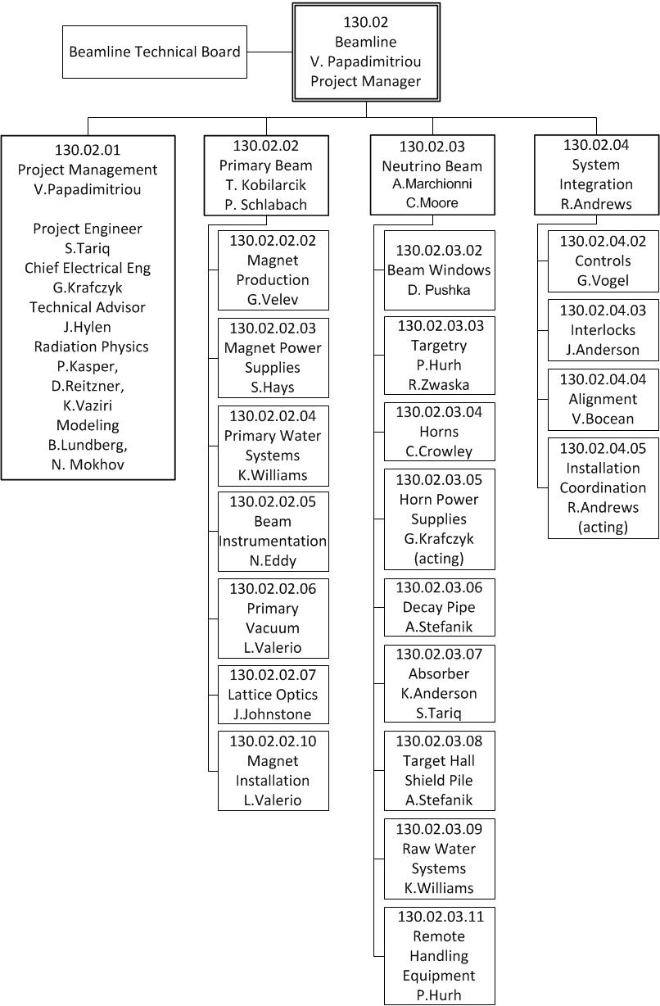
Beamline Organization & Staffing
Thank you!!
4 L4 Systems, 20 L5 Systems
A 22 member Technical Board
There are additional colleagues working within the Beamline Team from almost all Fermilab Divisions and Sections.
The Team has a lot of experience with NuMI/MINOS, NuMI/NOvA as well as with the Booster Neutrino Beam and accelerator operations in general
K. Ammigan, L. Bartoszek, B. Hartsell, A. Lee, I. Rakhno, V. Sidorov,…

Slide 27
Backup

Slide 28
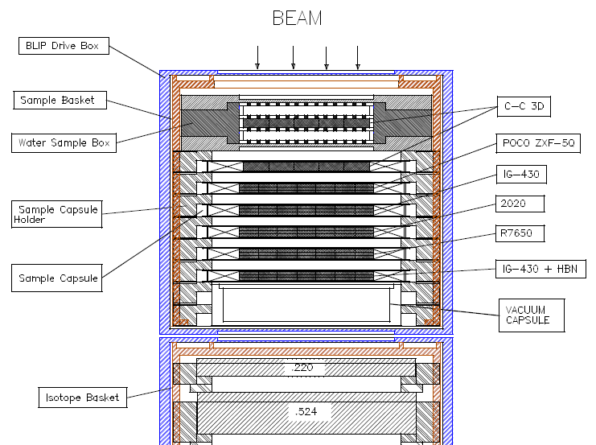
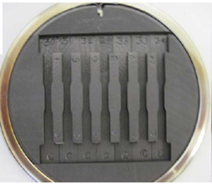
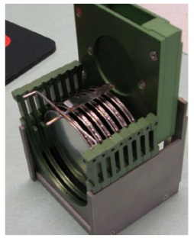
BNL/BLIP irradiation study March-June, 2010
~ 9 weeks of beam
Beam in at 181 MeV, must reach isotope box at 112.65 MeV
Top View
181 MeV
Six Argon capsules and one Water capsule
Carbon-Carbon composite
NuMI target graphite
T2K graphite (Toyo-Tanso)
CNGS graphite (Carbone-Loraine)
NuMI baffle graphite
Highest therm. shock metric
Beam View of Samples and Holder
112.6 MeV

Slide 29
Effects of accidental 2σ off-centre beam on stress waves in simply supported target rod
Be target R&D
As target diameter was increased in the study, the
beam spot size was also increased to match.
C. Densham et al. RAL report, LBNE docs 2400/3247, Nov. 2010
For 700 kW operation of a 13 mm diameter 1 m long beryllium cylinder falls inside the chosen design point stress. A series of spheres could be fit even better.
For 2.3 MW operation, a cylindrical rod beryllium target would have to be well above 21 mm in diameter in order to bring the peak dynamic stresses below the yield strength. The stress in a series of spheres can be kept below the design point with spheres of 13 mm diameter - advantage of longitudinal segmentation.

Slide 30
The Beamline LBNF Team so far and collaborative activities
From Fermilab’s Accelerator, Neutrino, Particle Physics and Technical Divisions, Computing Sector, FESS (Facil. Eng.) and ES&H Sections.
University of Texas at Arlington (Hadron Monitor)
University of Colorado (Muon Systems)
LANL (Muon Systems)
STFC/RAL (target R&D and target design)
RADIATE Collaboration (radiation damage for target and windows)
CERN (target R&D, corrosion, neutrino beamline monitoring,…)
  US-Japan Task force (radiation damage, non-interactive profile monitor, kicker magnets)
IHEP/China (simulations, beam window, special alloys)
Universities in Beam simulation efforts
  Bartoszek Eng. (Contract on baffle/target and horn support modules and on Muon Systems)

Slide 31
PIP/PIP-II Performance Goals
Performance Parameter | PIP | PIP-II
Linac Beam Energy | 400 | 800 | MeV
Linac Beam Current | 25 | 2 | mA
Linac Beam Pulse Length | 0.03 | 0.5 | msec
Linac Pulse Repetition Rate | 15 | 20 | Hz
Linac Beam Power to Booster | 4 | 13 | kW
Linac Beam Power Capability (@>10% Duty Factor) | 4 | ~200 | kW
Mu2e Upgrade Potential (800 MeV) | NA | >100 | kW
Booster Protons per Pulse | 4.2×10¹² | 6.4×10¹²
Booster Pulse Repetition Rate | 15 | 20 | Hz
Booster Beam Power @ 8 GeV | 80 | 160 | kW
Beam Power to 8 GeV Program (max) | 32 | 80 | kW
Main Injector Protons per Pulse | 4.9×10¹³ | 7.5×10¹³
Main Injector Cycle Time @ 120 GeV | 1.33 | 1.2 | sec
LBNF Beam Power @ 120 GeV | 0.7 | 1.2 | MW
LBNF Upgrade Potential @ 60-120 GeV | NA | >2 | MW

Slide 32
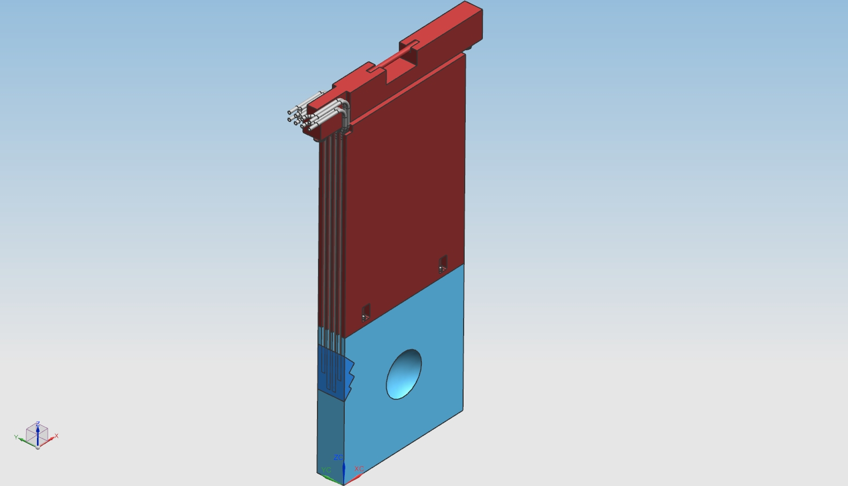
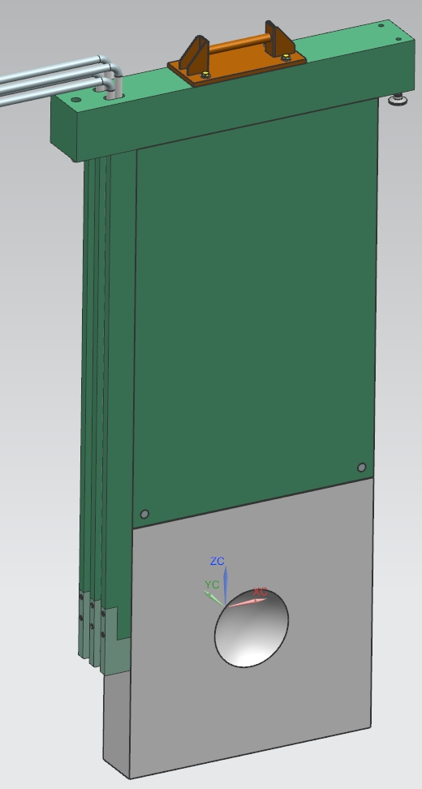
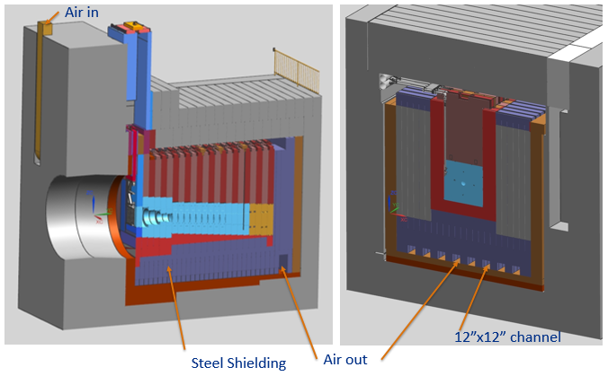
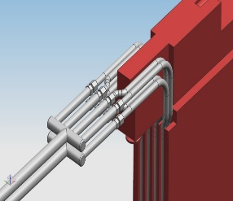
Beamline Recent Technical Progress - Absorber
Optimizing water cooling system for core
Working on air cooling system for shielding
Before
After
MARS and air cooling simulations to follow

Slide 33
Status of sampling to measure contaminants in
NuMI re-circulating chase air system for LBNF planning
J. Hylen
Want to measure as a function of time and beam power production in air by radiation:
Corrosive chemicals
  Ozone (monitor in place)
  Nitric Acid (monitor in place)
  NxOx (lower priority, instrument is expensive, not ordered)
Air-borne Radioisotopes
  Ar-41 / C-11 / N-13 / O15 (1st data taken at 240 kW beam power 2/12/2015 - Kamran)
Humidity Opportunistic measurement; the humidity monitors in target hall die quickly
Following are required to support understanding of the above measurements
Install sample line to recirculating air system (done during fall shutdown)
Build cart with sampling taps, air pump, flow meter etc (done, Cory et al)
Model radiation deposition in NuMI air per POT (I. Rakhno did MARS horn-on; horn off)
Model of corrosives production by radiation (ESI did literature search, we have the model)
Measure leak rate of chase air to target hall (1st meas Feb 18, 2015 -> 55 minute lifetime)

