Slide 1
Accelerator Driven Subcritical Reactors Introducing GEM*STAR – A Particularly Advantageous Example
Tom Roberts
Muons, Inc.
Technology to revitalize the nuclear power industry through improved safety, waste management, efficiency, and proliferation resistance.

Slide 2
Outline
“Nuclear Reactors 101” – how they work
Subcritical operation – avoids many problems
Why now? – answers to historical objections to ADSR
GEM*STAR – specific example of ADSR
Passive safety
Burns all nuclear waste streams, including its own
Extracts most of the 94% energy left in spent nuclear fuel
Needs no isotope enrichment or reprocessing
Summary

Slide 3
Nuclear Reactors 101 Fission Chain Reaction
Fuel
Nuclei
Each fission yields:
2-3 fragments
2-3 neutrons
1-3 gammas
Energy released ~ 200 MeV
Some neutrons are lost, some are absorbed.
Many fragments are radioactive – that is important.
Fission Fragments
Neutrons
http://www.scienceclarified.com

Slide 4
Nuclear Reactors 101 Criticality Factor
A key parameter of a nuclear reactor is the criticality factor:
k depends on the fuel mixture, the geometry, and the probability of a neutron inducing fission vs. being absorbed.
If k>1 the reaction grows without bound until something stops it (typically the system exploding violently). Bomb.
If k<1 the reaction stops, typically in less than 1 second. Subcritical reactor.
All current reactors operate with k=1, maintained within about 1 part per million. Critical reactor.

Slide 5
Nuclear Reactors 101 Neutron Moderation
The neutrons emitted from a fission are fast neutrons with kinetic energies of 1-10 MeV.
In a typical reactor fuel mixture, fast neutrons are more likely to be absorbed than to induce fission.
That makes k=1 difficult to achieve with fast neutrons.
A moderator is used to slow the neutrons down to become thermal neutrons (< 1 eV), via elastic collisions.
Thermal neutrons are much more likely to induce fission.
Moderators have low A and low neutron absorption.
Typical moderators: water, heavy water, and graphite.
The geometry is important.

Slide 6
Nuclear Reactors 101 Delayed Neutrons – Needed for Control
Neutron-induced fission occurs within femtoseconds; neutron moderation and transport takes microseconds.
That is too fast to be able to control the reaction.
Fortunately many fission products are radioactive, and some of them emit neutrons with a delay from milliseconds to minutes– typically 0.6−0.8% of the neutron flux.
The reactor operating point is set to be subcritical for the fission neutrons alone, but critical when the delayed neutrons are included.
This is slow enough that control can be maintained.

Slide 7
Nuclear Reactors 101 Cooling and Control
The reactor must be maintained at k=1 to operate.
Control rods are used, which are made of powerful neutron absorbers. With them fully inserted, k<<1.
In operation, the control rods are partially withdrawn to set the operating point (where k=1).
At the operating point, higher temperature will reduce k, while cooling down will increase it (combination of thermal expansion and moderation efficiency).
Thus the reactor will automatically generate enough power to maintain its temperature – if you increase the cooling capacity it will increase power, etc.
The control rods can be inserted at any time to shut down the reactor.

Slide 8
Nuclear Reactors 101 Fuel Handling
As a reactor operates, some of the fissionable portion of its fuel is burned, and fission fragments build up in the fuel rods.
Some fission fragments are powerful neutron absorbers.
So the control rods must be gradually withdrawn to maintain the operating point.
Typically every 12-18 months, ¼-⅓ of the fuel rods are replaced. They still contain ~ 94% of their initial energy.
The spent fuel rods are stored on-site, usually with water cooling to remove the decay heat from their residual radioactivity.
That radioactivity remains dangerous for > 100,000 years.

Slide 9
Nuclear Reactors 101 Summary
Nuclear reactors depend on many details of nuclear physics. Fortunately that is now very well known.
They must operate at k=1.000000 ± 0.000001. Fortunately this is possible.
They depend on ²³⁵U, which is difficult to obtain and of limited supply on earth. Isotopic enrichment is required, which makes it intimately connected with concerns about nuclear weapons proliferation.
There are significant concerns about safety.
But the big problem is that the U.S. has no viable plan for the handling of nuclear waste.

Slide 10
Subcritical Operation
Subcritical operation cannot sustain itself, so an external source of neutrons is required.
The most appropriate source is a proton accelerator generating spallation neutrons: 600-1000 MeV 1-10 MW
Appropriate k values: 0.97<k<0.99.
k closer to 1 gives more output power for a given beam power. That power ratio can range up to 200 or so.
As fission stops when the accelerator is turned off, this can provide significantly improved safety.
The neutron source permits operation even with large amounts of fission fragments – can burn waste.

Slide 11
Why now? Answers to Historical Objections to ADSR
Doubt that a multi-MW accelerator could be built.
Belief that such an accelerator would be too expensive and inefficient to operate.
Superconducting accelerators answer both.
Expectation that frequent accelerator trips would cause mechanical fatigue in the reactor fuel rods.
Eliminated by using molten salt fuel, and by designing the accelerator for high availability.
Doubt that the neutron economy would be viable.
Addressed with modern materials and simulations.

Slide 12
GEM*STAR
Our long-range goal is to sell intrinsically safe and versatile nuclear reactors to address world energy needs.
GEM*STAR is an Accelerator-Driven Subcritical Reactor designed to burn nuclear waste, natural uranium, depleted uranium, thorium, and excess weapons-grade plutonium.
It uses a superconducting accelerator and molten salt fuel to achieve greatly improved safety, address the issues of nuclear waste, and be both economically and politically feasible.
Note these technologies have already been demonstrated.
We believe that even in an era of cheap natural gas that GEM*STAR will be economically attractive.

Slide 13
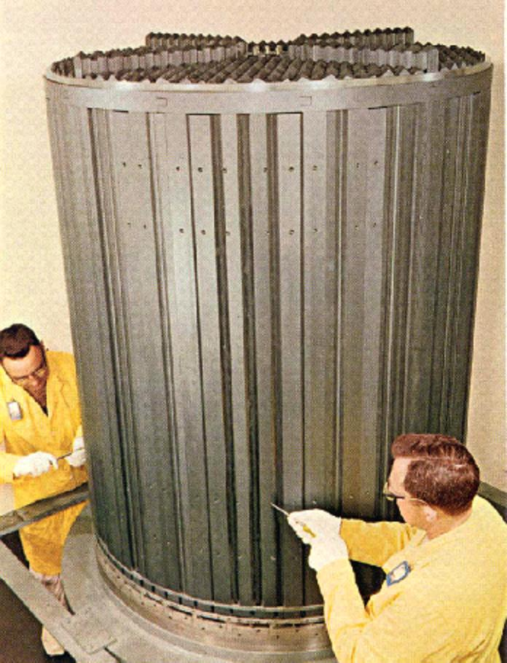
GEM*STAR Molten Salt Fuel
The Molten Salt Reactor Experiment operated at ORNL,1964-1969.
It demonstrated the key aspects of using molten salt fuel.
It was a critical reactor tested with several different fuels.
They routinely powered it down for weekends, something no conventional reactor could do.

Slide 14
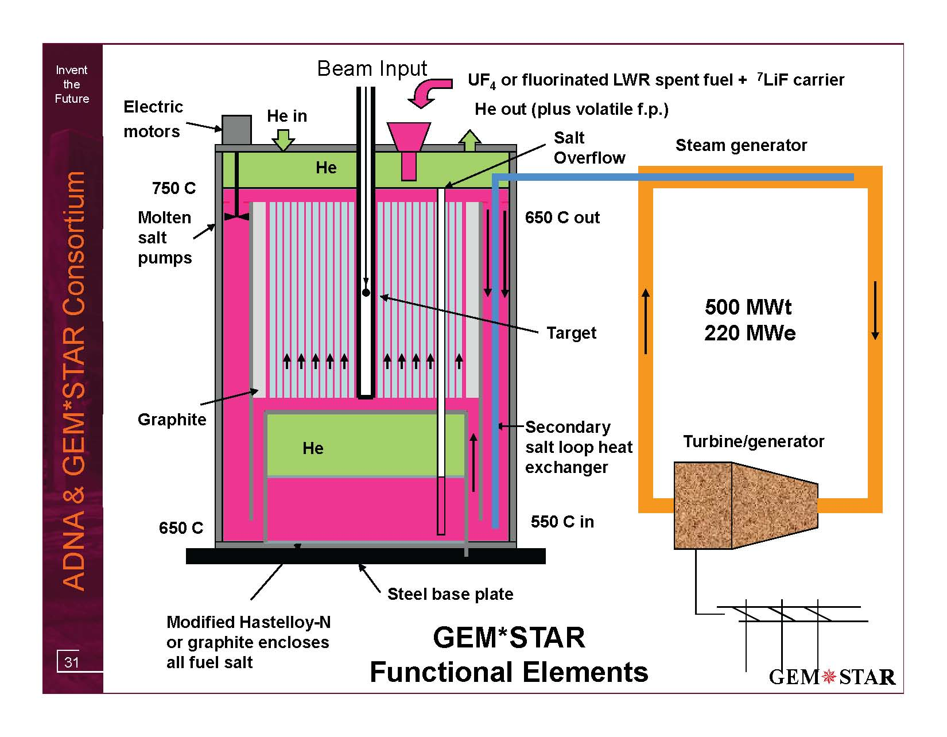
GEM*STAR
Nuclear fuel plus carrier salt
2.5 MWb yields:
Salt Storage Tank

Slide 15
GEM*STAR Advantages
Proven technology put together in a new way.
The reactor operates at atmospheric pressure.
No pressure vessel.
Major design simplification, and eliminates many accident scenarios.
Volatile fission products are continuously removed.
Avoids possibility of release (total ~ a million times lower).
No fuel rods.
No Zircaloy that can instigate a hydrogen explosion (Fukishima).
No mechanical fatigue from accelerator trips.
No critical mass is ever present, and cannot form.
No reprocessing or isotopic enrichment is needed.
More proliferation resistant than other technologies.
Passive response to most accident scenarios: turn off the accelerator – passive air cooling is then sufficient.

Slide 16
GEM*STAR
One thing it does particularly well is to dispose of excess weapons-grade Plutonium.
34 metric tons of excess weapons-grade plutonium is slated to be destroyed by the 2000 U.S.-Russian Plutonium Management and Disposition Agreement.
GEM*STAR destroys it more completely than other approaches.
The Pu is fed continuously into the reactor, and is immediately rendered not weapons-grade (even before burning is complete).

Slide 17
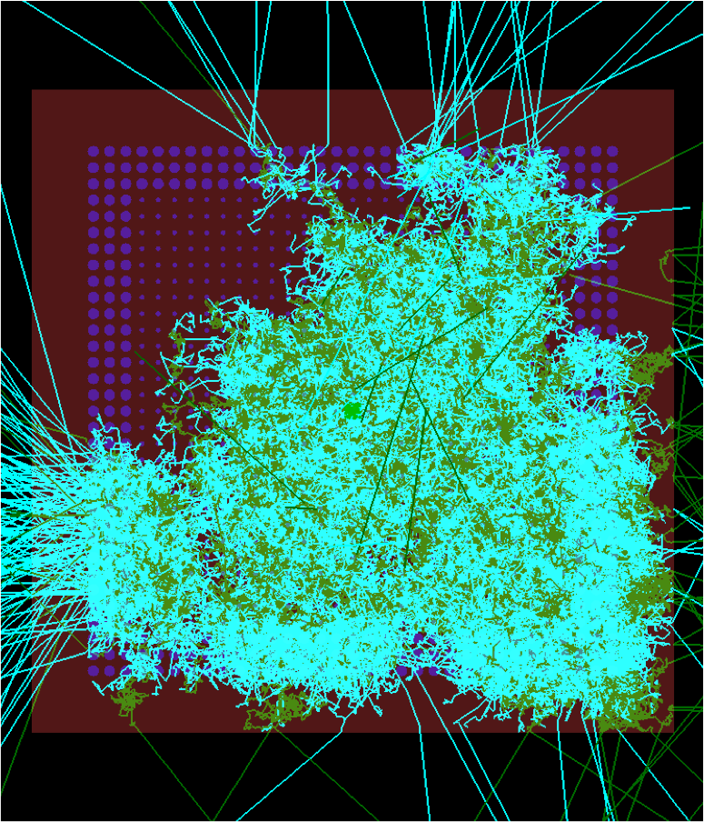
GEM*STAR Simulation Using MuSim
green=neutron, cyan=gamma, brown=graphite, purple=molten-salt fuel. This single 1 GeV proton generated 402,138 tracks (not counting e⁻).

Slide 18
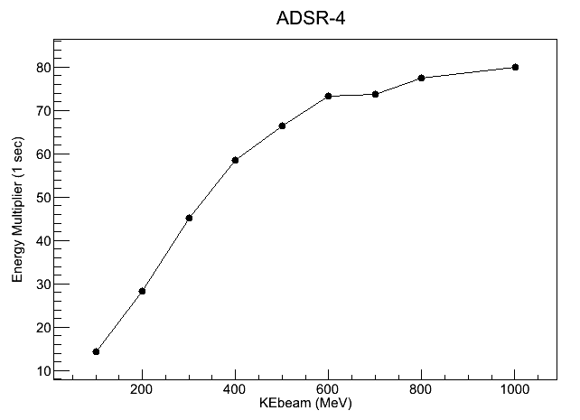
GEM*STAR Energy Multiplier vs. Beam Energy

Slide 19
Summary
Accelerator Driven Subcritical Reactors offer the promise to address the major problems associated with nuclear power – both technical and political.
ADSR can be very flexible in fuel: spent nuclear fuel, natural uranium, depleted uranium, surplus weapons material, and thorium.
Burning the waste from current reactors can potentially extend their lifetime and turn a huge liability into highly profitable use.
Burning the spent nuclear fuel from the current fleet of nuclear reactors is vastly superior to throwing away its enormous internal energy and just piling it in a hole in the ground for 100,000 years.
With a fleet of systems like GEM*STAR there is enough uranium out of the ground today to supply the current U.S. electrical power usage for more than 1,000 years.

Slide 20
Summary – GEM*STAR
Safety:
Fission stops when the accelerator is turned off.
Without fission, passive air cooling is sufficient.
Passive response to most accident scenarios.
Design avoids all historical reactor accident scenarios involving radioactive release.
Waste Management:
Burns all nuclear waste streams, including its own.
Ultimate waste stream is > two orders of magnitude smaller.
Efficiency:
Extracts most of the 94% energy left in spent nuclear fuel.
Proliferation Resistance:
Needs neither isotopic enrichment nor reprocessing.
Waste stream is never useful to build weapons.

Slide 21
Summary – Future
At the recent White House Summit on Nuclear Energy it was clear that nuclear energy is an important part of U.S. energy policy for the future.
That cannot happen without a sensible approach to the handling of nuclear waste#, which we don’t have today.
ADSR is among the best approaches known.
# E.g. Illinois has a moratorium on new nuclear facilities tied to a national policy on waste management.

