Slide 1
High Power Proton Linac Development
Ciprian Plostinar, STFC
- PASI Meeting, 12 November 2015, Fermilab -

Slide 2
The Big Picture: Global Demand for High Power Beams
Spallation Neutron Sources
ISIS (UK), SINQ@PSI (CH), SNS (USA), J-PARC (JP), LANSCE (USA), CSNS (CN), ESS (SE)
Radioactive Ion Beams (RIB)
FAIR@GSI (DE), FRIB (USA), EURISOL (Europe), ISOLDE (CH), RIKEN (JP), SPIRAL2 (FR), SPES (IT), SARAF (IL), etc.
Material Irradiation Facilities (MIF)
IFMIF-EVEDA, IFMIF and FAFNIR(Global effort).
Secondary Beams (Neutrino/Muon/Kaon Factories)
Linac4/SPL@CERN (CH), PIP-II at Fermilab, (IDS-NF (Global effort), UKNF (UK))
Accelerator Driven Subcritical Reactors (ADSR).
ADS (CN), MYRRHA (BE), ThorEA (UK).
Accelerator Driven Transmutation of Radioactive Waste (ATW)
TRASCO (IT)
Accelerator Production of Tritium (APT).
APT@LANL (USA)

Slide 3
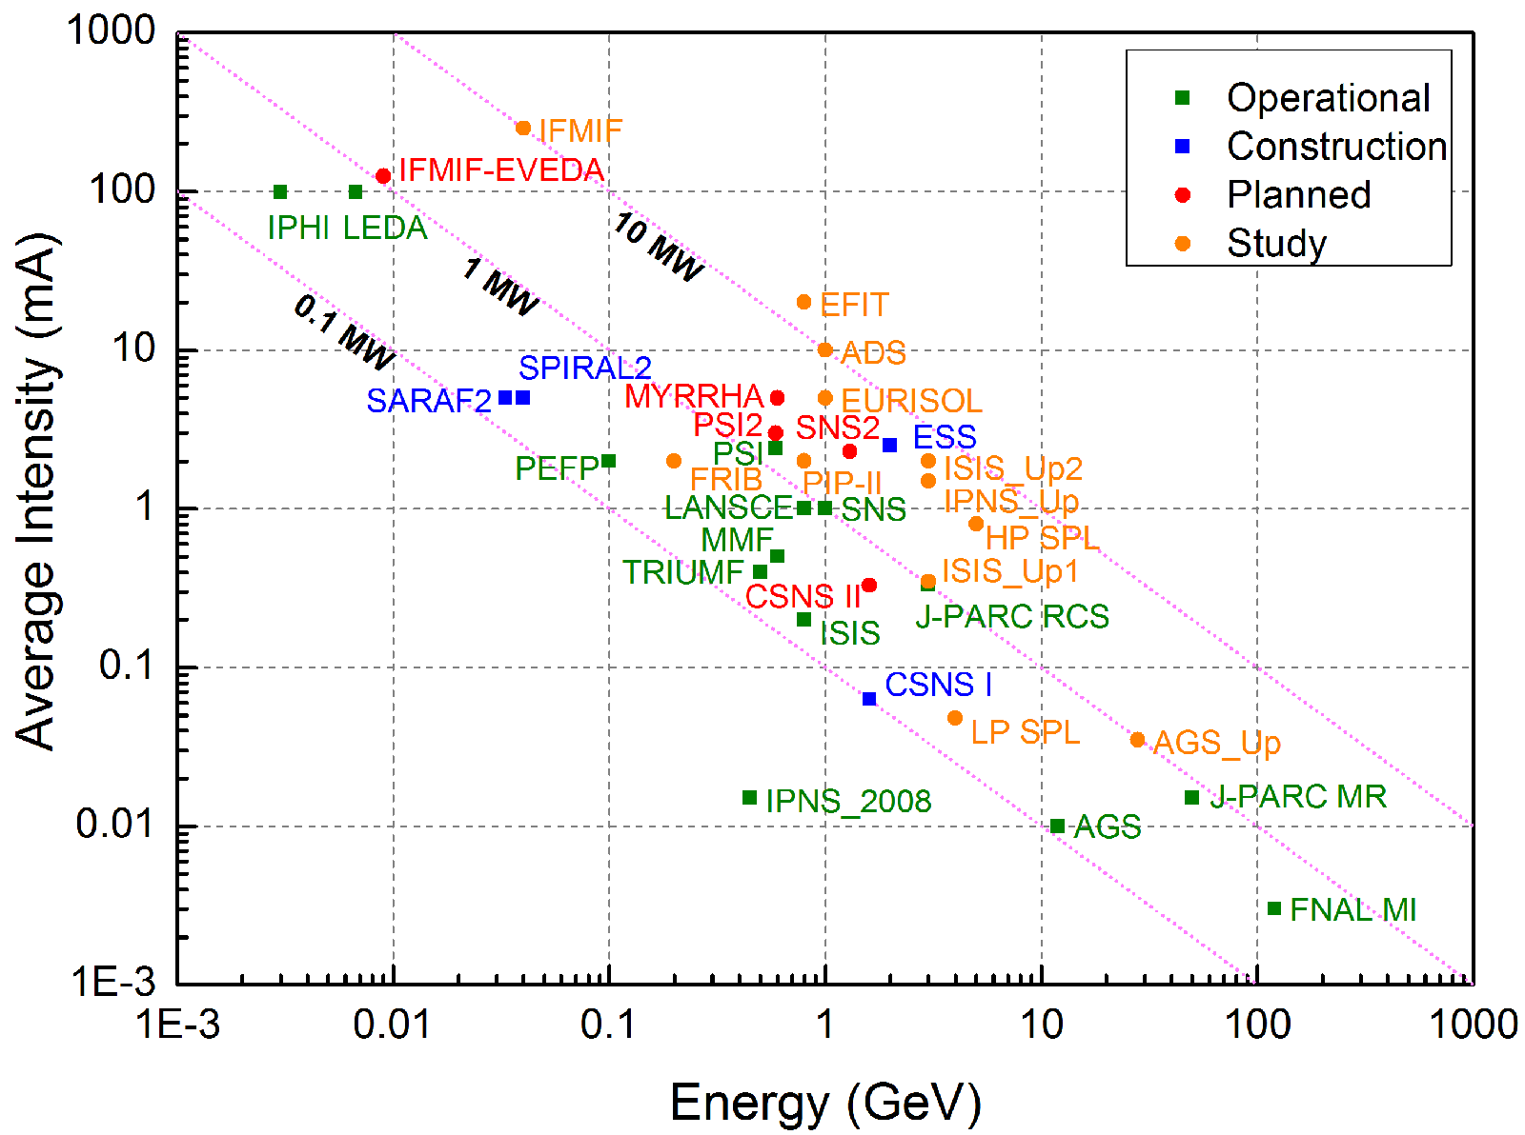
The Big Picture: Global Demand for High Power Beams

Slide 4
Modern High Power Proton Linacs - Operational
Different routes to high power:
Linacs, synchrotrons, cyclotrons, FFAGs
Linacs
Different technologies
Various design approaches
SNS
J-PARC
Ion Species | H⁻
Output Energy | 1 | GeV
Frequency | 402.5/805 | MHz
Pulse Length | 1.0 | ms
Peak Current | 38 | mA
Protons per Pulse | 1.5 x 10¹⁴
Repetition Rate | 60 | Hz
Duty Cycle | 6 | %
Average Beam Power | 1.4 | MW
Accelerating Structures | RFQ, DTL, CCL, SCL
Accelerator Length | ~257 | m
Ion Species | H⁻
Output Energy | 400 | MeV
Frequency | 324/972 | MHz
Pulse Length | 0.5 | ms
Peak Current | 30/50 | mA
Protons per Pulse | 9.4 x 10¹³/ 1.5 x 10¹⁴
Repetition Rate | 25 | Hz
Duty Cycle | 1.25 | %
Average Beam Power | 80/133 | kW
Accelerating Structures | RFQ, DTL, SDTL, ACS
Accelerator Length | ~244 | m

Slide 5
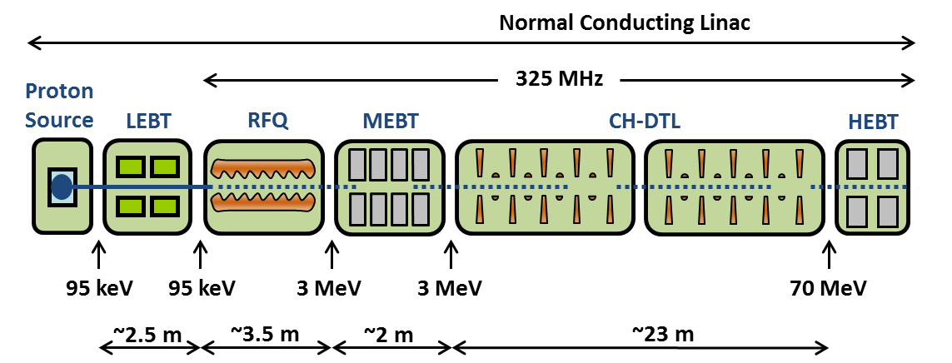
Modern Proton Linacs – Under Construction
Linac4
FAIR Proton Injector
Ion Species | H⁻
Output Energy | 160 | MeV
Frequency | 352.21 | MHz
Pulse Length | 0.4 | ms
Peak Current | 40 | mA
Protons per Pulse | 1.0 x 10¹⁴
Repetition Rate | 2 | Hz
Duty Cycle | 0.08 | %
Average Beam Power | 5.1 | kW
Accelerating Structures | RFQ, DTL, CCDTL, PIMS (*CCL)
Accelerator Length | ~80 | m
Ion Species | Protons
Output Energy | 70 | MeV
Frequency | 325.244 | MHz
Pulse Length | 36 | μs
Peak Current | 35 | mA
Protons per Pulse | 7.88 x 10¹²
Repetition Rate | 4 | Hz
Duty Cycle | 0.0144 | %
Average Beam Power | 3.53 | kW
Accelerating Structures | RFQ, CH-DTL
Accelerator Length | ~31 | m

Slide 6
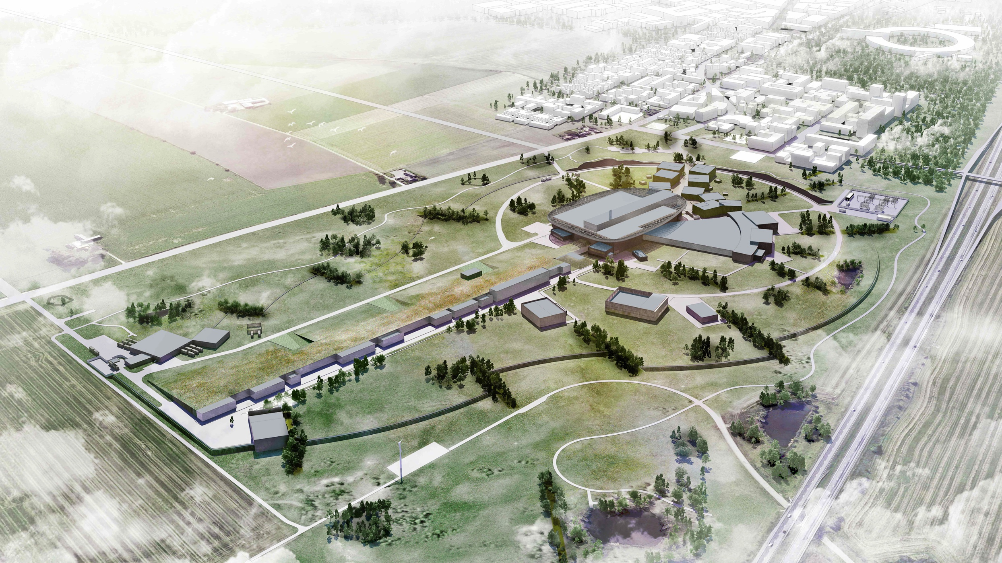
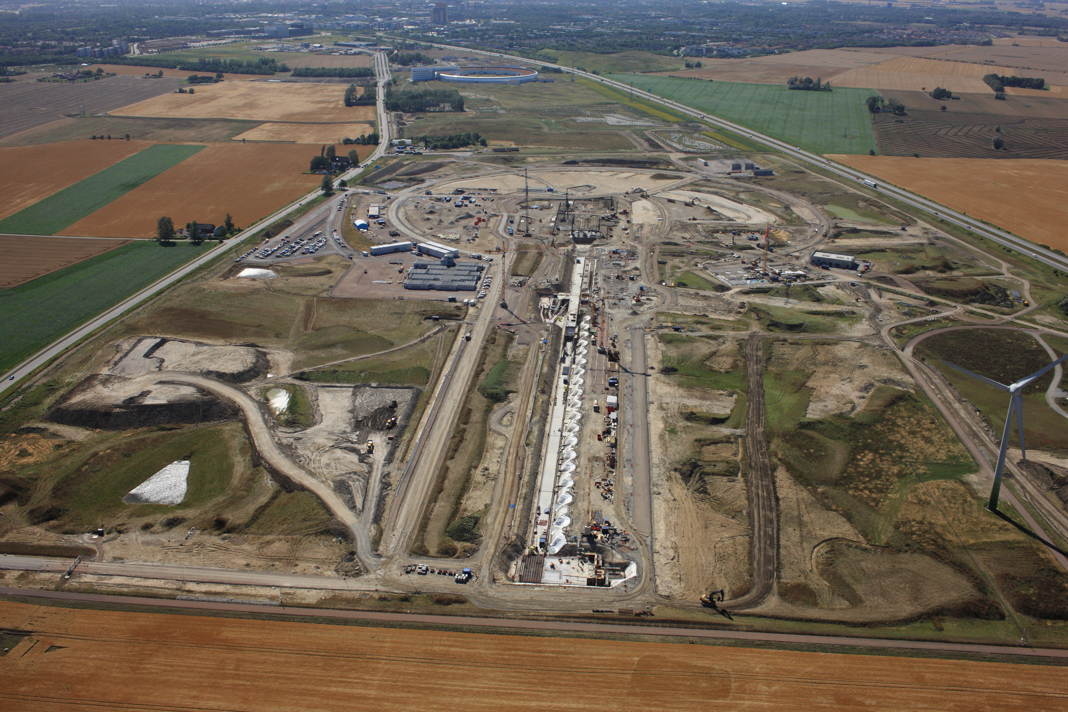
High Power Proton Linacs – Under Construction
ESS
Ion Species | Protons
Output Energy | 2 | GeV
Frequency | 352.21/704.42 | MHz
Pulse Length | 2.86 | Ms
Peak Current | 62.5 | mA
Protons per Pulse | 1.1 x 10¹⁵
Repetition Rate | 14 | Hz
Duty Cycle | 4 | %
Average Beam Power | 5 | MW
Accelerating Structures | RFQ, DTL, SC Spokes/Elliptical
Accelerator Length | ~365 | m

Slide 7
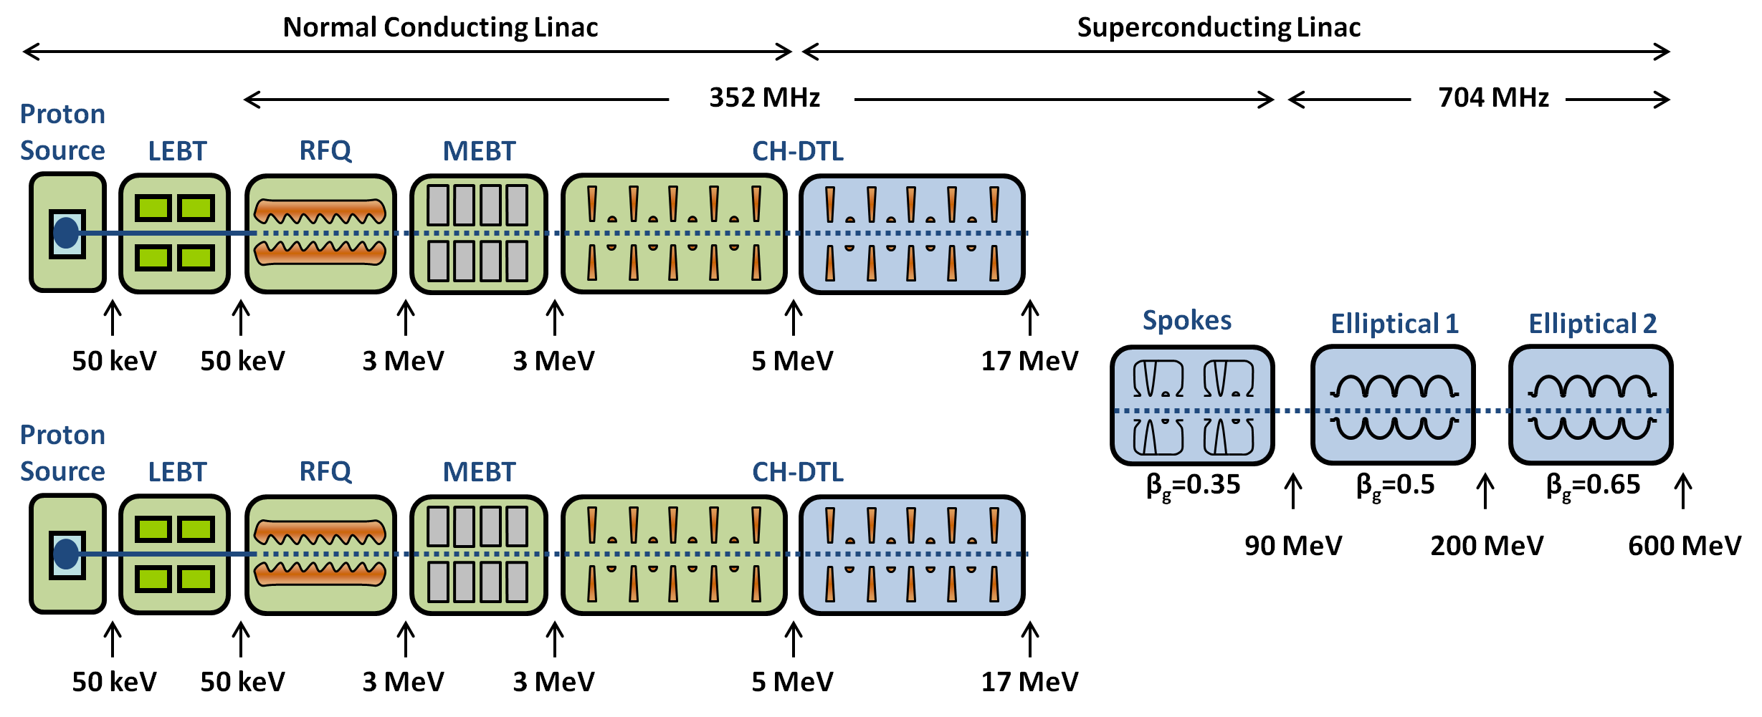
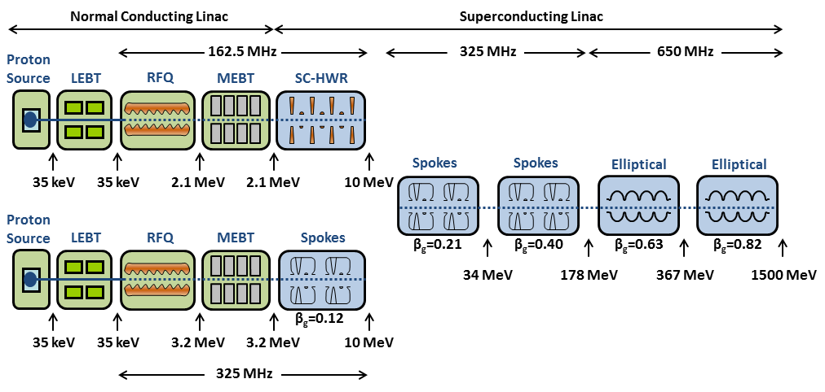
Future High Power Proton Linacs
MYRRHA
C-ADS
Ion Species | Protons
Output Energy | 600 | MeV
Frequency | 352/704 | MHz
Pulse Length | CW
Peak Current | 2.5-4 | mA
Repetition Rate | CW
Duty Cycle | CW
Average Beam Power | <2.4 | MW
Accelerating Structures | RFQ, CH-DTL, Spokes, SCL
Ion Species | Protons
Output Energy | 1500 | MeV
Frequency | 162.5/325/650 | MHz
Pulse Length | CW
Peak Current | 10 | mA
Repetition Rate | CW
Duty Cycle | CW
Average Beam Power | <15 | MW
Accelerating Structures | RFQ, SC-HWR, Spokes, SCL

Slide 8
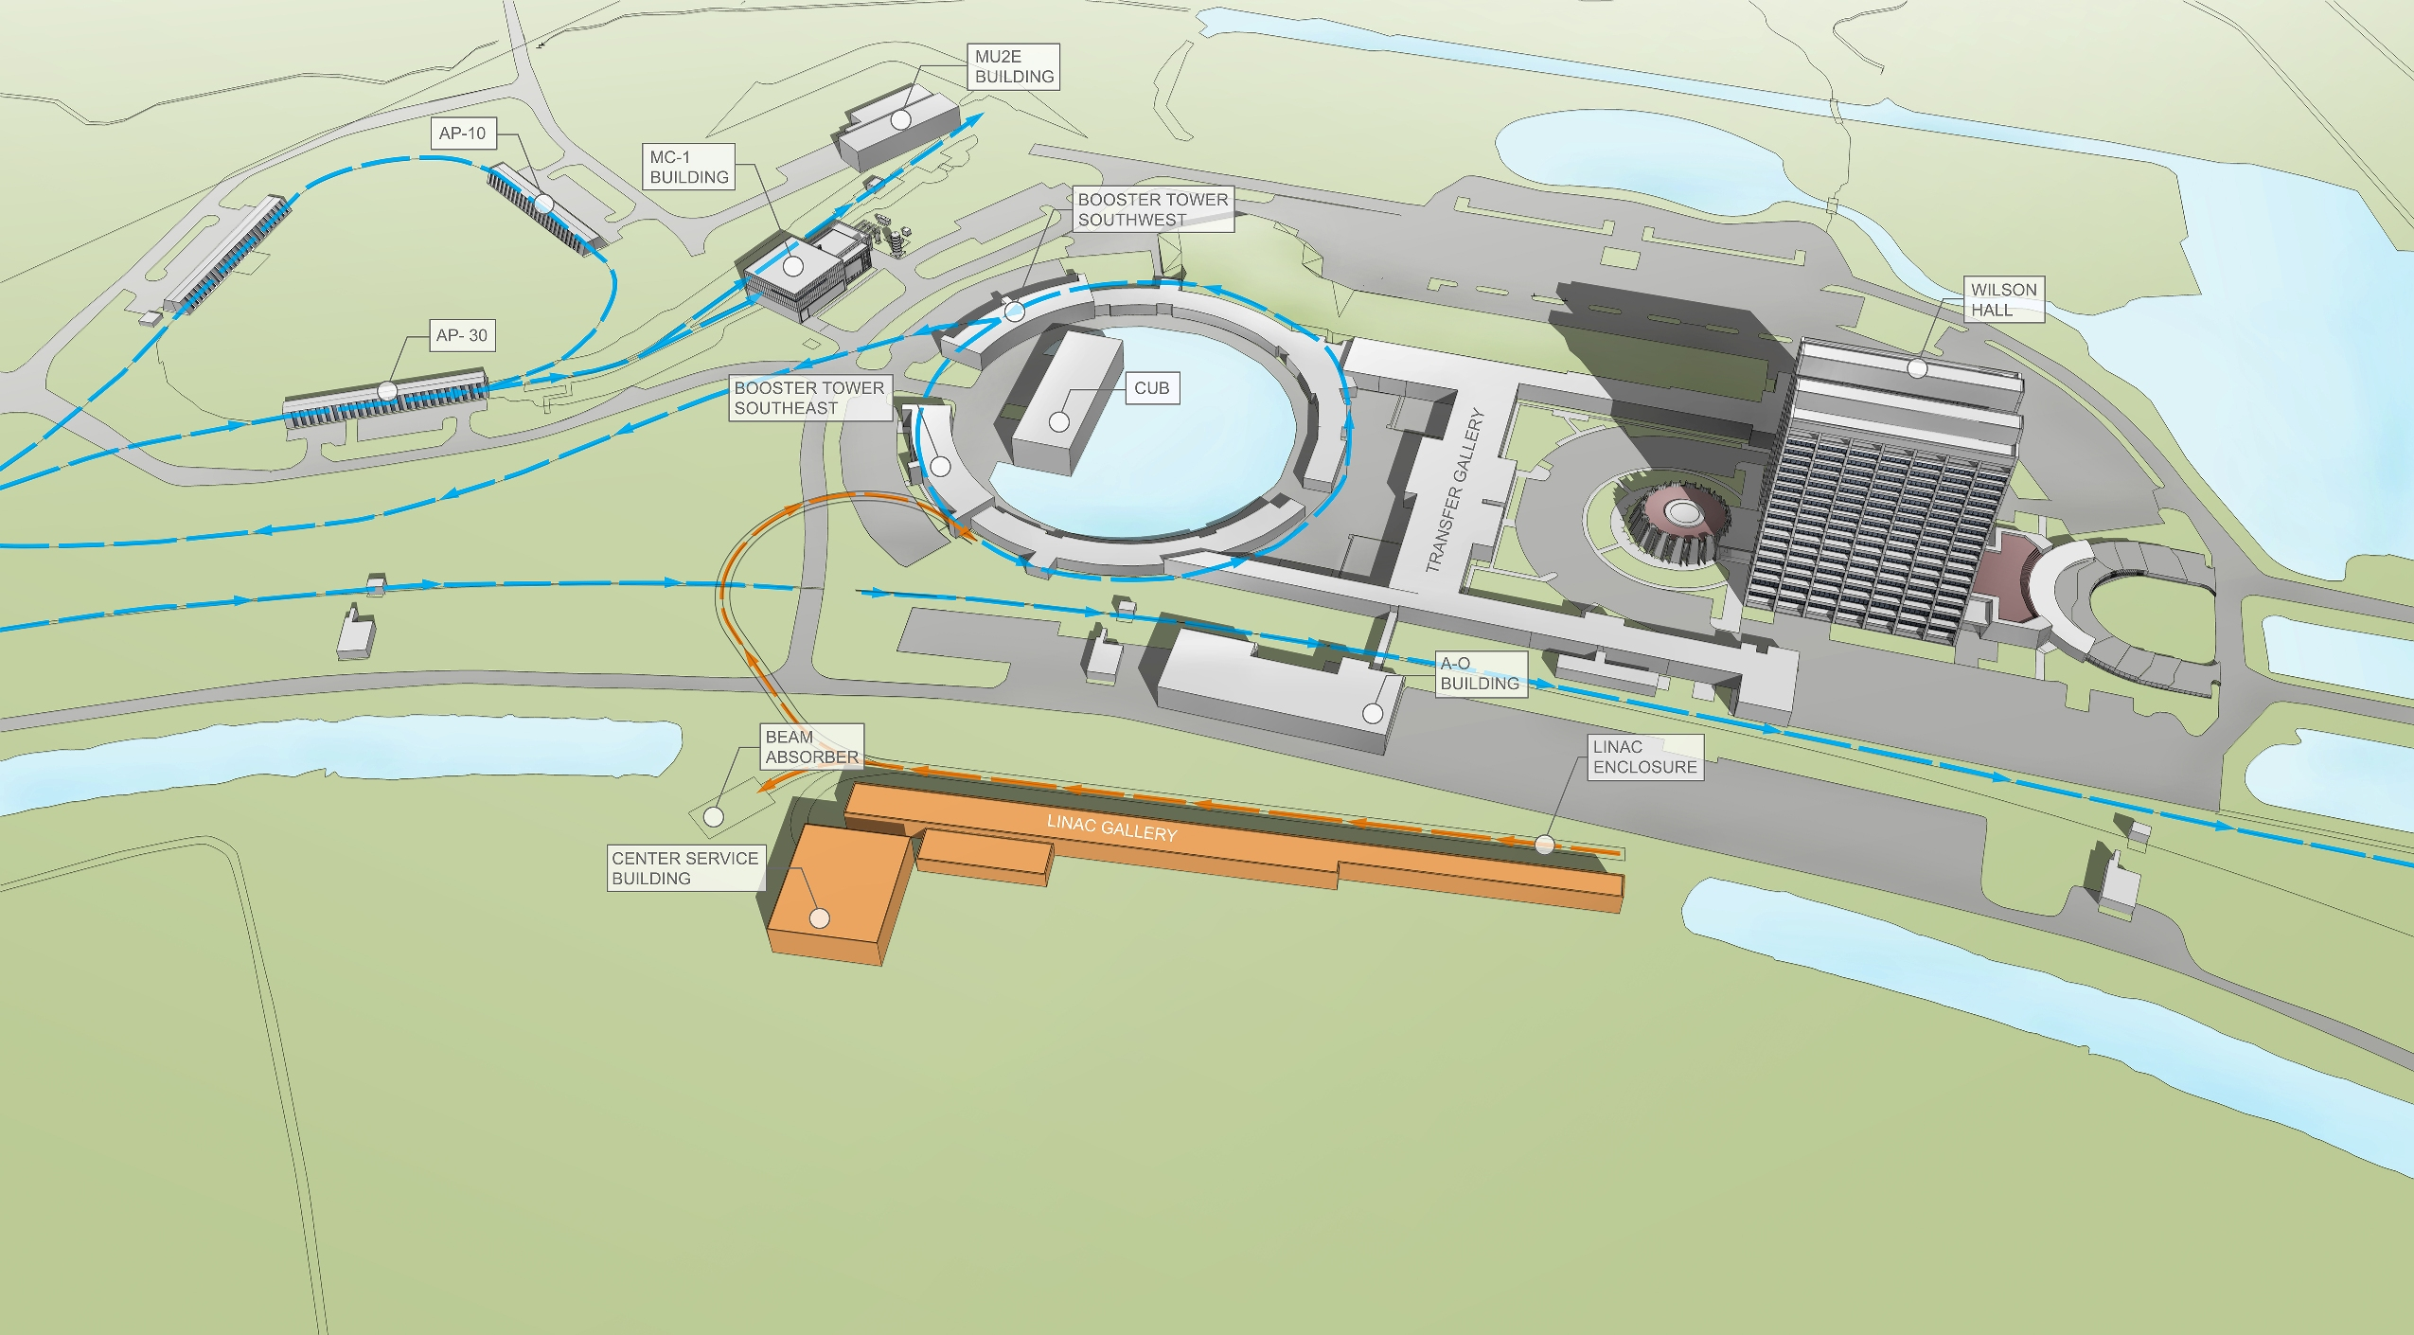
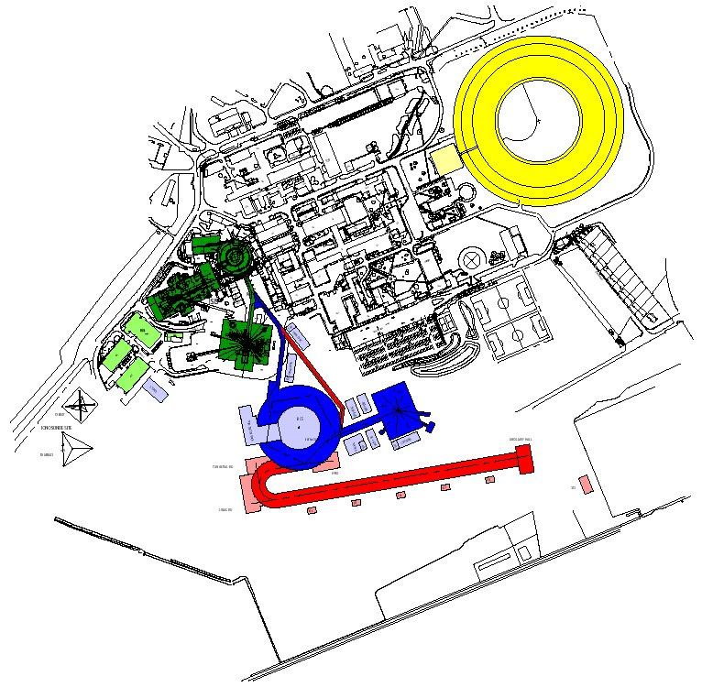
Future High Power Proton Linacs
PIP-II
ISIS Upgrades

Slide 9
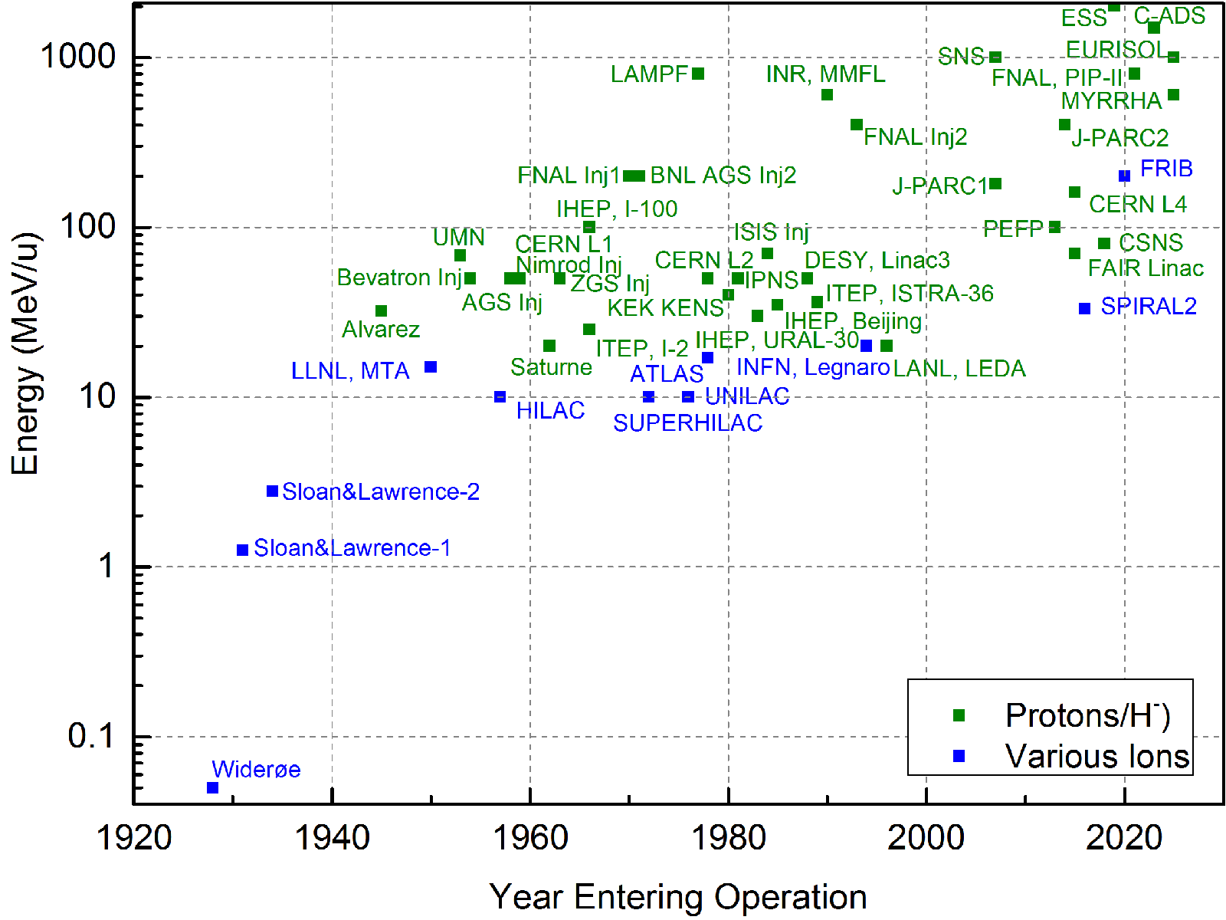
Proton/Ion Linacs

Slide 10
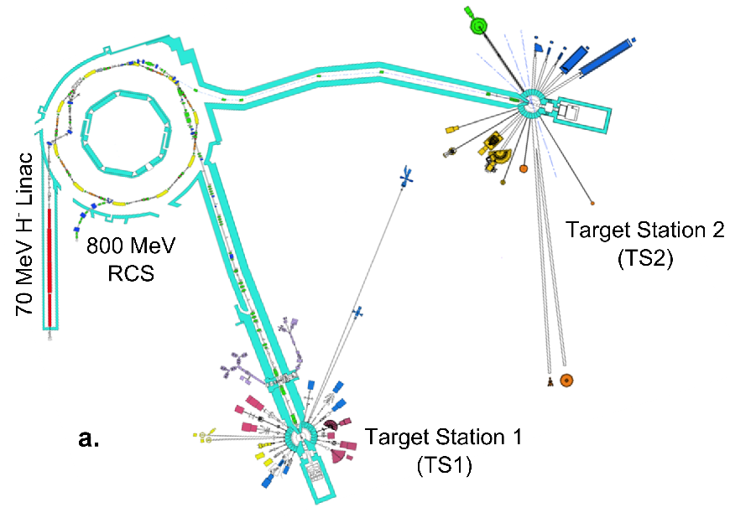
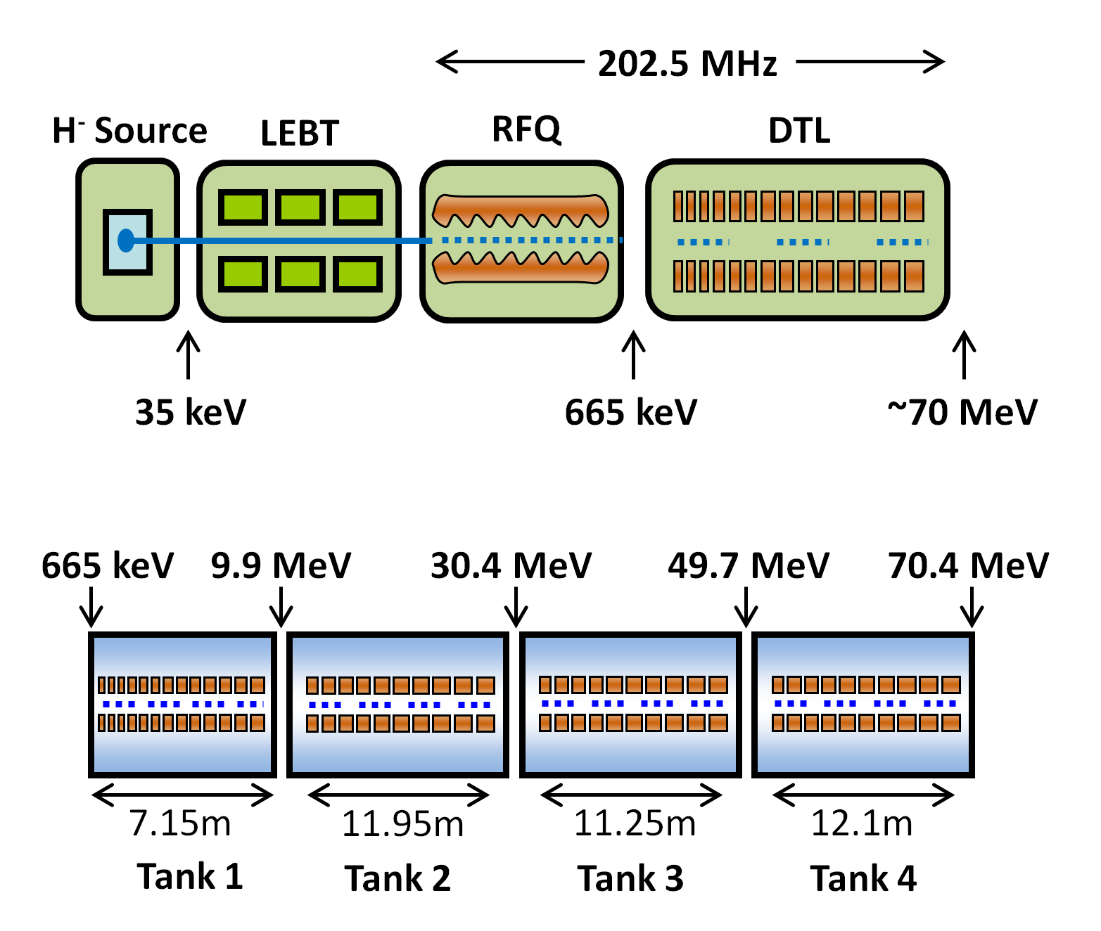
ISIS Today
Upgrades:
- Maintain current capabilities
- Demand for high power beams
- ISIS is an aging machine
- Various upgrade scenarios
Ion Species | H⁻
Output Energy | 70 | MeV
Frequency | 202.5 | MHz
Pulse Length | 0.2-0.25 | ms
Peak Current | 25 | mA
Repetition Rate | 50 | Hz
Duty Cycle | 1-1.25 | %
Average Beam Power | <20 | kW
Accelerating Structures | RFQ, DTL
Accelerator Length | ~55 | m

Slide 11
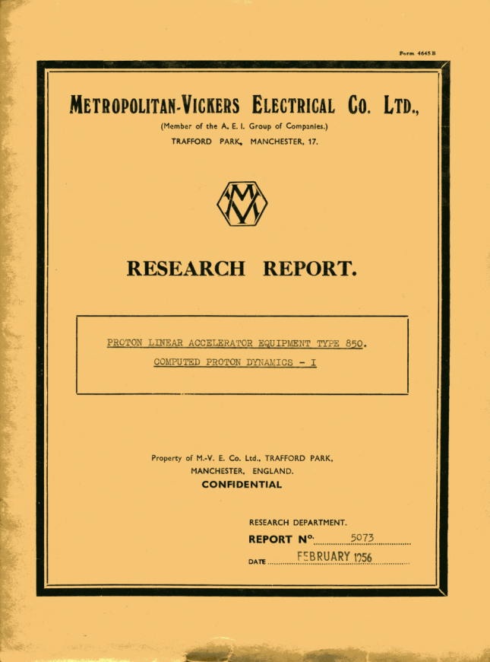
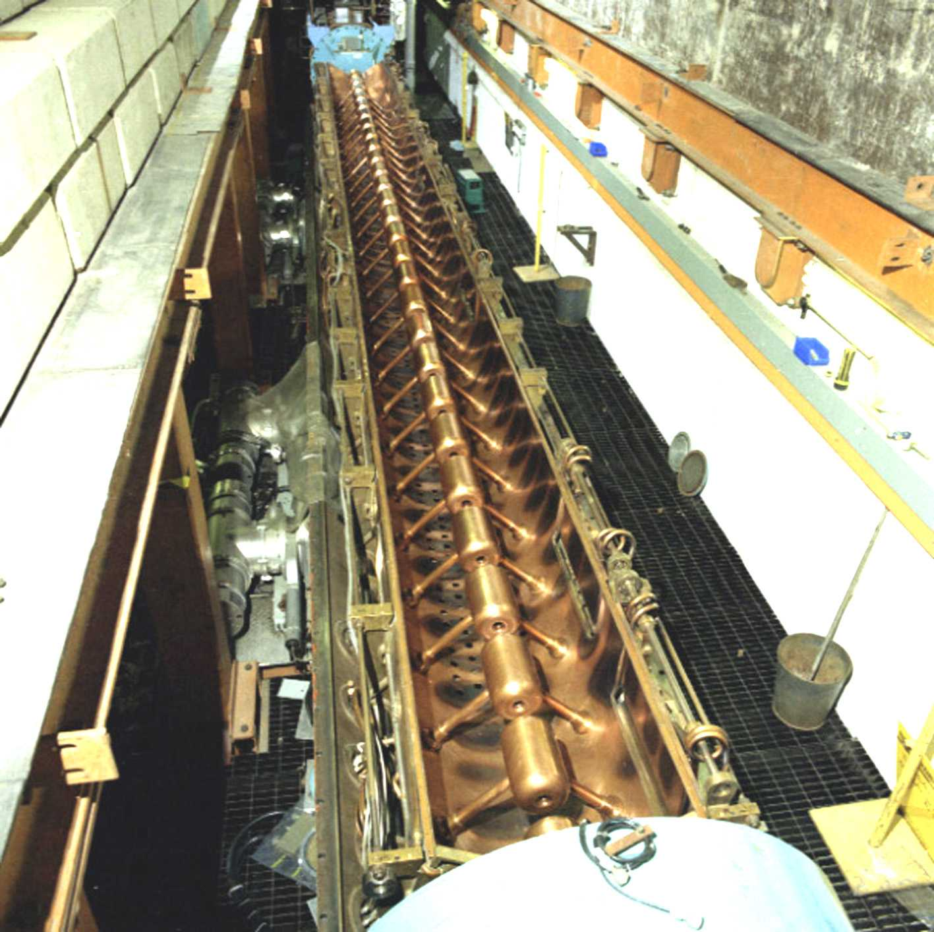
ISIS Linac Today

Slide 12
Two Linac Upgrade Options
High power adds severe constraints
Emittance growth, halo formation, etc.
Strict design laws
Beam loss mitigation
1 W/m?
Suitable structures
Normal Conducting vs Superconducting
Efficiency
Technology choice
Frequency choice
Etc.
Two options:
180 MeV Normal Conducting
800 MeV Superconducting

Slide 13
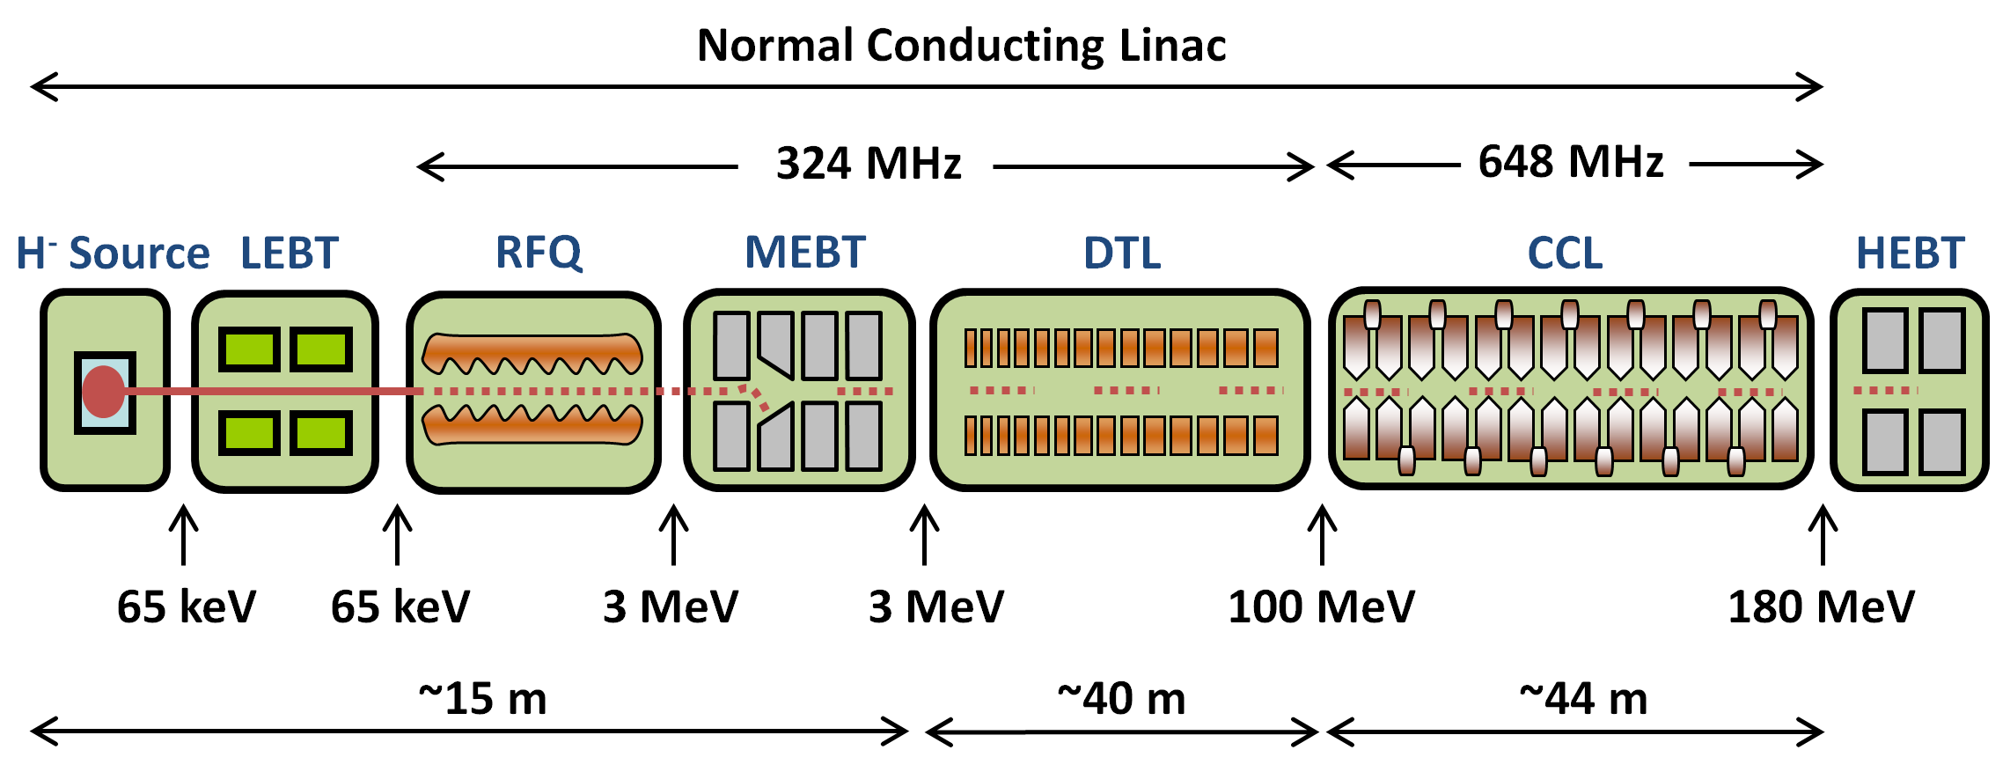
180 MeV Linac
Ion Species | H⁻
Output Energy | 180 | MeV
Frequency | 324/648 | MHz
Pulse Length | 0.1 – 1 | ms
Peak Current | 60 | mA
Repetition Rate | 50 | Hz
Duty Cycle | 0.5 – 5 | %
Average Beam Power | 54 - 540 | kW
Accelerating Structures | RFQ, DTL, CCL
Accelerator Length | ~99 | m

Slide 14
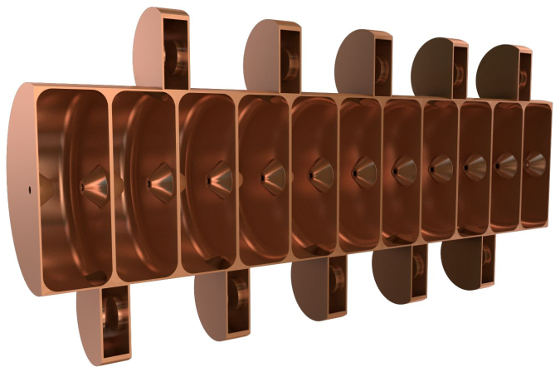
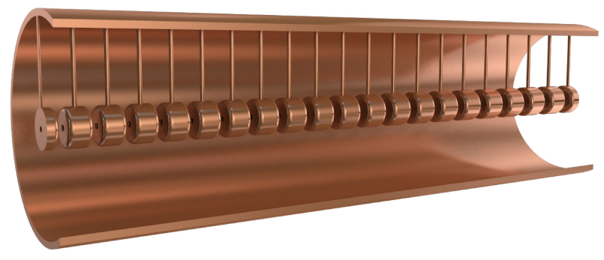
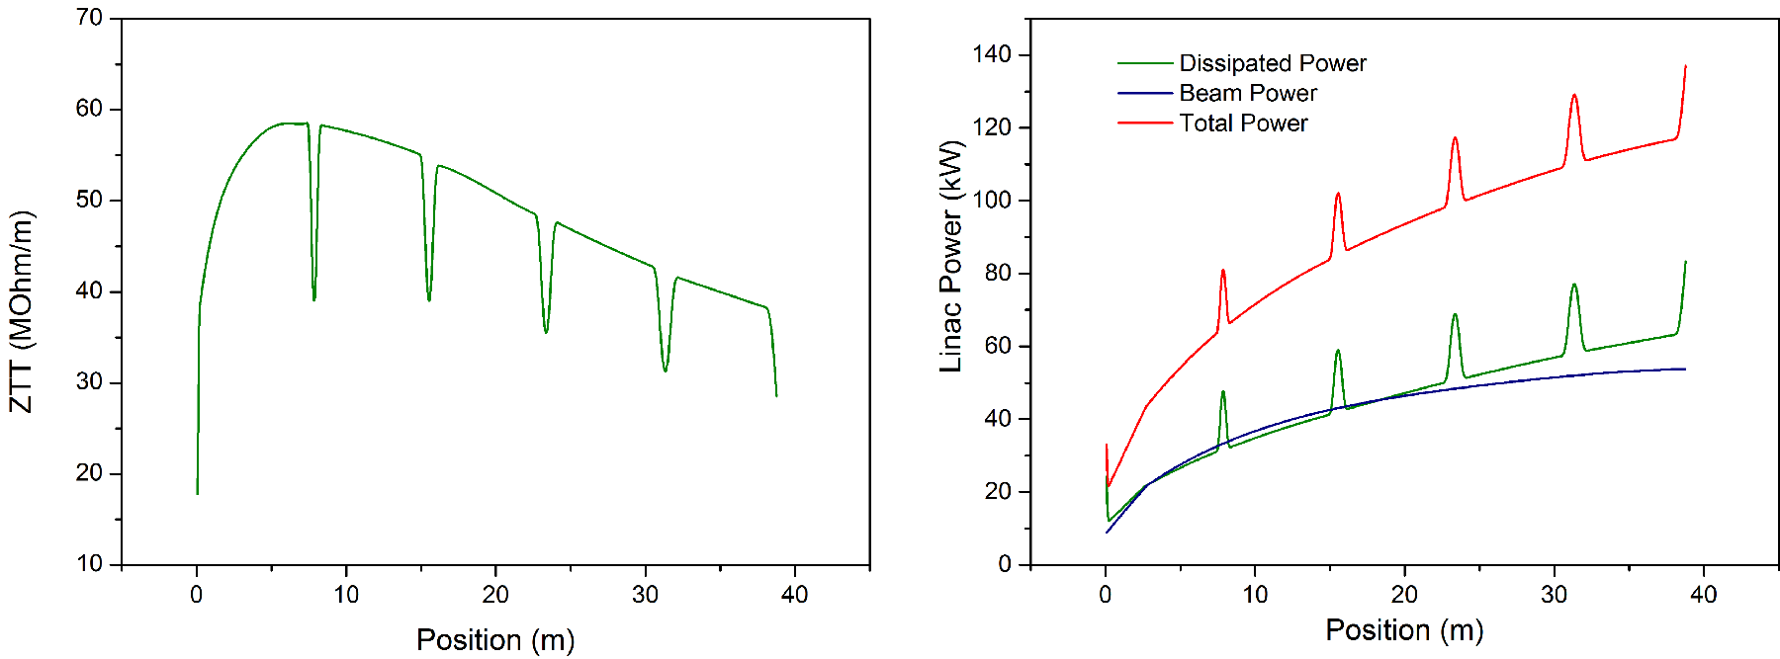
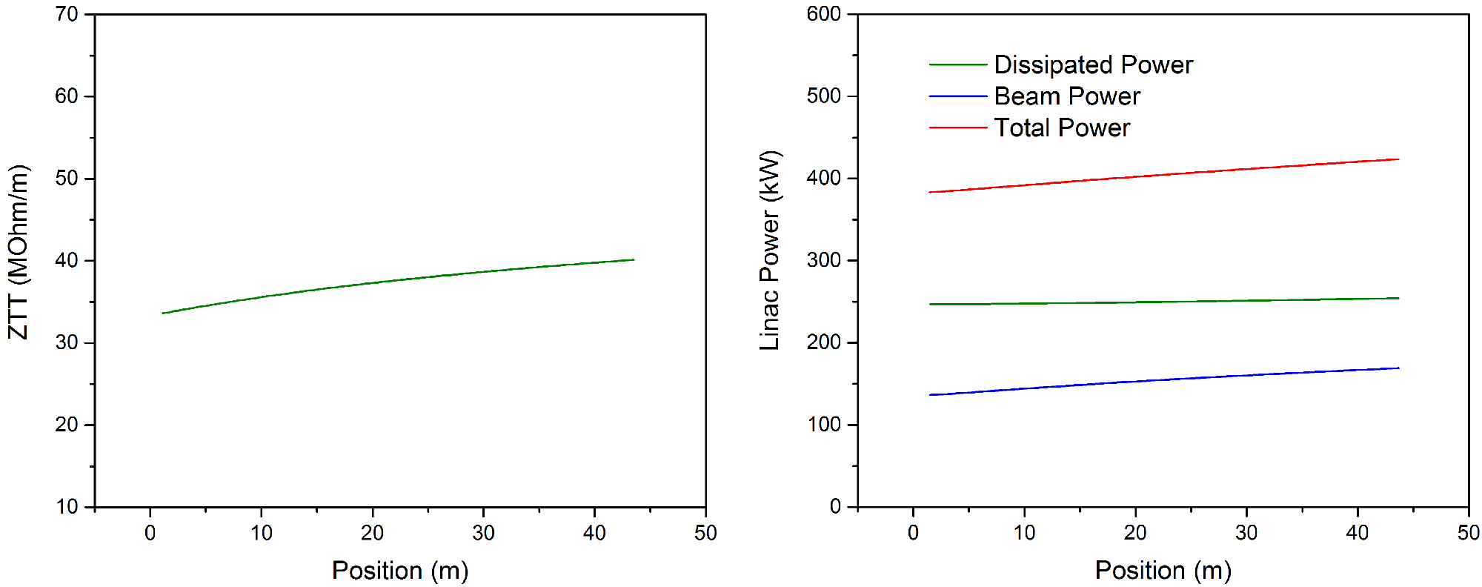
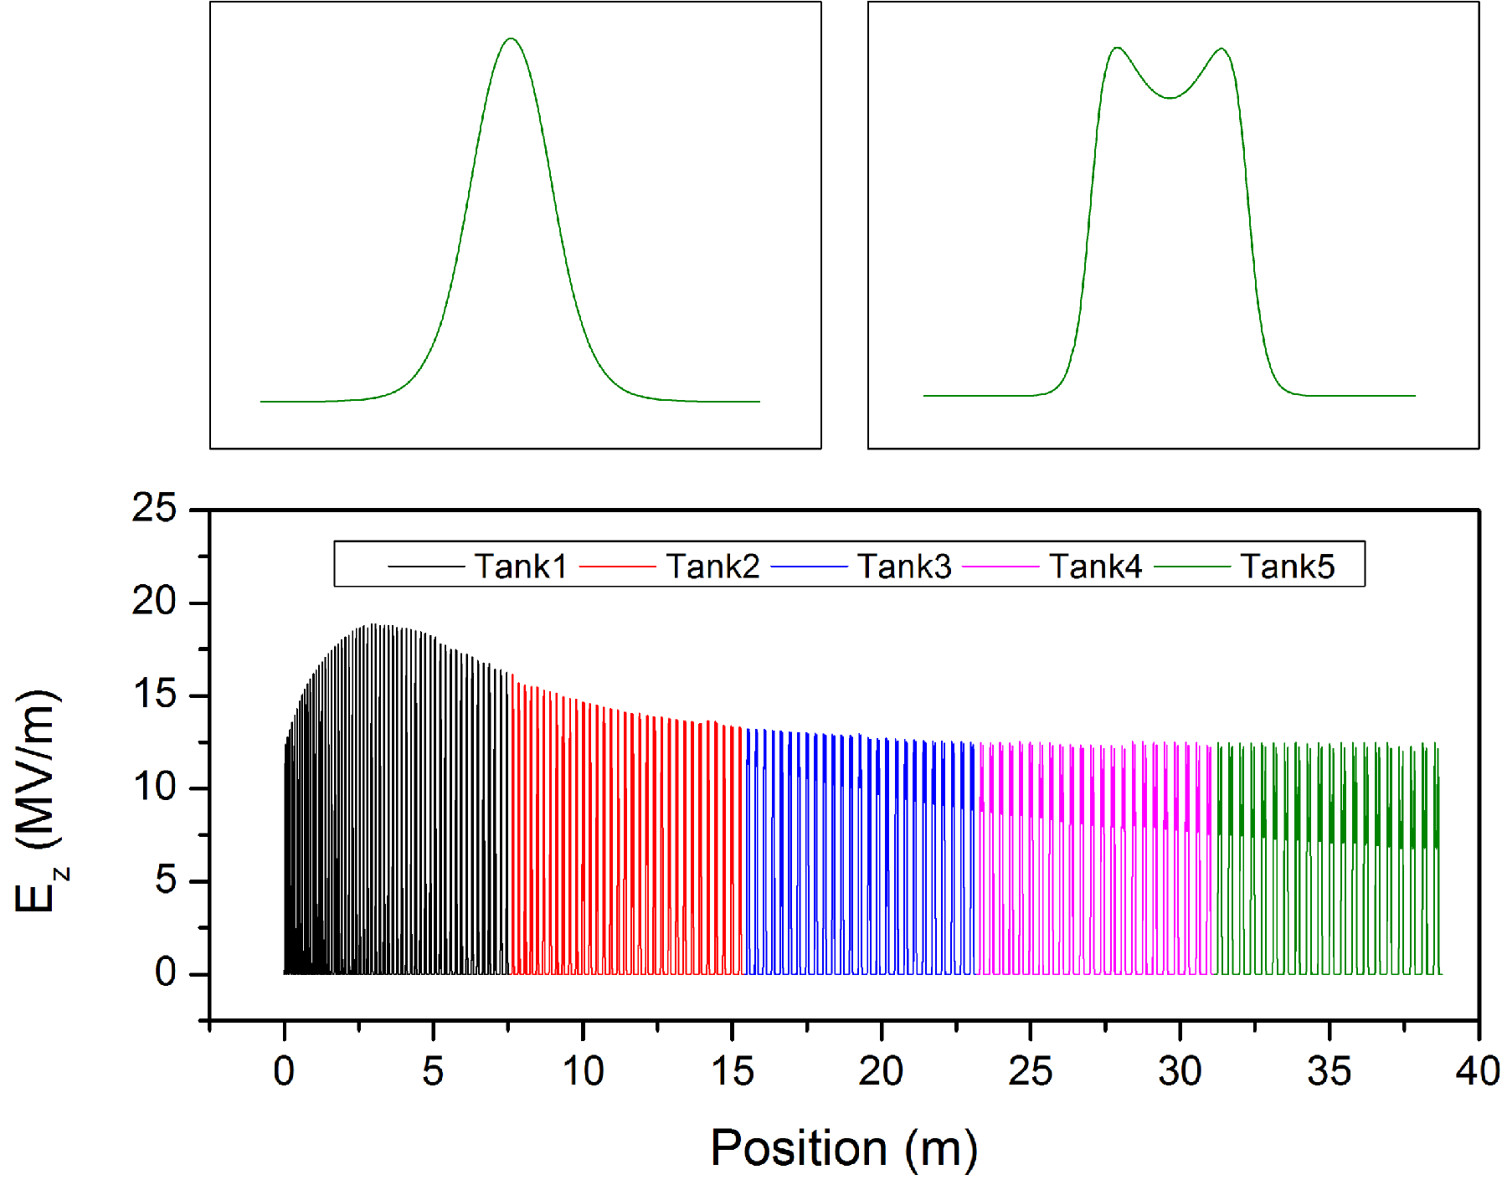
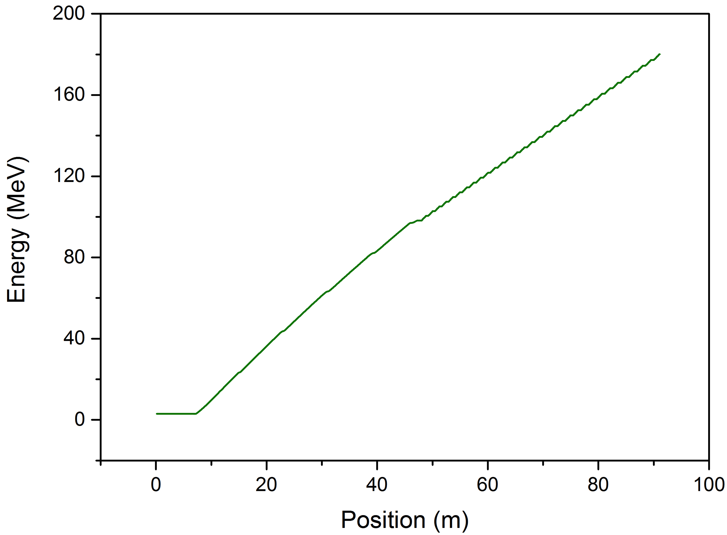
180 MeV Linac

Slide 15
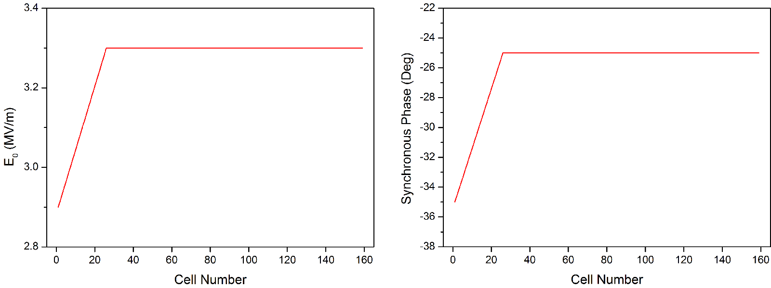
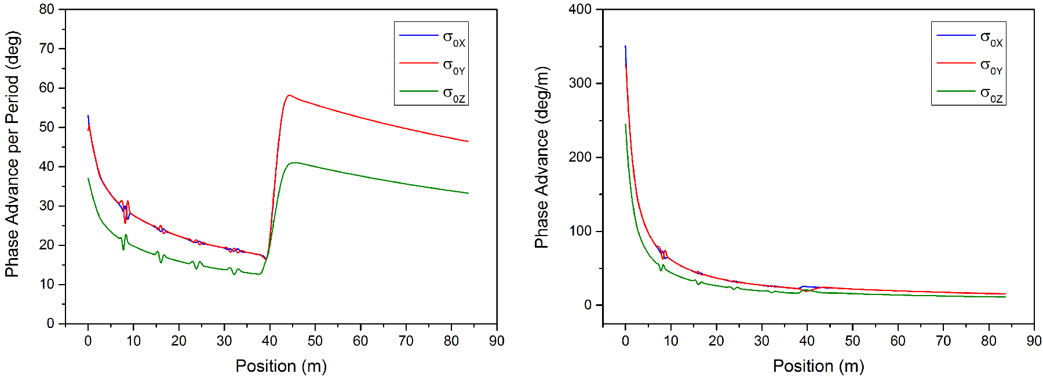
180 MeV Linac

Slide 16
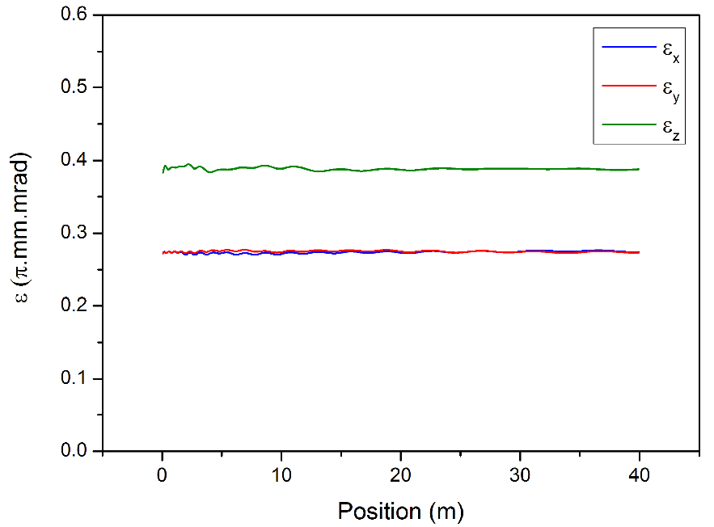
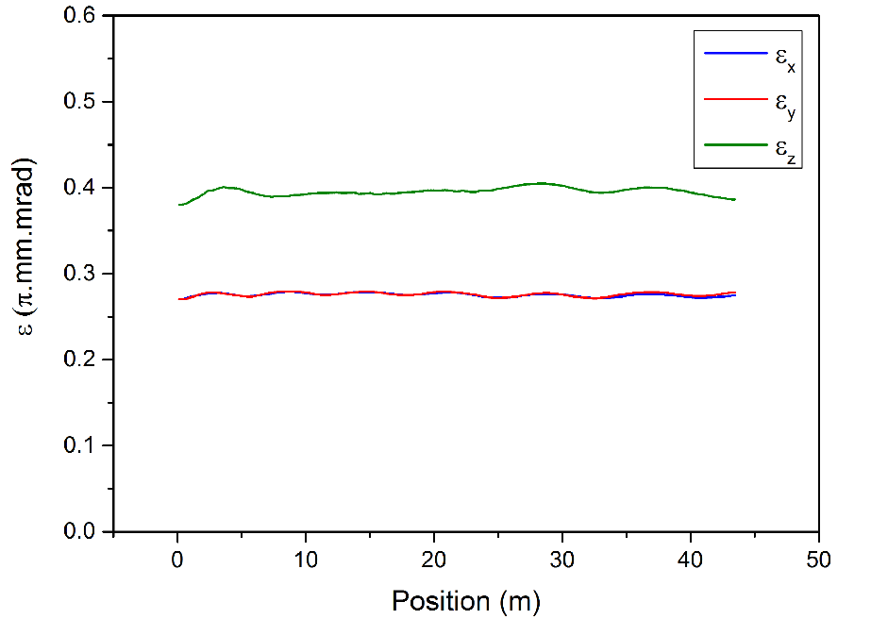
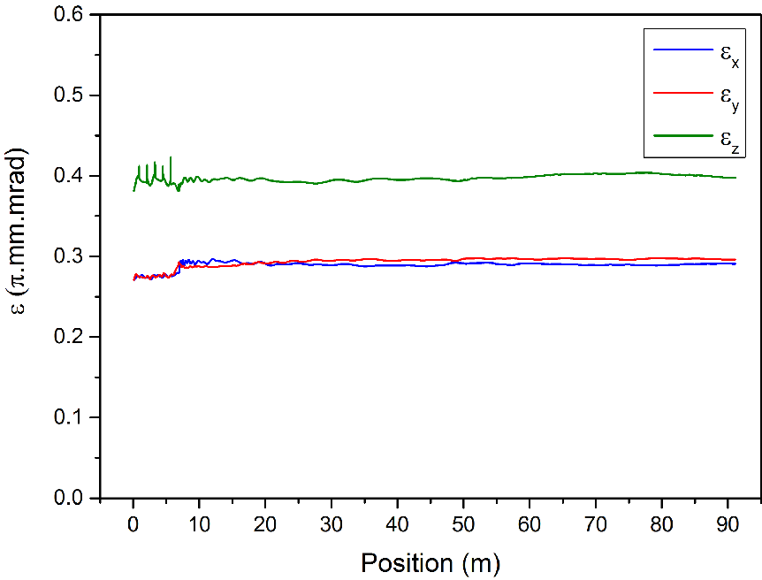
180 MeV Linac

Slide 17
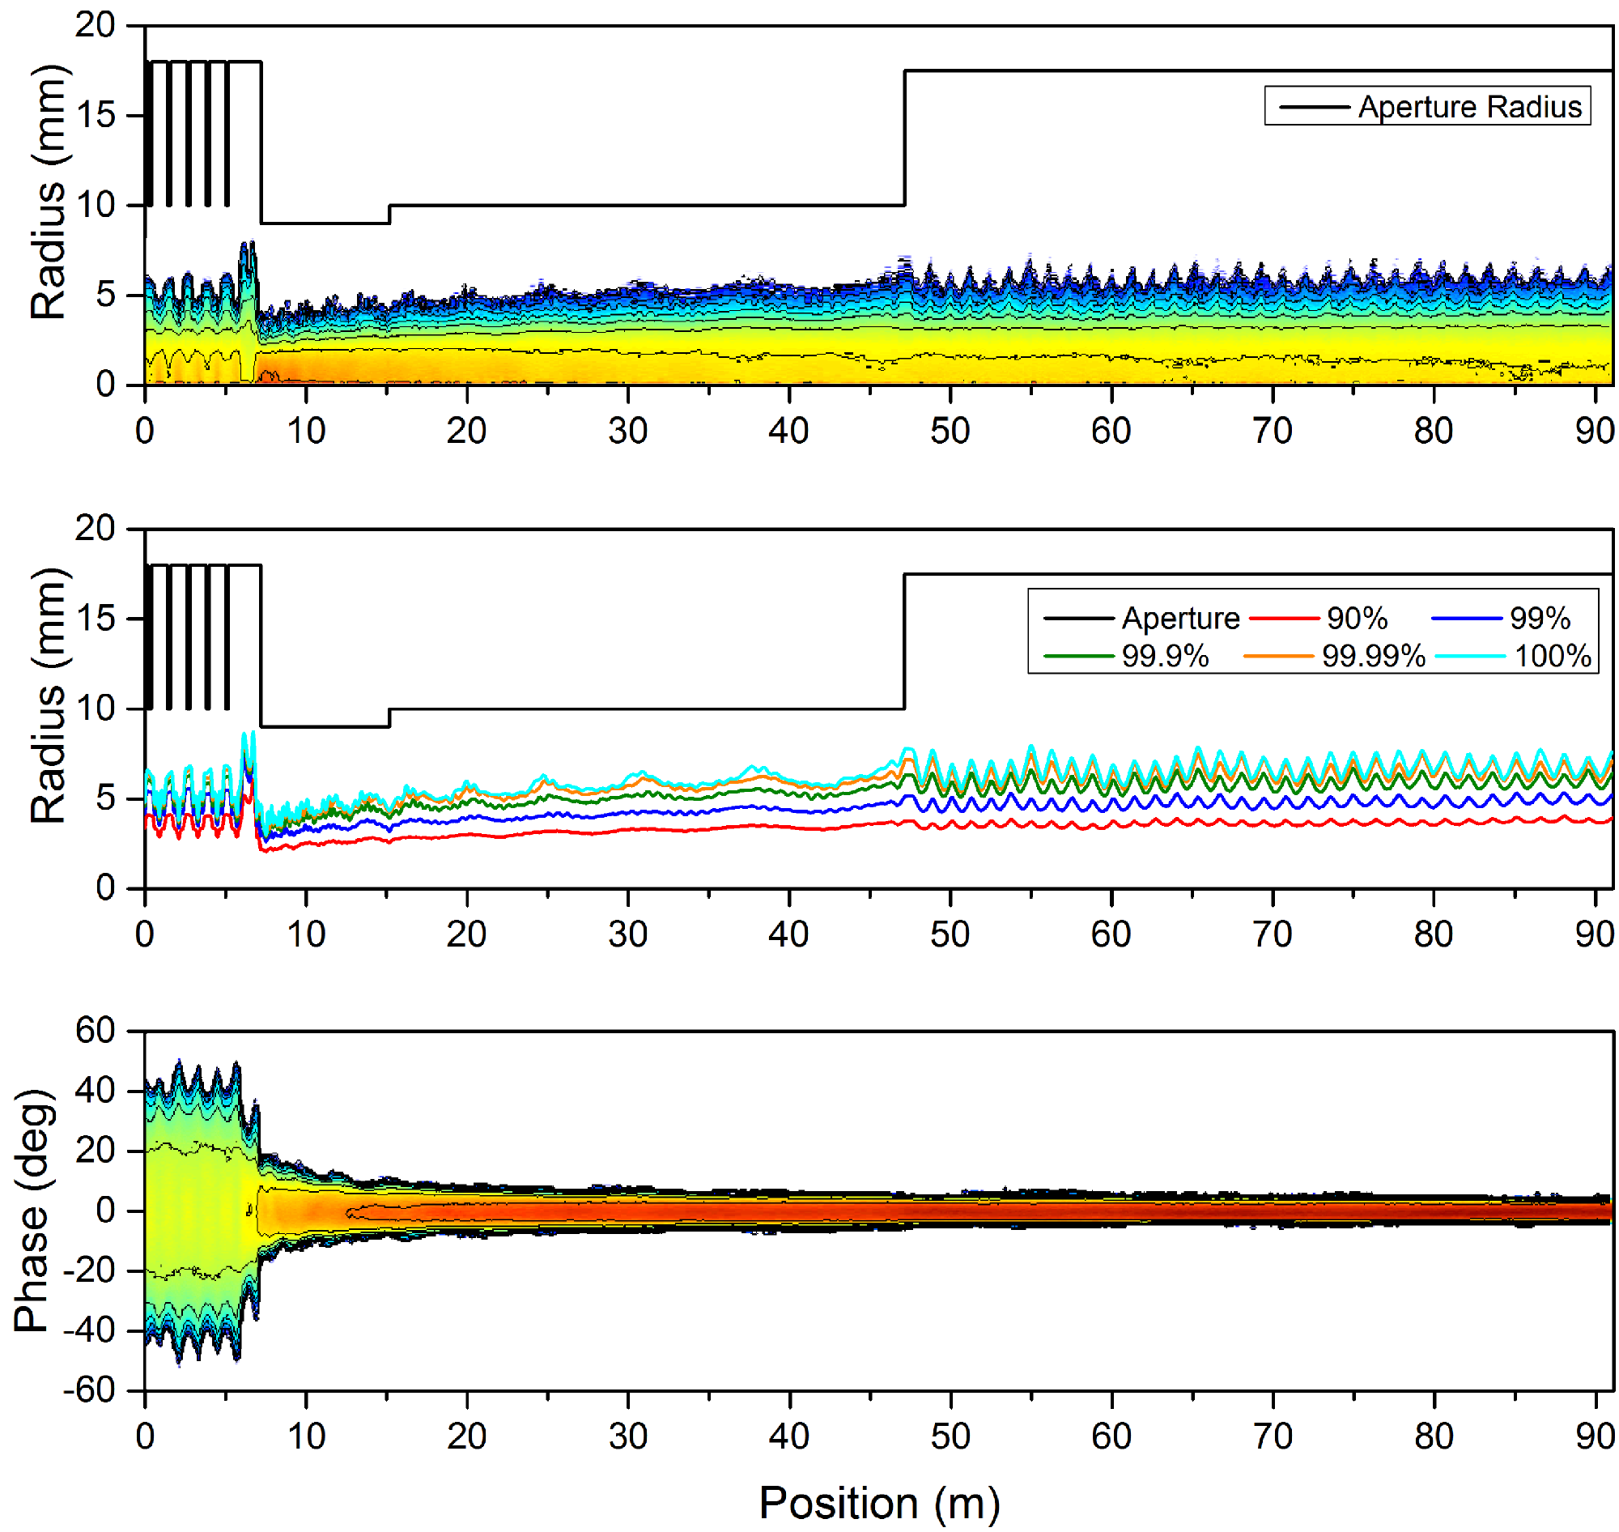
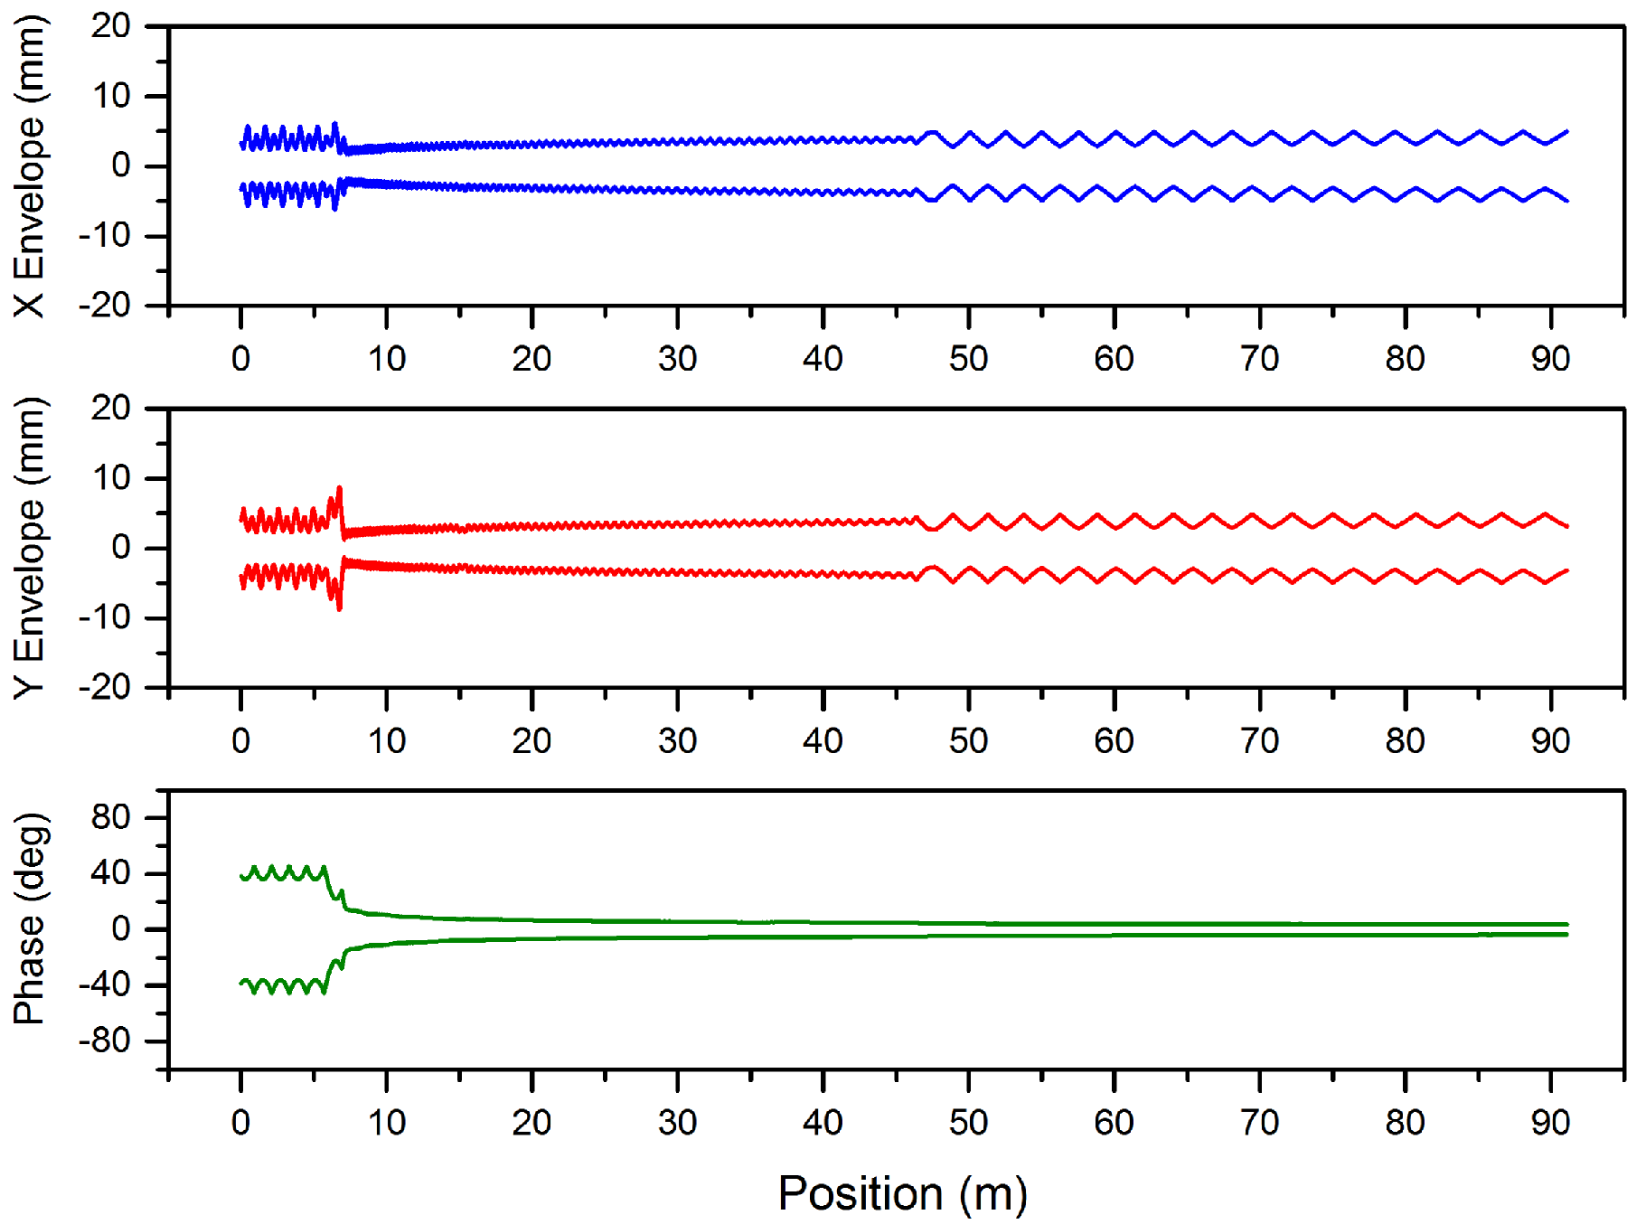
180 MeV Linac

Slide 18
800 MeV Linac
Ion Species | H⁻
Output Energy | 800 | MeV
Frequency | 324/648 | MHz
Pulse Length | 0.1 – 1 | ms
Peak Current | 60 | mA
Repetition Rate | 50 | Hz
Duty Cycle | 0.5 – 5 | %
Average Beam Power | 240 - 2400 | kW
Accelerating Structures | RFQ, DTL, CCL, SCL
Accelerator Length | ~244 | m

Slide 19
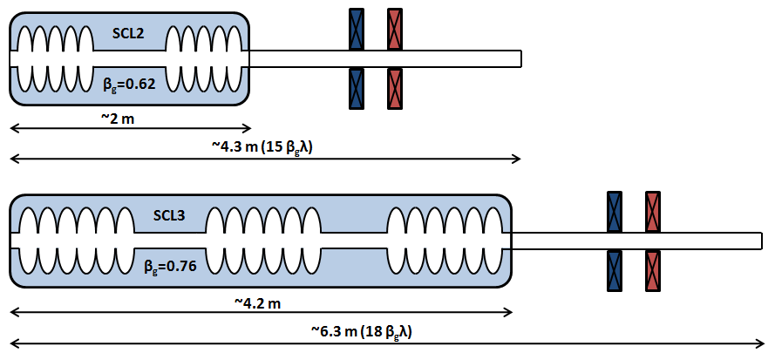
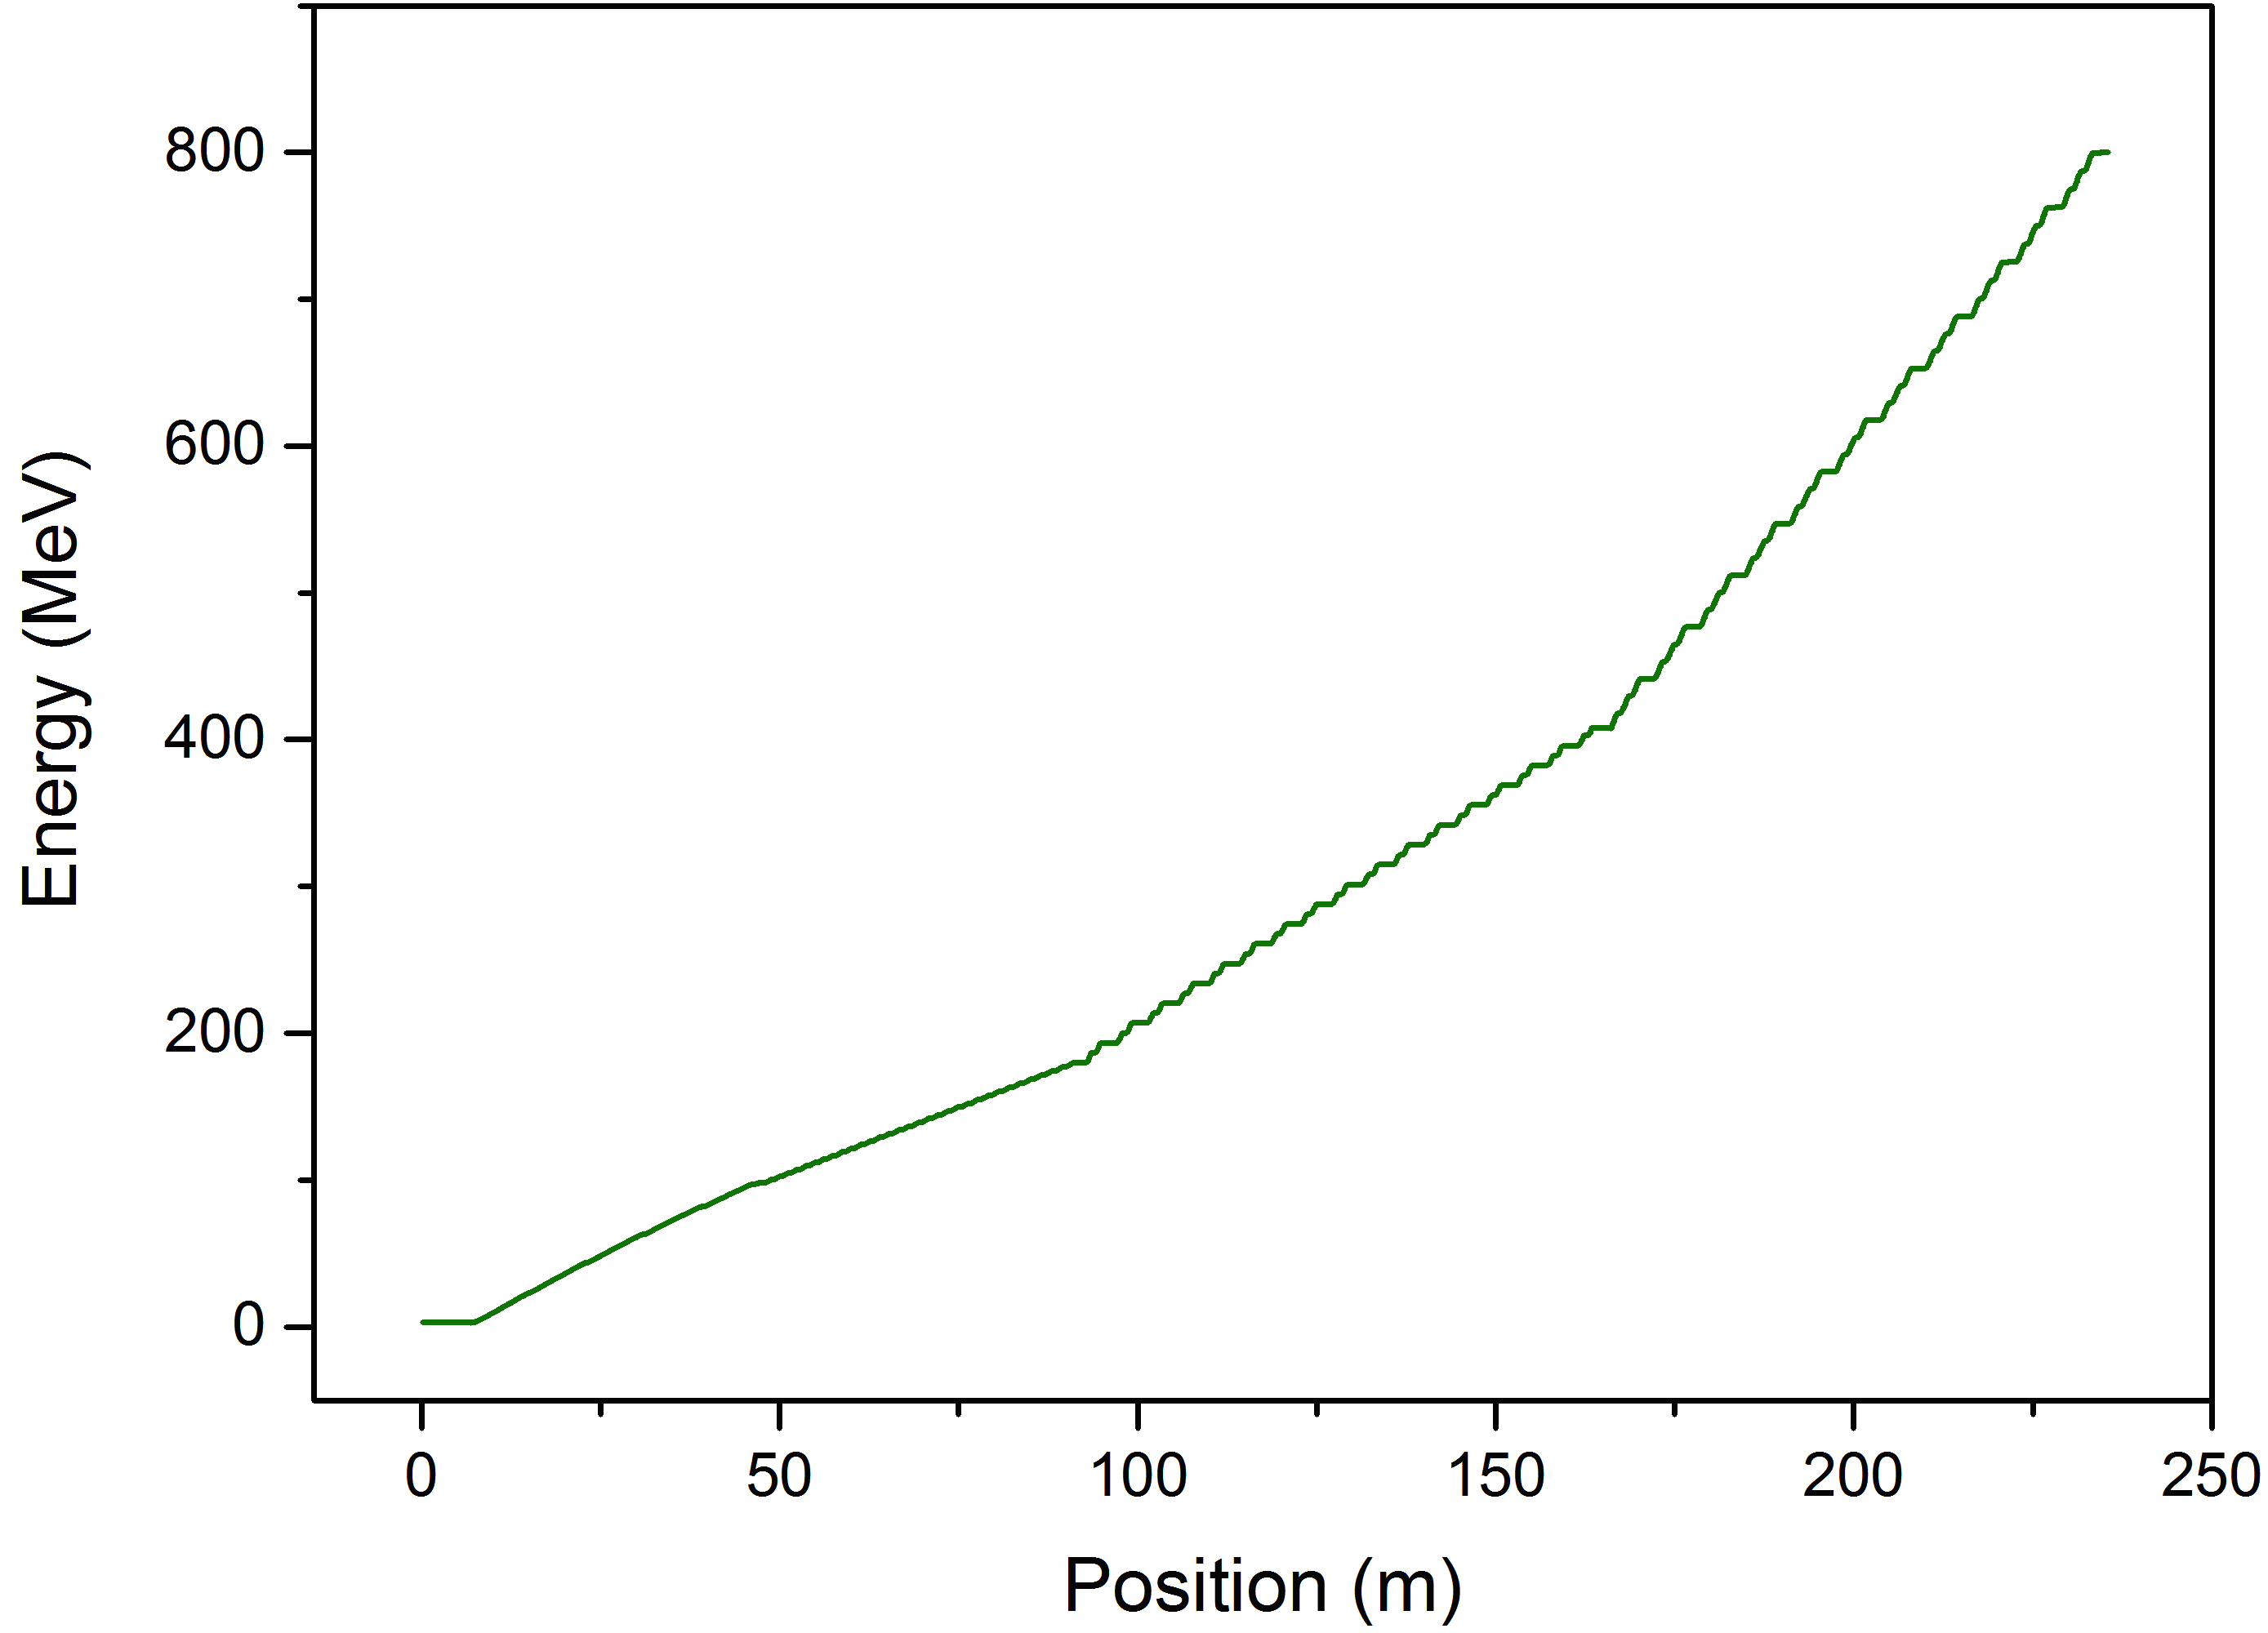
800 MeV Linac

Slide 20
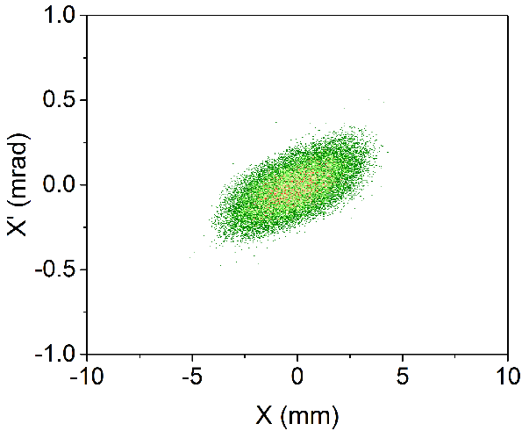
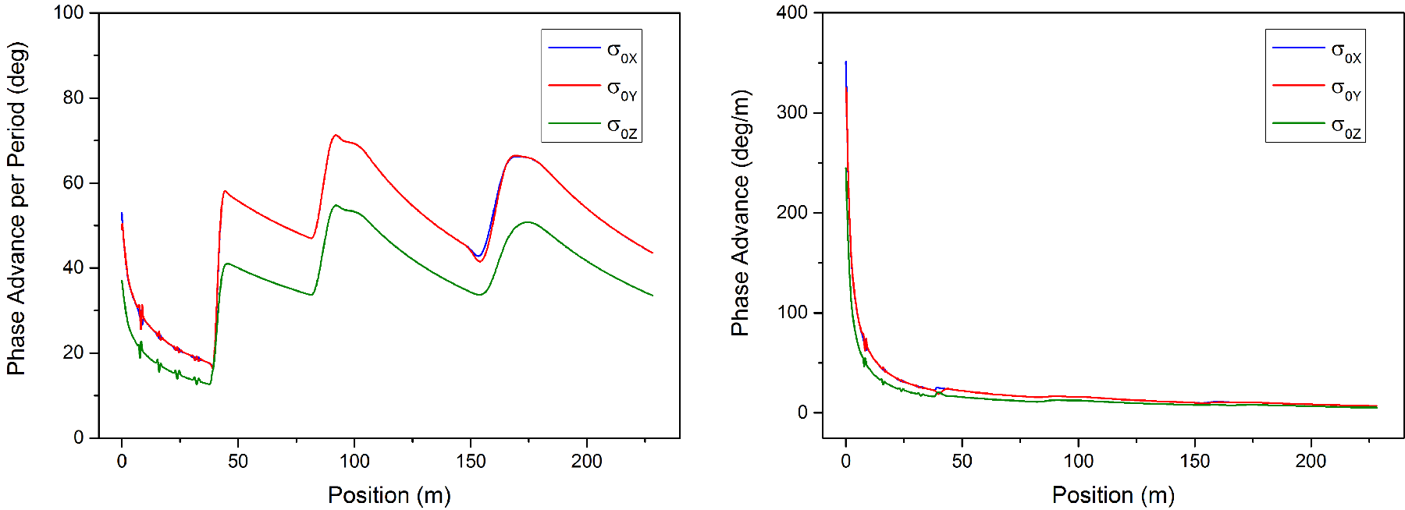
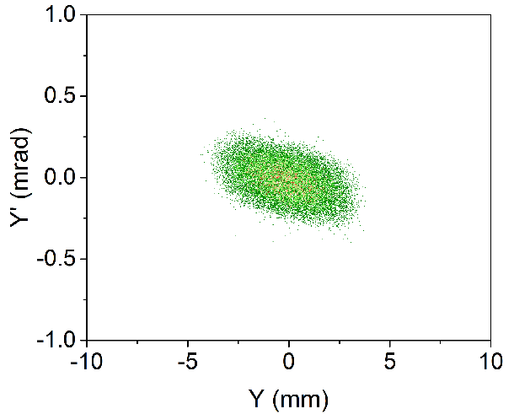
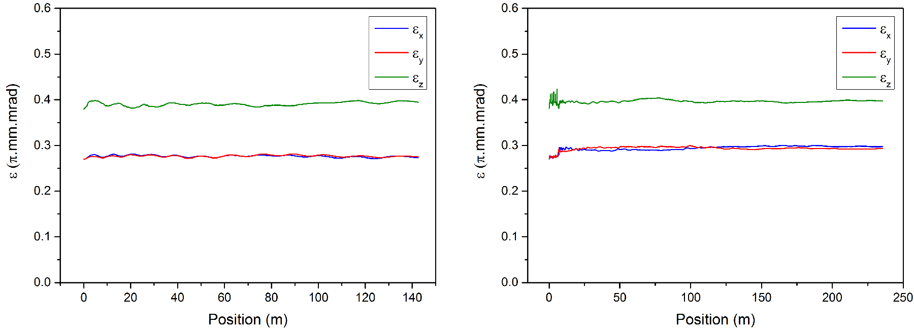
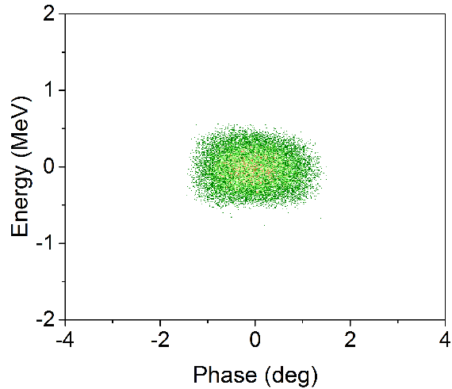
800 MeV Linac

Slide 21
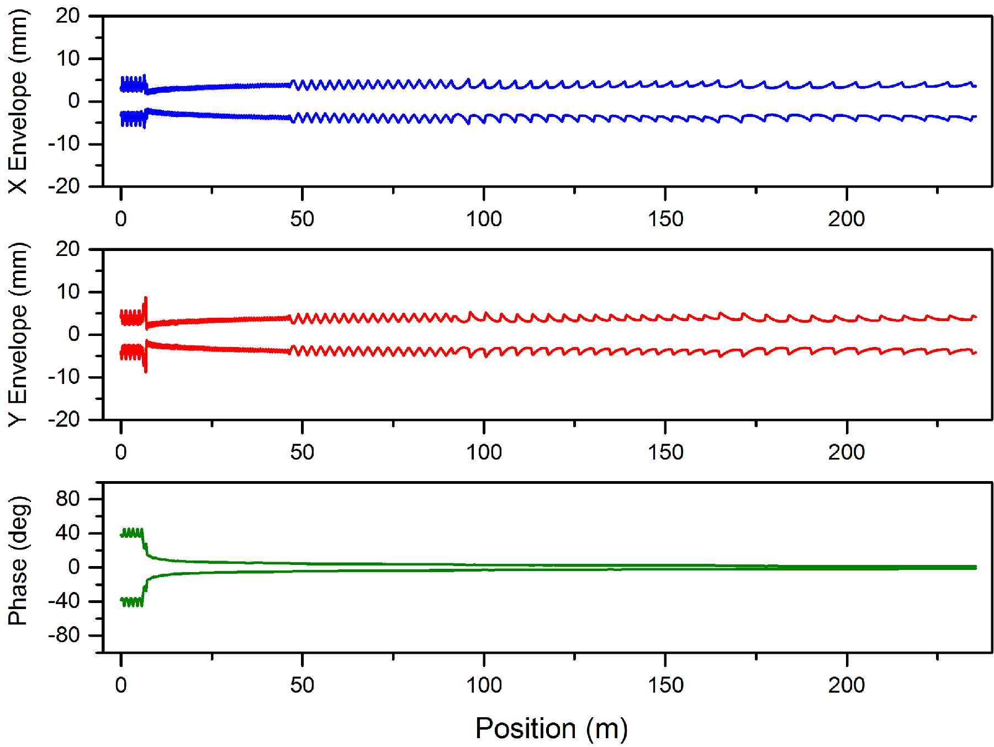
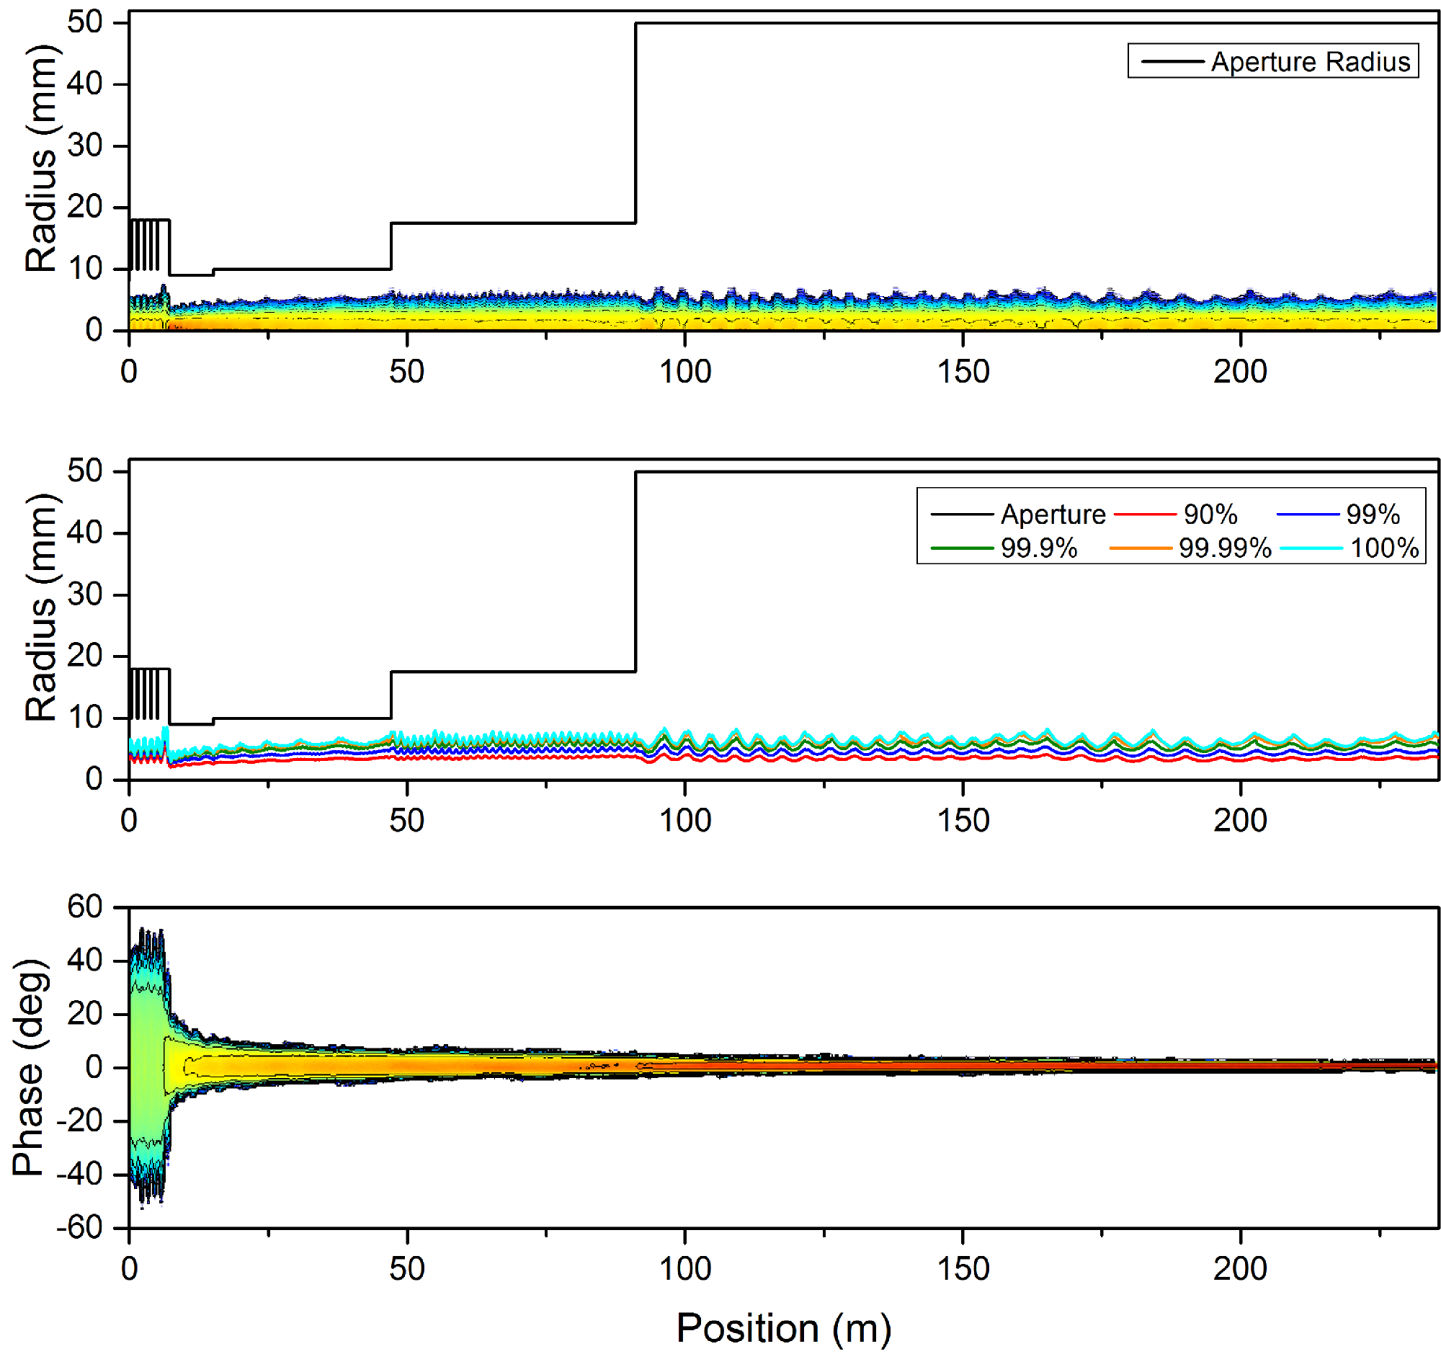
800 MeV Linac

Slide 22
High Power/Intensity Linac Studies
Generic beam dynamics studies of ultimate intensity limits in proton linacs
RAL-JAI-Industry collaboration
More details at IPAC’16
Parameter space
Energy: Up to 1 GeV
Beam Current: Up to 1 A
Beam Power: >100 MW
Technology
Normal/Super-Conducting
Many questions
Many potential limiting factors – well aware of
What are the intensity limits?
Can the technology be pushed to achieve proton beam powers orders of magnitude higher than what we have today?

Slide 23
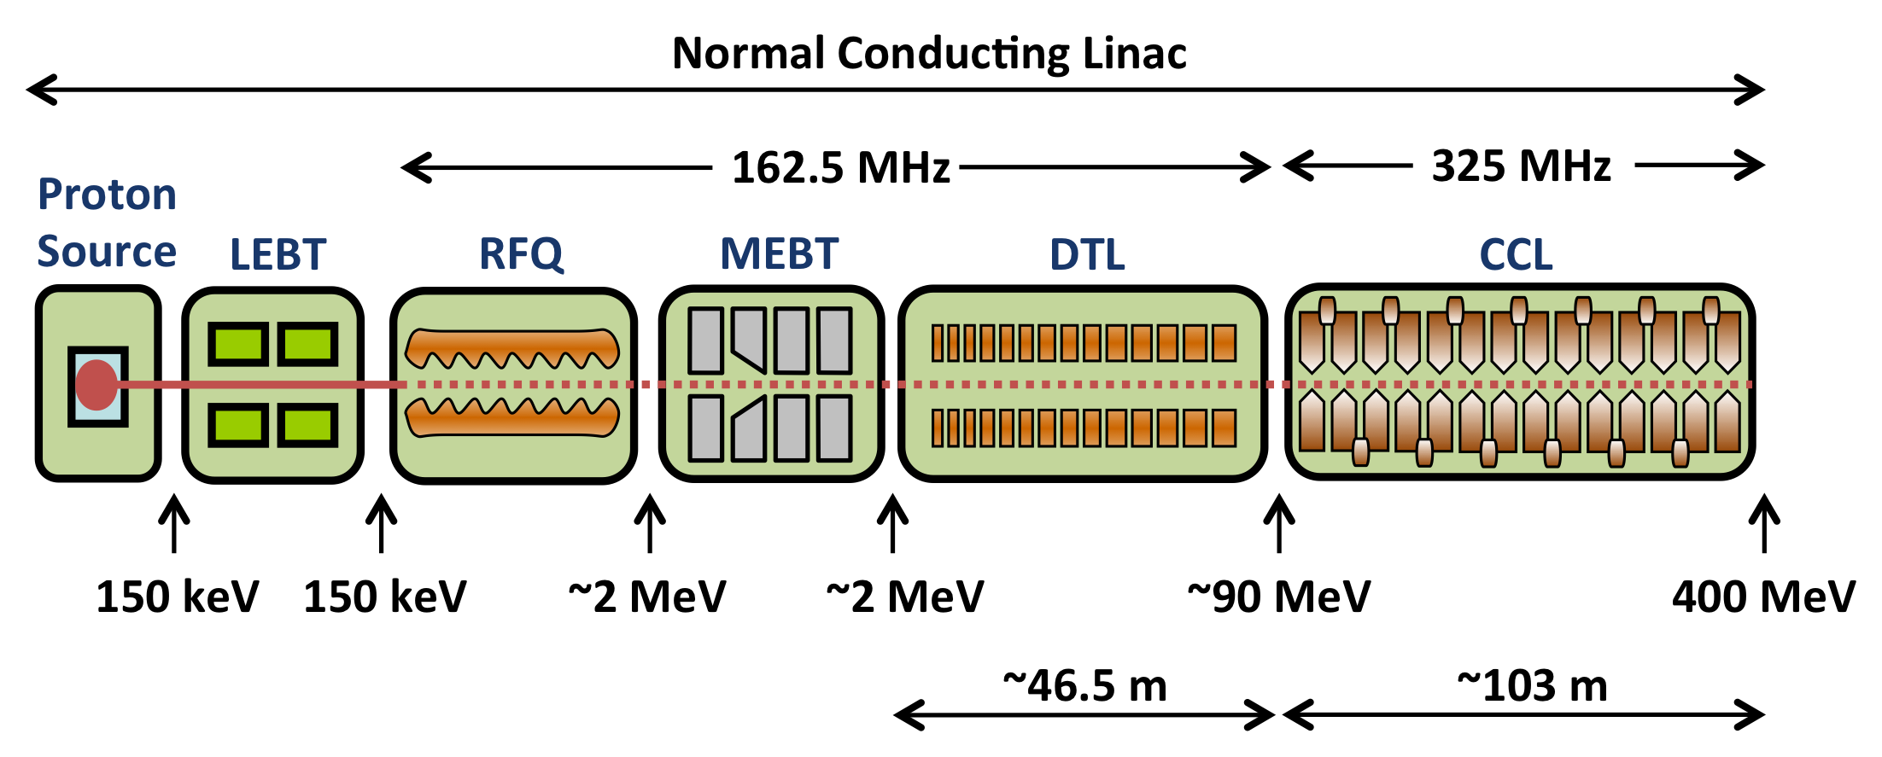
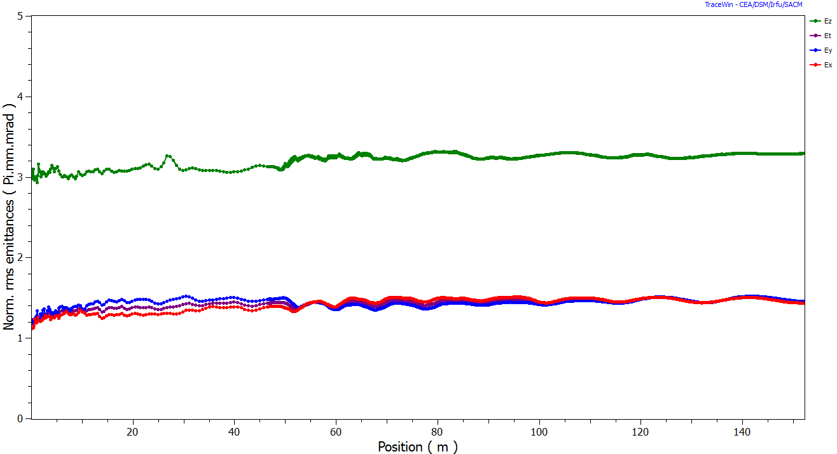
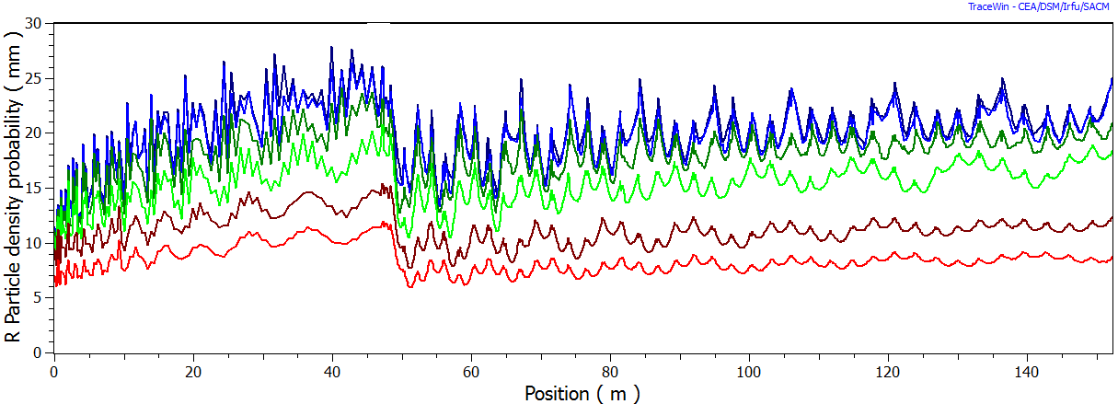
High Power/Intensity Linac Studies
Emittance Evolution
Particle Density
Radial Density Levels

Slide 24
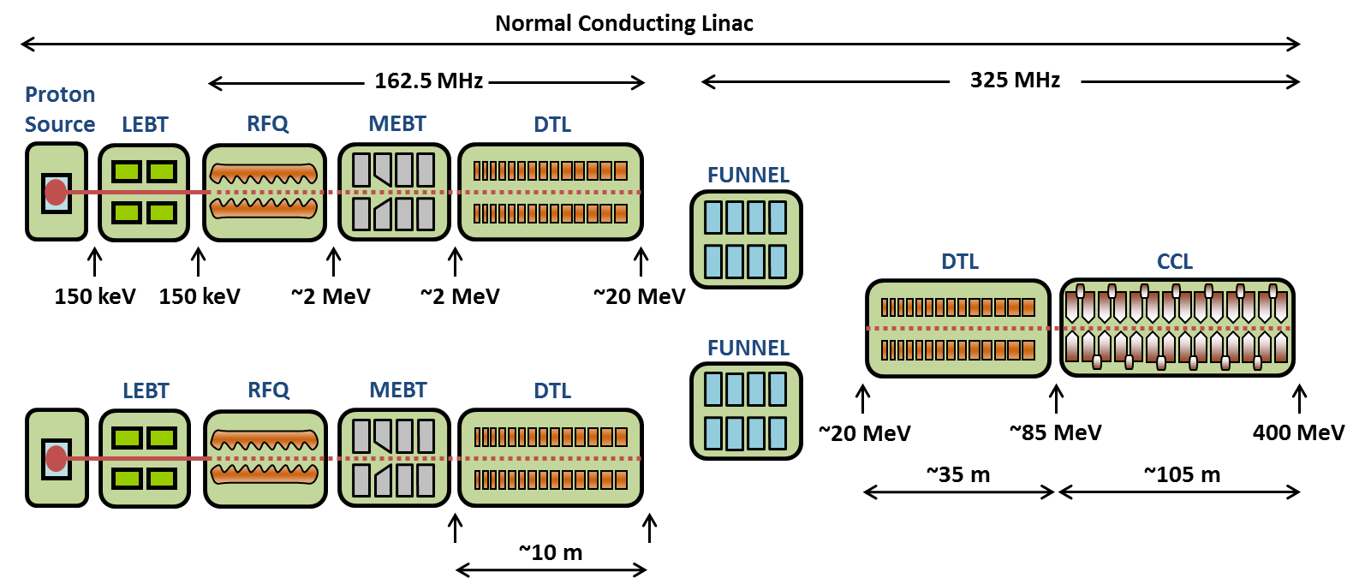
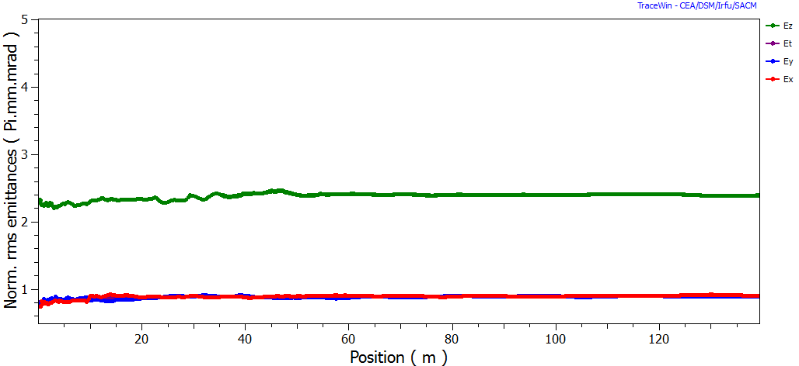
High Power/Intensity Linac Studies
Emittance Evolution
Particle Density
Radial Density Levels

Slide 25
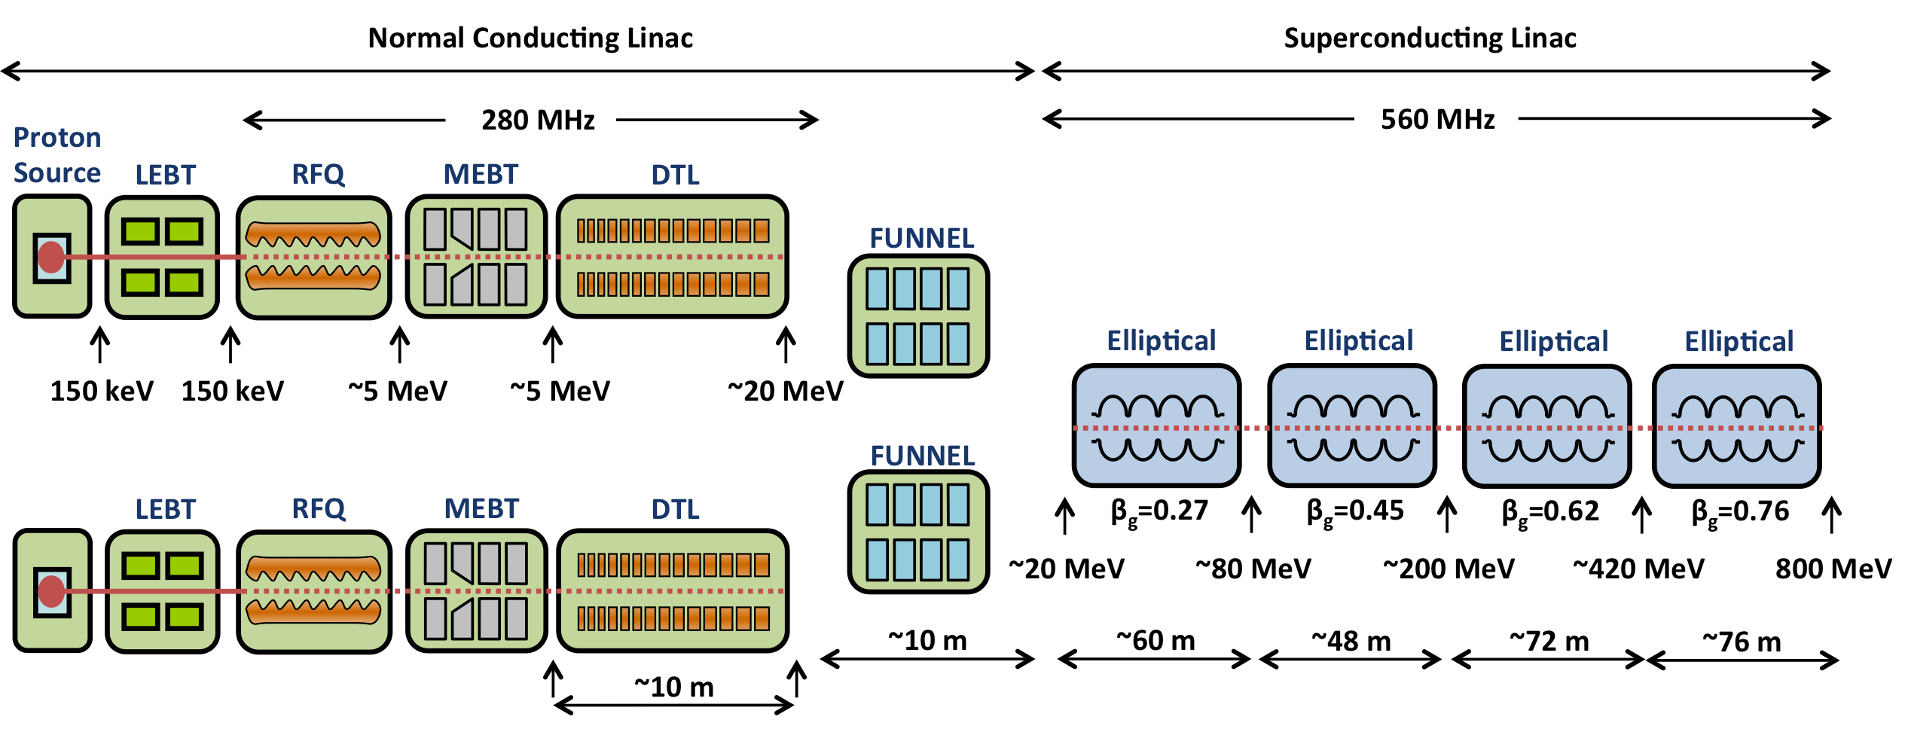
High Power/Intensity Linac Studies
Funnel Envelopes
Particle Density
Transition Section Envelopes

Slide 26
Summary
In the larger context of increased demand for high beam power, at ISIS, several upgrade scenarios have been developed
Two linac solutions presented here
More developed, better understood
Conceptual design stage
Development of a technical design dependent on a strategic decision about ISIS-2
Generic high power studies
Beam dynamics and ultimate intensity limits in proton linacs
Collaborative effort
What are the bottlenecks?
How much can the technology be pushed?

