Slide 1
An overview of Proton Therapy
in the United States
Mark Pankuch PhD
Northwestern Medicine Chicago Proton Center
Proton Accelerators for Science and Innovation : Medical Applications
Fermi National Accelerator Laboratory

Slide 2
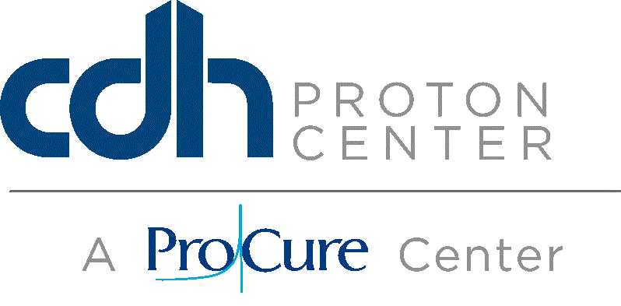
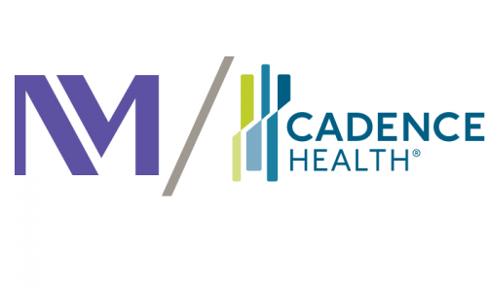
What’s in a name????

Slide 3
Northwestern Medicine Chicago Proton Center

Slide 4
The current state of Healthcare in United States
Costs
For Example: Direct cost of Diabetes in 2012 $176 billion *
Inconsistent pricing
Expensive medications
Over-testing, cautious medicine
New, more costly technologies
Robotic Surgery
Proton Therapy
Reimbursement
Value based medicine
Policies for denials of coverage
* American Diabetes Association

Slide 5
The current state of Proton Therapy in United States
Increasing Interest in Proton Therapy
2004 : 3 In operation
2006 : 7 in operation
2010 : 11 in operation
2015 : 17 in operation
At least 9 under construction
Insurance coverage is sometimes difficult
Often covered after dosimetric comparisons and peer reviews are presented
Many still say “Protons are not a proven technology”
As of Sept 2015 : 139 clinical protocols for particle therapy*
Pediatrics /,Head & Neck, Lung, CNS, Breast, GI, GU, Lymphoma, Sarcoma, Eye, Re-treat
NIH Funded : PCORI Pragmatic Randomized Trial of Proton vs. Photon Therapy for Patients with Stage II or III Breast Cancer : ~$12M 1,700 patients
* Reported to PTCOG from all particle therapy centers, worldwide, including heavy ions

Slide 6
In the United States

Slide 7
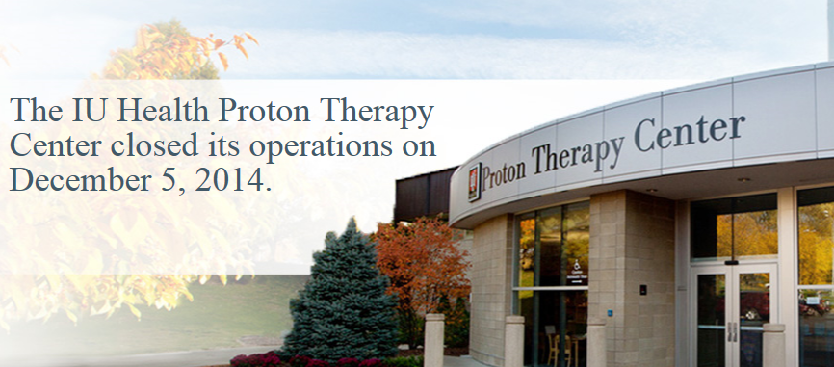
Indiana University Proton Therapy Center
Will other proton center close??
University’s scientific accelerator adopted into a Treatment Center
Not in the ideal location
Dated technology
High cost for upgrade

Slide 8
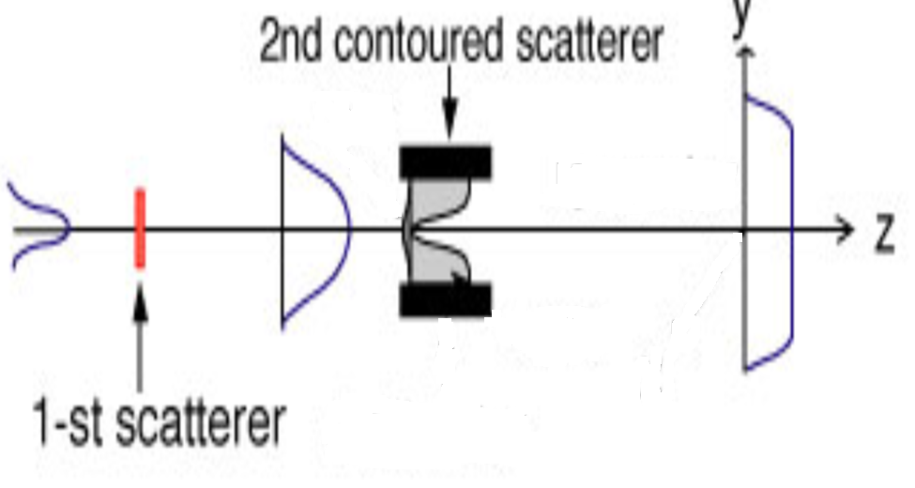
Passive Scattering : Single or Double scattered

Slide 9
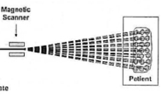
Active Scanning / Uniform Scanning

Slide 10
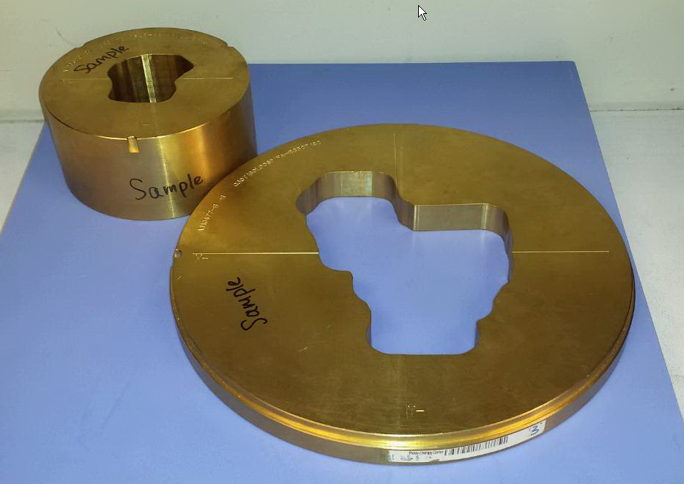
Patient Specific Devices
Aperture
Notes:
10

Slide 11
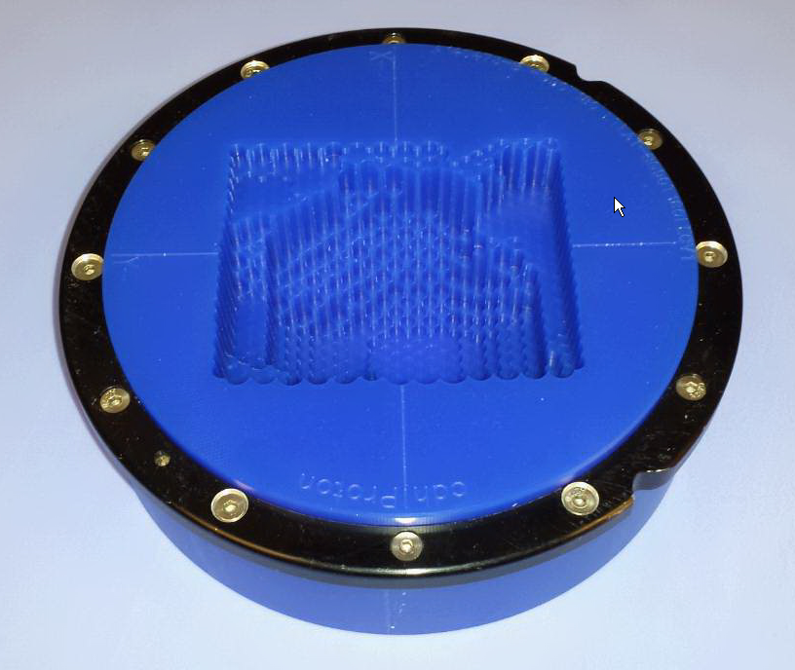
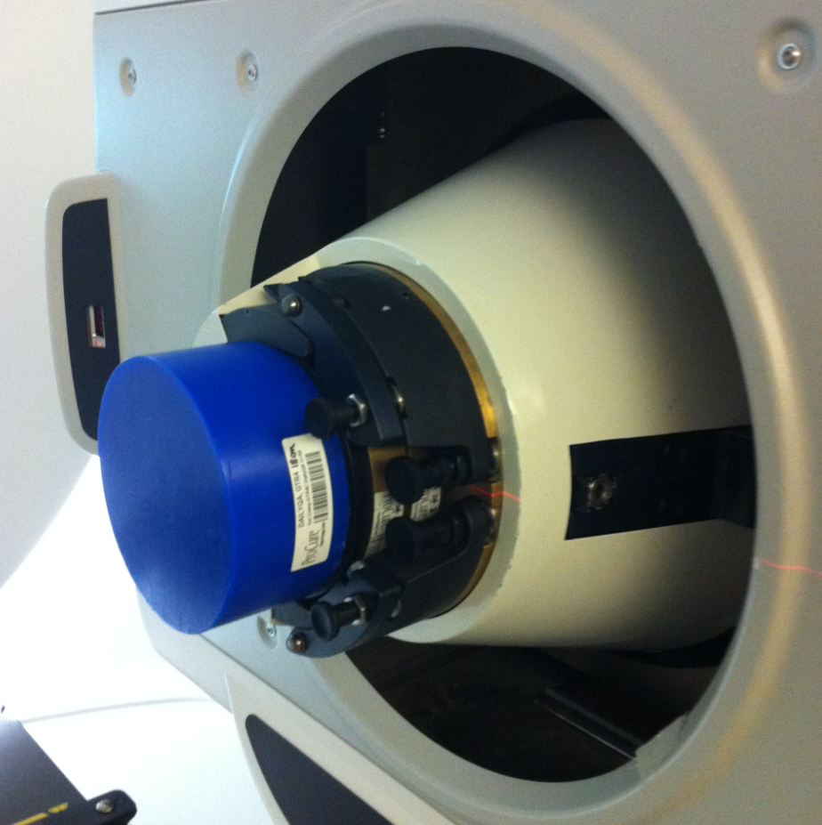
Universal Nozzle with Aperture and Compensator

Slide 12
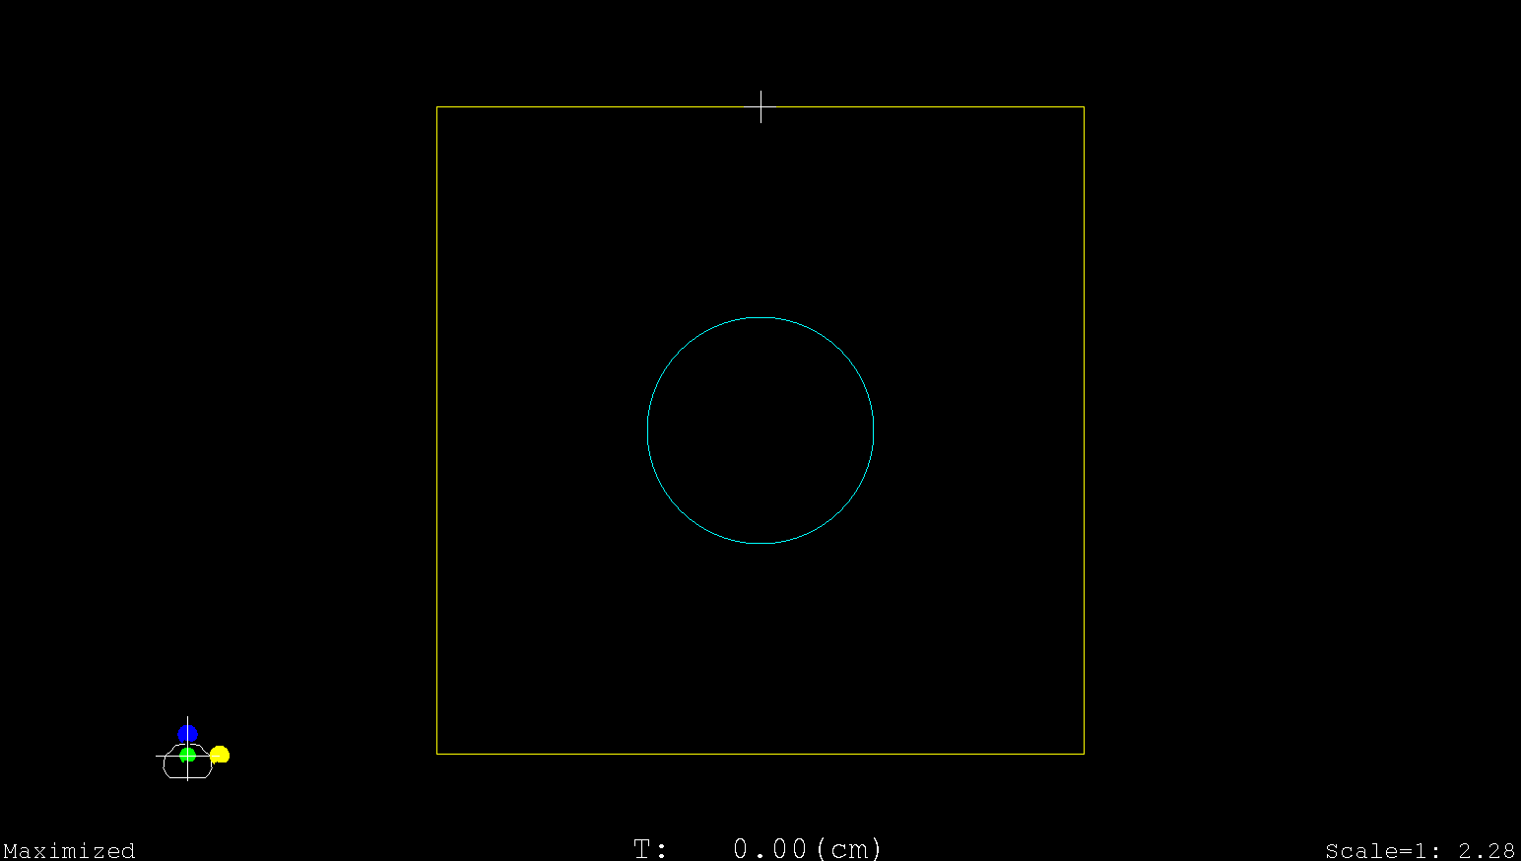
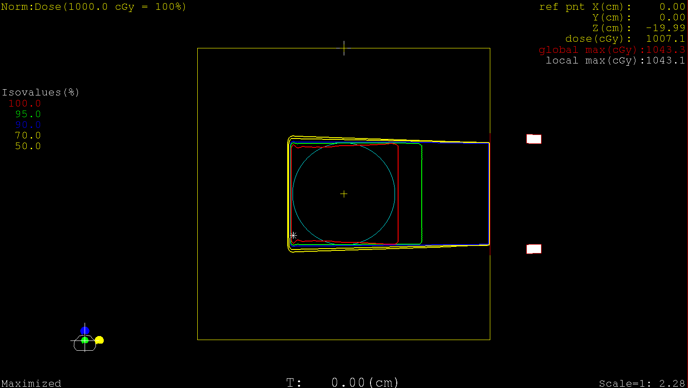
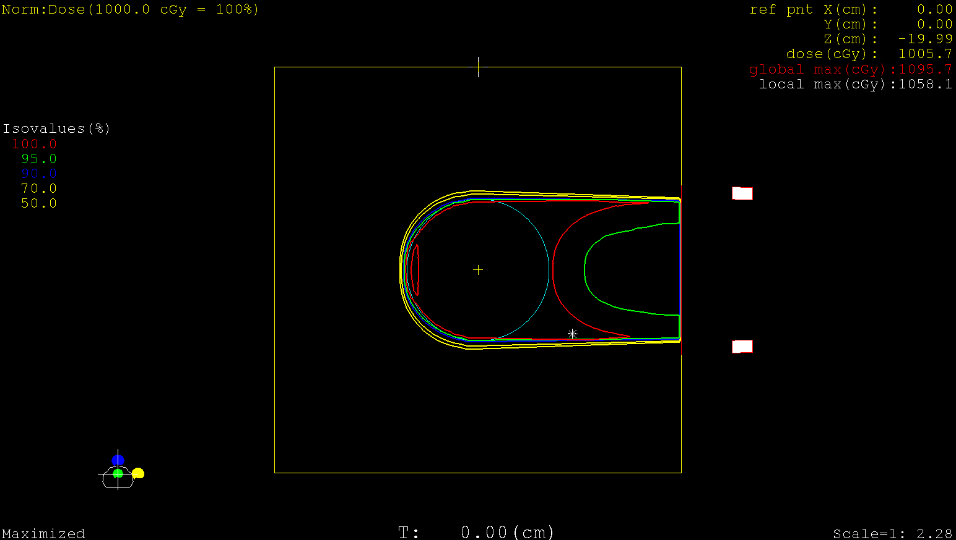
The benefits of a compensator

Slide 13
Pencil Beam Scanning

Slide 14
Pencil Beam Delivery
Layers of unique spot patterns delivered over the target volume
Distal AND Proximal conformity
The ability to perform Multi-Field Optimizations

Slide 15
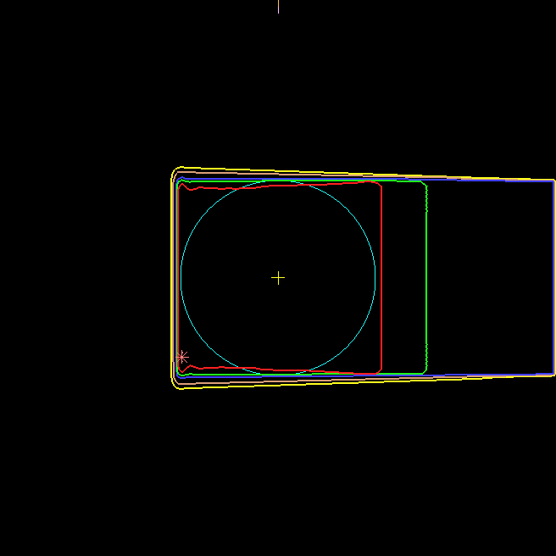
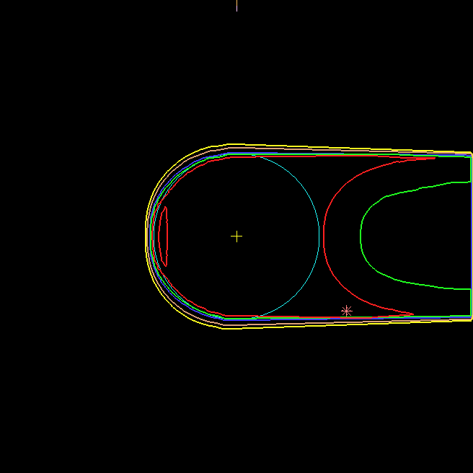
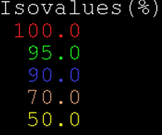
Advantage of Using a Compensator
No Compensator
With Compensator

Slide 16
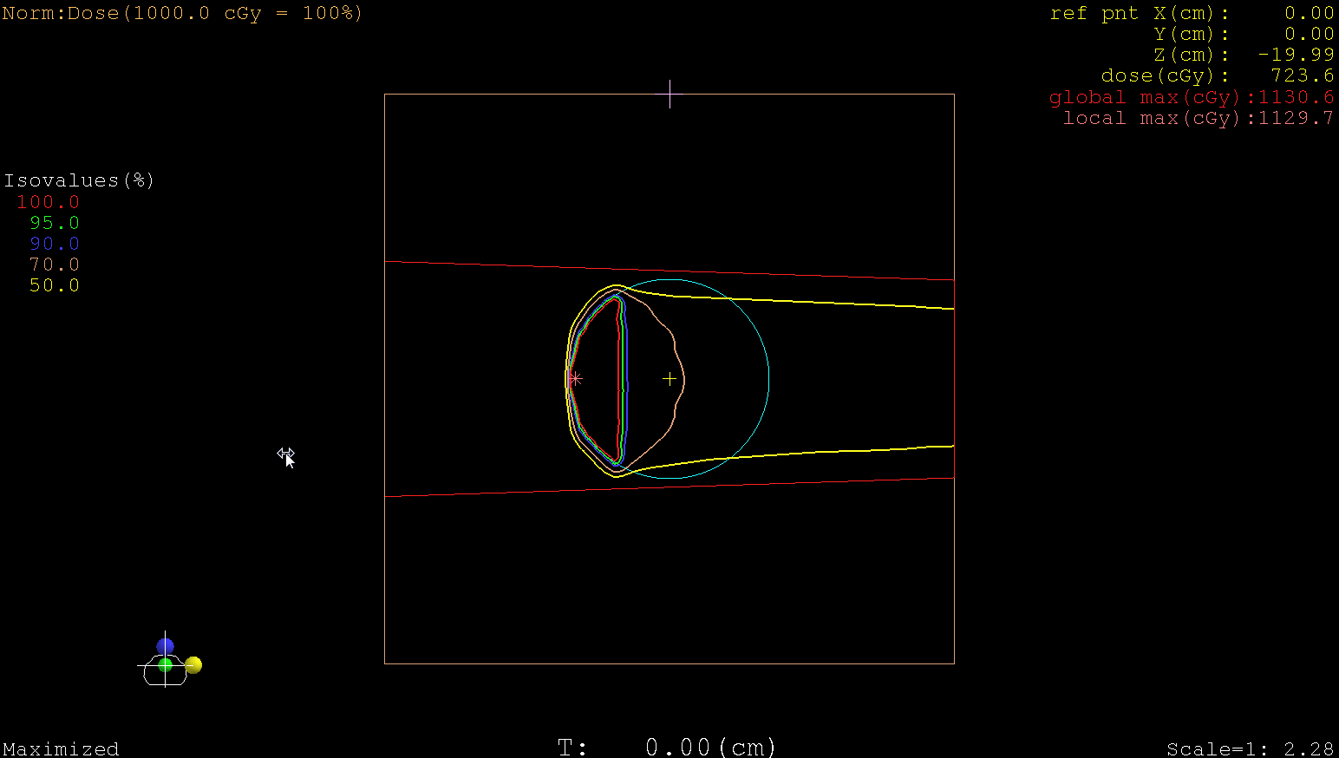
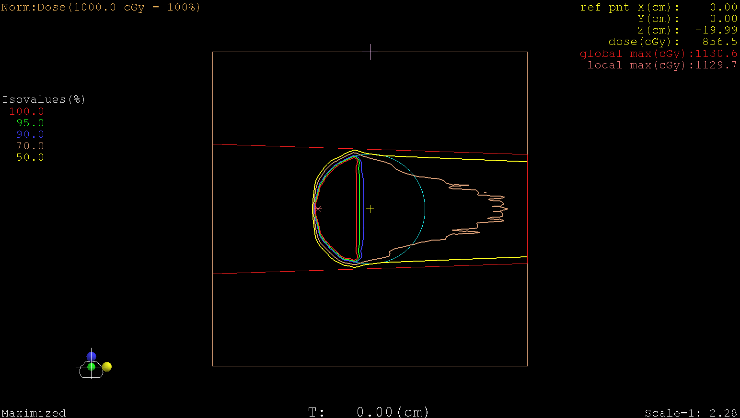
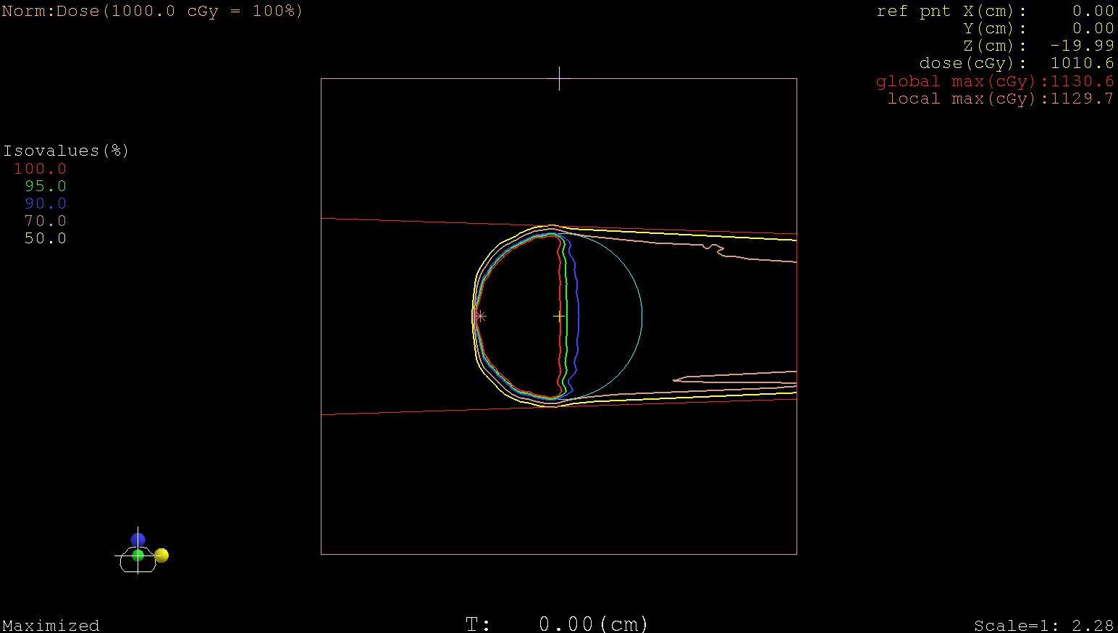
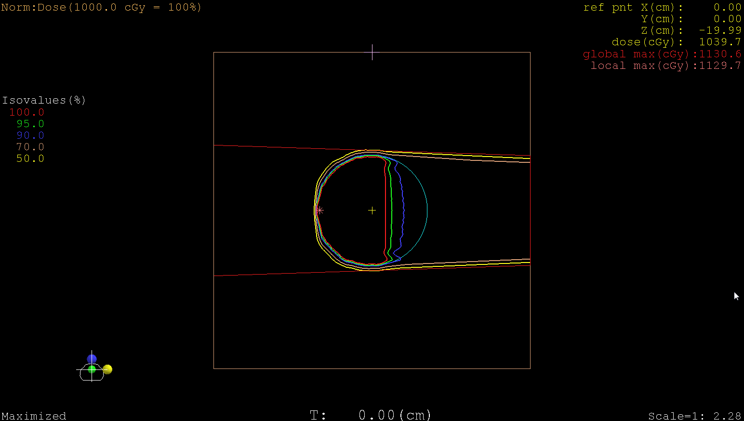
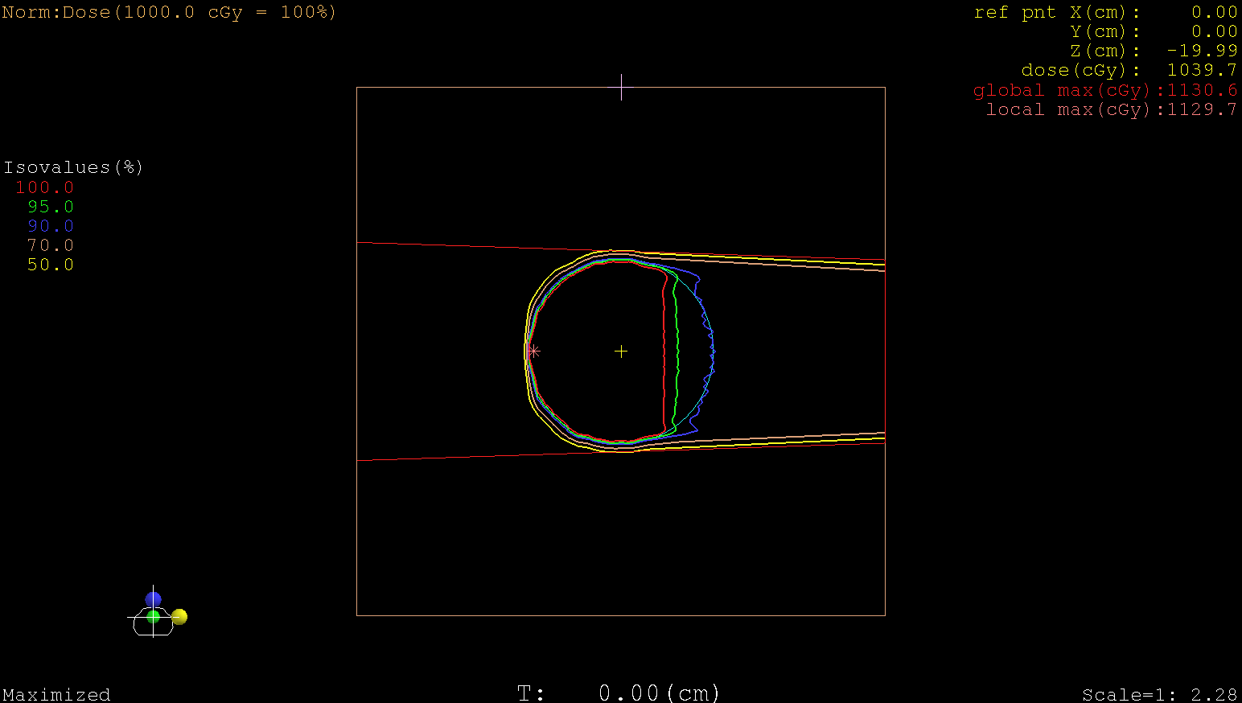
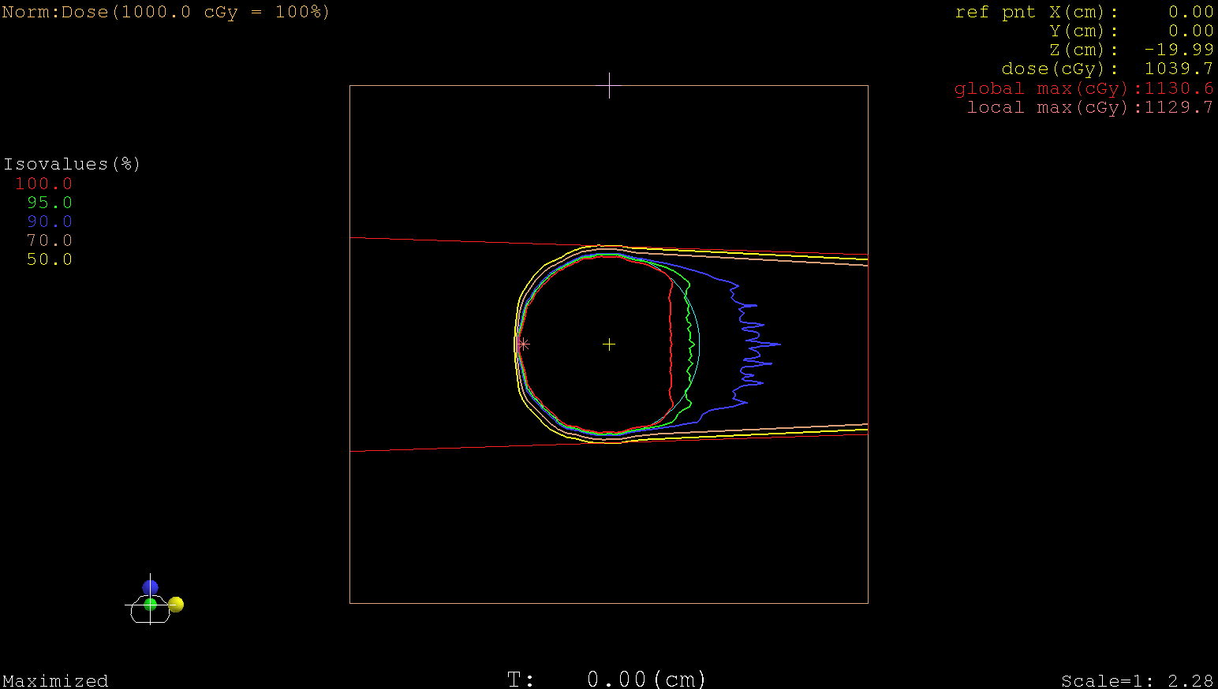
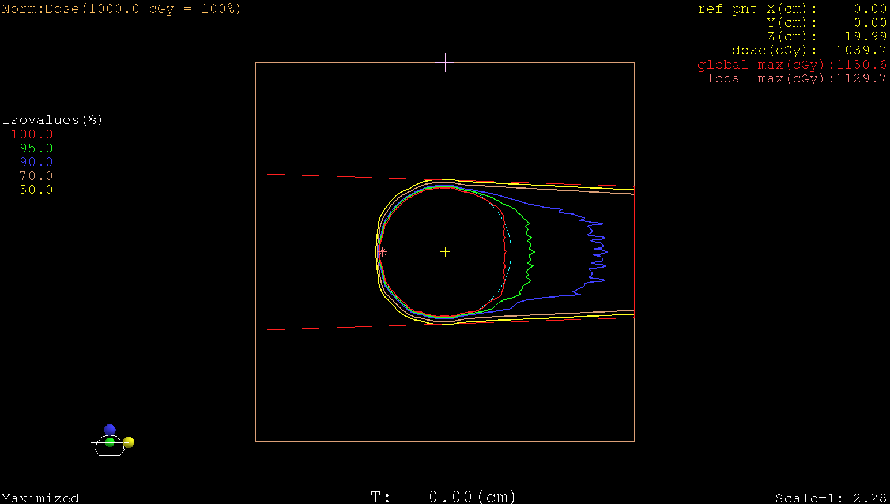
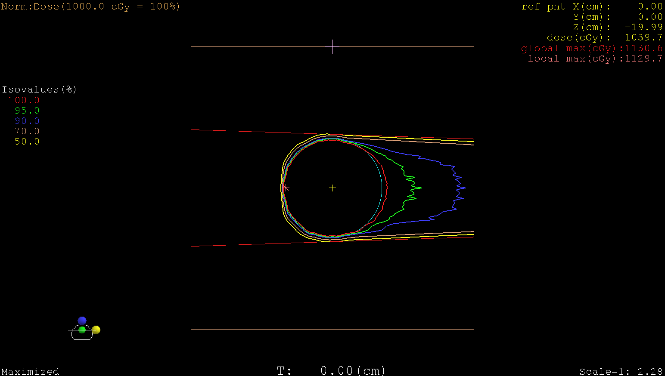
PBS Delivery with Layer Stacking

Slide 17
Advantages of PBS
PBS
With Compensator

Slide 18
Different Methods of Optimization
Single Field Uniform Dose Optimization
Uniform Dose is delivered by each field individually
Less sparing of critical structures
Less sensitive to uncertainties
Multi- Field Optimization
All field spot weights are optimized together
Better for sparing critical structures
More sensitive to uncertainties

Slide 19
Single Field Uniform Dose
OAR
< 100% of Dose
100% of Dose

Slide 20
Multi-Field Optimized
OAR
< 100% of Dose
100% of Dose

Slide 21
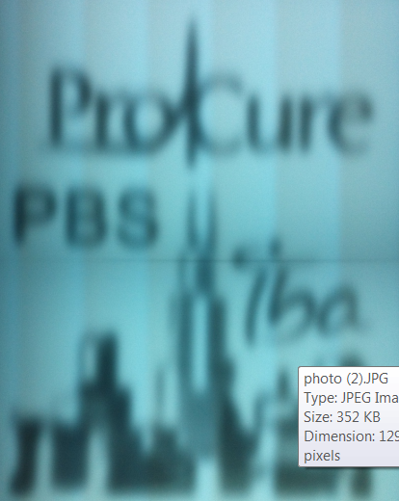
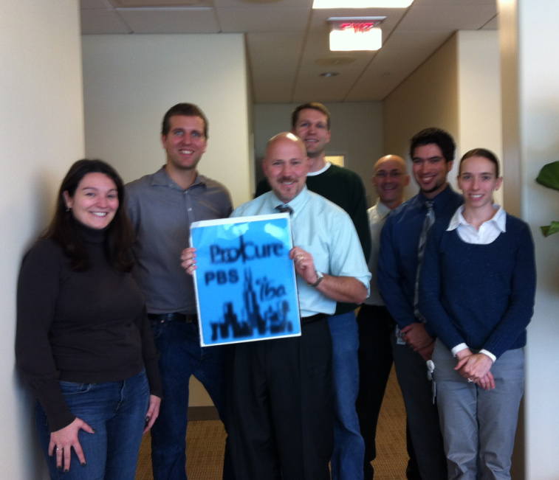
Spot Scanning in Chicago

Slide 22
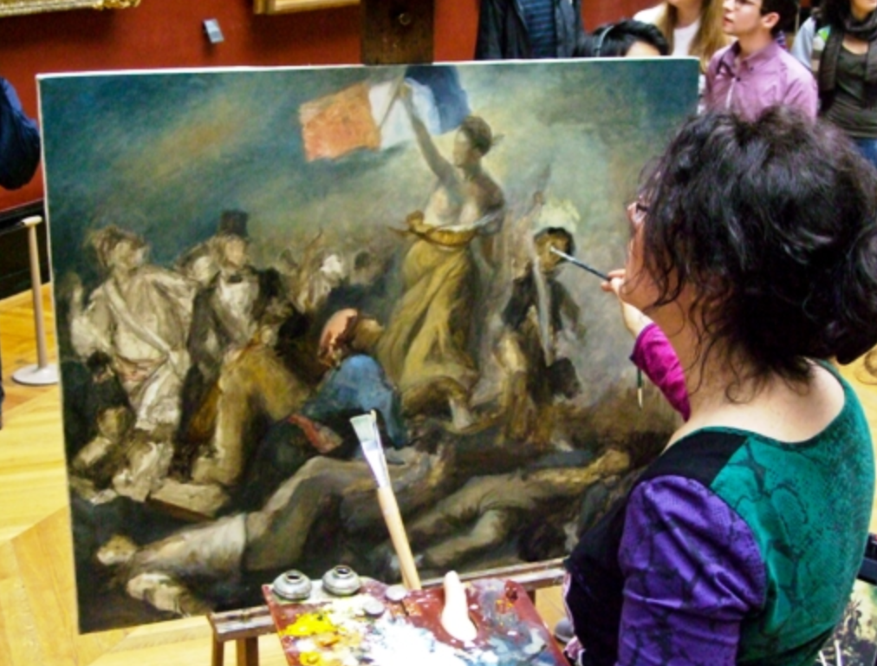
PBS and the Radiation Oncologist

Slide 23
SFUD with range error
OAR
< 100% of Dose
100% of Dose

Slide 24
MFO with a range error
OAR
< 100% of Dose
100% of Dose

Slide 25
Pencil Beam Scanning
Maximum Potential benefits for Protons require the implementation of PBS
Greatest dose control of dose
Better Target coverage
Lower dose to Organs at Risk (OAR)
All new proton centers have PBS capabilities, or have plans to implement in the future
Some new centers have dedicated to PBS delivery only
Most operating centers have upgraded or plan to upgrade to enable PBS delivery

Slide 26
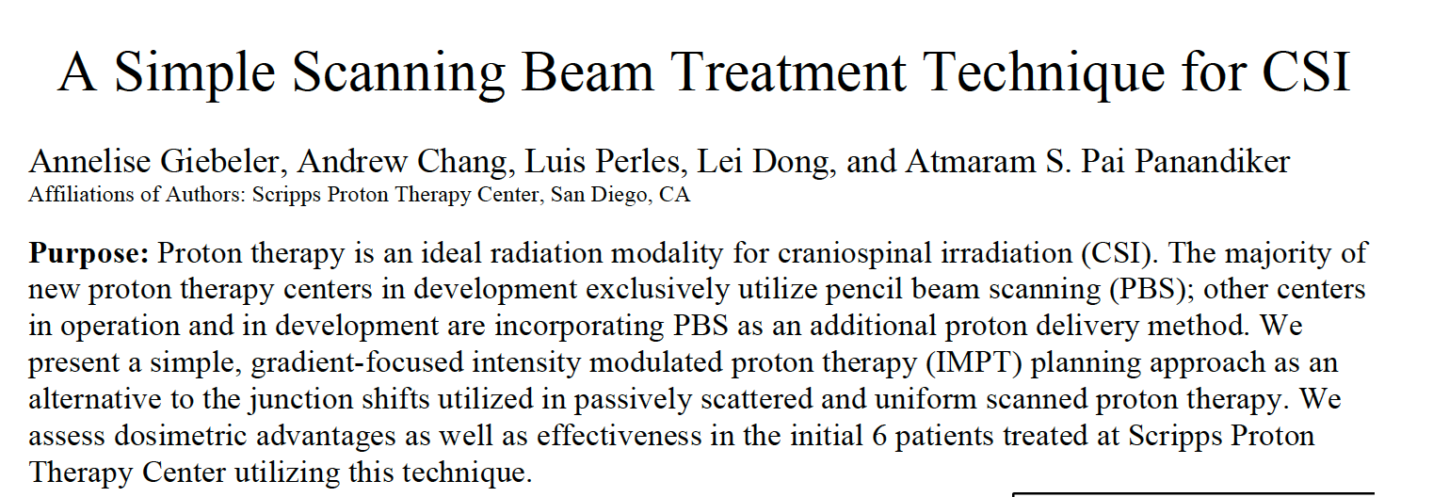
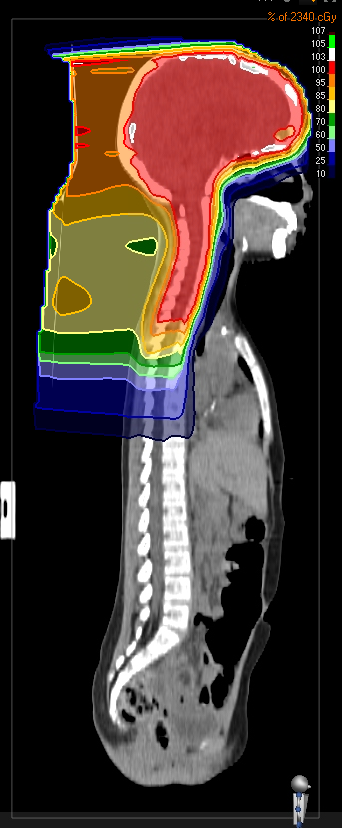
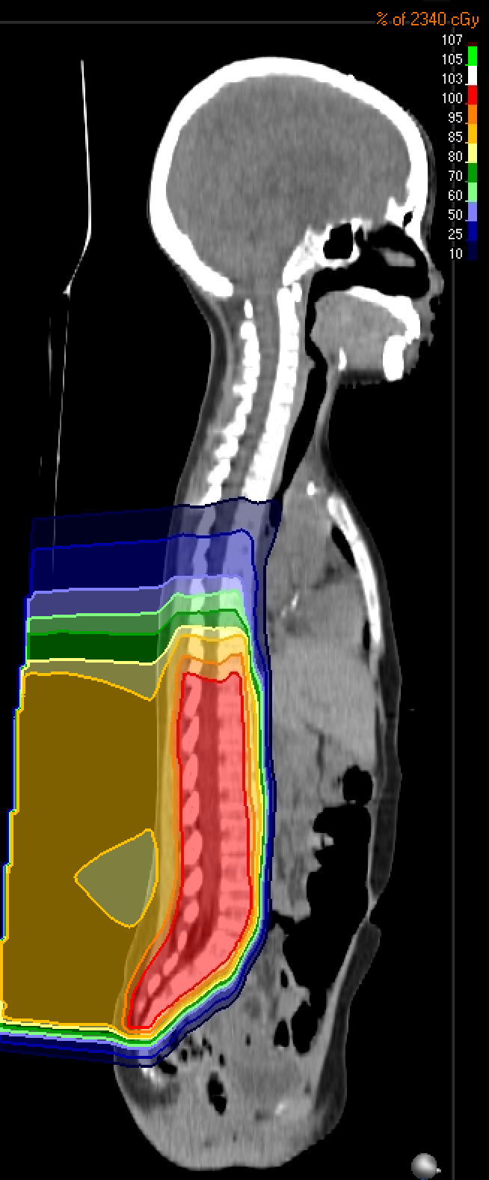
+
=

Slide 27
Head / Neck with PBS
Photon IMRT
Proton PBS

Slide 28
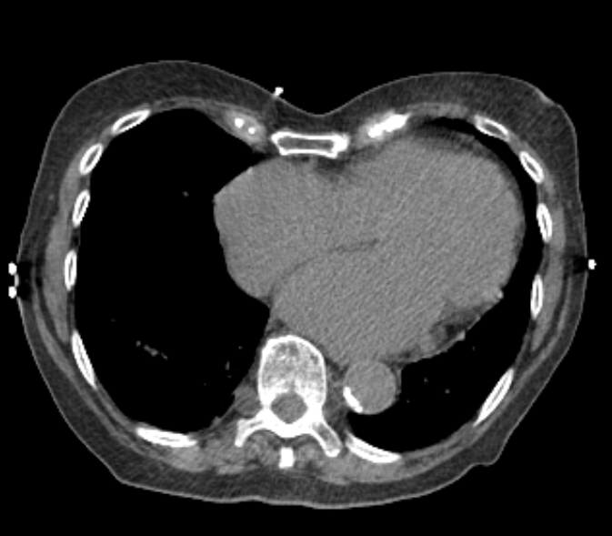
Lt Sided Breast

Slide 29
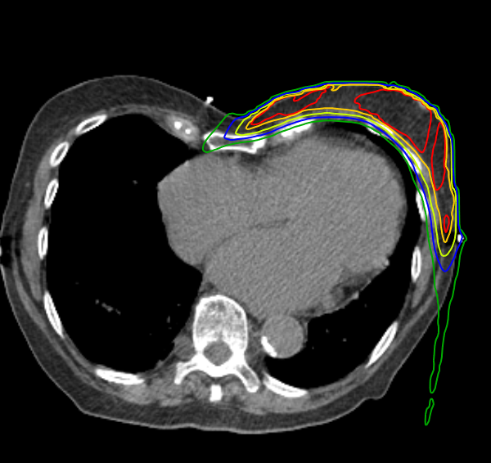
Protons beam

Slide 30
The future looks bright!
With some more work…….
Future development should be focused on Pencil Beam technology
Several things can be improved
Range uncertainty
Delivery system
Pencil Spot size
Cost

Slide 31
Range Uncertainty
On treatment Volumetric Imaging
Patient anatomical changes
Set-up variances
Changes in particle path length
Weight loss / Weight Gain
Target response to radiation
Motion
Inaccurate Range calculation
Errors in the conversion for HU to Stopping Powers
Trying to use X-ray as a spectrometer
X-Ray Beam hardening
Potential for inter-human tissue variability
Faster Delivery
Variable Spot Size
Improved Imaging Methods

Slide 32
On-Board Imaging / In-room Imaging
2-D Planar Image
3-D Volumetric Image

Slide 33
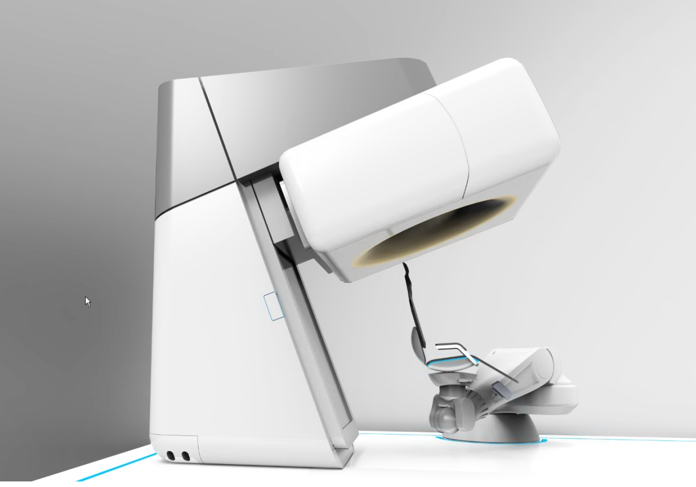
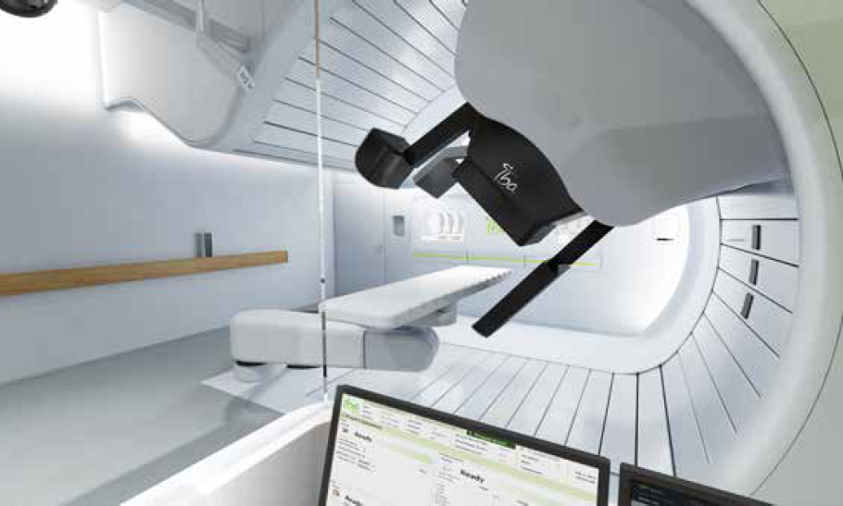
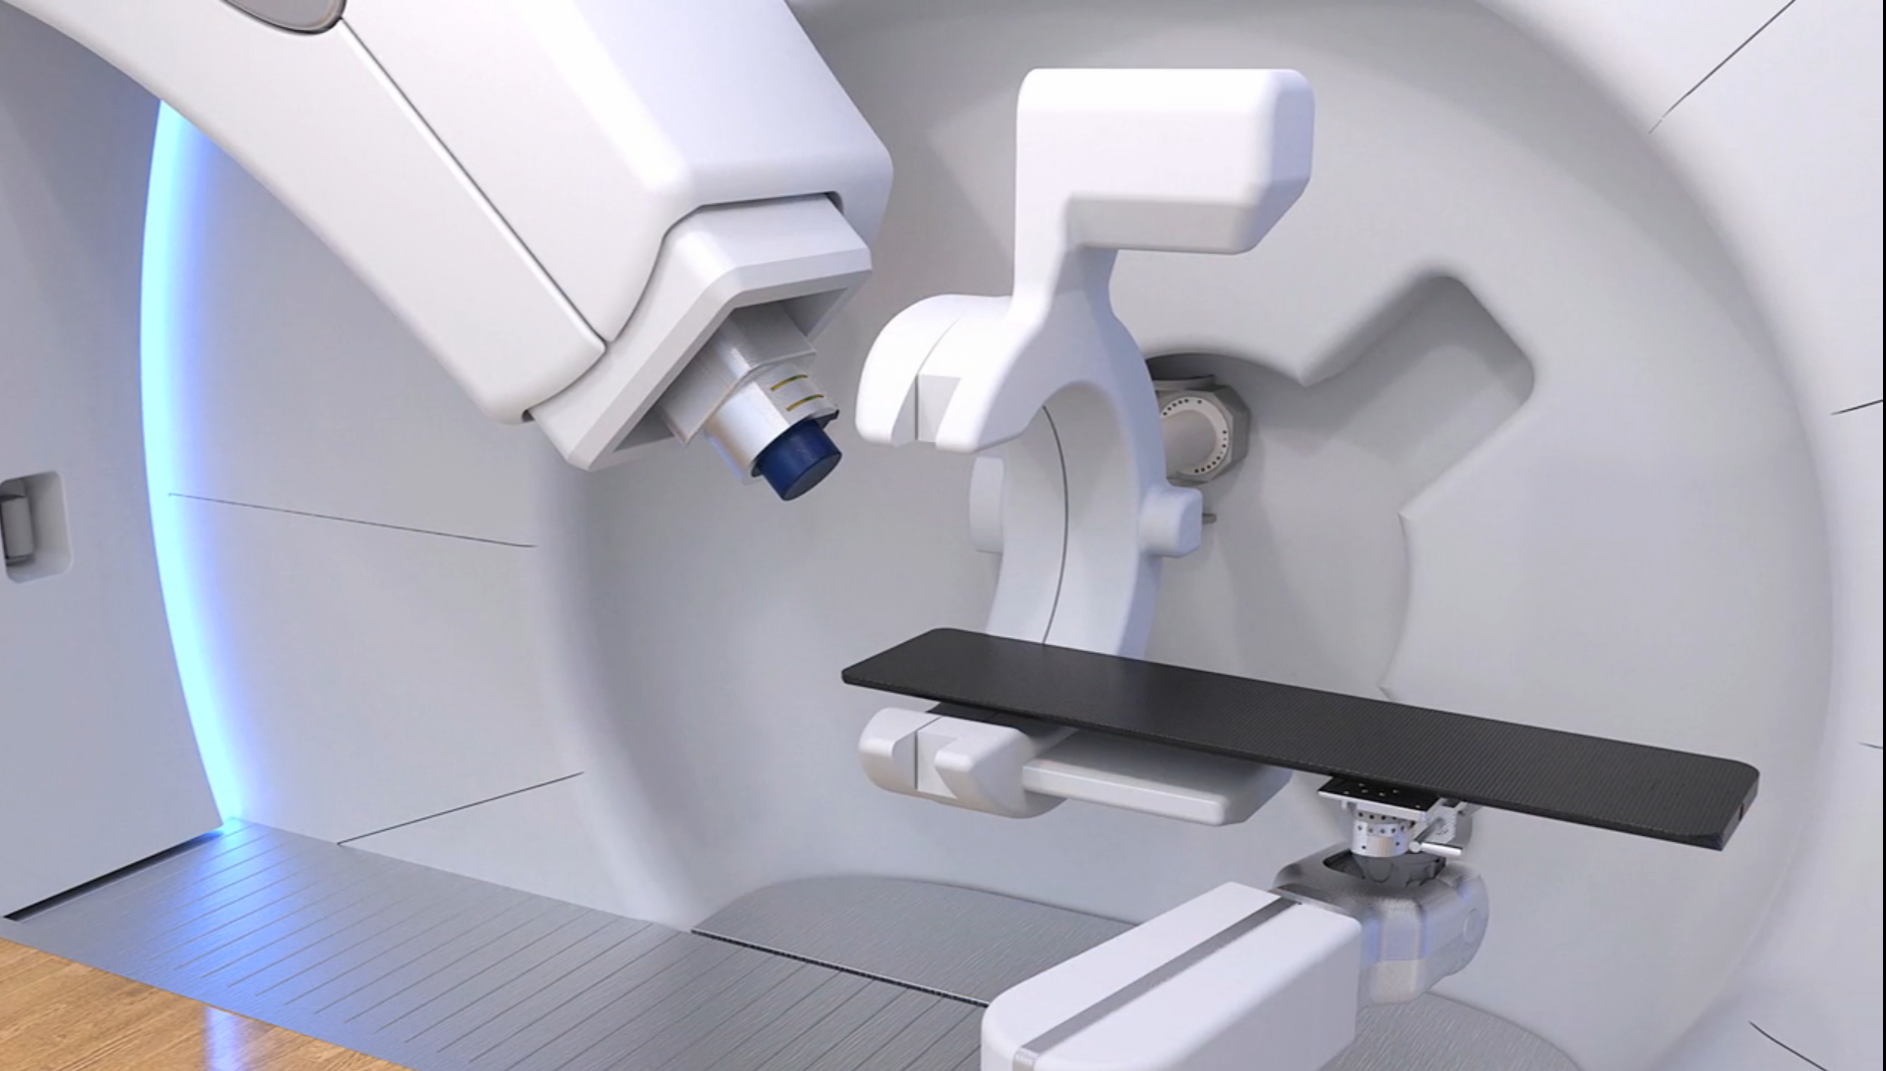
On-Board Imaging / In-room Imaging

Slide 34
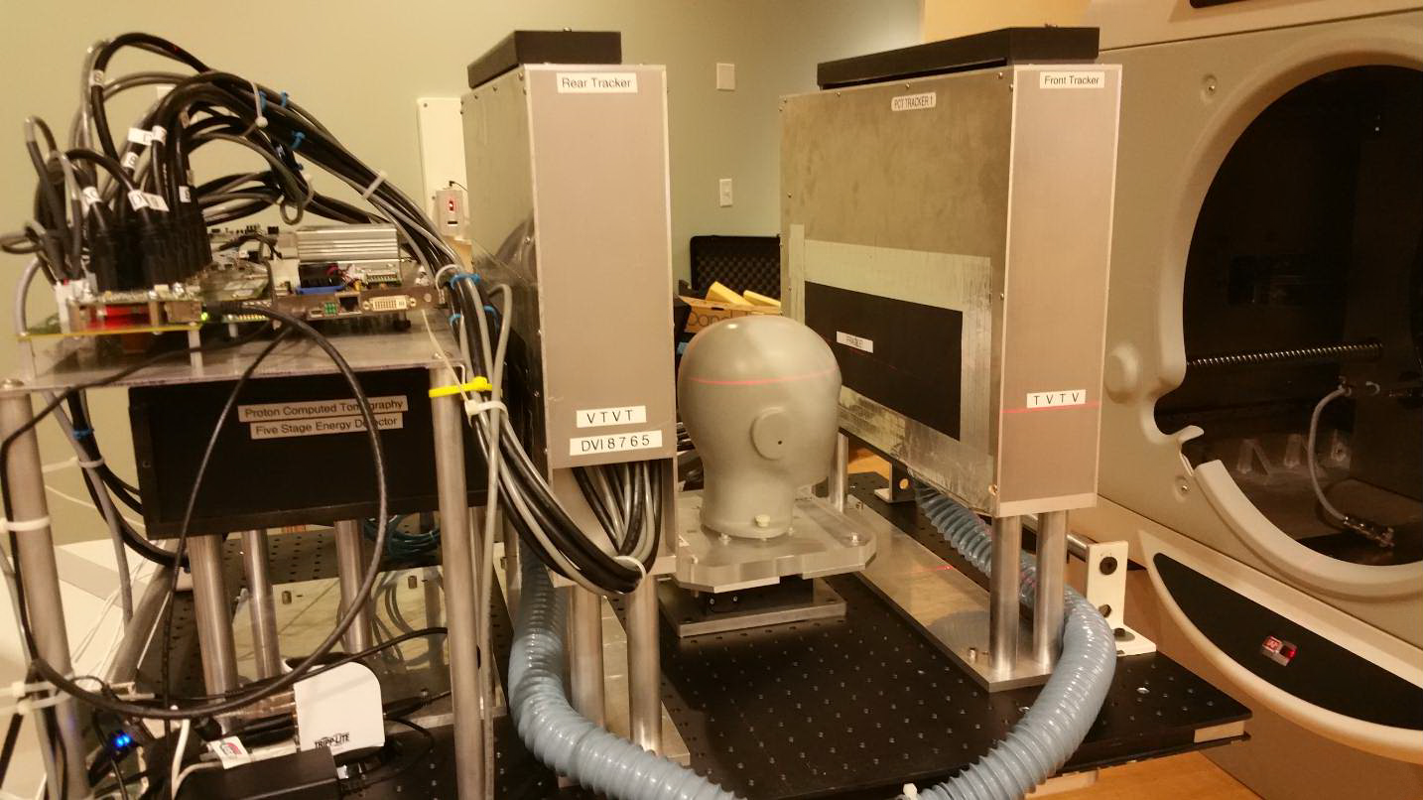
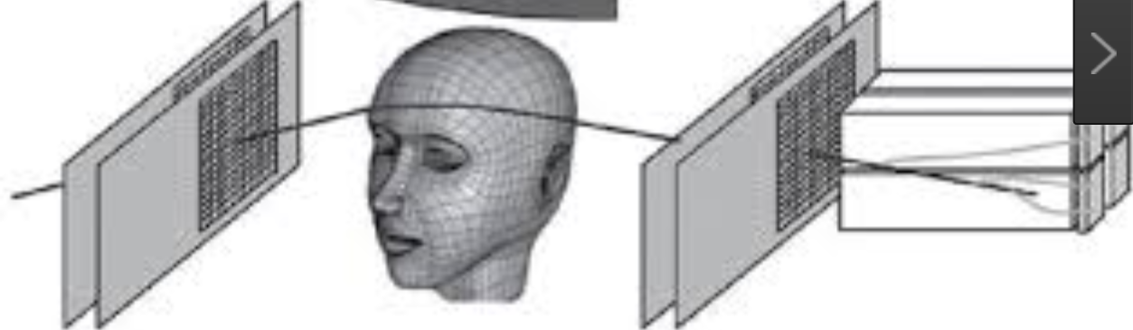
Proton Imaging
Using transmission protons to directly reconstruct
Proton Radiographs (Positioning AND Pre-treatment Range verification)
Precursor to volumetric Stopping Power maps

Slide 35
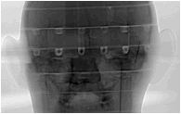
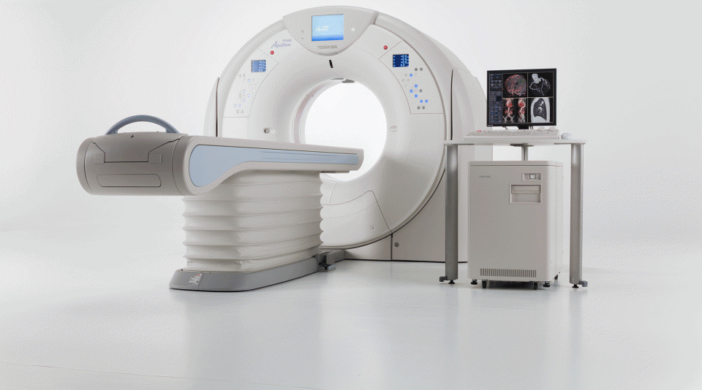
Will Proton tomography required in every room??
Standard CT
Proton CT
Proton radiograph
CT Corrections
Approximation
Truth
Dual Energy CT

Slide 36
Moving Targets
Temporal dependencies of the PBS delivery system need to be understood when there may be motion
Lateral Spread
Longitudinal Spread
How long each takes

Slide 37
Moving Target
Geometric miss of target

Slide 38
Moving Anatomy Altered Path-length
Altered
Path length
Range Error

Slide 39
Lateral Beam Spread
~ 1 second
Dose
Depth

Slide 40
Longitudinal Beam Spread
2 to 5 seconds
Dose
Depth

Slide 41
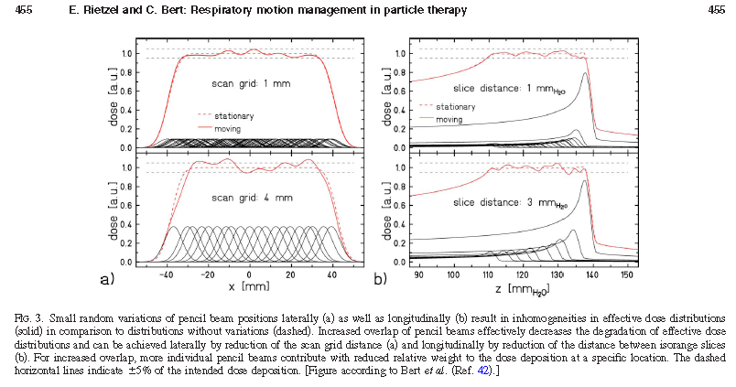
If our delivery is to a moving target : Interplay
Rietzel and Bert Med. Phys. 7, 2010

Slide 42
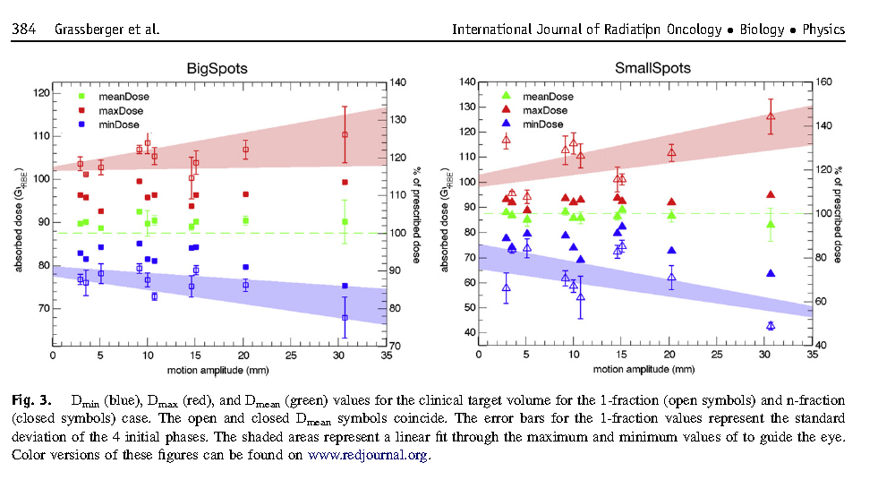
Single /Multiple Fraction and spot size
MGH/PSI Grassberger, et.al Int J of Rad Onc Biol Phy 86, 2013

Slide 43
The Proton Community's need :
Faster Spot to Spot switching (In a single Layer)
Faster Layer Switching (Layer Stacking)
Variable Spot Size
Variable Intra- Layer spot size

Slide 44
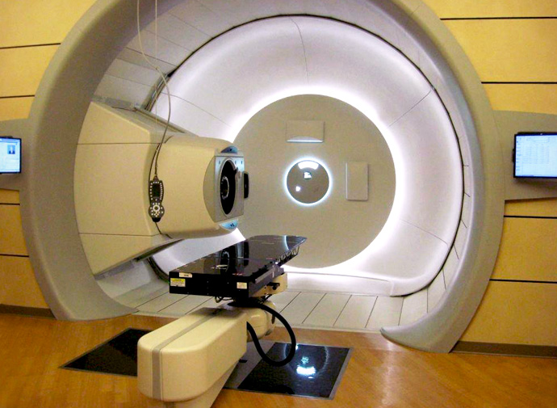
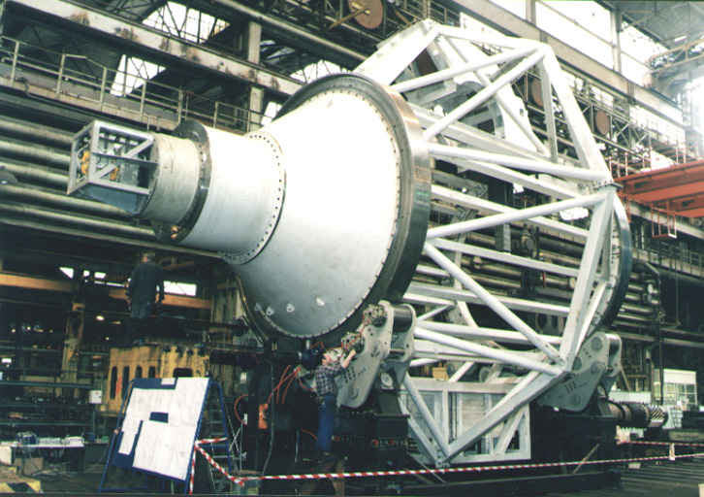
IBA Full Gantry

Slide 45
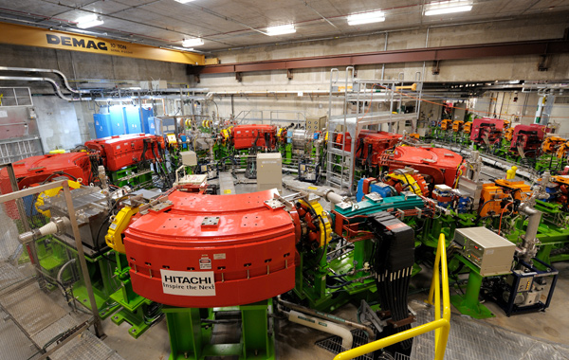
Hitachi : Mayo Clinic

Slide 46
The need for lower cost
Smaller Centers ??
Less expensive accelerators
All this functionality

Slide 48
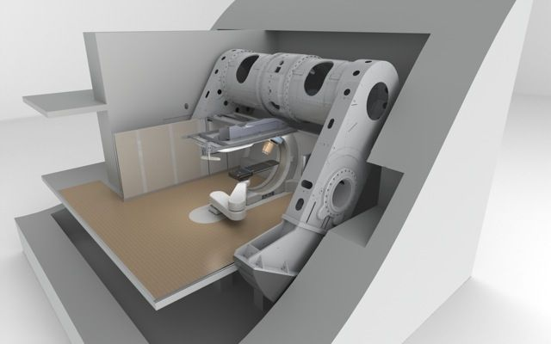
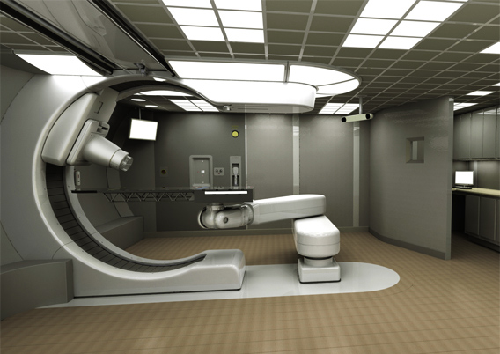
Mevion

Slide 49
Are we the best we can be yet???
Probably not…
But we are getting close
Pencil Beam Scanning
Faster control systems
Reduced range uncertainties
Smaller centers
All at a lower cost

