Slide 1
High Current, High Intensity Beams
&
New Accelerator Concepts at Berkeley Lab
Arun Persaud
Fusion and Ion Beam Technology Group
Lawrence Berkeley National Laboratory
Proton Accelerators for Science and Innovation,
Fermilab, 2015-11-12

Slide 2
Outline
Present two ongoing projects at LBNL with connection to proton beams and high power outputs.
MEMS based compact RF accelerators
Neutralized Drift Compression Experiment II

Slide 3
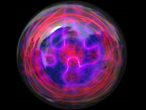
Novel Accelerator Concept for Fusion Experiments funded by ALPHA project at ARPA-E
ARPA-E ALPHA (Accelerating Low-Cost Plasma Heating and Assembly)
  Exploration of magnetized target fusion and fusion at intermediate densities
Ion beam drivers for fusion
  Heavy ion fusion (HIF): ~GeV, ~10² A/beam
  Magnetized target fusion (MTF): ~MeV, kA-MA
  …
“This program seeks to develop and demonstrate low-cost tools to aid in the development of fusion power, with a focus on approaches to produce thermonuclear plasmas in the final density range of 10¹⁸-10²³ ions/cm³.”
http://www.arpa-e.energy.gov/?q=arpa-e-programs/alpha

Slide 4

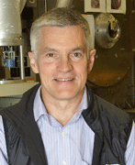
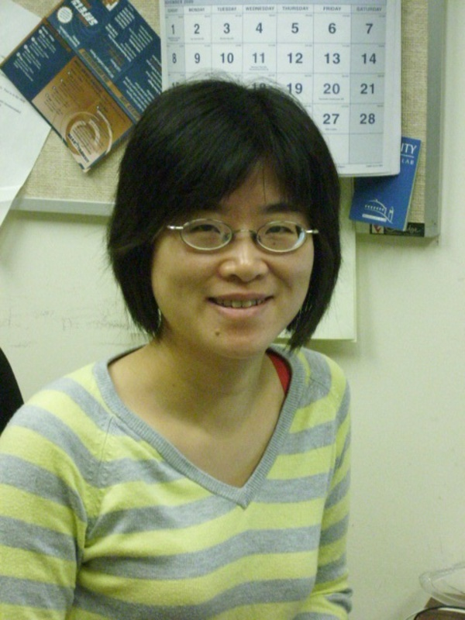
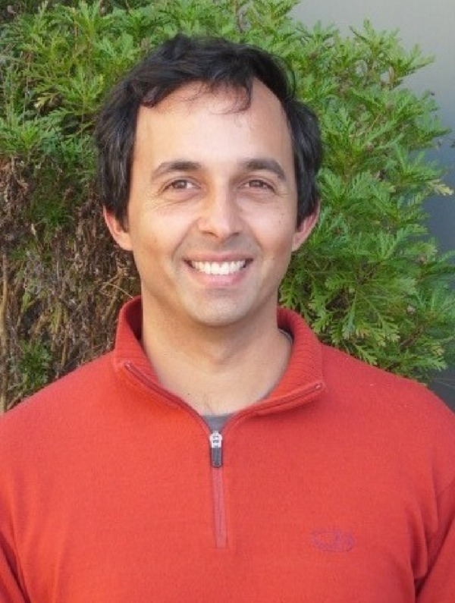
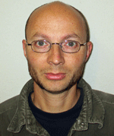

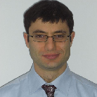

Projects is a collaboration between LBNL and Cornell
Accelerator Technology and Applied Physics Division @ LBNL:
Thomas Schenkel, Peter Seidl, Qing Ji, Arun Persaud, Will Waldron
http://ibt.lbl.gov
Sonicmems @ Cornell:
Amit Lal (Co-PI), Serhan Ardanuc, Joseph Miller
http://www.sonicmems.ece.cornell.edu/

Slide 5
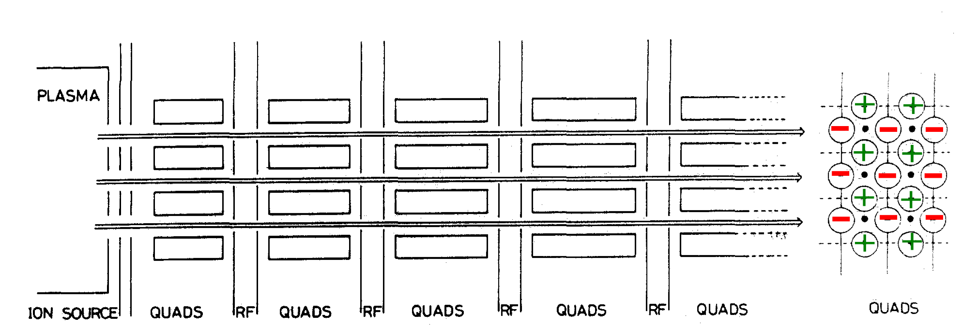
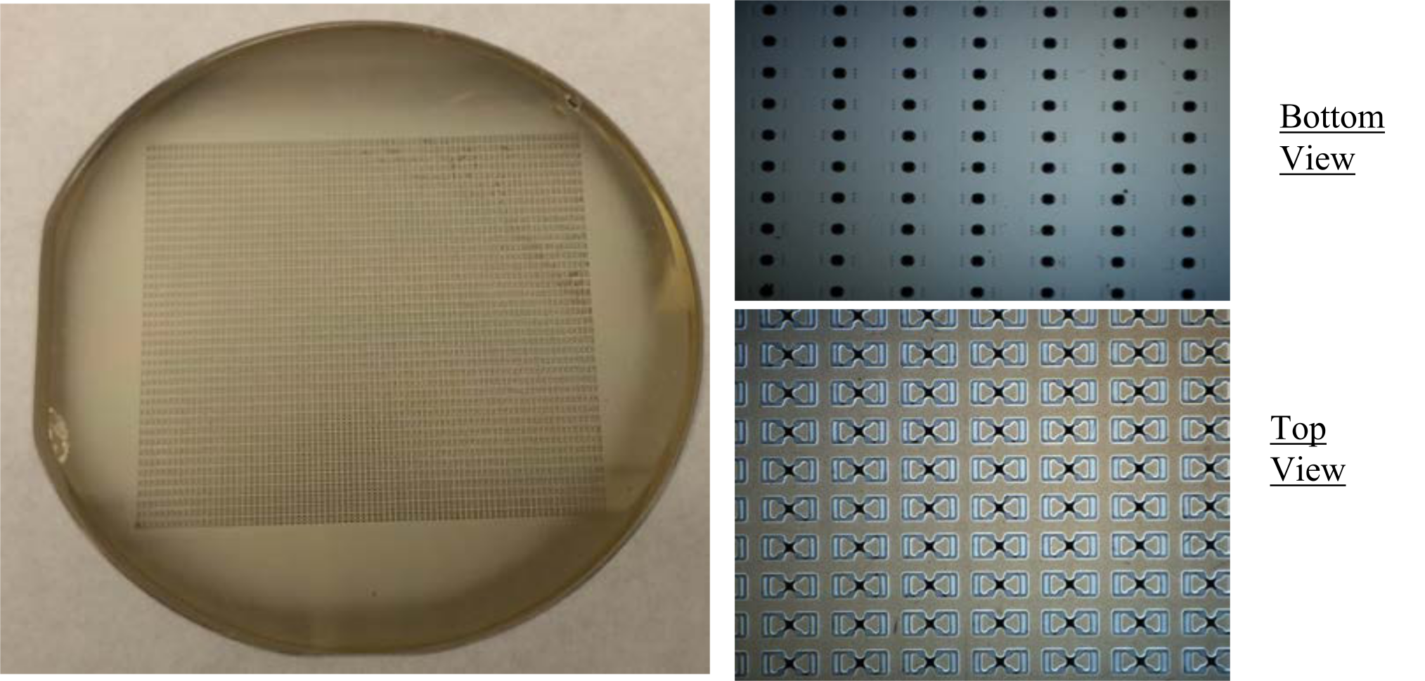
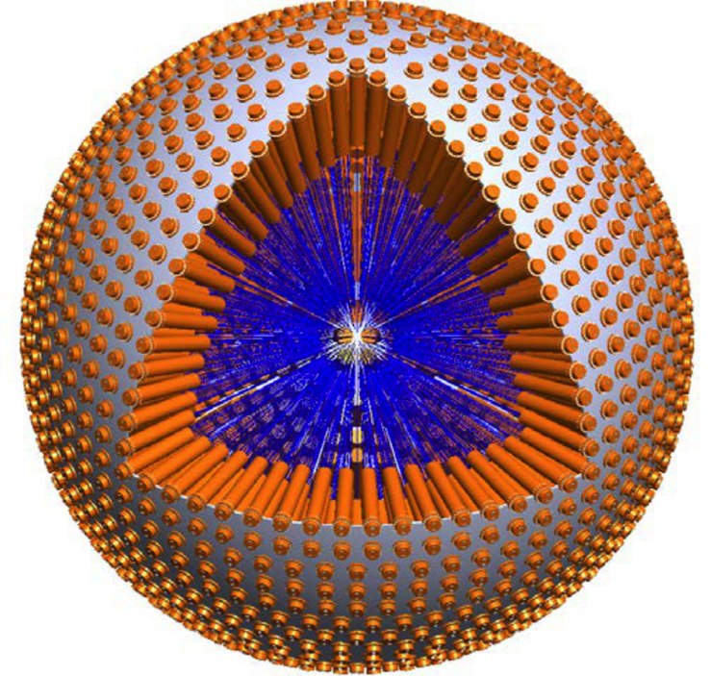
MEMS based ion beam drivers for magnetized target fusion
We aim at a proof of concept with ~100 beamlets and mA’s of ion currents at ~100 keV and at establishing a scaling path for MTF drivers
We envision that there will be many applications for this technology
MEQALAC, Thomae et al., 1989

Slide 6
MEQALAC concept from 1980s exploits the many beamlets idea
Multiple-Electrostatic-Quadrupole-Array Linear Accelerator
1980 Dimensions: ~ 1cm beam aperture, Quads length : ~cm
Thomae et al., Mat. Science & Eng., B2, 231 (1989)

Slide 7
Space charge limits can be beaten by dividing the beam into many beamlets
Transport of very intense ion beams is strongly affected by space charge forces that can lead to beam divergence
6D – phase space density ~ f ²/β³ A/Z (f=frequency, β=velocity)
Max current (long.) for quadrupole focusing ~ (β γ)³ A/Z
Max current (trans.) for quadrupole focusing ~ β² E/f
Current not depending on beam parameters (e.g. bore size)
To get bright beams, start with low β → low current
Electrostatic quadrupoles can be scaled down (no dependency on bore diameter)
Use many, smaller-diameter beamlets to get desired current
Maschke, BNL-51022 (1979)

Slide 8
Basic design consist of a lattice of ESQs and RF accelerator sections
Plasma
Source
Matching
section
ESQ
RF
A matching section will guide the beam from a plasma source into a lattice structure.
Goals:
Show transport and acceleration
Show scalability

Slide 9
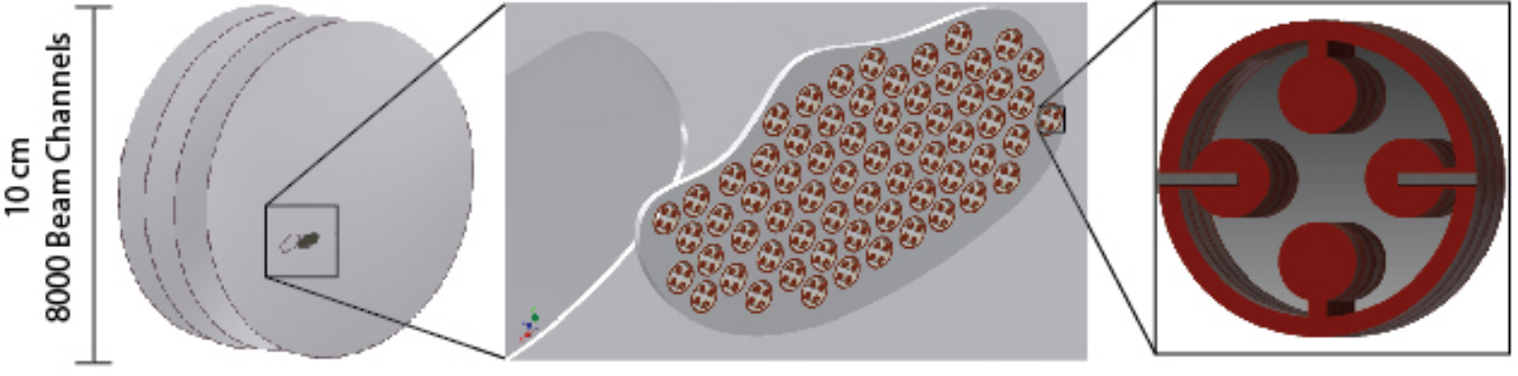
Arrays of electrostatic quadrupoles can be produced in silicon wafers with unit cells of the order of 1 mm
Prototype

Slide 10
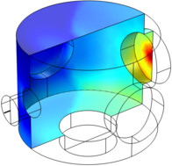
Current design phase relies on simulations and initial experiments using single test structures
Comsol Multiphysics for gas flow simulations
  Input to estimate particle loss, desorption, and beam-gas interaction
Envelope codes for fast beam
transport simulations
Warp3D for full particle trajectories,
for example, full space charge
simulation, pulsed beam, emittance growth
IGUN for beam extraction from plasma

Slide 11
Particle-in-Cell simulations give more details: full 6D phase-space
Warp3D (warp.lbl.gov)
Correct handling of space charge effects
Background gas interaction
Secondary electrons
Emittance growth and particle loss
Longer runtimes (tens of minutes)
Access to LBL clusters

Slide 12
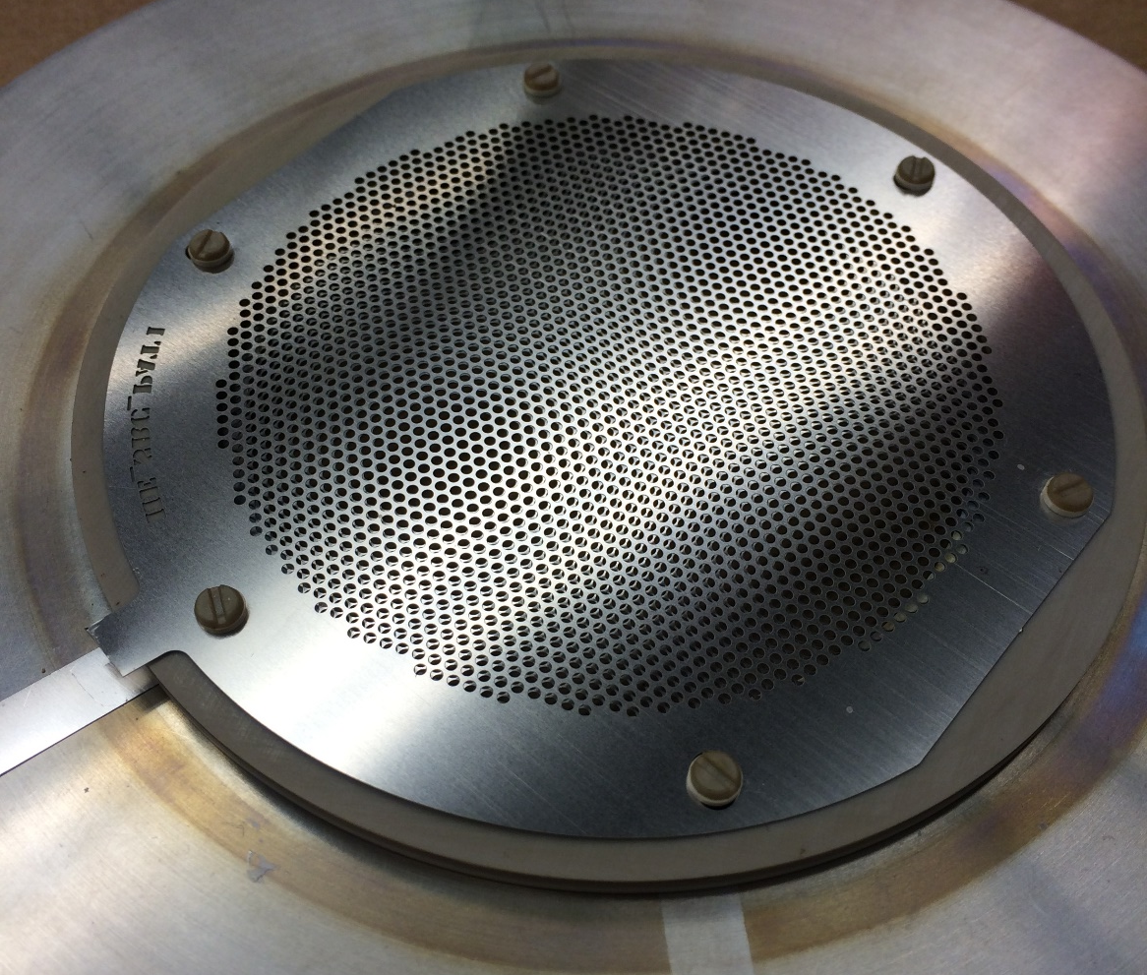
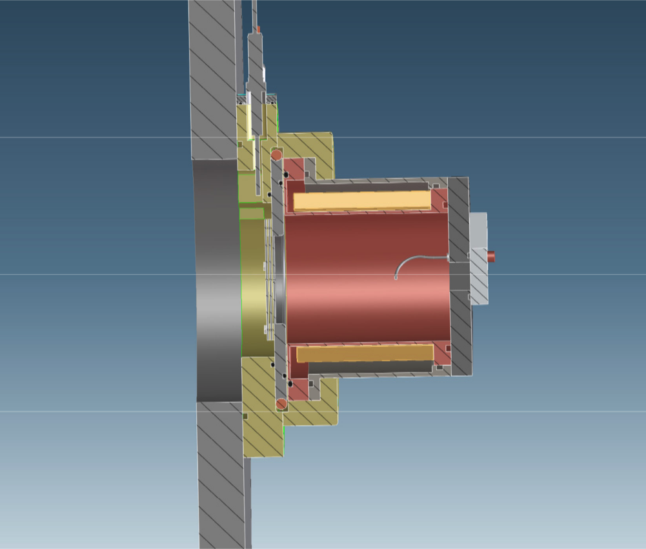
Multicusp plasma ion source with multigrid extraction for uniform plasma extraction over several cm
Filament driven gas ion source with multicusp magnets for plasma confinement
Multigrid extraction grids to extract multiple beamlets

Slide 13
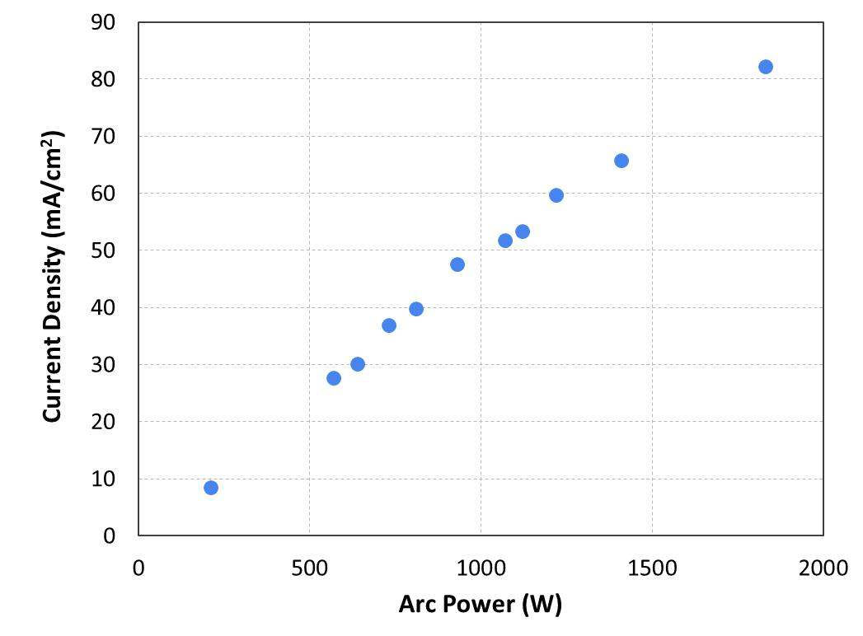
Current levels achieved with multi-grid plasma source
Measured He⁺ current density
The expected Xe⁺ current density is ≥ 10 mA/cm²

Slide 14
Exciting opportunity with applications outside of fusion drivers
There are many applications for this technology
Not all need multi-beamlet approach
10μA-100mA, 1 to tens of MeV ions produced with low voltages (~kV) in a few meter long structure could be used for:
  Ion beam analysis in material sciences
  Ion implantation
  High yield neutron generators (for example for national security applications)
  …

Slide 15
Outline
MEMS based compact RF accelerators
Neutralized Drift Compression Experiment II

Slide 16
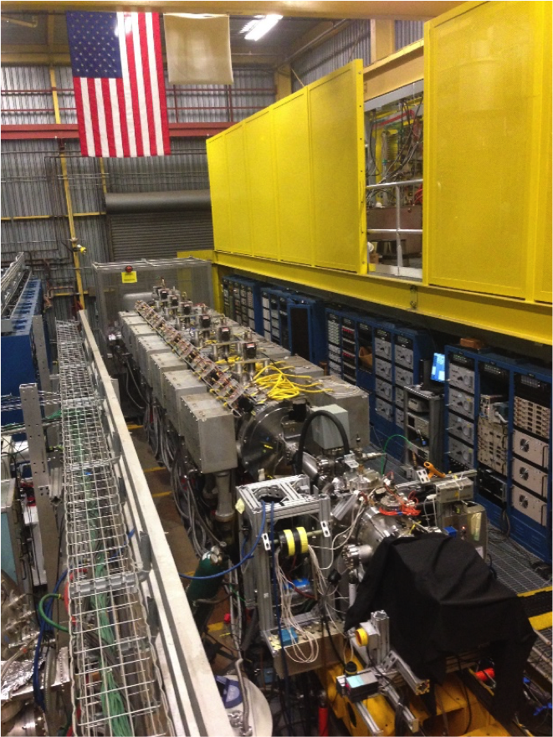
The Neutralized Drift Compression Experiment II
Scientific goals
The accelerator
Current status
Collaboration between
LBNL, LLNL, PPNL
Funded by DOE-FES

Slide 17

The Neutralized Drift Compression Experiment II
Beam Characteristics:
1.2 MeV
He, Li, K
Several nC
Short pulses (2-3 ns)
Spot size 1-2 mm
Possible to H, D, Ne, etc.
Possible to upgrade to 3 MeV

Slide 18
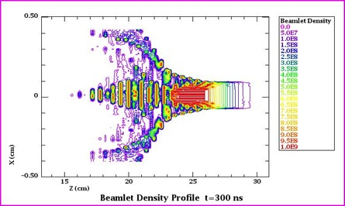
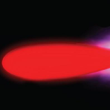
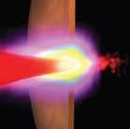
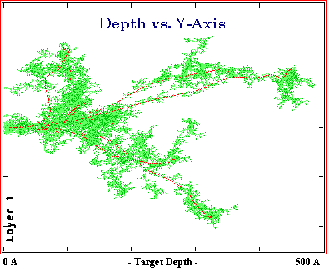
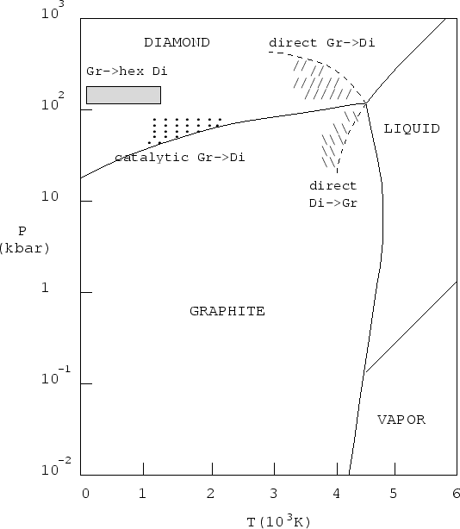
Short, intense ion pulses for current science drivers
Beam Physics
Warm Dense Matter Physics
Defect Dynamics
Extreme Chemistry

Slide 19
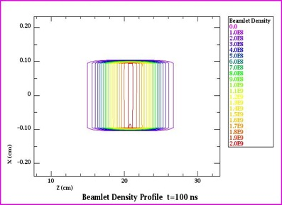
Two-stream instability of an ion beam propagating in background plasma predicted
In high energy accelerators: two-stream or electron cloud effects arise from stray (unwanted) electrons. → Reduce/eliminate!
For new high-intensity ion beam systems, plasma is introduced to cancel the defocusing space charge force.
Tokluoglu, Kaganovich, PPPL, Phys. Plasmas (2015)
NDCX-II beam parameters
r_{b}=1 mm.
x(cm)
Z(cm)
Z(cm)
Beam density contour at t = 100 ns
(1 m propagation).
Beam density contour at t = 300 ns
(3 m propagation).
Defocusing when Δv/v is small.
Goal: observe transverse defocusing and longitudinal self-bunching of beam

Slide 20
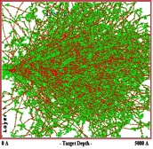
NDCX-II provides uniquely intense, short ion pulses for materials and warm-dense matter research
Lower intensities:
defect dynamics in materials
→ fusion materials
Higher intensities:
extreme chemistry and warm dense matter
warm (~1 eV),
dense matter
overlapping
cascades
amorphization
and melting
isolated
cascades
~50 nC, 1.2 MeV, ~1 mm², ~1 ns
1-30 nC, 0.3 -1.2 MeV, few mm², ~1-20 ns
Fusion relevance
Intense beams and beam-plasma physics
Materials studies for fusion reactors
Ion heating of matter (WDM)
Ions deposit energy via collisions with target electrons and nuclei
Ion driven heating is uniform for ion energies near the Bragg peak in stopping power
Notes:
Understanding the multi-scale dynamics of radiation induced defects is of fundamental interest. It is important to benchmark simulations codes of dynamics, but there is little data on short timescales. Application: Engineer fusion materials for the burning plasmas and IFE.

Slide 21
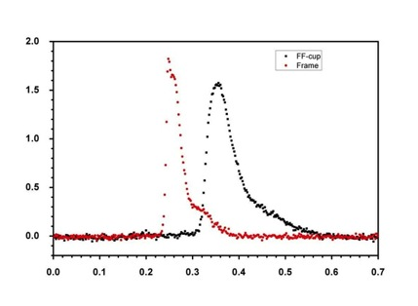
Opportunity to probe materials response to ionizing radiation (t, λ), e.g., channeling of ions in crystals
Beam
Aperture
Li 135 keV Si 250 nm
α
Target
Current [mA]
Faraday
Cup
1 µm target E₀=287 keV
F-cup only
x 0.1
F-cup
+ target
Rotation, α [degree]
Current [mA]
current
Loss due to
damage
build-up
Time [µs]
time
T. Schenkel et al., Towards pump–probe experiments of defect dynamics with short ion beam pulses, NIM B 315 (2013) 350
Notes:
A non-channeling ion hitting the material will create many interstitial-vacancy pairs in the material, temporarily blocking many channels in the material before the defects self-anneal. If the fluence of the ions is high enough, other ions will hit the same area as the remnants of the earlier ion cascade (before the self- annealing took place) and the channel transmission will be impeded. Therefore, we expect that the channeling current will change depending on the fluence, e.g., for low fluences channeling will be unobstructed (no over- lapping cascades) and for high fluences the channeling current will decrease during a single beam pulse (many overlapping cascades). The transmitted beam current can be monitored with high temporal resolution and by restricting the measured ions to a small scattering angle, mostly channeled ions can be recorded. Noise from non- channeled ions can be further reduced by time-of-flight measurement, since channeled ions will have a smaller energy loss than scattered ions.

Slide 22
Towards pump-probe experiments of defect dynamics in solids with short ion beam pulses
Pulse shaping, double bunches: Probe for materials studies
K⁺, ≈ 0.3 MeV
0.65 μs
9
t [µs]
10
Our pulsed ion beam accelerator might allow formation of well separated, narrow pulses with variable delay for pump-probe experiments with two ion pulses (in progress)

Slide 23
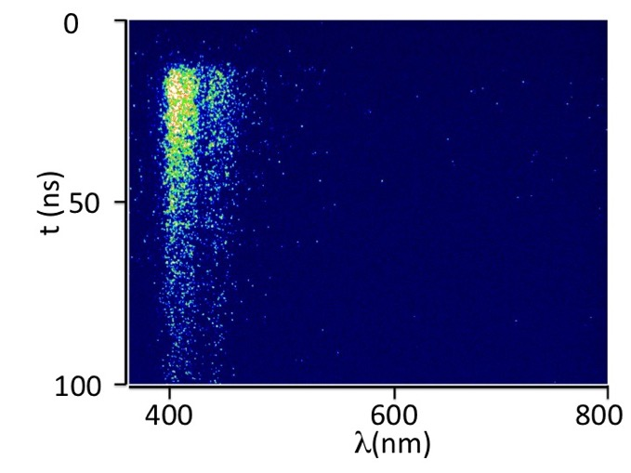
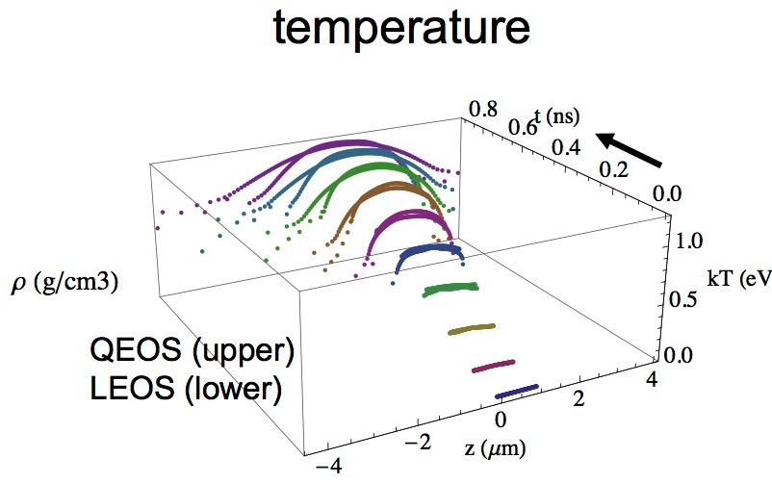
With pulsed ion beams we can access extreme chemistry, the materials physics of radiation and warm dense matter research
Novel opportunities with short, intense pulses to probe defect dynamics
NDCX creates WDM with ions, complementing laser driver research.
E.g., single shot ionoluminescence of YAP:Ce measured with a streaked optical spectrometer.
NDCX
Assumed fluence: 12 J/cm²;
1.2 MeV Li → Al target (1 ns)
Seidl, et al., NIM A, 800, 98 (2015)
http://arxiv.org/abs/1506.05839
Notes:
The peak near 400 nm is attributed to a convolution of the broad emission peak due to the d→ 􏰛f transition in Ce3+ [22] with the wavelength cut-off of the optical fiber at 400 nm. Separately, analysing the emission near 400 and 440 nm we find exponential decay constants of 30 and 24 ns, respectively, similar to photon luminescence results for YAP [22, 23, 24]. This structure will be explored in future experiments in relation to earlier observations of excitation specific emission structures from luminescent materials [25].
Right:
It does show differences in EOS, but might say that the temperature is optimistic, since our fluences will be lower than what was simulated.

Slide 24
NDCX-II allows for uniform heating of materials
 | NDCX-II (goal)
Ions/pulse (total) | 10¹⁰ (3x10¹¹)
Pulse length | 2 ns (~1 ns)
Typical spot size | 1 mm²
Ion species | He, (H, d, …)
E_{kin} | 0.12 - 1.2 MeV
Energy spread | ~10%
Repetition rate | 2/min
Target temperature | <0.1 eV (~1 eV)
Radiation environment at the target | Benign, no shielding required
Heated volume | ~1 mm² x 5µm =5x10⁶ μm³
Energy loss
Notes:
Benign rad
Uniform deposition
Volumes are similar but the aspect ratios are not

Slide 25
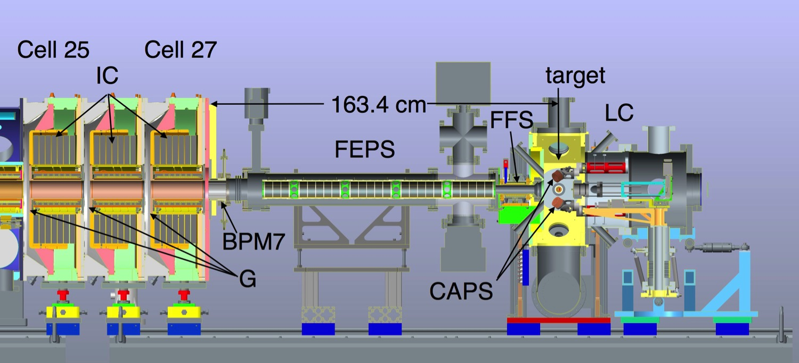
Diagnostics include fiber coupled streak spectrometer (~10 ps), II-CCD. Considering laser or x-ray probes.
Induction Core
Ferro-Electric Plasma Source
Cathodic Arc Plasma Source
Light Collection system
Beam Position Monitor
accel. Gap
Available diagnostics:
  Streaked optical spectrometry
  Ion scattering
  VISAR-interferometry
Future:
Auxiliary ps probes (e. g. laser based XUV, …)
Notes:
Diagnosis to short timescales not limited by the ns bunch duration, for example as with transient decrease in the transmission of channeled ions

Slide 26
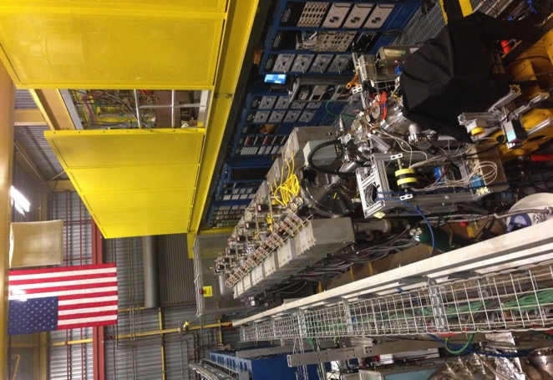
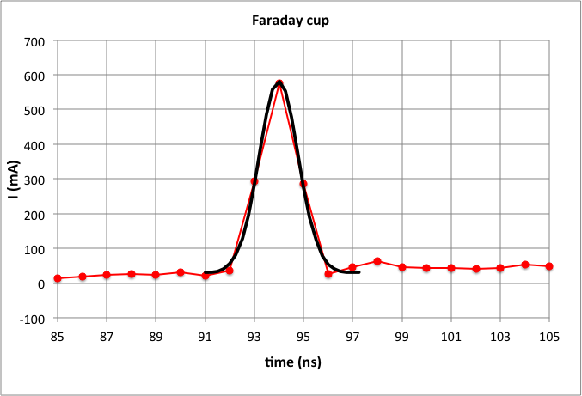

The Neutralized Drift Compression Experiment is operating
Since June 2014, we have brought NDCX-II to full operation
Pulse length: 2 ns, spot size 1.4 mm, 1.2 MeV, Li⁺
Now: He⁺, Peak currents: ~0.6 A (~40 A/cm²)
We are now tuning to reach the design goals: 1 ns, 1 mm, >50 A, for volumetric heating up to 1 eV
FHWM 1.4mm
Jitter: σ_{x,y} < 0.1 mm
Intensity σ_{A}/A < 7%
Notes:
the peak, the dose rate is 1 x 10^20 ions/cm2 /s, with ion fluence per shot of 2 x 10^11 ions/cm2 .
For WDM at 12 J/cm2, which heats to nearly 1 eV, the required fluence is 6 x 10^13, or factor 30 more than we have.
So far only 0.5 A at the peak as the Li source was still conditioning
shots centroids are stable to <0.2 mm
80% of charge is within 0.8 mm
Drift compression is working
Lateral focusing is working

Slide 27
The NDCX-II induction accelerator compresses beam
to ns and mm bunches on target.
1.2 MeV Li⁺
1.3 mm FWHM
beam spots size with radius r < 1 mm within 2 ns FWHM and approximately 10¹⁰ ions/pulse.
0.02 A → 0.1 mA → 0.6 A
P.A. Seidl et al, NIM A 800 (2015) 98
Ion source and injector, 500ns
Linac custom waveforms for rapid beam compression
Neutralized drift compression and final focus
Target
Z=10 m
Notes:
NDCX beam is characterized by high perveance and low emittance, which lends itself to studies of the beam physics questions raised here.
Velocity increase ~2.7x from 165 kV to 1.2 MeV
Current increase 5x
Bunch compression (length or lambda) = 5/2.7 = 1.8
All components of the Neutralized Drift Compression Experiment-II (NDCX-II) have been integrated and commissioned. The first results demonstrate the generation of intense nanosecond ion pulses with reproducible peak dose rates of 10^20 ions/cm /s. Higher dose rates are anticipated with a new plasma ion source, which will enable target
25 heating to the warm dense matter regime with protons and helium ions.

Slide 28
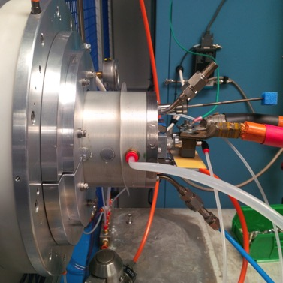
We are running NDCX-II with a multi-aperture, multi-cusp helium plasma source
Photo of plasma ion source
WARP3D simulation of He injection
A. Friedman & D. Grote, LLNL
We have a plasma ion source that delivers well over 80 mA/cm²
The goal is to extract ~160 mA of He⁺ ions during ~1 us, for 80 nC / pulse, achieved 50 mA to date
Trade-offs: current density, emission area, # of beamlets, emittance (~1.0 π-mm-mrad)

Slide 29
Outlook & Summary
 | NDCX-II (goal)
Ions/pulse (total) | 10¹⁰ (3x10¹¹)
Pulse length | 2 ns (~1 ns)
Typical spot size | 1 mm²
Ion species | He, (H, d, …)
E_{kin} | 0.12 - 1.2 MeV
Energy spread | ~10%
Repetition rate | 2/min
Target temperature | <0.1 eV (~1 eV)
Radiation environment at the target | Benign, no shielding required
Heated volume | ~1 mm² x 5µm =5x10⁶ μm³
Planning to run protons,
deuterium in near future. Other
gases are possible
Current focus: target heating experiment
Thank you for your attention!

