Slide 1
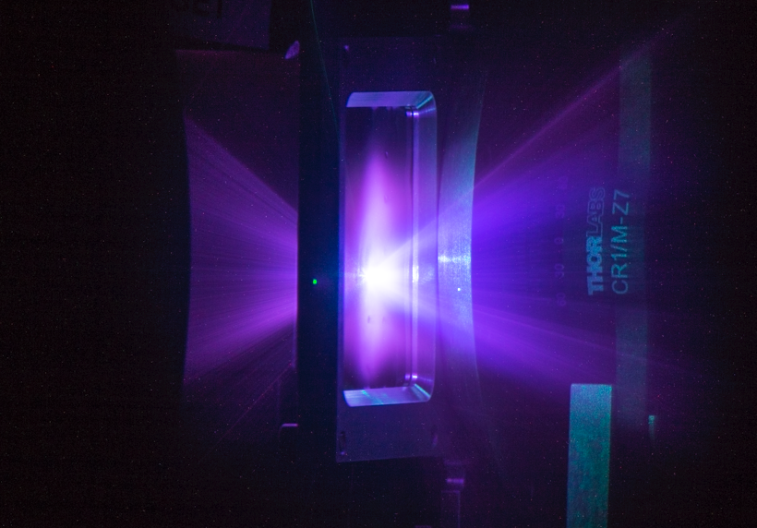
Bright, pulsed beams of laser-driven ions and neutrons for science and industry
Ceri. M. Brenner et al, PASI 2015, Fermi Lab

Slide 2
High intensity laser matter interactions
Ponderomotive acceleration
Laser ion acceleration schemes
Plasma sheath acceleration, radiation pressure and induced transparency
Tunable, bright proton beams
spectral control & flux enhancement
Applications
Medical and neutron generation

Slide 3
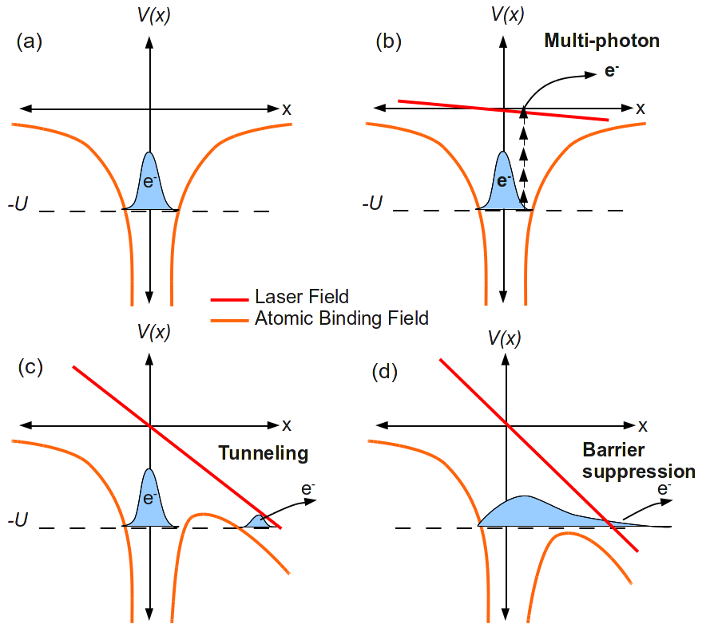
Vulcan petawatt laser, RAL: 500 J, 500 fs, 5 µm spot diameter, 1054 nm

Slide 4
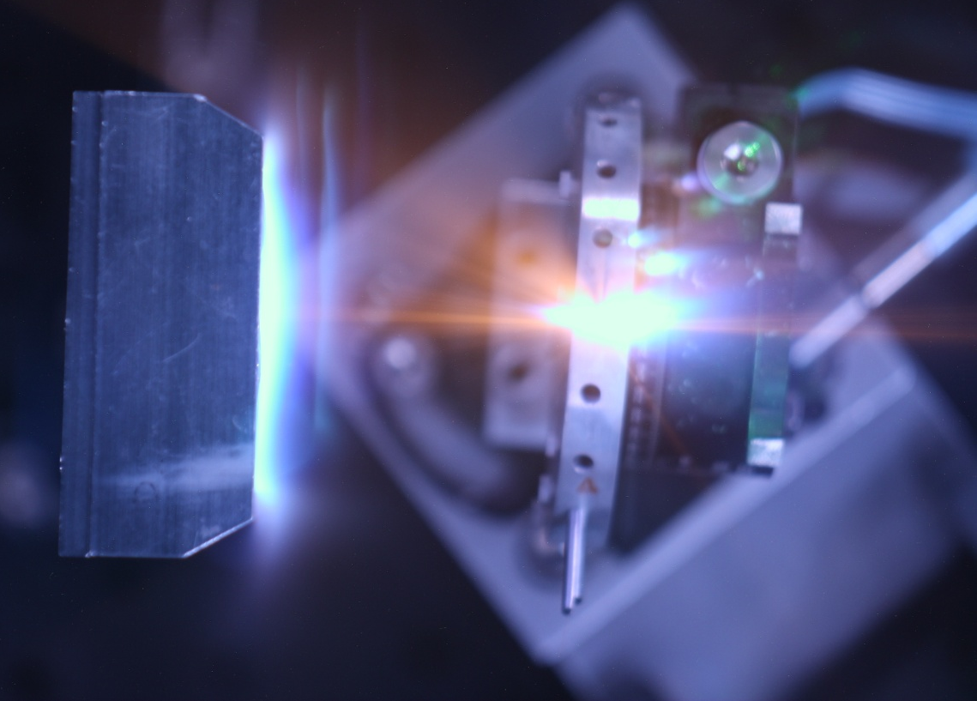
Relativistic intense laser pulses contain large E fields (TV/m)
Lorentz force interactions at I_{L} > 10¹⁸ W/cm²
^{F = q(E + v x B)}
Non planar wave => Ponderomotive force

Slide 5
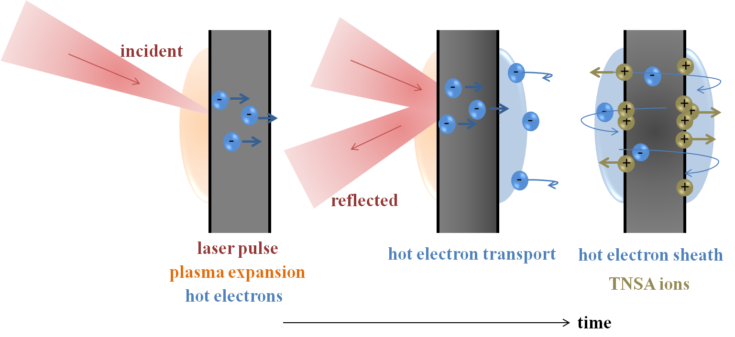
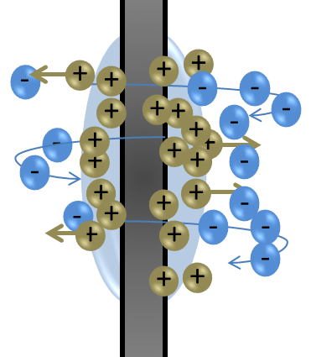
Plasma sheath acceleration
MA current of electrons with MeV temperature, maxwell-boltzmann distribution
Charge separation at rear surface generates TV/m fields
Rear surface ionised and ions exposed to accelerating field

Slide 6
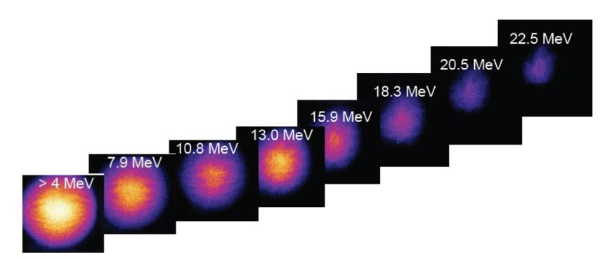
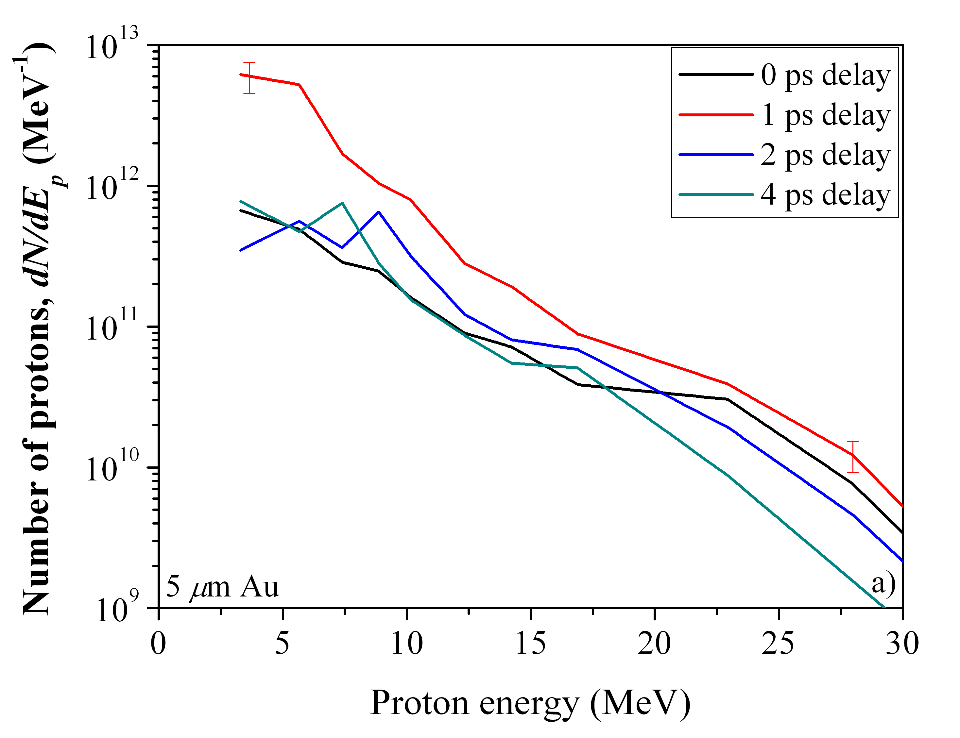
P.R. Bolton et al. / Physica Medica 30 (2014) 255-270
Routinely observed:
10¹¹⁻¹³ protons per pulse
Source size: < 10 µm
Emmittance: < 0.004 mm/mrad
Short duration, ps at source, ns with time of flight for particle beams
Cone beam, 30-40 ° divergence
Centrally peaked intensity profile, following on from laser profile
Reliable, robust laser-driven mechanism for bright source of pulsed proton beams with broadband energy spread

Slide 7
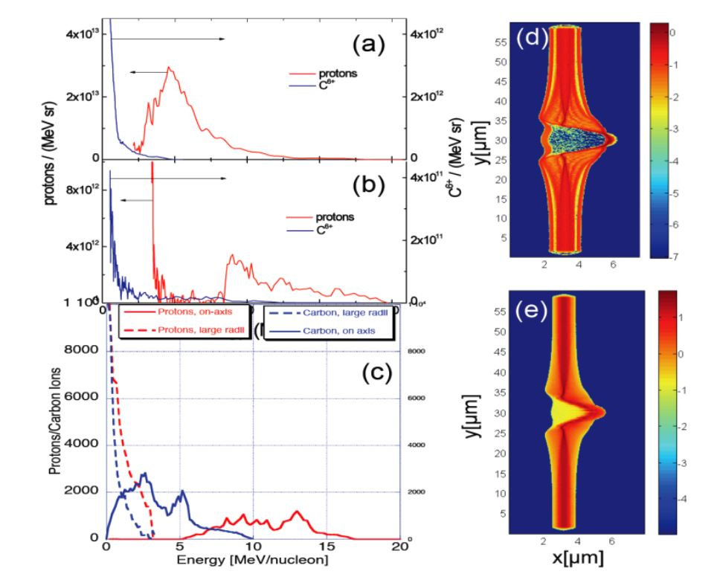
Borghesi et al, http://www.clf.stfc.ac.uk/resources/PDF/ar09-10_hpls_full_fpp.pdf
Radiation pressure
Or Light sail
Or Breakout afterburner
On the horizon……………..

Slide 8
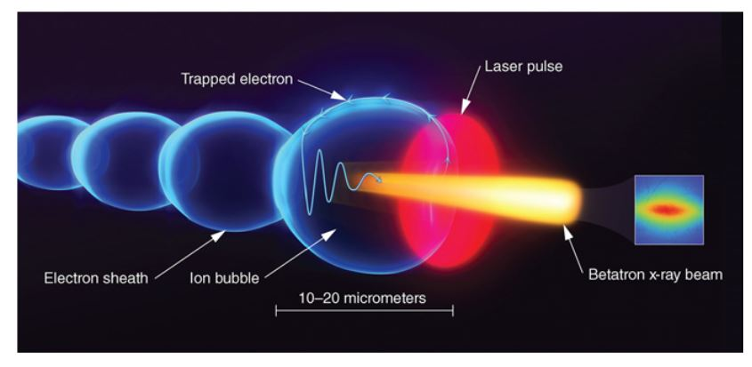
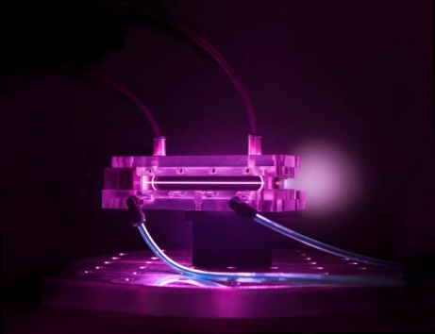
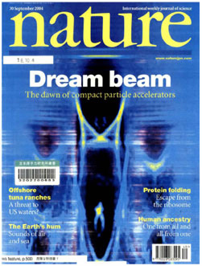
J. M. Cole et al, Scientific Reports 5, Article number: 13244 (2015)
F. Albert et al, Plasma Phys. Control. Fusion 56 084015 (2014)
Current record: 4.25 GeV in 9cm capillary
6% rms energy spread, 6 pC charge, and 0.3 mrad rms divergence
W. P. Leemans, A. J. Gonsalves, H.-S. Mao, et al. Phys. Rev. Lett. 113, 245002
Lawrence Berkley Lab
Nature ‘dream beam’ papers 2004
Laser wakefield acceleration for GeV electron beams:
coherent X-ray generation
Positron generation

Slide 9
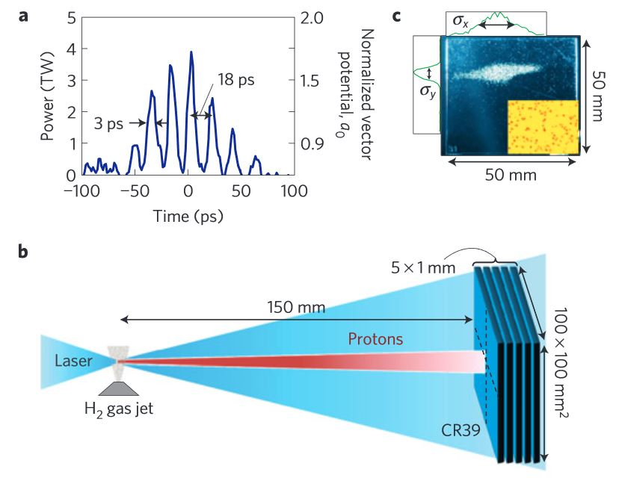
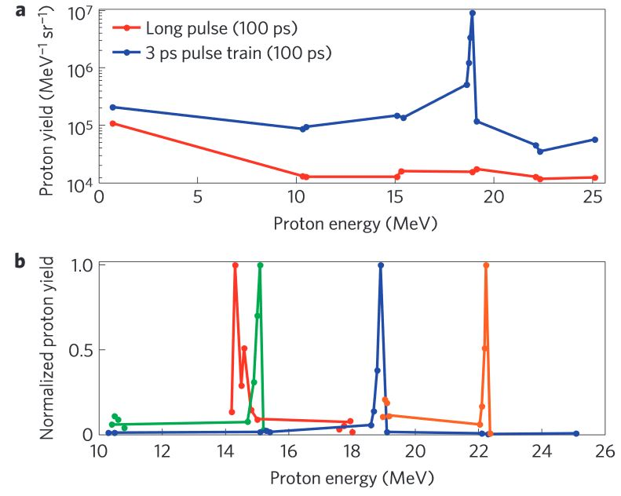
Haberberger et al, NATURE PHYSICS DOI: 10.1038/NPHYS213 (2012)
Collisionless shock acceleration from laser gas jet interactions
Chan Joshi group, UCLA

Slide 10
UK and US research groups
ASAIL
Queen’s University Belfast, University of Strathclyde, Central Laser Facility RAL, Imperial College London
JAI
University of Oxford, Imperial College London, Royal Holloway
US groups
Uni. Rochester, Uni. Michigan, LLNL, BNL, SLAC, UCLA, Ohio State, Uni. Texas, Los Alamos, LBNL

Slide 11
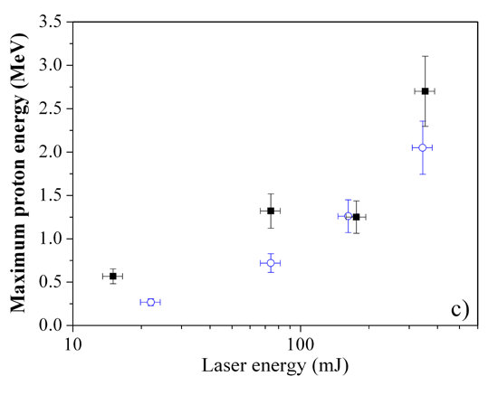
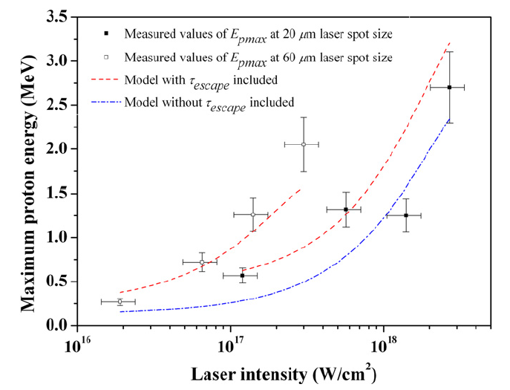
Optical control: E_{Pmax} vs laser spot size
C. M. Brenner et al, Laser and Particle Beams, 29, 345-351, (2011)
C. M. Brenner et al, Plasma Physics Controlled Fusion, 56, 084003, (2014)

Slide 12
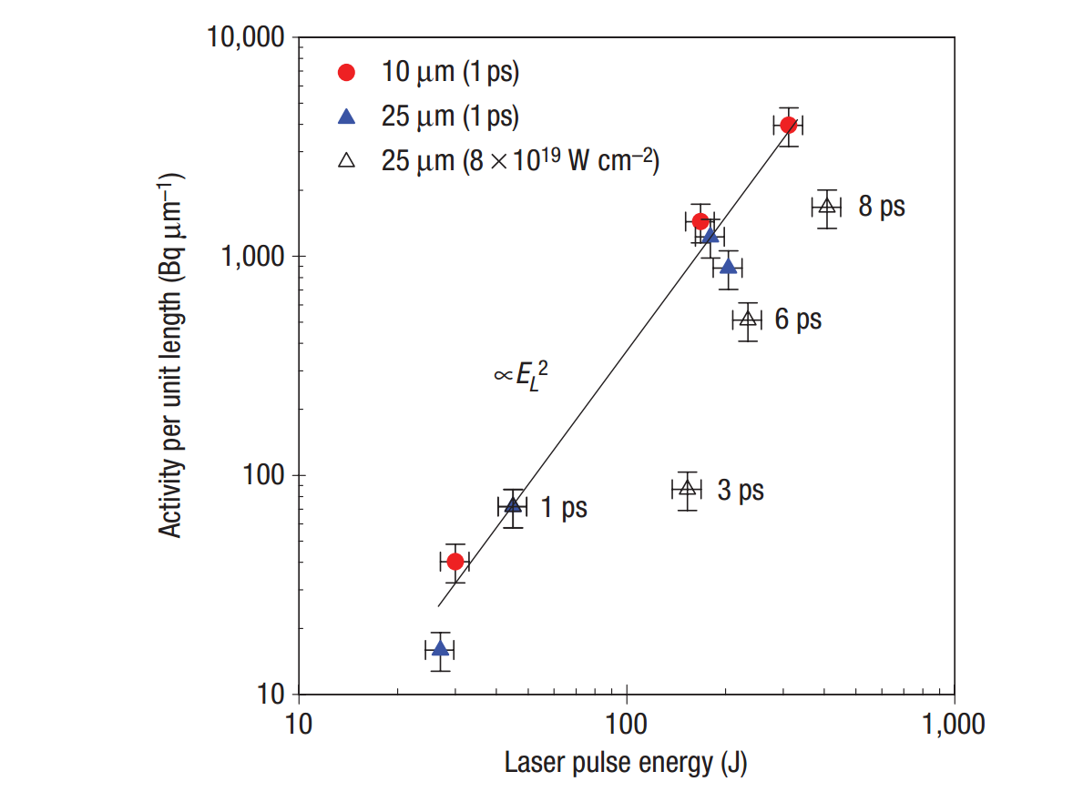
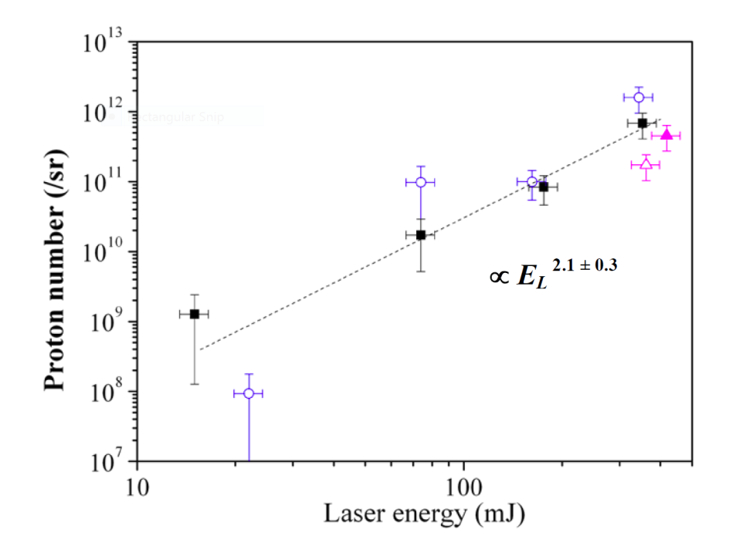
Optical control: proton number vs laser pulse energy
L. Robson et al, Nature, 3, 58-62, (2007)
1 ps, 10-25 µm Al
C. M. Brenner et al, Laser and Particle Beams, 29, 345-351, (2011)
40 fs, 25 nm CH

Slide 13
Optical enhancement: double pulse acceleration
C. M. Brenner et al, Applied Physics Letters, 104, 081123, (2014)

Slide 14
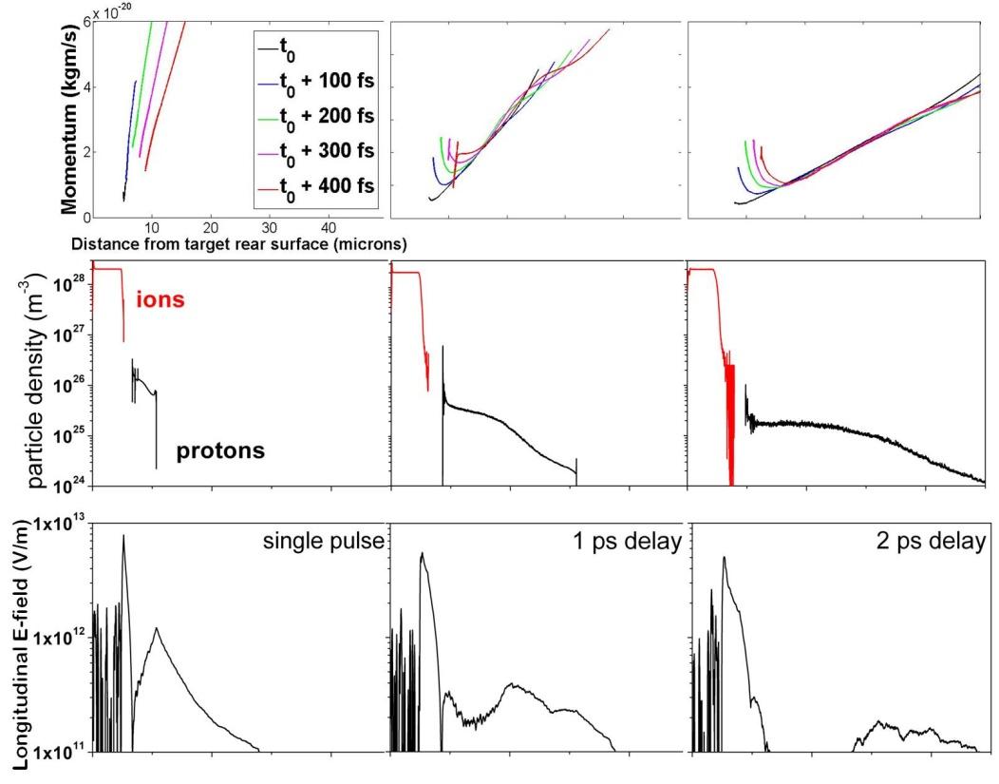
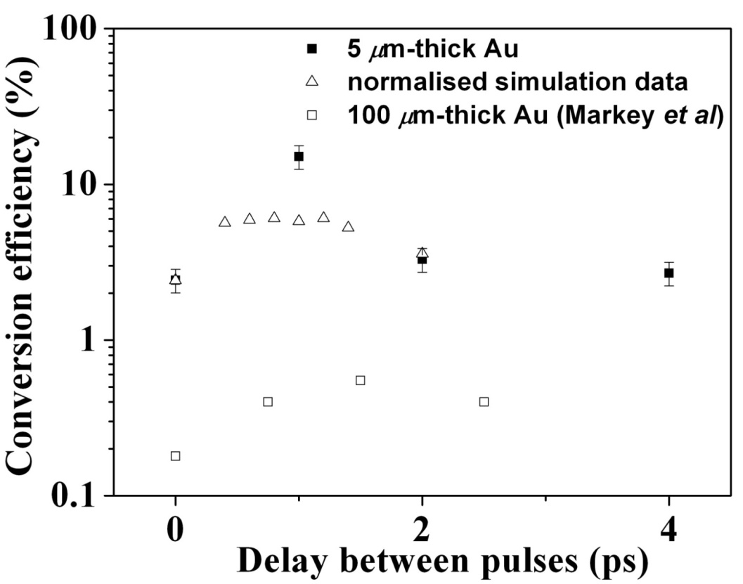
Record conversion efficiency: 15 % laser-to-proton energy
Vulcan laser: 180 J on target, 800 fs, I_{initial}:I_{main}, of 1:10
Momentum gain
Density gradients
Ion front repulsion + sheath acceleration
C. M. Brenner et al, Applied Physics Letters, 104, 081123, (2014)

Slide 15
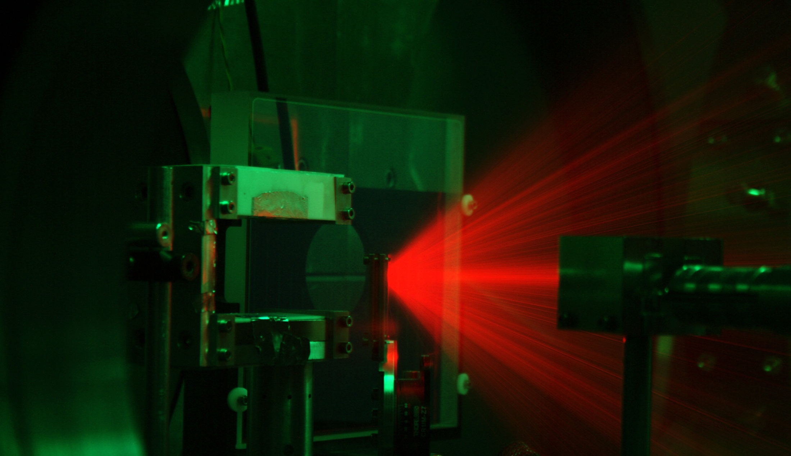
Laser-driven accelerator applications
Protons
Ions
X-rays
Neutrons
Electrons
Solid thin foil
High pressure gas
100’s J in ps pulse
10’s J in fs pulse

Slide 16
Laser-driven accelerator applications
Isochoric heating of matter
Proton radiography of hydrodynamic expansion and field lines
High energy X-ray radiography and phase-contrast imaging
Proton-driven reactions for radiotracers and neutron generation
Important beam qualities: high number of 1-15 MeV protons

Slide 17
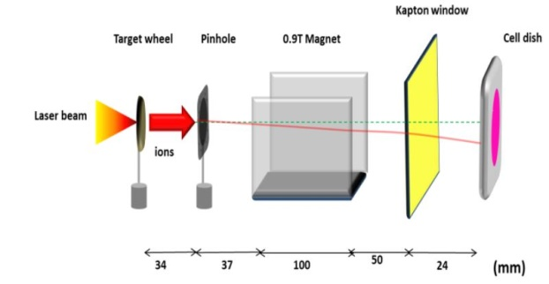
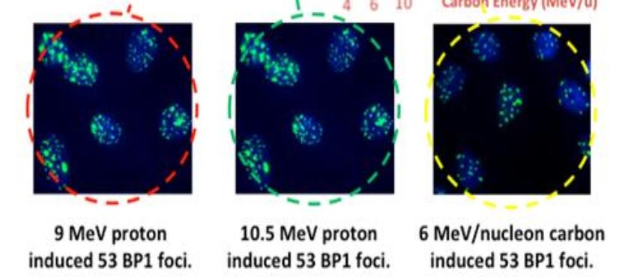
Laser-driven protons and ions for medicine
Technetium-99m one of the most widely used radioisotopes but supply at risk after closure of nuclear reactors
Can laser accelerators help support the demand and offer on-demand isotope types?
Cell irradiation with laser-driven proton and carbon beams
http://www.clf.stfc.ac.uk/CLF/resources/PDF/FullArticles/12.pdf
Laser-driven protons and ions have been investigated for double strand DNA breaks using 30 fs laser drivers and 500 fs laser drivers
How does biological effectiveness compare when using high dose, short pulse delivery
> 10⁹ Gy/s
R. Clarke ; S. Dorkings ; D. Neely and I. Musgrave " The production of patient dose level ^{99m}Tc medical radioisotope using laser-driven proton beams ", Proc. SPIE 8779, 87791C (May 9, 2013); doi:10.1117/12.2016971;
Towards Laser Driven Hadron Cancer Radiotherapy: A Review of Progress
http://arxiv.org/ftp/arxiv/papers/1405/1405.2657.pdf

Slide 18
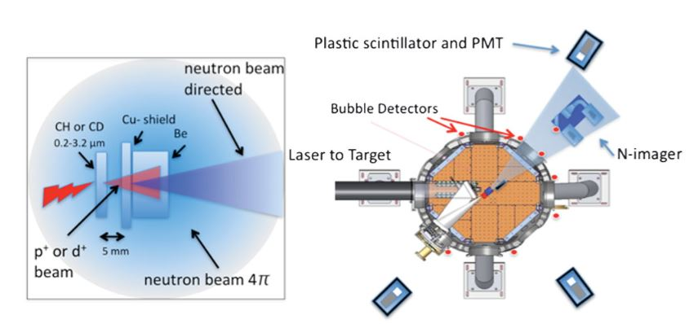
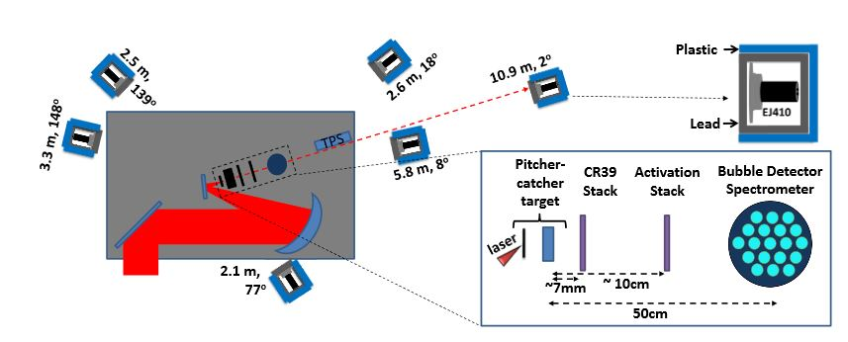
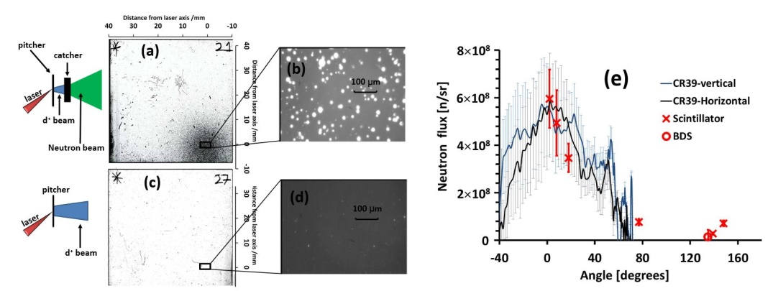
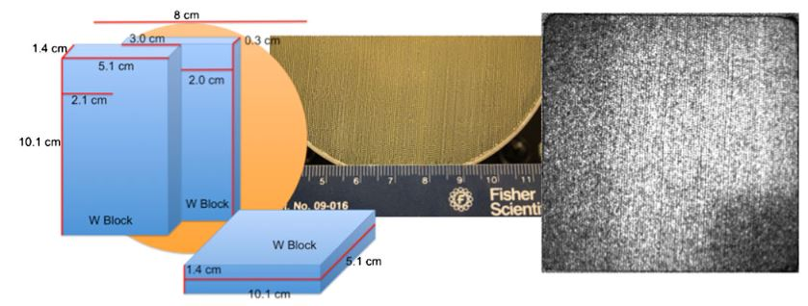
Laser-driven neutron generation for security and NDT
S. Kar et al, http://arxiv.org/pdf/1507.04511v1.pdf (2015)
M. Roth et al, PRL 110, 044802 (2013)
(p, n) reactions and (d,d) reactions in Li, Cu, Be, CD
Fast neutrons generated, > 1 MeV, ~ 10⁸⁻¹⁰ n/sr/pulse

Slide 19
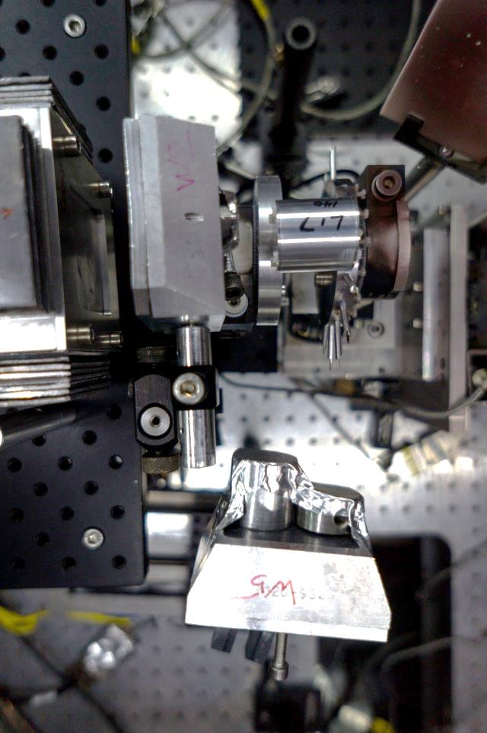
Absolutely calibrated neutron TOF spectrometer:
Mirfayzi et al, Review Scientific Instruments, 2015, Rev. Sci. Instr., 86, 073308
~ 5 cm
61 ± 2 J on 10 µm thick Au foil
Reproducible, 1- 6 MeV neutron beam, forward peaked
BUT X-ray flash dominate over neutron signal in detectors
Only active, fast-gated detectors can capture neutron flash
C. M. Brenner et al, Plasma Physics and Controlled Fusion, accepted (2015)

Slide 20
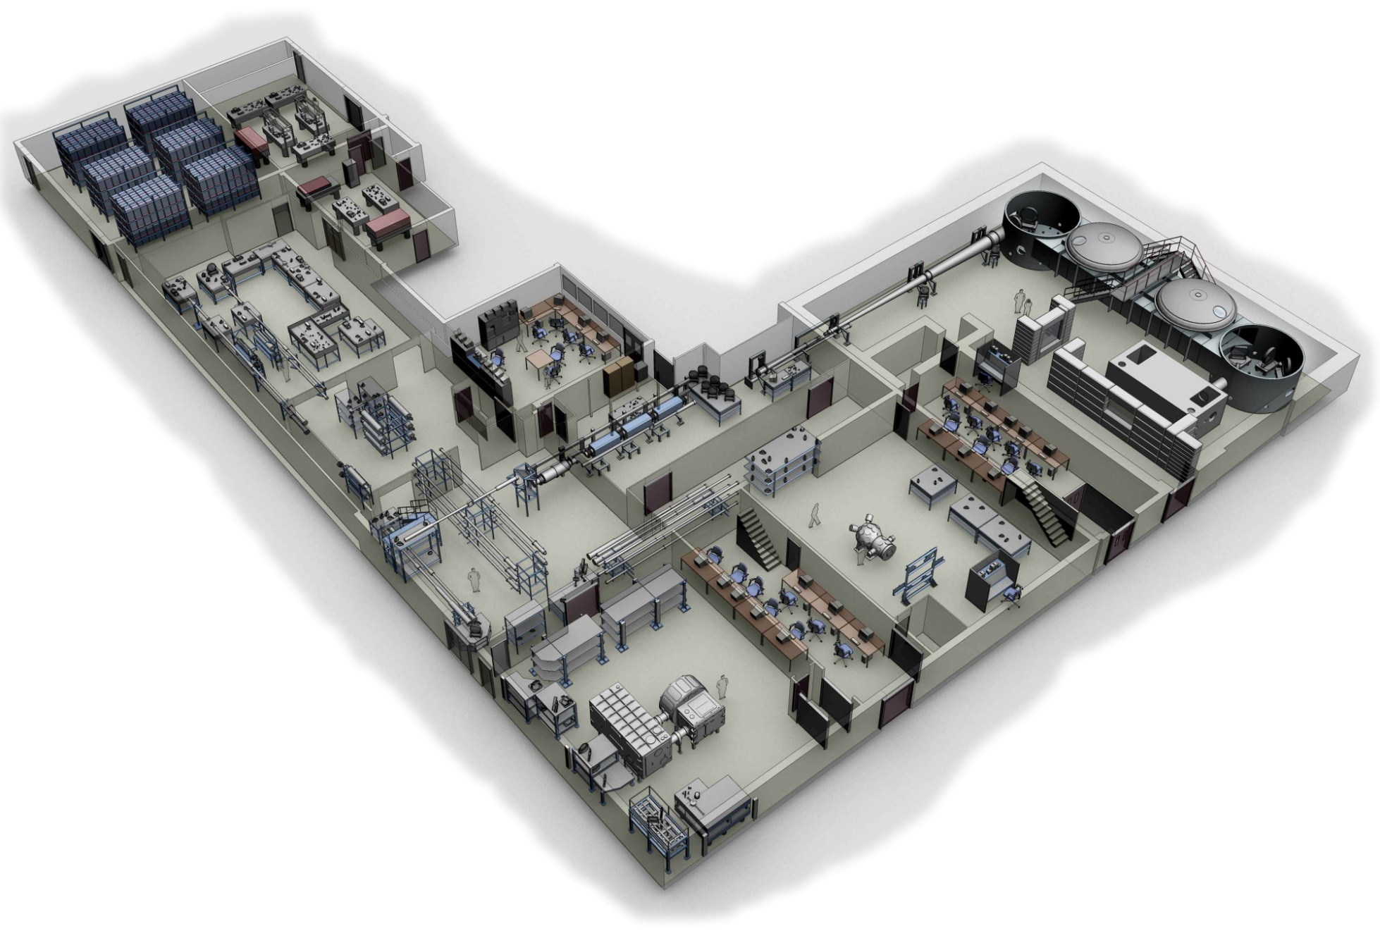
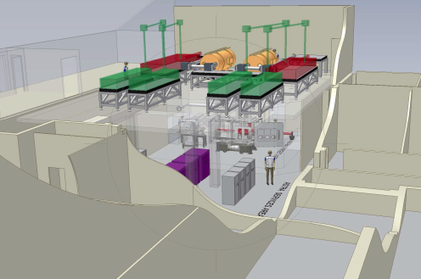
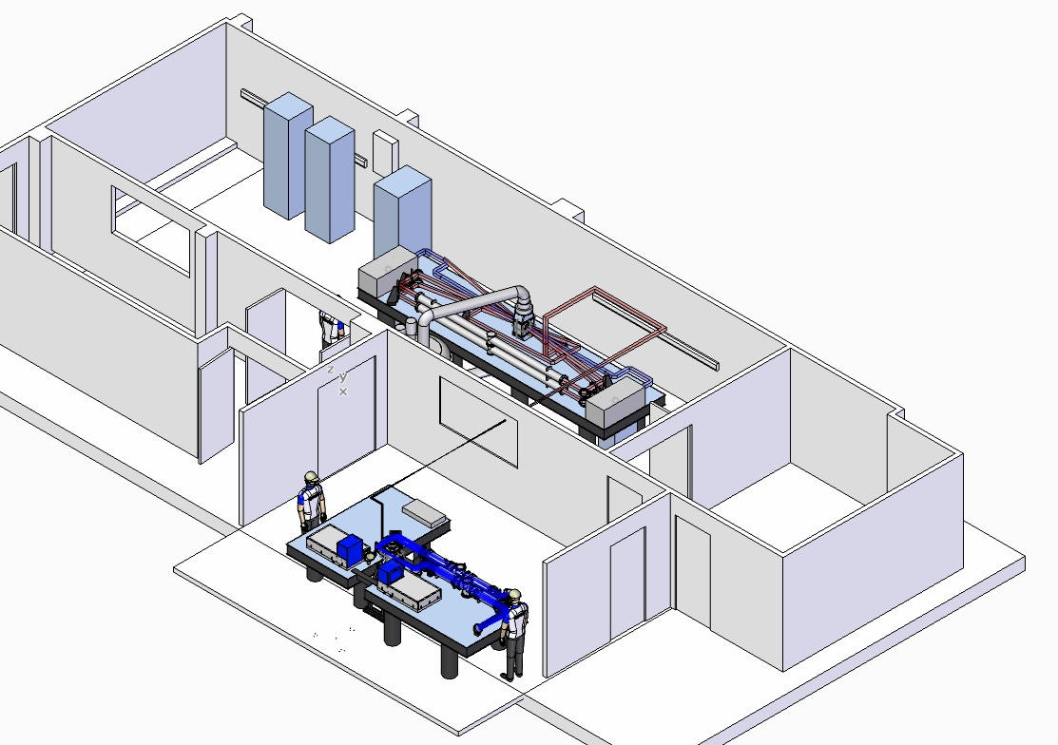
High power laser evolution at the CLF
Footprint
Footprint
1 shot per hour
1 shot per hour
10 shots per second
10 shots per second
3 shots per minute
3 shots per minute
Repetition Rate

Slide 21
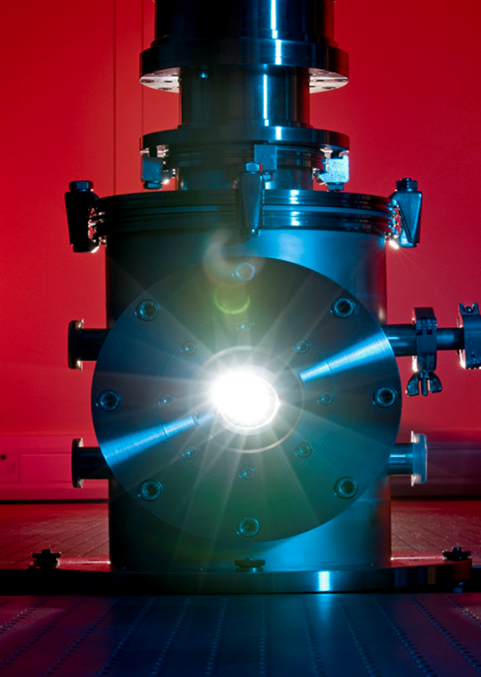
Vulcan and Gemini lasers currently demonstrating capability
DiPOLE laser design will enable portability
and high repetition rate
DiPOLE 100 (being delivered to HiLASE project, Czech Republic, this month!)
a unique combination of high average power with high peak power, diode-pumped laser technology
10 Hz, 100 J per pulse, > 20 % efficient
Currently ns pulse delivery

Slide 22
My actions
Send notification of when C ion cell irradiation paper comes out
Send PPCF special issue on Laser Plasma Acceleration Workshop
Your actions
Check out most recent review papers
Daido et al (Hiroyuki Daido et al 2012 Rep. Prog. Phys. 75 056401) and Macchi et al (Rev. Mod. Phys. 85, 751, 2013)
Our actions
Maintain dialogue between communities and keep sharing best practices
“For a successful technology, reality must take
precedence over public relations, for Nature
cannot be fooled”
Richard P. Feynman

