Slide 1
All in a spin – An introduction to muon science
Adrian Hillier
ISIS Muon Group
PASI ‘15 Chicago, Illinois, USA

Slide 2
MUONS:
Versatile probes of magnetic, superconducting, molecular systems
Analogues of protons/hydrogen in semiconductors
Complementary to other techniques ISIS / PSI / J-PARC all have n and μ facilities
Around 60 groups from 20 countries using ISIS muons
Further details:
www.isis.stfc.ac.uk/groups/muons/

Slide 3
Muon properties
Muons:
fundamental, charged particles
heavy electrons
spin 1/2
magnetic moment 3.2 x m_{p}
mass 0.11 x m_{p}
produced from pion decays
lifetime 2.2 μs
decay into a positron (+ 2xν)

Slide 4
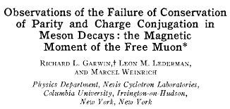
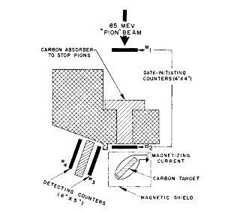
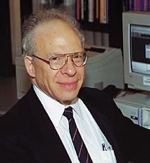
Muon death

Slide 5
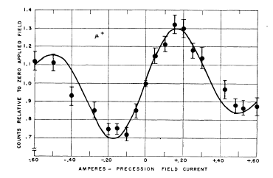
Muon death
‘It seems possible that polarised positive and negative muons will become a powerful tool for exploring magnetic fields in nuclei, atoms and interatomic regions’.
Garwin et al., Phys Rev 1957
The muon technique was born!
μSR . . . muon spin rotation, relaxation and resonance –
or just muon spin research

Slide 6
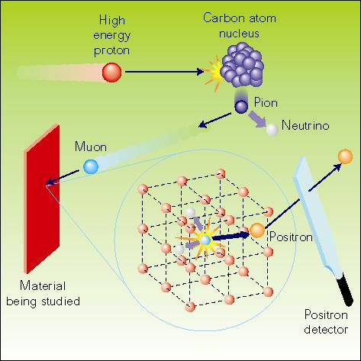
The μSR technique
High energy protons
(800 MeV at ISIS)
collide with carbon nuclei
producing pions
π⁺ → μ⁺ + ν_{μ}
4 MeV muons are 100% spin polarised
Decay, lifetime 2.2μs
μ⁺ → e⁺ + ν_{e} + ν_{μ}
we detect decay positrons
Implantation,
(stopped in ~1mm water)
The positrons are preferentially emitted in muon spin direction
Muons interact with local magnetic environment
Monitor the positron distribution to infer the muons’ polarisation after implantation. Learn about the muons’ local environment or the muon behaviour itself.

Slide 7
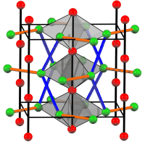
The muon in materials
Mu⁺ diamagnetic
μ⁺
Mu• paramagnetic
RMu• paramagnetic

Slide 8
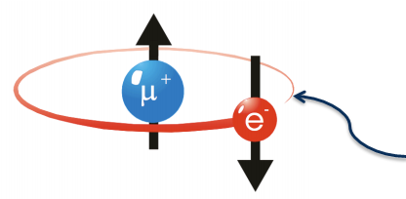
The muon in materials
Muonium: positive muon + electron -
hydrogen atom analogue
Mass: m_{Mu}=1/9m_{H}
Bohr radius: a_{Mu}=1.004a_{H}
Ionisation potential: I_{Mu}=0.996I_{H}
Chemical behaviour very similar – dynamics different

Slide 9
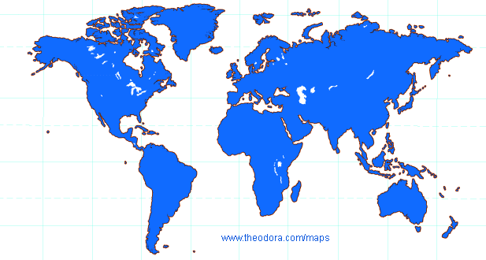
μSR facilities
UK: ISIS
South Korea:
RAON
Canada: TRIUMF
Japan: JPARC
China:
CSNS
Switzerland: PSI

Slide 10
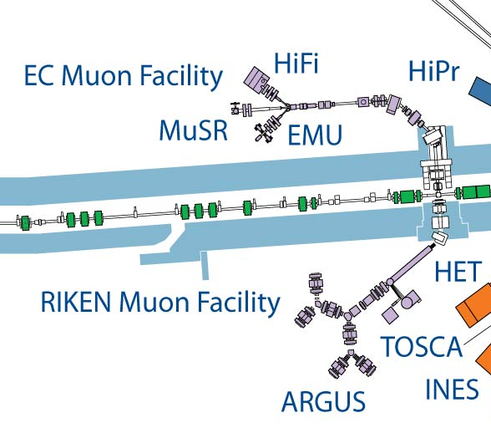


Muons at ISIS
CHRONUS

Slide 11
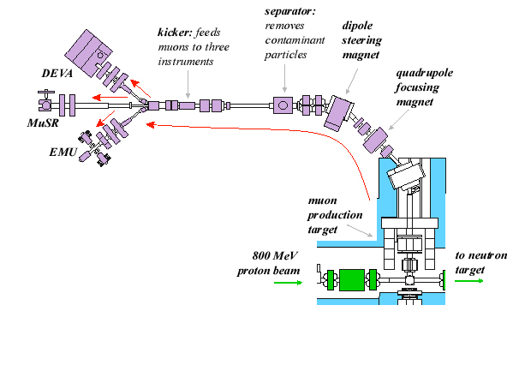
Muons at ISIS

Slide 12
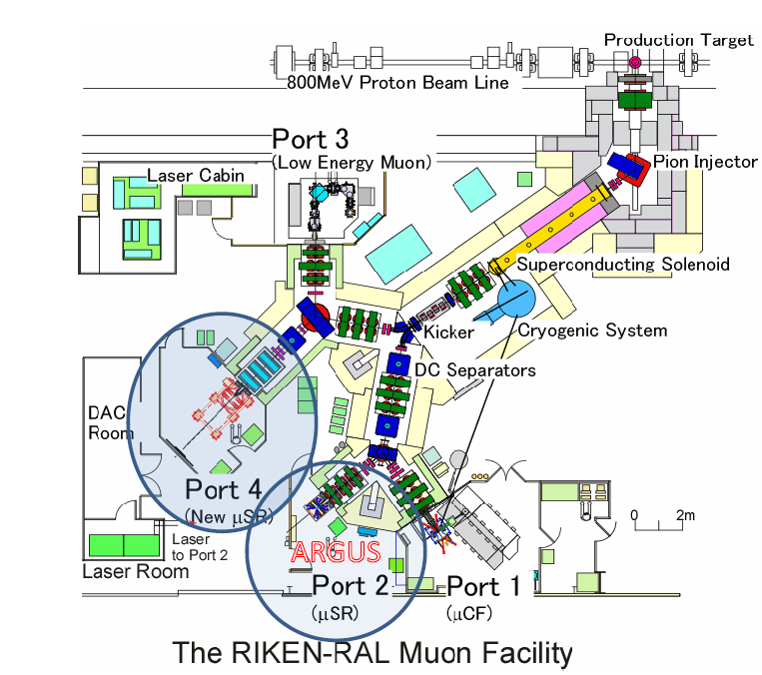
riken
RIKEN beamlines

Slide 13
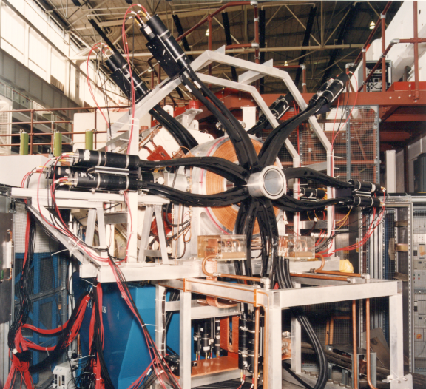
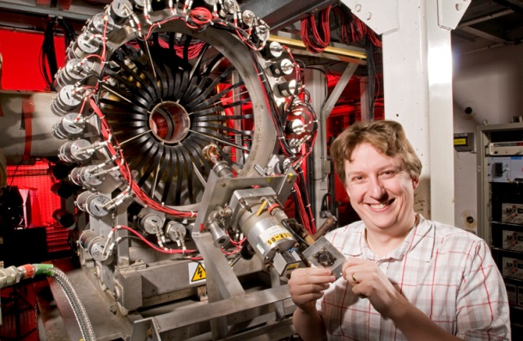
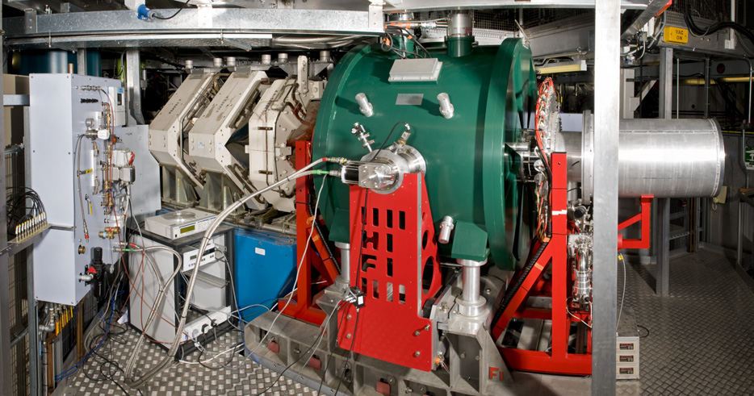
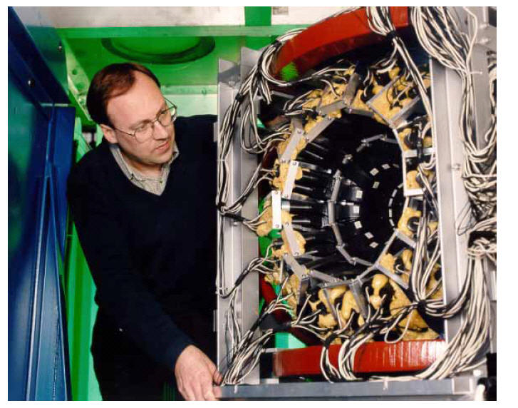
Muons at ISIS
MuSR
EMU
ARGUS
HiFi
Fields: 0G – 5 T
Temperatures:
30 mK – 1500 K
Pressure:
up to 6.4kbar
+ and - muons
Gas/liquid samples
Pulsed stimuli,
e.g. light, E/B-
fields, RF

Slide 14
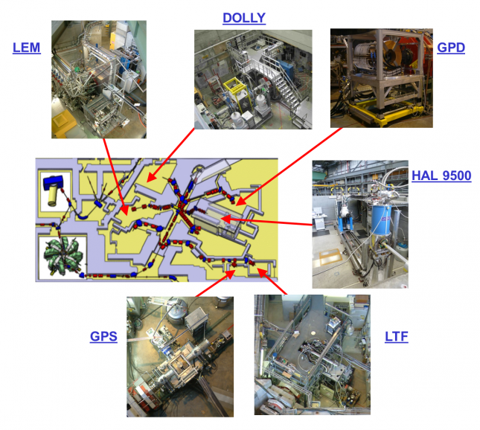
μSR facilities
PSI, Switzerland

Slide 15
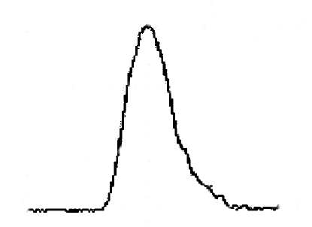
μSR facilities
Pulsed (e.g. ISIS, J-PARC)
Bursts of muons, ~50 Hz
Low intrinsic background
Weak relaxations, slow precession
No fundamental rate limit
Big detector arrays
Pulsed environments
Continuous (e.g. PSI, TRIUMF)
Single muons
Higher intrinsic background
Fast relaxations, rapid precession
Data rates limited
Small, compact detector arrays
PSI: low energy muons for surface studies, + pressure

Slide 16
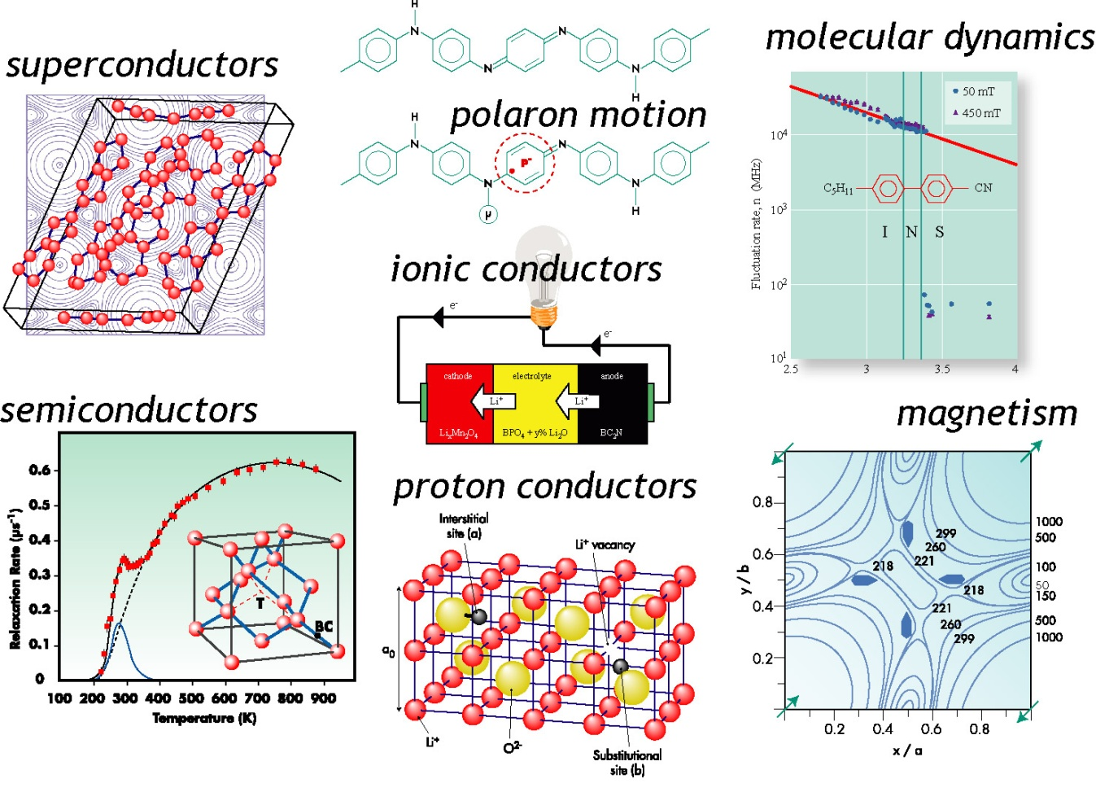
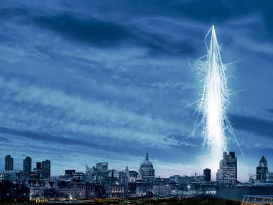
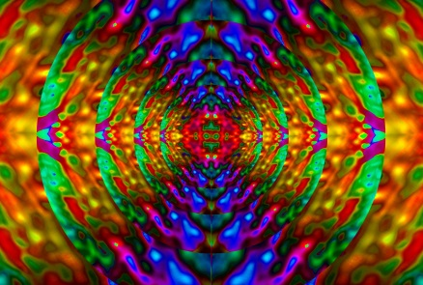
Muon science areas
Muons as passive probes in superconductivity, magnetism, molecular dynamics, charge transport.
Muons as active probes: proton analogues in semiconductors, proton conductors, light particle diffusion, etc.
Electronic irradiation
Elemental Analysis

Slide 17

Muons in Magnetism

Slide 18
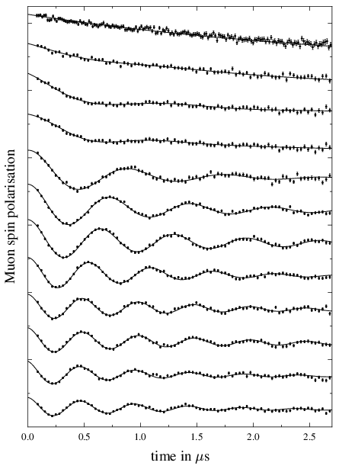
Magnetic Transitions
Characteristic regions versus T
Paramagnetic (T>T_{c}): weak static nuclear moments dominate
Critical (T~T_{c}): electronic fluctuations plus weak static moments from both electrons and nuclei
Ordered (T<T_{c}): static electronic moments dominate
NPNN organic magnet
High T
Low T
Cu(NO₃)₂(pyz): S=1/2 Heisenberg AF spin chain
Ordered moment is 0.13 μ_{B}
and T_{N} is 107 mK

Slide 19
Muons in Superconductivity

Slide 20
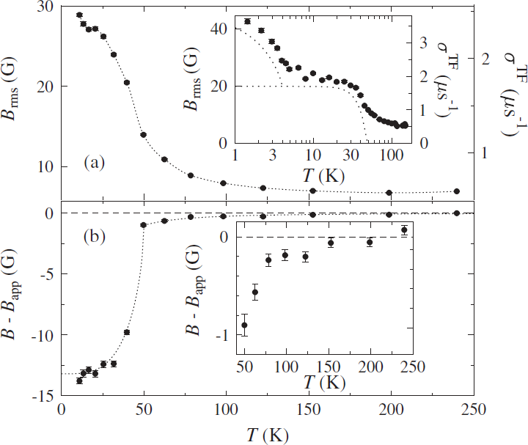
Applications – I
Determining properties of superconductors
Penetration depth λ
  Related to critical current
  Maximum field without vortex penetration (H_{c1})
Coherence length ξ
  Related to maximum superconducting field (H_{c2})
Structure/symmetry of the superconducting energy gap
  Gives clues about the interactions driving superconductivity
SmFeAsO_{1-x}F_{x}

Slide 21
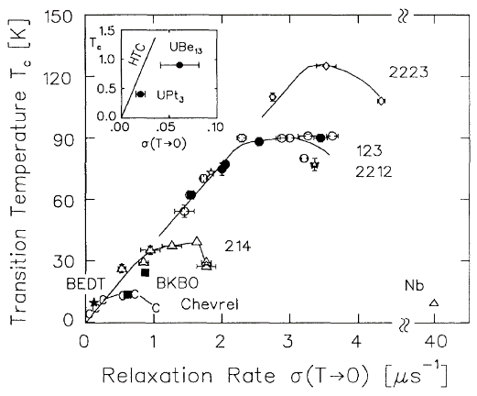
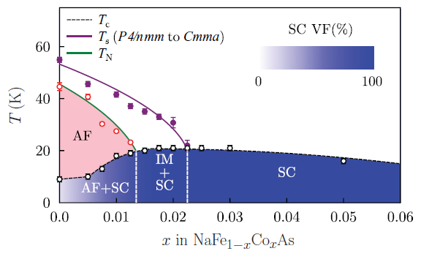
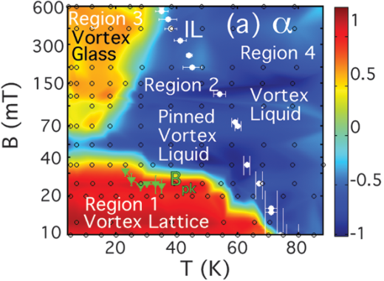
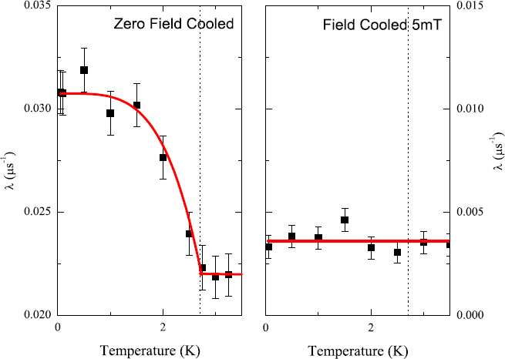
Applications – II
Finding trends in families of superconductors
  Uemura plot
  Phase diagrams for materials
Understanding the physics of the vortex lattice
  Vortex liquid and glass states
  Pancake vortices
Time-reversal symmetry breaking
  Measure in zero applied field compensating any external fields
  Tiny magnetic signal emerges
  Very hard to measure otherwise

Slide 22
Charge transport

Slide 23


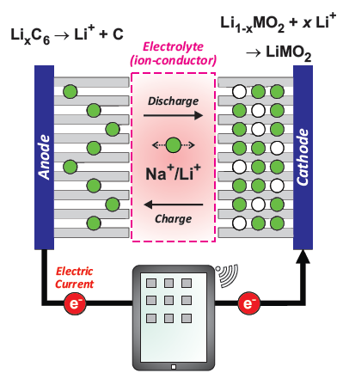
Fuel Cells
Fuel cells as well as batteries are electrochemical energy cells that directly transforms chemical energy into electricity.
A fuel cell uses externally supplied fuels, while a battery is a chemically closed system with a limited amount of internally stored energy.
Fuel cells directly produce exhaust gases (H₂O, CO₂ ...) while batteries only indirectly (electric power plant).
Very efficient devices:
  batteries up to 85-98% efficiency
  combustion engine ~35-50%
Figures courtesy of Dr Martin Mansson (PSI)

Slide 24
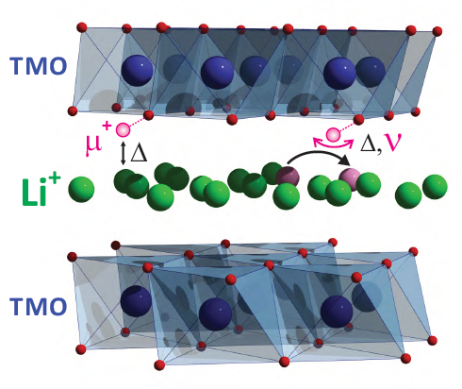
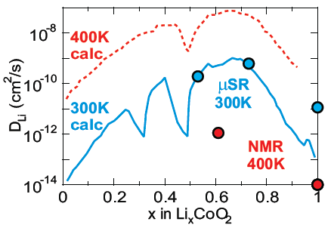
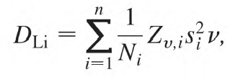

Ion diffusion as probed by μ⁺SR
Data is now described by the dynamic Kubo-Toyabe (DKT) function. As well as internal field width, Δ, the DKT also models the ion hopping rate (ν)
From T-dependence, ν(T), the ion self-diffusion coefficient (D_{ion}) is extracted
Muons allow us to measure D_{ion} directly with no influence of battery architecture (unlike EIS)
Muons allow us to separate magnetic relaxation and diffusion processes (unlike NMR)
J Sugiyama et al, PRL, 103 (147601) 2009
Figures courtesy of Dr Martin Mansson (PSI)

Slide 25


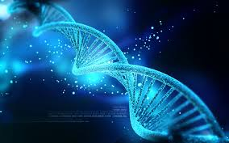
Electron transfer in bio-materials
Electron transfer in macro-molecules is the most important mechanism for many biological phenomena
  Energy consumption and storage
  Photo-synthesis and respiration
  Experimentally, most information on electron transfer is determined using macroscopic methods
Muons have proven extremely useful for probing LOCAL e⁻ transfer in conducting polymers …
  Francis Pratt (ISIS), Stephen Blundell (Oxford) et al
… now extended to bio-materials (DNA,cytochrome)
  Kanetada Nagamine (RIKEN) et al

Slide 26
Muons in Chemistry

Slide 27
µSR and Chemistry
Reaction Rates
Study
atoms and molecules
containing µ⁺
Molecular structure
Molecular dynamics
Molecular environment
Why study μ⁺ as a substitute for p⁺ ?
Because they are different: isotope effects
Because they are similar: tracer, spin label

Slide 28
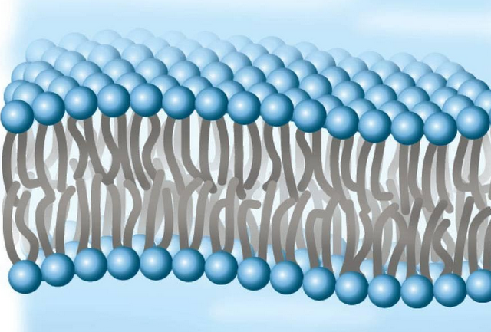
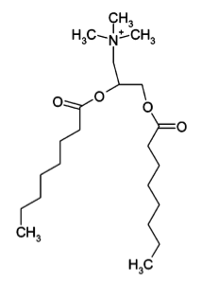
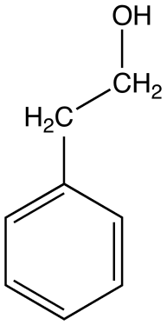
Phenylethanol in surfactants
polar head groups
DHTAC
aqueous layer
non-polar alkyl chains
Cosurfactant
aqueous layer
present in low concentrations
Mu adds to aromatic group

Slide 29
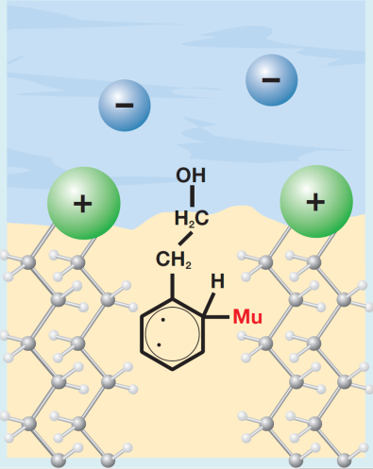
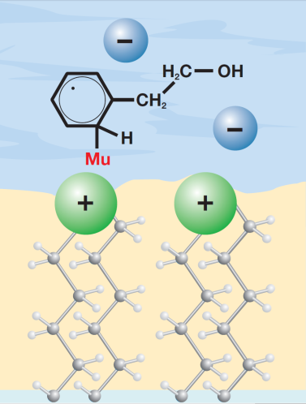
Partitioning of PEA in DHTAC
High temperature L_{α} phase
Δ₁ resonances present - anisotropic environment (in/associated with bilayer)
Resonance field characteristic of non-polar environment
L_{α}
Low temperature L_{β} phase
L_{β}
No Δ₁ resonances
Δ₀ resonances characteristic of aqueous environment
Scheuermann et al., PCCP, 4 (2002) 1510

Slide 30
Muons in semiconductor

Slide 31
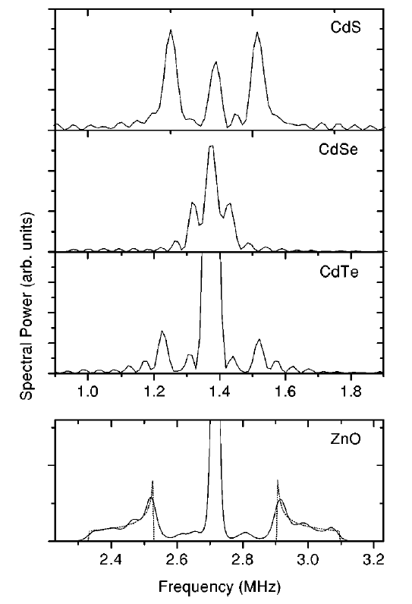
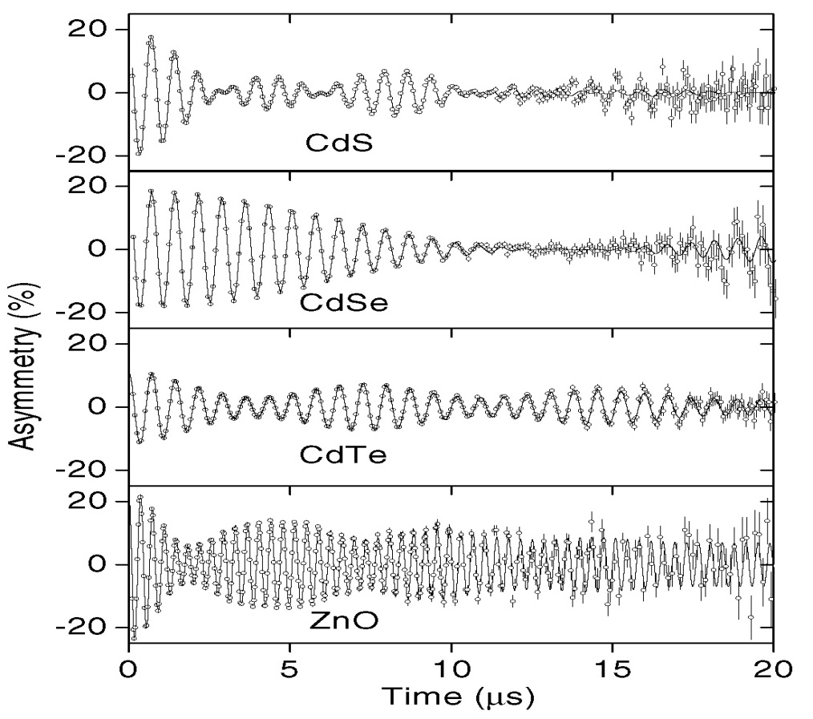
Shallow donor states in II-VI semiconductors
First experimental evidence of muonium (and hence hydrogen) forming shallow donor states in semiconductors
Of very real interest to semiconductor community
Pulsed muon source essential to allow measurements to long times - ISIS is unique in Europe.
Shallow donor muonium states in II-VI semiconductor compounds
J Gil et al, PRB 64 (2001) 075205

Slide 32
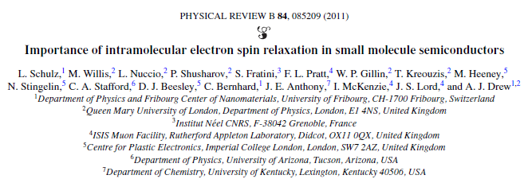
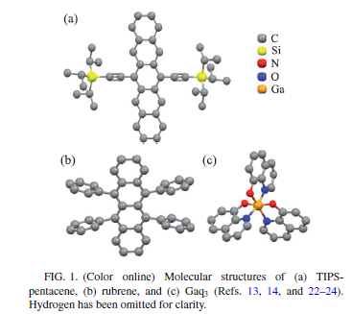
Organic Spintronics
Small molecule semiconductors used in molecular electronic devices such as:
Spin valves
OLEDs
FETs

Slide 33
Muons in Electronic Irradiation

Slide 34

Incident Primary Cosmic Ray
Cosmic Ray radiation at ‘Ground Level’
Cosmic Rays generate radiation at ground level
Cosmic Ray radiation are a major problem in electronic devices and systems

Slide 35
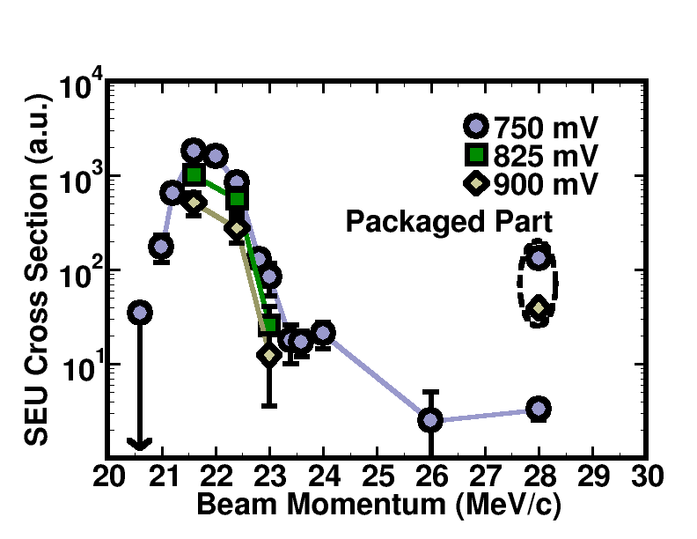
Bias Dependence
SRAM B1
Exposures at the highest momentum 28 MeV/c resulted in countable, but relatively few upsets
At 750 mV, critical charge threshold is reduced and allows muons with slightly higher momentum to upset the cells

Slide 36
Muons in Elemental Analysis

Slide 37
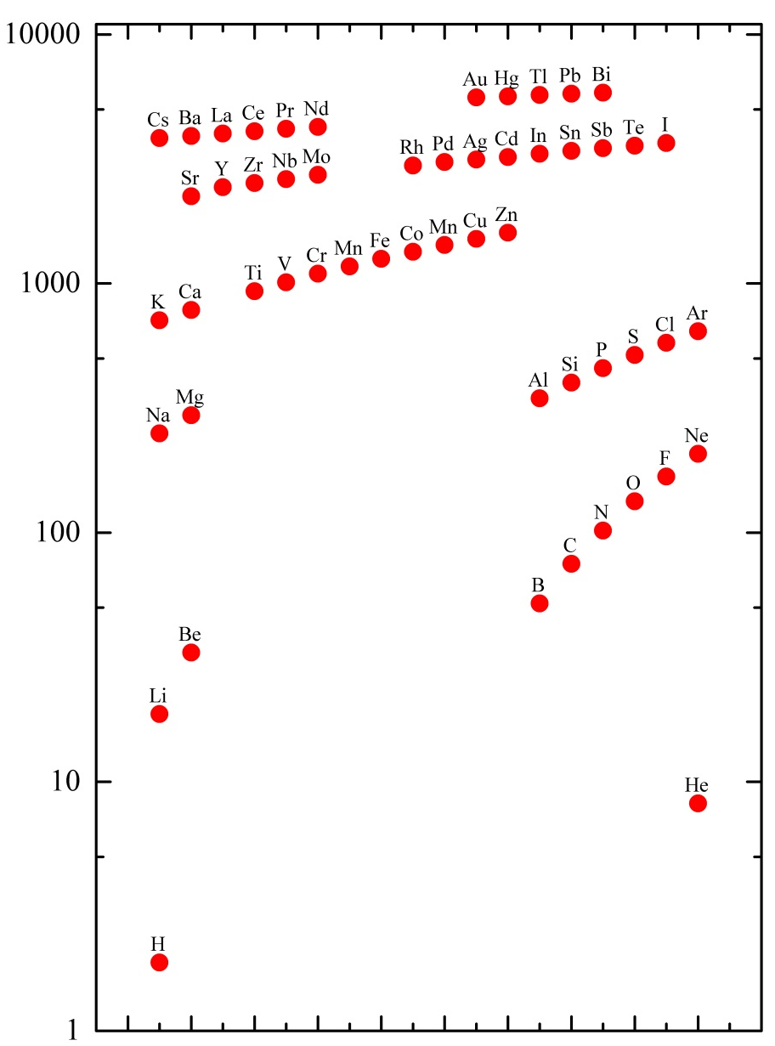
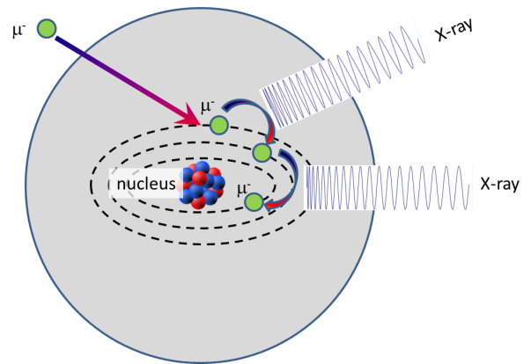
Negative muons
High Energy X-rays emitted
  0.1-10MeV
Transition Energies are known from measurement and calculation

Slide 38
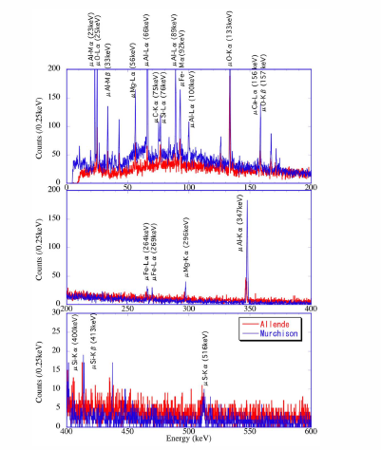
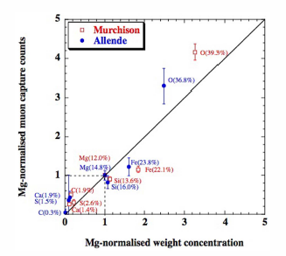
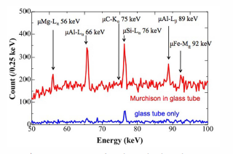
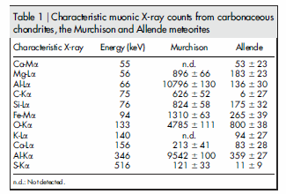
meteorites
Terada et al Sci. Rep. 4 5072 (2014)

Slide 39
Roman Coins

Slide 40
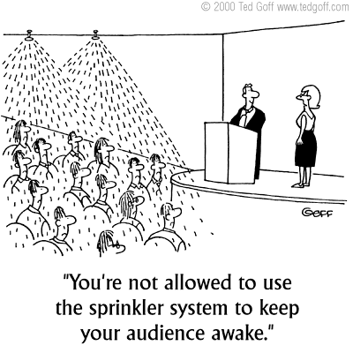
6. Summary

Slide 41
MUONS:
Versatile probes of magnetic, superconducting, molecular systems
Analogues of protons/hydrogen in semiconductors
Complementary to other techniques ISIS / PSI / J-PARC all have n and μ facilities
Around 60 groups from 20 countries using ISIS muons
Further details:
www.isis.stfc.ac.uk/groups/muons/

Slide 42
So the future….
Pulsed (e.g. ISIS, J-PARC)
Bursts of muons, ~50 Hz
Low intrinsic background
Weak relaxations, slow precession
No fundamental rate limit
Big detector arrays
Pulsed environments
What would we like..
More muons
More sources
Both continuous and pulsed sources
Pulsed sources
  Higher repetition rate
    30kHz?
  Although 50Hz has advantages for pulsed stimulation
  Shorter pulses
    10ns
Continuous (e.g. PSI, TRIUMF)
Single muons
Higher intrinsic background
Fast relaxations, rapid precession
Data rates limited
Small, compact detector arrays
PSI: low energy muons for surface studies, + pressure

