Slide 1
Integrable Optics Test Accelerator
Alexander Valishev
PASI-2015, Fermilab
12 November 2015

Slide 2
Acknowledgments
D.Broemmelsiek, A.Burov, K.Carlson, A.Didenko, N.Eddy, V.Kashikhin, V.Lebedev, J.Leibfritz, M.McGee, S.Nagaitsev, L.Nobrega, H.Piekarz, E.Prebys, A.Romanov, G.Romanov, V.Shiltsev, G.Stancari, J.Thangaraj, R.Thurman-Keup, A.Valishev, S.Wesseln, D.Wolff (FNAL)
S.Chattopadhyay, P.Piot, Y.M.Shin (NIU)
D.Shatilov (BINP)
G.Kafka (IIT)
S.Danilov (ORNL),
S.Antipov (U of Chicago)
J.Cary (Tech-X)
D.Bruhwiler, N.Cook, S.Webb (RadiaSoft)
F.O’Shea, A.Murokh (RadiaBeam)
R.Kishek, K.Ruisard (UMD)

Slide 3
PIP-III “multi-MW”- Option A: 8+ GeV smart RCS
(Rapid Cycling Synchrotron – ring)
120 GeV RCS
Main Injector
8 GeV
Recycler ?
≥ 2.5 MW
target
new 8-12 GeV “smart” RCS
800 MeV
SC Linac PIP-II

Slide 4
R&D on High Current Synchrotrons
The future is in beam control and mitigation of beam losses!
  High energy machines – beam can damage components
  High current machines – component activation
To enable multi-MW beam power, losses must be kept well <1% at high intensity:
  Very challenging after 50 years of development
Need to develop technology for
  Beam halo control
  Single-particle and coherent beam stability

Slide 5
Enter IOTA
We have two innovative ideas:
  Integrable Optics
  Space Charge Compensation
To test them, we are building the Integrable Optics Test Accelerator
  To become a machine for proof-of-principle R&D
There is are no dedicated ring-based accelerator test facilities in the US for high intensity research
  UMER at UMD is operating with 10keV electrons, only few turns

Slide 6
Integrable Optics Test Accelerator
Unique features:
  Can operate with either electrons or protons (up to 150 MeV/c momentum)
  Large aperture
  Significant flexibility of the lattice
  Precise control of the optics quality and stability
  Set up for very high intensity operation (with protons)
Based on conventional technology (magnets, RF)
Cost-effective solution
  Balance between low energy (low cost) and research potential

Slide 7
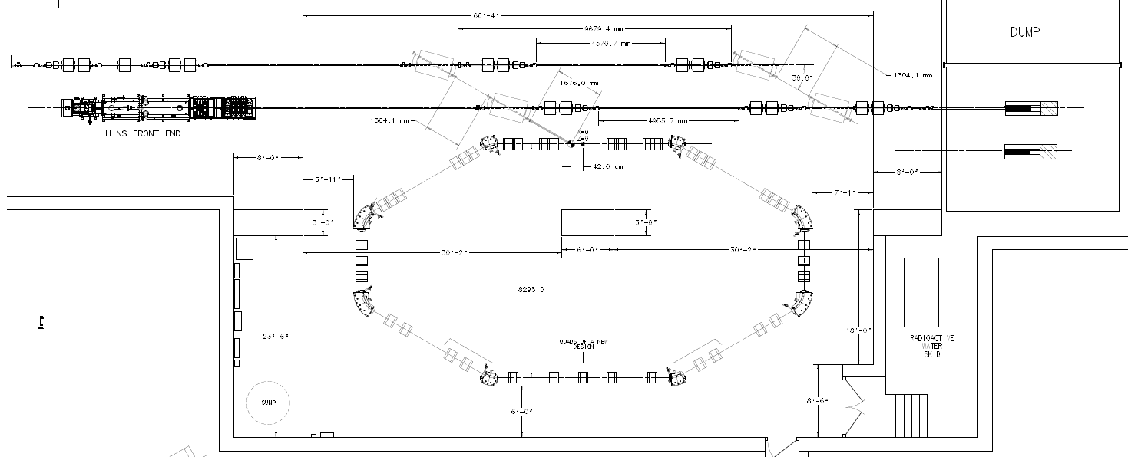
IOTA Ring
e- beam line
p beam line
2.5 MeV RFQ

Slide 8
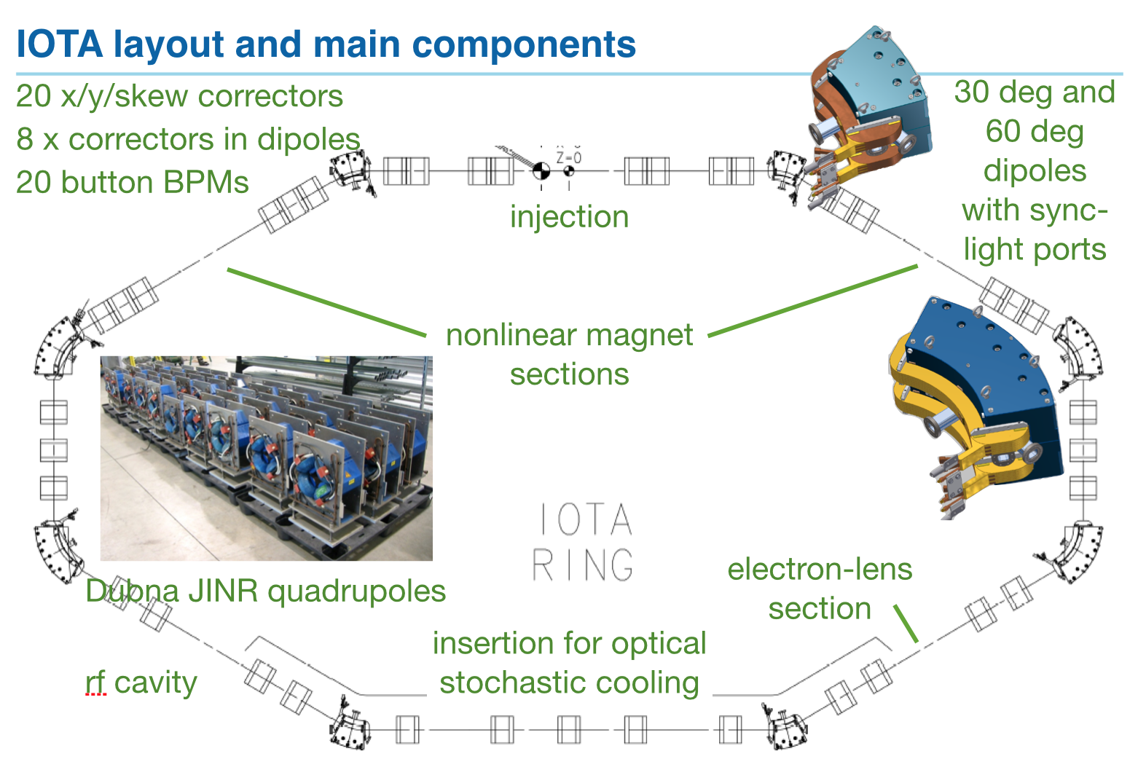
IOTA Layout

Slide 9
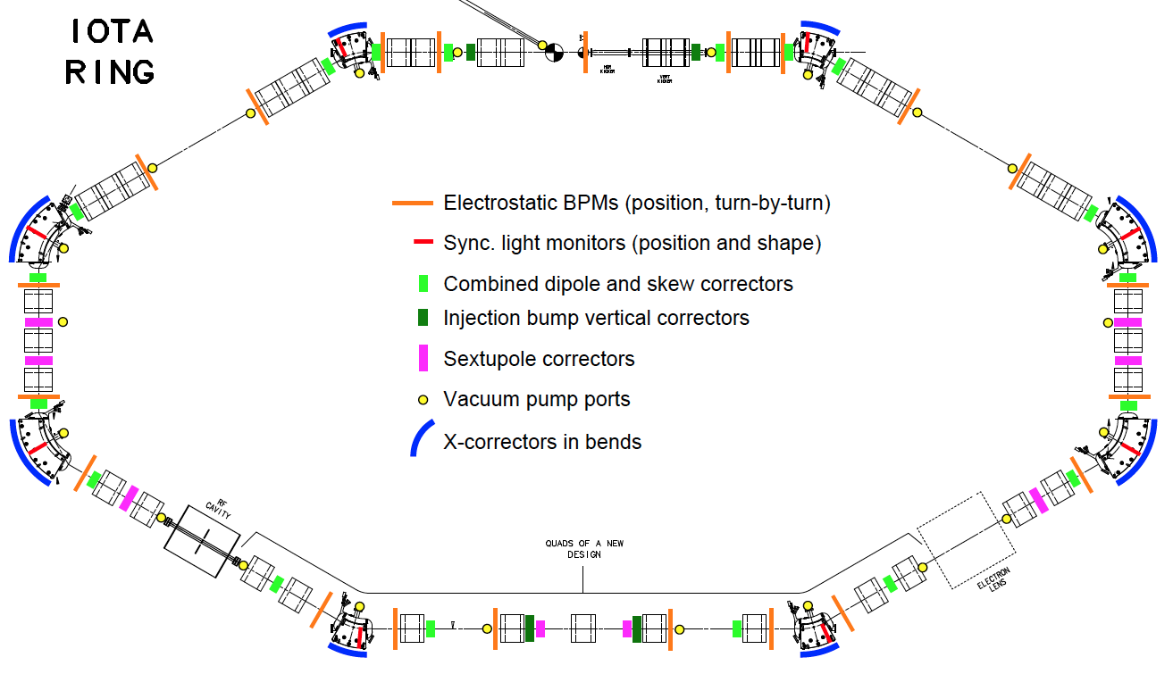
IOTA Layout

Slide 10
IOTA Parameters
Nominal kinetic energy | e⁻: 150 MeV, p+: 2.5 MeV
Nominal intensity | e⁻: 1×10⁹, p+: 1×10¹¹
Circumference | 40 m
Bending dipole field | 0.7 T
Beam pipe aperture | 50 mm dia.
Maximum b-function (x,y) | 12, 5 m
Momentum compaction | 0.02 ÷ 0.1
Betatron tune (integer) | 3 ÷ 5
Natural chromaticity | -5 ÷ -10
Transverse emittance r.m.s. | e⁻: 0.04 μm, p+: 2μm
SR damping time | 0.6s (5×10⁶ turns)
RF V,f,q | e⁻: 1 kV, 30 MHz, 4
Synchrotron tune | e⁻: 0.002 ÷ 0.005
Bunch length, momentum spread | e⁻: 12 cm, 1.4×10⁻⁴

Slide 11
IOTA Physics Drivers
Nonlinear Integrable Optics – Experimental demonstration of NIO lattice in a practical accelerator
Space Charge Compensation – Suppression of SC-related effects in high intensity circular accelerators
  Nonlinear Integrable Optics
  Electron lenses
  Electron columns
  Circular betatron modes
Optical Stochastic Cooling – Proof-of-principle demonstration
Beam collimation – Technology development for hollow electron beam collimation
Electron Cooling – Advanced techniques
Laser-Plasma Accelerator – Demonstration of injection into synchrotron
Quantum Physics – Localization of single electron wave function

Slide 12
IOTA Physics Drivers
Nonlinear Integrable Optics

Slide 13
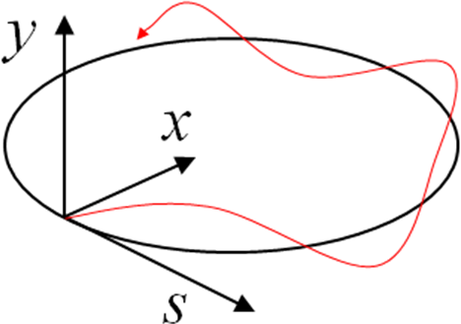
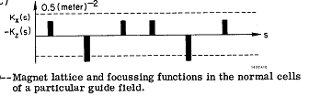

Strong Focusing – Standard Approach Since 1952
Christofilos (1949); Courant, Livingston and Snyder (1952)
Particle undergoes betatron oscillations
-- piecewise constant
alternating-sign functions
s is “time”
13

Slide 14
Focusing: Linear vs. Nonlinear
Accelerators are linear systems by design (frequency is independent of amplitude).
In accelerators, nonlinearities are unavoidable (space charge, beam-beam) and some are useful (Landau damping).
All nonlinearities (in present rings) lead to resonances and dynamic aperture limits.
Are there “magic” nonlinearities with zero resonance strength?
The answer is – yes (we call them “integrable”)

Slide 15
Do Accelerators Need to be Linear?
Search for solutions that are strongly nonlinear yet stable
Orlov (1963)
McMillan (1967) – 1D solution
Perevedentsev, Danilov (1990) – generalization of McMillan case to 2D, round colliding beams. Require non-Laplacian potentials to realize
  Round colliding beams possess 1 invariant – VEPP-2000 at BINP (Novosibirsk, Russia) commissioned in 2006. Record-high beam-beam tune shift ~0.25 attained in 2013
Danilov, Shiltsev (1998) – Non-linear low energy electron lenses suggested, FNAL-FN-0671
Chow, Cary (1994)
Nonlinear Integrable Optics: Danilov and Nagaitsev solution for nonlinear lattice with 2 invariants of motion that can be implemented with Laplacian potential, i.e. with special magnets – Phys. Rev. ST Accel. Beams 13, 084002 (2010)

Slide 16
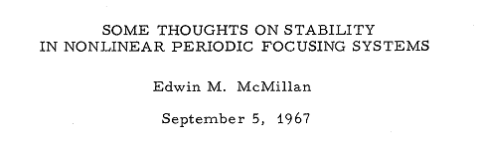
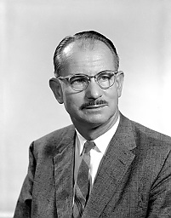
2D Generalization of McMillan Mapping
Thin lens
1D – thin lens kick
2D – a thin lens solution can be carried over to 2D case in axially symmetric system
1. The ring with transfer matrix
2. Axially-symmetric thin kick
can be created with electron lens

Slide 17
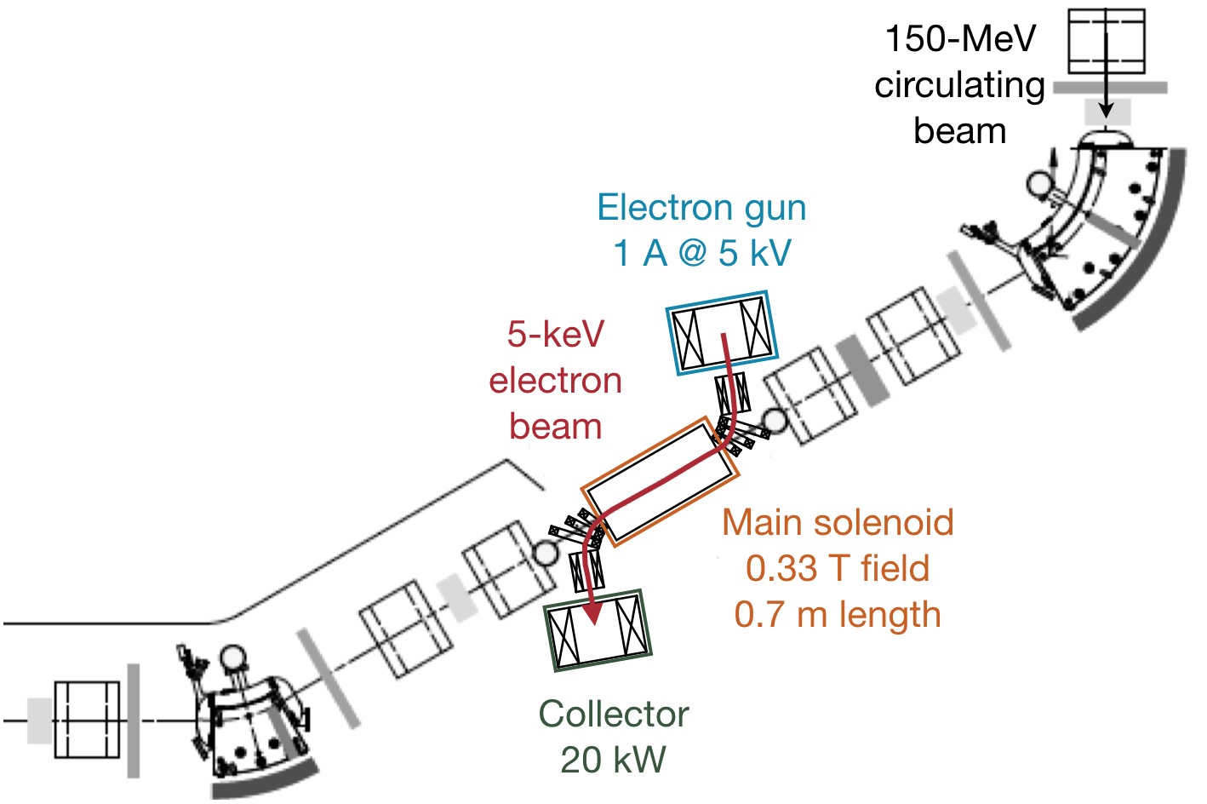
IOTA Electron Lens
Capitalize on the Tevatron experience and recent LARP work
Re-use Tevatron EL components

Slide 18
Other Solutions?
Implementation of axially symmetric cases requires electro-magnetic fields that do not satisfy Maxwell equations in vacuum (non-Laplacian potential)
  Electron Lenses: Danilov, Shiltsev, Fermilab-FN-0671 (1998) and Phys. Rev. ST Accel. Beams 2, 07001 (1999)
Solution with Laplacian potential: Danilov, Nagaitsev, Phys. Rev. ST Accel. Beams 13, 084002

Slide 19
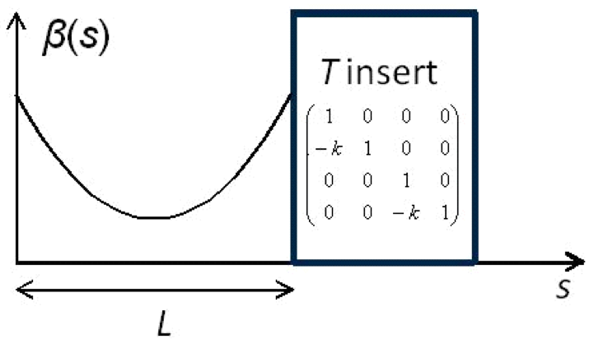
Nonlinear Integrable Optics with Laplacian Potential
Start with a round axially-symmetric linear lattice (FOFO) with the element of periodicity consisting of
  Drift L
  Axially-symmetric
  focusing block “T-insert”
  with phase advance n×π
Add special nonlinear potential V(x,y,s) in the drift such that

Slide 20
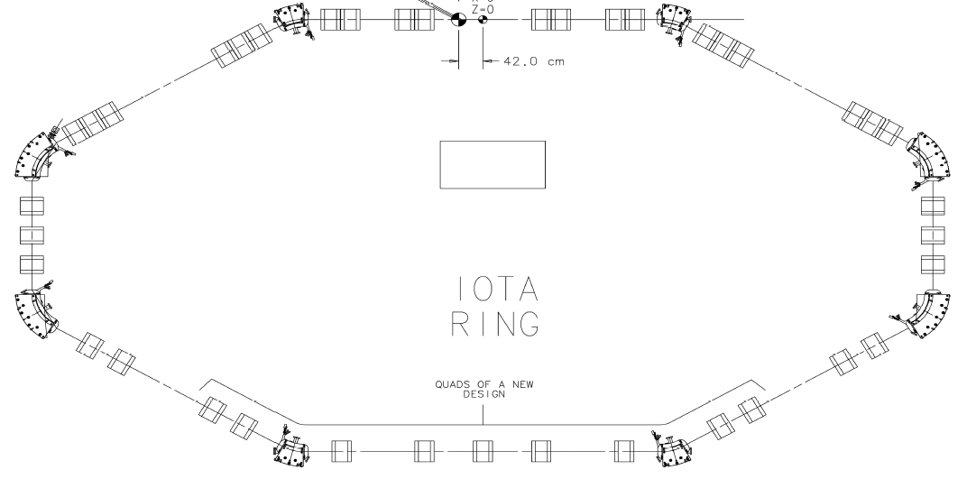
IOTA Optics – 2NL
1.8m
T-Insert
NL2
NL1
T-Insert
RF

Slide 21
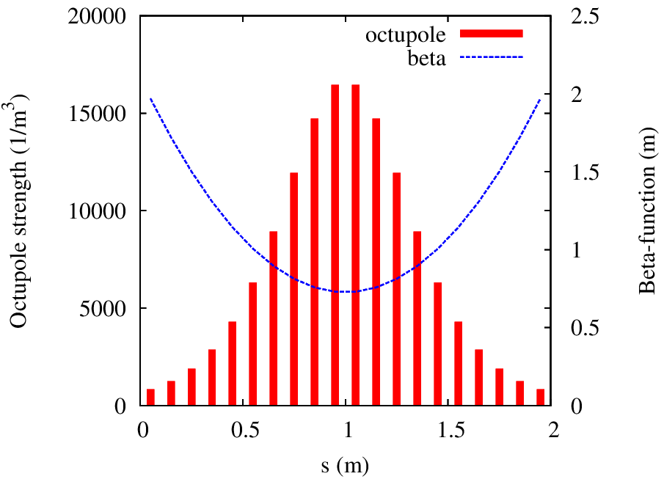
Quasi-Integrable System
Build V with Octupoles
Only one integral of motion – H
Tune spread limited to ~12% of Q₀

Slide 22
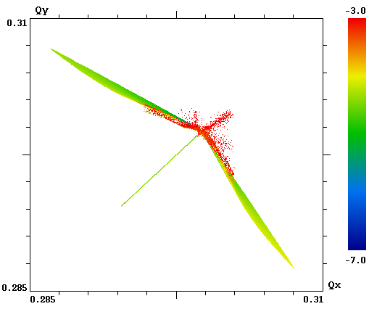
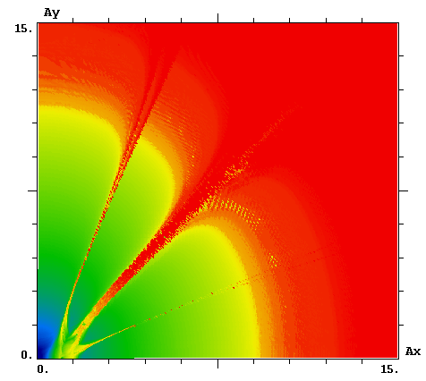
Quasi-Integrable System with Octupoles
While dynamic aperture is limited, the attainable tune spread is large ~0.03 – compare to 0.001 created by LHC octupoles
Q_{y}
A_{y}
A_{x}
Q_{x}

Slide 23
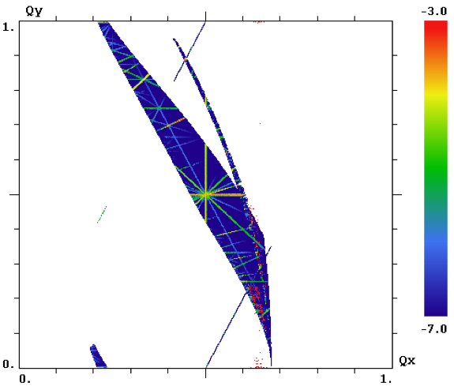
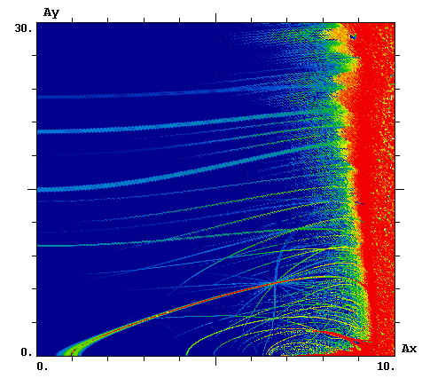
Single Particle Dynamics in Integrable Optics
Q_{y}
A_{y}
Q_{x}
A_{x}
Integer resonance Q_{y} = m

Slide 24
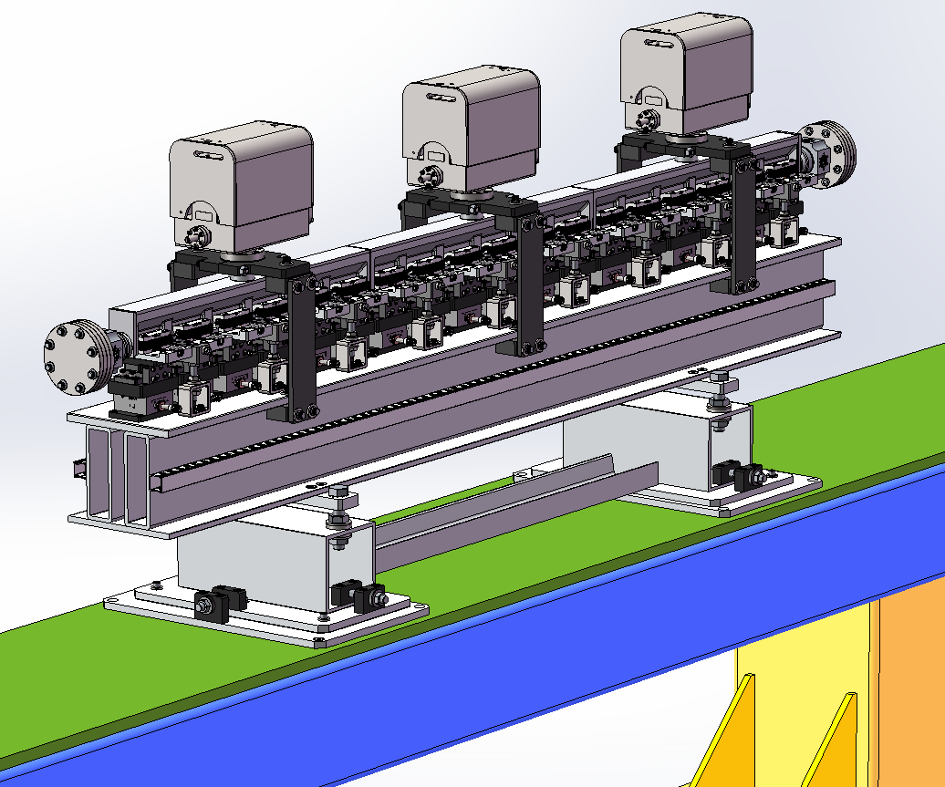
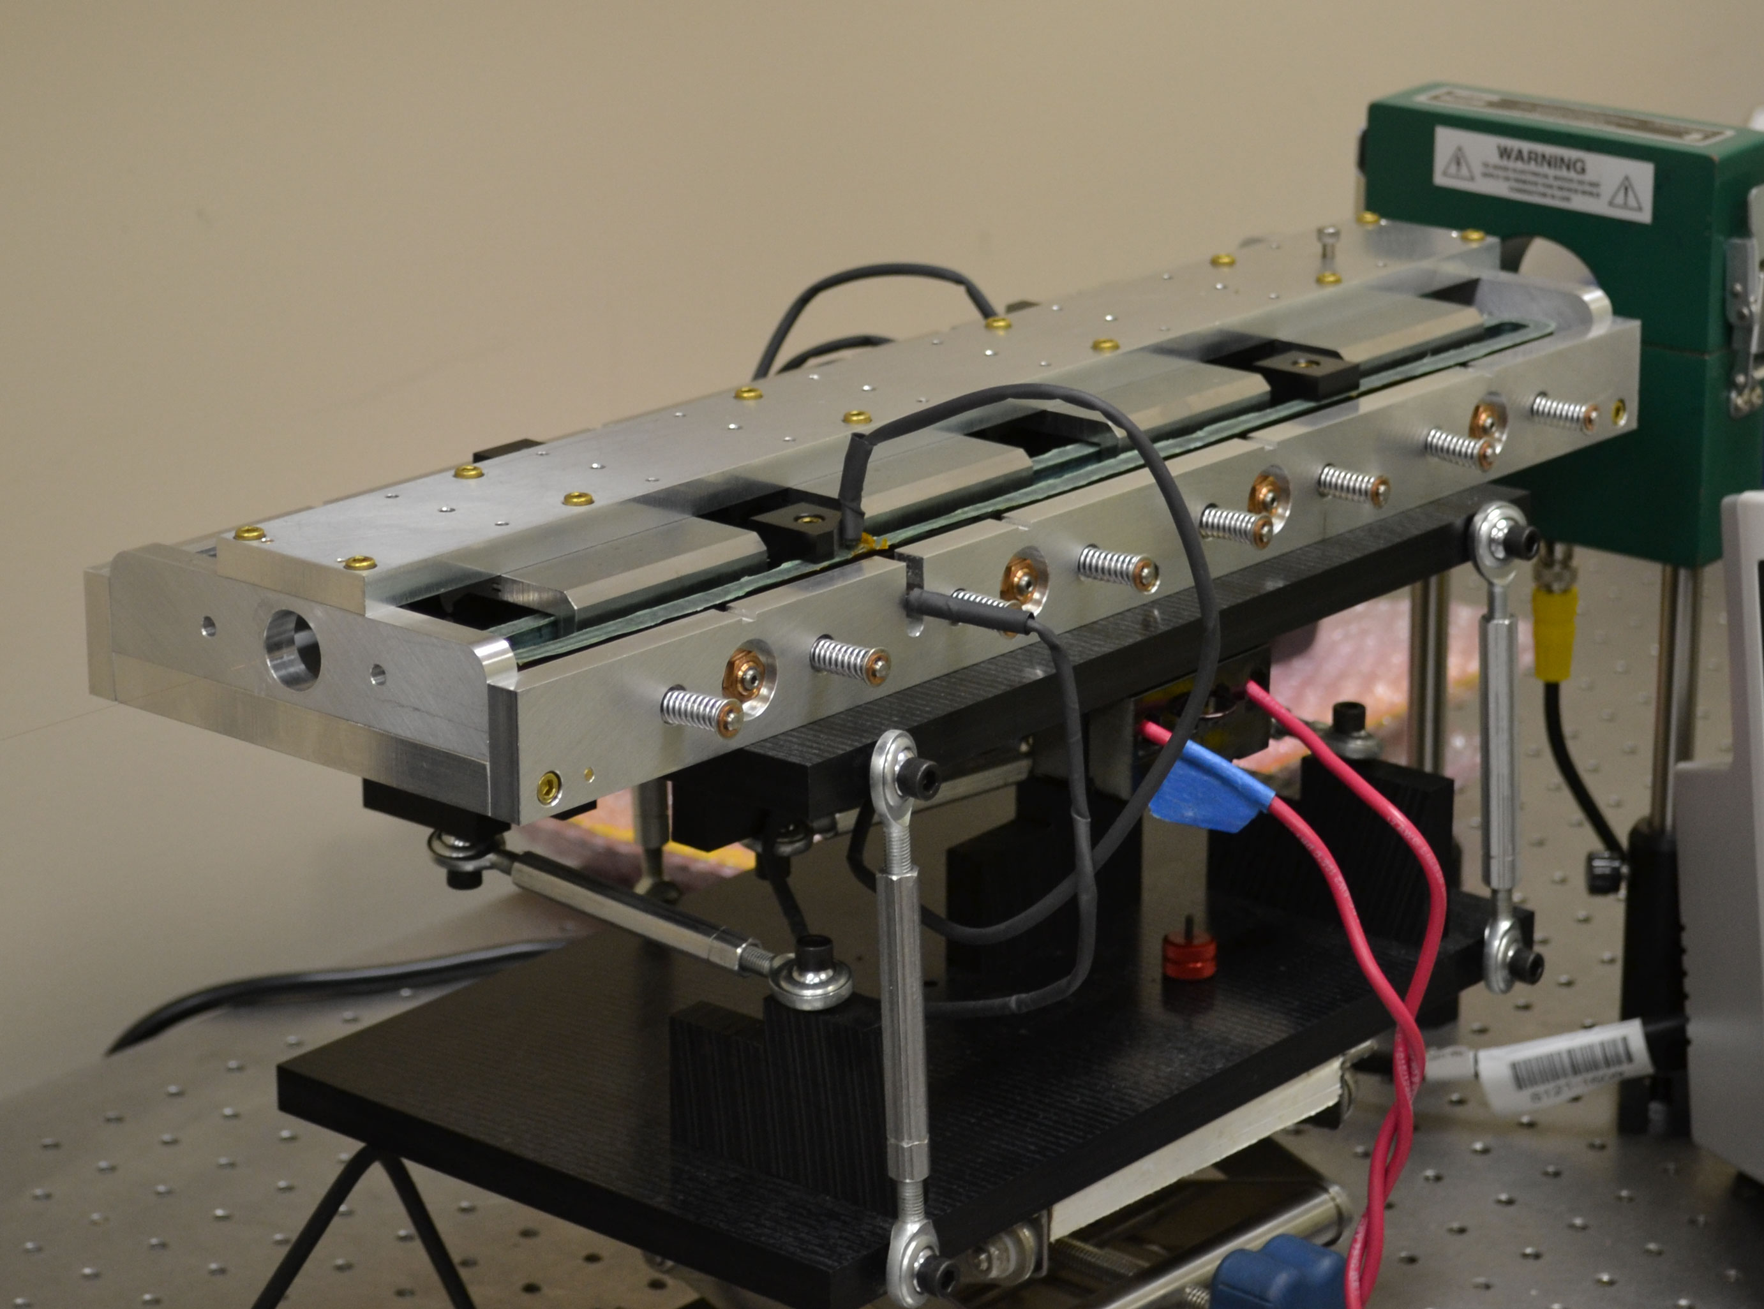
Nonlinear Magnet
Joint effort with RadiaBeam Technologies (Phase I and II SBIR)
Short prototype built in Phase I
1.8-m long magnet to be delivered in 2016

Slide 25
What is Unique About These Solutions?
One can add the special potential (Laplacian or E-Lens) to a drift of a conventional accelerator (albeit specially designed and carefully controlled) and make the lattice integrable.
  Does not require new technology for the significant portion of accelerator circumference – same cost!

Slide 26
IOTA Goals for Integrable Optics
The IOTA experiment has the goal to demonstrate the possibility to implement nonlinear integrable optics with a large betatron frequency spread ΔQ>1 and stable particle motion in a realistic accelerator design
Benefits of nonlinear integrable optics include
Increased Landau damping
Improved stability to perturbations
Resonance detuning

Slide 27
IOTA Staging – Phase I
Phase I will concentrate on the academic aspect of single-particle motion stability using e- beams
  Achieve large nonlinear tune shift/spread without degradation of dynamic aperture by “painting” the accelerator aperture with a “pencil” beam
  Suppress strong lattice resonances = cross the integer resonance by part of the beam without intensity loss
  Investigate stability of nonlinear systems to perturbations, develop practical designs of nonlinear magnets
  The measure of success will be the achievement of high nonlinear tune shift = 0.25
Notes:
color pencil beam

Slide 28
IOTA Staging – Phase I
The magnet quality, optics stability, instrumentation system and optics measurement techniques must be of highest standards in order to meet the requirements for integrable optics
  1% or better measurement and control of β-function, and 0.001 or better control of betatron phase
This is why Phase I needs pencil e⁻ beams as such optics parameters are not immediately reachable in a small ring operating with protons

Slide 29
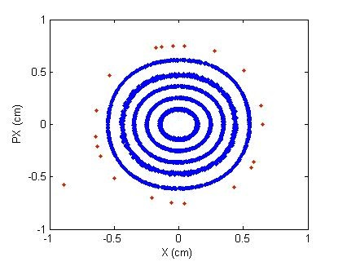
Experimental Procedure
Two kickers, horizontal and vertical, place particles at arbitrary points in phase space
Measure beam position on every
turn to create a Poincare map
As electrons lose energy due to
synchrotron radiation,
they will cover all available phase space
Can control the strength on the nonlinearity
Final goal – measure dependence of betatron frequency on amplitude

Slide 30
IOTA Timeline
FY15 | 20 MeV e- commissioned HE beam line 40% IOTA parts 60%
FY16 | 50 MeV e- commissioned 150 MeV CM2 to dump IOTA installed 60%
FY17 | IOTA installed IOTA e- commissioned p+ RFQ re-commiss’d 50% IOTA research starts with e-
FY18 | Proton RFQ moved 100% p+ RFQ commissioned, move to IOTA
FY19 | IOTA research starts with p+
FY20 | (IOTA research continues)

Slide 31
Topics for Collaboration
Proton emittance issue
  0.3 μm from RFQ is a very large emittance for this ring
    Would be nice to go to a higher tune shift
    This beam will scrape on the non-linear inserts
Instrumentation – Beam Loss Monitors
Instrumentation – Beam Profile Monitors, Halo Monitoring
  Transfer line
    Retractable wire planes in transfer lines
    One placed to measure emittance
  Ring? Big question
Beam Physics in general

Slide 32
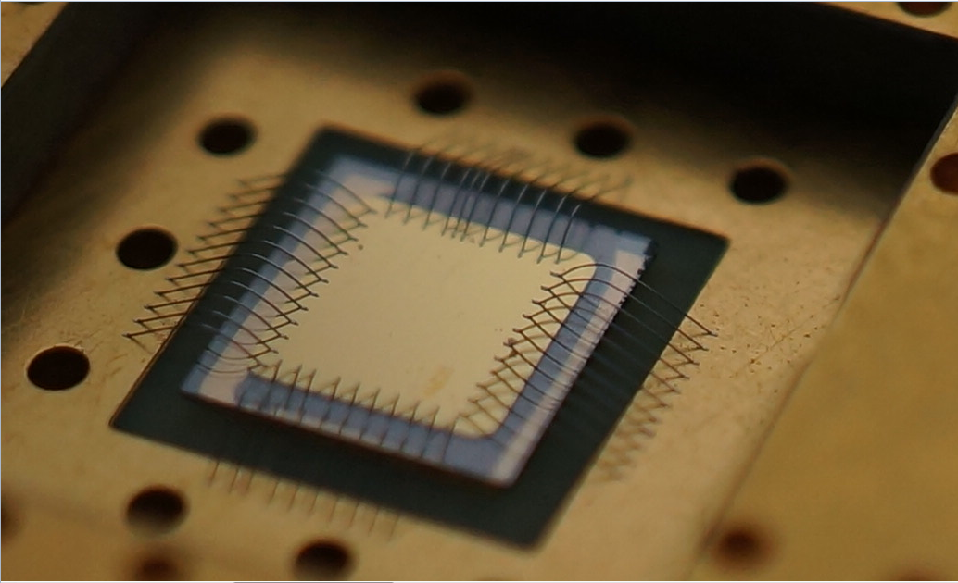
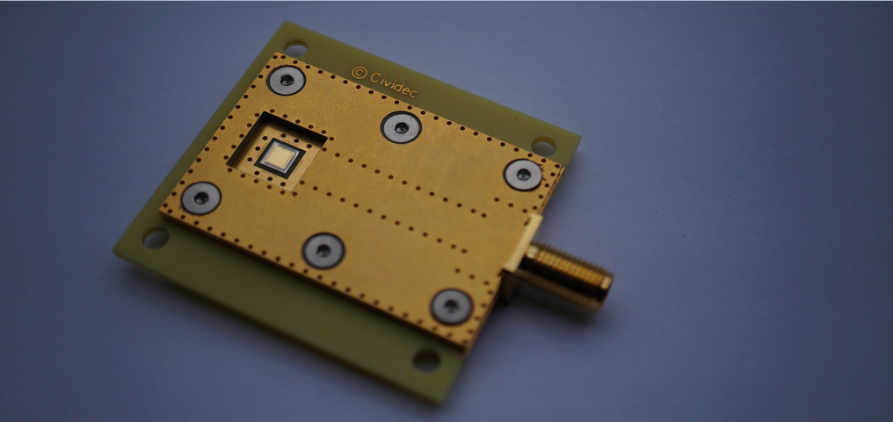
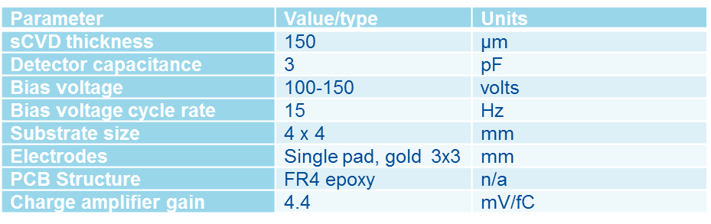
Test sCVD Diamond Parameters
Stage 1 Detector:
Thickness: 150 m
Sice 4 mm x 4 mm
Electrodes: Single pad, gold, 3 mm x 3 mm
PCB structure: FR4 epoxy
Stage 2 Detector
25 – 50 µm, adequate for 2.1 MeV protons
Size 10 mm x 10 mm
Electrodes: Single pad, gold, 4 mm x 4 mm
PCB structure: Vacuum compatible
Detector open front window & RF protection: Polarity such that surface forms a faraday cage with bond wires ands ground layer of readout structure.
Single connector for AC-readout

Slide 33
IOTA Beam Profile Options
Ionization Profile Monitor?
  Needs local pressure bump
Gas jet monitor
  Similar to IPM, but complex injection/capture hardware
  Need more details on existing system
Electron deflection
  Need more details
Beam neutralization
  Use electron beam to neutralize beam.
Still looking for any good ideas.
  Possibly a hybrid solution
    Crude profile measurement
    Precision tail measurement

Slide 34
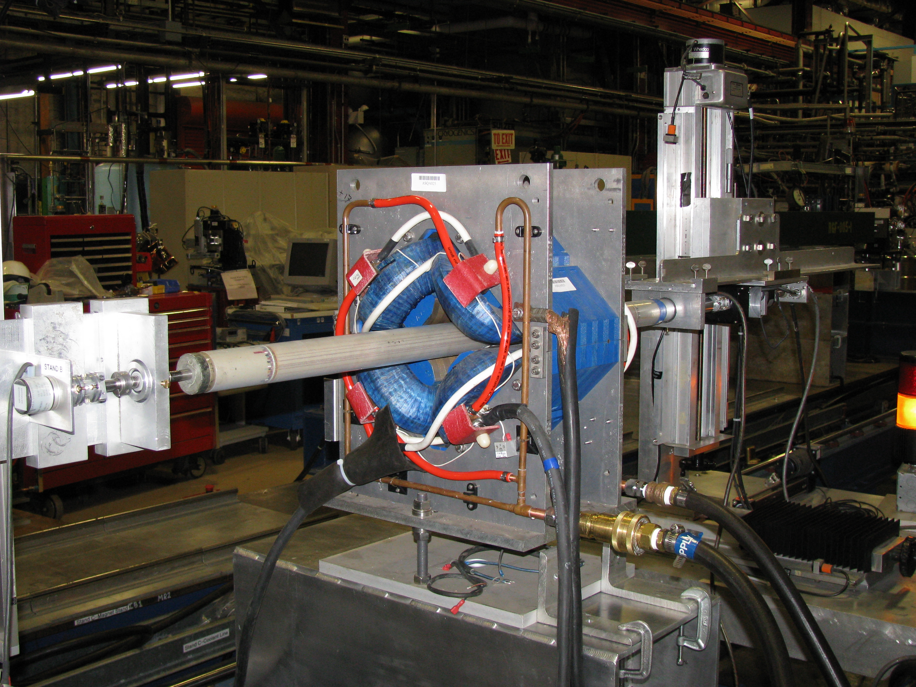

Slide 35
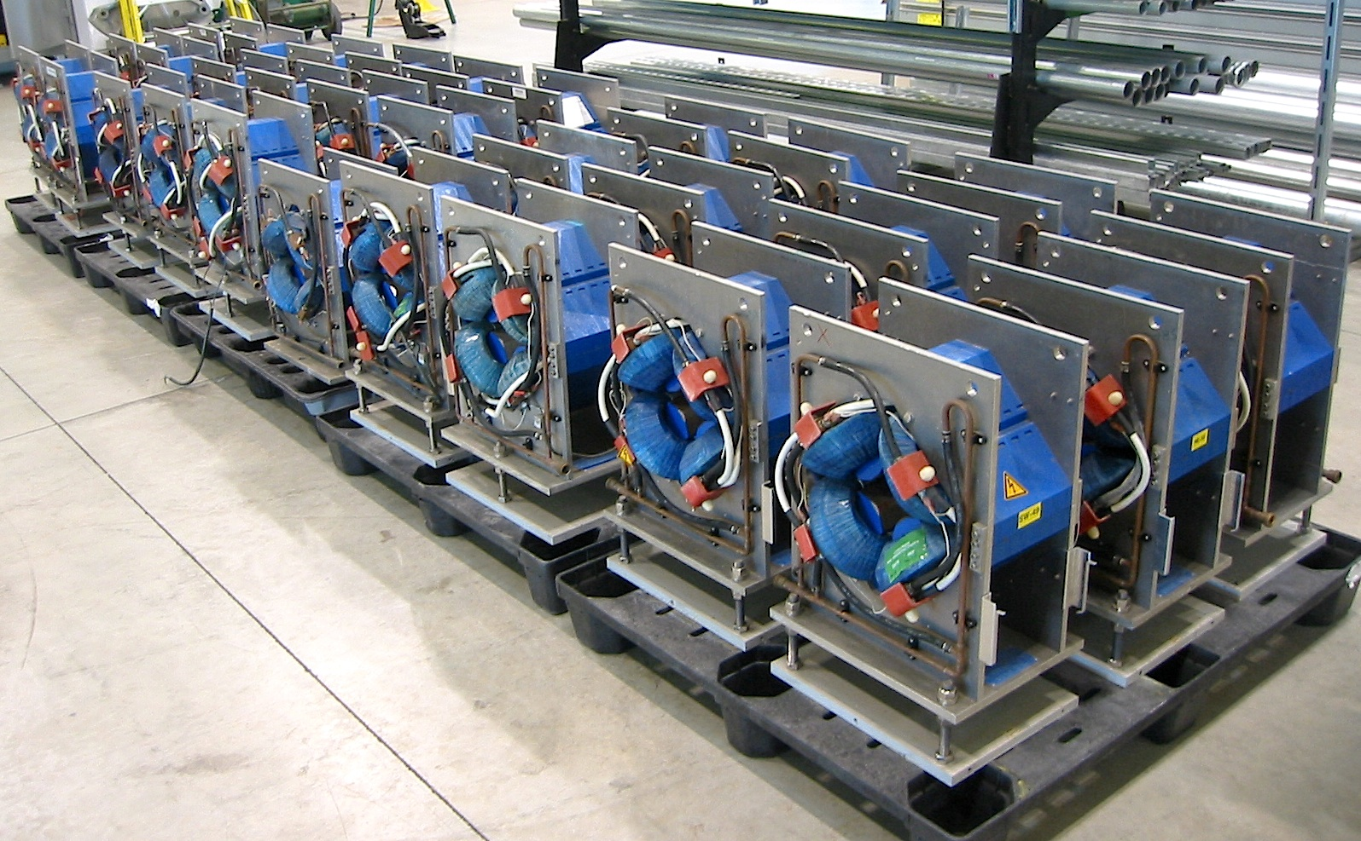

Slide 36
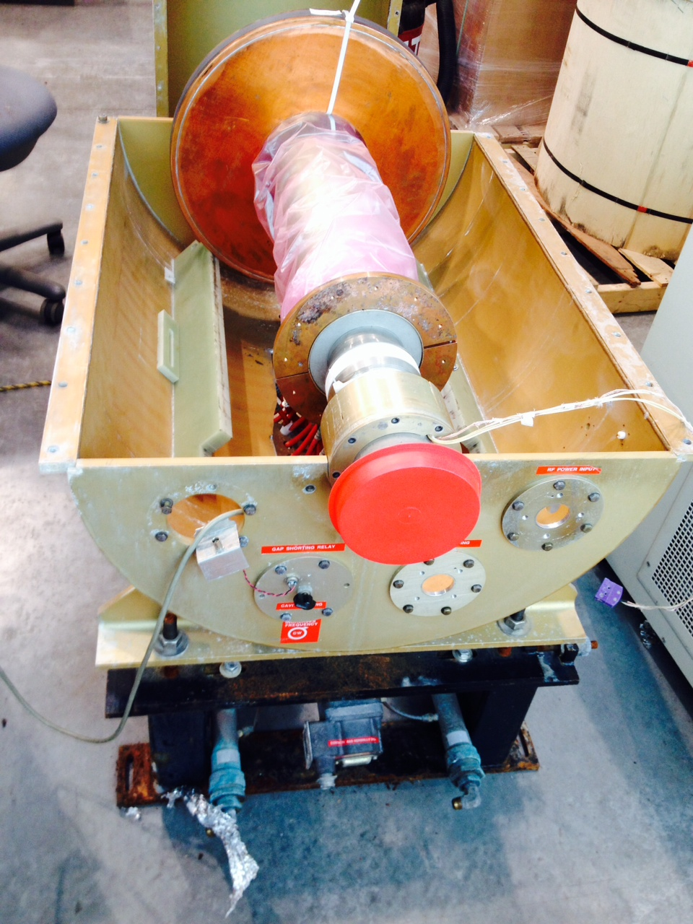

Slide 37
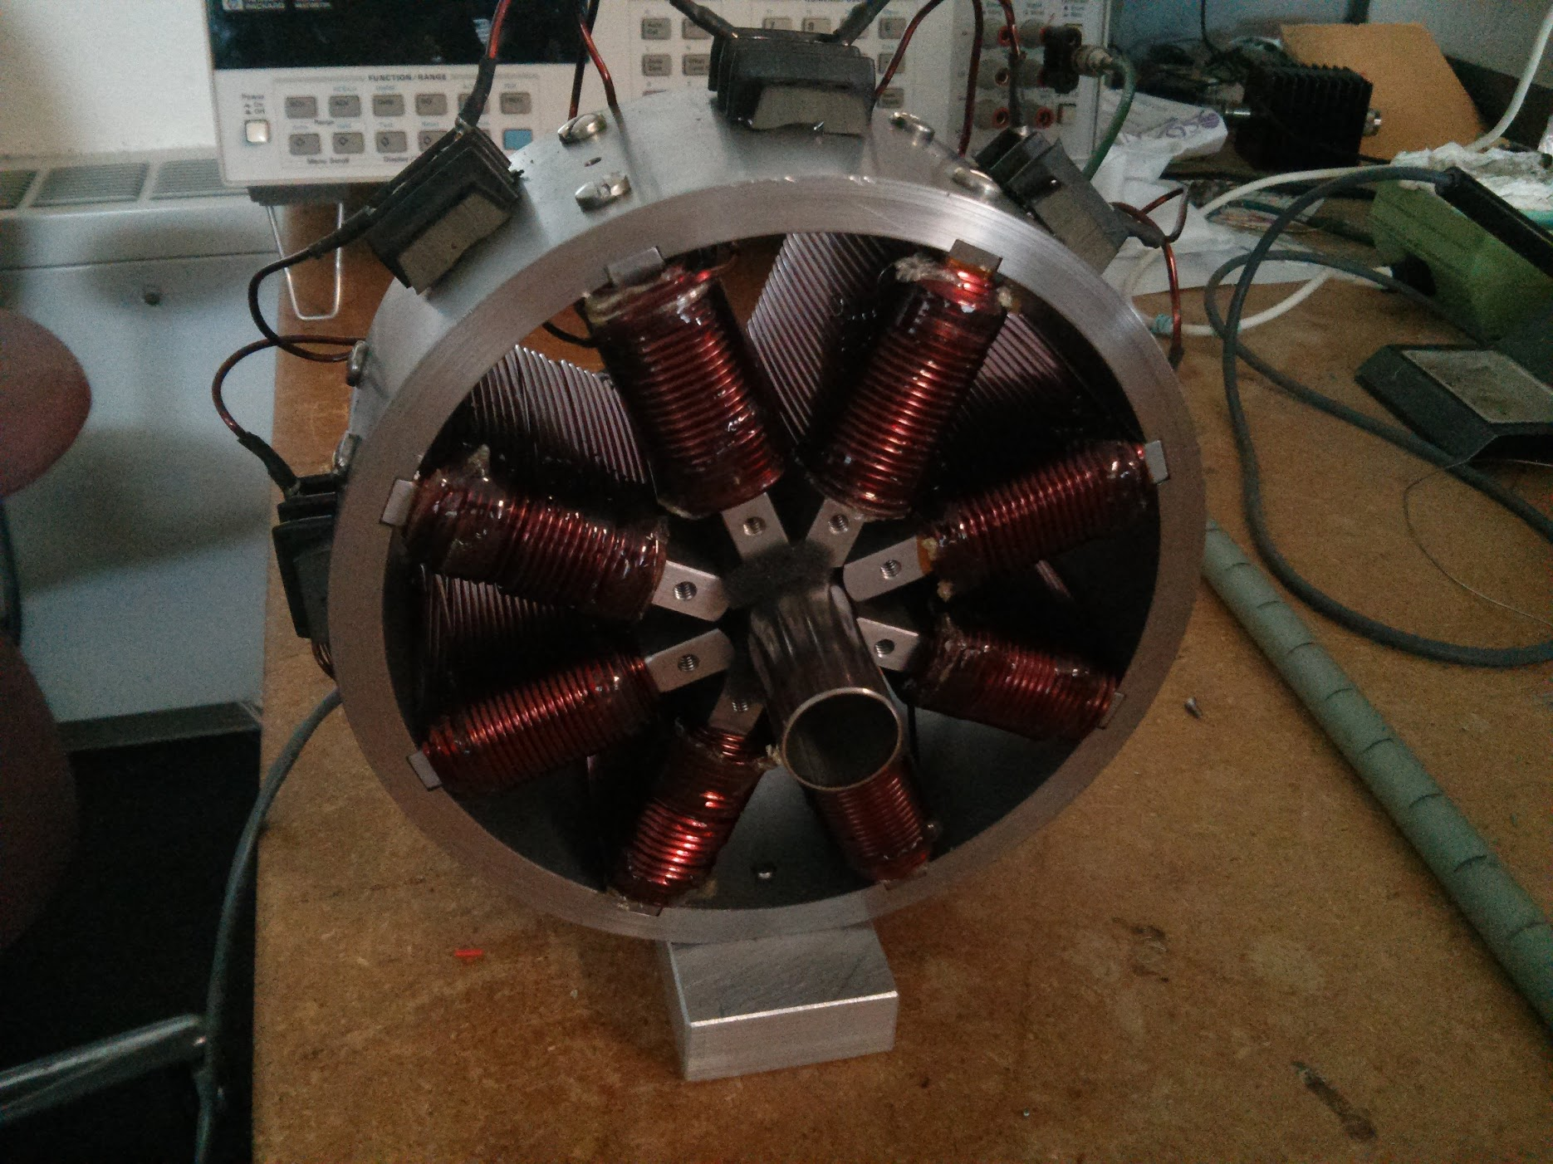

Slide 38
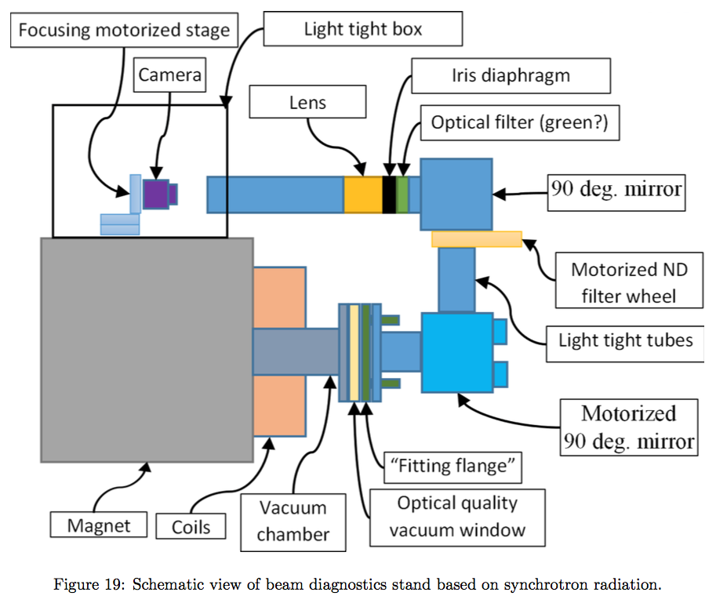

Slide 39
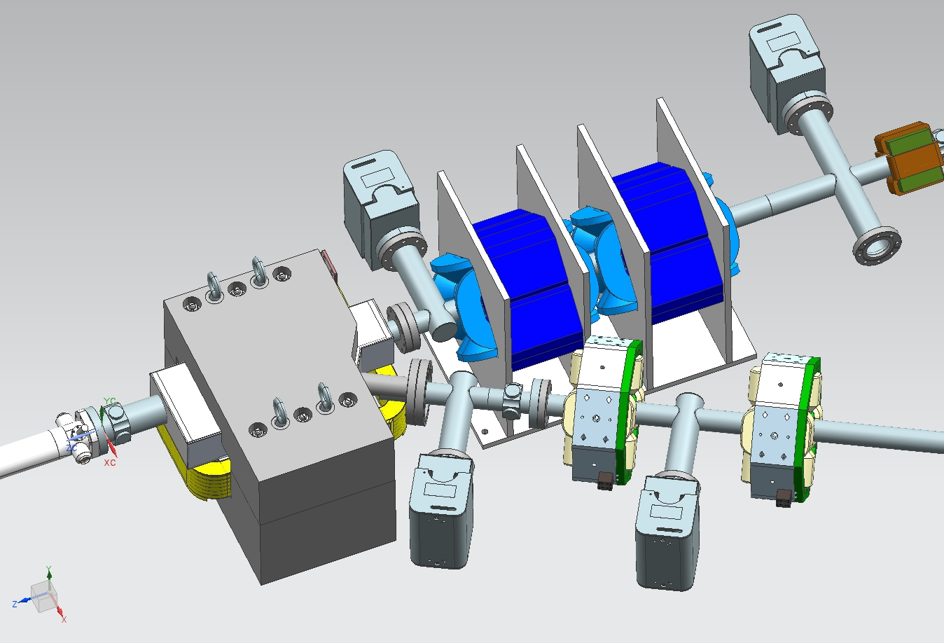
IOTA Injection Lambertson

Slide 40
