Slide 1
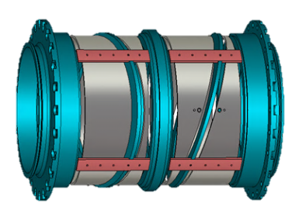
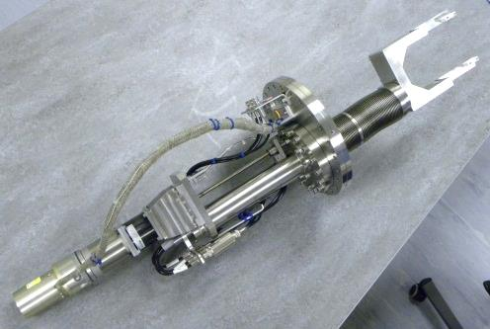
Overview of Diagnostics Work on the ISIS Accelerator
Alex Pertica
(…and Steve Payne, Chris Wilcox, David Posthuma De Boer, Tony Kershaw and John Medland)
PASI’15 Workshop - 11th – 13th November 2015 - Fermi National Accelerator Laboratory, Ilinois, USA

Slide 2
Outline
An introduction to ISIS Diagnostics
Recent developments and projects status
Data Acquisition Systems
Question Time
PASI’15 – Fermilab, IL, USA

Slide 3
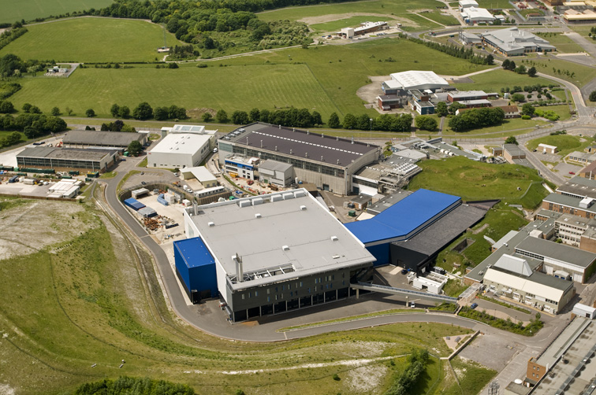
An Introduction to ISIS Diagnostics
The ISIS Spallation Neutron Source
Accelerators:
Linac: 70 MeV H⁻, 200 μs, 3×10¹³ ppp
Synchrotron: 800 MeV p⁺, 2x 100ns bunches, 300ns apart, 50 Hz, 200 kW
Operations:
Two target stations: TS1 (40pps) and TS2 (10pps)
Beam On 120-160 days/year in 4/5 cycles
Long shutdown of ~6 months every 3 years
PASI’15 – Fermilab, IL, USA

Slide 4
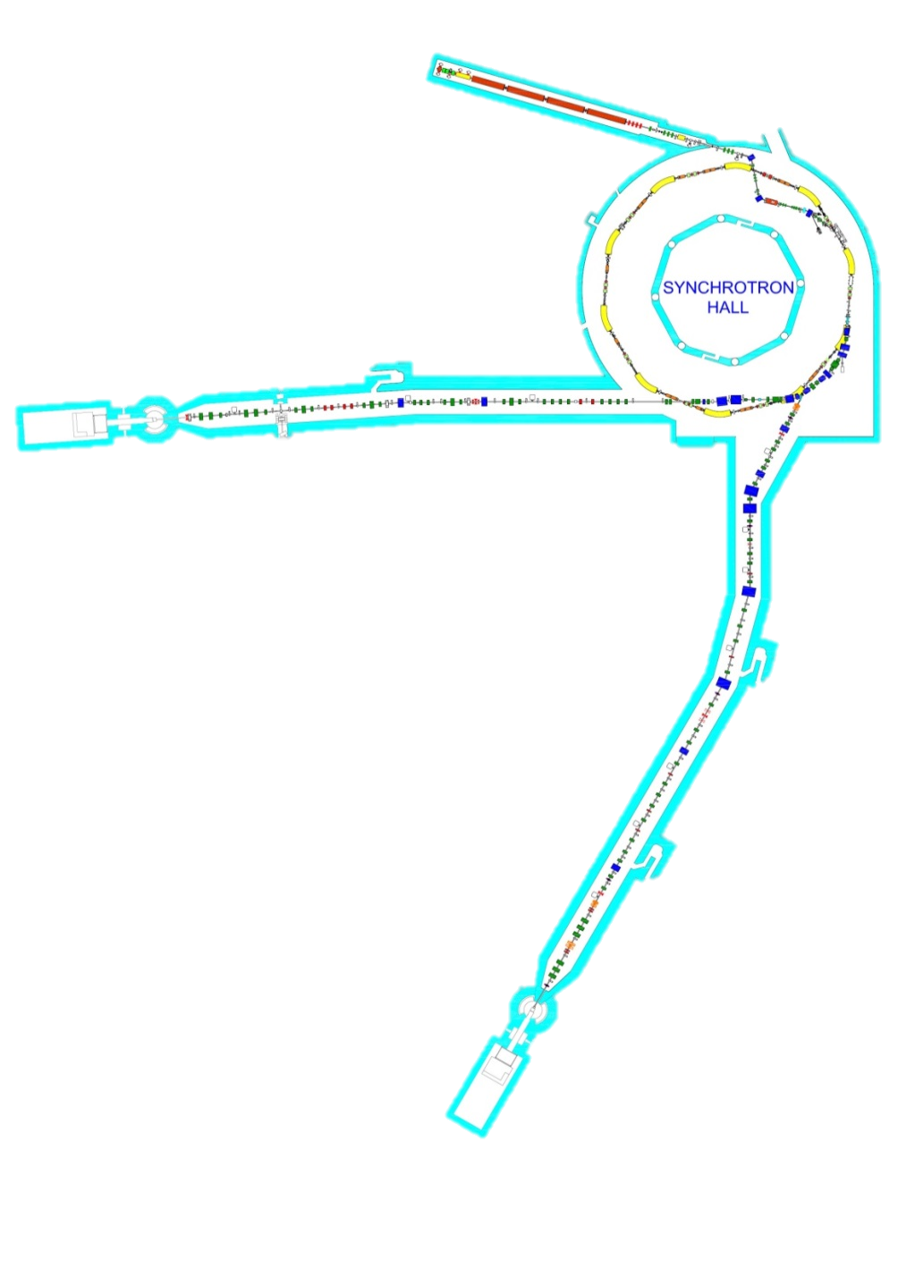
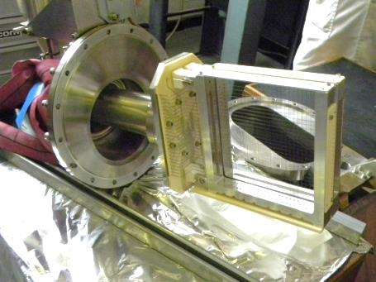
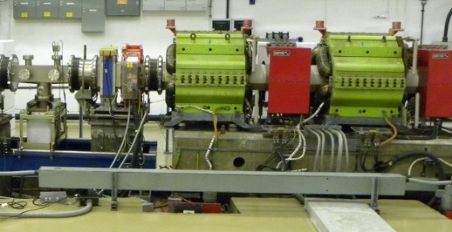
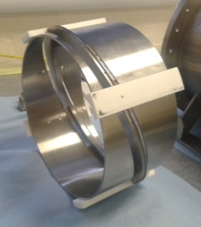
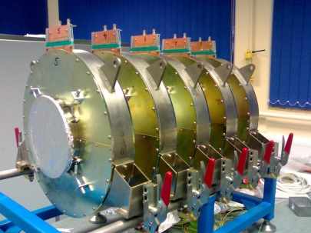
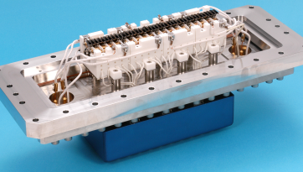
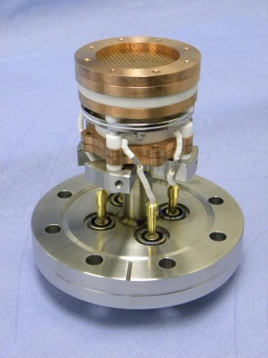
An Introduction to ISIS Diagnostics
Distribution of the Main Diagnostics
Injector:
17 Beam Loss Monitors
15 Scanning wire Profile Monitors
1 Gas Ionisation Profile Monitor
11 Intensity Monitors
Accelerator Ring:
39 Beam Loss Monitors
6 Gas Ionisation Profile Monitors
1 Wire Width Probe
2 Intensity Monitors
32 ‘Split Electrode’ Position Monitors
16 Scintillators
2 Electron Cloud Monitors
Beam Line to Target 1:
10 Beam Loss Monitors
29 ‘SEM Grid’ Profile Monitors
6 Intensity Monitors
2 ‘Split Plate’ Position Monitors
(1 Halo Monitor)
Beam Line to Target 2:
15 Beam Loss Monitors
35 ‘SEM Grid’ Profile Monitors
5 Intensity Monitors
6 ‘Split Plate’ Position Monitors
(1 Halo Monitor)
PASI’15 – Fermilab, IL, USA

Slide 5
Recent Developments and Project’s Status
PASI’15 – Fermilab, IL, USA

Slide 6
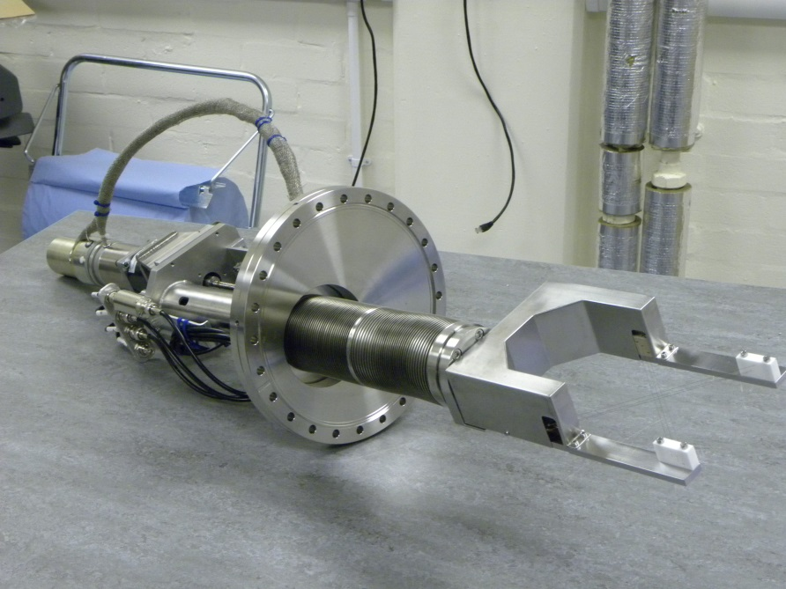
Recent Developments and Project’s Status
New Injector Wire Scanner
Double plane (1 wire per plane) - 90mm aperture
Wires material: silicon carbide
To be installed during January 2016 shutdown
If successful, the next version will include multiple wires on each plane.
Detail of the wires on the bracket
Wire Scanner assembly
PASI’15 – Fermilab, IL, USA

Slide 7
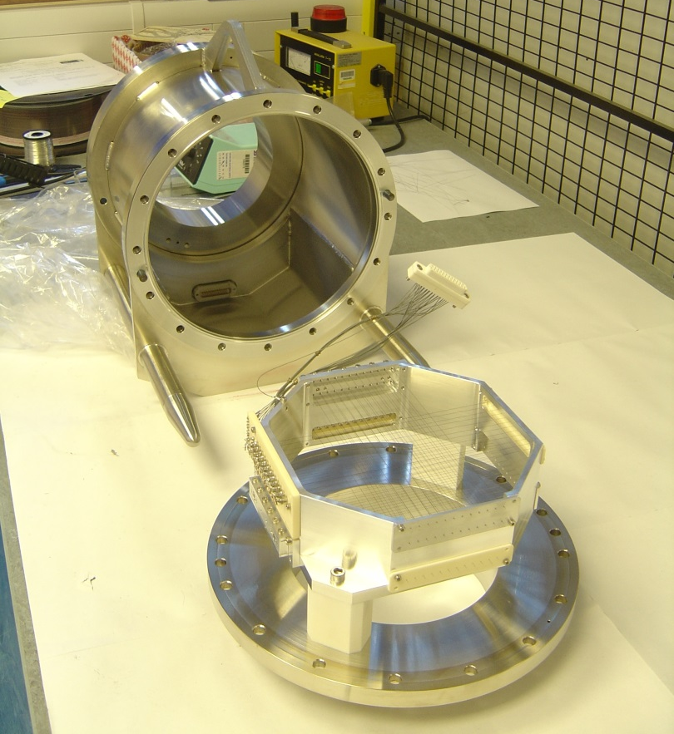
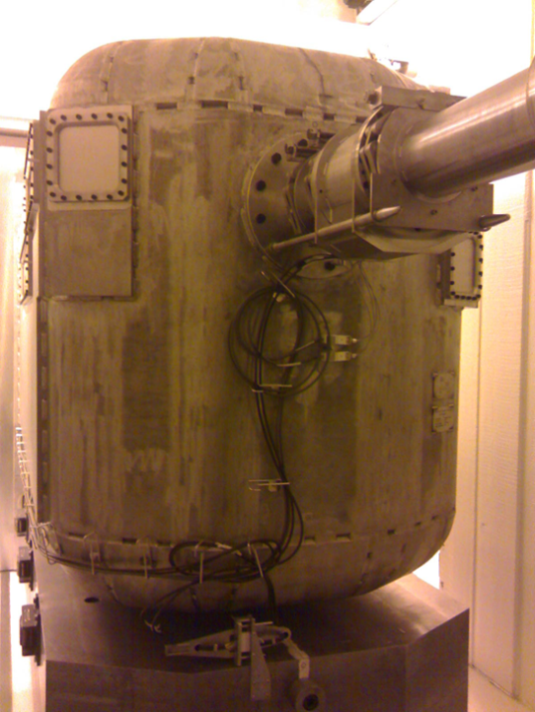
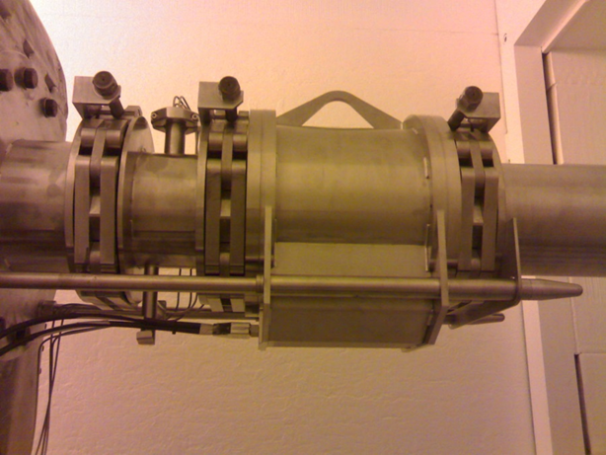
Recent Developments and Project’s Status
EPB Near Target Profile Monitor
Located just before the exit window on the EPB 2 target void vessel
10 pps repetition rate beam onto the target
Ongoing work on wire heating studies for a 40pps operation on target station 1
The mounted monitor SEM grid assembly and the monitor body
The new monitor installed next to the void vessel
PASI’15 – Fermilab, IL, USA

Slide 8
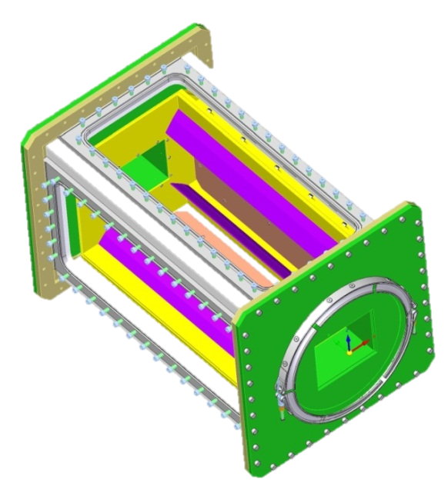
Recent Developments and Project’s Status
Strip-Line Monitor
Designed in collaboration with SNS (ORNL)
1 – 250 MHz bandwidth
First component of the fast feedback system
In manufacturing stage now! ☺
(Estimated delivery by Feb. 2016)
Racks and cables installation ongoing
Strip-line electrodes arrangement
Strip-line 3D model
PASI’15 – Fermilab, IL, USA

Slide 9
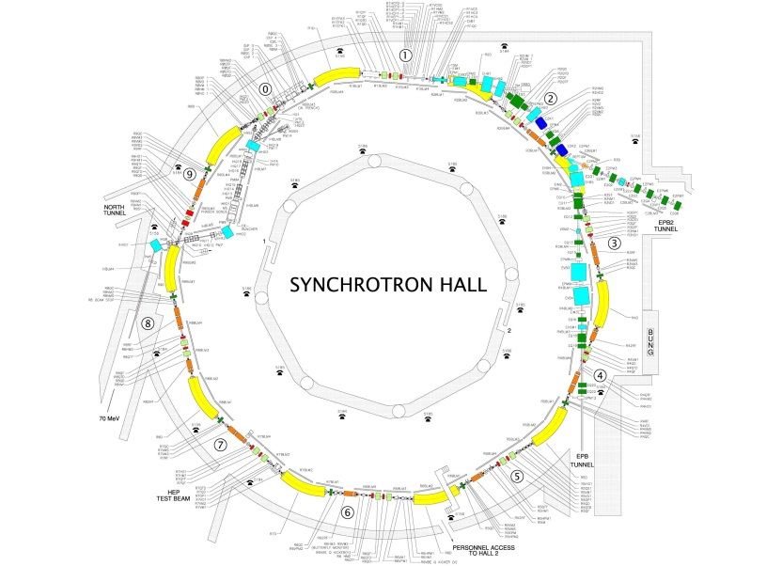
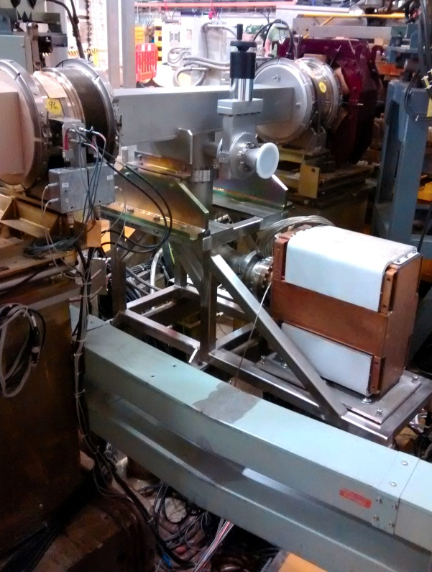
Recent Developments and Project’s Status
Strip-Line Monitor
First monitor to be installed in super period 9 of the Synchrotron
Feedback system to be tested initially with split electrode BPM + Strip-line (up to 50MHz)
ISIS Synchrotron Strip-line chosen location
PASI’15 – Fermilab, IL, USA

Slide 10
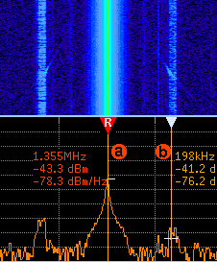
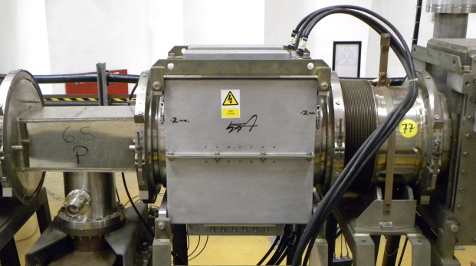
Recent Developments and Project’s Status
Betatron Exciter Based Damping System
Use of a ferrite loaded kicker for damping instabilities up to 20MHz
Experimentation opportunity for Strip-line feedback system
Beam excitation tests (vertical plane) using a sine wave frequency sweep to drive transverse beam motion
ISIS Vertical Betatron Exciter (Ferrite Loaded Kicker)
PASI’15 – Fermilab, IL, USA

Slide 11
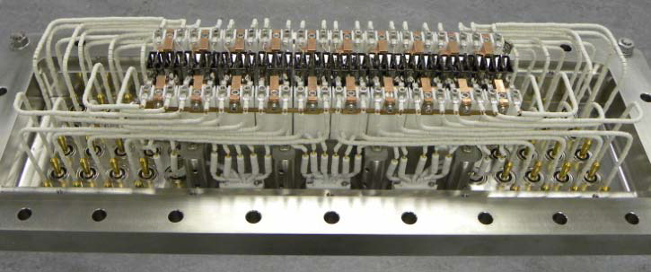
Recent Developments and Project’s Status
Ionization profile monitor work
Positive drift field for residual gas ion detection
40 individual Channeltron tubes (electron multipliers)
6mm separation between centres
Single pulse acquisition (not bunch by bunch)
Auto-calibration performed against a motorized single Channeltron detector
The 40 channeltron array used to measure beam profile
Detector array
Of 40 channeltrons
Beam
A Channeltron
Single channeltron detector
PASI’15 – Fermilab, IL, USA

Slide 12
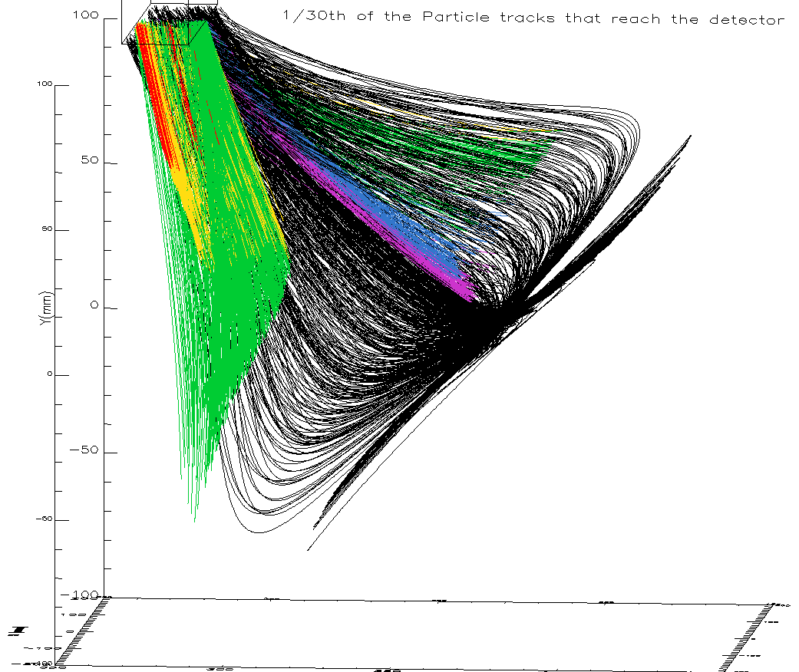
Recent Developments and Project’s Status
Ionization profile monitor work
The ring IPMS have no field shaping electrodes so the measured profile must be corrected for both space charge and drift field effects after measurement
In addition, it is thought that extra ions reach the detectors due to the electric field shape where the 2 opposing drift fields meet (‘saddle point’)
Work is being carried out to improve our understanding of the monitors by tracking the movement of residual gas ions through the monitor
Compensating field HV plate
Saddle point
Sample trajectories of ions that reach the
channeltrons
Drift field HV plate
PASI’15 – Fermilab, IL, USA

Slide 13
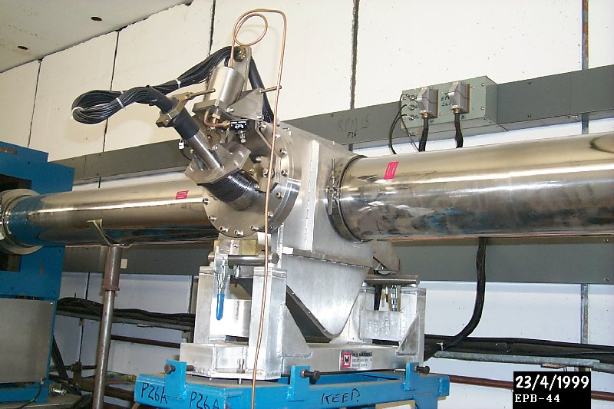
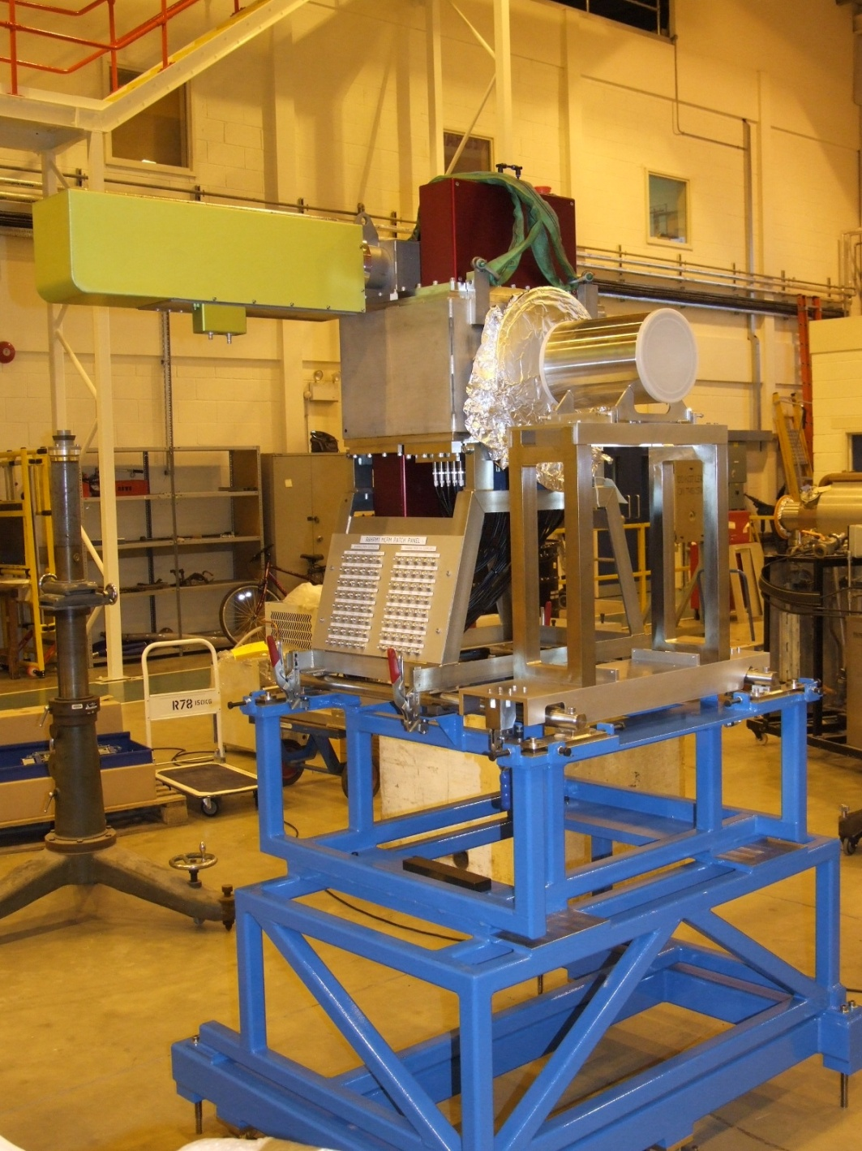
Recent Developments and Project’s Status
Ionization profile monitor work ISIS Extracted Proton Beam 1 (EPB1)
Profile monitor
Position monitor
Beam
Beam
Profile
Harp
Position
SEM grid will highlight errors in gas ionisation profile monitors – this information will be used to correct measured profiles in the accelerator ring
PASI’15 – Fermilab, IL, USA

Slide 14
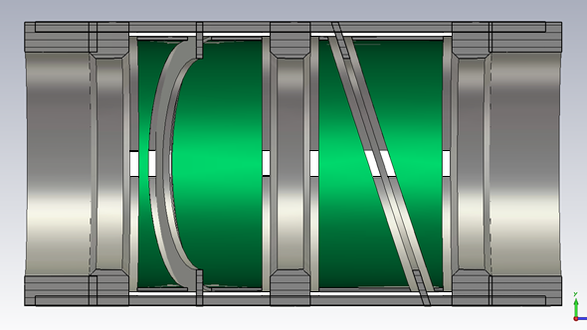
Recent Developments and Project’s Status
EPB1 Double Plane Position Monitor
Improved version from the one already installed on EPB1.
Thinner electrodes
(12mm → 3mm)
Additional “guard rings” at each end of the monitor for symmetry
Additional “separator rings” between each pair of electrodes
Increased sensitivity
To be installed on EPB1 upstream of IPM
Guard Ring
Electrodes
Beam
Separating Rings
Guard Rings
PASI’15 – Fermilab, IL, USA

Slide 15
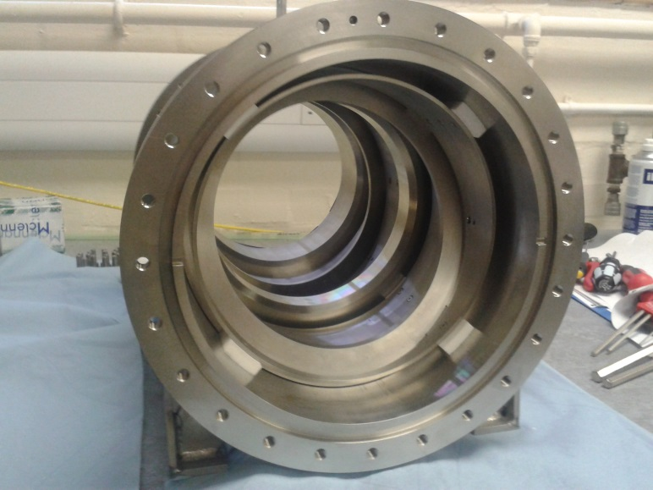
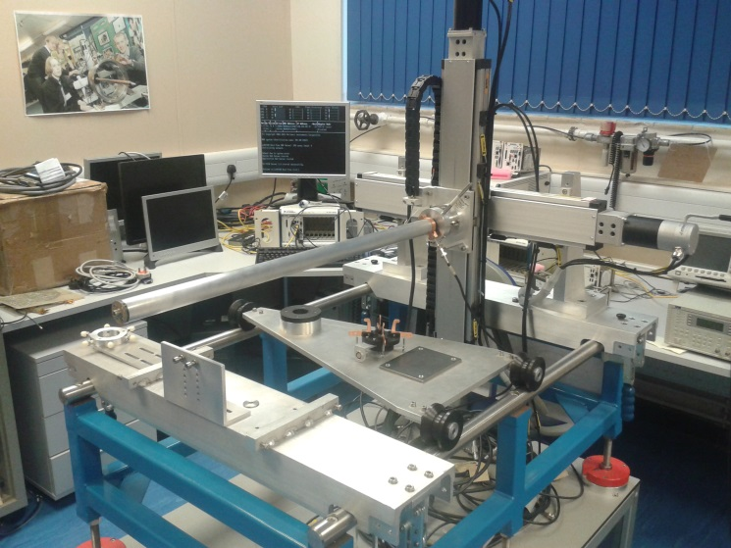
Recent Developments and Project’s Status
EPB1 Double Plane Position Monitor
The new monitor has now been manufactured and is ready for testing
A new test rig has been built to calibrate the monitor and to verify the simulations results
Inside the New BPM
An Electrode Pair
The New BPM Test Rig
PASI’15 – Fermilab, IL, USA

Slide 16
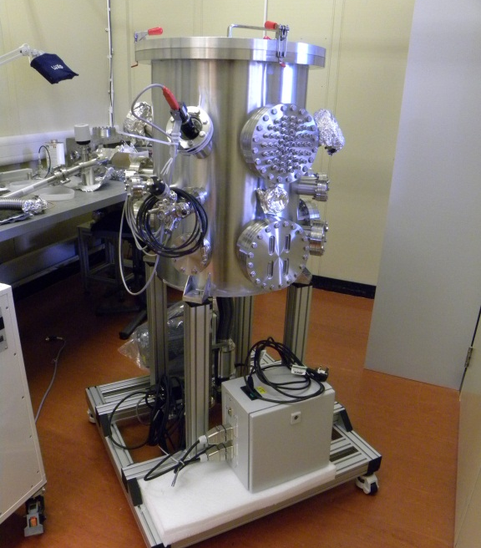
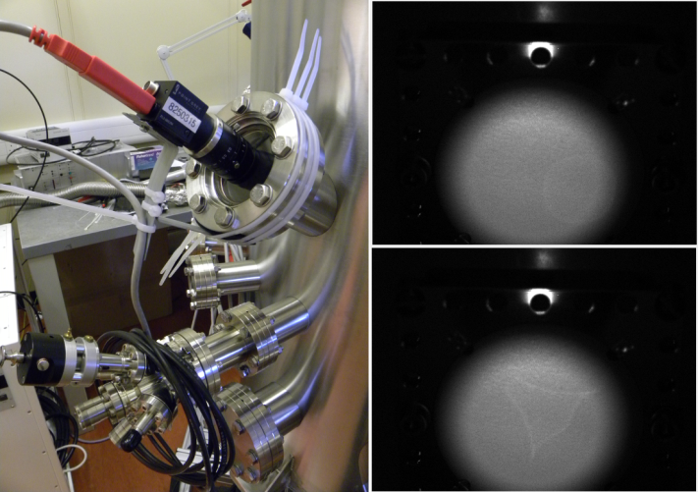
Recent Developments and Project’s Status
Vacuum Tank for Diagnostics Testing
Aimed for detectors characterization/experimentation
Electron gun installed and tested
Ion gun and turbo-pump supports under development
Ionization Ring Profile Monitor detectors to be characterized for electrons and ions
Electron gun, screens and camera setup
ISIS Diagnostics vacuum tank
PASI’15 – Fermilab, IL, USA

Slide 17
Data Acquisition Systems
PASI’15 – Fermilab, IL, USA

Slide 18
Data Acquisition Systems
Data Acquisition Overview
The majority of the data acquisition systems used for beam instrumentation are based on National Instrument PXI hardware (approximately 30 systems)
Critical systems are based on custom made dedicated hardware (i.e. beam protection)
PXI systems are distributed around the accelerator in areas of varying shielding/accessibility
Interfacing varies depending on beam instrument type
BPMs/Ionization chamber BLMs/SEM grid Profile Monitors interface through the ISIS Control System (Vsystems VISTA)
IPMs/Scintillator BLMs interface directly to User applications
PASI’15 – Fermilab, IL, USA

Slide 19
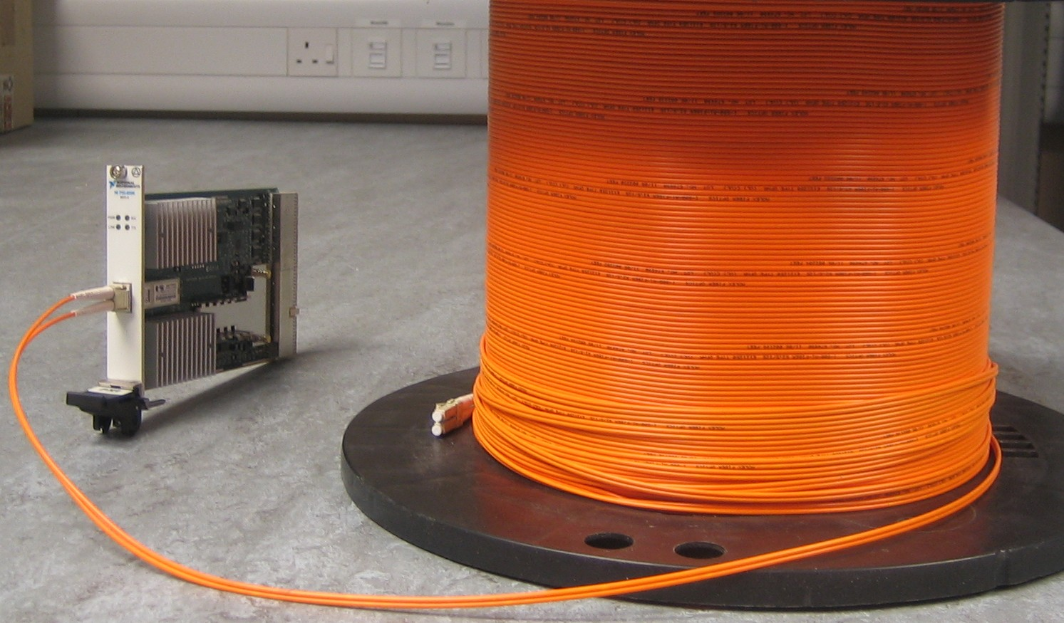
Data Acquisition Systems
Mitigating Radiation
National instruments provide a means of extending the PCI bus of a PXI chassis to a remote chassis using a MXI interface card
Use of a fibre-optic version of the MXI card, it is possible to situate the vulnerable PXI controller in a safe and easily accessible area
A PXI MXI-4 Card and fibre-optic spool
A chassis operating as a remote MXI drop
PASI’15 – Fermilab, IL, USA

Slide 20
Special thanks to: Steve Payne, Tony Kershaw, Chris Wilcox, David Posthuma de Boer and John Medland
Thank you!
PASI’15 – Fermilab, IL, USA

Slide 21
Spare Slides
PASI’15 – Fermilab, IL, USA

Slide 22
Recent Developments and Project’s Status
EPB1 Double Plane Position Monitor
Beam position is calculated by taking the difference over the sum (DOS) of the signals on a pair of electrodes
The gradient of the graph between the DOS and the beam position characterises the sensitivity of the monitor
The new monitor has significantly improved sensitivity when compared to the prototype, due to the decrease in electrode coupling
EHM Difference Over Sum vs Beam Position
PASI’15 – Fermilab, IL, USA

Slide 23
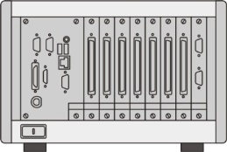
Data Acquisition Systems
Mitigating Radiation
SCADA Database
Machine
Operator
Additional Benefits
Reduced power and heat-generation in remote DAQ chassis improves chassis lifetime
Controllers are always accessible in case of failure
Multiple remote DAQ chassis can be connected to one controller
LAN
Real-Time
Controller
~ 150m
MXI
Remote
Data Acquisition
Chassis
~ 50m
Beam Instruments
&
Analogue Amplification stages (if required)
PASI’15 – Fermilab, IL, USA
Notes:
Starting with the beam instruments in an area of high radiation. The signals from these pass through some low level electronics and approximately 60 m of cables. For signals which would degrade over the length of the cables, radiation hard electronics are place close to the instrument. In other cases, the electronics can be placed further away from the instrument.
There are then remote acquisition chassis in an area with some shielding, meaning that although access is not available whilst the machine is on, there is limited access during accelerator operations and there is less likelihood of damage to electronics situated there.
Finally, we use a MXI fiber-optic link up to a controller chassis situated in a nice air-conditioned room with unlimited access. Then the controller connects to other systems though a local area network.

