Slide 1
Recent Dielectric Loaded Gas-filled RF Experiment
K. Yonehara
APC, Fermilab

Slide 2
Goal of current experiment
Study AC characteristic of Alumina in high RF power with various purities
To design realistic RF cavities for a cooling channel
Dry run for MTA beam test
Use Nitrogen gas instead of using Hydrogen

Slide 3
B. Freemire, MAP Collaboration Meeting 2015
Maximum field enhancement on Alumina is 1.7
by comparing the RF gradient on axis

Slide 4
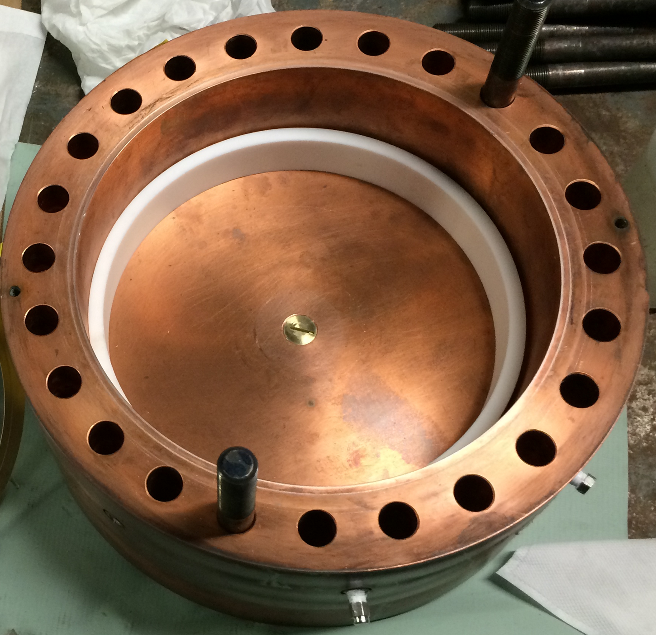
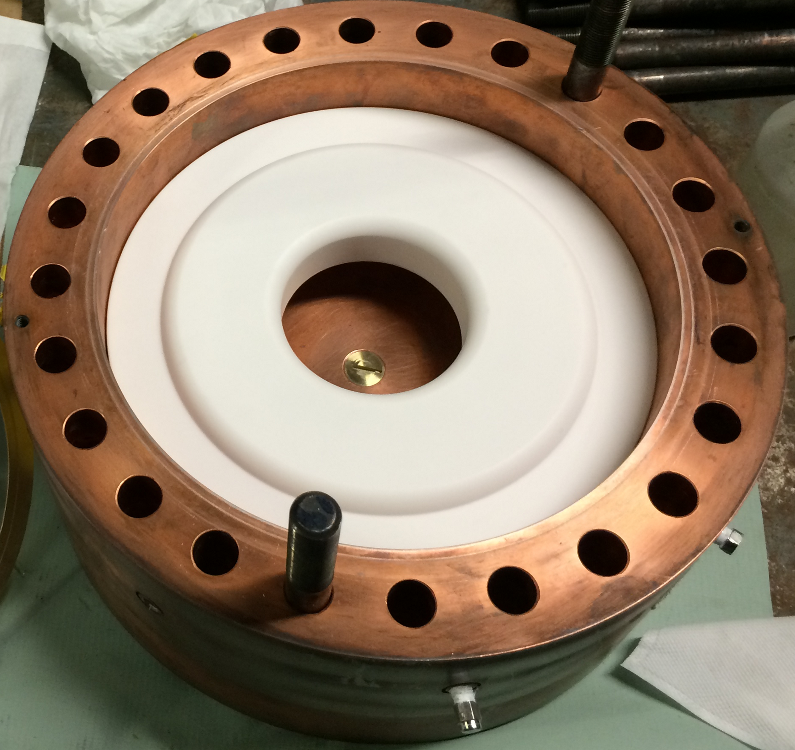
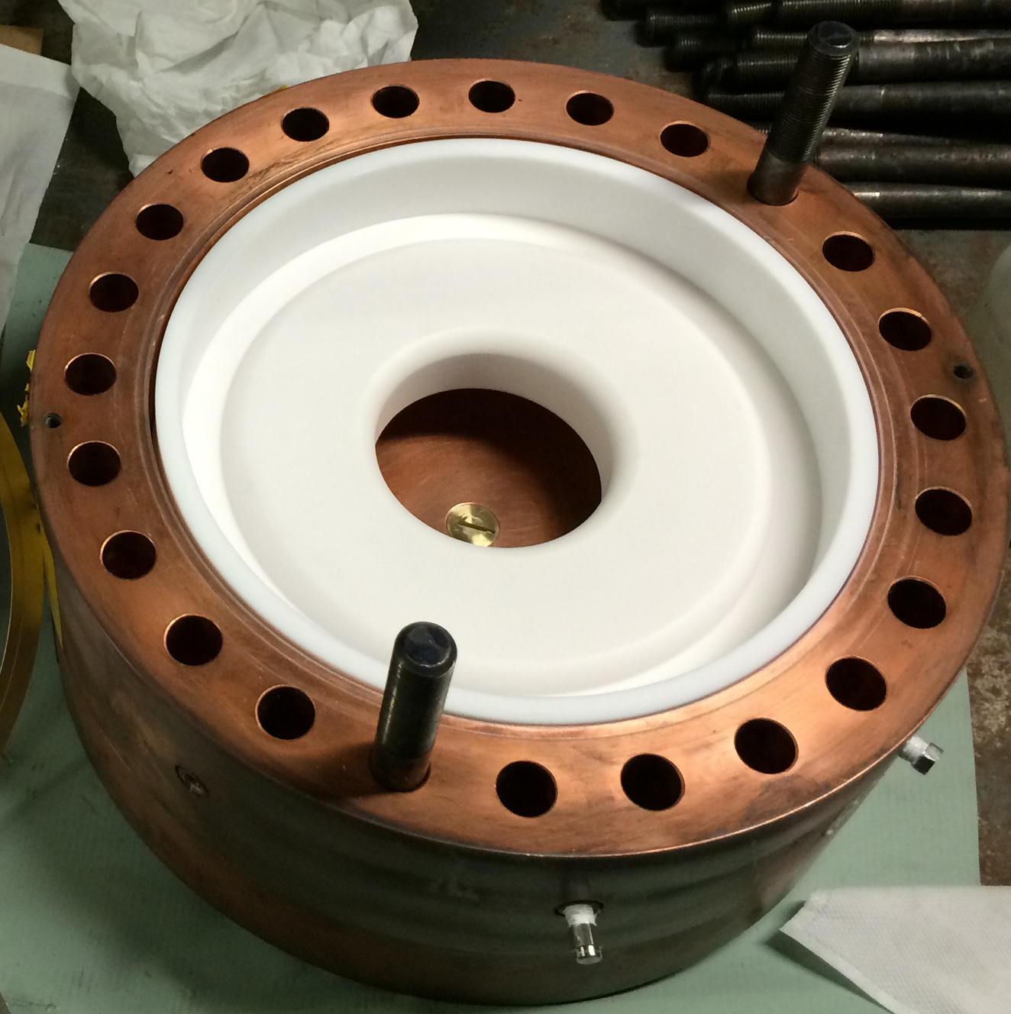
Assemble Alumina Donut
Bottom teflon spacer
Ceramic donut
Top teflon spacer
• Dielectric constant of a ceramic donut is dependent on its purity
- ε = 8.8@96, 9.1@98.5, 9.4@99.5 and 9.5@99.8 %
• Teflon space is used to tune the resonant frequency
• Improved pressure sealing by using a new diamond-shape Al gasket
- This technique is more practical than an old flat-shape Al gasket

Slide 5
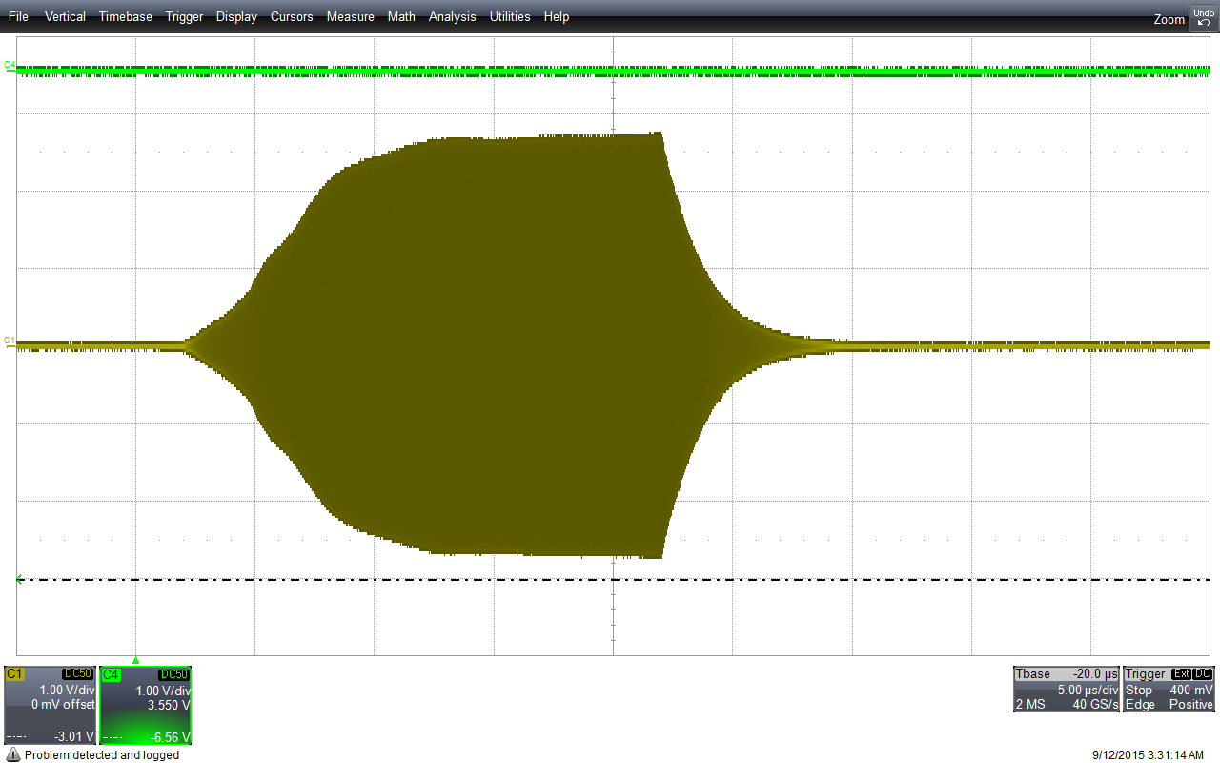
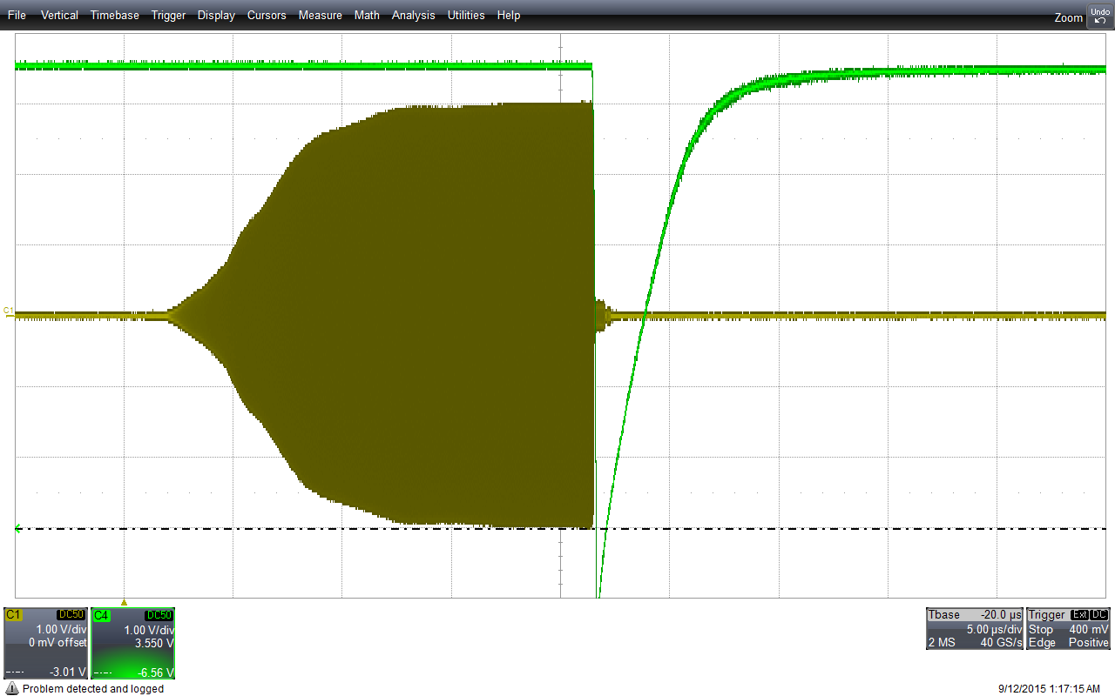
First Run (Test 99.5 % donut)
Breakdown
Light signal
Light signal
RF pickup
RF pickup
• Achieved maximum RF gradient on axis ~ 8 MV/m
• RF gradient on ceramic surface ~ 14 MV/m

Slide 6
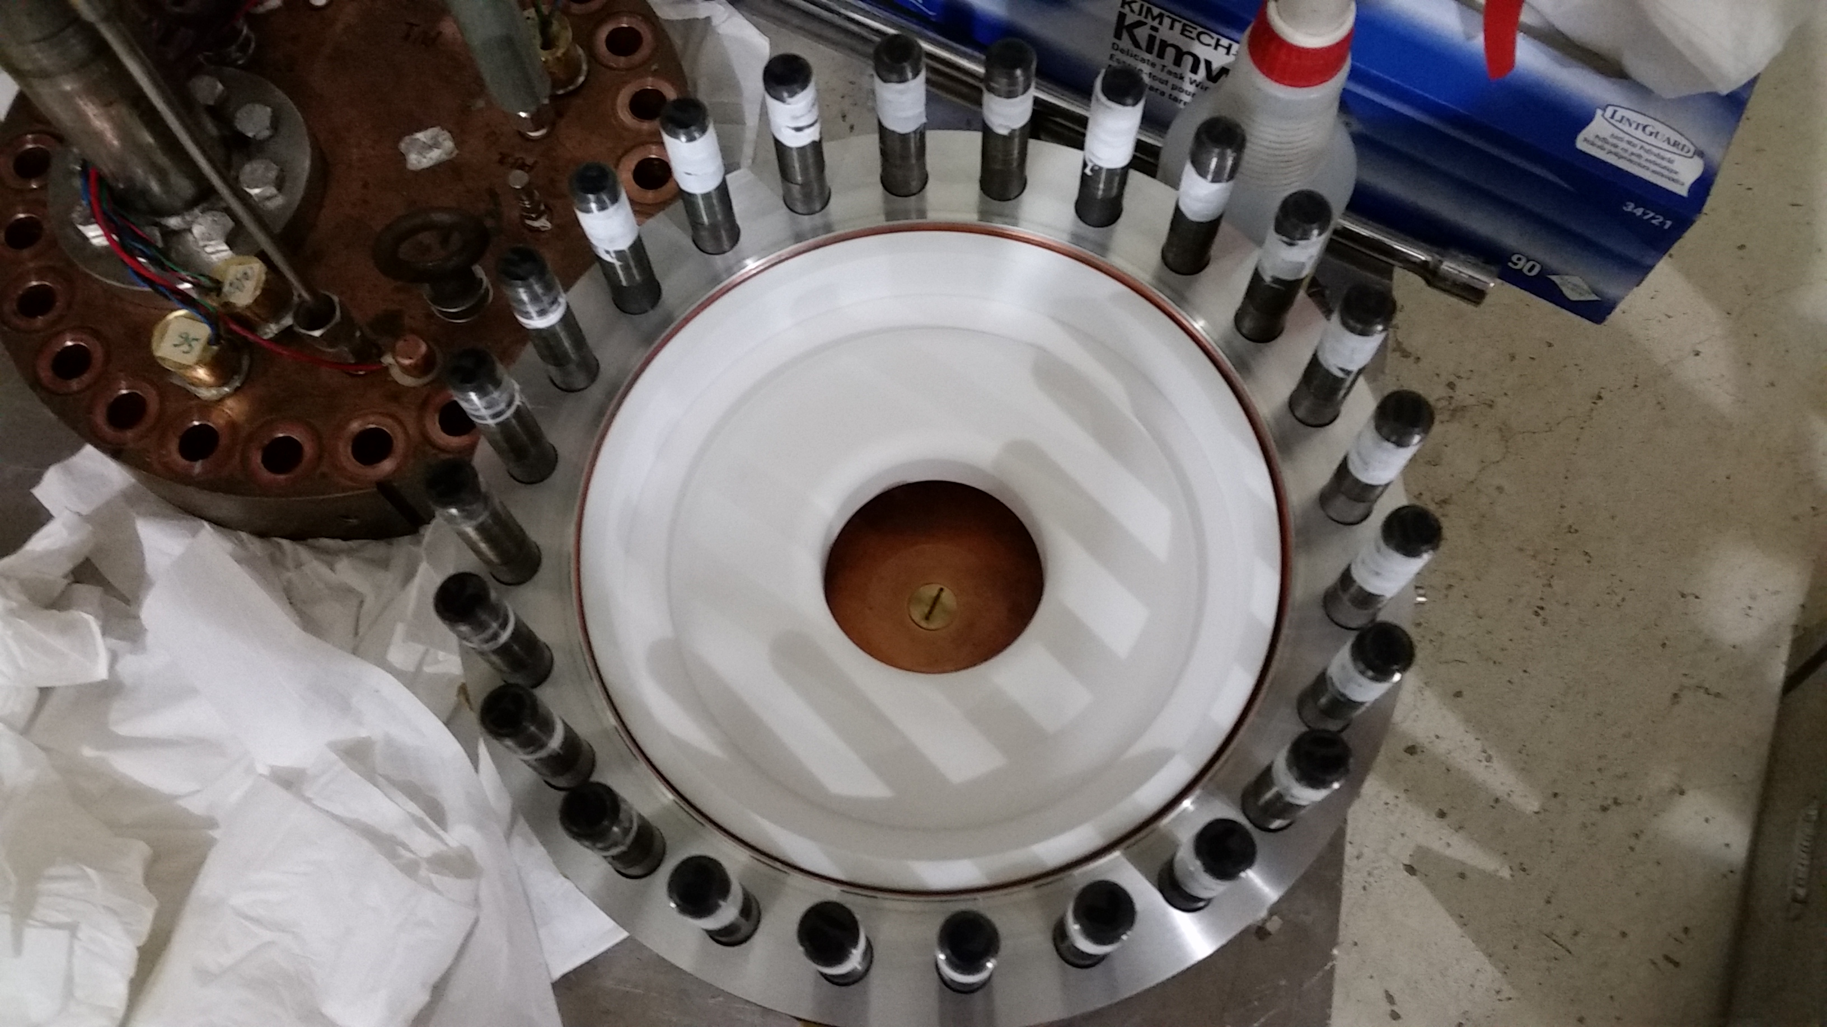
Inspection after first run
• No damage on a ceramic donut

Slide 7
Observation
• First run with 99.5 % and 98.5 % Donuts and achieved 8 and 6 MV/m on axis
• Corresponding gradient on ceramic surface is 14 and 10 MV/m, respectively
• Current data is similar or exceed the reference value
• Indeed, the dielectric strength is strongly dependent on a special (secret)
ingredient of impurity materials (fraction of Mg, Cr, etc)

Slide 8
Observation (cont’d)
• RF repetition rate is 1 Hz
• No temperature increment w/o any active cooling even
in a sequential breakdown
• No frequency shift found even in a sequential breakdown
• Successfully demonstrated feasibility of the cavity at this
RF power level
• Still learning about radiation mechanism in the cavity
- Conditioning cavity
- Treating multipactoring
- Breakdown mechanism

Slide 9
Next step
More measurement
We have two more donuts (99.8 % and 96 %)
Need more measurements in various conditions
Analysis
Full analysis of RF parameters
Breakdown event
Design realistic RF cavity

