Slide 1
Why you should upgrade to Geant4.10.1.p02
Hans Wenzel
22nd September 2015,LArSoft Coordination Meeting

Slide 2
Outline
About the current version of Geant 4.
Physics of LArIAT as example for IF exp.
Changes affecting physics of interest for LArIAT.
More info.

Slide 3
About Geant 4.10.1.p02
Geant4.10.1.p02 released on 19 June 2015
> 4.10 releases include support for multi-threaded Geant4 applications (event level).
No more changes to Geant4.9.6 (currently p04) series by the end of the year.
Good to be able to compare to previous versions of Geant 4.

Slide 4
e.g. Science outlook for LArIAT as example for IF exp.

Slide 5
Changes affecting physics of interest (previous slide) for LArIAT
All the six electromagnetic variants of the physics lists: _EMV, _EMX, _EMY, _EMZ, _LIV, _PEN are available by using the physics list factory G4PhysListFactory. This option can be specified as part of the physics list name.
Expect 5% speed up in electromagnetic physics. Better performance in general.
Labeling tracks originating from the muon stopping by the (sub) process which created them, dio, nuclear capture, atomic cascade.
Replaced native PreCompound model with Bertini in G4MuonMinusCapture giving better agreement with the data
Bug in charged Kaon response in Bertini model fixed in > 4.10
Three new physics lists have been introduced: QGSP_INCLXX_HP, FTFP_INCLXX, FTFP_INCLXX_HP.
More compact, complete and correct xs datasets.

Slide 6
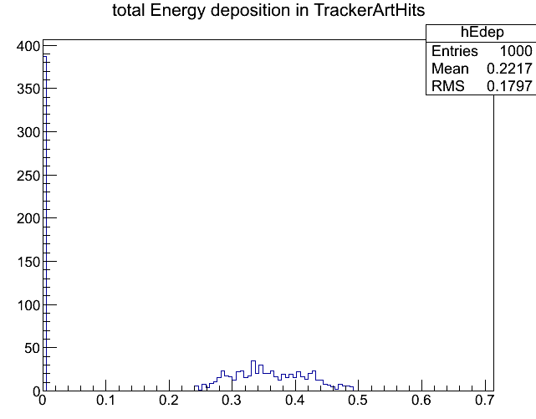
Charged Kaon response
Bug in Bertini cascade
K not passed to process
decaying the particle

Slide 7
More info:
http://geant4.web.cern.ch/geant4/support/ReleaseNotes4.10.0.html
http://geant4.web.cern.ch/geant4/support/ReleaseNotes4.10.1.html
Next week the Geant 4 collaboration meeting will be at FNAL. There will be a technical forum next Friday Oct. 2 at 1:30 pm in WH1W.

Slide 8
Backup

Slide 9
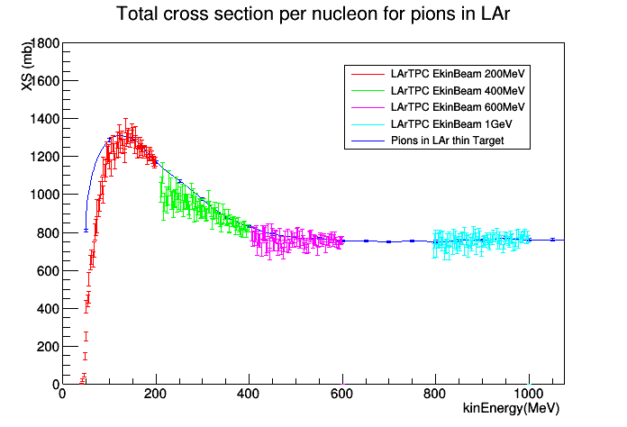
Science outlook (cont.)

Slide 10
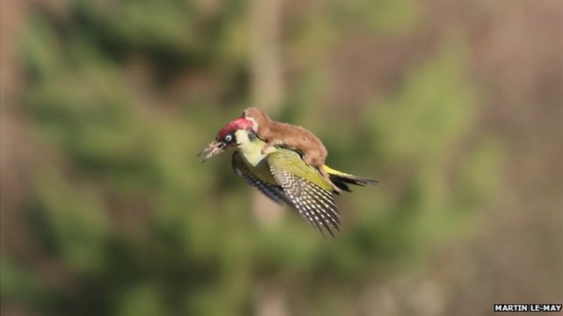
Smooth ride from here on!

