Slide 1
Electronics and DAQ
Matthew Jones (Purdue University)
Mu2e Extinction Technical Design Review
2 November 2015

Slide 2
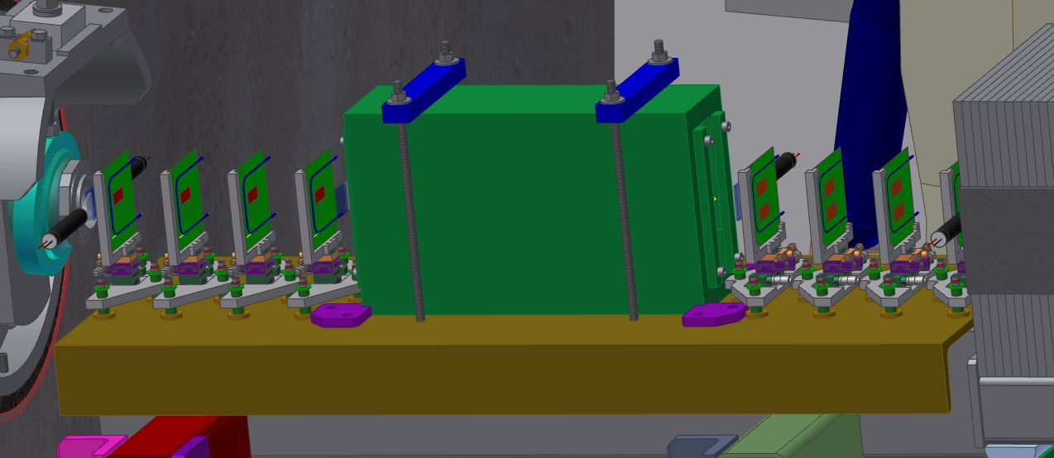
Extinction Monitor System Overview
Production target
Two types of detectors to read out:
Photomultiplier tubes
Pixel sensors

Slide 3
Extinction Monitor Electronics – Photomultiplier Tubes
Trigger scintillators:
6 scintillators (3 upstream/3 downstream of the pixel planes)
Coincidence used to trigger pixel readout
Particle ID/range stack
4 scintillators with embedded wavelength shifting fibers
Signals in scintillators at greater depth indicate muons
Readout architecture:
Waveform sampling ADC’s
Allows independent estimate of flux in the beam pulse
We considered, but decided against leading edge discriminators:
Only motivate by possible cost savings
Requires engineering effort for design and production
Unlikely to be cost effective for a small number of channels
Not sensitive to flux during beam pulse

Slide 4
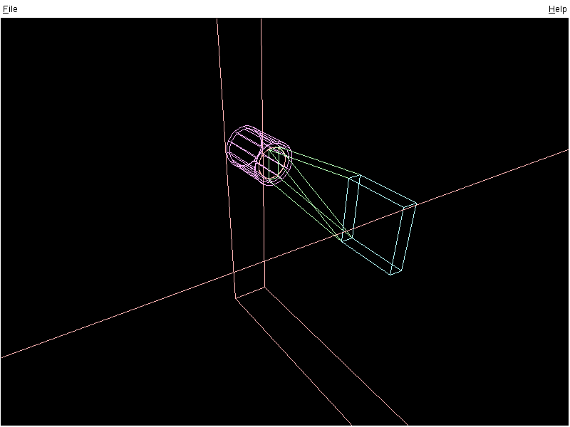
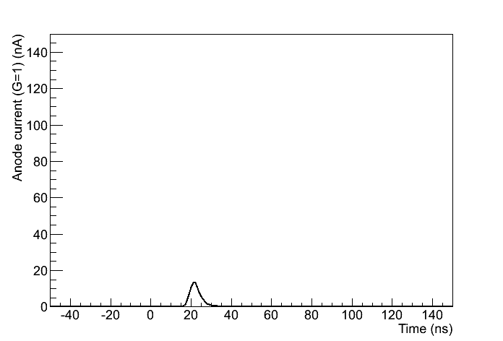
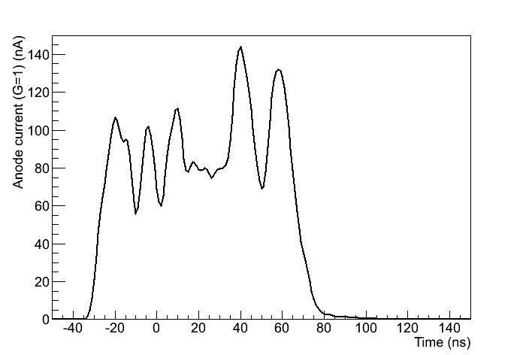
Photomultiplier Tube Signals
Light yield estimates based on photon transport Monte Carlo simulation (originally developed and validated for CDF TOF system)
PMT
(R5946)
Light guide
(Lucite)
One proton
(of order 500 p.e.)
Scintillator
5x5x1 cm³
(BC408)
Incident proton
Used for deriving scaling relations. (gain is arbitrary in these simulations)
100 protons in 100 ns

Slide 5
Photomultiplier Tube Signals
Average anode current estimate:
$$I_{A}=NMGTe/P$$
Generally desirable to keep $I_{A}<100 μA$
Plan to accommodate 50% beam intensity fluctuations
Reduce the average anode current further by
Reducing gain of last dynode stages in the base
Instrument using a preamplifier to match dynamic range of ADC
N = photoelectrons per cm = 500/cm
T = scintillator thickness = 5 mm
M = tracks per beam pulse = 45
G = PMT gain = 10⁵
P = extraction period = 1695 ns
I_{A} = 106 µA

Slide 6
Extinction Monitor Electronics – Pixel Tracker
Pixel sensors
Channel count:
4 planes upstream of bending dipole (16 readout chips)
4 planes downstream of bending dipole (24 readout chips)
Requirements:
Fully efficient between beam pulses (scintillator trigger)
Sample time structure during beam pulse (prescaled trigger)
Readout architecture:
ATLAS FE-I4b readout chips (80x336=26880 pixel array)
Programming interface/readout using FPGA (eg. Kintex-7)

Slide 7
DAQ Design Based on MicroTCA
MicroTCA is a relatively new architecture that has been widely adopted for DAQ applications in high energy physics over the past decade
Extensively used at SLAC, DESY, European XFEL
Demonstrated performance of mixed analog-digital designs for LLRF
Drivers of MTCA.4 standard (MicroTCA for physics)
Used for Phase-1 upgrades (DAQ and trigger) at CMS
Features:
Backplane provides network interface to cards, not a bus
Capable of 40 GBPS total bandwidth
Extensive supervisory features
Management network (1 GbE), remote monitoring and control (IPMI), intelligent power/cooling management
Interoperable components from multiple vendors

Slide 8
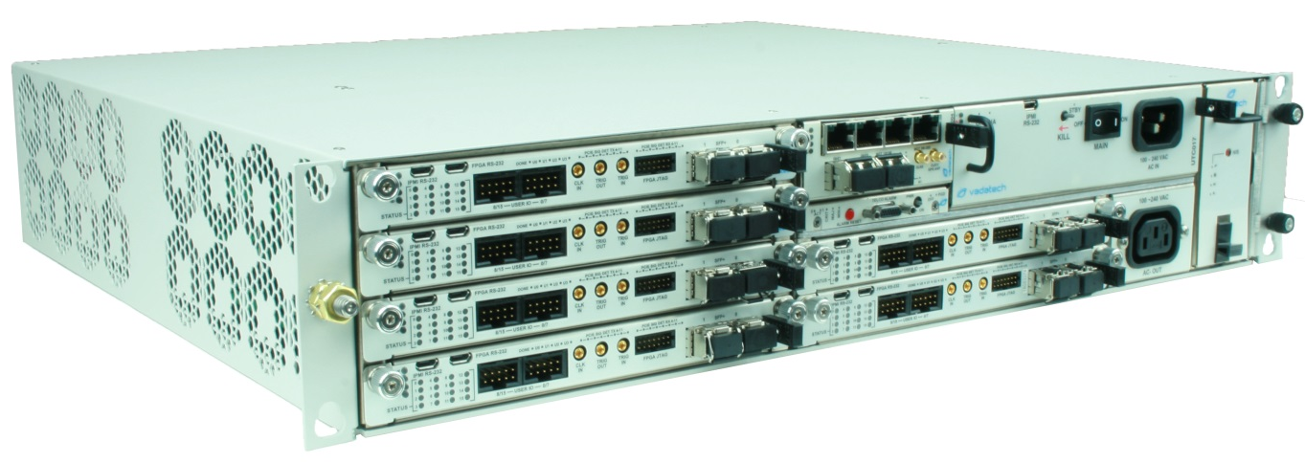
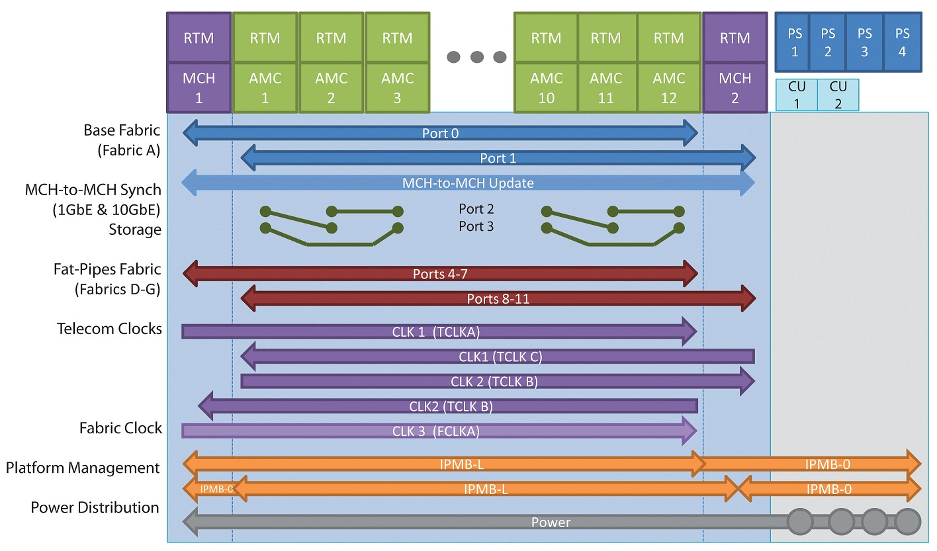
DAQ Design Based on MicroTCA
Modules are referred to as ATCA Mezzanine Cards (AMC’s)

Slide 9
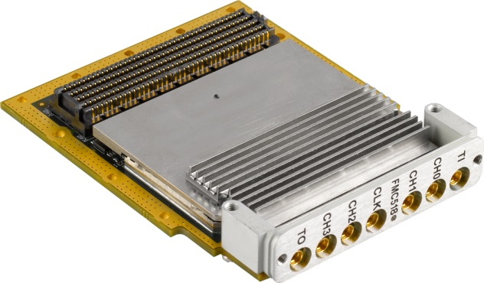
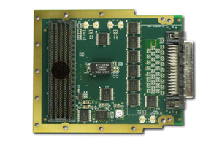
DAQ Design Based on MicroTCA
FPGA carrier AMC
Xilinx Kintex-7 FPGA
Clock synthesis
Dual VITA-57 connectors
Waveform digitizer example:
4-channel 500 MSPS 14-bit ADC
Digital interface example:
34 differential pairs to SCSI connector

Slide 10
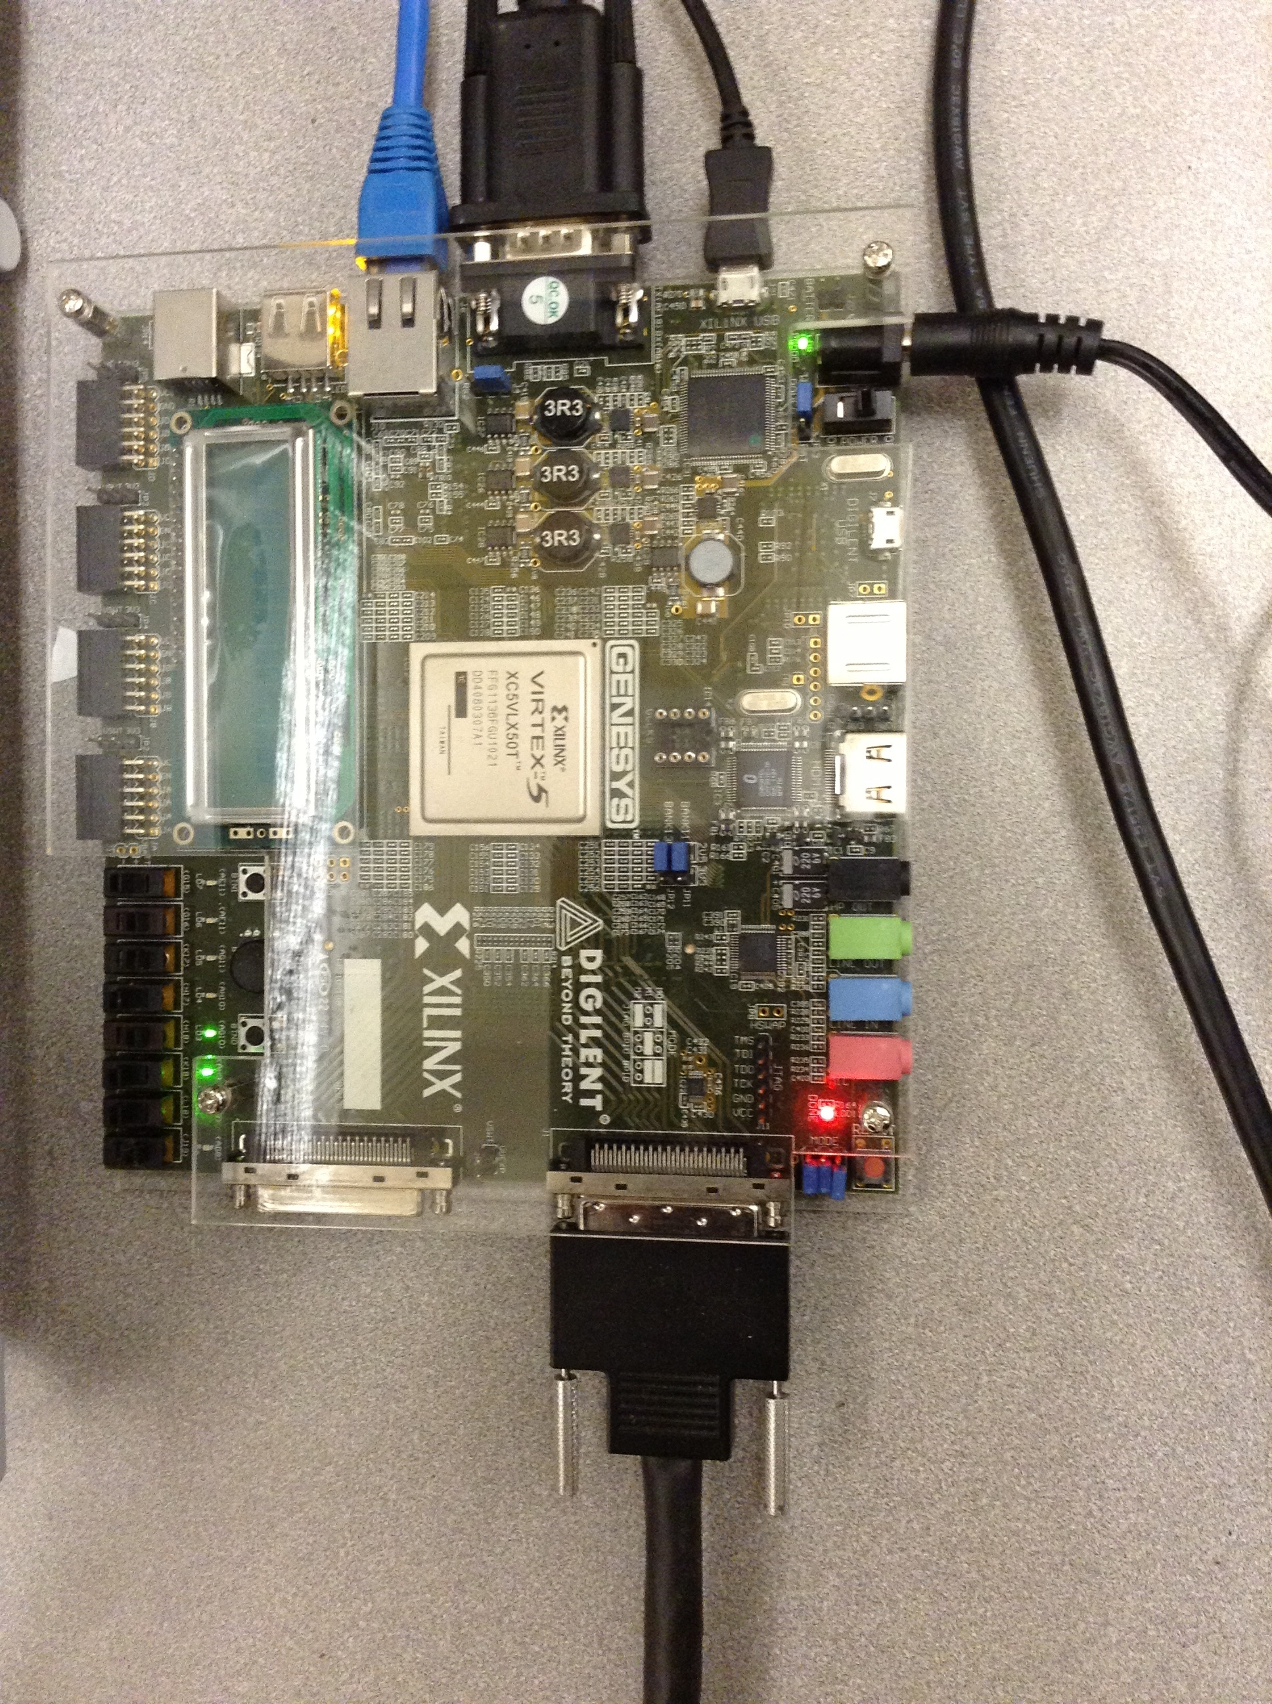
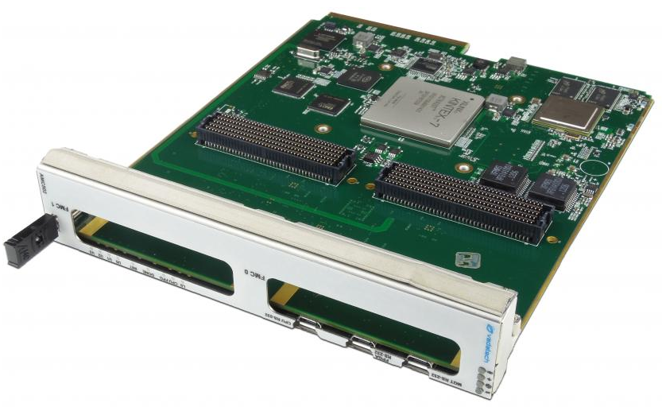
Modular Architecture Facilitates Design Development and Re-use
Virtex-5 based demonstration board (stand-alone architecture used in test beam)
Virtex-6 based GLIB v.2 AMC developed at CERN
Vadatech AMC502 (Kintex-7)

Slide 11
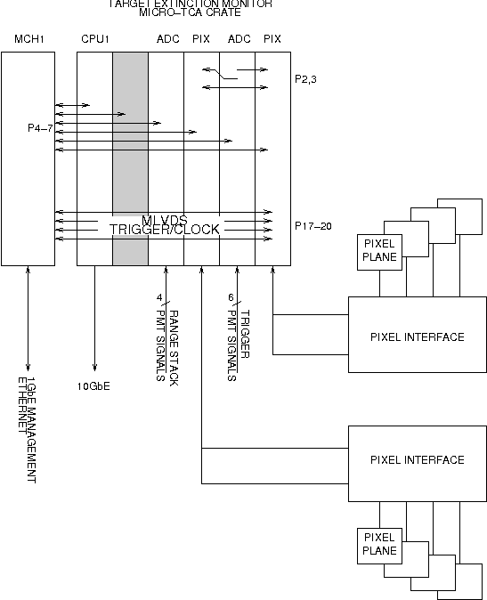
Proposed DAQ Configuration
One MicroTCA chassis
Four identical AMC’s
Kintex-7 dual FMC carrier
Data streamed over 10GbE, routed using integrated network switch
PMT signals read out using waveform digitizers
Digital interface to pixel readout via a Pixel Interface board
Logic level translation
Clock distribution
Power control
Monitoring interface
(eg. voltage, current, temperature)

Slide 12
Pixel Plane Construction – physical and electrical
Upstream of bending dipole
Downstream of bending dipole
2 sensors/4 ROC’s
3 sensors/6 ROC’s
Will be assembled using techniques developed for CMS FPix module construction: placement, gluing, wire bonding.
The FE-I4b electrical interface consists of
Power: 1.2 V (digital), 1.5 V (analog)
CLK (40 MHz – LHC BX clock)
CMD (serial data, synchronous with clock)
DATA (8b10b encoded frames) 160 Mbit/s
CLK, CMD and DATA are 1.2 V current mode logic (CML)

Slide 13
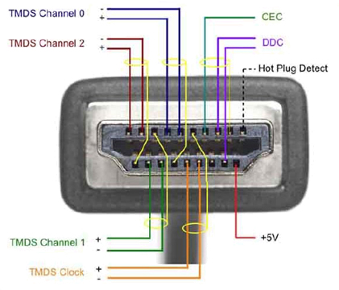
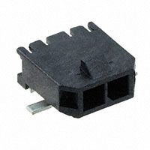
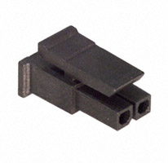
Cables and Connectors
Robustness requirements particularly important during development phase
Prefer to use connectors that are readily available and widely used in consumer electronics
HDMI (digital video) has similar bandwidth and signal integrity requirements:
HDMI supports 4 Gbit/s (now 14 Gbit/s)
Clock speeds 165 MHz (now 600 MHz)
I²C interface
Micro HDMI connector fits geometry
Have used MCX connectors for bias voltage (up to 250V)
The small CMS/ATLAS HV connector is simply not commercially available

Slide 14
Pixel Interface Board – FE-I4b modules and MicroTCA
Logic level translation (1.2 V CML ↔ 2.5 V LVDS)
Working prototypes use Micrel SY56016 (5 GHZ LINE DVR/RCVR CML DIFF 10-MLF)
Clock fanout (send only one clock signal from the FPGA)
Control, distribution and monitoring of LV power
Experience has shown that the ability to power cycle individual FE-I4b modules is extremely valuable
Desirable to measure current, ideally on the FE-I4b module but also on the Pixel Interface Board
Convenient place to distribute bias voltage
Experience using Picovolt modules in strip telescope at FTBF
Monitoring/slow controls
I²C multiplexing to FE-I4b modules for voltage, current, temperature and inventory control
Unconstrained physical form factor (fits in a box with sufficient panel space for connectors, not a crate)

Slide 15
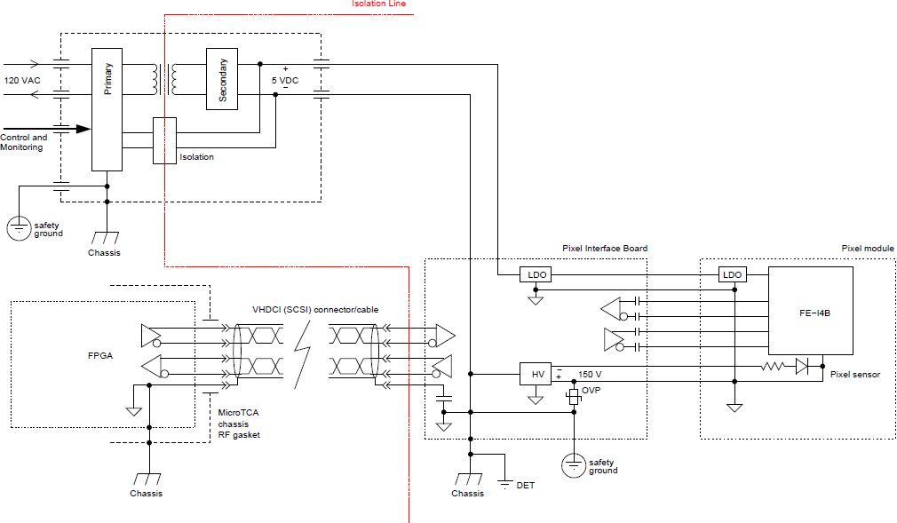
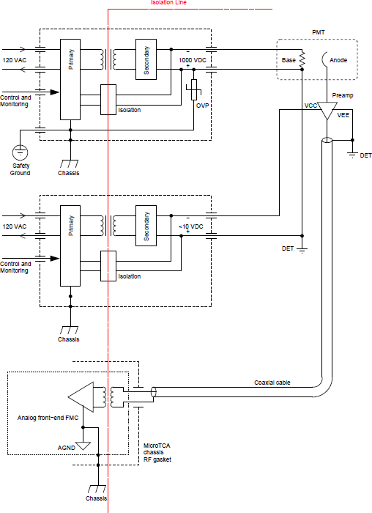
Grounding and Shielding
The proposal is under collaboration review.
Potential ground loops mitigated
Suitable isolation components identified
Prior experience with much larger systems
The CDF TOF system had 432 PMT’s with preamps, a much more complicated clock fanout , and achieved expected timing precision

Slide 16
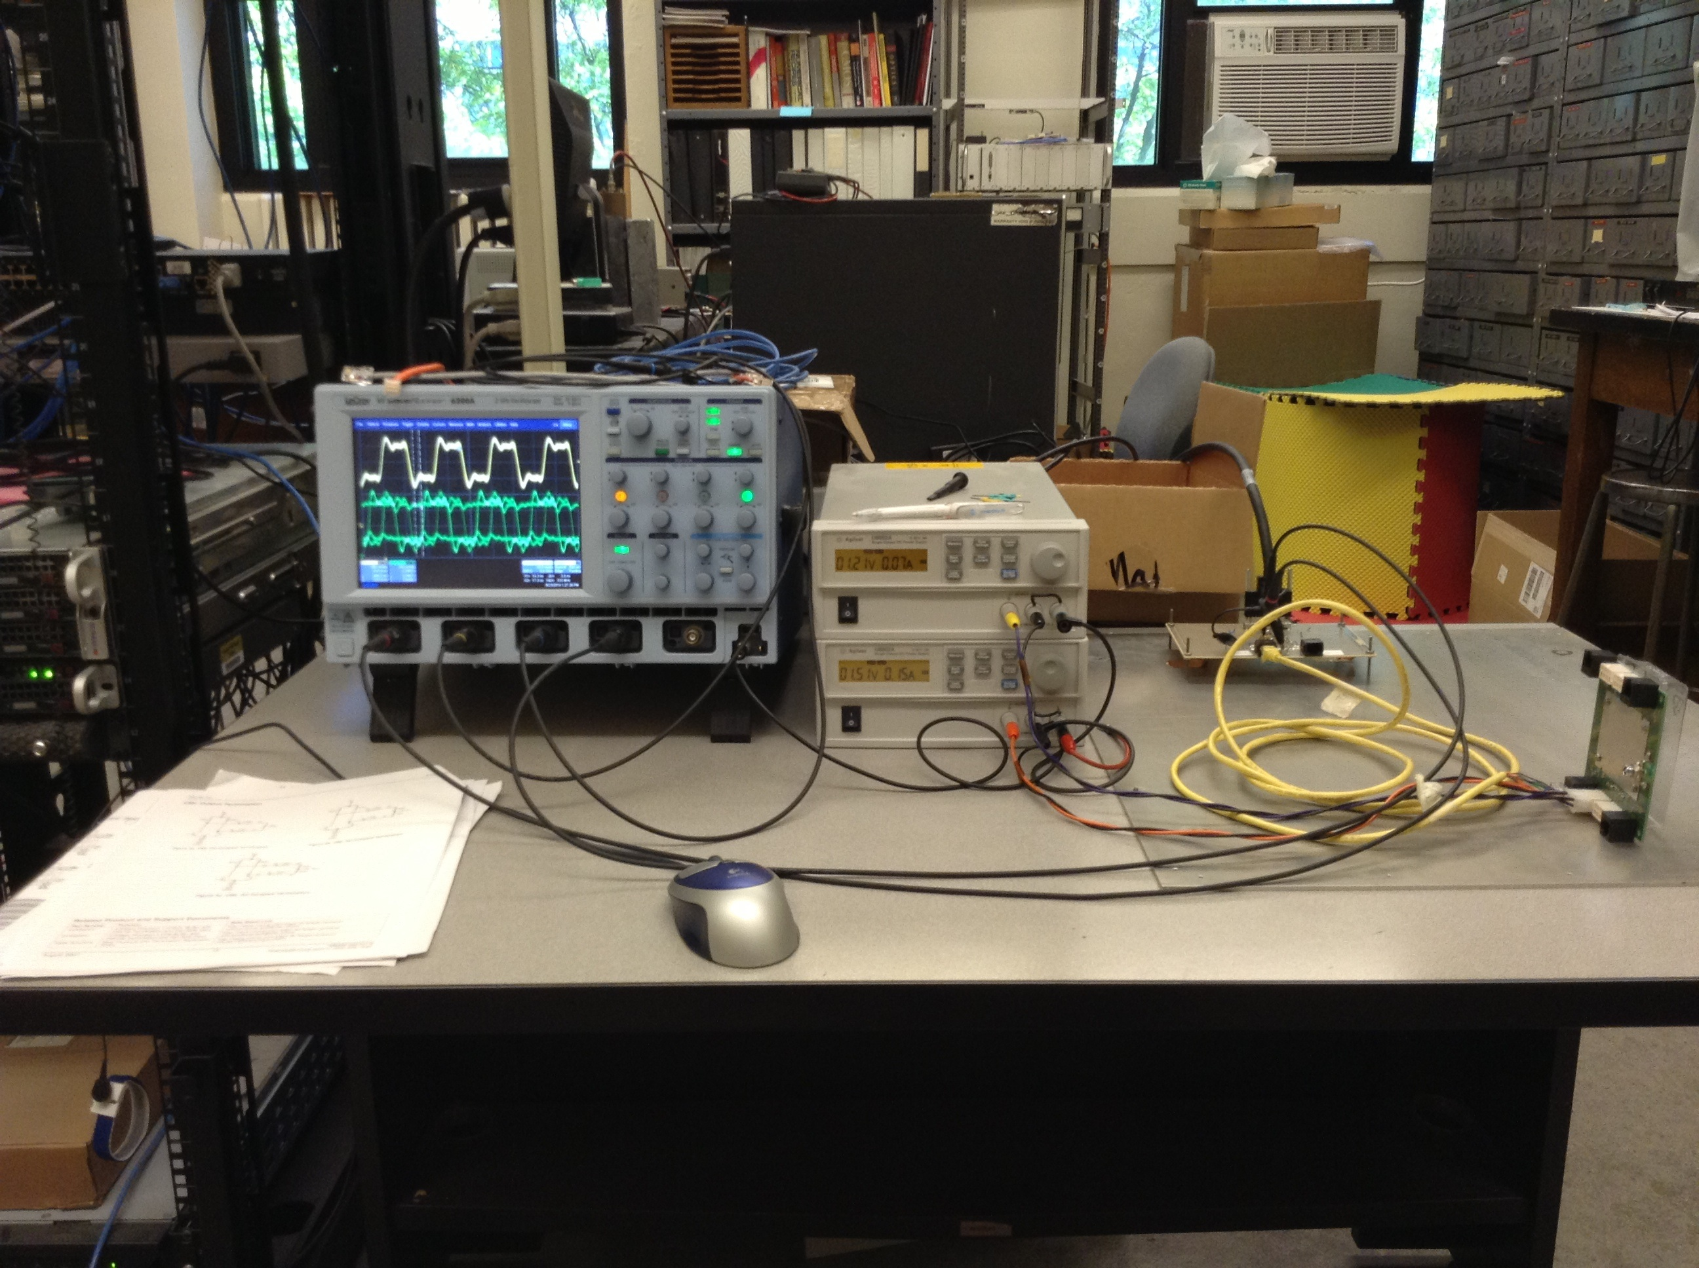
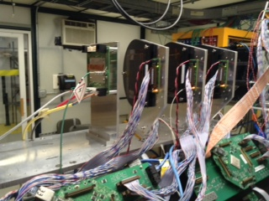
Prototype Pixel Readout
Implemented the complete readout of two channels:
Using a Virtex 5 demonstration board (10,000 lines of VHDL)
Demonstrated that capacitive coupling works for CLK, CMD, DATA
160 MHz data synchronous with 40 MHz clock - no clock recovery required (high speed GTX transceivers not used)
Implemented 10b8b decoding, data stream parsing implemented in firmware
Data streamed via 1 GbE
Successfully acquired data during test beam in June

Slide 17
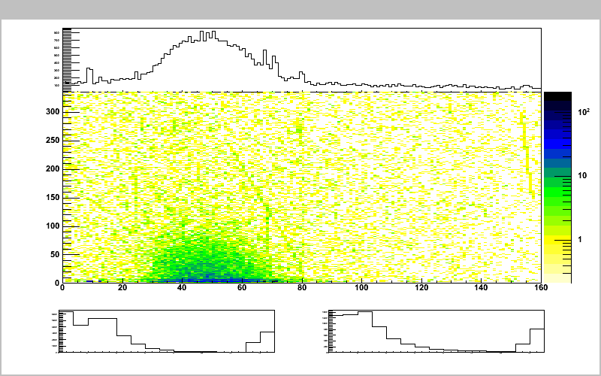
Prototype Pixel Readout
Read out in self-triggered mode during June test beam
Strip telescope and pixels ran with different timestamp clocks
Scintillator provided a trigger signal
Trigger numbers written to both strip and pixel data streams, tagged with timestamp counters in each system

Slide 18
Bandwidth Estimates
All data tagged with a timestamp derived from 40 MHz clock
Formatted in FPGA to match Mu2e data stream
Coincidence trigger for pixels formed using FPGA
Monitor statistics on individual + coincidence counts
Full readout of trigger scintillators primarily for diagnostic purposes
Particle identification
$$BW=\frac{NTSB}{P}$$
N = number of channels = 4
T = duration of spill = 250 ns
S = sample rate = 500 MSPS
B = bits per sample = 12 bits
P = extraction period = 1695 ns
3500 Mbps raw data rate.
Significant reduction from from zero suppression, averaging, and data compression.

Slide 19
Bandwidth Estimates
Data from pixel planes
On-chip zero suppression
Bandwidth from out-of-time hits expected to be negligible
During the beam pulse
$$BW=T(H+NMD)/BP$$
N = number of planes = 8
T = duration of pulse = 250 ns
M = number of tracks = 100 (high estimate)
B = timestamp clock period = 25 ns
H = event header size = 128?
D = bits per cluster = 104 bits (4x24+8)
P = extraction period = 1695 ns
500 Mbps
However, bandwidth limit is actually in the FE-I4b readout.

Slide 20
FE-I4b Readout Bandwidth
Data from FE-I4b readout chips is sent in frames:
At 160 Mbps, it takes 3 $μs$ to read out (two extraction periods)
Data type | Bits (10b encoded)
Start-of-frame | 10
Data header | 30
Service record 14 | 30
Service record 15 | 30
Service record 16 | 30
Data record | 10 x 30
Other service record | 30
End-of-frame | 10
TOTAL: | 470 bits
100 tracks distributed uniformly over time and space

Slide 21
Trigger Scheme
Triggers commands sent on CMD
5-bit pattern latches data from a previous clock cycle
Additional overhead due to capacitive coupling
Estimate 200 ns to send trigger command
Between beam pulses:
Any coincidence in scintillators generates a trigger
Data read out in order – guarantees delivery (or flagged as error)
During beam pulse:
Read out up to 15 consecutive time slices (375 ns)
Prescaled sampling of different pulses
Sufficient flexibility in FPGA to completely sample average time structure of bunches and maintain single track sensitivity between beam pulses.

Slide 22
Summary
The DAQ requirements are easily satisfied by modern FPGA architectures
MicroTCA provides a coherent framework for the design
Commercially available FPGA carriers, digital I/O and ADC’s
Flexible design:
Modular firmware design
Portable to a wide range of FPGA families
Different vendor products easily accommodated in design
Flexible trigger implemented in FPGA logic
10 GbE provides sufficient bandwidth
Demonstrated FE-I4b readout using prototype hardware
Identified system-level constraints prior to board layout
Ready to proceed with Rev 0 schematics and PCB layouts

