Slide 1
Beam Transverse Phase Space From Resonant Extraction
V.Nagaslaev
Mu2e Extinction Technical Design Review
2 November 2015

Slide 2
Mu2e Slow Extraction in the Delivery Ring
Parameter | Value | Units
MI Cycle time | 1.333 | sec
Number of spills per MI cycle | 8
Duration of each spill | 34-54 | msec
Number of protons per micro-pulse | (3.0-5.0)×10⁷ | protons
Maximum DR Beam Intensity | 1.0×10¹² | protons
Duty Factor (Total Spill Time ÷ MI Cycle Length) | 32 | %
Reset Time Gap between spills | 5 | msec
Operation point (Qx/Qy) | 9.650/9.735
Extraction efficiency | >98 | %
Spill uniformity | <50 | %

Slide 3
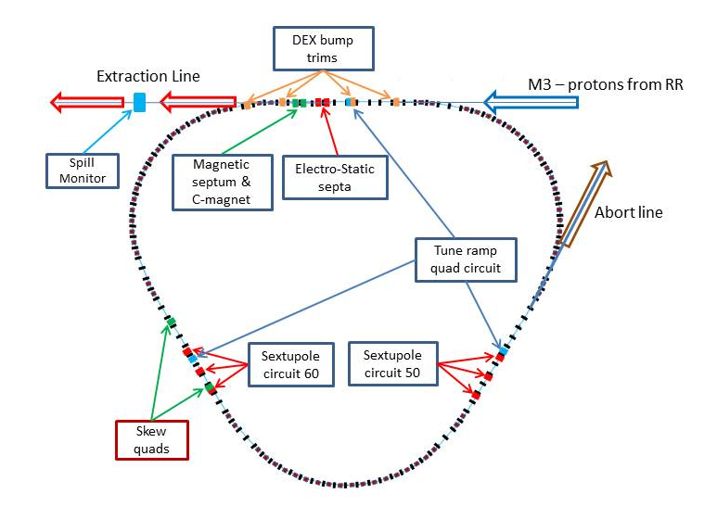
Mu2e Resonant Extraction – General Scheme
Delivery Ring (fka Debuncher)
Resonance: 3rd Integer
Driving H-tune to resonance
H-RF Knock Out (RFKO) system
Dynamic orbit control
ESS: foils instead of wires
Abort leftover beam
SS20-30
RFKO kicker
SS10-60
SS40-50

Slide 4
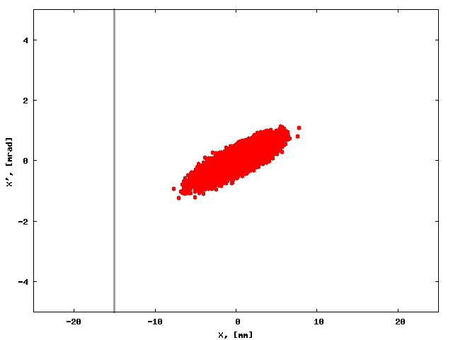
Beam Phase Space Formation in the Ring
Unperturbed machine: phase space motion in ellipses

Slide 5
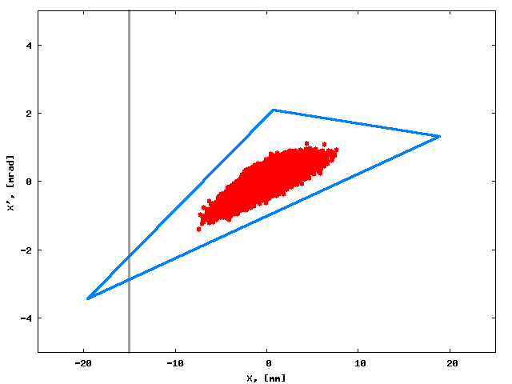
Beam Phase Space Formation in the Ring
Sextupole field added: areas of unstable motion appear

Slide 6
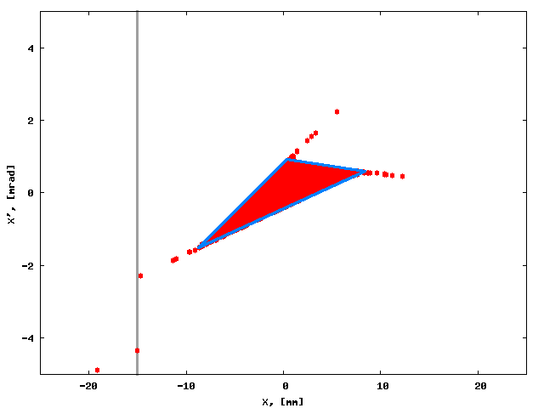
Beam Phase Space Formation in the Ring
Moving machine to the resonance: extraction starts

Slide 7
Circulating and Extracted Beam at Upstream End of ESS1
Cathode
Beam center
Clearing Electrode
E
-100 kV
60 mm
Foil Plane
S.Werkema
Notes:
The electro-static septum is being designed and built under a separate level 3 sub-project (475.05)
Notes:
Proton beam goes into the page
Distribution shown is not expected beam distribution.
These particles were generated for loss simulations (emphasis on high amplitude particles)
Relative intensities of extracted and circulated beam have been altered to make the extracted beam visible

Slide 8
Beam Phase Space Formation in the Ring

Slide 9
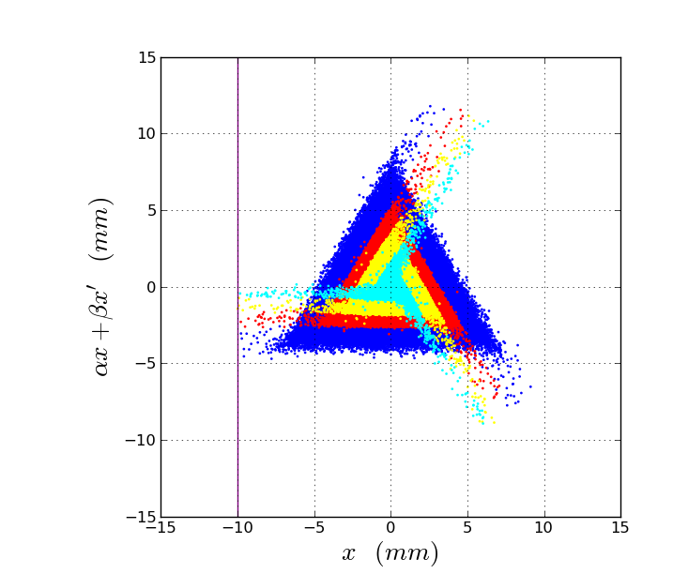
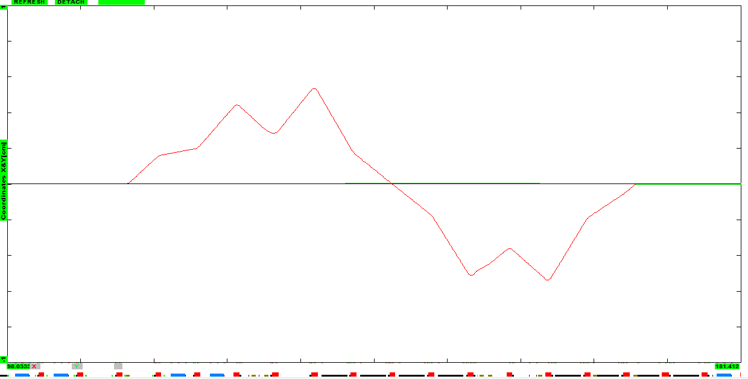
Beam Phase Space Formation in the Ring
X-width: “Step size”
X’-width: Orbit control
Natural X’-width
Dynamic (DEX) bump
0.4mR
1cm
Beam
2Q7
2Q5
3Q0
3Q3
3Q5
H210
H206
H301
H305
2Q10

Slide 10
Beam Phase Space Formation in the Ring
X-width: “Step size”
X’-width: Orbit control
Natural X’-width
Dynamic (DEX) bump
0.4mR
1cm
Beam
2Q7
2Q5
3Q0
3Q3
3Q5
H210
H206
H301
H305
2Q10

Slide 11
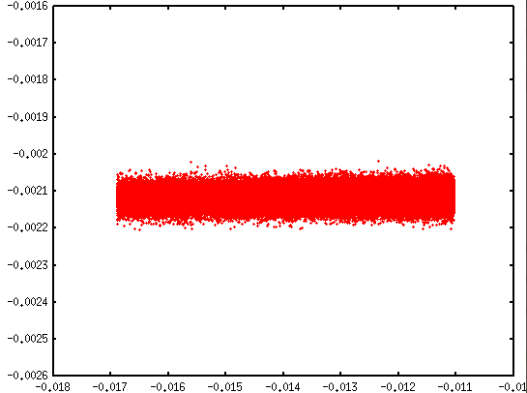
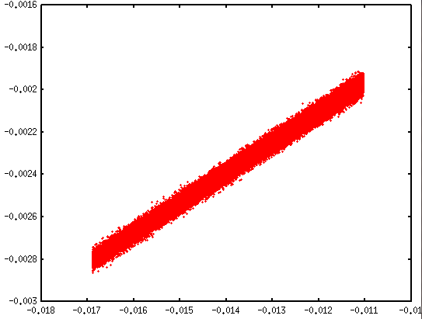
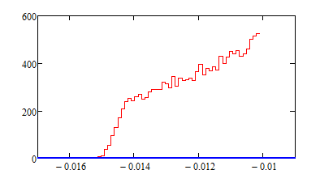
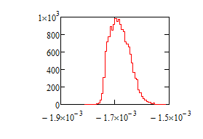
Beam sample at the entrance of ESS1
Norm. coordinates
Regular coordinates
X-distribution
X’-distribution

Slide 12
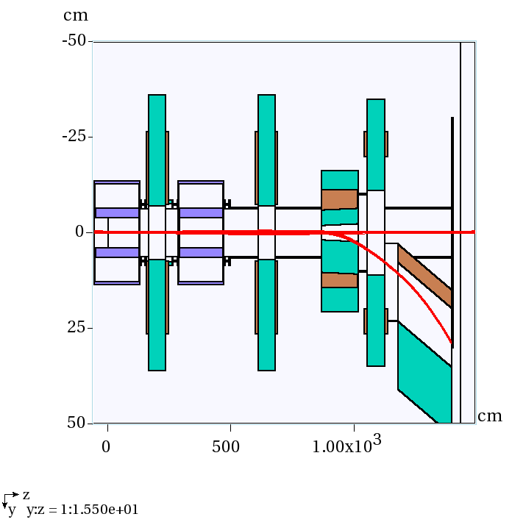
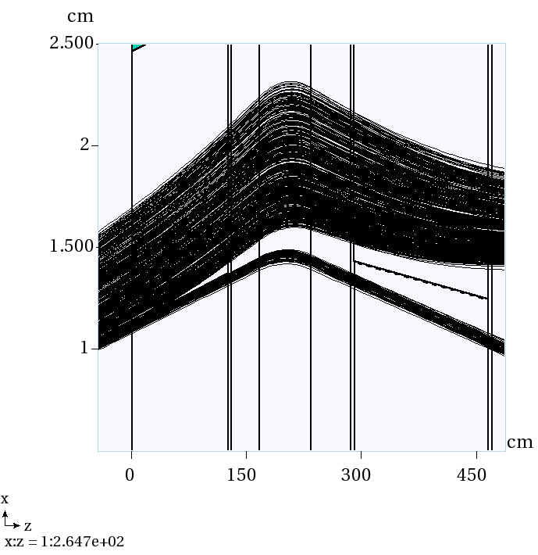
Beam Tracking in Extraction Channel using MARS
Beam tracking in Extraction channel:
Passage in apertures, scattering
Beam losses, radiation issues
Geometry optimization
Collecting the sample for further tracking

Slide 13
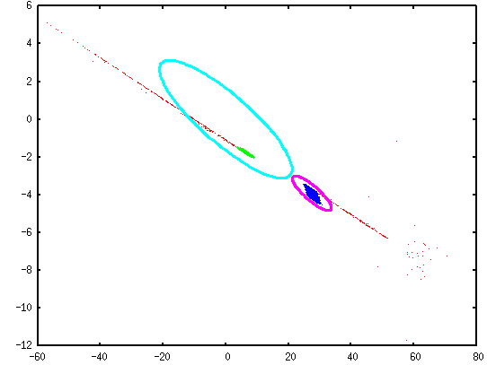
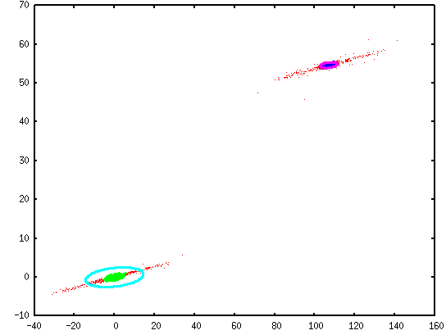
Beam Scattering in the Extraction Channel
Horizontal PS upstream of CMAG
Vertical PS upstream of CMAG
Extracted beam
Extracted beam
- DR acceptance, 35 π-mm-mrad
- BL design emittance, 3 π-mm-mrad

Slide 14
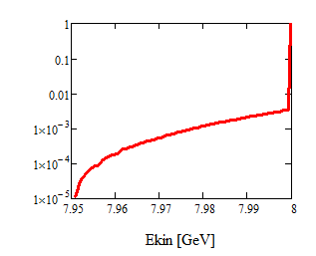
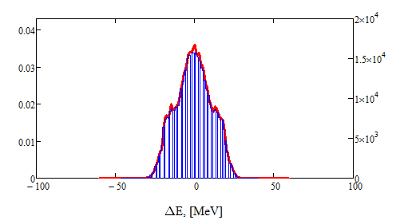
Beam Scattering in the Extraction Channel
Momentum distribution US of CMAG
Integrated tail due to energy loss in scattering
Added E-distribution according to RF tracking simulations

Slide 15
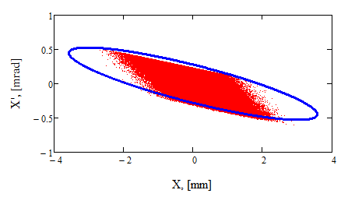
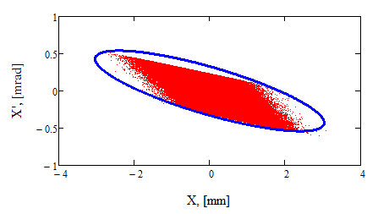
Beam Line Matching to The Extracted Beam
Common recipe:
Match optics of the beam lines
And then
Beam envelope follows $∆x\sim \sqrt{εβ(s) }$
It is not quite so in this case
β_{X}=12.8m; α_{X}=1.60
β_{X}=9.2m; α_{X}=1.30
Irregular shape- sharp edges
Doesn’t fill the ellipse
Tumbling in ellipse
Matching to Ring optics
98% contained
Matching to the beam shape
99.98% contained

Slide 16
Summary
Resonant Extraction reshapes the beam
Beam shape has sharp, asymmetric edges
Beam has a halo with signature orientation in phase space
Beam line optics should be matched to the beam shape
Expect noticeable tumbling of the beam shape
Particle samples are (being) prepared for tracking in the beam line

