Slide 1
Simulation of Extinction Channel
Eric Prebys
Mu2e Extinction Technical Design Review
2 November 2015

Slide 2
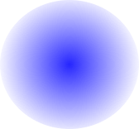
Reminder: Two Separate Collimation Issues
Phase space distribution of out of time beam at location of AC dipole
Beam core: out of time beam will be steered into the collimator or collimators
90° downstream of the AC dipole
AC dipole shifts distribution along x’ axis in phase space
Admittance of downstream collimation system
High amplitude beam tails will be steered into the collimation channel, so they must be cleaned up
90° upstream of the AC dipole

Slide 3
Summary: Collimator Needs and Locations
Halo Collimator (-90°, 1m Steel)
Tail Collimator (1m Steel)
AC Dipole
Extinction Collimator (+90°, 1m Tungsten)
Collimator Details:
talk by V. Sidorov

Slide 4
Simulation Procedure
A Python program was used convert the MADX optics file to a g4beamline* script
  g4Beamline is a GEANT4 scripting tool developed by Muons, Inc.
  Magnets, collimators, and beam pipes were included.
  The GEANT4 model begins just following the C-magnet at the exit of the Delivery Ring Enclosure.
To save computing power, simulation is done in two parts
  A mathematical model is used for the “core” of the beam (within the 50 π-mm-mrad nominal aperture), and this is simulated from just upstream of the AC dipole
    Beam line admittances insure they will make it that far without scattering.
  The entire beam line is simulated for high amplitude beam tails (ε_{x} >30 OR ε_{y} >40 π-mm-mrad), which are based on extraction simulations (V. Nagaslaev’s talk)
*http://public.muonsinc.com/Projects/G4beamline.aspx

Slide 5
Simulation Procedure (cont’d)
Particles are defined to be “transmitted” if they fall within 5 mm of the target (actual radius 3 mm).
  Particles that miss the target do not produce experimental backgrounds, but they could produce false signals in the Extinction Monitor, so that sample is passed to given to that group for evaluation (see P. Kasper’s talk).
Transmission results are tabulated as function of of normalized deflection angle
in increments of .1, with up to 108 particles per point (106 events on 100 processors)
These tables are combined with the dipole waveform to determine transmission vs. time, which is then convoluted with the simulated bunch shape (S. Werkema’s talk) to determine both final in time efficiency and out-of-time transmission.

Slide 6
G4BL Model
AC Dipole
Collimator

Slide 7
Collimator Jaw Settings
Collimator | Distance from C-magnet [m] | β_{x} [m] | Half gap [mm] | Comment
Tail | 33 | 38 | 4.0 | Observed edge of distribution.
Halo | 106 | 4.29 | 4.75 | A=50 π-mm-mrad
Extinction | 160 | 3.0 | 3.98 | A=50 π-mm-mrad

Slide 8
Important Changes In Design Development
Original collimation scheme was based on traditional halo collimation, and included space for multiple (5 total) collimators after the AC dipole, but none before
Unlike beam halo, the out-of-time beam strikes the downstream collimator solidly, so multiple collimators are not necessary.
After CD1, the AC dipole was moved downstream to allow space for upstream collimation.
The reduced phase advance caused an increased transmission of punch-through beam, which was resolved by changing the downstream collimator from steel to Tungsten.

Slide 9
Important Changes (cont’d)
In the original optics, the phase advance between the AC dipole and the extinction collimator resulted in an amplitude maximum between the two, causing out of time beam to strike quadrupoles in between the two and scatter back into the transmission channel.
The solution at CD2 (ie, the TDR!) was to add a third harmonic to the waveform to limit the maximum amplitude.
After CD2, the optics were modified to eliminate the problem, allowing us to go back to the two-harmonic solution.
  Because the two solutions look the same near the transmission window, this does not change the results in CD2 in any significant way.

Slide 10
Original Optics
ψ=90° collimator
Problem: this caused high amplitude beam to hit upstream of the collimator, which would scatter back into the transmission channel:
ψ=0 collimator (unnecessary)
Our baseline solution was to add a third harmonic to limit the amplitude:

Slide 11
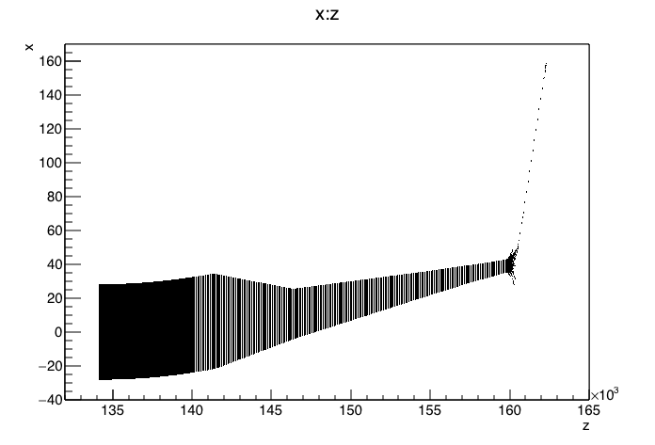
High Amplitude with New Optics
Can return to two harmonic waveform
δ=10
No hits upstream of collimator!
This is very good news!!

Slide 12
Simulated Distributions for Downstream Modeling
Used:
  30 π-mm-mrad full normalized emittance for beam in bend (extraction) plane
  15 π-mm-mrad 95% normalized Gaussian emittance in non-bend plane

Slide 13
Results for Core Transmission
We use these results to generate a lookup table to use in further calculations.
Below, this table is compared to the simple numerical integration (assuming a “black hole” collimator) that was used for our initial choice of waveforms.
≤5 ➔ 5x10-8

Slide 14
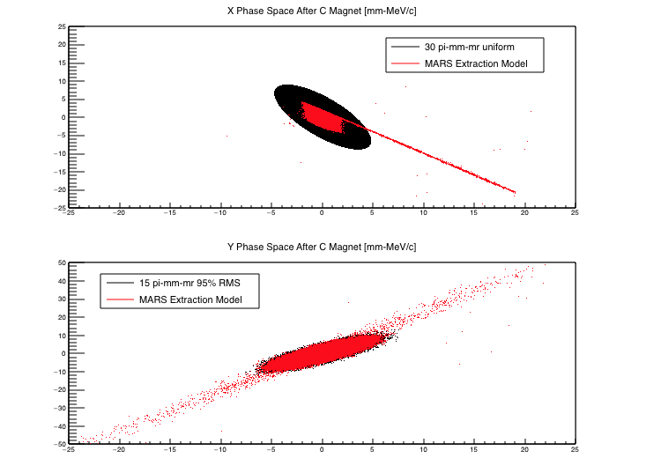
Model vs. Extraction Simulation: Significance of Tails
This is conservative (mostly)
Scatters from extraction septum, which cause a lot of problems (more about that shortly)

Slide 15
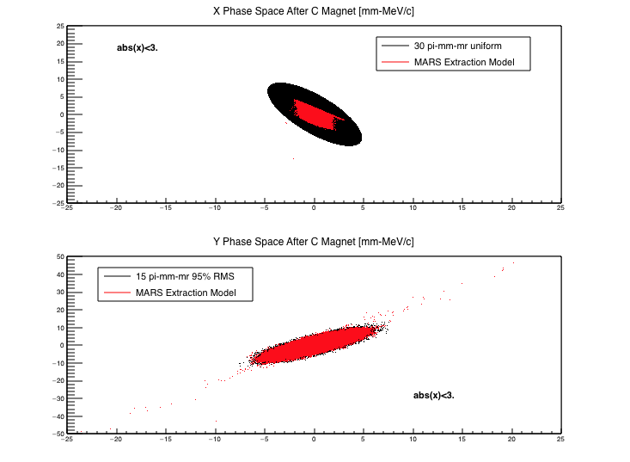
Need For Upstream Collimation
No collimation
After upstream collimation
Causes out of time transmission at the 10⁻⁶ level
Used for final simulation

Slide 16
Simulation of Tails
Results of extraction simulation were evaluated after the C-magnet at the exit of the delivery ring and used to generate input tracks for g4beamline.
Tracks were selected for which the normalized emittance ε_{x} >30 OR ε_{y} > 40 π-mm-mrad, and propagated down the whole beam line
  Fully complementary with x-plane core distribution.
  Some small amount of double counting in y-plane, but it’s not a problem.
  Lower amplitude tracks would have been transported cleanly to the the AC dipole, and have therefore already been accounted for with the core simulation.
  This greatly reduced the computing time required
Again, transmission was evaluated as a function of normalized deflection angle, but only for δ≥2
  Negligible fraction of transmitted beam below δ=2
  “Extinction” only defined outside of transmission window, where δ>2 by definition.

Slide 17
Results of Tail Simulations
Goal: <10⁻⁷ outside of ±125ns
±130ns
±300ns
±115ns
Without upstream collimation, there is transmission at the 10⁻⁶ level near the edges of the transmission window
With both upstream collimators in place, there are NO particles transmitted for 10⁸ initial tracks ➔ use core simulation table for final transmission.

Slide 18
Final Steps and Evaluation
Original transmission calculations and waveform optimizations used purely mathematical calculations
  Uniform transverse distributions in X
  Gaussian distributions in Y
  Gaussian distributions in time
  These were convoluted with a numerical integration, assuming a perfect collimator.
These were redone:
  Replacing time Gaussian time distribution. with lookup table based on S. Werkema’s simulations.
  Replacing the numerical integration with “transmission vs. delta” table, based on the g4beamline simulations.

Slide 19
Harmonic Optimization (as shown in introduction)
In the end, result did not change significantly compared to numerical approximation.
Efficiency too low
Transmission window too wide

Slide 20
Final Wave Form
In time transmission: 99.5%

Slide 21
Extinction Performance
Putting it all together…
Results:
Fraction of extracted beam outside of ±125 ns: 3.2×10⁻⁵
In-time beam transmission: 99.5%
Beam line extinction: <5×10⁻⁸
Total extinction: <1.6×10⁻¹²
Reminder:
Extinction Requirement: <1×10⁻¹⁰

Slide 22
Summary
We have developed an extinction methodology to meet the critical Mu2e requirement of <10⁻¹⁰ fractional out-of-time beam outside of the ±125 ns nominal transmission window.
Using a GEANT4 based tracking simulation, we have demonstrated that this system is capable of exceeding this requirement by almost two orders of magnitude, which we feel is a reasonable safety margin, given the importance of the specification.

