Slide 1
Design and Installation of the Mu2e Extinction Monitor
Larry Bartoszek, Bartoszek Engineering
Mu2e Extinction Technical Design Review
2 November 2015

Slide 2
Overview of slides
The next set of slides shows the overall and detailed design of extinction monitor components
The set after shows details of how some of the major components will be installed
The requirements are to be able to position each of the devices to coordinates determined for the extinction monitor to tolerances typical of accelerators at Fermilab (±0.005” transverse to beam)
Every component has the ability to be positioned in all six degrees of freedom (in some cases in multiple layers) to the required accuracy

Slide 3
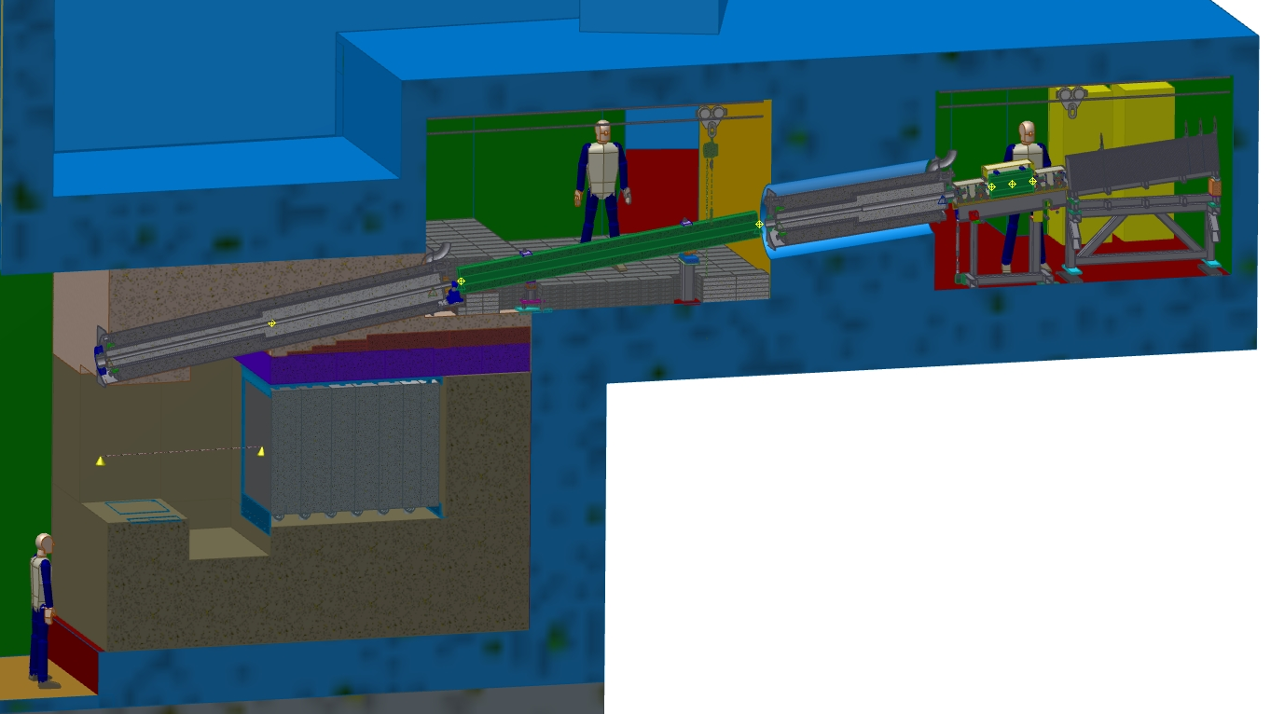
Cross section overview through the Extinction Monitor
Extinction Monitor Filter
Extinction Monitor Detectors
Proton Absorber

Slide 4
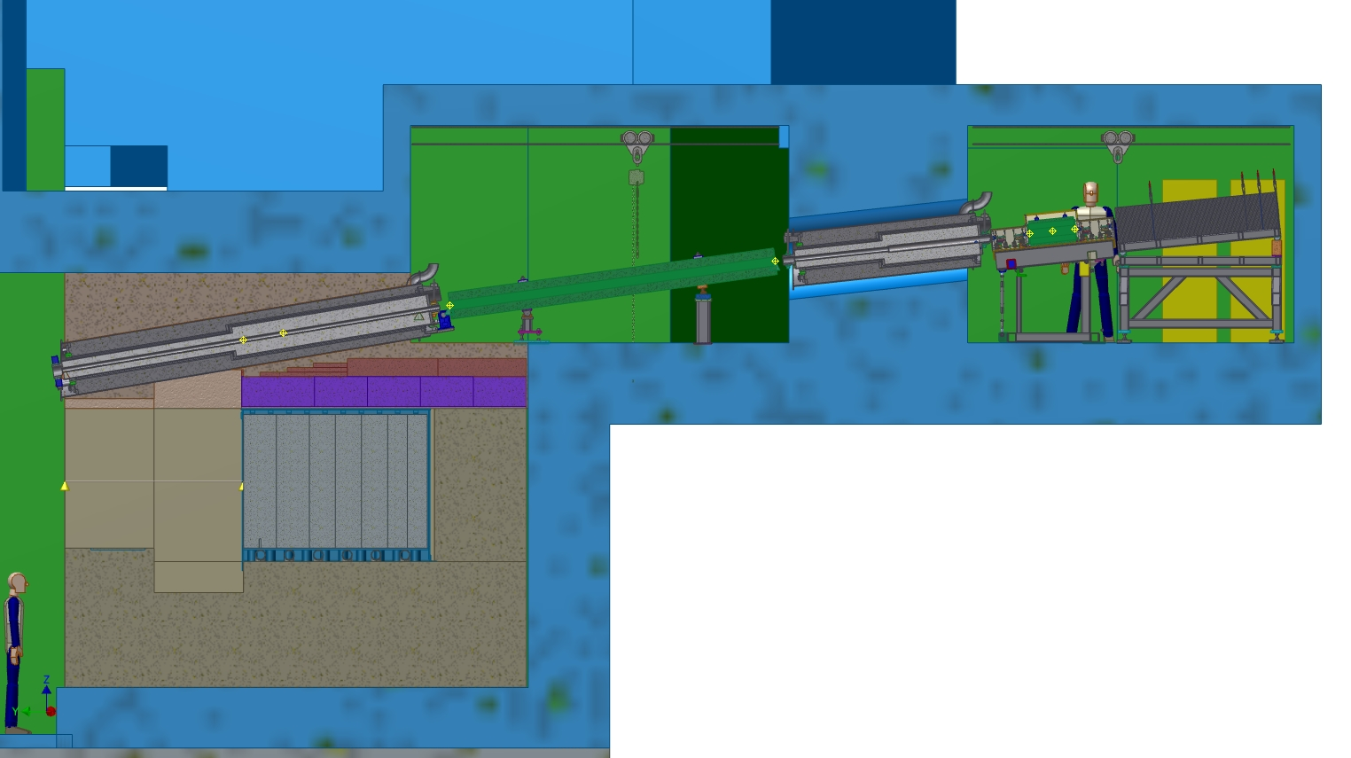
Major components of the Extinction Monitor
Magnet room
Spectrometer magnet
Detector room
Upstream/Entrance collimator
Downstream/Exit collimator
Muon ID (HAMR)
Filter magnet
Triggers and pixel planes

Slide 5
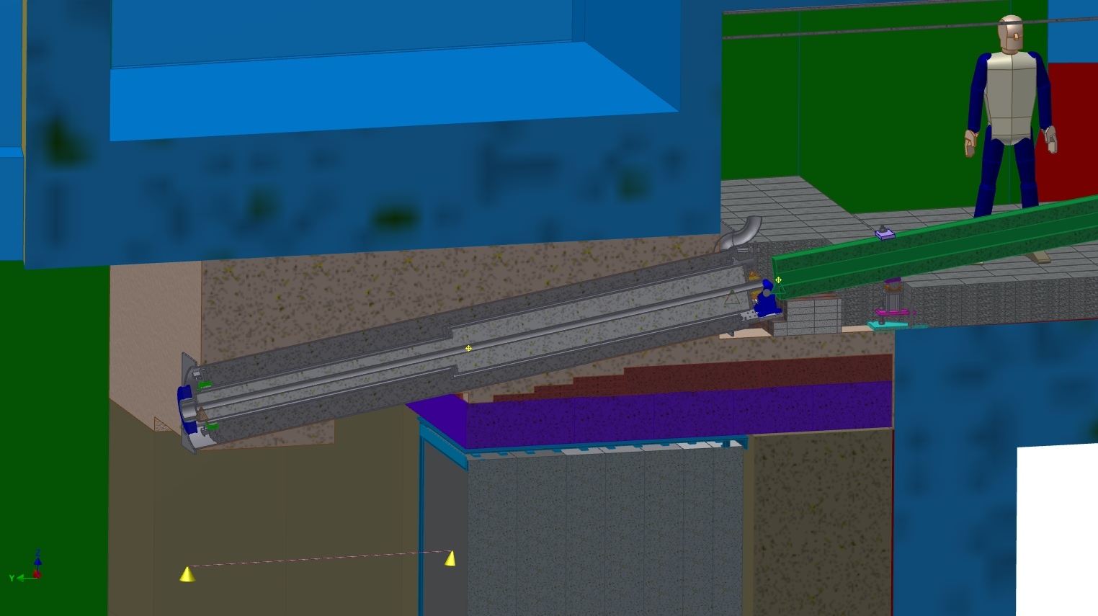
Close-up of the Entrance Collimator
Concrete poured with embedded pipe for entrance collimator after absorber is placed

Slide 6
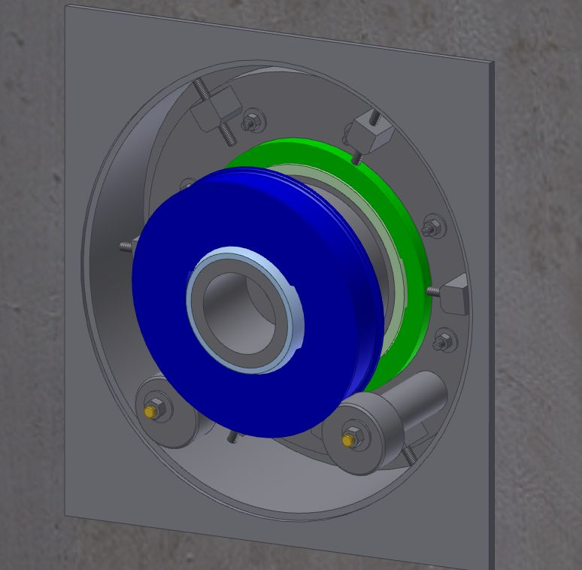
View of the upstream end of the entrance collimator
The entrance collimator has one end in the PS room right above the absorber. Alignment of this end from within the PS will not be possible because of radiation levels. This end of the collimator is supported by two eccentric cams that are driven by gearboxes in the magnet room. The cams can position this end of the collimator anywhere within the ½” annular space around the collimator.
Spherical plain bearing on end of plug collimator
Cam support/alignment with Grafoil bearings

Slide 7
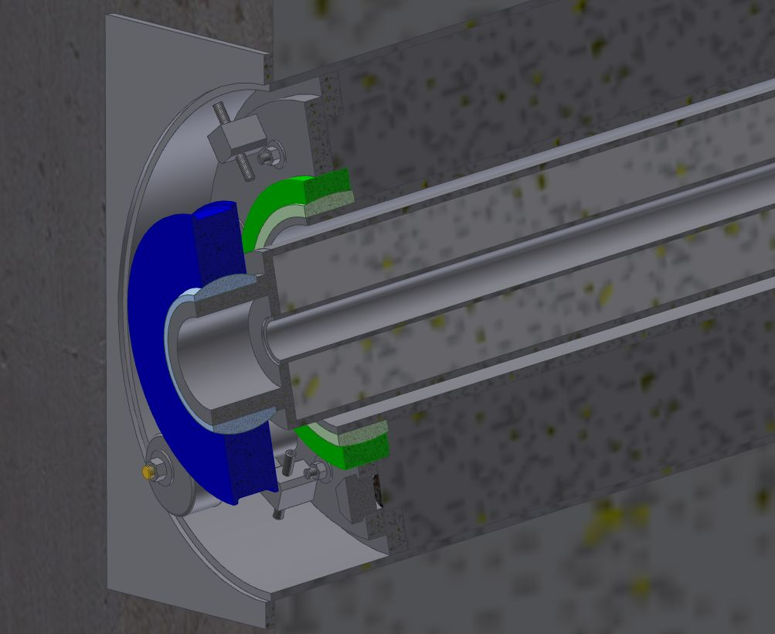
Cross-section through upstream end of entrance collimator
As shown below, the shot liner is installed first and has a ±1” adjustment at both ends. The green object is a spherical bearing allowing angular adjustment. This adjustment is fixed when the steel shot is poured in.
The entrance collimator is installed after the shot liner and it has ±0.5” of adjustment which is only locked after the air barrier at the DS end is installed.
Shot liner
Steel shot fill
0.5” Air gap all around plug
Concrete fill
Steel shot fill

Slide 8
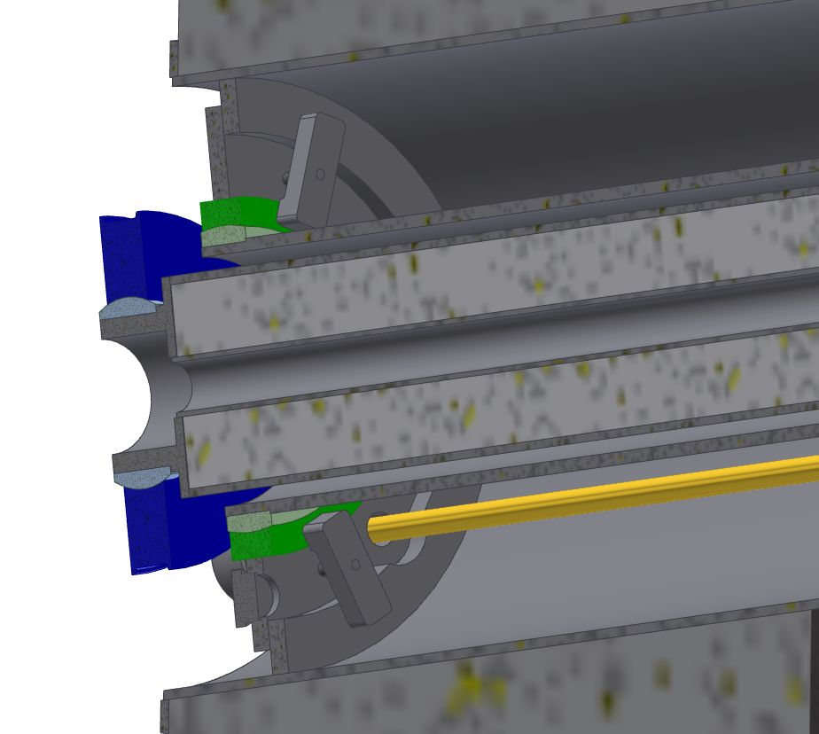
Section view with shot removed showing cam drive shaft
Cam drive shaft

Slide 9
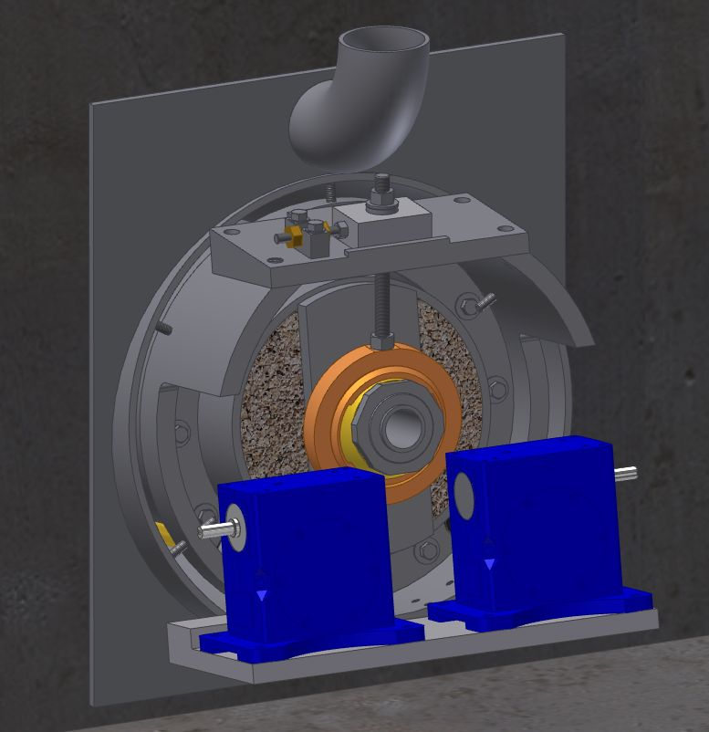
View of the downstream end of the entrance collimator
Fill port for steel shot
Horizontal and vertical adjustments for the downstream end
Custom spherical plain bearing
Manually adjusted gear boxes to drive the cams at the upstream end

Slide 10
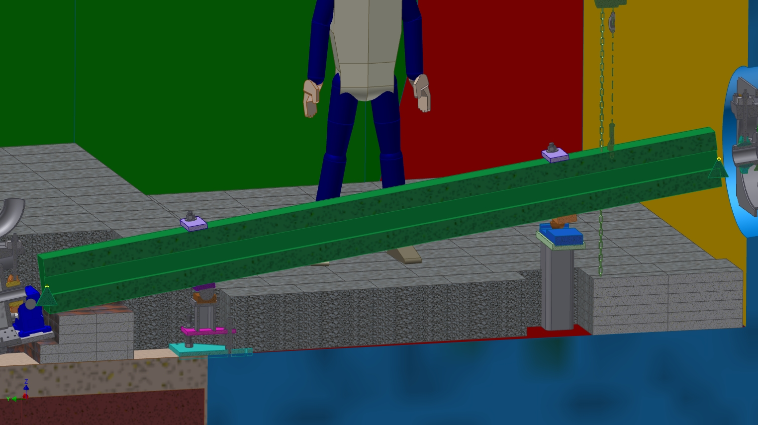
Close-up of the filter permanent magnet
This magnet has been located and visually verified.
The green cones are workpoints in the integration model. The EM model originally created in Inventor has been aligned to the workpoints in the integration model.
After assembly of the magnet and its support, the steel and concrete block shield can be placed.

Slide 11
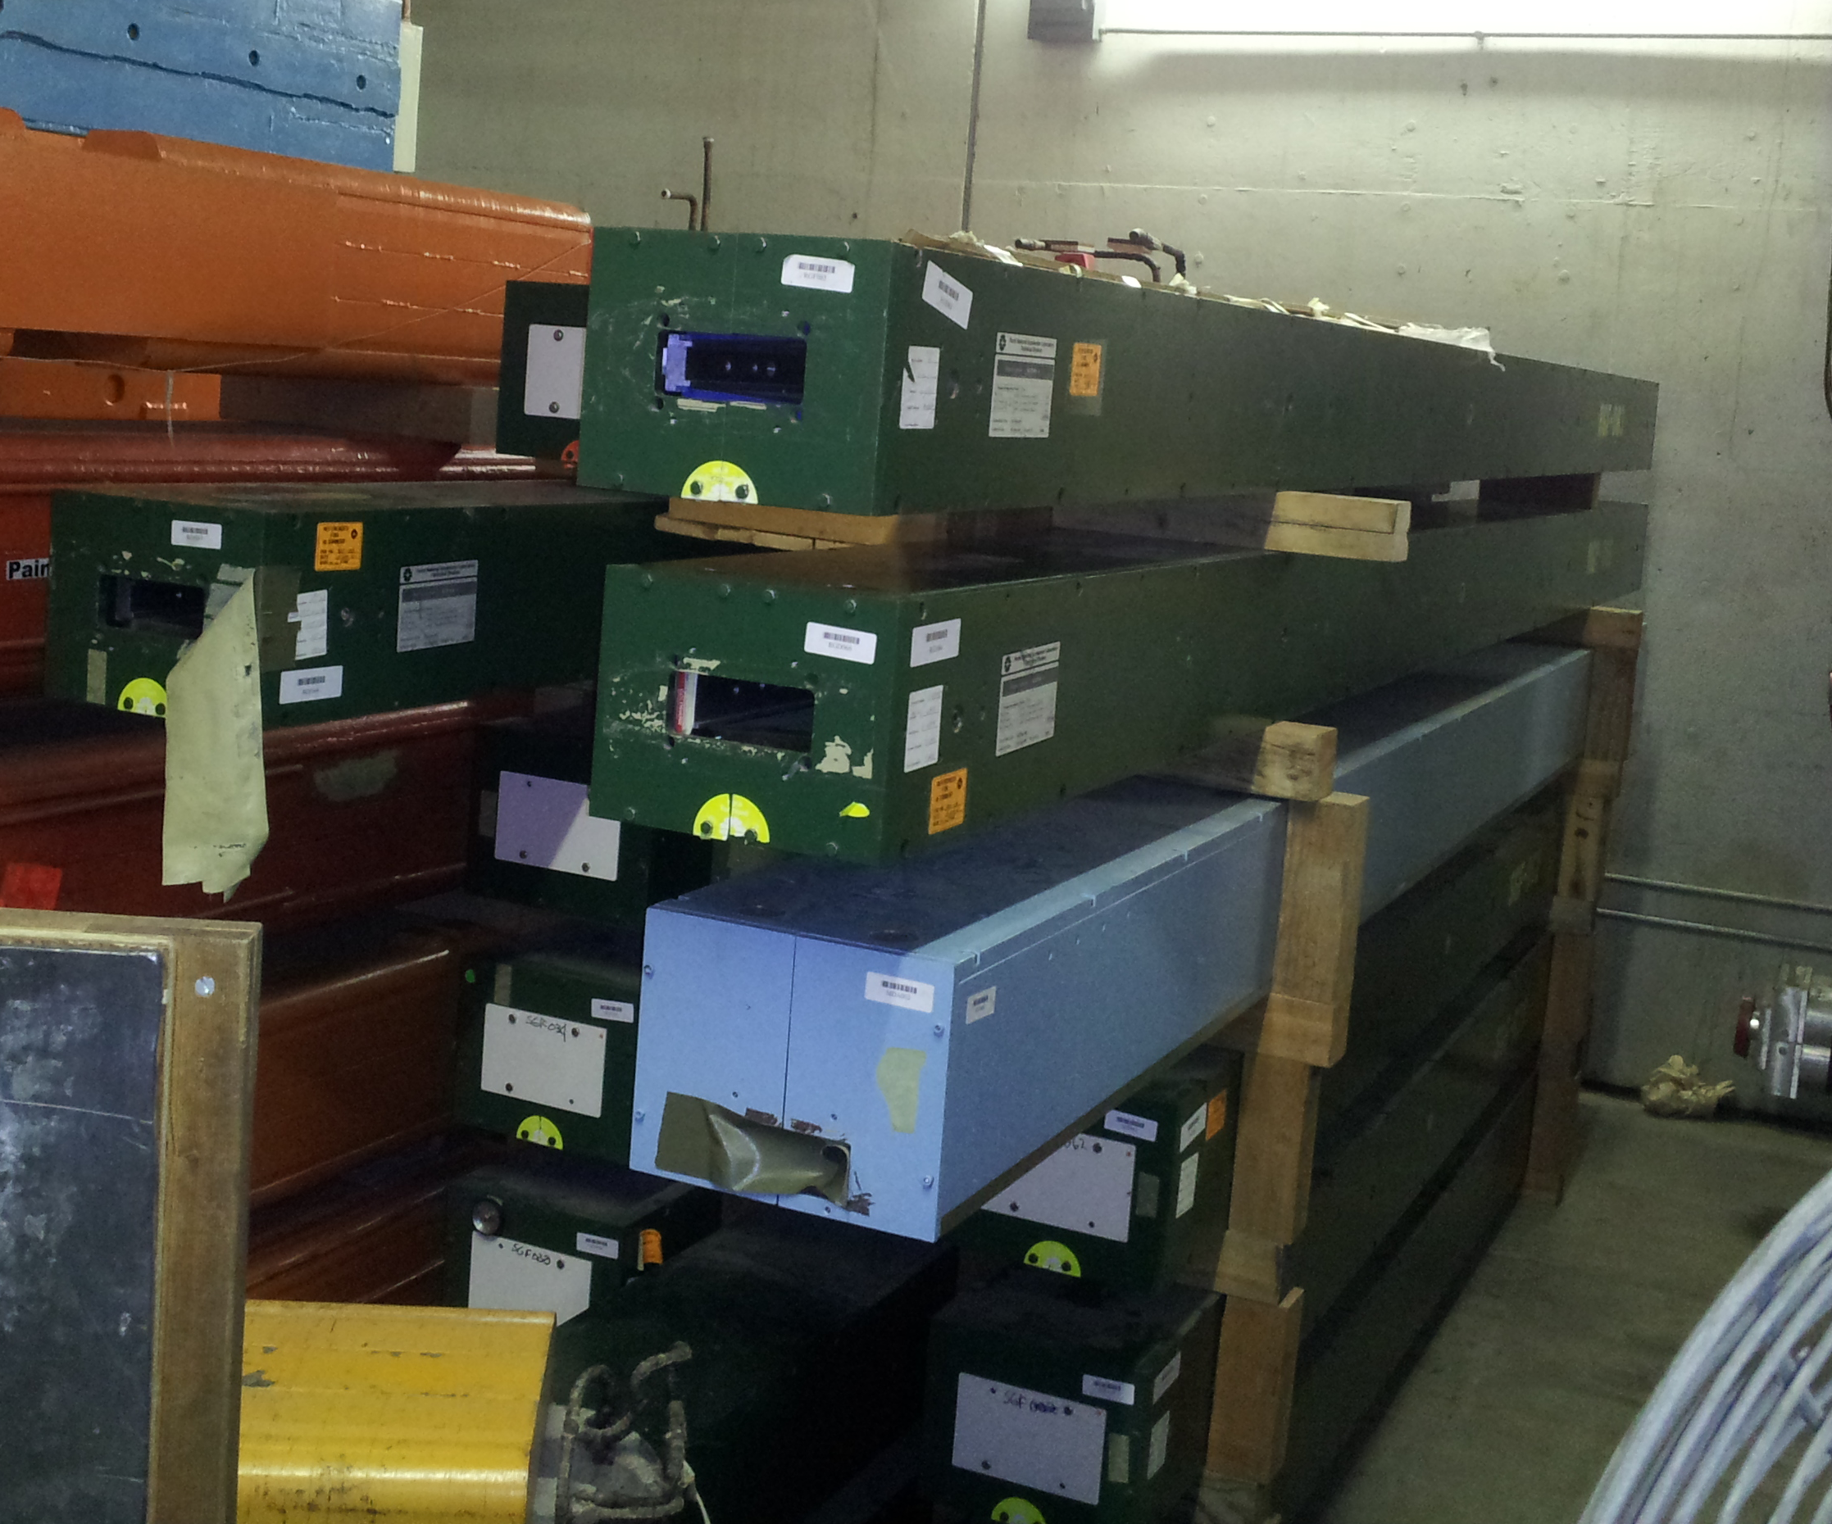
Filter magnet at magnet storage

Slide 12
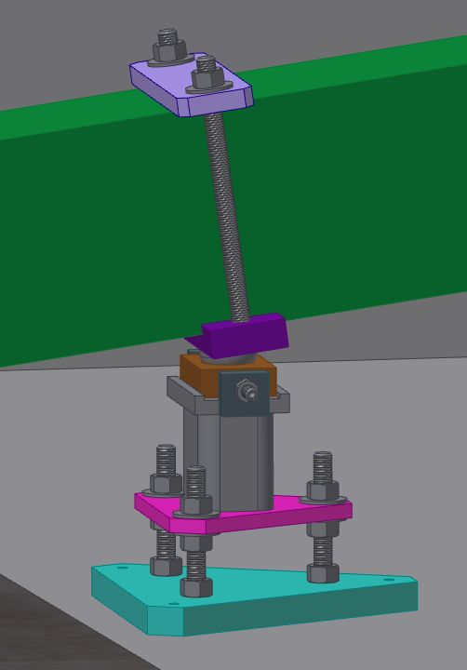
Upstream end Filter Magnet Support ball and socket joint
The three point support for the permanent filter magnet is a kinematic mount allowing the magnet to be moved away from its stand and replaced in the same location. This end is the ball and socket.
Horizontal/yaw adjustment
Vertical adjustment

Slide 13
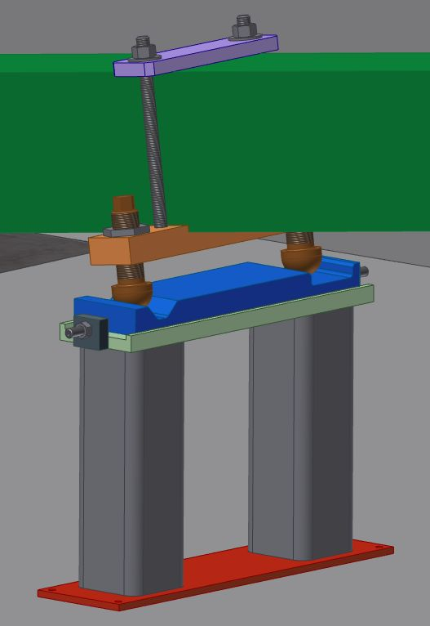
Downstream end Filter Magnet Support vee groove and flat joints
This end of the kinematic mount is the vee groove and flat surface.
The kinematic mount allows any adjustment to be made without binding another adjustment.
Changing the horizontal/yaw adjustment does not cause a change in the pitch or roll of the magnet.
Vertical/roll adjustment
Horizontal/yaw adjustment

Slide 14
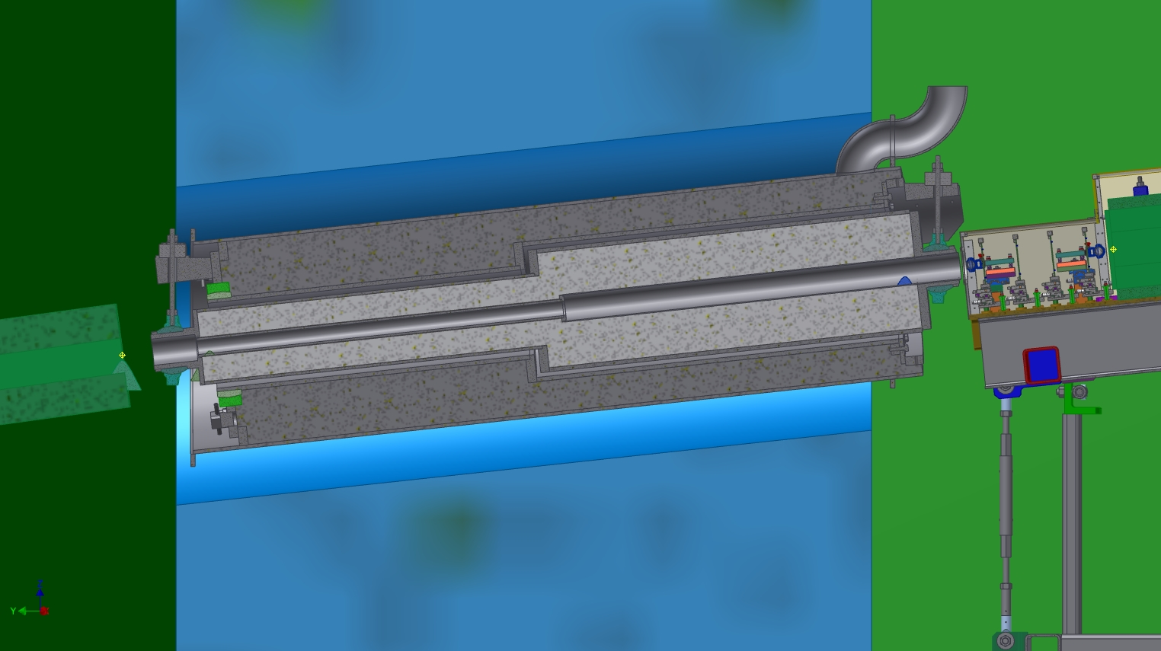
Close-up of the Exit Collimator in the Integration Model architecture
The embedded pipe in the concrete needs to be adjusted to match the new locations of shield walls (that have moved several times.) Concrete fill not shown.

Slide 15
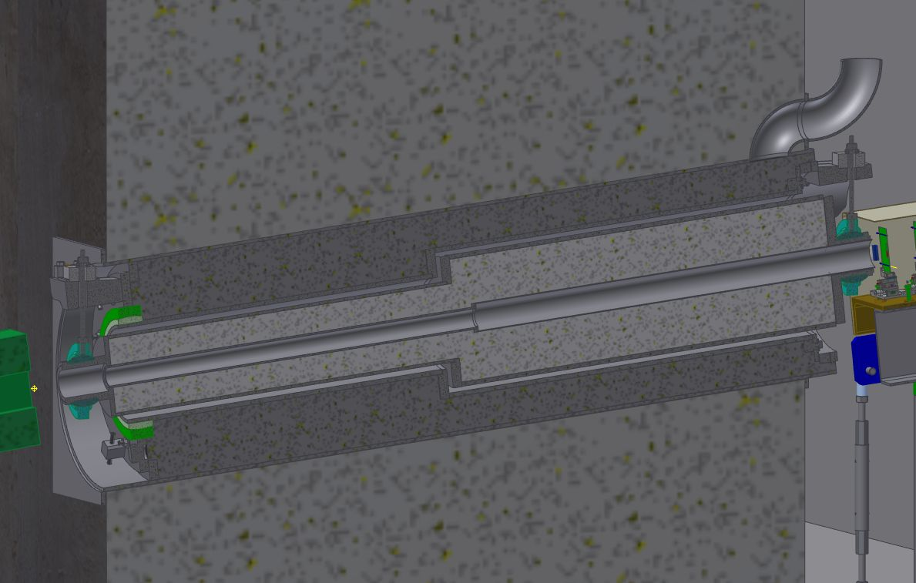
Cross-section through the Downstream (exit) collimator
The exit collimator is supported at both ends by spherical bearings and a vertical tension rod that can be adjusted horizontally and vertically. Spherical bearings allow for angular changes.
Exit collimator beam aperture expands from 50 mm to 75 mm ID.
Concrete around embedded pipe shown and steel shot installed.

Slide 16
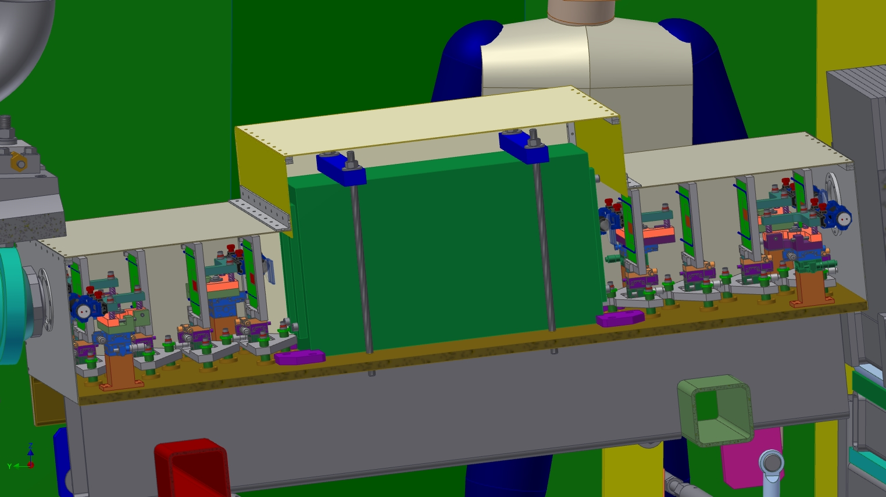
Section view showing the trigger, pixels and spectrometer magnet
The downstream trigger and pixel arrangement is the mirror of the upstream, with larger active pixel area.
Pixel planes
Permanent magnet spectrometer magnet*
Trigger paddles
*This magnet has been located in storage.

Slide 17
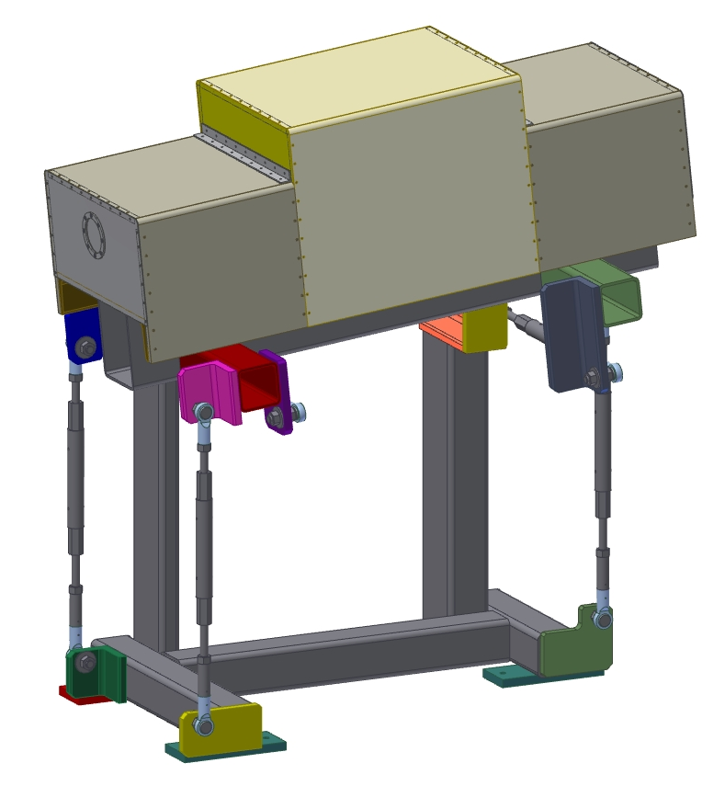
The six strut support of the spectrometer magnet and pixels
The cover is to allow dry air flow around the pixel planes. Dry air is needed because the pixel planes are liquid cooled to below room temperature.
Any of the three cover sections can be removed independently of the others. Air duct inlet is not shown. Air flows out between the cover and the C-channel base. Cooling tubes for the pixels can also be routed out through the air exhaust gap. Beam goes through a thin foil at each end.
The support is a six-strut design modeled after the one that supports the MiniBooNE target at MI-8. The struts allow alignment without interference with each other and minimal interactions between adjustments. The rod ends and turnbuckles are designed to provide maximum rigidity and easy alignment.
Likely inlet air duct location, duct not shown
Air exhaust passages

Slide 18
The cover removed from the spectrometer magnet and pixels
These plates block air from flowing out around the spectrometer. Air will probably be input through the cover above the magnet, but it needs to exit at each end of the channel so that it can flush dry air around the pixels.

Slide 19
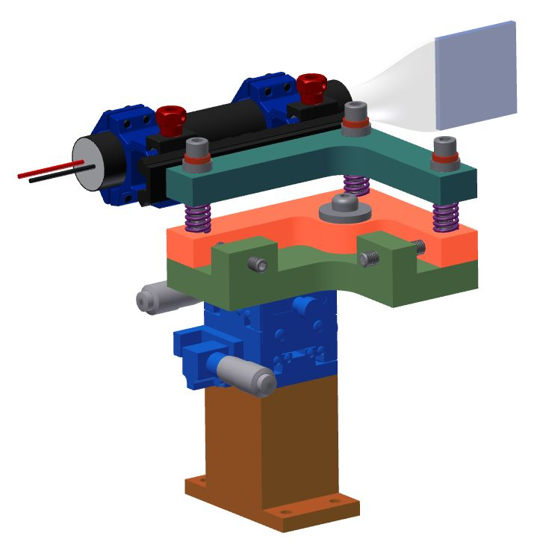
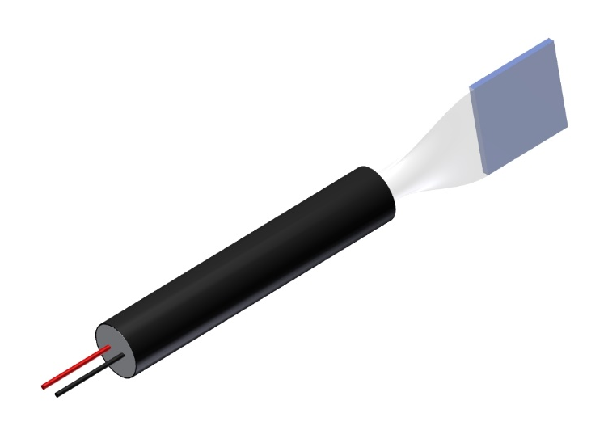
Alignment/support structure for the trigger scintillator
The support offers all six degrees of freedom of alignment of the scintillator paddle.
Trigger scintillator with light guide, PMT and mu metal shield

Slide 20
Pixel plane support/alignment mechanism
The support offers all six degrees of freedom of alignment of the pixel planes.
Details of connectors and mechanically gripping the circuit board by the support are still being worked out.
An ethylene glycol based coolant will be pumped through the blue tubing and cooled using a recirculating chiller.
A cooling system is needed to prevent the readout chips from overheating. The leakage current in a silicon sensor drops quickly with temperature, improving the signal to noise ratio. The sensors will be cooled to an operating temperature of a few degrees Centigrade, safely above the dew point of dry air.
Liquid cooling tubing

Slide 21
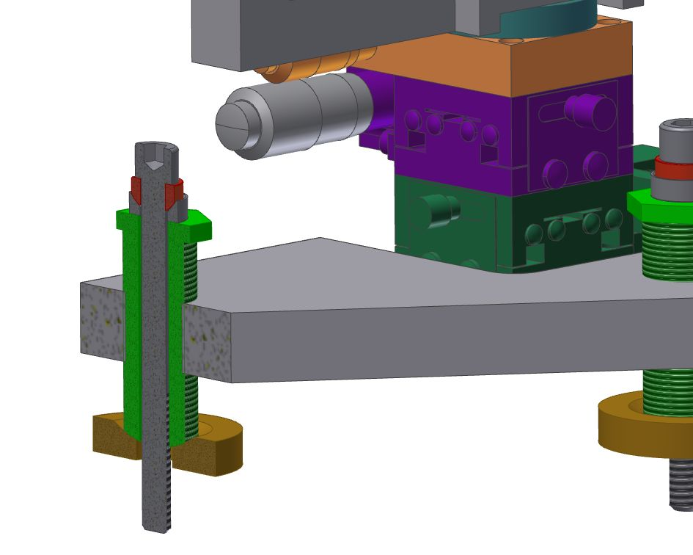
Cross-section through the shim bushing in the pixel alignment mechanism
Rotating the green externally threaded bushing adjusts the pitch, height and roll of the pixel planes. The .250-20 socket head bolt locks the mechanism to the bottom beam.

Slide 22
Front and back views of the upstream pixel planes
Water cooling loop

Slide 23
Front and back views of the downstream pixel planes
Three chips for larger active area

Slide 24
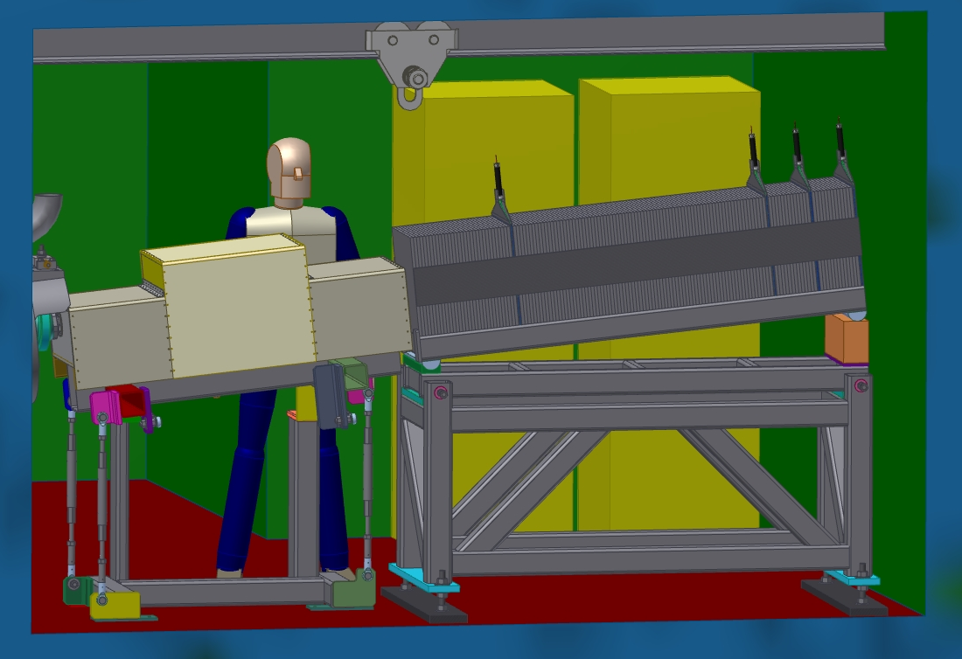
The Muon Range Stack/Muon ID
Muon Range Stack/Muon ID

Slide 25
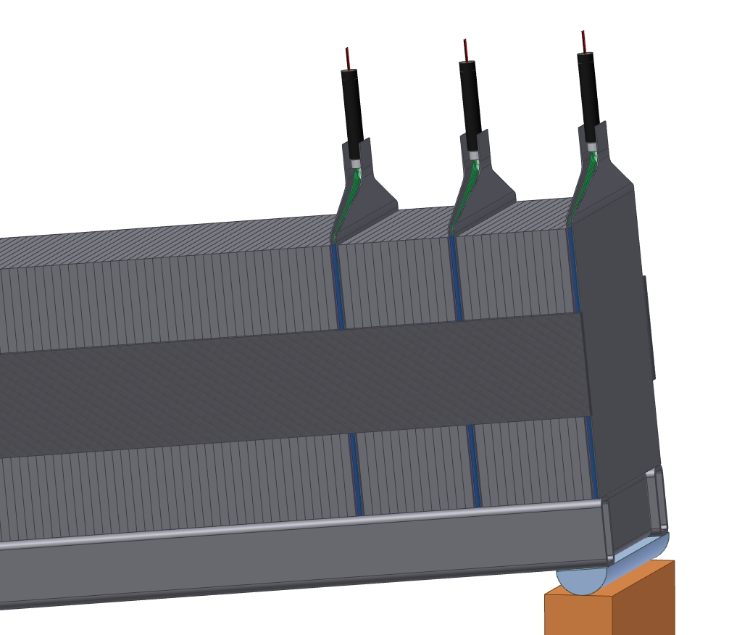
Close-up of the tile-fiber pans of the Muon ID
Half inch steel plates will be hand-stacked in the detector room and welded together to form a 5,000 lb block of steel with spaces to put scintillator tile assemblies.

Slide 26
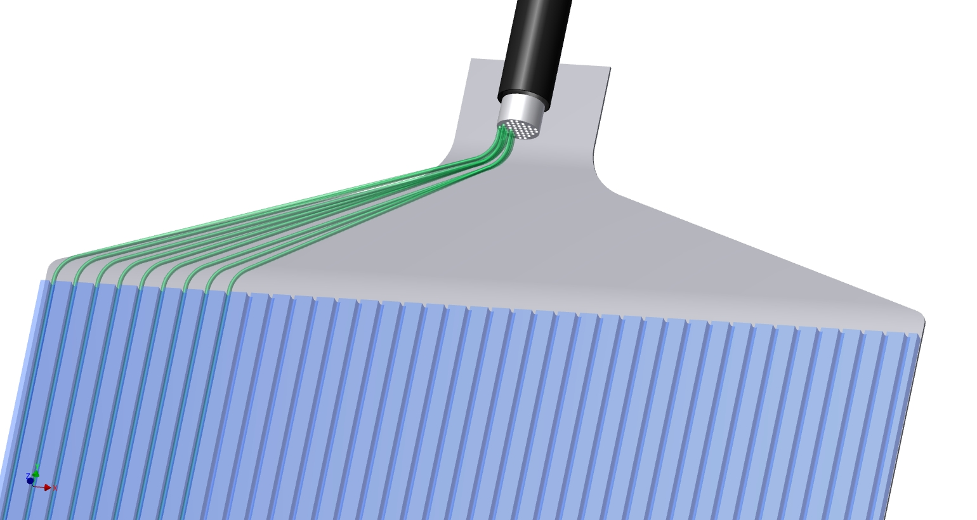
View inside the Muon ID tile-fiber pan
¾” PMT, Hamamatsu H6520
Fiber connector “cookie”
WLS fiber
Grooved scintillator plate

Slide 27
Details of Major Component Installation
The following slides focus on the rigging hardware that could be used to install the entrance collimator, the filter magnet and the heavier components in the detector room.
Final choices will depend on whether FNAL technicians or contract riggers will do the component placement.

Slide 28
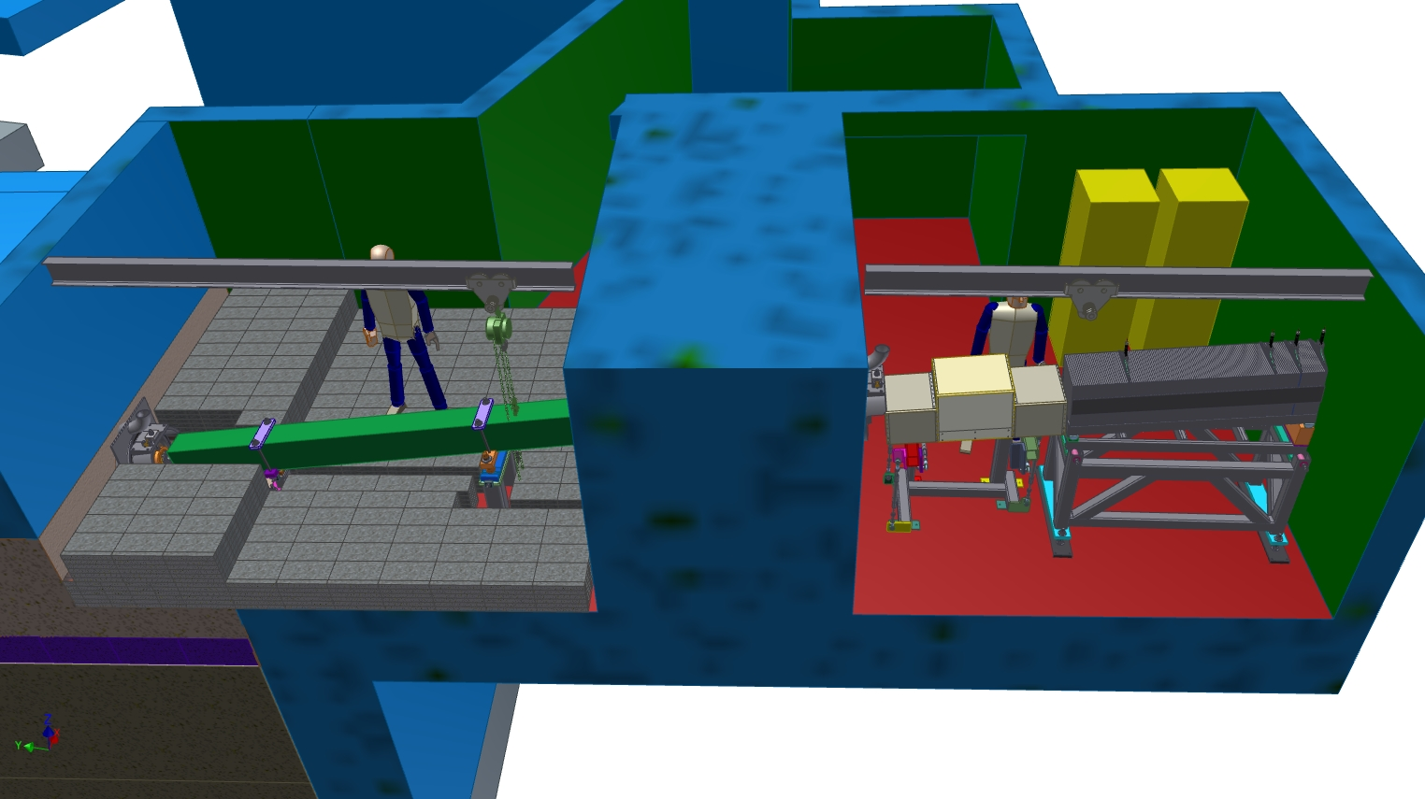
Beams and chain fall hoist trolleys on the ceilings in the rooms
Chain fall hoists and trolleys shown have 6000 lb capacity.

Slide 29
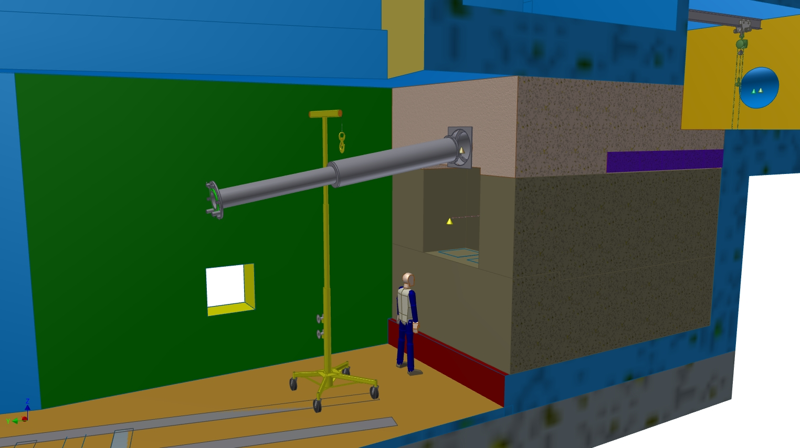
Using a Roust-A-Bout to install the US fixed shot liner

Slide 30
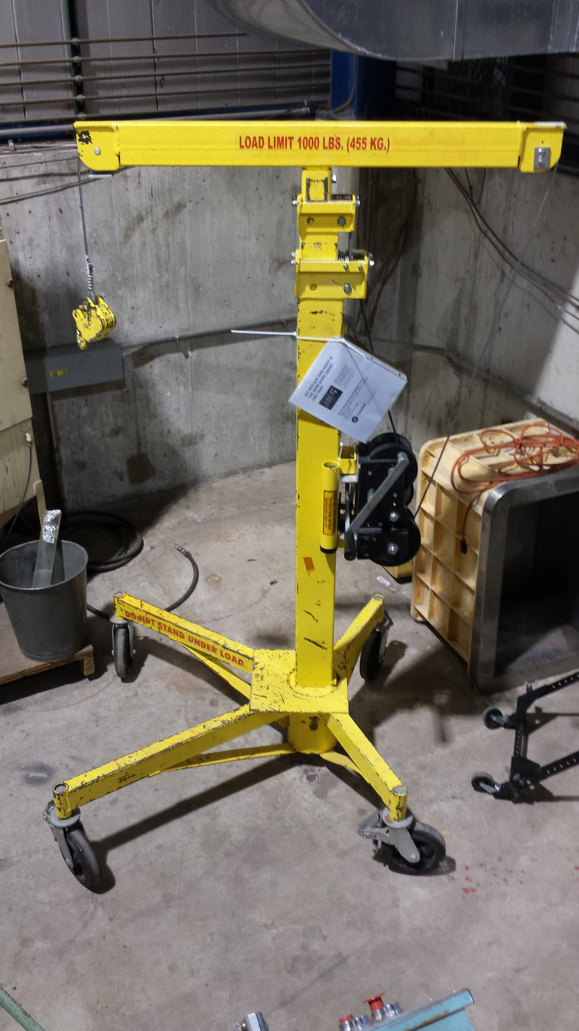
The Roust-A-Bout at Lab F
John Voirin has this useful lifting device at Lab F. It says 1,000 lb capacity on the top bar, but a different top bar that brings it up to 1,500 lbs can be purchased from Sumner. John does not have that piece.
It can also be disassembled and brought into the magnet room should that prove useful.
The shot liner weighs <1,100 lbs

Slide 31
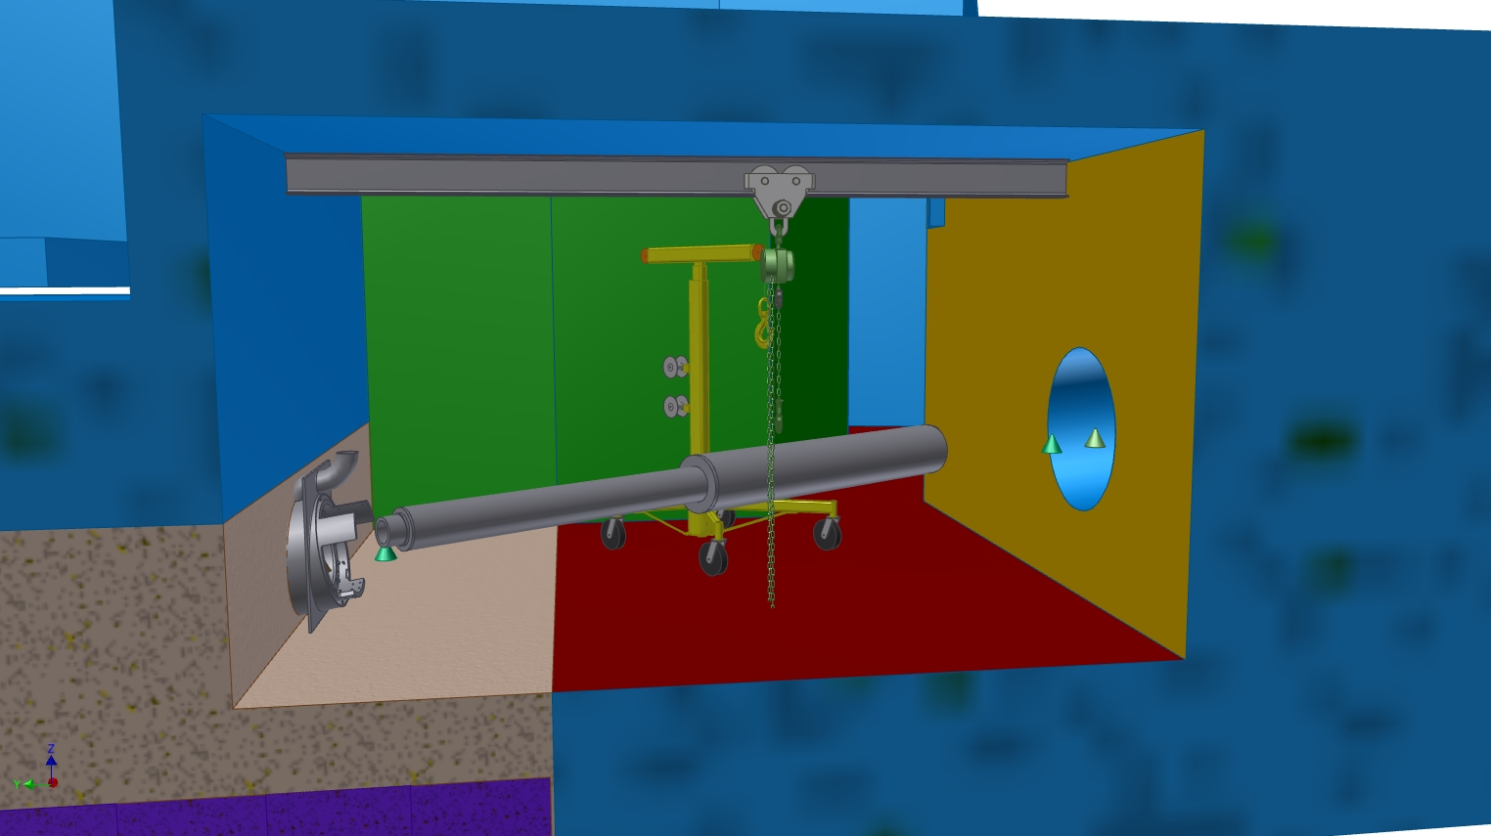
The entrance collimator installed from the magnet room
The entrance collimator weighs 2,022 lbs. The trolley lifts the US end while the Roust-A-Bout lifts the DS end.
The Roust-A-Bout gives the ability to move the DS end horizontally and lift it to clear the shield wall of the exit collimator.

Slide 32
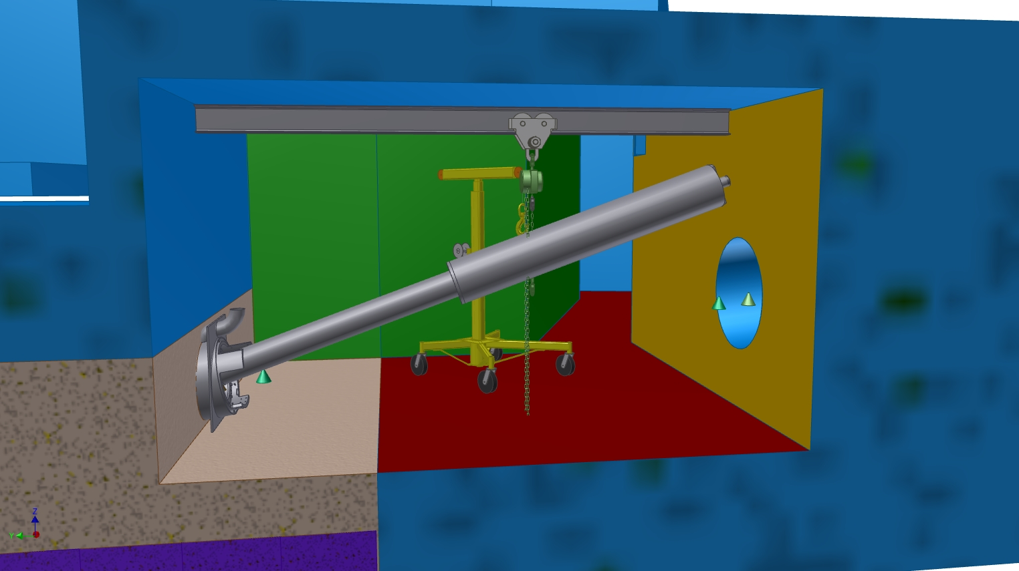
Another step in Entrance collimator insertion
The goal is to lift the DS end of the entrance collimator and have it clear the exit collimator shield wall. The US end is inserted into the fixed shot liner previously installed. It is not known whether the exit collimator embedded pipe has been installed at this time.

Slide 33
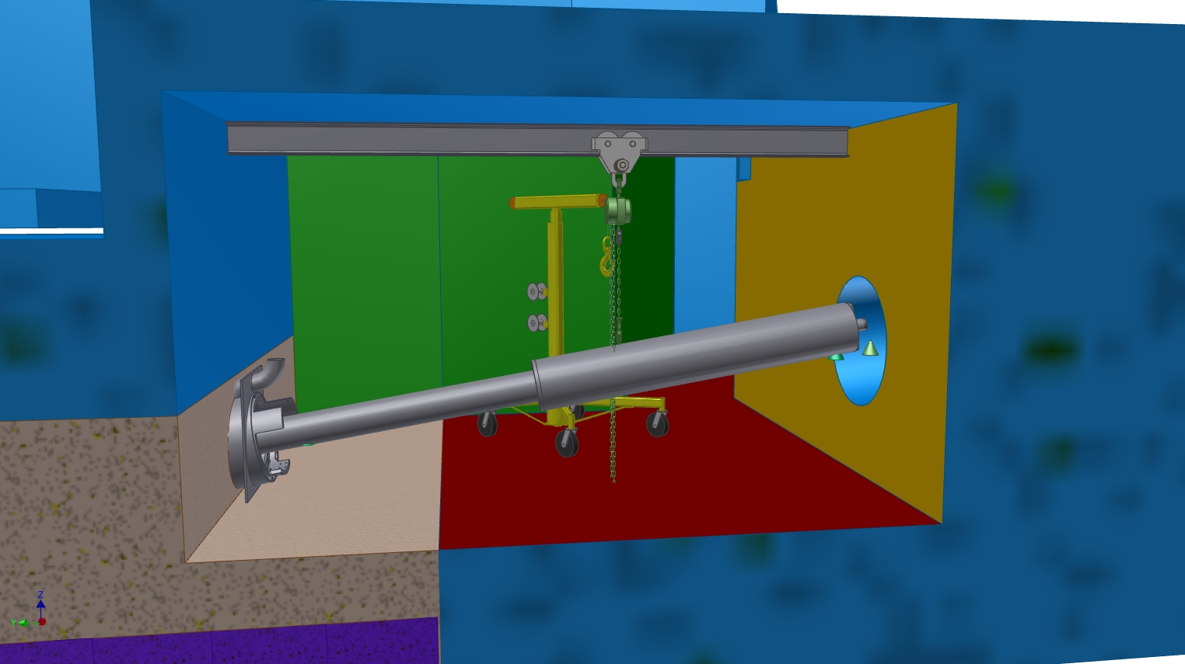
Entrance collimator insertion continued
Once the collimator has been aligned to the axis of the fixed shot liner, it can be inserted its full length. Additional hoists for horizontal restraint are not shown.
The alignment hardware is installed after the collimator is in place in the shot liner.

Slide 34
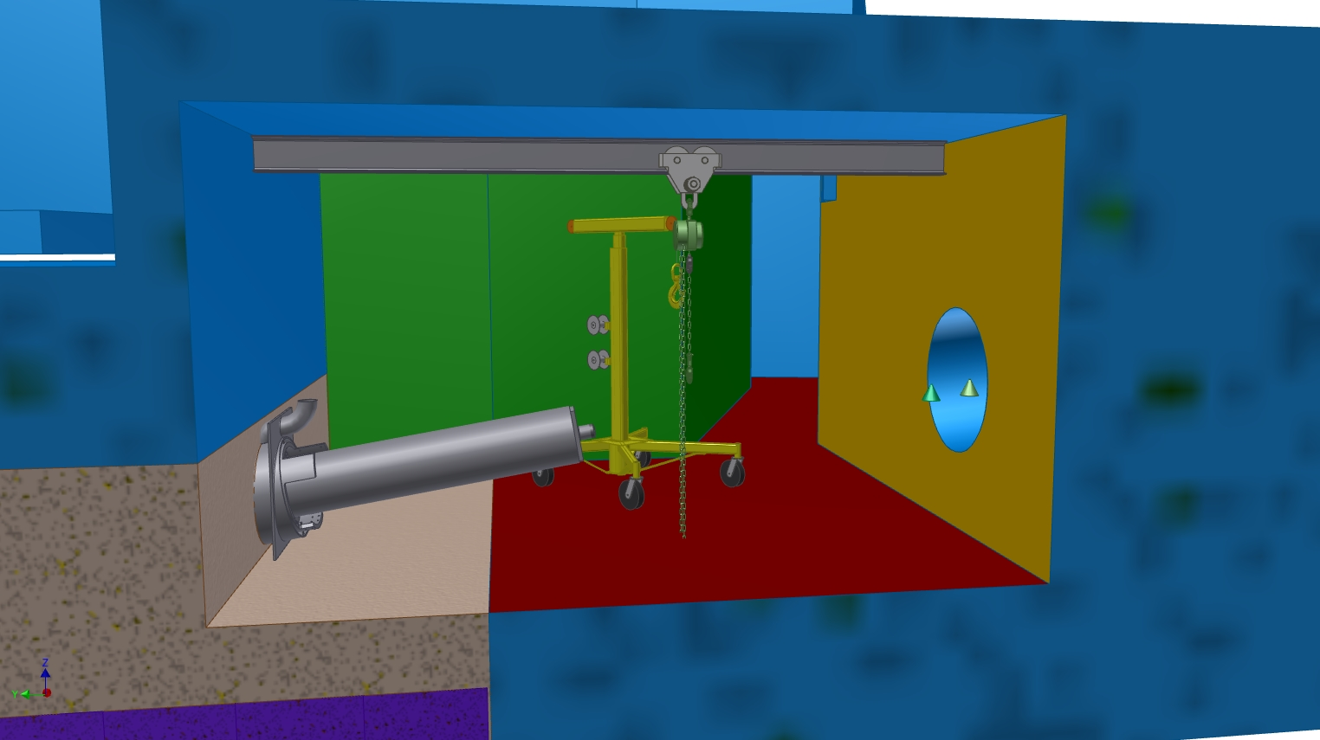
Entrance collimator about half way installed

Slide 35
Summary
The mechanisms used to support and align the components of the extinction monitor will satisfy the positioning requirements
The majority of the design work on these components is finished.
~5% design work is needed to:
finish the thrust collars that keep the entrance collimator from sliding down the fixed shot liner
Some redesign to adapt the collimators to the actual concrete walls of the enclosure
Design the alignment devices that mate to the concrete forms for the embedded pipes
Miscellaneous plumbing and electrical connections in the detector room
Additional tapped holes for rigging fixtures

