Slide 1
LARP–LHC Upgrades
Eddie ‘Trey’ Holik – LARP Toohig Fellow
Fermilab Users Meeting
June 16th, 2016
Notes:
LOGOS SHOWN ARE EXAMPLES – REPLACE THESE WITH YOUR PARTNER LOGOS

Slide 2
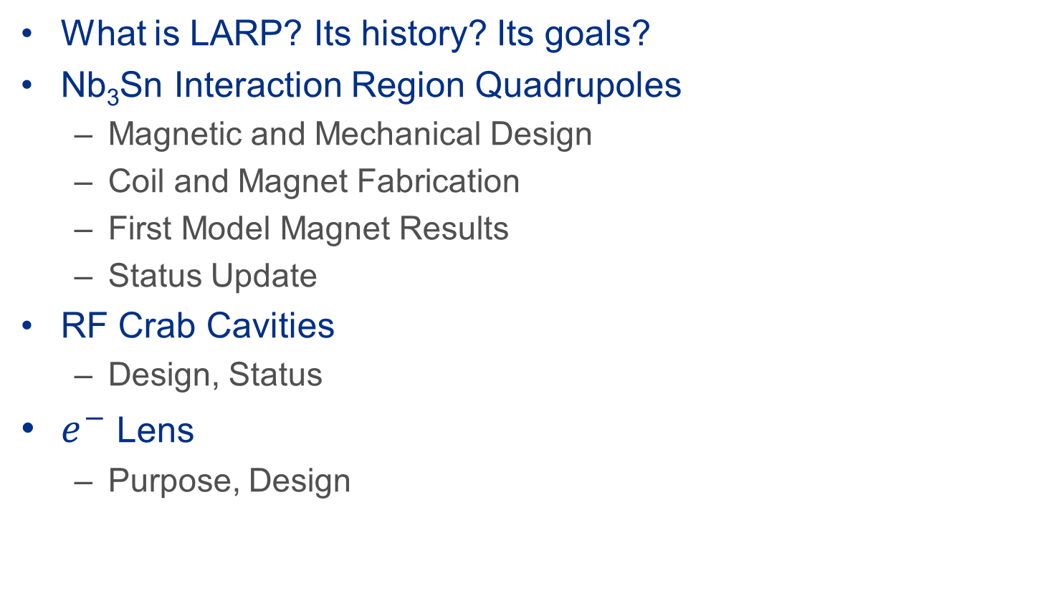
Content
What is LARP? Its history? Its goals?
Nb₃Sn Interaction Region Quadrupoles
  Magnetic and Mechanical Design
  Coil and Magnet Fabrication
  First Model Magnet Results
  Status Update
RF Crab Cavities
  Design, Status
$e^{−}$Lens
  Purpose, Design

Slide 3
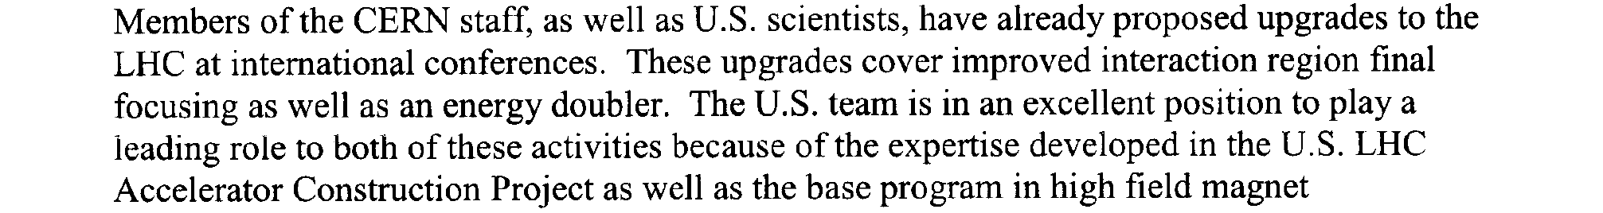


What is US-LARP?
The US – LHC Accelerator Research Program brings ~12 years of Intellectual and Development effort for HL-LHC
Many successful efforts have been supported by LARP:
  Magnets, Crab Cavities, e-lens, Wide Band Feedback System, Rotating Collimators, Luminosity Monitors, Accelerator Physics, Beam Instrumentation, Irradiation assessment, etc.
HiLumi-LHC became an official CERN project late 2015
CD-0 for the HL-LHC Accelerator Upgrade Project (AUP) was approved in March
LARP Mandate - 2004

Slide 4

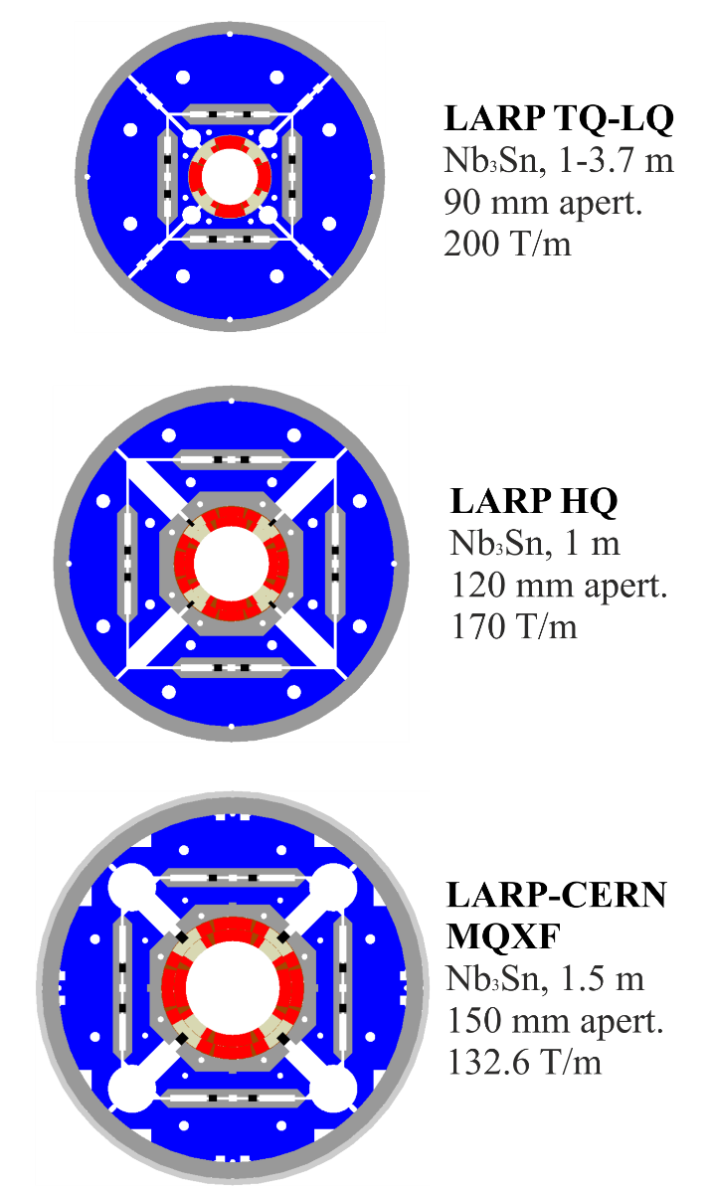
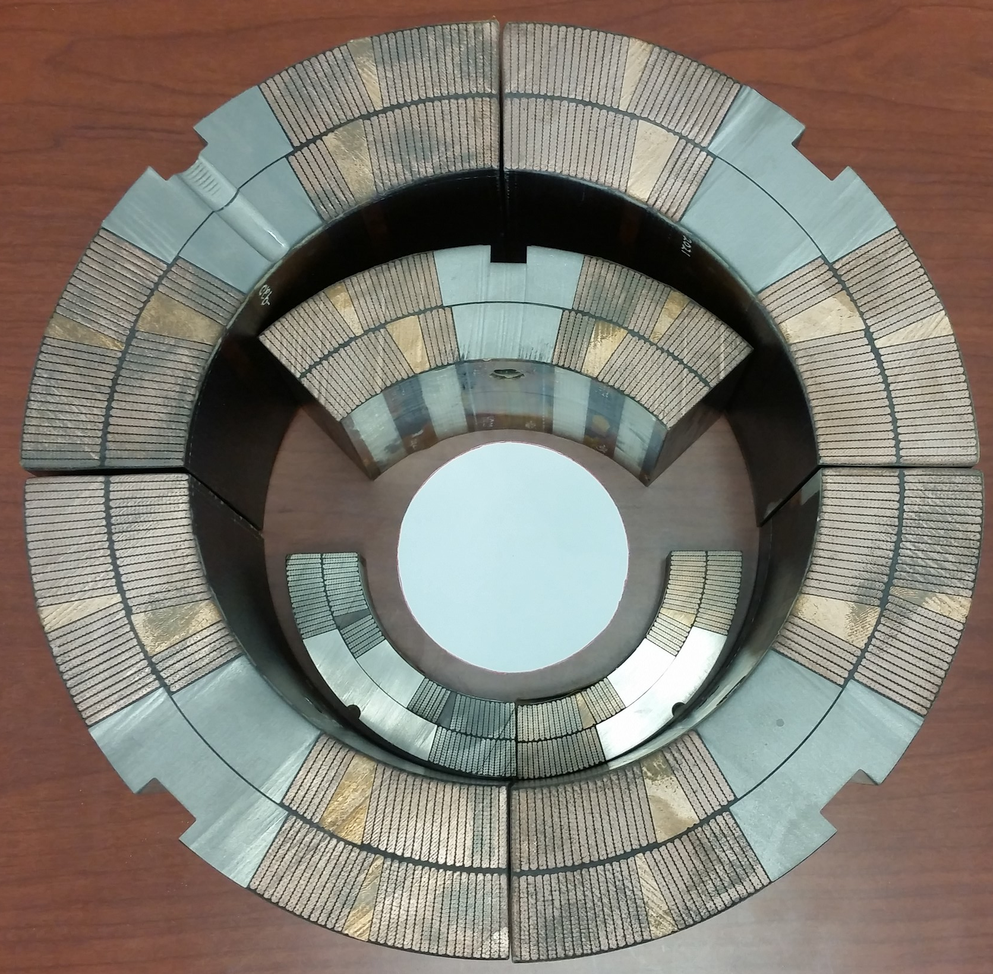
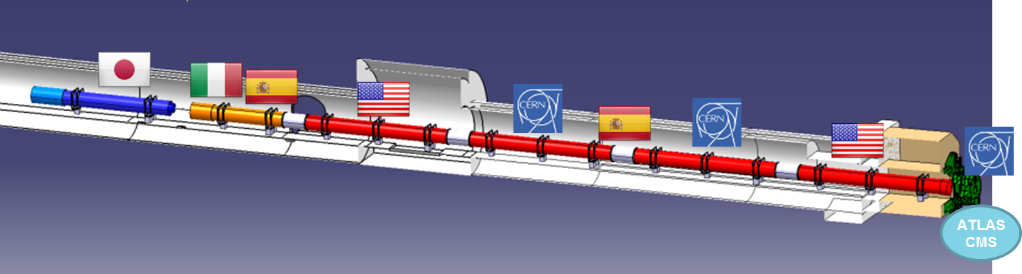
Some Context
P5 report places Hi-Lumi LHC as its highest-priority near-term large project.
US LHC Accelerator Research Program (LARP)
LARP is a collaboration between BNL, FNAL, LBNL, and SLAC along with CERN in the context of HL-LHC
Since 2004, LARP has developed Nb₃Sn as a viable material for the Low-β IR quads enabling HL-LHC
US will provide 10 cold masses
  8 coils per cold mass
  Coils fab. at BNL and FNAL
  Magnet Assembly at LBNL
MQXFA-(Q1)
MQXFA-(Q3)

Slide 5
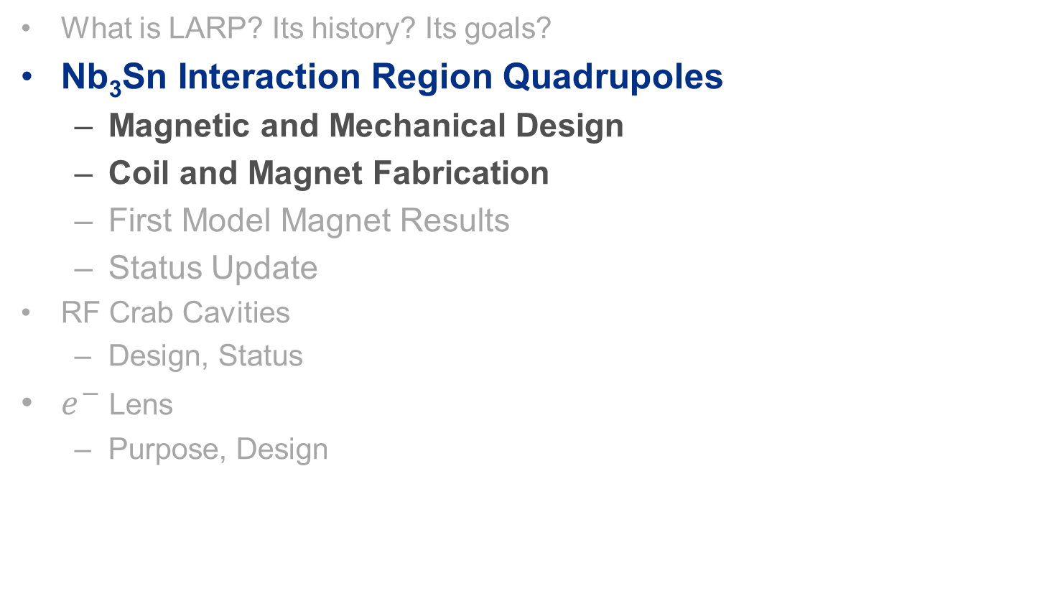
Content
What is LARP? Its history? Its goals?
Nb₃Sn Interaction Region Quadrupoles
  Magnetic and Mechanical Design
  Coil and Magnet Fabrication
  First Model Magnet Results
  Status Update
RF Crab Cavities
  Design, Status
$e^{−}$Lens
  Purpose, Design

Slide 6
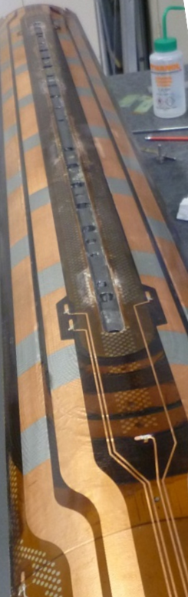
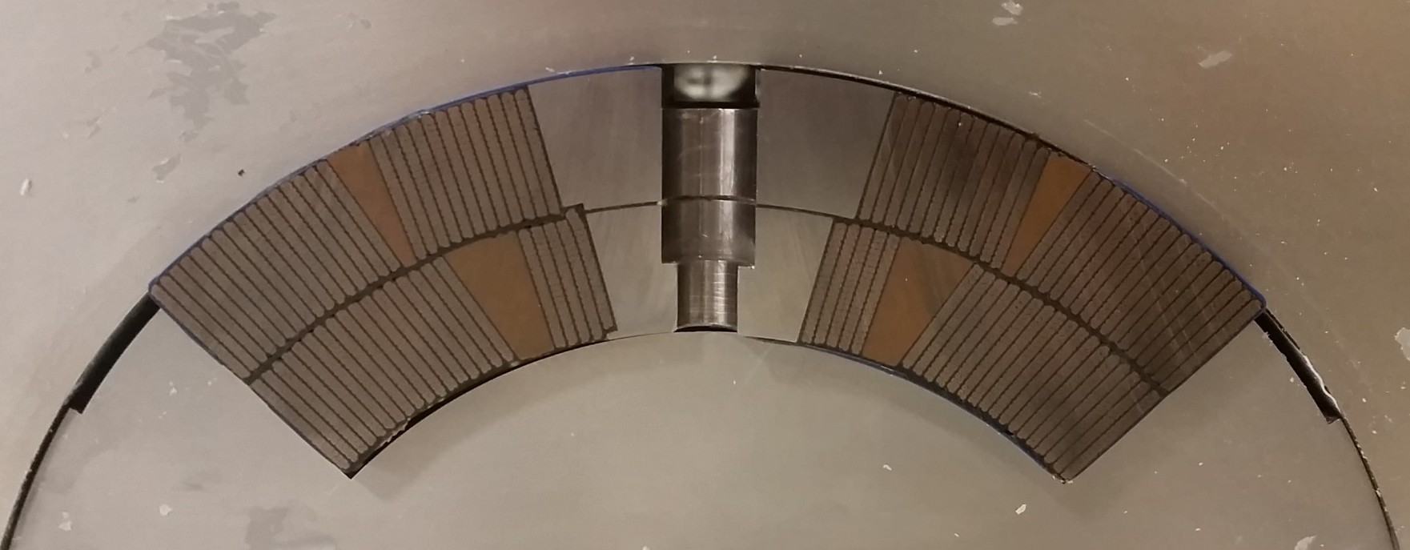
MQXF Design
  2 layer cos(2θ) design with 150 mm aperture and 4.2 m length
  At operation: 11.4 T, 16.5 kA, 132.7 T/m (Ultimate: 12.3 T, 17.8 kA)
    Reference: Tev: 4.4 T, 4 kA; LHC: 8.3 T, 11.9 kA
  Cu coated quench heaters enable long coil lengths
  Titanium pole optimizes preload
  Robust insulation scheme reduces risk
Quench Protection Heaters
Alignment Keyway
ø 113.376 mm
Reaction & Impregnation ‘Form’ Blocks
Ti-6Al-4V pole
660 µm insulation
ø 74.75 mm
Reaction & Impregnation ‘Mandrel’ Blocks

Slide 7
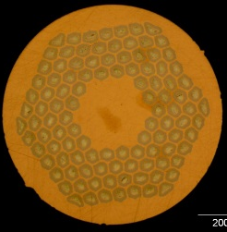
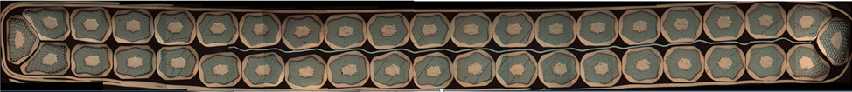
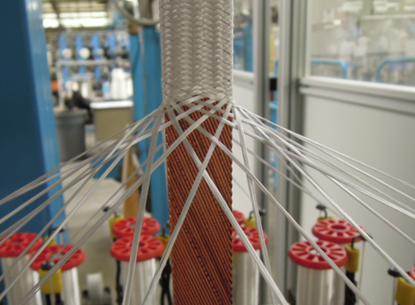
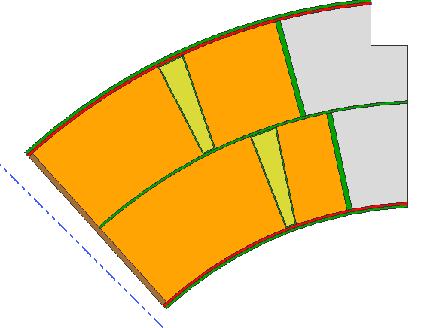
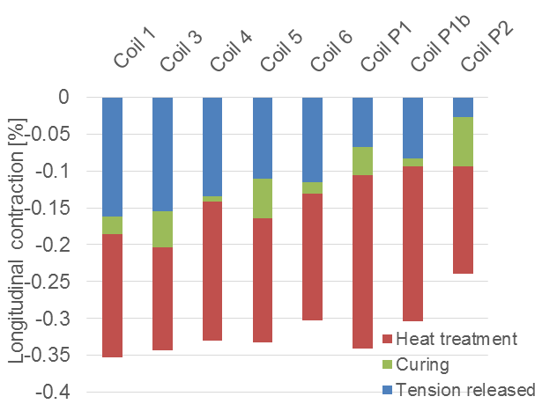
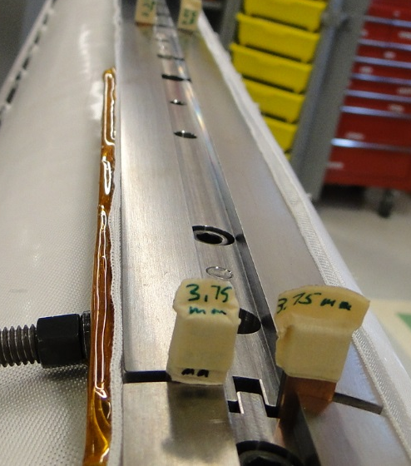
Nb₃Sn Cable Technology
Convergence on Oxford ST RRP® 108/127 wire.
40 wire Cable with SS core and Braided-On Insulation for long cable unit lengths
Nb₃Sn Cable expands laterally when heat treated.
Nb₃Sn Cable contracts axially when heat treated.
Room is left in coil cavity for cable to expand during heat treatment.
Gaps are left in the pole to allow cable to contract
Photo courtesy of P. Ferracin
Longitudinal Contraction
Azimuthal:
4.5% expansion allowed
Measured: 3.0 ± 0.3%
Radial:
2% → 1.2% allowed expansion
Free Cable 1.4%
LARP Cable 0.3%
Pole Gaps allow Contraction
6/16/2016

Slide 8
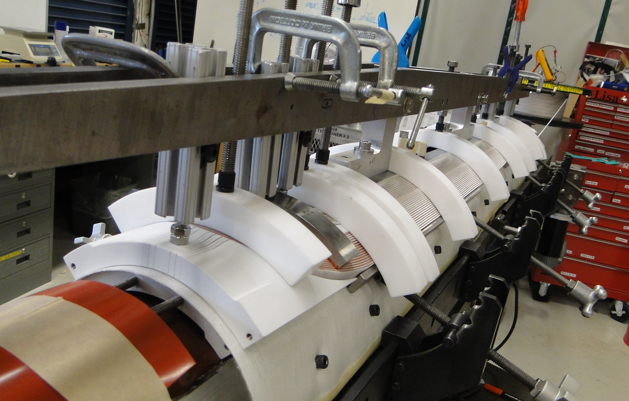
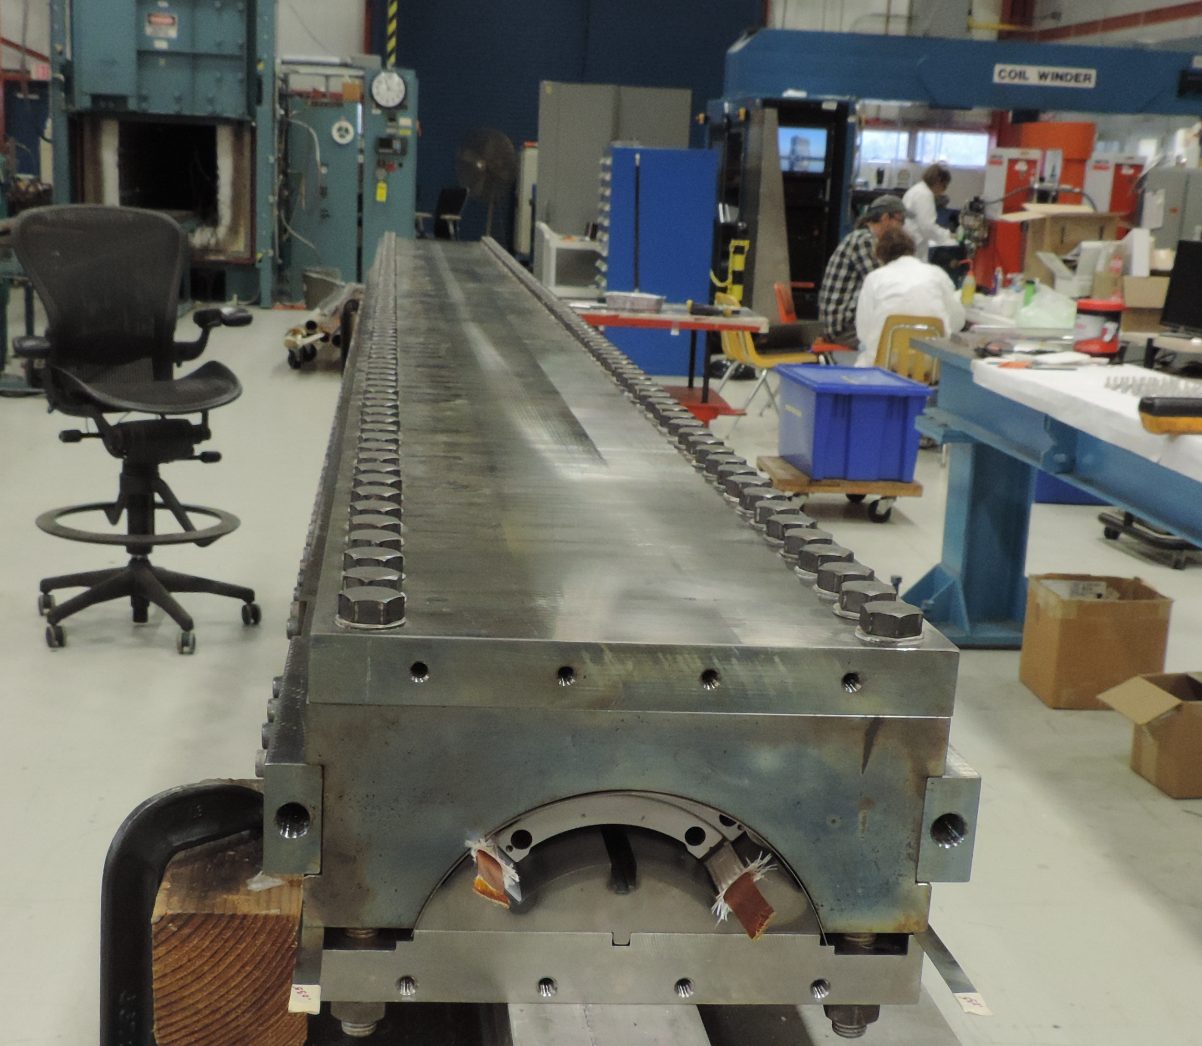
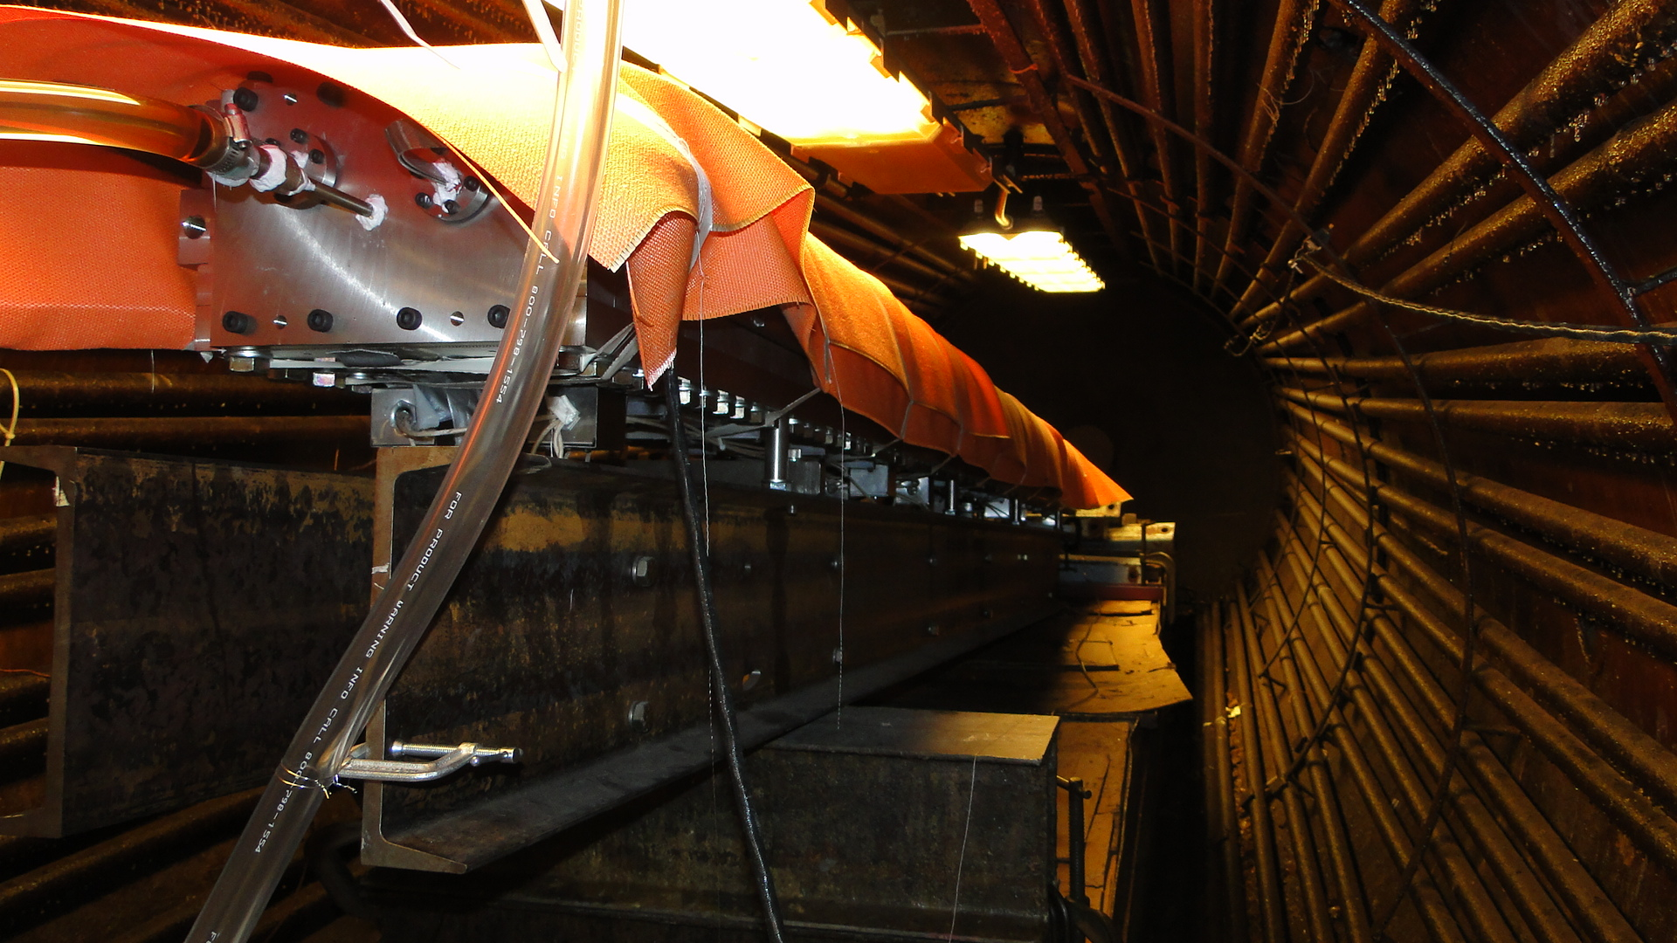
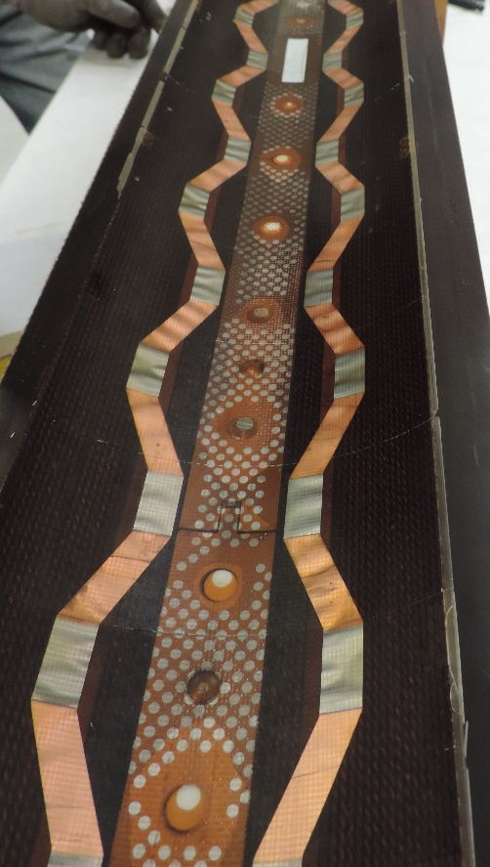
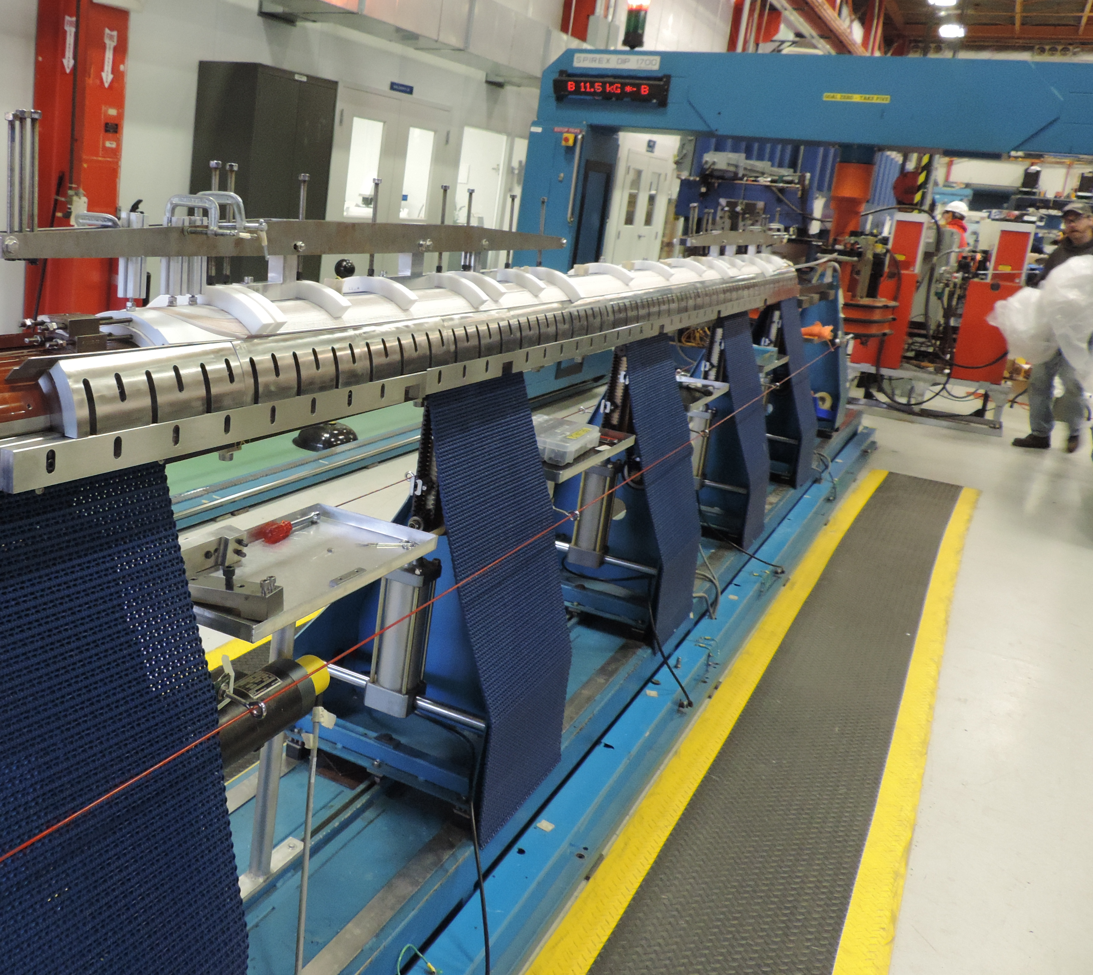
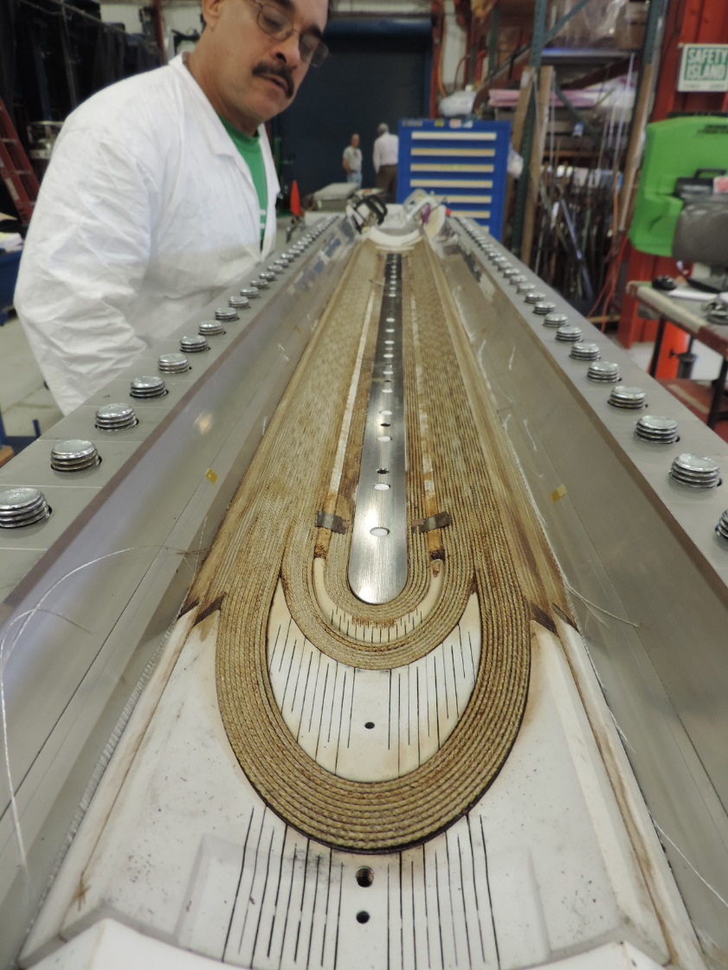
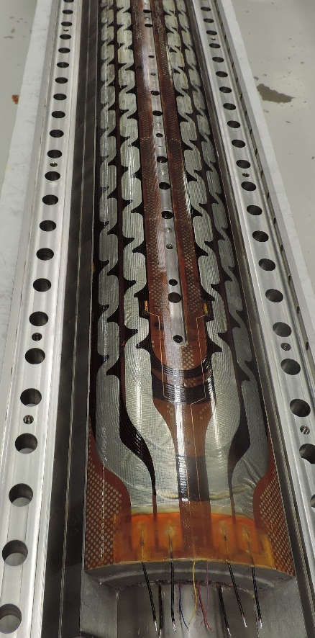
QXF Nb₃Sn Quad Coil Technology
Impregnation
Winding & Curing
Reaction
Coils have 25 kg of winding tension and cured with a ceramic binder
Nb₃Sn Formation ~9 days with peak plateau at 650°C
Impregnation protects conductor from Lorentz force
6/16/2016

Slide 9
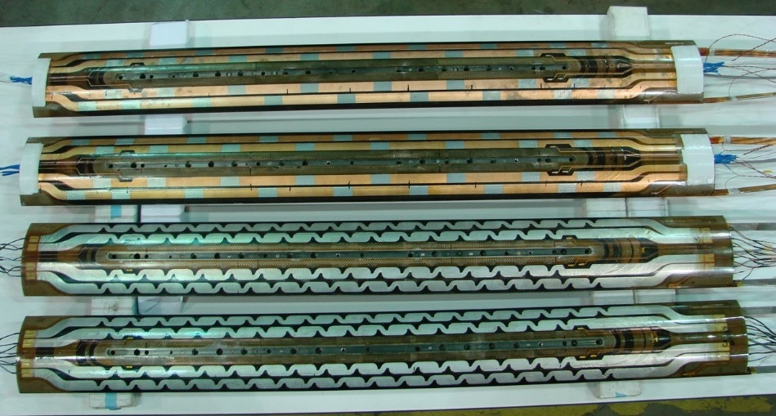
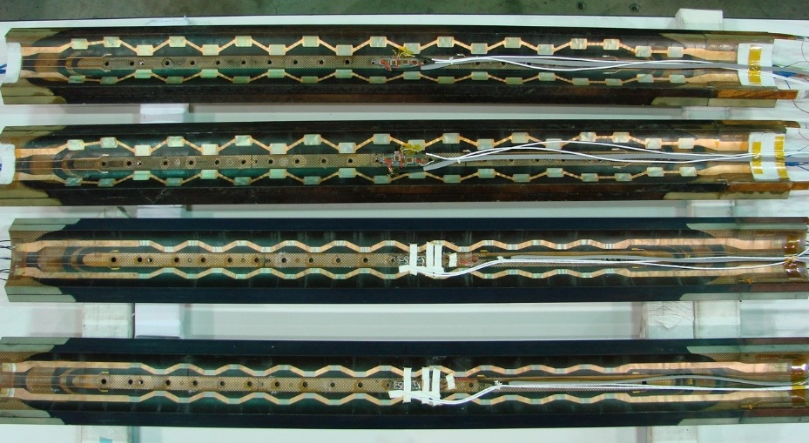
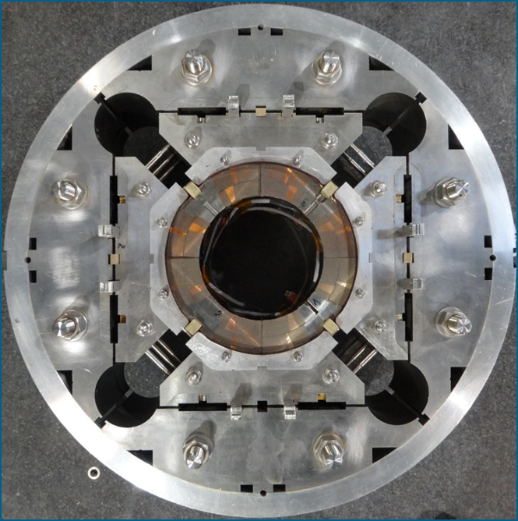
Mechanical Structure / Magnet Assembly
MQXFS1a Quadrupole Coils
2 CERN Coils
2 LARP Coils
6x the e.m. forces than current MQXA/B Quads
‘Bladder & Key’ Technology from HQ series
Peak stress -140 MPa or less
Very Strong collaboration between LARP and CERN
Very integrated design and development plan
Exchanging parts, procedures, and coils!!
Deformed shape and coil peak azimuthal stress from ANSYS
Courtesy Paolo Ferracin
-110 MPa
-100 MPa
-140 MPa
-140 MPa
Bladder Pressure
Pressure Release
4.2 K
Nominal Field
6/16/2016
Notes:
6x the axial forces
4x the transverse forces
F_{x} = 680 t / m
σ_{θ_e.m.}= 100-110 MPa
F_{z_aperture} = 120 t

Slide 10
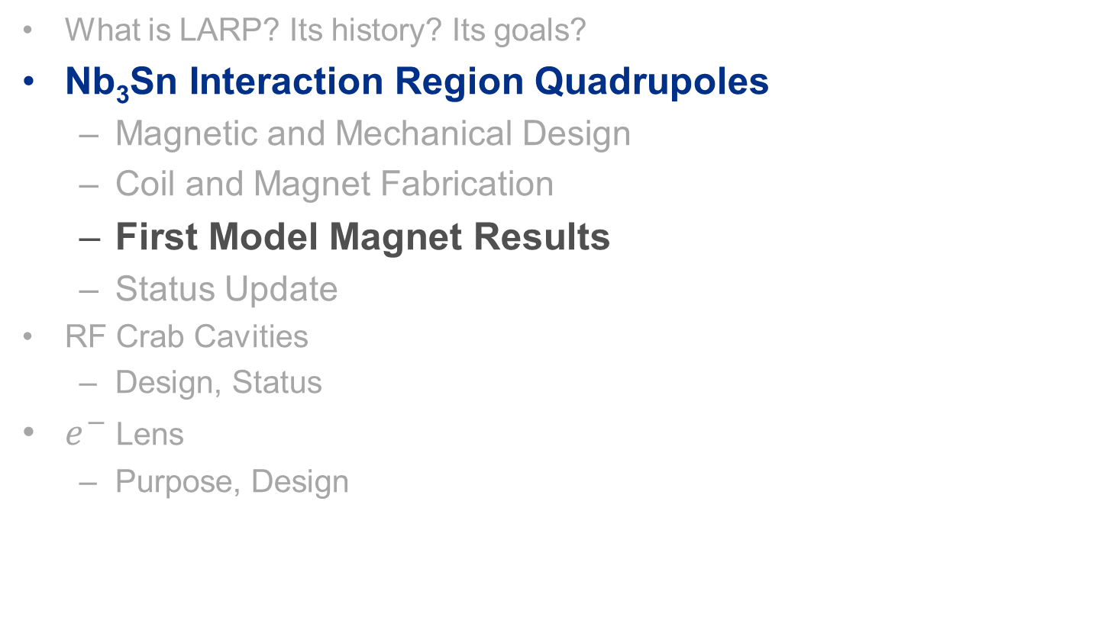
Content
What is LARP? Its history? Its goals?
Nb₃Sn Interaction Region Quadrupoles
  Magnetic and Mechanical Design
  Coil and Magnet Fabrication
  First Model Magnet Results
  Status Update
RF Crab Cavities
  Design, Status
$e^{−}$Lens
  Purpose, Design
6/16/2016

Slide 11

Testing the first model MQXF magnet:
Training Curve
Ramp rate of 20 A/s used for training
50 A/s at the beginning, then 20 A/s to quench
A quench at 4.5 K reached 18.1 kA – same current as at 1.9 K! >93% SSL
-> Large Temperature Margin
6/16/2016

Slide 12
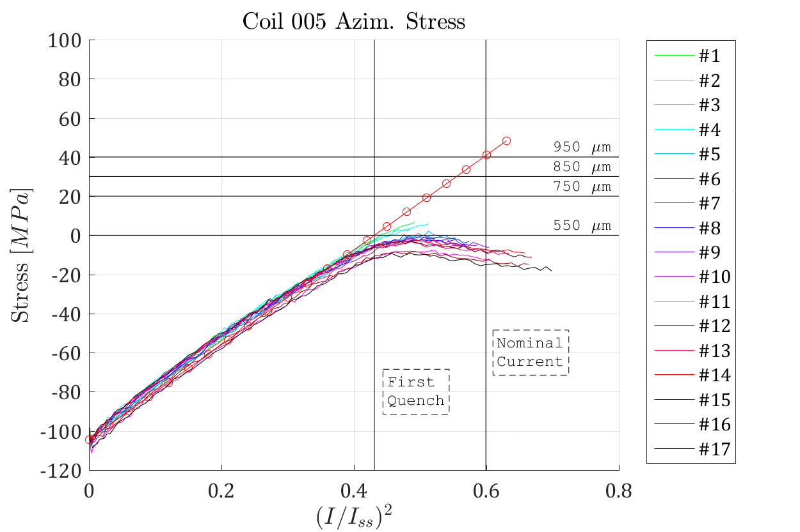
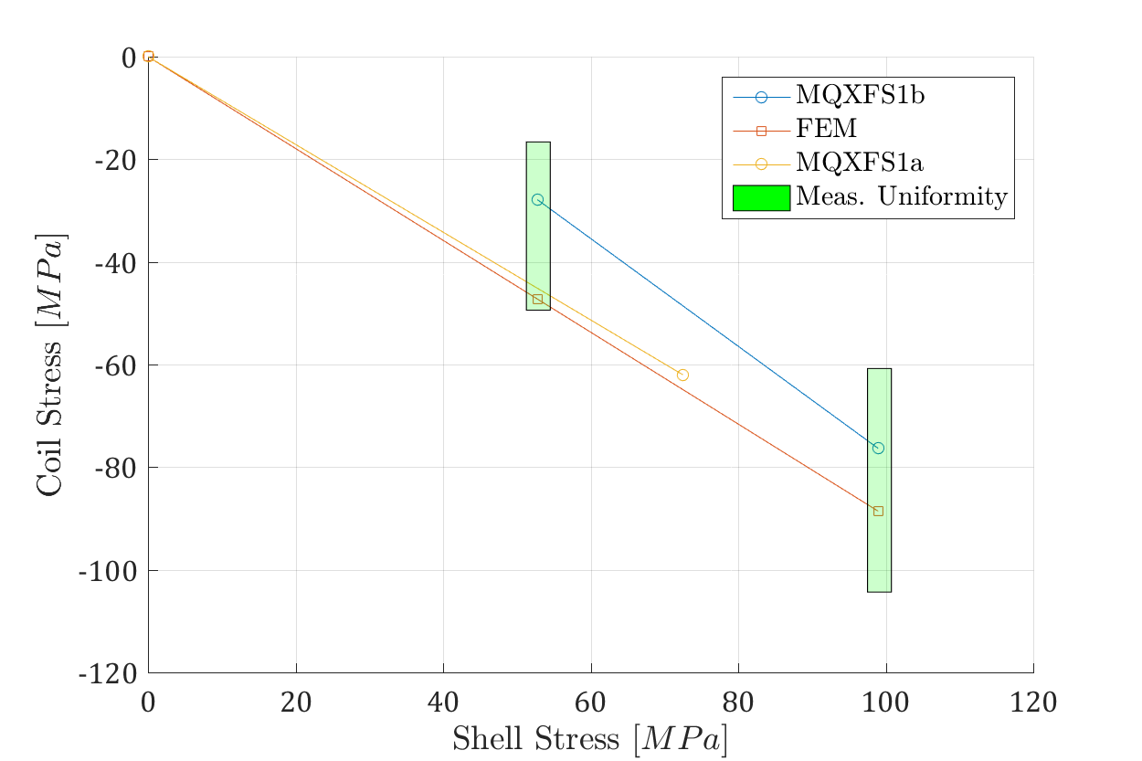
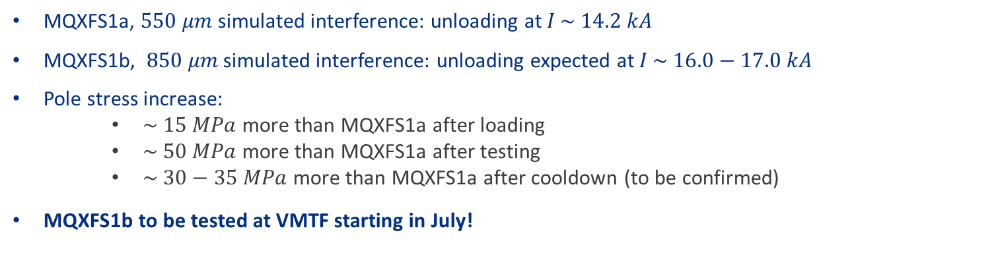
MQXFS1 Strain Gauge Data and Pre-load
After
Testing
1st Preload
2nd Preload
MQXFS1a, $550 μm$ simulated interference: unloading at $I \sim 14.2 kA$
MQXFS1b, $850 μm$ simulated interference: unloading expected at $I \sim 16.0−17.0 kA$
Pole stress increase:
    $\sim 15 MPa$ more than MQXFS1a after loading
    $\sim 50 MPa$ more than MQXFS1a after testing
    $\sim 30−35 MPa$ more than MQXFS1a after cooldown (to be confirmed)
MQXFS1b to be tested at VMTF starting in July!
6/16/2016

Slide 13
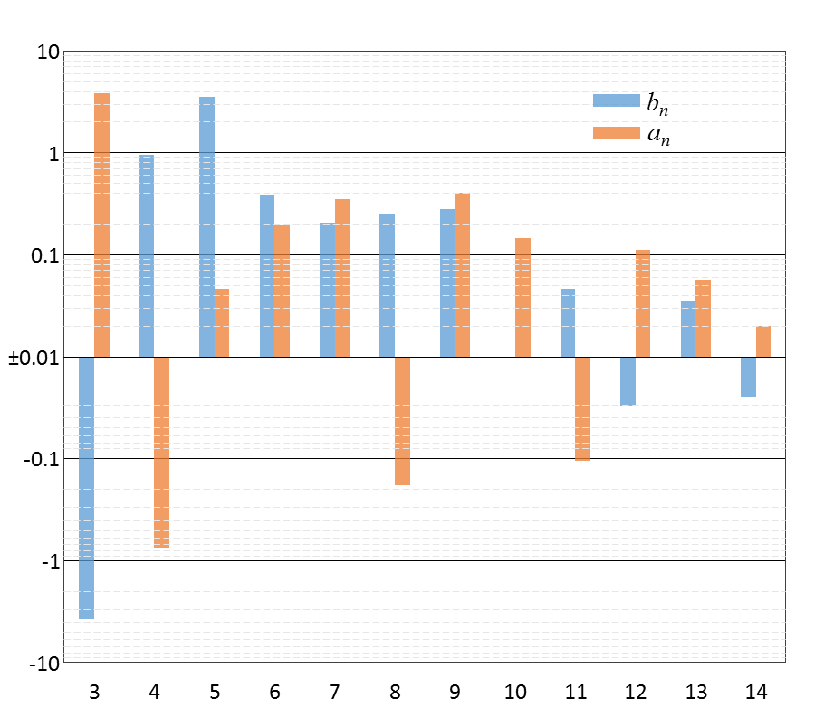
MQXFS1a Field Quality – Final focusing…
Standard Fourier analysis of accelerator magnets
MQXFS1a Field Quality
Error Bars are from Random Conductor Displacements
= Normal harmonics
Number of Units
= Skew harmonics
Harmonics take into account asymmetric assembly shimming.
Only a₃, b₃, and b₅ are larger than anticipated
Everything else is within expectation or < 1 unit
Harmonic index (n)
6/16/2016

Slide 14
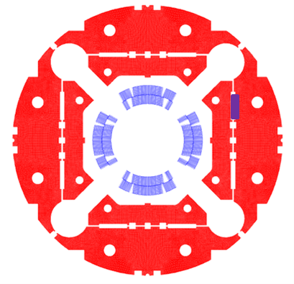
Magnetic Shims, Correcting b₃ and a₃
Measured normal and skew sextupole can be corrected inserting magnetic shims in the bladders slot
  Magnetic shims installed in MQXFS1b to prove the correction capabilities
Correction capabilities using 9x58 mm shim in the bladder slots
Order | b_{n} | a_{n}
3 | 4.24 | -4.24
4 | 0.00 | 0.00
5 | 0.40 | 0.40
6 | 0.00 | 0.00
MQXFS1 Meas. | b₃ | a₃
 | -4.44 | 3.37
6/16/2016

Slide 15
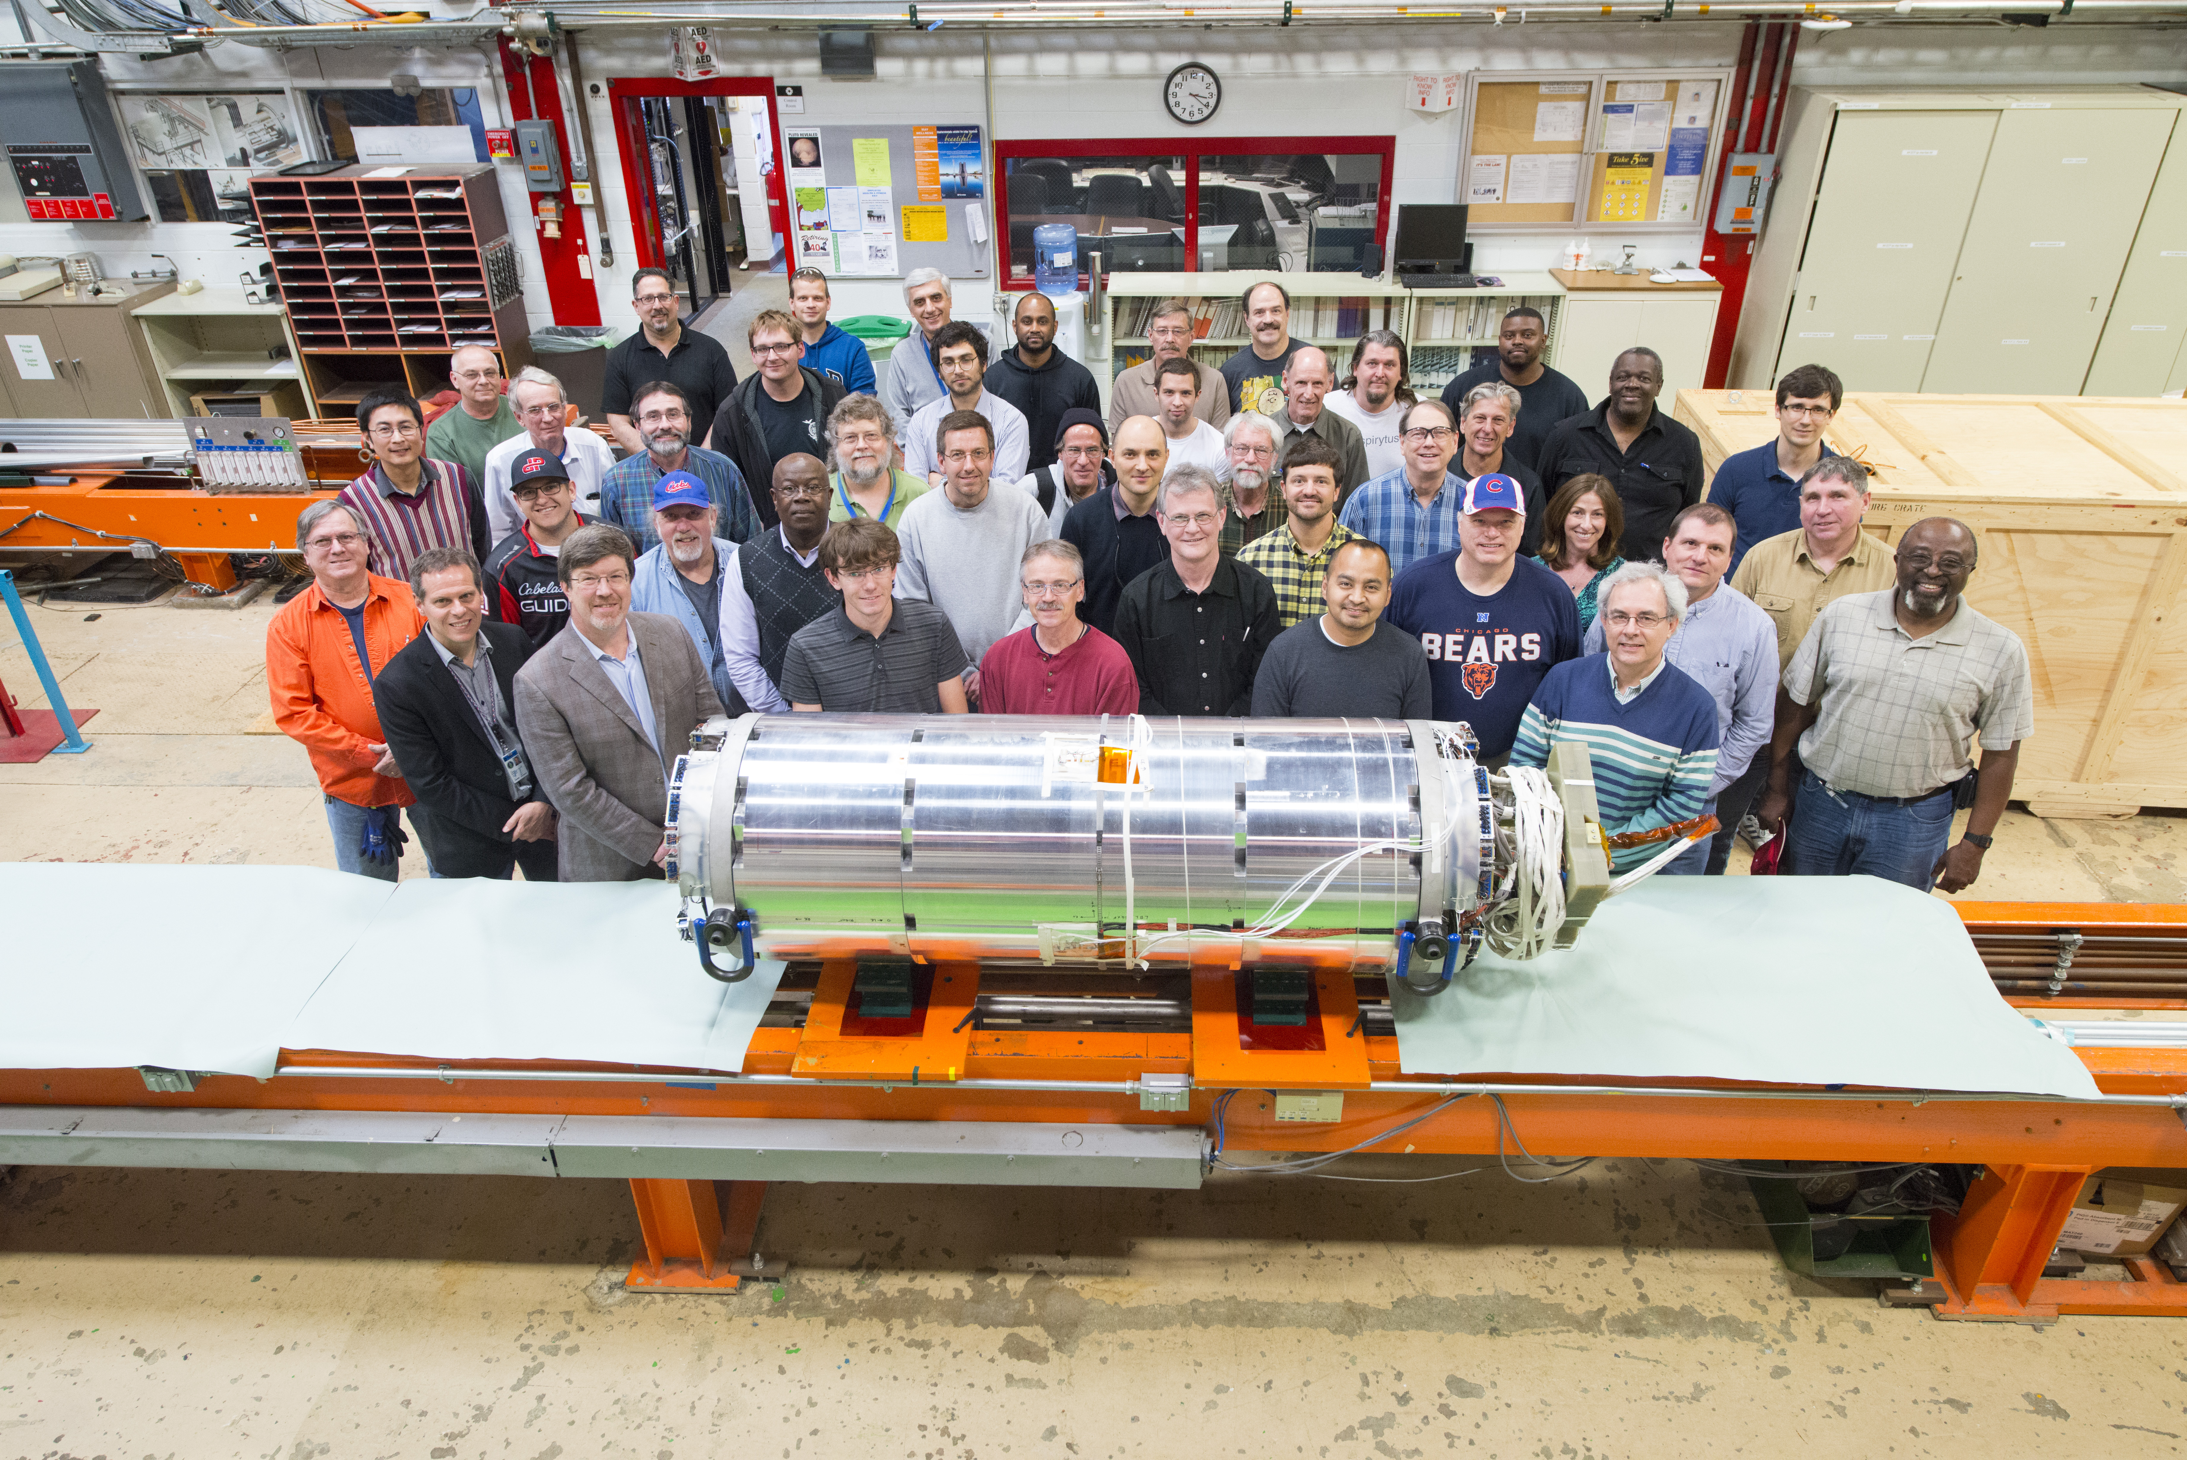
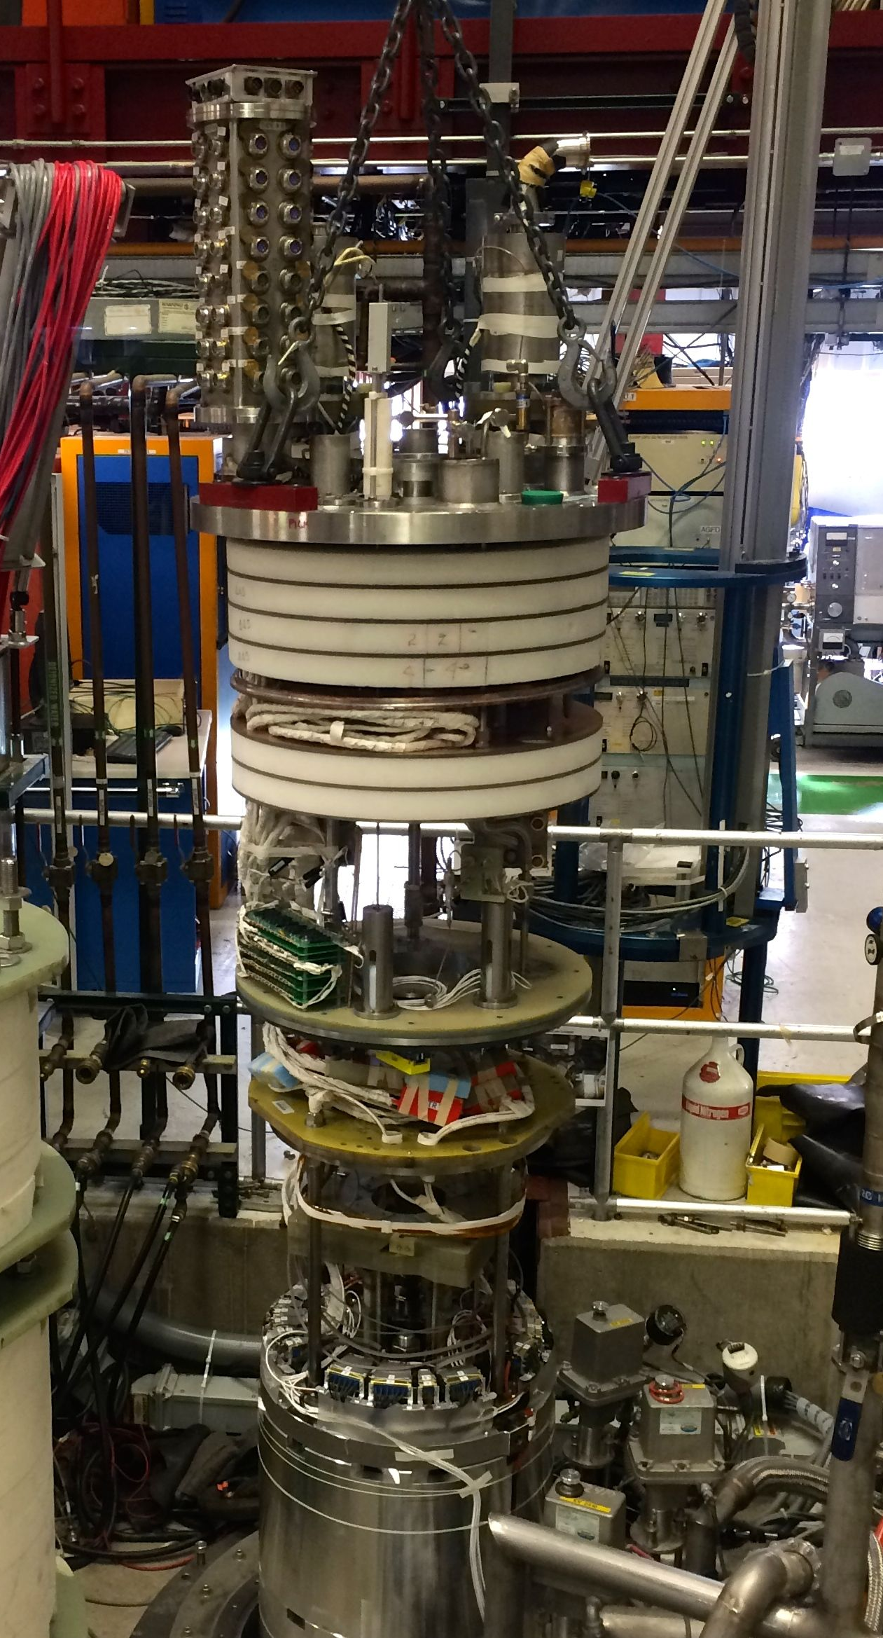
Testing the first model MQXF magnet:
MQXFS1a after first test in bldg 1 of the Industrial Building Complex of FNAL Technical Division
Installing MQXFS1a in the
Vertical Magnet Test Facility
6/16/2016

Slide 16
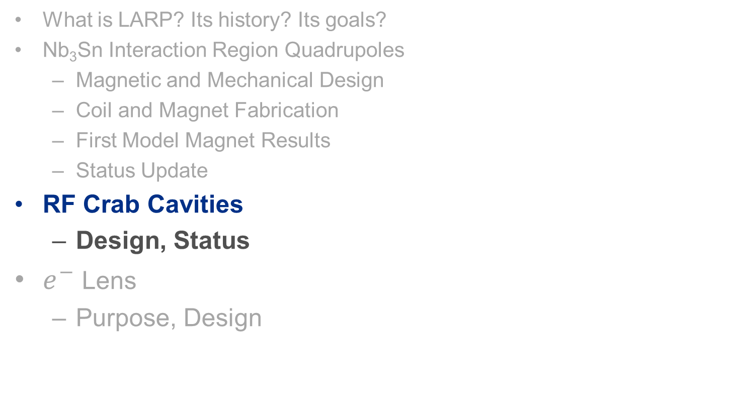
Content
What is LARP? Its history? Its goals?
Nb₃Sn Interaction Region Quadrupoles
  Magnetic and Mechanical Design
  Coil and Magnet Fabrication
  First Model Magnet Results
  Status Update
RF Crab Cavities
  Design, Status
$e^{−}$Lens
  Purpose, Design
6/16/2016

Slide 17
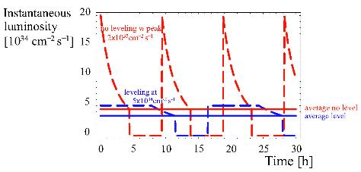
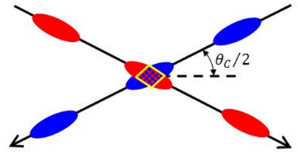
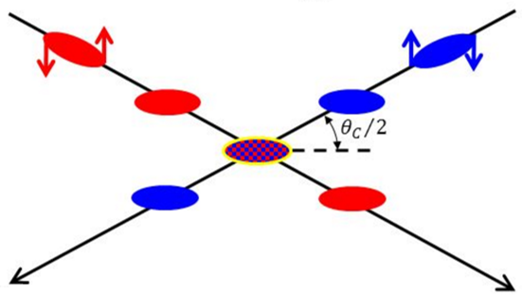
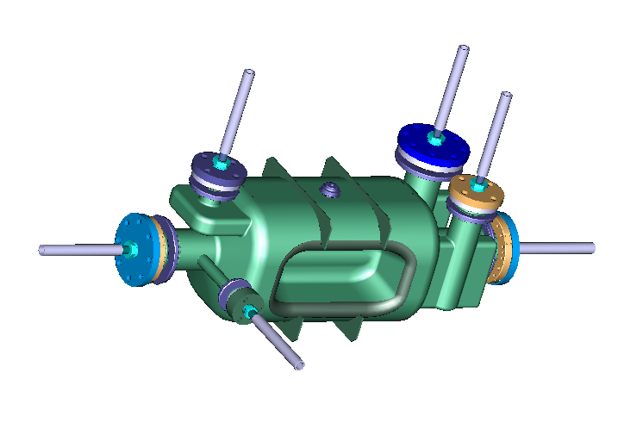
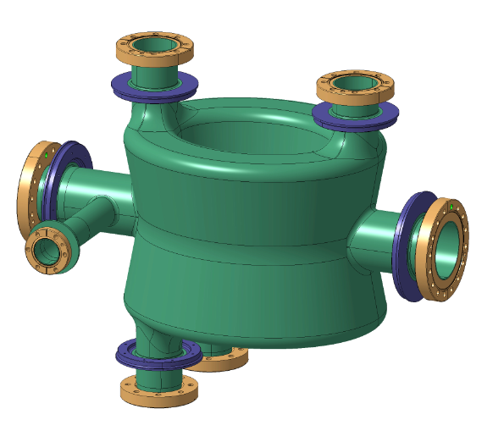
Crab Cavities – another key to High Lumi.
Crab cavities rotate each bunch to increase luminosity
DQW and RFD designs under development
Luminosity Leveling
No Rotation
Bunch Rotation
Reduced luminosity
Maximum luminosity
Maximum Integrated luminosity
Double Quarter Wave CC
RF Dipole CC
Leonardo Ristori
6/16/2016

Slide 18
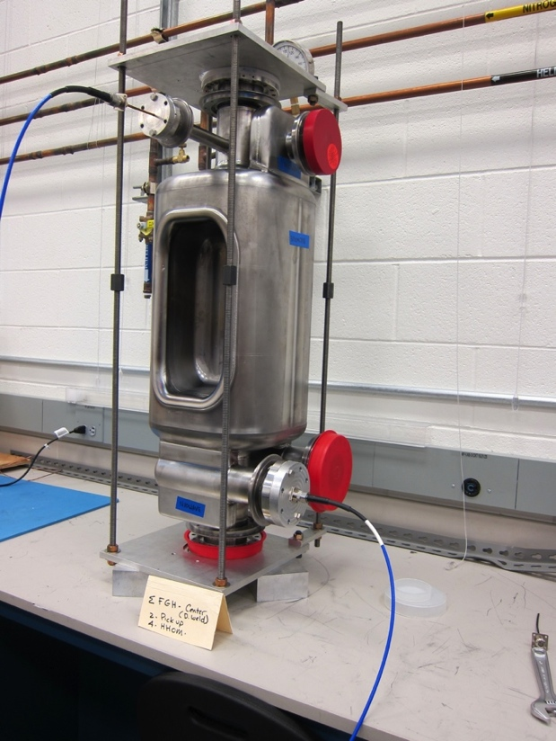
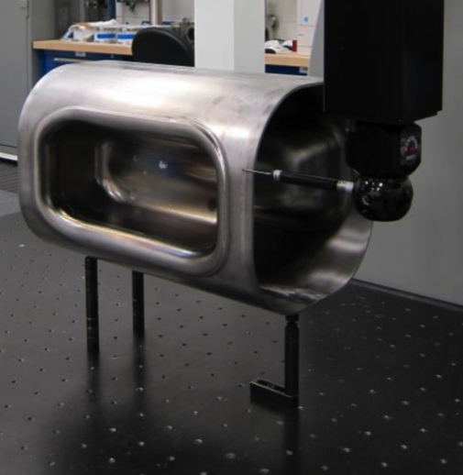
Status of Crab Cavities
Have received two RFD cavities from vendor
  LARP is supporting JLAB, BNL, and ODU efforts to characterize and learn from NW cavities
  Mechanical Measurements, X-rays, processing, final weld “tuning”,… up to test in vertical configuration
2 DQWs are expected from vendor in June.
FNAL Engineering leadership will work for the qualification and acceptance - by CERN - of SRF vendors under US contract
  LARP to fund qualification of Cavities Suppliers (1 or more). CERN to review and grant qualification.
  Full reliance on FNAL SRF Facilities
6/16/2016

Slide 19
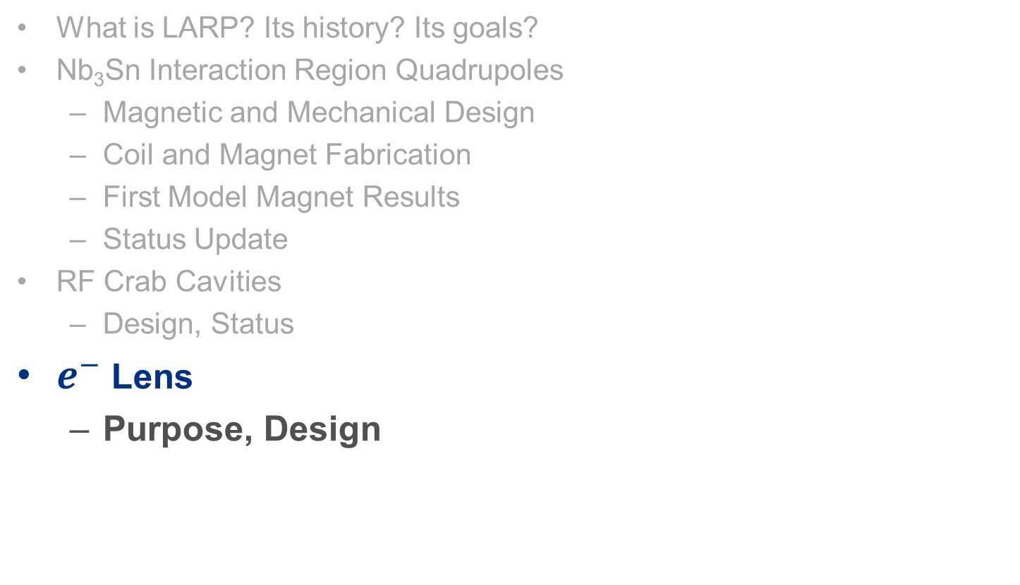
Content
What is LARP? Its history? Its goals?
Nb₃Sn Interaction Region Quadrupoles
  Magnetic and Mechanical Design
  Coil and Magnet Fabrication
  First Model Magnet Results
  Status Update
RF Crab Cavities
  Design, Status
$e^{−}$Lens
  Purpose, Design
6/16/2016

Slide 20
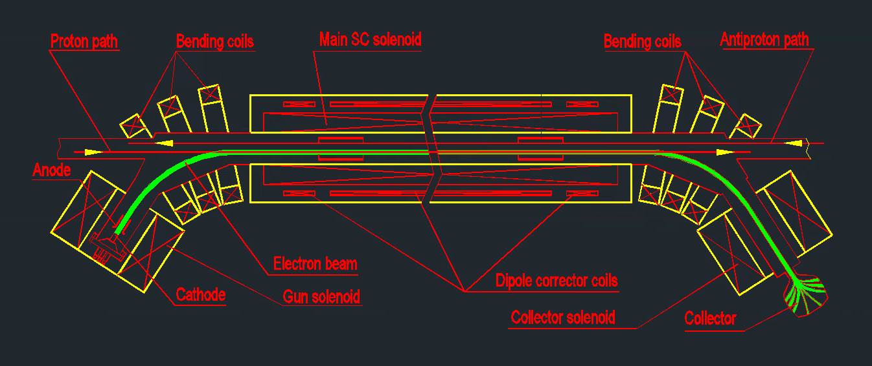
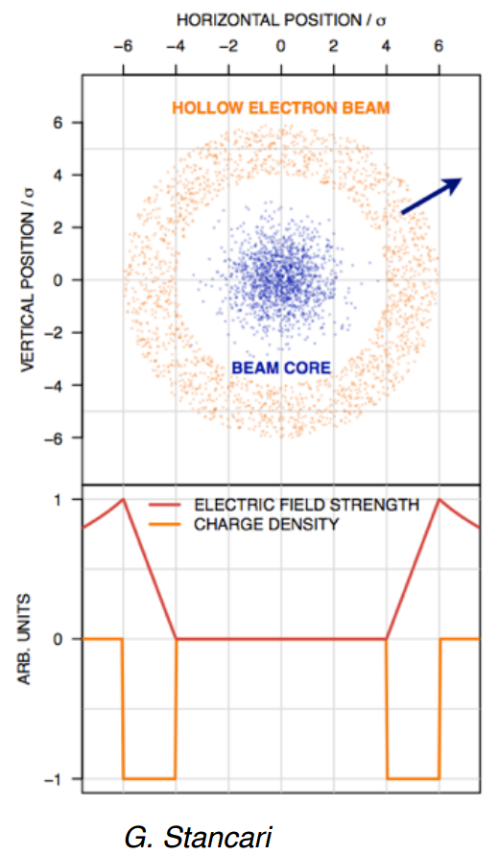
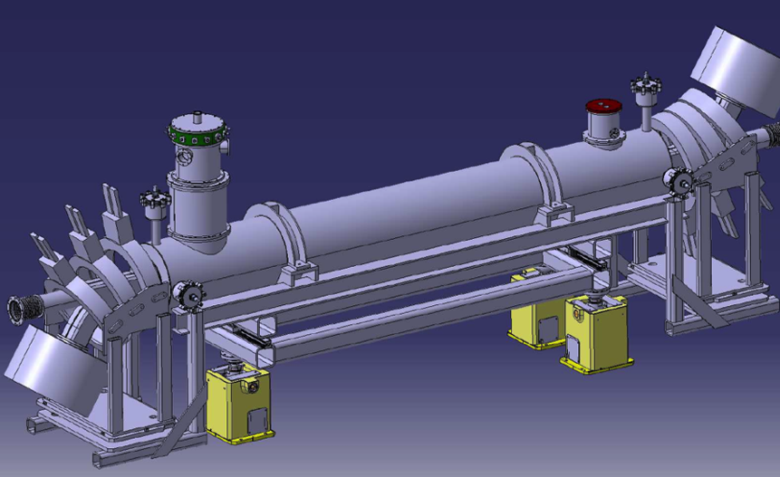
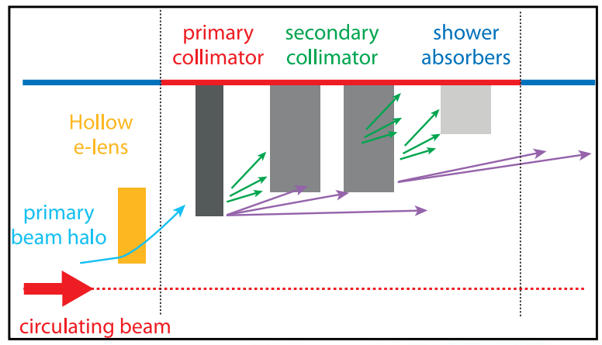
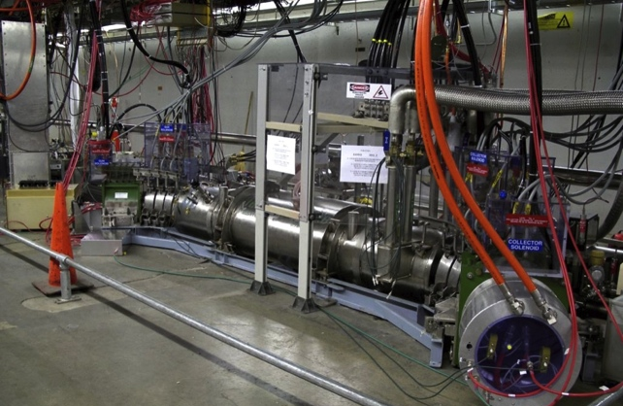
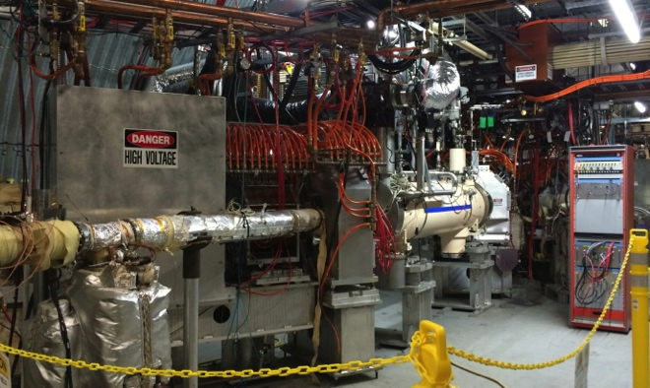
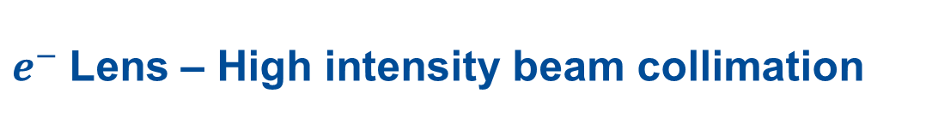
$e^{−}$Lens – High intensity beam collimation
Power deposited on collimators is doubled for HL-LHC
Hollow e-lens beams selectively divert particles above a certain amplitude
Novel technology developed at Fermilab and based on existing FNAL/BNL designs
-> Robust, low-risk HL-LHC contribution
  BNL on SC Solenoid
  FNAL on Gun/Collector & other magnets
Giulio Stancari
Tev e-Lens
RHIC e-Lens
6/16/2016

Slide 21
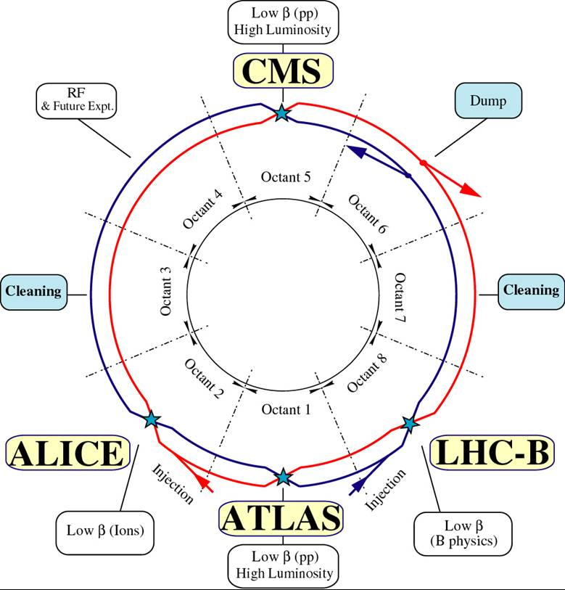
Summary
LARP has substantially developed U.S. expertise in several areas especially Nb₃Sn.
The first MQXF model magnet reached ultimate LHC operational current with sufficient margin.
Nb₃Sn magnets will be installed in a ring for the first time and are the backbone of HL-LHC.
LARP developed crab cavities maximize the integrated luminosity and are part of the baseline
Tevatron and RHIC hollow e-lens expertise should significantly contribute to HL-LHC collimation
LARP and LAUP have strong collaboration with CERN and strong P5 support
LAUP passed CD-0 in March with CD-1 scheduled in early FY17
Combined CD-2/3 is scheduled in FY18 and is largely dependent on
long MQXF prototypes and baselined crab cavity and e-lens efforts
THANK YOU!!!
6/16/2016

Slide 22
Extra Slides

Slide 23
Moving forward in HL-LHC AUP…
Retest MQXFS1b with increased preload and magnetic shims
  Already reached the ultimate current!
  The magnet demonstrated stable operation at the nominal current (16480 A) for more than 8 hours (“Holding Current” test)
  A single test at 4.5 K reached 93.6% SSL
Coil Fabrication for Long QXF Prototypes
  All coils for first long prototype (MQXFP1) are Wound and Cured with assembly and test in FY 17
  Parts procured for QXFA coils (Full Q1/Q3 prototype)
    Winding to begin in July!
CD-1 approval by early FY17 and Consolidated CD-2/3 approval by Q3 FY18.
  Will requires 2 successful Prototype magnets
  Will require ‘baselined’ crab cavity and e-lens efforts
6/16/2016

Slide 24
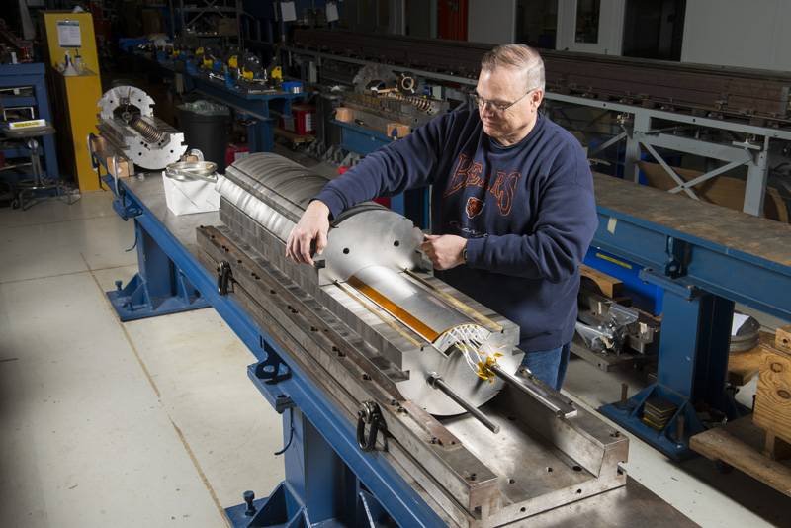
Mirror Test of First HL-LHC Coil!
First model coil for HL-LHC magnets assembled and tested in mirror configuration at FNAL. The Mirror Magnet was tested in the IB1 Vertical Magnet Test Facility using for the
first time an upgraded 30kA setup!
  Higher current needed for higher-performing Nb₃Sn magnets
Coil achieved HL-LHC “operating current” (16.5kA) in 3 quenches during the first day of testing!
Next Goal: Test of first 4-coil complete QXF quadrupole!!!
Ultimate
16.5 kA
Nominal
6/16/2016

