Slide 1
PIP-II
Valeri Lebedev
49th Annual Fermilab Users Meeting
June 14-16, 2016

Slide 2
Outline
PIP-II Goals
Design Concept and Design Choices
  Linac
  Booster
  Recycler and MI
Summary

Slide 3
Motivation and Goals
The goal of PIP-II is to support long-term physics research goals outlined in the P5 plan, by delivering world-leading beam power to the U.S. neutrino program and providing a platform for the future.
Design Criteria
Short and medium term goals
  Deliver >1 MW of proton beam power from the Main Injector over the energy range 60 – 120 GeV, at the start of LBNF operations
  Support the current 8 GeV program including Mu2e, g-2, and short-baseline neutrinos
  Provide an upgrade path for Mu2e
    ~7 kW -> ~100 kW, arbitrary time structure,
    99% duty factor, negligible beam current fluctuations
Long term goals
  Provide a platform for extension of beam power to LBNF to >2 MW
  Provide a platform to support future high duty factor/higher beam power operations
At a cost affordable to DOE

Slide 4
PIP-II Proposed Technical Approach
Construct a modern 800-MeV superconducting linac, of CW-capable components, operated initially in pulsed mode
  Increase Booster power from 80 to 160 kW
  Increase Booster/Recycler/Main Injector per pulse intensity by ~50%
  Increase Booster repetition rate to 20 Hz
Modest modifications to Booster/Recycler/Main Injector
  Accommodate higher intensities and higher Booster injection energy
This approach is described in the Reference Design Report:
  Builds on significant existing infrastructure
  Capitalizes on major investment in superconducting RF technologies
  Eliminates significant operational risks inherent in existing 400 MeV linac
    Existing linac removed from service upon completion of PIP-II
  Siting consistent with eventual replacement of the Booster by new Rapid Cycling Synchrotron (RCS)

Slide 5
PIP-II Performance Goals
Performance Parameter | PIP | PIP-II
Linac Beam Energy | 400 | 800 | MeV
Linac Beam Current | 25 | 2 | mA
Linac Beam Pulse Length | 0.03 | 0.6 | msec
Linac Pulse Repetition Rate | 15 | 20 | Hz
Linac Beam Power to Booster | 4 | 18 | kW
Booster Protons per Pulse | 4.3×10¹² | 6.5×10¹²
Booster Pulse Repetition Rate | 15 | 20 | Hz
Booster Beam Power @ 8 GeV | 80 | 160 | kW
Beam Power to 8 GeV Program (max; MI @ 120 MeV) | 32 | 80 | kW
Main Injector Protons per Pulse | 4.9×10¹³ | 7.6×10¹³
Main Injector Cycle Time @ 60-120 GeV | 1.33* | 0.7-1.2 | sec
LBNF Beam Power @ 60-120 GeV | 0.7* | 1.0-1.2 | MW
LBNF Upgrade Potential @ 60-120 GeV | NA | >2 | MW
*NOvA operations at 120 GeV

Slide 6
Linac Requirements
New SC Linac
  Design compatible with both Pulsed and CW operations
  => Small beam current (actually an advantage due to painting)
  MEBT bunch-by-bunch chopper chops out bunches at boundaries of Booster RF buckets and from the extraction gap
  Energy stability of ~10⁻⁴ to support longitudinal painting
  Emittance less than 0.3 mm mrad (rms, norm)
    to minimize injection loss, and support of tailless transverse painting

Slide 7
Booster/Recycler/MI Requirements
Booster
  Injection energy: 400 -> 800 MeV
  => intensity×1.5, reduction ΔQ_{SC}
  New injection region to accept 800 MeV H⁻
  Transverse and longitudinal painting:
    small I_{beam} helps
    Reduces tails, uncontrolled injection loss and ΔQ_{SC}
  RF sufficient to support acceleration and transition crossing manipulations (22 cavities total)
  20 Hz operations
    Larger power
    larger momentum separation in slip-stacking
    => smaller loss in Recycler & MI
Recycler/Main Injector
  RF for slip-stacking at cycle times as low as 0.7 sec (RR)
    Supports 60 GeV protons to LBNF target
  RF power upgrade (MI)
  Loss control measures: collimation in Recycler, …

Slide 8
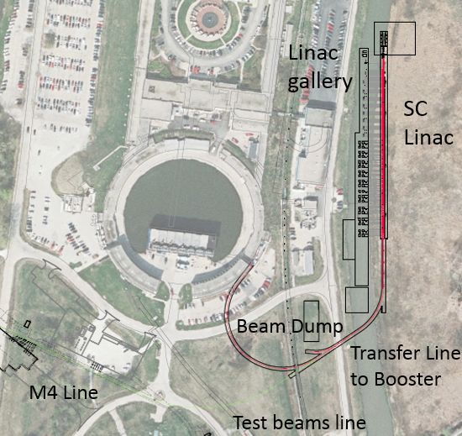
PIP-II Components
New 0.8 GeV linac
  L≈210 m
    Includes 4 empty slots at the linac end, L≈40 m
      Beam energy stabilization
      Possible energy upgrade
New Linac-to-Booster transfer line
  L≈300 m
200 m linac extension is anticipated for a possible future energy upgrade & RCS

Slide 9

PIP-II Technology Map
Section | Freq | Energy (MeV) | Cav/mag/CM | Type
RFQ | 162.5 | 0.03-2.1
HWR (β_{opt}=0.11) | 162.5 | 2.1-10.3 | 8/8/1 | HWR, solenoid
SSR1 (β_{opt}=0.22) | 325 | 10.3-35 | 16/8/ 2 | SSR, solenoid
SSR2 (β_{opt}=0.47) | 325 | 35-185 | 35/21/7 | SSR, solenoid
LB 650 (β_{g}=0.61) | 650 | 185-500 | 33/22/11 | 5-cell elliptical, doublet*
HB 650 (β_{g}=0.92) | 650 | 500-800 | 24/8/4 | 5-cell elliptical, doublet*
*Warm doublets external to cryomodules All components CW-capable

Slide 10
PIP-II R&D Program
The goal is to mitigate risk: Technical/cost/schedule
Technical Risks
  Front End
    Delivery of beam with required characteristics and reliability
  Operate SC Linac in pulsed mode at low current
    Primary issue is resonance control in cavities
  Booster/Recycler/Main Injector beam intensity
    50% per pulse intensity increase over current operations
    Booster longitudinal emittance (should be small for slip-stacking)
    Transition crossing
    Beam loss/activation
  Develop requisite capabilities of partners and vendors
Cost/Schedule Risks
  Superconducting RF
    Cavities, cryomodules, RF sources
Goal: Complete R&D program in 2019
PXIE

Slide 11
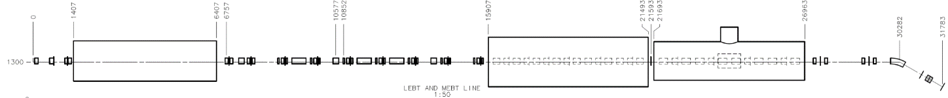
PIP-II R&D: Linac Frontend
Now
2016
2017
2018
30 keV
2.1 MeV
10 MeV
25 MeV
RFQ
MEBT
HWR
SSR1
HEBT
LEBT
40 m, ~25 MeV
PXIE will address/measure the following:
  LEBT pre-chopping: Demonstrated
  Vacuum management in the LEBT/RFQ region: Demonstrated
  Validation of chopper performance
    Bunch extinction, effective emittance growth
  MEBT beam absorber
    Reliability and lifetime
  MEBT vacuum management
  CW operation of HWR
    Degradation of cavity performance
    Optimal distance to 10 kW absorber
  Operation of SSR with beam
    CW and pulsed operation
    Resonance control and LFD compensation in pulsed operations
  Emittance preservation and beam halo formation through the front end
Collaborators
ANL: HWR
LBNL:LEBT, RFQ
SNS: LEBT
BARC: MEBT, SSR1, RF
IUAC: SSR1

Slide 12
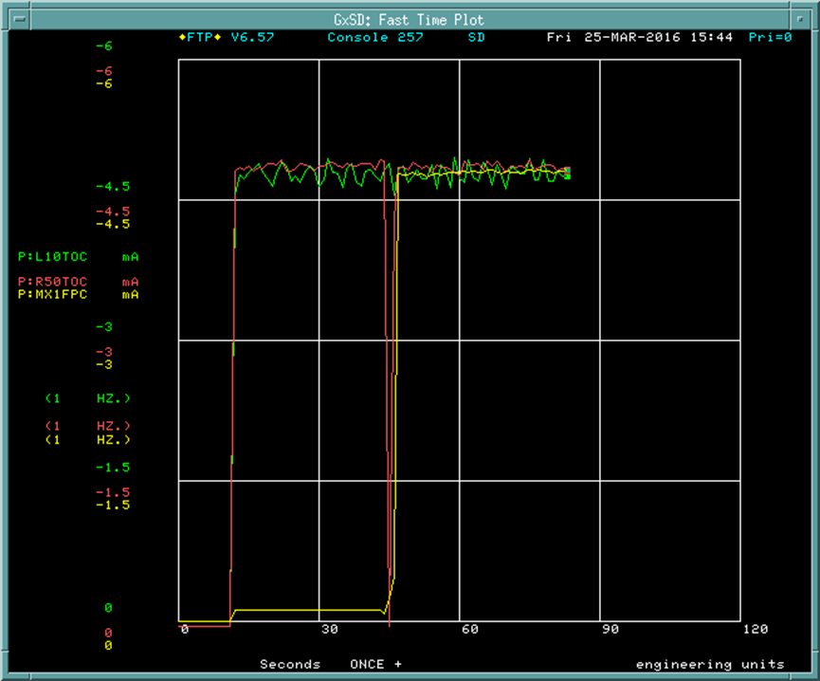
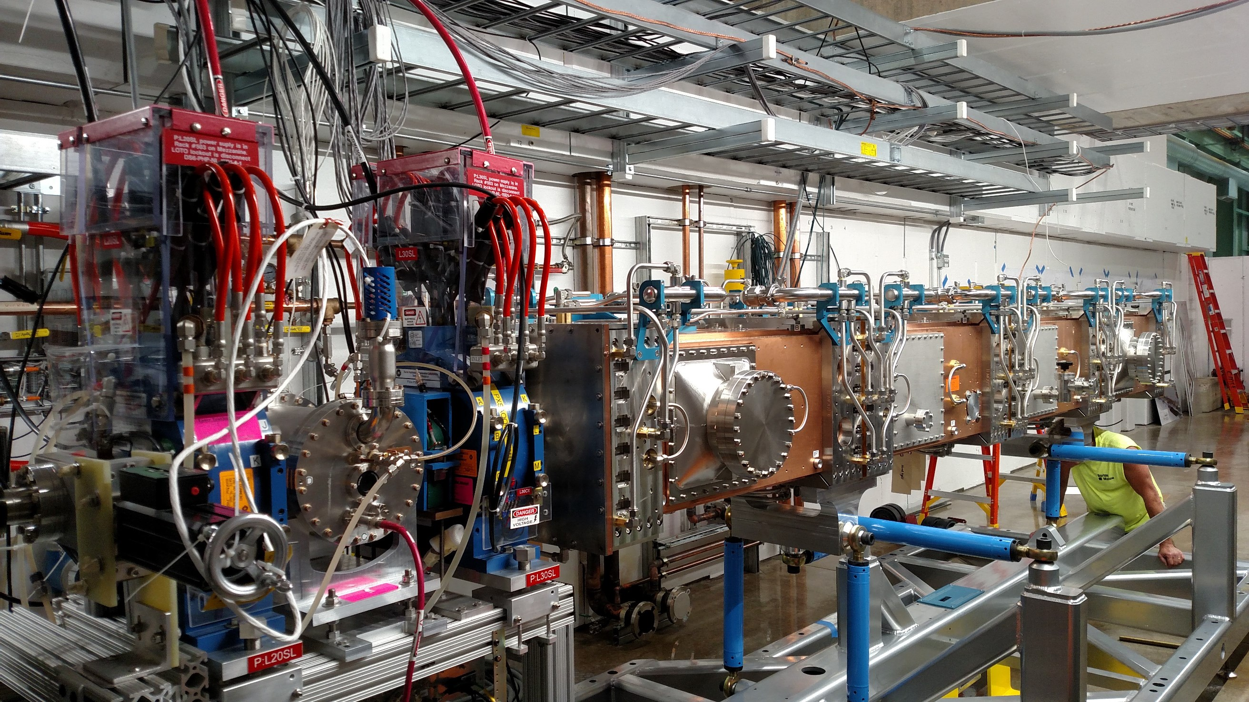
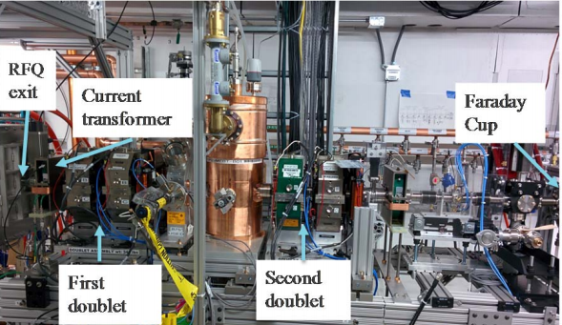
PIP-II R&D: Linac Frontend
Green – beam current at the entrance of RFQ.
Red - beam current at the exit of RFQ.
Yellow – beam current in the Faraday Cup.
Vertical axis – beam current, 1.5 mA/div.
Horizontal axis – time, 30 sec/div.
5 mA, 20 µs, 10 Hz
We received permission to run the beam through RFQ on March 23, and saw an accelerated beam within an hour

Slide 13
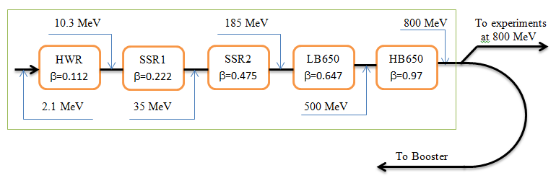
Status of SC Cryomodules
HWR design complete. CM is in production
Designs of SSR1 & HB650 are more advanced than SSR2 & LB650
  SSR1 design is mostly complete (~90% in TC), production started
    Interface document is getting to be ready for review
  HB650 design is advancing well
  Collaboration with Indian Institutions progresses
Significant progress with High Q0 and Resonance control

Slide 14
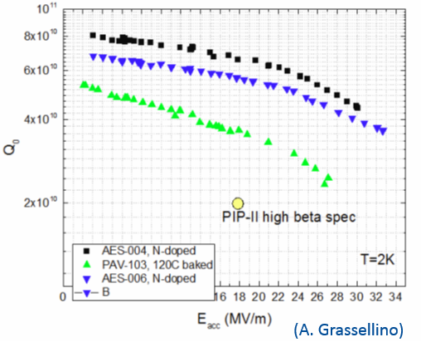
High Q0 R&D
High Q0:
  N-doping evolved from discovery to proven technology for LCLS-II
  Technology has been transferred to PIP-II
Fast cooling
  Suppresses magnetic flux penetration to SC cavity
    Reduces requirements to the
    residual magnetic field
    However
      2 layer magnetic screen
      + Active suppression of
      longitudinal magnetic field.
    As LCLS-II

Slide 15
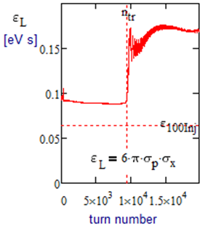
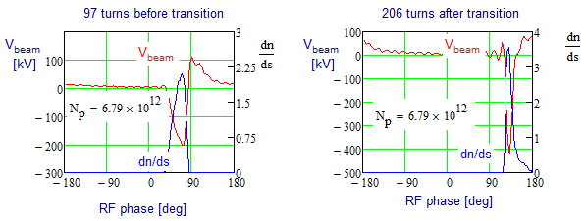
Booster Longitudinal Impedance
Beam aperture in the Booster is formed by poles of laminated combined function dipoles
  That greatly amplifies Booster impedance
Z|| will generate ~400 kV peak decelerating voltage at transition at PIP-II intensity (max(V_{RF})≈1.2 MeV)
Simulations show that the transition crossing at
PIP-II intensity is possible and does not deliver unacceptably large long. emittance
Intensity growth beyond PIP-II intensity does not look realistic => New RCS is required in the future

Slide 16
Acceleration in MI
More powerful RF system in MI
  Present system can accelerate up to 6.2•10¹³
  PIP-II requires 7.5•10¹³
A design of γ_{t} jump system for the Main Injector was completed as part of the Project X Reference design
  Transition crossing simulations for the PIP II intensities have confirmed that the γ_{t} jump system is needed for loss-free transition crossing
Electron cloud simulations indicate that a SEY smaller than 1.4 is sufficient to suppress the e-cloud in both MI and Recycler.
We have a capability to coat both the MI and the Recycler beam pipe.
  The MI beam coating has to be done in situ.
  The Recycler beam pipe can be replaced.

Slide 17
PIP-II Status
CD-0 received in November 2015
  MNS (Mission Need Statement) shows completion in 2025
CDR and Alternatives Analysis in preparation
Fermilab-India collaboration in full swing with first deliverables received and tested
  MEBT magnets and SSR1 cavities

Slide 18
Summary
  PIP-II represents a first step in the realization of the future potential of the Fermilab complex
  Complete concept is outlined in the Reference Design Report
  Initial goal is to establish LBNF as the leading long-baseline program in the world, with >1 MW at startup
  Platform for subsequent development of the accelerator complex
    LBNF >2 MW
    Mu2e sensitivity ×10
    MW-class, high duty factor beams for future experiments
PIP-II R&D program aligned with the requirements outlined in the RDR
  Organized to support a 2019 construction start
  India is a major partner in the R&D program
CD-0 has been received and we are working towards CD-1 in 2017
  Conceptual Design Report to be released in the fall of 2016
  Alternatives analysis will proceed this summer
PIP-II is aimed well beyond what is required for neutrino program
  We are looking for community input supporting particle physics with PIP-II operating at full power

Slide 19
BACKUP
SLIDES

Slide 20
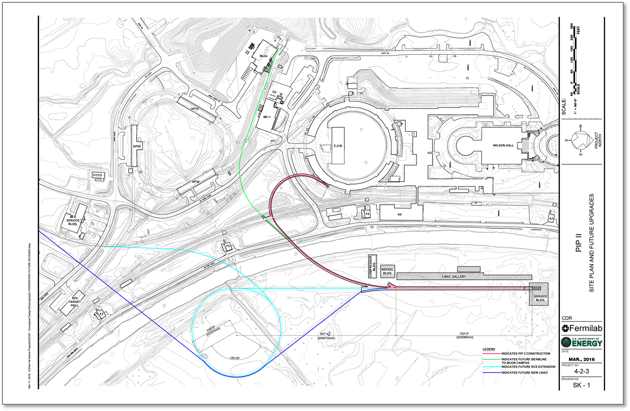
Siting Strategies

Slide 21
Suppression of Microphonics and LFD (W. Schappert, Y. Pischalnikov)
Adaptive LFD Control Algorithm developed at FNAL for NML/CM1 (Pulsed operation, 1.3 GHz)
  Tested with KEK cryomodule in KEK in 2011
LFD is greatly increased in PIP-II (LFD/Δf : 4(XFEL) →11(HB))
  Well above the present state of the art
Resonance Control and Microphonics Workshop at FNAL was carried out in Fermilab in the fall of 2015; indico.fnal.gov/event/micro1
Presently dressed SSR1 cavity is used for R&D
  Considerable progress on active control has already been made at FNAL
  Good compensation of LFD in a test with narrow band cavity was achieved
  Close attention to reliability of fast tuner

Slide 22
General Approaches to Design of Cryomodules
All the CMs are based on SSR1-type concept
  They should contain as much identical parts as possible
SSR1 and SSR2 should be as much similar as possible
  The same concept of the He vessel with small df/dP
  The same high power couplers
  Similar tuners. The goal is to use identical tuners
  Similar designs of solenoids
LB650 and HB650 should be as much similar as possible
  The same concept of He vessel
    small df/dP & no magnets inside
    Similar magnetic screens
  The same HP coupler as HB 650
  Similar tuners as HB 650. The goal is to use identical tuners

