Slide 1
LArIAT T-1034 Operational Readiness Review Data Acquisition and Trigger William Badgett Fermilab on behalf of The LArIAT Collaboration

Slide 2
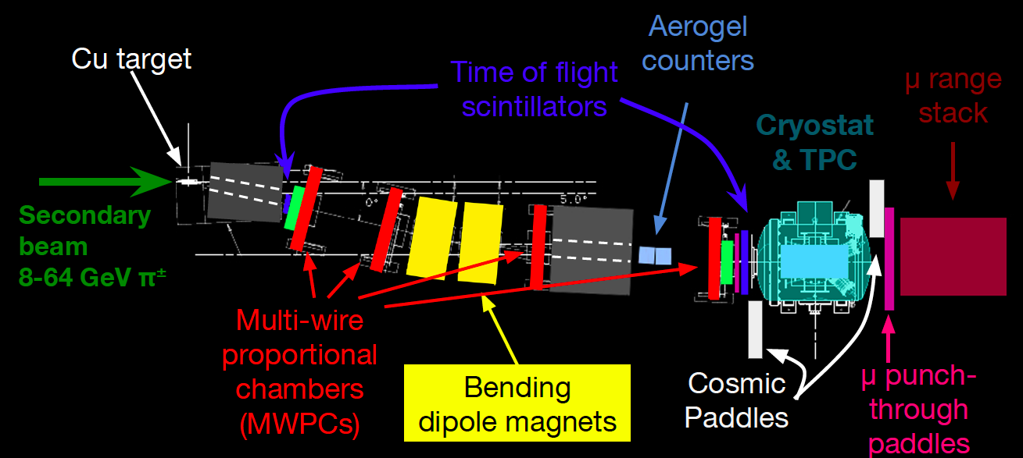
DAQ Top View
Five independent asynchronous readout systems
FTBF TDCs 1.2ns
V1751 1nsec
V1740 128nsec
V1740 128ns
WUT 15psec
Tasks:
“Configure, Trigger, Readout, Build and Write”

Slide 3
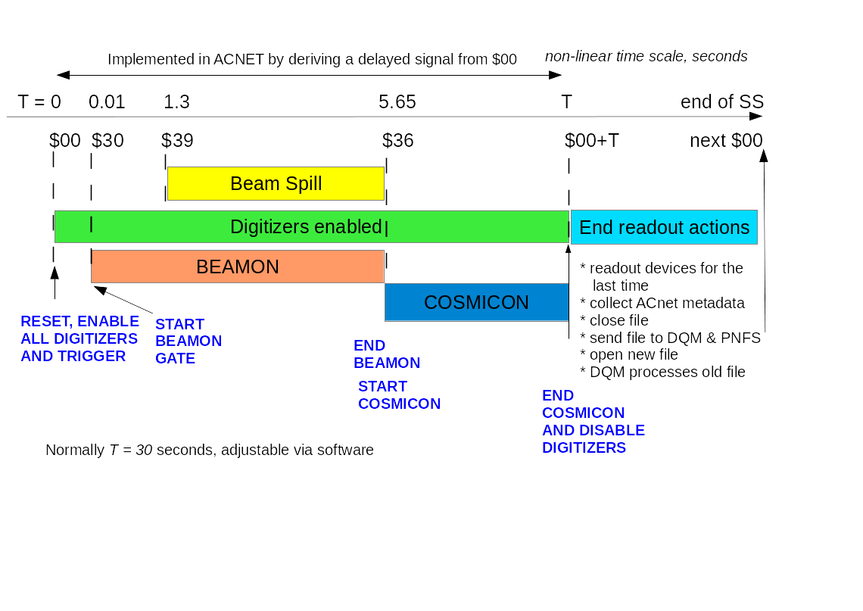
Beam and DAQ+Trigger Timing
$00 All systems and data fragments synchronized to $00 start of each super cycle
BEAMON and COSMICON are inputs to trigger

Slide 4
Requirements & Solutions
Have 4.2 second window beam spill + 24 seconds cosmics every 60 second super cycle
Cannot read every sample without custom readout hw $$$
Must have triggered system handle ~ 100 – 200 triggers/spill
TPC Data volume dominates requirements
~ 350 μsec max drift time, plus padding = 393 μsec
Ideally 128 nsec sample time, 256 nsec adequate, 512 ns if needed
480 wires to readout, no zero suppression, two bytes per channel per sample
Found solution with CAEN V1740 64 channel wave form digitizer
High density 6U VME, single width – need 8 cards
Required new “decimation” in firmware to slow 16 nsec to 128 nsec …
Large buffers can store 64, 128, 256 events, depending on T width

Slide 5
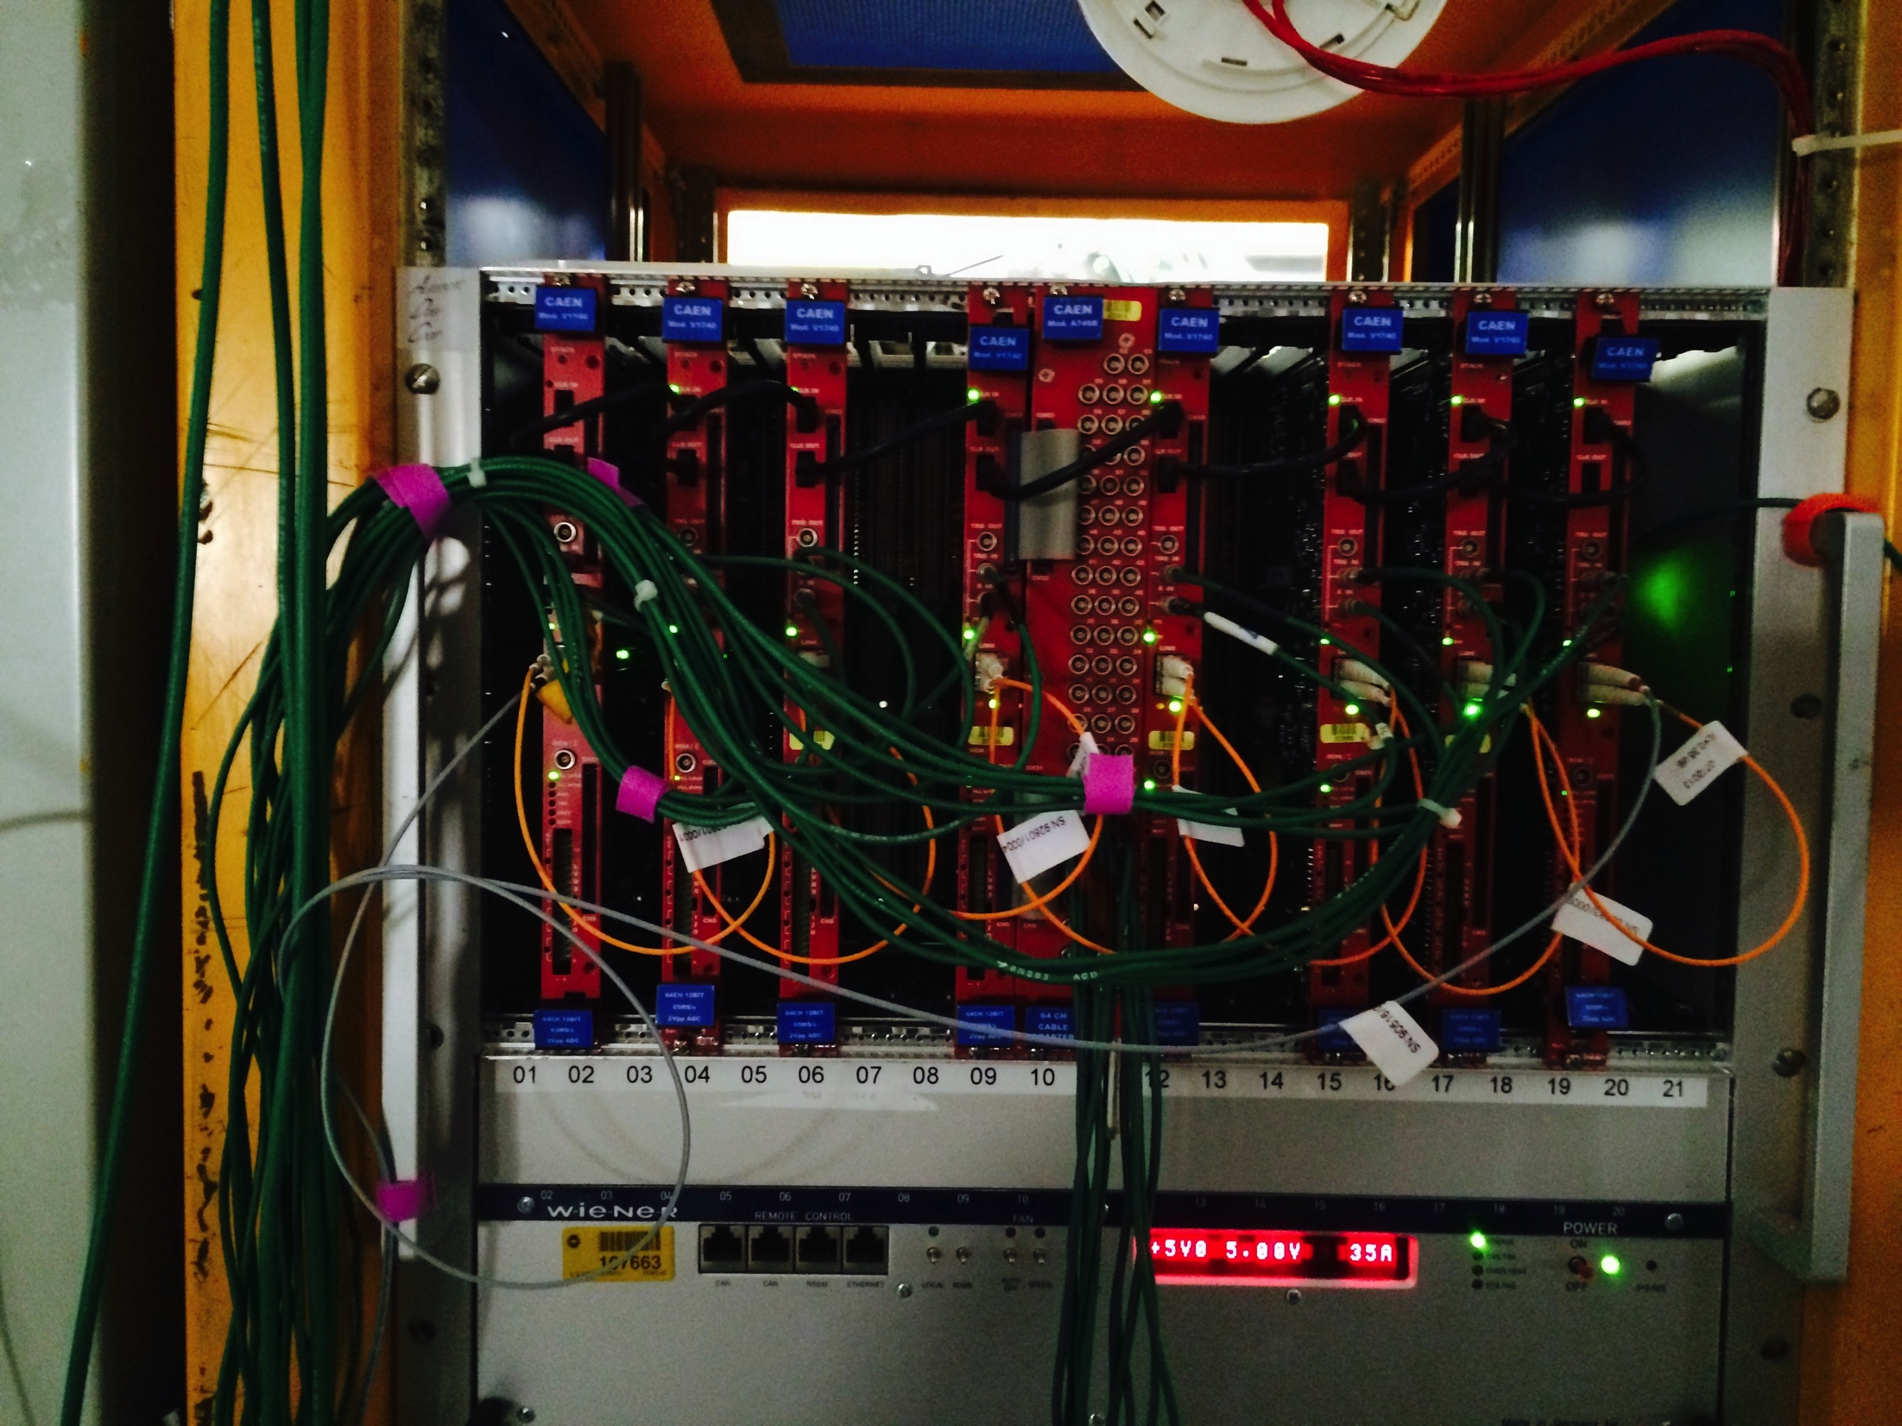
CAEN V1740 VME Crate
V1740 Crate prior to analog hookup
Note daisy-chained digitizer clock
Chained optical link for configuration and readout
Common trigger and reset $00 inputs from fanouts
V1740s constantly digitizing to circular buffer
On receipt of trigger, copy buffer to memory location
Ready immediately for subsequent trigger

Slide 6
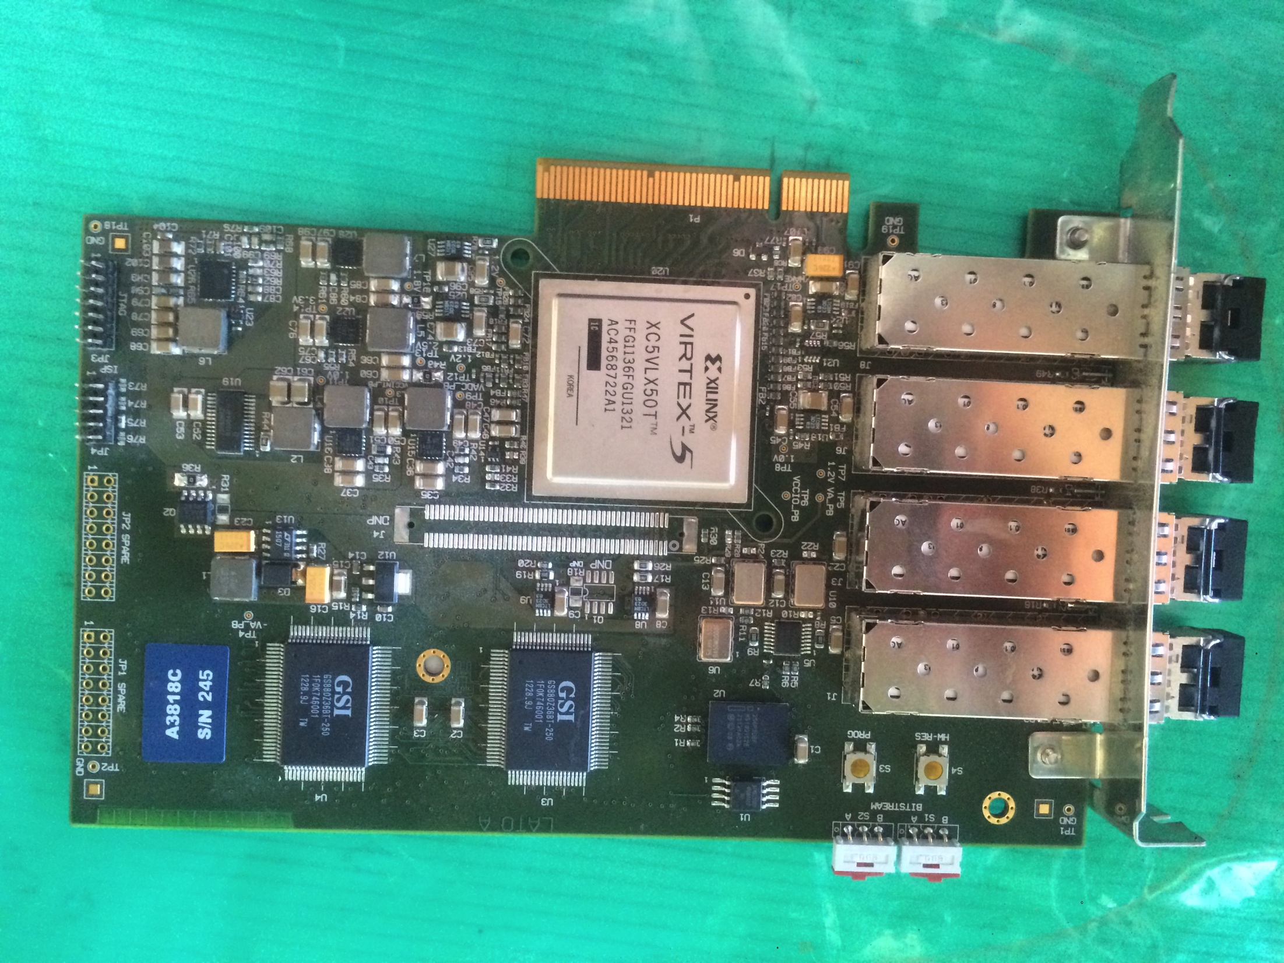
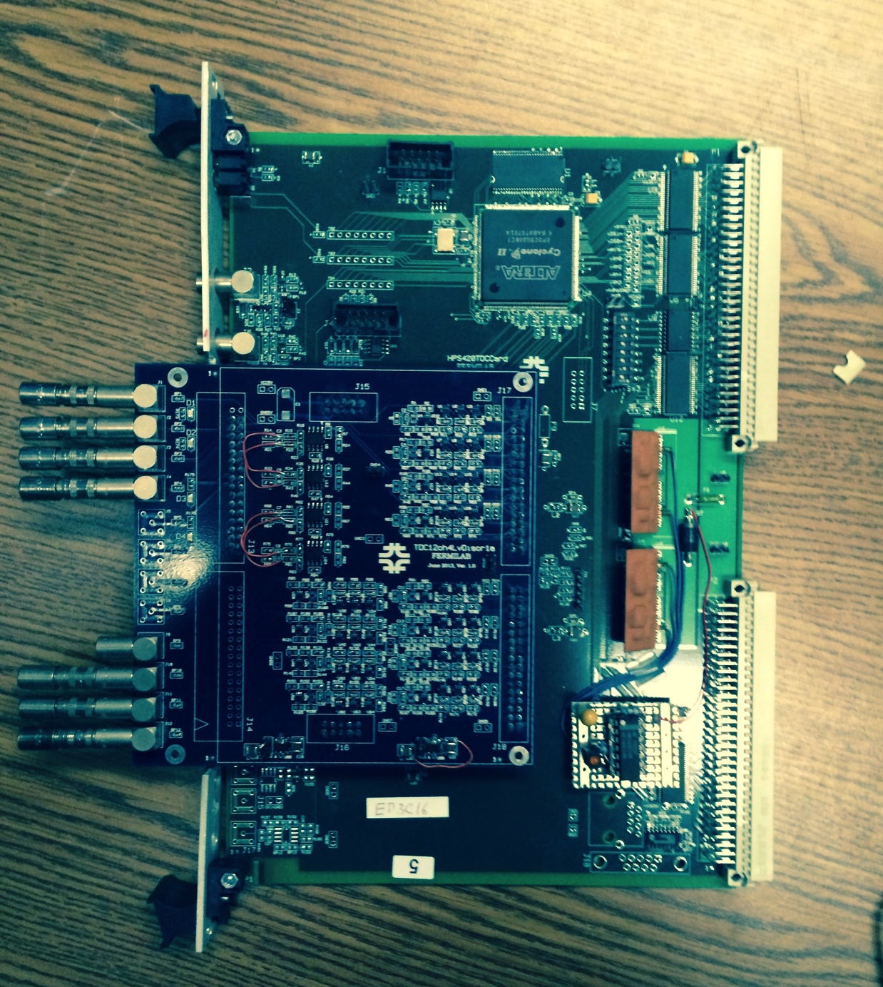
Beam line and Light Collection
Light collection (ToF, Aerogel, LCS) have much faster time scales
~ 10’s of nsec
2 ✕ CAEN V1751, eight channels each, 1 nsec sampling
Typical wave form width 28 μsec
Specially modified for 200 mV scale (single photo-electrons)
Read via CAEN CONET optical link to A3818 PCI bridge
For precision ToF hit timing use WUT Wave Union TDC, resolution ~ 15 psec
Read via VME via PCI bridge
Wire Chambers with max drift ~ μsec
Use established Hansen readout supported by FTBF staff
Have 1.17 nsec granularity, independent clock
Multi-hit TDCs, four chambers, (x,y) (128,128) 1024 channels
Spill stored entirely in on-board buffers, collated to central controller
Read at end of spill by main Lariat DAQ over ethernet
TPC contra mundum
Two very different time scales ➔ fast and slow triggers!
A3818
WUT

Slide 7
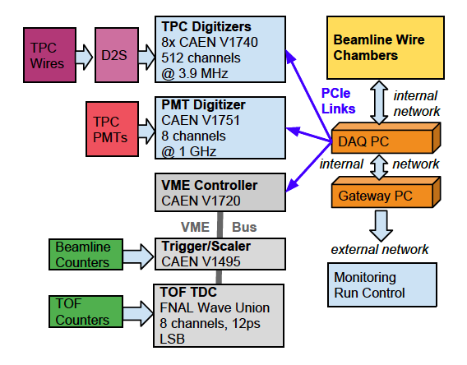
Data Flow Diagram
Details of LArIAT DAQ Readout Data Flow
Several external sources read and collated by single event builder “DAQ PC”

Slide 8
Online Computing
Demand for online computing modest but critical
One 8 core for configuration, readout, archiving
Install CAEN A3818 four channel optical bridge (large)
Locally cache at least one week of data (more in reality)
One 8 core for online data quality monitoring
Need one minute feedback for beam and detector conditions
Redundant power, redundant disk (thanks, SLAM group!)
Hot backups for each function
Two thin gateways for access
Strong firewall to access main DAQ, DQM per FNAL and DoE security requirements (unusual for test beam)

Slide 9
DAQ Software
“KISS” – Keep It Simple, Stupid!
No Quixotic GUI developments, nunca!
Configure system via human readable XML text files
One per subsystem, store entirety in data stream and LArIAT database every run in structured form
Easy to include, exclude components and tweak their setting
Expert access only, shifters do not access
To start a run, simply type “go” at the prompt
Yes, it’s really that easy!
Display run status in a single easy-to-use web page
No, it doesn’t really count as a GUI

Slide 10
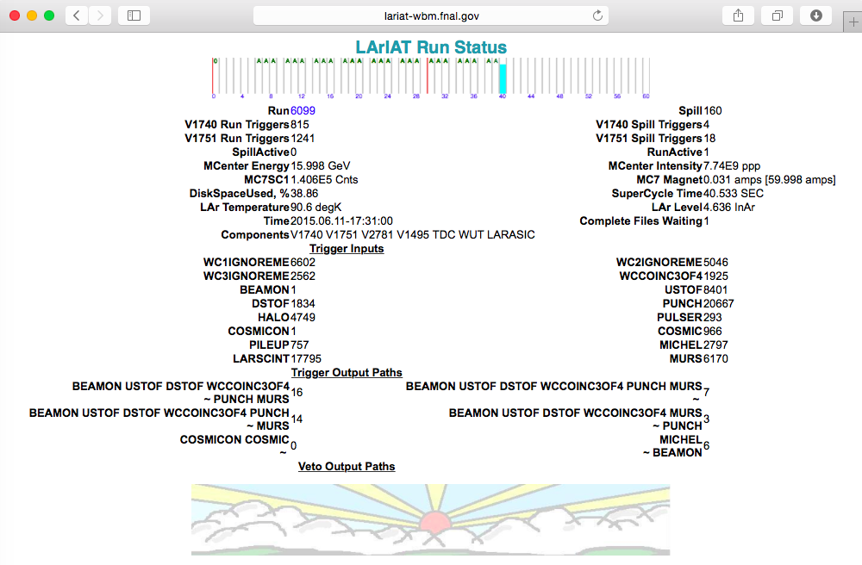
LArIAT Run Status
Simple, succinct table indicating all pertinent DAQ and Trigger quantities showing the run is proceeding apace

Slide 11
DAQ Software, Details
LArIAT Readout Kernel
Configuration and Readout factorized by C++ classes per subsystem, using OO inheritance to simplify coding
Each subsystem class outputs Lariat specific data fragments
Main LariatReadout class conducts configuration and readout
Monitors triggers via interrupts and polling
Watches for spill status in order to cleanup and end and restart
LArIAT kernel wrapped into ArtDaq Boardreader class
Lariat_generator extends LariatReadout
Wraps all Lariat specific fragments into one ArtDaq Fragment per spill
Converts raw binary to Root object readable by Art and LArSoft

Slide 12
LArIAT Data Fragments
Class names and contents, produced by LariatReadout, defined in shared online and offline package LariatFragments
V1740Fragment
TPC wires’ wave forms
Trigger hit timing digital wave form
Muon Range Stack
V1751Fragment
ToF, AeroGel, Light Collection (PMTs, SiPMS)
V1495Fragment
Trigger counters and configuration
TriggerFragment
Pipeline of all trigger input pattern, including time stamps
WUTFragment
High precision ToF hit times
TDCFragment
Beam wire chambers’ hit times
NB: At this level, each fragment is asynchronous to the others and time slicing takes place down stream (see later talk). At readout time, all fragments from one spill are concatenated into one ArtDaq Fragment. See backup slides for synchronization demonstration.

Slide 13
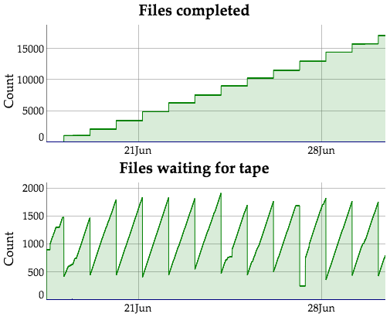
Data Archiving
Data available signal
HTTP Transfer
SAM file header
DAQ
Collection
DAQ
Disk
Transporter
File
Catalog*
SAMweb
DAQ Computer
FTP
Data File
dCache/
enStore
Request/Get File Names
Request/Get Files by Name
DAQ closes data file and signals archiver to pick up file
dCache/enStore/PNFS: Archiving/file serving process
SAM: Cataloging / description / metadata process
Uses standard Fermilab FTS file transport service
Data files easily retrievable via simple SAM queries
User

Slide 14
DAQ Hiccups in Run 1
Getting new and existing futures on the CAEN digitizers involved months of iterative debugging and fixes
Most issues solved prior to Run 1
Remaining issues, CAEN V1740 and V1751 digitizers
Occasional event counter mismatches, expect BUSY mechanism to help
Pedestal jumps on V1751s – “ameliorated” by register retries
Found unexpected V1740 post-trigger dead-time – fixed by CAEN
Rare readout hang-ups < 0.1%
Wire Chamber TDC readout
Occasional loss of configuration registers
Regular failure of basic data sanity checks, data nonsense
Text based interfaced to TDC controller not reliable – losing bytes

Slide 15
LArIAT Trigger
Several detectors means several possible trigger sources
With long TPC time scale, fast light time scale:
Fast Trigger: Readout light, wire chamber, ToF, AeroGel (on V1751s), plus Wire Chambers’ TDCs
Delayed Trigger: Readout TPC, one readout window later
Allows time to veto TPC readout in case of pile-up or halo, saves bandwidth
Also allows intra-drift trigger, e.g. Michel electrons, more info
Need flexible, programmable trigger
Implement trigger logic and scalers on user-programmable CAEN V1495 VME based FPGA card
Think CDF Fred or CMS GL1T, unusual for test beam
Configurable and readable over VME bus
Serves as final logic for several crates of NIM logic discriminating many detector signals

Slide 16
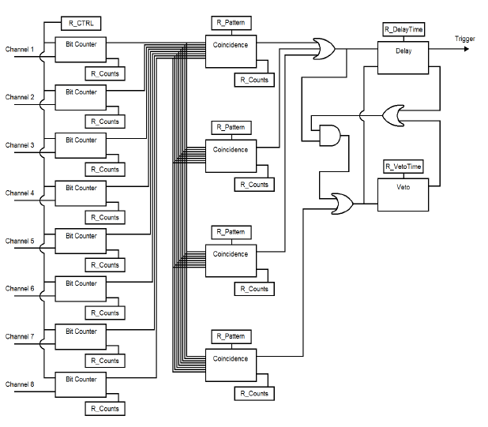
Simplified Trigger Logic
32 arbitrary external NIM inputs on the left
Input latch and counters at 100 MHz ✕ 2
16 coïncidence logic units trigger paths
OR of paths indicates fast trigger
Delay, plus NOT VETO indicates delayed trigger
Record triggers + times in FIFO for VME readout

Slide 17
V1495 Trigger Card
CAEN V1495 Card in situ, prior to cabling
Three 32 bit built-in logic I/O ports
One optional NIM input module
32 Trigger Input, twisted pair ECL (NIM to ECL)
Reset Input on $00
Fast and Delayed Trigger Output
Trigger Counter and Trigger Path Identifier
Send to V1740 for latching on trigger
(synchronization check)

Slide 18
16 Typical Trigger Inputs
Input | Source | Input | Source
WC1 | Wire chamber up stream | HALO | Beam halo counters
WC2 | Wire chamber 2 | PULSER | Hardware pulser, testing
WC3 | Wire chamber 3 | COSMICON | Cosmic post-beam gate
WCC * | Wire chamber majority logic | COSMIC | Cosmic paddles
BEAMON | Spill beam gate | LARRY | Cosmic trigger with light
USTOF | Upstream Time of Flight | MICHEL | Michel electron
DSTOF | Downstream Time of Flight | LARSCINT | LAr scintillation light
PUNCH | Punch-through counter | MURS | Muon Range Stack
* WC exceptionally has majority logic, 3 / 4
Above inputs can be specific in up to 16 trigger output paths, required ON or OFF
Delayed trigger VETO uses same input logics with opposite logic
All logic stored in LArIAT database available for offline use

Slide 19
Typical Trigger Output Paths
Run 6373, near end of LArIAT Run 1 when things were quite stable
With 866 spills, > 14 hour run
Path | Trigger Requirements ON | Required OFF
1 | BEAMON+USTOF+DSTOF+WCC
2 | BEAMON+USTOF+DSTOF+WCC+PUNCH+MURS
3 | BEAMON+USTOF+DSTOF+WCC+PUNCH | -MURS
4 | BEAMON+USTOF+DSTOF+WCC+MURS | -PUNCH
5 | COSMIC | -BEAMON
6 | LARRY | -BEAMON
The delayed trigger VETO function was not normally required
Run 2 we will use a BUSY function in the VETO logic

Slide 20
Trigger Running Experience
Generally excellent reliability and functionality
Firmware code often difficult to understand – most problems related to us not understanding the logic
Flaws with the PCI to VME bridge had already been worked out by CMS a while back
Implementing upgrades during shutdown
Adding 16 additional trigger input for a total of 32, since we were over-subscribed at 16
Adding adjustable software-controllable pulser logic
Capability to pre-scale one or more trigger paths – useful for background studies with high rate triggers à la colliders

Slide 21
Backup Slides

Slide 22
Hardware Spares
Detector | Digitizer | In System | Spares
TPC | CAEN V1740 | 8 | 0
μ Range Stack + | CAEN V1740 | 1 | 0
Light collection + ToF | CAEN V1751 | 2 | 0
High res ToF | WUT | 1 | 0+
Trigger | CAEN V1495 | 1 | 0
VME Master | CAEN V2718 | 1 | 0
PCI-VME Bridge | CAEN A3818 | 1 | 1
There may be money for spares in FY16
VME Crate | Spare | Spare
TPC and μRS+ | Wiener VME64x | One chassis, no power supply
ToF, Light, Trigger | CAEN VME64x | One spare CAEN with power supply

Slide 23
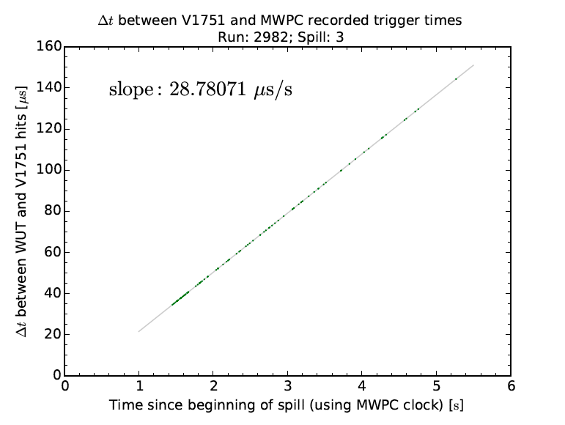
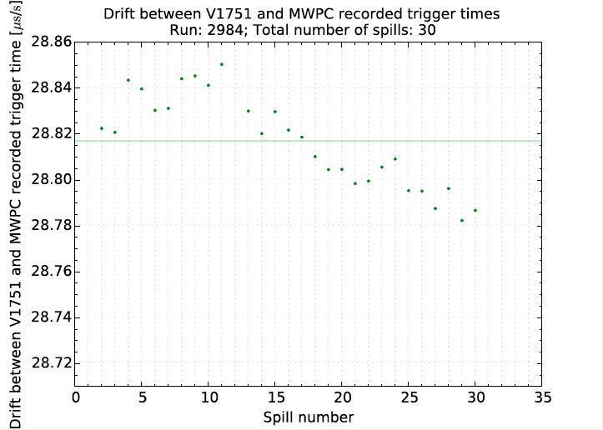
Cross-Detector Synchronization
Time matching between wire chambers and ToF PMTs
Note offset and slope corrections
Stability improved with time

