Slide 1
DUNE DAQ-CF interface
slides by Giles Barr
for Technical Board
Sept 30th 2015

Slide 2
Overview of Single-Phase DAQ
For CD1:
ADCs in cold, - pipe data out: 80 1Gbit/s serial links/APA (=12000 links/10kt), ~1TB/s/10kt
Zero suppress in FPGAs, do sensible trigger get all physics without moving most of the data.
Other ideas:
Don’t do zero suppression in cold, read all 4TB/s/40kt into computers and process there. – More flexibility, but needs ‘lots of computers’.
Difficulty is right now we want to pin down power/space requirements - not easy with such nascent designs.

Slide 3
Risks
Before this interface document signoff, appropriate risks that it may change must be established for both LBNF and DUNE.
The funding for DAQ has not been secured yet. It is likely that the ultimate provider of the DAQ in one or many of the caverns chooses to implement it differently from the assumptions here, and this has the risk of incurring additional costs in both projects.
Additionally, the current designs have large uncertainties on power consumption. Experts have refused to give me estimates, they say it is impossible to pin down. Some chip manufacturers deliberately do not specify a way to estimate power consumption of their devices, because it is hard with FPGAs to do this with any accuracy.

Slide 4
For the ‘lots of computers’ option, the calculation goes like this….
One computer pulls about 300W can sink about 80Gbits/s = 10 GB/s (they say, not tried by me).
We tested computers can just about read data from memory to CPU for processing at 1GB/s/core; on a multicore about 10GB/s
This is DAQ, we must never lose the data (1TB/s/10kt), which never stops coming, so we need at least a factor two, better a factor three in capacity for overhead. With a factor three, 40kt = 1200 machines.
The processor takes ~200W, memory ~100W, some DUNE DAQ designs, receive and sort data on FPGA cards with custom firmware. Hard to estimate power well but have added 3 x 100W. Then add 20% for PSU inefficiency and 20% kW->kVA and you get 940VA/machine.
At 3kW/rack, this is an enormous number of racks, could push it to 10kW/rack, but that is O(100 racks), so a sizeable computer center.
Reminder: This is for the ‘lots of computers’ option. The FPGA DAQ design satisfies our requirements fine.

Slide 5
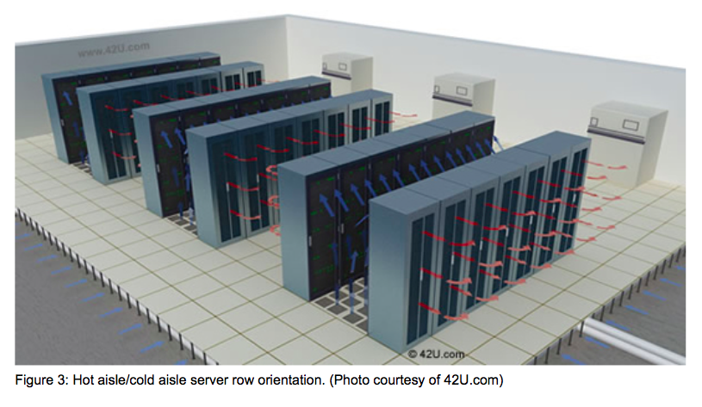
Cross check: Data-center design tool at amazon web services.
Ask tool to quote for 1200 machines, each with 16 cores and 1000TB of storage (good for 25secs of raw data). Ask for max network speed tool allows, which is 10GB/s
It estimates 88 racks and 671kW. So our estimate is OK.
Side remark: AmazonWS points at good articles on data center layout at www.energystar.gov, e.g. picture on right showing hot-cold-hot aisle layout. Worth a read (me too).
This will probably give correct method of going from #racks to floor area.

Slide 6
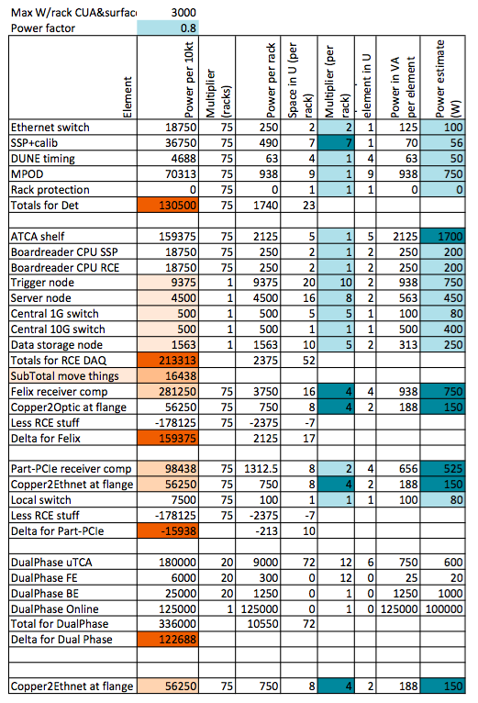
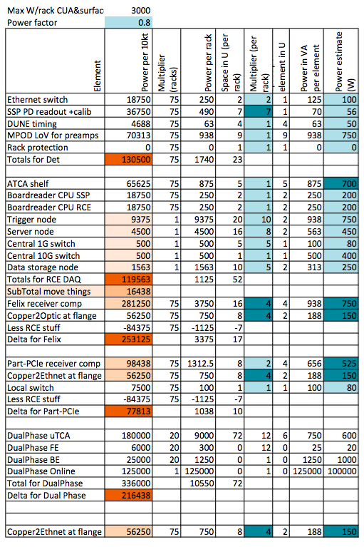
Component Power estimates
I have attempted to estimate power for each type of item in racks, including non-DAQ ones from Terri.
Dark blue = less certainty.
Crucial ones:
ATCA shelf– New values today from Matt, based on measurements at 35t and scaled up.
Felix receiver computers – see two slides back
Trigger nodes – similar calculation

Slide 7
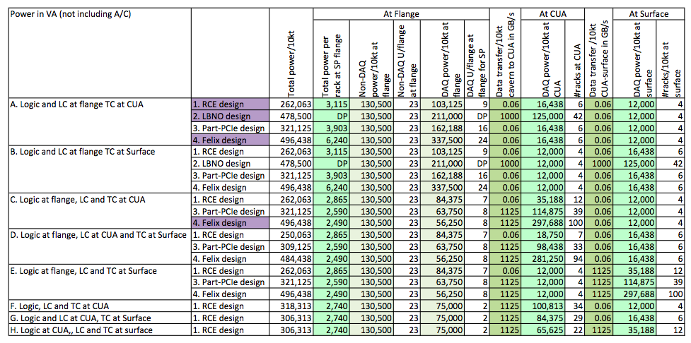
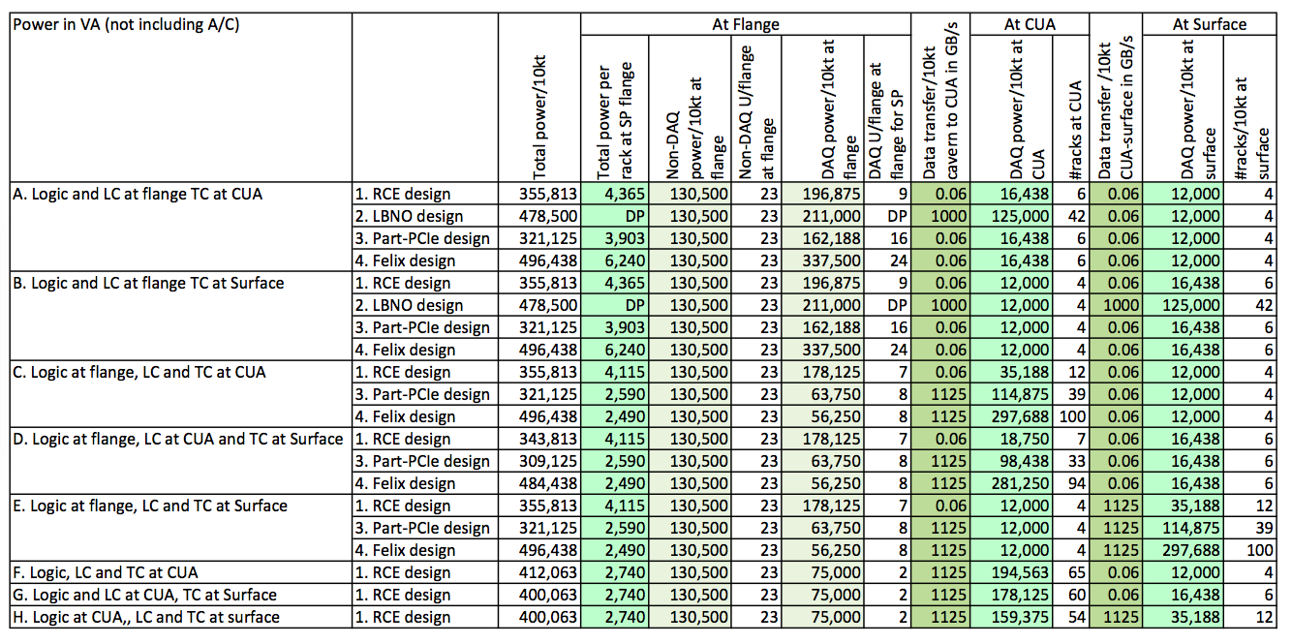
System power estimates
Considered 4 design philosophies: (‘RCE’ = reference design from CDR but with optical coupling removed, ‘LBNO’=alternate deign, a.k.a. scaled up WA105, Felix = CERN suggestion to read all data into computers, part-PCIe =some mix of the other philosophies).
Considered combinations of ‘on cryostat (flange), in central utility or surface.

Slide 8
General conclusions
The total power estimates are in the broad range from 320kVA to 490kVA per 10kt module.
The ones that put more processing in computers rather than FPGAs generally offer more flexibility but use more power. All of them will satisfy the physics requirements.
The network capacity to the surface is either (a) rather modest, if trigger selection is underground or (b) rather demanding (approx. 1000 fast links) for the options where we do all at surface.
The power needed at each flange port is either, 2.9kVA (no processing) or 3.1kVA (RCE), 4.5kVA (LBNO-style) or 6.3kVA (Felix style computer processing at flange).
These numbers are still very approximate and the appropriate level of contingency has not been considered yet (none included). This is one of several warnings needed – these are all back-of-envelope numbers.
The main choices can be captured in three questions to the technical board.

Slide 9
Technical board question #1 Network capacity in shafts
There are only two possible ways this requirement can go, either we trigger underground or we trigger on surface.
If we trigger underground, the data rate is about 60MB/s/10kt, and the proposed provision of 96 strands (16 per 10kt and 32 for CF) with backup in the other shaft is OK. Could we have slightly more, e.g. 72 fibers (18 fibers per 10kt) and 24 fibers for CF? [Added after discussion with colleagues: Or another 96 bundle?]
The 18 fibers would then be four fibers for GPS (1PPS up/down, 10MHz up/down), or (transmit L1/L2 r.f. down for two receivers), seven-pairs for 10Gb Ethernet (3 pairs data, 1 pair low-latency trigger, 1 pair slow control and 2 pairs spare).
If we trigger on surface, the data rate vastly exceeds the capacity of 96 strands using todays sure off-the-shelf solutions (we need about 1000 strands per 10kt at 10Gbit/s), but there may be big improvements on the 5-year horizon. It would be too risky to propose that in a CD3A review now. Scope for a group to investigate – so allow room in the interface document if possible for this change.
Propose interface agreement something like:
The CF shall provide 72 single-mode fibers for the DAQ between underground central area and the surface, capable of running 10Gbit/s Ethernet and GPS signals (i.e. similar to Ethernet ones but no Ethernet-specific repeaters) and will have 24 more strands for their own use. There shall be at least a duplicate set of 96 fibers in the other shaft for backup. The exact fiber type (wavelength, single mode etc.) selection shall be made shortly before procurement by a joint LBNF-DUNE discussion to allow selection of the most future-proof option apparent at that time, and could incorporate findings of DUNE collaborators for running much faster Ethernet to get the un-triggered data out, if progress has been made in the intervening time.

Slide 10
Technical board question #2 Top of cryostat power/cooling
Summary is per flange/port (=2 APAs). 2.8kW min, 3.2kW with RCEs on flange, 4.5kVA for LBNO style, 6.0kW with Felix type computer on flange.
In all cases, power exceeds capacity of a rack with local cooler, so strongly recommend we look for another solution. CF group also think a centralized system where the heat can be deposited directly in the airflow up to the surface is better. Can be distributed with air ducting or water. Lots of experience at CERN with building water cooling sturdily into racks. The racks can still be enclosed if that reduces humidity/dust.
Suggestion is to specify 4.5kW power provision here. That may be modified with question #3. If we still need the individual cooler this becomes 9kW/rack
Propose interface agreement:
Ask CF group to provide wording to describe the central cooling and the interface to it. It would be nice if we can be vague about water/air choice at CD3A so we can get future unrushed work on designing it. It would be even better if we can add to schedule a joint LBNF/DUNE VE exercise on this aspect of the design..
There shall be one 42U 19-inch NEMA-12 rack, with power capacity for 4.5kW at each of 75 port locations in the first detector hall. There will be doors both at the front and back of the rack and access will be needed to both, including min 3.5ft in front of the rack for equipment loading. The subsequent detector halls may have different TPC readout structures, so different arrangements of power, but the total will be the same.

Slide 11
Technical board question #3 Where to locate all the computers?
Both the Felix design and the LBNO design currently foresee reading all the data into computers. This is about 1TB/s/10kt. It uses about 125kVA/10kt in the LBNO design (some processing takes place in FPGAs) and 300kW/10kt in the Felix design.
Technical board to choose which options to be considered further by LBNF and DAQ-group (numbers are for 40kt, all identical): []=scheme from slide 7 ‘System power estimates’
In underground area LBNO style (4.5kVA at each port + 500kVA 160 rack = 4500ft² underground + 50kVA 16 rack = 450ft² facility on surface) [A2]
In underground area Felix style (4.5kVA at each port + 1200kVA 400 rack = 11200ft² underground + 50kVA 16 rack = 450ft² facility on surface) [C4]
On surface (see question #1, best not to say now at review we rely on getting data to surface – but can we avoid precluding it now? (e.g. [B2] or even [E4])
Distributed on top of cryostat [A4] vs [A1]/[A2] changes power per port from 6.2kVA to 4.5 kVA, is this much?
Don’t allow it, or technical board can place a constraint on power budget – will not preclude much physics, but it is a political question. [A4]/[C4] vs [A1]
If we can avoid giving division of power between central area and cryostat, choice now for TB boils down to
Do we build a 400 rack or a 160 rack or a 32 rack facility underground (compare [C4] vs [A2] vs [A1])?
Or do we leave enough capacity for Felix by including the extra 1200kVA/40kt to distribute over the cryostats, but don’t dig the extra space centrally? [A4] vs [C4]
Propose interface agreement: Pick from [A1], [A2], [A4], [C4] depending on technical board decision.
We should include a risk that a collaborator that can provide funding for hardware needs a changed requirement from LBNF – this is to cover that this aspect of these DAQ designs are still very preliminary.

Slide 12
From management
(1) We think that we should allow for 450 kW of total power for each 10-kton far detector module.
(2) We think we should limit the number of racks in the central utility cavern to no more than 50 with a total power budget of 450 KW
(3) No specific limits for the surface at this time
Giles’s Google Docs link: (Also in Email)
https://docs.google.com/spreadsheets/d/12PjSeKaawC0JCCJbJjtMw5yifUvONiDeK66eWYUdTTI/edit?usp=sharing
The next slide is a copy of the page on this google-docs that we discussed in the meeting.

Slide 13
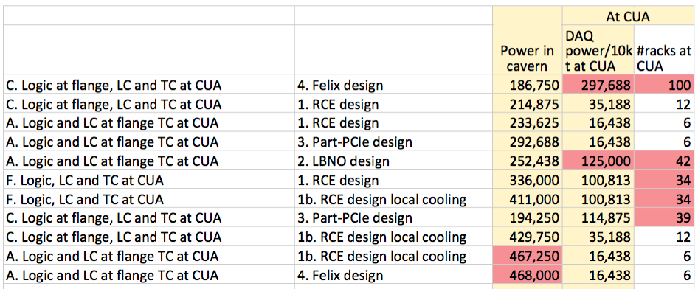

Slide 14
Backup slides

Slide 15
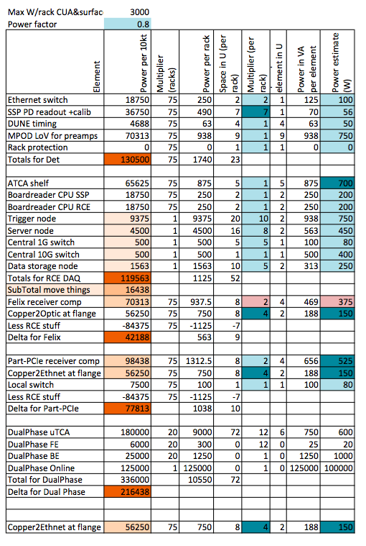
Component Power estimates aggressive targets
I have attempted to estimate power for each type of item in racks, including non-DAQ ones from Terri.
Dark blue = less certainty.
Crucial ones:
ATCA shelf– New values today from Matt, based on measurements at 35t and scaled up.
Felix receiver computers – A much more aggressive estimate, but may be possible.
Trigger nodes – same calculation as before

Slide 16
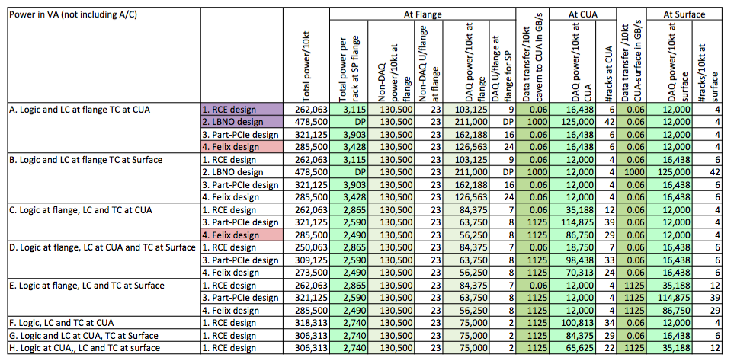
System power estimates - aggressive targets
Considered 4 design philosophies: (‘RCE’ = reference design from CDR but with optical coupling removed, ‘LBNO’=alternate deign, a.k.a. scaled up WA105, Felix = CERN suggestion to read all data into computers, part-PCIe =some mix of the other philosophies).
Considered combinations of ‘on cryostat (flange), in central utility or surface.

Slide 17
Backup
The following slides are some screen grabs of the quote from amazonws.com
Remember, this site is intended to show that their AWS solution is attractive, so they add some quite high costs to the alternative ‘in-house’ solution. Nevertheless, it is a useful confirmation we are not too far off the mark.
The notes that go along with the quotes document what they have assumed very well, and the notes and links are instructive.

Slide 18
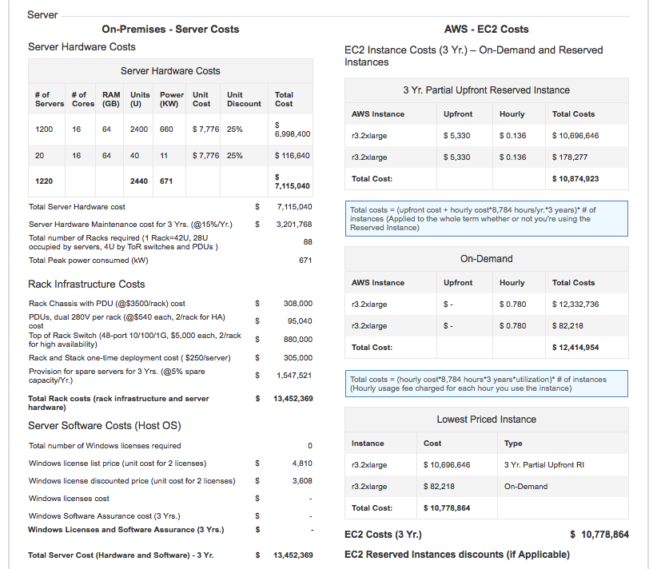

Slide 19
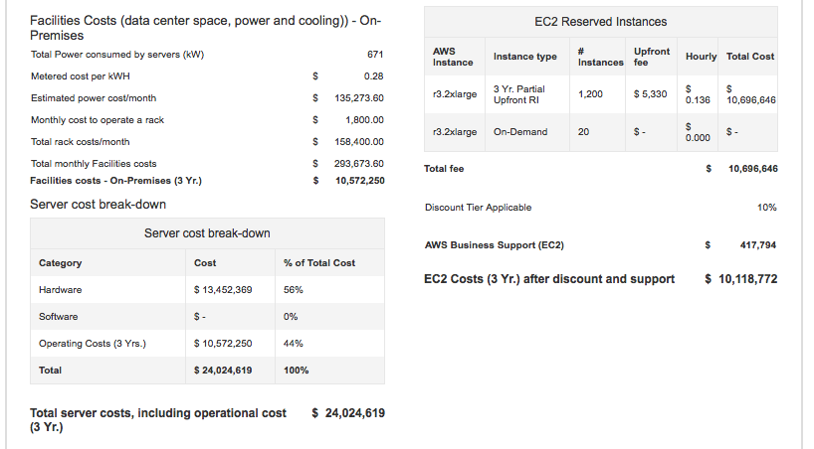

Slide 20
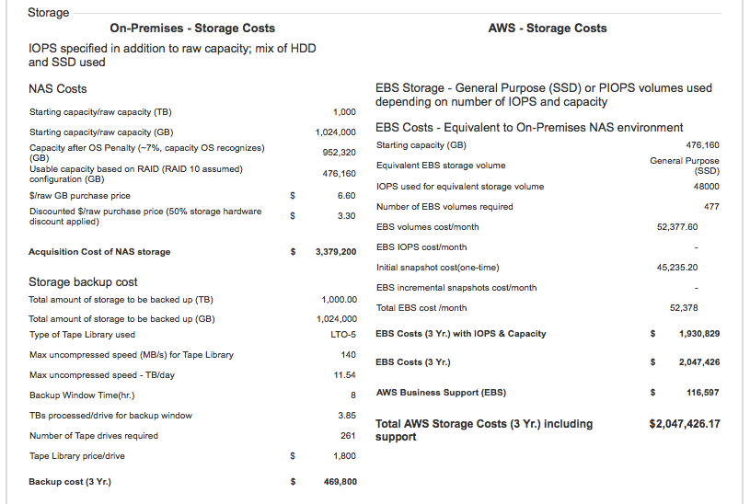

Slide 21
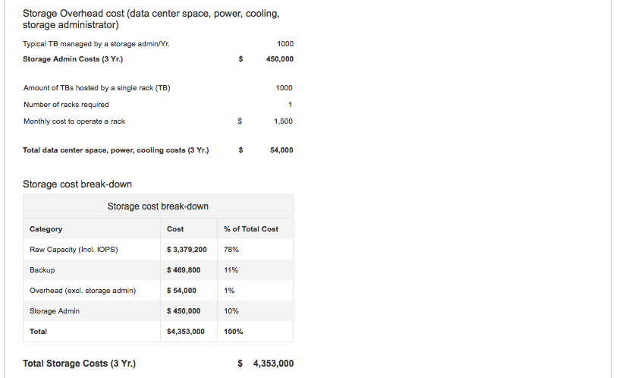

Slide 22
