Slide 1
PIP-II Requirements
Paul Derwent
Workshop on Booster Performance and Enhancements
23-24 November 2015

Slide 2
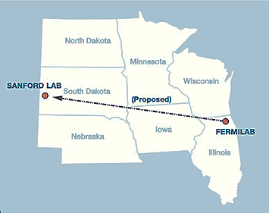
Fermilab Program Goals
Fermilab’s goal is to construct & operate the foremost facility in the world for particle physics research utilizing intense beams.
Neutrinos
  MINOS+, NOvA @700 kW
  LBNF @ multi-MW
  SBN @ 10’s kW
Muons
  Muon g-2 @ 17-25 kW
  Mu2e @ 8-100 kW
Longer term opportunities
This requires more protons!
(and this statement tends to be time invariant)
P5 Report has several specific recommendations on the Fermilab Program
Notes:
I think the theme is summarized by the statements in RED. Just documenting our current model of how to get there, and point out R&D being done by PIP-II and other places where we would benefit from it (GARD supported)
PIP-II approach supports the first 100 kt MW years of the P5 target of 600.

Slide 3
Recommendations from May 2014 P5 Report
Recommendation 12: In collaboration with international partners, develop a coherent short- and long-baseline neutrino program hosted at Fermilab.
Recommendation 13: Form a new international collaboration to design and execute a highly capable Long-Baseline Neutrino Facility (LBNF) hosted by the U.S. To proceed, a project plan and identified resources must exist to meet the minimum requirements in the text. LBNF is the highest-priority large project in its timeframe.
Recommendation14: Upgrade the Fermilab proton accelerator complex to produce higher intensity beams. R&D for the Proton Improvement Plan II (PIP- II) should proceed immediately, followed by construction, to provide proton beams of >1 MW by the time of first operation of the new long-baseline neutrino facility.

Slide 4
STATISTICS in Neutrino Experiments
Neutrino Events/Unit Time =
Neutrino Flux x
Neutrino Cross-section/Nucleon x
Number of Nucleons
BEAM = Protons/year +
Target/horns, Beam Energy
PHYSICS!
Detector = Mass +
Efficiency
Neutrino Experiments Need : Mass * Power * Time
We want to achieve our physics goals in a timely manner!
Notes:
You might point out that the neutrino flux is pretty much proportional to protons/time x proton energy = beam power
Gina’s slide on Mission Need

Slide 5
Time : Neutrino experiments take time
Consider several options for how one could reach the P5 goals
We see that the existing 700kW capability, even when paired with the full detector mass leads to an unrealistic time line for achieving the physics goals
Given the size and complexity – it is difficult to imagine more mass (at least at this time) 40kT with 1.2 MW is a 20 year program
Notes:
It would make more sense if the left column of this table was 120 kT-MW-years since that is the P5 recommendation.
This table is basically the statement of need for LBNF based on the P5 report. This needs to feed directly into PIP-II design criteria.

Slide 6
What are the requirements?
Design Criteria
  Deliver 1.2 MW of beam power at 120 GeV, approaching 1 MW down to 60 GeV, at the start of LBNF operations
  Support the current 8 GeV program, including Mu2e, g-2, and the suite of short-baseline neutrino experiments
  Provide an upgrade path for Mu2e
  Provide a platform for extension of beam power to LBNF to >2 MW
  Provide a platform for extension of capability to high duty factor/higher beam power operations
Build it over 2015 – 2025
Notes:
Injection energy increase: keep space charge effects at ~same as currently

Slide 7
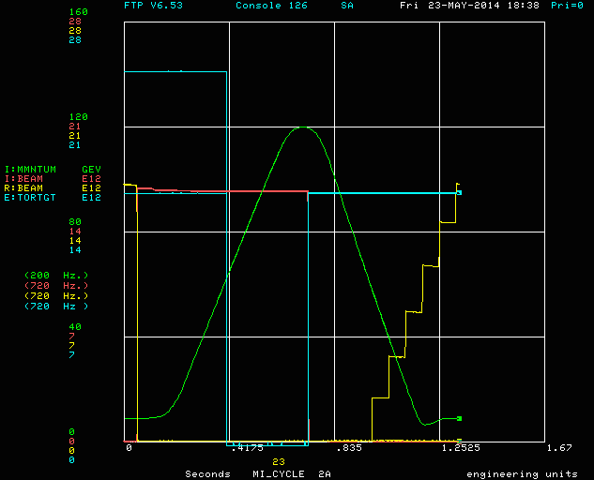
Power and Beam Characteristics
P = 1.6 ^{EN}/_{t} kW
E in GeV
N in 1e13
t in seconds
Getting to 1.2 MW
  7.5e13 @ 120 GeV every 1.2 seconds
  MI Ramp: 240 GeV/second + parabolas + reset
  Booster operating at 20 Hz: cycles multiples of 50 msec
  Slip Stacking: 12 cycles = 0.6 sec
Energy (GeV) | Intensity(e13) | Cycle Time (sec) | Power (kW)
120 | 7.5 | 1.2 | 1200
110 | 7.5 | 1.1 | 1200
100 | 7.5 | 1.05 | 1143
90 | 7.5 | 0.95 | 1137
80 | 7.5 | 0.9 | 1067
70 | 7.5 | 0.8 | 1050
60 | 7.5 | 0.7 | 1029
50 | 7.5 | 0.65 | 923
40 | 7.5 | 0.6 | 800
30 | 7.5 | 0.6 | 600

Slide 8
Proton Improvement Plan-II (PIP-II)
“The central element is a new 800 MeV superconducting linac operated at low duty factor but constructed to be capable of continuous operation” P5 report, p. 47
PIP-II plans to build an 800 MeV superconducting pulsed linac, extendible to support multi-MW operations to LBNF and constructed of continuous wave (CW) capable components
  Builds on significant existing infrastructure
  Capitalizes on major investment in superconducting rf technologies
  Eliminates significant operational risks inherent in existing linac
  Siting consistent with eventual replacement of the Booster as the source of protons for injection into Main Injector
Reference Design Report available at:
pip2-docdb.fnal.gov/cgi-bin/ShowDocument?docid=1
At completion of PIP-II the existing 400 MeV linac will be removed from service
Notes:
SRF linac is looking to future viable platform for more intensity

Slide 9
PIP-II Status and Strategy
Reference Design Report describes:
  An 800-MeV superconducting linac, constructed of CW-capable components, operated initially in pulsed mode
  Modifications to Booster/Recycler/Main Injector to accommodate higher intensities
    New Booster injection region to accept 800-MeV beam
    Upgrades to Booster damper and collimator systems
    Recycler RF upgrade for slip-stacking at 0.7 sec cycle time
    MI RF power upgrade
    MI γ_{t}-jump system
  Increase of Booster repetition rate to 20 Hz
    Maintain 1 MW down to 60 GeV or,
    Provide factor of 2.5 increase in power to 8 GeV program
Notes:
Initially in pulsed mode to save on cryogenic plant costs. India collaboration plan appears to enable full cryo capacity to support CW operation at Day 1.

Slide 10
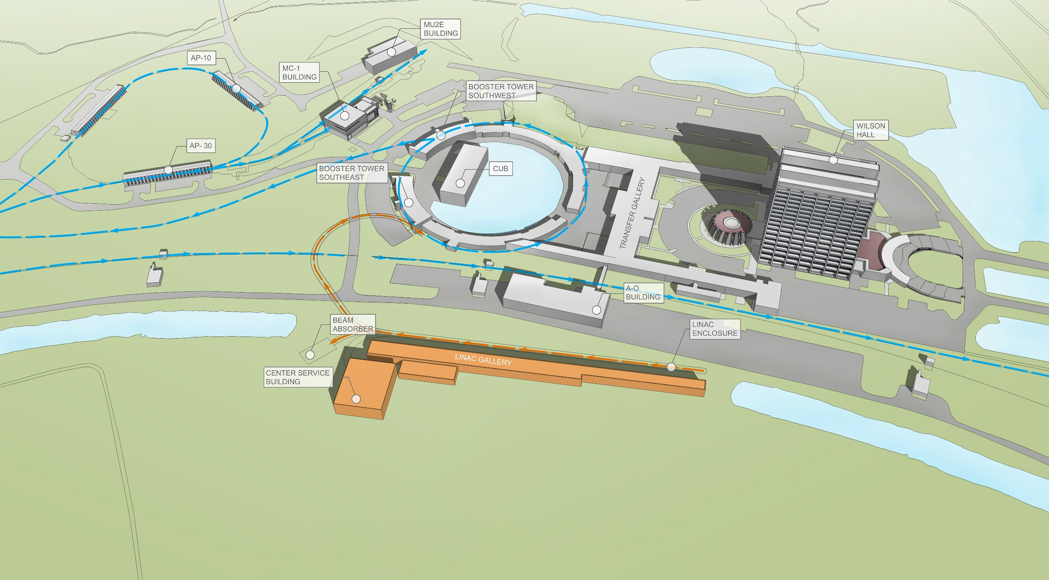
PIP-II Status and Strategy/Site Layout

Slide 11
Performance Goals
Performance Parameter | PIP | PIP-II
Linac Beam Energy | 400 | 800 | MeV
Linac Beam Current | 25 | 2 | mA
Linac Beam Pulse Length | 0.03 | 0.5 | msec
Linac Pulse Repetition Rate | 15 | 20 | Hz
Linac Beam Power to Booster | 4 | 18 | kW
Linac Beam Power Capability (@>10% Duty Factor) | 4 | ~200 | kW
Mu2e upgrade potential | NA | >100 | kW
Booster Protons per Pulse | 4.2×10¹² | 6.5×10¹²
Booster Pulse Repetition Rate | 15 | 20 | Hz
Booster Beam Power @ 8 GeV | 80 | 160 | kW
Beam Power to 8 GeV Program (max) | 32 | 80 | kW
Main Injector Protons per Pulse | 4.9×10¹³ | 7.6×10¹³
Main Injector Cycle Time @ 60-120 GeV | 1.33* | 0.7-1.2 | sec
LBNF Beam Power @ 60-120 GeV | 0.7* | 1.0-1.2 | MW
LBNF Upgrade Potential @ 60-120 GeV | NA | >2 | MW
*NOvA operations at 120 GeV
Notes:
Linac in PIP-II needs to be 20 Hz if Booster is 20 Hz, probably changes power around somewhat too…
Mu2e Power is 8 GeV beam in PIP, 800 MeV in PIP-II
Remember that going to 50% more intensity, 33% more cycles -> doubling of the flux. But keep the total power loss the same! An unwritten requirement.

Slide 12
PIP-II Strategy
PIP-II will be executed as a DOE 413.3b project
  CD-0 November 12 2015
Strategy
  Develop/evolve concepts aligned with community needs
  Undertake R&D targeting major technical/cost risk elements
  RDR defines concept for meeting community requirements, and provides context for R&D
  Coordinate with other Fermilab projects and programs
Construction complete in 2025
  LBNF tie in to MI tunnel in 2023?
  Booster construction tie in at same time
  Commission operations with beam before turning off current Linac and finishing the Booster tie in
Status
  PIP-II endorsed by P5 as a key element in the U.S. neutrino program
  R&D program underway:
    PXIE and SRF R&D geared toward a 2020 construction (CD-3) start
  P2MAC review of RDR and R&D program (March)
  Strong collaboration with Indian and U.S. laboratories
    Possible collaboration with Europe
  Project Office established

Slide 13
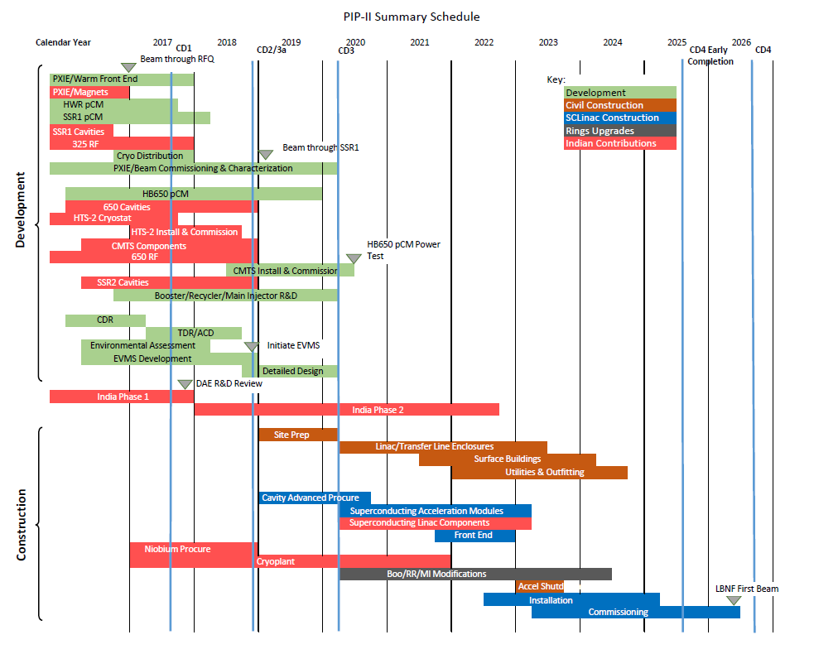
Project Strategy/Preliminary Schedule

Slide 14
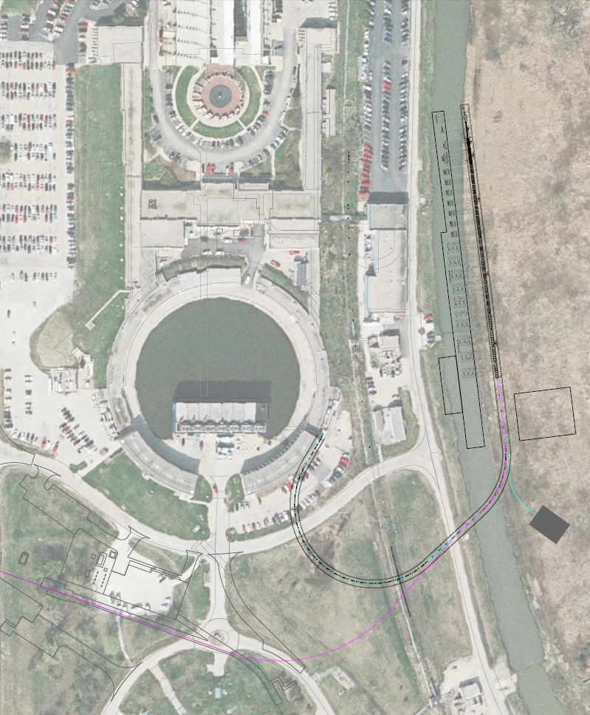
Why on the other side of the Booster?
SC Linac
Transfer Line to Booster
Beam Dump (Changed)
Beam line to SY
M4 Line
Transfer Line to Mu2e
Beam line to Mu2e

Slide 15
Future Directions
The configuration and siting of the PIP-II linac are chosen to provide opportunities for future performance enhancements to the Fermilab proton complex
  multi-MW to LBNF
    PIP-III : Possible Booster Replacement?
      8 GeV Linac
      New RCS
  PIP-II may very well be a CW facility from day 1
    100’s kW for a rare processes program
      Muons
      Kaons (at 3 GeV?)
      Neutrons
  Front end for a muon-based facility
E. Prebys later this morning
Notes:
multi MW for the 500 kt MW years part of the P5, looking at expanding accelerator capabilities rather than more mass and more years
Day 1 CW: building with CW capable components (cavities, cryomodules, RF sources) AND working toward cryoplant to support (with Indian assistance)

Slide 16
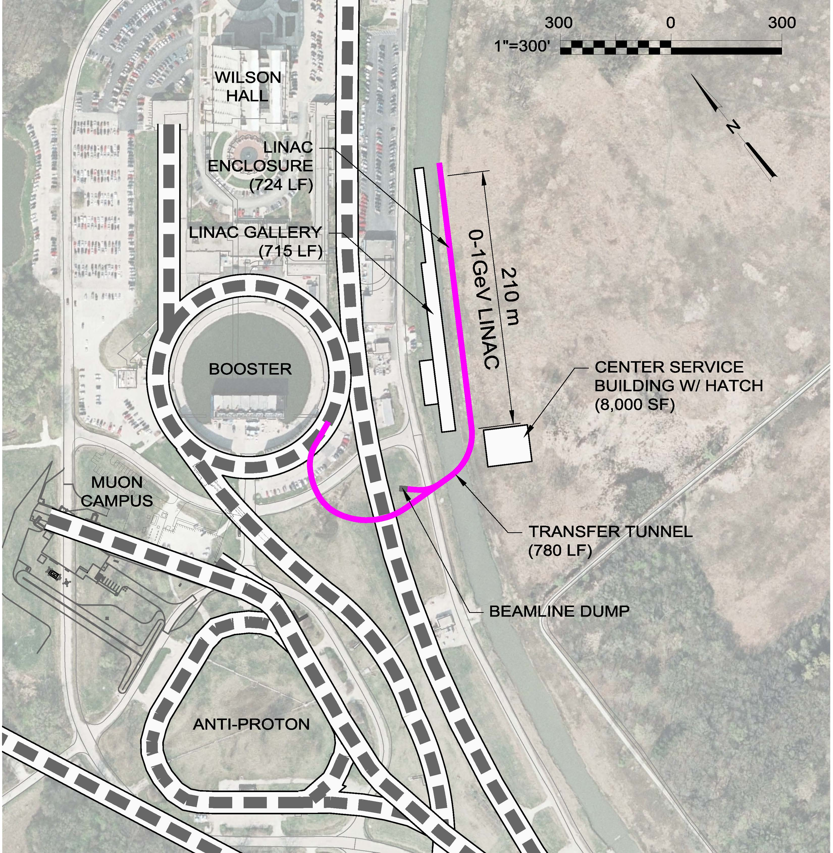
Why the other side of the Booster?
To MI

Slide 17
Why the other side of the Booster?
Future 8 GeV thingy
To MI

Slide 18
Summary
PIP and PIP-II have been developed as steps in establishing a world-leading facility for particle physics research based on intense beams, at Fermilab
  LBNF >1 MW at startup
  8 GeV program >40 kW coincident with LBNF
  Requirements for the Booster:
    6.5e12 per pulse
    20 Hz
    Longitudinal and Transverse Emittance for Slip Stacking
PIP-II retains flexibility to eventually realize the full potential of the Fermilab complex
  multi-MW to LBNF
  multi-MW to SBN program
  CW capability at 800 MeV
Notes:
SRF capitalized, multi-MW, beam loss / space charge

Slide 19
Performance Goals
Performance Parameter | PIP | PIP-II
Linac Beam Energy | 400 | 800 | MeV
Linac Beam Current | 25 | 2 | mA
Linac Beam Pulse Length | 0.03 | 0.5 | msec
Linac Pulse Repetition Rate | 15 | 20 | Hz
Linac Beam Power to Booster | 4 | 18 | kW
Linac Beam Power Capability (@>10% Duty Factor) | 4 | ~200 | kW
Mu2e upgrade potential | NA | >100 | kW
Booster Protons per Pulse | 4.2×10¹² | 6.5×10¹²
Booster Pulse Repetition Rate | 15 | 20 | Hz
Booster Beam Power @ 8 GeV | 80 | 160 | kW
Beam Power to 8 GeV Program (max) | 32 | 80 | kW
Main Injector Protons per Pulse | 4.9×10¹³ | 7.6×10¹³
Main Injector Cycle Time @ 60-120 GeV | 1.33* | 0.7-1.2 | sec
LBNF Beam Power @ 60-120 GeV | 0.7* | 1.0-1.2 | MW
LBNF Upgrade Potential @ 60-120 GeV | NA | >2 | MW
*NOvA operations at 120 GeV
Notes:
Linac in PIP-II needs to be 20 Hz if Booster is 20 Hz, probably changes power around somewhat too…
Mu2e Power is 8 GeV beam in PIP, 800 MeV in PIP-II

