Slide 1
Space Charge Losses in Booster at Injection
Alexander Valishev, Valeri Lebedev
November 24, 2015

Slide 2
Credits and Acknowledgments
Y.Alexahin, J.Amundson, C.Ankenbrandt, W.Chou, A.Drozhdin, X.Huang, N.Kazarinov, J.Lackey, J.MacLachlan, E.Malamud, E.McCrory, L.Michelotti, F.Mills, D.Moehs, K.Y.Ng, S.Ohnuma, F.Ostiguy, M.Popovic, E.Prebys, P.Spentzouris, R.Tomlin, Xi.Yang, R.Zwaska
M.Fitterer, F.Schmidt, D.Shatilov

Slide 3
Selected References
http://www-bd.fnal.gov/pdriver/booster/
http://frs.home.cern.ch/frs/Source/space_charge/
F.J.Sacherer, Ph.D Thesis, University of. California, Berkeley, UCRL-18454 (1968)
A.Fedotov, I.Hofmann, “Half-integer resonance crossing in high-intensity rings”, PRSTAB 5, 024202 (2002)
E.Prebys et al., “Increasing the intensity of the Fermilab Booster”, PAC’03
W.Chou et al., “Fermilab Booster Modeling and Space Charge Study”, PAC’03, DOE Review
S.Cousineau et al., “Resonant beam behavior studies in the Proton Storage Ring”, PRSTAB 6, 074202 (2003)
J.Amundson P.Spentzouris, “Space Charge Experiments And Simulation In The Fermilab Booster”, PAC’05
Y.Alexahin et al., “Effects of Space Charge and Magnet Nonlinearities on Beam Dynamics in the Fermilab Booster”, PAC’07
S.Bernal et al., “RMS envelope matching of electron beams from ‘‘zero’’ current to extreme space charge in a fixed lattice of short magnets”, PRSTAB 9, 064202 (2006)
X.Huang et al., “Emittance measurement and modeling for the Fermilab Booster”, PRSTAB 9, 014202 (2006)
M.Fitterer et al., “Systematic studies on the effect of linear lattice optics for space-charge limited beams”, PRSTAB (2015)

Slide 4
Motivation and Outline
Another look at incoherent Space Charge effect in Booster at injection aiming to
Understand the current limitations.
Make projections for PIP-II and post-PIP-II era.
Synergistic with IOTA program
This presentation is about work in progress.
Outline:
The problem, approach and previous work
Modeling tools
Some results
Questions, proposals and next steps

Slide 6
Our Study Goals (Back to the Future Part II)
With the help of realistic and useful Booster model (talk by C.Y.Tan)
It appears many previous studies might have been using incorrect models
Understand the role of Booster lattice on space charge induced loss and emittance blowup
Quantify the requirements on optics control
Iterate with models
Propose and evaluate possible improvements

Slide 7
Approach
If one forgets about coherent instabilities (A.Macridin’s talk), the action of direct SC on stability of particle motion is through the time modulation of nonlinear transverse field and consequently, betatron and synchrobetatron resonances.
Emittance growth and particle losses.
Modeling can be done with following simplifying approximations (frozen SC):
No self-consistency: Gaussian beam profile.
Many thin kicks per turn instead of smooth action.
This approach offers quick turnaround time with decent physics
Can and should be followed by true self consistent modeling

Slide 8
Previous Work
2003 – W.Chou et al., “Fermilab Booster Modeling and Space Charge Study”
Effect of doglegs on acceptance
Modeling chromaticity
2006 – X.Huang et al., “Emittance measurement and modeling for the Fermilab Booster”
Half-integer resonance not important
Vertical emittance growth through coupling
2007 – Y.Alexahin et al., “Effects of Space Charge and Magnet Nonlinearities on Beam Dynamics in the Fermilab Booster”
Half-integer resonance contribution evaluated
Proposed sc compensation

Slide 9
Previous Work
Simulations
ESME
ORBIT-FNAL
STRUCT
MAD/Mathematica
madx-PTC
Synergia (the sole survivor)

Slide 10
Modeling Tools
We were using Lifetrac:
20 years of development as beam-beam tracking code (many e+e- colliders, Tevatron, LHC, HL-LHC).
Single-particle tracking, well-parallelized tracking of multiparticle distributions, Frequency Map Analysis, Dynamical Aperture.
Workflow:
Start with madx lattice file.
Install thin beam-beam elements (120, 17 per betatron period).
Produce FMA (quick) and multiparticle distribution evolution (slower).
Limitations:
Non-adaptive SC (so far, for simplicity).
Synchrotron modulation not taken into account.
over-estimate
SC

Slide 11
Booster Parameters in Simulation
Energy | 400 MeV (β=0.713, γ=1.426)
U_{RF} | 0.7 MV
Q_{s} | 0.078 (ω_{s}=35 kHz)
Bucket size | 4.2×10⁻³
Energy spread | 2.1×10⁻³ (σ_{z}=1.26 m) – fully bunched beam
Transverse emittance | 15 mm×mrad (95% normalized)
Aperture | Ax=2.86 cm, Ay=2.08 cm
N_{p} | 0.42×10¹³ in 84 bunches
SC tuneshift | ΔQ_{x}=-0.197, ΔQ_{y}=-0.307
Betatron tunes | Q_{x}=6.70, Q_{y}=6.80
Chromaticity | C_{x}=-20, C_{y}=-14

Slide 12
Booster Parameters for “PIP-II mode”
Energy | 400 MeV (β=0.713, γ=1.426)
U_{RF} | 0.7 MV
Q_{s} | 0.078 (ω_{s}=35 kHz)
Bucket size | 4.2×10⁻³
Energy spread | 2.1×10⁻³ (σ_{z}=1.26 m) – fully bunched beam
Transverse emittance | 15 mm×mrad (95% normalized)
Aperture | Ax=2.86 cm, Ay=2.08 cm
N_{p} | 0.66×10¹³ in 84 bunches
SC tuneshift | ΔQ_{x}=-0.31, ΔQ_{y}=-0.4
Betatron tunes | Q_{x}=6.70, Q_{y}=6.80
Chromaticity | C_{x}=-20, C_{y}=-14

Slide 13
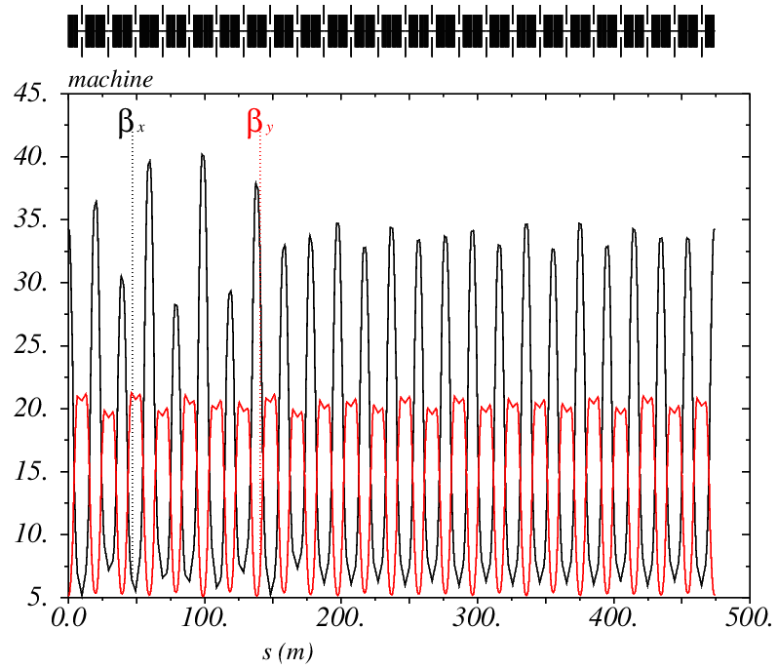
Lattices Used in Simulation
24-cell fully symetrical FODO (V.Kapin)
24-cell with 10% beta-beat, no coupling
24-cell with 20% beta-beat, no coupling
Actual Booster (C.Y.Tan)
Chromaticity work in progress

Slide 14
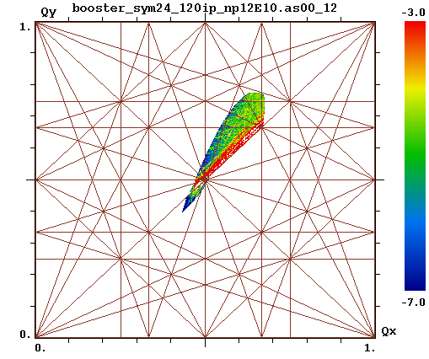
Results – FMA (a) 0.42×10¹³

Slide 15
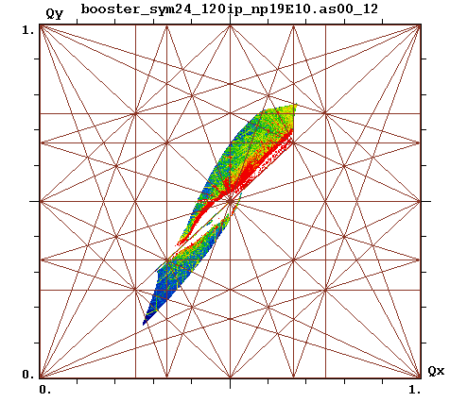
Results – FMA (a) 0.66×10¹³

Slide 16
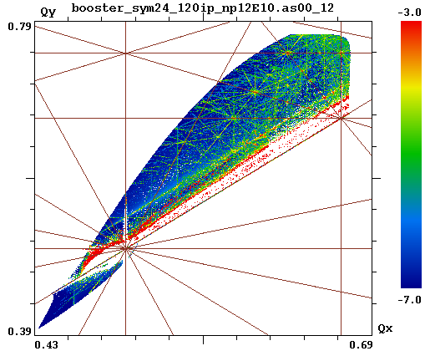
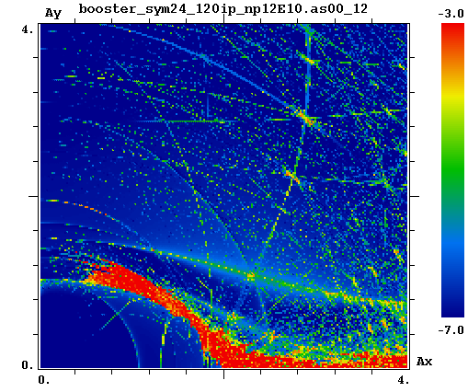
Results – FMA (a) A_{s}=0, 0.42×10¹³

Slide 17
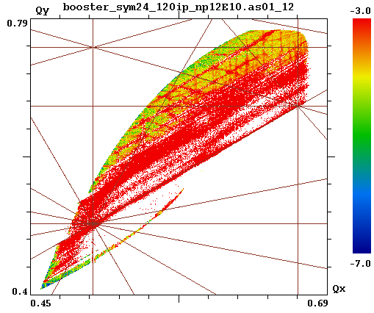
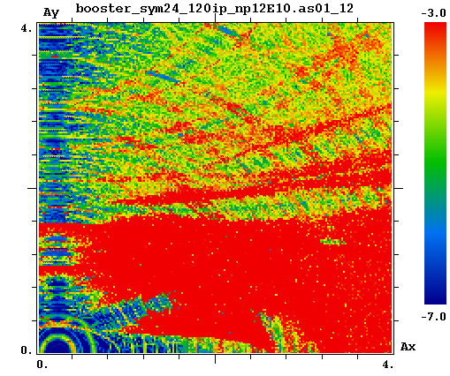
Results – FMA (a) A_{s}=1*, 0.42×10¹³
* SC is over estimated for off-momentum particles

Slide 18
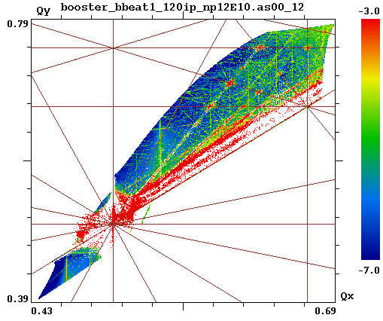
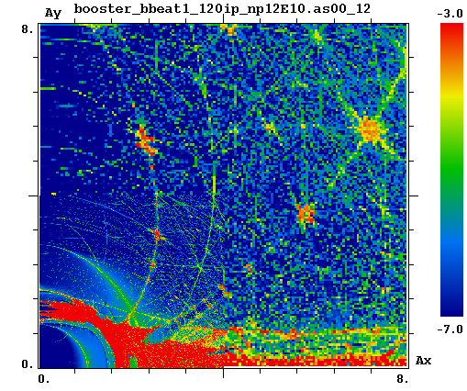
Results – FMA (b) A_{s}=0, 0.42×10¹³

Slide 19
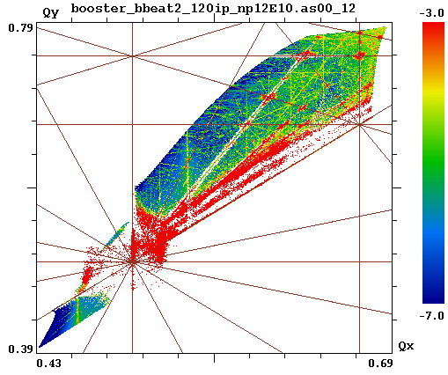
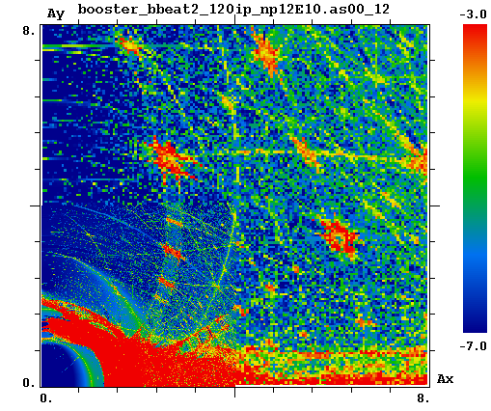
Results – FMA (c) A_{s}=0, 0.42×10¹³

Slide 20
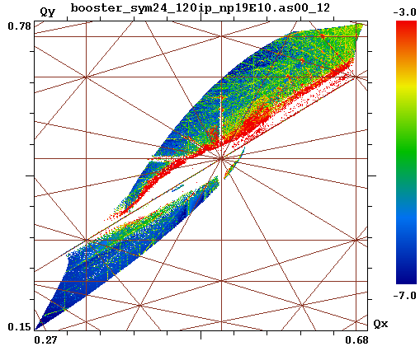
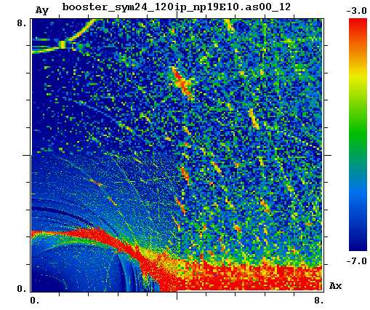
Results – FMA (a) A_{s}=0, 0.66×10¹³

Slide 21
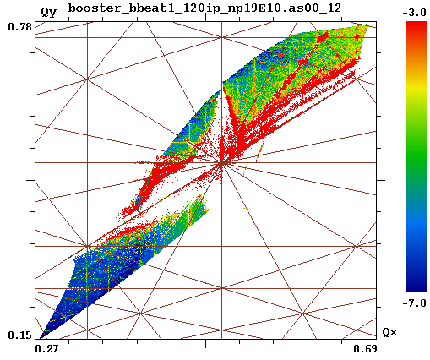
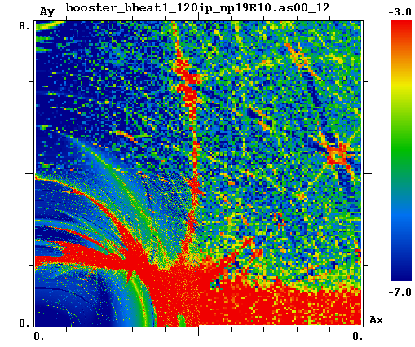
Results – FMA (b) A_{s}=0, 0.66×10¹³

Slide 22
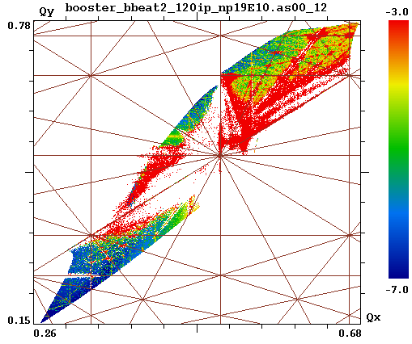
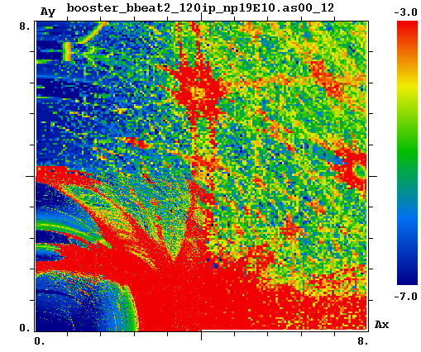
Results – FMA (c) A_{s}=0, 0.66×10¹³

Slide 23
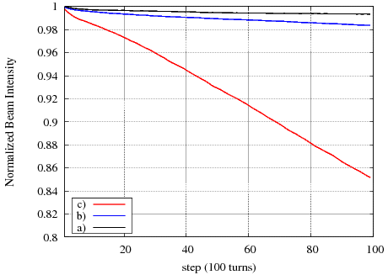
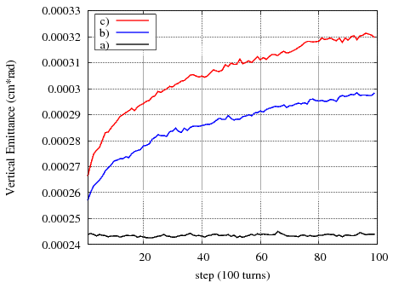
Results – Multiparticle Tracking, 0.42×10¹³

Slide 24
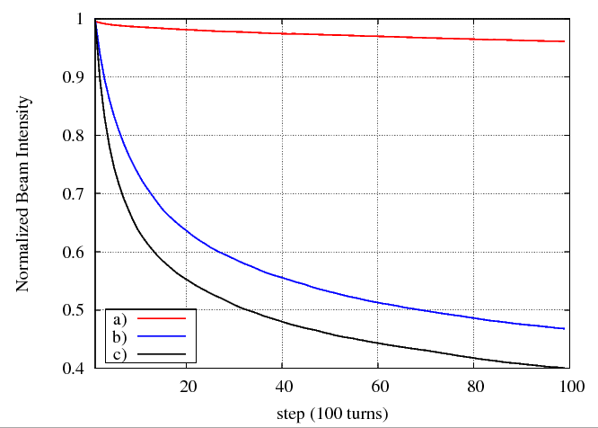
Results – Multiparticle Tracking, 0.66×10¹³

Slide 25
Summary and Next Steps
With known limitations, the method allows for very fast evaluation of options
Code improvements are in progress
PIC simulations to follow
The half-integer resonance seems to be the limiting factor
At intensity of 4×10¹² the core particles cross ½
6.6×10¹² is allowed in the ideal 24-fold symmetry lattice
We are studying the possibility of creating lattice with two-fold symmetry
We will work with the optics team to achieve good understanding of the machine model and proper correction of relevant imperfections
Booster does not have the luxury of large aperture – need to rely on control and precision

