Slide 1
A Fifteen Year Perspective on the Design and Performance of the SNS Accumulator Ring
Sarah Cousineau
on behalf of the SNS Project
Fermilab
11/24/2015

Slide 2
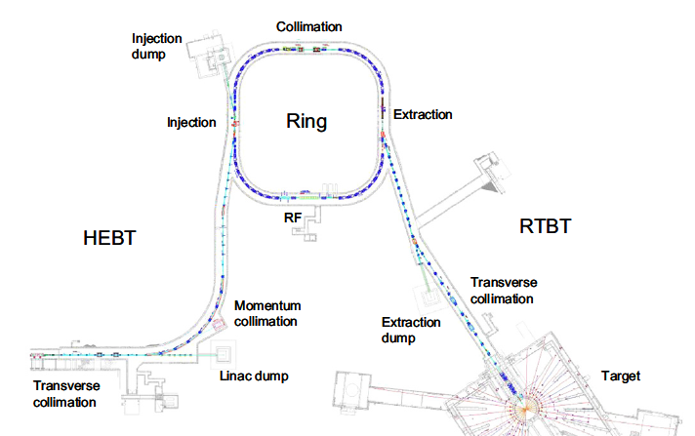
SNS Accumulator Ring Design Parameters
Design Parameters
Circumference: 250 m
Energy: 1 GeV
Intensity: 1.5e14 ppp
# bunches: 1
Bunch length: 700 ns
Accumulation Time: 1 ms
Repetition Rate: 60 Hz
1 GeV p
1 GeV H-
= Beam Power: 1.4 MW
1.4 MW production achieved Friday, November 20.

Slide 3
Outline
Performance measures.
What we got right: High pay-off investments
Stuff we worried too much about.
Stuff we should have worried more about.
The power upgrade project.
Attacking our biggest challenge: The H⁻ laser stripping effort

Slide 4
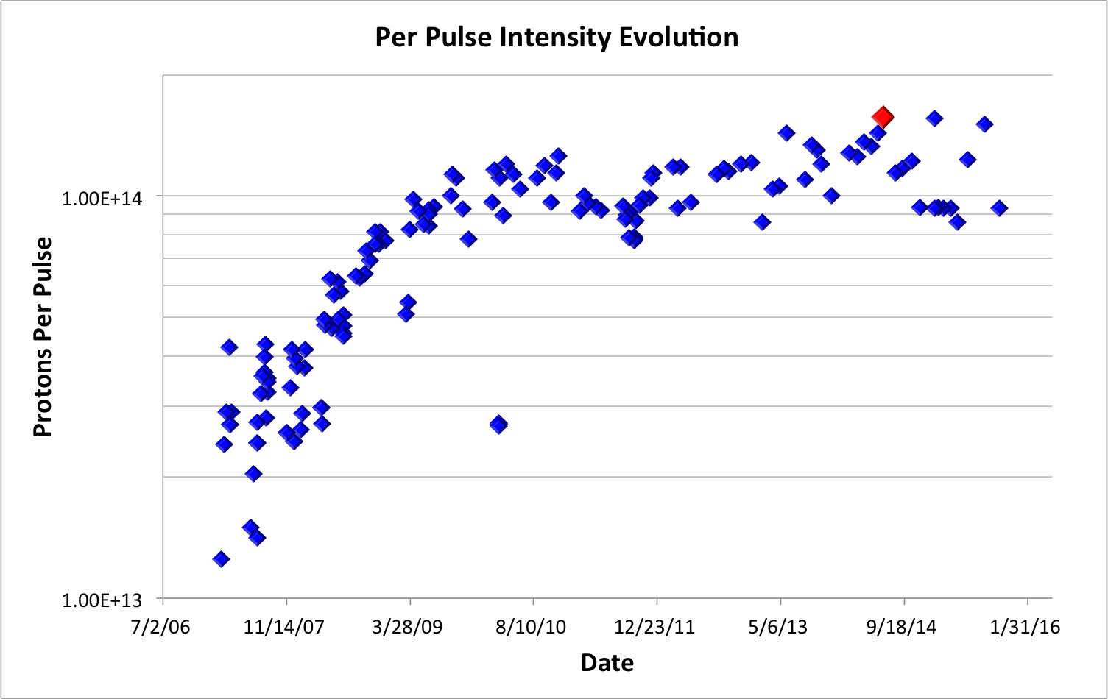
Ring Performance: Intensity
The SNS accumulator ring has been in operation for 10 years.
It has performed beautifully.
Production intensity: 1.55e14 ppp
Intensity Limitation: Unknown – not yet found
1.56×10¹⁴ ppp 1.4 MW

Slide 5
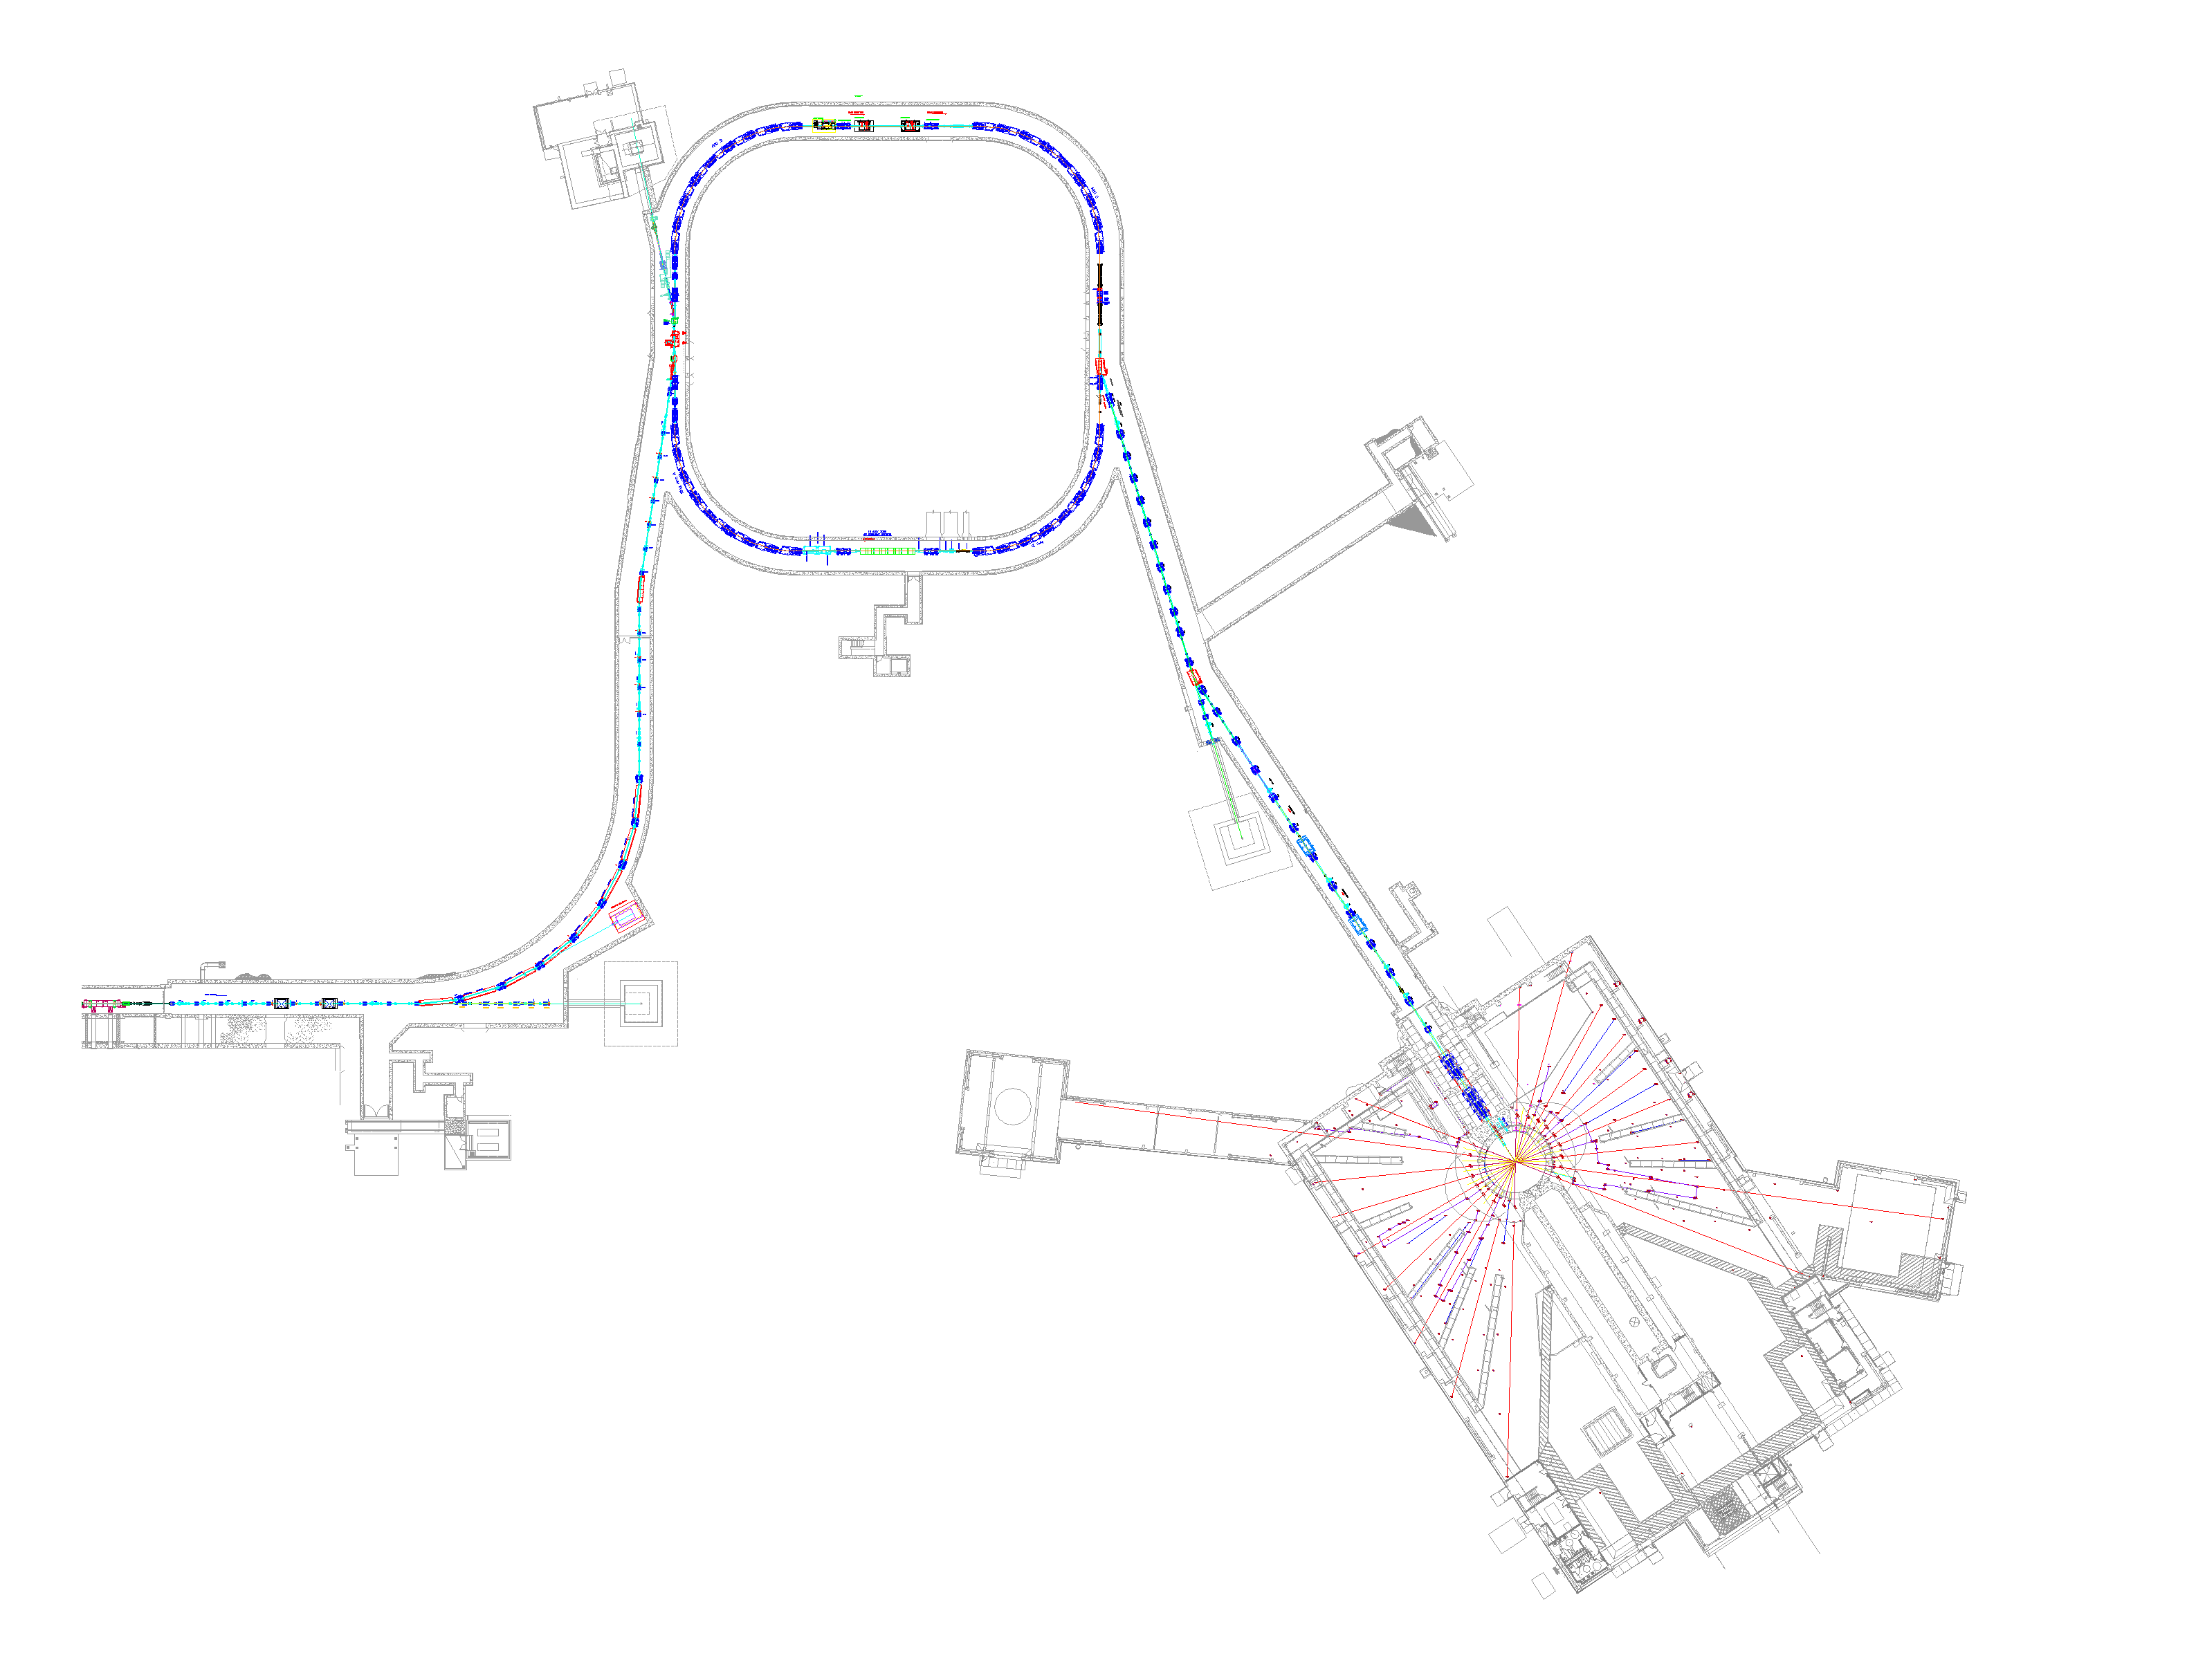
Ring Performance: Beam Loss
The SNS ring was designed for very low loss.
The result - A very clean ring
Loss level achieved: ~ 2x10⁻⁴ of beam at full intensity.
Dosage in mrem/hr @ 30 cm
< 5
10 - 50
< 5
collimation
< 5
20
< 5
800
300
< 5
extraction
injection
< 5
< 5
< 5
< 5
< 5
< 5
A long list of investments made to ensure this…
...What worked?

Slide 6
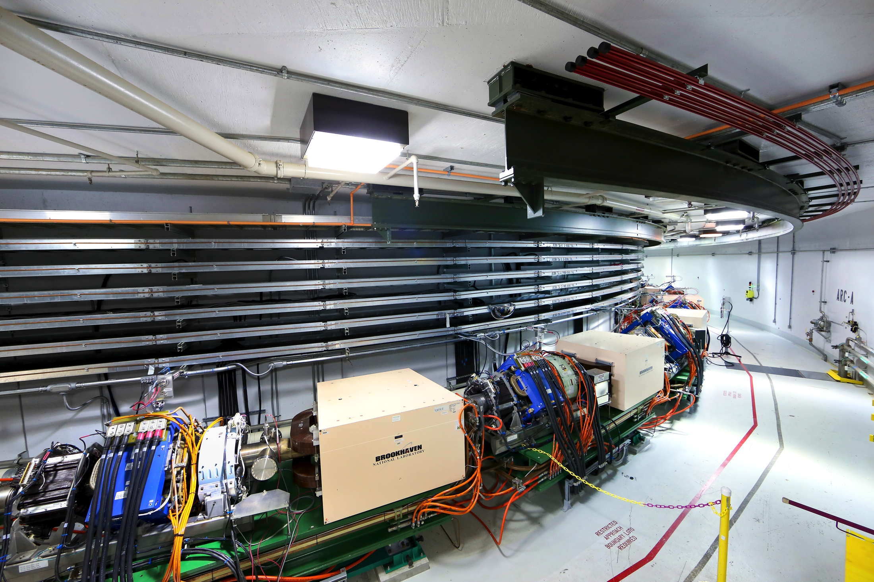
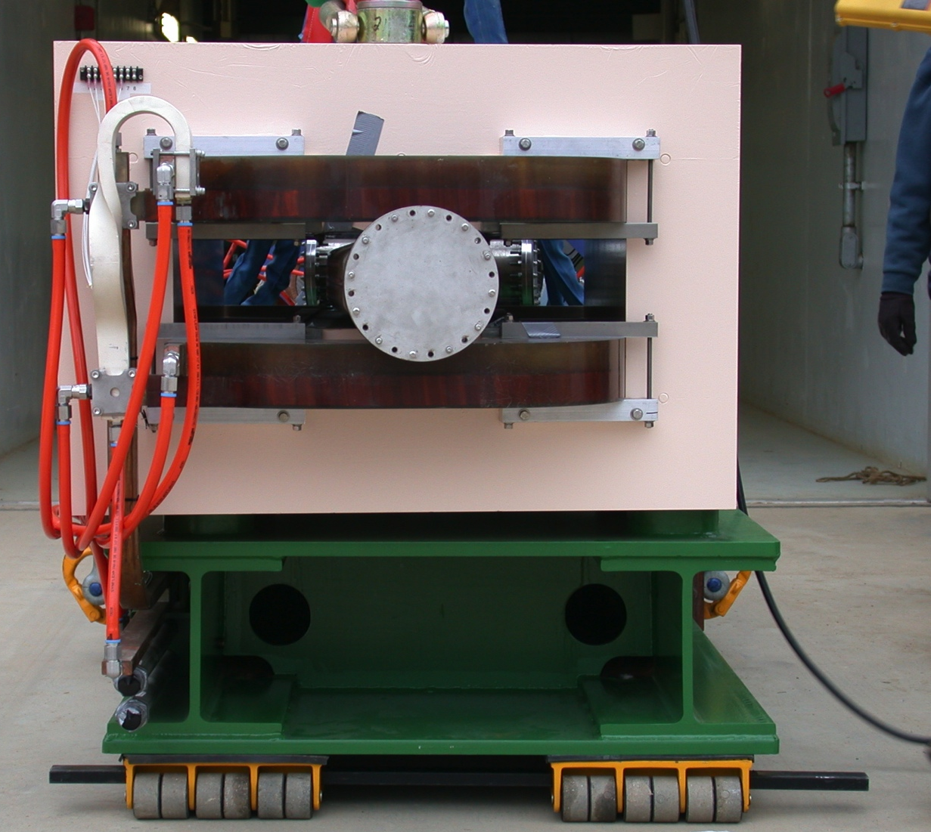
Large Aperture:
The Highest Payoff Investment We Made
Based on considerations of collective effects, decided to use a very big aperture.
Element | Diameter (cm) | Acceptance (mm mrad)
Vacuum Pipe | 20 - 30 | 480 pi
Dipole | 23 x 15 | 480 pi
Quadrupole | 21 – 30 | 480 pi
Collimator | 10 – 16 | 300 pi
And it works. We use it all.
(Thanks Y.Y. Lee and B. Wang!!)

Slide 7
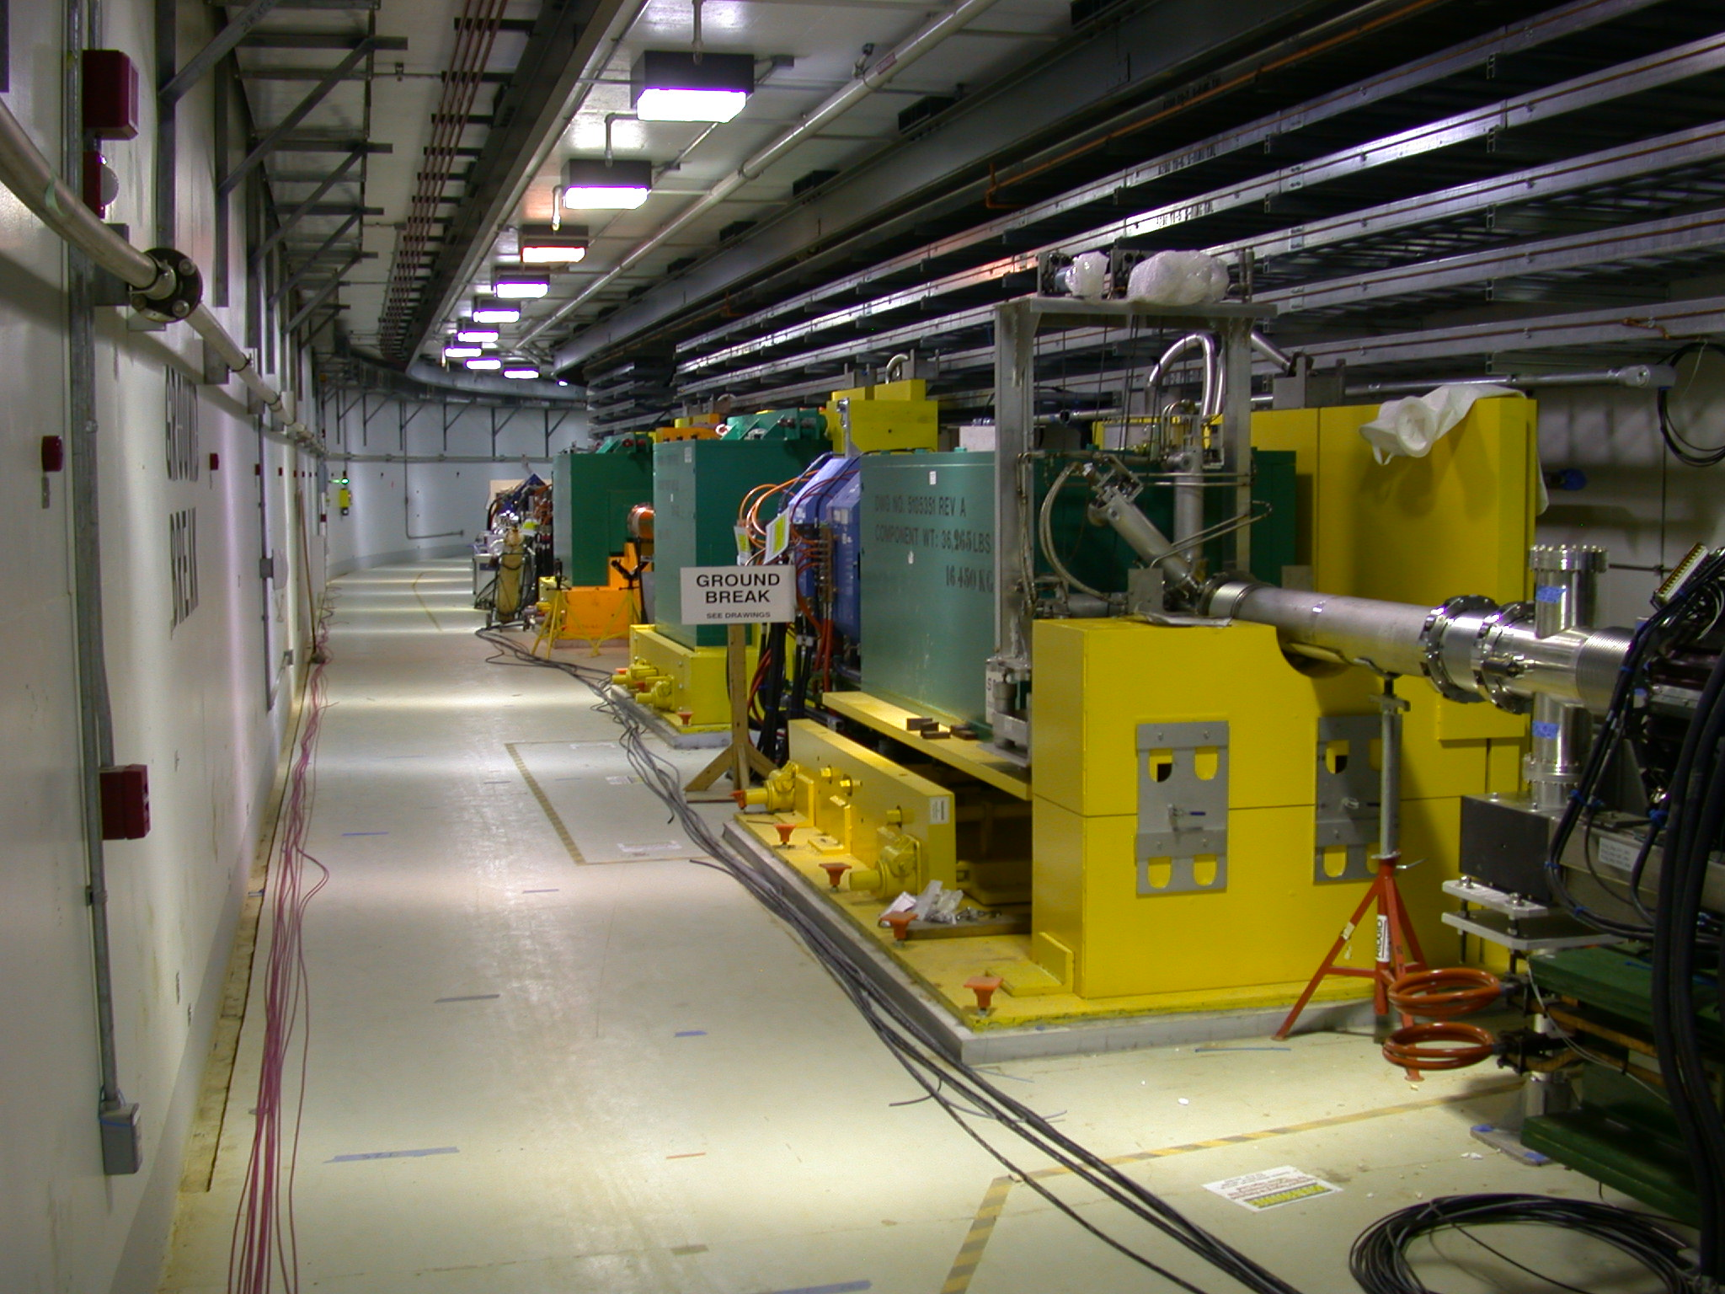
Ring Betatron Collimation: High Payoff
Two stage collimator occupies an entire straight section.
Each secondary collimator can absorb:
2 kW continuously, or
2 consecutive 2 MW pulses in failure mode.
We believe that collimation is one of the main reasons we have a clean ring.
We do not use the collimator in a two stage fashion. Prioritize aperture.

Slide 8
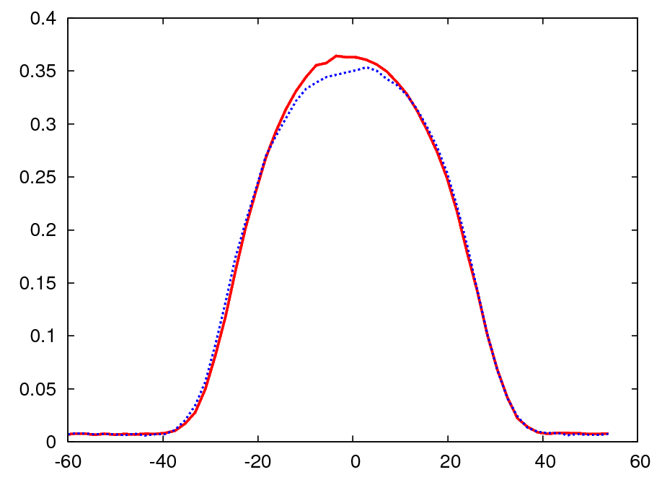
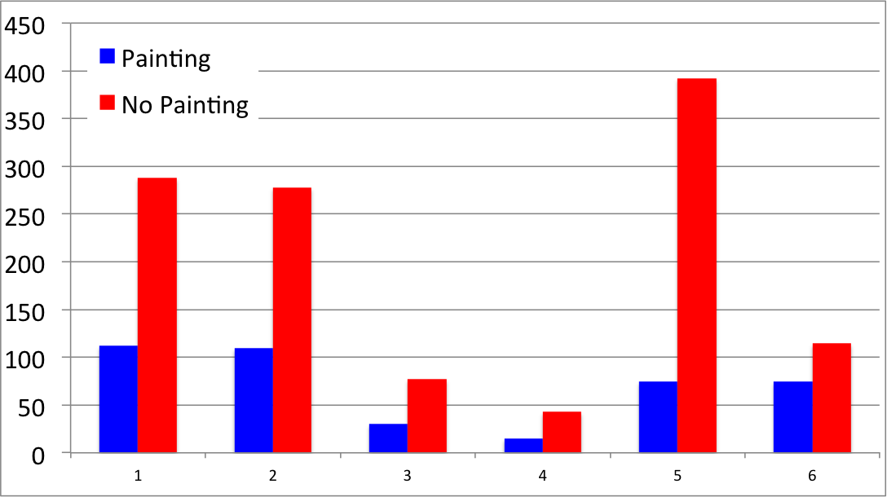
Dual Plane Injection Painting: High Payoff
We paint in both planes with a correlated beam, all the way to collimator aperture.
The injection losses would be intolerable without it.
~ 1 MW Equivalent Beam Profiles
For Two Equal Emittance Beams
Injection Region Beam Loss Monitor Signals
Painting
No Painting
A11c
A11d
A11e
A13
A13b
B01

Slide 9
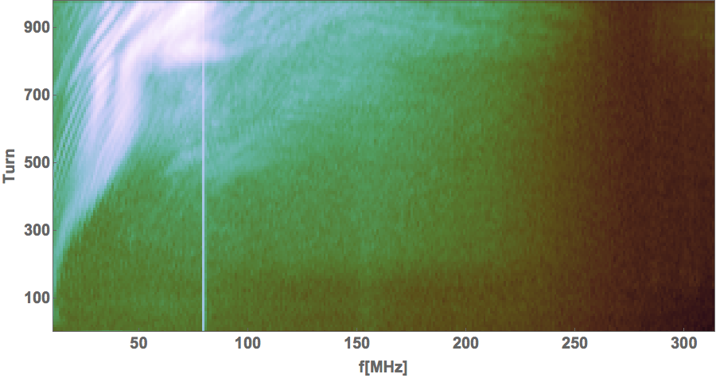
e-P Mitigation: Worth the Investment ??
In the area of collective effects, e-p was the biggest concern.
Mitigation Feature | Usage Now
2nd Harmonic RF | Strong knob when e-p present
TiN coating | No way to know if it helps
Clearing solenoids | Not in use
Clearing electrodes | Not in use
Feedback system | Working but not needed
e-p Activity for 1.4 MW Production Beam
No significant e-p seen during production so far.
< 1 mm oscillation
No appr
Trace levels after opening vacuum. No beam loss.
N. Evans

Slide 10
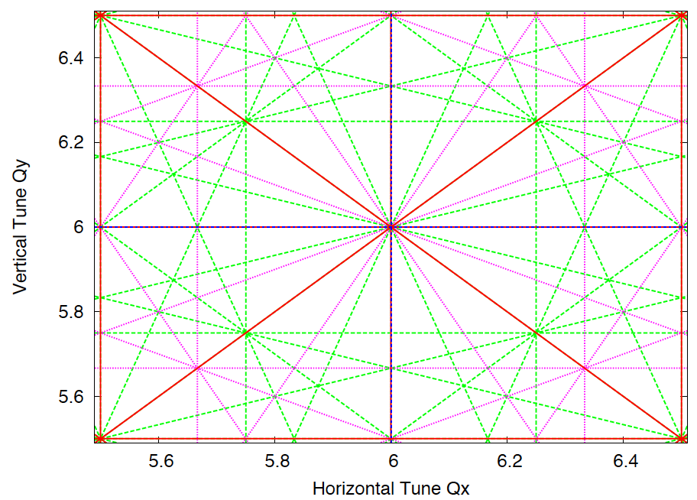
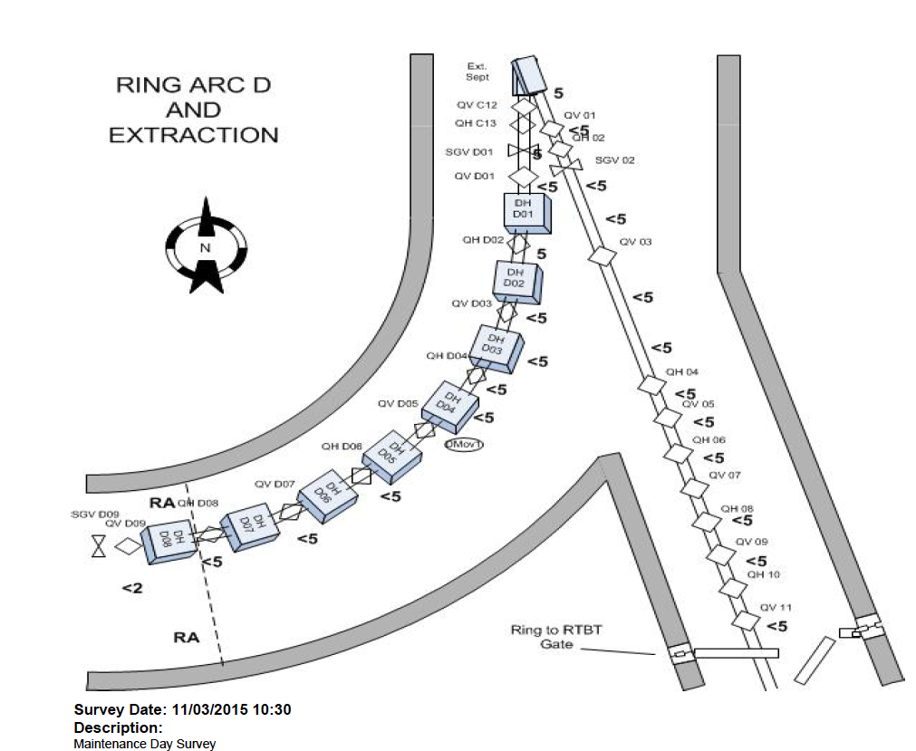
Two Things We Worried Too Much About
1. Space charge effecst: resonances, halo
Feature | Usage Now
Sextupoles (4 families) | Never used during production
Octupoles (2 families) | Never been used
Sextupole correctors | Never been used
Octupoles correctors | Never been used
2. Extraction loss:
Beam in gap kicker – never installed
Gap smaller, cleaner than expected:
Very good LEBT chopping
Reduced extraction kicker drift

Slide 11
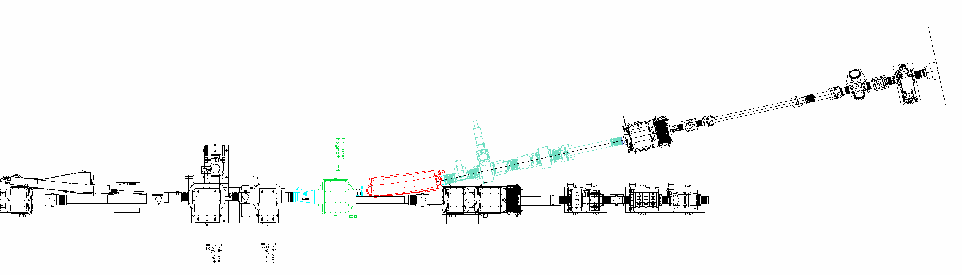
Injection: We Didn’t Worry Enough
Trajectories not sufficiently modeled.
H⁰* excited state loss over-constrained the design.
Fallout was many changes once reality struck:
New C-magnet
Increase septum
magnet gap by 2 cm
Oversize & thicker primary stripper foil
New WS, view screen,
BPM, NCD (ridicules)
Thinner, wider
secondary stripper
foil
Increased beam pipe aperture
Shift 8 cm
beam left

Slide 12
Menu of Initial Investments and Payoff
Feature | Cost | Payoff So Far
Large Aperture | $$$$ | High
Injection Painting | $$$ | High
Collimation | $$$ | High
TiN coating | $$$ | Unknown
2nd harmonic RF | $$ | Medium
Main sextupoles | $$ | Low
Main octupoles | $$ | None
Sextupole correctors | $ | None
Octupole correctors | $ | None
Clearing solenoids | $ | None
Beam in gap kicker | $ | None
Clearing electrodes | $ | None
We spent the big bucks where it counted most.

Slide 13
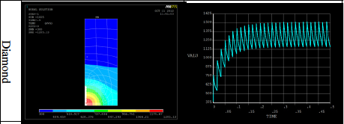
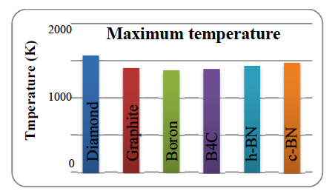
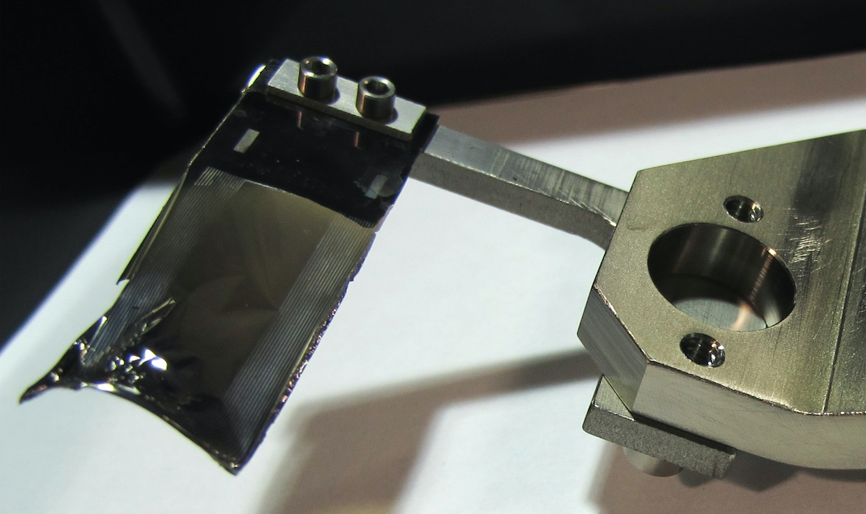
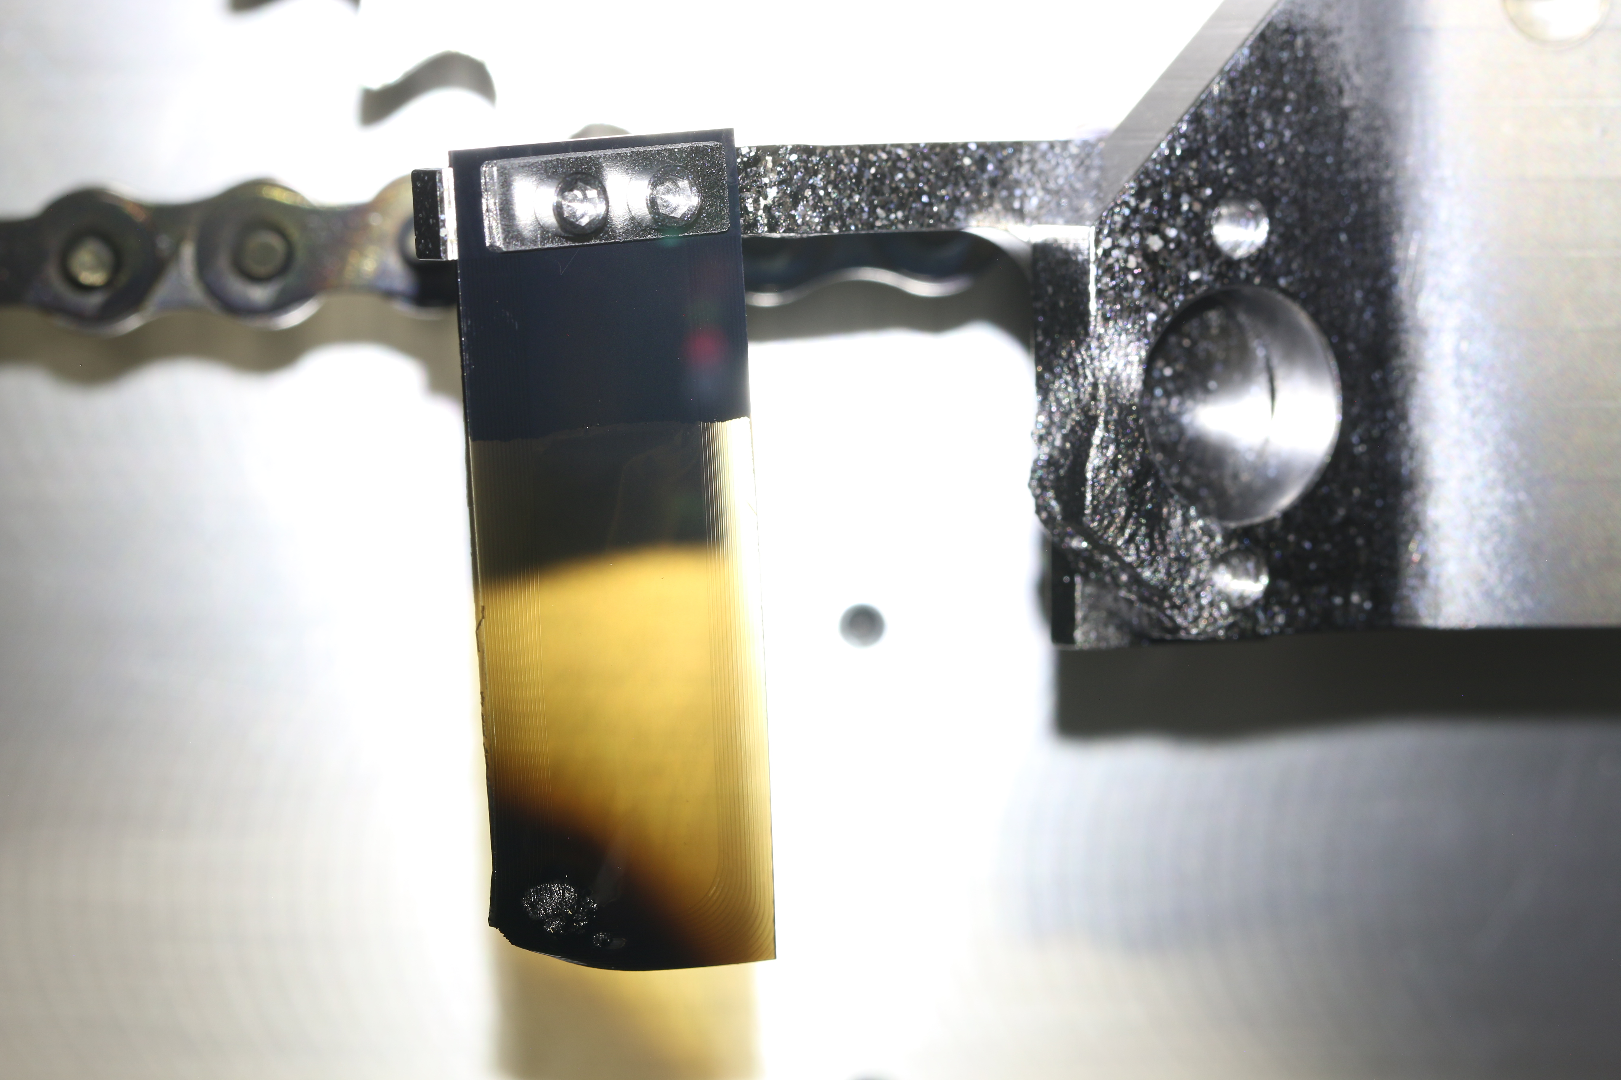
Biggest Challenge: Injection Loss and Foil
Nanocrystalline Diamond
~400 ug/cm² (1 μm thick)
~1500K
Sublimation Range
~1 month @1.3 MW
We have an aggressive foil development program that has allowed us to get to 1.4MW

Slide 14
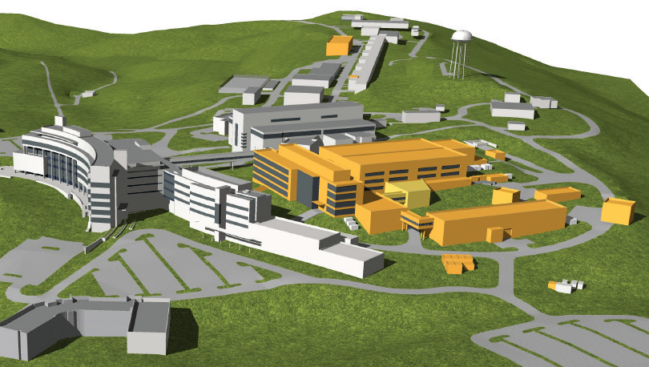
STS and the Beam Power Upgrade
Parameter | Now | Upgrade
Beam Power | 1.4 MW | 2.0 MW
Beam Energy | 1.0 GeV | 1.3 GeV
Beam Intensity | 1.5e14 ppp | 2.5e14 ppp
Second target will steal every 10th pulse.
Ring injection region will be carefully redesigned.
We are still worried about e-p.

Slide 15
Injection Foils at 2 MW and Beyond
The 2 MW upgrade will used the same foil-based injection scheme, based on:
  No evidence for sublimation right now
  Estimates of 300K temperature increase (not too bad)
  We can take the ~66% increase injection radiation
  We don’t have any other options
What if we could inject without the foil?
  Virtually no injection beam loss (no radiation)
  No foil lifetime issues
  Possibility of much higher densities
We are interested in attacking this problem for the high intensity community.

Slide 16
The Laser Stripping Concept:
A Foil-Free H⁻ Charge Exchange Injection Scheme
?
UV Laser Beam
High-field Dipole
High-field Dipole
H⁰
α
H^{0*}
H⁻
p+
H⁰ (n=1) + γ → H^{0*} (n=3)
H⁻ → H⁰ + e⁻
H^{0*} → p + e⁻

Slide 17
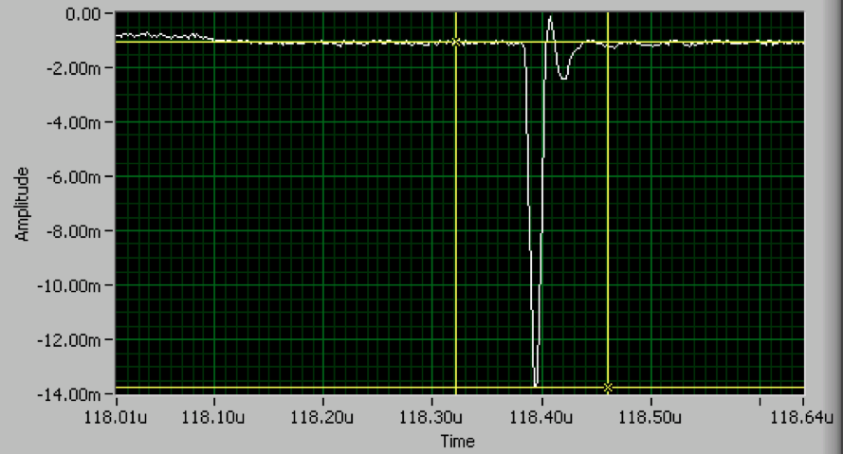


The Laser Stripping Project
2006 Proof of Principal Experiment
H-
6 ns
p
Required 10 MW, diverging laser to accommodate excitation frequency spread
Straightforward scaling to 1 ms requires ~600 kW avg UV laser power (too much!)
Laser Stripping Project:
Demonstrate laser stripping for longer pulse lengths:
  10 us (2016)
  1 ms (2019?)
Technology aimed at HEP applications.
Funded by DOE HEP grant (DE‐FG0213ER41967) UT, ORNL, Fermilab

Slide 18
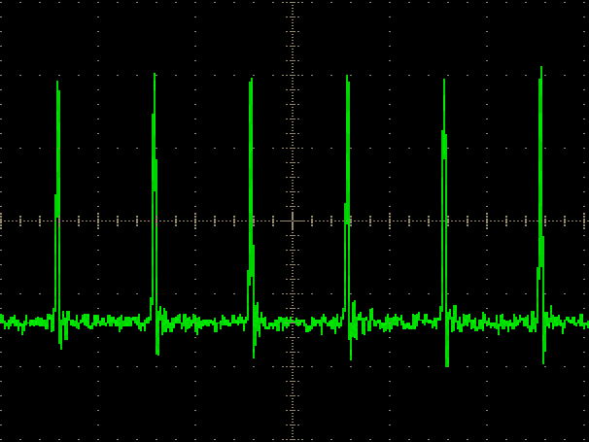
Reducing the Required Laser Power
600 KW
Don’t waste the laser power: Temporal matching:
H⁻ Beam
UV Laser
Average
Laser
Power
2.5 ns
402.5 MHz
402.5 MHz
30 ps
2. Eliminate resonance transition frequency spread:
γ₁
H⁰
UV
UV
α_{n}
α_{n}
H^{0*}
γ
H^{0*}
γ₂
H⁰
POP experiment setup used a diverging laser beam
γ_{n}
3. Maximize laser ion cross section: Squeeze the beam:
σ_{y} ≈ 0.2 mm
σ_{l} ≈ 30 ps
60 W

Slide 19
Laser-Ion Beam Temporal Matching
Master oscillator power amplification (MOPA) system
Y. Liu, A. Rakhman
UV peak power achieved: 1.3 - 3.0 MW
Structure | Time | Frequency
Micropulse | 30 – 55 ps | 402.5 MHz
Macropulse | 5 – 10 us | 10 Hz

Slide 20
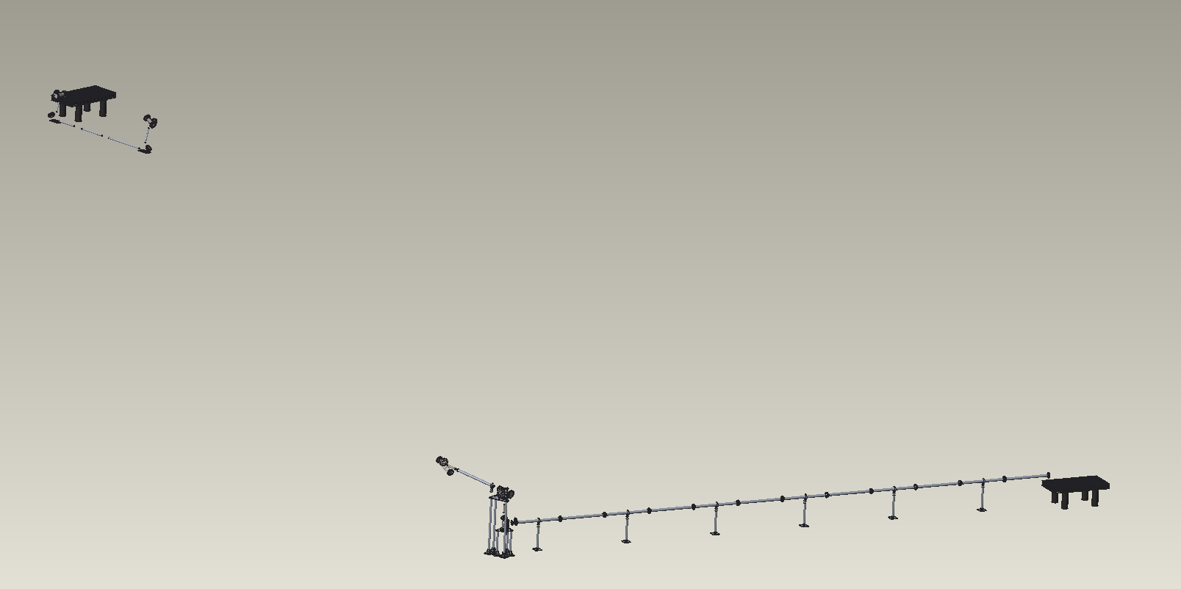

Experimental Configuration
Interaction point in the HEBT, laser in the Ring Service Building.
Laser transport introduces complications (power loss, pointing stability)
Laser table
Ring Service Building
Transport Line:
70 m
7 mirrors, 2 windows
chase
Final optics station and IP
Ring/HEBT Tunnel
A. Menshov

Slide 21
Laser Transport Mock-Ups
Piezoelectric tuner will stabilize laser against > 1 Hz drift.
Mirror losses independently measured to be ≤1%.
Expect ~ 1/3 power loss (Fresnel diffraction, higher order mode loss).
Conclusion: Remote laser placement is feasible.
6 cycles = ~48m
8 m
Output Power
From Laser
Y. Liu, A. Rakhman

Slide 22
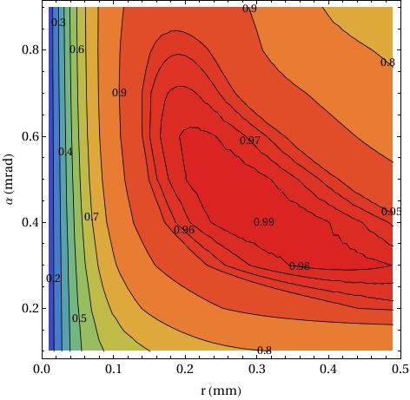
Laser Stripping Efficiency Calculation
All ion and laser beam parameters achieved.
Efficiencies calculated with as-measured parameters, >90% (pyORBIT)
One major concern is that we will break the vessel window
Final Stripping Efficiency
Experimental Procedure
90%
Final demonstration
only
Stripping Efficiency
Laser divergence (mrad)
30%
Tuning here
Laser radius (mm)
Laser Power
~1 MW
Concern about power density on window
Courtesy T. Gorlov

Slide 23
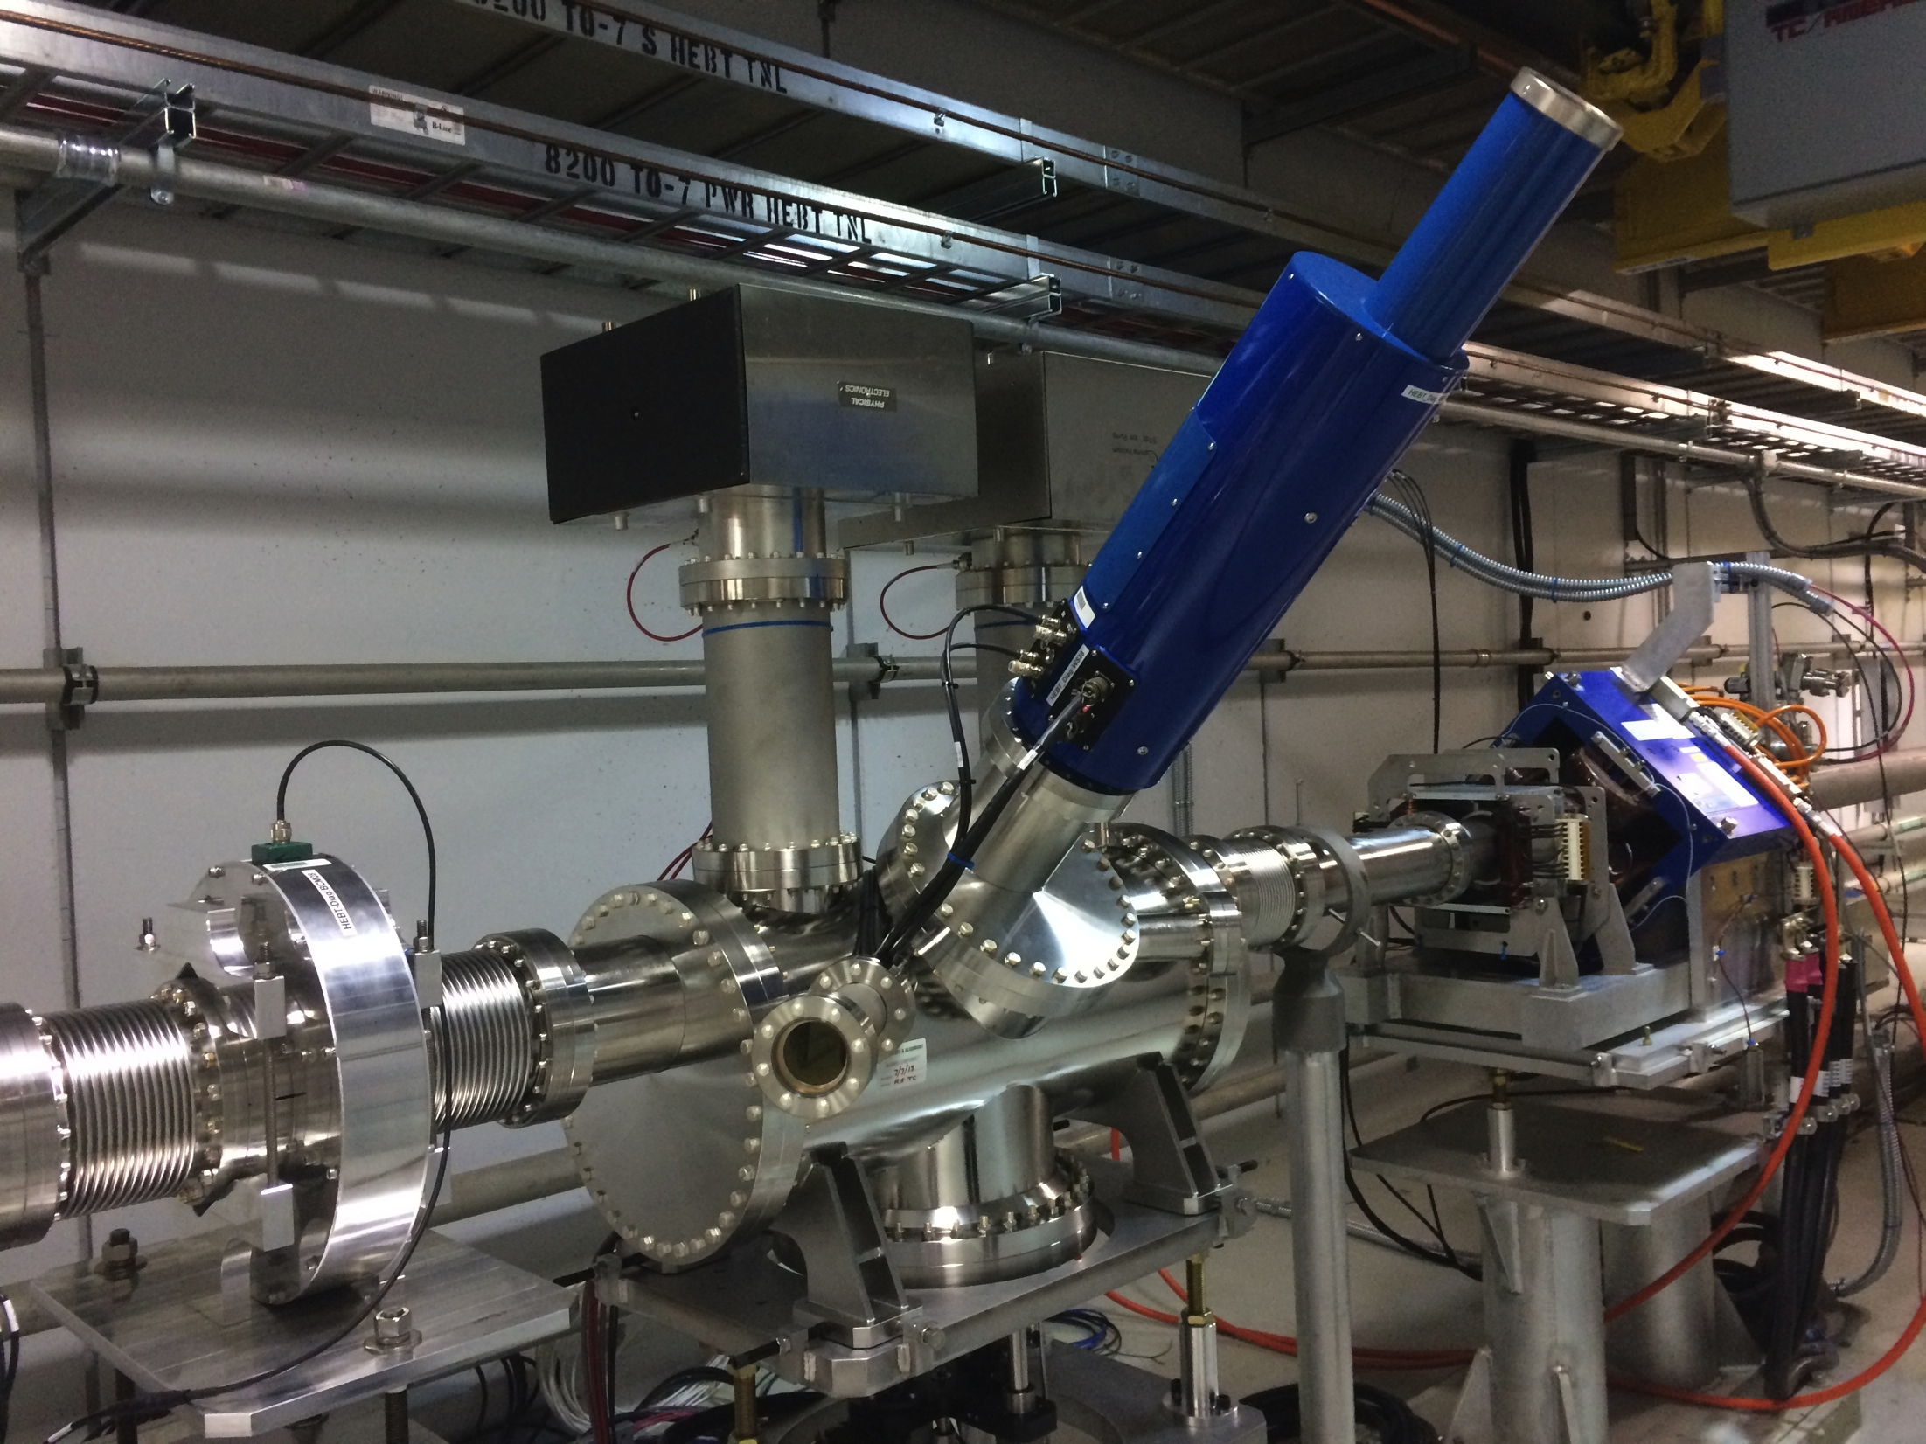
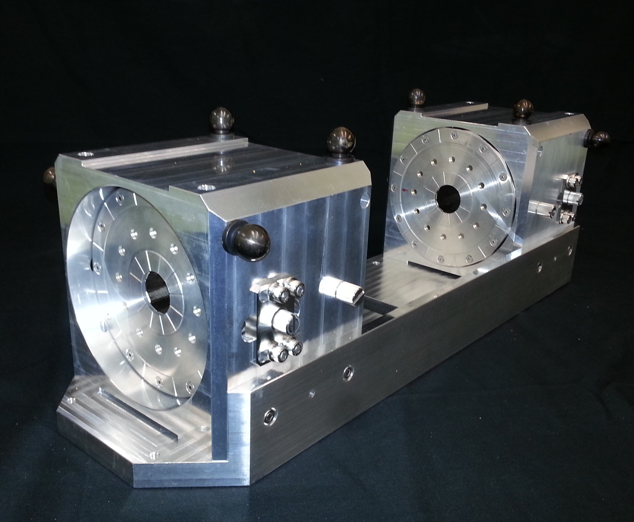
Installed Experimental Station
Almost finished installation
Experiments schedule for Spring 2016.

Slide 24
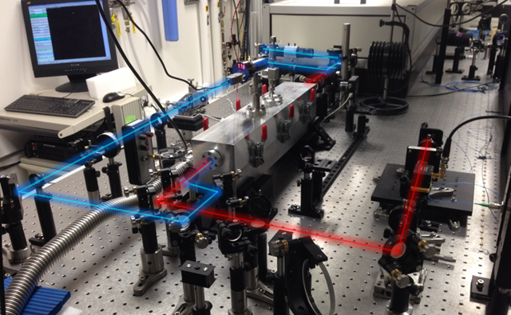
The Next Step: 1 ms Stripping
Add the recycling cavity to achieve 1 ms laser pulses
H⁻ beam
Power recycling cavity relies on CW laser for stable lock.
Amplification of burst mode laser.
50 times power enhancement demonstrated.
Burst-mode UV beam
Cavity
Cavity locking beam

Slide 25
Summary
The SNS ring is performing extremely well at it’s design parameters.
We struggle with injection foil issues.
We are planning for an upgrade in beam power from 1.4MW to 2MW.
We are working on the development of H⁻ laser assisted stripping.

