Slide 1
Recent progress of
J-PARC RCS beam commissioning
Workshop on Booster Performance and Enhancements
Nov. 23-24, 2015, Fermilab
Michikazu Kinsho
(J-PARC Center, JAEA)
Contents
Outline of the J-PARC RCS
RCS operational history
1-MW beam tests
Recent effort for further beam loss mitigation
Summary

Slide 2
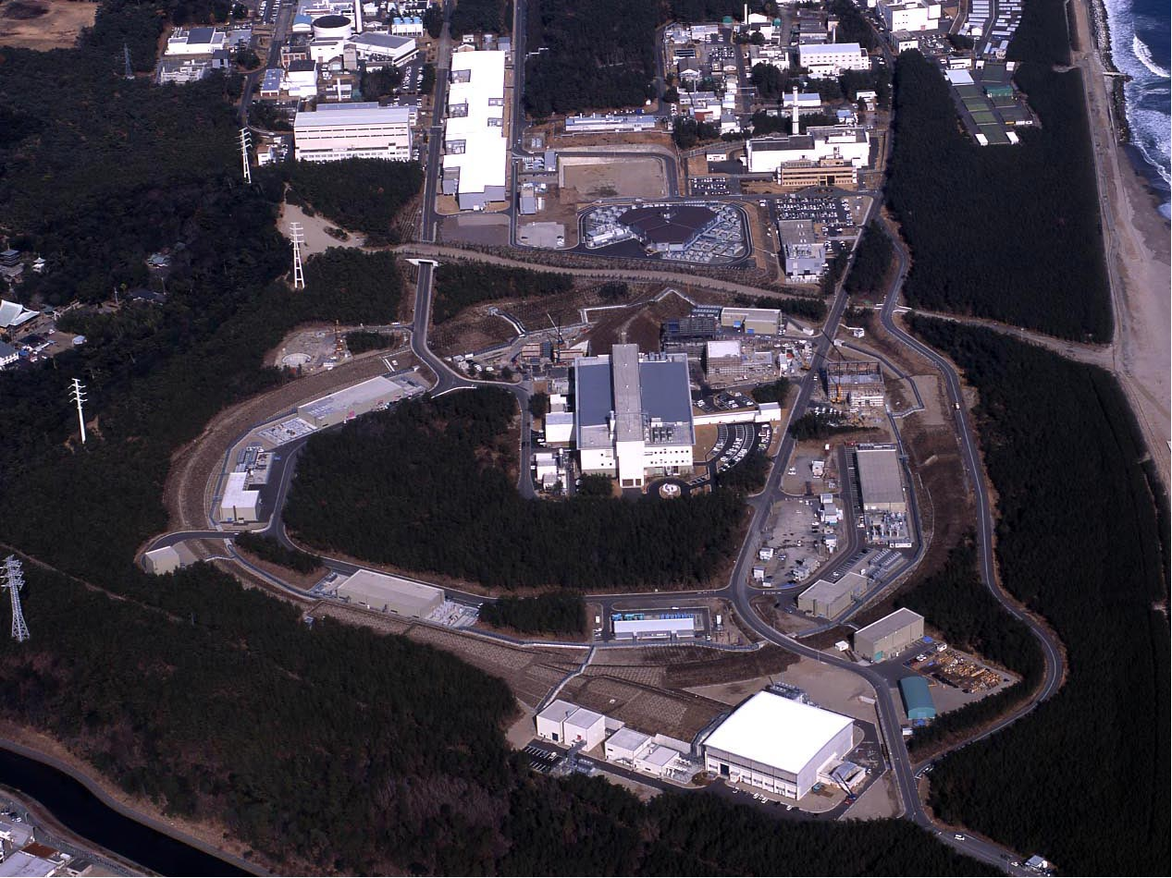
J-PARC
(JAEA & KEK)
400 MeV H⁻ Linac
3 GeV Rapid Cycling Synchrotron (RCS)
Neutrino Beam Line to Kamioka (NU)
50 GeV Main Ring Synchrotron (MR) [30 GeV at present]
Materials & Life Science Facility (MLF)
JFY 2006 / 2007
JFY 2008
Hadron Experimental Hall (HD)
JFY 2009
Notes:
J-PARC consists of 3 accelerators and 3 experimental facilities.
RCS delivers high intensity proton beam to both MLF and MR.

Slide 3
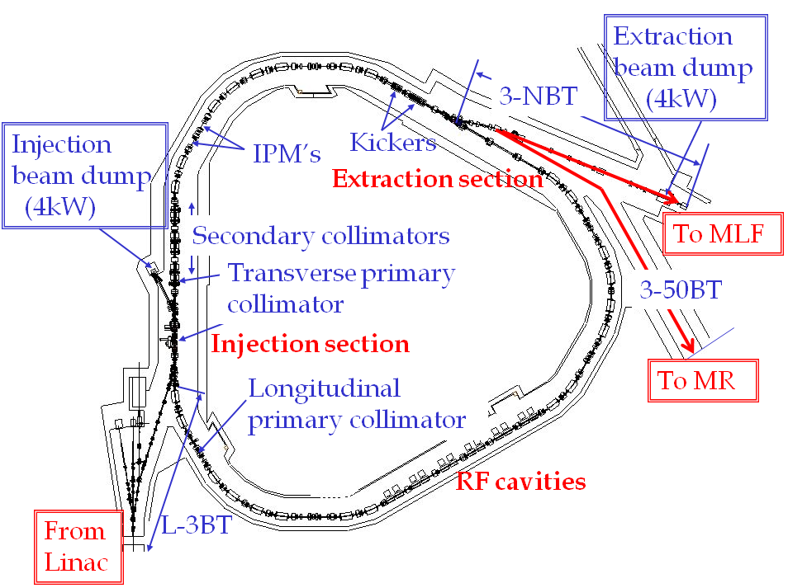
Outline of the J-PARC RCS
Circumference | 348.333 m
Superperiodicity | 3
Harmonic number | 2
Number of bunches | 2
Injection | Charge-exchange, Multi-turn
Injection energy | 181 MeV
Injection period | 0.5 ms (307 turns)
Extraction energy | 3 GeV
Repetition rate | 25 Hz
Particles per pulse | 5e13
Output beam power | 600 kW
Transition gamma | 9.14 GeV
Number of dipoles | 24
quadrupoles | 60 (7 families)
sextupoles | 18 (3 families)
steerings | 52
RF cavities | 12
⇒ 400 MeV in 2013
3GeV
proton
⇒ 8.3e13 in 2014
⇒ 1 MW
MLF : Material and Life Science
Experimental Facility
MR : 50-GeV Main Ring Synchrotron
400 MeV H-
Recently the hardware improvement of the injector linac has been completed.
The RCS have just got all the design hardware parameters
to try the 1-MW design beam operation.

Slide 4
History of the RCS beam operation
Injection energy
upgrade
Injection beam
current upgrade
E_{inj}=181 MeV
I_{max}=30 mA
E_{inj}=181 MeV
I_{max}=30 mA
E_{inj}=400 MeV
I_{max}=30 mA
E_{inj}=400 MeV
I_{max}=50 mA
1-MW-eq
beam test
Startup of the user program
in December 2008
~540-kW
beam test
~550-kW-eq
beam test
Output power to MLF (kW)
500 kW
for users
The output beam power from the RCS has been steadily increasing
following progressions in beam tuning and hardware improvements.
Present output beam power for the routine user program : 500 kW
1-MW beam tests from October 2014
after completing the injector linac upgrades
Main topic of this talk :
- 1-MW beam experimental results
- Approaches to beam loss issues
Notes:
User operation for the MLF was started from Decc.2008 with 50 kW.
In that time injection energy was 181MeV.

Slide 5
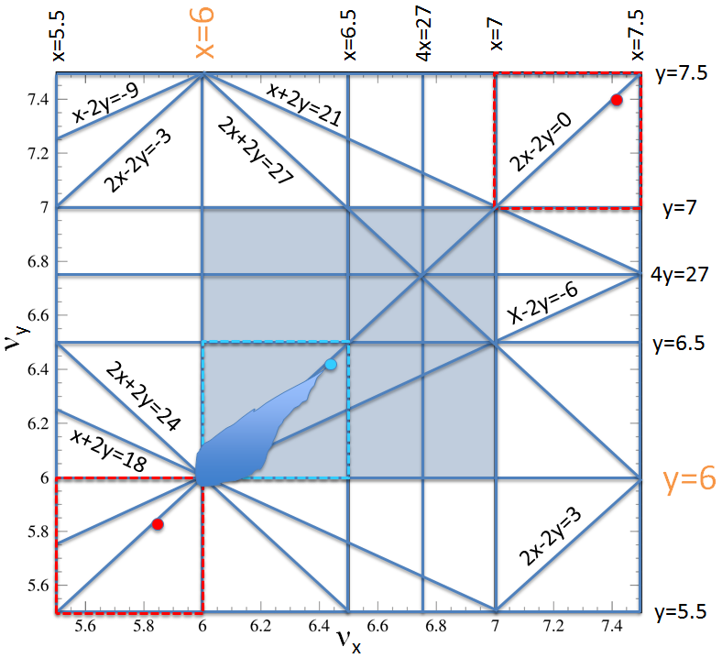
1-MW beam tests conducted
after the injector linac upgrade
The injection energy was upgraded
by adding an ACS linac section in 2013
Injection beam condition
Injection energy : 400 MeV
Peak current : 45.0 mA
at the entrance of RCS
Pulse length : 0.5 ms
Chopper beam-on duty factor : 60%
Beam intensity : 8.4 x 10¹³ ppp,
corresponding to 1010 kW at 3 GeV
Operating point :
(6.45, 6.42)~(6.45, 6.38)
allow a space-charge tune shift
to avoid serious multipole resonances
Injection painting parameter :
100π transverse painting
(“correlated painting”)
+ full longitudinal painting
The injection beam current was upgraded by replacing the front-end system
(IS & RFQ) of the linac in 2014.
Notes:
This is a tune diagram.
We set an operation point these number.

Slide 6
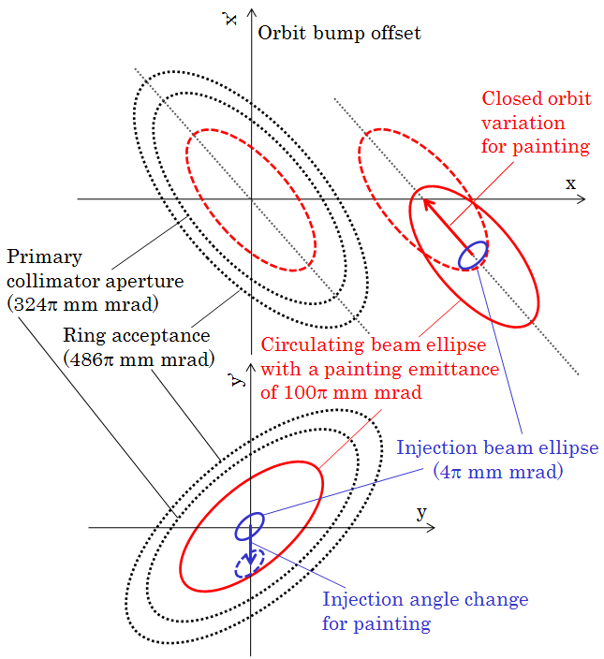
Transverse injection painting
Horizontal painting
by a horizontal closed orbit
variation during injection
Vertical painting
by a vertical injection
angle change during injection
Correlated painting
ε_{tp}= 100 π mm mrad
The injection beam is painted from the middle to the outside
on both horizontal and vertical planes.

Slide 7
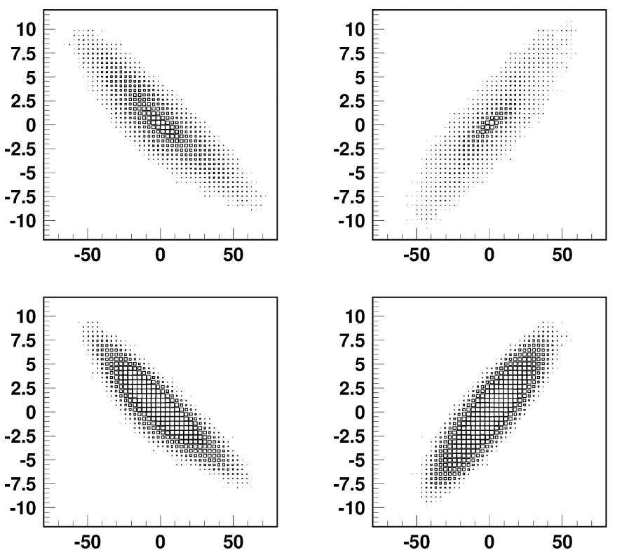
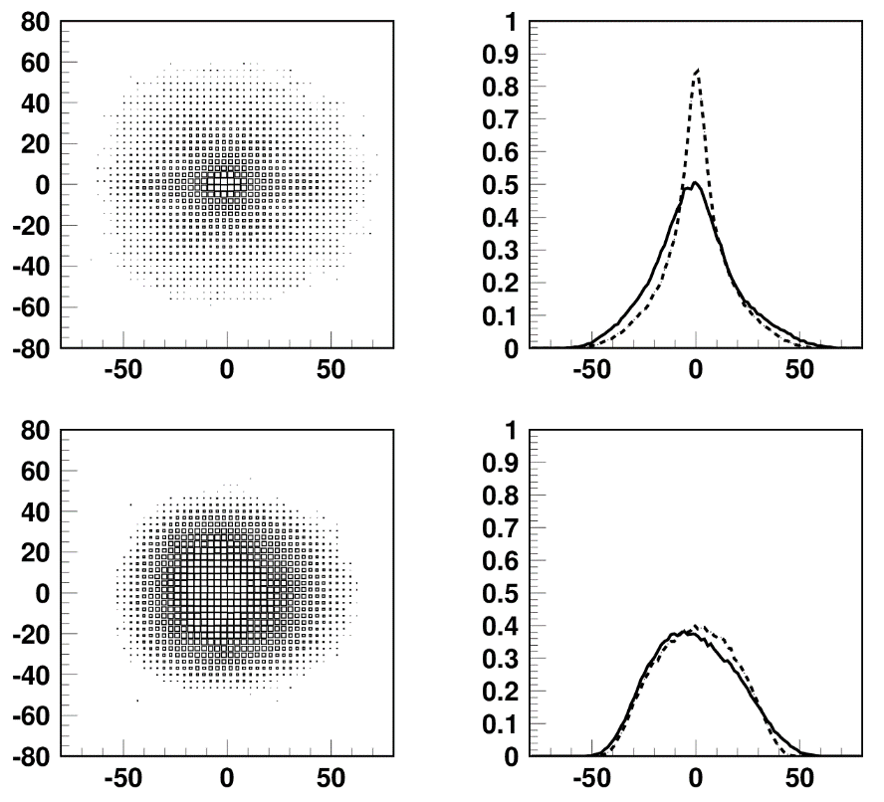
Transverse injection painting
Numerical simulations
Transverse beam distribution just after beam injection
calculated without and with transverse painting
No painting
Horizontal
Vertical
x‘ (mrad)
y‘ (mrad)
y (mm)
Density (Arb.)
x (mm)
y (mm)
x (mm)
Position (mm)
x‘ (mrad)
y‘ (mrad)
y (mm)
Density (Arb.)
x (mm)
y (mm)
x (mm)
Position (mm)
100π transverse painting
from H. Hotchi et. al., PRST-AB 15, 040402 (2011).

Slide 8
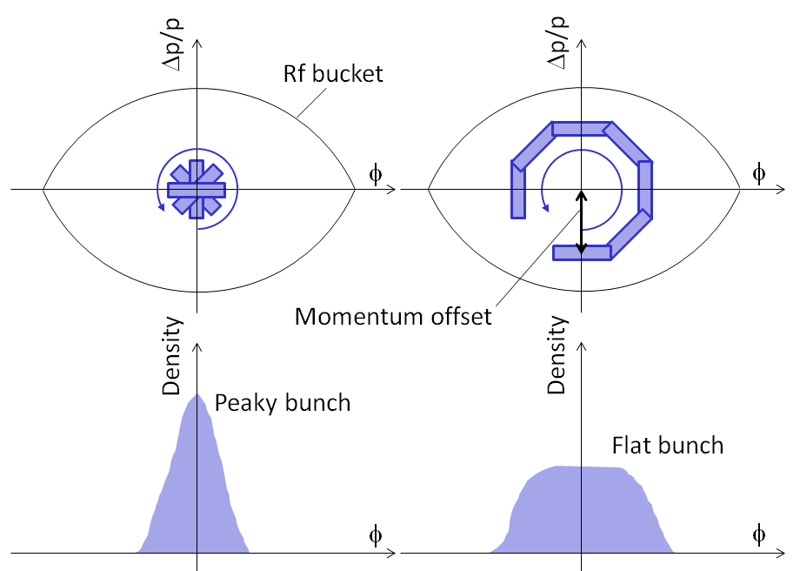
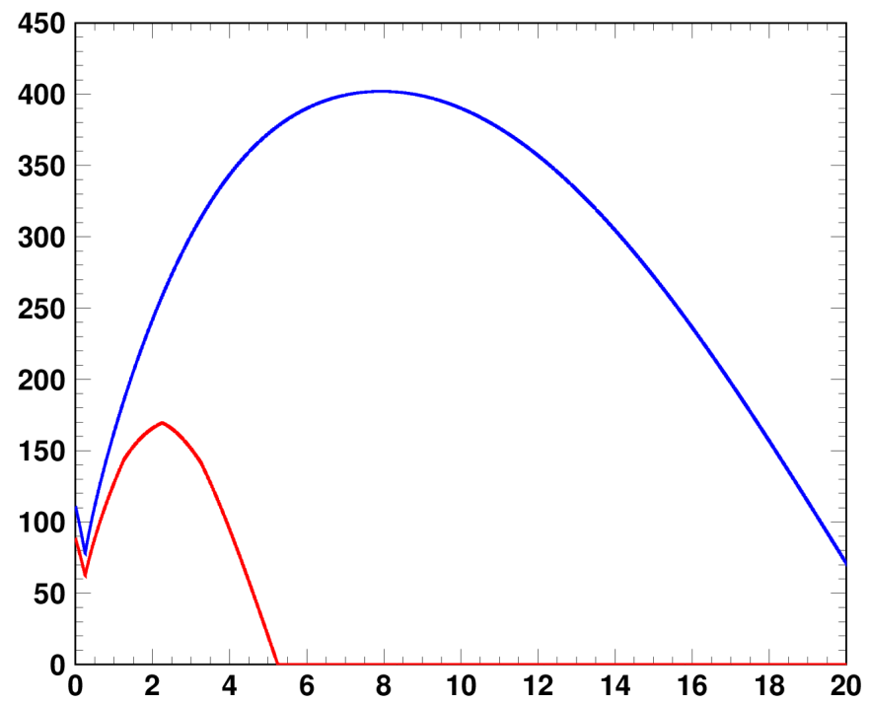
Longitudinal injection painting
Momentum offset injection
RF voltage pattern
Fundamental rf
V₁
RF voltage (kV)
V₂
Second harmonic rf
Time (ms)
Δp/p=0, −0.1 and −0.2%
V₂/V₁=80%
Uniform bunch distribution is formed
Through emittance dilution
by the large synchrotron motion excited
by momentum offset.
The second harmonic rf fills the role
in shaping flatter and wider rf bucket potential,
leading to better longitudinal motion
to make a flatter bunch distribution.
F. Tamura et al, PRST-AB 12, 041001 (2009).
M. Yamamoto et al, NIM., Sect. A 621, 15 (2010).

Slide 9
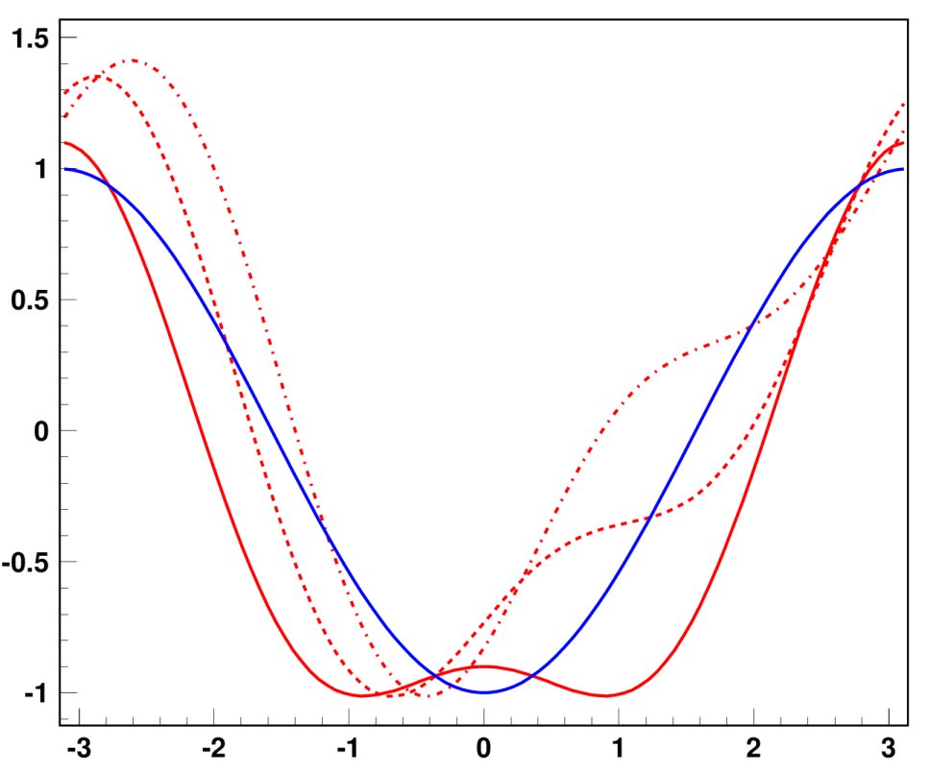
Longitudinal injection painting
Additional control in longitudinal painting ; phase sweep of V₂ during injection
V_{rf}=V₁sinφ-V₂sin{2(φ-φ_{s})+φ₂}
V₂/V₁=0
φ₂=−100⇒0 deg
V₂/V₁=80%
(A) φ₂=−100 deg
(B) φ₂=−50 deg
RF potential well (Arb.)
(C) φ₂=0
The second harmonic phase sweep method enables further bunch distribution control through a dynamical change of the rf bucket potential during injection.
φ (Degrees)

Slide 10
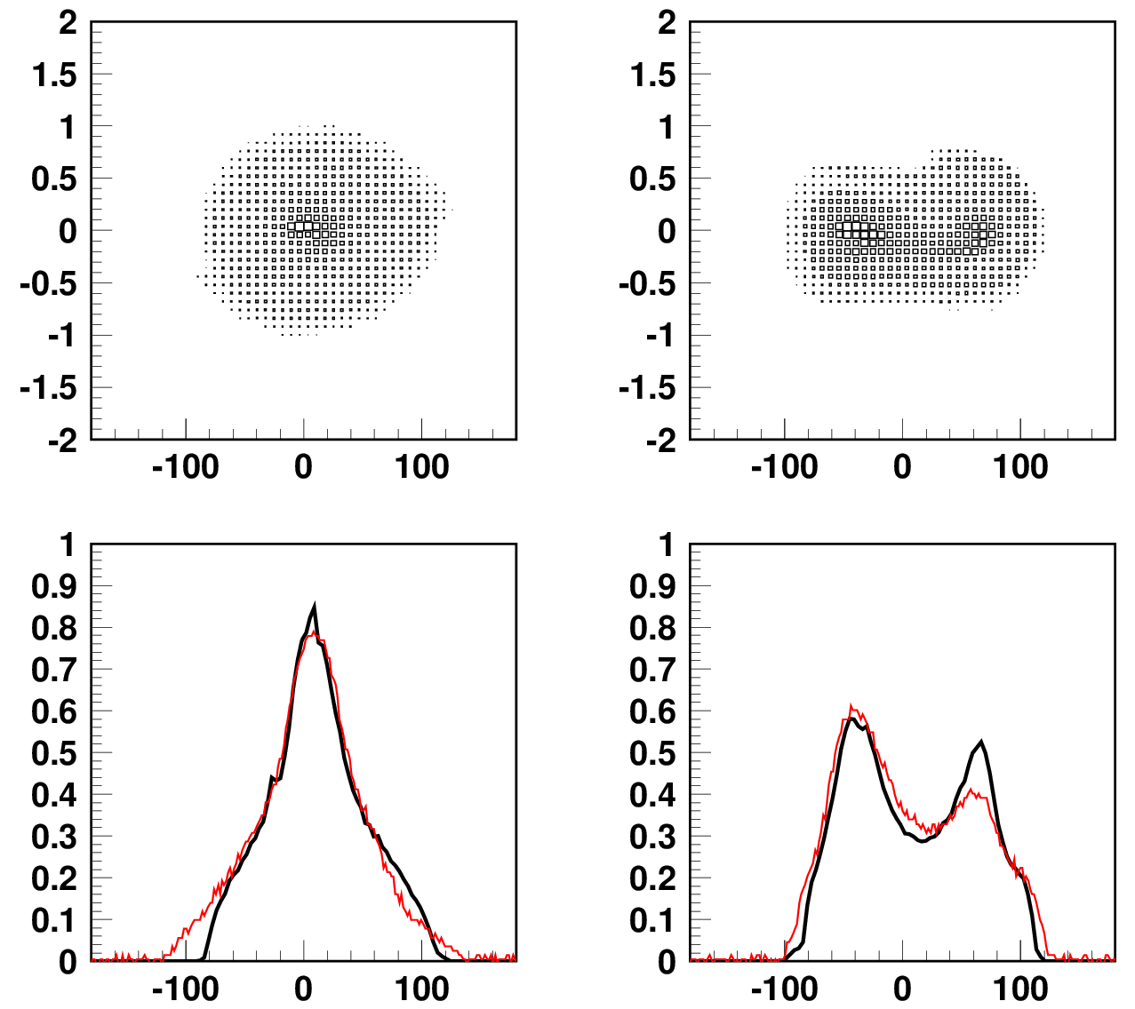
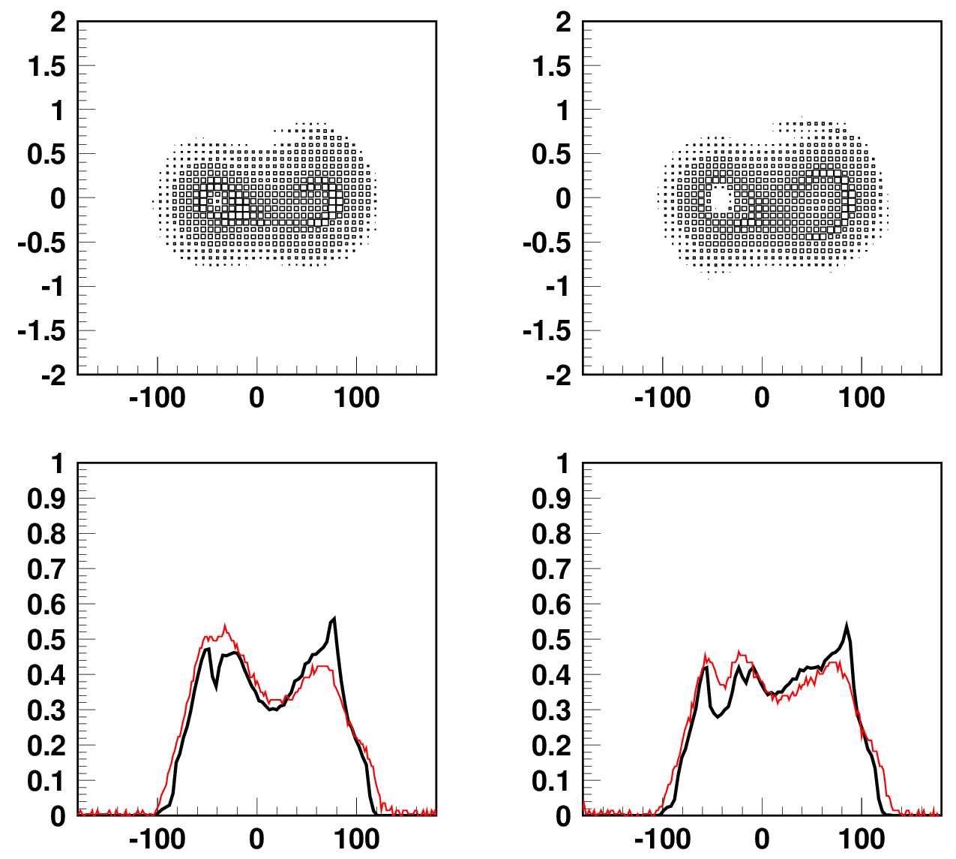
Longitudinal injection painting
Longitudinal beam distribution just after beam injection (at 0.5 ms)
No longitudinal
painting
V₂/V₁=80%
φ₂=-100 to 0 deg
Δp/p= 0.0%
V₂/V₁=80%
φ₂=-100 to 0 deg
Δp/p=-0.1%
V₂/V₁=80%
φ₂=-100 to 0 deg
Δp/p=-0.2%
Δp/p (%)
Δp/p (%)
Δp/p (%)
Δp/p (%)
φ (degrees)
φ (degrees)
φ (degrees)
φ (degrees)
B_{f} ~0.15
B_{f} >0.40
Density (Arb.)
Density (Arb.)
Density (Arb.)
Density (Arb.)
φ (degrees)
φ (degrees)
φ (degrees)
φ (degrees)
Measurements (WCM)
Numerical simulations
from H. Hotchi et. al., PRST-AB 15, 040402 (2011).

Slide 11
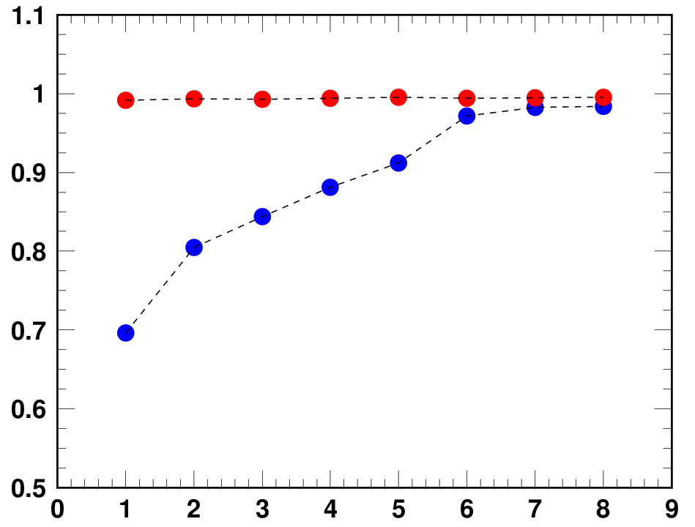
Painting parameter dependence of beam survival rate
● E_{inj}=181 MeV, 539 kW-eq. intensity (Run#44, Nov., 2012)
● E_{inj}=400 MeV, 553 kW-eq. intensity (Run#54, Apr., 2014)
By adding 100π transverse painting
ID | ε_{tp} (π mm mrad) | V₂/V₁ (%) | Δφ₂ (deg) | Δp/p (%)
1 | - | - | - | -
2 | 100π | - | - | -
3 | - | 80 | -100 | -0.0
4 | - | 80 | -100 | -0.1
5 | - | 80 | -100 | -0.2
6 | 100π | 80 | -100 | -0.0
7 | 100π | 80 | -100 | -0.1
8 | 100π | 80 | -100 | -0.2
By longitudinal
painting
Beam survival rate
Further space-charge mitigation
by the injection energy upgrade
No painting
β²γ³_{400MeV}/β²γ³_{181MeV}=2.9
Painting parameter ID
This experimental data clearly show the big gain
from the injection energy upgrade as well as the excellent ability
of injection painting for the space-charge mitigation.
Notes:
This figure shows the beam survival rates measured with various combinations of transverse and longitudinal painting.
In this figure red circles correspond to the data taken in this beam test with a beam intensity of 553kW.
Blue circles are the old data taken with the lower injection energy 181MeV with a similar beam intensity of 539kW.

Slide 12
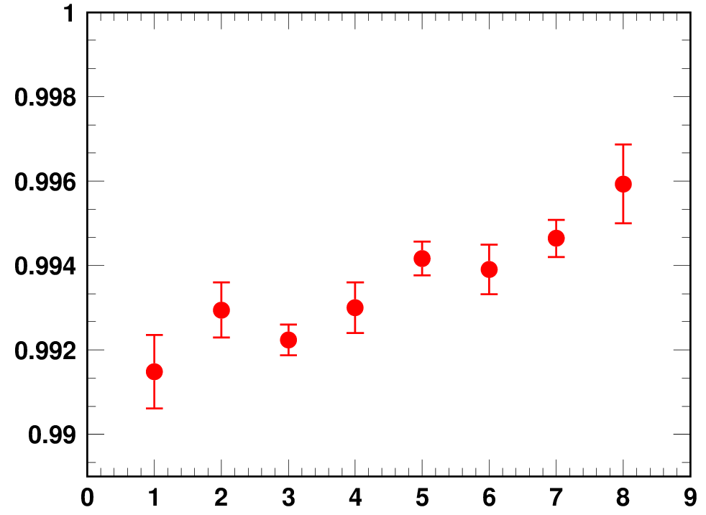
Painting parameter dependence of beam survival rate
● E_{inj}=400 MeV, 553 kW-eq. intensity (Run#54, Apr., 2014)
By adding 100π transverse painting
ID | ε_{tp} (π mm mrad) | V₂/V₁ (%) | Δφ₂ (deg) | Δp/p (%)
1 | - | - | - | -
2 | 100π | - | - | -
3 | - | 80 | -100 | -0.0
4 | - | 80 | -100 | -0.1
5 | - | 80 | -100 | -0.2
6 | 100π | 80 | -100 | -0.0
7 | 100π | 80 | -100 | -0.1
8 | 100π | 80 | -100 | -0.2
By longitudinal
painting
Beam survival rate
No painting
Painting parameter ID
The parameter dependence for nearly flat, but it has a similar dependence to that for the blue circles (injection energy : 181MeV).

Slide 13
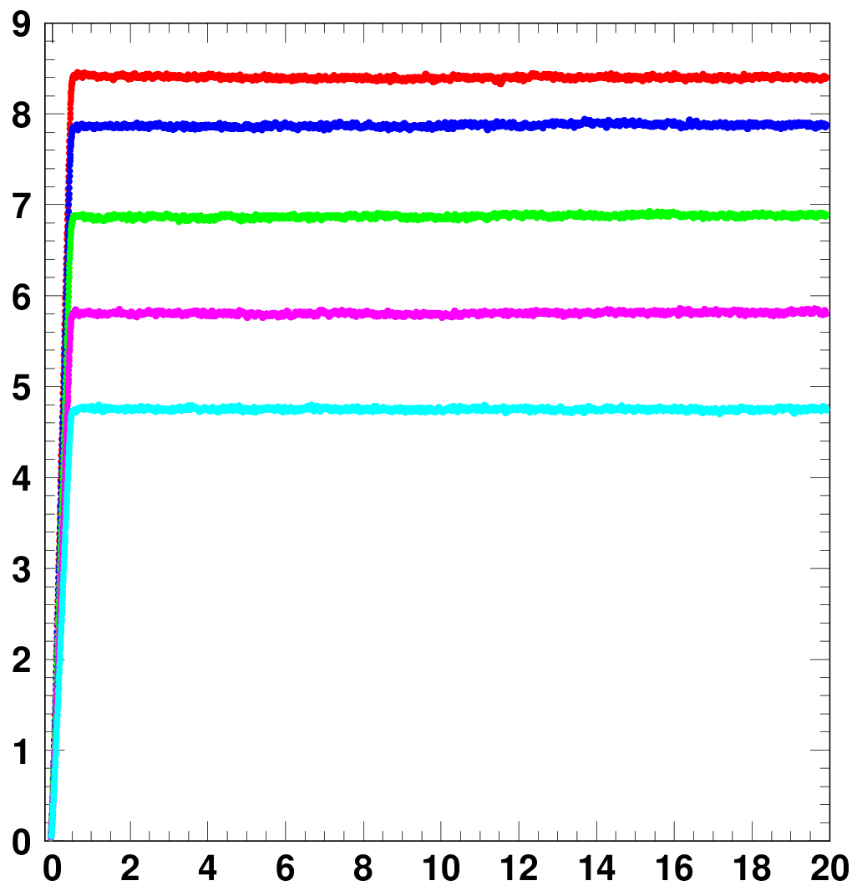
Result of the 1-MW trial in Jan. 2015
Circulating beam intensity over the 20 ms
from injection to extraction measured by CT
Experimental condition
Injection beam condition
Injection energy : 400 MeV
Peak current : 45.0 mA
@ the entrance of RCS
Pulse length : 0.5 ms
Chopper beam-on duty factor : 60%
8.41 x 10¹³ particles/pulse,
corresponding to 1010 kW at 3 GeV
Operating point;
(6.45, 6.42)
Injection painting parameter;
ID8 (100π transverse painting
+ full longitudinal painting)
8.41 x 10¹³ ppp : 1010 kW-eq.
7.86 x 10¹³ ppp : 944 kW-eq.
6.87 x 10¹³ ppp : 825 kW-eq.
5.80 x 10¹³ ppp : 696 kW-eq.
Particles /pulse (x 10¹³)
4.73 x 10¹³ ppp : 568 kW-eq.
In January 10, 2015
we successfully achieved
the 1-MW beam acceleration.
Injection
Time (ms)
Extraction
There is no terrible beam loss, but some unnecessary beam losses was detected at the arc sections.

Slide 14
Beam loss in the high dispersion area (arc sections)
― 8.41 x 10¹³ ppp : 1010 kW-eq.
― 7.86 x 10¹³ ppp : 944 kW-eq.
BLM signal (arb.)
― 6.87 x 10¹³ ppp : 825 kW-eq.
― 5.80 x 10¹³ ppp : 696 kW-eq.
― 4.73 x 10¹³ ppp : 568 kW-eq.
Injection
Time (ms)
Extraction
The beam losses observed for the 944-kW (blue) and 1010 kW (red) beams can be interpreted
as longitudinal beam loss arising from a distortion of the RF bucket
caused by the beam loading effect.
Such beam particles suffer from large momentum excursion and most of them are lost in
the high dispersion area, not at the collimator section located in the dispersion-free section.
This type of longitudinal beam loss has to be cured by beam loading compensation.
But then the anode power supply in the RF system had no enough margin to complete
sufficient beam loading compensation for the 1-MW beam.
We carried out the anode power supply upgrade using the 2015 summer maintenance period.
1MW beam test again in October 2015

Slide 15
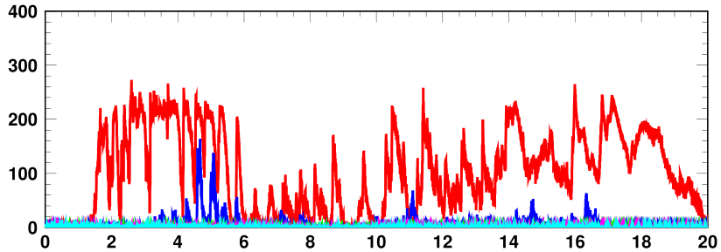
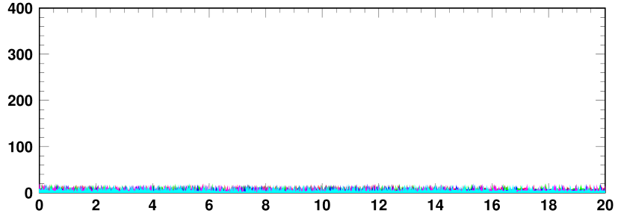
Result of the 1-MW trial in Oct. 2015
BLM signals at the high dispersion area (arc sections)
Injection
Extraction
Run#60
― 8.41 x 10¹³ ppp : 1010 kW-eq.
― 7.86 x 10¹³ ppp : 944 kW-eq.
BLM signal (arb.)
― 6.87 x 10¹³ ppp : 825 kW-eq.
― 5.80 x 10¹³ ppp : 696 kW-eq.
― 4.73 x 10¹³ ppp : 568 kW-eq.
Run#64
― 8.45 x 10¹³ ppp : 1014 kW-eq.
― 7.25 x 10¹³ ppp : 870 kW-eq.
― 6.09 x 10¹³ ppp : 731 kW-eq.
― 5.05 x 10¹³ ppp : 606 kW-eq.
― 3.94 x 10¹³ ppp : 473 kW-eq.
BLM signal (arb.)
Time (ms)
Longitudinal beam loss was well mitigated as expected
by sufficient beam loading compensation after the RF power supply upgrade.

Slide 16
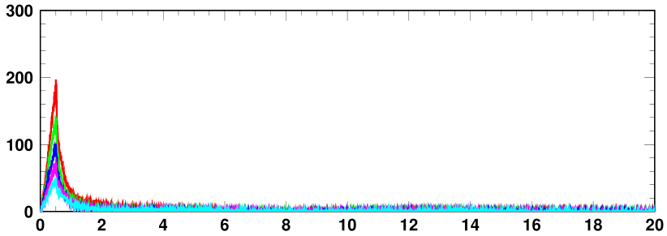
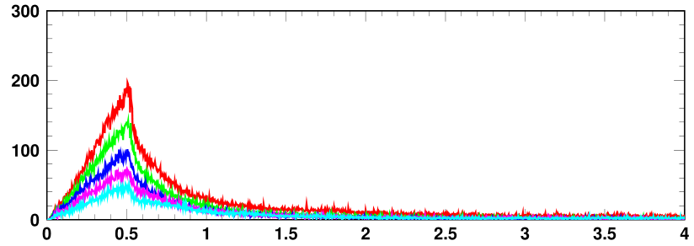
Beam loss at the collimator
BLM signals at the collimator section (dispersion-free straight section)
BLM HV=-600 V
― 8.45 x 10¹³ ppp : 1014 kW-eq.
― 7.25 x 10¹³ ppp : 870 kW-eq.
― 6.09 x 10¹³ ppp : 731 kW-eq.
― 5.05 x 10¹³ ppp : 606 kW-eq.
― 3.94 x 10¹³ ppp : 473 kW-eq.
BLM signal (arb.)
Time (ms)
Injection
Injection bump “ON”
BLM signal (arb.)
Foil scattering beam loss
during charge-exchange injection < 0.1%
Time (ms)
The beam loss at the collimator section mainly arises from foil scattering during injection.
The other beam loss, such as space-charge induced beam loss, was well minimized
by injection painting even for the 1-MW beam.
The remaining beam loss for the 1-MW beam was estimated
to be < 0.1% (< 133 W in power) << Collimator limit of 4 kW.
RCS beam commissioning made big progresses in this beam test.

Slide 17
Recent efforts for further beam loss mitigation
The beam loss other than foil scattering beam loss was well minimized.
Next subject : further mitigation of the foil scattering beam loss
Most of the foil scattering beam loss is well localized at the collimators,
but some of them with large scattering angles cause uncontrolled beam loss,
making relatively high machine activations near the charge-exchange foil;
~15 mSv/h on the chamber surface after the 400-kW beam operation.
~40 mSv/h if the output beam power is increased to 1 MW as is.
This radiation level is still considered to be within the acceptable level
if assuming enough cooling time,
but it has to be reduced as low as possible in terms of preserving a better hands-on-maintenance environment.
further mitigation of the foil scattering beam loss
The amount of the foil scattering beam loss
in proportion to the foil hitting rate during charge-exchange injection.
One possible solution to reduce the foil hitting rate
: to expand the transverse painting area.

Slide 18
Transverse injection painting
Foil
Horizontal painting
by a horizontal closed orbit variation during injection
The foil hitting rate decreases as the horizontal painting area becomes wider,
because the circulating beam more rapidly escapes from the foil thanks to the larger horizontal closed orbit variation.
Vertical painting
by a vertical injection angle change during injection
Vertical painting also acts to reduce the foil hitting rate through the wider painting area than the vertical dimension of the foil.
Estimation of foil-hits number
Foil
Painting area (p mm mrad) | Averaged number of foil-hits per particle
100 | 21
150 | 12
200 | 7
The foil scattering beam loss can be reduced by larger transverse painting.
But such a large transverse painting had not been realized until recently
due to beta function beating
caused by the edge focus of the injection
bump magnets.
vertical dimension of the foil : 20mm

Slide 19
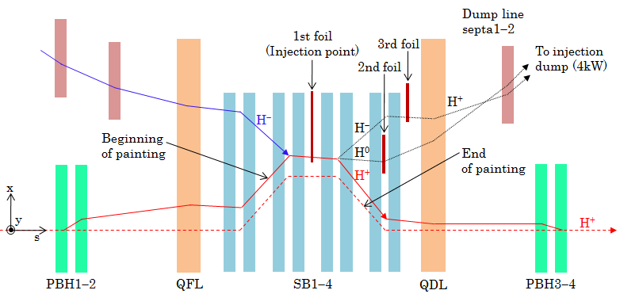
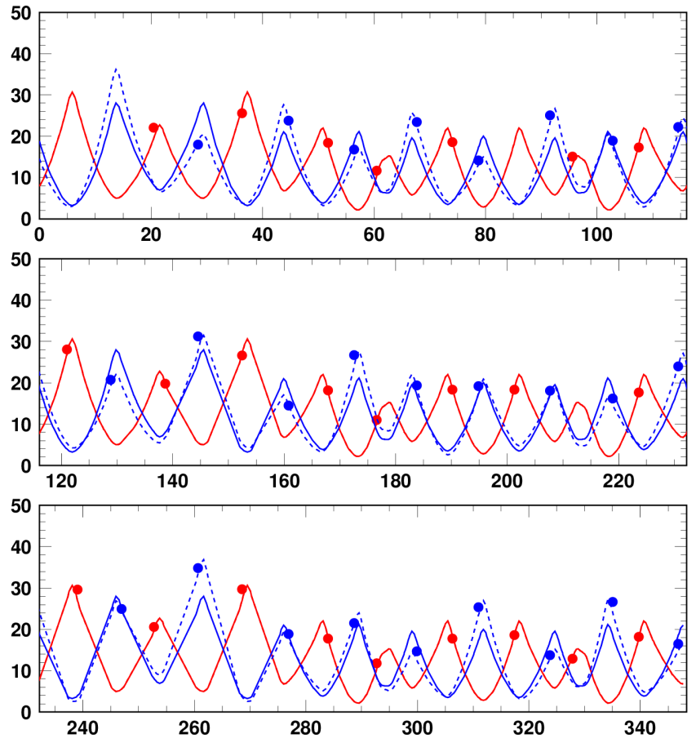
Beta function beating caused by the injection bump magnets
Horizontal (Bump off)
Horizontal (Bump on)
Vertical (Bump off)
Vertical (Bump on)
1st super-period
Beam injection is performed with a time dependent horizontal local bump orbit by using 8 sets of rectangular pulse dipoles magnets (SB1-4 & PBH1-4 ).
2nd super-period
Beta functions (m)
Edge focuses are generated
at the entrance and exit of the injection
bump magnets.
3rd super-period
There is no beta function beating on the horizontal plane,
because the horizontal edge focus effects
are canceled out by another focusing
property intrinsic on the bending plane.
s (m)
Beta function beating caused by the edge
focus of the injection bump magnets

Slide 20
Beta function beating caused by the injection bump magnets
Horizontal (Bump off)
1st super-period
Horizontal (Bump on)
Vertical (Bump off)
Vertical (Bump on)
The vertical edge focus affect the beam as is,
making 30% beta function
beating on the vertical plane
during injection period.
2nd super-period
Beta functions (m)
The beta function beating makes a distortion of the lattice super-periodicity
and additionally excites various
random betatron resonances.
3rd super-period
Such random resonances cause an additional shrinkage of the dynamic aperture during injection period,
and leads to extra beam loss
when applying large transverse
painting.
s (m)
Beta function beating caused by the edge
focus of the injection bump magnets

Slide 21
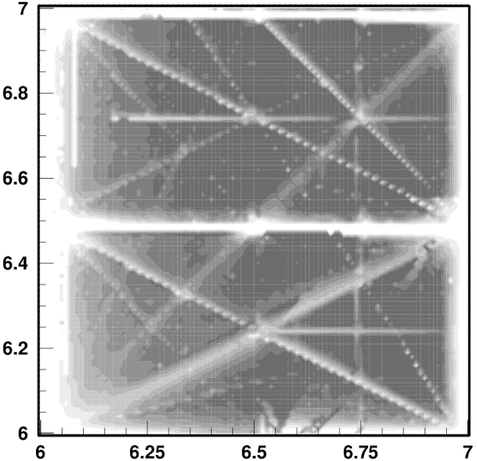
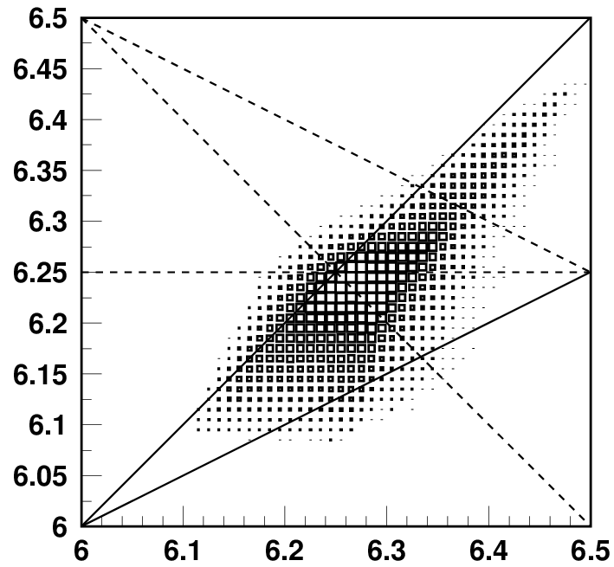
Random betatron resonances
excited through a distortion of the super-periodicity
Present
operating point
(6.45,6.42)
ν_{x}+2ν_{y}=19
Vertical tune ν_{y}
Vertical tune ν_{y}
Horizontal tune ν_{x}
Horizontal tune ν_{x}
Systematic resonances
Random resonances
that can be additionally excited through a distortion of the super-periodicity
on the vertical plane caused by the edge focus.
These random resonances cause a shrinkage of the dynamic aperture
during the injection period, and leads to extra beam loss
when applying large transverse painting.
Especially, this 3rd order sum resonance strongly affects the beam
in the present operational condition.

Slide 22
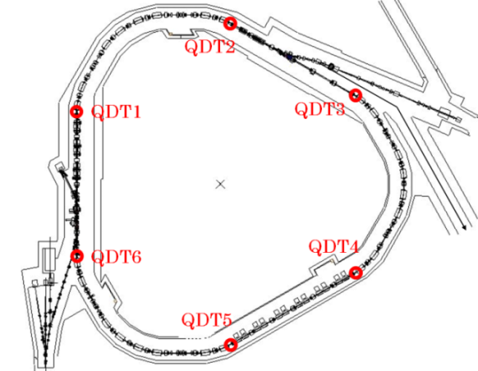
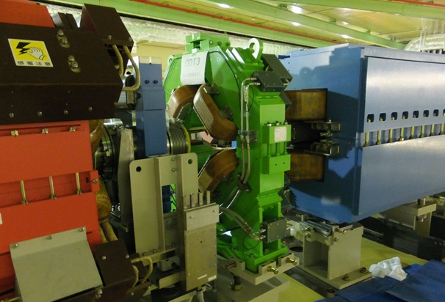
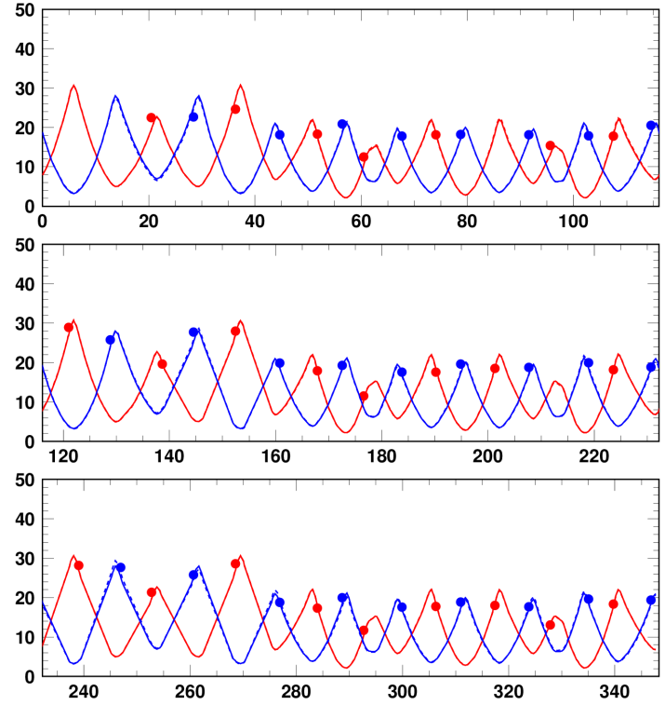
Correction of beta function beating
We have recently installed 6 sets of pulse type quadrupole correctors (QDTs),
to compensate beta function beating, and to minimize the effect of the random resonances
through the recovery of the super-periodic condition.
QDT
Vertical beta function beating was successfully corrected
by QDTs,
while keeping the super-
periodic condition
on the horizontal plane.
Beta function beating correction by these quadrupole correctors
Before correction
After correction
1st super-period
2nd super-period
Beta functions (m)
Beta functions (m)
3rd super-period
s (m)
s (m)

Slide 23
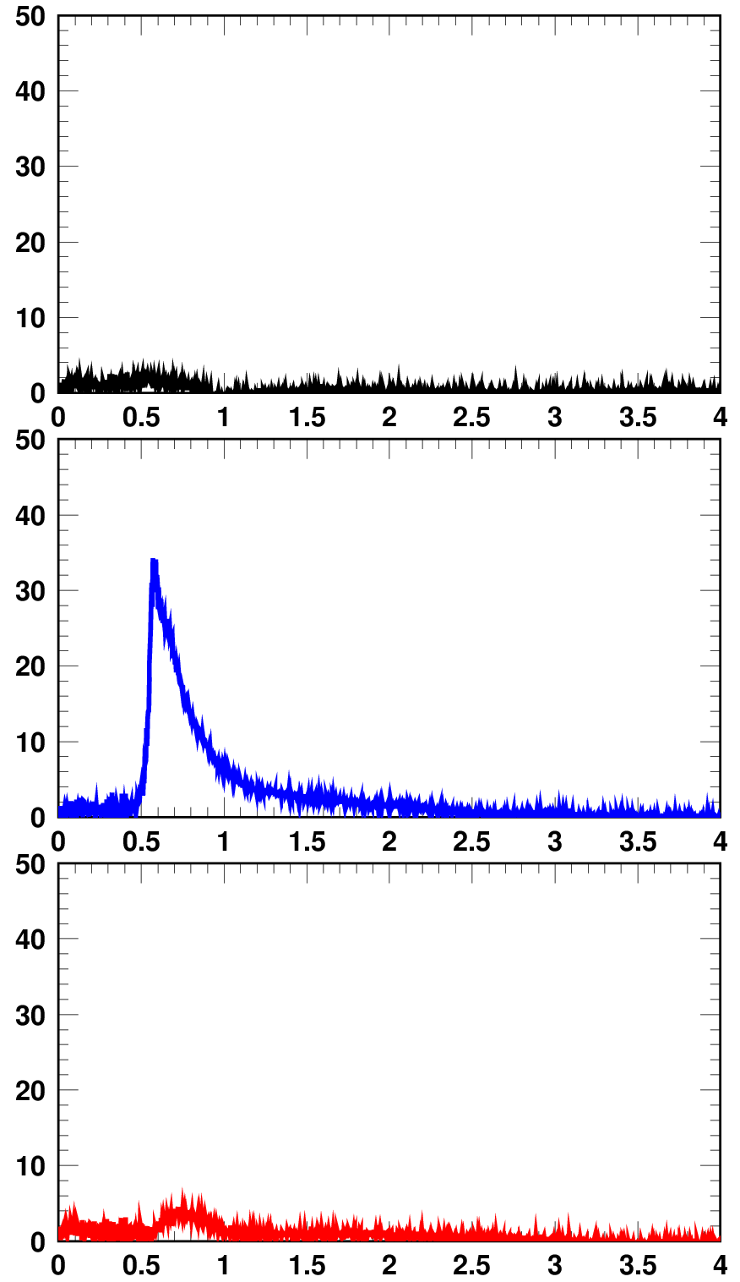
Beam loss reduction by QDTs
BLM signals @ collimator
Experimental condition
Transverse painting area:
100π mm mrad (Horizontal)
100π mm mrad (Vertical)
Injection beam condition
Injection energy : 400 MeV
Peak current : 29.8 mA
@ the entrance of RCS
Pulse length : 0.5 ms
Chopper beam-on duty factor : 60%
⇒ 5.58 x 10¹³ particles/pulse,
corresponding to 670 kW at 3 GeV
Operating point;
(6.45, 6.42)
150π mm mrad (Horizontal)
100π mm mrad (Vertical)
BLM signal (arb.)
When expanding the horizontal
painting area to 150π mm mrad,
significant extra beam loss appeared.
But this beam loss was well mitigated
as expected by introducing QDTs.
150π mm mrad (Horizontal)
100π mm mrad (Vertical)
+ QDTs
Now we are conducting the 500-kW routine
user operation with this large transverse
painting using QDTs.
By this large transverse painting, and also by optimizing the foil position,
the residual radiation level near the charge exchange foil was well reduced as expected.
Time (ms)

Slide 24
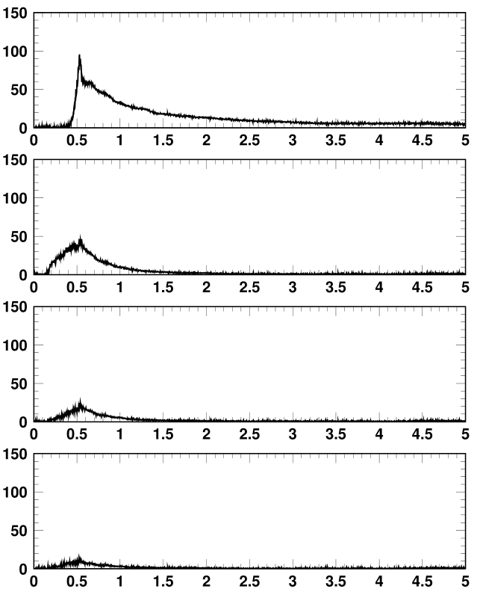
1-MW beam experimental results
BLM signals at the collimator section
(a) 200π-mm-mrad correlated painting
~1.9% loss
By the mitigation of the emittance growth
caused by the ν_{x}-ν_{y} /2ν_{x}-2ν_{y}=0 resonance
(b) 200π–mm-mrad anti-correlated painting
~0.8% loss
By the mitigation of
the ν_{x}+2ν_{y}=19 resonance
BLM signals (arb.)
(c) 200π-mm-mrad anti-correlated painting
No chromatic corr.
~0.4% loss
By the further mitigation of
ν_{x}+2ν_{y}=19 resonance through
the recovery of the lattice super-periodicity
(d) 200π anti-correlated painting
No chromatic corr.
With QDTs
~0.2% loss
The remaining extra beam loss is expected
to be minimized
by optimizing the field patterns of QDTs,
and also by fine adjustment of the betatron tunes.
Time (ms)
We got good prospects of realizing the wide-ranging transverse painting
for the 1-MW beam by introducing both QDTs and anti-correlated painting.

Slide 25
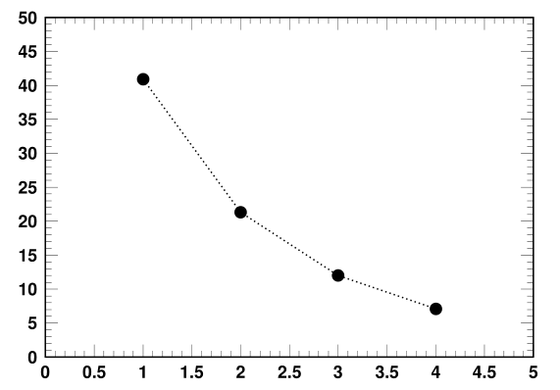
Averaged number of foil-hits per particle during injection
41
ID1: ε_{tp}=100π mm mrad, W=30 mm, Δx=13 mm
ID2: ε_{tp}=100π mm mrad, W=20 mm, Δx=9 mm
ID3: ε_{tp}=150π mm mrad, W=20 mm, Δx=9 mm
ID4: ε_{tp}=200π mm mrad, W=20 mm, Δx=9 mm
Number of foil hits
21
Charge-exchange foil (330-μg/cm²-thick HBC)
12
Injection
beam
W=30 mm
Δx=13mm
7
The foil was pulled
out by 4 mm and
its size is also reduced.
W=20 mm
Δx=9mm
Parameter ID
Now we perform 500-kW routine beam operation with ID3.
The present residual radiation level near the charge exchange foil is
~4.5 mSv/h on the chamber surface, which is sufficiently within the acceptable level.
When we realize 200π-mm-mrad transverse painting,
the radiation level can be kept at the same level as the present value
( ~5.3 mSv/h on the chamber surface) even for the 1-MW operation.
We continue the beam test aiming to realize the wide-ranging transverse painting before startup of the 1-MW routine user operation.

Slide 26
Summary
We started 1-MW beam tuning from October 2014,
and successfully achieved 1-MW beam acceleration in January 2015.
Major part of beam loss, such as space-charge induced beam
was well minimized by the injection painting technique.
The remaining beam loss is mainly from foil scattering during injection.
The transverse painting area was successfully expanded by correcting beta function beating during injection caused by the edge focus of the injection bump magnets, by which the foil scattering beam loss was further reduced.
By these efforts, now the beam loss is at the permissible level for the 1-MW routine beam operation.
The 1-MW routine beam operation is ready.
Present output beam power for the routine user program is 500kW, and we plan to continue this situation from end of this December required from the MLF.
We will be gradually increasing the routine output beam power by 100-kW step every one month or two month from next June.
If this beam power ramp-up scenario is going well, the 1-MW routine beam operation will be to start up from next autumn.

Slide 27
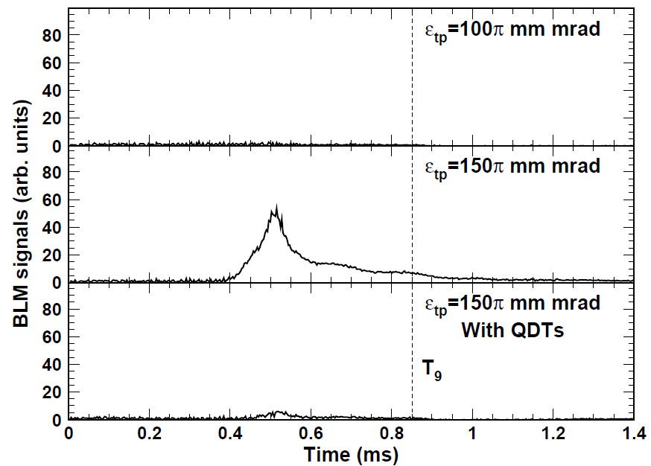
Beam loss reduction by QDTs (Run#63)
Experimental condition
BLM signals at the collimator section
Date : June, 2015 (Run#63)
Injection beam condition
Injection energy : 400 MeV
Peak current : 37.6 mA
@ the entrance of RCS
Pulse length : 0.5 ms
Chopper beam-on duty factor : 60%
⇒ 7.06 x 10¹³ particles/pulse,
corresponding to 847 kW at 3 GeV
Operating point;
(6.45, 6.38)
(i)
BLM HV=-300 V
(ii)
(iii)
(ii) When expanding the transverse
painting area to 150π mm mrad,
significant extra beam loss appeared.
(iii) The extra beam loss was well mitigated
as expected by introducing QDTs.

Slide 28
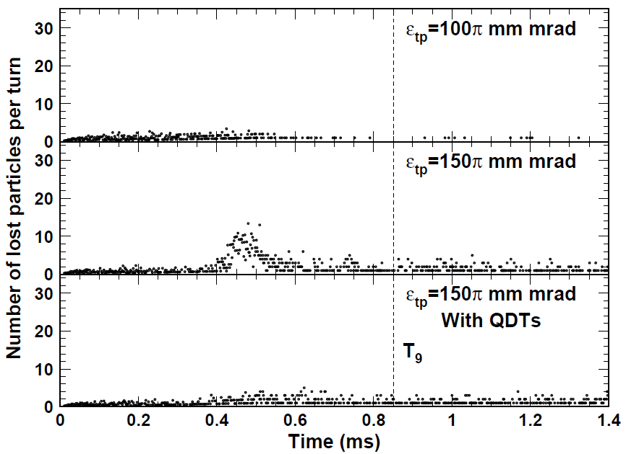
Measurement vs Numerical simulation
Measurement
(BLM signals at the collimator section)
Numerical simulation by “Simpsons”
(i)
(i)
(ii)
(ii)
(iii)
(iii)
The experimental results were well reproduced by numerical simulations.
We investigated more detailed beam loss mechanism
using the numerical simulation results.

Slide 29
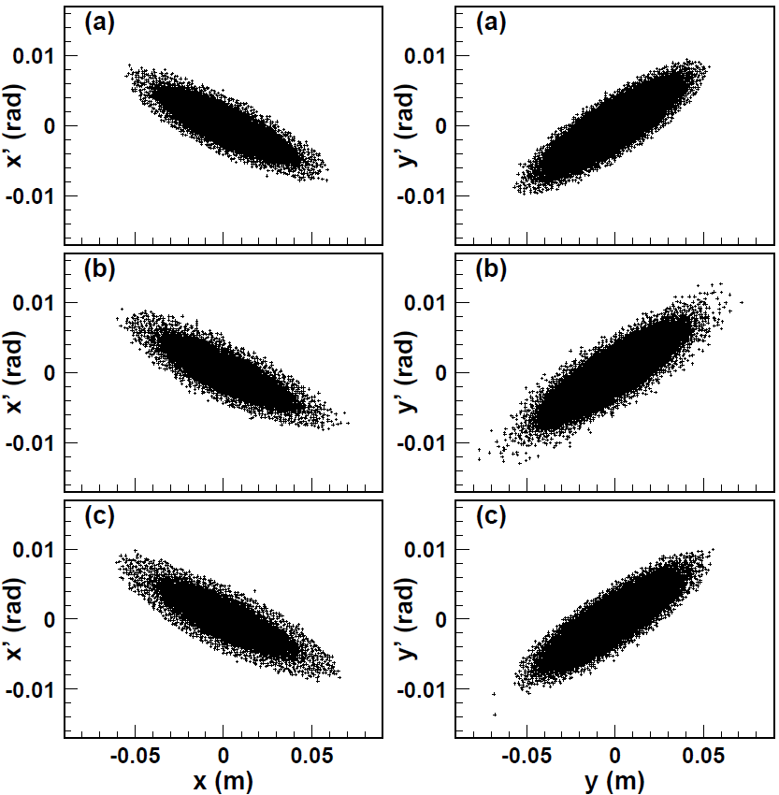
Beam halo formation caused by the edge focus
Transverse phase space coordinates
at the end of injection calculated
with ε_{tp}=150π mm mrad
Without edge focus
The edge focus enhances
beam halo formation
especially on the vertical plane.
The beam halo formation
causes the extra beam loss
observed when expanding
the transverse painting area.
The beam halo is well mitigated
by QDTs, by which the extra beam
loss is minimized.
With edge focus
With edge focus & QDTs

Slide 30
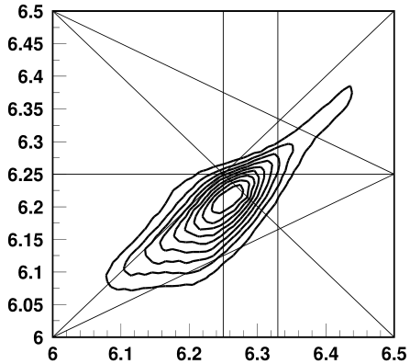
Random betatron resonances
excited through a distortion of the super-periodicity
Operating bare tunes : (6.45, 6.38)
Systematic resonances
Random resonances
that can be additionally excited through
a distortion of the super-periodicity
caused by the edge focus
of the injection bump magnets
Vertical tune ν_{y}
Horizontal tune ν_{x}
The edge focus of the injection bump magnets make a distortion
of the lattice super-periodicity only on the vertical plane.
Therefore, it selectively excites random resonances related
to the vertical motion and its coupling to the horizontal motion.
The beam halo formation mainly arises from these random betatron resonances.
To identify the most critical random resonance for the beam halo formation,
the single-particle behavior of each macro particle was investigated.

Slide 31
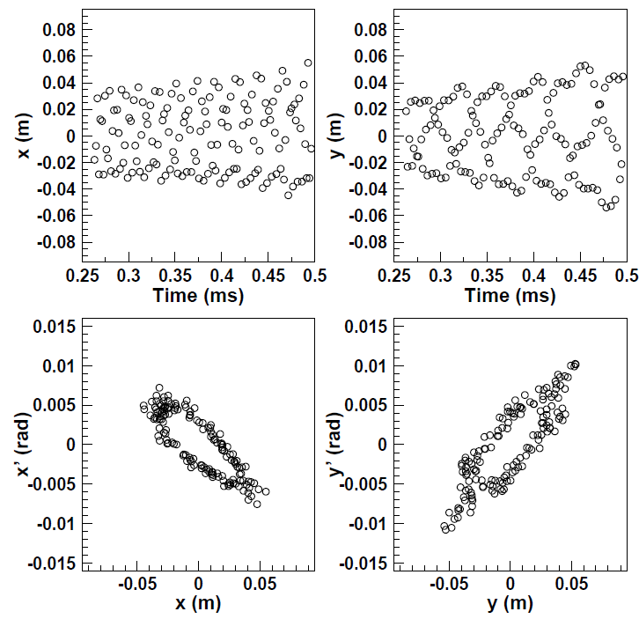
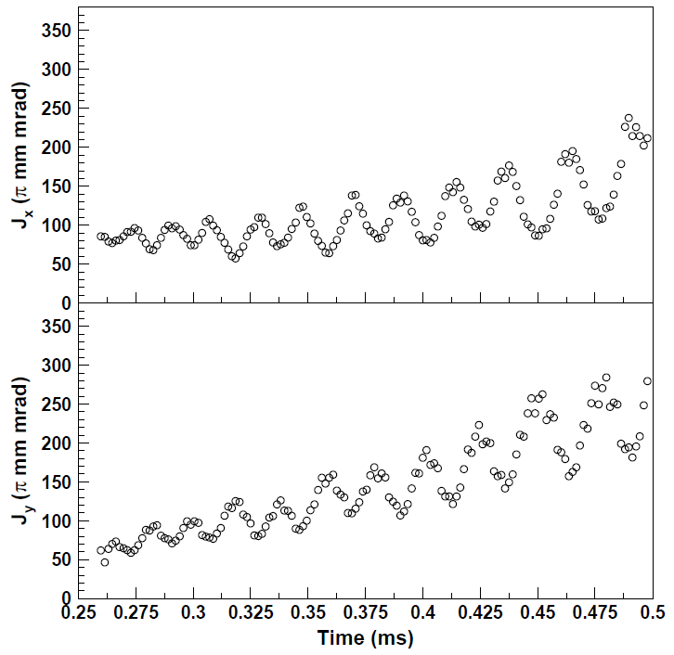
Typical sample of the turn-by-turn incoherent motion
of one macro-particle that forms the beam halo
Turn-by-turn incoherent oscillation
Turn-by-turn betatron actions
The betatron actions gradually increase on both
horizontal and vertical planes while oscillating.
This single-particle behavior can be interpreted
as the combined effect of two resonances
ν_{x}+2ν_{y}=19 and ν_{x}−ν_{y} /2ν_{x}−2ν_{y}=0.

Slide 32
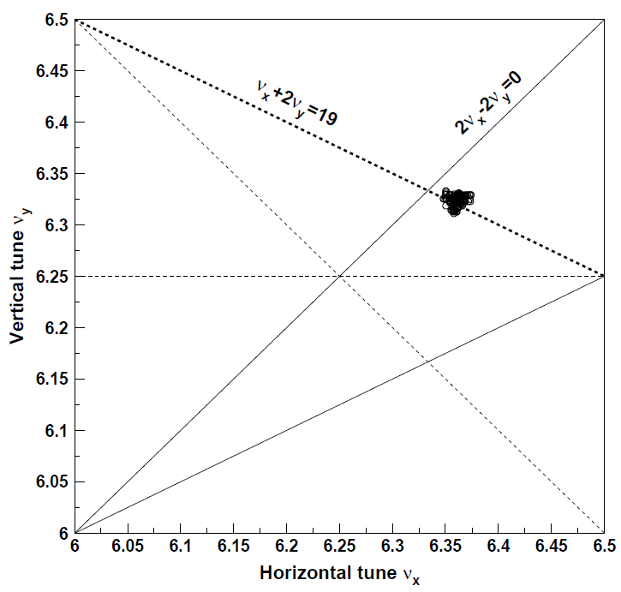
Behavior of a beam halo particle
Turn-by-turn incoherent tunes
The incoherent tunes are located
on the ν_{x}+2ν_{y}=19 resonance as well as
near the ν_{x}−ν_{y} / 2ν_{x}−2ν_{y}=0 resonances.
ν_{x}+2ν_{y}=19 (Random resonance);
- arises from the chromatic correction sextupole field
and the intrinsic sextupole field component
in the main bending magnets, and is additionally
excited by a distortion of the lattice super-
periodicity caused by the edge focus of
the injection bump magnets.
- induces emittance growth on both horizontal and
vertical planes while 2J_{x}−J_{y} =const.
- leads to two times larger emittance growth on
the vertical plane than that on the horizontal plane.
ν_{x}−ν_{y} / 2ν_{x}−2ν_{y}=0 (Systematic resonance);
- is excited by skew quadrupole errors,
2nd order effect of the sextupole field, and
octupole component in the space charge field
- induces emittance exchange between
the horizontal and the vertical planes
while J_{x}+J_{y} =const.

Slide 33
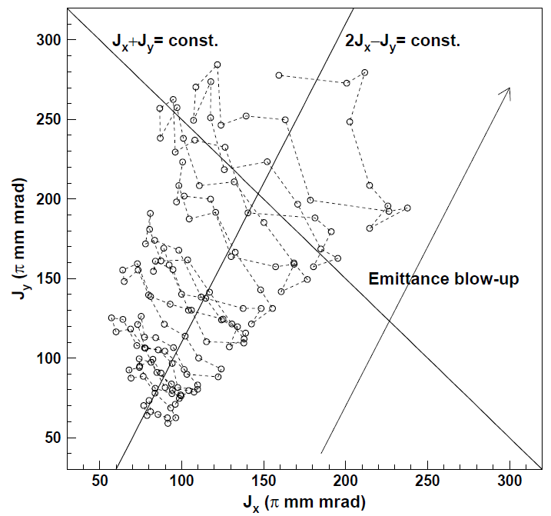
Behavior of a beam halo particle
2D plot of turn-by-turn betatron actions
This analysis confirmed :
- Most of the beam halo particles
are generated through such a single-particle
behavior caused by the two resonances.
- The contribution of the ν_{x}+2ν_{y}=19 resonance
is more critical for the observed extra beam loss,
because the resonance causes more severe
beam halo formation on the vertical plane.
This analysis suggest a possibility :
the further expansion of transverse painting
area may be realized by reducing
the effect of the ν_{x}-ν_{y} /2ν_{x}-2ν_{y}=0 resonance,
as well as mitigating
the ν_{x}+2ν_{y}=19 resonance with QDTs.
ν_{x}+2ν_{y}=19
ν_{x}−ν_{y}/2ν_{x}−2ν_{y}=0
Characteristic emittance blow-up
that implies the combined effect
of the two resonances,
ν_{x}+2ν_{y}=19 and ν_{x}−ν_{y} /2ν_{x}−2ν_{y}=0;
The horizontal and vertical actions
gradually grow up along the line of
2J_{x}−J_{y}=const., while oscillating
in a direction parallel to the line of
J_{x}+J_{y}=const..
“Anti-correlated painting”
Anti-correlated painting has several
advantages for mitigating the effect of
the ν_{x}-ν_{y} /2ν_{x}-2ν_{y}=0 resonance.

Slide 34
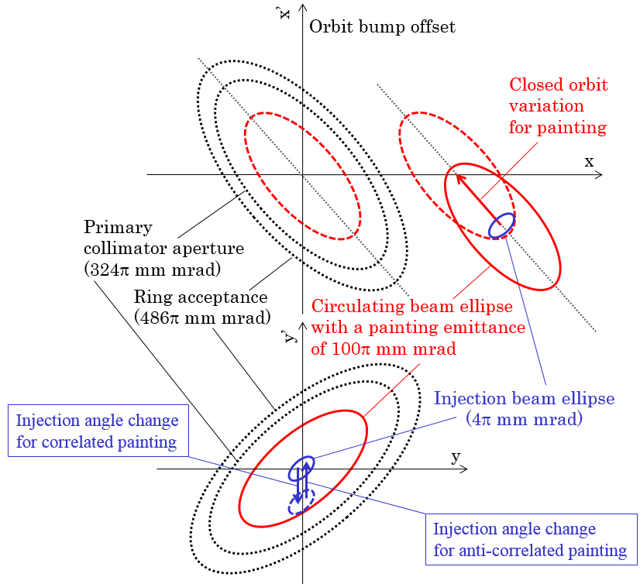
Introduction of “Anti-correlated painting”
In the RCS, both correlated and
anti-correlated painting are available.
Correlated painting:
the injection beam is filled
from the middle to the outside
on both horizontal and vertical planes.
Anti-correlated painting:
the direction of the vertical
injection angle change is reversed.
⇒ the injection beam is filled
from the outside to the middle
on the vertical plane,
in reverse to
the horizontal painting process.

Slide 35
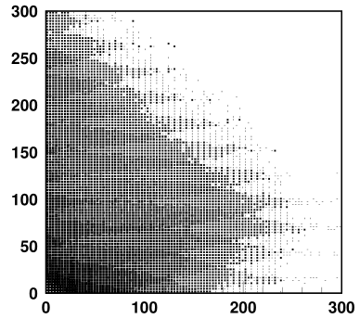
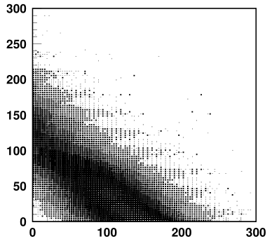
Correlated painting vs Anti-correlated painting
Anti-correlated painting has several advantages
for mitigating the effect of the ν_{x}-ν_{y} /2ν_{x}-2ν_{y}=0 resonance.
Correlated painting
Anti-correlated painting
Emittance-exchange
oscillation
Emittance-exchange
oscillation
Calculated
@ the end of inj.
ε_{y} (π mm mrad)
ε_{y} (π mm mrad)
ε_{x} (π mm mrad)
ε_{x} (π mm mrad)
To the direction of beam painting,
the emittance exchange caused
by the ν_{x}-ν_{y} /2ν_{x}-2ν_{y}=0 resonance occurs in the orthogonal direction.
The direction of beam painting is
the same as the direction
of the emittance exchange.
The emittance exchange is directly
connected to the emittance growth.
The emittance exchange does not
lead to the emittance growth.

Slide 36
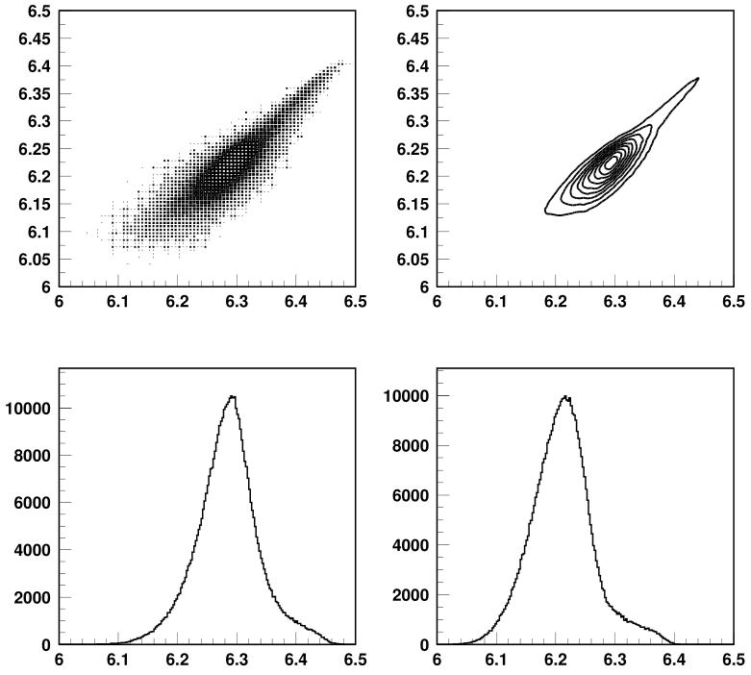
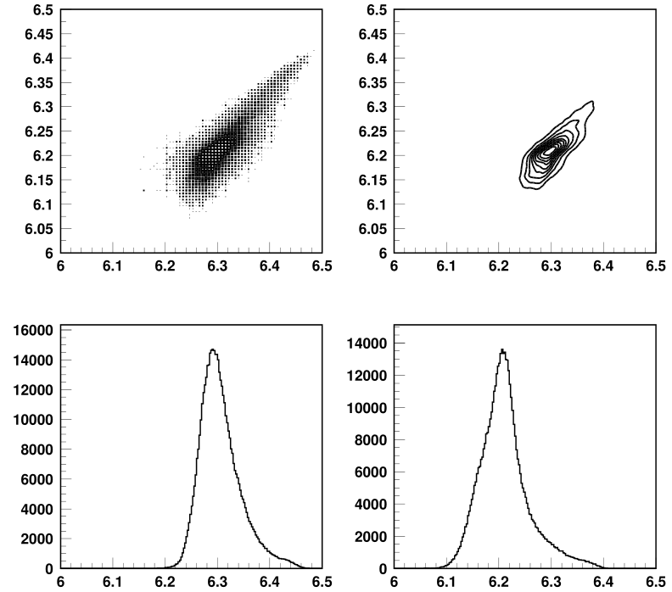
Correlated painting vs Anti-correlated painting
Another advantage of the anti-correlated painting is
to make a KV-like distribution.
Anti-correlated painting acts to reduce ;
- the octupole component of the space-charge field,
leading to the mitigation of the 2ν_{x}-2ν_{y}=0 resonance.
- the space charge tune spread
thanks to less octupole field component.
Correlated painting
Anti-correlated painting
Vertical tune ν_{y}
Vertical tune ν_{y}
Horizontal tune ν_{x}
Horizontal tune ν_{x}
Horizontal tune ν_{x}
Vertical tune ν_{y}
Horizontal tune ν_{x}
Vertical tune ν_{y}

