Slide 1
2nd Harmonic Perpendicular Biased Cavity for Booster
C.Y. Tan
Booster workshop
23 Nov 2015

Slide 2
People
C.Y. Tan, W. Pellico (Proton source)
G. Romanov, I. Terechkine (TD)
R. Madrak, D. Sun, J. Dey (RF group)
K. Duel (Mechanical)
A lot of work has been done, especially simulations to get us to this point. Preliminary work started in summer 2013! First group meeting in Apr 2014.

Slide 3
Motivation and goals
Motivation
  To improve capture efficiency in the Booster at injection.
  To improve efficiency of transition crossing.
Goal
  Build a 2nd harmonic cavity
  Use as much as possible existing RF infrastructure
    Tube Y567
      Power module
    Bias supplies
Choice of biasing
  Parallel
    Currently used in Booster
  Perpendicular
    Currently used in Recycler capture cavities (10 kHz swing)

Slide 4
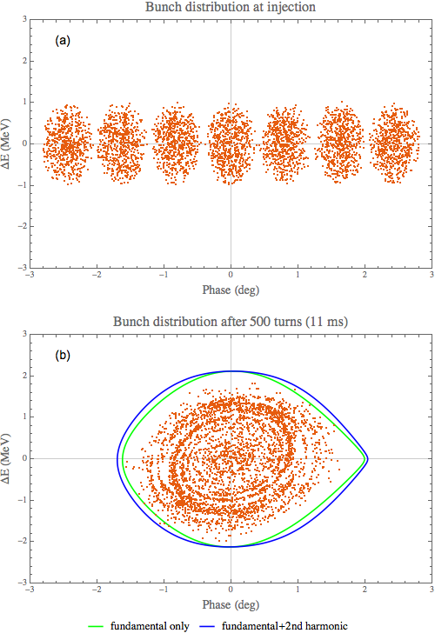
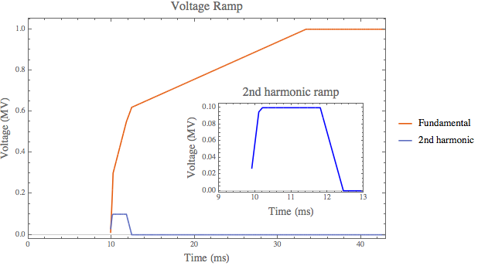
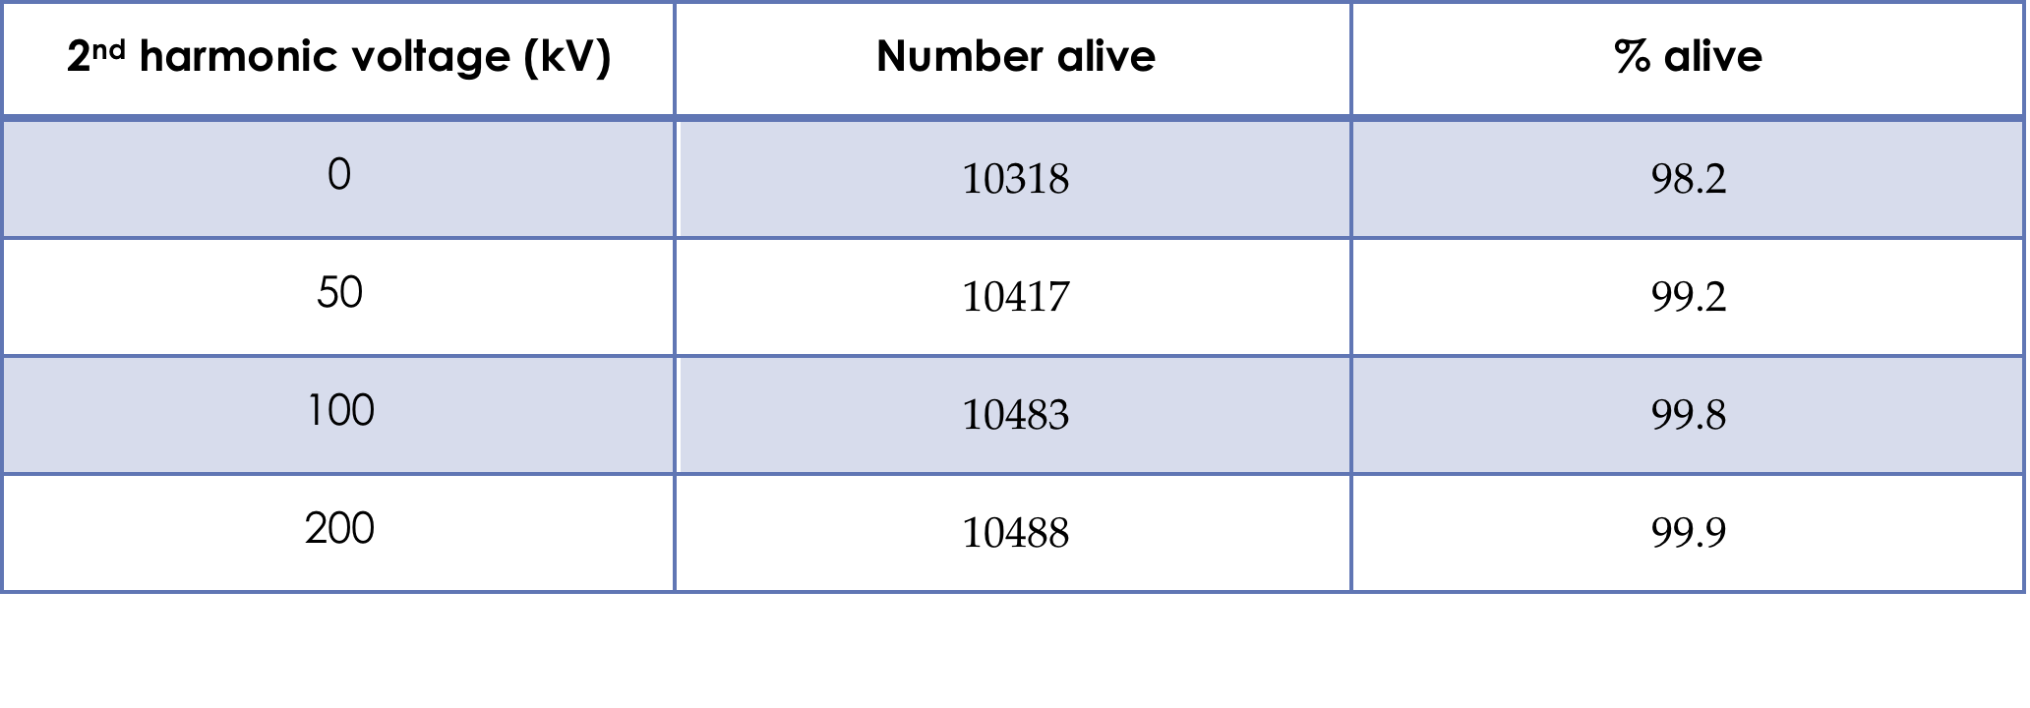
Capture
Add in 2nd harmonic cavity to help with capture
  Flattens bucket
  Increases bucket area
ESME simulation with 10500 particles, 5e12 protons at injection with 200 MHz Linac bunch structure.
  Improvement of ~1.5 – 2% at 100 kV with 2nd harmonic cavity than without.

Slide 5
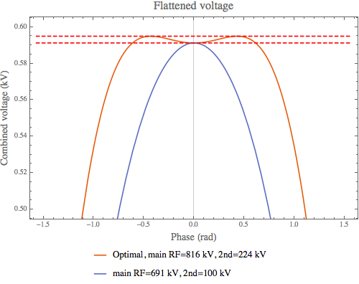
Transition crossing
There is a quadrupole oscillation after transition from bucket mismatch after transition even without space charge.
Goal is to use 2nd harmonic to reduce mismatch.
One method is focus free transition crossing (FFTC).
  Note this is an example
    For FFTC to work, we have to have ~200 kV 2nd harmonic voltage
      This requires 2 2nd harmonic cavities.
    The idea is to flatten the RF voltage across the bunch before and after transition.
    This makes bunch “drift” with acceleration across transition.
    And an accelerating bucket with only the main RF is matched to the bunch distribution after transition.
  FFTC has been demonstrated to work in Main Ring.
    Bhat et al, “Transition crossing in proton synchrotrons using a flattened rf wave”, Phys Rev E, Vol 55, Num 1, 1028-1034, 1997.

Slide 6
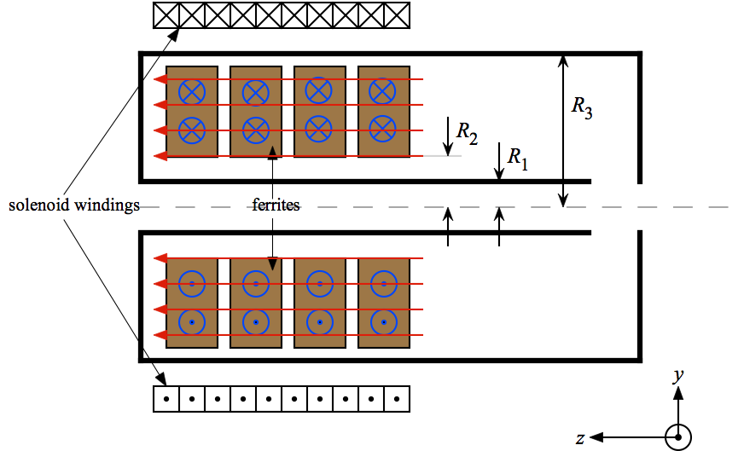
What is perpendicular bias?
Ferrite material is usually a “garnet”: Al doped Yttrium Iron Garnet “YIG”.

Slide 7
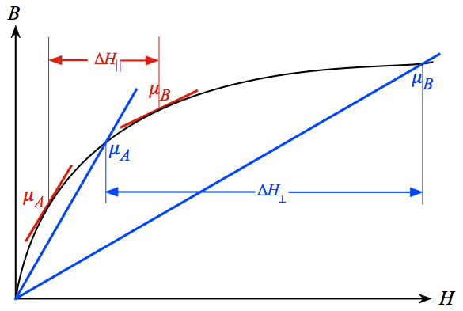
μ values in parallel and perpendicular biasing

Slide 8
Perpendicular bias vs Parallel bias
Garnet – Al doped ferrite that contains yttrium.
Perpendicular biased garnet has higher Q than parallel bias
  Q can be a factor of 2 to 4 times higher (frequency dependent)
  Higher Q means higher gap voltage
  Higher Q means lower average power loss in garnet
Made the technical choice of doing a perpendicular biased cavity to get 100 kV in a cavity < 1 m long.
However, losses are not uniform in garnet
  Local hotspots have to be taken care of with cooling
  Location of hotspot makes cooling a challenge
Heating is the major cause of prior failures of perpendicular cavities with a large frequency swing > 10 MHz.
  Special care and feeding to make sure that this does not happen.

Slide 9
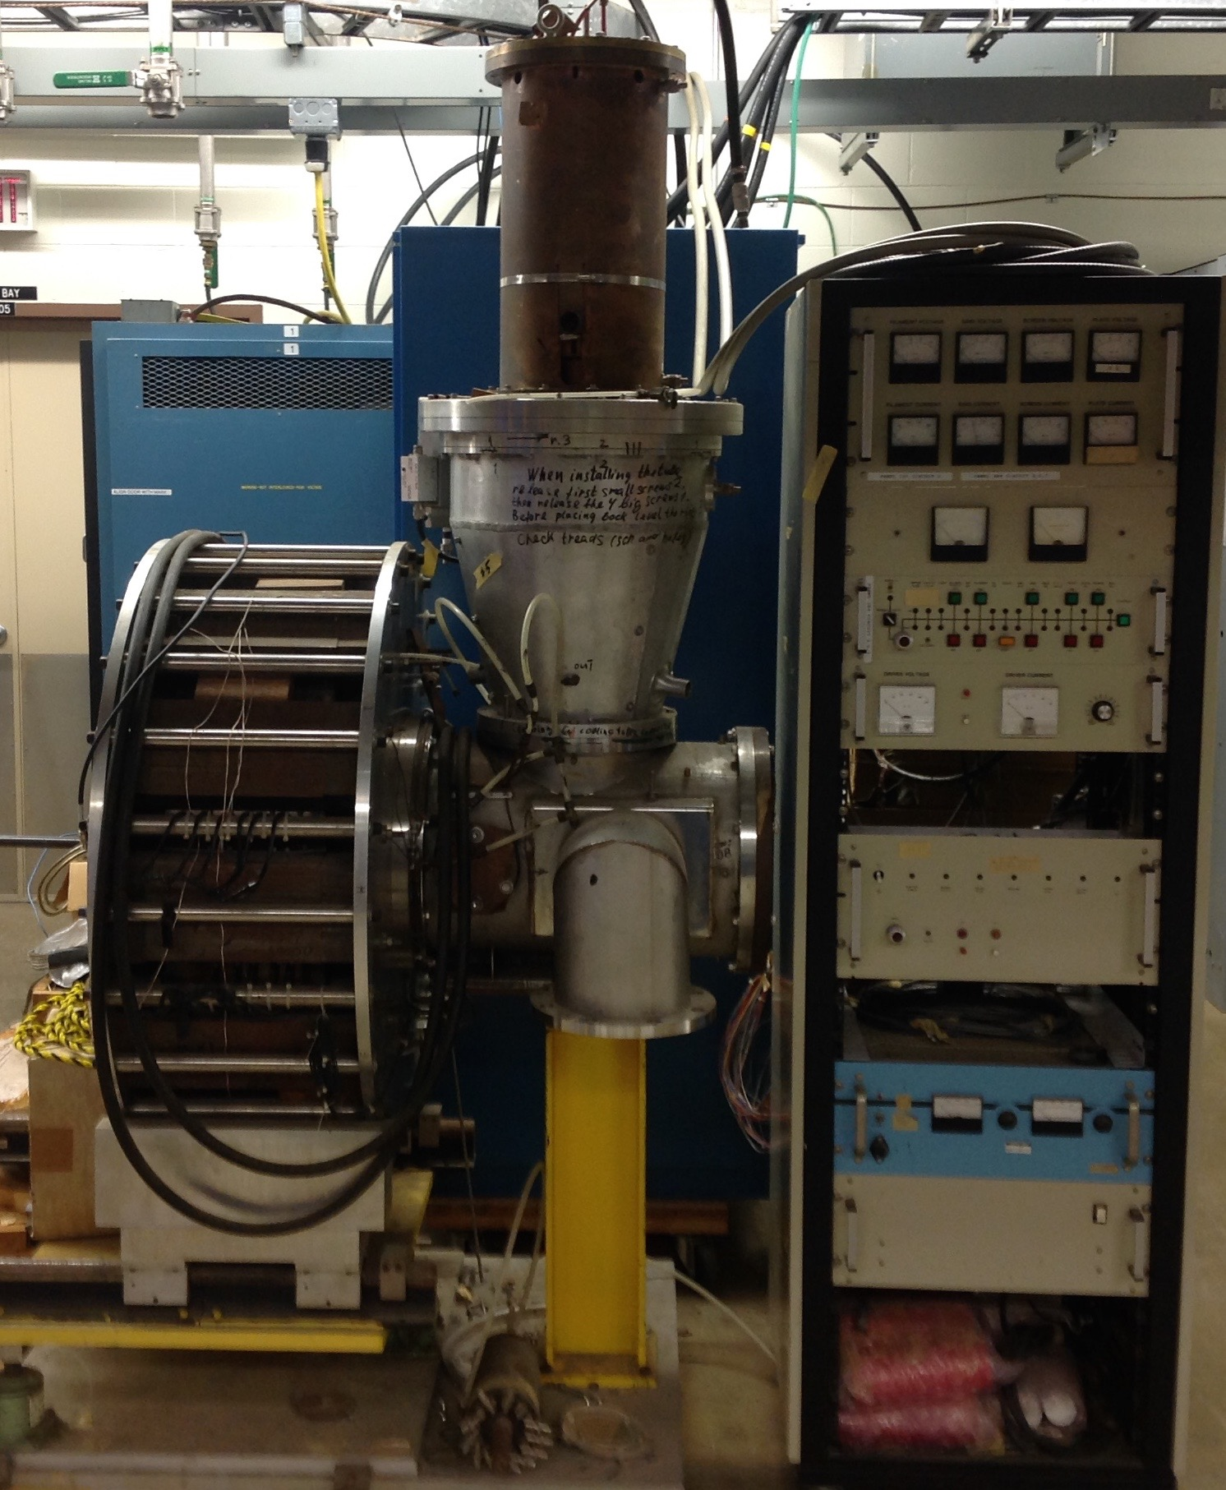
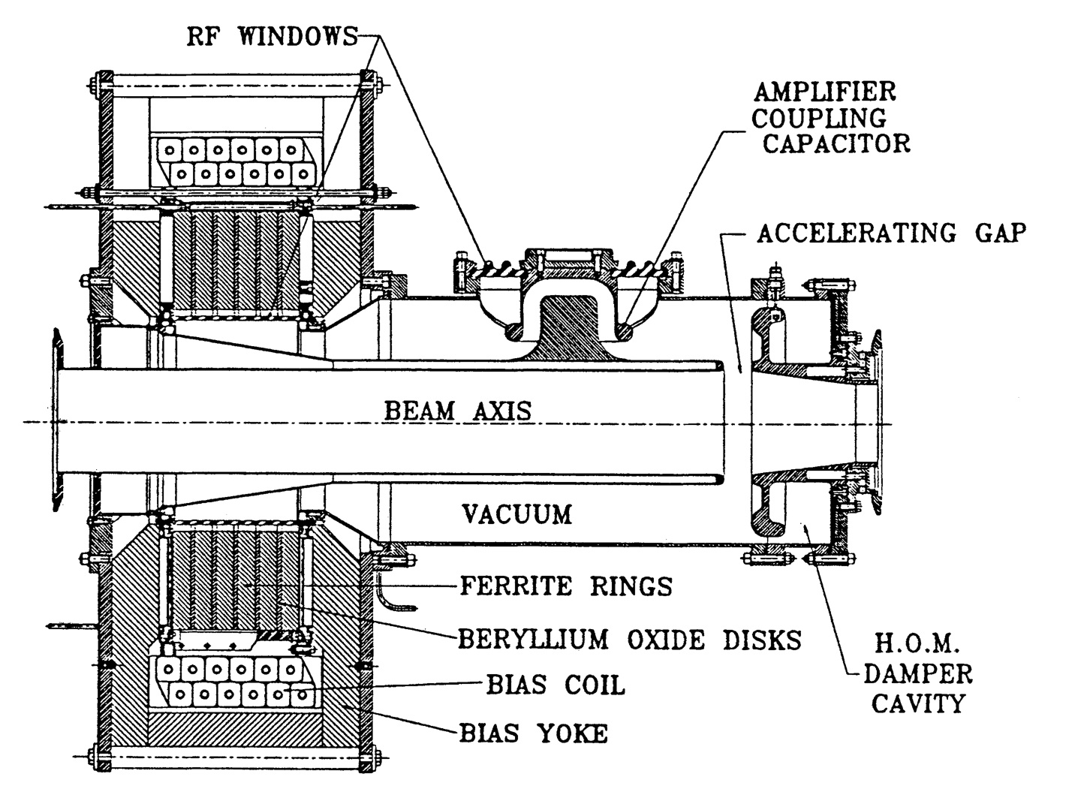
TRIUMF cavity
Freq. range: 47.5 – 60 MHz (Δf = 12.5 MHz)
Note: Recycler cavities used for slip stacking also has perpendicular biased tuners. But tuning range is small ~ 10 kHz

Slide 10
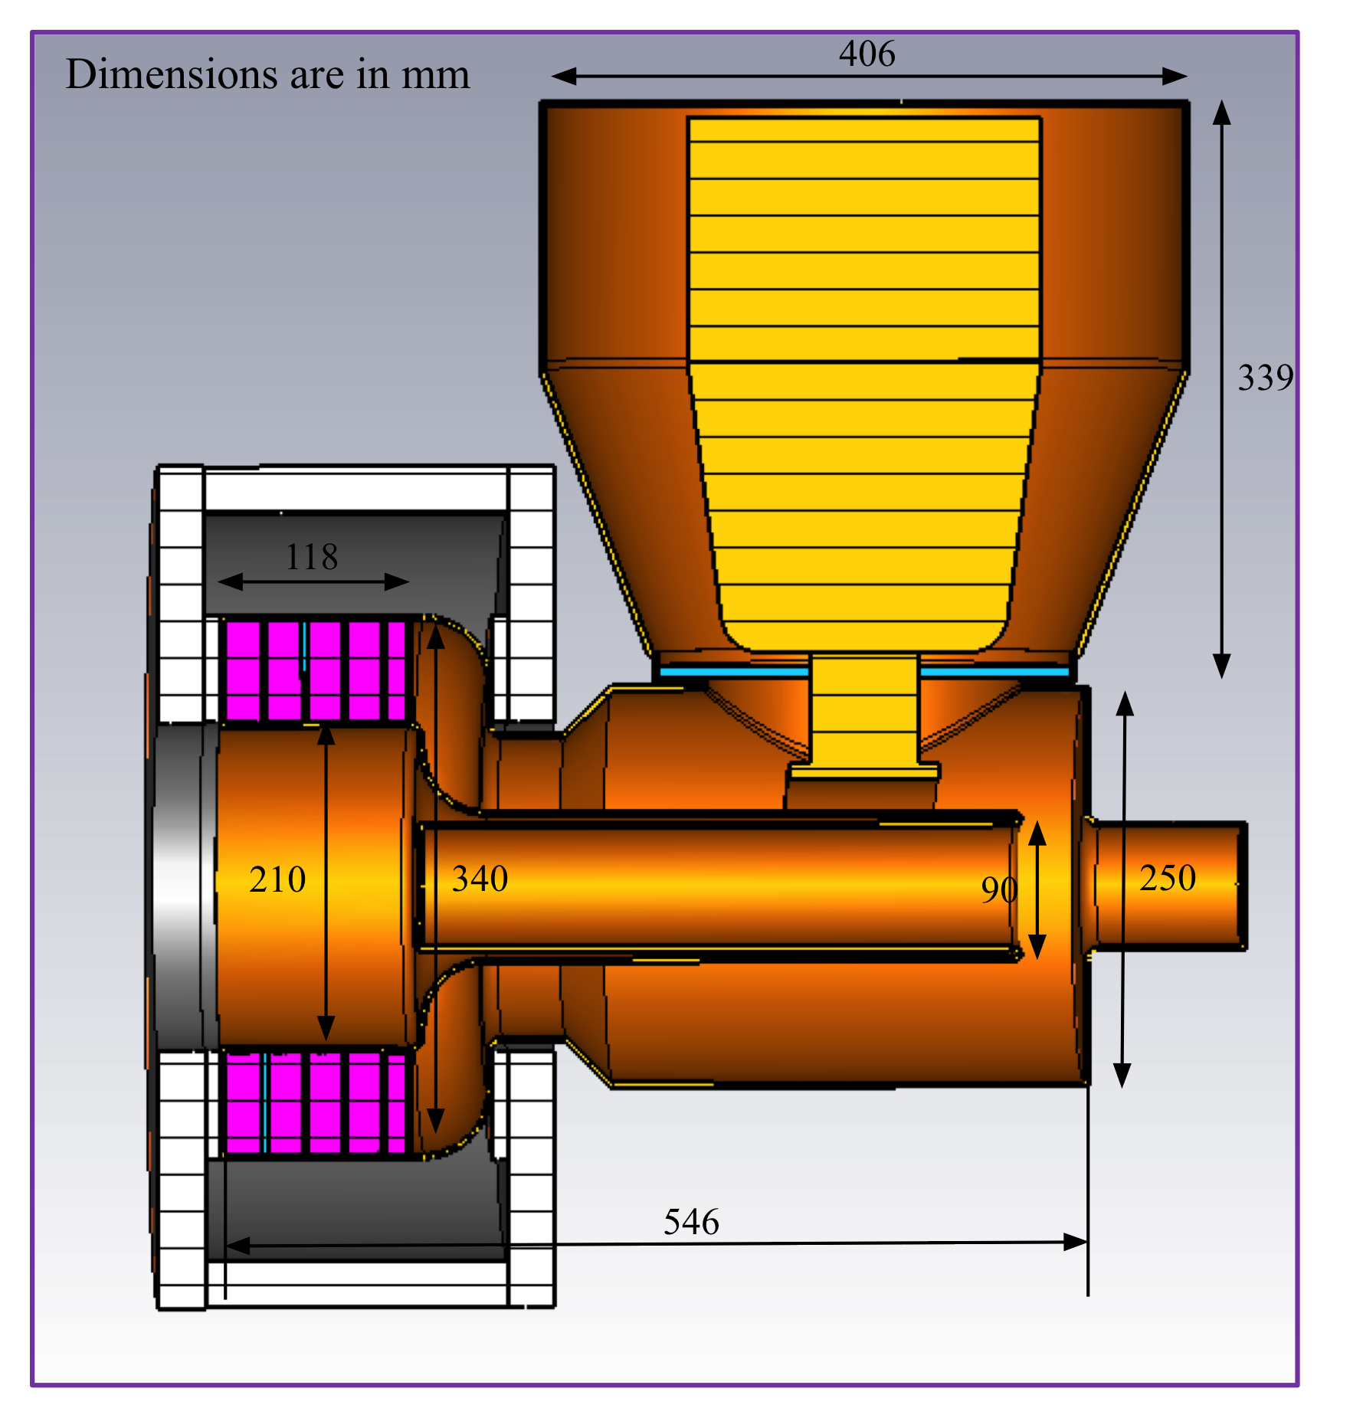
Cavity (as of 08 Oct 2015)
Power module is modified Booster power module
Uses same Y567 tube
Beampipe ID to match 3”.
Frequency range: 76 – 106 MHz (Δf = 30 MHz)
Not shown:
RF windows.
HOM damper cavity
Final solenoid design.
Refinements continue.

Slide 11
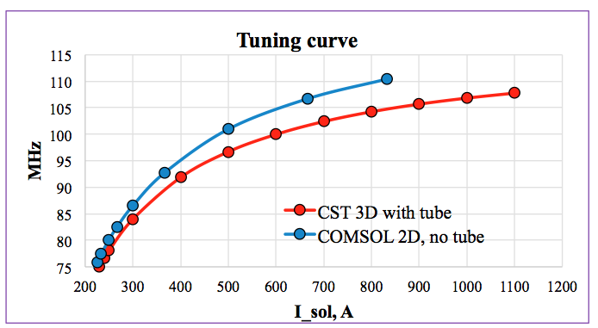
Tuning range and proposed ramps
injection: 75.73 MHz
transition: 104.5 MHz
The tuning range is 30 MHz starting from 76 MHz to 106 MHz
Reduce duty factor to 3 ms on at injection and 3 ms on at transition to mitigate any heating problems.
Duty factor 10%.

Slide 12
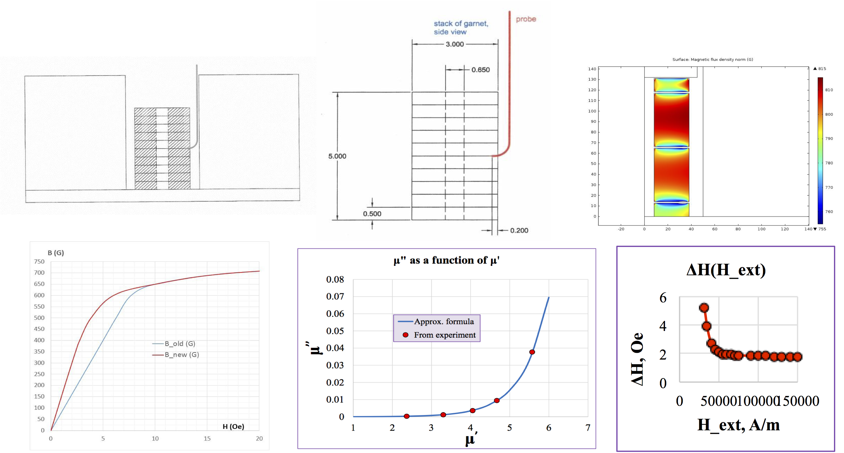
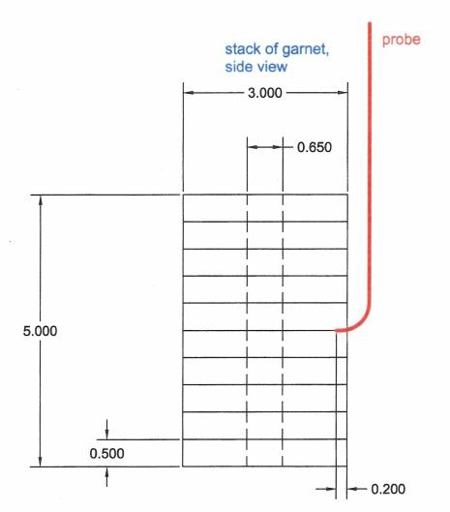
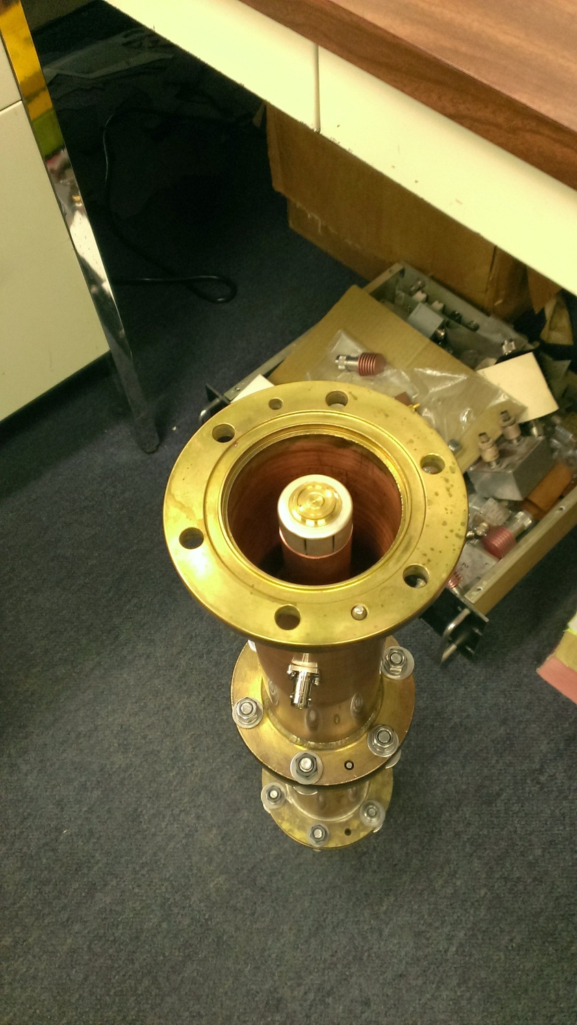
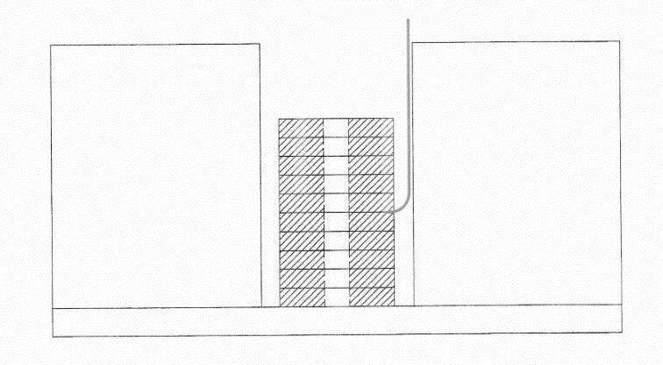
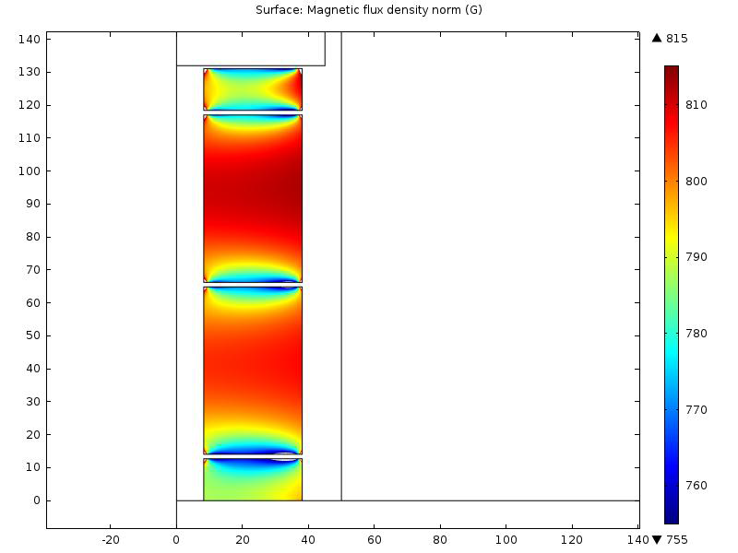
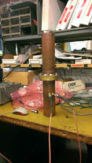
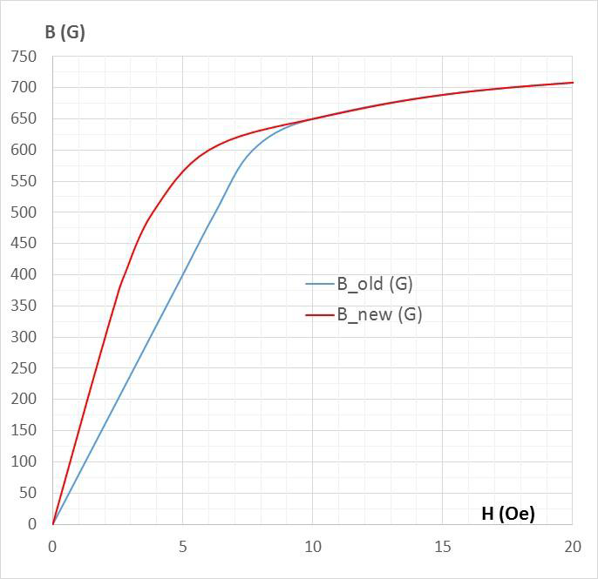
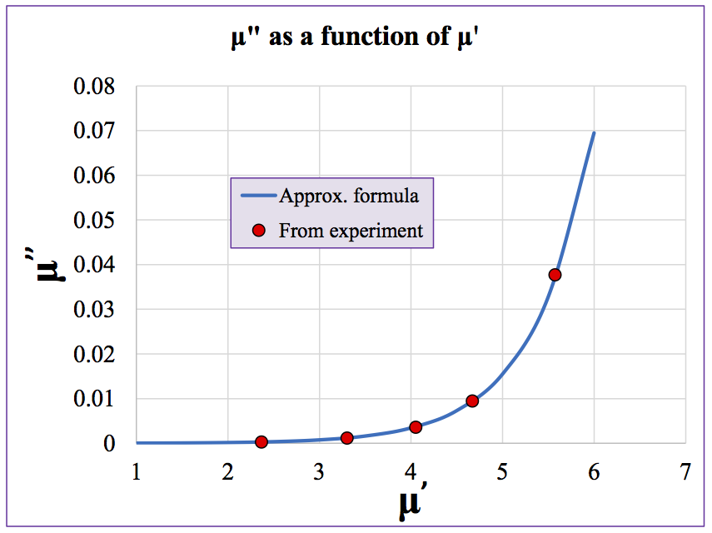
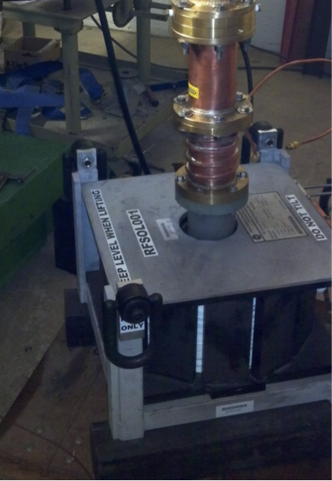
Measurement of AL800 loss tangent
Surface magnetic flux density
300 G
It is critical to get the loss tangent tanδ = μ’’/μ’ correct.
I. Terechine, G. Romanov (TD) and R. Madrak (AD) spent 6 months doing both simulations and measurements to get these numbers.
These are the best measurements of AL800.

Slide 13
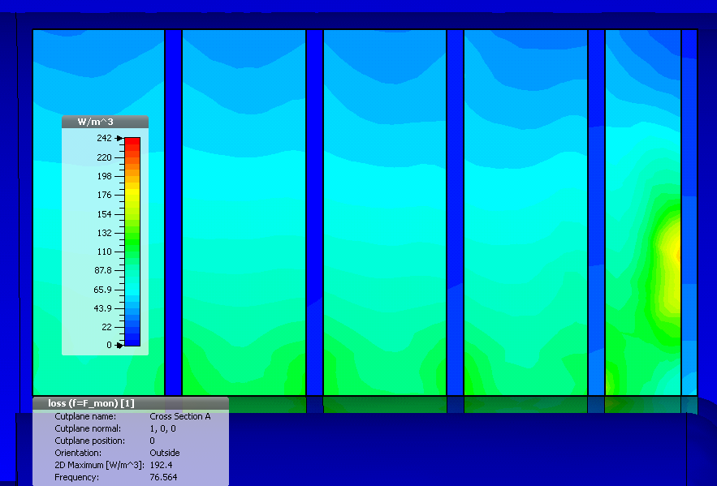
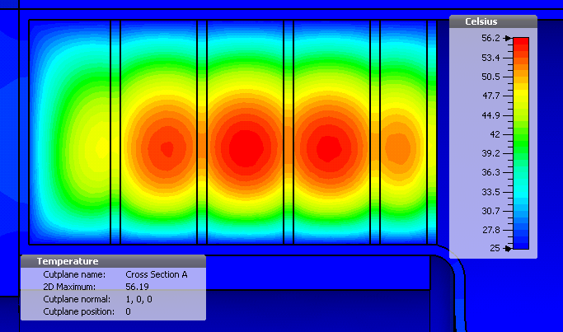
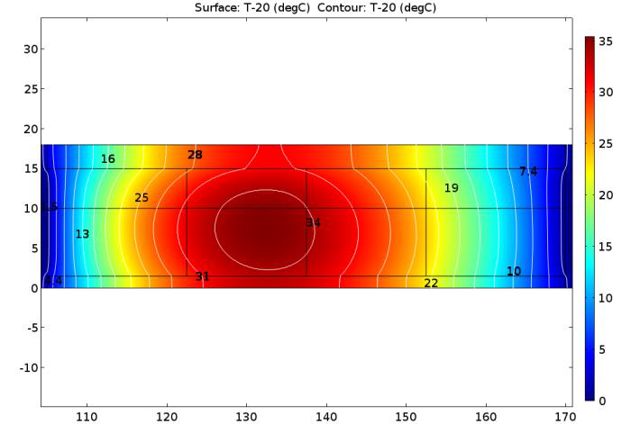
Thermal analysis
22 mm
22 mm
22 mm
17 mm
23.5 mm
Loss density distribution
Using given ramp and time averaging the maximum temperature rise in the top most garnet/alumina sandwich is 35 deg C.
4 kW, max 66.6°C

Slide 14
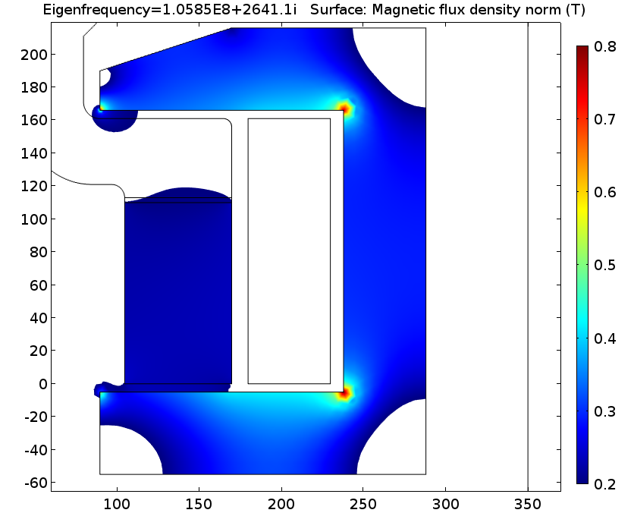
Solenoid magnet (Preliminary)
Central part of the flux return is made of low-frequency high permeability ferrite; peripheral part of the flux return is assembled using silicon steel plates.
Thickness of the yoke will be optimized to avoid saturation.
Shape of the poles will be optimized for better field uniformity in the garnet material
Towards accelerating gap
Expected inductance of the coil is ~2.5 mH at the maximum current and ~3.5 mH at the minimum current
Expected resistive voltage is ~9 V;
Inductive voltage is ~45 V.
Existing Booster bias supplies or commercial supplies will be able to drive this solenoid.

Slide 15
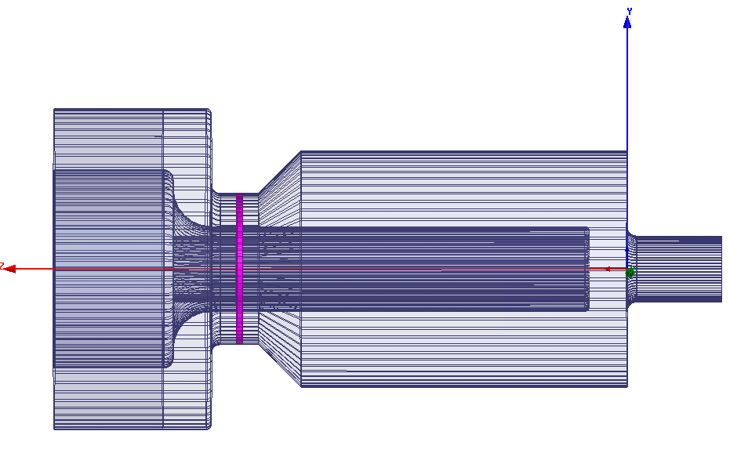
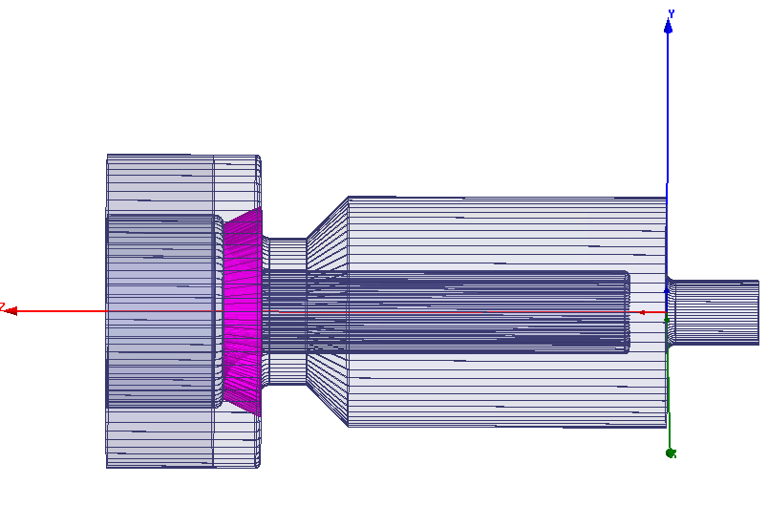
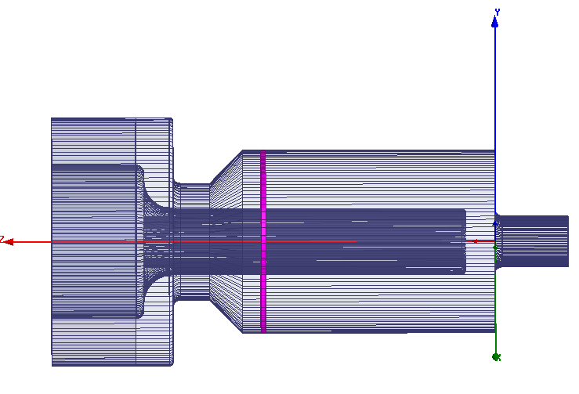
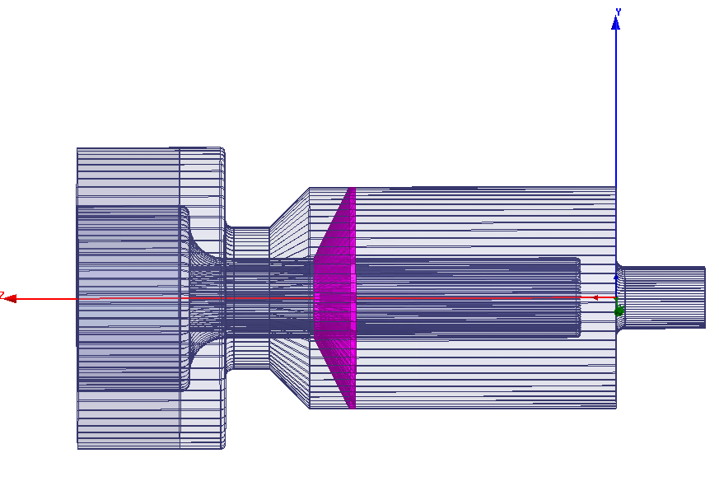
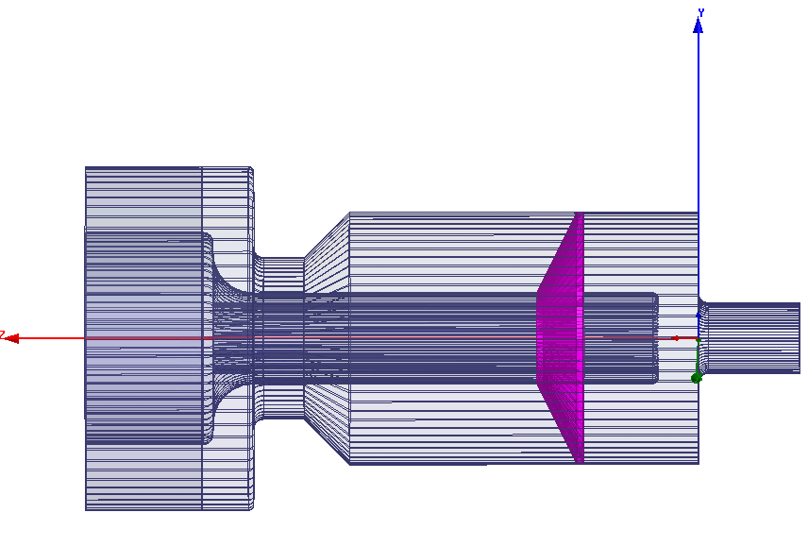
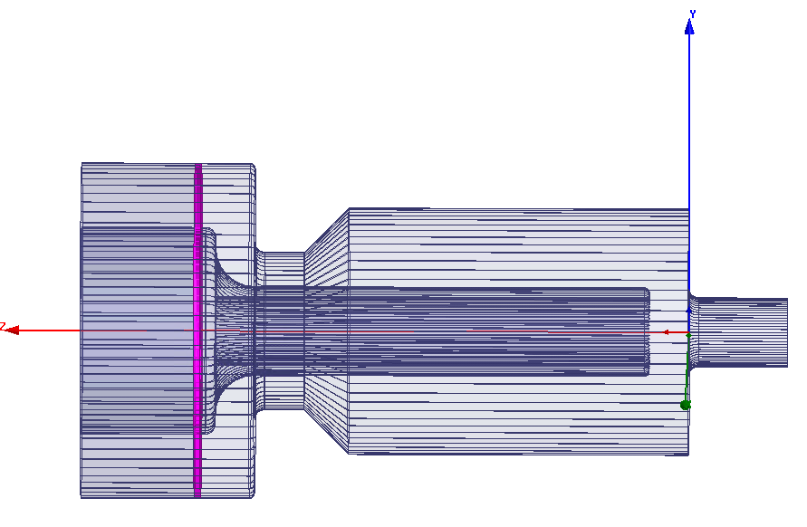
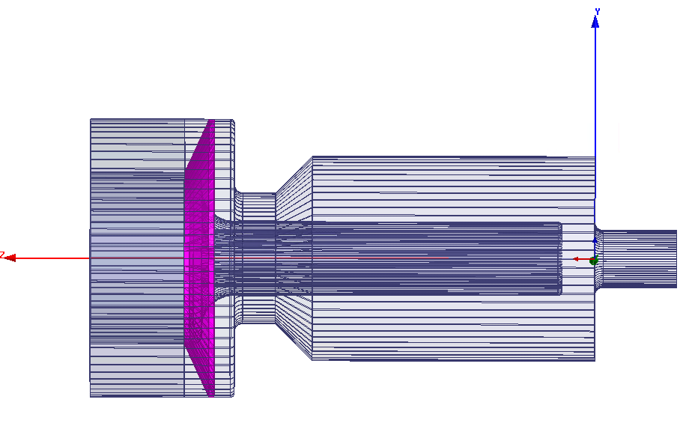
Window locations
HFSS used to calculate surface currents, E-fields, volume losses in ceramic.
Looking at the data, this is the initial choice. This allows us to have dry nitrogen, or SF6 in garnet region to reduce multipactoring.
This choice also allows for easier assembly.

Slide 16
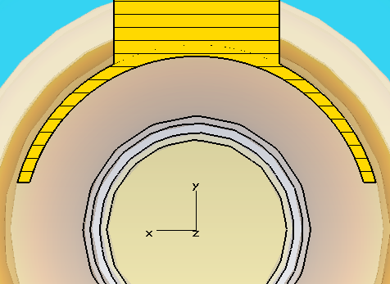
Power coupler
Power coupler is capacitively coupled to the cavity.
It is strongly coupled and is part of the resonator.
  2 resonators in the system, implies that there are two normal modes.
  Must make sure that the mode that is excited in the power coupler is not close to the cavity mode.
    Separation of > 30 MHz is required to not excite the power coupler.
    Excitation in power coupler is bad because we lose power going into the accelerating mode.
    Impedance of this mode needs to be small.

Slide 17
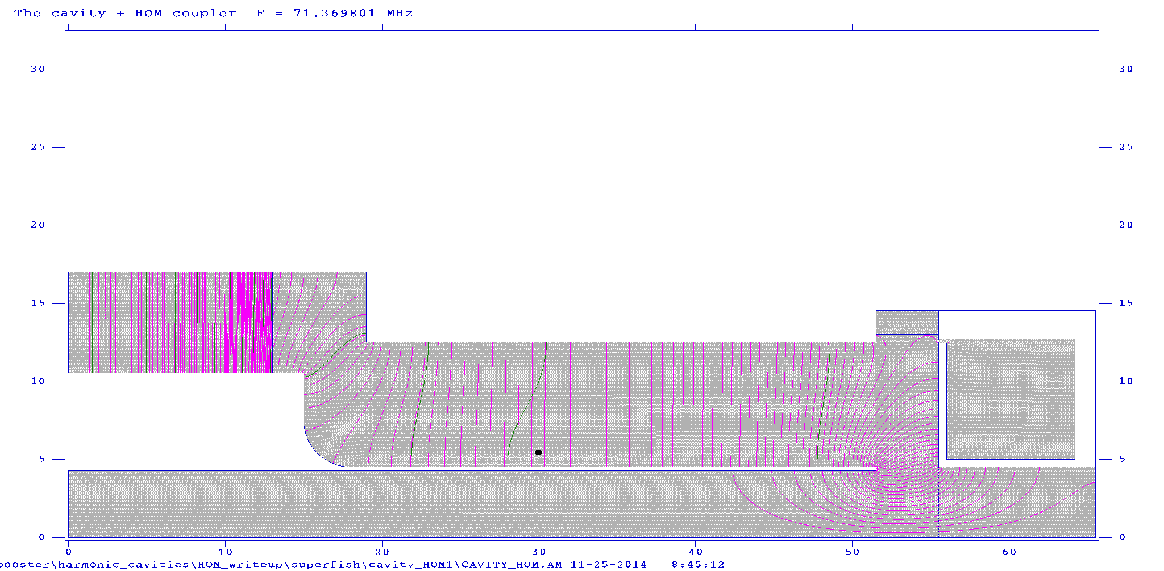
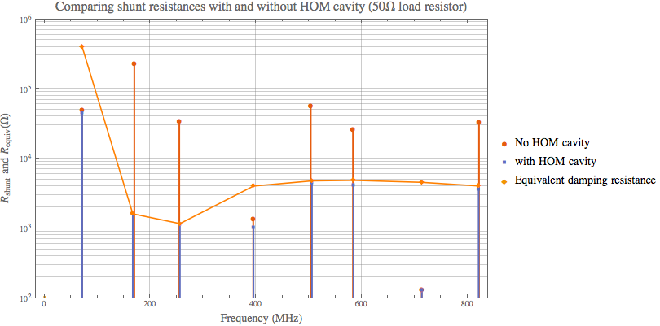
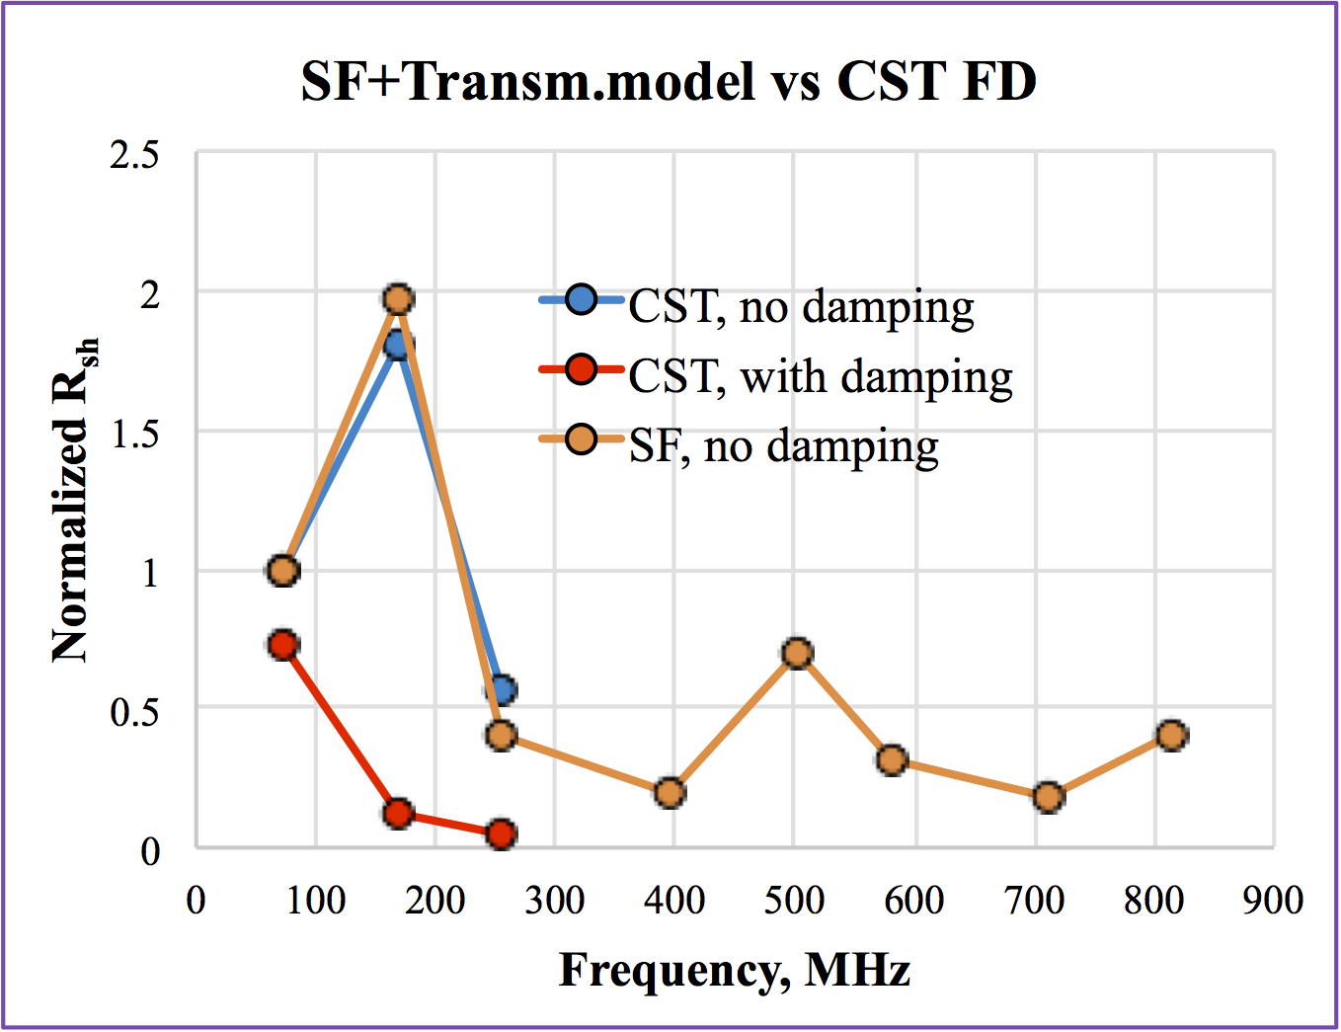
HOM damper
Preliminary concept done.
  Will bench test HOM damper with mock cavity.
    Check CST results
Shunt impedance of fundamental reduced by 11% (Superfish and semi-analytic calculations, more reduction with CST).
Next higher order mode reduced by 99.3%.
Everybody else between 84% to 96%. (except for 713 MHz which is small to begin with)
Load resistance is 50Ω.
HOM
R_{shunt} and R_{equiv} (Ω)

Slide 18
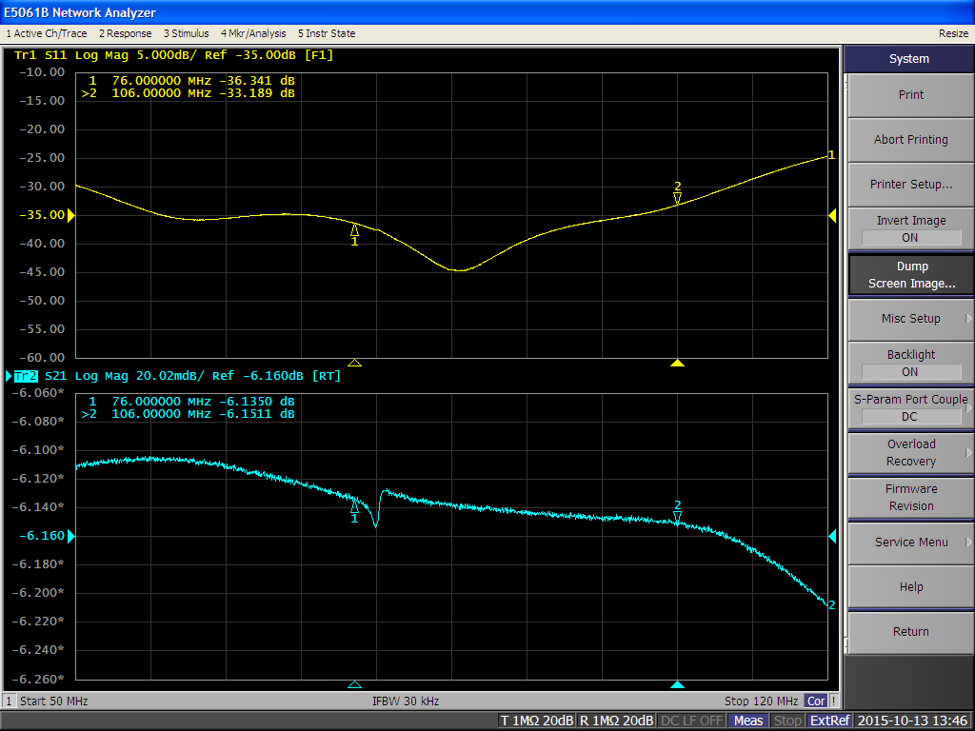
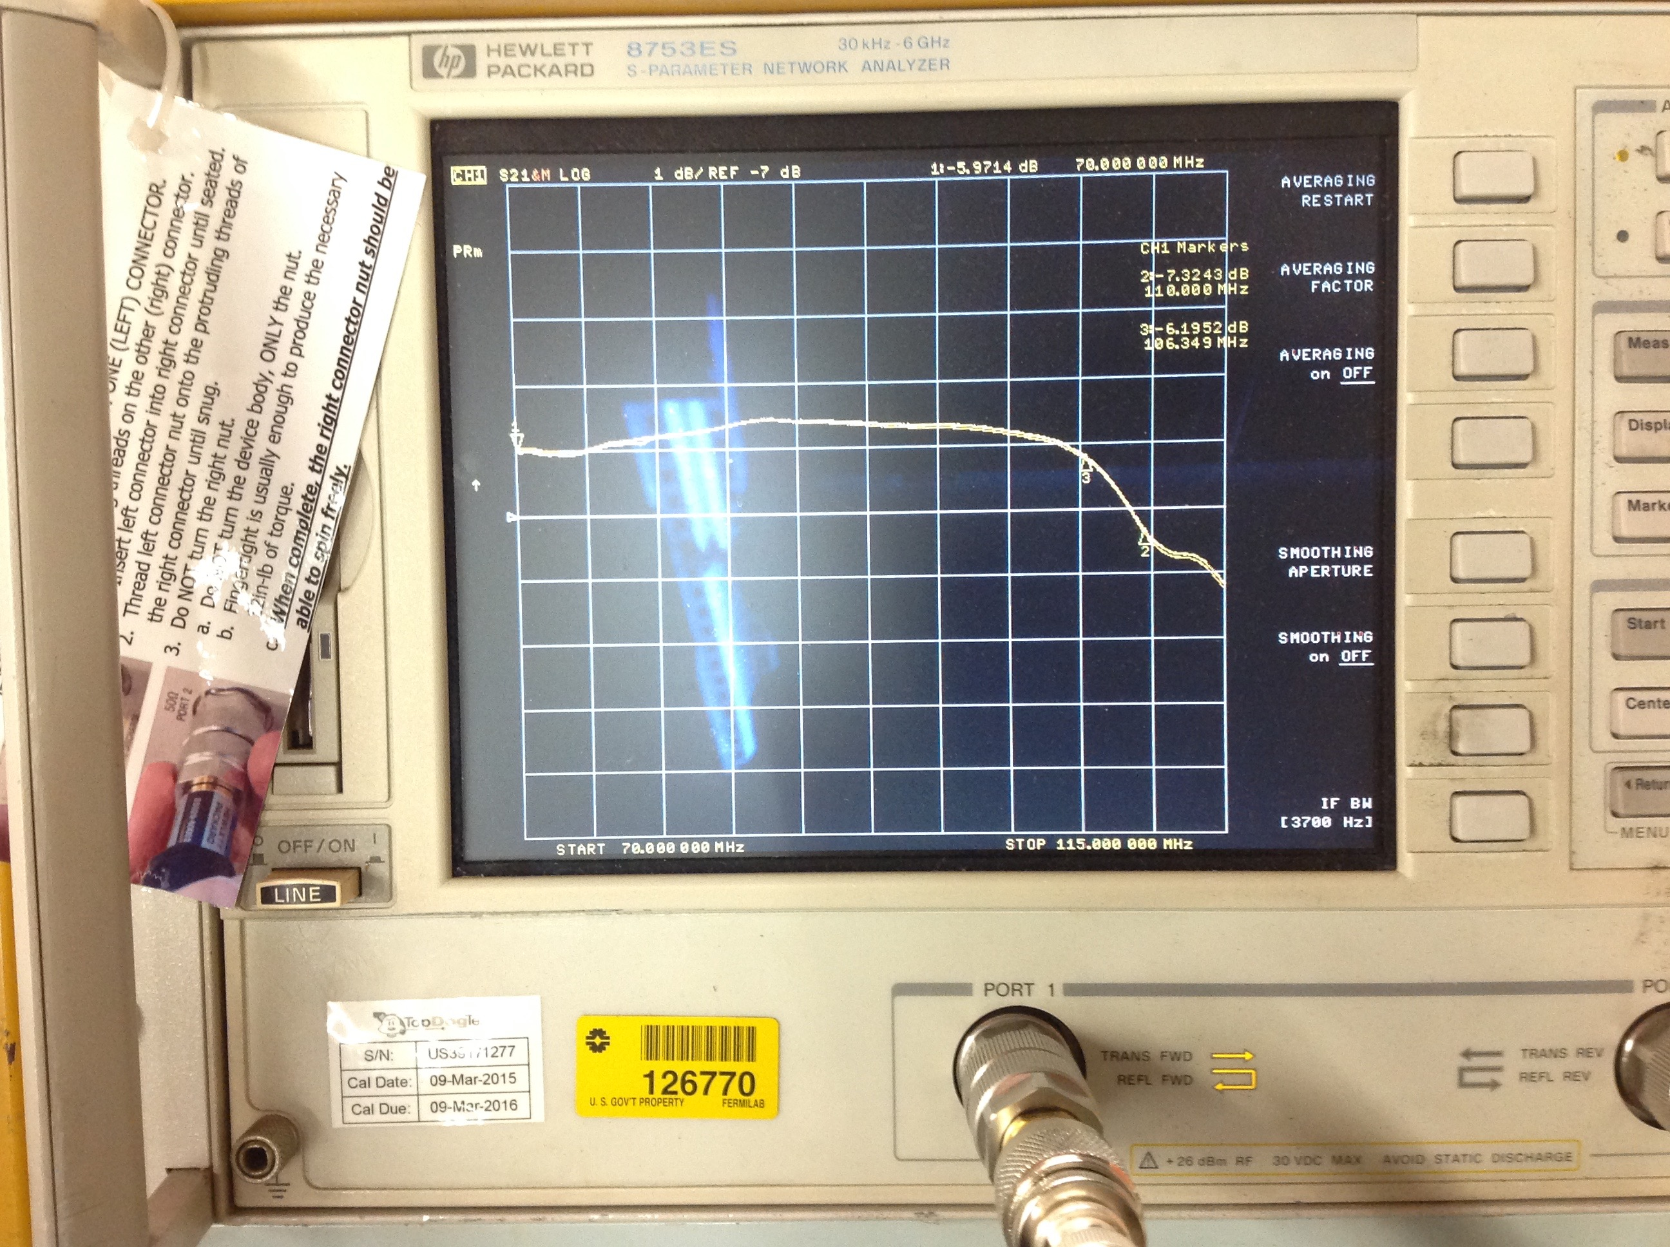
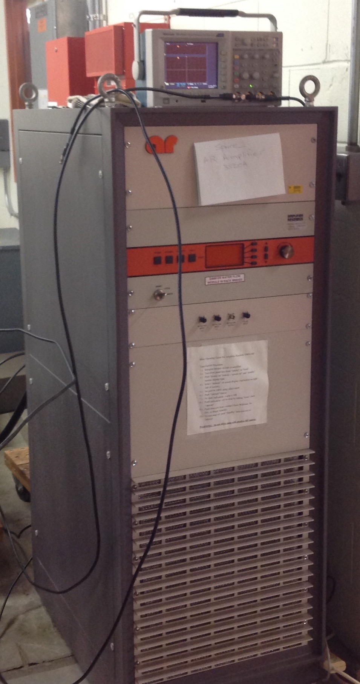
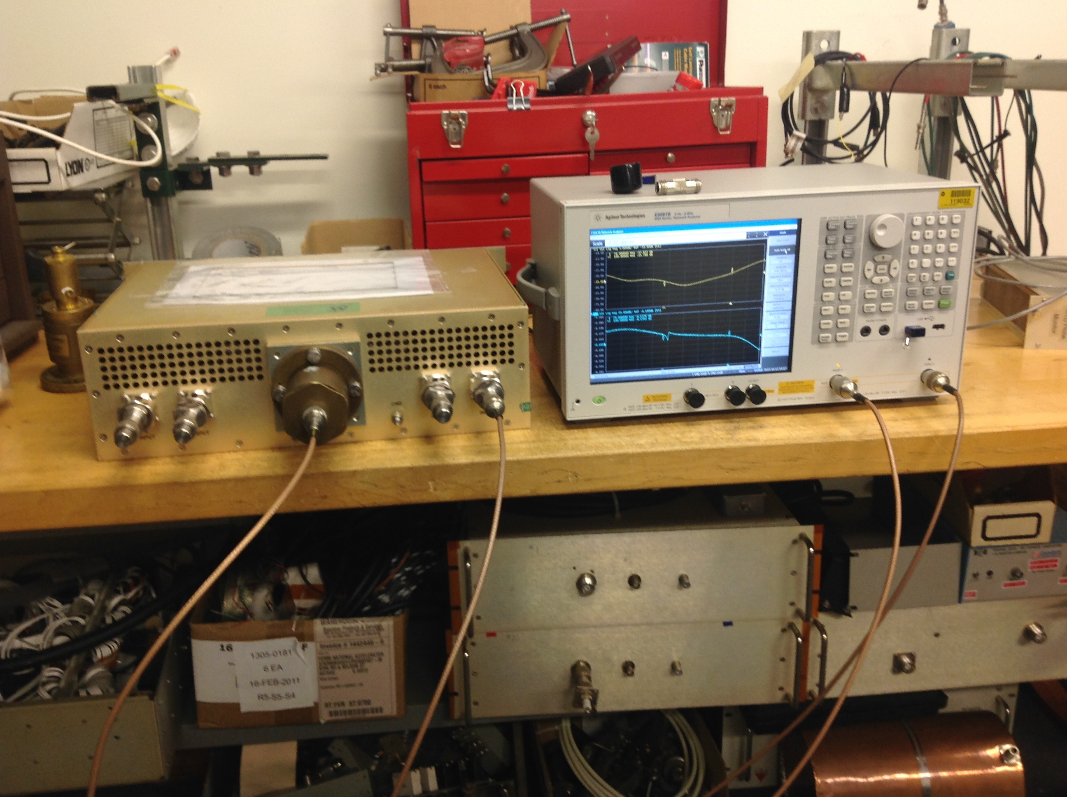
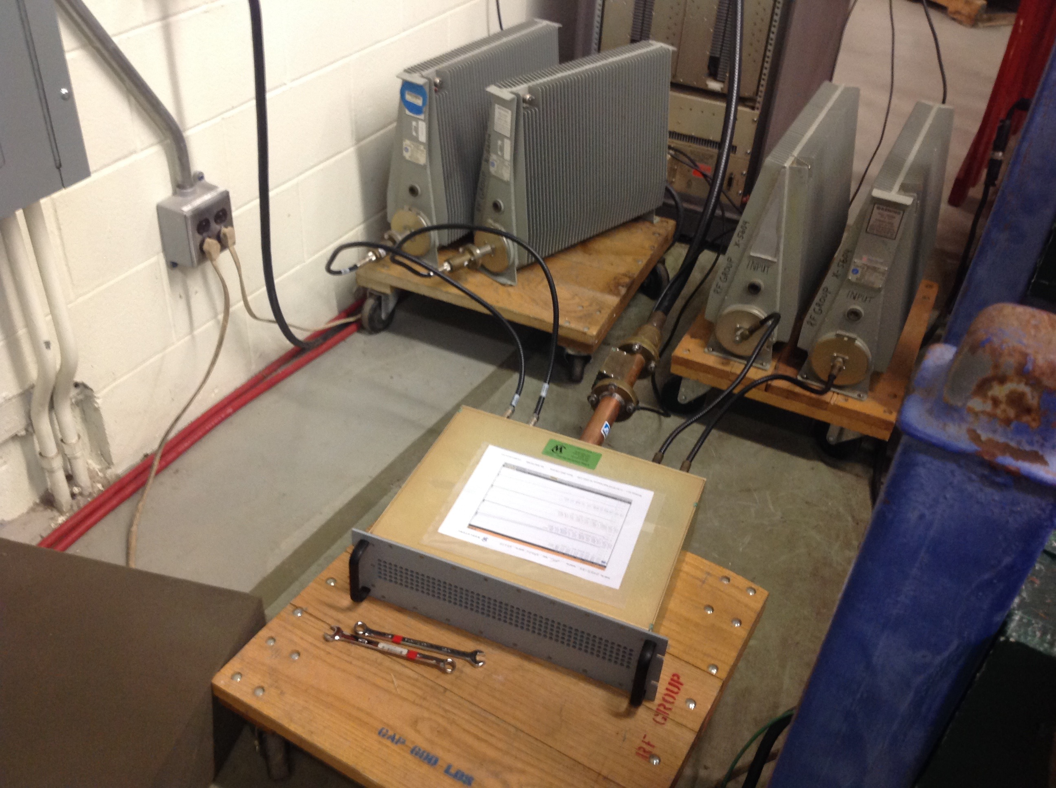
Werlatone combiner low and high power tested
Low and high power tests (~2.1 kW) of werlatone combiner has been done. Looks good over the bandwidth of interest: 76 MHz to 106 MHz.

Slide 19
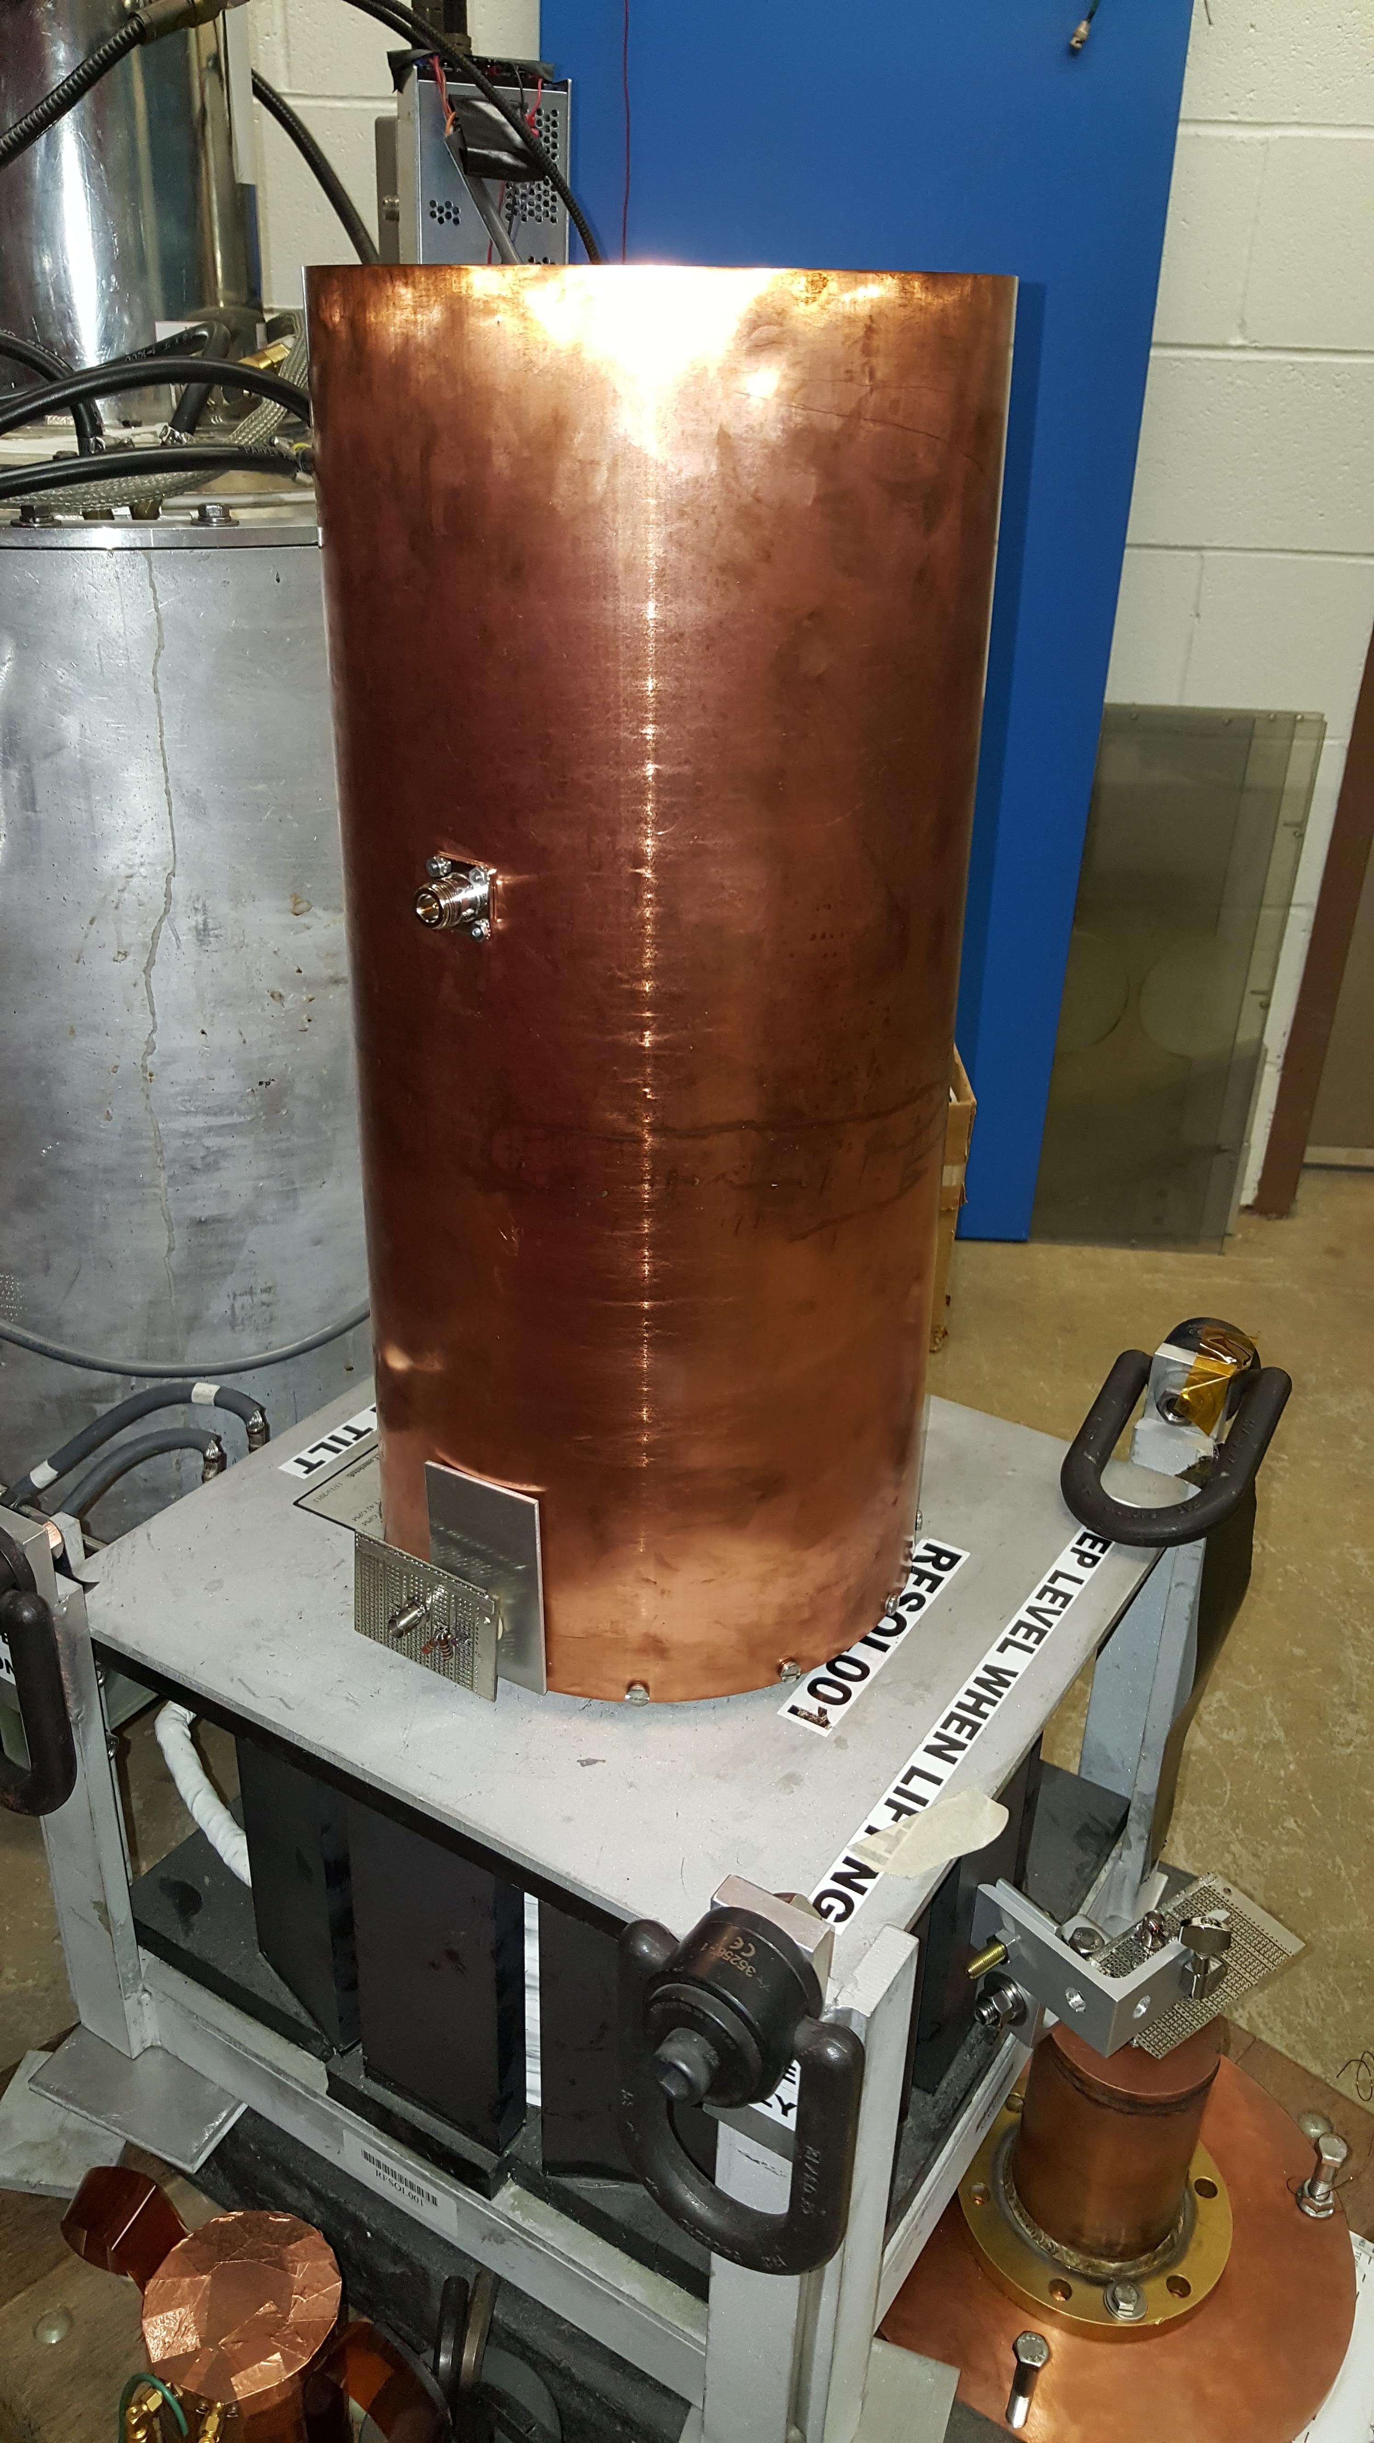
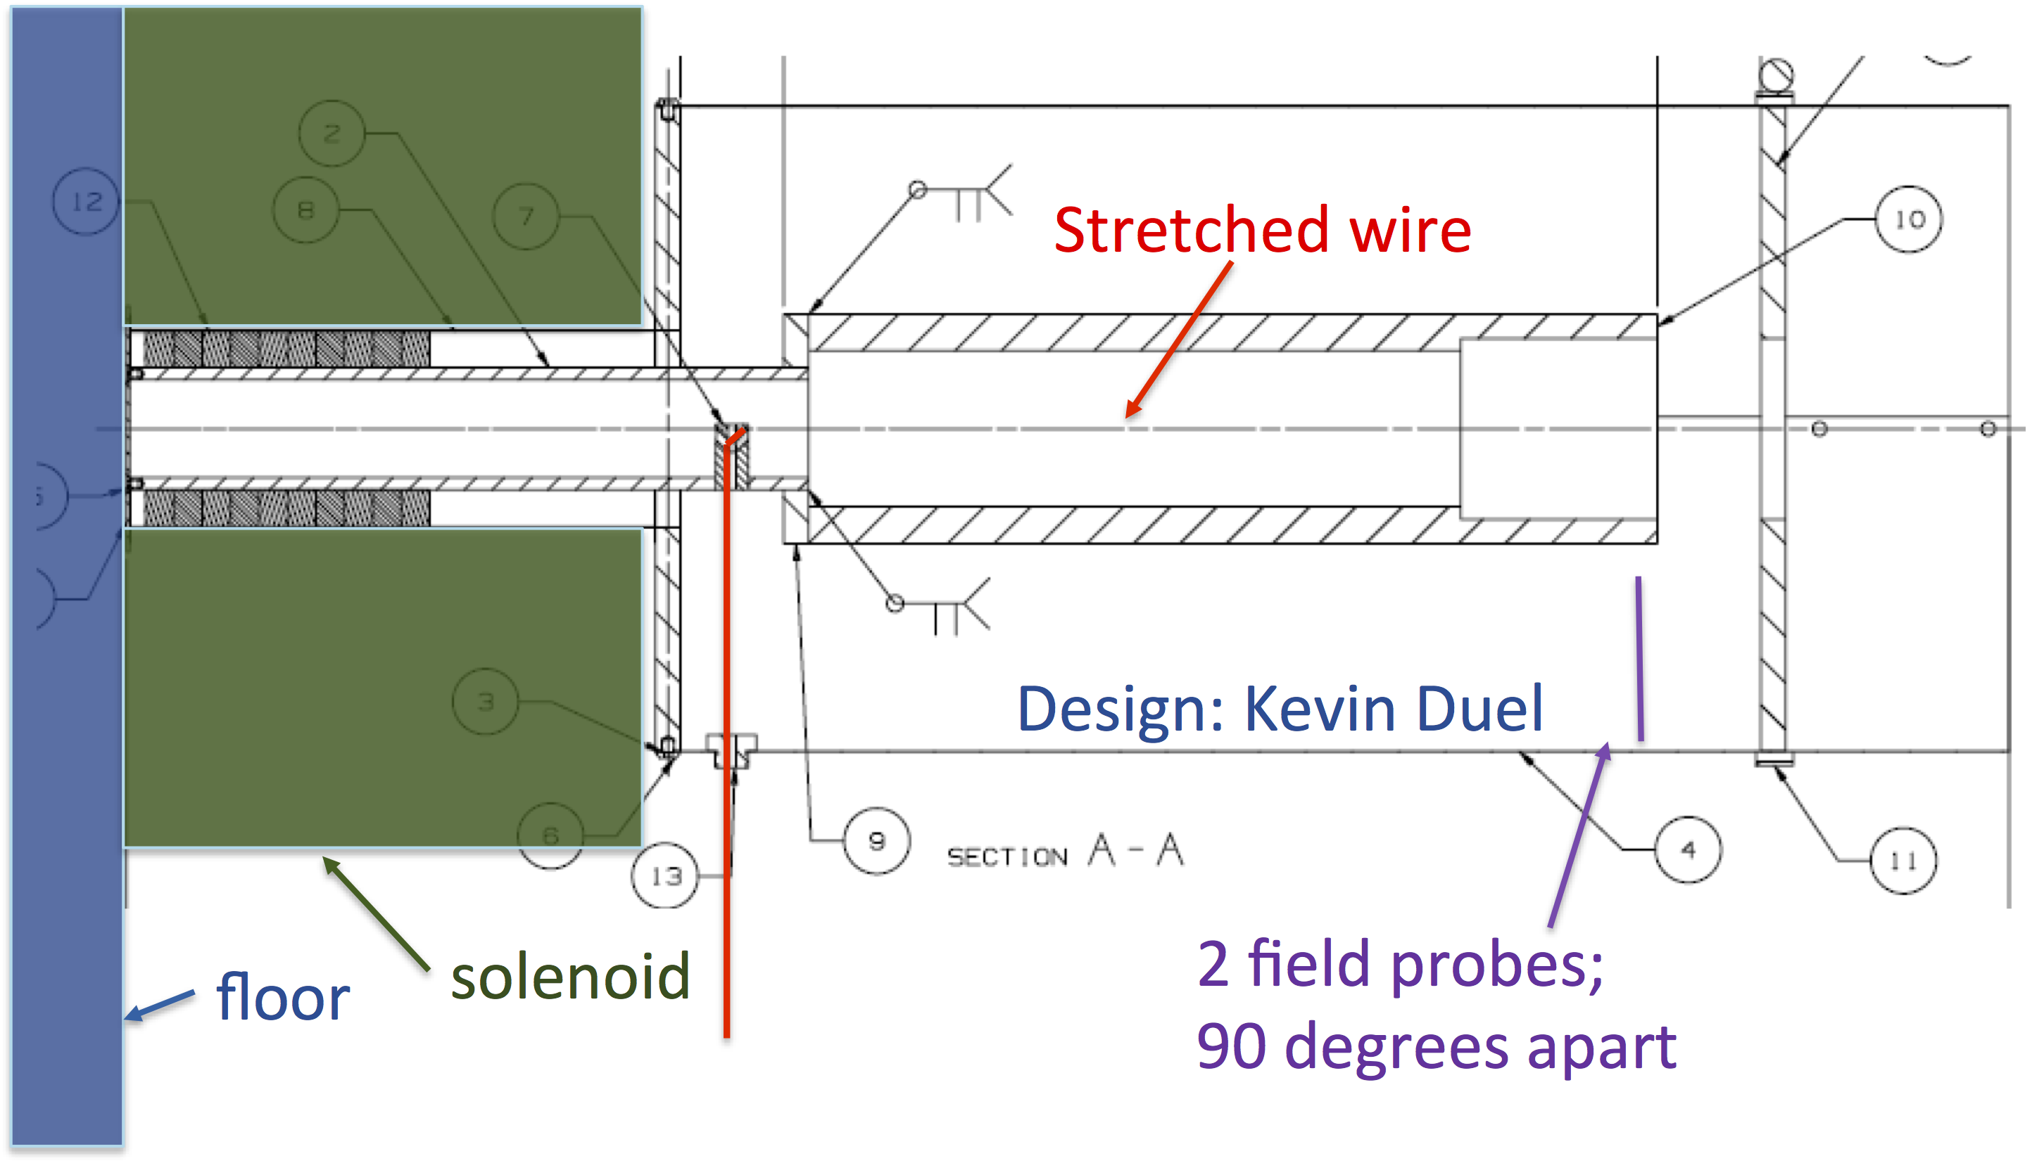
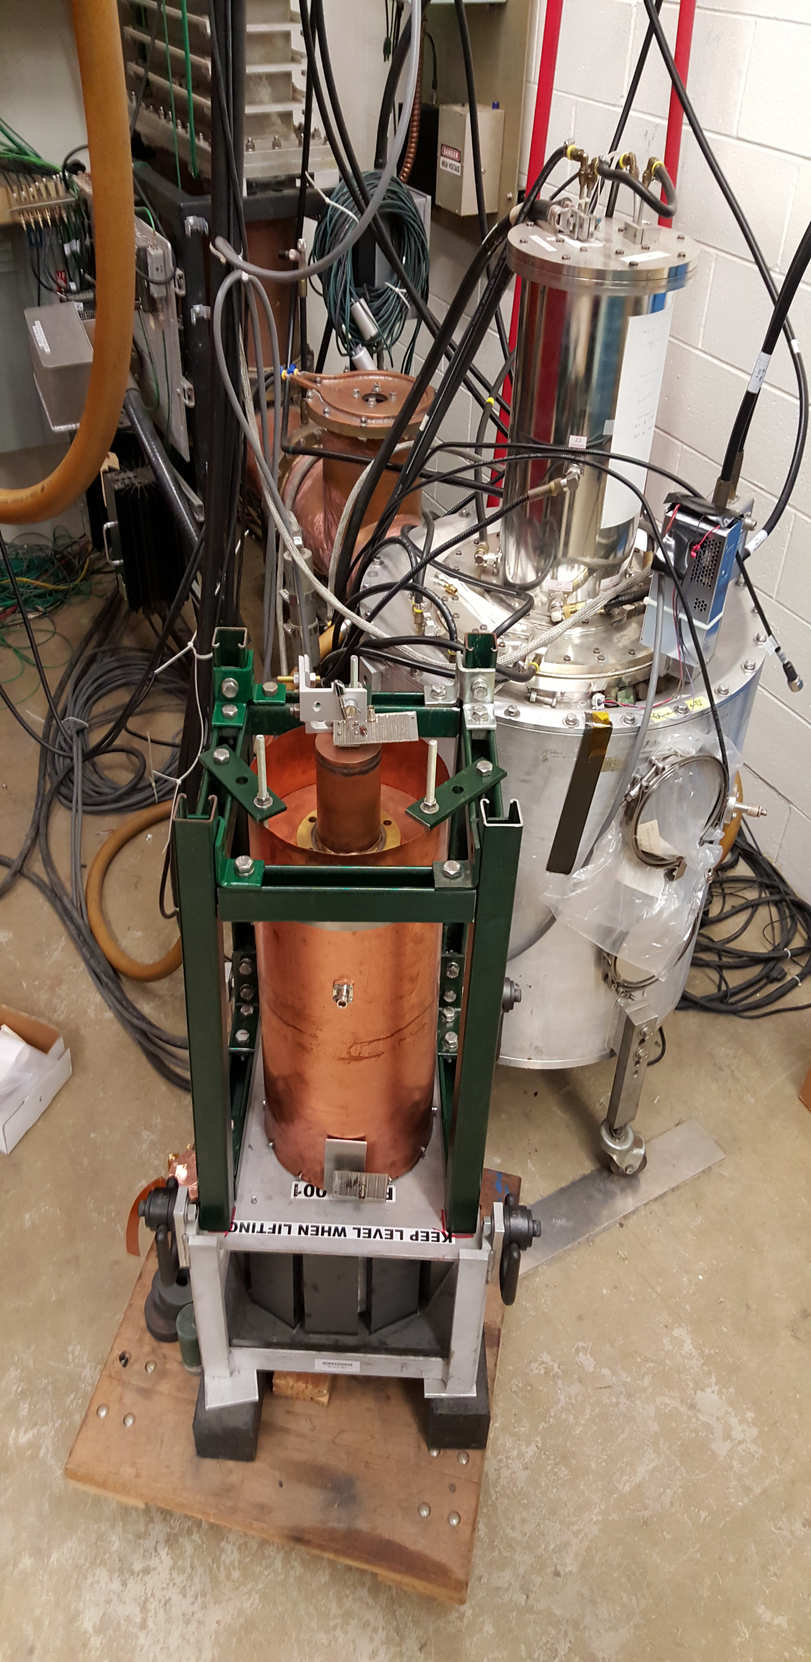
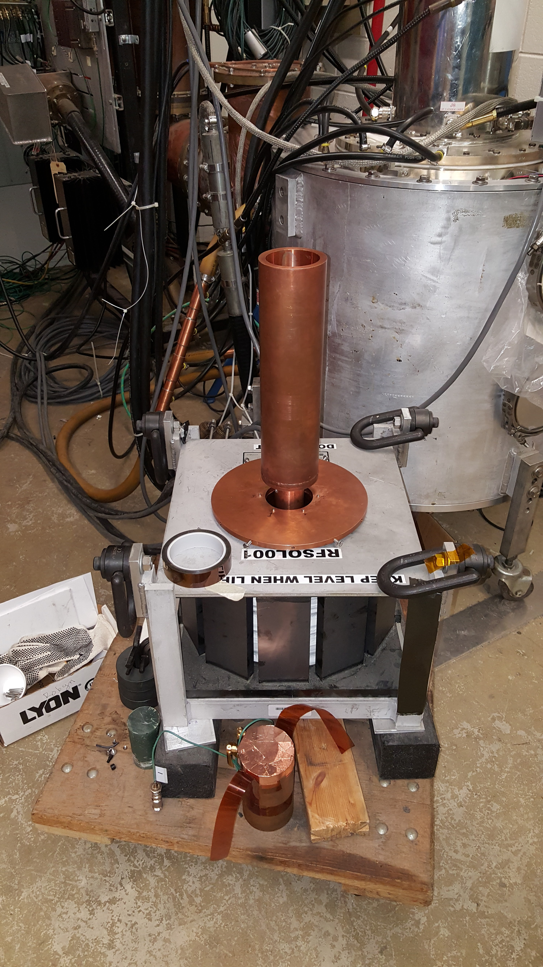
Mock cavity test
Mock cavity:
Measure Rshunt, Q, resonances etc.
  Check CST results
  Test HOM damper cavity

Slide 20
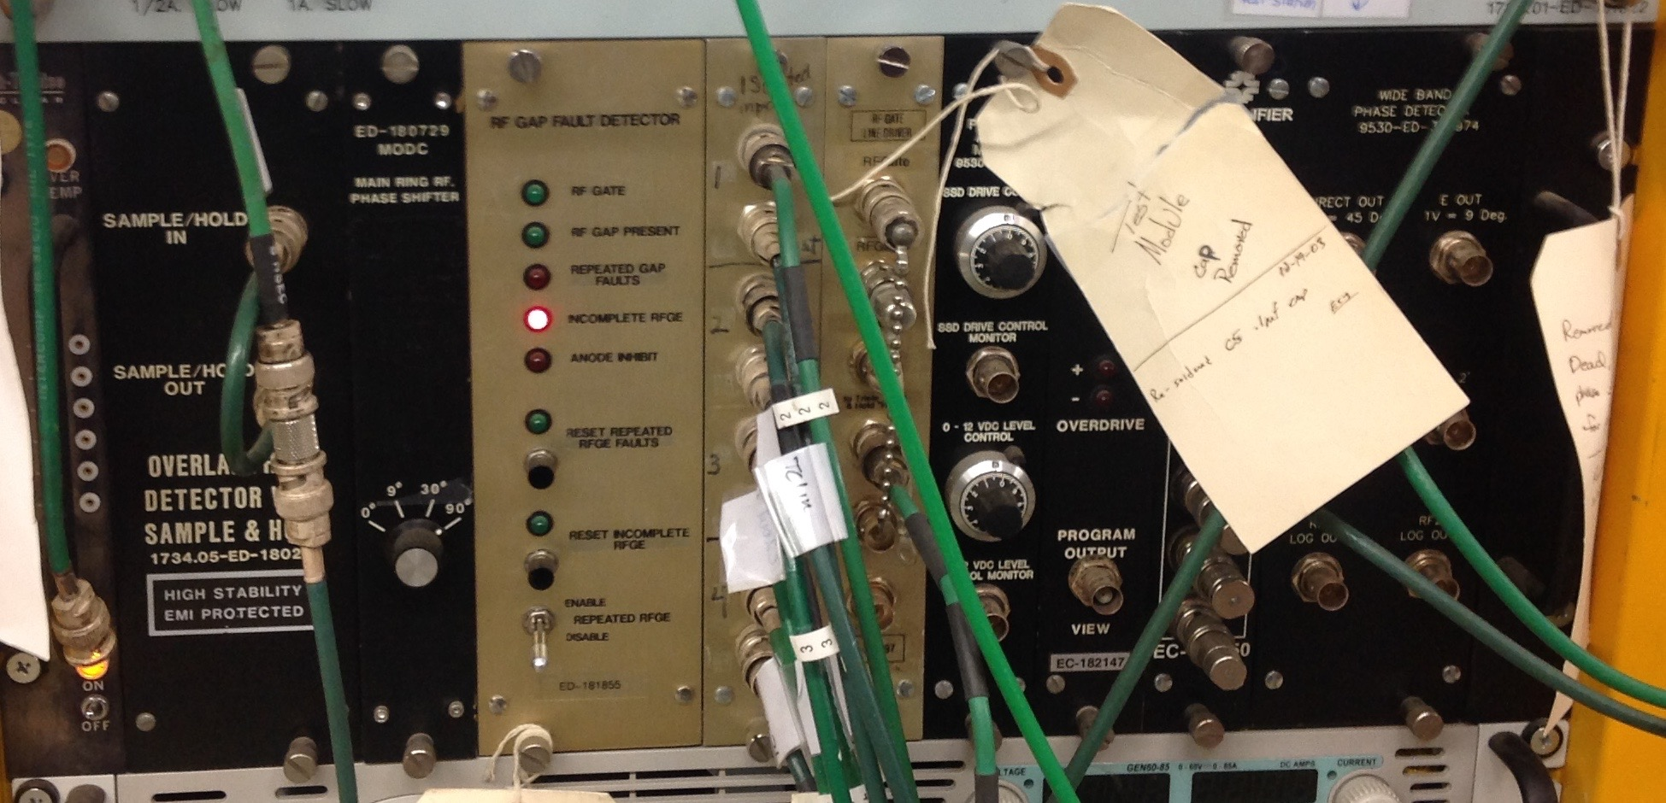
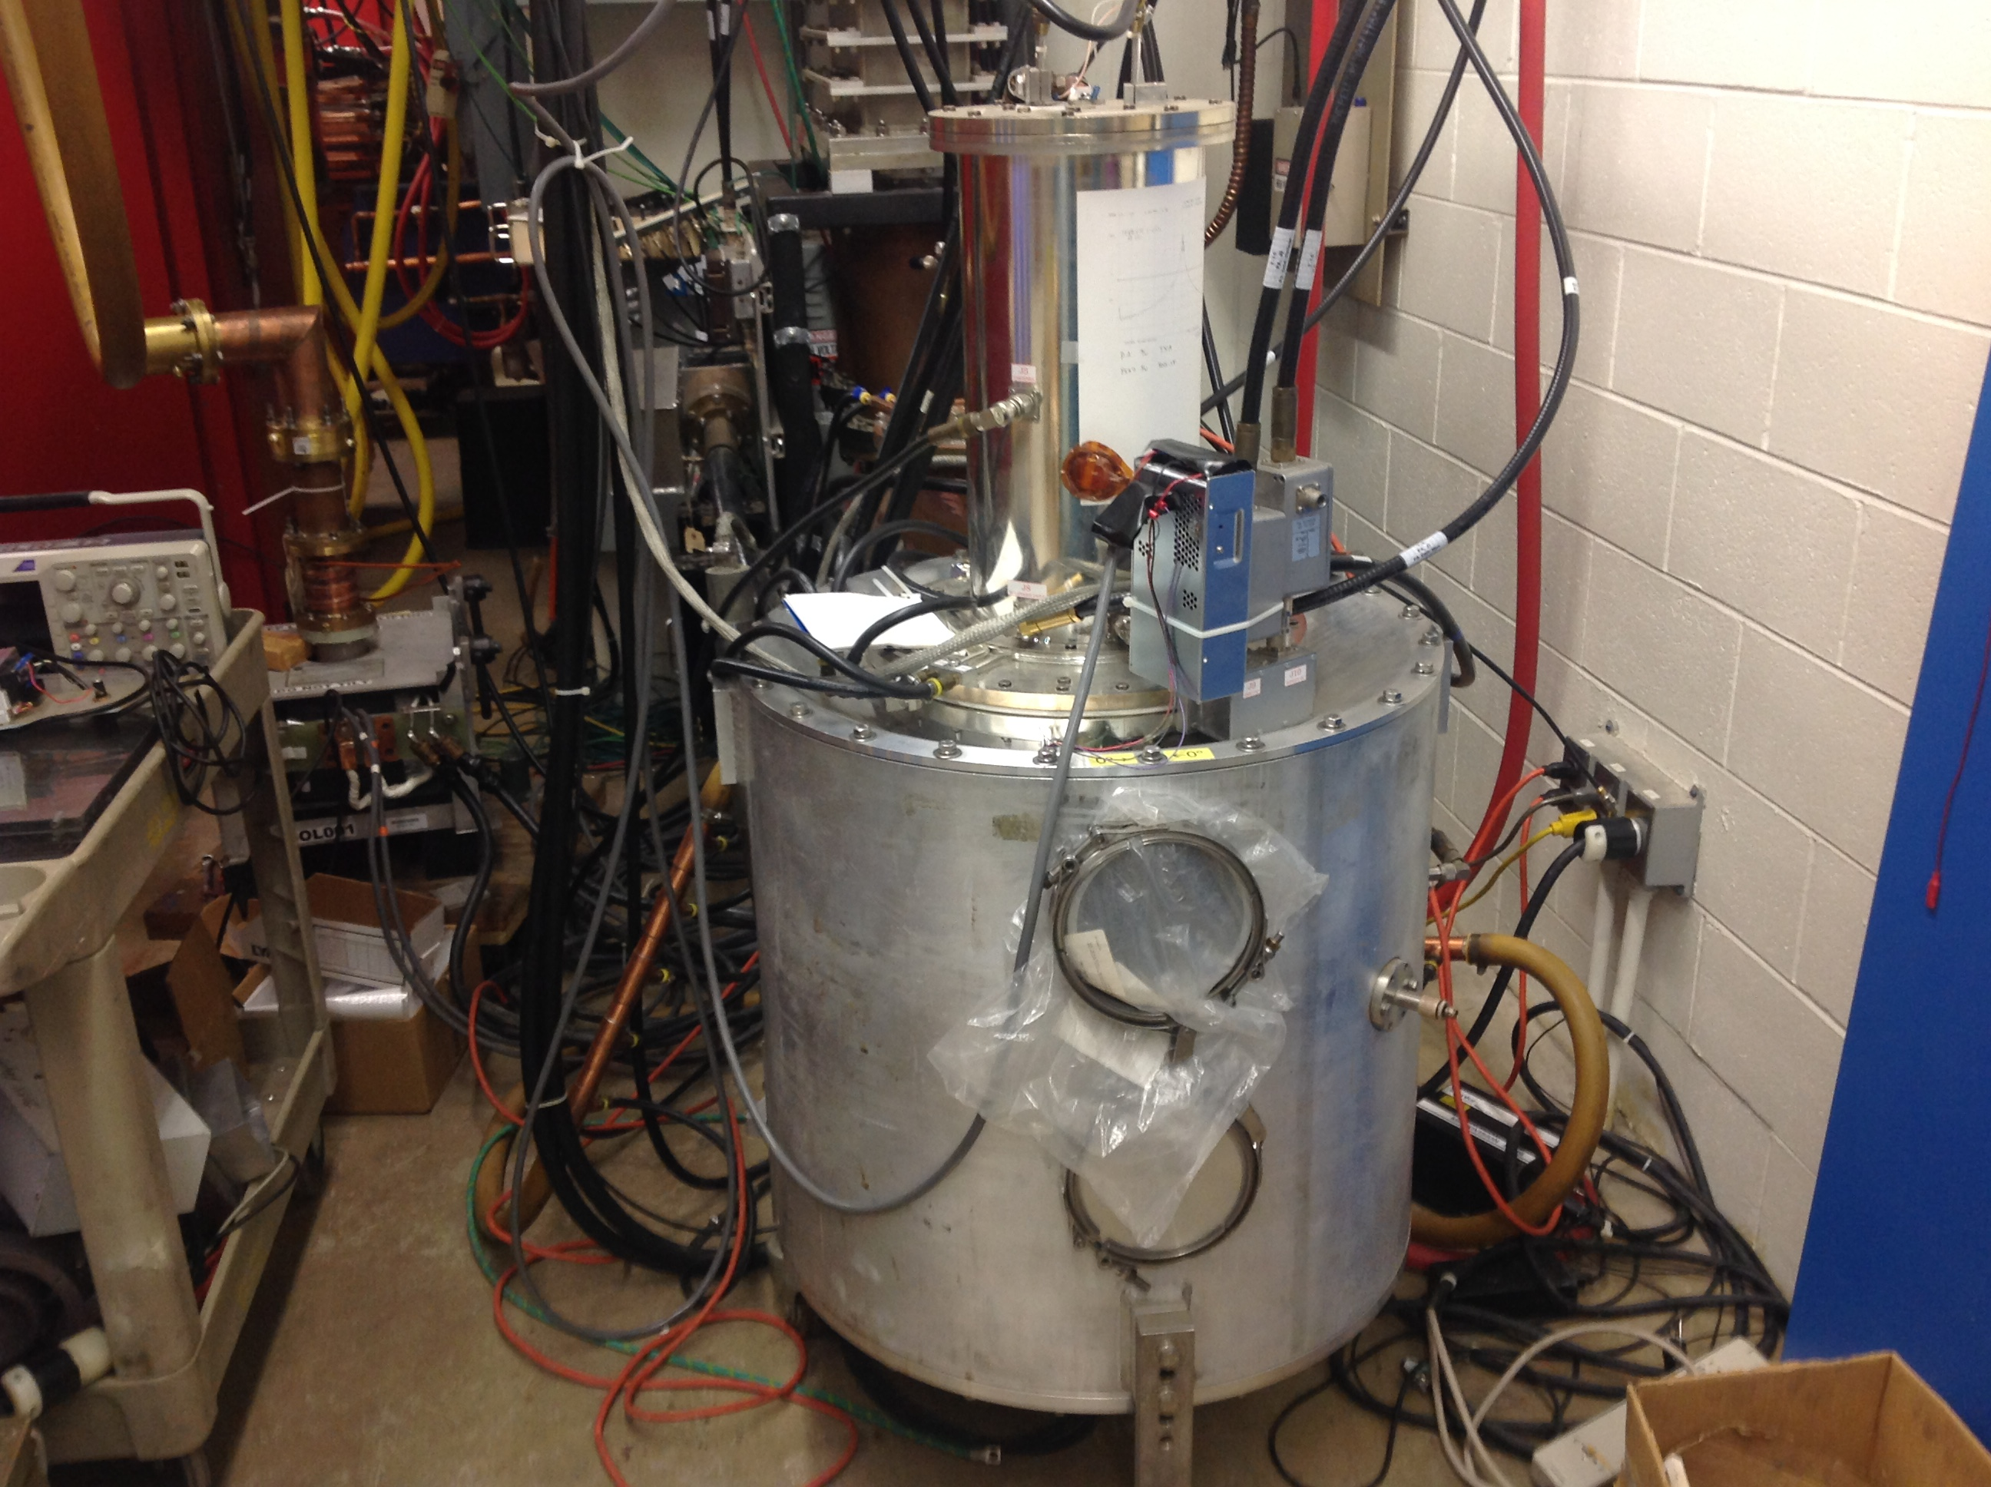
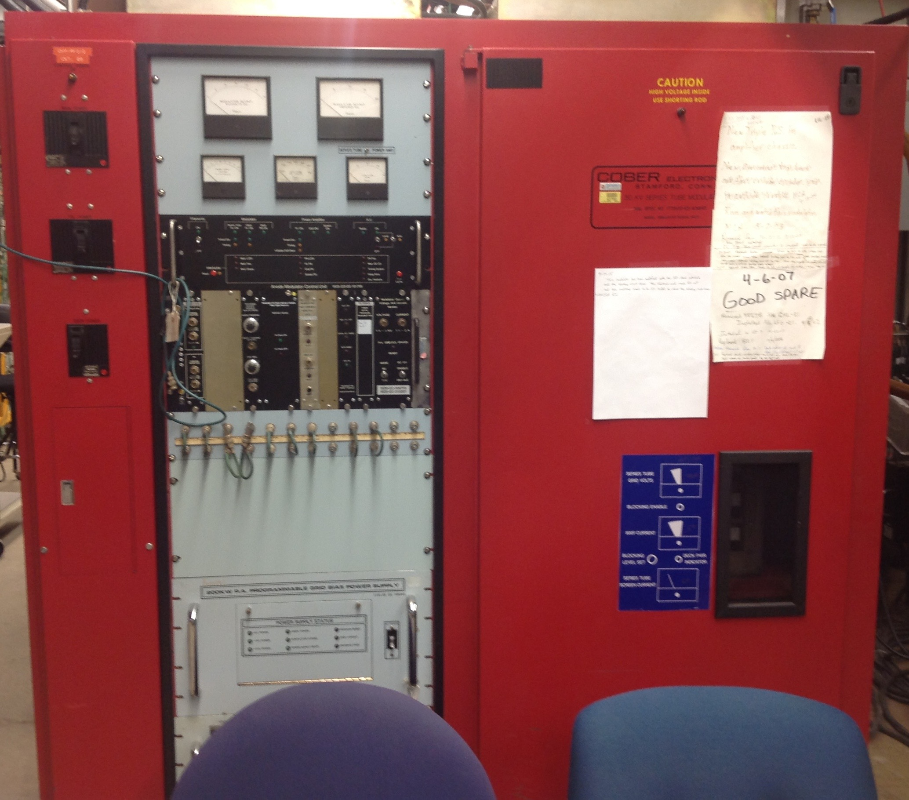
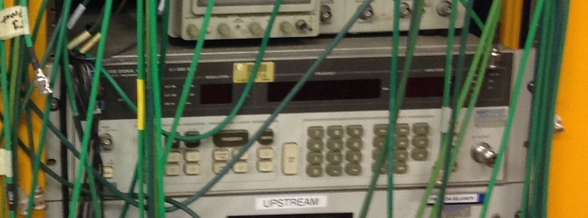
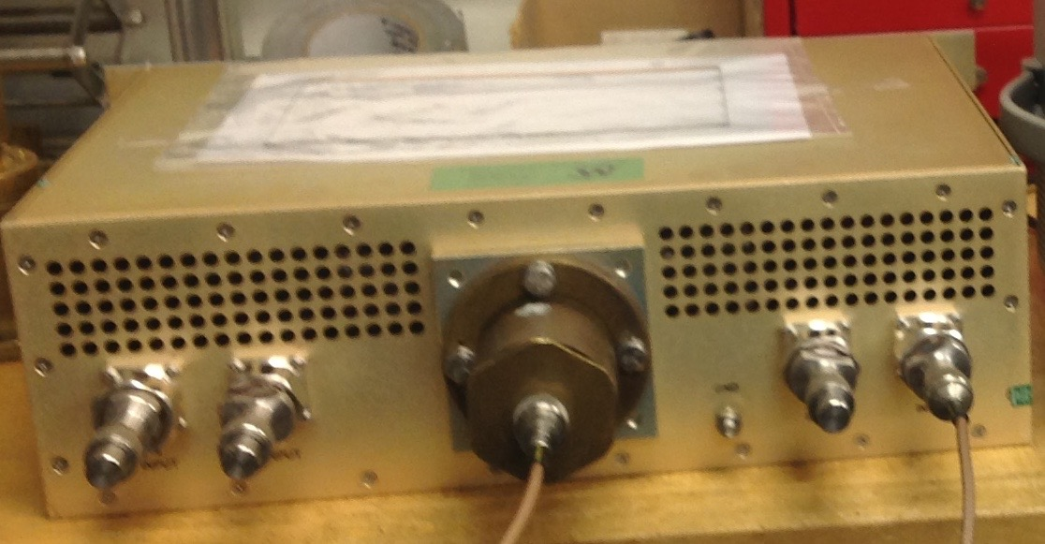
PA test (being prepared)
Not shown:
Differential temperature probes (total =4) and readout (total =2) for anode and load
cathode To phi det
Modified prototype cathode res
Anode To phi det
Booster power module and choke at 76 MHz
Test resonator and water load(to be installed)
3 kW PA
modulator
signal generator
To cathode resonator
Driver Power monitoring
(directional cplr?)
combiner

Slide 21
Conclusion
A lot of simulations and measurements have been done.
  Working on HOM cavity design.
No show stoppers so far
  Mechanical design has started
    Some challenges as to how to assemble the garnet and the alumina and RF windows.
      Got information from CERN RF group who are also working on a 2nd harmonic cavity on how to glue garnet to alumina.
    RF windows design is a huge engineering challenge.
  Solenoid design has started.
  Low power mock cavity finished.
  PA test stand design nearly done. Will assemble soon when test resonator is done.
  RF components
    Werlatone power combiner has been low and high power tested.
    Solid state driver ordered.

Slide 22
Spare slides

Slide 23
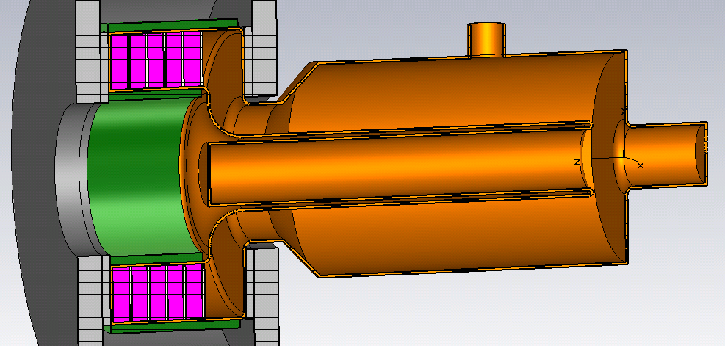
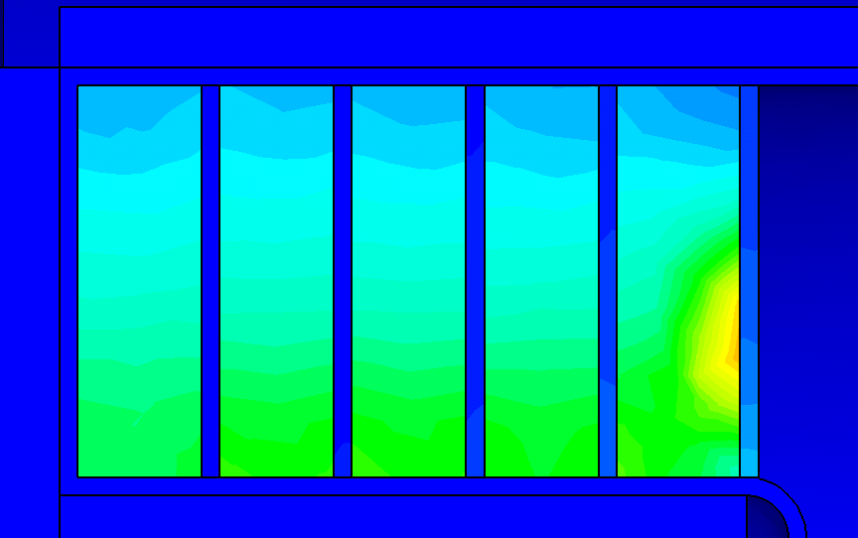



Thermal analyses with alumina cooling disks
Imported distribution of thermal losses for f=74.7 MHz
Alumina disks, 99.5%, 3 mm thickness
Water jackets
W_max = 1.13 W/cm^3
Ferrite disks,
25 mm thickness
Thermal conductivity
Al₂O₃ - 30 W/K/m
Al800 - 3.5 W/K/m
Simulation with thermal losses of P=3.2 kW and cooling water temperature of 25 °C, old ramp.
T_max = 63°C
CW
Temperature distribution

